Slide 1
Low- and intermediate-energy nuclear physics, Nuclear physics with neutrons and Non-accelerator neutrino physics
Mikhail Itkis
124-th Session of the Scientific Council
of JINR, September 20-21, 2018, Dubna

Slide 2

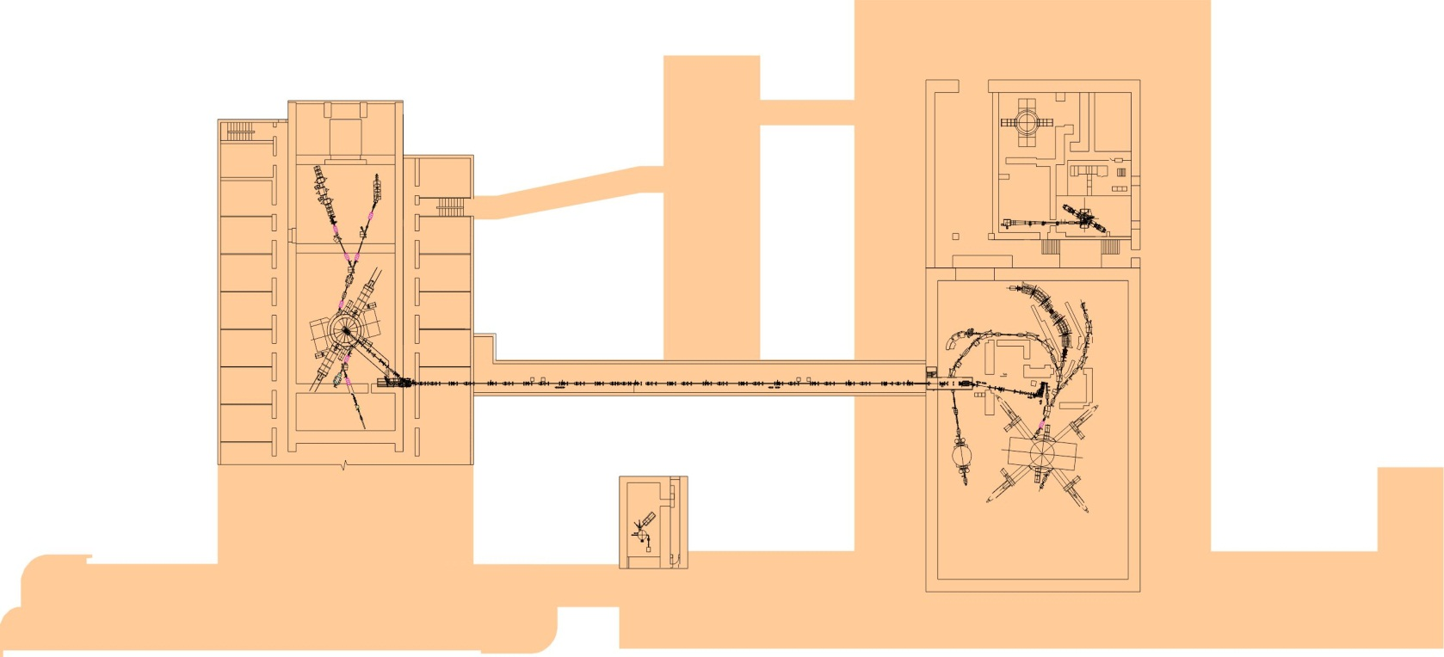

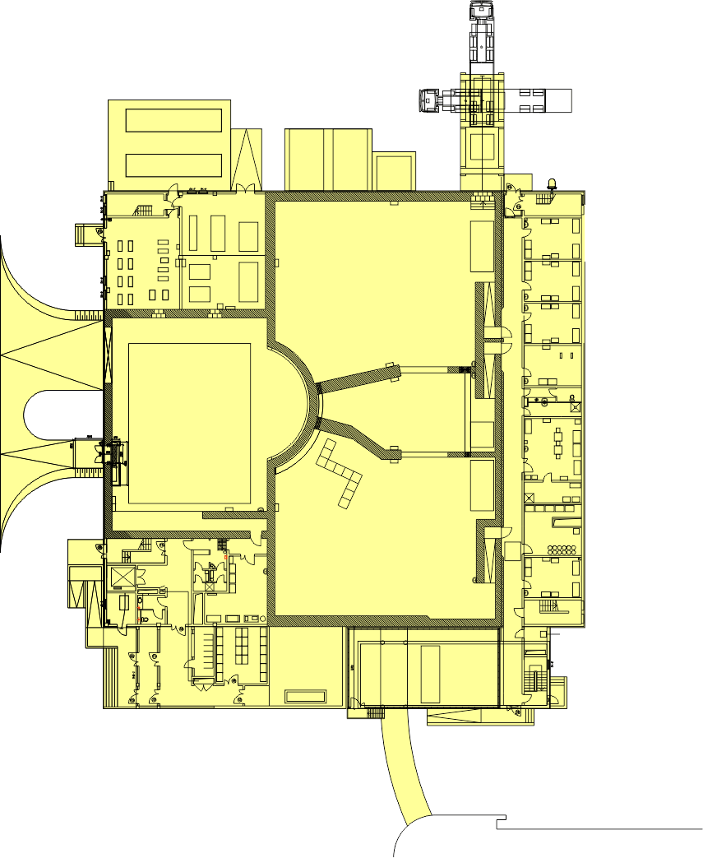
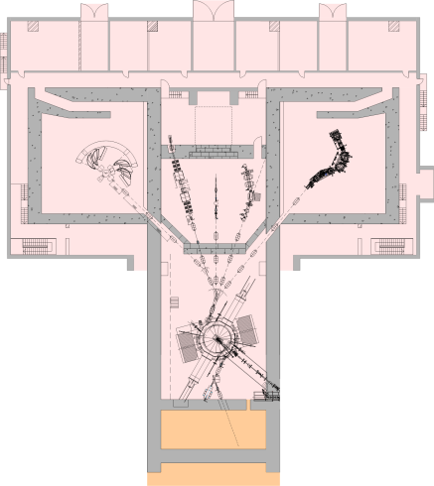
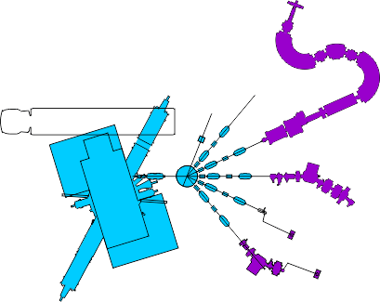

SHE factory
Study of reactions with stable
and radioactive beams
U200
Applied researches
IC100
^{1000м2}
^{1500м2}
Nano-laboratory
DRIBs
^{1500m2}
New accelerator DC-280
Upgraded U400R
U400M
&SC ECR
Synthesis of exotic nuclei and study of their properties
FLNR’s basic directions of research:
1. Heavy and superheavy nuclei:
synthesis and study of properties of superheavy elements;
chemistry of new elements;
fusion-fission and multi-nucleon transfer reactions;
nuclear- , mass-, & laser-spectrometry of SH nuclei.
2. Light exotic nuclei:
properties and structure of light exotic nuclei;
reactions with exotic nuclei.
3. Radiation effects and physical groundwork of nanotechnology.

Slide 3
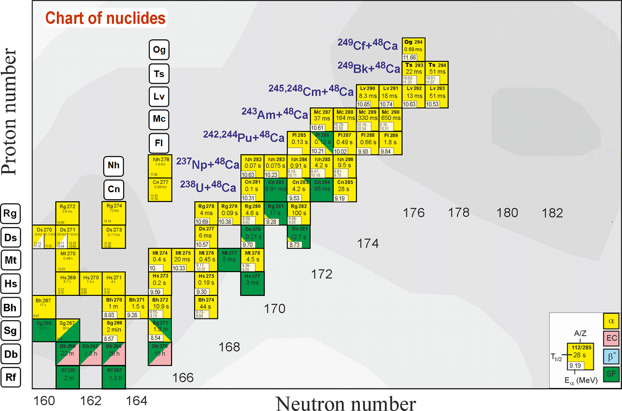
Search for superheavies
Z = 114
184
What is the next step?
Ti, Cr, Fe, Ni +
Th, U, Np, Am, Cm, Bk, Cf
The excitation energies of CN formed in the reactions with Ti, Cr, Fe, Ni ions are 30-40MeV at the Coulomb barrier energy that allows to observe 3n and 4n ER channels (similar to ⁴⁸Ca-induced reaction).
Notes:
50 years ago The existence of island of stability in the region of nuclei with Z = 114 and N = 184 was predicted theoretically [A. Sobiczewski, F. A. Gareev, and B. N. Kalinkin, Phys. Lett. 22, 500 (1966)]
That caused the experimental investigations in the field of the superheavy element (SHE) synthesis.
Nowadays more than 30 isotopes of superheavy elements with Z = 108-118 have been synthesized both in cold an hot fusion reactions
In the Flerov Laboratory of Nuclear Reactions a great success was achieved in the synthesis of superheavy elements in hot fusion reactions of ⁴⁸Ca ions with actinide target nuclei.
Unfortunately, nuclei with Z > 118 cannot be synthesized in ⁴⁸Ca-induced reactions since ²⁴⁹Cf is the heaviest target material available for these purposes.
One of the possible pathways to synthesize new isotopes of superheavy elements with Z = 118 -126 is the reactions of actinide targets with Ti, Cr, Fe and Ni ions.
The interest in damped collisions of heavy nuclei is conditioned by the necessity to find new ways to produce neutron-rich superheavy elements (SHE). Few years ago the inverse (antisymmetrizing) quasifission (QF) process, was proposed to produce SHE in the collisions of transactinides [1]. The low-energy damped collisions of intermediate mass nuclei are less difficult for experimental study than the reactions with transactinides. One may expect that the antisymmetrizing shell effect will be similar in both cases [2].
To study the role of shell effects in inverse QF, the binary reaction channels in the reactions ^{156,160}Gd + ¹⁸⁶W at the Coulomb barrier energy have been investigated. In these reactions the projectile and target nuclei are located between the closed shells with Z = 50, N = 82 (double magic tin) and Z = 82, N = 126 (double magic lead) which should play a significant role in the nucleon transfer process. To form lead-like fragment the projectile nucleus has to transfer about 22 nucleons to the target.

Slide 4
Cross sections of symmetric fragment formations
For 4n channel (E*=40÷50MeV):
⁴⁸Ca+²³⁸U→⁴⁸Ca+²⁴⁴Pu
σ(A_{CN}/2±20) drops ∼2 times
⁴⁸Ca+²³⁸U→⁴⁸Ti+²³⁸U
σ(A_{CN}/2±20) drops ∼10 times
For 3n channel (E*=30÷40MeV):
⁴⁸Ca+²³⁸U→⁴⁸Ca+²⁴⁴Pu
σ(A_{CN}/2±20) drops ∼10 times
⁴⁸Ca+²³⁸U→⁴⁸Ti+²³⁸U
σ(A_{CN}/2±20) drops ∼100 times
3n
4n
For the studied reactions the excitation energies at the barrier energy vary strongly ( 36MeV for the Ca+Pu, 44MeV for the Ti+U and 41MeV for the Cr+Th). It leads to decrease of CS in the case of Ti+U and Cr+Th for 3n ER channel.

Slide 5
Superheavy Elements (SHE) Factory – the Goals
Experiments at the extremely low (σ<100 fb) cross sections:
Synthesis of new SHE in reactions with ⁵⁰Ti, ⁵⁴Cr ...(119, 120);
Shaping of the region of SHE (synthesis of new isotopes of SHE);
Study of decay properties of SHE;
Study of excitation functions.
Experiments requiring high statistics:
Nuclear spectroscopy of SHE;
Precise mass measurements;
Study of chemical properties of SHE.

Slide 6
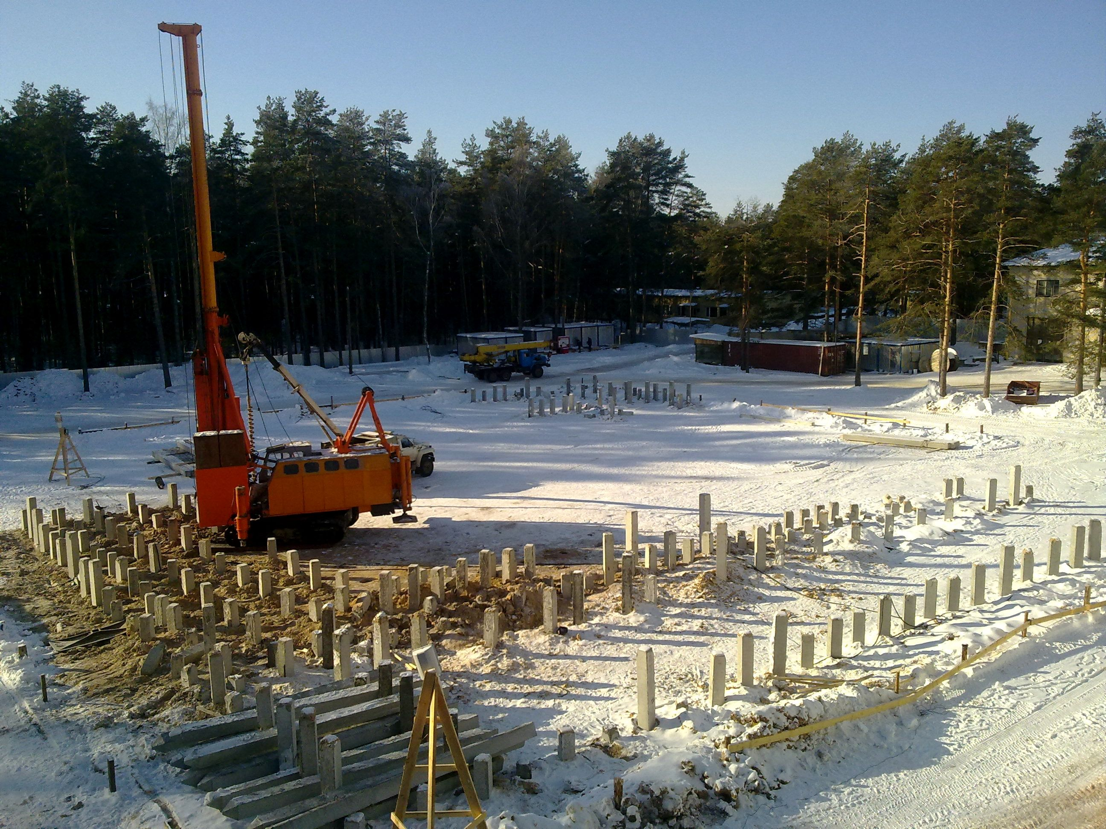
March 2012, Dubna

Slide 7
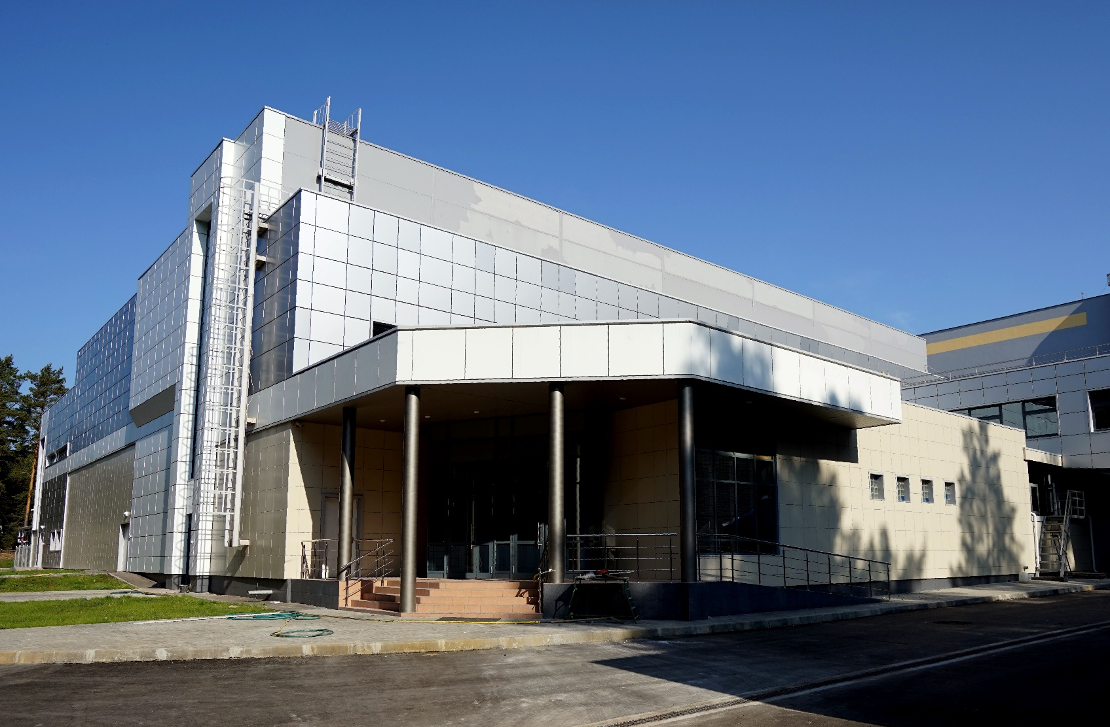
Superheavy Element Factory
DC-280
Onset of day-one experiments – Nov. – Dec. 2018

Slide 8
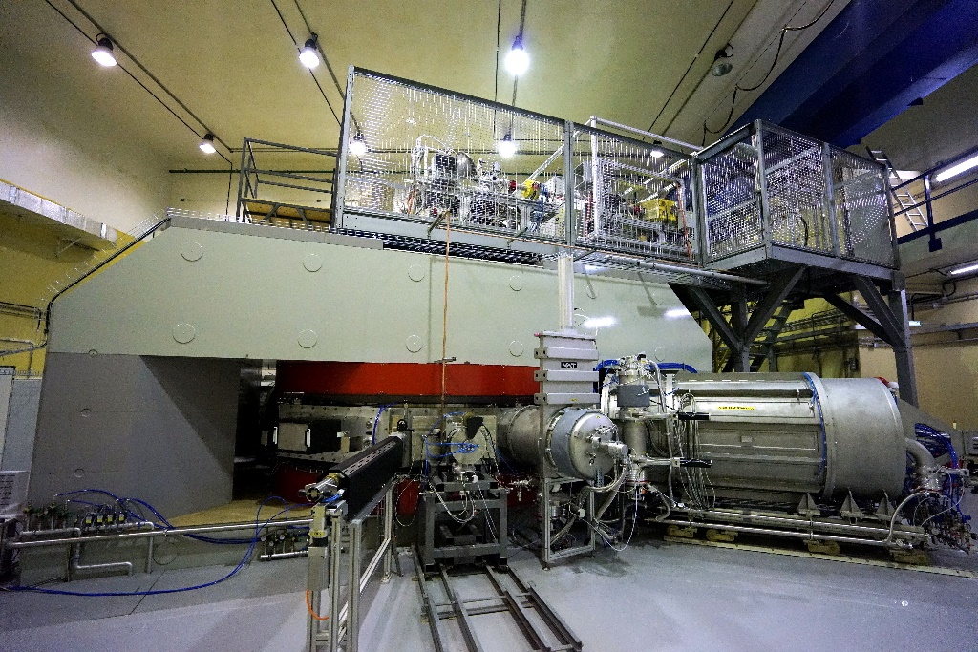
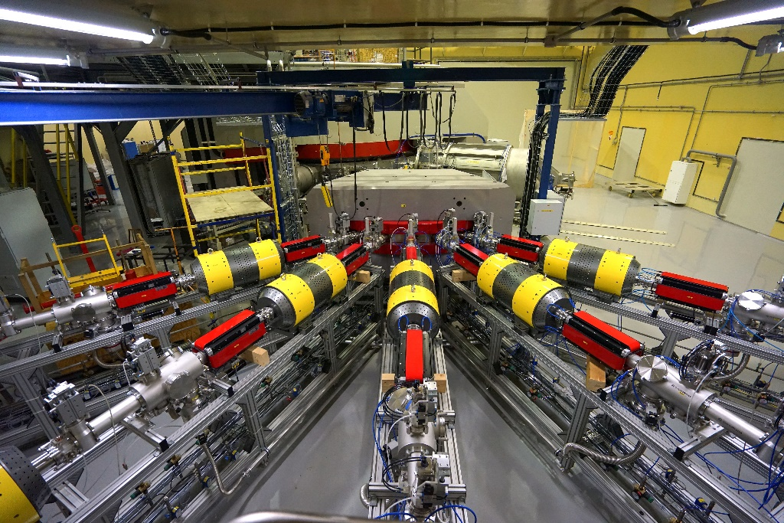
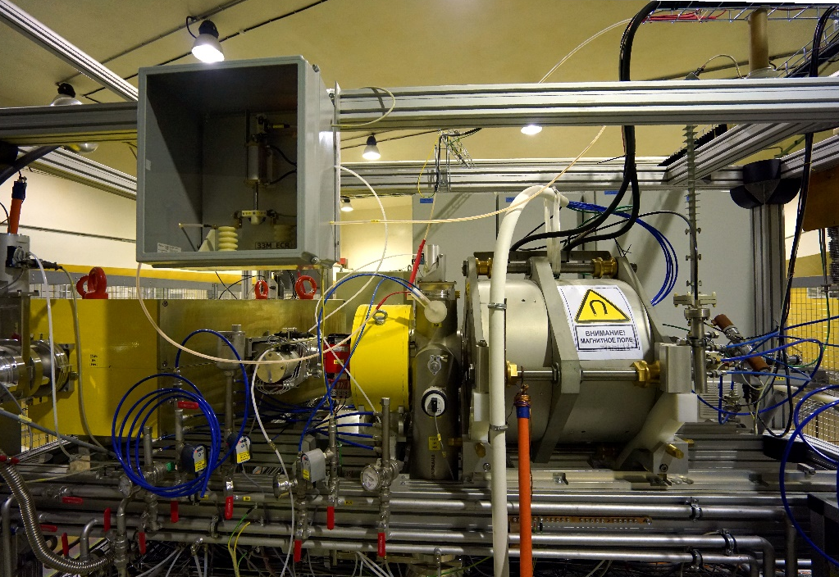
Specialized high-current cyclotron DC280
DC280 (expected) E=4÷8 MeV/A
⁷Li | 4 | 1×10¹⁴
¹⁸O | 8 | 1×10¹⁴
⁴⁰Ar | 5 | 6×10¹³
⁴⁸Ca | 5 | 1×10¹⁴
⁵⁴Cr | 5 | 2×10¹³
¹³⁶Xe | 5 | 1×10¹⁴
²³⁸U | 7 | 5×10¹⁰

Slide 9
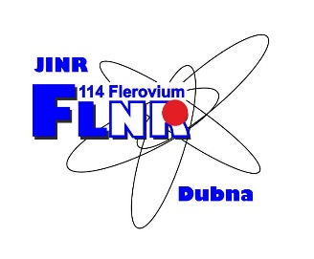
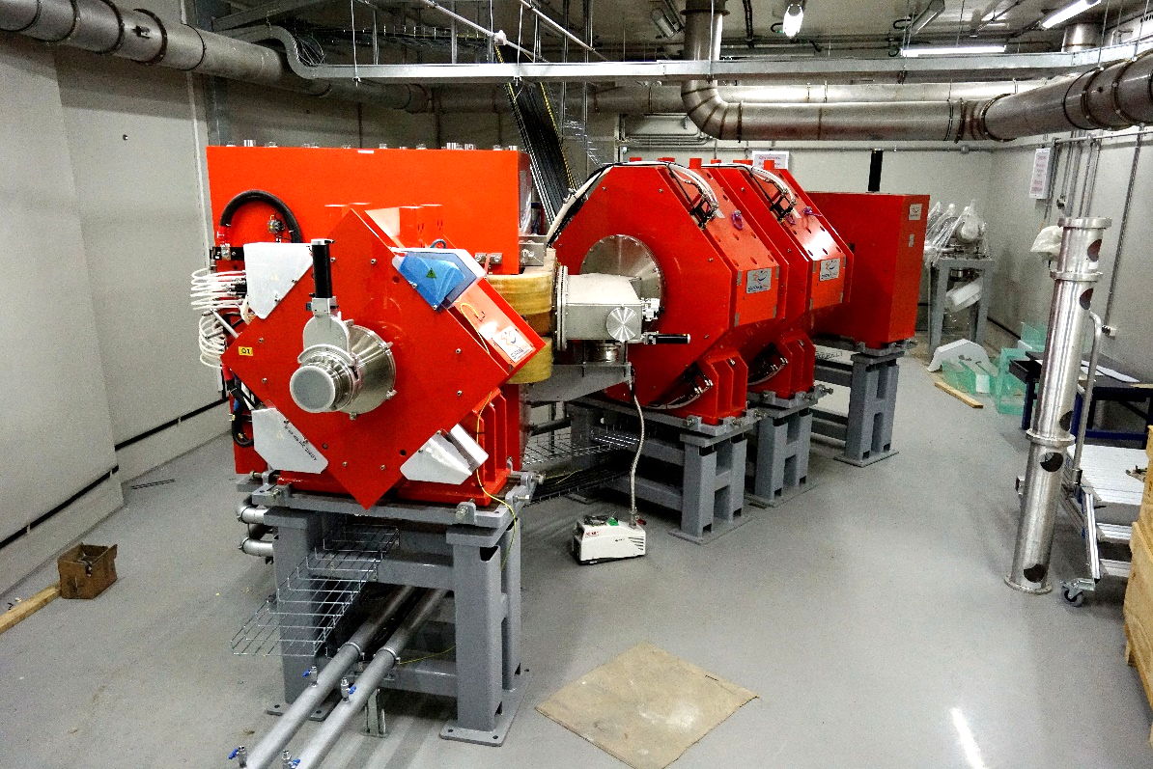
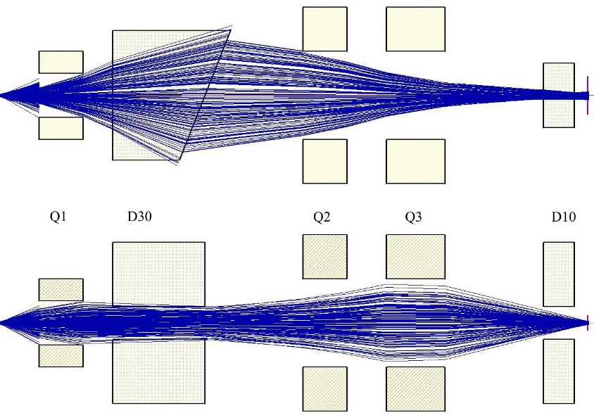
New FLNR’s gas-filled separator
Reaction | Transmission
²⁴⁴Pu(⁴⁸Ca,3n)²⁸⁹114 | 60 %
²⁴⁴Pu(⁵⁸Fe,4n)²⁹⁸120 | 75 %

Slide 10
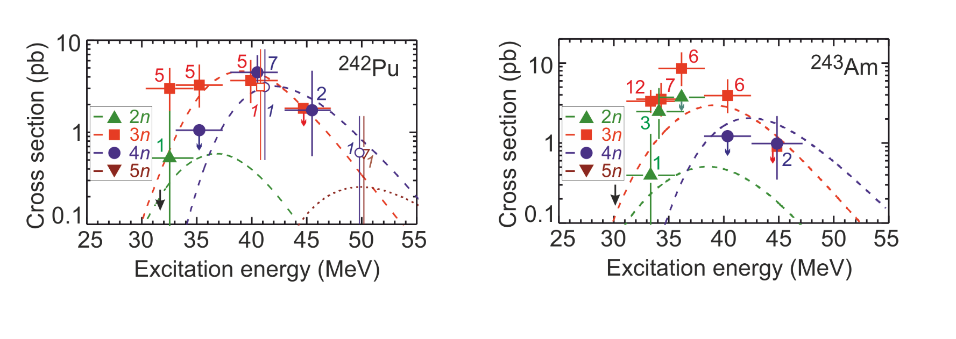
Day-one experiments at SHE Factory
Test experiments I:
Test of functionalities of all the systems of the accelerator and gas-filled separator
⁴⁰Ar+^{nat}Dy and ¹⁸O+²⁰⁸Pb
Test experiments II:
⁴⁸Ca+²⁴²Pu and ⁴⁸Ca+²⁴³Am
Enough material to prepare “big” targets
Well-studied in previous experiments
Relatively large cross sections
⁴⁸Ca+²⁴²Pu
Existing experimental data
⁴⁸Ca+²⁴³Am

Slide 11
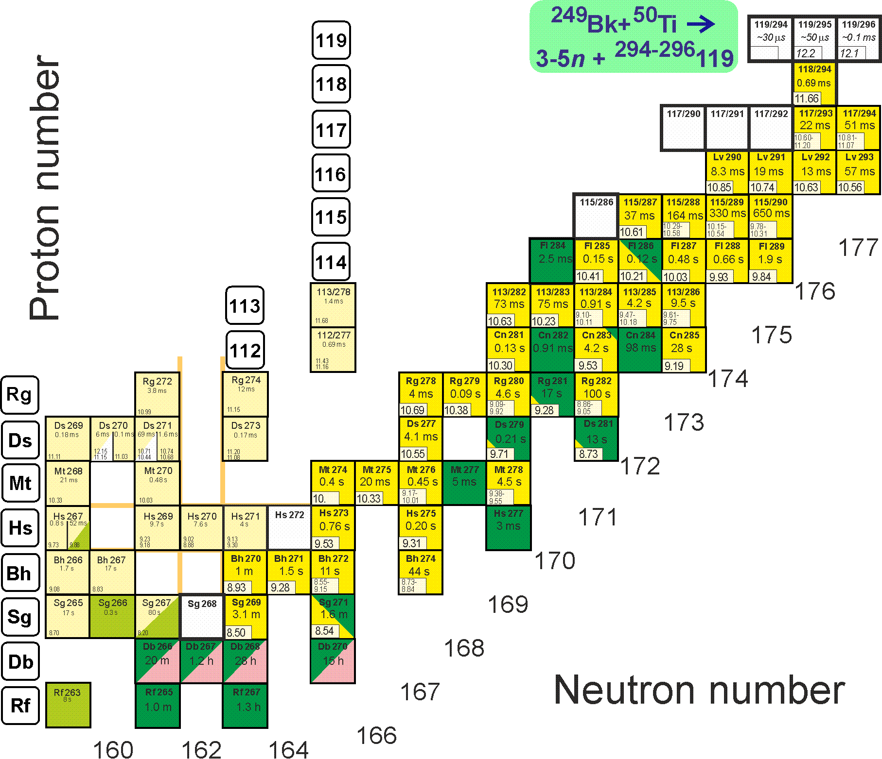
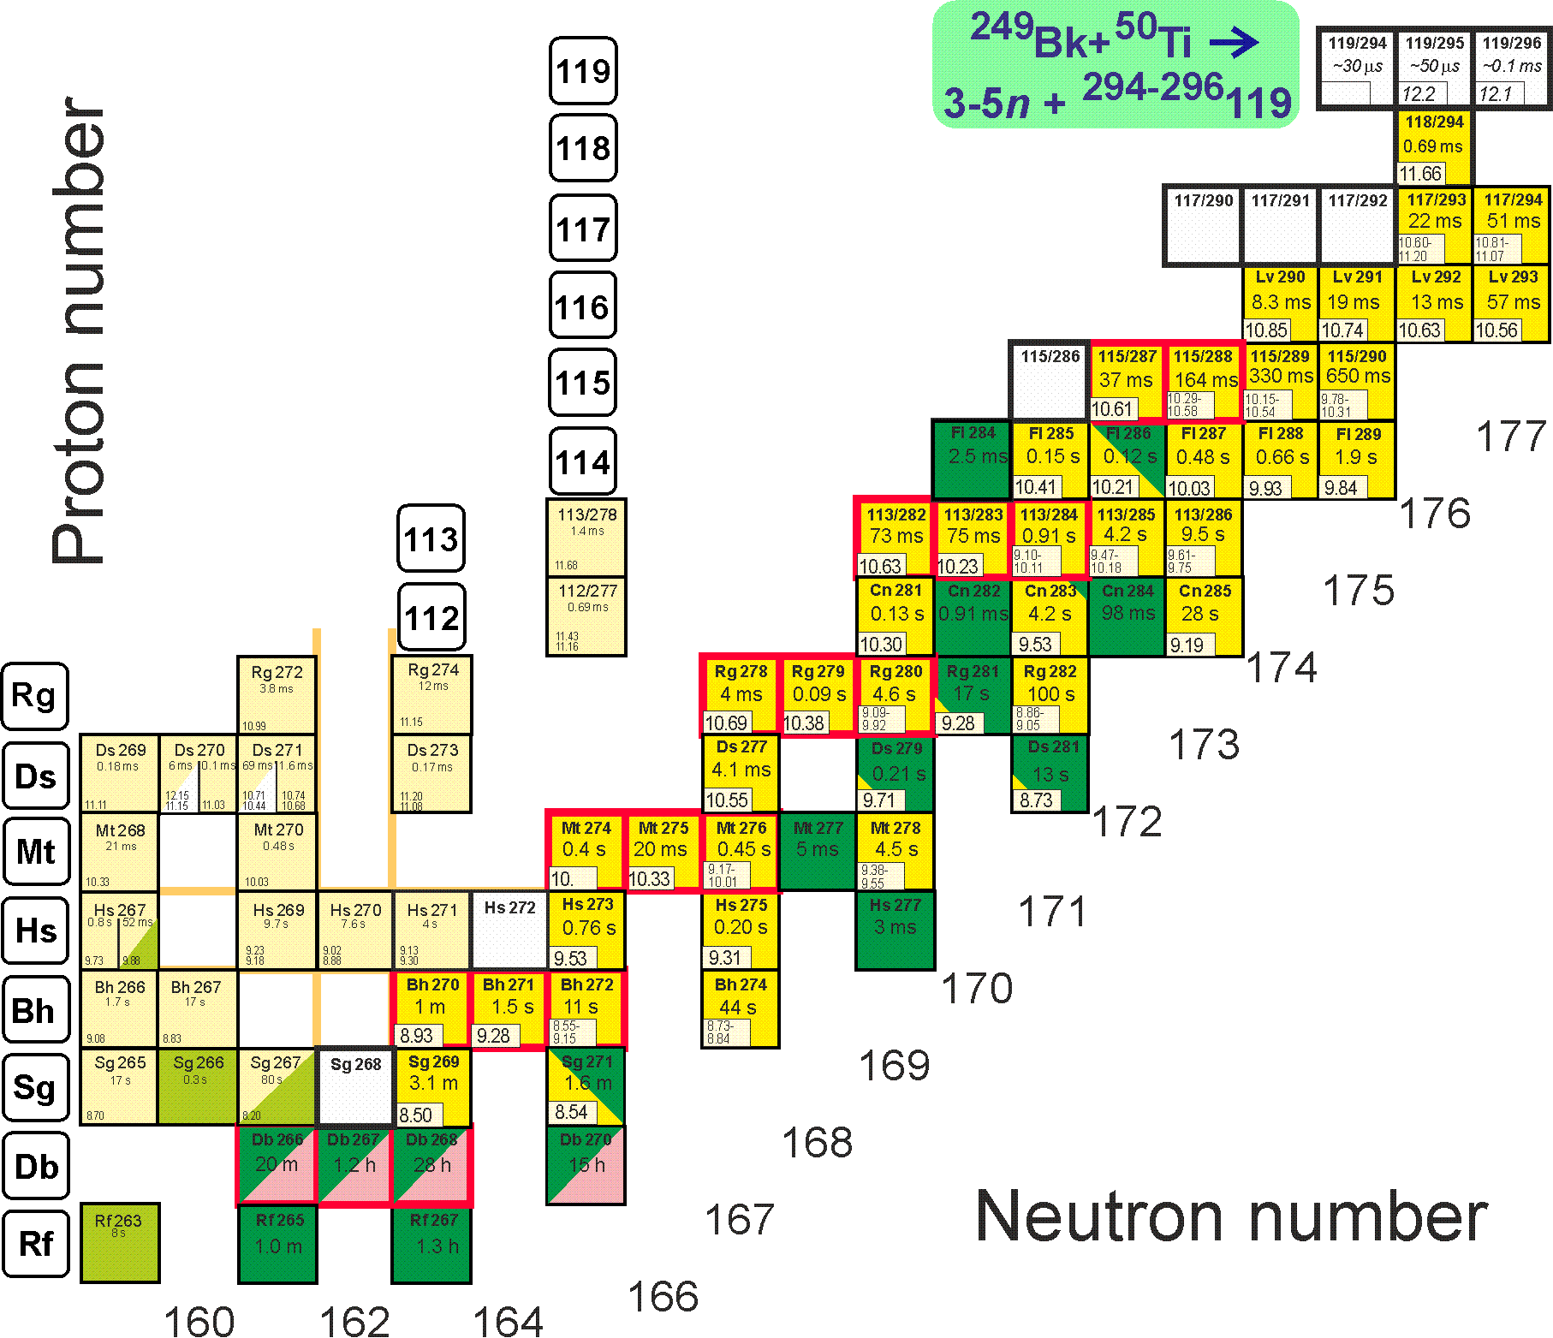
First experiments at SHE Factory
Synthesis of new element 119
²⁴⁹Bk(⁵⁰Ti,3-4n)^{295,296}119
Descendants ^{287,288}Mc, ²⁸²⁻²⁹⁴Nh… are known
s=50 fb, h_{t}=0.3 mg/cm², ε_{coll}=0.6, I_{beam}=3 pmA → ≈1 event per month

Slide 12
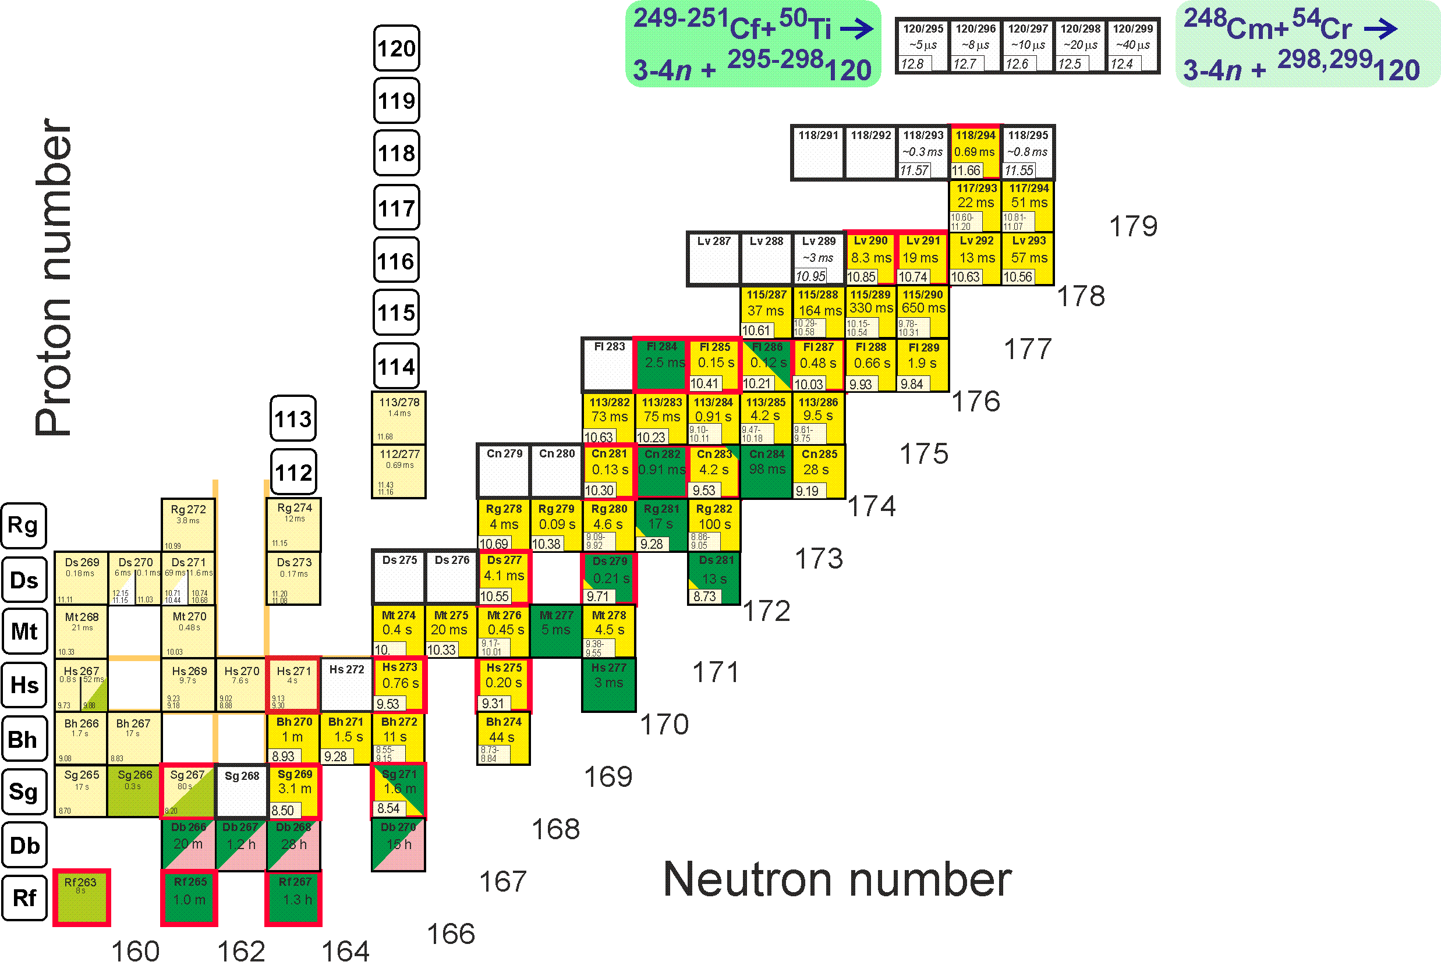
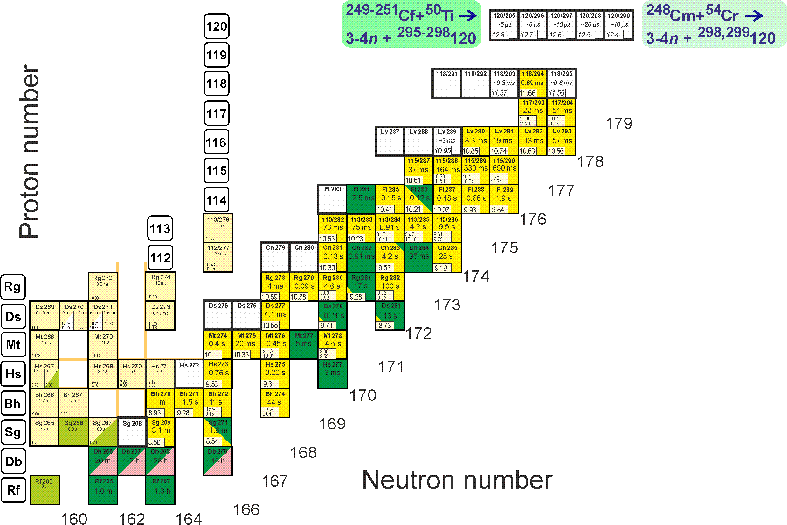
First experiments at SHE Factory
Synthesis of new element 120
²⁴⁹Cf(⁵⁰Ti,3-4n)^{295,296}120
²⁵¹Cf(⁵⁰Ti,3-4n)^{297,298}120
²⁴⁸Cm(⁵⁴Cr,3-4n)^{298,299}120
Descendants ²⁹⁴Og, ^{290,291}Lv, ^{284–286}Fl … are known
s=50 fb, h_{t}=0.3 mg/cm², ε_{coll}=0.6, I_{beam}=3 pmA → ≈1 event per month

Slide 13
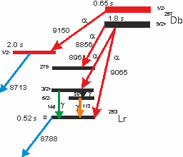
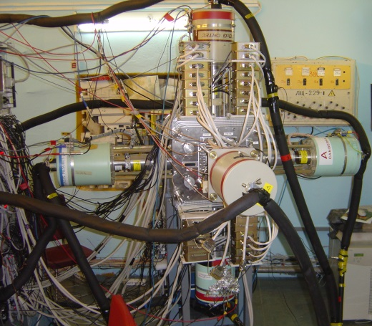
Modernization of the GABRIELA detector set-up
5 Clover Ge detectors

Slide 14
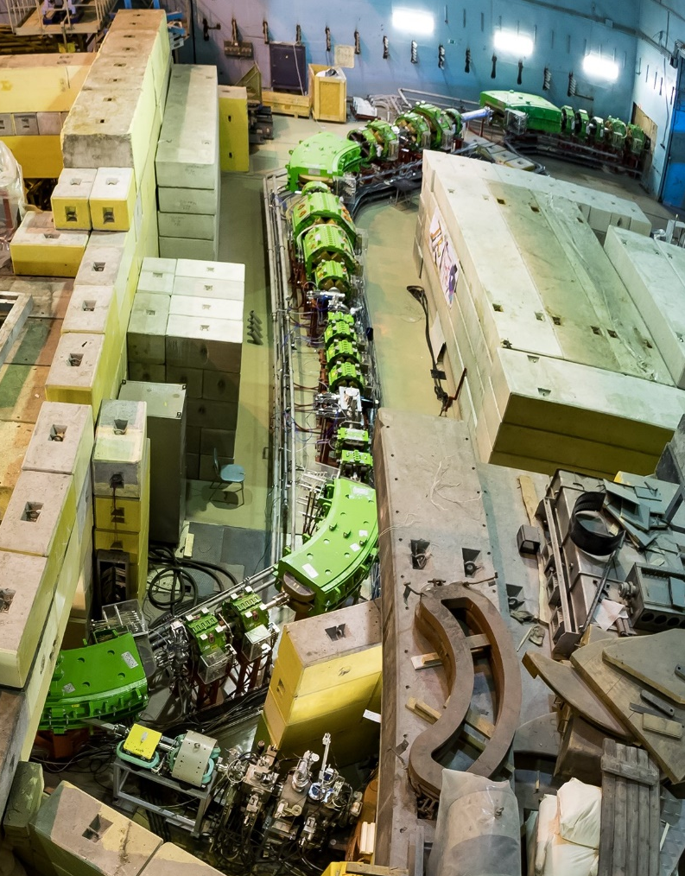
RIB researches via ACCULINNA-2@U-400M are possible since 2018
First experiments with ⁶He and ⁹Li on CD₂ target were carried out at ACC-2 in 2018:
elastic scattering ⁶He(25 AMeV)+d;
d(⁶He,³He)⁵H reaction;
d(⁹Li,p)¹⁰Li → n+⁹Li run.
⁷H and its 4n-decay in the reaction d(⁸He,³He)⁷H is proposed as a flag ship experiment for the years 2018/19

Slide 15

Neutron Nuclear Physcis
2018 highlights

Slide 16
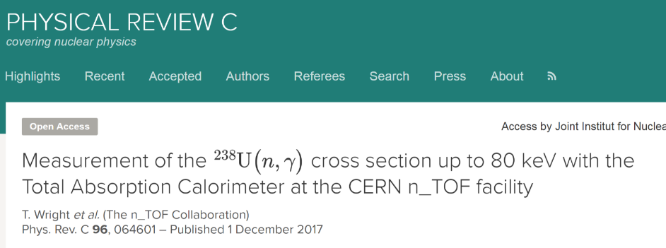
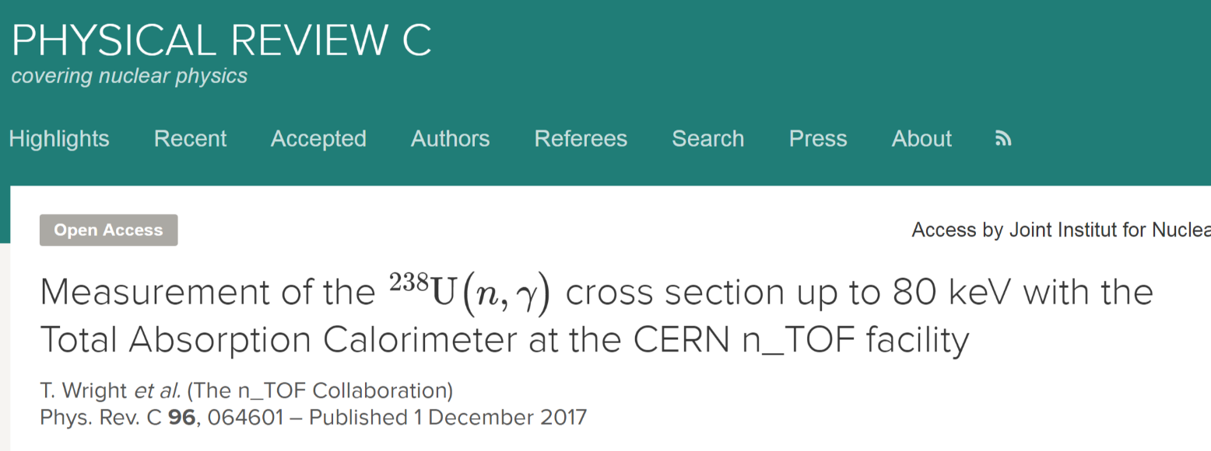
FLNP JINR Participation in the n_TOF CERN Collaboration
Notes:
Time of flight measurements 238U(n,gamma) at CERN n_TOF facility. FLNP JINR is the member of the n_TOF collaboration.

Slide 17
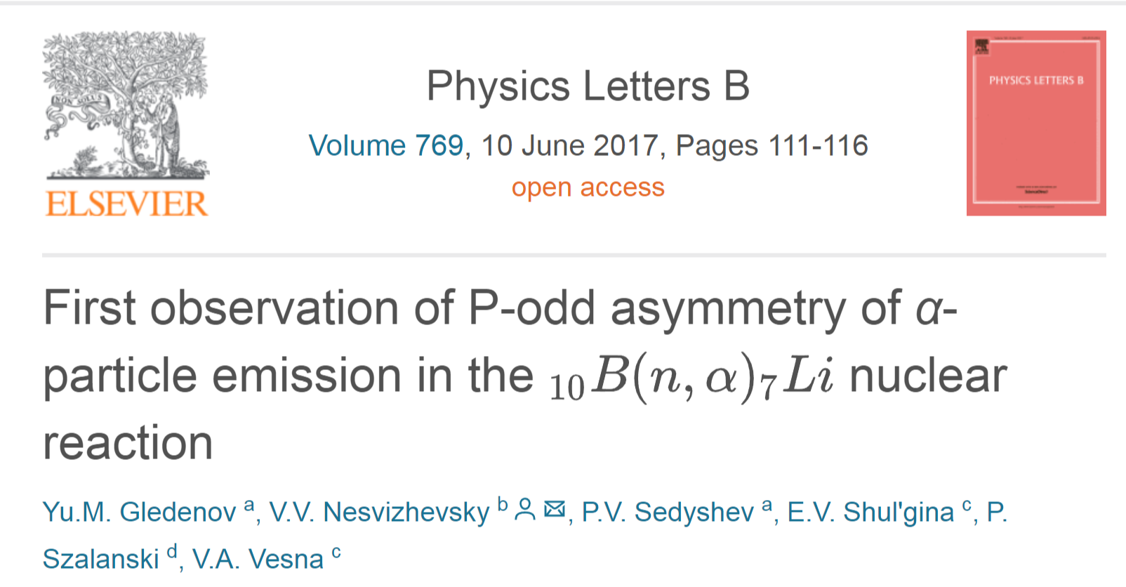
Notes:
First observation of P-odd asymmetry of α-particle emission in the 10B(n, α)7Linuclear reaction. Experimental investigation of spatial parity in reactions of polarized neutrons with light nuclei is an important topic in the framework of exploring the fundamental problem of manifestations of weak interaction in nuclear processes as well as evaluating constants of weak nucleon–nucleon (NN) potential. The precision of measurement of P-odd asymmetry in the emission of α-particles in the reaction 10B(n, α)7Li =−(11.2 ±3.4) ·10−8) is comparable with the precision of measurement of P-odd effect in the reaction 6Li(n, α)3H. The non-zero result in the reaction 10B(n, α)7Li. is obtained for the first time. 10Bis the second light nucleus, after 6Li, where P-odd effect has been observed. P-odd effect in the reaction 10B(n, α)7Lican be theoretically calculated within the cluster model; it would be of high importance to describe the considered reaction also from “first principles”.

Slide 18
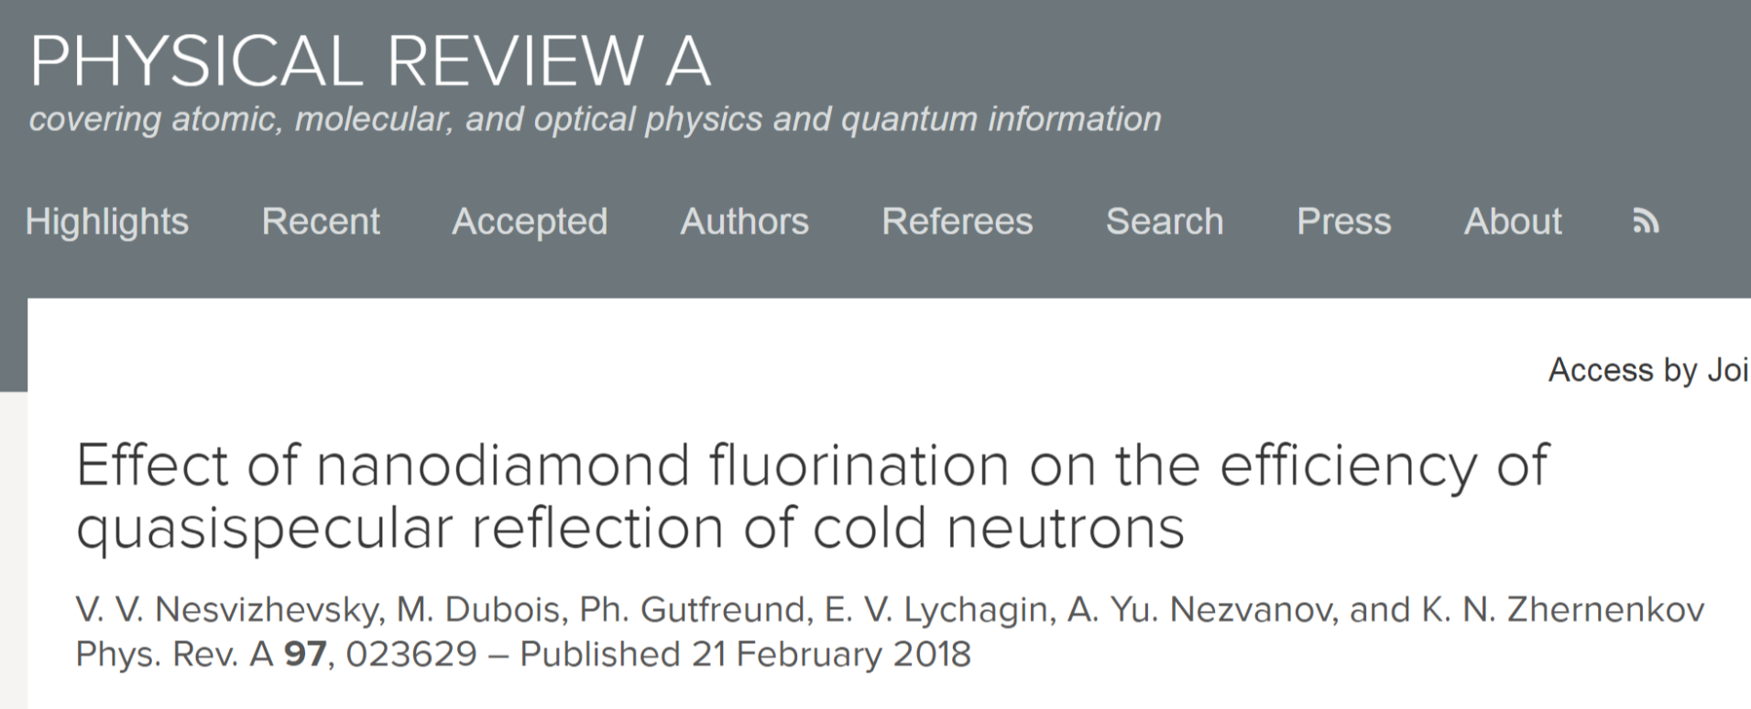
Notes:
The quasispecular reflection of cold neutrons from powders of raw and fluorinated detonation nanodiamonds have been studied. As expected, fluorination, which had removed hydrogen and amorphous arbon from the surface of the nanoparticles, increased the probability of quasispecular reflection. This method can be used for focusing and delivery of neutrons, and is thus complementary to supermirrors [25], at certain conditions. It might serve for designing and building more efficient neutron facilities and sources.

Slide 19
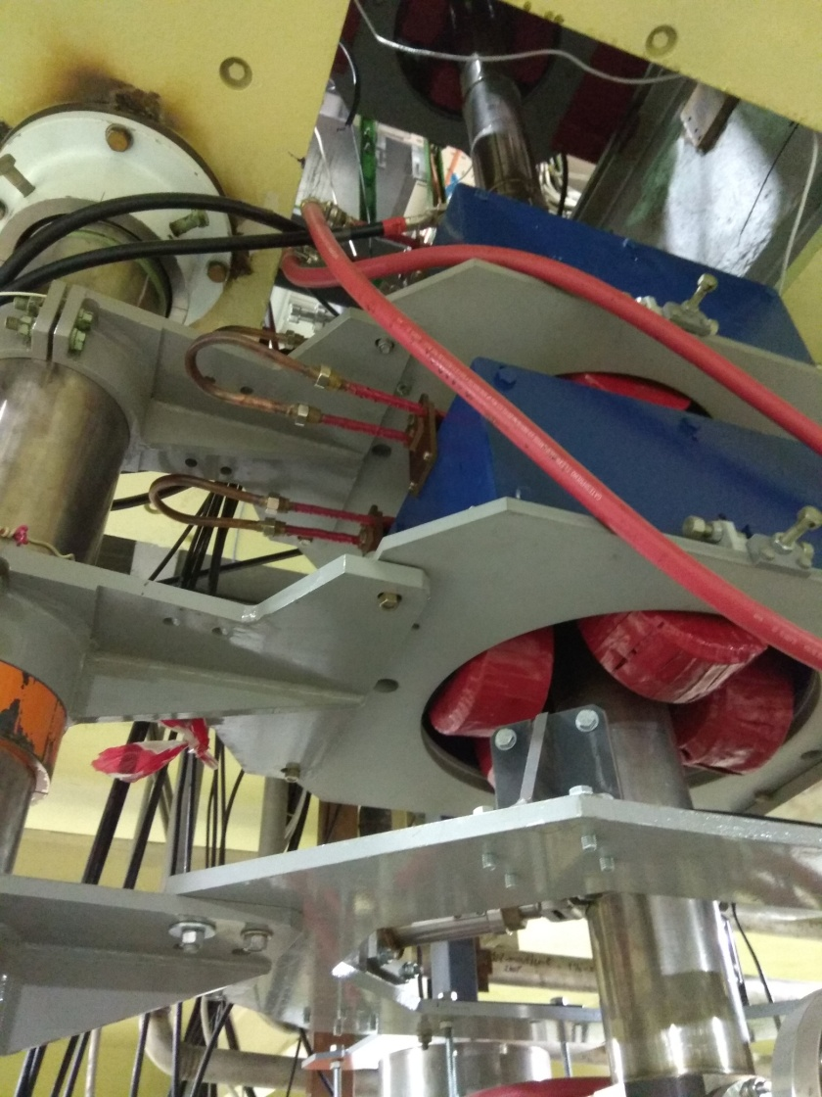
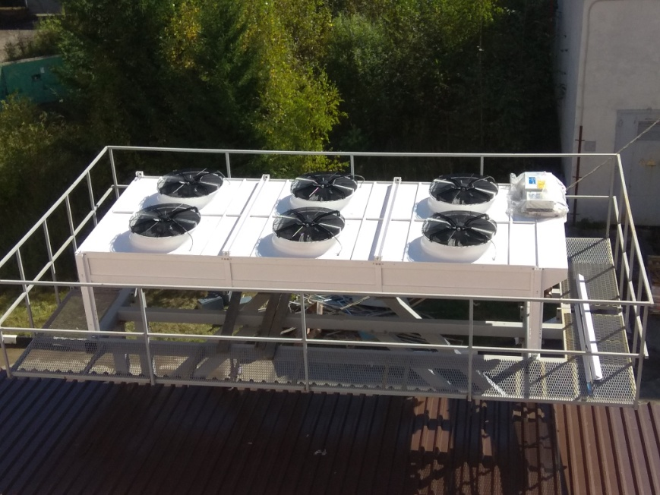
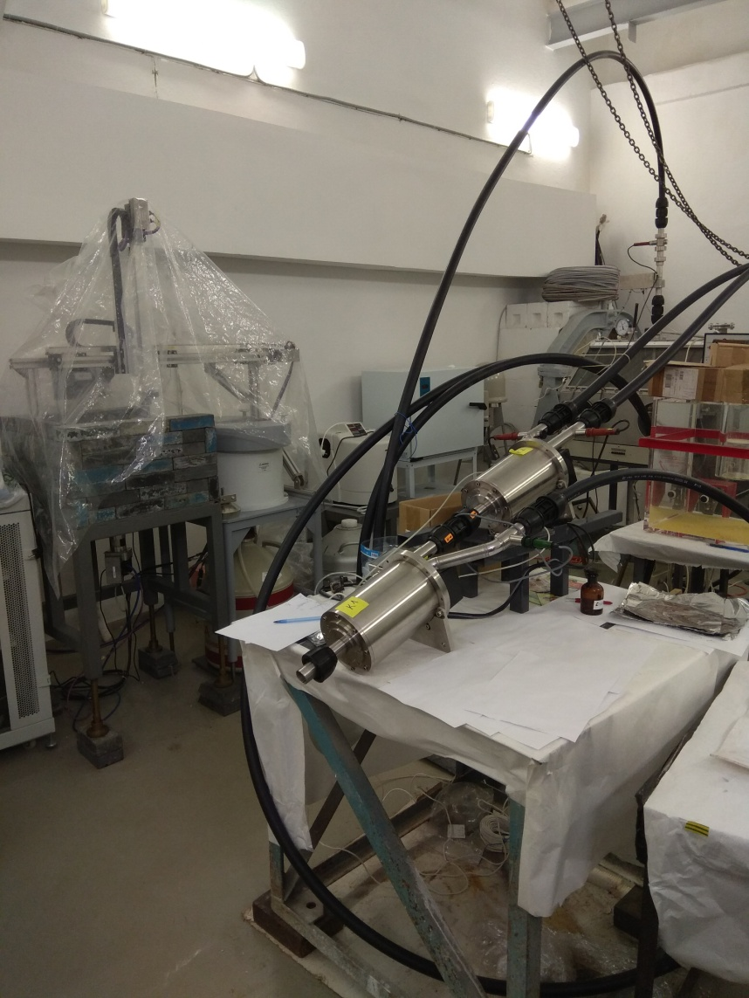
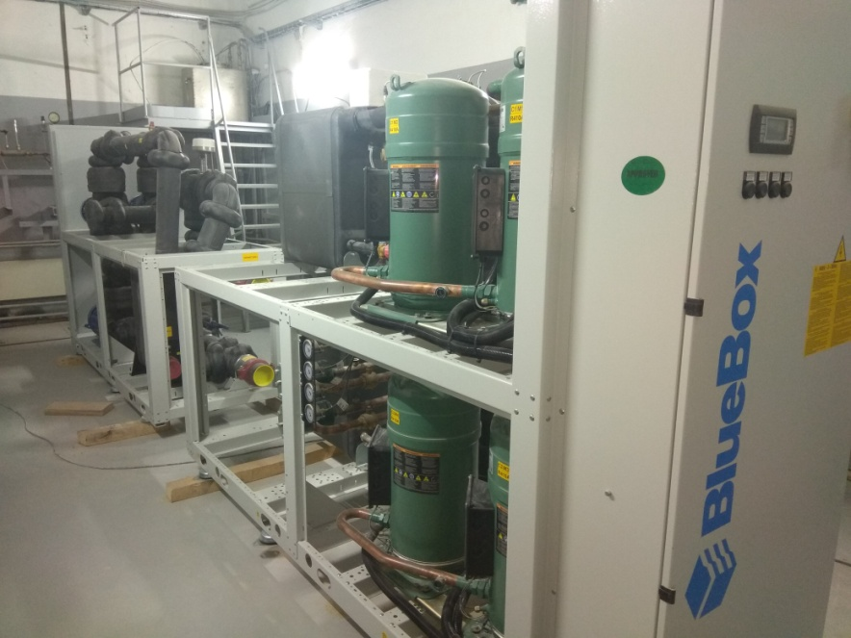
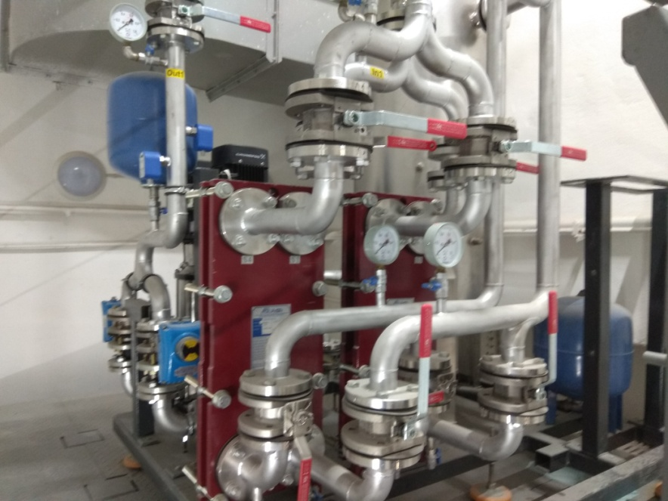
Developing of IREN during 2018
Working with two accelerating section was started at 2017
REGATA-2 pneumatic transportation system at stand
Dry cooling tower
During 2018
Deep modernization of the cooling system to work independent of IBR-2 (will finished to the end of year)
New ventilation for target hall was mounted
The REGATA-2 equipment was assembled and test at the stand
To work with ANA at IREN the renovations of rooms (sanitary inspection room, chemical laboratory, etc.) are going
Preparatory works was done for designing overhauls of experimental halls
Manufacturing of new waveguide
Manufacturing of new klystrons (120 Hz) will be finished at the first month of 2019
One of two Chillers
Four heat exchange
modules
Plans for 2019:
Start to operate with new cooling system routinely
REGATA-2 mounting at its place
Designing overhauls of experimental halls

Slide 20
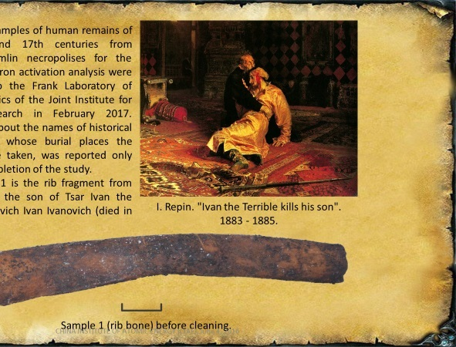
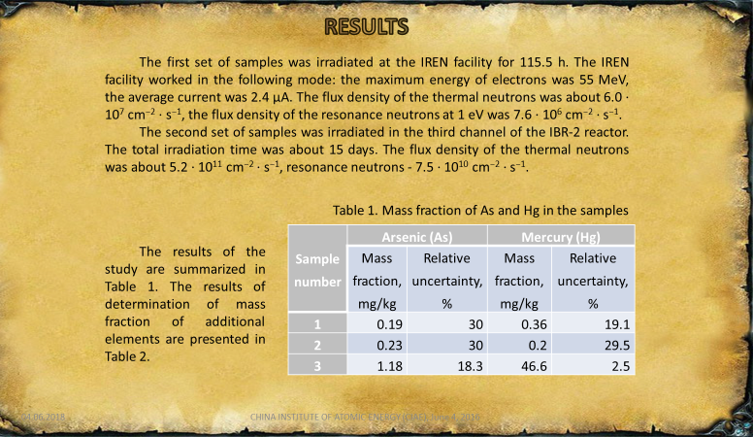
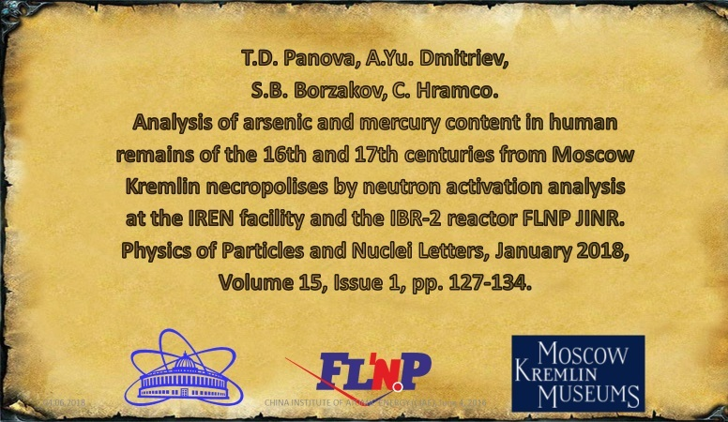
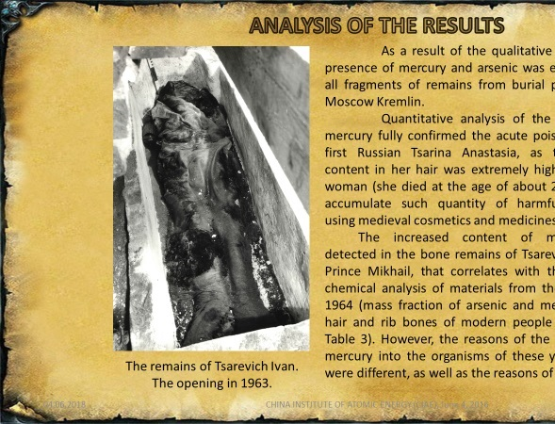
Notes:
Analysis of Arsenic and Mercury content in human remains of the 16th and 17th centuries from Moscow Kremlin necropolises by neutron activation analysis at the IREN facility.

Slide 21

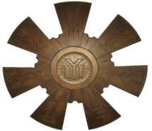
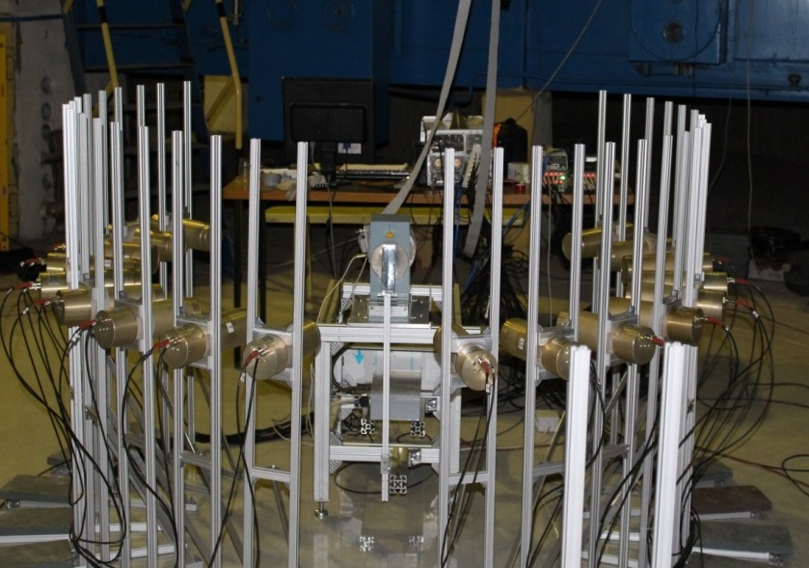
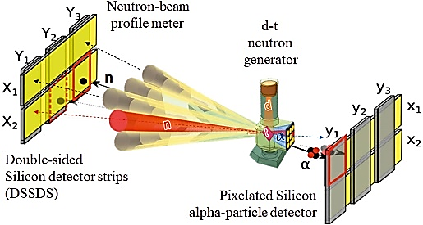
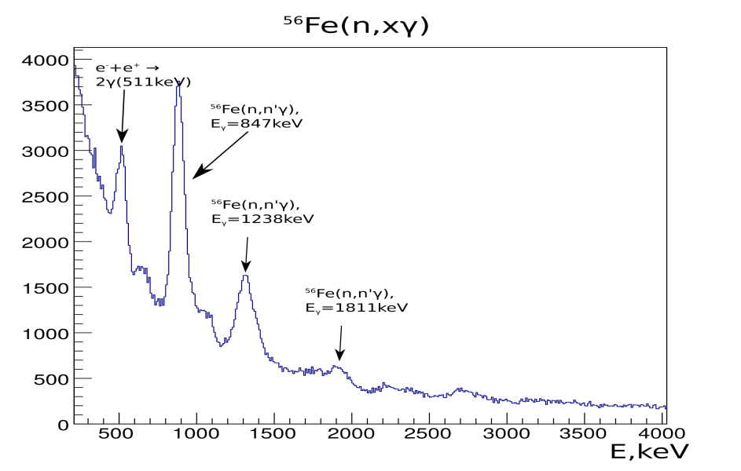
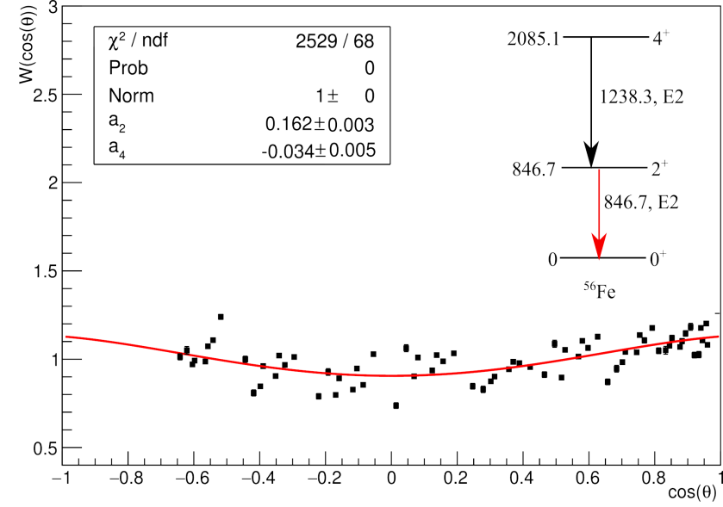
Modernization of the framework of the TANGRA Project
BGO Romashka
The tagged neutron method
γ-quanta angular distribution for
846.7 keV line of ⁵⁶Fe
Measured γ-spectrum for ⁵⁶Fe
Notes:
TANGRA project is one of bigest project of Department of Nuclear Physics of FLNP. In 2018 the experimental setup was modernized.
18 new detectors based on BGO have been installed, which make it possible to detect the angular and energy spectra of gamma quanta in fast neutron reactions with high accuracy and efficiency.
The data acquisition system was also modernized, a new position-sensitive fast neutron detector was designed and constructed. T
he experimental program for the new facility is aimed at measuring the angular correlations in inelastic scattering of tagged neutrons at various nuclei, as well as at elemental analysis using prompt gamma-rays.

Slide 22
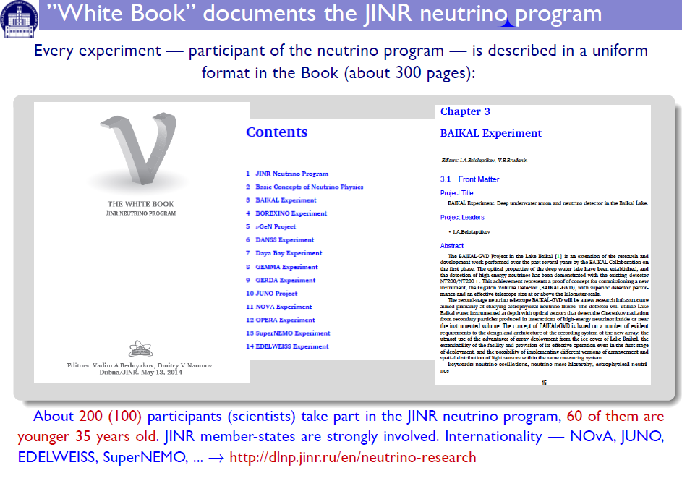

Slide 23
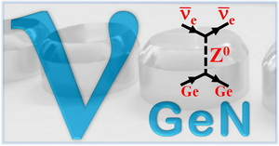
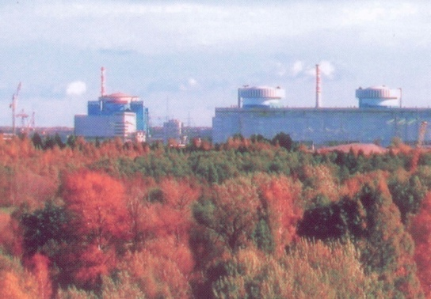
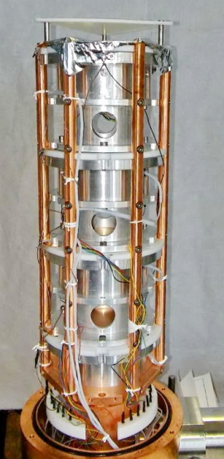
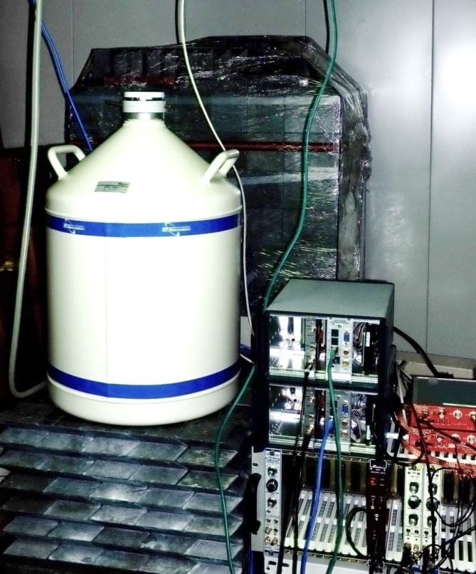
The νGeN Experiment at the Kalinin Nuclear Power Plant
Experiment for Detection Coherent
ν – Ge Nucleus Elastic Scattering
Measurements with highest available neutrino flux
Detectors with low energy threshold
Point contact HPGe detectors produced by Dubna in cooperation with BSI (Riga)
(4x400 g).
The energy thresholds from 300-350 eV
Low background cryostat (material selection: Dubna, production: BSI), and low noise electronics
For correct interpretation of results many methodical studies (energy calibration for E~1 keV, fiducial volume, own background).
We use one of the best low background infrastructure available – EDELWEISS-I shield in the LSM underground laboratory.
Kalinin Nuclear Power Plant at 10 m from the reactor core the flux is 5.4 х 10¹³ cm² per sec.
Improved low background shield of GEMMA experiment (world leader of neutrino magnetic moment measururements) .
The available place for measurements is just under the reactor, which provides about 70 m.w.e. shielding from cosmic rays.
Notes:
The νGeN is experiment is intended for detection of coherent neutrino - Ge nucleus elastic scattering using special HPGe detectors developed by DLNP (JINR, Dubna) in collaboration with BSI (Riga). To be sensitive to the coherent scattering signal, the νGeN experiment is placed under reactor of power #3 at the Kalinin Nuclear Power Plant (KNPP) at the point where the neutrino flux is greater than 5.4·10¹³ per cm² per sec (minimal distance 10 m). In the scope of the project we work on creation and investigation of new low-threshold semiconductor detectors made from different materials (HPGe, CZT, SiC). The aim of this R&D is to build detectors with an energy threshold of 200 eV and below for further delated study of the coherent scattering process.

Slide 24
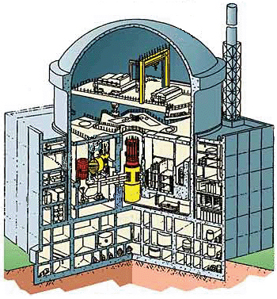
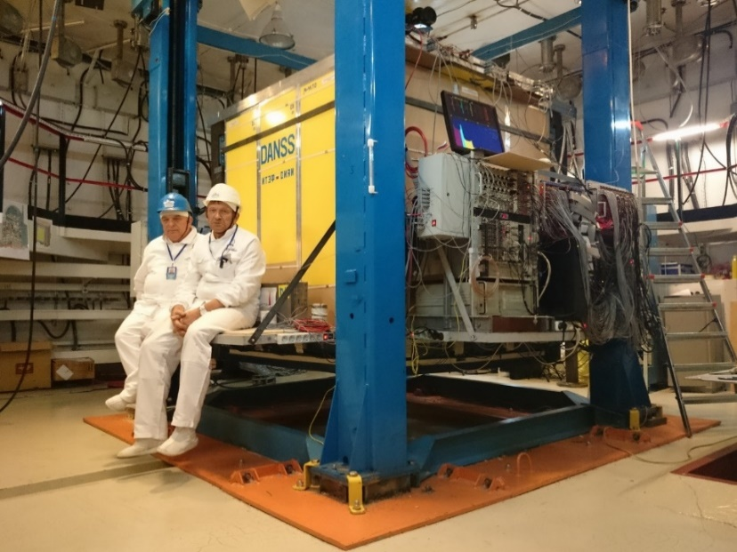
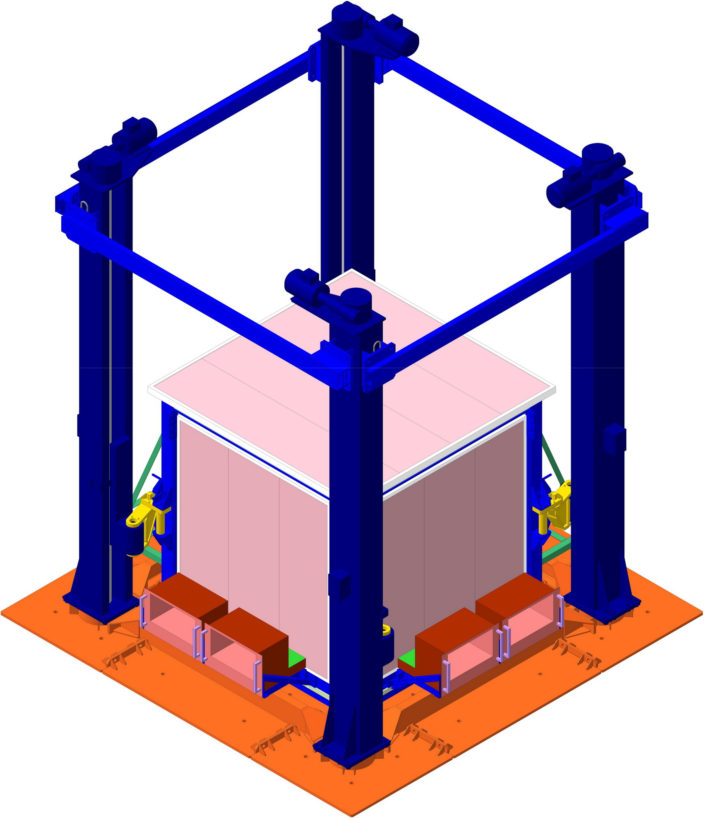
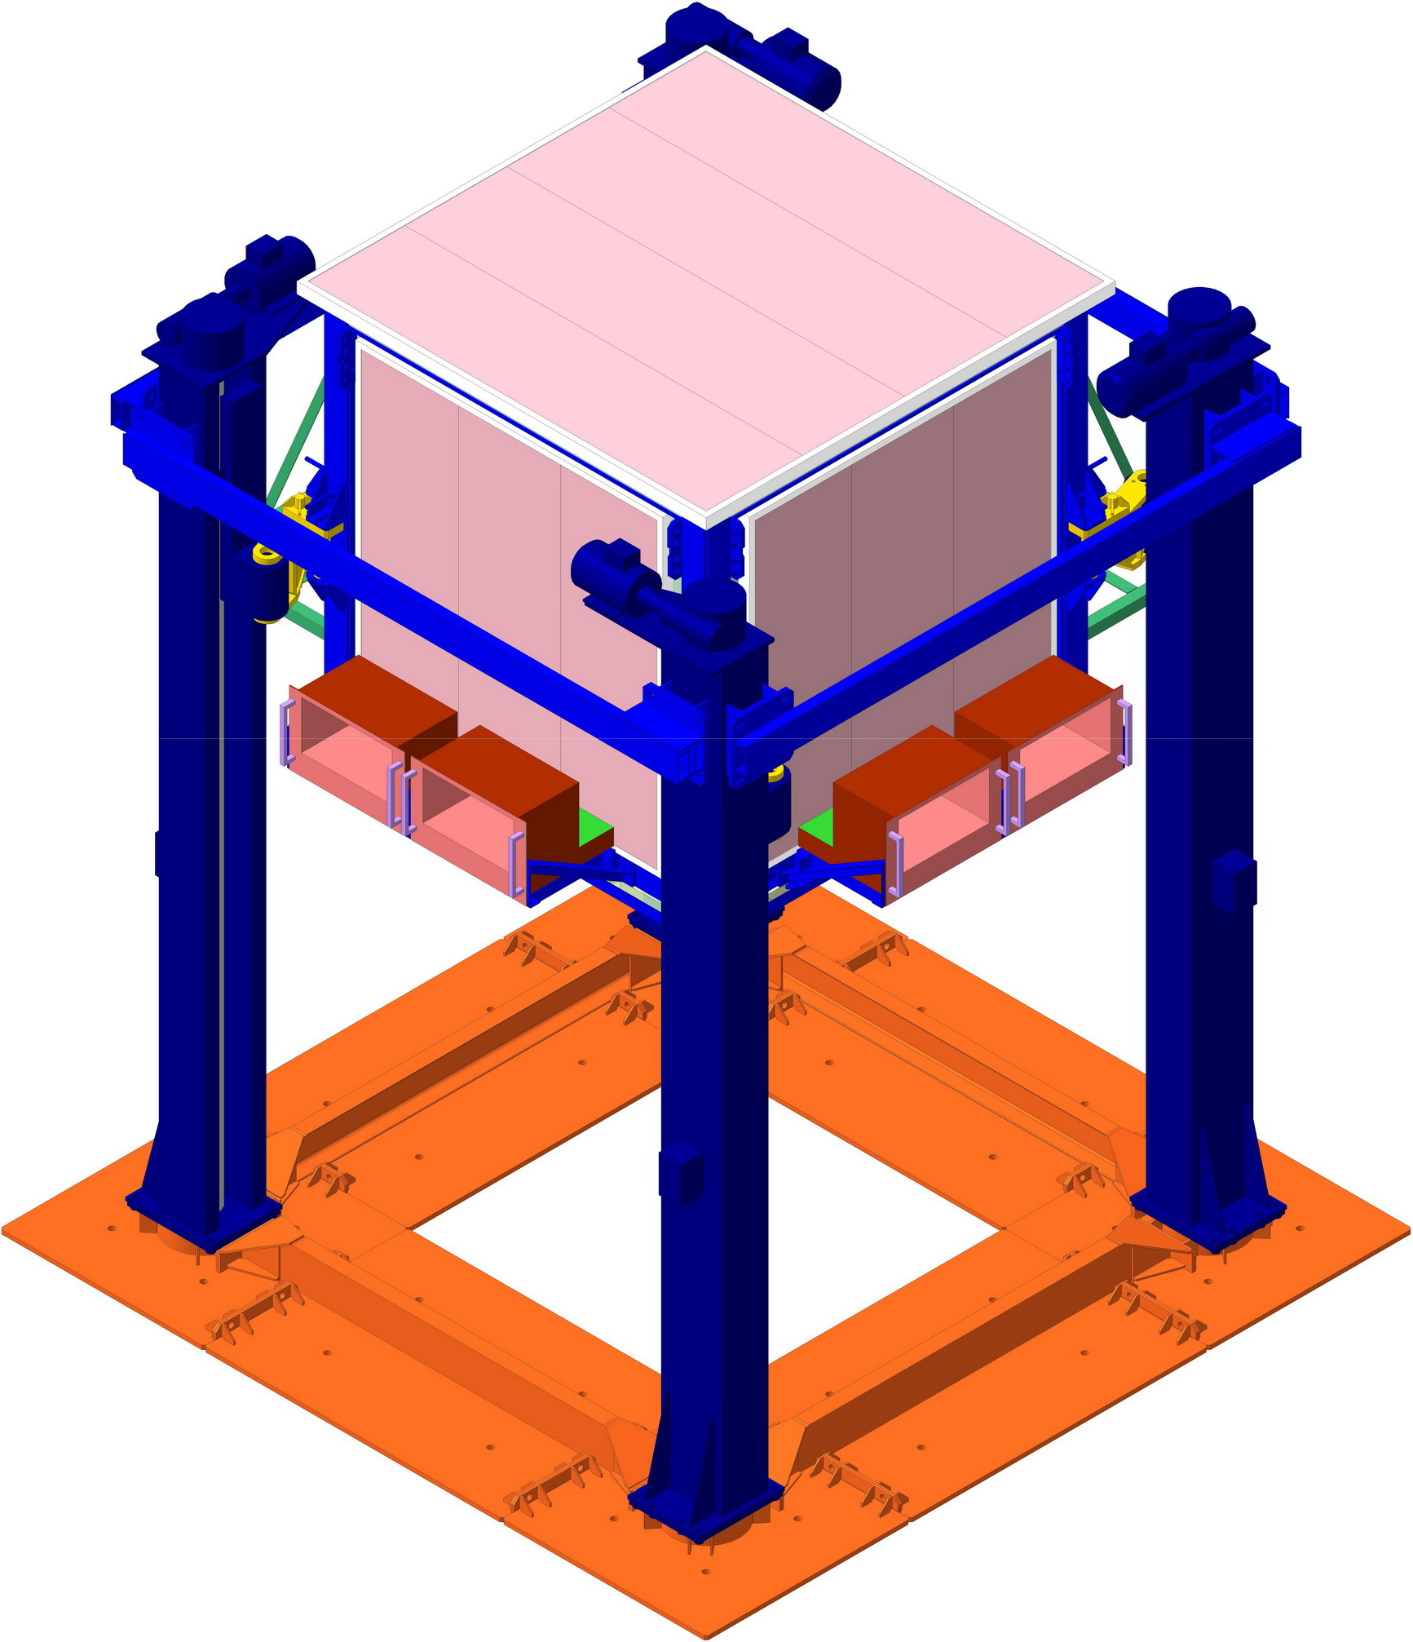
Neutrino programme: DANSS
Reactor monitoring and search for short-range neutrino oscillations
JINST 11 (2016) no.11, P11011; arXiv:1606.02896
Segmented "XY" plastic scintillator (1 m³ =1.1 tn) close to the core of the Kalinin NPP reactor #4
Overburden $\sim$50 m w.e. (reactor cauldron, cooling pond, concrete)
3D-information about each event
IBD count rate $\sim 4000 \overline{ν_{e}}$ / day; Signal / BG ~ 40
Lifting platform => distance variable on-line (L ≈ 10.7-12.7 m)
Status: data taking
Reactor core
DANSS
Notes:
The goal of the common (JINR + ITEP) project started in 2010 was to develop and create a detector of the reactor antineutrino and then explore it in order to monitor industrial power reactors. After the “Reactor Anomaly” claimed in 2011, one more goal has appeared – search for short-range neutrino oscillation to a sterile state.
Within the 2013-2016 period of the project realization, the unique neutrino spectrometer DANSS was developed, created and started to operation. Some features of the detector make it free of numerous disadvantages being inherent in similar projects (such as NUCIFER, ANGRA, IDREAM, etc.) and therefore our project takes the leading place between all ones mentioned above.
First, instead of liquid scintillator, our detector uses solid-state polystyrene-based scintillator. As it does not contain flammable, explosive, caustic, volatile or toxic liquids, there are no restrictions on its location close to the industrial reactor. As a result, the detector is mounted in the room #A336 which is located just below the core of the WWER1000 reactor with 3100 MW thermal power. Due to such position, more than 10⁴ IBD neutrino interactions per day occur in the detector body. Moreover, being in the bottom part of the building, the detector is shielded against cosmic rays with a big amount of hydrogen-containing materials located above it – the reactor cauldron, thick concrete walls, cooling pond for the spent fuel, reservoirs with boric acid, etc. The total thickness of this gratis overburden is 50 m of water equivalent, which removes completely the hadronic component of cosmic rays being the most dangerous source of background events similar to IBD.
DANSS detector including the shielding, acquisition electronics and auxiliary devices is mounted on a movable platform (Fig.). A lifting gear moves it on-line by 2 meter per 4 minutes, varying the distance to the reactor core from 10.7 to 12.7 m. Due to this feature, the DANSS detector is used now to search for short-range neutrino oscillation to a sterile state. In the most of other similar projects it is done (or planned to be done) by means of precise measurement of the neutrino energy spectrum at fixed position and then comparing it with a calculated spectrum. In this case, the reliability and precision of the conclusion depends on the calculation model which is quite questionable.
Для нейтринной диагностики промышленных ядерных реакторов, а также для поиска короткопробежных осцилляций нейтрино в стерильное состояние нами совместно с ИТЭФ создан детектор реакторных антинейтрино – DANSS.
Отличительная особенность нашего нейтринного детектора – это то, что он представляет собой не традиционно используемый кубометр жидкого сцинтиллятора (едкая токсичная жидкость вроде керосина, которую из соображений безопасности просто нельзя располагать близко от реактора), а твердый сцинтиллятор на основе полистирола. Это позволило установить детектор в непосредственной близи от мощного промышленного реактора (на рисунке позиция детектора под котлом ВВЭР-1000 Калининской АЭС показана цветным квадратиком) и исследовать экстремально большие нейтринные потоки, что делает наш детектор на порядок более чувствительным по сравнению с другими (существующими или проектируемыми) аналогичными детекторами – даже грубый предварительный анализ данных показывает, что мы надежно регистрируем несколько тысяч ОБР-событий в сутки.
Близкое к реактору расположение детектора не только дает аномально высокий нейтринный поток, но и обеспечивает хорошую защиту от космического фона. Действительно, над нашим детектором расположена огромная масса самого реактора с 70 тоннами урана, толстый слой бетонной защиты и, главное – многометровый слой воды в бассейне выдержки отработанного топлива! Все это надежно прикрывает сверху наш детектор, полностью убирая быстрые нейтроны от космики, которые являются основным источником фона для такого рода детекторов. Все наши конкуренты лишены такой защиты.
Близкое к реактору расположение детектора не только дает аномально высокий нейтринный поток, но и обеспечивает хорошую защиту от космического фона. Действительно, над нашим детектором расположена огромная масса самого реактора с 70 тоннами урана, толстый слой бетонной защиты и, главное – многометровый слой воды в бассейне выдержки отработанного топлива! Все это надежно прикрывает сверху наш детектор, полностью убирая быстрые нейтроны от космики, которые являются основным источником фона для такого рода детекторов. Все наши конкуренты лишены такой защиты.
Высокая сегментация детектора (он состоит из 2500 независимых элементов в виде перекрещенных X- и Y-полос) обеспечивает трехмерную картину каждого события ОБР, что позволяет значительно ужесточить условия отбора событий и тем самым дополнительно подавить фон, который в итоге не превышает 3 процентов.
Подъемный механизм позволяет за 5 минут переместить детектор на 2 метра по вертикали, не выключая его. Таким образом, можно измерять эволюцию нейтринного потока с расстоянием, максимально исключив возможные систематические ошибки, присущие подобным экспериментам в иной постановке (с неподвижными детекторами).

Slide 25
Significance of the best regions
BF: 2.8 σ
Results are preliminary:
more syst. effects are under study
3 σ means
not a discovery,
but just
a cause of thinking
Notes:
The main preliminary result could be formulated as follows. A big part of sterile neutrino parameters region is excluded. In particular, the Reactor Antineutrino Anomaly optimum point is excluded with a confidence level higher than 5σ (Fig.). On the other hand, we cannot exclude existence of short-range oscillations with other parameter values at 2.8 σ.
Основной предварительный результат можно сформулировать следующим образом. Исключена большая часть области параметров стерильных нейтрино. В частности, оптимальная точка реакционной антинейтринной аномалии исключается с уровнем достоверности выше 5σ (рис.). С другой стороны, нельзя исключать существование короткодействующих колебаний с другими значениями параметров при 2,8 σ.

Slide 26
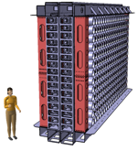
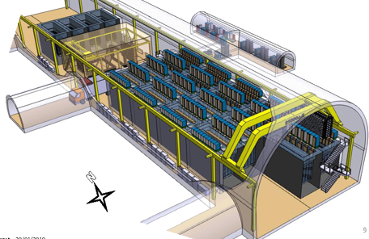
SuperNEMO sensitivity
NEMO-3 |  | SuperNEMO | Status
¹⁰⁰Mo | isotope | ⁸²Se (or other, e.g. ¹⁵⁰Nd) | ✓
7 kg | isotope mass | 7 ➔ 100 kg | ✓
5 mBq/m³ | radon | 0.15 mBq/m³ | ✓
²⁰⁸Tl: 100 μBq/kg ²¹⁴Bi: 300 μBq/kg | internal contamination | ²⁰⁸Tl ≤ 2 μBq/kg ²¹⁴Bi ≤ 10 μBq/kg | in progress
14% @ 1 MeV | FWHM | 8% @ 1 MeV | ✓
(7 kg)
Demonstrator Module
Full SuperNEMO
17.5 kg.yr :
500 kg.yr :
Demonstrator module will be complete by early 2017
Notes:
As evolution of NEMO-3, the SuperNEMO experiment (new generation experiment to search for neutrinoless double beta decay) is being performed. As the first phase, its first module called Demonstrator is under construction. It will contain 7 kg of ⁸²Se and will be able to reach the NEMO-3 sensitivity for the 0νββ decay in only 5 months. If no background events in the 0νββ region are detected after 2.5 years of data taking, which implies an exposure of 17.5 kg·y, the half-life sensitivity will be increased to T(0ν) > 6.5·10²⁴ y (90% C.L.), leading to a mass sensitivity of <mββ> <200-400 meV. The SuperNEMO Demonstrator module is currently under assembly at the LSM, the last part will be assembled at the beginning of 2017. Data taking will start in the second half of the year to measure the level of background achieved.

Slide 27


The SuperNEMO Demonstrator
Modane (Fréjus) Underground Laboratory (LSM) : 4800 m.w.e.
Calorimeter
Tracker Calorimeter
Source: 7 kg of ⁸²Se, 36 strips
planar geometry, S ~ 15 m², 40-80 mg/cm²
Tracking detector:
drift wire chamber operating
in Geiger mode (2034 cells)
Gas: He + 4% ethyl alcohol + 1% Ar + 0.1% H₂O
Calorimeter:
520 plastic scintillators in 2 main walls
+ PMTs: 8" R5912-03 HAMAMATSU
200 PS in side walls (X-walls)
+ PMTs: 5” R6594 HAMAMATSU
Magnetic field: 25 Gauss.
VETO:
60 plastic scintillators in top/bottom walls
+ PMTs: 5” R6594 HAMAMATSU
PASSIVE SHIELD:
To be built. Planned: 20 cm of iron + 30 cm of borated polyethylene.
B
ββ source
Top view
27

Slide 28






Calorimeter R&D
Optical unit
The SuperNEMO Demonstrator
Tracker R&D:
Wiring robot
Source: 7kg of ⁸²Se
CO: 1 quarter of tracker
Calorimeter wall
Low background R&D: BiPo-3
The current goal: the start of the first module, which should achieve the claimed background conditions.
28

Slide 29

The current status of the Demonstrator
SuperNEMO The demonstrator is almost completely assembled in the LSM (except for a few source foils and a calibration system). The closure and start in full configuration is planned for the autumn of 2018.
29

Slide 30


Thank You!

