Slide 1
CBM STS tracking system for BM@N
Progress with CBM-STS
System definition of BM@N-STS
CBM-STS timeline, links to BM@N planning
Johann M. Heuser, GSI Darmstadt
for the CBM-STS team
2nd Collaboration Meeting of the MPD and BM@N experiments at NICA
29 – 30 October 2018, JINR-VBLHEP, Dubna

Slide 2
I.
Progress with CBM-STS

Slide 3

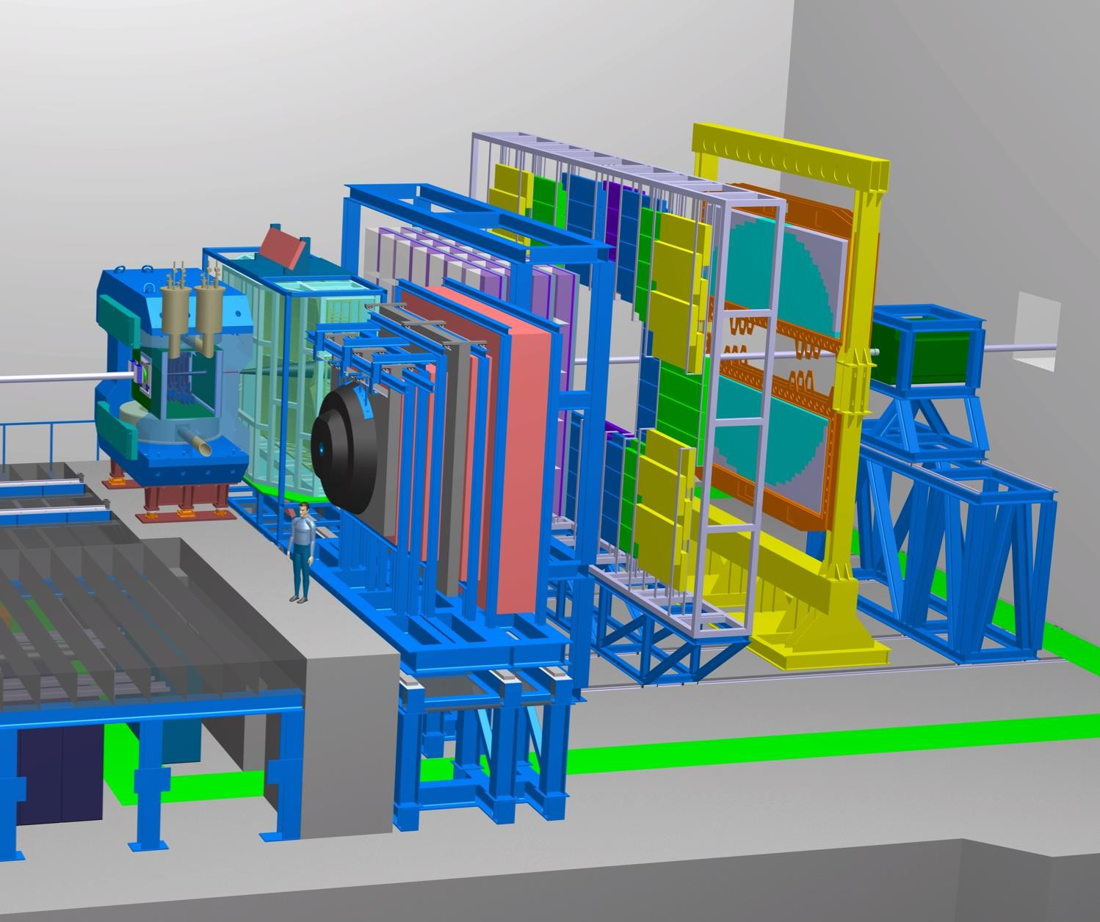



















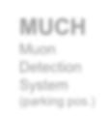







STS in CBM Experiment at FAIR
Dipole Magnet
RICH
Ring Imaging Cherenkov
TRD
Transition Radiation Detector
TOF
Resistive Plate Chambers
Tracking acceptance:
2º < θ < 25º
lab
Target
Beam
Free streaming DAQ
R_{int} = 10 MHz (Au+Au)
with
R_{int} (MVD) = 0.1 MHz
Software based event selection
MVD
Micro Vertex Detector
STS
Silicon Tracking System
MUCH
Muon Detection System (parking pos.)
ECAL
Electro- Magnetic Calorimeter
PSD
Projectile Spectator Detector

Slide 4
Silicon Tracking System
Central CBM detector: charged-particle tracking + momentum measurement
Challenges:
up to ~ 700 charged particles per heavy-ion collision → high granularity
10⁵ − 10⁷ heavy-ion collisions per second → fast, radiation tolerant
Technical solutions:
8 tracking stations, ≈ 4 m² total area, 896 detector modules, 106 ladders
double-sided silicon microstrip sensors
  hit spatial resolution ≈ 25 µm
  material budget per tracking station: ≈ 0.3% – 2% X₀
  radiation tolerance up to 1 × 10¹⁴ n/cm² (1 MeV equivalent)
self-triggering electronics, time-stamp resolution ≈ 5 ns
low-mass detector modules/ladders
Construction: 2019 – 2023 Install in CBM: 2024 Physics: 2025 …

Slide 5
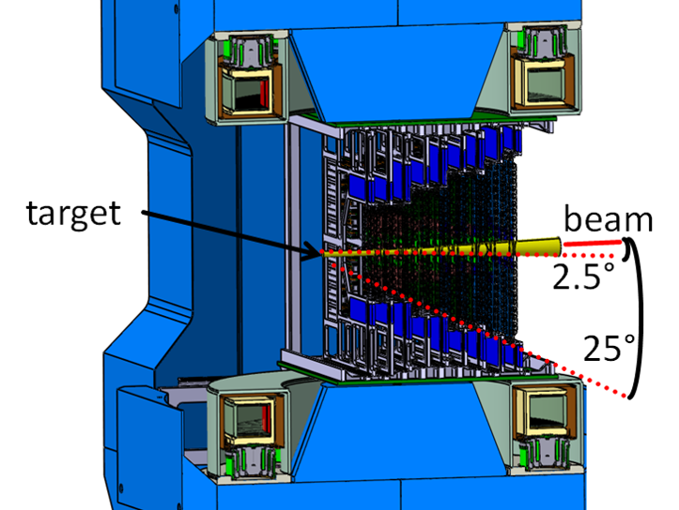
Silicon Tracking System

Slide 6
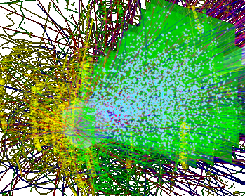
Silicon Tracking System

Slide 7
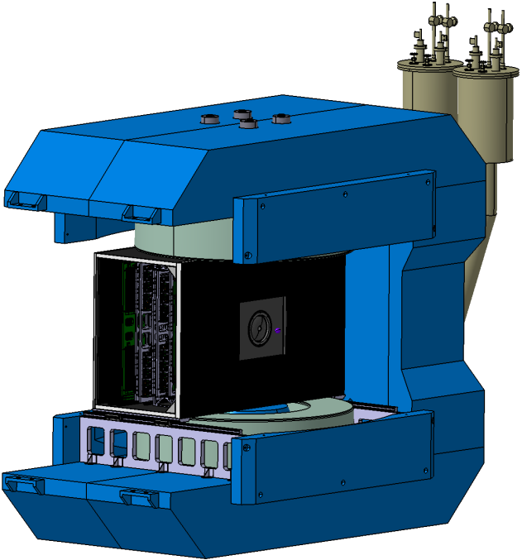
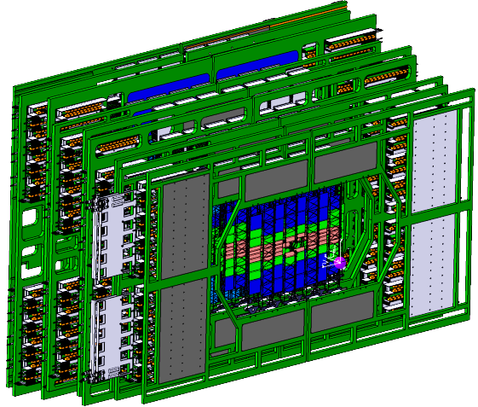
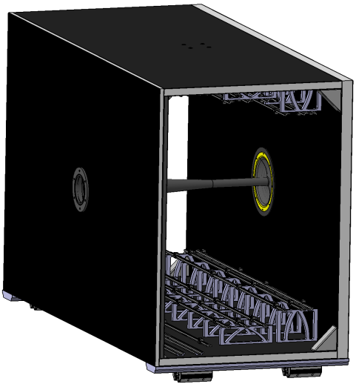
System Engineering
Consistent design being worked on. Current issues:
Mechanical frames:
Sensor cooling
Cooling plate shape / technology
Cabling not tested
Material
Rail system
Positioning / Adjustment
Thermal enclosure:
Sealing
Panel connections
Material budget rear panel
Overall stiffness
C-Frame positioning / measurement / adjustment concept
Service / support mechanics
Overall assembly procedure is an idea
Global system aspects:
STS services, mechanic supports and details
  Cabling
  Cooling
  Positioning
  Safety / emergency systems
  Integration upstream and downstream
  vibrations / structural analysis

Slide 8
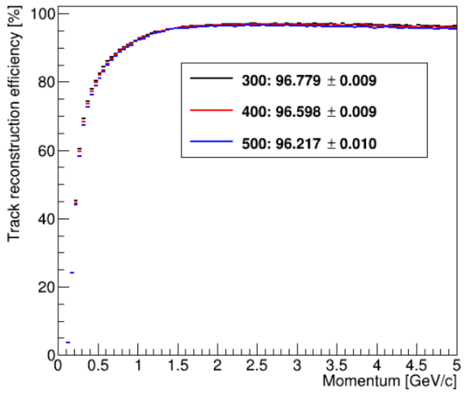
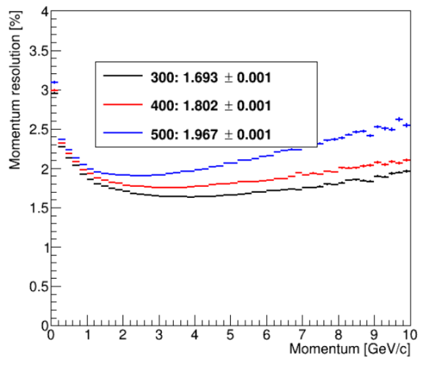
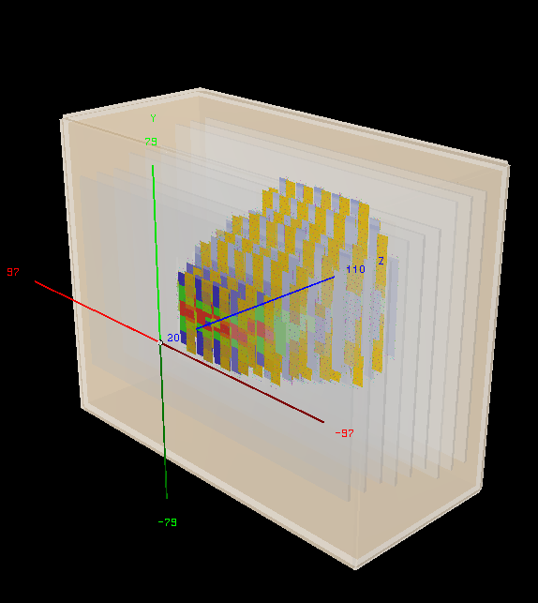
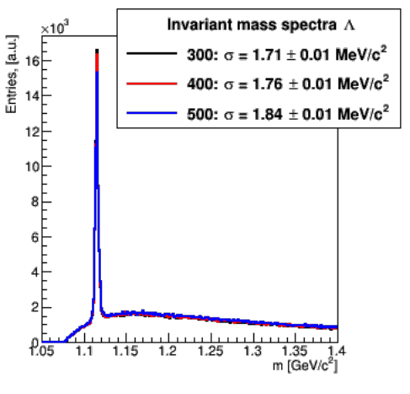
Updated Performance Studies
track reco efficiency
momentum resolution
physics observables
data rates
delta electrons
...
detector model with passive materials

Slide 9
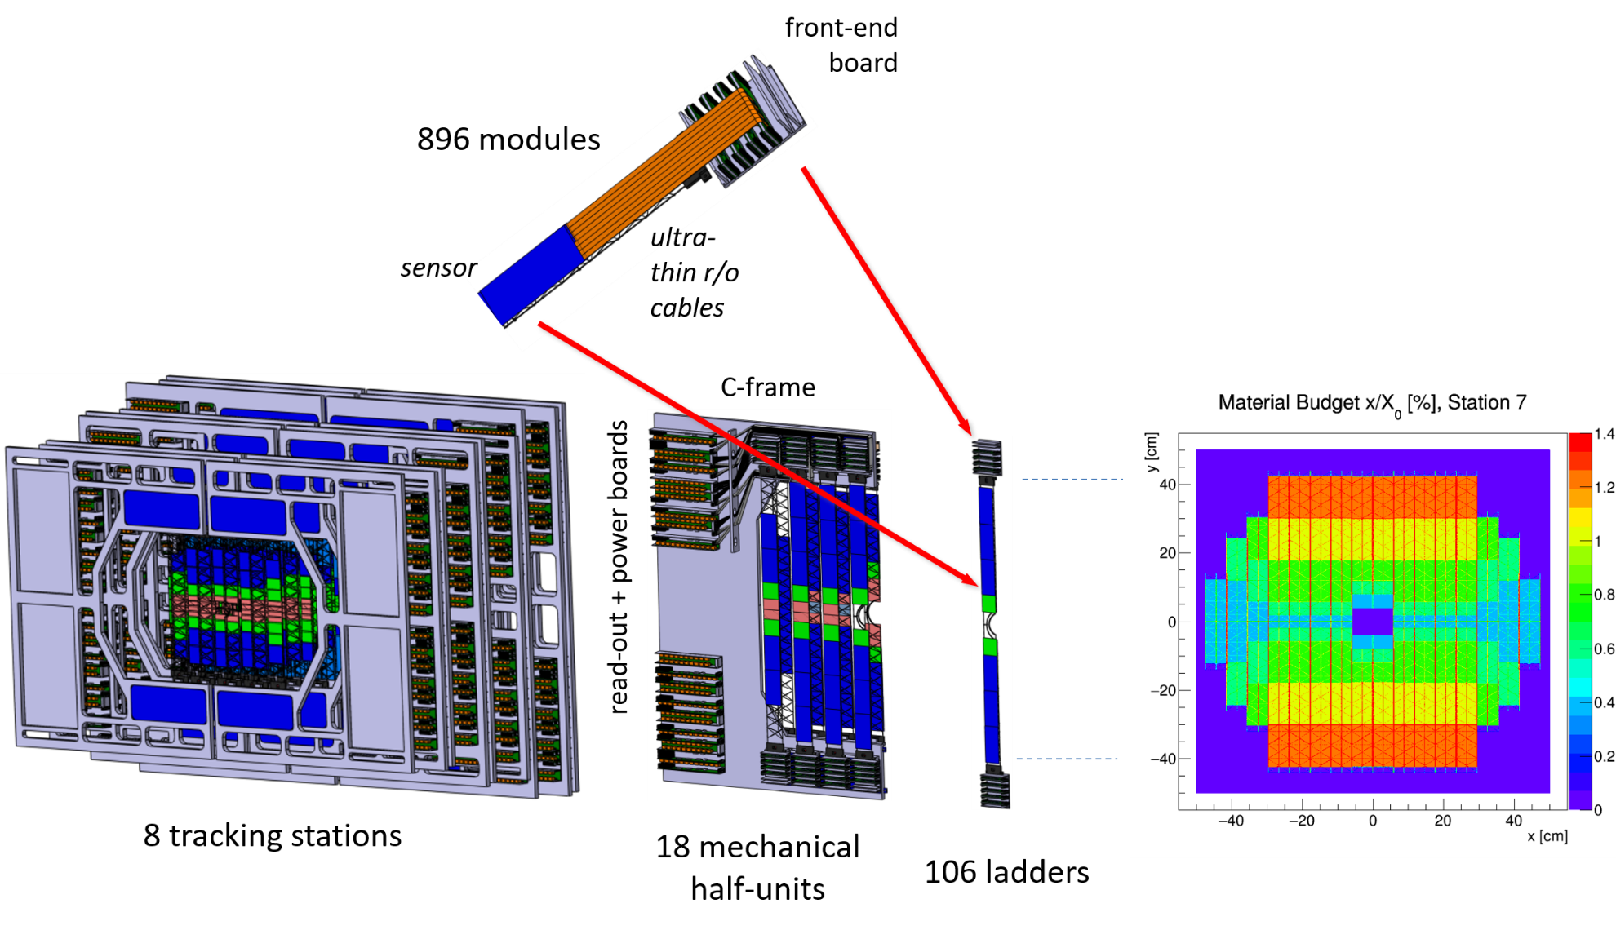
STS – exploded view
(18 variants)
(17 variants)

Slide 10
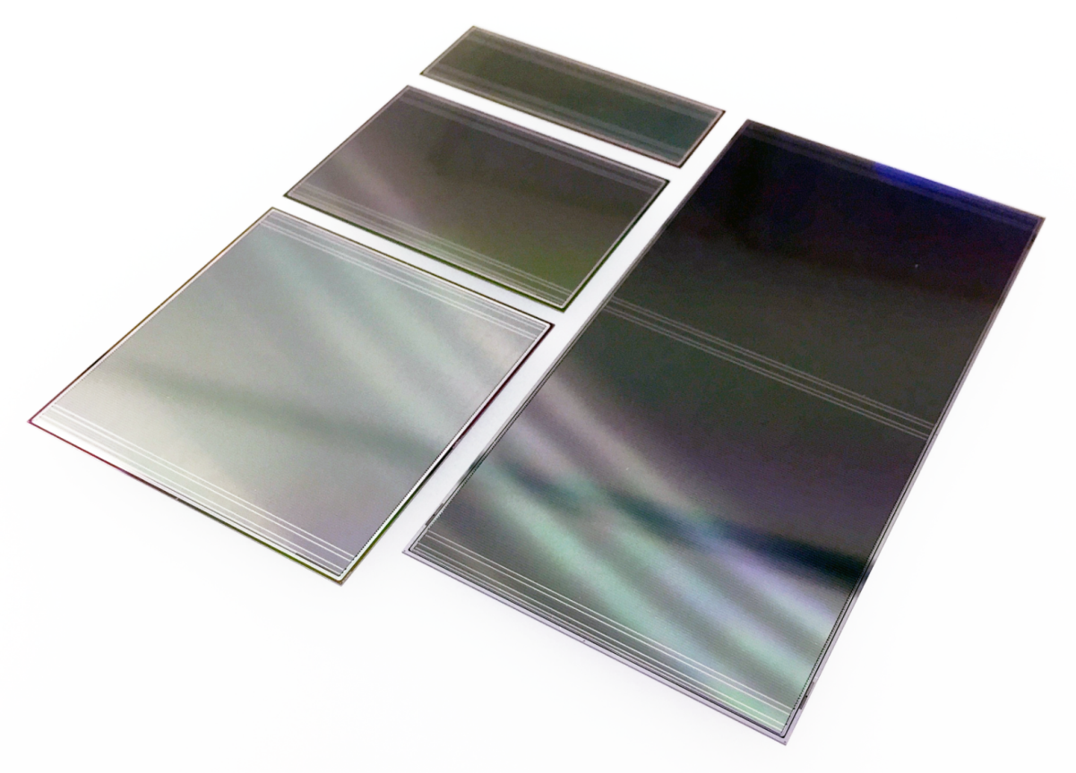
Silicon Microstrip Sensors
double-sided
1024 strips of 58 µm pitch
4 variants/strip lengths
final prototypes realized with two vendors:
  CiS, Germany
  Hamamatsu, Japan
6.2 x 2.2 cm²
6.2 x 4.2 cm²
6.2 x 6.2 cm²
6.2 x 12.4 cm²
Internal Sensor Review: April 2018
Tendering: August – September 2018
Offers received, negotiations ahead
Aim: Production 2019 – 2020

Slide 11
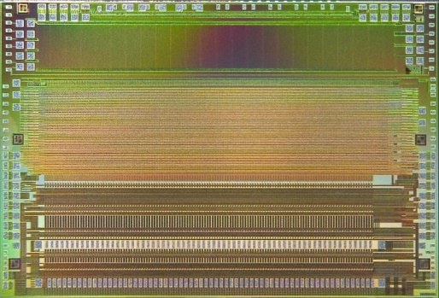
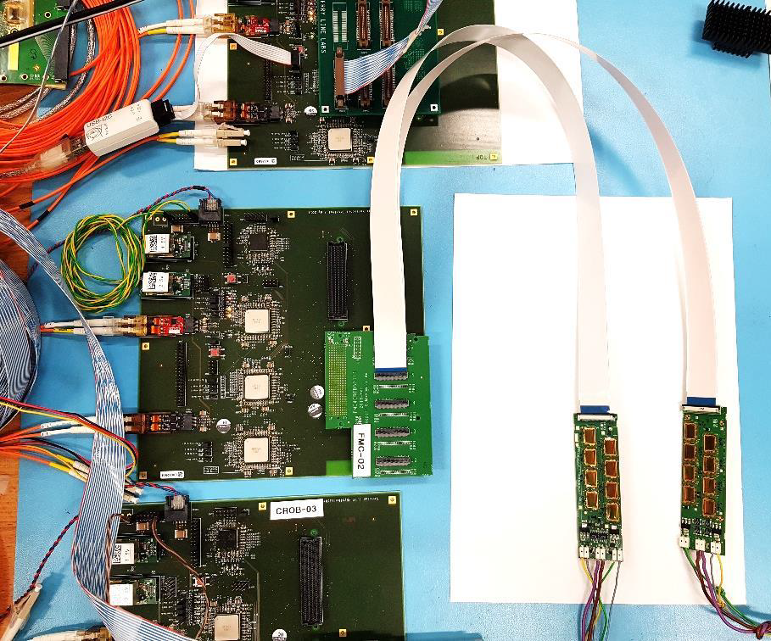
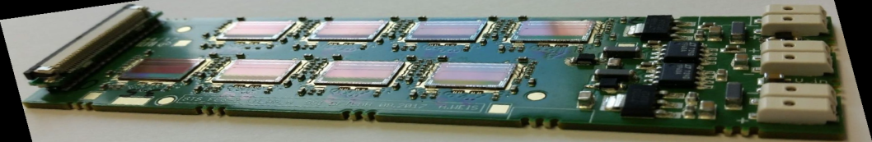
Front-end ASIC and read-out electronics
current prototype
STS-XYTER v2.0
STS-XYTER v2.1 submitted
128 channels
self-triggering
5 bit ADC, time resolution < 5 ns
Front-end electronics board FEB-8
Common Read-out Board test chain with GBT chipset
(not applicable to BM@N)

Slide 12
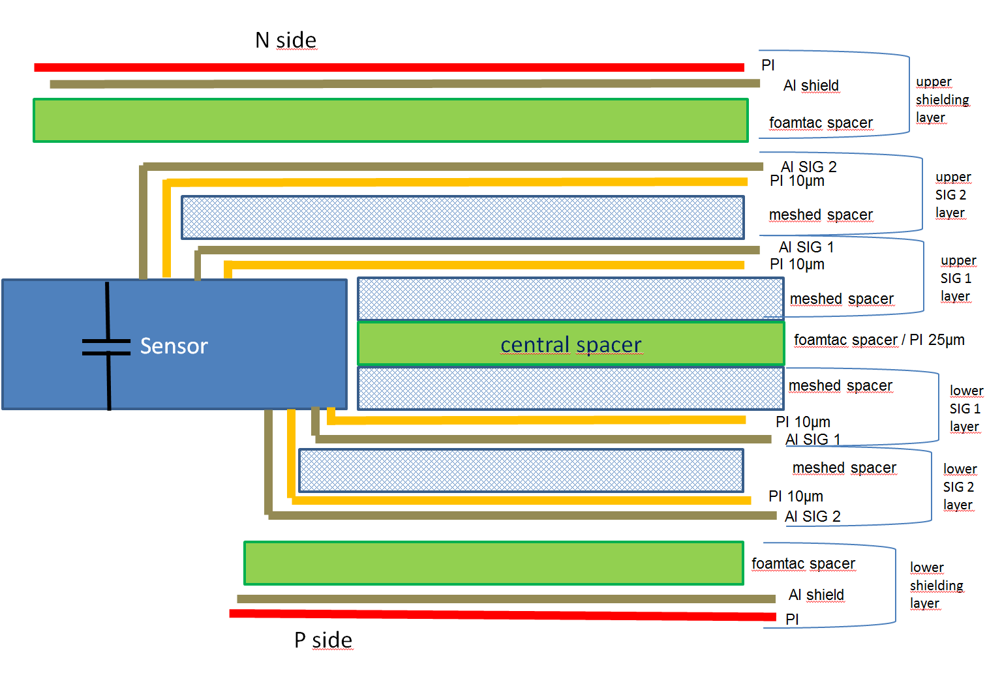
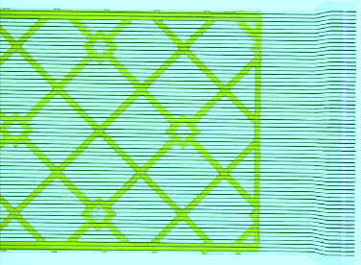
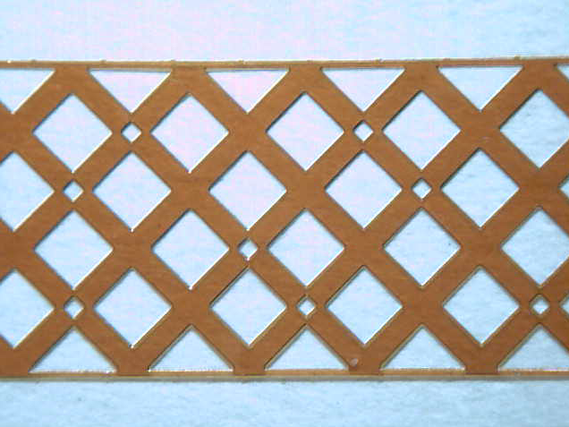
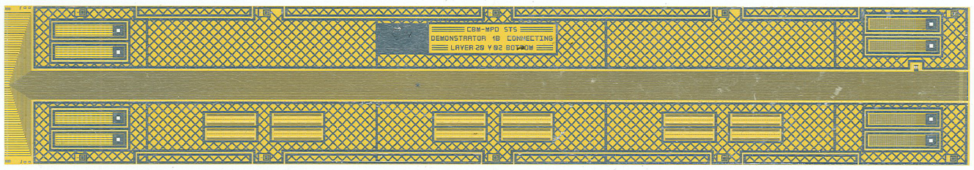
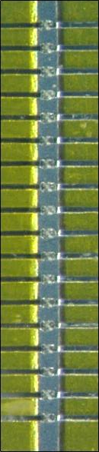
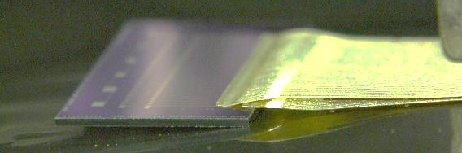
Micro-cables
64 traces per signal layer
2 signal layers per cable
8 cables per sensor side
cable stack: thickness ~ 800 µm / 0.23% X₀
meshed spacer layer
N-side read-out
P-side
read-out
(foam spacers also)
signal layer: 64 Al lines of 116 µm pitch, 14 µm thick on 10 µm polyimide
tab-bonding of
2 signal layers to
Al pads on ASIC
and sensor
trace capacitance 0.45 pF/cm
trace lengths 5 - 55 cm
Alternative Cu cable under test.

Slide 13
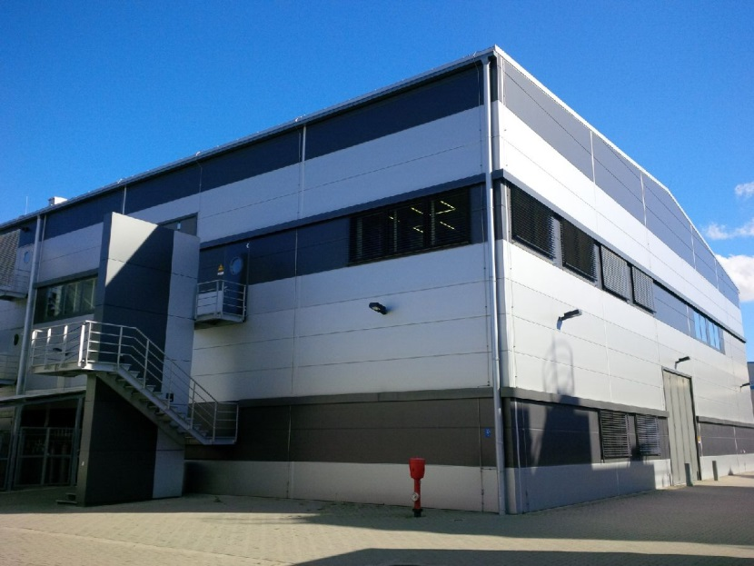
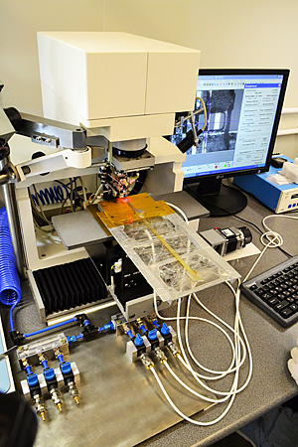
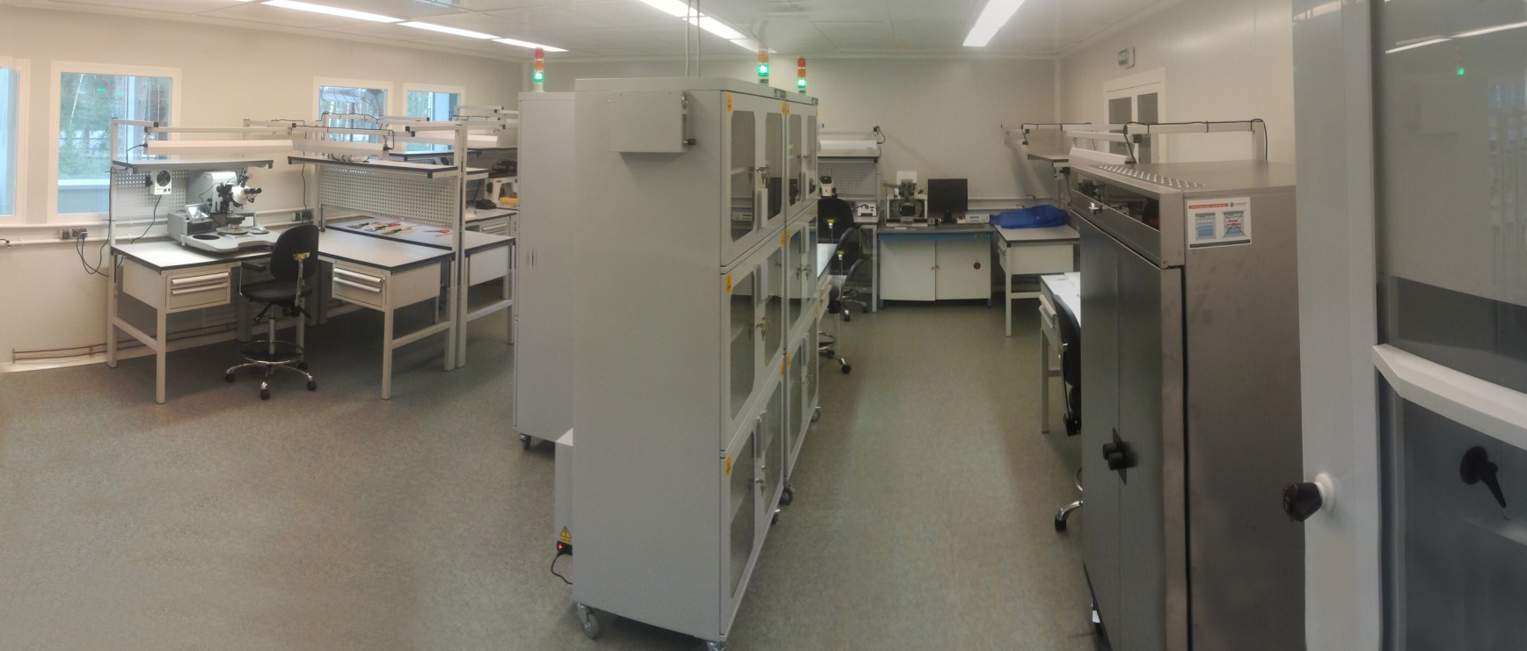
STS assembly centers: GSI and JINR
STS Lab at JINR-VBLHEP
GSI Detector Laboratory
600 m² clean rooms (2nd floor),
600 m² gray rooms + workshops (1st floor)
realized in GSI + JINR cooperation
with BMBF-JINR funding (2015) and EU-H2020 CREMLIN grants
150 m² clean rooms, Solid State Section

Slide 14

Module assembly satellite to GSI: KIT
Karlsruhe Institute of Technology, Germany
Institute for Process Electronics Laboratory

Slide 15
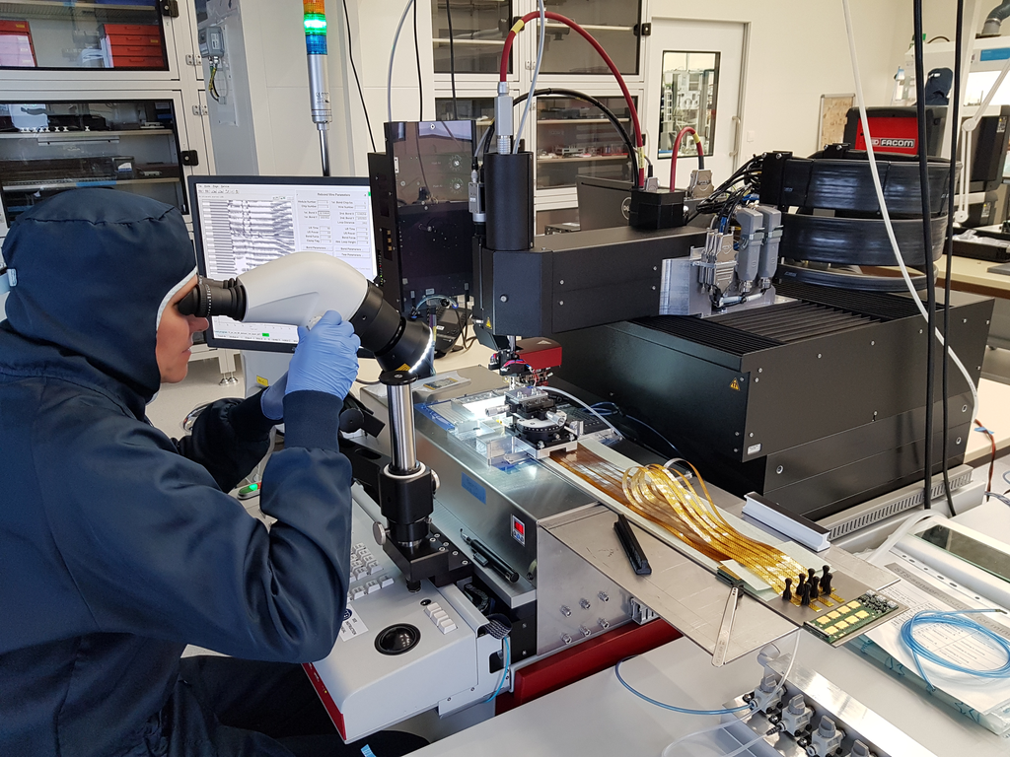
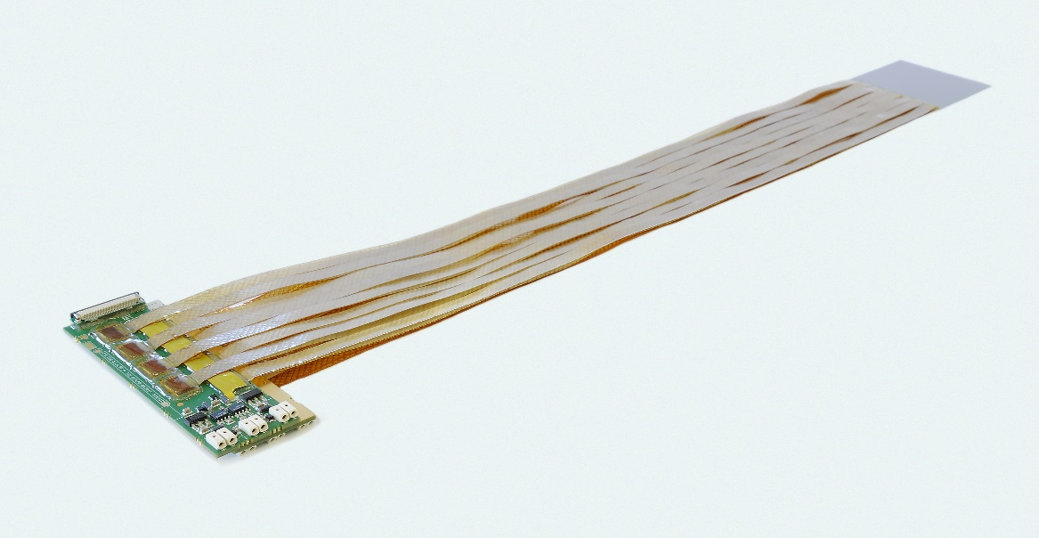
Module assembly at GSI
First full-size module for mSTS

Slide 16

Module assembly at GSI

Slide 17
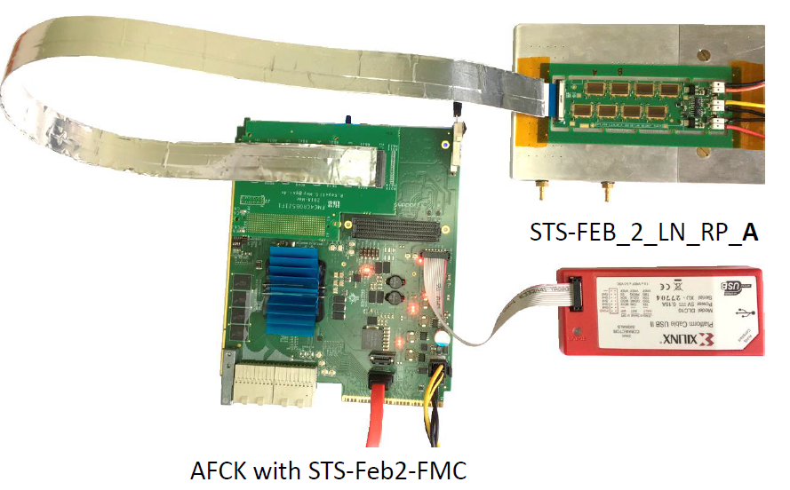
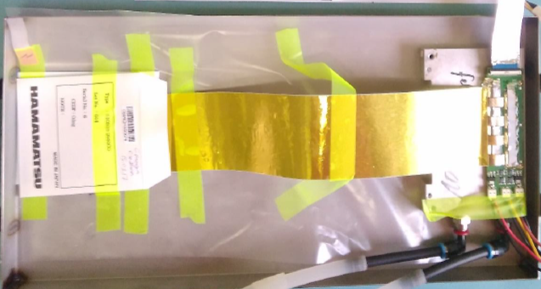
Module assembly at JINR-VBLHEP
first fully read-out module

Slide 18
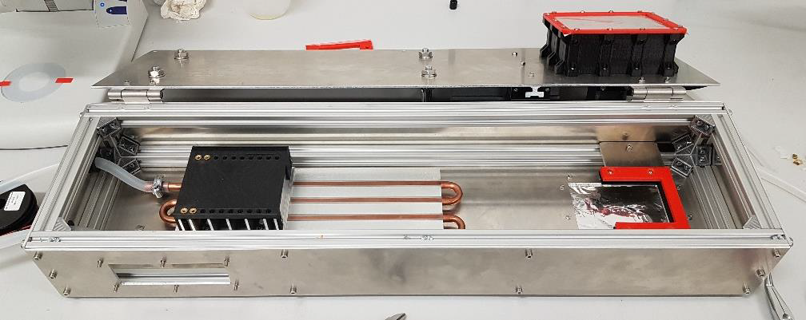
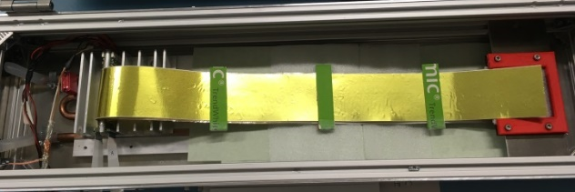
Module test stand at GSI
connections to power supplies and read-out system, DAQ
FEB-8 mounted on cooling fins
FEB-8
⁹⁰Sr
microcables and shield
longest in STS (50 cm)
sensor

Slide 19
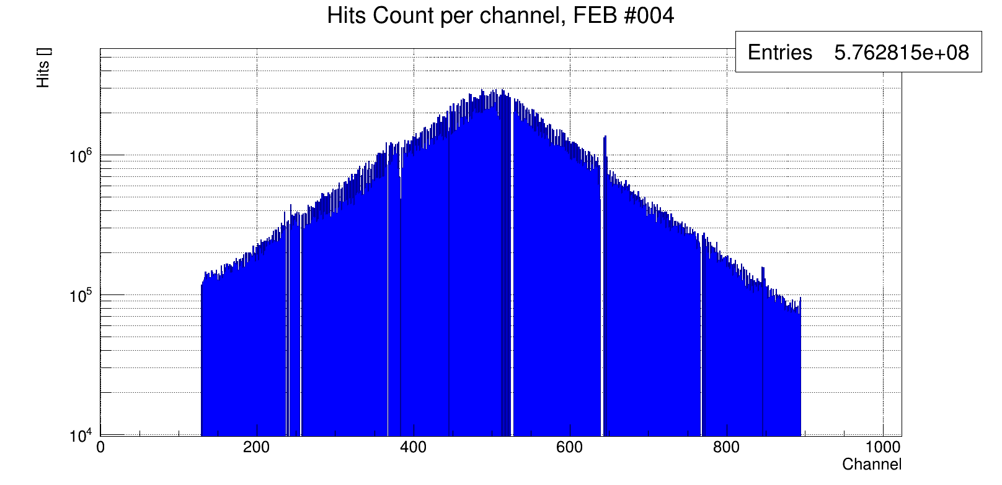
First STS module with full 2-side r/o
2 x 1024 channels (front/back side)
FEB-8
⁹⁰Sr
microcables and shield
longest in STS (50 cm)
sensor
detailed study ongoing
β-source spot
gain uniformity
noise

Slide 20
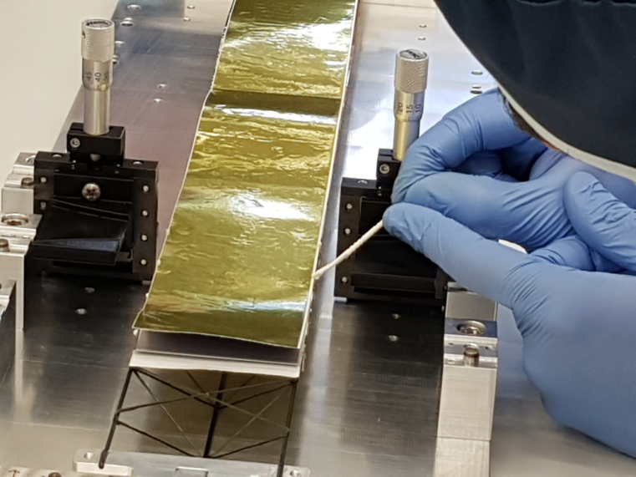
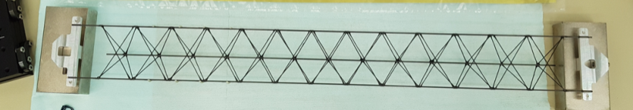
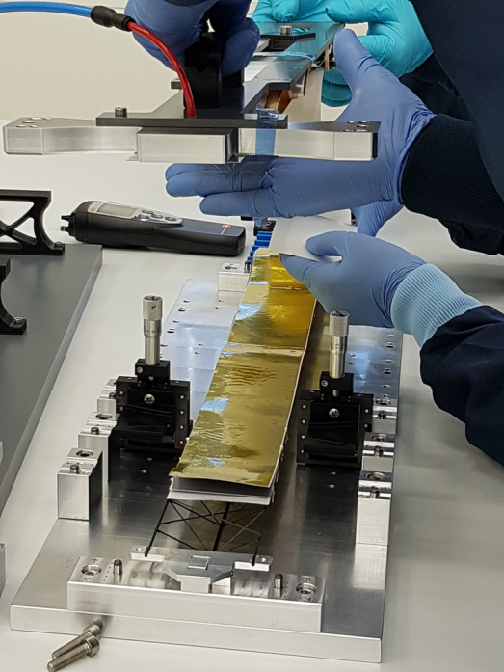
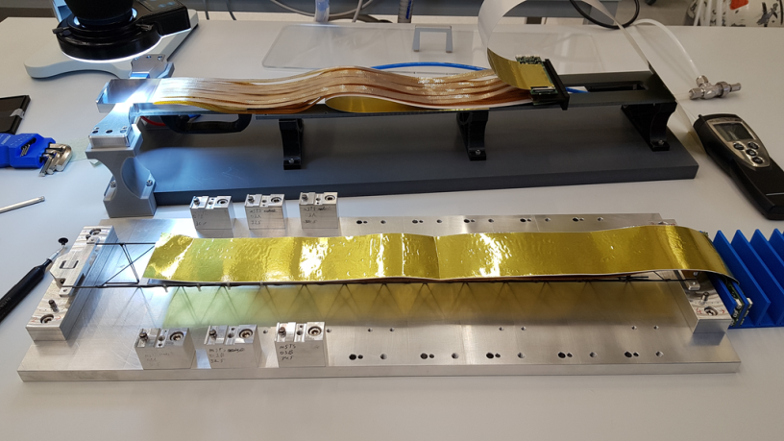
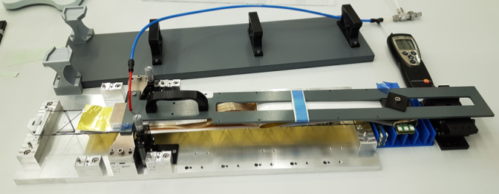
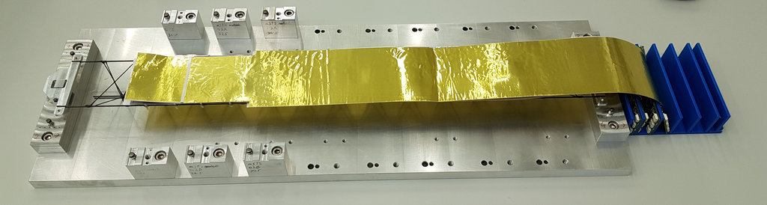
Ladder assembly at GSI
ladder #0 for mSTS
transfer of module #1 to ladder
application of glue onto L-legs
module #0 installed on ladder;
module #1 on transfer tool
module #1 tansferred, fixed during curing of glue

Slide 21
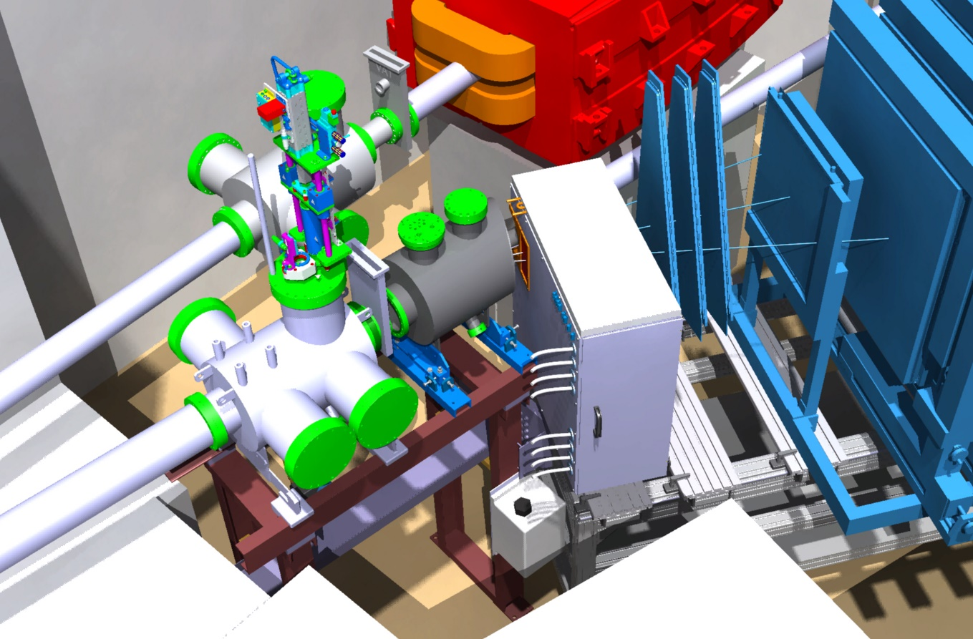
mSTS in mCBM at SIS18
Demonstrator experiment for data transport and online event finding from prototype detector systems to the Green IT Cube
  mSTS
  mMUCH
  mTRD
  mTOF
  ...
  2018 – 2020/21/22
mSTS
https://fair-center.eu/for-users/experiments/nuclear-matter-physics/cbm/projects/mcbm.html

Slide 22
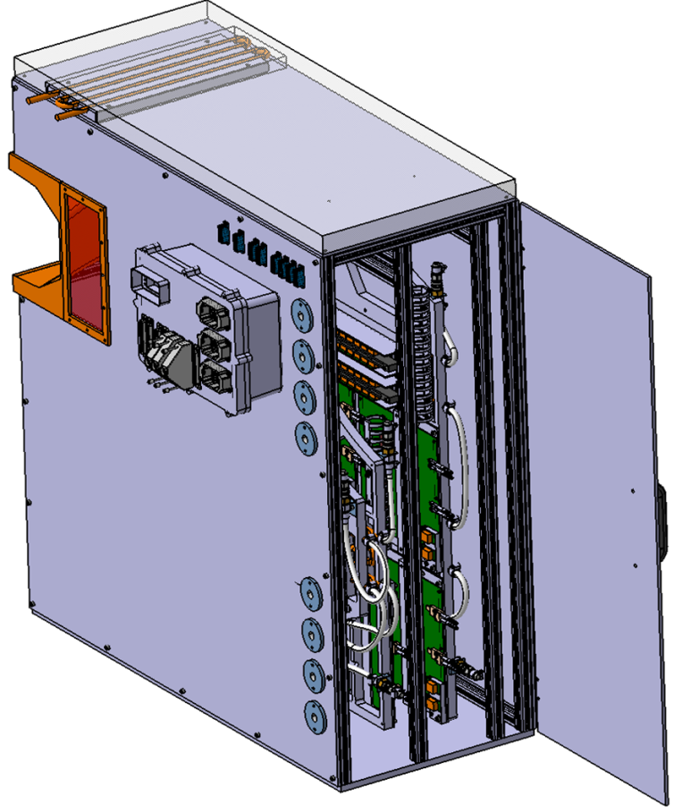
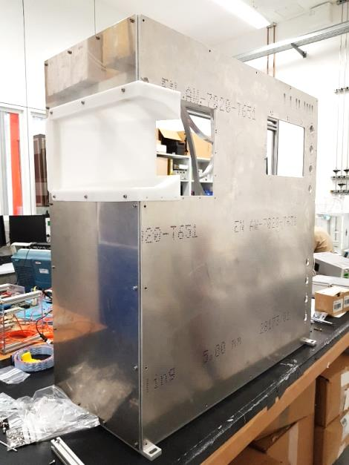
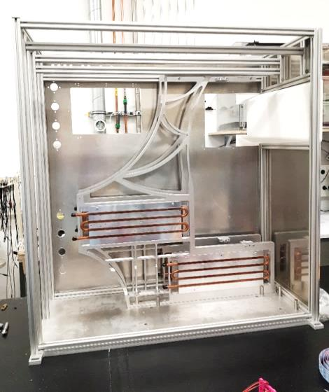

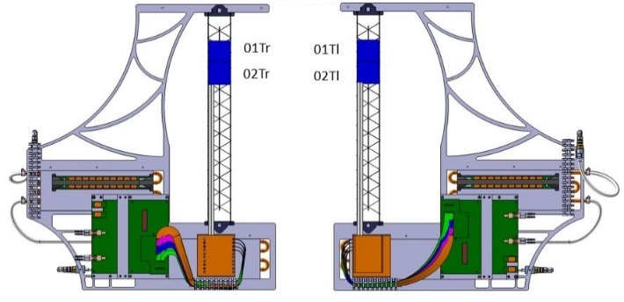
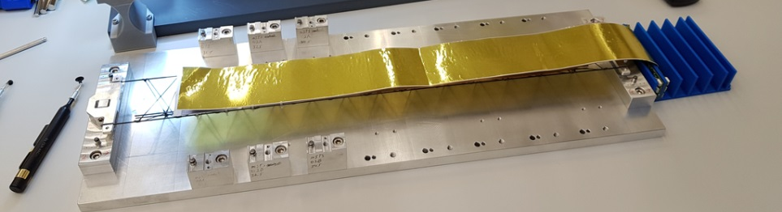
mSTS system
2 tracking stations:
#0: 2 ladders à 2 modules (2018)
#1: 3 ladders à 3 modules (add 2019)
mSTS box with C-frames
station #0
area 12 x 12 cm²
assembly of ladder #0
station #0: C-frames #0 and #1
→ installation into mCBM: 11/2018

Slide 23
II.
System definition of BM@N-STS

Slide 24
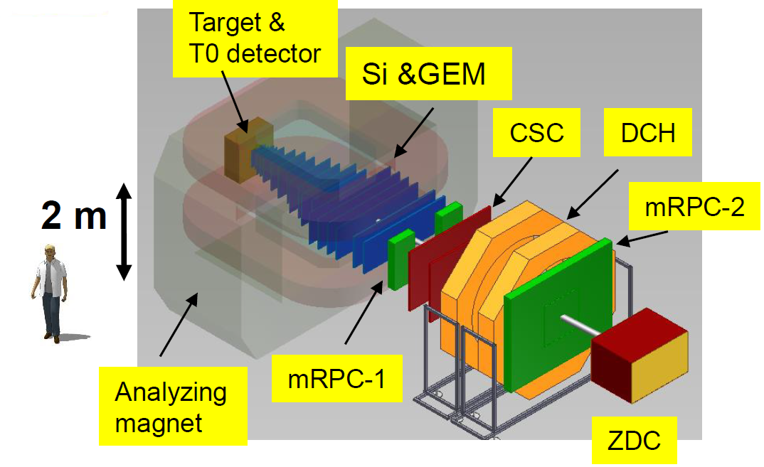
STS in BM@N-2 experiment at Nuclotron
STS

Slide 25
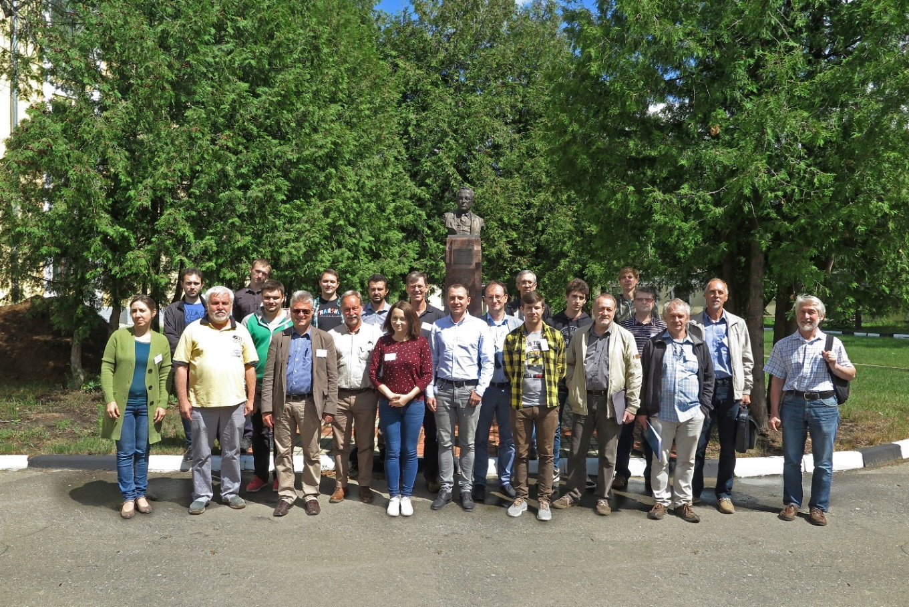
Workshop on
DSSD-GEM Tracking System for BM@N-2
5-6 July 2018
at JINR LHEP
BM@N upgrade for high intensity Au beams
BM@N simulations
BM@N-STS layout
R/o electronics, DAQ
CBM-STS status and project plan, link to BM@N-STS
→ Indico agenda
JINR News 10 July 2018: http://www.jinr.ru/posts/joint-plans-for-the-nearest-future/

Slide 26
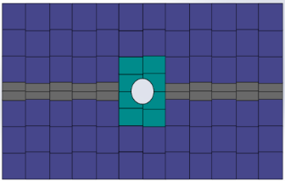
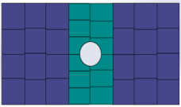
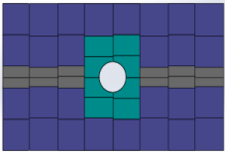
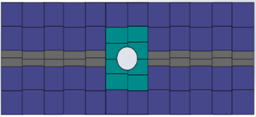
Tentative layout of the STS for BM@N2
8 x 294 mm
pin to pin ladders
8 x 414 mm
pin to pin ladders
12 x 414 mm
pin to pin ladders
12 x 414 mm
pin to pin ladders
Num. of modules | Size of the sensor
24 | 62*62 mm
8 | 42*62 mm
4 | 42*62c mm
Num. of modules | Size of the sensor
44 | 62*62 mm
4 | 42*62 mm
4 | 42*62c mm
20 | 22*62 mm
Num. of modules | Size of the sensor
28 | 62*62 mm
4 | 42*62 mm
4 | 42*62c mm
12 | 22*62 mm
Num. of modules | Size of the sensor
68 | 62*62 mm
4 | 42*62 mm
4 | 42*62 mm
20 | 22*62 mm
36 modules
72 modules
48 modules
96 modules
Total numbers: 252 modules, 40 ladders

Slide 27



Geometries
bmn_v18a
10 cm
bmn_v18b
15 cm
bmn_v18c
20 cm
implemented for simulations (E. Lavrik, Univ. Tübingen)

Slide 28





Simulation studies
E. Lavrik, Univ. Tübingen:
geometry studies
hit occupancies
tracking efficiency
momentum resolution
physics observables

Slide 29
III.
CBM-STS timeline, links to BM@N planning

Slide 30
CBM-STS Project Plan
Official planning document at GSI-FAIR, together with other planning documents from CBM, civil construction and accelerator.
General timeline: 2018 – 2024
Pre-production phase: until Q3/2019 (mSTS completed with 2 tracking stations)
    development of final components and prototypes, as well as assembly methods
Production readiness: reviews/milestones - including:
  STS module/ladder assembly procedure: 9/2018
  STS sensors ready for order 10/2018
  STS Core Preliminary Design Review: 11/2018
Production phase: 2019 until 2024 2/2024 STS ready for installation
technology + procedure freeze

Slide 31
CBM-STS Project Plan summary
Task Name | Start | Finish
STS ready for installation | 22-02-24 | 22-02-24
STS assembly and commissioning in lab | 25-02-21 | 25-01-24
Ladder assembly (GSI) | 21-05-20 | 18-05-23
Ladder assembly (JINR) | 18-06-20 | 18-05-23
Module assembly (GSI) | 30-01-20 | 15-09-22
Module assembly (KIT) | 30-01-20 | 15-09-22
Module assembly (JINR) | 27-02-20 | 15-09-22
STS-XYTER ASIC production | 07-06-19 | 02-07-20
Microcable production | 06-04-19 | 12-04-21
FEB-8 production | 19-03-19 | 17-02-20
Sensor production | 10-01-19 | 07-12-20
STS-XYTER ASIC production readiness review | 06-06-19 | 06-06-19
Sensor tendering completed, orders placed | 27-02-18 | 10-12-18
STS core readiness | 30-10-18 | 30-10-18
Module/ladder assembly readiness [internal] | 15-09-18 | 15-09-18
Sensor readiness | 23-04-18 | 10-10-18

Slide 32
Upcoming CBM-STS milestones
Sensor Readiness completed ............................................... (10/2018)
  Reviews held in 3/2017 and 4/2018
  Summary report – Technical Note close to finalization
Sensor tendering:
  Deadline for reception of offers .............................................. (28/9/ 2018)
  Negotiations with vendors, orders placed .............................. (10 - 12/2018)
Module/ladder assembly readiness [internal] .................... (15/9/2018)
STS core readiness ............................................................... (11/2018)
mSTS with tracking station 0 installed in mCBM ................. (11/2018)
Start of sensor production ................................................... (1/2019)
Start of FEB-8 production ..................................................... (3/2019)
Start of microcable production ............................................ (4/2019)
STS-XYTER ASIC production readiness review ...................... (6/2019)
Start of STS-XYTER ASIC production ...................................... (7/2019)
mSTS with tracking stations 0 and 1 installed in mCBM ...... (Q3/2019)

Slide 33
Links to BM@N-2 STS planning
CBM-STS construction model fully detailed
  modules and ladders exactly defined: 11/2018
  available for BM@N-STS construction model
CBM-STS front-end electronics and read-out chain demonstrated
  start adaptation for BM@N: in the course of mCBM preparation and running: 11/2018
  including prior definitions of BM@N r/o needs, e.g. at this meeting
CBM-STS modules – first of series available
  lessons learned from mSTS: 11/2018, Q3/2019
  start producing modules for BM@N-STS: 2/2020
CBM-STS ladders – first of series available
  lessons learned from mSTS: 11/2018
  start producing ladders for BM@N-STS: 6/2020
  In order to use the same module and ladder make in BM@N as later in CBM:
modules available in larger numbers for BM@N earliest from mid 2020 on
ladders available in larger numbers for BM@N-STS earliest from end 2020 on
a few prototypes may be available already earlier (in 2019 - 2020)
plan BM@N-STS system and component availability accordingly, detector completed in 2021?

Slide 34

Estimated module production time
module assembly – most time consuming assembly step
JINR team:
Mockups modules assembled at JINR
BM@N-STS modules:
2.5 years

Slide 35
Module + Ladder production volume
CBM-STS
JINR assembly: | 400 modules, 46 ladders | + 15% spares
GSI (+KIT) assembly: | 496 modules, 60 ladders
BM@N-STS
JINR assembly: | 252 modules, 40 ladders | + 15% spares
consider a further satellite lab
for at least the module assembly

