Slide 1

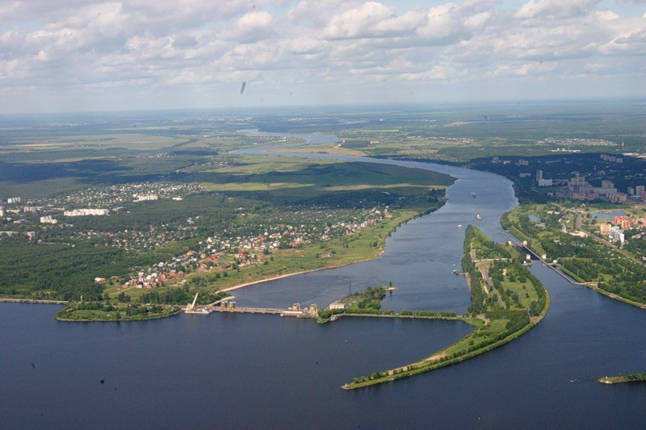
Project Overview
V.Kekelidze
NICA
Volga
river
II Collaboration meeting
Of the BM@N and MPD,
Dubna, October 29, 2018
Notes:
Good afternoon! First of all I would like to express my gratitude to organizers for the opportunity to give a short presentations on the NICA project and related physics

Slide 2
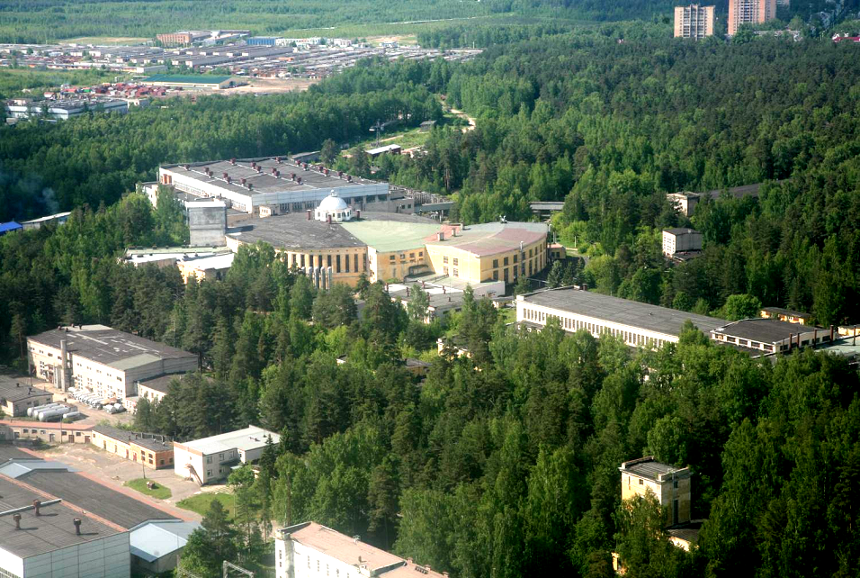
NICA (Nuclotron based Ion Colider fAcility)
Main targets:
study of hot and dense baryonic matter
at the energy range of max net baryonic density
investigation of nucleon spin structure, polarization phenomena
modernization of existing accelerator facility
construction of Collider to collide
  relativistic ions from p to Au at energy range √S_{NN}= 4 - 11 GeV
  polarized p and d at energy up to √S =27 GeV (p)
Notes:
NICA is a Nuclotron … The main targets of the project are: ..
That has required a development of accelerator facility and construction of

Slide 3
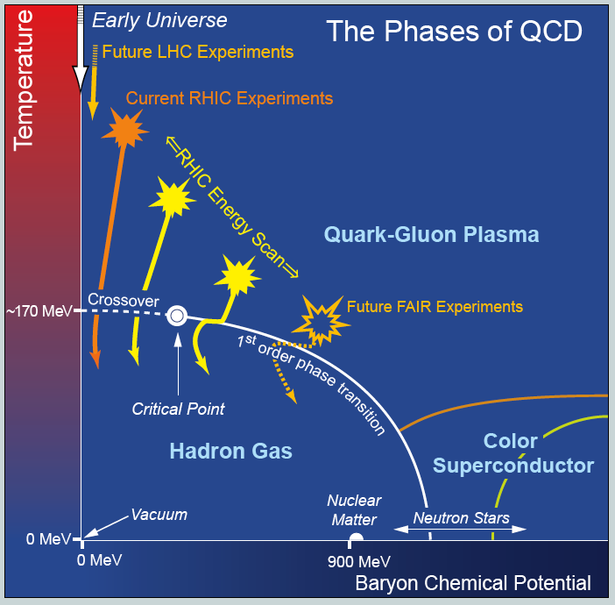
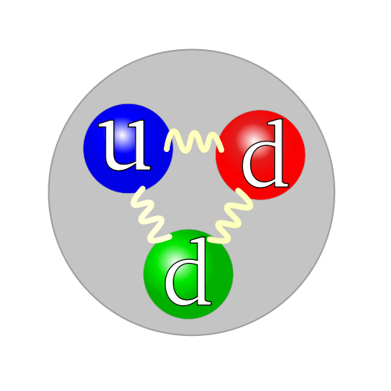
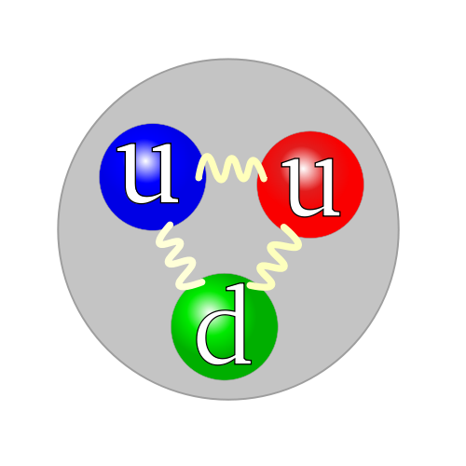
Lattice
QCD
LHC
NICA
NICA
2 10¹² K
nuclei
baryonic density ρ / ρ₀
0 1 ρ₀ = 0,16 fm⁻³
Notes:
The main task of heavy ion collision physics is exploration of the QCD phase diagram, in particular, transition between hadron gas and quark-gluon matter. From the world of our Universe to the world of quarks and gluons.
Special interest is related with a phase transition at the highest baryon chemical potential or max baryonic density, which could exist in the core of neutron stars.

Slide 4
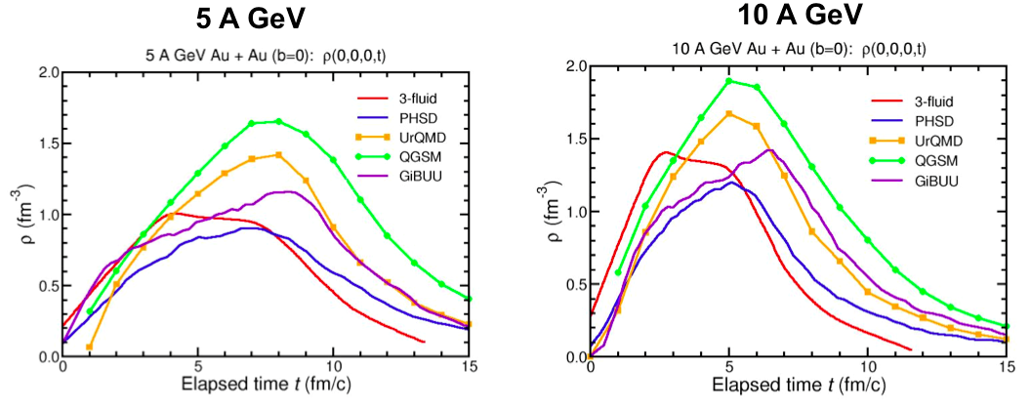
Net Baryonic density to be reached
in Au + Au collisions
FAIR SIS-100
NICA
8 ρ₀
5 ρ₀
I.C. Arsene at al., Phys. Rev. C75 (2007) 24902.
Notes:
Net baryonic density to be reached in Au+Au collisions according various models is 5 and 8 standard densities at FAIR and NICA energies correspondingly

Slide 5
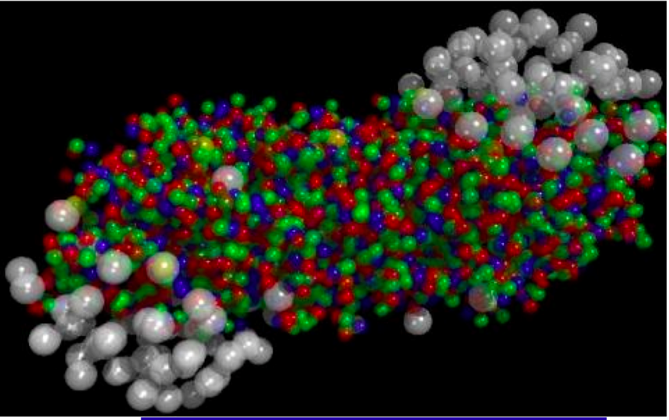
«The only source of knowledge is experience»
A. Einstein
main goal
to obtain new data on hot baryonic matter
at the region of max baryonic density
Comprehensive study of:
bulk properties, EOS
- particle yields & spectra, ratios, femtoscopy, flow
in-medium modification of hadron properties
- onset of low-mass dilepton enhancement
Y-N interactions in dense nuclear matter
- hypernuclei
Search for:
deconfinement (chiral) phase transition
- strangeness production
- Chiral Magnetic (Vortical) effect, Λ polarization
QCD Critical Point
- event-by-event fluctuations & correlations

Slide 6
QCD matter at the NICA energies:
maximum in the net baryon density – density frontier;
maximum in Κ⁺/π⁺ ratio;
maximum in Λ/π ratio;
maximum yield if hypernuclei
transition from a Baryon dominated system
to a Meson dominated one;
maximum of the Λ polarization;
1-st order transition & mixed phase creation;
Critical Endpoint ?

Slide 7
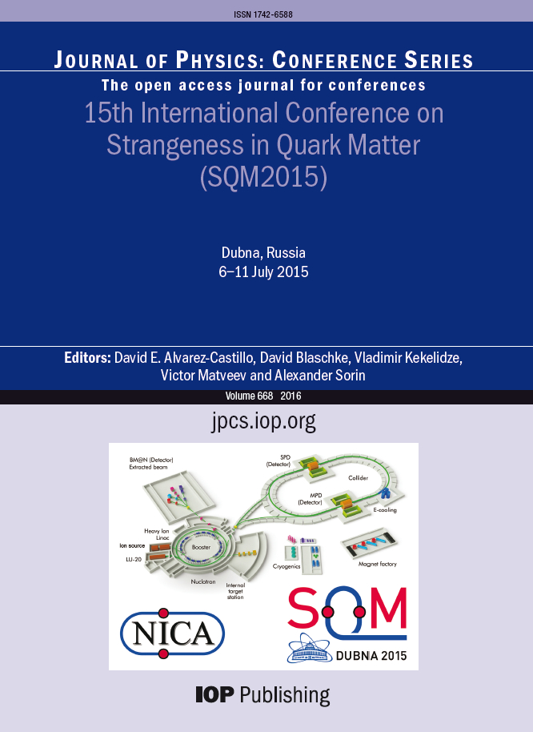
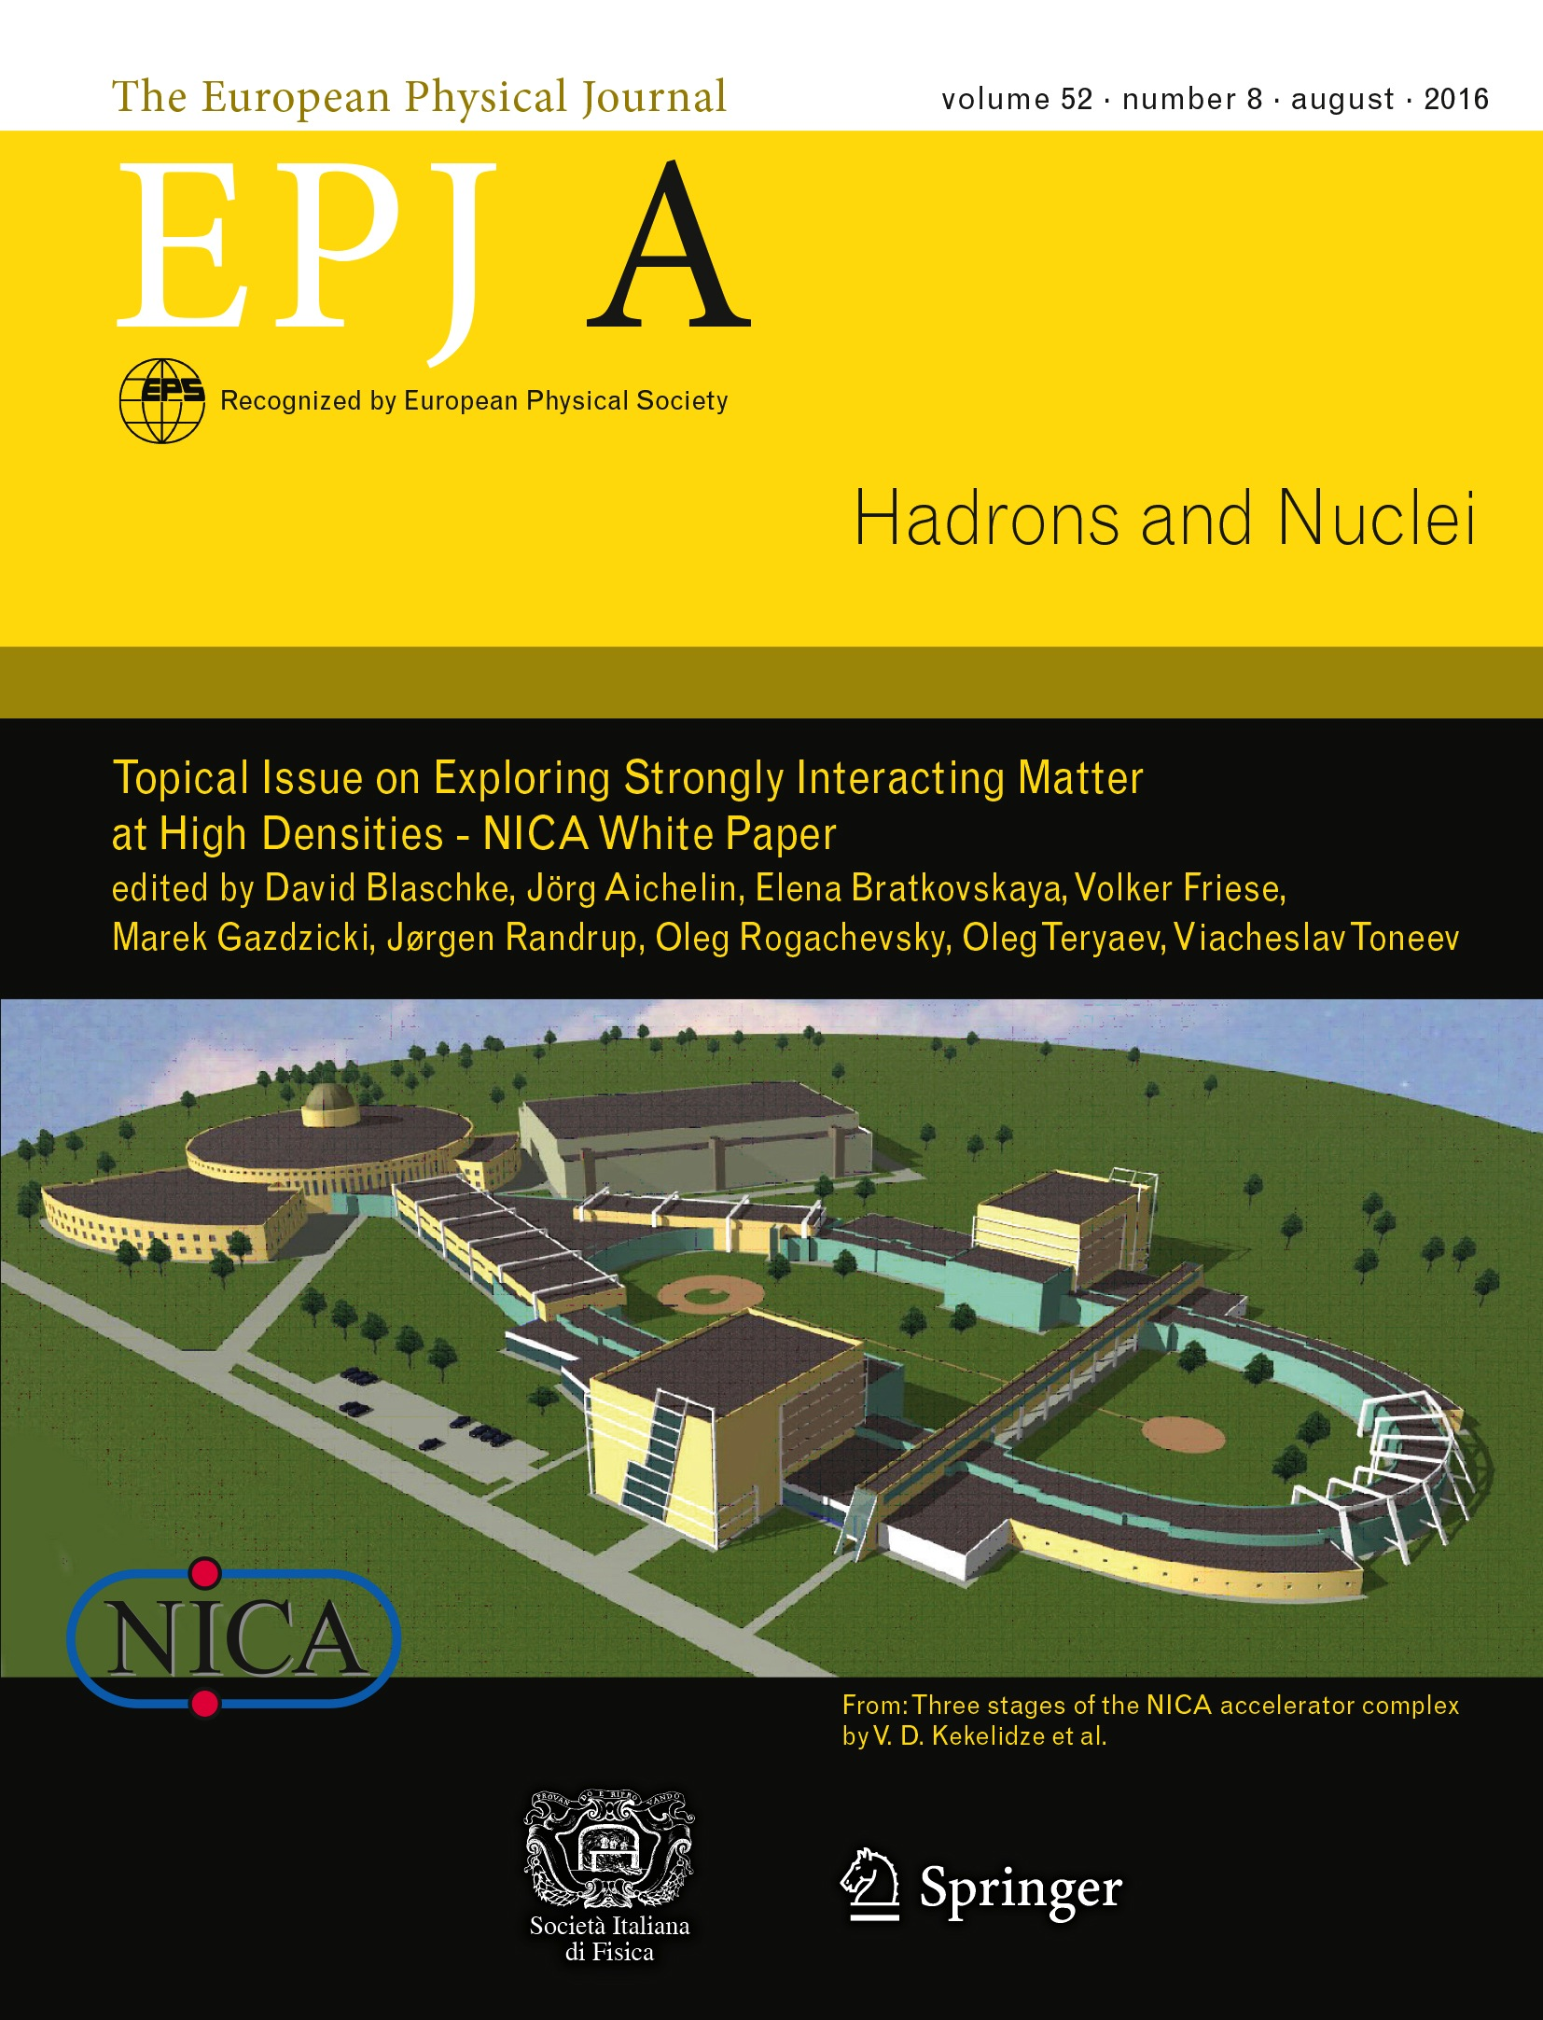
New issues: NICA White Paper, SQM proceedings
Physics targets for the exploration of first order phase transitions in the region of the QCD phase diagram accessible to NICA & FAIR and possible observable effects of a “mixed phase indicated in the release of the “NICA White Paper” as a Topical Issue of the EPJ A (July 2016).
111 contributions,
188 authors
from 24 countries

Slide 8
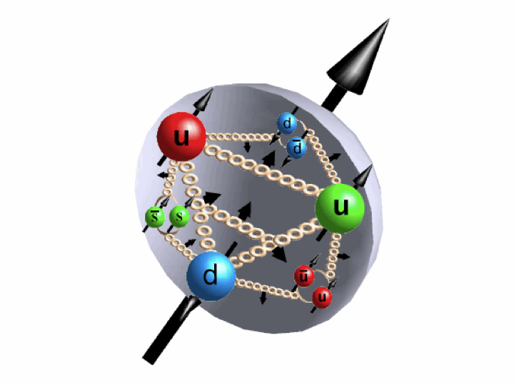
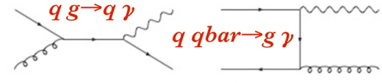
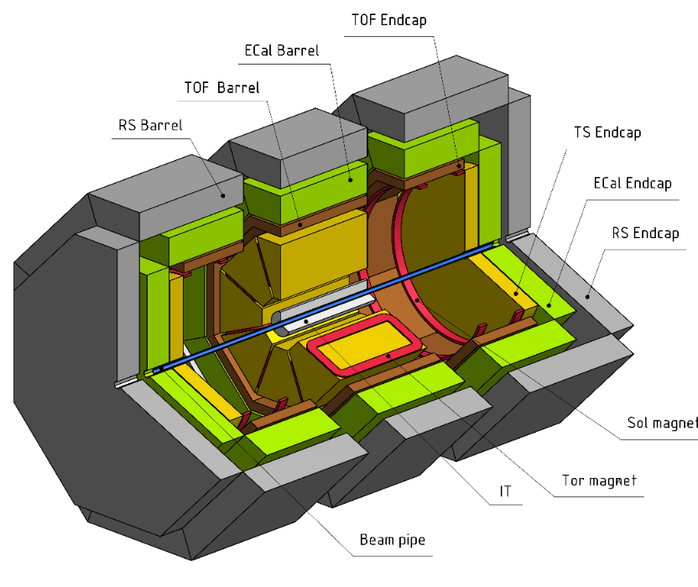
Spin Physics Detector (SPD)
Physics tasks
Nucleon spin structure studies
Drell-Yan pairs Direct photons J/ψ production
spin-dependent effects in elastic pp, pd and dd scattering;
spin effects in exclusive hadron production;
spin effects in production of hadrons with high p_{T}
Timeline
open a project for the SPD design: Jan. 2019
preparation of CDR: 2019
preparation of TDR (+ prototyping); stage I: 2020 – 2022
stage II: 2023
construction of the detector: 2022 – 2025
first measurements: 2025
Polarized beams
p↑p↑ at √s_{pp} = 12 - 27 GeV, L_{av} ≈ 10³² cm⁻²s⁻¹
d↑d↑ at √s_{NN} = 4 - 13 GeV
longitudinal and transverse polarization in SPD and MPD
SPD/NICA will provide a unique opportunity not available at other facilities
to study all the eight nucleon PDF in one experiment
and obtain comprehensive information on the nucleon spin structure
at high statistical level and with minimal systematic uncertainties.
Notes:
Study of nucleon spin structure must prove the sum rule and to solve a puzzle of “spin deficit”. NICA collider will provide collisions of protons and deuterons with all combinations of polarization – transversal and longitudinal. It will allow to measure all 8 intrinsic-transverse-momentum PDFs at leading twists in one experiment. MMTDY mechanism and SIDIS processes are good tools for these measurements.

Slide 9
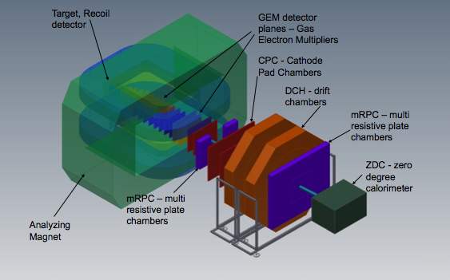


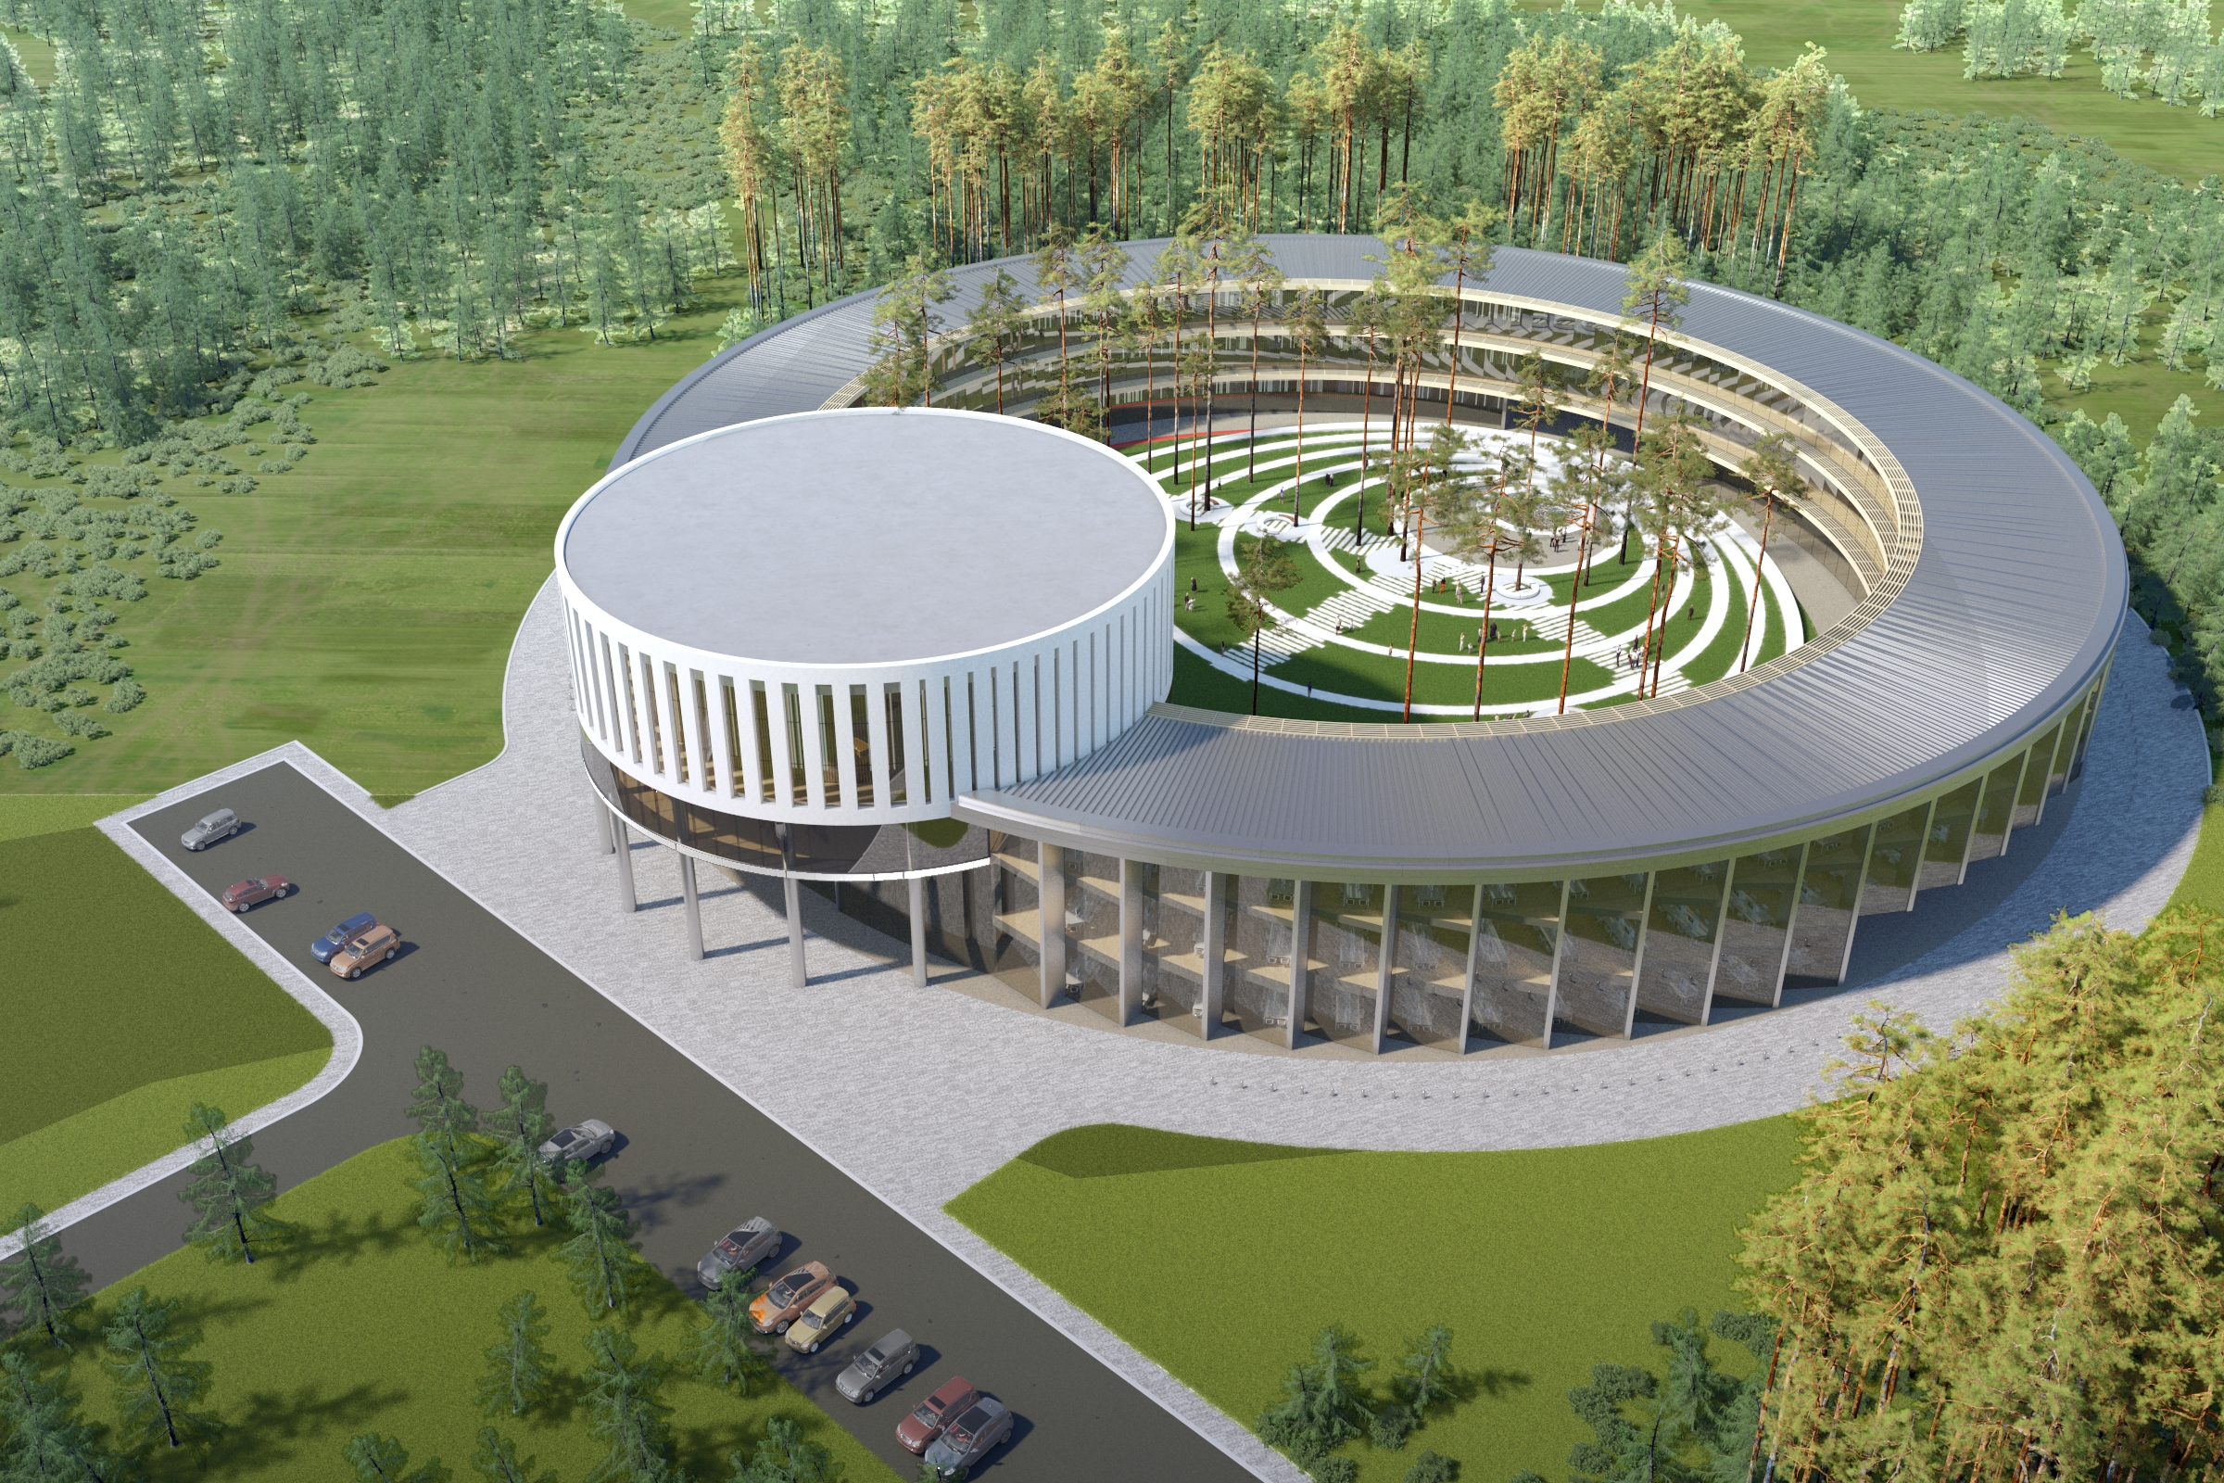
basic facility
2 major milestones in 2018
BM@N
the first
physics run
SPD
Collider ring (c=503 m)
starting Booster assembly
& commissioning
Center NICA
MPD
Nuclotron ring (c=251,5 m)
Notes:
This is a view of major NICA facilities. The Nuclotron – supercoducting synchrotron with circumference of 250 meters was put in operation 24 years ago. The beams from Nuclotron are extracted to the experimental hall, where the first experiment of NICA program BM@N is located. The plan is to put in operation a booster in 2019, and collider - in 2020 simultaneously with the MPD.

Slide 10
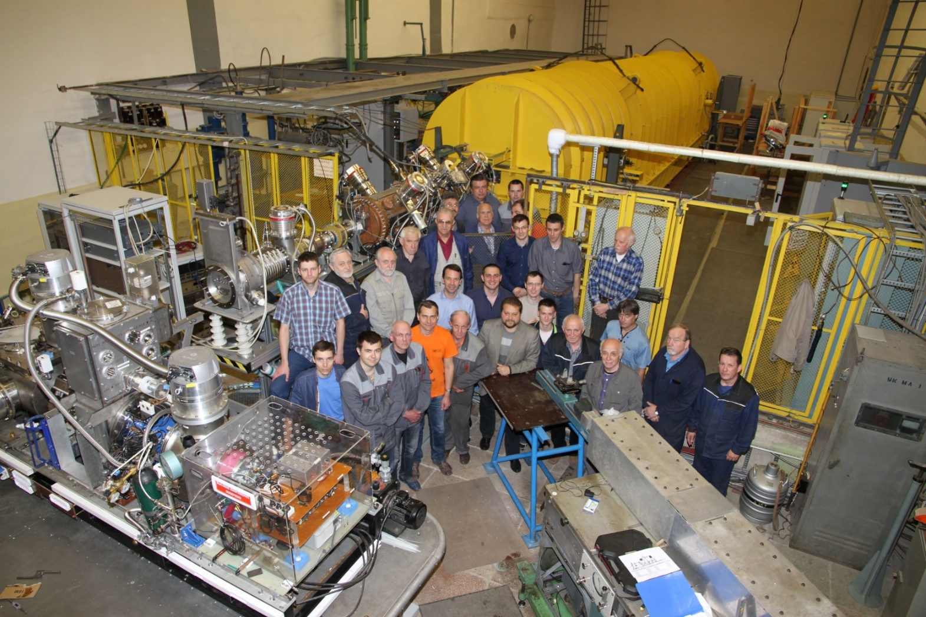
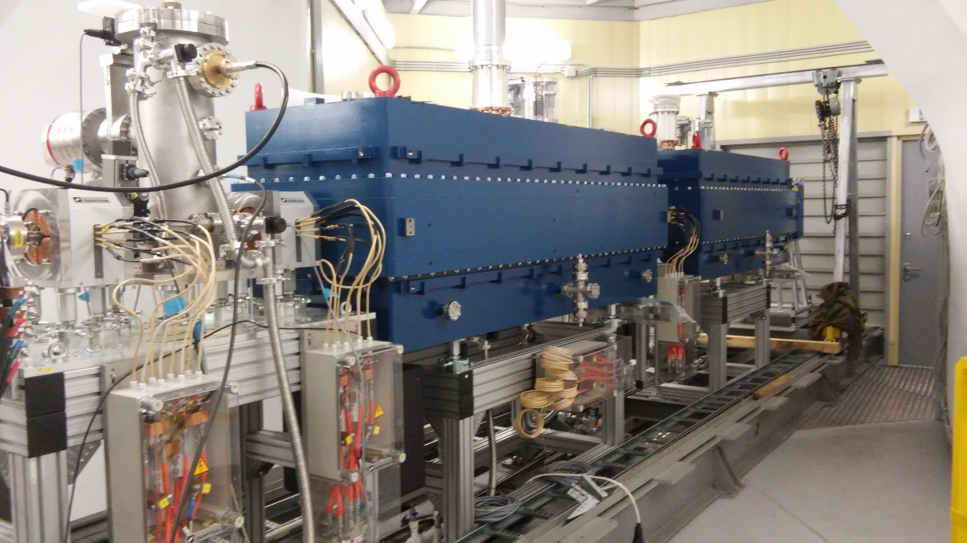
Linacs
Linac | LU-20 | HILAC new !
structure (section number) | RFQ + Alvarez type | RFQ + IH DTL(2)
mass to charge ratio A/Z | 1-3 | 1-6
injection energy, keV/amu | 150 for A/Z 1-3 | 17
extraction energy, MeV/amu | 5 (A/Z 1-3) | 3.24 (A/Z=6)
input current, mA | up to 20 | up to 10
LU-20 – new for-injector:
JINR, INR, ITEP, MEPI
HILAC: “BEVATECH OHG”
commissioning: May ‘16
commissioning: Oct. .‘16
Notes:
We have two linacs. The old one, LU-20, is for polarized particles and light ions. Last year it was upgraded with a new fore-injector. The ions from LU-20 are injected directly to the NUCLOTRON.
The new linac, HILAc, dedicated for heavy ions, was fully commissioned in October 2016. The heavy ions will be injected to the booster.

Slide 11
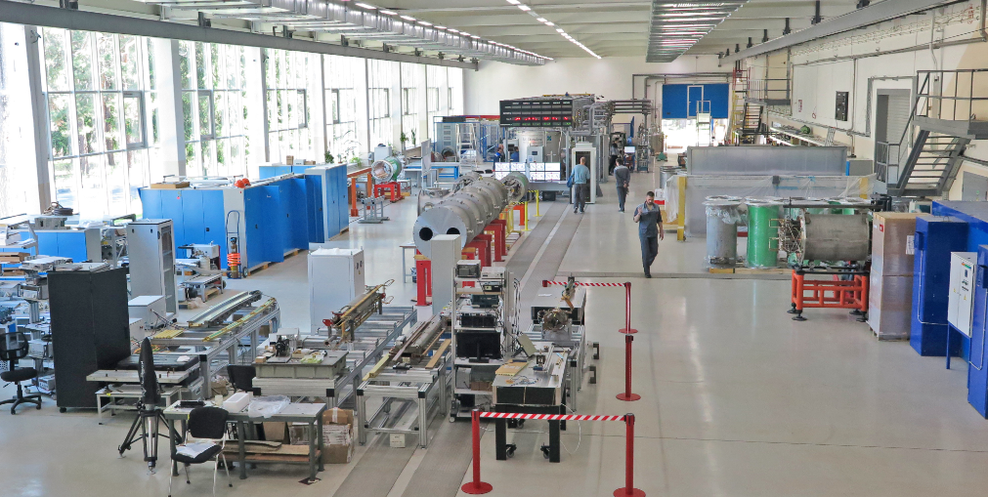
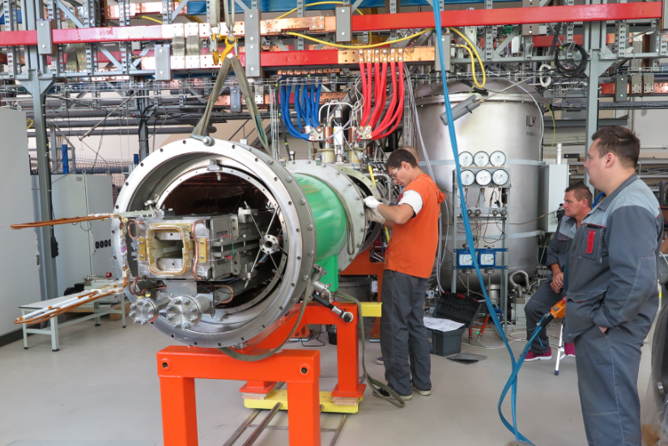
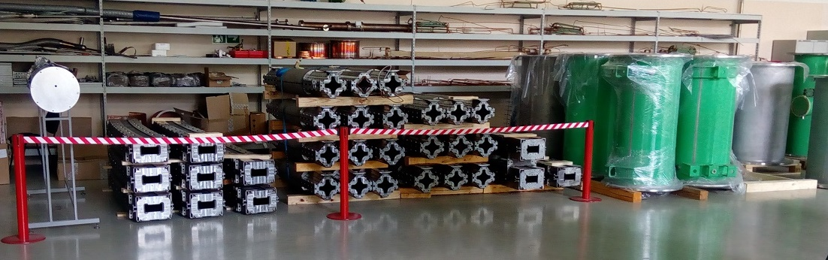
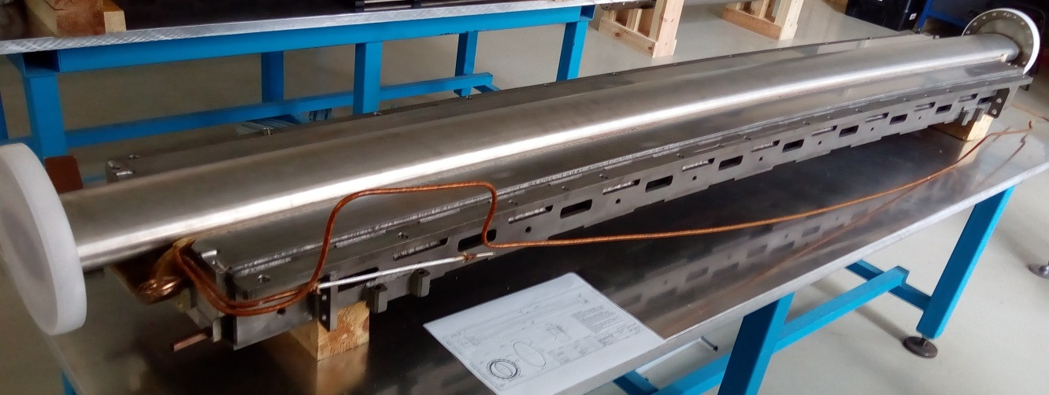
Workshop at VBLHEP (bld. 217) for production
of SC magnets for NICA & SIS-100/FAIR
was put in operation in Nov. 2016
all of the Booster magnets are produced & tested
Notes:
The technological line for magnet assembly and test has been put in operation. In total almost 450 magnets will be fabricated for NICA and FAIR /SIS100 accelerators. The booster magnet fabrication is going well.
All yokes are already produced and delivered.

Slide 12
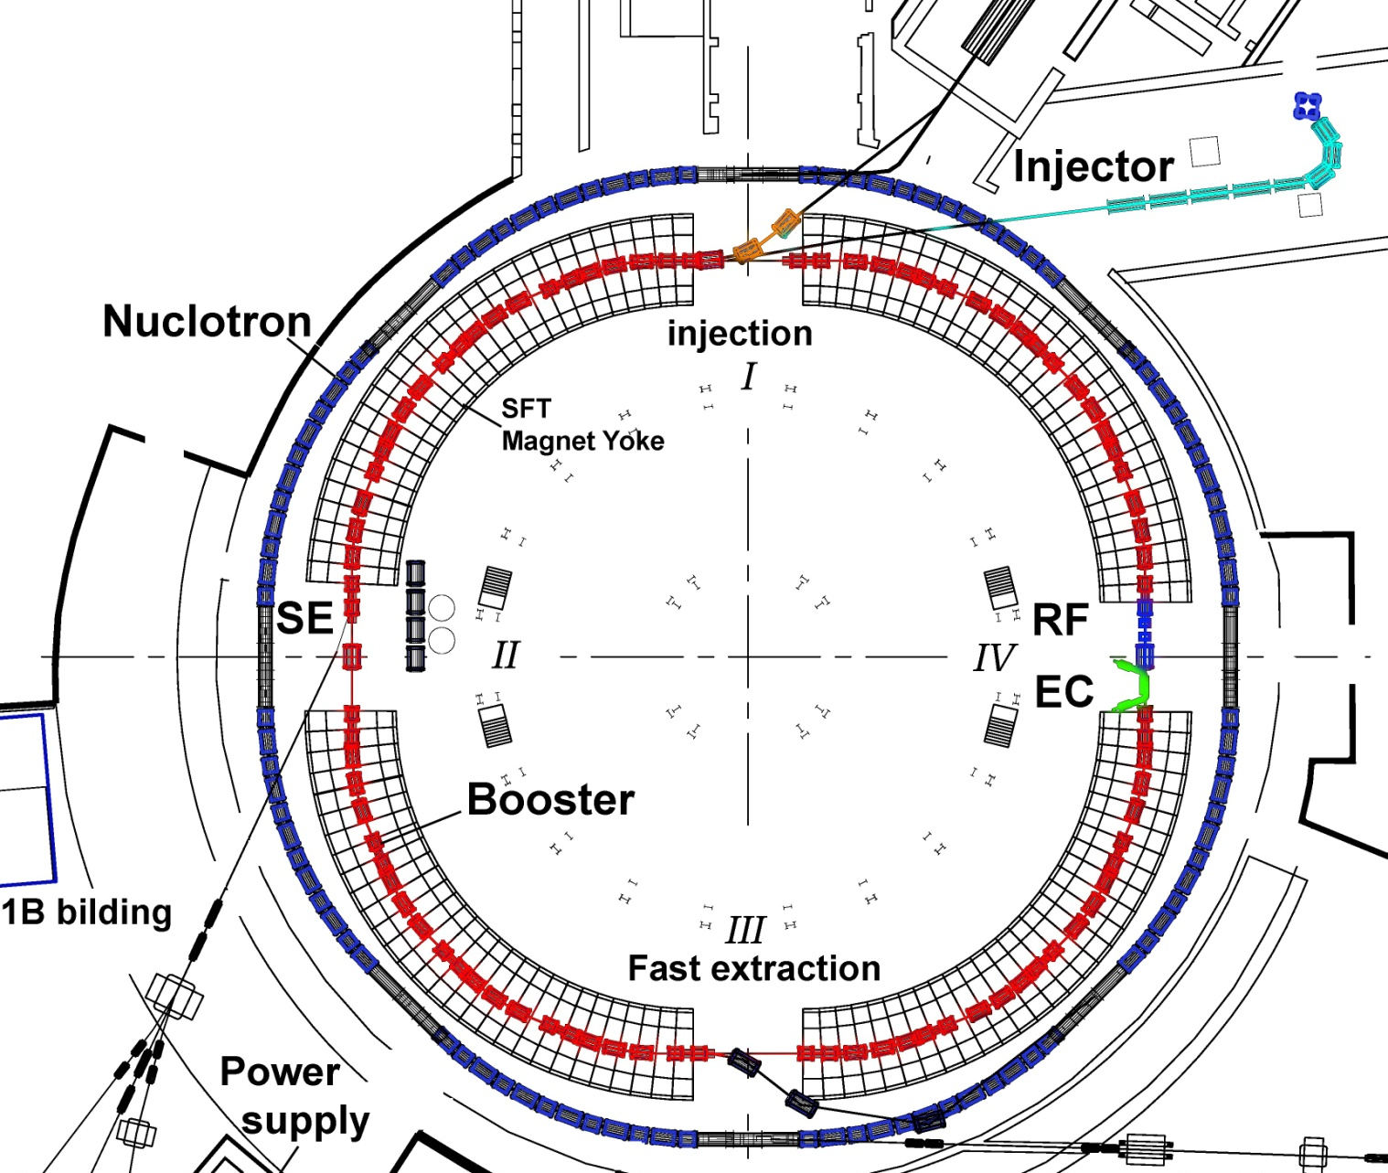
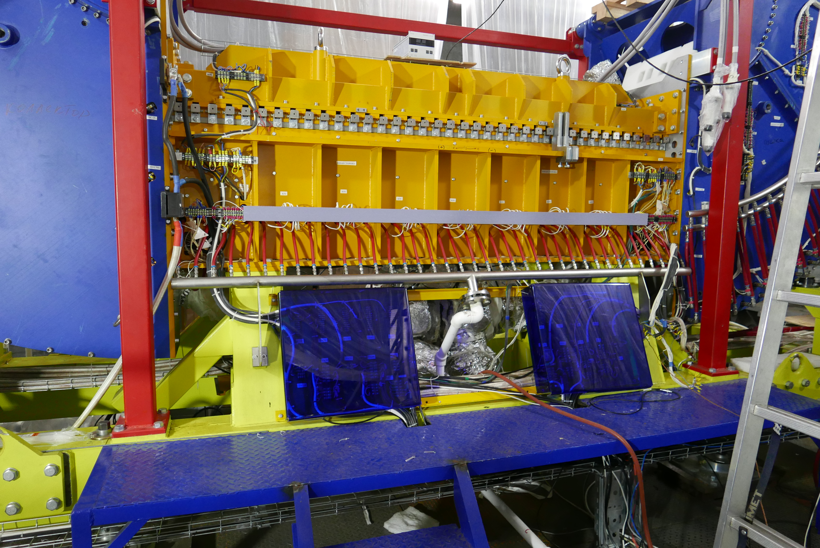
Booster assembly started
commissioning in 2019
Parameter | Booster
type | SC synchrotr.
particles | ions A/Z < 3
E inj., MeV/u | 3.2
max E, MeV/u | 600
magnetic rigidity, Tm | 1.6 – 25.0
circum., m | 210.96
cycle for collider, s | 4.02 (active); 5.0 (total)
vacuum, Torr | 10⁻¹¹
I, Au /pulse | 1.5 10⁹
E tr., GeV/u | 3.25
RF, MHz | 0.5 -2.53
slow extr., s | up to 10
Nuclotron
ref. mag. sec.
Booster
PS
RF
Ecool

Slide 13
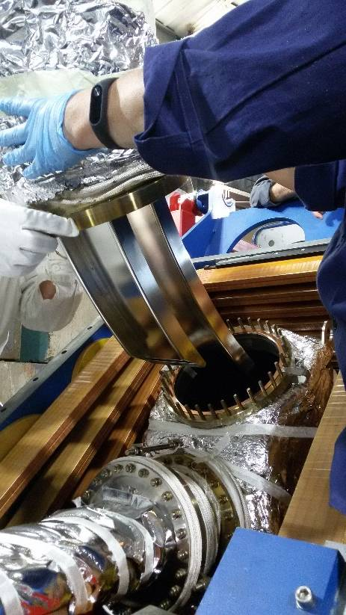
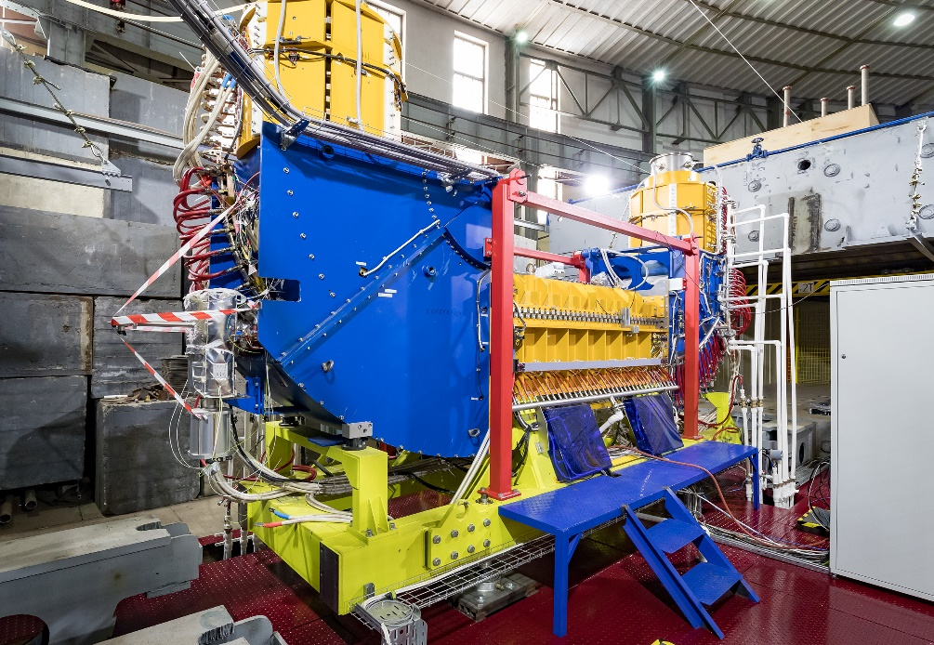
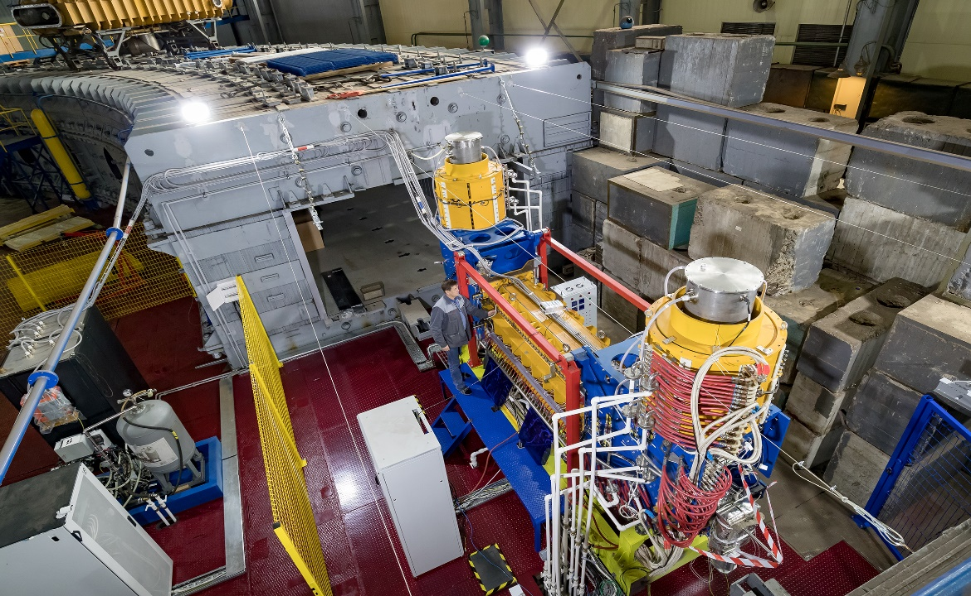
Electron Cooling System: final stage of commissioning
parameters | value
Electron energy, keV | 2
Electron current, mA | 170
Magnetic field, kGs | 1
Filed homogeneity | 2×10⁻⁵
Vacuum pressure, Pa | 3×10⁻⁹
Total power, kW | 120
rms(B_{x})=1,6 10⁻⁵
rms(B_{Y})= 2,0 10⁻⁵
Notes:
Проведены геодезические работы (юстировка) для установки СЭО относительно
оси бустера. Юстировка производилась трекером Leica AT4101.
Точность юстировки составила 0.1 мм.
Смонтирована и подключена по временной схеме
для работы с магнитным полем до 1 кГс при потребляемой мощность 120 кВт
система питания соленоидов, состоящая из 4 шкафов ИСТ
совместно с их трансформаторами.
Максимальное проектное поле составляет 2 кГс,
и для его возбуждения требуется полная мощность питания примерно 400 кВт,
что будет возможно применить после введения в строй новой подстанции.
Создана система водоснабжения замкнутого контура для охлаждения СЭО
с рабочим давлением в системе от 3-х до 6-и Атм.
Проведены измерения однородности и настройка магнитного поля
центрального соленоида. Для измерения однородности магнитных полей
в СЭО использовался метод «компаса», разработанный в ИЯФ им Будкера.
В итоге при настройке секции охлаждения СЭО бустера
достигнута среднеквадратичная неоднородность магнитного поля ΔB/B=2×10⁻⁵
(при проектной величине ΔB/B<10⁻⁴) в широком диапазоне значений
магнитного поля при пропорциональной перестройке магнитных полей.
- Осуществлена сборка вакуумной системы. После проведения магнитных измерений магнитная система СЭО была полностью разобрана за исключением центрального соленоида. Далее сборка вакуумной системы осуществлялась поэтапно совместно с магнитной системой. После сборки части вакуумной камеры и части магнитной системы осуществлялся контроль герметичности собранных вакуумных соединений. Только после этого переходили к следующему этапу сборки вакуумной и магнитной систем.
- Для получения необходимого вакуума в течение 3-х дней была проведена процедура прогрева и через пару недель после прогрева достигнуто значение вакуума 2.5×10⁻⁹ мбар, что соответствует необходимым вакуумным условиям в бустере. В ходе процедуры прогрева были проведены следующие работы: монтаж системы прогрева, дегазация титановых насосов TSP, активация нераспыляемых геттеров NEG, активация катода электронной пушки, включение ионных насосов, подключение UHV вакуумметров, включение титановых распылителей.
- Смонтированы высоковольтные коммуникации, масляная система охлаждения коллектора электронов и проведено тестирование всех высоковольтных источников.

Slide 14
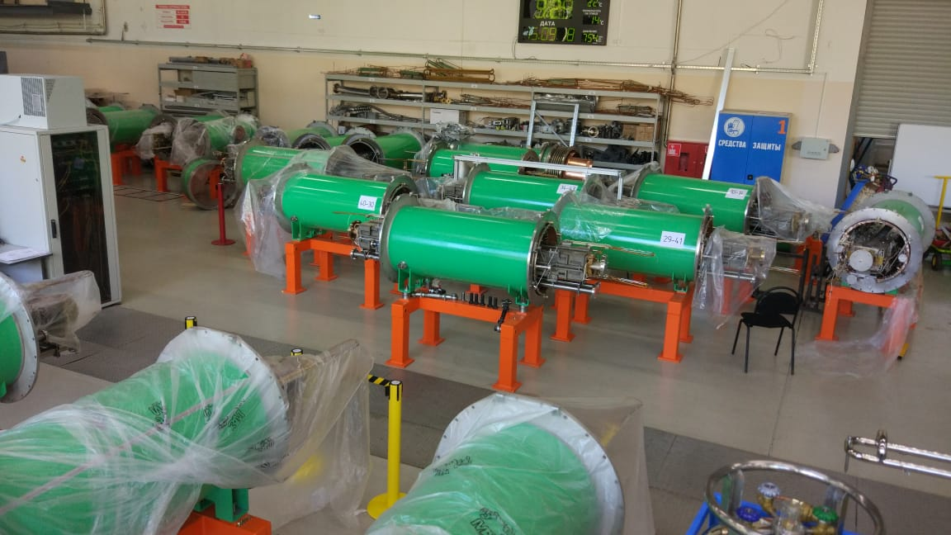
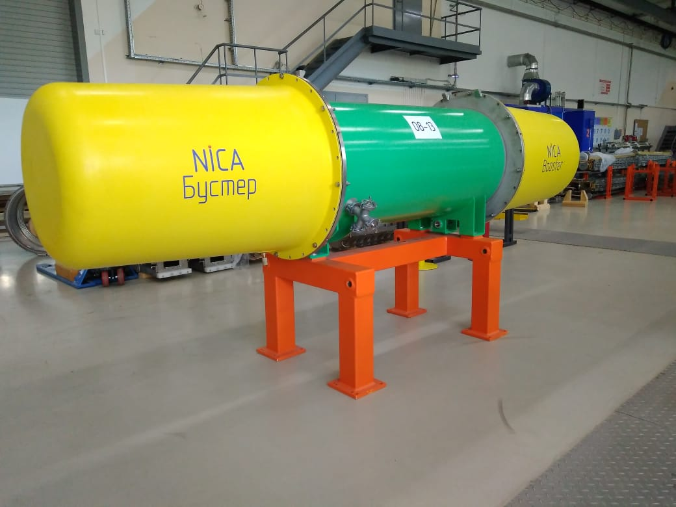
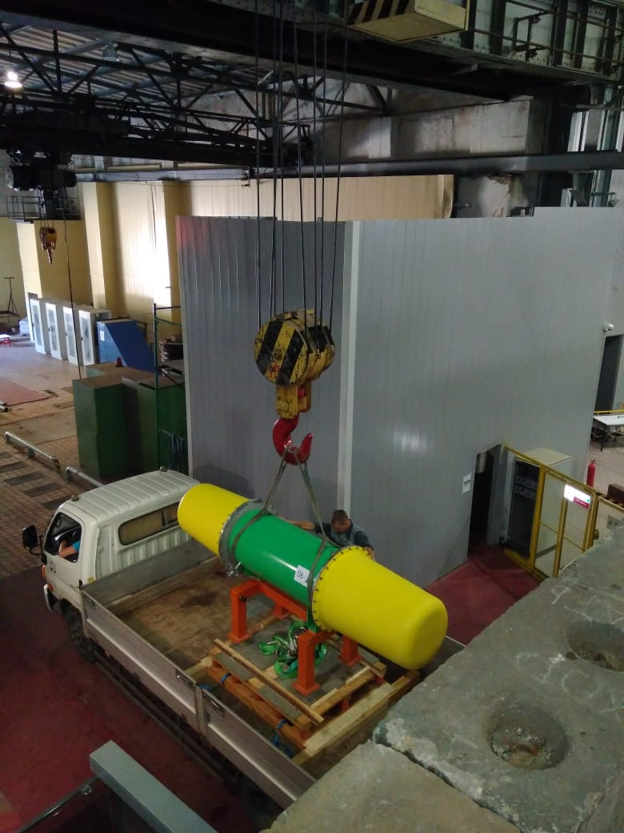
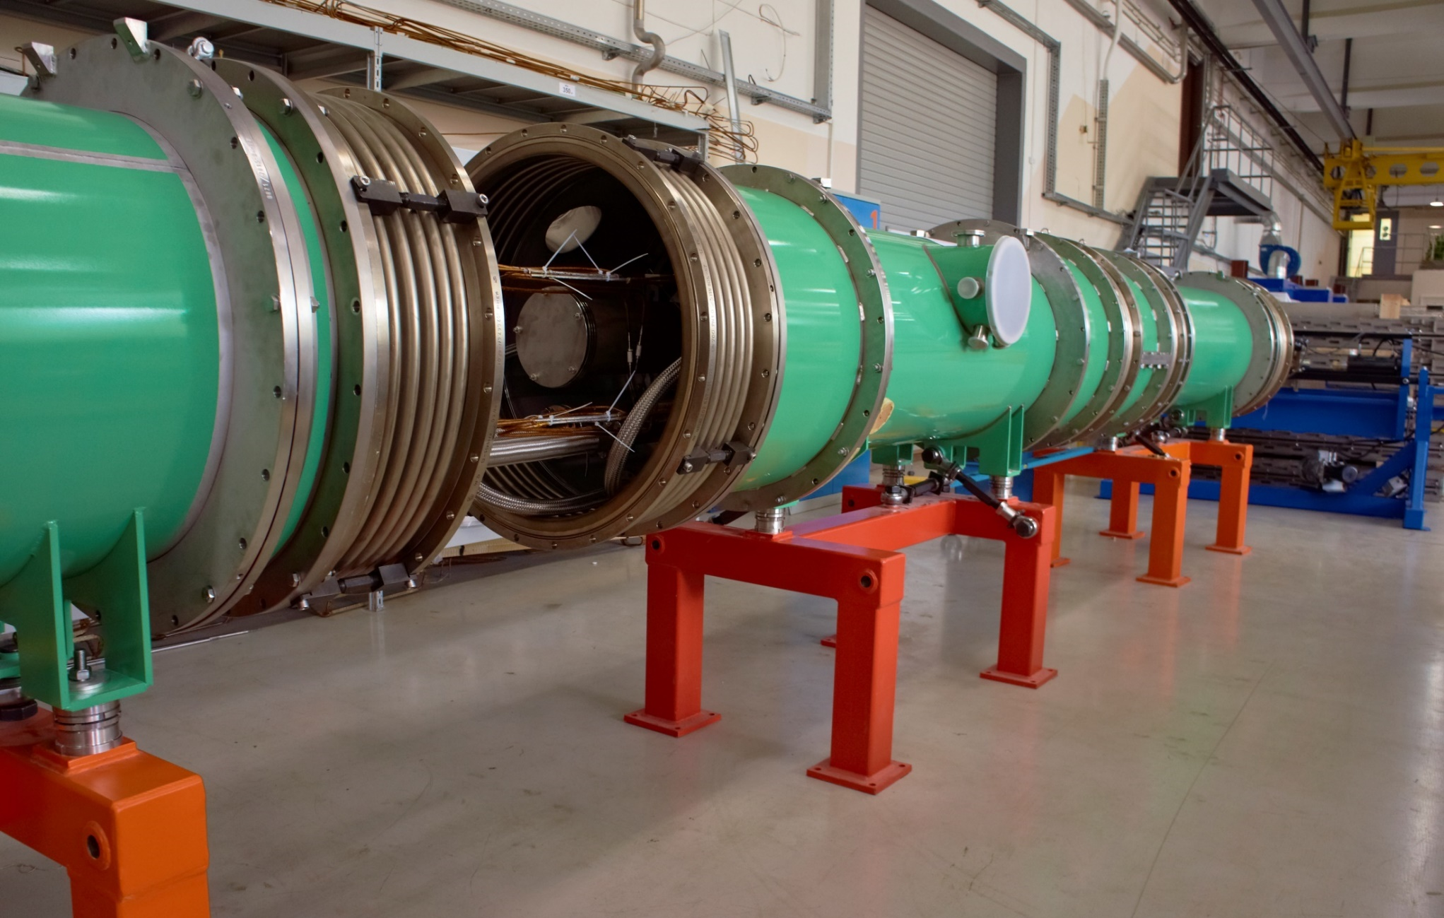
dipole magnets are transporting to Booster site
the first magnet was installed on 19 Sept. 2018 !
test assembly of 4 Booster magnets

Slide 15
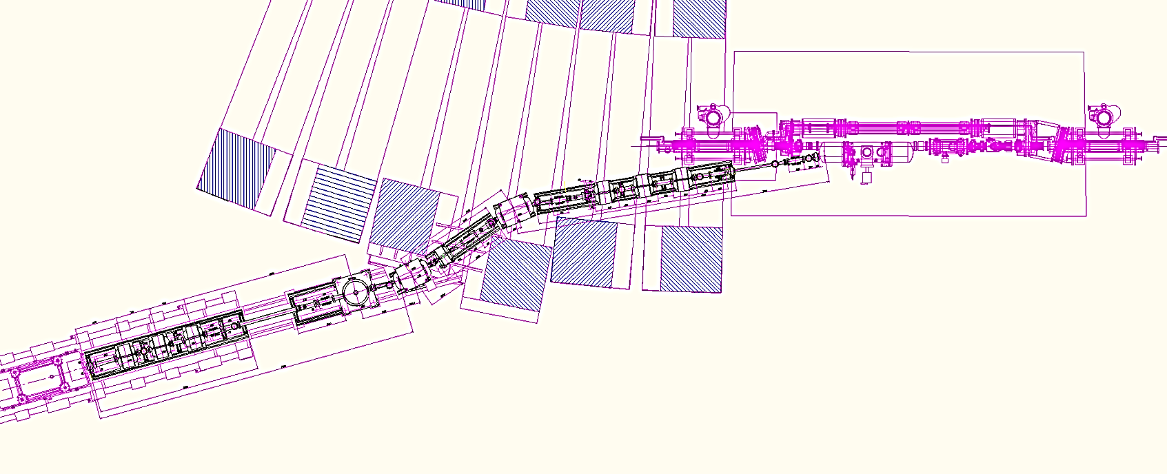
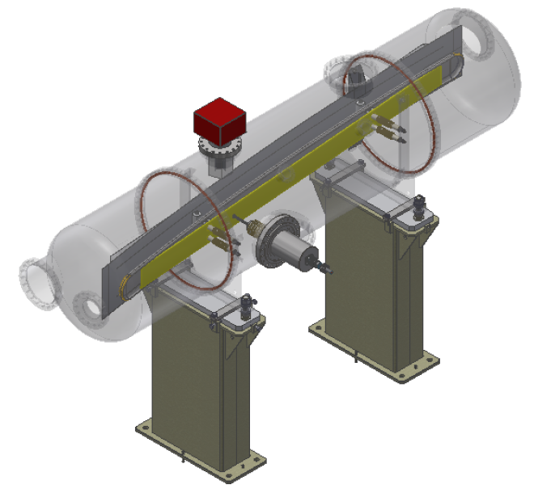
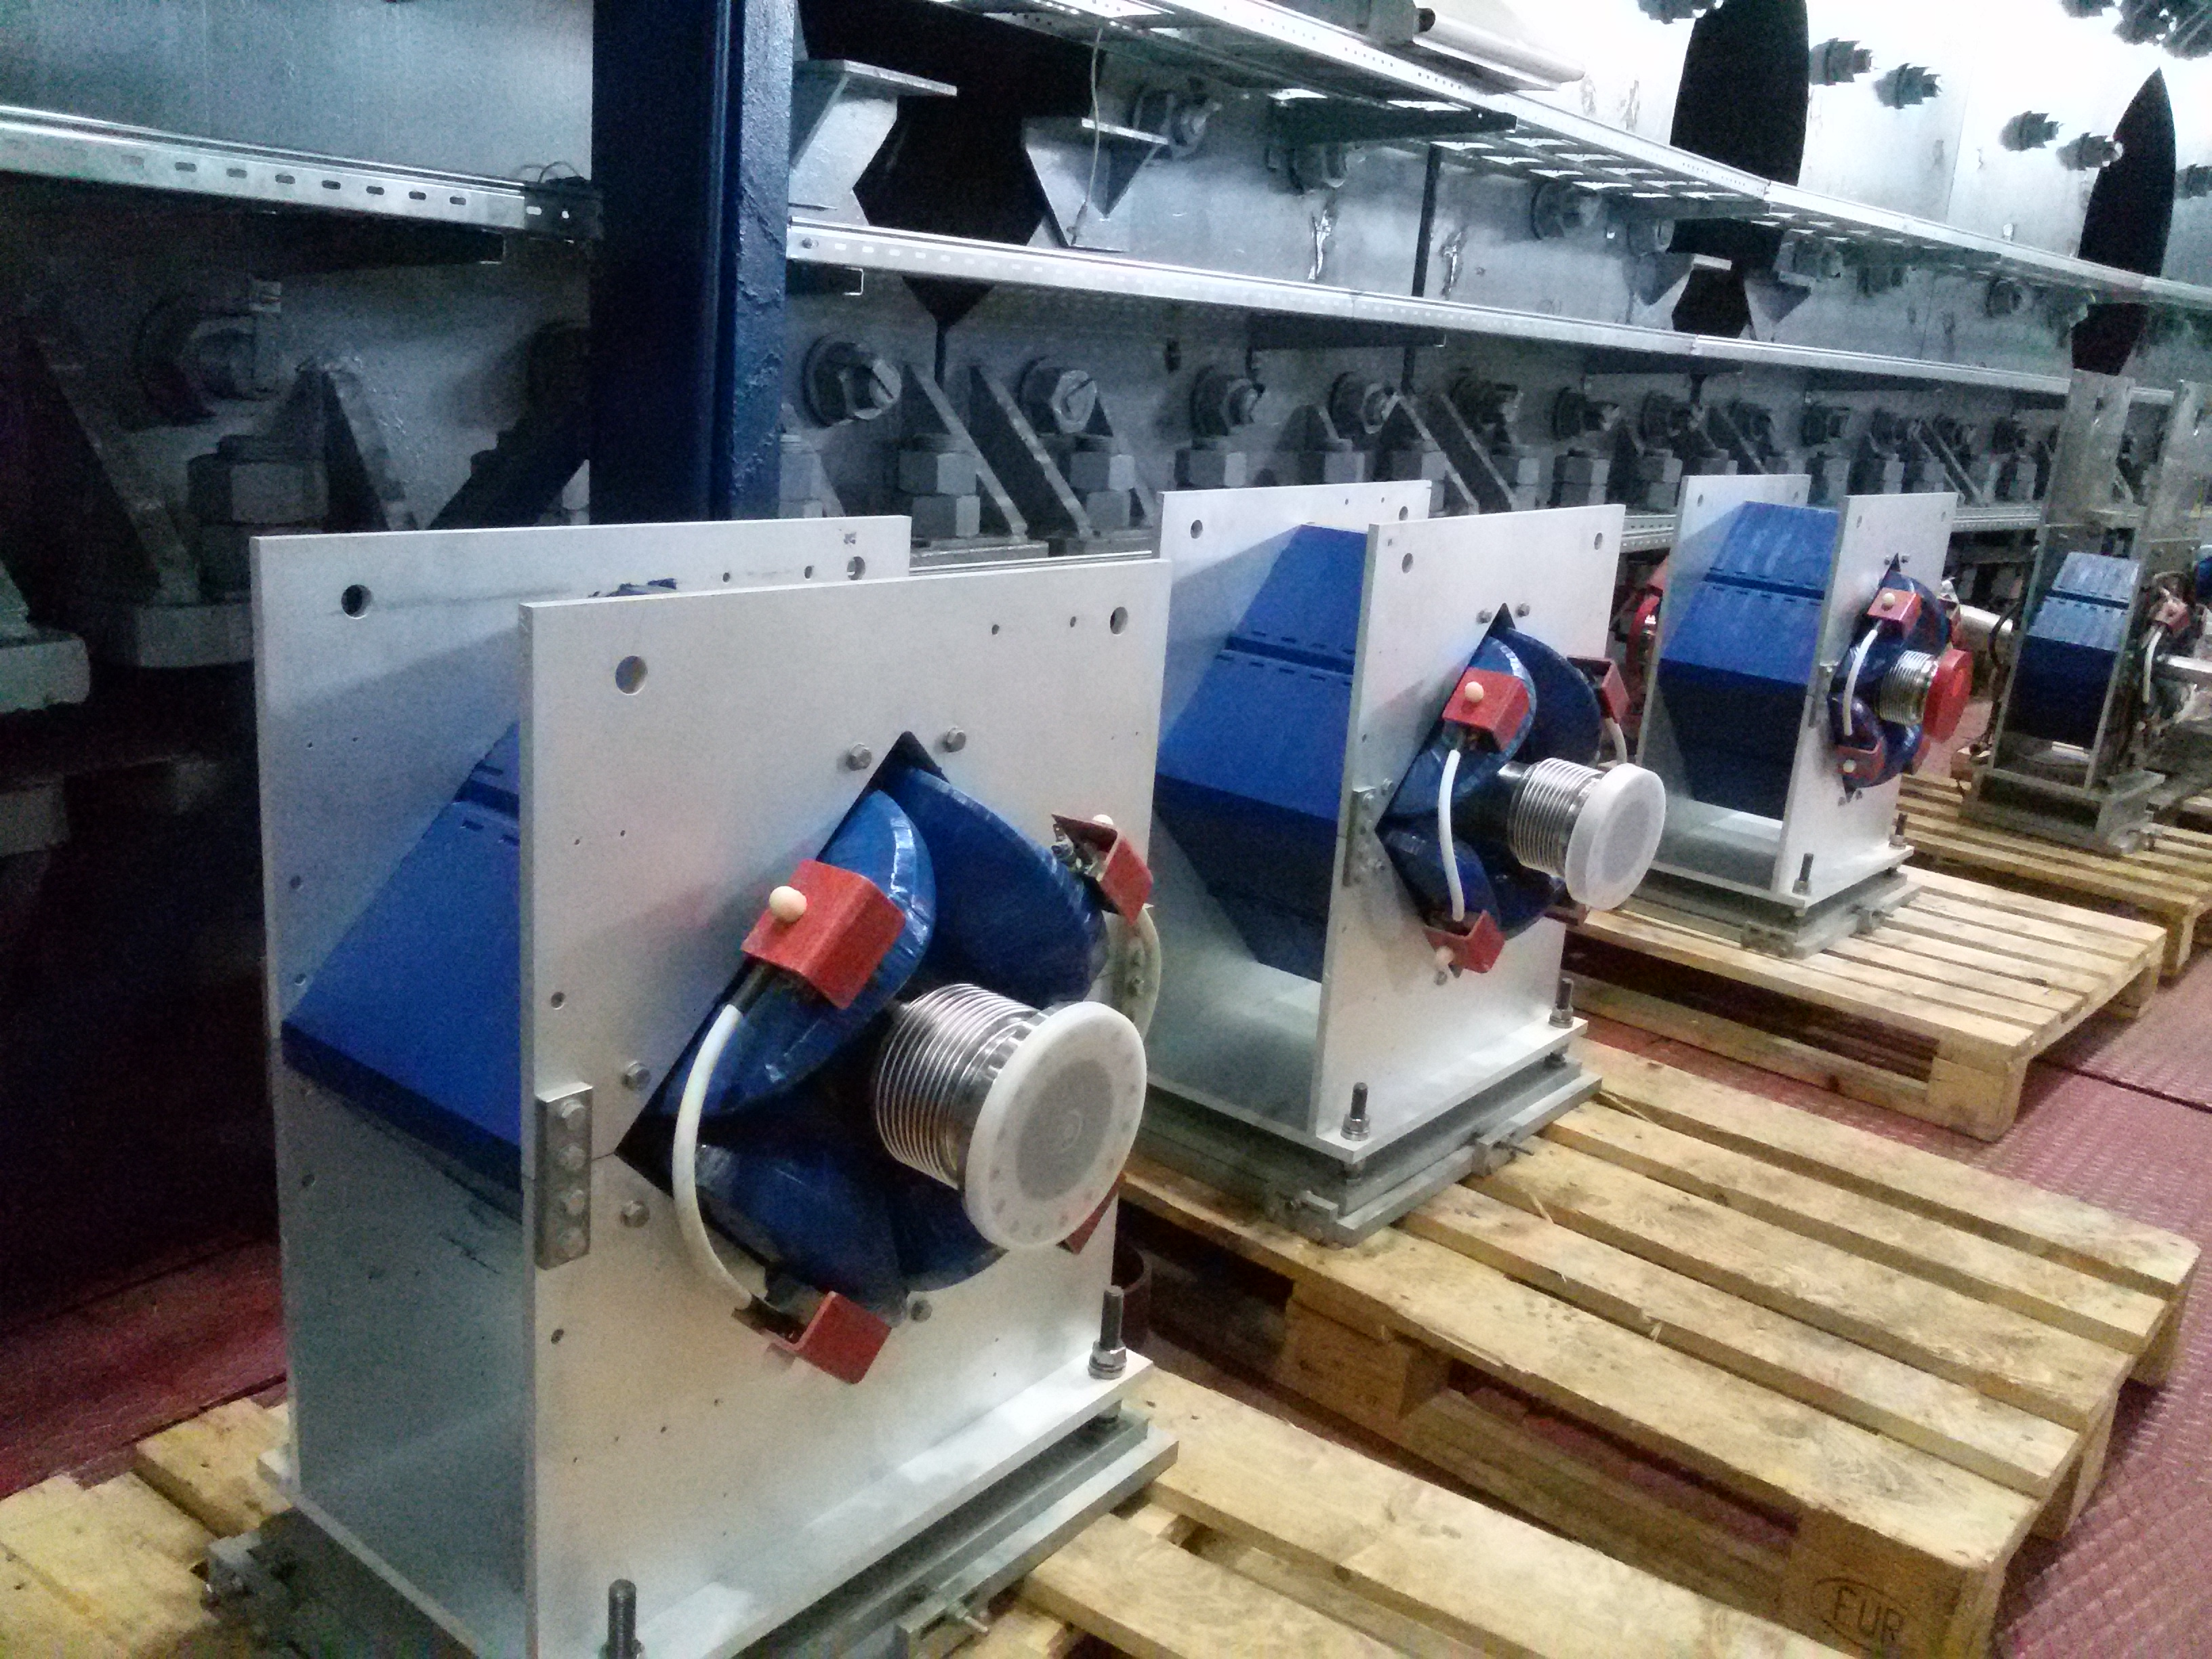
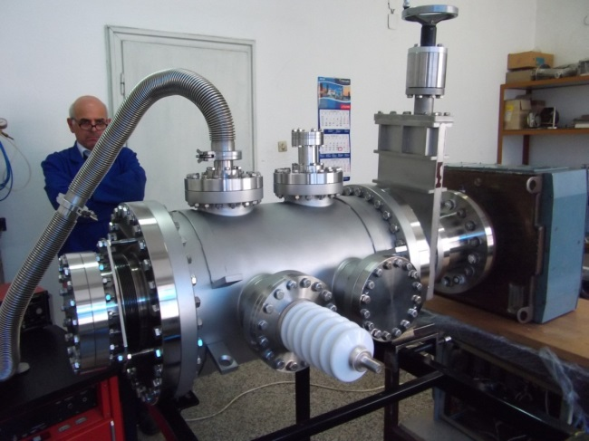
beam injection into Booster
Septum is ready on 70%
“Cryosystems”, UK.
main elements
prototype of
electrostatic
deflector
was tested;
contract for the plates is in progress.
all magnets are ready for installation

Slide 16
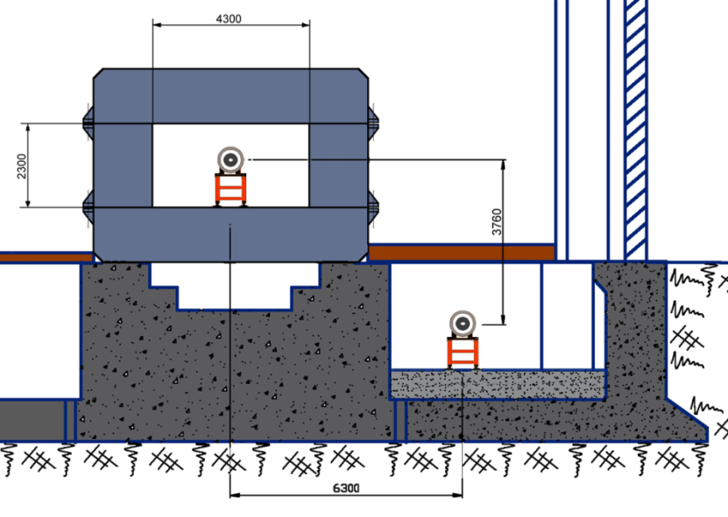
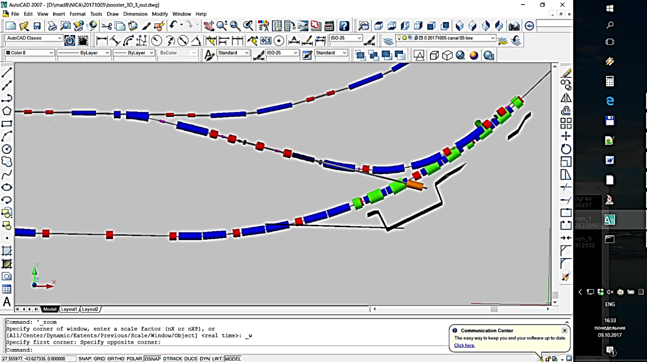
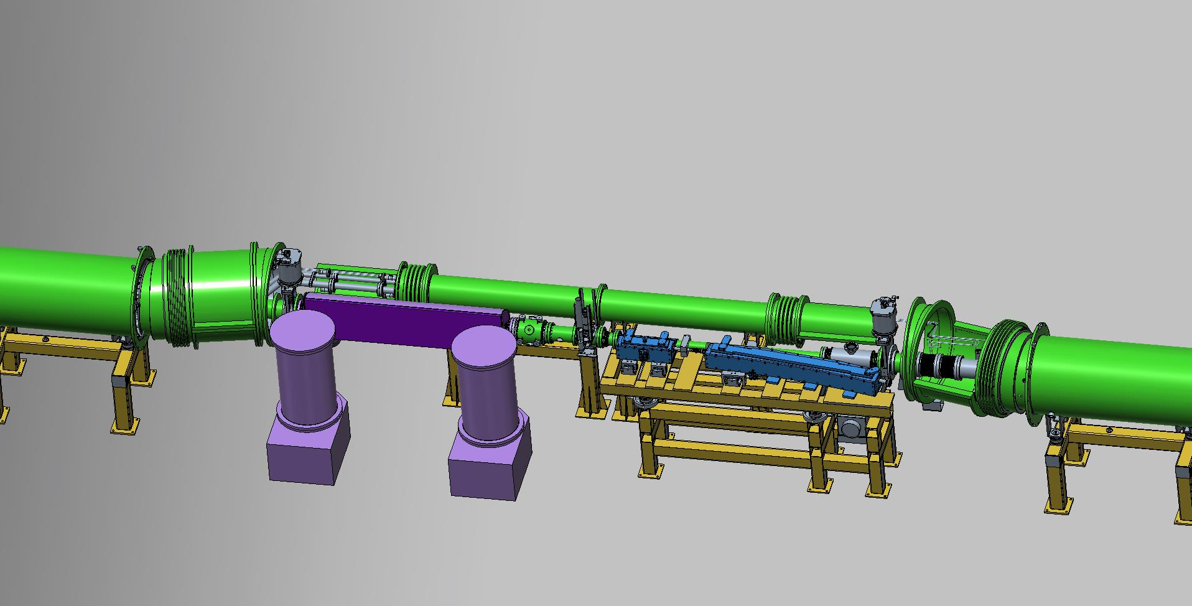
beam transfer from Booster to Nuclotron
BINP is ready to start production of the extraction kicker and septa;
magnets of channel are in development;
Lambertson magnet for Nuclotron injection system is under design;
prototype of a injection kicker is manufactured and tested; design of a kicker for Nuclotron injection system is being developed;
commissioning – December 2019
Booster
Nuclotron
main elements of beam transfer systems

Slide 17
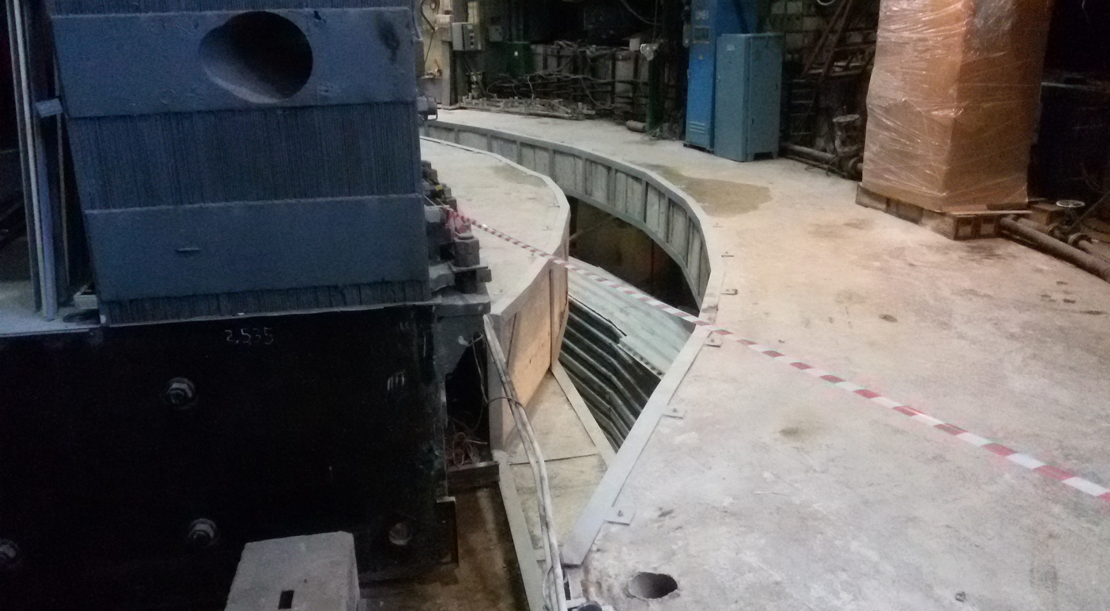
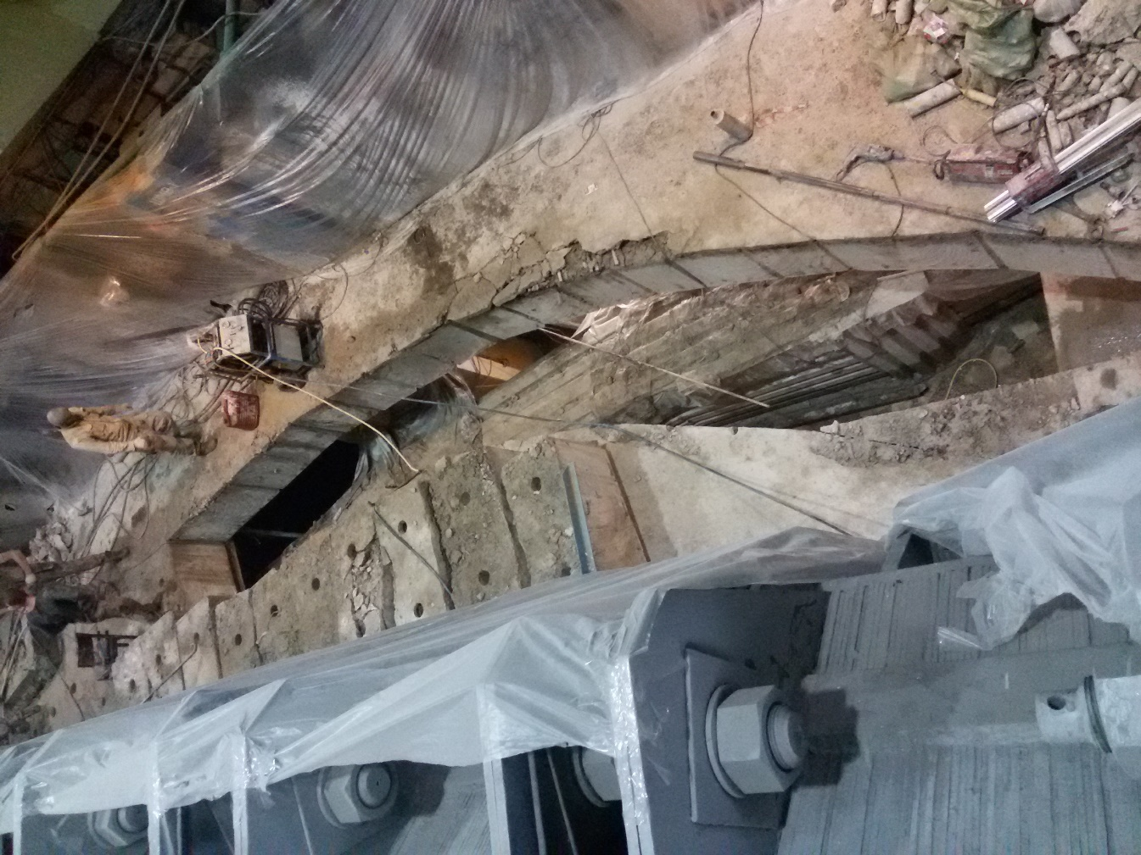
Civil construction works for the transfer channel Booster-Nuclotron are completed.
September 14
September 20

Slide 18

Booster assembling time-schedule
Booster assembly |  | 2018 |  |  |  |  |  |  |  | 2019
 |  | V | VI | VII | VIII | IX | X | XI | XII | I | II | III | IV | V | VI | VII | VIII | IX | X | XI
“Cold” sections
 | Quadrant 1
 | Quadrant 2
 | Quadrant 3
 | Quadrant 4
 | bypasses and ends
 | reference magnets
 | “Warm” sections
 | E-cooling |  |  |  | commissioned
 | injection section
 | beam extraction section
 | RF system
Systems
 | vacuum system
 | power supply
 | cryogenic system
 | thermometry system
technological commissioning
commissioning
with beam

Slide 19

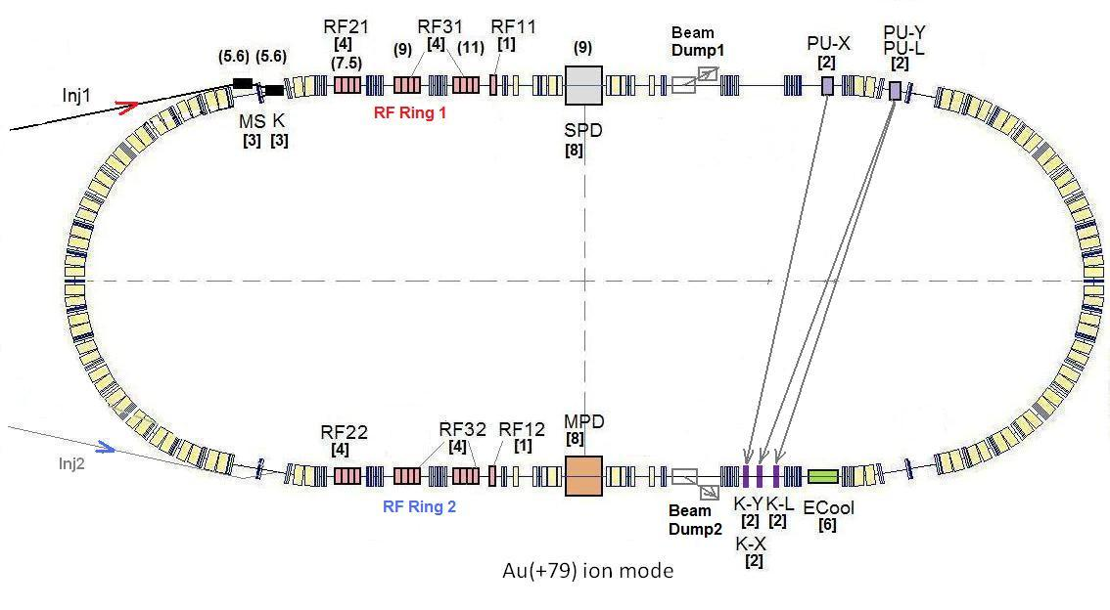
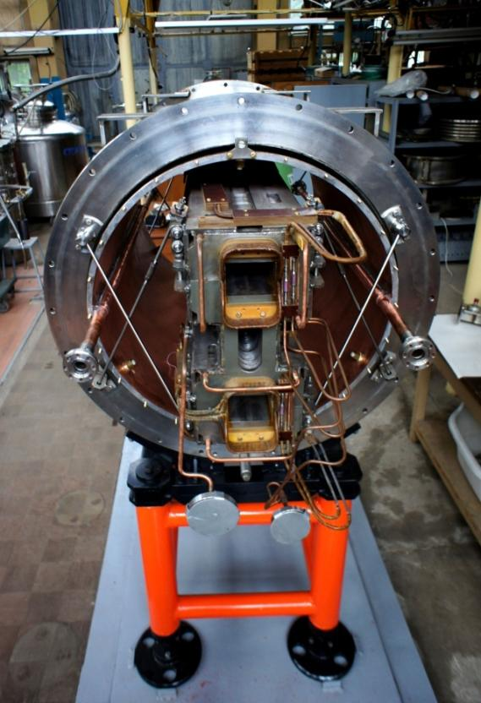
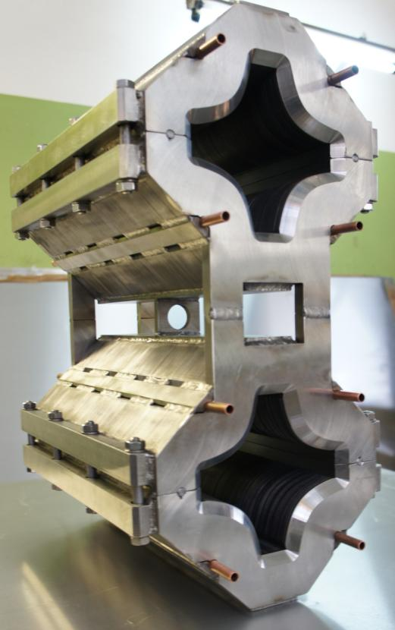
The Collider
45 T*m, 4.5 GeV/u for Au⁷⁹⁺
SPD
Ring circumference, m | 503,04
Number of bunches | 22
r.m.s. bunch length, m | 0,6
β, m | 0,35
max. int. Energy, Gev/u | 11,0
r.m.s. Δp/p, 10-3 | 1,6
IBS growth time, s | 1800
Luminosity, cm⁻² s⁻¹ | 1x10²⁷
MPD
Double aperture magnets:
dipole & quadrupole
prototypes
Notes:
The lattice design and prototyping of most collider elements are completed. The ring circumference is twice as one of the Nuclotron. For the gold beam a Luminosity at the energy above 10 GeV per nucleon will be 10 to the 27

Slide 20
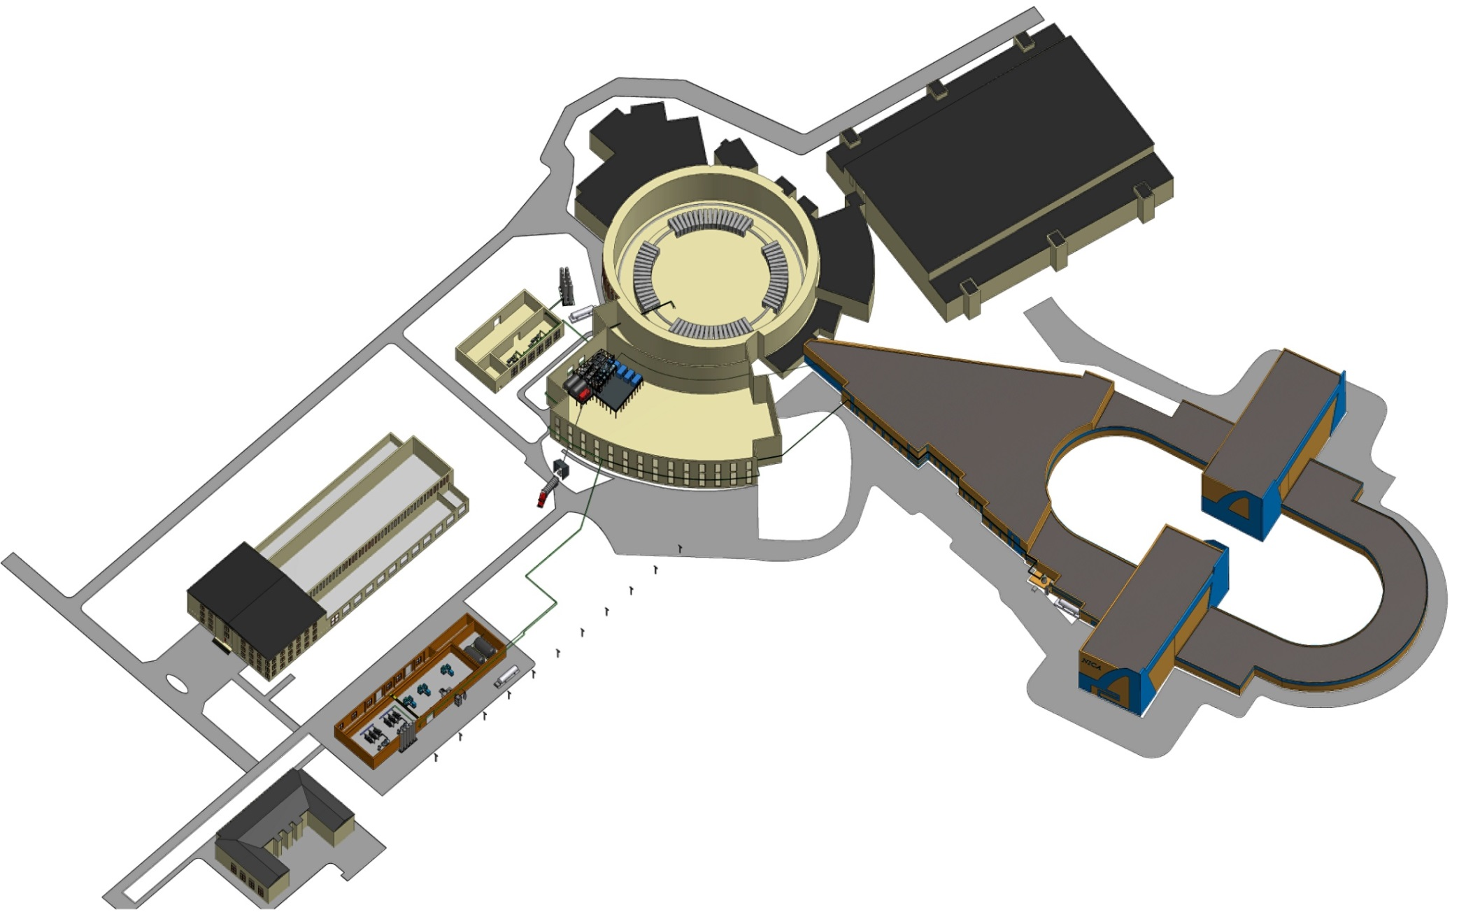
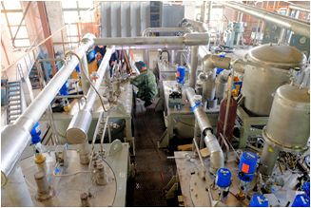
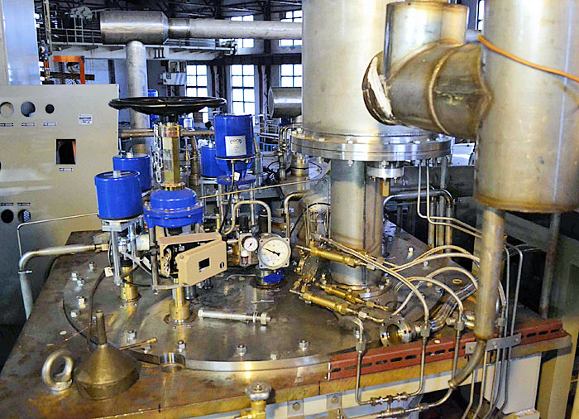
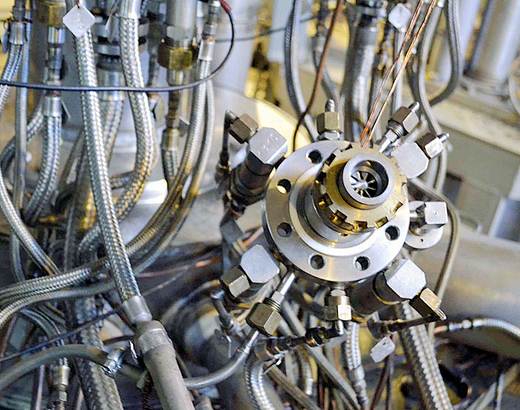
Cryogenics at
completion in 2017
recondenser RA-05
- designed
500 kg/h nitrogen re-condenser RA-0.5
3 satellite
refrigerators
- design in progress
Existing compressor
station 4,4 MW
the cooling power
should be doubled
from 4 kW to 8 kW @ 4.5K
New 1000 l/h He liquefier
40 m³ liquid helium tank
New compressor station 9,6 MW;
Status: construction works started; tendering for new contractor due to problems with initial one

Slide 21
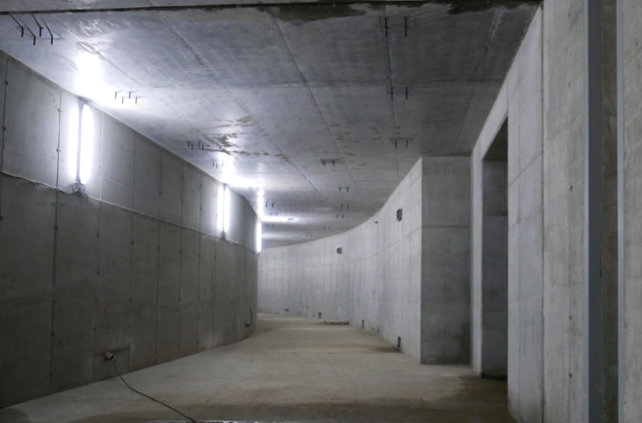
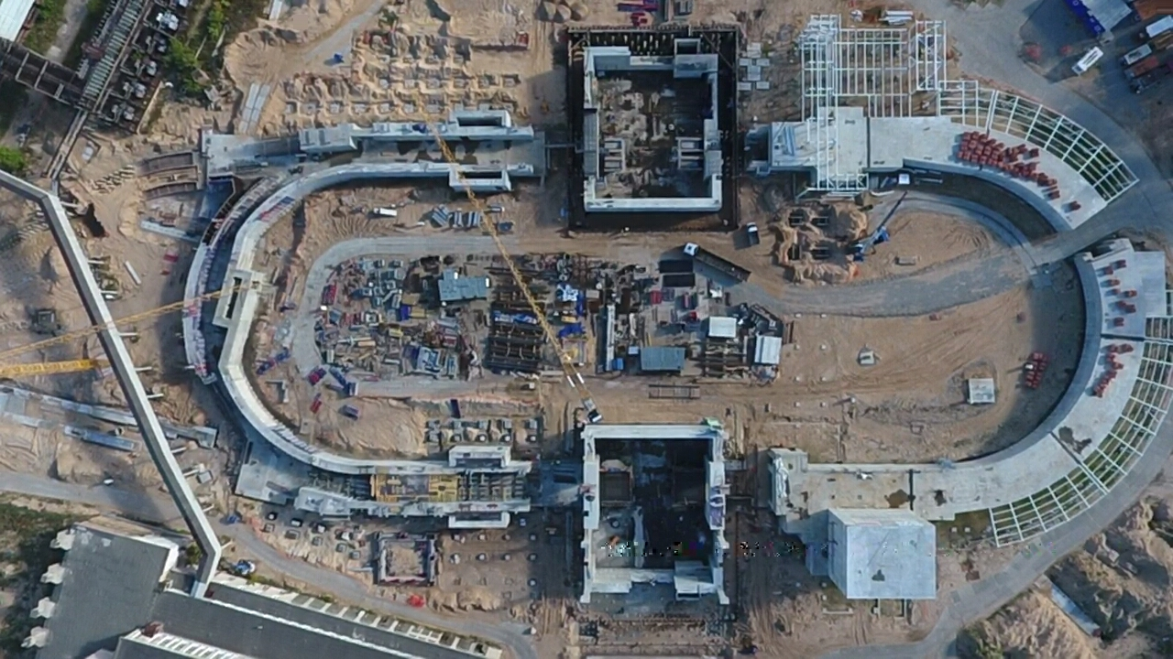
Civil Construction, bld.17
September 2018
SPD
Hall
tunnel
Western
semiring
MPD
Hall
readiness for equipment installation in the MPD Hall - 2019

Slide 22
Experiments
Notes:
Few words on the NICA …

Slide 23
Baryonic Matter at Nuclotron
(BM@N) Collaboration
(not complete):
NNRC, Baku State University, Azerbaijan;
University of Plovdiv, Bulgaria;
Institute of High Energy Physics, China;
Shanghai Institute of Nuclear and Applied Physics, CFS, China;
Tsinghua University, Beijing, China;
Nuclear Physics Institute CAS, Czech Republic;
Tubingen University, Germany;
Tel Aviv University, Israel;
Joint Institute for Nuclear Research;
Almaty Institute of Physics and Technology, Kazakhstan;
Institute of Applied Physics, Chisinev, Moldova;
Warsaw University of Technology, Poland;
Institute of Nuclear Research RAS, Moscow, Russia;
Institute of Nuclear Research RAS, Moscow, Russia;
Institute of Theoretical & Experimental Physics, NRC KI, Moscow, Russia;
NRC Kurchatov Institute, Moscow, Russia;
Moscow Engineer and Physics Institute, Russia;
Skobeltsin Institute of Nuclear Physics, MSU, Russia;
Massachusetts Institute of Technology, Cambridge, USA.

Slide 24
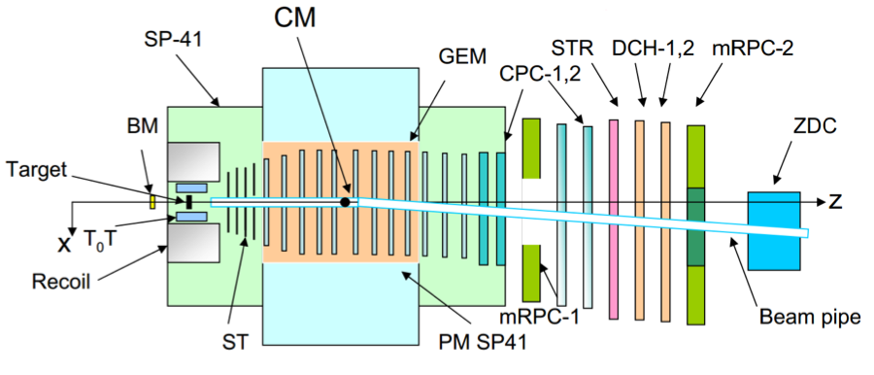
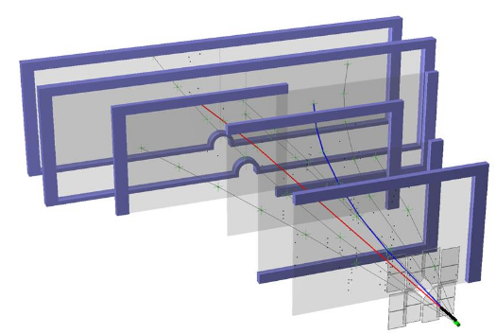
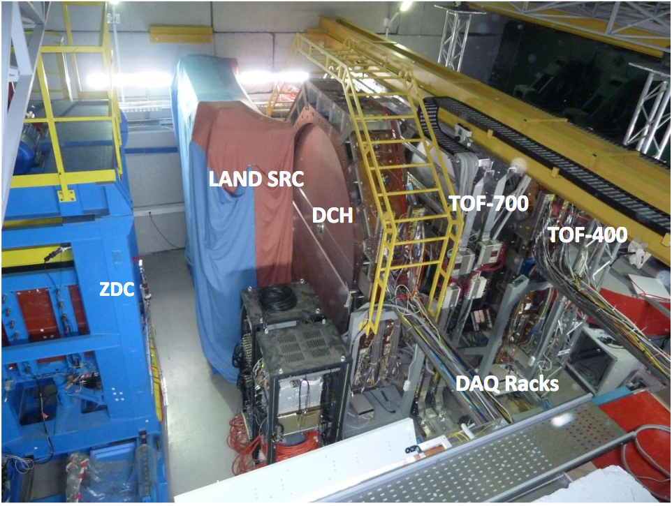



Baryonic Matter at Nuclotron (BM@N)
milestone I:
the first run: March 22 – April 3, 2018:
targets: C, Al, Cu, Sn, Pb;
beams statistics
      ¹²C⁶⁺ 4,0 -4,5 AGeV 20 M events
      ⁴⁰Ar¹⁶⁺ 3,2 AGeV 130 M events
      ⁸⁴Kr²⁶⁺ 2,3 AGeV 50 M events
time resolution:
T0 ~43 ps
• ToF-700 ~65 ps
• ToF-400 ~53 ps
ECal
π−
p
beam
pipe
Λ p + π− decay
reconstruction
GEM: 163 x 45 cm²
schematic view
plans
year | 2018 | 2020 | 2021 +
beam | C, Ar/Kr | Au | Au, p
intensity, Hz | 0,5M | 1M | 10M
trig. rate, Hz | 10k | 20k | 50k
central tracker | 10 GEM half pl. | 8 GEM full pl. | 12 GEM or 8+2Si
status | stage 0 | stage 1 | stage 2
momentum resolution
Notes:
Several milestones are foreseen to put in operation the fully equipped detector. There major tracker is based on the GEM chambers installed inside the gap of dipole magnet. Fully equipped set-up contains as well TOF system, Ecal, zero degree calorimeter and silicon tracker, which will be installed just downstream the target.

Slide 25

MultiPurpose Detector (MPD)
Collaboration
(not complete):
IHEP, Beijing, China;
University of South China, China;
Palacky University, Olomouc, Czech Republic;
NPI CAS, Rez, Czech Republic;
Tbilisi State University, Tbilisi, Georgia;
Tubingen University, Tubingen, Germany;
Tel Aviv University, Tel Aviv, Israel;
Joint Institute for Nuclear Research;
IPT, Almaty, Kazakhstan;
FHCal
UNAM, Mexico City, Mexico;
Institute of Applied Physics, Chisinev, Moldova;
WUT, Warsaw, Poland;
NCN, Otwock – Swierk, Poland;
UW, Wroclaw, Poland;
Jan Kochanowski University, Kielce, Poland;
INR RAS, Moscow, Russia;
MEPhI, Moscow, Russia;
PNPI, Gatchina, Russia;
INP MSU, Moscow, Russia;
SPSU - Dept. of NP, Russia;
St. Petersburg, Russia;
SPSU – Dept. of HEP, St. Petersburg, Russia;
KI NRS, Moscow, Russia;
Baku State University, NNRC, Azerbaijan;
University of Plovdiv, Bulgaria;
University Tecnica Federico Santa Maria, Valparaiso, Chili;
Tsinghua University, Beijing, China;
USTC, Hefei, China;
Huizhou University, Huizhou, China;
Institute of Nuclear and Applied Physics, CAS, Shanghai, China;
Central China Normal University, China;
Shandong University, Shandong, China;

Slide 26





Magnet fabrication: ASG (Genova) & Vitkovice HM
yoke control assembly at HM Vitkovice
final assembly in the MPD hall - June 2019
winding machune
cryostat
trim coil
Notes:
8 contracts have been signed for the construction of large superconducting solenoid. All works are well progressing. The yoke production is going on at Vitkovice heavy machinery in Czech Republic. The cold mass is under production in other European enter[prizes.

Slide 27


Multi-Purpose Detector (MPD)
Stage I: TPC, TOF, ECAL, ZDC, FFD
acceptance
URQMD
charged
b<11 fm
4 A GeV
11 A GeV
dN/dη
TPC
TOF
ECal
FFD
FHCal
FHCal
FFD
η
Stage I: overall commissioning
starts in 2020
Notes:
The MPD will be put in operation at two stages. At the first one the barrel part will be equipped with major tracking detector TPC, TOF end ECAL. FHC and FD will be operational as well.
At the second stage the detector will be supplemented with IT and end cap subdetectors.

Slide 28
Multi-Purpose Detector (MPD)
Stage I: TPC, TOF, ECAL, ZDC, FFD
Stage II ( 2023): + ITS + EndCap (CPC, Straw, TOF, ECAL)
Stage II
acceptance
URQMD
charged
b<11 fm
4 A GeV
11 A GeV
dN/dη
TPC
CPC
TOF
ECal
FFD
FHCal
FHCal
FFD
η
Stage I: overall commissioning
starts in 2020
Notes:
The MPD will be put in operation at two stages. At the first one the barrel part will be equipped with major tracking detector TPC, TOF end ECAL. FHC and FD will be operational as well.
At the second stage the detector will be supplemented with IT and end cap subdetectors.

Slide 29




Electromagnetic calorimeter: ECAL
Barrel ECAL ~ 43 000 modules
Pb+Sc “Shashlyk”
read-out: WLS fibers + MAPD
L ~35 cm (~ 14 X₀)
Segmentation (4x4 cm²),
σ(E) better than 5% @ 1 GeV;
time resolution ~500 ps
projective geometry
module prototype
block of modules
Notes:
One of the unique high-tech projects within the framework of the MPD experiment is the large scale electromagnetic calorimeter of the shashlik type with projection geometry. This is a joint project with Tsinghua University (Beijing). It is required to produce more than 40 thousand modules and assemble them into a single cylindrical system, calibrate and put into operation.

Slide 30




two scenarios of ECal integration
scenario A
scenario B
~ 90 tons
184 towers
5 tons
5520 mm

Slide 31



Inner Tracker System (MPD stage II)
technology transfer
from ALICE/CERN
MAPS of new ALICE ITS
carbon fiber space frames;
D⁺
K⁻
π⁺
π⁺
~ 9 500
ALPIDE MAPS
in 5 cylinders of 2 barrels
tentative assembly
layout
4,9۰10⁹ pixels, active area 3,9 m².
beam pipe: possible cooperation with CERN
Stage II:
38 mm in diameter
Stage I: 64 mm in diameter

Slide 32
Conclusions
and summary
Notes:
Few words on the NICA …

Slide 33
major milestones
2018 – start of BM@N experiment (min. configuration)
2018 –2019 – Booster commissioning
2019 – readiness of MPD Hall
2019 – MPD magnet commissioning
2020 – completion of civil construction (build. 17)
2020 – MPD commissioning (Stage I)
2021 – Collider commissioning
2020 – completion of “NICA Center” construction
2021 – commissioning of Computer center
2023 – MPD commissioning (Stage II)
2025 – SPD commissioning (Stage I)

Slide 34
The Russian Fund of Basic Research announced:
http://www.rfbr.ru/rffi/ru/classifieds/o_2076537
2018 competition for the best projects on "Fundamental properties and phase transitions of hadronic and quark-gluon matter”:
a mega-class facility of the complex "NICA”
("Megasciense - NICA”).
Starting date and time of application submission: 10.09.2018
15:00 (MSK)
Time of the deadline for submission of applications was
prolonged up to: 26/10/2018 23:59 (MSK)
RF National Project «НАУКА» (SCIENCE):
2-nd Federal Project
“Research Infrastructure incl. Megasciense Facilities”.
We are preparing application in the framework of 2-nd Federal Project
to get necessary funding for NICA Complex

Slide 35
summary
Density frontier is less explored area
of the QCD phase diagram and its study
could lead to interesting discoveries
NICA complex has a potential for competitive research
in the field of baryon rich matter
Preparations of accelerator complex
and both detectors BM@N and MPD
are going close to the schedule
CDR of SPD project will be presented in 2019
two major milestones 2018 to be fulfilled with slight delay
Both BM@N and MPD collaborations are crowing
Recently opened RFBR grants are very important
for larger involvement of Russian researches to the NICA project

Slide 36

Welcome to the 2-nd Collaboration Meeting
Dubna, 11-13 April, 2018
Thank you

