Slide 1




MCORD
MPD Cosmic Ray Detector for NICA
by Polish consortium NICA-PL
Dr Bielewicz (NCBJ-Swierk, JINR)

Slide 2

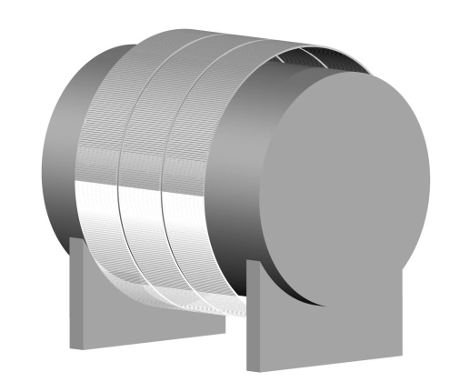
Outline
Cosmic Ray Detector – Goals
Main tasks and schedule
Design, modeling proposition
Conclusion

Slide 3
1. Cosmic Ray Detector – Goals
Trigger (for testing or calibration)
-before finishing of MPD (testing of TOF, ECAL modules and TPC)
-before experimental session
Veto (normal mode -
track and time window recognition)
__________________________________
Additionally
Astrophysics (muon shower and bundles)
- unique for horizontal events

Slide 4
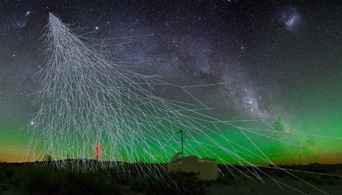
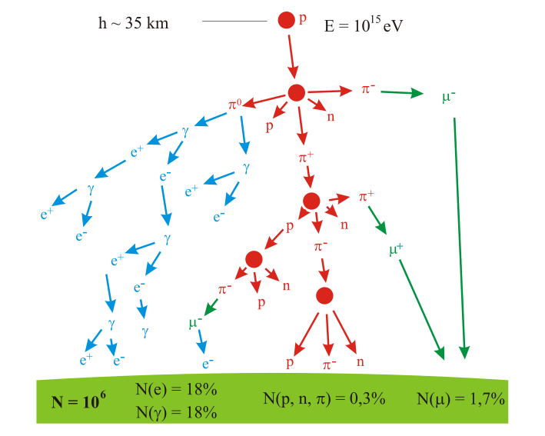
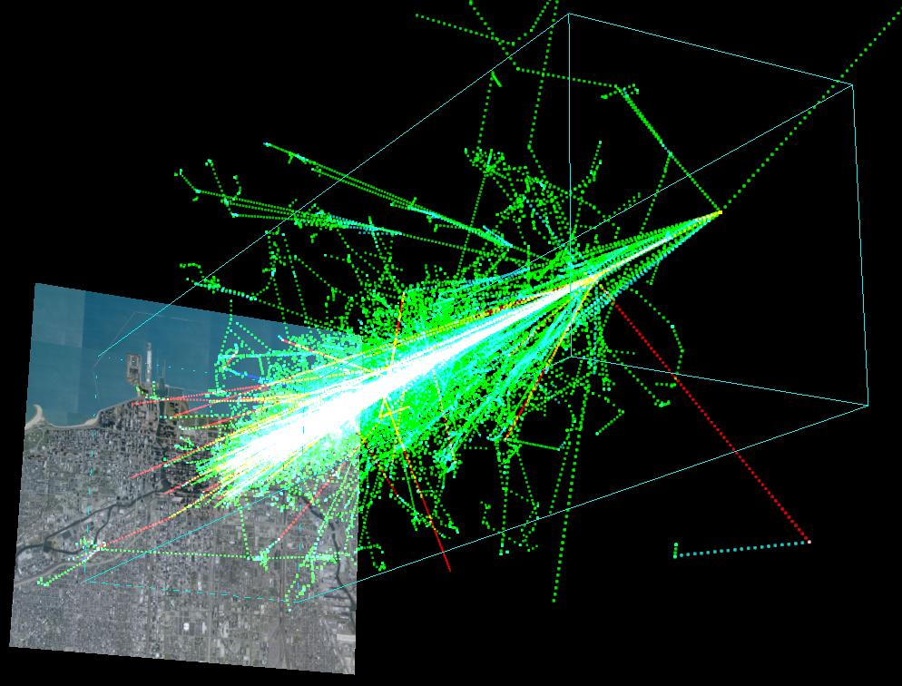
1. Cosmic Ray Detector – Goals
PRIMARY PARTICLE
Cosmic ray air shower created by a 1TeV proton hitting the atmosphere 20 km above the Earth. The shower was simulated using the AIRES package.
GROUND LEVEL

Slide 5
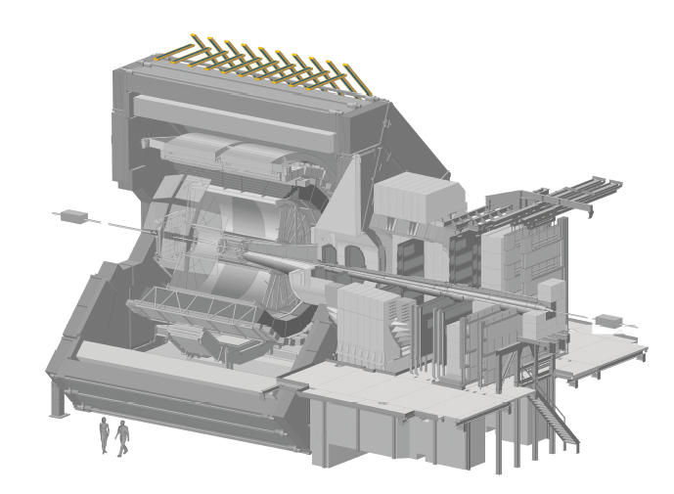
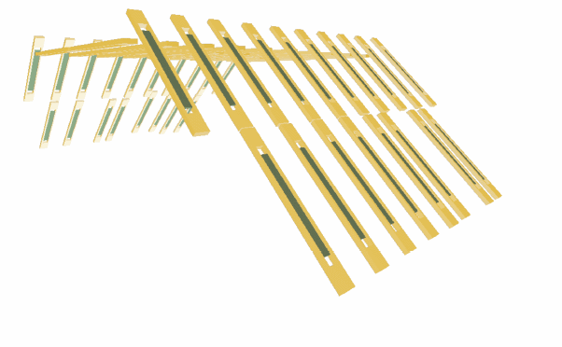
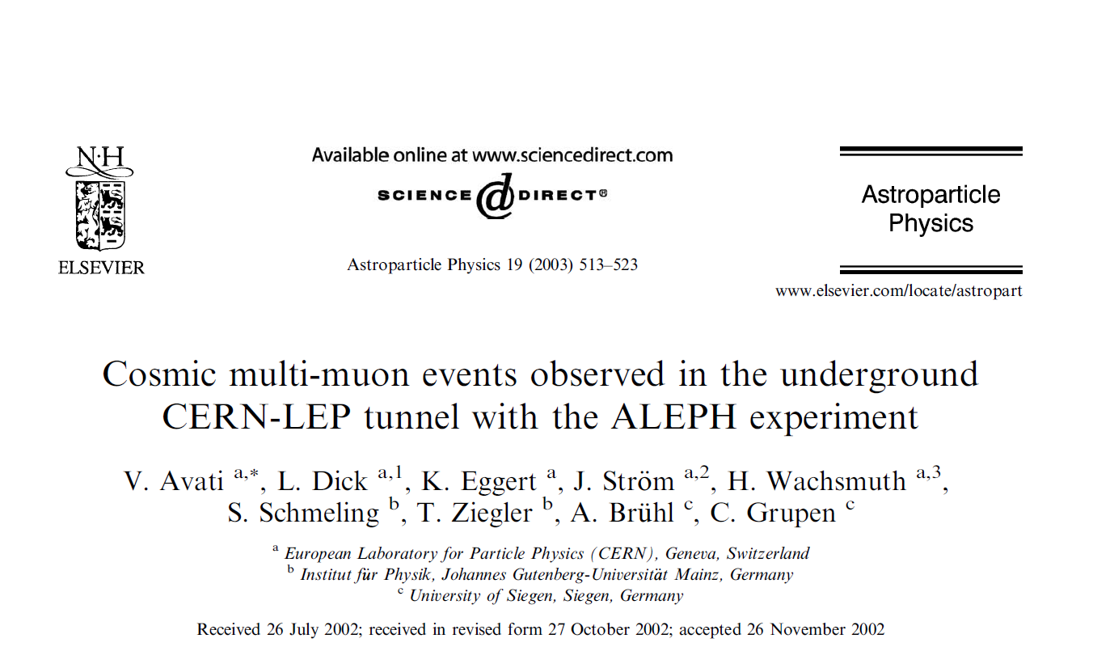
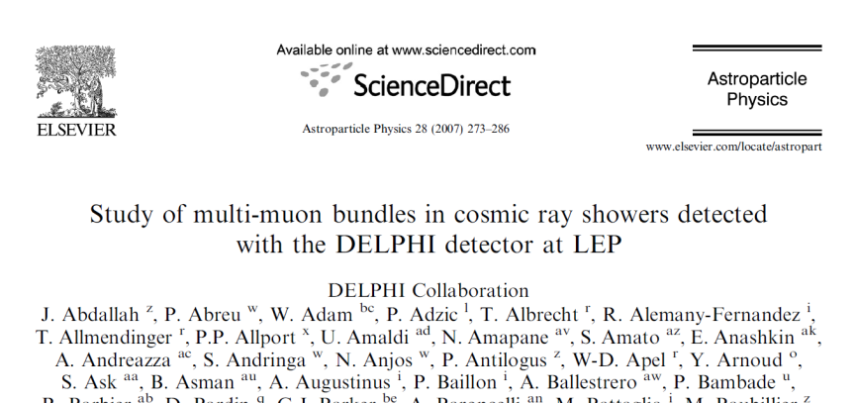
1. Cosmic Ray Detector – other experiments
ALICE ACORDE

Slide 6
2. Main tasks and schedule
Conceptual Design (9-12 months)
(Preliminary Technical and Electronic Design, Market Research, Literature Studies, Cost Estimates, TPC and TOF requirements)
Module Optimization (9-15 months )
(Scintillator, Power Supply, Fron-End and Digital electronic characterization; Detector response, Cosmic-ray and MPD spectra simulation, Veto response, Integration )
Demonstrator constr. (2-4 ready to use modules) (10-20 month) (Demo. detail design, Procurement of Modules, Lab. Tests, Installation on MPD
Final Detector constr. (all modules procurement, test and installation –12 months)

Slide 7
2. Main tasks and schedule

Slide 8
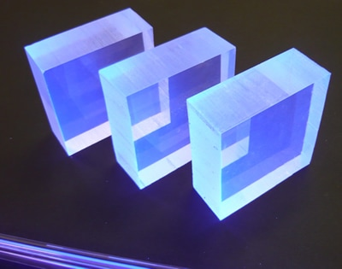
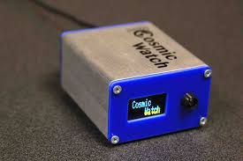
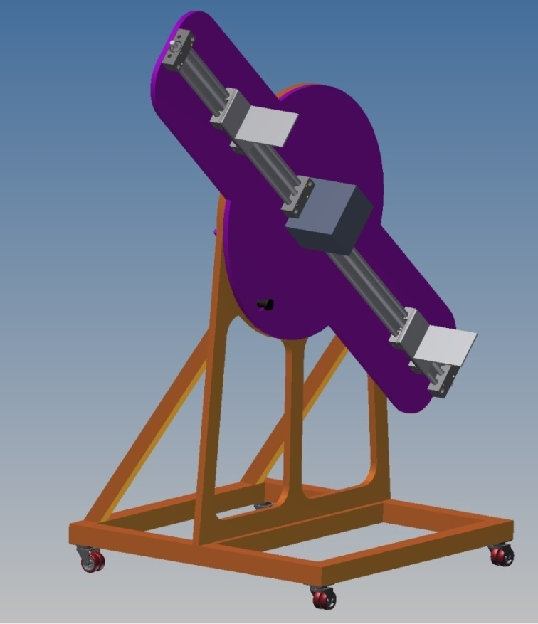
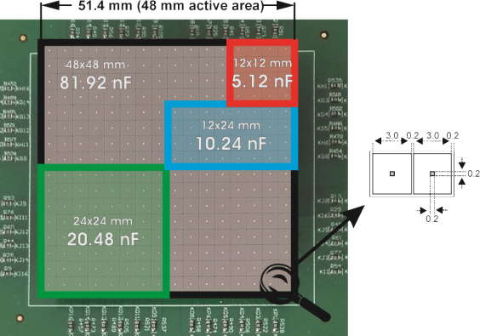
Conceptual Design
Measurement of cosmic irradiation - Azimuthal and horizontal distribution
Angular influence of the building (concrete walls and ceilling)
Testing of scintillator shape (length, width, thickness) and scintillation response to ionizing radiation
Size and number of optical elements
Numerical calculation – simulation (MCNPX, GEANT4 and CORSIKA, Showersim)
Cooperation with
scintillators
manufacturers and
providers:
Uniplast (Russia)
Amcrys-H (Ucraine)
Saint-Gobain (FR)
Scionix (Holland)
Nuvia (Czech)
Cooperation with SiPM vendors:
Hamamatsu (Japan)
AdvanSiD (Italy),
Ketek (Germany),
SensL (Ireland)
Wide range of size:
1×1 mm² to 51×51 mm².

Slide 9
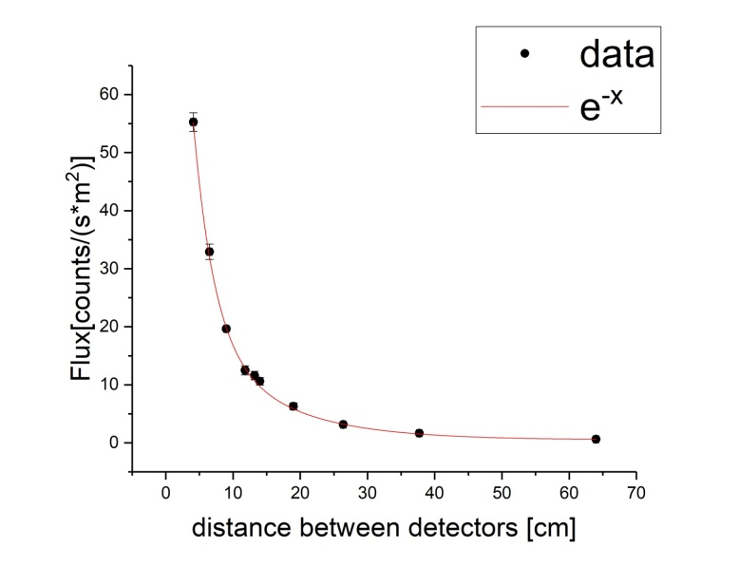
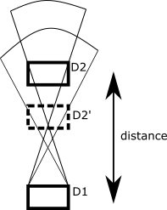
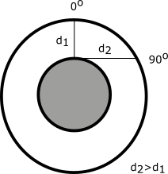
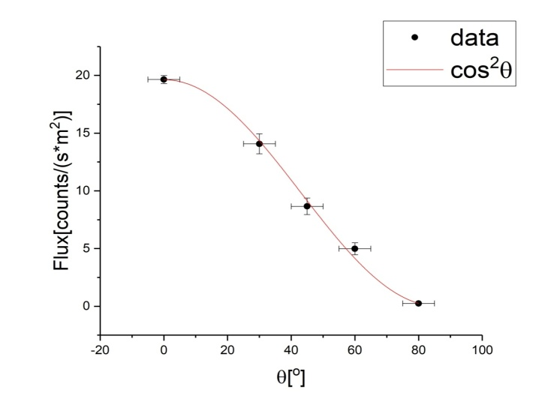
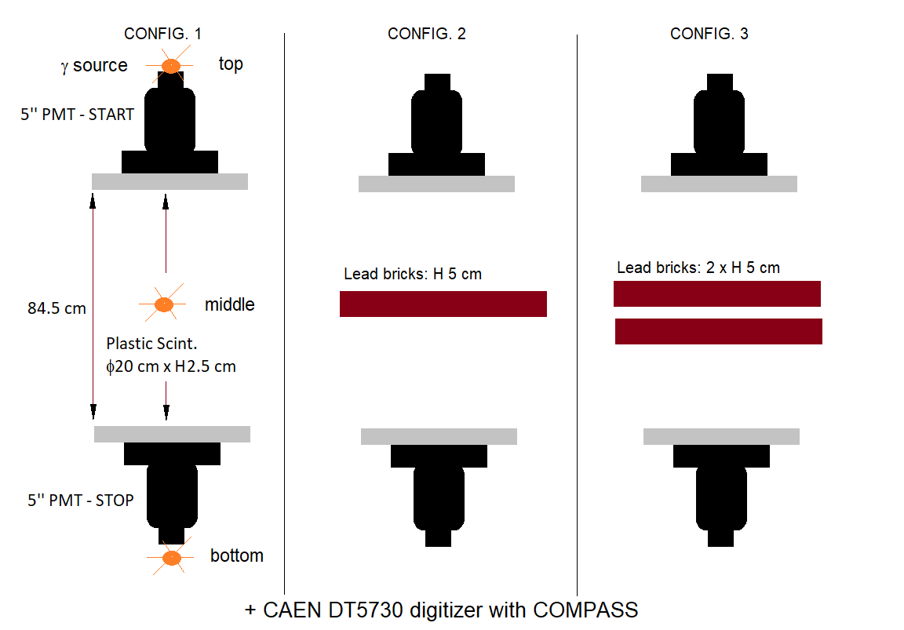
Conceptual Design - measurements
First measurements at Dubna
Azimuthally and horizontal distribution
Angular influence of the building
With Pb filter

Slide 10
Conceptual Design - simulations
Simulations of muon energy deposition in plastic scintillator (MCNPX and GEANT4),
and multi-purpose shower simulation programs of air shower development (CORSICA and Showersim)
Energy spectrum reconstruction
Implementation of more complex muon source definition
Launching particle tracking and the coincidence analysis
Design and validation of the pre-demonstration system , which will be built at NCBJ
Evaluate the muon detection for scintillators of various sizes:
  50 – 200 cm length bars
  5 – 20 cm width
  1 – 5 cm thick
Comparison and calibration with experimental data

Slide 11
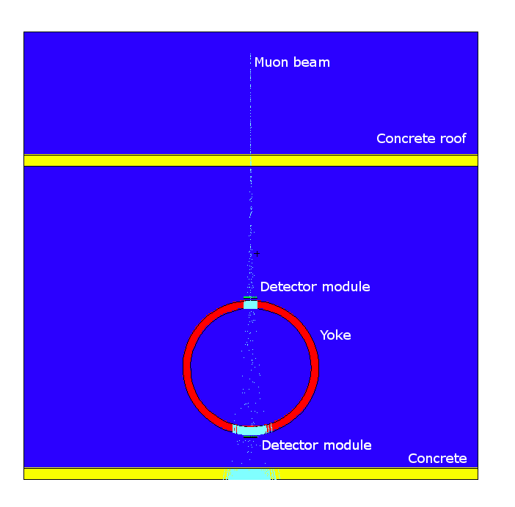
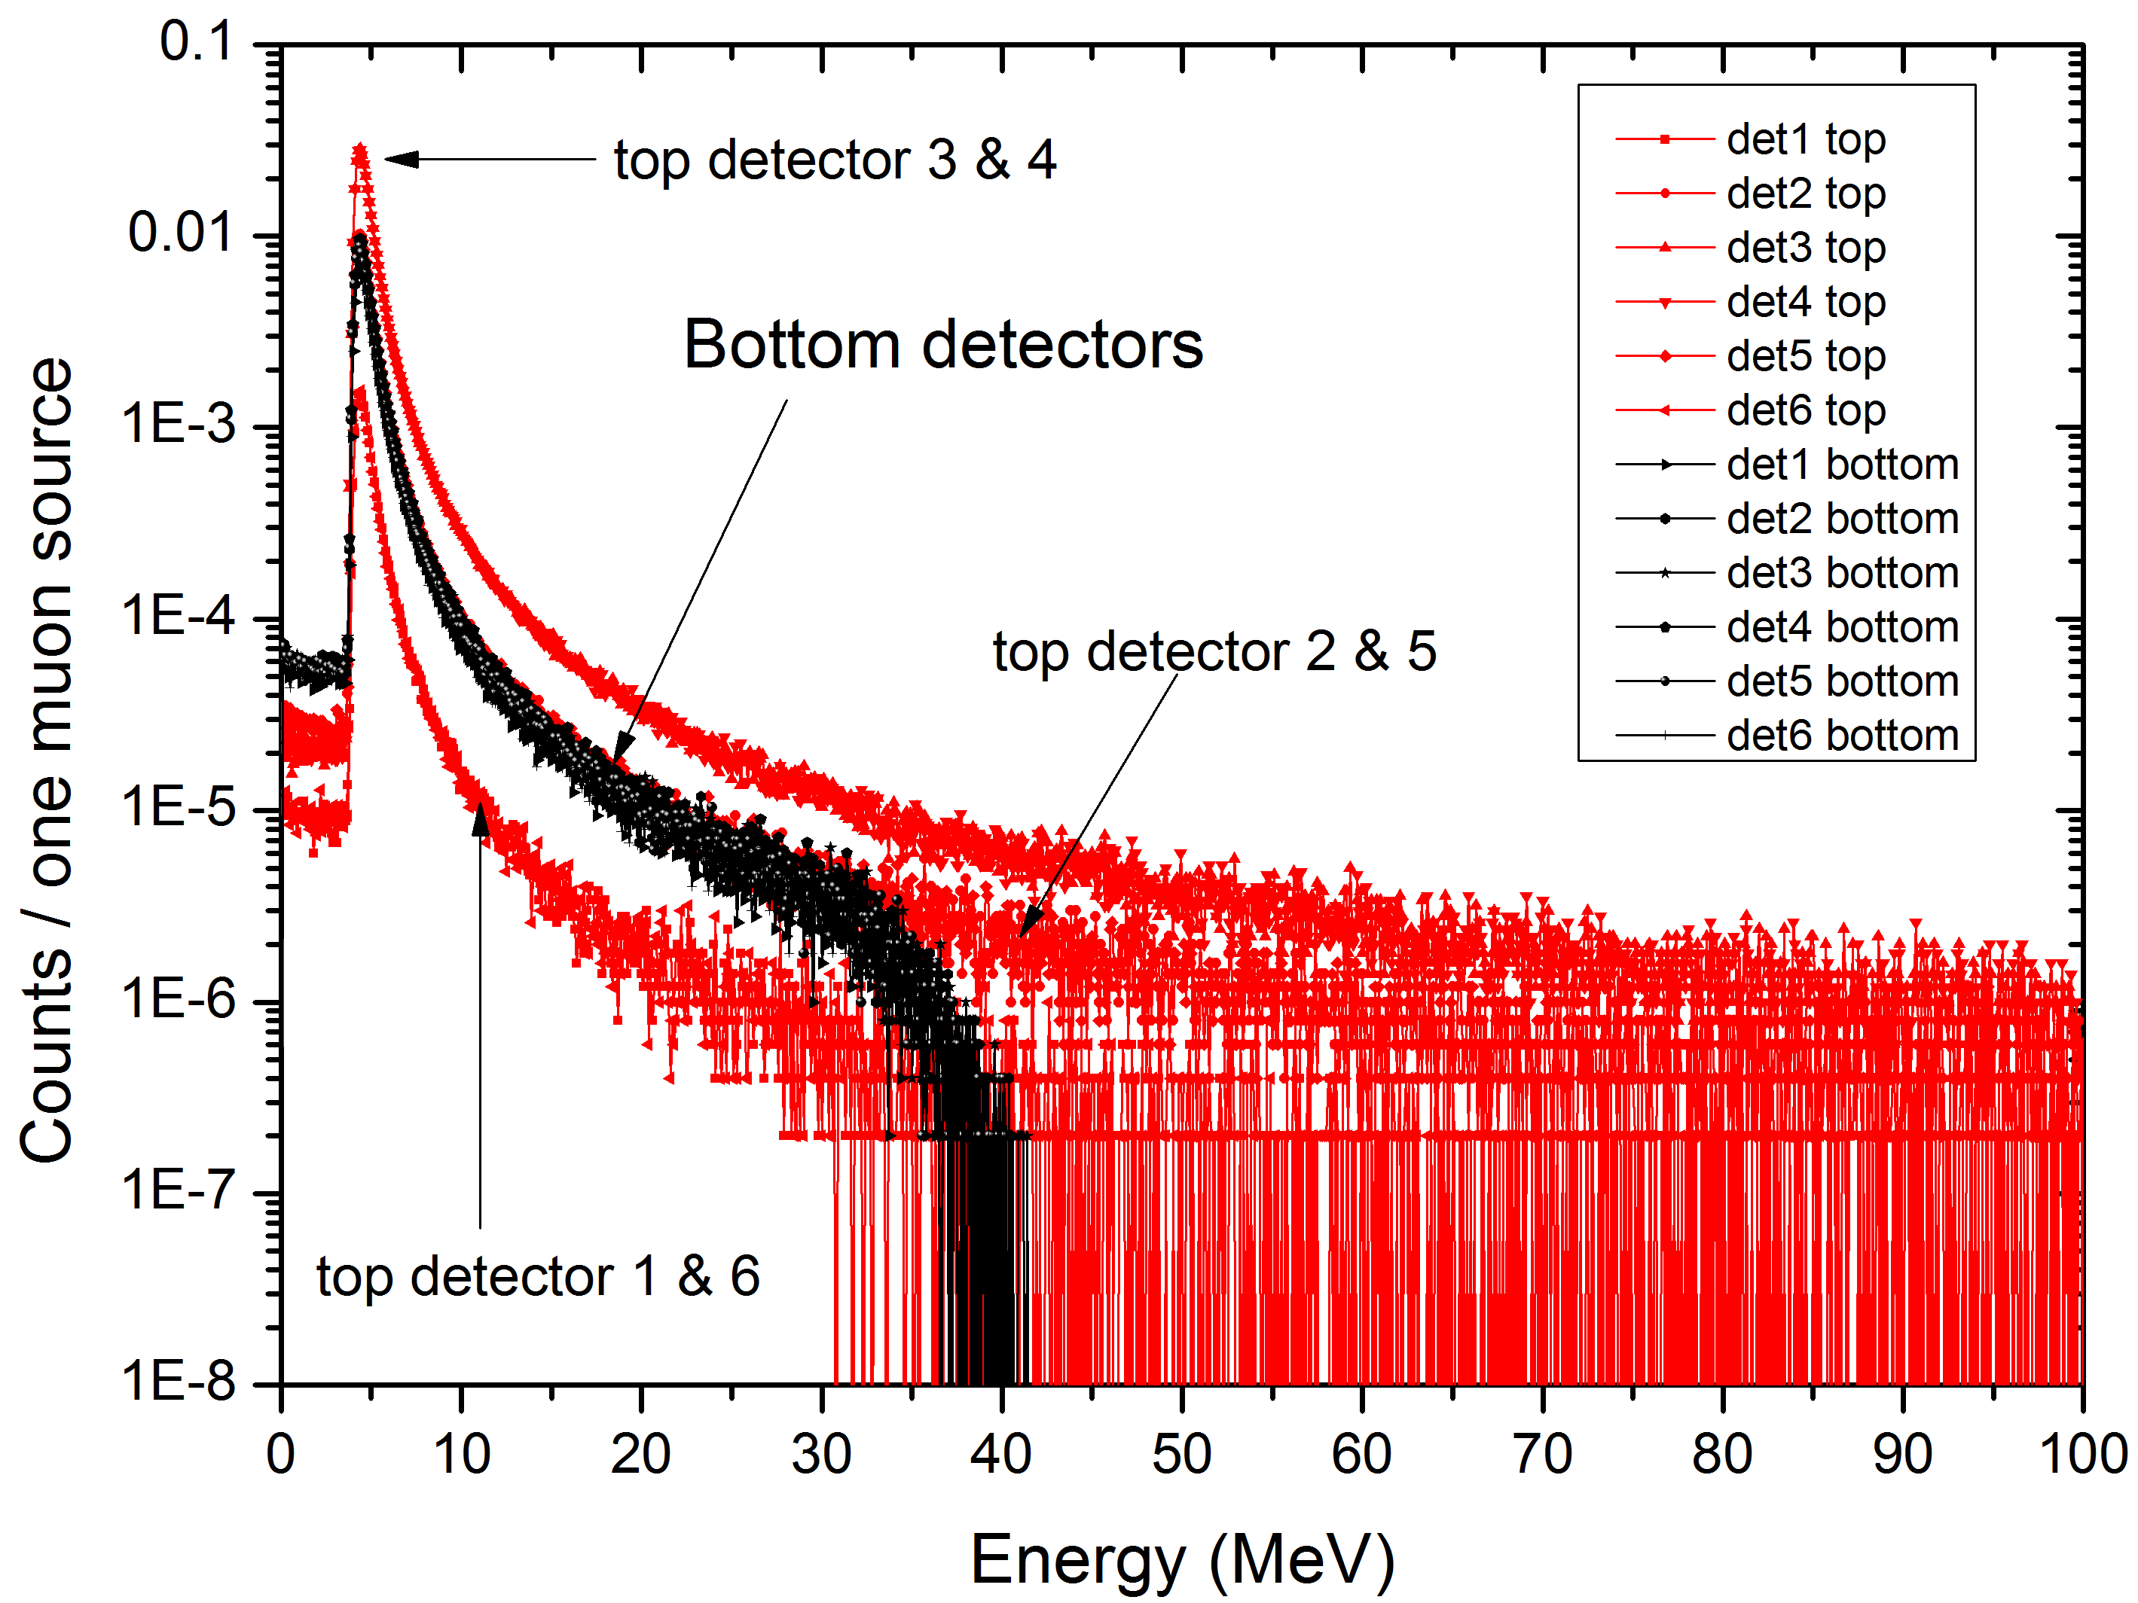
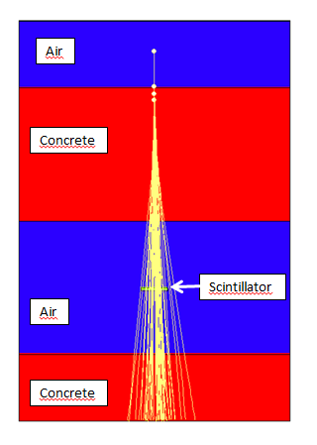
Conceptual Design - simulations
The first MCNPX simulation of muon energy deposition in plastic scintillator for NICA
Energy spectrum reconstruction
Cylindrical plastic scintillator Ø20 × 2.5 cm³ – the same
used for experiment at NCBJ
The maximum energy deposition centroid is around 4 MeV - reasonable result, assuming 2 MeV/cm dE/dx energy loss for muons in organic scintillator. Light generation due to ionization in plastic scintillator will be implemented in the near future.
Energy deposition spectrum
µ
Geometry used (40000 tracks)
Energy deposition spectra of 2 GeV monoenergetic muons
Marcin Bielewicz, tytuł
11

Slide 12
Conceptual Design - simulations
CORSICA simulation of Cosmic Showers
Angular distribution of atmospheric cosmic shower particles
Marcin Bielewicz, tytuł
12

Slide 13
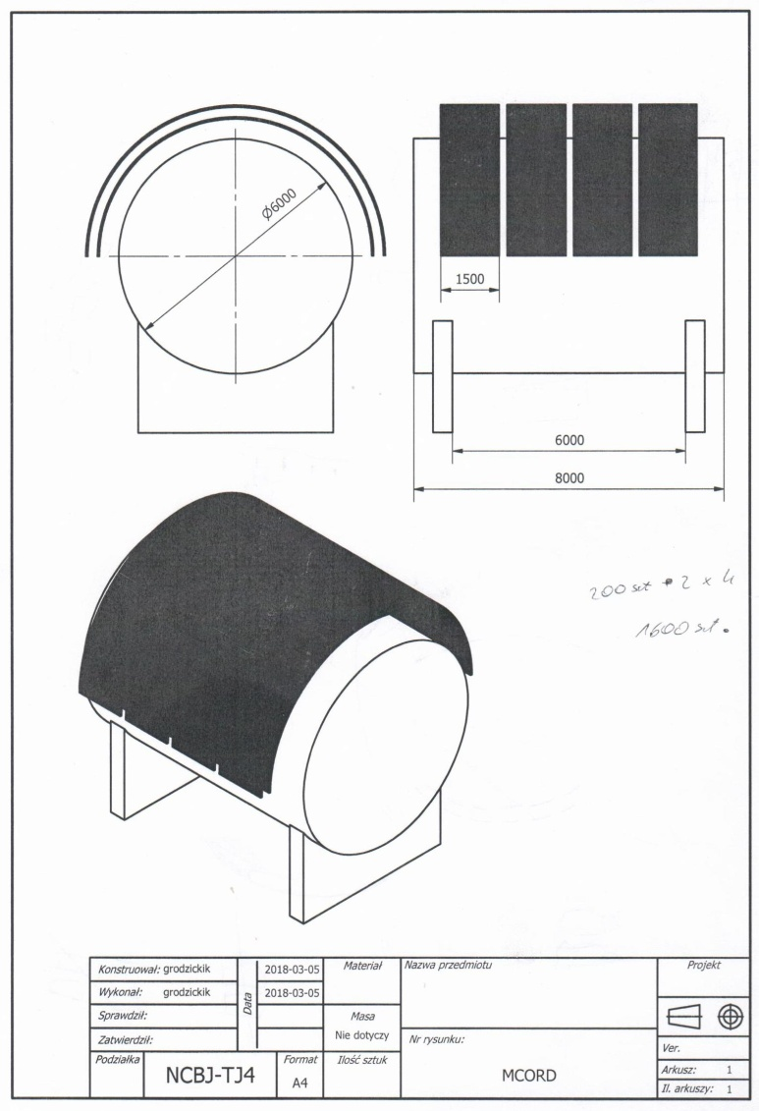
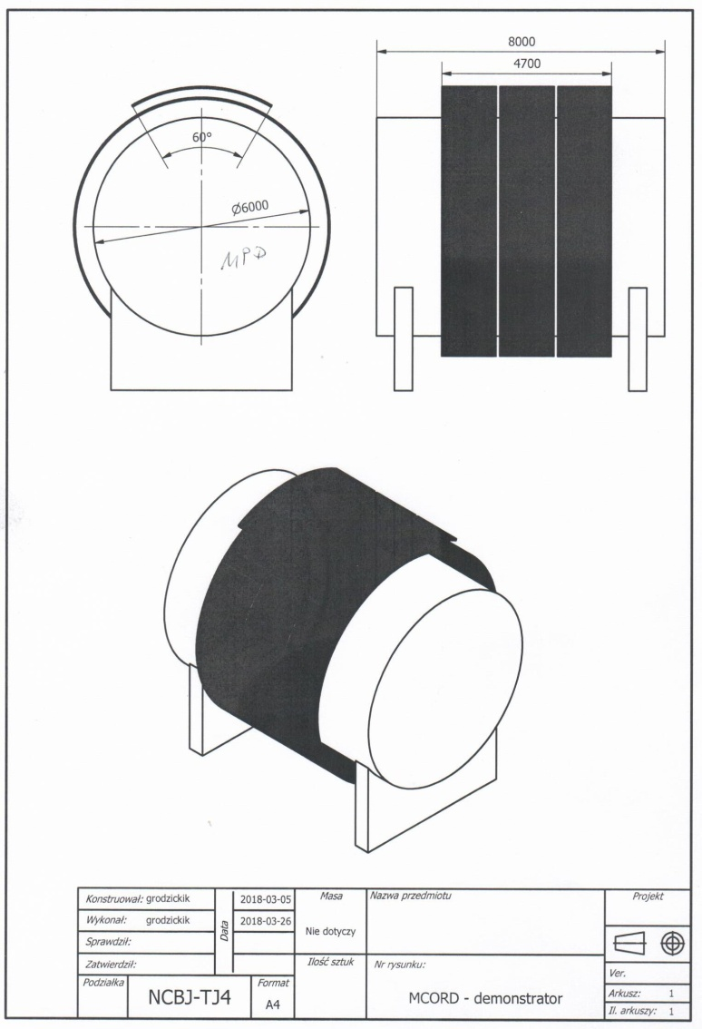
3. Design, moadeling proposition
Two surfaces on half circumference
One surface on full circumference

Slide 14
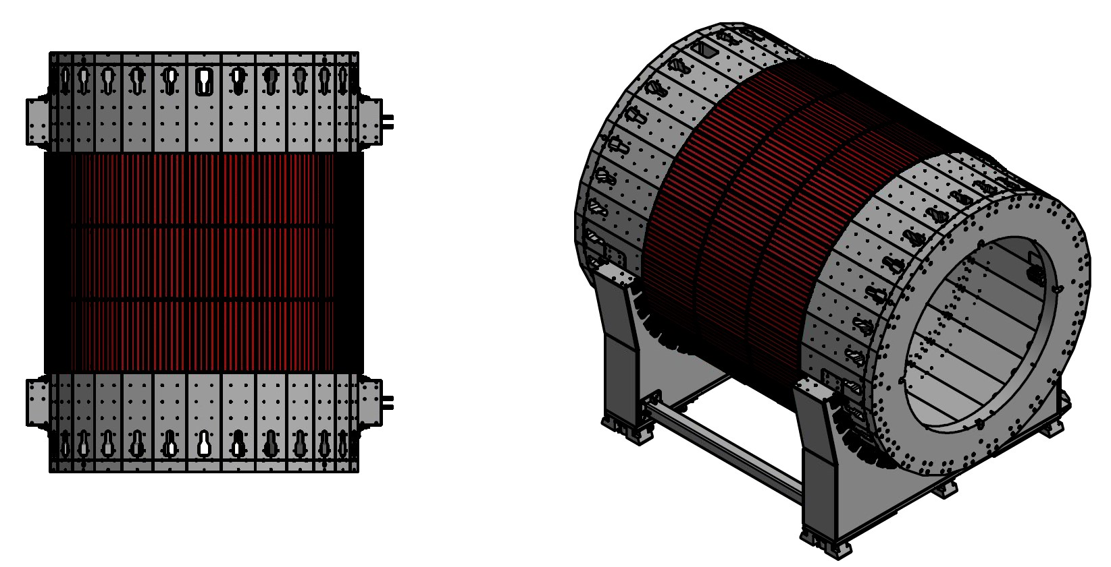
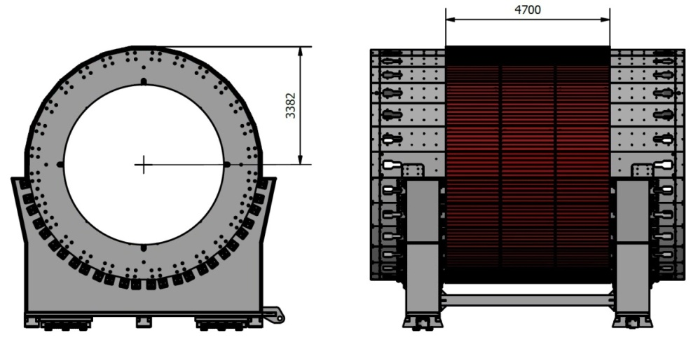
3. Design, moadeling proposition
MCORD on MPD scheme

Slide 15
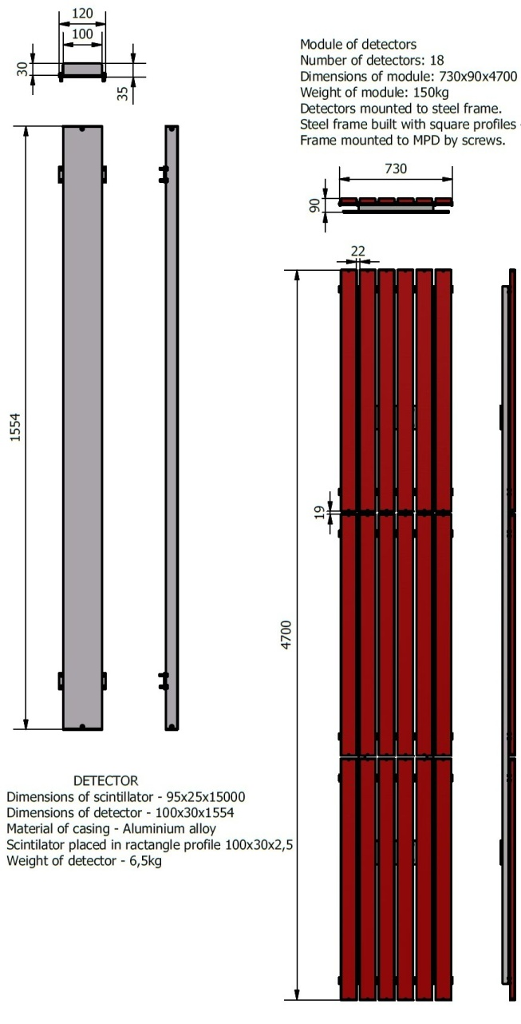
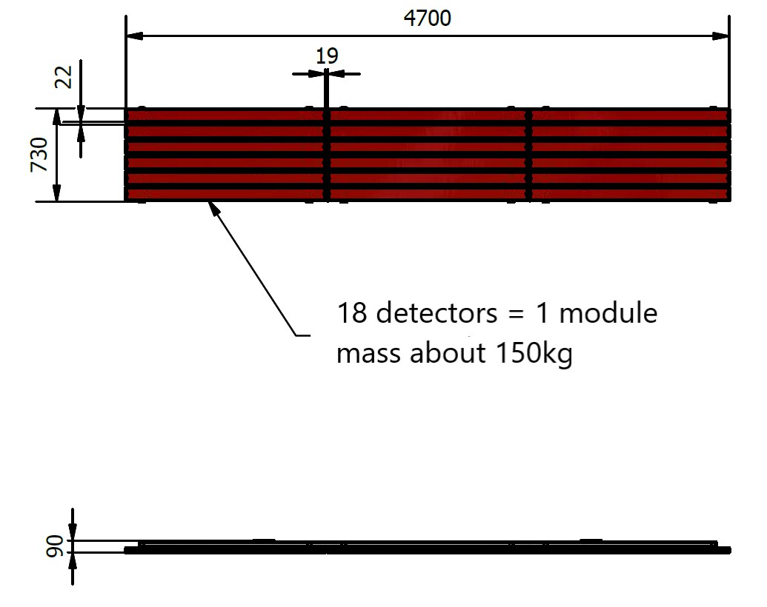
3. Design, moadeling proposition
Scintilators and modules

Slide 16
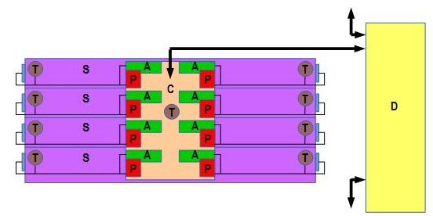
3. Design, moadeling proposition
THE MUON DETECTOR SCHEME OF ANALOG SIGNAL PATH
Legend: S (violet) – plastic scintillator, (blue) – SiPM, P (red) – power supply with temperature compensation circuit, T (brown) – temperature sensor, A (green) – amplifier, D (yellow) – MicroTCA system with ADC boards, C (orange) – Analog Front End Module.
Photomultiplier are not so good for us!!! MPPC are much better !!!

Slide 17
3. Design, moadeling proposition
THE MUON DETECTOR SCHEME OF DIGITAL SIGNAL PATH
uTCA based modular muon trigger system
MTCA crate
Detector
AFE
FMC
AMC FPGA
FMC carrier
MicroTCA Carrier Hub
(MCH Tongue 3)
Xilinx FPGA
on board
Main MCH
10/40G Ethernet
Muon trigger out
AFE
FMC
12x
AFE
FMC
AMC FPGA
FMC carrier
AFE
FMC
Triggers @ SYNC
Another sub-trigger system (AFE + FMC + AMC +MCH)
10G Ethernet / Aurora
Another sub-trigger system (AFE + FMC + AMC +MCH)

Slide 18
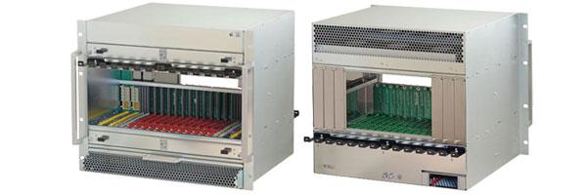
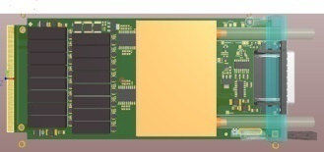
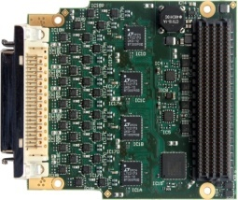
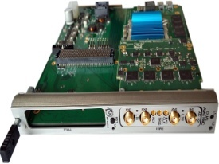
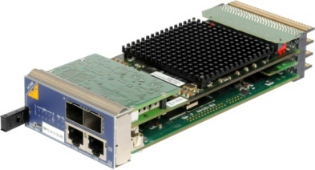
MicroTCA (MTCA) configuration
3. Design, moadeling proposition
Analog Front-End module
FPGA mezzanine card (FMC)
AMC FMC carrier board
Standard MTCA crate (14U)
(cable fi1,5cm 24 channels +8)
(additional cable for 5V and 40V power)
Crate number depends on channel count and sampling speed
At 250MS/s: 192 channels / crate
At 125MS/s: 384 channels / crate
(16 cables)
At 80MS/s: 576 channels / crate
At 50MS/s: 768 channels / crate
MTCA Carrier Hub
For several MTCAs one main MCH concentrate data from slaves MHCs to generate final muon trigger

Slide 19


4. Conclusion
30 people
Including
18 scientists (professors and doctors) 12 engineers
from
3 universities and 2 science institutes
With knowledge and experience in digital and analog electronics,
scintillators and photodetectors, nuclear and astrophysics,
data acquisition and analysis, simulation and experiments.
Our group is a member of Polish consortium NICA-PL

Slide 20
4. Conclusion
Cosmic ray detector is necessary for good calibration of TPC and TOF, MPD detectors before finalizing of MPD construction.
Cosmic ray detector is helpful for good calibration of TPC and TOF, before each experimental session.
Additionally MCORD can be use to astrophysics observation like in another experiments.
Our team have realistic plan and possibilities for build this detector.
Our group is a member of Polish consortium NICA-PL

Slide 21
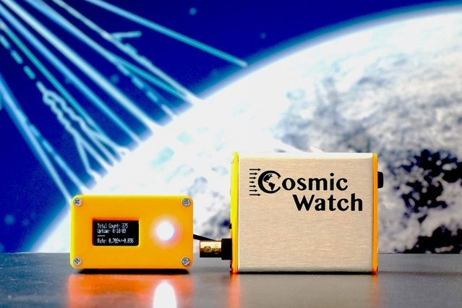
Polish consortium NICA-PL
Thank You for Attention

