Slide 1
On development of diagnostic systems for Nuclotron extracted beams
A.A.Baldin
October 30, 2018

Slide 2
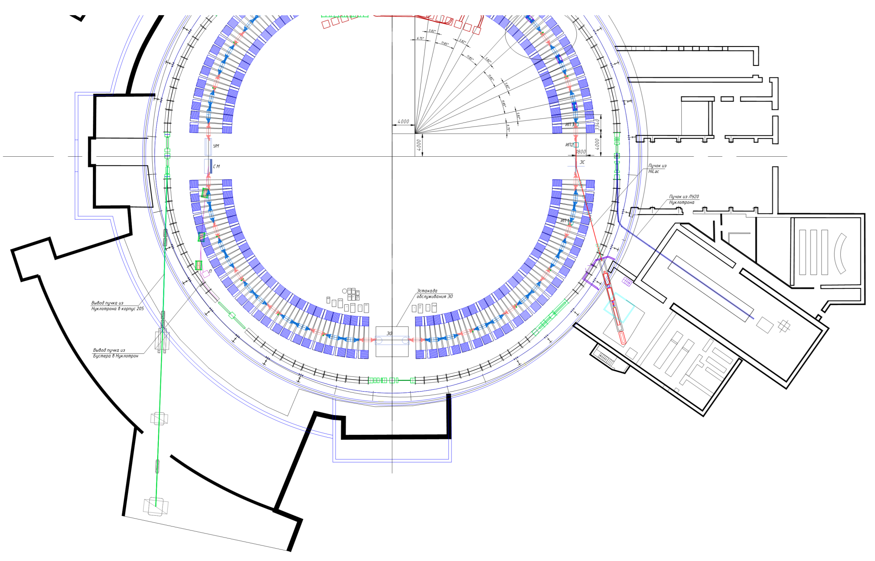
Diagnostic systems of the accelerator complex
Diagnostic system at the beam output
Diagnostic system in the experimental hall
MCP-based profilometer

Slide 3
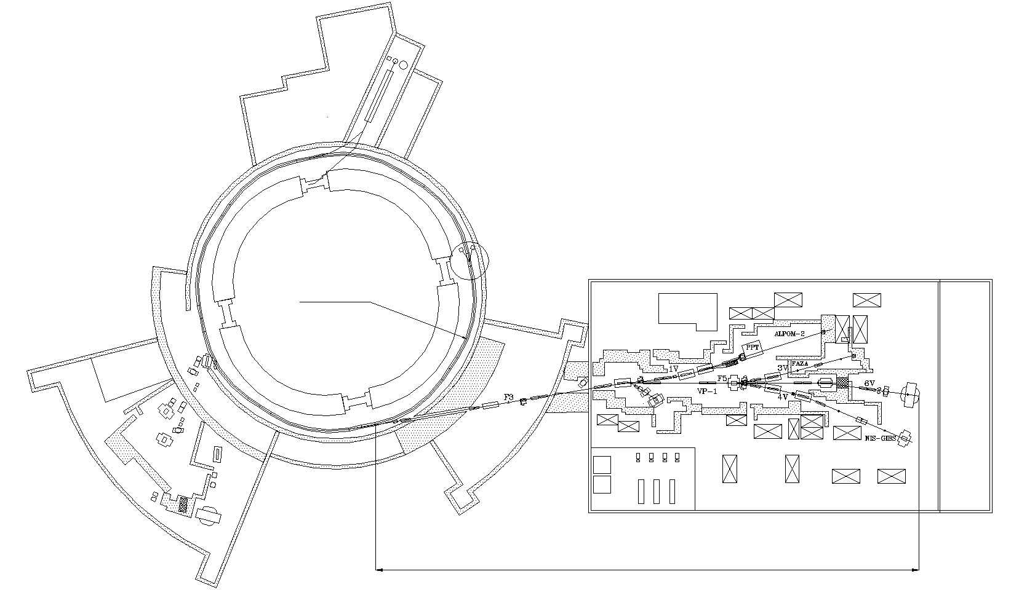
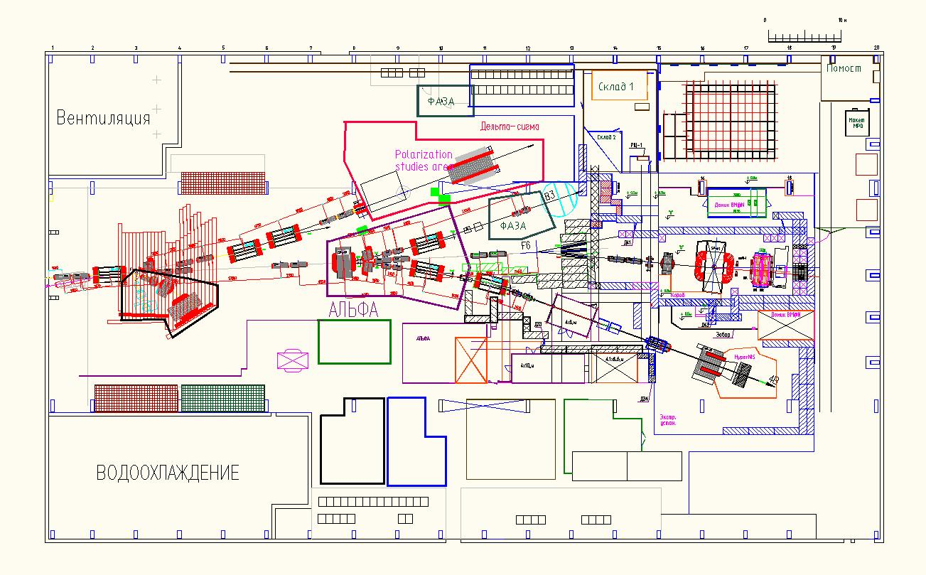
RUN 55 - 2018
Building 205
Nuclotron
BM@N
~160 m

Slide 4
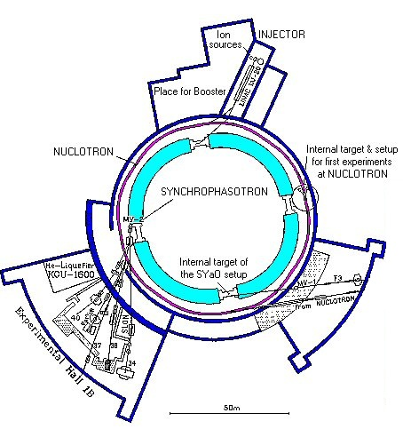
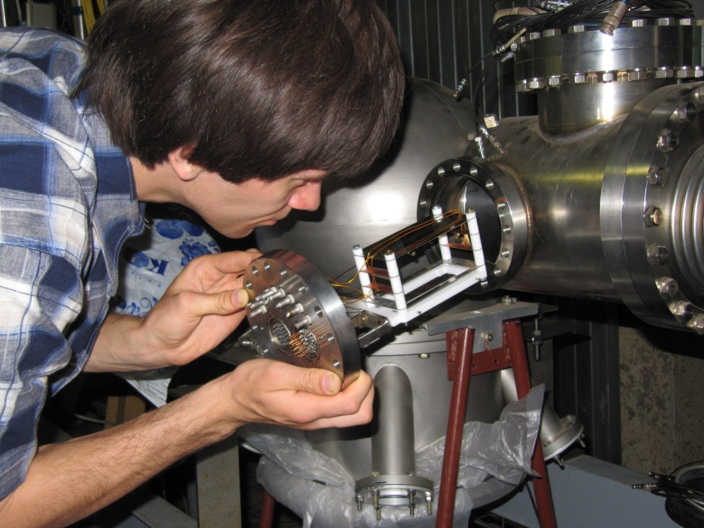
Diagnostics of circulating beam
Creation of modern nondestructive control systems of space-time characteristics of the beam during acceleration and extraction is the one of the most important tasks for exploitation of the Nuclotron accelerator complex (JINR LHEP).
The detector was developed for registration of the space-time characteristics of the radial beam component. The system provides measurements in the intensity range of 10⁶ – 10⁸ for singly charged ions which is not covered by existing measuring devices.
The warm section of Nuclotron
Детектор монитори-рования пучка
Nuclotron
The detector based on
microchannel plates (MCP)

Slide 5
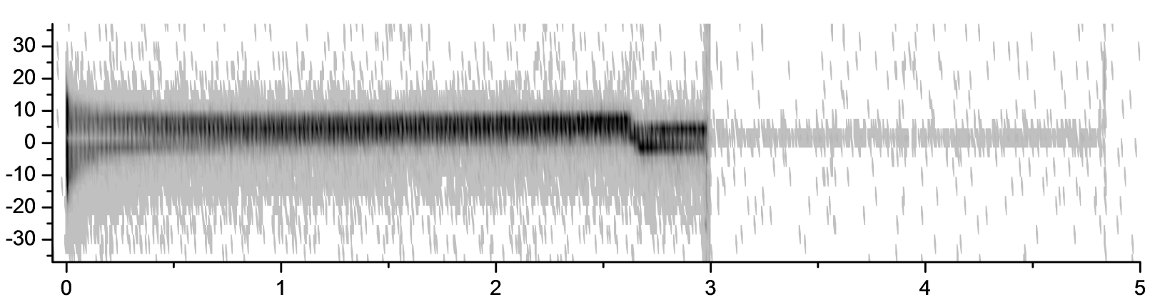
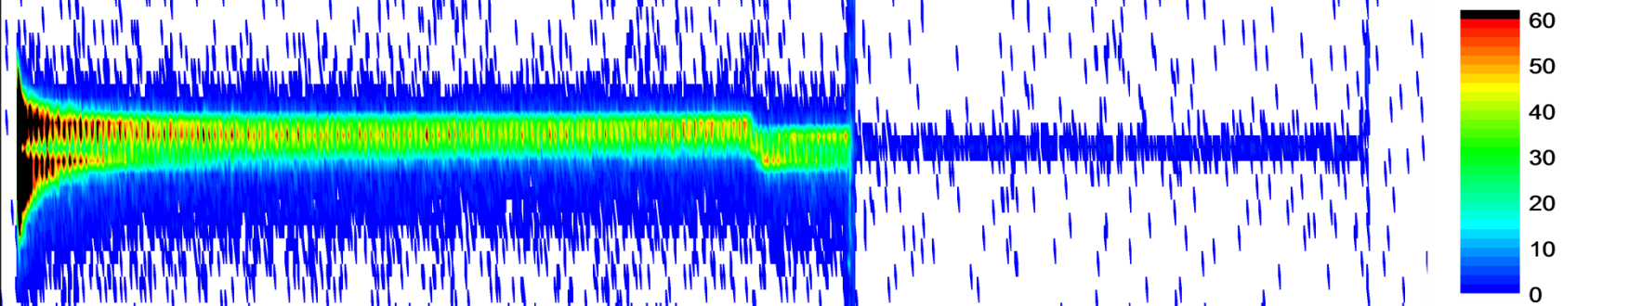
Diagnostics of circulating beam.
Deuteron 2 GeV/n.
The graph of an accelerator cycle with fast beam extraction (50 ms) at an intensity corresponding to the upper limit of the detector operating range (10⁸ single charged ions). At the beginning of the acceleration (the first 0.5 seconds from the time of injection) the detector is overloaded. After transition to the constant magnetic field the beam extraction is produced (3 seconds after injection moment) and than the circulating beam remnants is registered.
Injection
Detector overloading
The beam extraction area
Beam remnants continue to circulate
Beam
Coordinate, mm
Time, s
Radial beam profile.

Slide 6
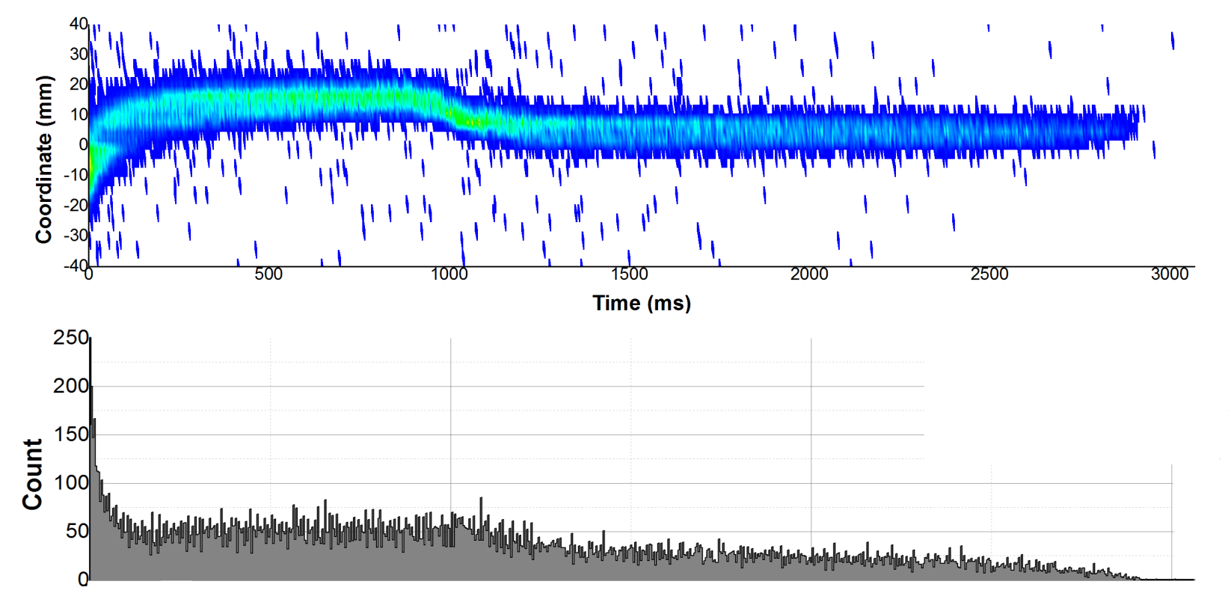
2014.06 – циркулирующий пучок Ar⁺¹⁶.
Ar 500 MeV/n
Динамический профиль циркулирующего пучка Ar⁺¹⁶ 500 МэВ/нуклон.

Slide 7
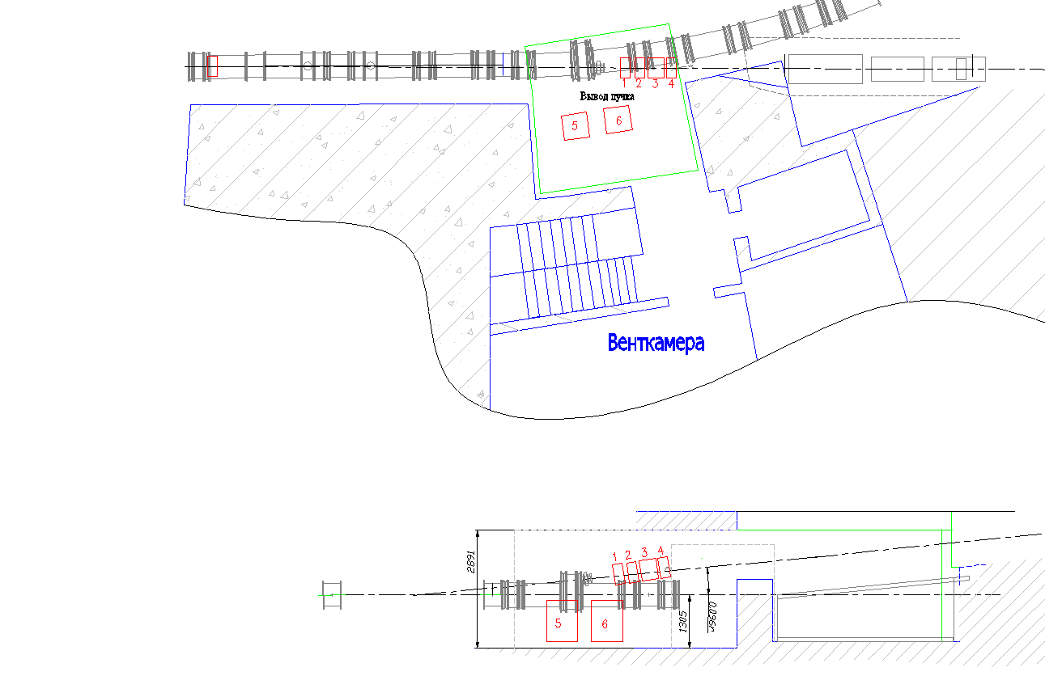
Диагностика пучка в зоне вывода из Нуклотрона.
Beam
Nuclotron ring
Beam extraction
Detectors
Extraction region (top view)
Extraction region (side view)

Slide 8
Диагностика пучка в зоне вывода из Нуклотрона.
Nuclear photoemulsions
  Ionization chamber
Thin scintillation counter
Scintillation profilometer
Beam extraction
Detector stations
Nuclotron ring
Area of the beam extraction

Slide 9
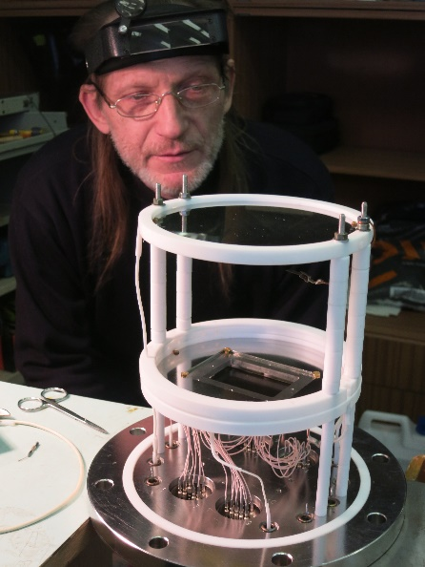
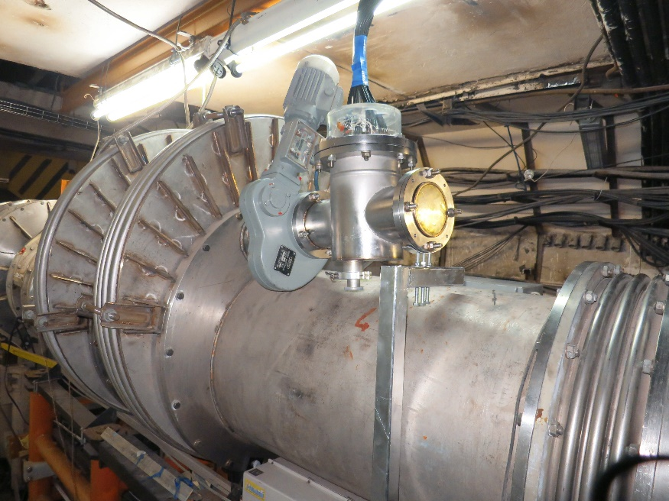

Slide 10
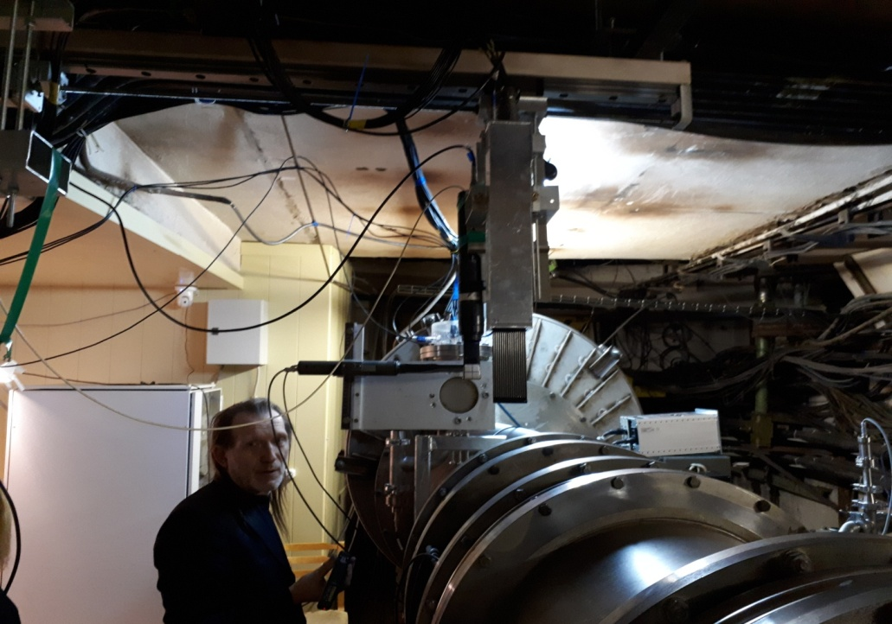
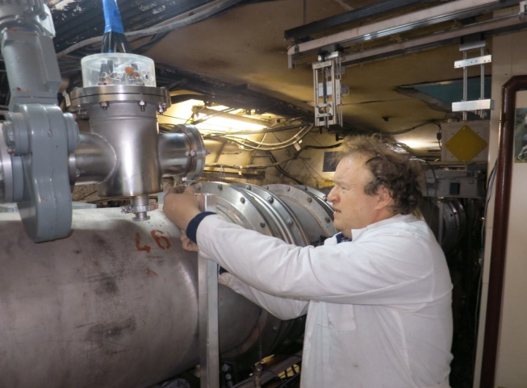
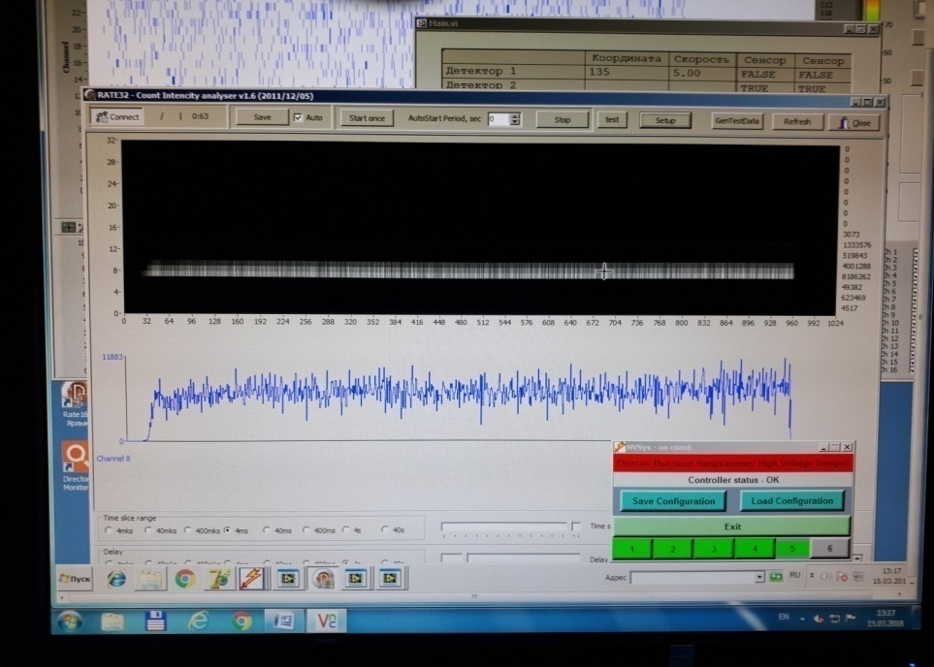
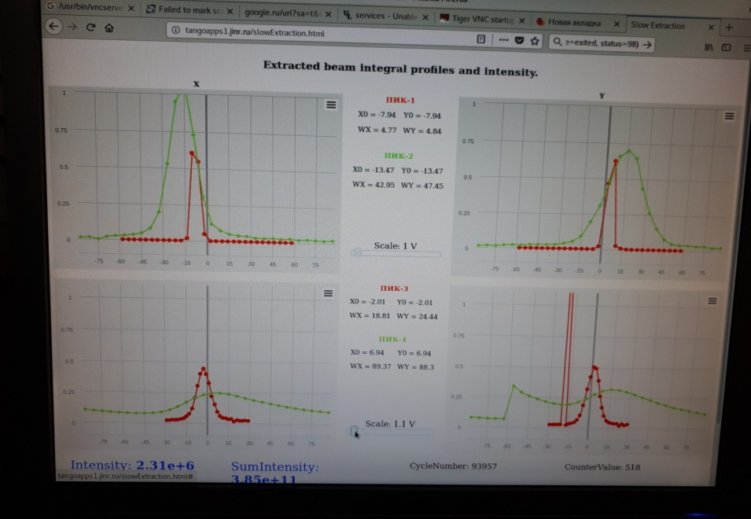

Slide 11
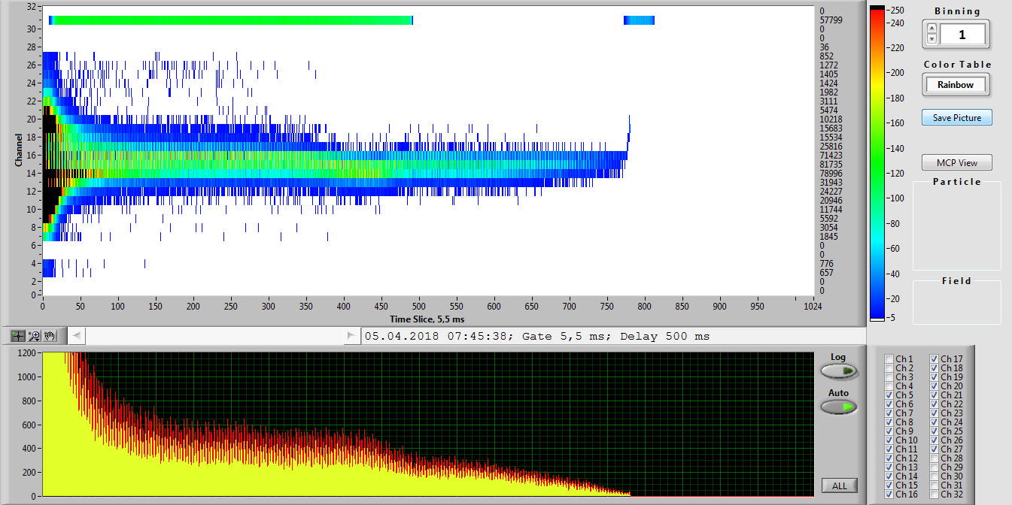
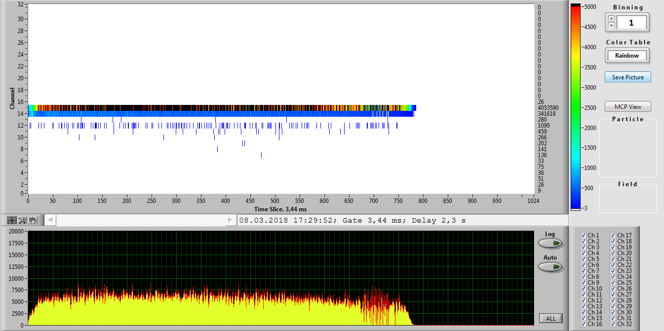

Slide 12
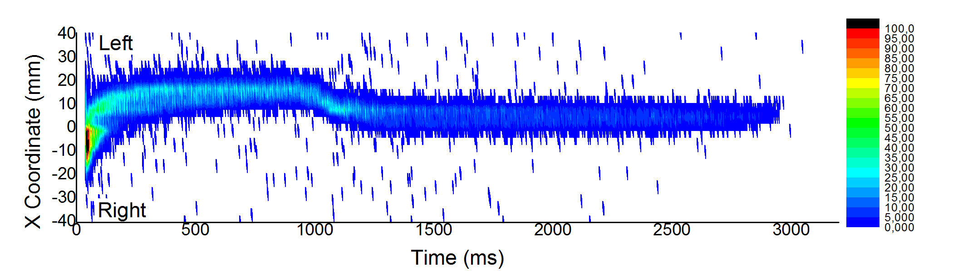
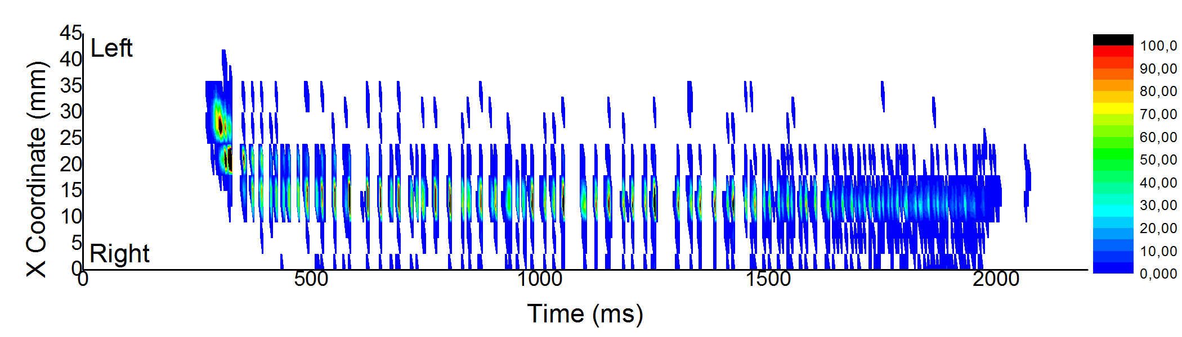
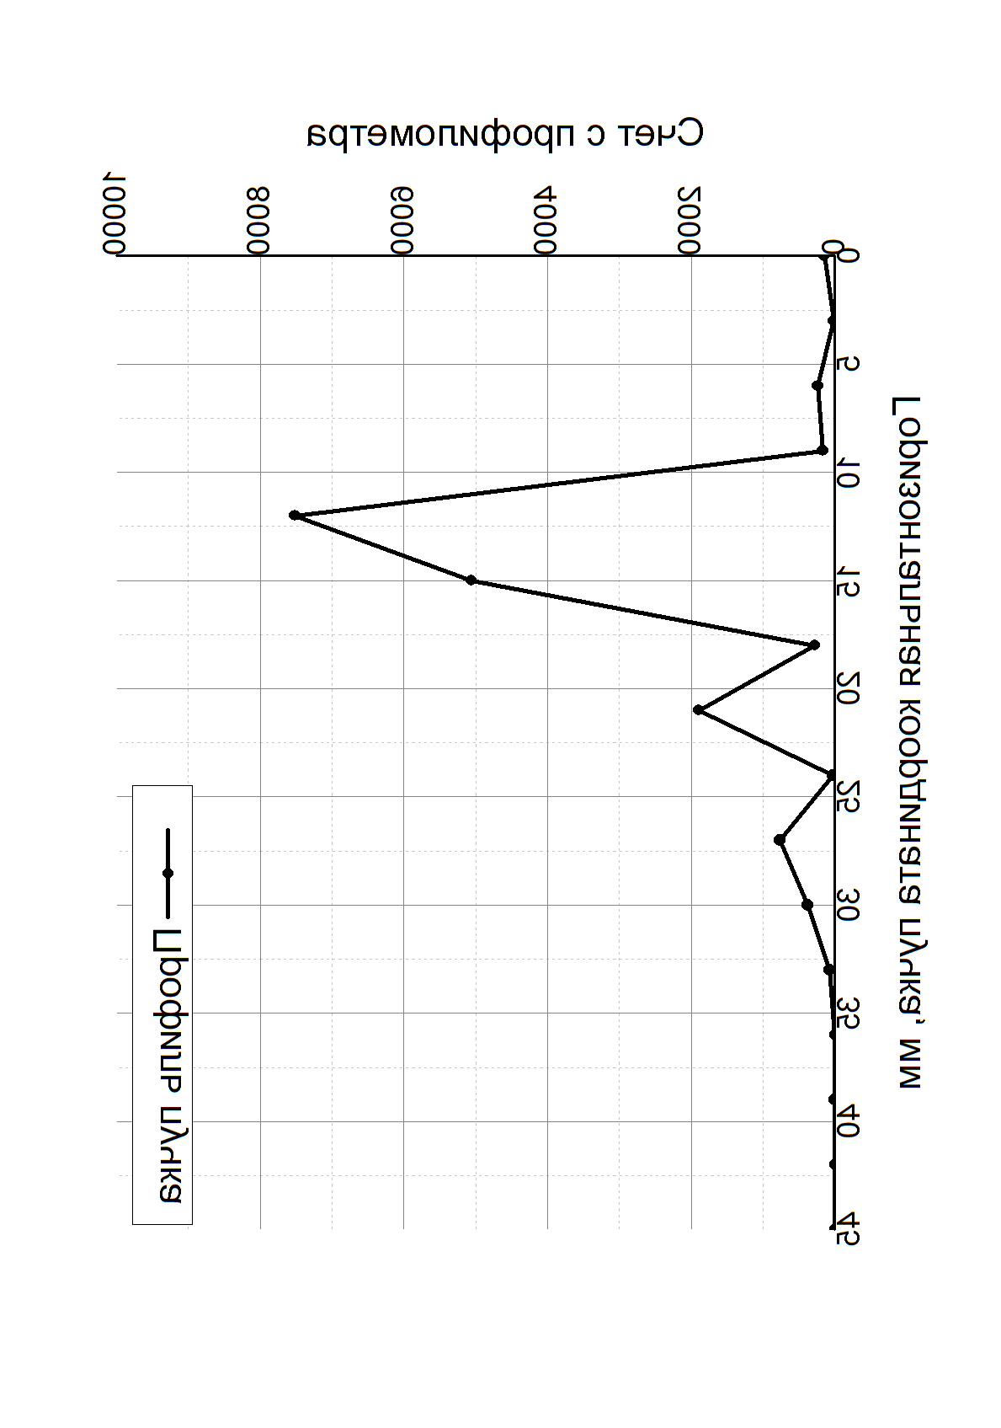
Run 50. Diagnostics of the extracted beam.
The beam orbit shifting.
Ar 500 MeV/n
Dynamic profile of the circulating beam registered by the MCP detector.
X Coordinate, mm
Time, ms
Horizontal dynamic profile of the extracted beam of Ar⁺¹⁸ 500 MeV/n.

Slide 13
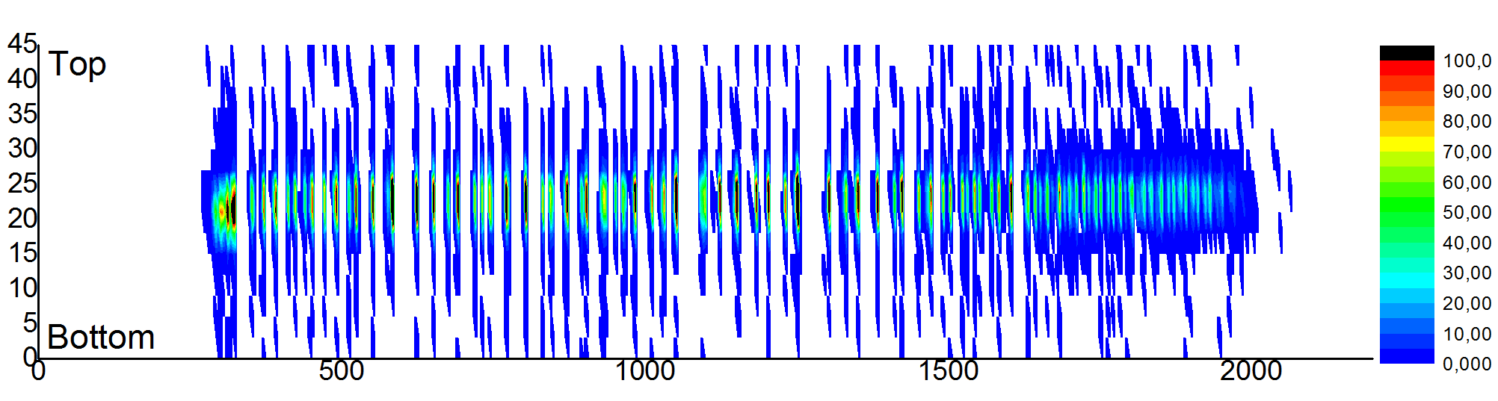
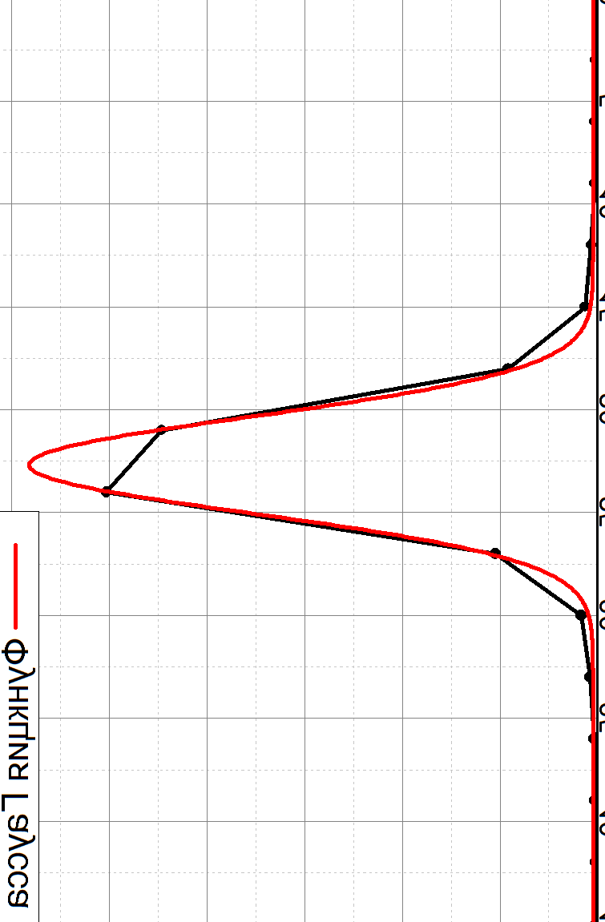
Run 50. Diagnostics of the extracted beam.
Spatial Distribution.
The spatial distribution of the extracted beam was registered by the scintillation profilometer (hodoscopic PMT Hamamatsu; X, Y – 16 channels; step – 3 mm)
Y Coordinate, mm
Time, ms
Vertical dynamic profile of the extracted beam of Ar⁺¹⁸ 500 MeV/n.
X Coordinate, mm
Time, ms
Horizontal dynamic profile of the extracted beam of Ar⁺¹⁸ 500 MeV/n.

Slide 14
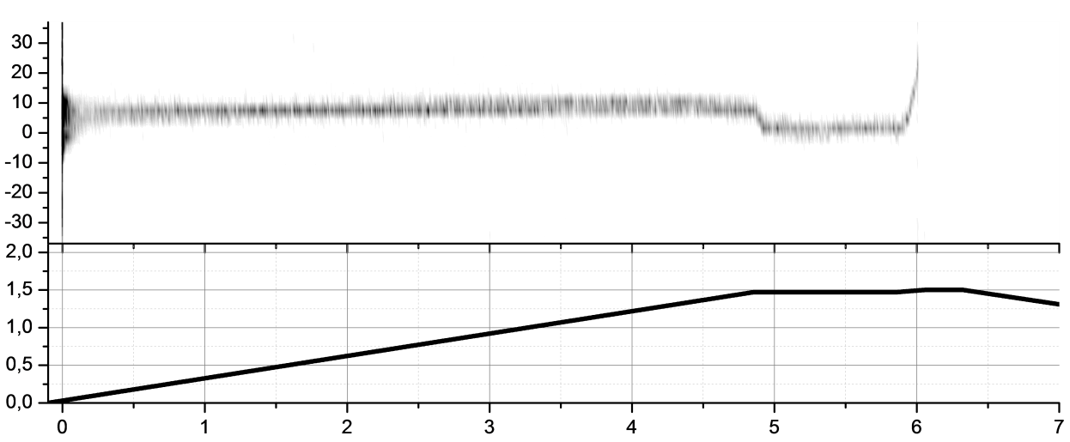
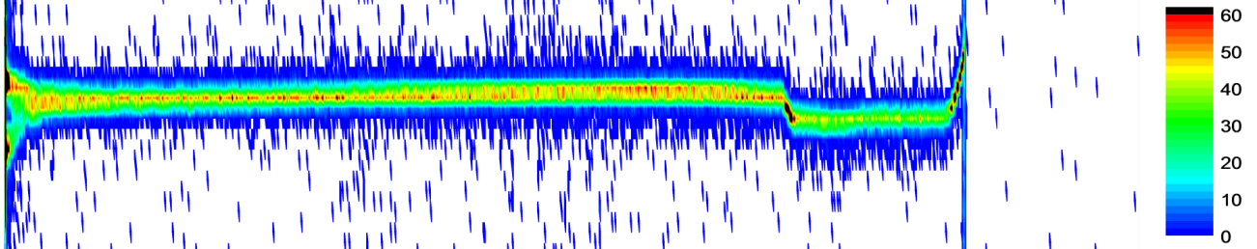
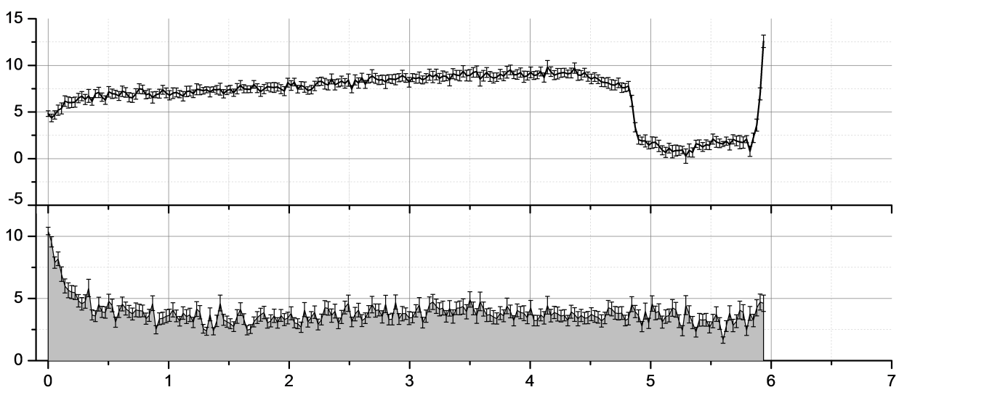
Diagnostics of circulating beam.
Deuteron 4 GeV/n
Acceleration
The beam interacts with the vacuum chamber
Beam
Coordinate, mm
Injection moment
Beam orbit shifting
Magnetic
Field, T
Time, s
Radial beam profile (top graph) and magnetic accelerator field (bottom graph).
Beam
Coordinate, mm
Beam
Width, mm
Time, s
Radial beam coordinate (top graph) and beam width (bottom graph).

Slide 15
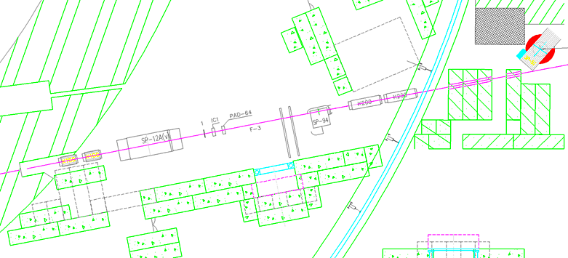
Диагностика пучка в экспериментальном зале фокуса Ф-3.
Magnet SP-12
Detectors
Focus F3
Magnet SP-94
Lenses
Lenses
Beam
Экспериментальный зал фокуса Ф-3

Slide 16
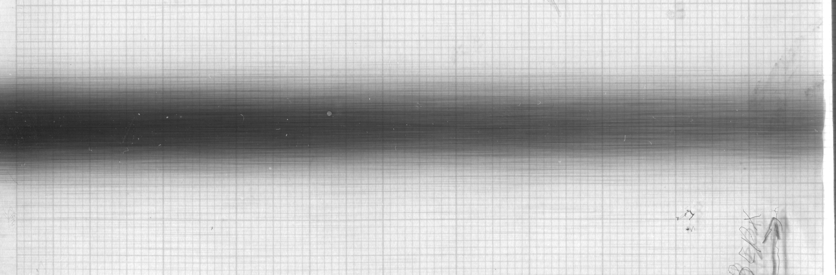
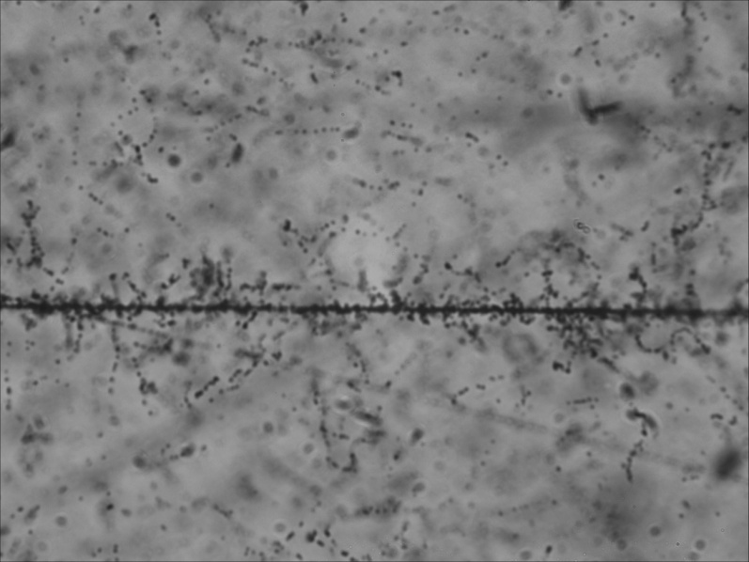
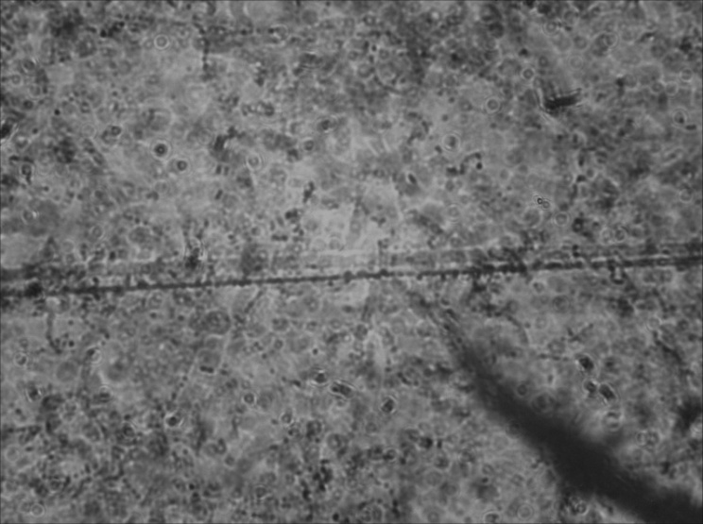
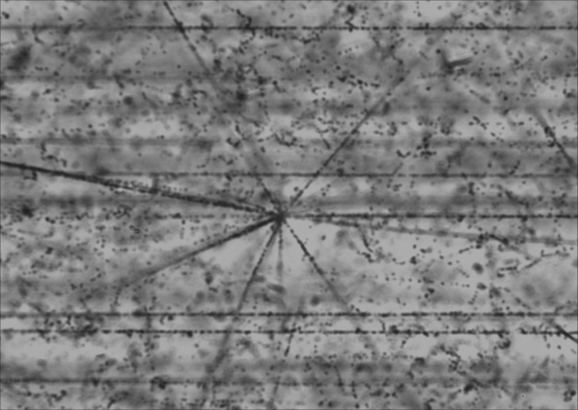
Kr 2,5 GeV/n
Kr
C
Ar

Slide 17
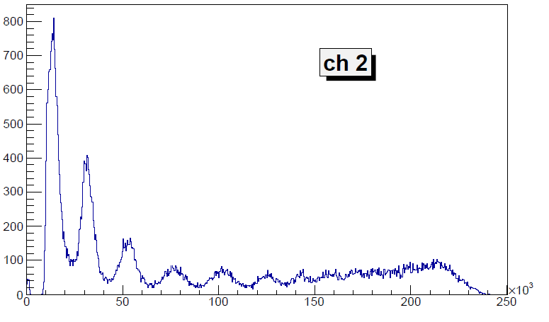

Slide 18
Kr 2,5 GeV/n

Slide 19
ARGON
Ar_File 20180328-213035.dat pos1X=185mm, pos2X=-95mm, pos2Y=470, th1=7mV,th2=15mV, HV1=1061V,HT2=1190Vstart from Xp2
The amplitude of the signal in the scintillators

Slide 20
Z1
Z2
Z6
Z7
Z8
Z3
Z4
Z5
Run 55 Carbon – file 2018/ 03/ 14 - 17/ 45 /51

Slide 21
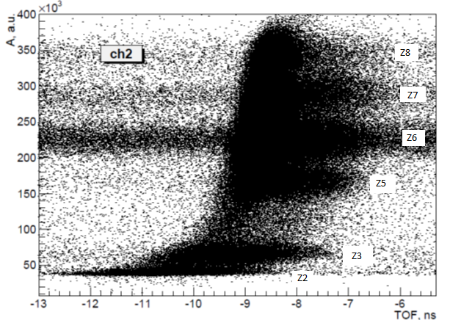
Carbon 3.16 AGeV

Slide 22
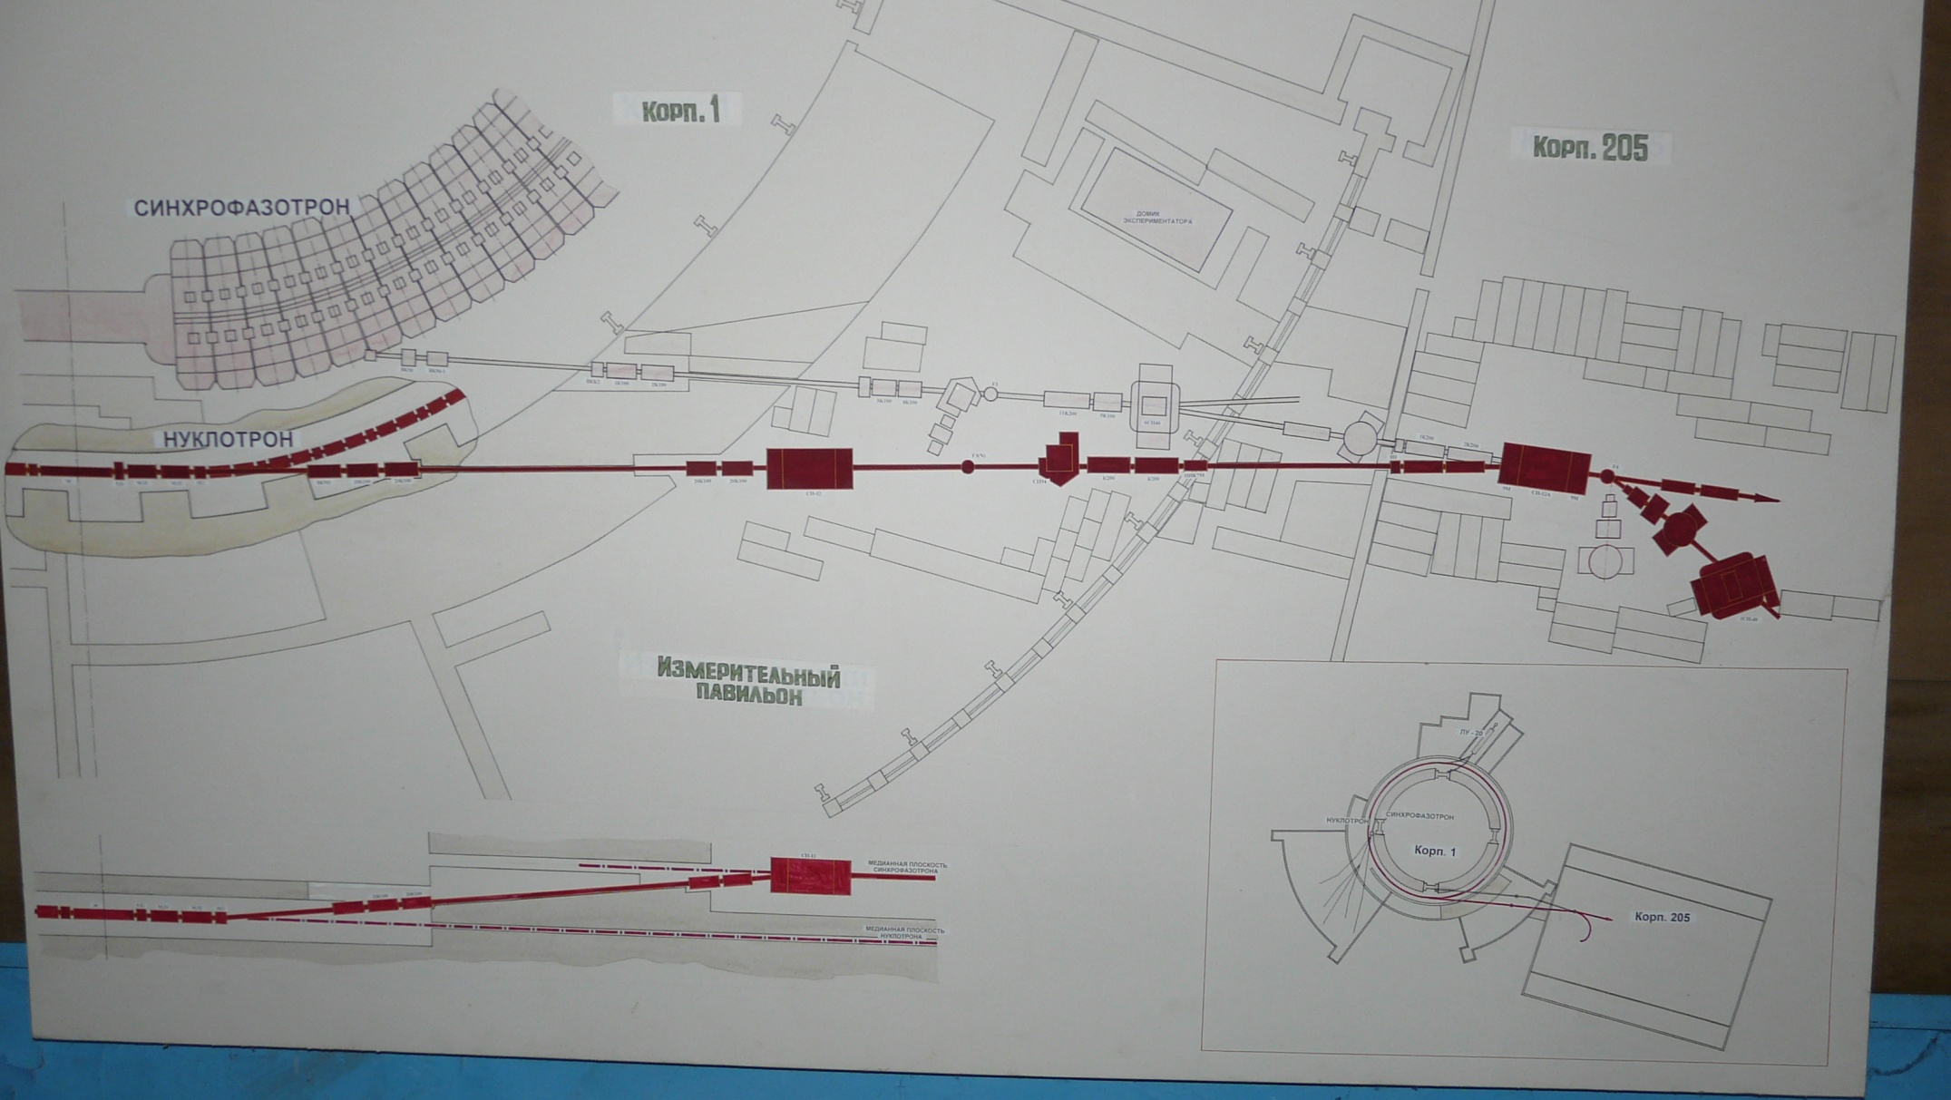
Пролетная база = 33,5 м

Slide 23
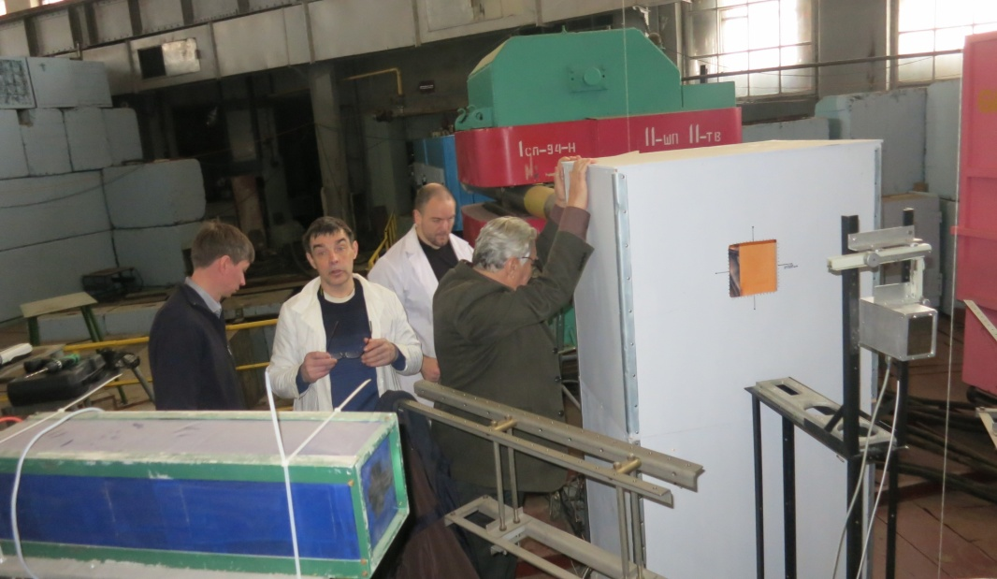
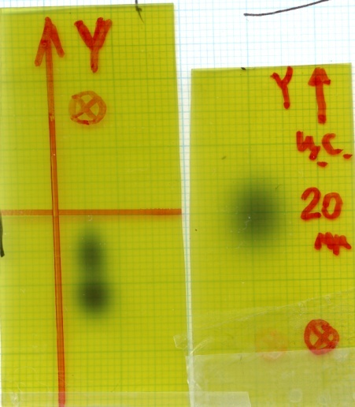

Slide 24
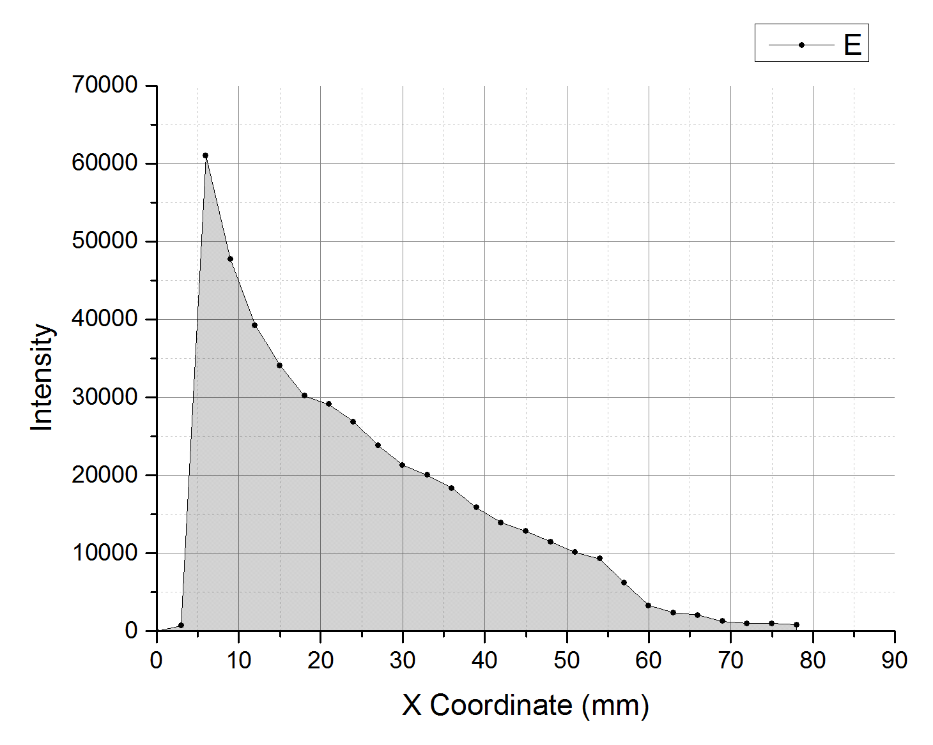
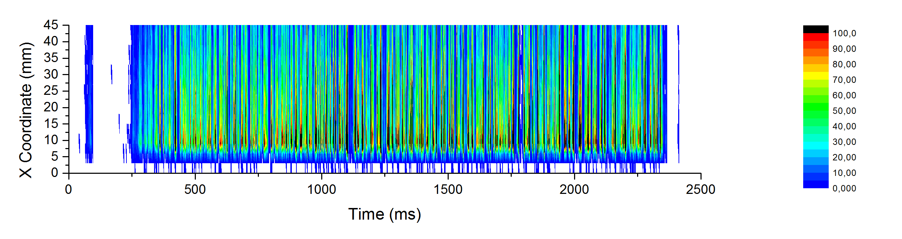
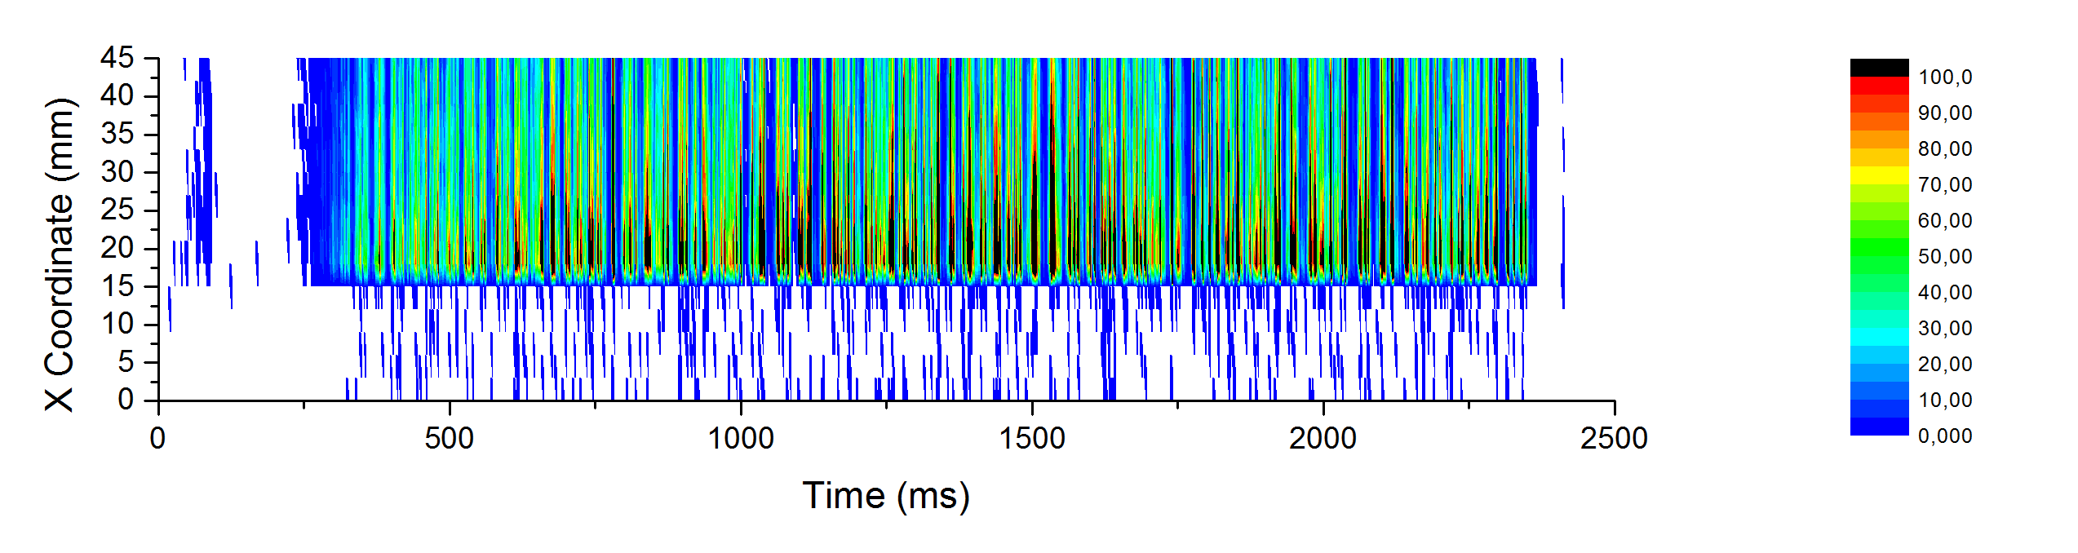
Сеанс 51. Диагностика пучка углерода 3,5 ГэВ/нуклон.
Dynamic beam profile of 3.5 GeV/n C

Slide 25
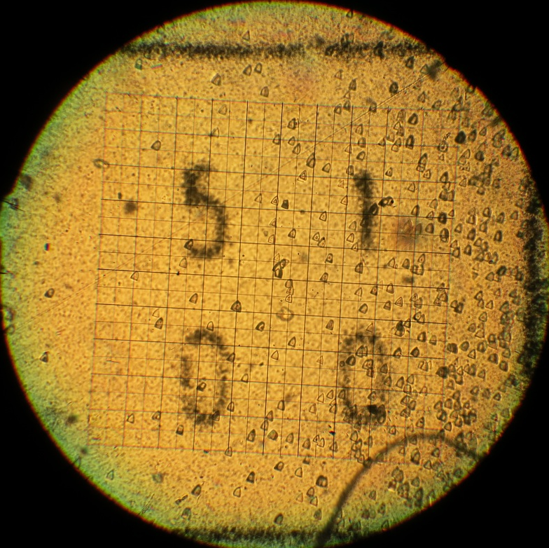
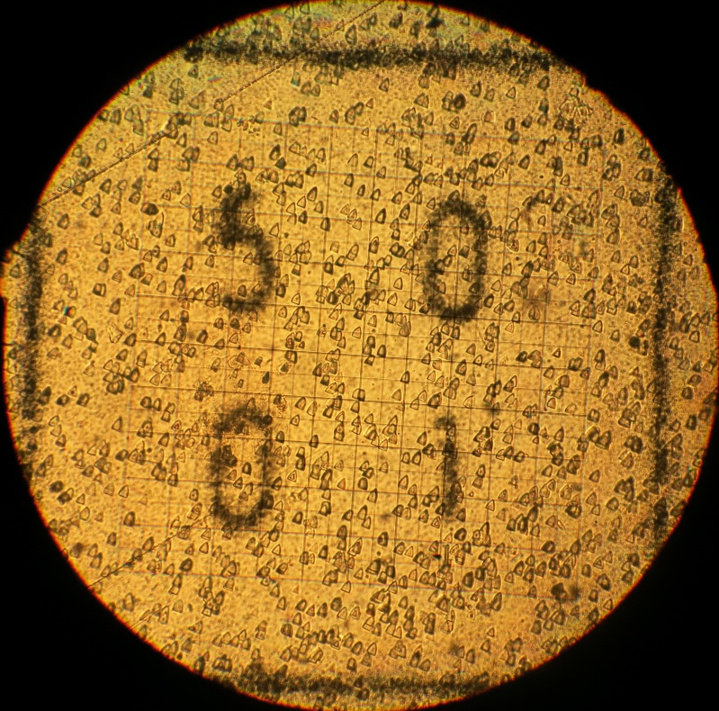
1 mm

Slide 26
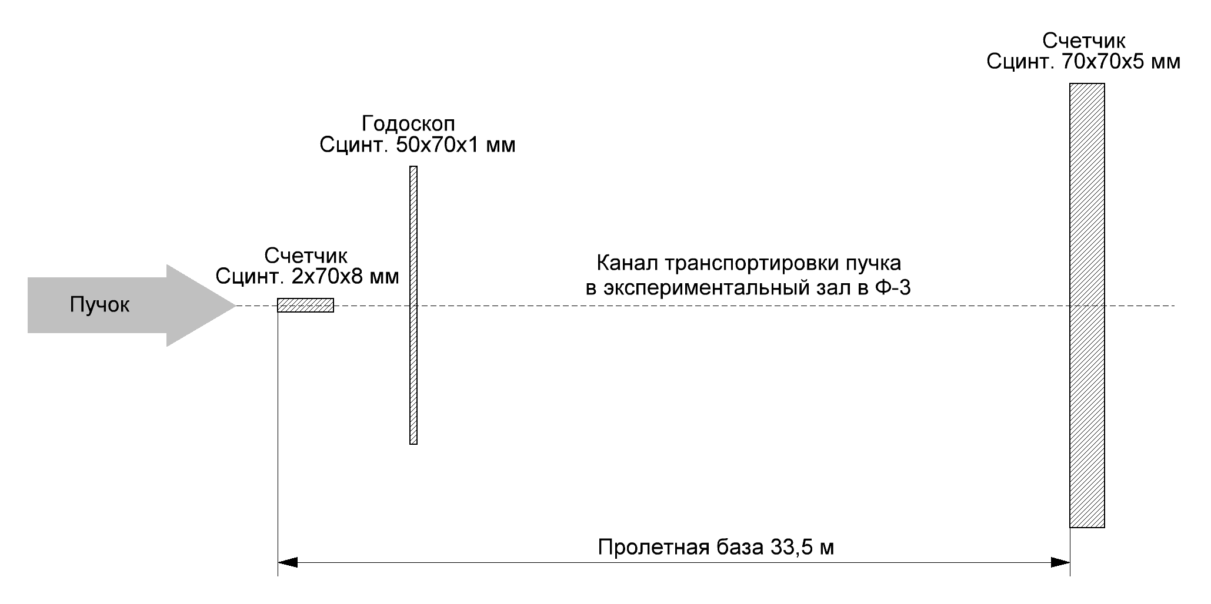
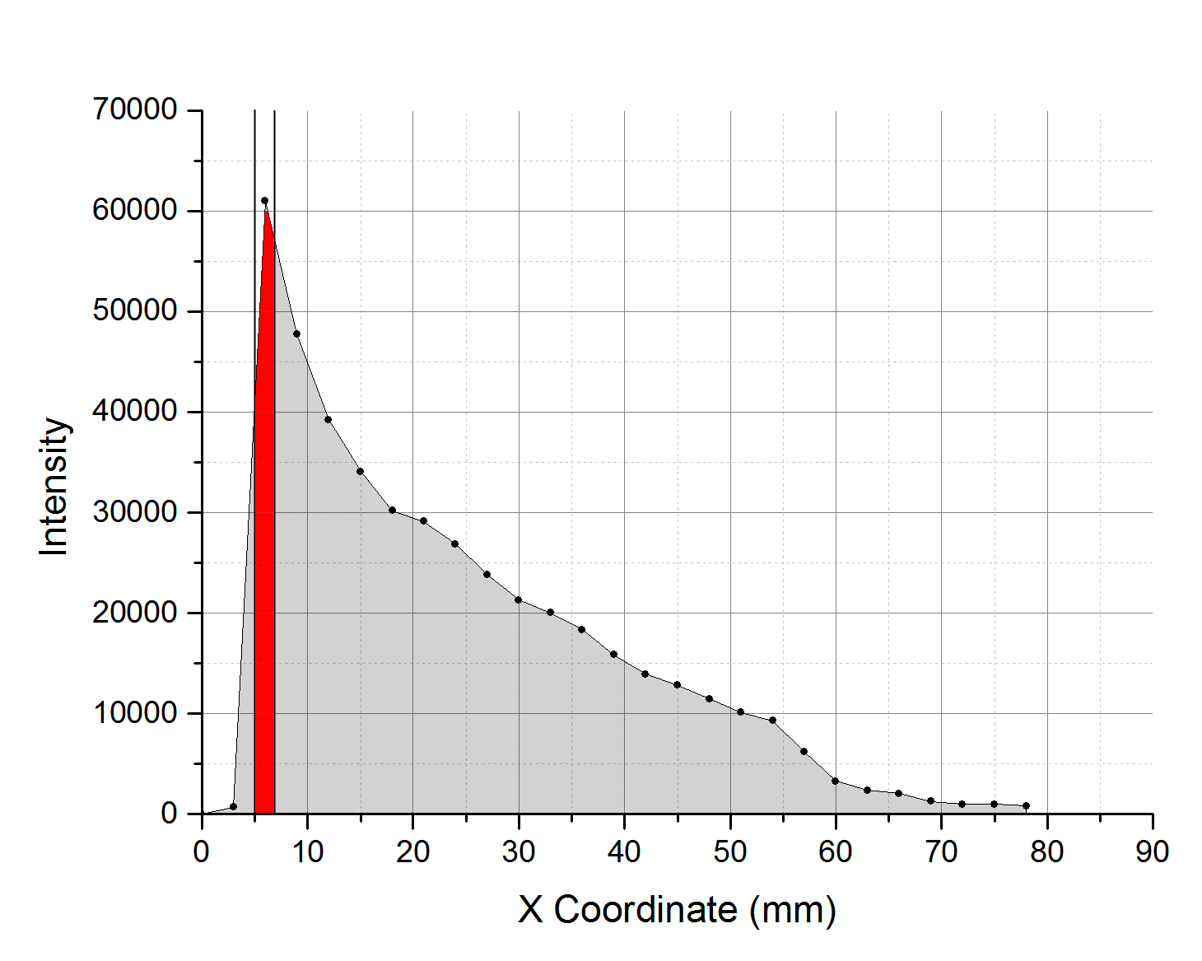
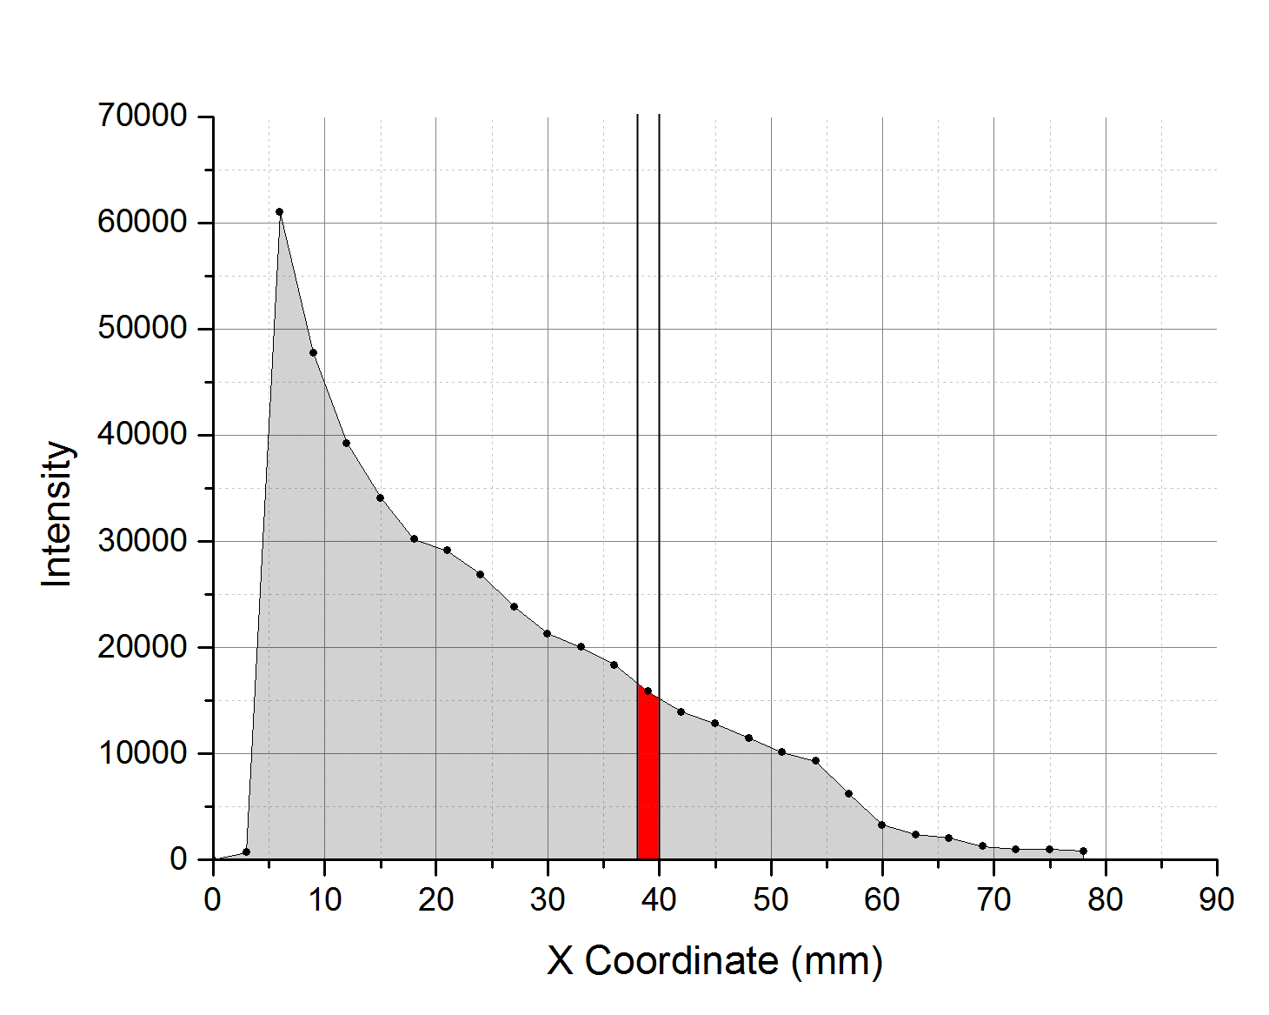
Сеанс 51. Диагностика пучка углерода 3,5 ГэВ/нуклон.

Slide 27
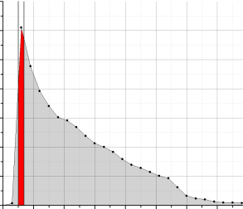

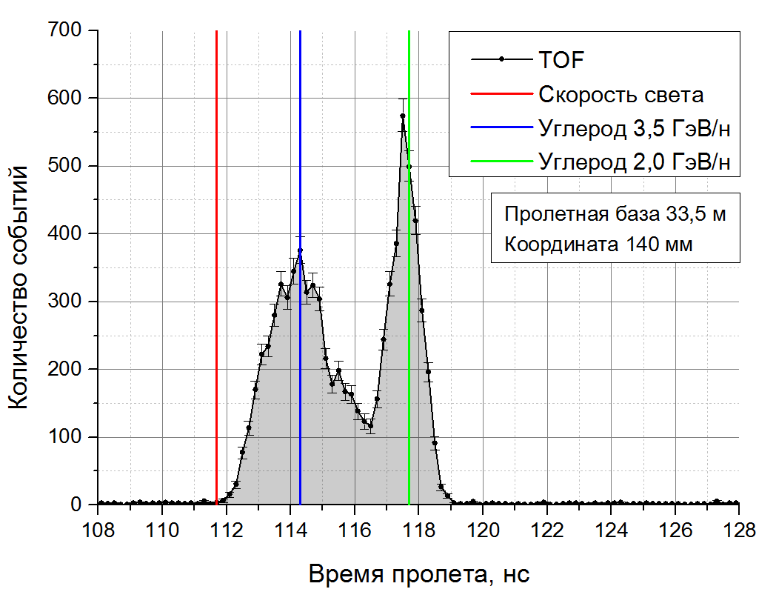
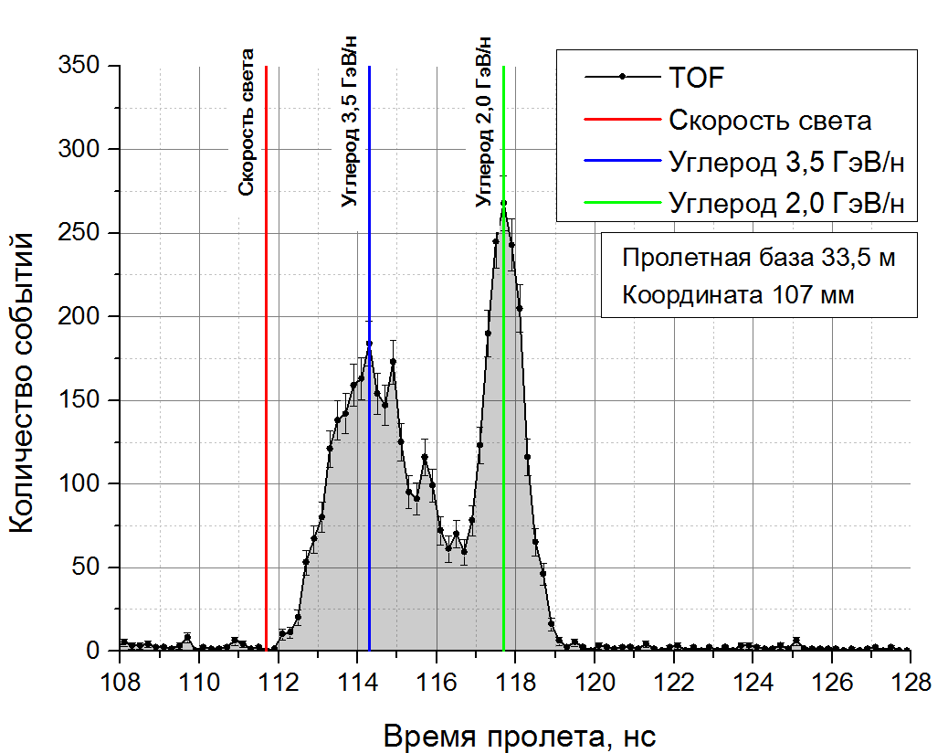
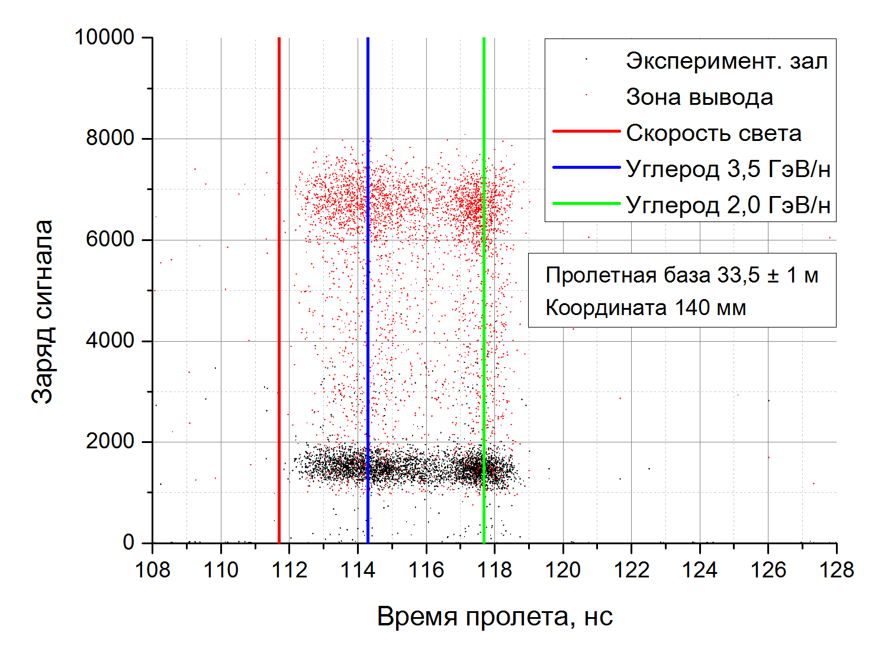
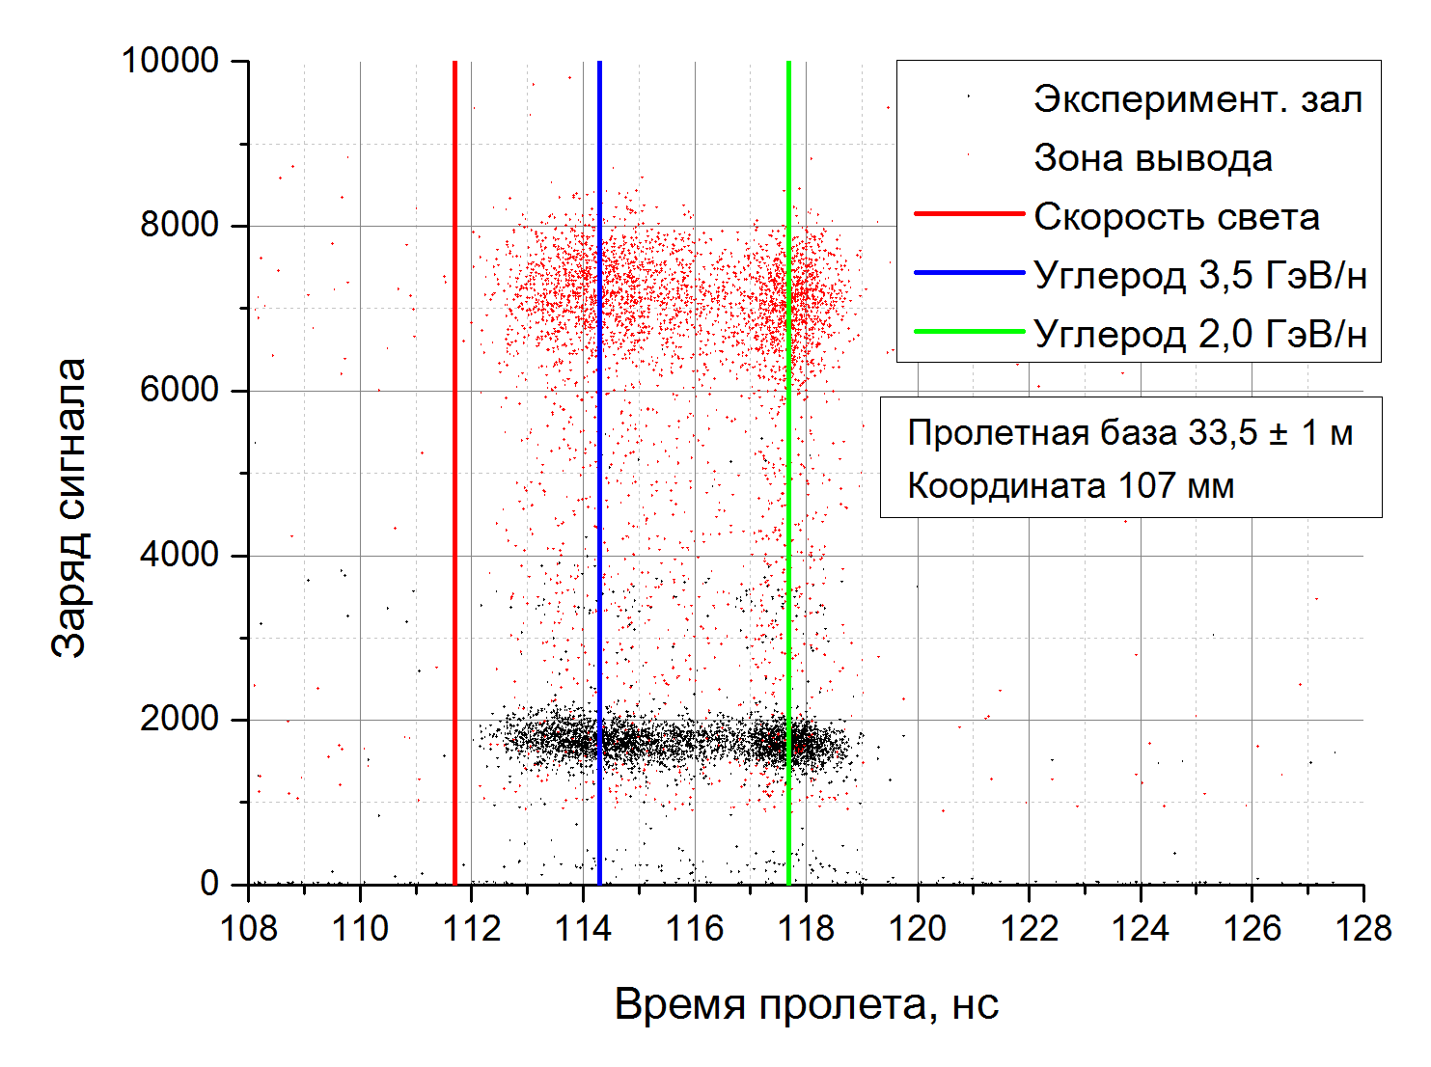
Сеанс 51. Диагностика пучка углерода 3,5 ГэВ/нуклон.

Slide 28
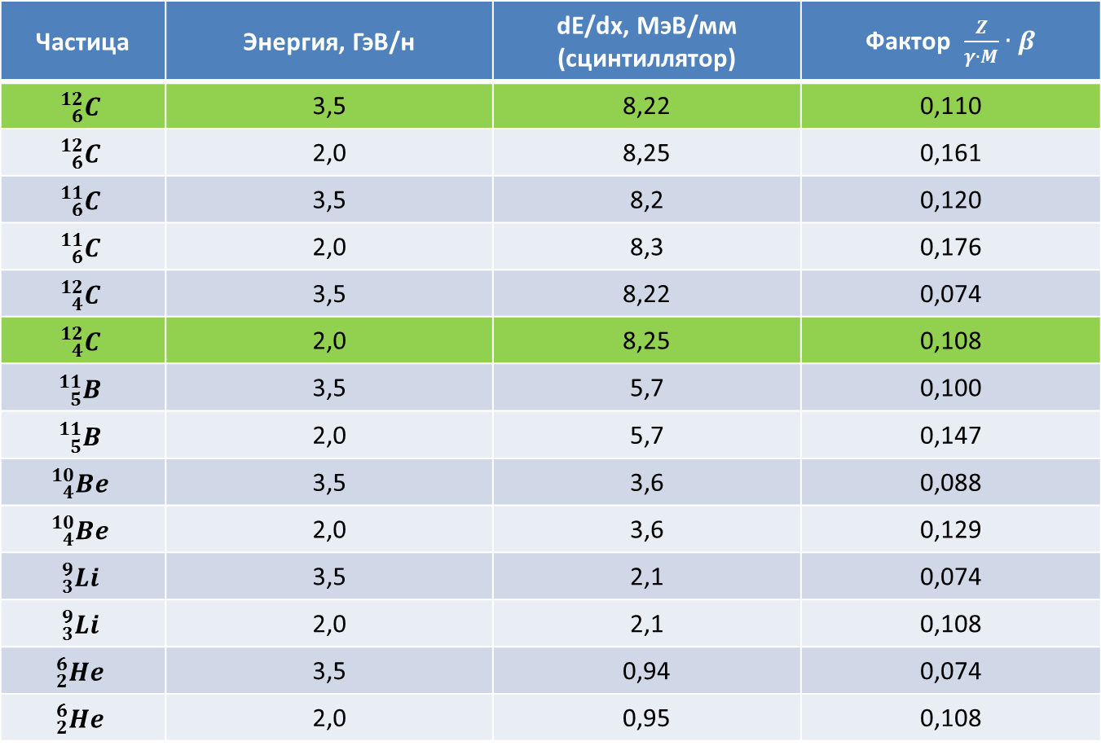
Сеанс 51. Диагностика пучка углерода 3,5 ГэВ/нуклон.
Ионизационные потери частиц в сцинтилляторе.
Частица | Энергия, ГэВ/н | dE/dx, MэВ/мм (сцинтиллятор)
 | 3,5 | 8,22 | 0,110
 | 2,0 | 8,25 | 0,161
 | 3,5 | 8,2 | 0,120
 | 2,0 | 8,3 | 0,176
 | 3,5 | 8,22 | 0,074
 | 2,0 | 8,25 | 0,108
 | 3,5 | 5,7 | 0,100
 | 2,0 | 5,7 | 0,147
 | 3,5 | 3,6 | 0,088
 | 2,0 | 3,6 | 0,129
 | 3,5 | 2,1 | 0,074
 | 2,0 | 2,1 | 0,108
 | 3,5 | 0,94 | 0,074
 | 2,0 | 0,95 | 0,108

Slide 29
Dynamic profile and time structure of the beam
Circulating beam
MCP based detector
Vacuum 2×10⁻⁶ Pa
Intensity d ≥ 10⁶
Intensity Ar⁺¹⁶ ≥ 10⁴
Intensity Au⁺⁶⁵ ≥ 5×10³
Extracted beam
MCP based detector
Vacuum 1×10⁻³ Pa
Intensity d ≥ 10⁸
Intensity Ar⁺¹⁸ ≥ 10⁶
Intensity Au⁺⁷⁹ ≥ 3×10⁴
Notes:
Детектора предназначен для диагностики пучка многозарядных ионов. Пучки тяжелых ионов на Нуклотроне имеют интенсивность не превышающую 10^8. Так как на Нуклотроне не было детектора способного чувствовать данные интенсивности, возникла потребность в таком детекторе. Была создана система для определения пространственно временных характеристик пучка (профиль; радиальная координата пучка в вакуумной камере, ширину пучка, а также характерные частоты колебаний и качество проводки пучка в моменты инжекции, ускорения и вывода).

Slide 30
CONCLUSIONS
In order to provide adequate beams at BM&N setup it is required to:
Equip all magnetic elements with Hall sensors;
Vacuum the whole beam line;
Manufacture 4-5 detector stations for
  beam adjustment,
  beam monitoring;
  All information from these detectors (beam position, time structure, channel transportation mode) should be sent to the accelerator control room and be available to users.

Slide 31
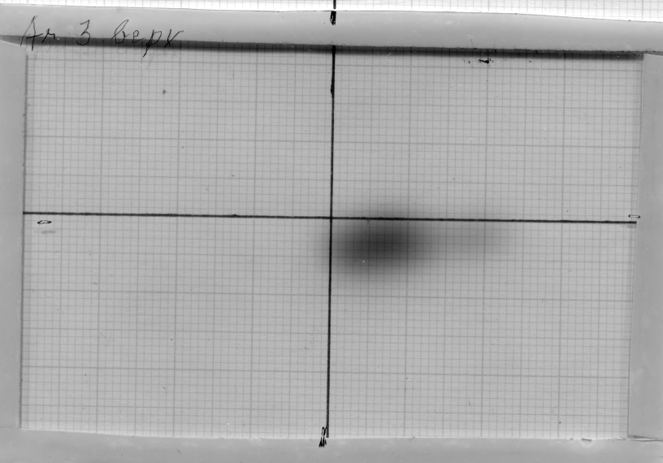


Run 50. Calibration of the thin scintillation counter and the scintillation profilometer
Beam shifting
Photo of manifested nuclear emulsion of Ar⁺¹⁸ beam.
Photo of nuclear emulsion. Zoom 200.
Vertical Coordinate, mm
Beam shifting
Horizontal Coordinate, mm
Profile of extracted beam registered by nuclear photoemulsion.

Slide 32


Study of the impact of irradiated samples on the monitoring system
To explain the differences of the activation analysis method between the groups we studied the effect of the samples impacting on the beam parameters and on the monitoring system.
To study this effect, we placed lead samples of different thickness between two ionization chambers. Then we observed dependence of the ratio of two chambers from the lead thickness.
The lead samples:
Pb 1 mm;
Pb 2 mm;
Pb 3 mm.
The place of irradiation samples
A Lead Sample
Ionization Chamber 1
Ionization Chamber 2

Slide 33


Study of the impact of irradiated samples on the monitoring system
This result was obtained at the constant beam intensity
Histogram of the dependence of the ratio of two chambers from the lead thickness.
Relative intensity of the extracted beam at the measurement time. Deuteron 2 GeV/n.

