Slide 1



The MPD Group at IMP China
Chengxin Zhao
Institute of Modern Physics
Chinese Academy of Science

Slide 2
Outline
IMP Group
Expertise
Plan of Contributions to MPD

Slide 3
The IMP group
IMP Group
SLIMP (Silicon Lab at IMP)
Physics Group
IC Group
Electronics Group
Detector
Group
8 staffs + 5 students will join MPD

Slide 4
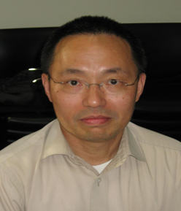
The IMP group
Prof. Nu Xu
IMP Group Leader
Prof. Chengxin Zhao
SLIMP director
Goal: Develop and Test Pixel and Silicon Detector
Founded in May 2018

Slide 5

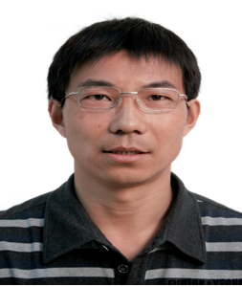
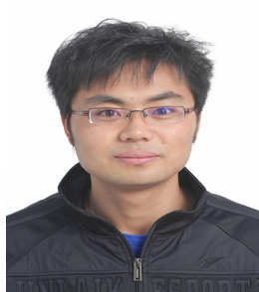
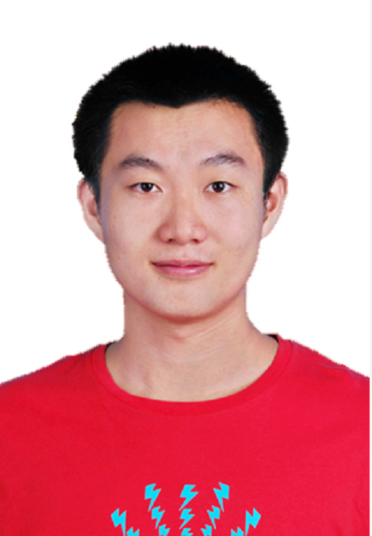

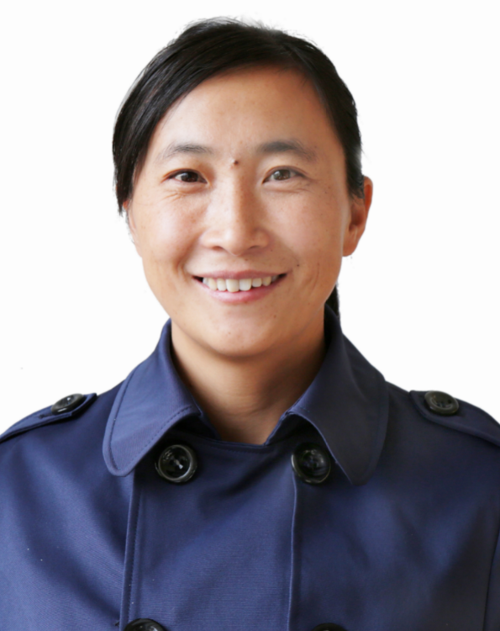
The IMP group
Prof. Yi Qian (IC design)
Prof. Zhankui Li
(Detector )
Assoc. Prof. Haibo Yang (Electronics)
Assoc. Prof. Yapeng Zhang (Physics)
ASST. Prof. Ronghua Li (Detector)
ASST. Prof. Tianlei Pu
(IC design)

Slide 6
Facility
Clean Room:
200 square meters (ISO7)
60 square meters (ISO6)
20 square meters (ISO5)
Manufacture Line
Silicon Strip Detector
Pixel Detector

Slide 7
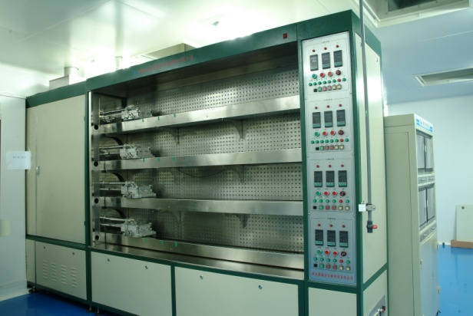
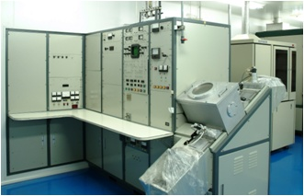
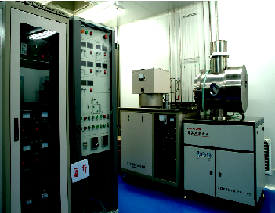
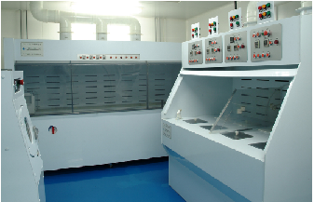
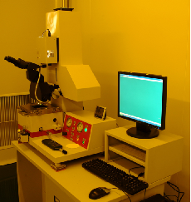
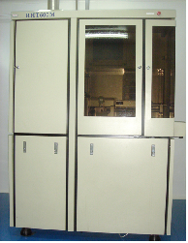
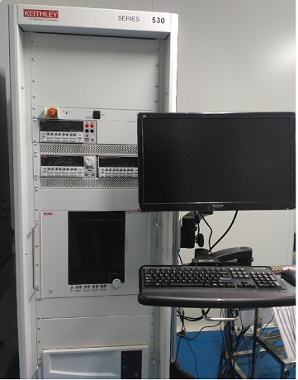
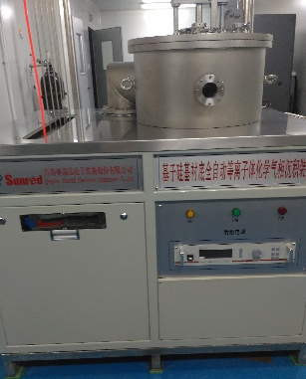
Facility- Silicon Detector
Oxidation furnace
Ion implanter
Plasma etching machine
Silicon washer
lithography machine
annealing furnace
Parameter Tester
PECVD
Notes:
We have the full manufacture line for Silicon detector. We have produced silicon micro-strip detectors, silicon multi-strip detectors, square silicon detectors, Si (Li) drift detectors, gold-silicon surface barrier detectors. These detectors have been used in space charge particle detection and nuclear physics experiment at the HIRFL-CSR.

Slide 8
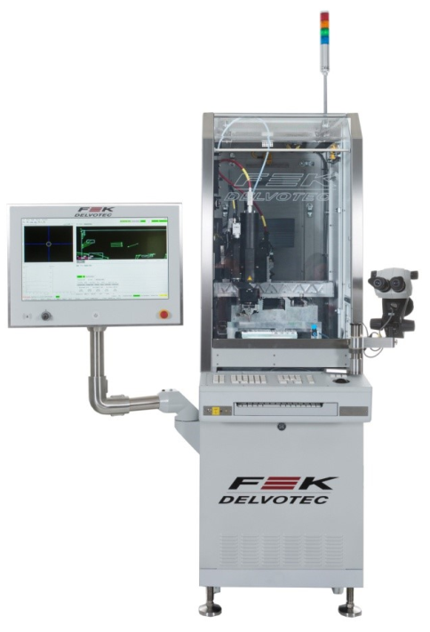
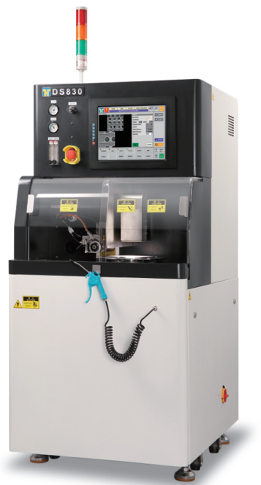
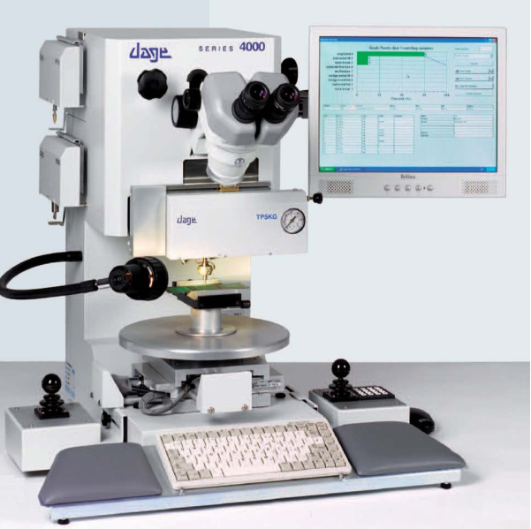
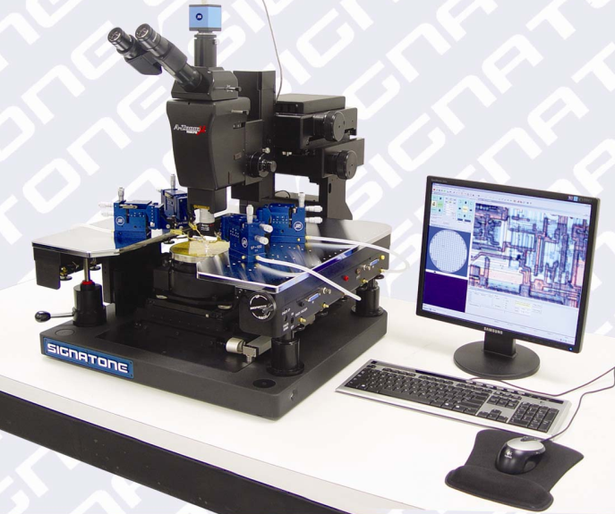
Facility- Pixel Detector
Binding machine
Pull Tester
Dicing Machine
Probing Station
Notes:
We are now building the full production line for pixel detectors with the resolution of 10-100um. We will be able to perform massive production of pixel detectors.

Slide 9
Expertise
IC design
Electronics Design
Detector Development

Slide 10
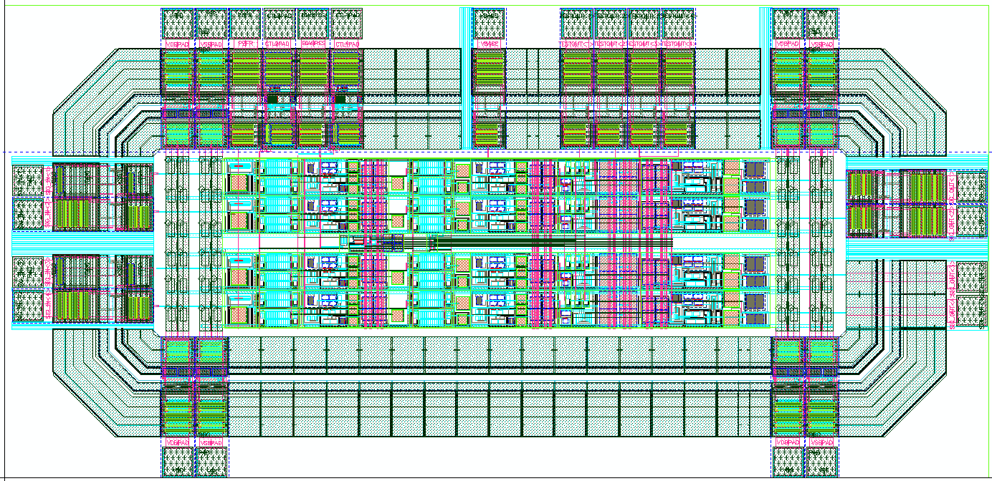
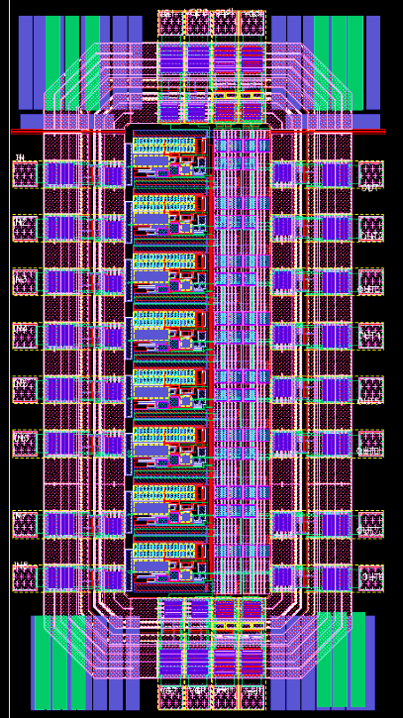
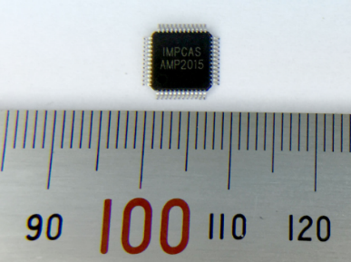
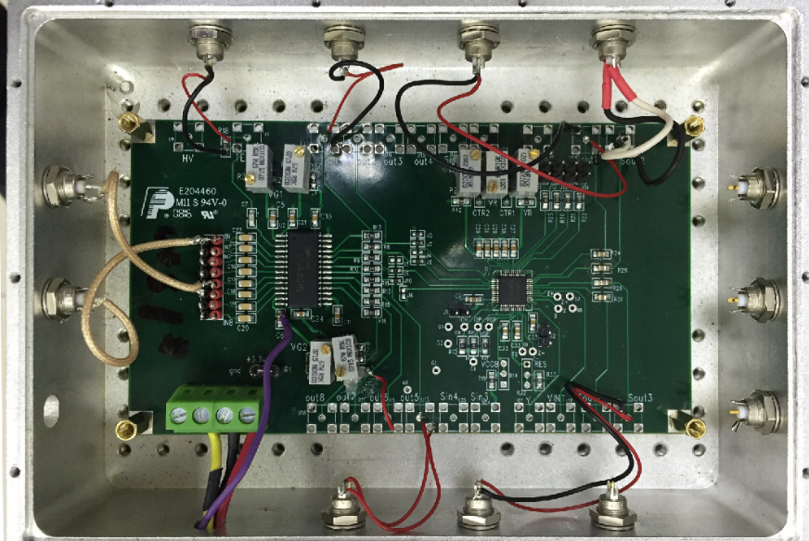
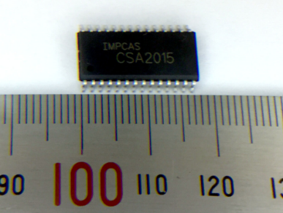
IC design – Silicon Detector
Amplifier
Shaper
Test Board
Notes:
We have been designed the IC chips for Silicon detector and some other detectors. Such as the pre-amplifier, the Charge Sensitive Amplifier (CSA), the Shaper, etc. And also perform the test of these chips.

Slide 11
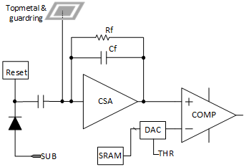
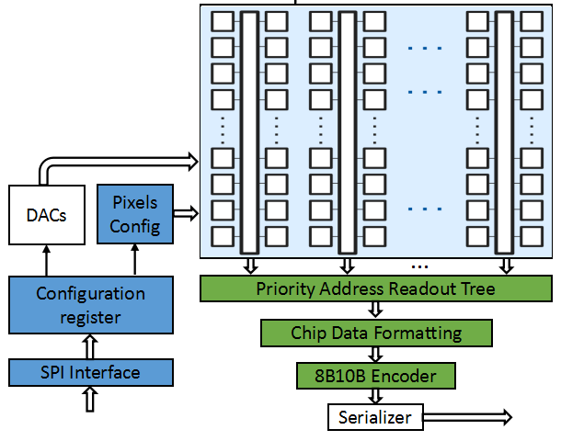
IC design – Pixel Detector
Topmetal-M (Design with CCNU)
Chip size：3cmX1.5cm Pixel Size：20um X 20um
Readout
Priority Zero-suppression readout scheme
Data Frame Formatting Module
Encoding Circuit
SERDES interface (8b10b Encoder)
SPI interface
Pixel Configuration Module and DAC
Pixel Node
Photodiode and reset circuit
Top Metal and Guarding
Charge sensitive preamplifier
Comparator and Threshold Adjustable circuit (Include DAC and SRAM)
Notes:
Together with CCNU, we are now developing pixel chip named Topmetal-M, this chip will be taped out at the end of this year.

Slide 12
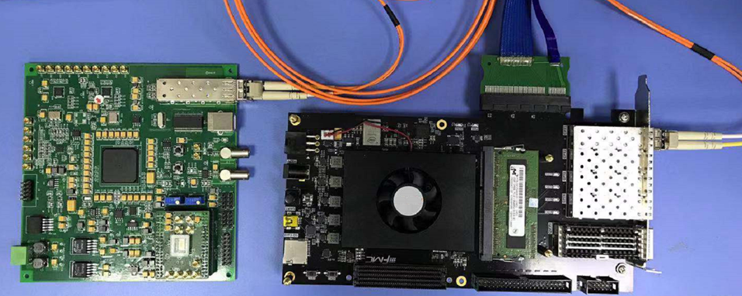
Electronics – Pixel Detector
Electronics for Pixel Detector
Fiber Transmission
PCIe link
Flash-based FPGA
MAPs binding board
Notes:
We have been developed the electronics for the pixel detectors. This covers from the Front-end readout electronics and the DAQ, including the hoster for pixel chips, the high speed transmission line, the one line algorithms and the radiation tolerance study.

Slide 13
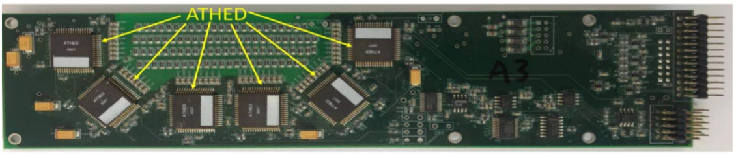
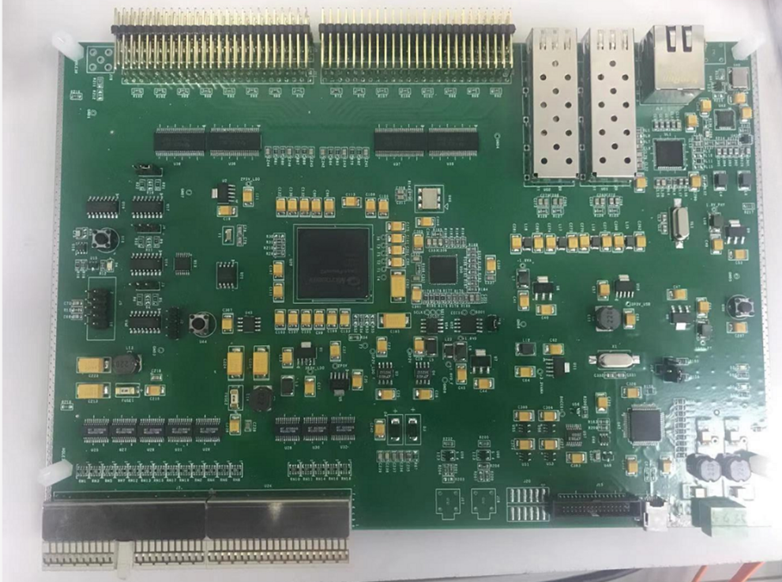
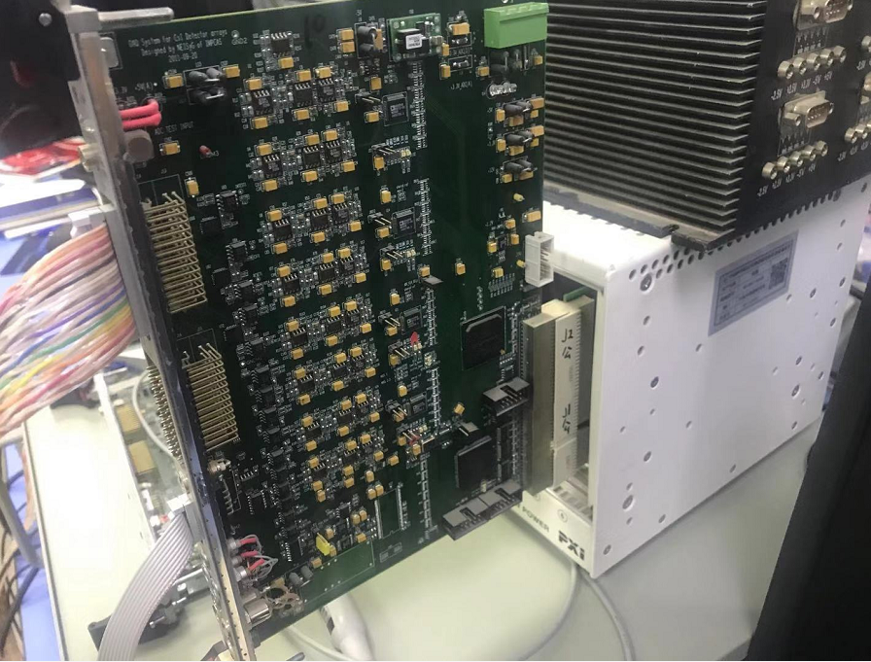
Electronics – Silicon Strip Detector at HIRFL
Front-end Electronics
Trigger Electronics
Readout Electronics
Notes:
We have been responsible for several readout electronics for the HIRFL experiments. This is the front-electronics, trigger and readout for the Silicon Strip detector at HIRFL.

Slide 14
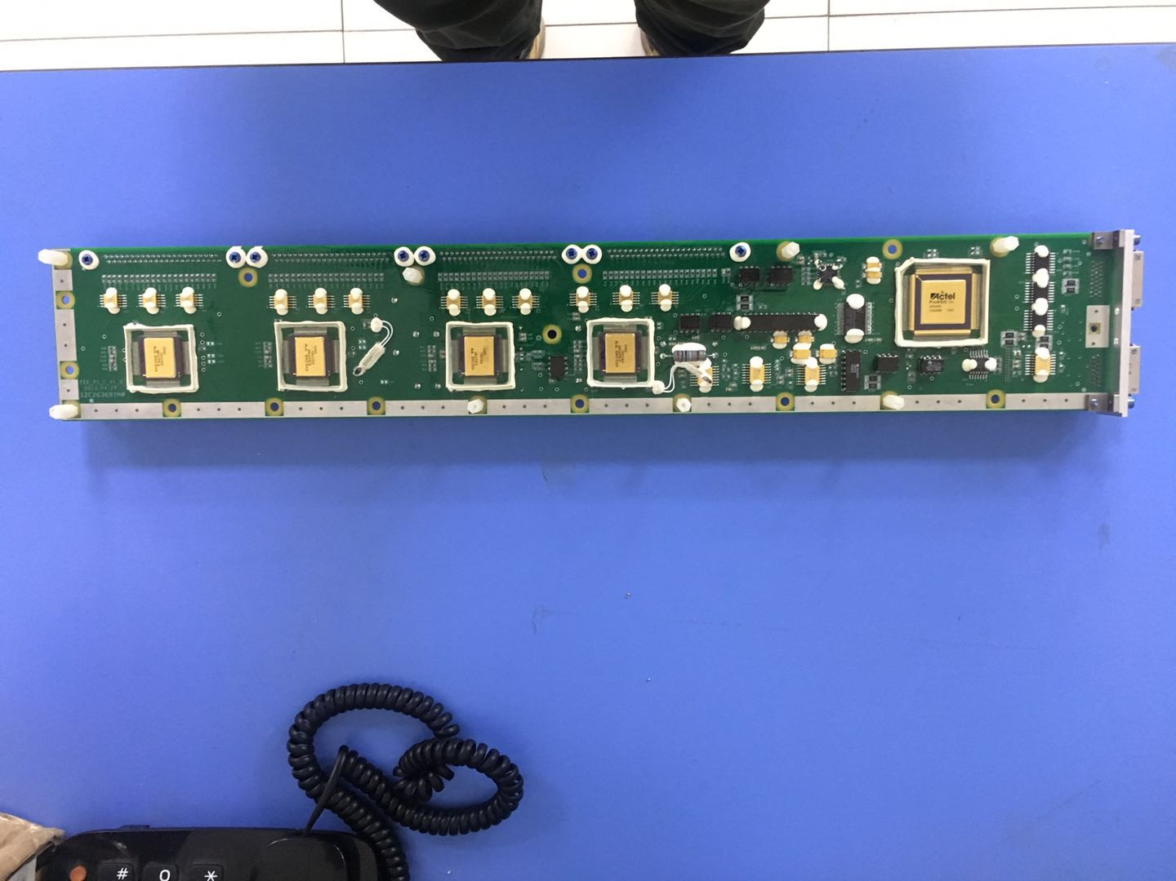
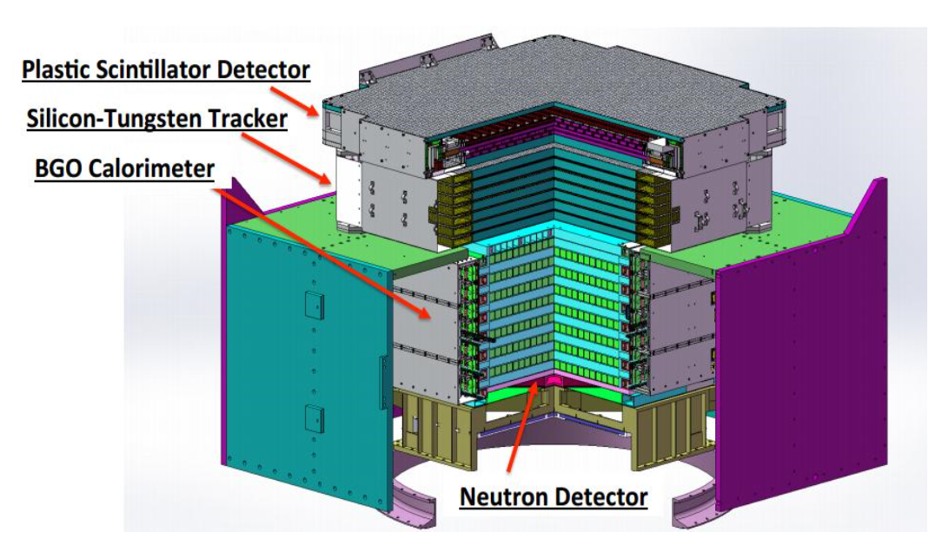
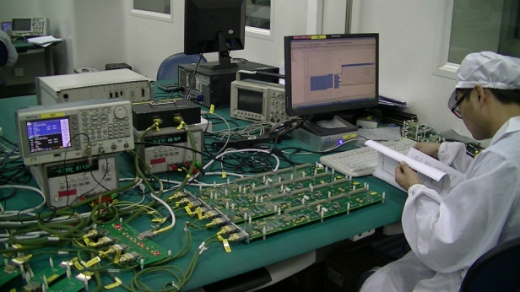
Electronics-PSD detector on DAMPE
Notes:
We have strong experience in space electronics and radiation hard electronics as well. We were responsible for the Front-end electronics of the Plastic Scintillator Detector on the DArk Matter Particle Explorer (DAMPE), including the design, production, environment test, etc. The detector is now on-orbit for 3 years, and working in stable manner. We are now developing the electronics for the first Chinese Mars Explorer.

Slide 15
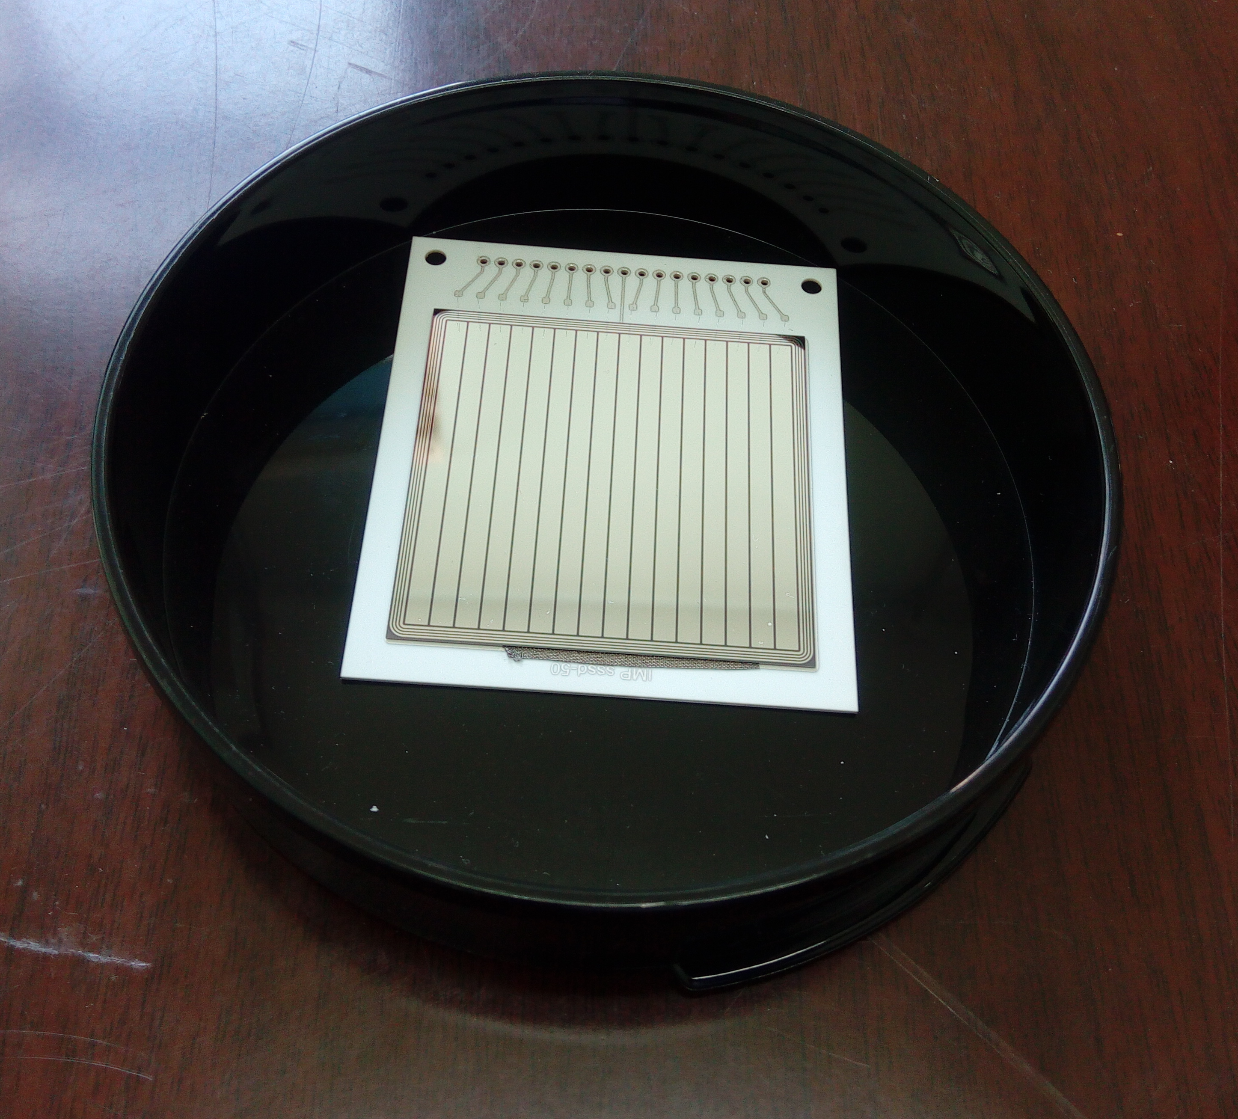
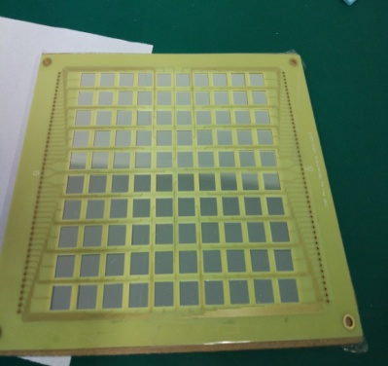
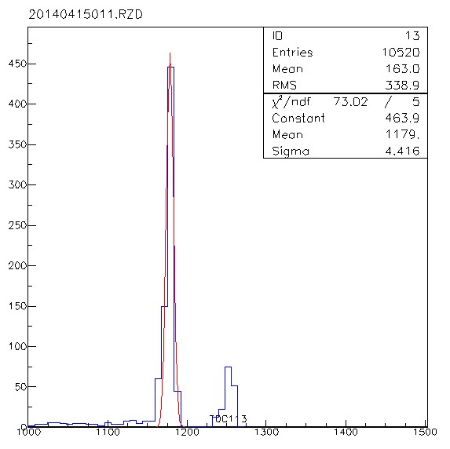
Detector Development – Silicon Detector
Silicon Strip Detector
Silicon Square Detector
Energy Resolution of 1.1%
Energy Resolution of 1%
Notes:
With our production line, we have produced the Silicon Strip Detector and the Silicon Square Detector, both of which achieves quite good energy resolution and being used at the physics experiments.

Slide 16
Detector Development – Pixel Detector
Bounding Machine/Test Platform
Pixel Detector Size 6cm x 6cm
One Pixel Detector with 2x4 Topmetal-M chip
Developing chip placing platform (For any combination)
Placement error < 2μm
Building detector test platform
Chip binding and test
TPM
TPM
TPM
TPM
TPM
TPM
TPM
TPM
TPM
Placement error <2μm
Chip Placing platform
Notes:
We are developing the independent intellectual technology placing machine and testing platform for pixel chips. The first milestone will be packge 8 Topmetal M chip in to one detector with the placement error better than 2um. The whole process will be automatic.

Slide 17
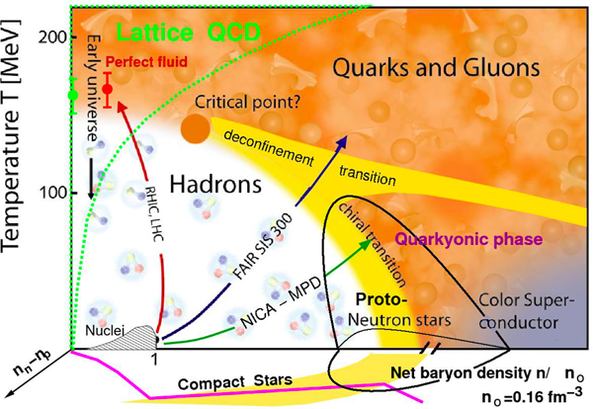
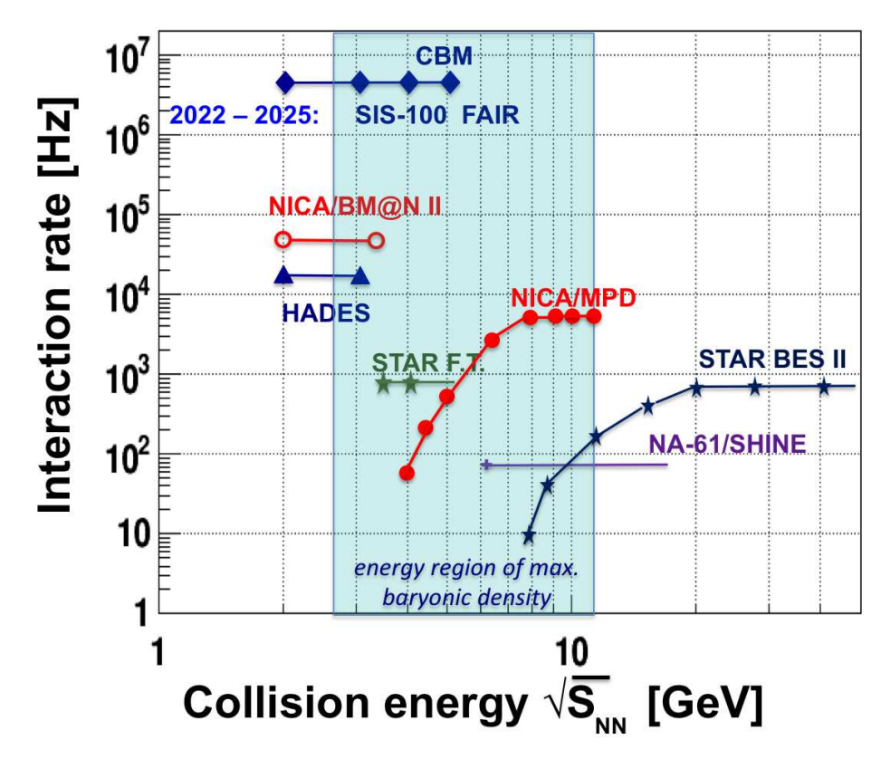
Physics - QCD Phase diagram
Notes:
QCD相变结构是当前高能核物理研究的核心问题, MPD@NICA的束流能量介于RHIC和SIS100之间, 非常适合研究QCD相变临界点的位置.

Slide 18
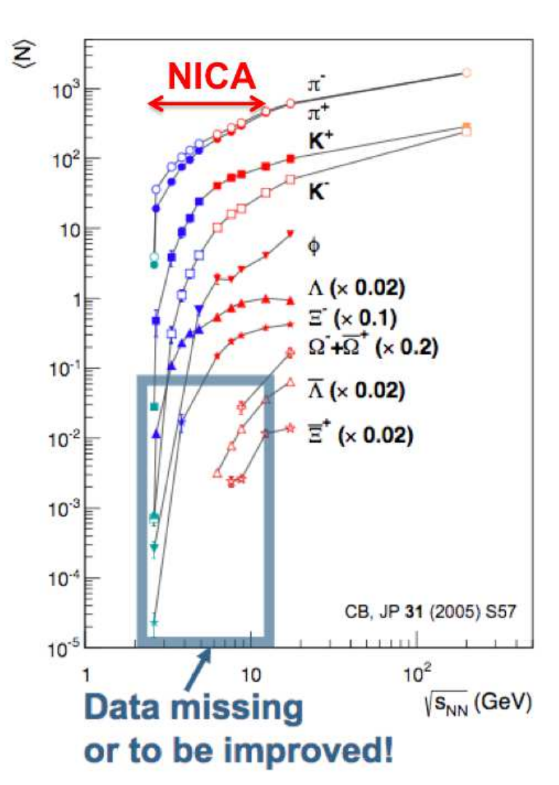
Physics -Multistrange baryon production
Yield of heavy strangeness baryon (e.g. Ξ, Ω baryon)
Study thermal and chemical equilibrium of systems
In-medium properties of strangeness baryon
Hyperon-hyperon (YY) interaction and neturon star
Hypernuclei
Notes:
我们对右边这些课题非常感兴趣再研究，在MPD上测量多奇异夸克的重子产额对这些课题得研究我们都有兴趣。

Slide 19
Possible contributions
ASIC design
- Pixel detector sensor, Amplifier, TDC, etc.
Sensor test and characterization
-Probe station for sensor selection
Readout electronics
-Trigger and readout electronics
Detector Packing and test
Physics Analysis
- Multistrange baryon production, etc.

Slide 20
Thank you!!!

