Slide 1
THE NON-FERROMAGNETIC KICKER MAGNETS FOR INJECTION AND EXTRACTION OF PARTICLES IN NICA COLLIDER
Fateev A.A., Lebedev N.I., Petukhov A.S., Tuzikov A.V.,
JINR, Dubna, 141980, Russia
Созополь 2018

Slide 2
Standard kicker module
Cross-section of typical module.
Main feature
- magnetic core with ferrite as a material
- ceramic vacuum chamber with semi-conductive coating on the inside
- current conductors outside the ceramic chamber
Main feature
- magnetic core with ferrite as a material
- ceramic vacuum chamber with semi-conductive coating on the inside
- current conductors outside the ceramic chamber
Advantages
high uniformity of the magnetic field throughout the vacuum volume
the current-carrying conductors are located outside the vacuum chamber
high efficiency (there is no scattered magnetic fields)
Disadvantages
extremely expensive
it does not work at cryogenic temperatures
Созополь 2018
Созополь 2018

Slide 3
KICKER-MAGNET WIHTOUT MAGNETIC CORE (1)
In kicker magnets without ferromagnetic cores, the deflecting magnetic field is formed by means of current-carrying conductors and conducting shields.
One of the simplest variants (without shield) of such a magnet is shown in Fig.1.
Fig.1. Cross-section of first variant of «ironless» kicker for BUSTER extraction system.
A pair of conductors with the same currents in one direction and a symmetrical pair with currents in the opposite direction form a homogeneous field in the center.
Of course, in General, such a geometry of the magnetic field is energy inefficient, but in many specific cases its use may be justified. In particular, in a fairly common version, when the maximum aperture of the circulating beam significantly exceeds the aperture of the output (injected) beam.
Созополь 2018

Slide 4
KICKER-MAGNET WIHTOUT MAGNETIC CORE (2)
Distributions of magnetic fields at different distances between pairs of current-carrying conductors and at a current in a pair of 6kA are shown in Fig.2.
Fig.2. Distributions of magnetic field for d=60, 70 and 80 mm.
The optimal (homogeneity) ratio of the distances between the pairs and between the conductors in the pair is approximately 2: 1.
From the above data it can be seen that in a fairly wide central region there is a relatively uniform distribution of the magnetic field.
Созополь 2018

Slide 5
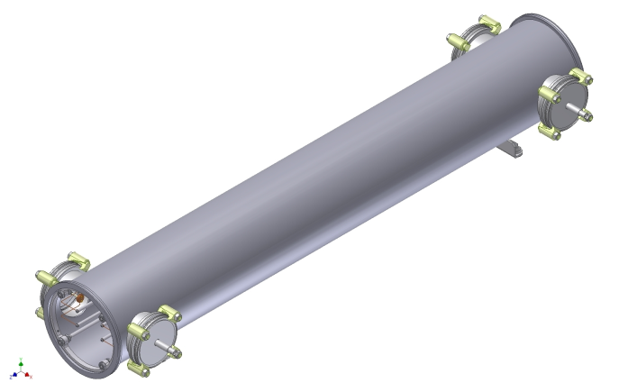
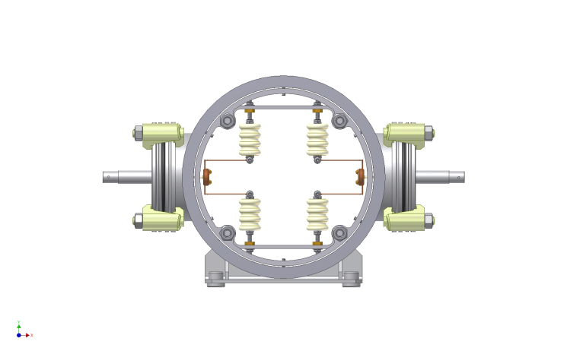
KICKER-MAGNET WIHTOUT MAGNETIC CORE (3)
Main feature
- deflecting magnetic field is formed by means of current-carrying conductors and conducting shields
- metal vacuum chamber
- current conductors are placed inside metal chamber
Advantages
relatively simple design and low cost in manufacturing
no severe operating temperature limitations, ability to operate at cryogenic temperatures
Disadvantages
a relatively small region of uniform magnetic field
the need to introduce high-power high-voltage pulses into the high-vacuum volume
Fig.3. 3-D model of kicker-magnet
Созополь 2018

Slide 6
«ASYMMETRICAL» KICKER-MAGNET
The preliminary adiabatic displacement of the beam towards the output – the so-called bump - is often used in the output of beams with dimensions much smaller than the chamber in the output zone.
To output such beams it has been proposed "asymmetric" design of the kicker magnet without ferromagnetic core
The magnetic field in the region of the output beam is formed by a pair of current-carrying conductors and a conductive screen.
This type of kicker magnet is currently being manufactured for the beam extraction system from the NICA BOOSTER
Созополь 2018

Slide 7
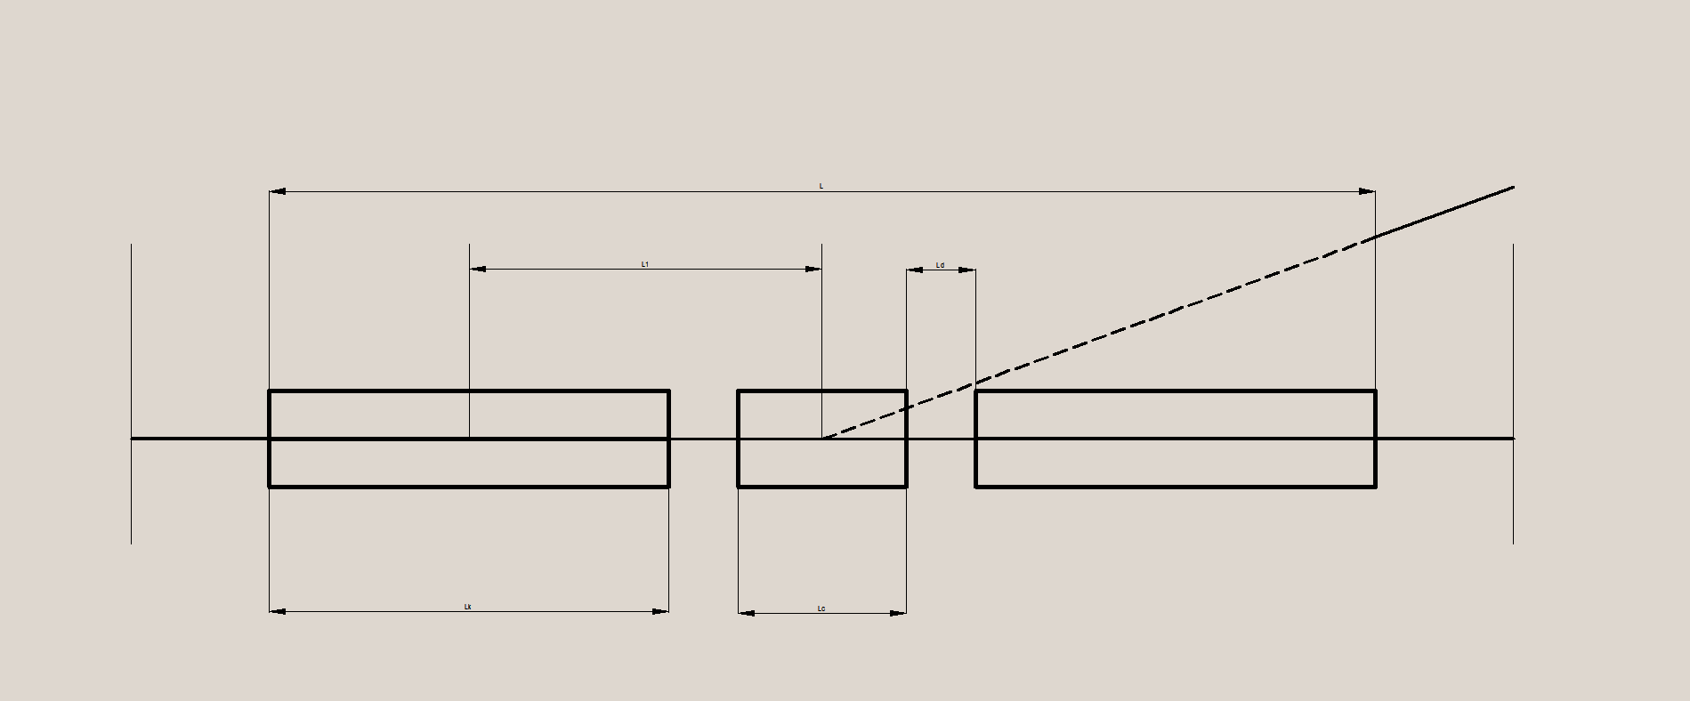
FORMATION OF A FLAT TOP OF THE PULSE MAGNETIC FIELD (1)
To form a flat top of the pulse, a traditional scheme with forming lines working on a matched load with a series of shock magnet is usually used. Such circuits have fairly low power efficiency (peak energy of the magnetic fields\ the stored energy).
Alternatively, several modules with bell-shaped pulses can be used
corrective kicker
kicker
kicker
The correcting module with a bell-shaped magnetic pulse with opposite direction of magnetic field is placed between two main kickers.
Normalized currents in the magnets: main (green), correcting (red) and difference (blue).
Созополь 2018

Slide 8
THE FORMATION OF THE FLAT TOP OF THE PULSE MAGNETIC FIELD (2)
Kicker power supply circuits : main kicker (upper) and correcting kicker (bottom).
Pulsed power supply is based on an capacity aperiodic discharge with the inductive load. This scheme allows to form a bell-shaped pulse. This approach can be effective in some cases. Particularly for extraction systems.
Созополь 2018

Slide 9
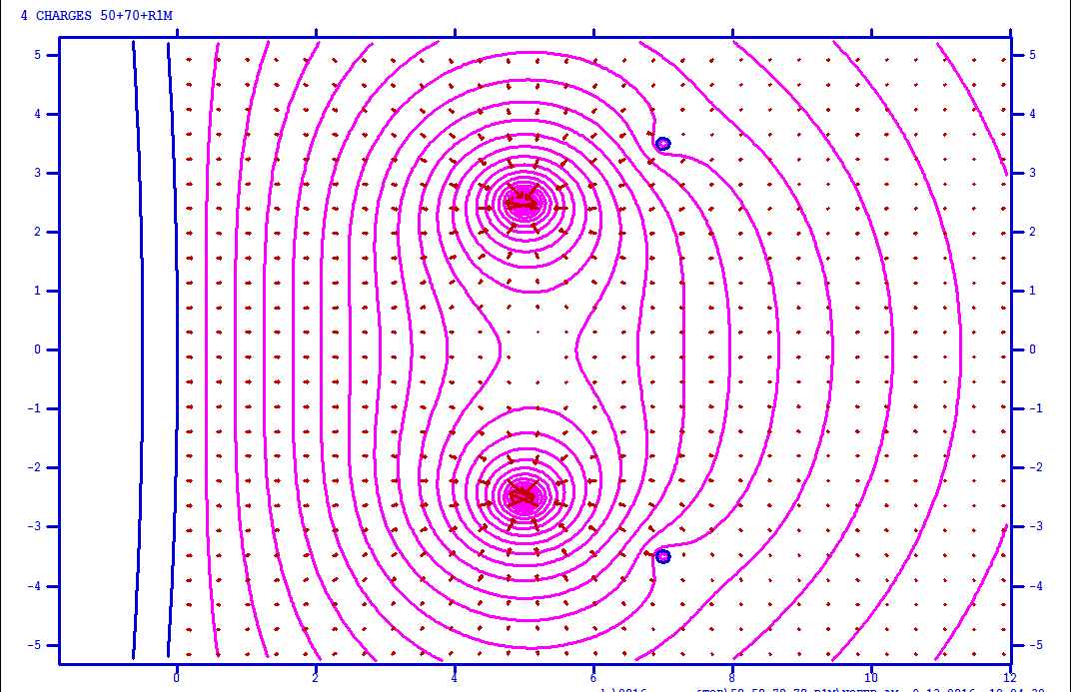
DESIGN OF THE KICKER MAGNET, WITH THE COMBINED FUNCTIONS OF THE DEFLECTION AND THE FORMATION OF THE FLAT TOP
The magnets without ferromagnetic cores have an additional possibility of adjusting the spatial or (and) temporal distribution by the method of superposition.
As an example we consider the" asymmetric " version of the kicker magnet with additional current-carrying conductors
The location of the elements of the magnet with padding conductors
The main conductors are located at a distance of 50 mm from each other and from the conductive screen. Corrective conductors are located at a distance of 70 mm from each other and from the conductive screen.
Созополь 2018

Slide 10
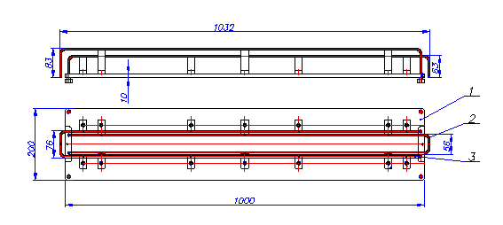
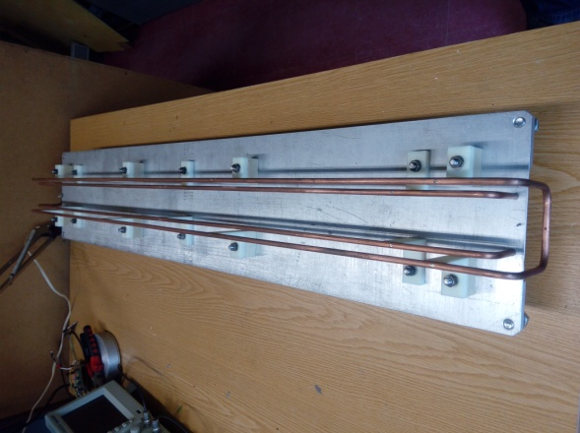
THE KICKER WITH COMBINED FUNCTIONS (1)
A drawing of the layout
2-basic conductors, 3-corrective conductors
Photo layout
PSpice diagram for modeling of linked circuits
Созополь 2018

Slide 11
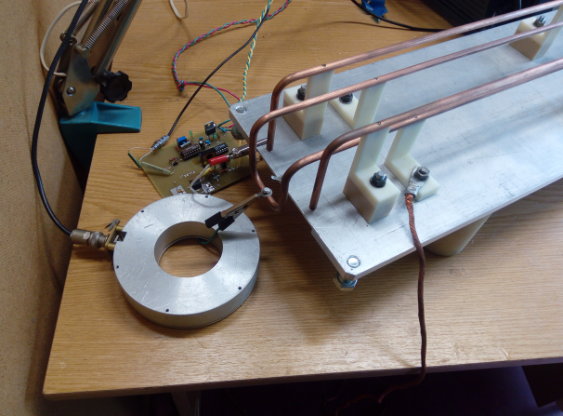
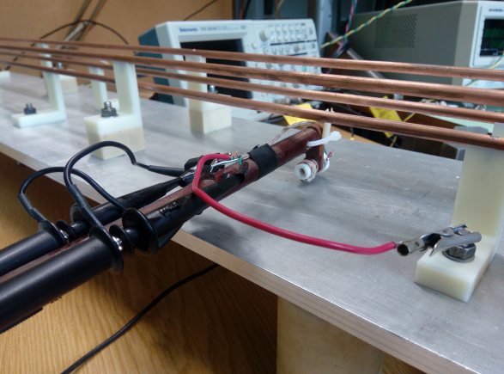
THE KICKER WITH COMBINED FUNCTIONS (2)
Total magnetic field simulation
For experimental verification of the calculated results two pulse generators with transistor switches and a differential magnetic field meter were developed and manufactured.
Pulse generator with a transistor switch
The differential magnetic field meter
Созополь 2018

Slide 12
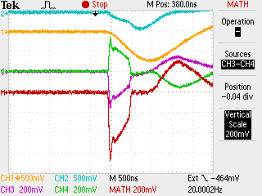
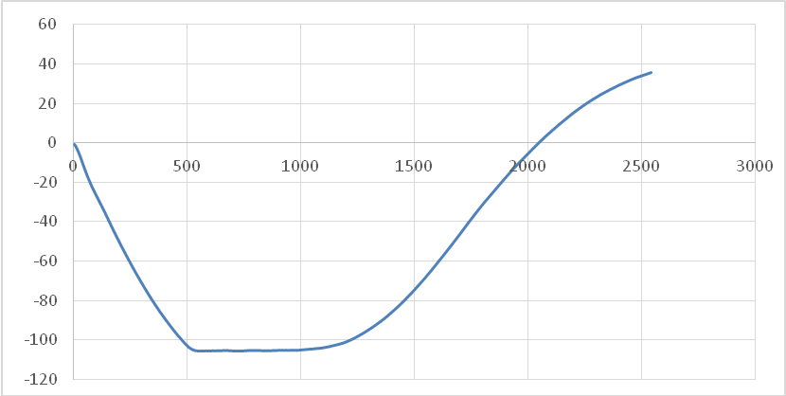
THE KICKER WITH COMBINED FUNCTIONS (3)
The waveforms of signals of the experimental device
1-current in the main coil; 2 - current in the correcting coil; 3,4, - voltage pulses at the terminals of the measuring coil; M-difference signal
The difference signal is proportional to the derivative of the magnetic field in the measuring coil. The data array of the digital oscilloscope makes it easy to integrate and restore the real shape of the magnetic field
conventional units
conclusion
The concept of formation of a flat top of a deflecting magnetic field by superposition of two bell-shaped pulses is considered. Mathematical modeling and experimental testing have shown the practical applicability of this approach.
nanoseconds
The reproduced form of the magnetic field pulse
Созополь 2018

Slide 13
Thyratron generator with lumped forming line (1)
Scheme of 6-link forming line with corrective capacitance and diode-resistive matching
The current pulse in the load
Such a scheme allows to form a relatively short falling edge of the current pulse in the inductive load. This is very important for injection systems. The disadvantage is two after pulses with an amplitude of a few percent of the main pulse.
Созополь 2018

Slide 14
Thyratron generator with lumped forming line (2)
Power supply circuit for kicker magnets of NICA Collider injection system with active damping circuit.
The current pulse in the load
The disadvantage of this scheme is the difficulty of the technical implementation.
Созополь 2018

Slide 15
"Warm" version of the kicker magnets for Collider
Созополь 2018

Slide 16
“Cold" version of the kicker magnets for Collider
Созополь 2018

Slide 17
CONCLUSION
In VBLHEP JINR for several years kicker magnets without ferromagnetic cores are developed.
- magnets of such type can be very effective in cases where the working area is significantly less than the full aperture
+
- magnets of such type can operate at cryogenic temperatures
=
- magnets of such type meet the requirements of the NICA project
Magnets of such type are manufactured for the output system of the ion beams of the NUCLOTRON BOOSTER
Magnets of such type are currently being developed for injection and extraction systems of the NUCLOTRON and COLLIDER of NICA project
Созополь 2018

Slide 18
Thank you for listening
Созополь 2018

