Slide 1

DYNAMICS SIMULATIONS
OF THREE-COMPONENT ION BEAM
IN HILAC-BOOSTER TRANSPORT CHANNEL
Tuzikov A.

Slide 2
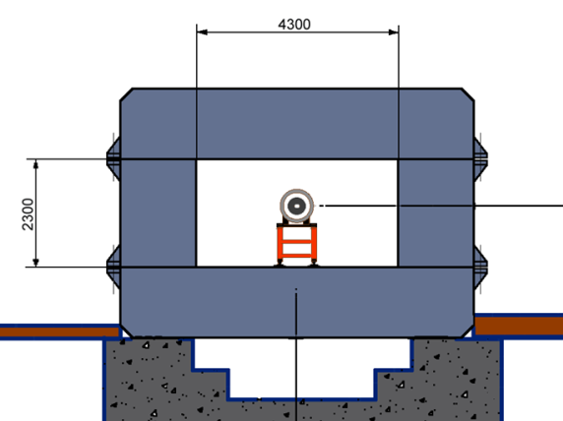

Beam transfer from HILAC to Booster
Beam parameters
Goals
Accumulation of required intensity of ions in Booster by means of several methods of beam injection.
Commissioning: March 2019
Ions | Au³¹⁺
Energy, MeV/u | 3.2
Magnetic rigidity, T m | 1.6
Electric rigidity, MV | 40
Ion number | 2∙10⁹
HILac
Booster

Slide 3
HILAC-Booster beam transport channel
Main goals
The beam transport with minimal ion losses.
The beam debunching.
The beam matching.
Separation and adsorption of neighbor charge states of ions.
Providing different schemes of the beam injection into the Booster.
Features
Beam transport in the median plane of the Booster.
The debuncher in non-dispersive region of the beam transport channel.

Slide 4
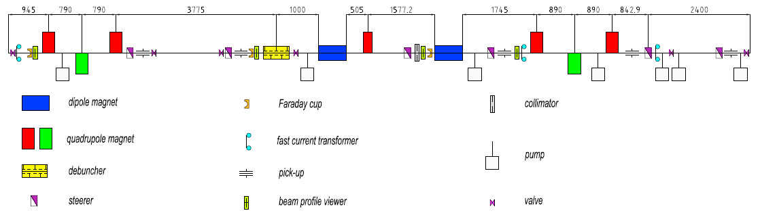
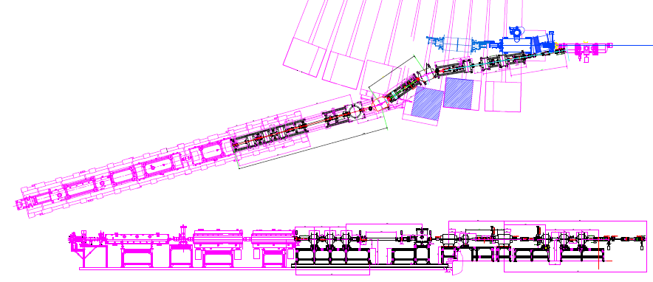
Composition

Slide 5
Beam dynamics simulations
Goals
To provide simultaneous tracking of three charge states of ions: Au³⁰⁺, Au³¹⁺, Au³²⁺.
Influence of debunching on transverse dynamics should be taken into account.
Chromatic aberrations should be taken into account.
Ions of Au³⁰⁺ and Au³²⁺ should be collimated before the second dipole magnet.
Space charge effects should be taken into account.
To define acceptances of the channel.
To study flexibility of the channel tuning for different beam injection schemes.
To study flexibility of the channel tuning for different betatron tunes of the Booster.
To study flexibility of the channel tuning for different initial beam parameters.
To study influence of alignment and field errors of the magnetic elements on the beam dynamics.
To define tolerances on alignment and field errors of the magnetic elements.
To simulate the process of the channel tuning by means of the steerers and the beam diagnostics devices.
Methods/models
2D Twiss simulations (MAD-X).
3D Twiss/r.m.s. simulations:
MAD-X, PTC module (no user-defined elements, no space charge);
TraceWin (two charge states of ions only);
MCIB (2D only);
Own code.

Slide 6
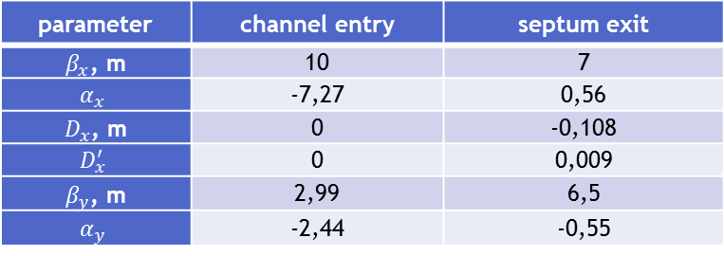
Lattice functions
Reference tuning of the channel
parameter | channel entry | septum exit
$β_{x}$, m | 10 | 7
$$α_{x}$$ | -7,27 | 0,56
$D_{x}$, m | 0 | -0,108
$$D_{x}^{′}$$ | 0 | 0,009
$β_{y}$, m | 2,99 | 6,5
$$α_{y}$$ | -2,44 | -0,55
lens | gradient, T/m
Q1 | 5
Q2 | -6.7
Q3 | 3.6
Q4 | 2.5
Q5 | 8.8
Q6 | -7.8
Q7 | 6.8

Slide 7
Acceptances
Horizontal and vertical acceptances – 38 π·mm·mrad.

Slide 8
Separation

Slide 9
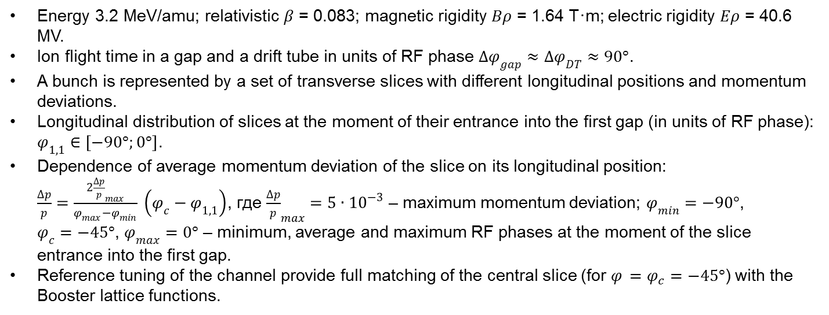
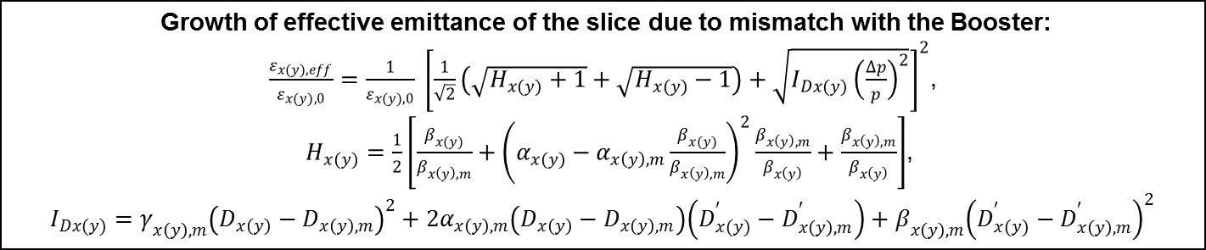
Debunching effects (2D)
Beam model
Energy 3.2 MeV/amu; relativistic $β$ = 0.083; magnetic rigidity $Bρ$ = 1.64 T·m; electric rigidity $Eρ$ = 40.6 MV.
Ion flight time in a gap and a drift tube in units of RF phase $∆φ_{gap}≈∆φ_{DT}≈90°$.
A bunch is represented by a set of transverse slices with different longitudinal positions and momentum deviations.
Longitudinal distribution of slices at the moment of their entrance into the first gap (in units of RF phase): $φ_{1,1}∈\left[−90°;0°\right]$.
Dependence of average momentum deviation of the slice on its longitudinal position: $\frac{∆p}{p}=\frac{2{\frac{∆p}{p}}_{max}}{φ_{max}−φ_{min}} \left(φ_{c}−φ_{1,1}\right)$, где ${\frac{∆p}{p}}_{max}=5∙{10}^{−3}$ – maximum momentum deviation; $φ_{min}=−90°$, $φ_{c}=−45°$, $φ_{max}=0°$ – minimum, average and maximum RF phases at the moment of the slice entrance into the first gap.
Reference tuning of the channel provide full matching of the central slice (for $φ_{ }=φ_{c}=−45°$) with the Booster lattice functions.
Growth of effective emittance of the slice due to mismatch with the Booster:
$\frac{ε_{x(y),eff}}{ε_{x(y),0}}=\frac{1}{ε_{x(y),0}} {\left[\frac{1}{\sqrt{2}}\left(\sqrt{H_{x(y)}+1}+\sqrt{H_{x(y)}−1}\right)+\sqrt{I_{Dx(y)}{\left(\frac{∆p}{p}\right)}^{2}}\right]}^{2}$,
$H_{x(y)}=\frac{1}{2}\left[\frac{β_{x(y)}}{β_{x\left(y\right),m}}+{\left(α_{x(y)}−α_{x\left(y\right),m}\frac{β_{x(y)}}{β_{x\left(y\right),m}}\right)}^{2}\frac{β_{x\left(y\right),m}}{β_{x\left(y\right)}}+\frac{β_{x\left(y\right),m}}{β_{x\left(y\right)}}\right]$,
$I_{Dx(y)}=γ_{x\left(y\right),m}{\left(D_{x\left(y\right)}−D_{x\left(y\right),m}\right)}^{2}+2α_{x\left(y\right),m}\left(D_{x\left(y\right)}−D_{x\left(y\right),m}\right)\left(D_{x(y)}^{′}−D_{x\left(y\right),m}^{′}\right)+β_{x\left(y\right),m}{\left(D_{x(y)}^{′}−D_{x\left(y\right),m}^{′}\right)}^{2}$

Slide 10
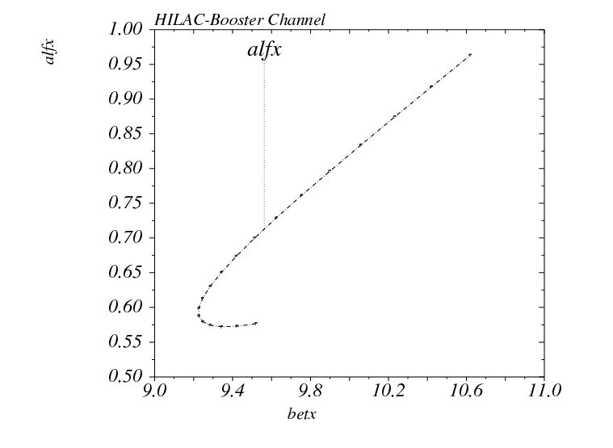
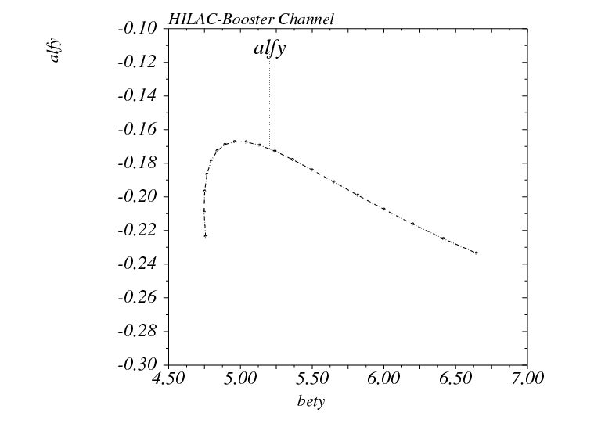
Debunching effects (2D)
Twiss parameters

Slide 11
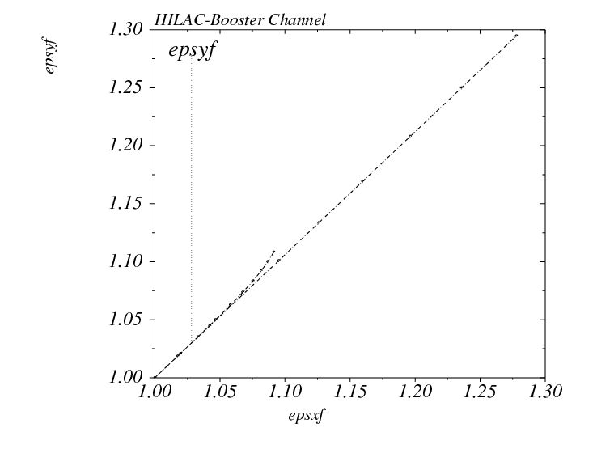
Debunching effects (2D)
Emittance growth

Slide 12
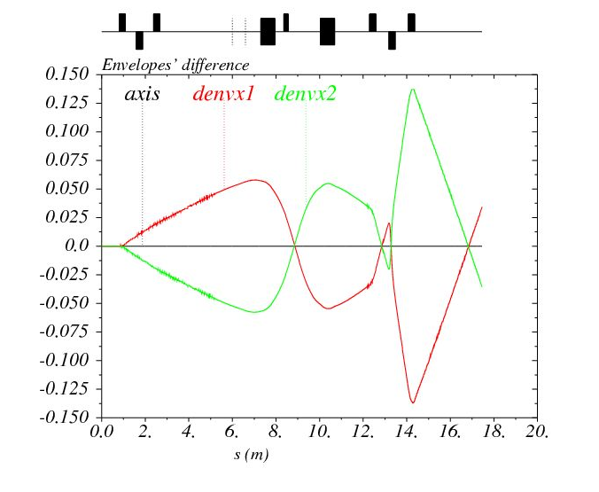
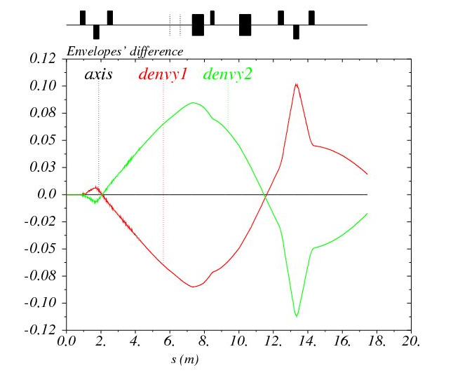
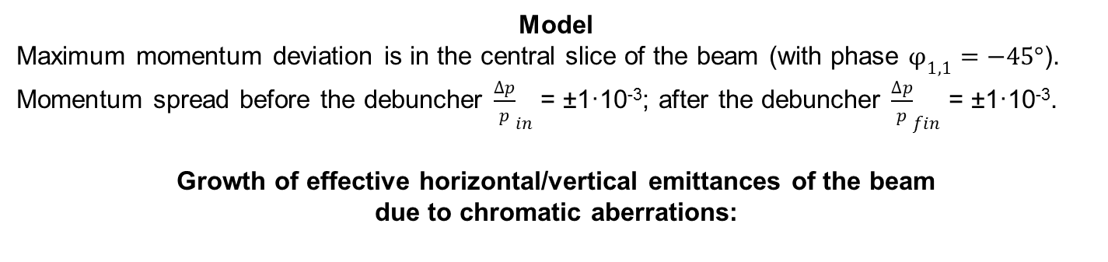
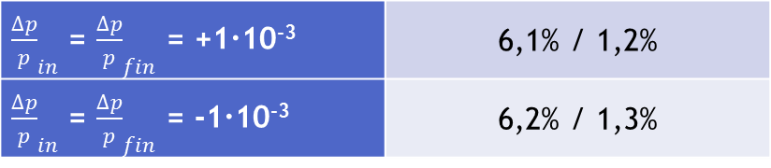
Chromatic effects (2D)
Emittance growth
Model
Maximum momentum deviation is in the central slice of the beam (with phase $φ_{1,1}=−45°$). Momentum spread before the debuncher ${\frac{∆p}{p}}_{in}$ = ±1·10⁻³; after the debuncher ${\frac{∆p}{p}}_{fin}$ = ±1·10⁻³.
Growth of effective horizontal/vertical emittances of the beam
due to chromatic aberrations:
${\frac{∆p}{p}}_{in}$ = ${\frac{∆p}{p}}_{fin}$ = +1·10⁻³ | 6,1% / 1,2%
${\frac{∆p}{p}}_{in}$ = ${\frac{∆p}{p}}_{fin}$ = -1·10⁻³ | 6,2% / 1,3%

Slide 13
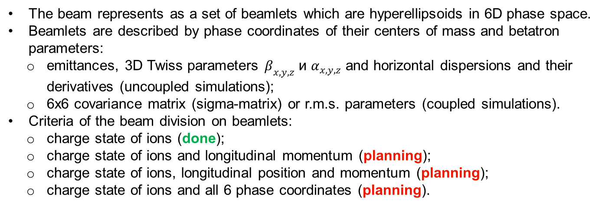
Beam dynamics simulations (3D)
Goals
To cross-check 2D simulations.
To study debunching effects.
To study chromatic effects.
To study coupling effects in the septum.
To study influence of space charge of three-component beam on:
transverse dynamics
debunching
separation of parasitic charge states
To study non-linear effects.
Methods/models
The beam represents as a set of beamlets which are hyperellipsoids in 6D phase space.
Beamlets are described by phase coordinates of their centers of mass and betatron parameters:
emittances, 3D Twiss parameters $β_{x,y,z}$ и $α_{x,y,z}$ and horizontal dispersions and their derivatives (uncoupled simulations);
6x6 covariance matrix (sigma-matrix) or r.m.s. parameters (coupled simulations).
Criteria of the beam division on beamlets:
charge state of ions (done);
charge state of ions and longitudinal momentum (planning);
charge state of ions, longitudinal position and momentum (planning);
charge state of ions and all 6 phase coordinates (planning).

Slide 14
Beam dynamics simulations (3D)
Lattice functions and envelopes

Slide 15
Beam dynamics simulations (3D)
Beam length and momentum spread

Slide 16
Beam dynamics simulations (3D)
Separation

Slide 17
Channel flexibility
Tuning for different injection schemes
Injection scheme | X, mm | X’, mrad | β_{x}, m | α_{x}
1) Single-turn injection. | 49 | -9,98 | 7 | 0,56
2) Multiturn injection with single-plateau pulse. | 48,5 | -1,58 | 7 | 0,56
3) Two-turn injection with double-plateau pulse. | 48,5 | -1,58 | 7 | 0,56
4) Twice injection with single-plateau pulse without dynamic retuning of the channel. | 45,9 | -9,35; -3,59 | 3,9 | 0,32
5) Twice injection with single-plateau pulse with dynamic retuning of the channel. | 49; 44,4 | -9,98; -3,46 | 7; 2,5 | 0,56; 0,2
6) Twice injection with double-plateau pulse without dynamic retuning of the channel. | 49; 48,5 | -9,98; -3,78 | 7 | 0,56
7) Twice injection with double-plateau pulse with dynamic retuning of the channel. | 49; 45,4 | -9,98; -3,54 | 7; 3,4 | 0,56; 0,27
8) Triple injection with double-plateau pulse without dynamic retuning of the channel. | 45,9 | -9,35; -3,59; -3,62 | 3,9 | 0,32
9) Triple injection with double-plateau pulse with dynamic retuning of the channel. | 49; 45,4; 44,9 | -9,98; -3,54; -3,53 | 7; 3,4; 3 | 0,56; 0,27; 0,24

Slide 18
Channel flexibility
Tuning for different injection schemes
Injection scheme | x, mm | x’, mrad | U_{sep}, kV | φ_{corr}, mrad
1) Single-turn injection. | 3,8 | -0,85 | 116,6 | 0
2) Multiturn injection with single-plateau pulse. | -2,3 | -3,41 | 124,7 | -2,56
3) Two-turn injection with double-plateau pulse. | -2,3 | -3,41 | 124,7 | -2,56
4) Twice injection with single-plateau pulse without dynamic retuning of the channel. | 1,2; -2,7 | -1,95; -3,6 | 117,8; 123,3 | -1,1; -2,75
5) Twice injection with single-plateau pulse with dynamic retuning of the channel. | 3,8; -3,9 | -0,85; -4,11 | 116,6; 123,8 | 0; -3,26
6) Twice injection with double-plateau pulse without dynamic retuning of the channel. | 3,8; -0,8 | -0,85; -2,78 | 116,6; 122,6 | 0; -1,93
7) Twice injection with double-plateau pulse with dynamic retuning of the channel. | 3,8; -3,1 | -0,85; -3,77 | 116,6; 123,5 | 0; -2,92
8) Triple injection with double-plateau pulse without dynamic retuning of the channel. | 1,2; -2,7; -2,7 | -1,95; -3,6; -3,59 | 117,8; 123,3; 123,3 | -1,1; -2,75; -2,74
9) Triple injection with double-plateau pulse with dynamic retuning of the channel. | 3,8; -3,1; -3,5 | -0,85; -3,77; -3,93 | 116,6; 123,5; 123,6 | 0; -2,92; -3,08

Slide 19
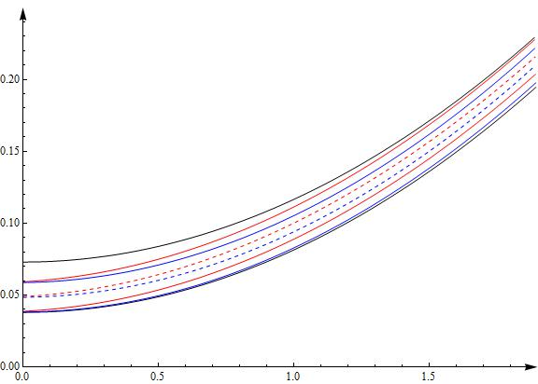
Channel flexibility
Tuning for different injection schemes

Slide 20


Channel flexibility
Tuning for different injection schemes
Variation of $β_{x}$ and $α_{x}$ at the entrance of the septum
$$α_{x}$$
$$β_{x}$$

Slide 21
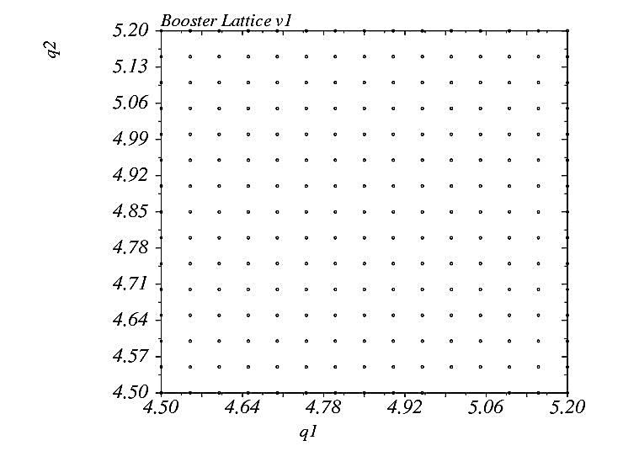
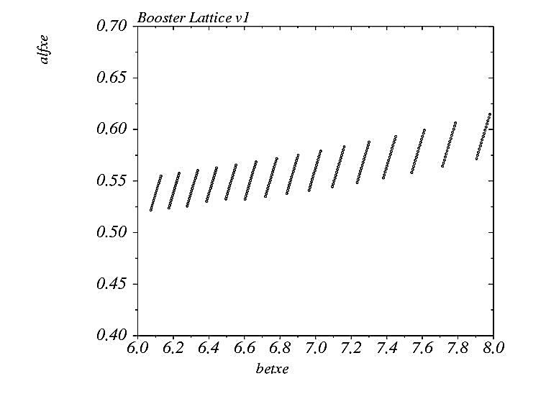
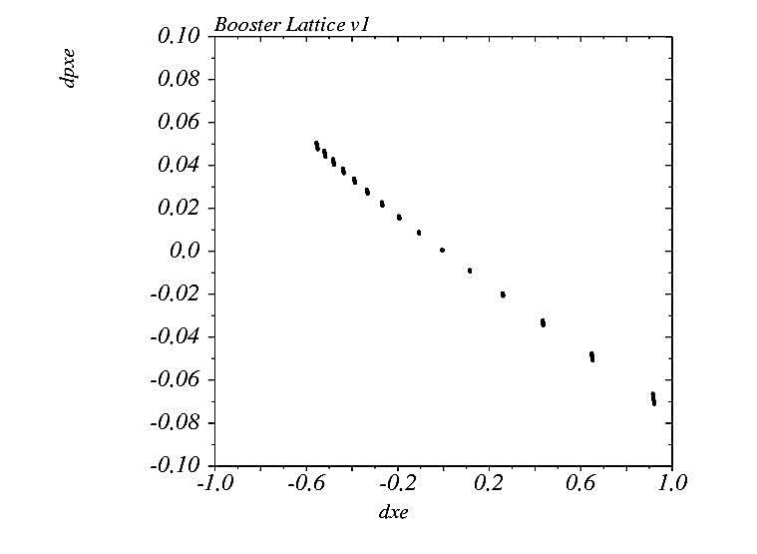
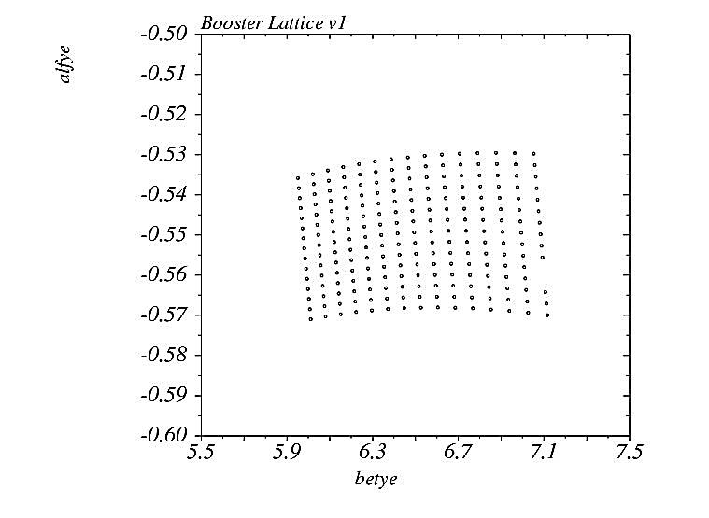
Channel flexibility
Tuning for different betatron tunes
Booster tunes $Q_{x}/Q_{y}$ and lattice functions at the exit of the septum

Slide 22


Channel flexibility
Tuning for different betatron tunes
Variation of Booster tunes $Q_{x}$ and $Q_{y}$
$$Q_{y}$$
$$Q_{x}$$

Slide 23
Channel flexibility
Tuning for different initial beam parameters
Variation of $β_{x}$, $α_{x}$, $β_{y}$ and $α_{y}$ at the exit of the HILAC

Slide 24
Tolerances
Alignment errors
Dipoles
Displacement along longitudinal axis, mm | 20
Horizontal displacement, mm | 1
Vertical displacement, mm | 1
Rotation around vertical axis, deg | 0,5
Rotation around horizontal transverse axis, deg | 0,5
Rotation around longitudinal axis, deg | 0,5
Quadrupoles
Displacement along longitudinal axis, mm | 5
Transverse displacement, mm | 1
Rotation around vertical axis, deg | 0,5
Rotation around horizontal transverse axis, deg | 0,5
Rotation around longitudinal axis, deg | 0,5
Magnetic field inhomogeneities on pulse top
Dipoles | ± 5·10⁻⁴
Quadrupoles | ± 1·10⁻³
Steerers | ± 1·10⁻²

Slide 25
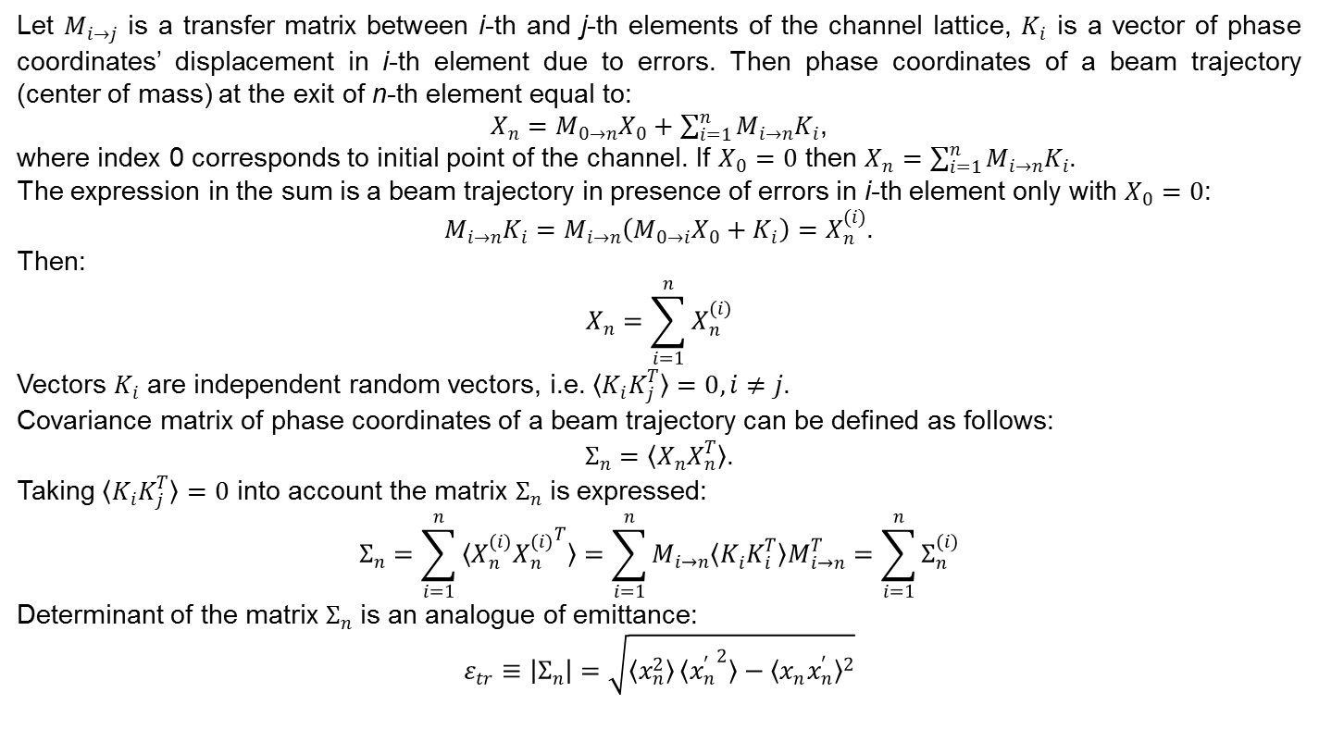
Alignment and field errors
Statistical analysis of beam trajectory
Let $M_{i→j}$ is a transfer matrix between i-th and j-th elements of the channel lattice, $K_{i}$ is a vector of phase coordinates’ displacement in i-th element due to errors. Then phase coordinates of a beam trajectory (center of mass) at the exit of n-th element equal to:
$X_{n}=M_{0→n}X_{0}+\sum_{i=1}^{n}{M_{i→n}K_{i}}$,
where index 0 corresponds to initial point of the channel. If $X_{0}=0$ then $X_{n}=\sum_{i=1}^{n}{M_{i→n}K_{i}}$.
The expression in the sum is a beam trajectory in presence of errors in i-th element only with $X_{0}=0$:
$M_{i→n}K_{i}=M_{i→n}\left(M_{0→i}X_{0}+K_{i}\right)=X_{n}^{(i)}$.
Then:
$$X_{n}=\sum_{i=1}^{n}{X_{n}^{(i)}}$$
Vectors $K_{i}$ are independent random vectors, i.e. $〈K_{i}K_{j}^{T}〉=0, i≠j$.
Covariance matrix of phase coordinates of a beam trajectory can be defined as follows:
$Σ_{n}=〈X_{n}X_{n}^{T}〉$.
Taking $〈K_{i}K_{j}^{T}〉=0$ into account the matrix $Σ_{n}$ is expressed:
$$Σ_{n}=\sum_{i=1}^{n}{〈X_{n}^{(i)}{X_{n}^{(i)}}^{T}〉}=\sum_{i=1}^{n}{M_{i→n}〈K_{i}^{ }K_{i}^{T}〉M_{i→n}^{T}}=\sum_{i=1}^{n}{Σ_{n}^{(i)}}$$
Determinant of the matrix $Σ_{n}$ is an analogue of emittance:
$$ε_{tr}≡\left|Σ_{n}\right|=\sqrt{〈x_{n}^{2}〉〈{x_{n}^{′}}^{2}〉−{〈x_{n}^{ }x_{n}^{′}〉}^{2}}$$

Slide 26
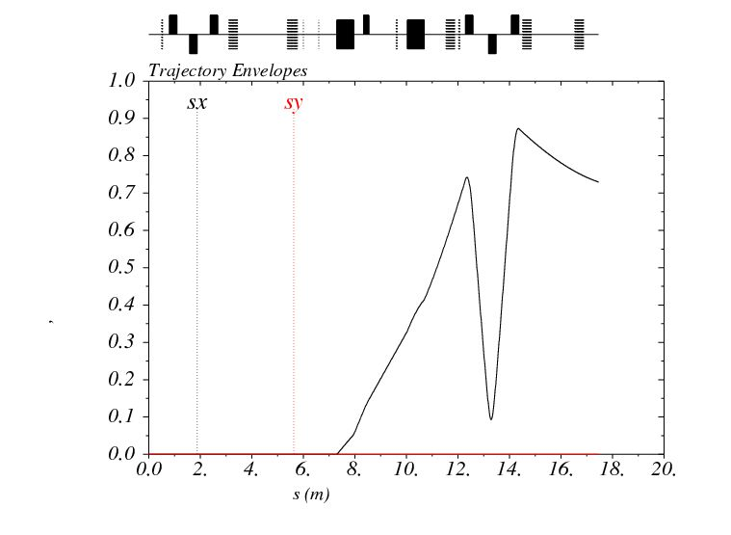
Dipoles’ field errors
Beam trajectory distribution

Slide 27
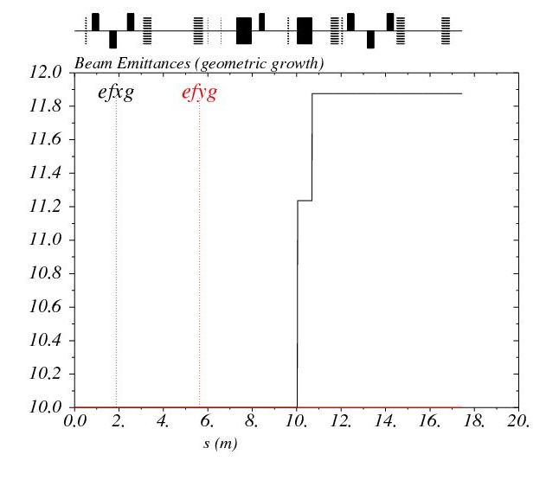
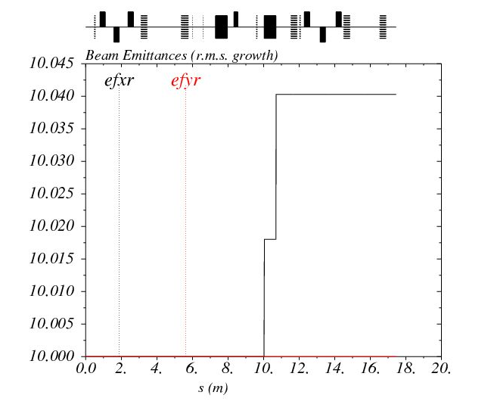
Dipoles’ field errors
Beam emittance growth

Slide 28
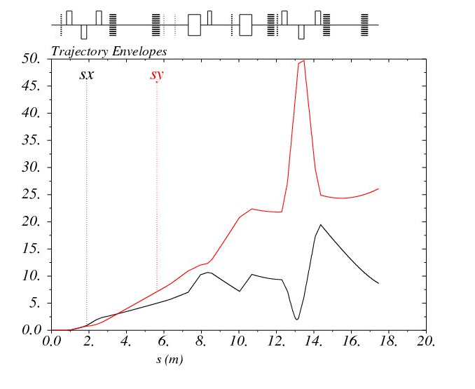
Alignment errors
Beam trajectory distribution

Slide 29
Alignment errors
Local trajectory correction
Two pick-ups + two steerers on drift section $⟹$ beam trajectory gets zero

Slide 30
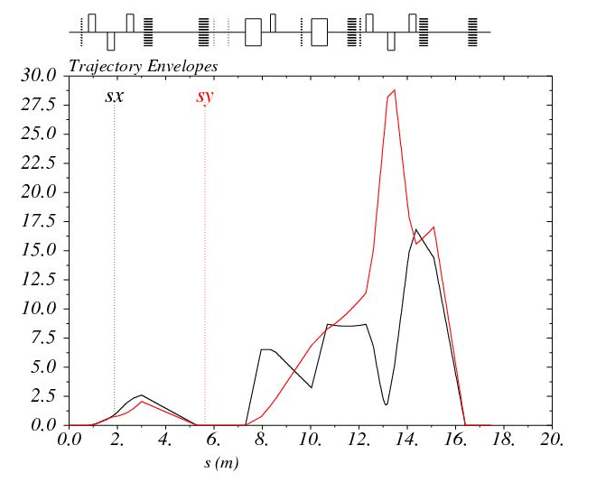
Alignment errors
Beam trajectory distribution with local correction

Slide 31
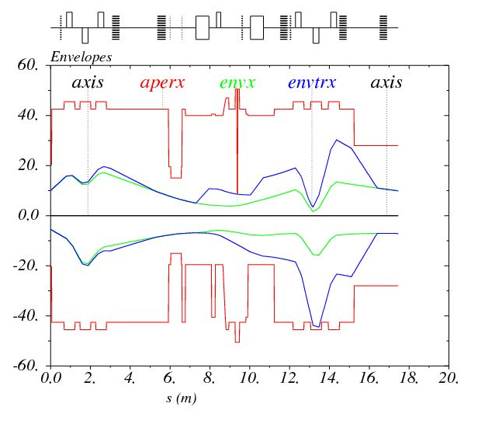
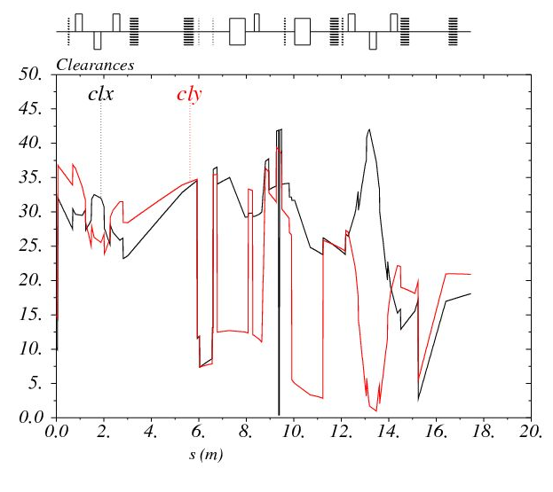
Alignment errors
Beam envelopes and clearances

Slide 32
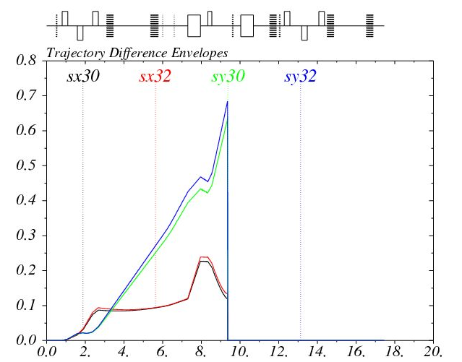
Alignment errors
Beam trajectory distributions for different charge states

Slide 33
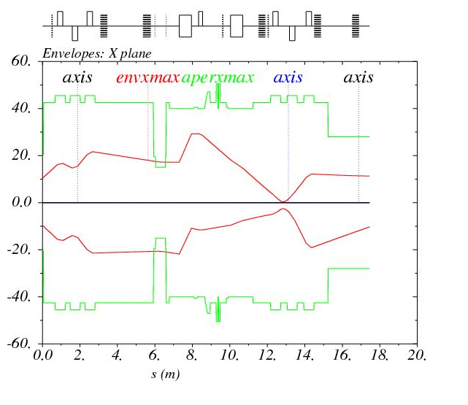
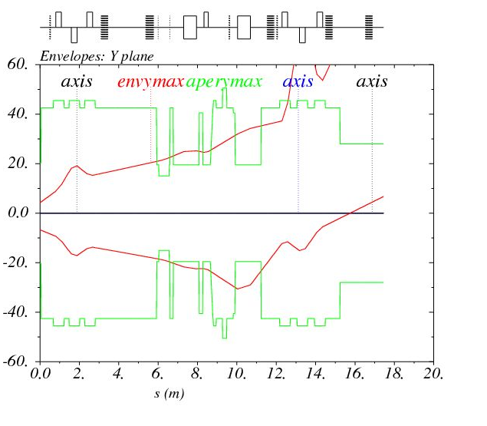
Tuning simulations (example 1)
Initial state
Beam current
FCT1, FC1, FC2 | 100%
FC3 | ~70%
FCT2 | ~50%
FCT3 | ~20%
Sigma of errors
Dipole long. shift, mm | 20
Dipole rotation, mrad | 7.5
Quadrupole transverse shift, mm | 1

Slide 34
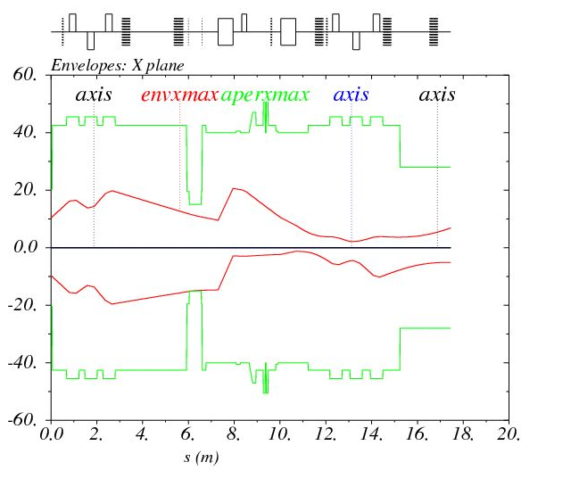
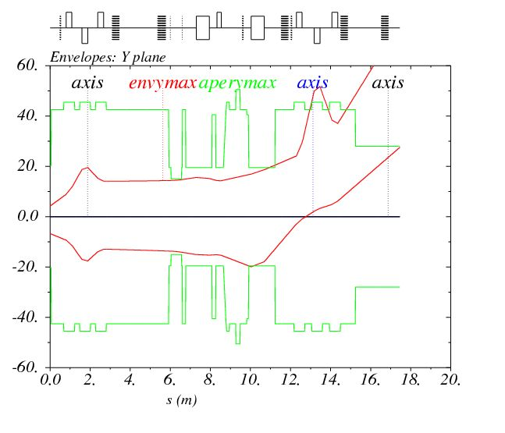
Tuning simulations (example 1)
Iteration 1 (Q1-Q3 tuning)
Beam current
FCT1, FC1, FC2 | 100%
FC3 | ~100%
FCT2 | ~95%
FCT3 | ~80%

Slide 35
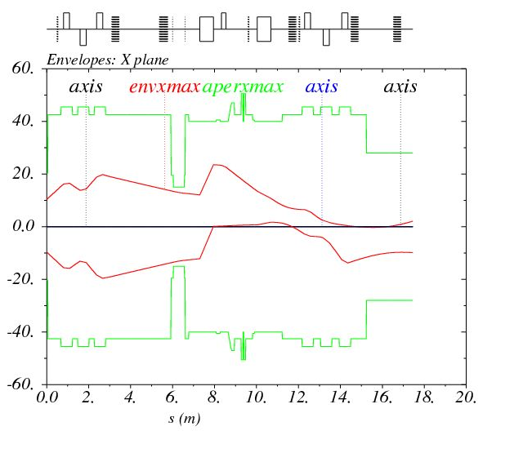

Tuning simulations (example 1)
Iteration 2 (correction by CM1-CM2)
Beam position (X/Y) , mm
 | before | after
BPM1 | 0 / 0.5 | 0 / 0.5
BPM2 | -1.5 / 0.5 | 0 / 0.5

Slide 36
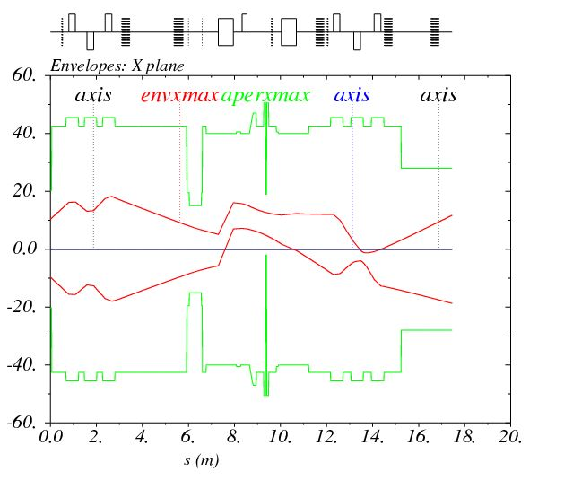
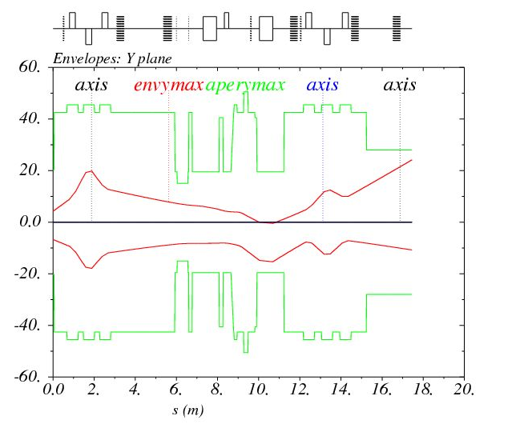
Tuning simulations (example 1)
Iterations 3-4 (collimation, correction by CM3 and Q1-Q3 tuning)
Beam current
 | before | after
FCT2, BPM4 | ~90% | 100%
BPM5 | ~10% | 100%

Slide 37
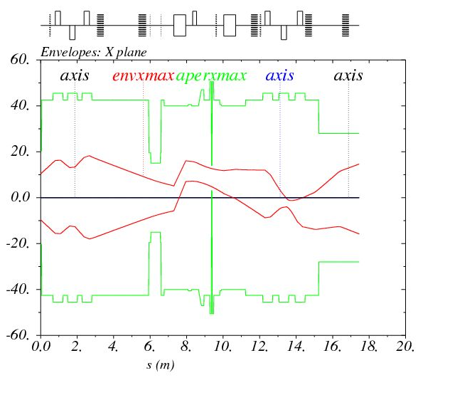
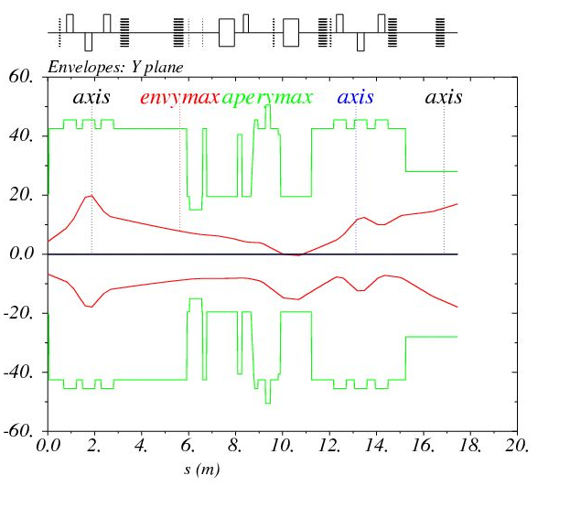
Tuning simulations (example 1)
Iteration 5 (correction by CM5-CM6)
Beam position (X/Y) , mm
 | before | after
BPM4 | -6 / 2 | -6 / 2
BPM5 | -4 / 6 | 0 / 0

Slide 38
Beam dynamics simulations
Plans
To develop 3D code with space charge in order:
to study debunching effects;
to study chromatic effects;
to study coupling effects in the septum;
to study influence of space charge of three-component beam on transverse dynamics, debunching, separation of parasitic charge states;
to study non-linear effects.
To study influence of field errors of quadrupoles on the beam dynamics.
To simulate the full process of the channel tuning by means of quadrupoles, steerers and beam diagnostics devices.
To develop methods and tools of the channel tuning.

Slide 39
THANK YOU FOR ATTENTION

Slide 40
EXTRA SLIDES

Slide 41
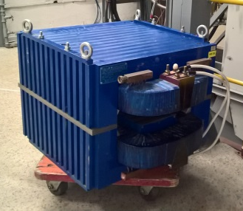
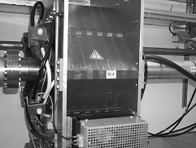
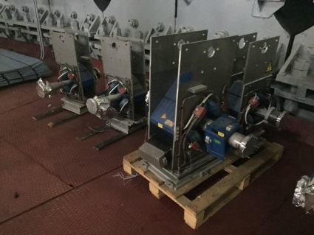
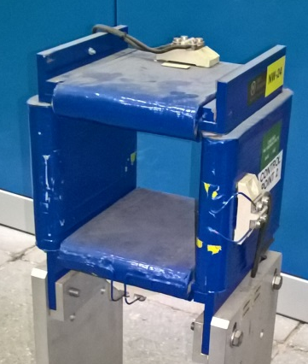
Channel equipment
Parameters of main elements
Dipoles
Effective length, m | 0.65
Max field, T | 1
Gap, mm | 45
Quadrupoles
Effective length, m | 0.29 / 0.21
Max gradient, T/m | 10 / 19
Gap (diameter), mm | 95 / 71
Steerers
Effective length, m | 0.25
Max field, T | 0.05
Gap, mm | 125 × 110

Slide 42
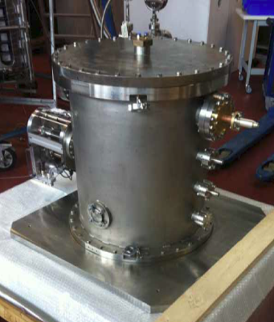
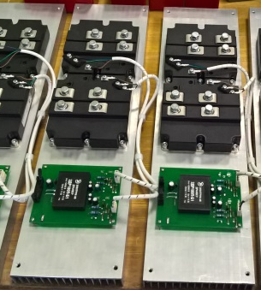
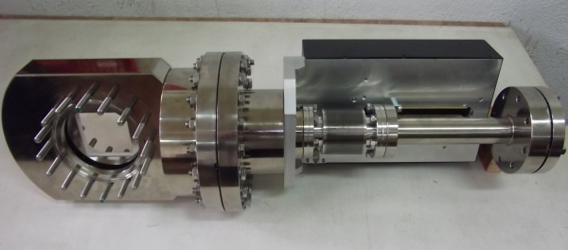
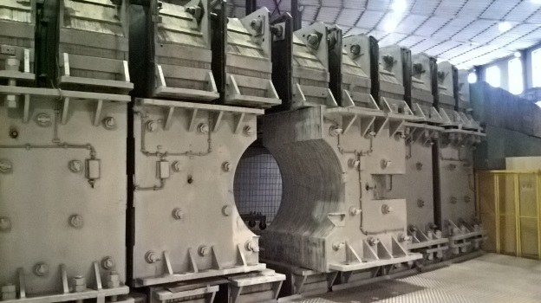
Channel equipment
Parameters of main elements
Debuncher
Inner length, m | 0.49
Frequency, MHz | 100.625
Max effective voltage, kV | 260
Designed and fabricated by Bevatech team
Status of channel equipment
Power supplies are being assembled.
Beam diagnostics is purchased partially. Full set of beam diagnostics will not be purchased until the channel commissioning.
First part of vacuum equipment is delivered. Full set of vacuum equipment will be delivered in the nearest future.
Design of stands is near completion.

Slide 43
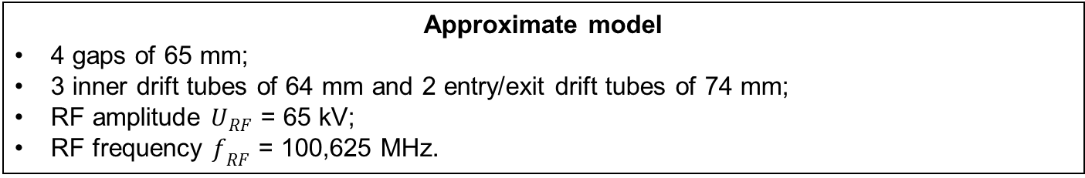
Mathematical models
Debuncher
Approximate model
4 gaps of 65 mm;
3 inner drift tubes of 64 mm and 2 entry/exit drift tubes of 74 mm;
RF amplitude $U_{RF}$ = 65 kV;
RF frequency $f_{RF}$ = 100,625 MHz.

Slide 44
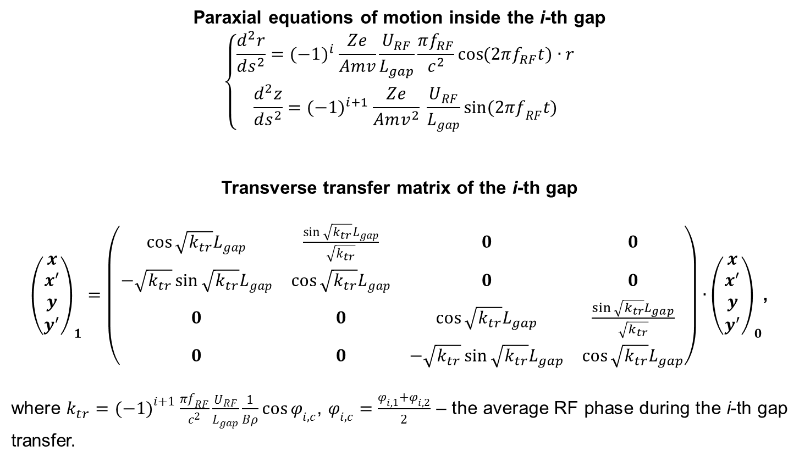
Mathematical models
Debuncher
Paraxial equations of motion inside the i-th gap
$$\left\{\begin{matrix}\frac{d^{2}r}{ds^{2}}={(−1)}^{i} \frac{Ze}{Amv}\frac{U_{RF}}{L_{gap}}\frac{πf_{RF}}{c^{2}}\cos{(2πf_{RF}t)}∙r \\ \frac{d^{2}z}{ds^{2}}={(−1)}^{i+1} \frac{Ze}{Amv^{2}} \frac{U_{RF}}{L_{gap}}\sin{(2πf_{RF}t)}\end{matrix}\right.$$
Transverse transfer matrix of the i-th gap
${\left(\begin{matrix}x \\ x^{′} \\ y \\ y^{′}\end{matrix}\right)}_{1}=\left(\begin{matrix}\cos{\sqrt{k_{tr}}L_{gap}} & \frac{\sin{\sqrt{k_{tr}}L_{gap}}}{\sqrt{k_{tr}}} & 0 & 0 \\ −\sqrt{k_{tr}}\sin{\sqrt{k_{tr}}L_{gap}} & \cos{\sqrt{k_{tr}}L_{gap}} & 0 & 0 \\ 0 & 0 & \cos{\sqrt{k_{tr}}L_{gap}} & \frac{\sin{\sqrt{k_{tr}}L_{gap}}}{\sqrt{k_{tr}}} \\ 0 & 0 & −\sqrt{k_{tr}}\sin{\sqrt{k_{tr}}L_{gap}} & \cos{\sqrt{k_{tr}}L_{gap}}\end{matrix}\right)∙{\left(\begin{matrix}x \\ x^{′} \\ y \\ y^{′}\end{matrix}\right)}_{0}$,
where $k_{tr}={(−1)}^{i+1} \frac{πf_{RF}}{c^{2}}\frac{U_{RF}}{L_{gap}}\frac{1}{Bρ}\cos{φ_{i,c}}$, $φ_{i,c}=\frac{φ_{i,1}+φ_{i,2}}{2}$ – the average RF phase during the i-th gap transfer.

Slide 45
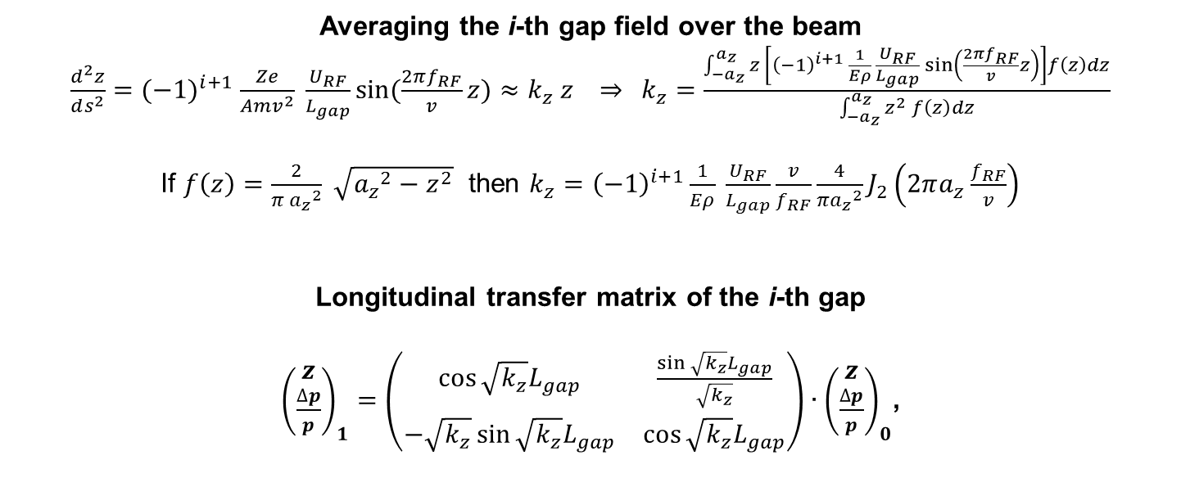
Mathematical models
Debuncher
Averaging the i-th gap field over the beam
$\frac{d^{2}z}{ds^{2}}={(−1)}^{i+1} \frac{Ze}{Amv^{2}} \frac{U_{RF}}{L_{gap}}\sin{(\frac{2πf_{RF}}{v}z)}≈k_{z} z ⇒$ $k_{z}=\frac{\int_{−a_{z}}^{a_{z}}{z \left[{\left(−1\right)}^{i+1} \frac{1}{Eρ} \frac{U_{RF}}{L_{gap}}\sin\left(\frac{2πf_{RF}}{v}z\right)\right]f\left(z\right)dz}}{\int_{−a_{z}}^{a_{z}}{z^{2} f\left(z\right)dz}}$
If $f\left(z\right)=\frac{2}{π {a_{z}}^{2}} \sqrt{{a_{z}}^{2}−z^{2}}$ then $k_{z}={\left(−1\right)}^{i+1}\frac{1}{Eρ} \frac{U_{RF}}{L_{gap}}\frac{v}{f_{RF}}\frac{4}{π{a_{z}}^{2}}J_{2}\left(2πa_{z}\frac{f_{RF}}{v}\right)$
Longitudinal transfer matrix of the i-th gap
${\left(\begin{matrix}z \\ \frac{∆p}{p}\end{matrix}\right)}_{1}=\left(\begin{matrix}\cos{\sqrt{k_{z}}L_{gap}} & \frac{\sin{\sqrt{k_{z}}L_{gap}}}{\sqrt{k_{z}}} \\ −\sqrt{k_{z}}\sin{\sqrt{k_{z}}L_{gap}} & \cos{\sqrt{k_{z}}L_{gap}}\end{matrix}\right)∙{\left(\begin{matrix}z \\ \frac{∆p}{p}\end{matrix}\right)}_{0}$,

Slide 46
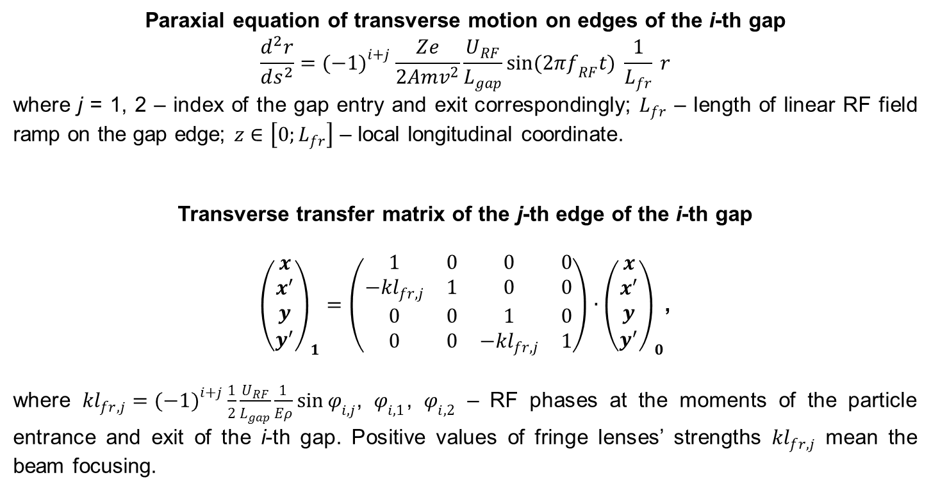
Mathematical models
Debuncher
Paraxial equation of transverse motion on edges of the i-th gap
$$\frac{d^{2}r}{ds^{2}}={(−1)}^{i+j} \frac{Ze}{2Amv^{2}}\frac{U_{RF}}{L_{gap}}\sin{(2πf_{RF}t)} \frac{1}{L_{fr}} r$$
where j = 1, 2 – index of the gap entry and exit correspondingly; $L_{fr}$ – length of linear RF field ramp on the gap edge; $z∈\left[0;L_{fr}\right]$ – local longitudinal coordinate.
Transverse transfer matrix of the j-th edge of the i-th gap
${\left(\begin{matrix}x \\ x^{′} \\ y \\ y^{′}\end{matrix}\right)}_{1}=\left(\begin{matrix}1 & 0 & 0 & 0 \\ −{kl}_{fr,j} & 1 & 0 & 0 \\ 0 & 0 & 1 & 0 \\ 0 & 0 & −{kl}_{fr,j} & 1\end{matrix}\right)∙{\left(\begin{matrix}x \\ x^{′} \\ y \\ y^{′}\end{matrix}\right)}_{0}$,
where ${kl}_{fr,j}={(−1)}^{i+j} \frac{1}{2}\frac{U_{RF}}{L_{gap}}\frac{1}{Eρ}\sin{φ_{i,j}}$, $φ_{i,1}$, $φ_{i,2}$ – RF phases at the moments of the particle entrance and exit of the i-th gap. Positive values of fringe lenses’ strengths ${kl}_{fr,j}$ mean the beam focusing.

Slide 47
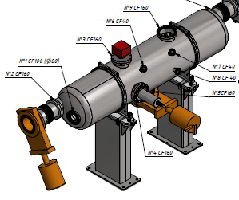


Mathematical models
Booster injection system
IP1
ESS
IP2
IP3
Electrostatic septum ESS

Slide 48

Mathematical models
Electrostatic cylindrical deflector
Equations of motion in cylindrical coordinates (over time)
$$\left\{\begin{matrix}\ddot{r}=r{\dot{θ}}^{2}−\frac{Ze}{Am}∙\frac{U_{RF}}{\ln{\frac{r_{2}}{r_{1}}}}∙\frac{1}{r} \\ \ddot{y}=0 \\ r\ddot{θ}+2\dot{r}\dot{θ}=0\end{matrix}\right.$$
$M=Amr^{2}\dot{θ}=const$, $\frac{∆p}{p}$ varies!!!
Accompanying coordinates: $\left(s≡r_{0}\dot{θ}t;x≡r−r_{0};x^{′};y;y^{′};z≡−v_{0}∆t; \frac{∆M}{M}\right) ⇒$
linearized equations of motion
$$\left\{\begin{matrix}x^{′′}≡\frac{d^{2}x}{ds^{2}}=\frac{2}{{r_{0}}^{ }}\frac{∆M}{M}−\frac{2}{{r_{0}}^{2}}x \\ y^{′′}≡\frac{d^{2}y}{ds^{2}}=0 \\ z\left(s\right)=z\left(0\right)+\frac{∆M}{M}s−\frac{2}{{r_{0}}^{ }}\int_{0}^{s}{x\left(s^{′}\right)ds′}\end{matrix}\right.$$

Slide 49

Mathematical models
Electrostatic cylindrical deflector
6x6 transfer matrix (for $\frac{∆M}{M}$ as a phase coordinate)
$${\left(\begin{matrix}x \\ x^{′} \\ y \\ y^{′} \\ z \\ \frac{∆M}{M}\end{matrix}\right)}_{1}=\left(\begin{matrix}\cos\left(\frac{\sqrt{2}L}{r_{0}}\right) & \frac{r_{0}}{\sqrt{2}}\sin\left(\frac{\sqrt{2}L}{r_{0}}\right) & 0 & 0 & 0 & r_{0}\left(1−\cos\left(\frac{\sqrt{2}L}{r_{0}}\right)\right) \\ −\frac{\sqrt{2}}{r_{0}}\sin\left(\frac{\sqrt{2}L}{r_{0}}\right) & \cos\left(\frac{\sqrt{2}L}{r_{0}}\right) & 0 & 0 & 0 & \sqrt{2}\sin\left(\frac{\sqrt{2}L}{r_{0}}\right) \\ 0 & 0 & 1 & L & 0 & 0 \\ 0 & 0 & 0 & 1 & 0 & 0 \\ −\sqrt{2}\sin\left(\frac{\sqrt{2}L}{r_{0}}\right) & −r_{0}\left(1−\cos\left(\frac{\sqrt{2}L}{r_{0}}\right)\right) & 0 & 0 & 1 & \sqrt{2}r_{0}\sin\left(\frac{\sqrt{2}L}{r_{0}}\right)−L \\ 0 & 0 & 0 & 0 & 0 & 1\end{matrix}\right)∙{\left(\begin{matrix}x \\ x^{′} \\ y \\ y^{′} \\ z \\ \frac{∆M}{M}\end{matrix}\right)}_{0}$$
Motion is uncoupled
If $\frac{∆M}{M}≈\frac{∆p}{p}$ then the matrix can be used for uncoupled Twiss simulations.

Slide 50

Mathematical models
Electrostatic cylindrical deflector
Linearized angular momentum: $\frac{∆M}{M}=\frac{∆p}{p}+\frac{x}{r_{0}} ⇒$
6x6 transfer matrix (for $\frac{∆p}{p}$ as a phase coordinate)
$${\left(\begin{matrix}x \\ x^{′} \\ y \\ y^{′} \\ z \\ \frac{∆p}{p}\end{matrix}\right)}_{1}=\left(\begin{matrix}1 & \frac{r_{0}}{\sqrt{2}}\sin\left(\frac{\sqrt{2}L}{r_{0}}\right) & 0 & 0 & 0 & r_{0}\left(1−\cos\left(\frac{\sqrt{2}L}{r_{0}}\right)\right) \\ 0 & \cos\left(\frac{\sqrt{2}L}{r_{0}}\right) & 0 & 0 & 0 & \sqrt{2}\sin\left(\frac{\sqrt{2}L}{r_{0}}\right) \\ 0 & 0 & 1 & L & 0 & 0 \\ 0 & 0 & 0 & 1 & 0 & 0 \\ −\frac{L}{r_{0}} & −r_{0}\left(1−\cos\left(\frac{\sqrt{2}L}{r_{0}}\right)\right) & 0 & 0 & 1 & \sqrt{2}r_{0}\sin\left(\frac{\sqrt{2}L}{r_{0}}\right)−L \\ 0 & −\frac{1}{\sqrt{2}}\sin\left(\frac{\sqrt{2}L}{r_{0}}\right) & 0 & 0 & 0 & \cos\left(\frac{\sqrt{2}L}{r_{0}}\right)\end{matrix}\right)∙{\left(\begin{matrix}x \\ x^{′} \\ y \\ y^{′} \\ z \\ \frac{∆p}{p}\end{matrix}\right)}_{0}$$
Longitudinal-transverse coupling!!!
The matrix can be used for coupled 3D r.m.s. simulations.

Slide 51


Tuning simulations (example 2)
Initial state
Beam current
FCT1, FC1 | 100%
FC2 | ~95%
FC3 | ~40%
FCT2, FCT3 | <10%
Sigma of errors
Dipole long. shift, mm | 20
Dipole rotation, mrad | 7.5
Quadrupole transverse shift, mm | 2

Slide 52


Tuning simulations (example 2)
Iterations 1-3 (tuning of Q1-Q5, correction by CM1-CM2, collimation)
Beam position (X/Y) , mm
 | before | after
BPM1 | 9 / 3.5 | 7 / 2
BPM2 | 12 / 8 | 0 / 0

Slide 53


Tuning simulations (example 2)
Iterations 4-5 (correction by CM3-CM5)
Beam position (X/Y) , mm
 | before | after
BPM4 | 8 / -1.5 | 0 / 0
BPM5 | 2 / -5 | 0 / 0

