Slide 1
Test Bench for the NICA Stochastic Cooling Elements
I.Gorelyshev on behalf of the team

Slide 2
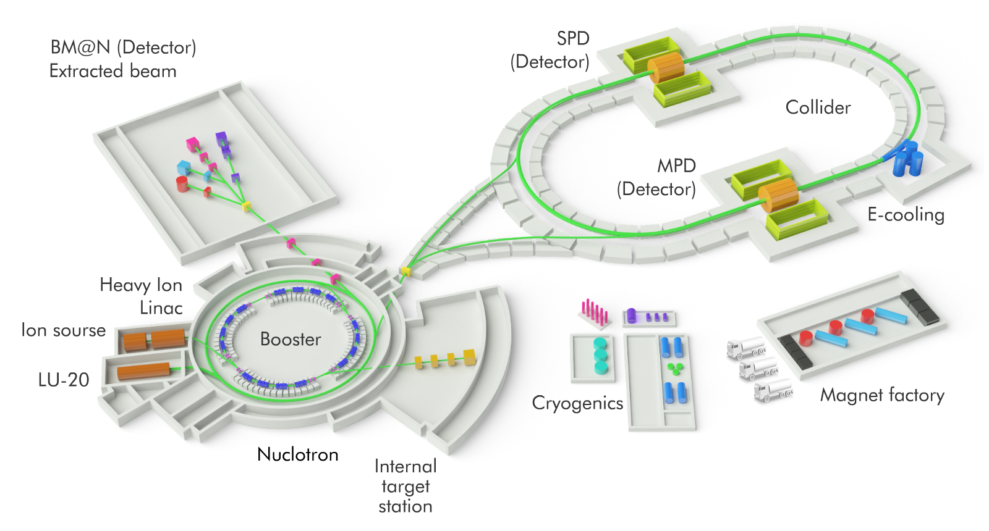
Nuclotron-based Ion Collider fAcility
Tasks:
Beam accumulation
Longitudinal emittance reduction during the bunching
Luminosity preservation (IBS suppression)

Slide 3
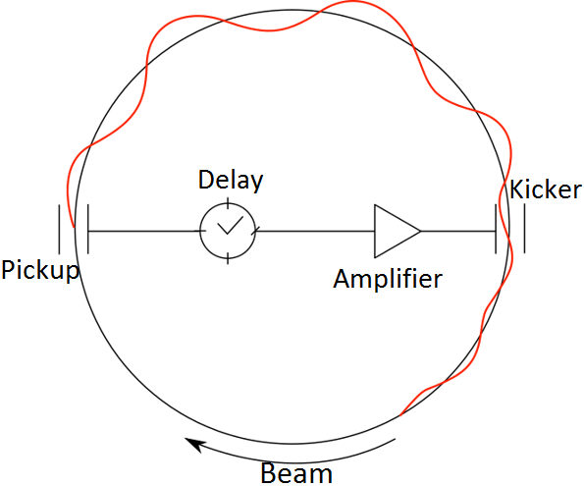
Stochastic cooling
Broadband RF system with feedback via the beam
Energy distribution
Provides the reduction of the betatron amplitudes ($⊥$) or momentum spread ($‖$)

Slide 4
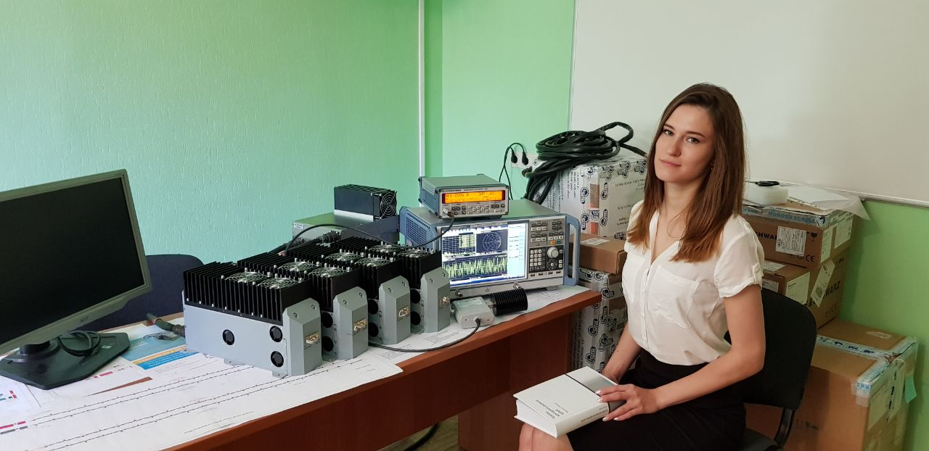
How many equipment units do we need?
6 pickups
4 kickers
80 Amplifiers

Slide 5
Why do we need a test bench?
Quality control
Measurements(PU/KK, Amplifiers, etc …)
Pickup/Kicker
Impedance dependence on azimuthal and longitudinal position
Electrical center position as a function of frequency
Influence of High-Order Mode suppressors
Influence of ceramic vacuum chamber
Kicker SWR
Amplifiers
Gain vs frequency
Gain vs input power
Gain linearity (frequency & power)
Phase linearity
Group delay
Intermodulation products
Reproducibility (gain, electrical length, …)

Slide 6
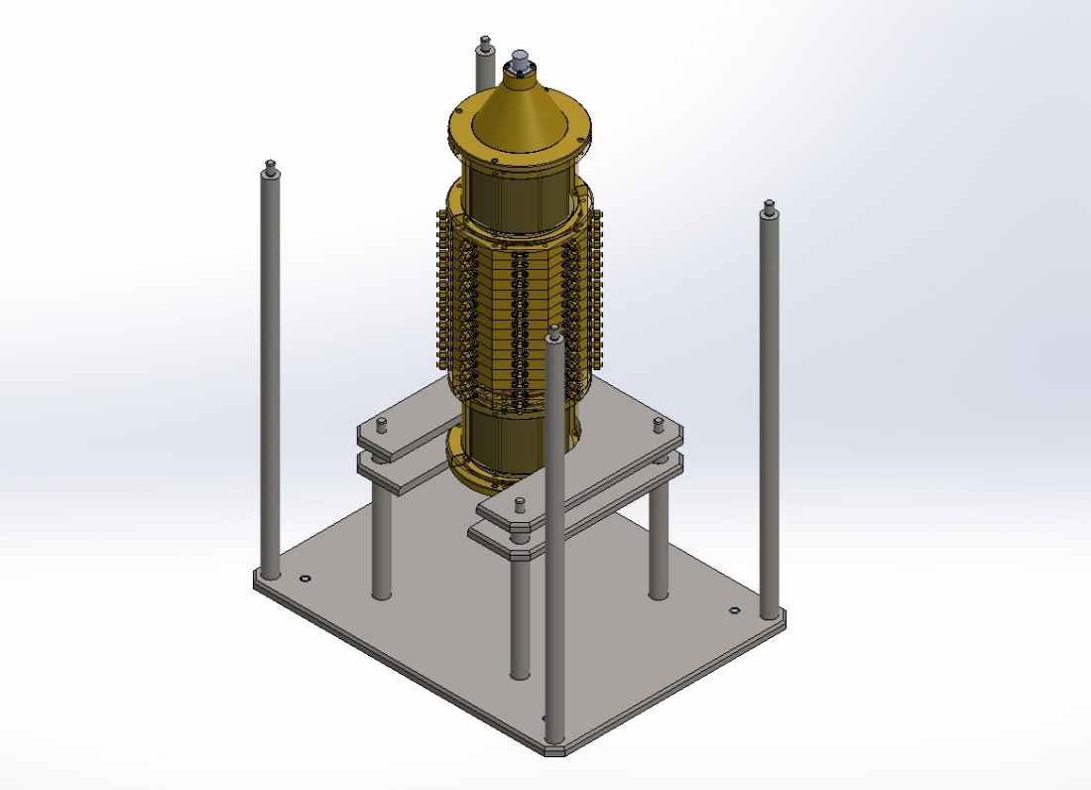
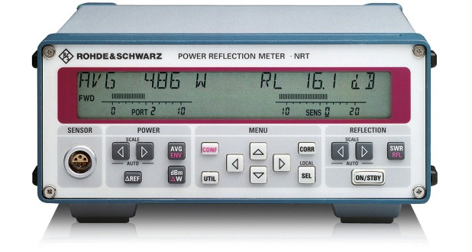
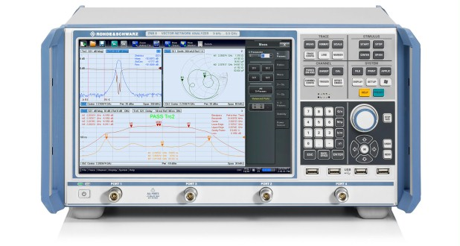
Test Bench
Comb Filter
Power meter
4-channel Vector Network Analyzer

Slide 7

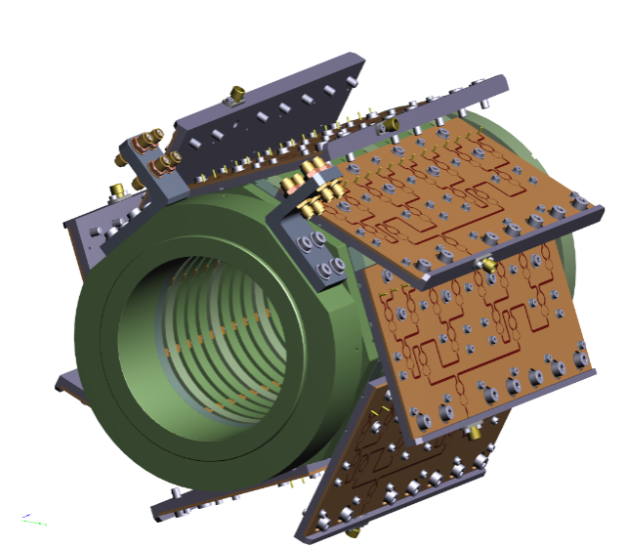
Pickup and Kicker
Ring Slot Couplers
Universal for 3 degrees of freedom
Large impedance
Bandwidth | 2-4 GHz
Aperture | 90 mm
Length | 300 mm
Ring Shunt Impedance | 9 Ω
Pickup Shunt Impedance | 144 Ω
Structure of one ring
Structure of 16 rings
with combiner boards
Quality control –> loop impedance
128 loops –> electrical center

Slide 8
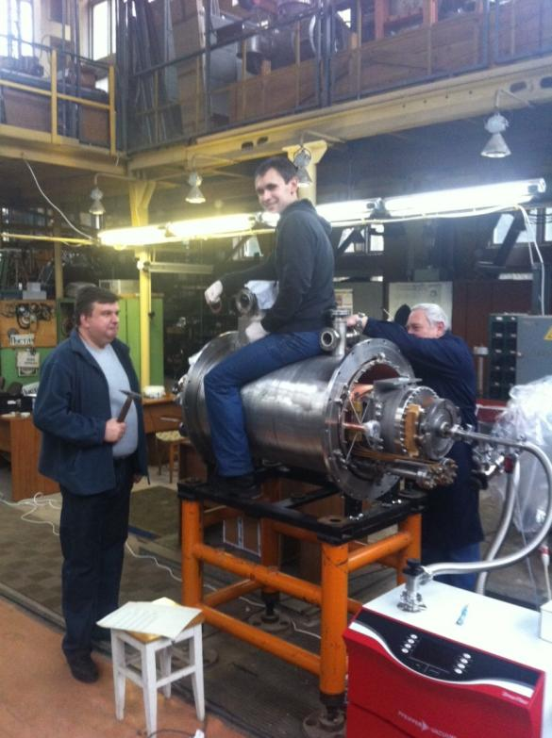
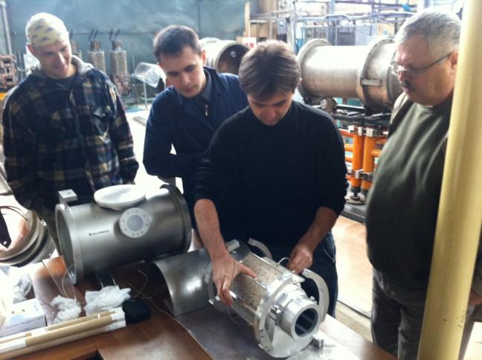
Stochastic Cooling Experiment at Nuclotron
Assembling of the kicker
In this design it is hard
to achieve ultra-high vacuum
Pick-up inside cryostat

Slide 9
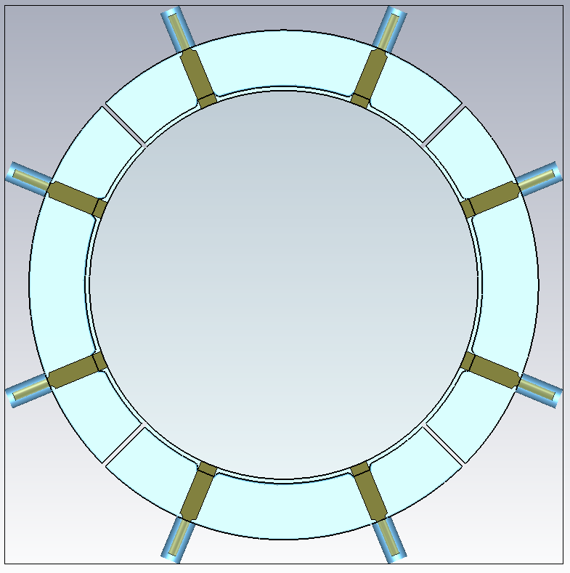
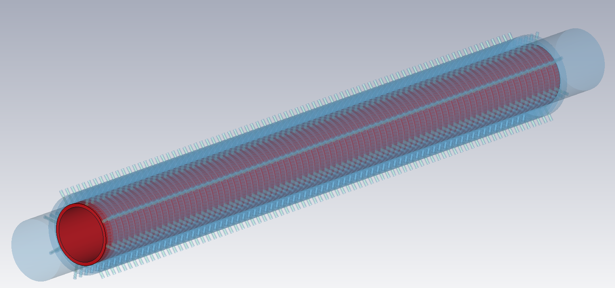
Possible Improvement of Pickup/Kicker
Separated structure with ceramic vacuum chamber inside rings

Slide 10
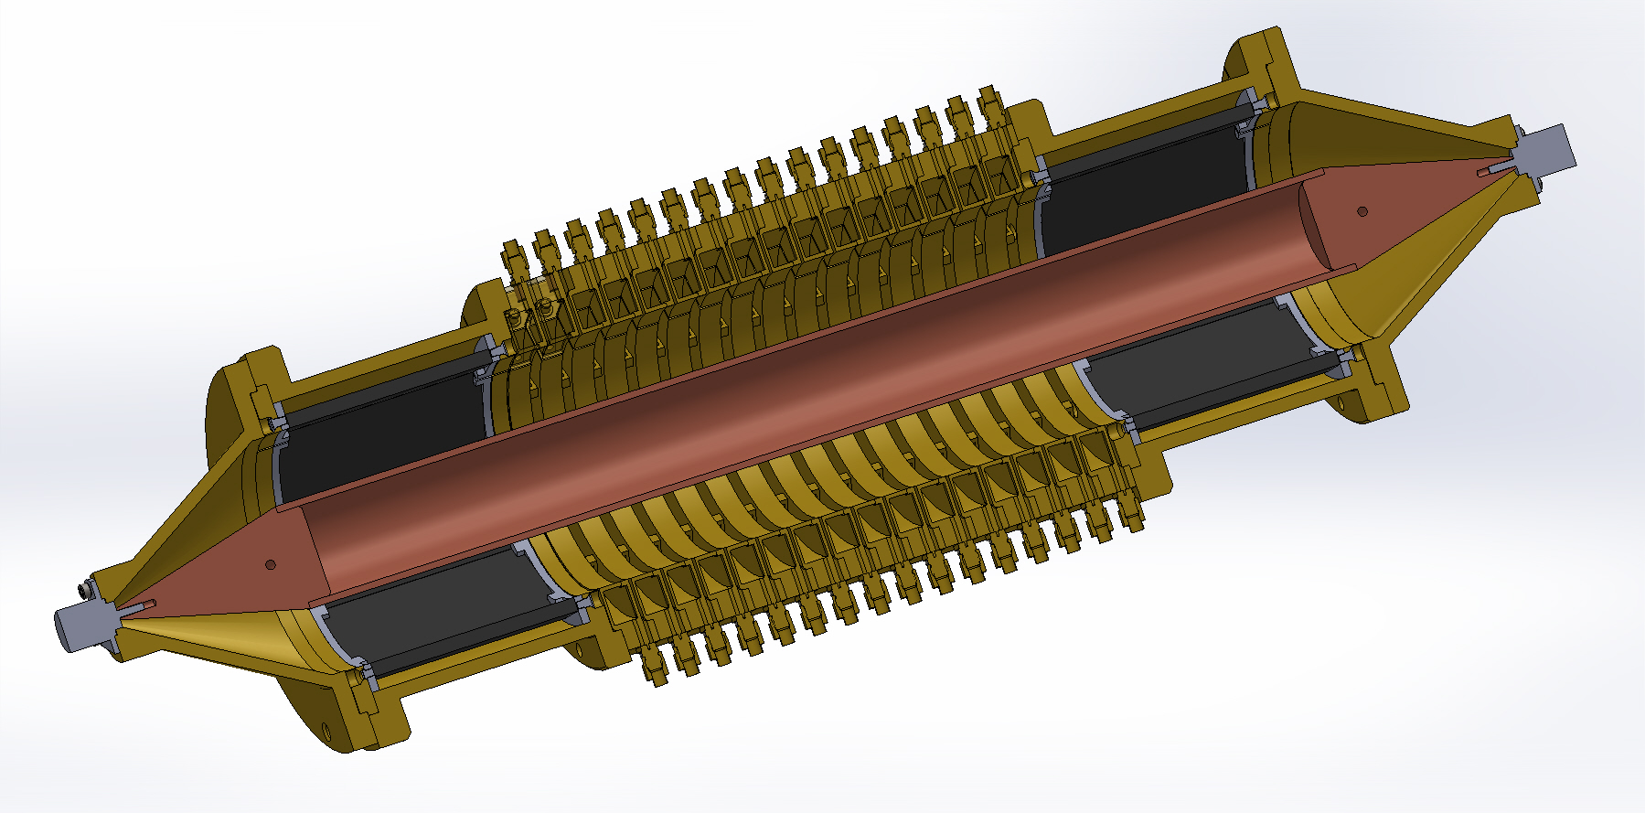
Prototype to Test

Slide 11
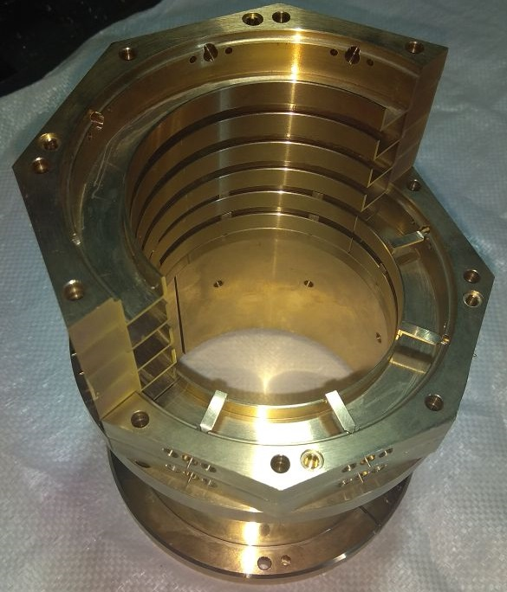
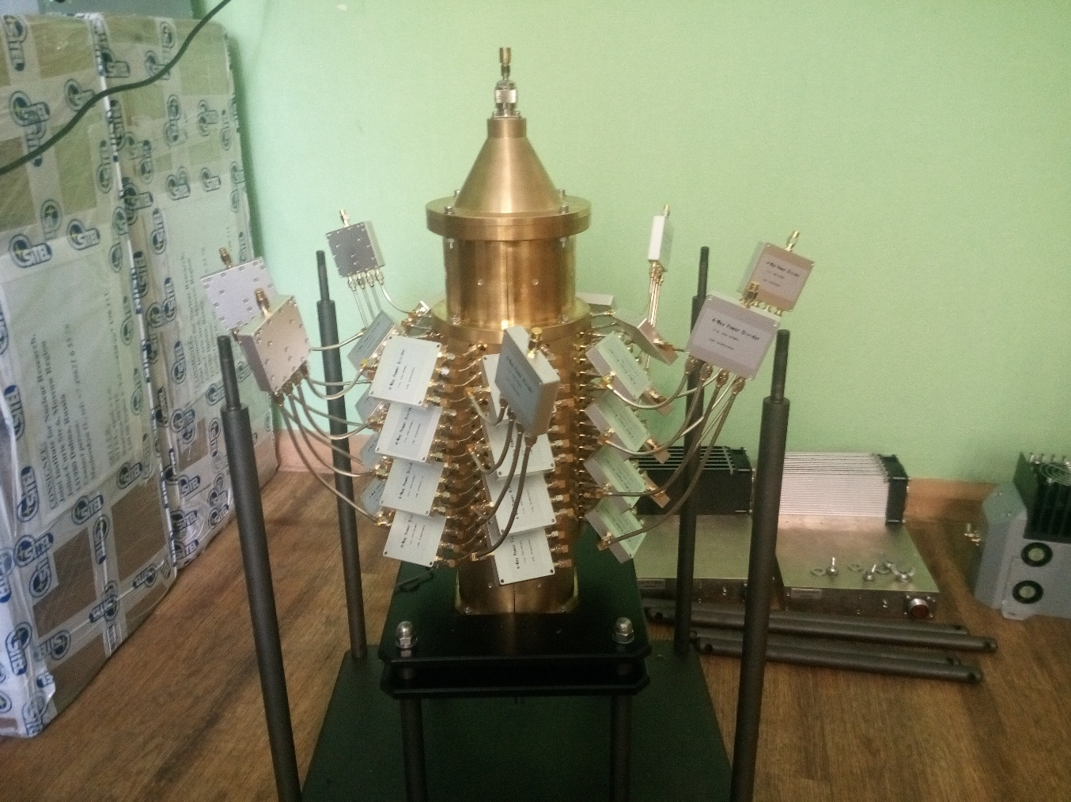
PU & KK Test Bench

Slide 12

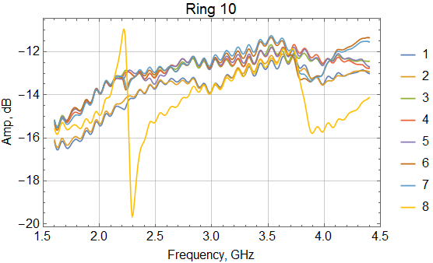
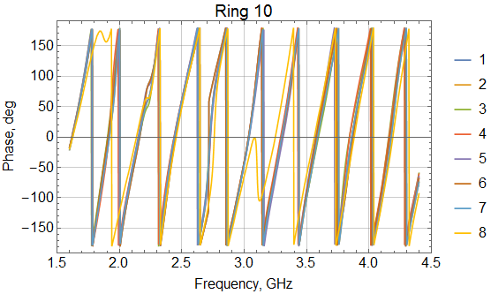
Quality control (Impedance)
OUT
IN

Slide 13
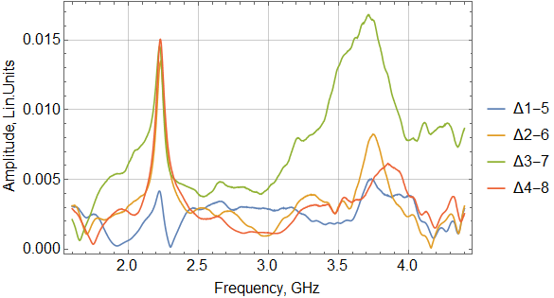
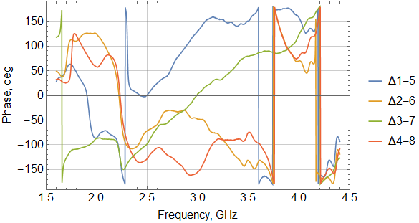
Electrical center
IN
OUT
Δ

Slide 14
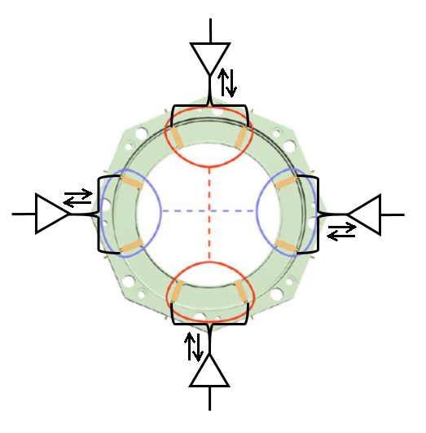
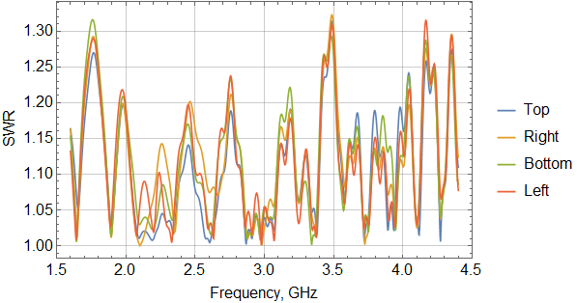
Kicker SWR
SWR < 1.3
Back Reflected Power 4,76% ≃ 1.5W

Slide 15
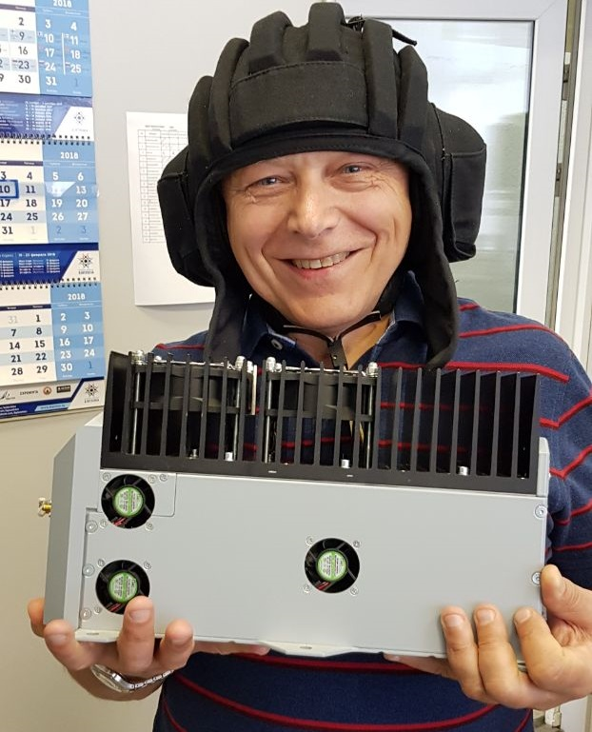
Amplifiers
Requirements
Bandwidth | 2 – 4 GHz
Gain | 43 ± 2 dB
1 dB compression (3 GHz) | Input 0 dBm (1 mW)
Power linearity (intermodulation products) | Notch depth reduction <10 dB
Phase linearity | ± 5 deg
Group delay variation | ±200 ps
Reproducibility

Slide 16
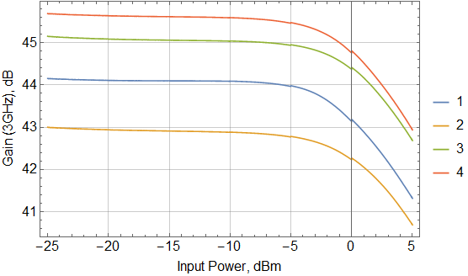
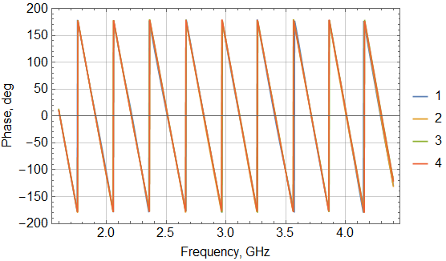
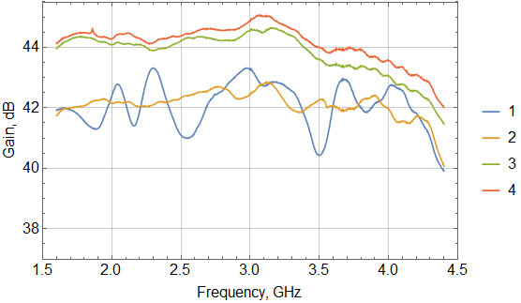
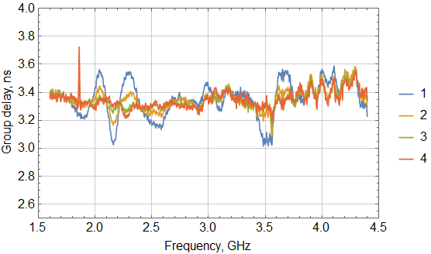
Amplifiers

Slide 17
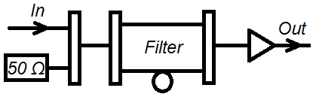
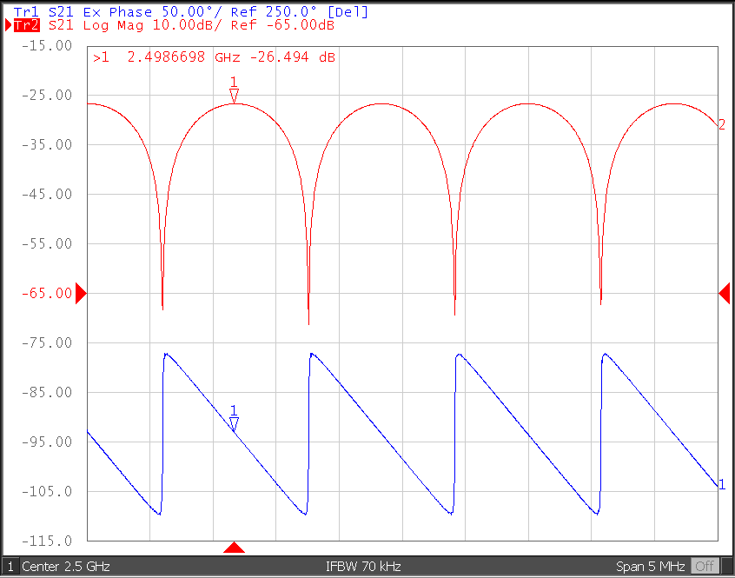
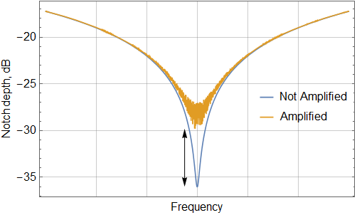
Intermodulation products
Δ
Δ < 10 dB

Slide 18
Summary
Pickup Manufacturing Technology has been tested
Pickup prototype has been produced
Amplifier prototypes have been produced
Test Bench has been created
Measurement methodic has been developed
Measurements has been started

Slide 19
Thank you for attention

Slide 20
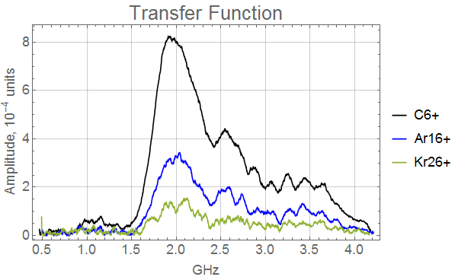
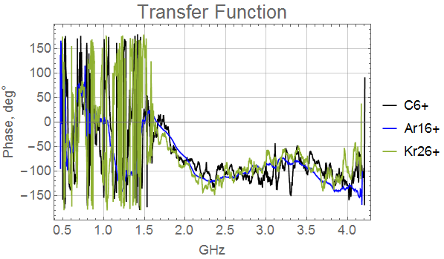
BTF Measurements from the Run 2018
Intensity (elementary charges): C⁶⁺ 3×10⁸ Ar¹⁶⁺ 1,5×10⁷ Kr²⁶⁺ 2×10⁶
Sensitivity is high enough to obtain response from low intensity beams

Slide 21
Disadvantages of Actual Pickup/Kicker Structure
Ultra high vacuum (10⁻¹¹) can not be guaranteed
Some RF characteristics were not measured
Combiner board frequency (3 GHz) does not matched to that of the rings (2 GHz)

Slide 22
Advantages of new Pickup/Kicker Structures
Ultra high vacuum is achievable
Easy to repair in case of malfunctions
Higher power can be dissipated in the kicker

