Slide 1
The beam position measurement system of Booster NICA
E. Gorbachev, D. Monakhov, H.Nazlev,
S. Romanov, V. Volkov

Slide 2
BPM systems
based on Beam Position Monitors (BPM), which are beam detectors located along the accelerator:
  Beam Position Monitor - Beam pickup with read-out electronics.
  4 or more BPMs per betatron oscillation period, typically located near each quadruple magnet.
deliver beam orbit information:
  Non-destructive monitoring based on the EM-field of the passing beam.
  turn-by-turn, bunch-by-bunch, or averaged over many turns
are a powerful beam diagnostics tool
  Machine commissioning, characterization of the beam optics, measurement of beam parameters, trouble-shooting

Slide 3
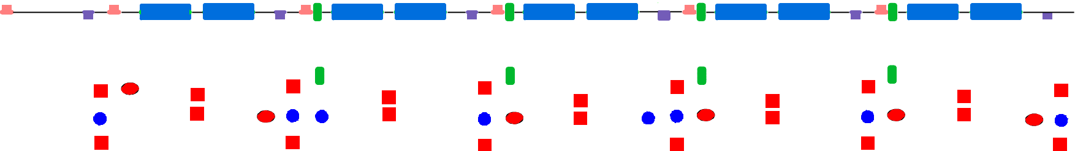


Booster diagnostics layout
One quadrant:
F
D
F
M
M
D
F
M
M
D
F
M
M
D
F
M
M
D
F
M
M
D
bpmZ
bpmZ
bpmZ
bpmZ
bpmZ
bpmZ
bpm
bpm
bpm
bpm
bpm
bpmX
bpmX
bpmX
bpmX
bpmX
bpmX
Vacuum station
F quadrupole
Total number of diagnostic devices in the ring:
D quadrupole
Magnet
BPM in lenses modules (X/Z) | 24
BPM in magnet modules (X/Z) | 20
BPM in bump region (X/Z) | 4
Multipole corrector
BPM
scraper
Lenses block:
F
D
PU(Z)
PU(X)

Slide 4
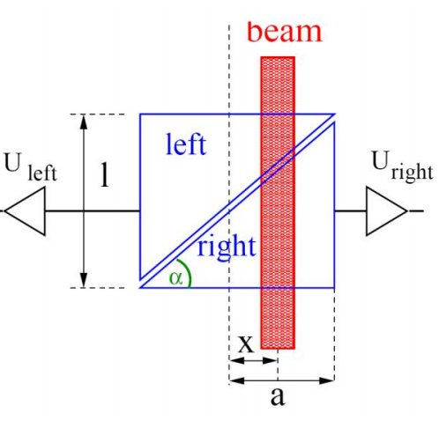
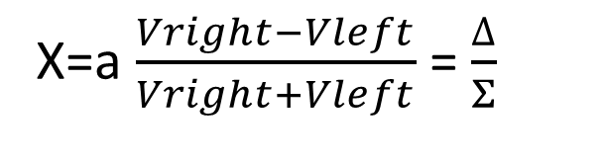
Linear-cut pickup
X=a $\frac{Vright−Vleft}{Vright+Vleft}$ = $\frac{∆}{Σ}$
Pros:
Linear position response: easy displacement calculations.
High Transfer at low frequencies: high signal levels, good for long bunches, allows operations at low frequencies with high load impedance
Cons:
Complicated mechanics.
Limited to low frequency operation, typically <300 MHz.
High capacitive source impedance, reflective
*BPM Systems, Manfred Wendt, CERN,BI CAS 2018

Slide 5
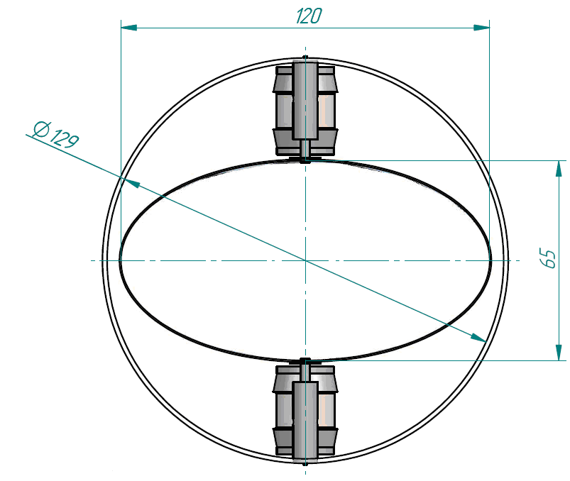
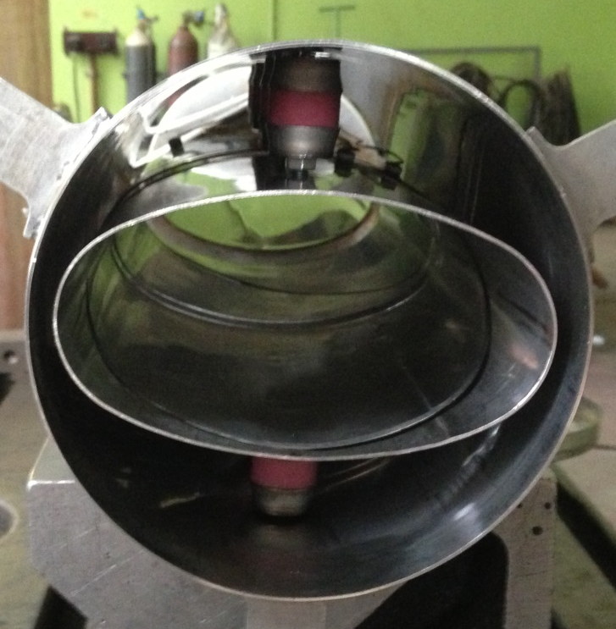
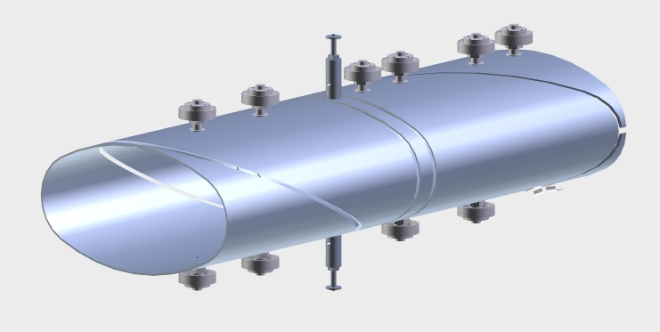
Booster pickup
Elliptical linear-cut electrostatic (“shoe-box”) pickup.

Slide 6
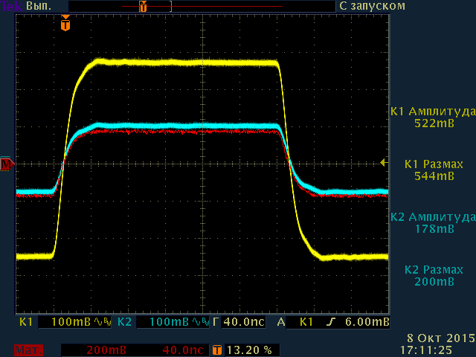
Pickup linearity
BPM prototype was measured with current pulses through movable wire and rods of different diameters.
Measurements show good linearity of the BPM prototype despite mechanical problems.
V, mV
∆/Σ
wire position
wire position

Slide 7
Read-out electronics
The read-out system interfaces the BPM pickup to the accelerator data acquisition (control) system:
Signal conditioning,
Normalization,
Linearization,
Conversion to a digital format to provide a time-stamped beam position.

Slide 8
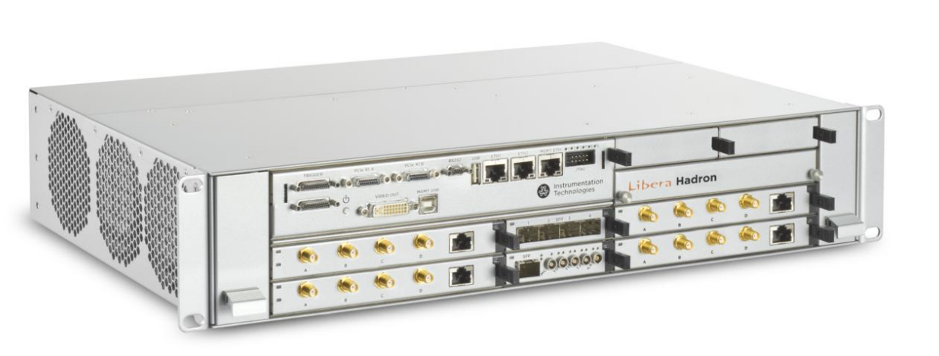
Libera Hadron
Libera Hadron (Instrumentation Technologies, Slovenia):
Used in hadron synchrotrons
Bunch-by-bunch position measurements
Large buffers for ADC and position data storage
Tune measurements, FFT processing, closed orbit feedback functionality
Performance:
Typical Bunch-by-bunch RMS uncertainty, Uin = 1.5 V peak, pulse FWHM = 100 ns ~ 4 µm
8-hour stability (ambient temp. = T±1° C): < 2 µm
Max temperature drift (ambient temp. range: 20 to 30°C): ~ 2 µm/°C

Slide 9
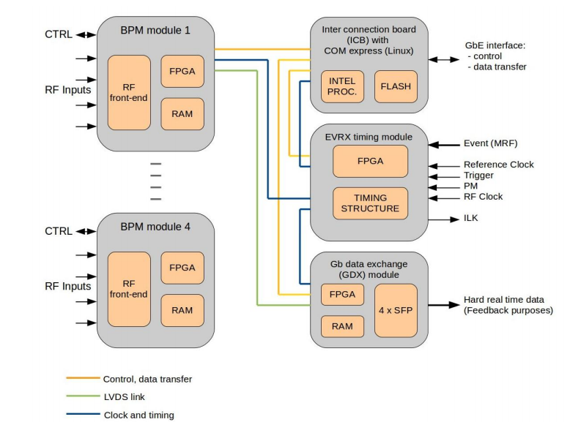
Libera Hadron block diagram
4 types of modules:
The beam position processor (BPM) module receives the signal from the pick-ups, does analog signal processing and conversion to digital. Contains the FPGA for digital data processing and RAM to store the data.
The inter connection board (ICB) provides both HW and SW interface towards the user’s control system. It performs the control actions of all boards in the Libera Hadron chassis and enables the data transfer to the user.
Timing (EVRX) module is reception of the events (including optical events) and the distribution of clock and trigger signals to all application boards.
Gigabit data exchange (GDX) module offers fast links (SFP connectors) through which the FA data are transferred in hard real time. These data can be used for building a fast feedback application.

Slide 10
Libera Hadron Specifications
Specifications:
16 input channels (4 per module)
16 bit ADC
250MS/s
55 MHz input frequency range
6.5Gbps Rocket I/O
4GB memory per module
Output data:
Raw(A,B,C,D)
Calculated beam position (X,Y)
Charge(SUM)
FFT, FFT peak
Data paths:
Broadband data (ADC@250MHz) -270MS (>1s of data), 4 channels
Bunch-by-bunch data – 270MS (>66s of data @1MHz bunch rep rate)
Synthetic beam position data – user defined decimation with averaging
Slow data stream (10 S/s)
Fast data stream (10kS/s)

Slide 11
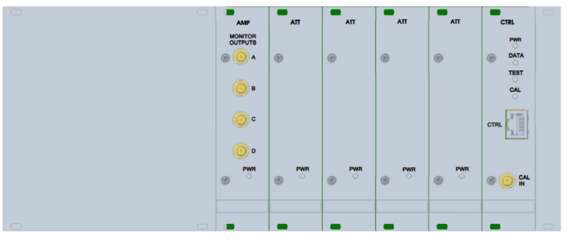
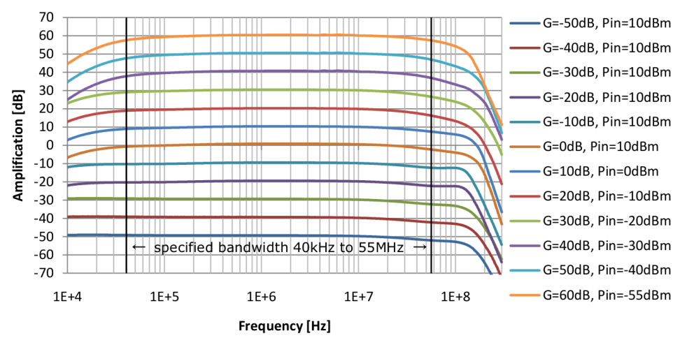
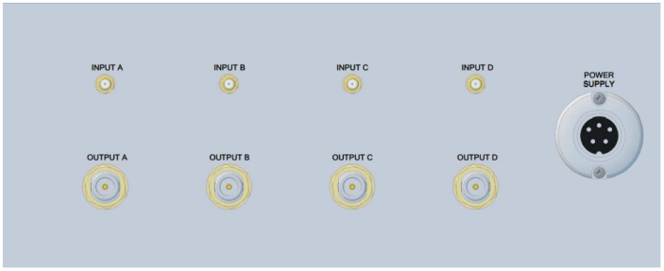
BPM signals processing
The external preamplifier mounted close to the BPM is in charged to provide
high intensity and low noise signals to the Libera Hadron unit. A huge 110 dB
beam dynamic can be coupled with the Amplifier 110.
Supported gain ranges: 60, 50, 40, 30, 20, 10, 0, -10, -20, -30, -40 and -50 dB
Gain error between channels: ±0.1 dB
Gain switching time: <1 us

Slide 12
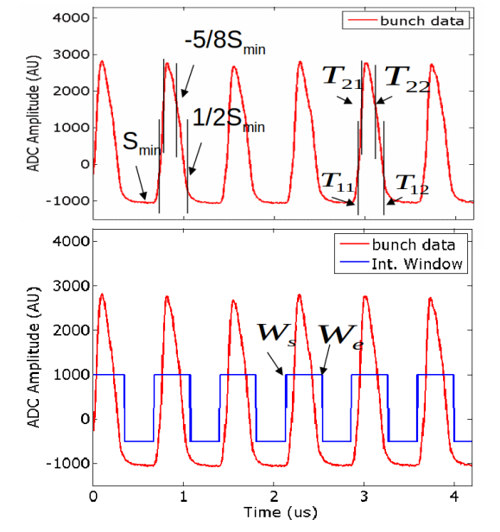
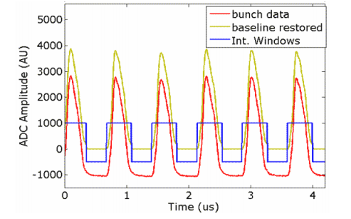
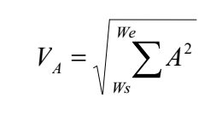
BPM signals processing
Bunch-by-bunch algorithm, detection for “shoe-box” sensor:
Bunch detection.
Processing window calculation.
Baseline restorer (shoe-box).
Energy calculation.
Position calculation.
Output data rate = Bunch-by-bunch (varying)

Slide 13
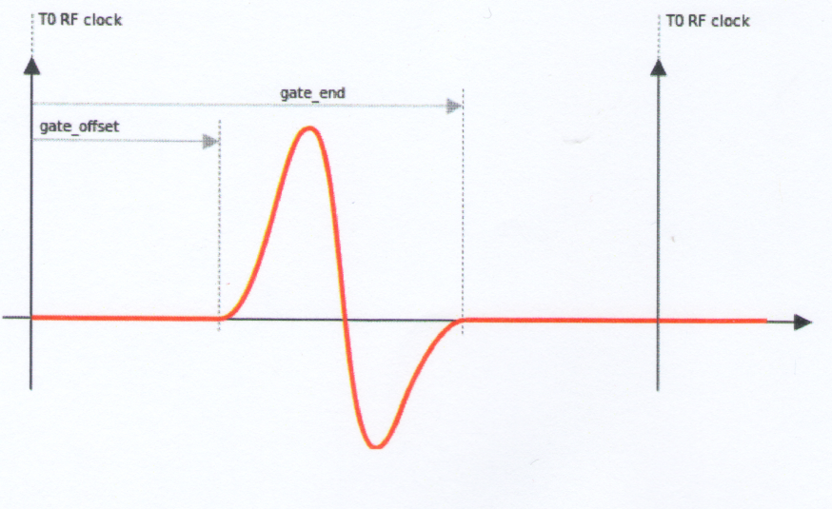
BPM signals processing
Timed BBB algorithm:
Bunch position synchronized with external RF clock.
RF clock can be delayed
Signal energy calculated in the gated region.

Slide 14
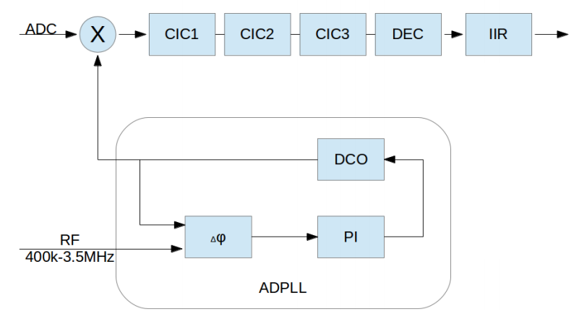
BPM signals processing
Narrow-Band Analysis “nba”
The narrow-band analysis is a superheterodyne SDR receiver. The algorithm is intended for processing extremely low signals where individual bunches can not be detected. Four ADC signals are
mixed to f_{IF} with the DCO locked to external #RF signal using ADPLL :
SDR receiver.
Three filters enabling different output data bandwidths can be selected in the DSP nba block: iir0 – 1 kHz, iir1 – 2 kHz, iir2 – 5 kHz.
Output data rate = 50 kHz (fixed).

Slide 15
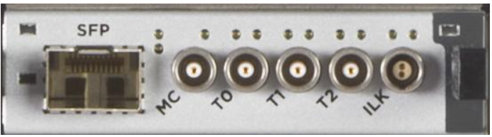
#Start, #stop and #postmortem
The EVRX module supports both electrical and optical event based synchronization.
The #START and #STOP events relate to the instrument observation interval. The Observation cycles can be selected as being one-shot or repeatable. The #PM event can occur anytime. The Observation intervals
are:
Raw ADC data storing: 2 GB ADC buffer
Bunch-by-bunch data storing: 2 GB Bunch-by-bunch buffer
Following events affect observation cycle:
#START (T2 trigger)
#STOP (T2 trigger)
#PM (T1 trigger)

Slide 16
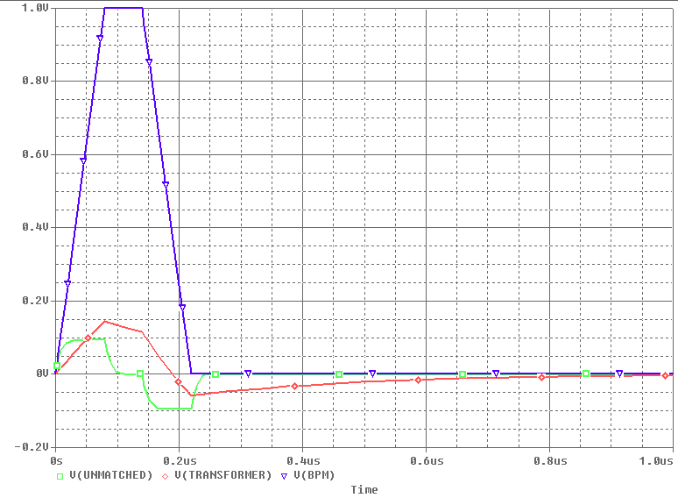
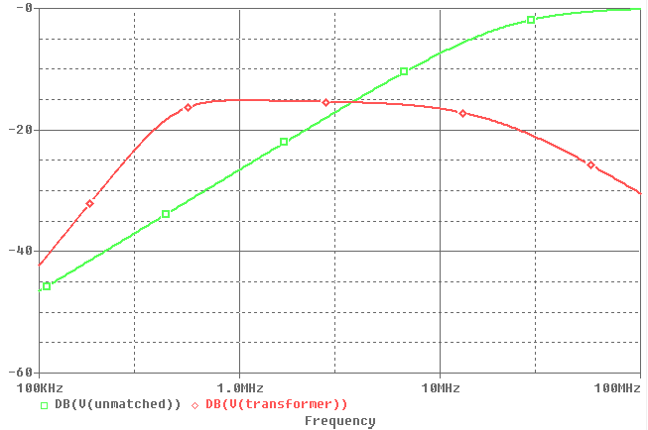
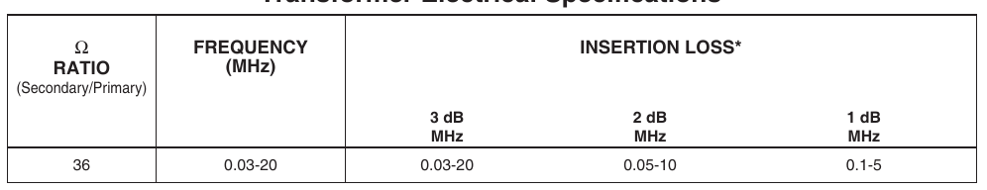
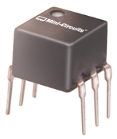
BPM signals processing
Different impedance matching schemes:
no matching (signal distorted).
buffer amplifier (S/N is affected).
matching transformer (signal amplitude is affected).
Matching with 6:1 transformer

Slide 17
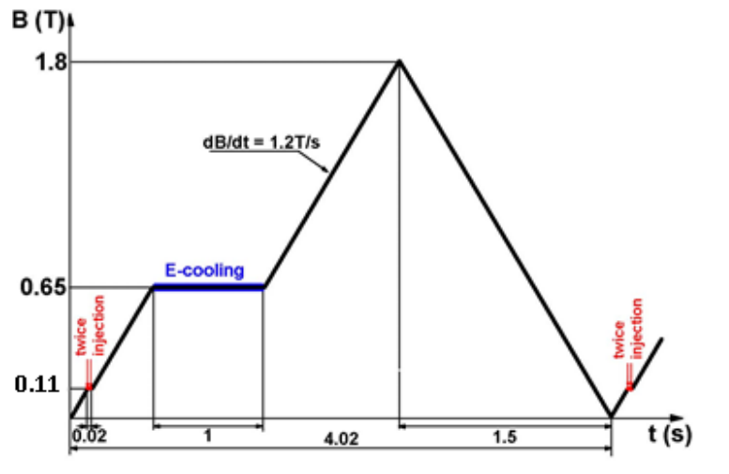
Booster beam parameters
Particles | Au³¹⁺
Nominal intensity | 2·10⁹
Injection Energy | 3.2 MeV/n
Extraction Energy | 600 MeV/n
Harmonics number | 5 (after injection) / 1 (after cooling)

Slide 18
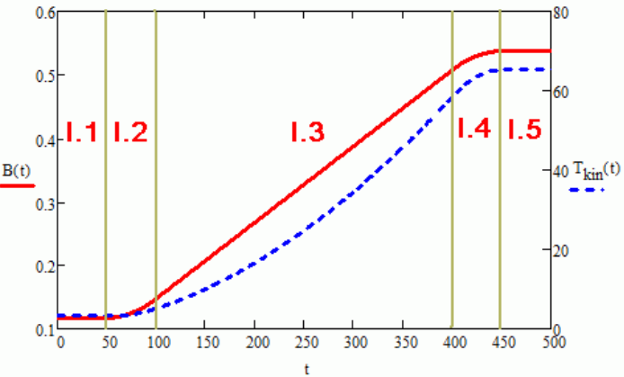
RF parameters (1 stage)
 | I.1 | I.2 | I.3 | I.4 | I.5
Time, s | 0,0/0,05 | 0,05/0.1 | 0,1/0,4 | 0,4/0,45 | 0,45/0,475
B, T | 0,117/0,117 | 0,117/0,147 | 0,147/0,507 | 0,507/0,537 | 0,537/0,537
RF frequency, kHz | 587/587 | 587/736 | 736/2401 | 2401/2526 | 2526/2526
Bunches number | 0/5 | 5 | 5 | 5 | 5/0
Bunch RMS, m | -/5,3 | 5,3/3,75 | 3,75/3,64 | 3,64/5,6 | 5,6/-
Sync. Phase, deg. | 0/0 | 0/21 | 21/22,6 | 22,6/0 | 0/0
Peak current, mA | 1,16/3,68 | 3,68/6,54 | 6,54/21,9 | 21,9/15,0 | 15,0/5,0

Slide 19
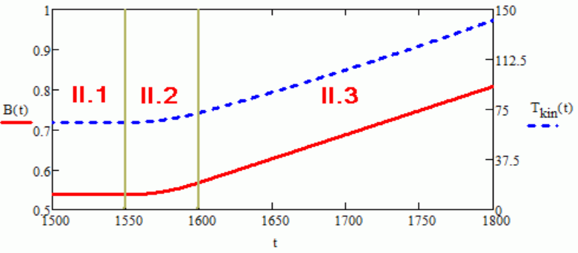
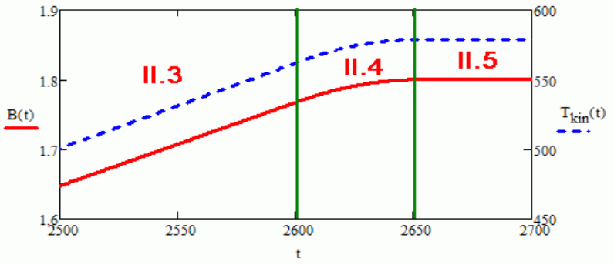
RF parameters (2 stage)
 | II.1 | II.2 | II.3 | II.4
Time, s | 0,0/0,05 | 0,05/0,1 | 0,1/1,1025 | 1,1025/1,1525
B, T | 0,537/0,537 | 0,537/0,567 | 0,567/1,77 | 1,77/1,80
RF frequency, kHz | 505,2/505,2 | 505,2/529,5 | 529,5/1110,2 | 1110,2/1117,4
Bunches number | 1/1 | 1/1 | 1/1 | 1/1
Bunch RMS, m | -/20,6 | 20,6/13,78 | 13,78/11,16 | 11,16/20,94
Sync. Phase, deg. | 0,0/0,0 | 0/31,2 | 31,2/42,1 | 42,1/0
Peak current, mA | 5,0/20,5 | 20,5/32,1 | 32,1/83 | 83/44,6

Slide 20
BPM acquisition parameters
 | Stage I | Stage II
Peak current, mA | (1,16) 3,68 ÷ 21,9 | 5 ÷ 83
RF frequency, kHz | 587 ÷ 2526 | 505,2 ÷ 1117,4
Revolution period, us | 8.5 ÷ 2 | 2 ÷ 0,895
Bunch full length (±3σ), us | 1,28 ÷ 0,215 | 1,1 ÷ 0,285
Synchronous phase, deg. | 0 ÷ 22,6 | 0 ÷ 42,1
Number of bunches | 5 | 1

Slide 21
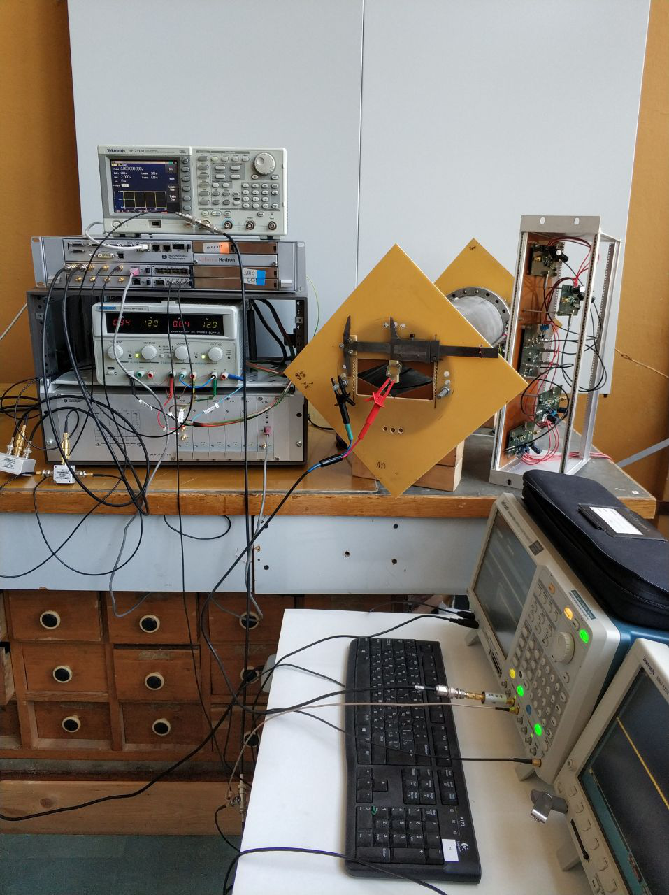
Test bench
Pickup prototype with positioning system.
Libera Hadron.
Amplifier 110.
Arbitrary signal generator feeding a movable wire loaded by characteristic impedance.
Oscilloscope.
Main goal is to measure position and estimate the accuracy by using 3 algorithms with 2 different impedance matching schemes:
At nominal intensity injection (low current, low frequency)
At nominal intensity extraction (high current, high frequency)
At low intensity for beam commissioning.

Slide 22
Impedance matching
Pickup loaded by
6:1 transformer
Pickup with preamplifier
Pickup on 50 Ohm load

Slide 23
Libera hadron calibration methodics
Place wire to the geometric center of the pickup.
Libera ADC calibration: remove DC offset – automatic or manual.
Amplifier110 calibration: achieve equal gain of 4 channels in 12 gain ranges by achieving 0 position measurements in both planes.
  Take into account preamps or transformers gains.
  Obtain an even gain step over all ranges.
Calibrate SUM coefficient to obtain correct intensity measurements. The coefficient depends on gain.
Displace wire to the extreme position in one plane.
Calibrate Libera geometric coefficients to obtain correct position measurements in the plane.
Repeat 5,6 for the other plane.

Slide 24
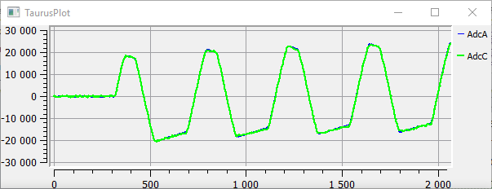
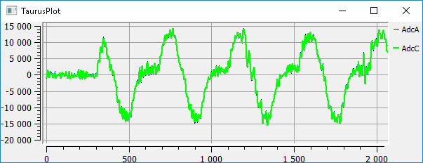
Position measurements results
Preamplifiers, injection, 2e9 ions (3.7mA, 587kHz RF)
 | BBB | BBB synth | tBBB | tBBB synth | NBA | NBA synth
Mean, mm | 4.857 | 4.853 | 5.210 | 5.184 | 4.986 | 5.028
Std err, um | 108 | 132 | 124 | 12.7 | 7.50 | 3.69
Transformers, injection, 2e9 ions (3.7mA, 587kHz RF)
 | BBB | BBB synth | tBBB | tBBB synth | NBA | NBA synth
Mean, mm | 5.375 | 5.365 | 5.386 | 5.385 | 5.418 | 5.416
Std err, um | 547 | 221 | 131 | 13.6 | 7.63 | 4.01
ADC with preamplifiers,
Amplifier110 gain=10dB
ADC with impedance transformers,
Amplifier110 gain=60dB

Slide 25
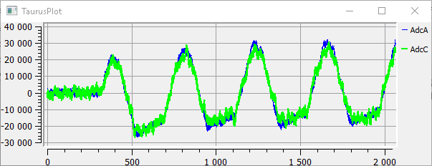
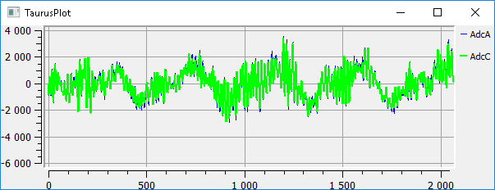
Position measurements results
Preamplifiers, injection, 2e8 ions (0.37mA, 587kHz RF)
 | BBB | BBB synth | tBBB | tBBB synth | NBA | NBA synth
Mean, mm | 4.777 | 4.748 | 4.650 | 4.639 | 5.025 | 5.023
Std err, um | 1093 | 124 | 1200 | 113.1 | 74.2 | 38.4
Transformers, injection, 2e8 ions (0.37mA, 587kHz RF)
 | BBB | BBB synth | tBBB | tBBB synth | NBA | NBA synth
Mean, mm | 1.646 | 1.761 | 3.925 | 3.891 | 5.392 | 5.404
Std err, um | 6382 | 650 | 776 | 96.8 | 88.3 | 37.3
ADC with preamplifier,
Amplifier110 gain=40dB
ADC with impedance transformer,
Amplifier110 gain=60dB

Slide 26
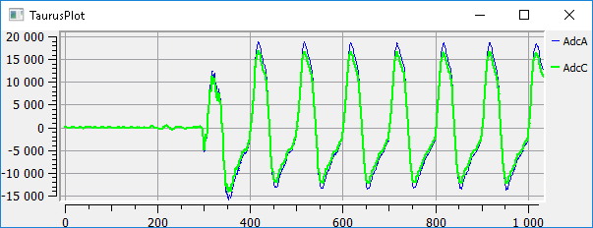
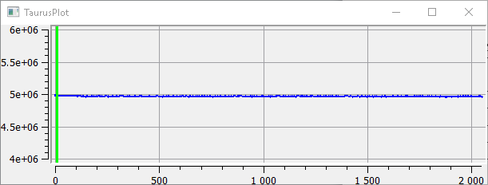
Position measurements results
Transformers, end of 1 stage, 2e9 ions (22mA, 2401 kHz RF)
 | BBB | BBB synth | tBBB | tBBB synth | NBA | NBA synth
Mean, mm | 4.976 | 4.975 | 5.060 | 5.051 | 4.958 | 4.957
Std err, um | 33.21 | 3.83 | 35.70 | 4.43 | 1.911 | 1.06
Preamplifiers were not wideband enough and were not used.
nm
ADC with impedance transformers,
Amplifier110 gain=40dB
Position with transformers, BBB synth algorithm, averaged over 100 bunches

Slide 27
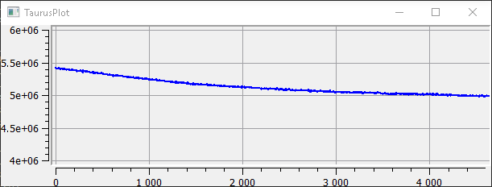
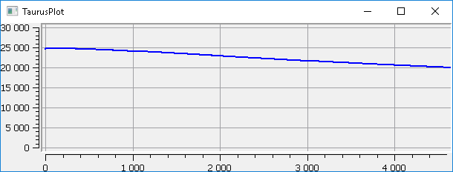
Position measurements results
Conclusion:
both transformer and preamp can be used for matching impedance. Preamps are better for low intensities, transformers are more robust.
Libera Hadron provides adequate position measurements for booster beam from injection to extraction. NBA algorithm is preferable for low intensities
Transformers, sweep from 736kHz to 2401kHz in 360ms , 2e9 ions
nm
Position with transformers, BBB synth algorithm, averaged over 100 bunches
SUM with transformers, BBB synth algorithm, averaged over 100 bunches

Slide 28
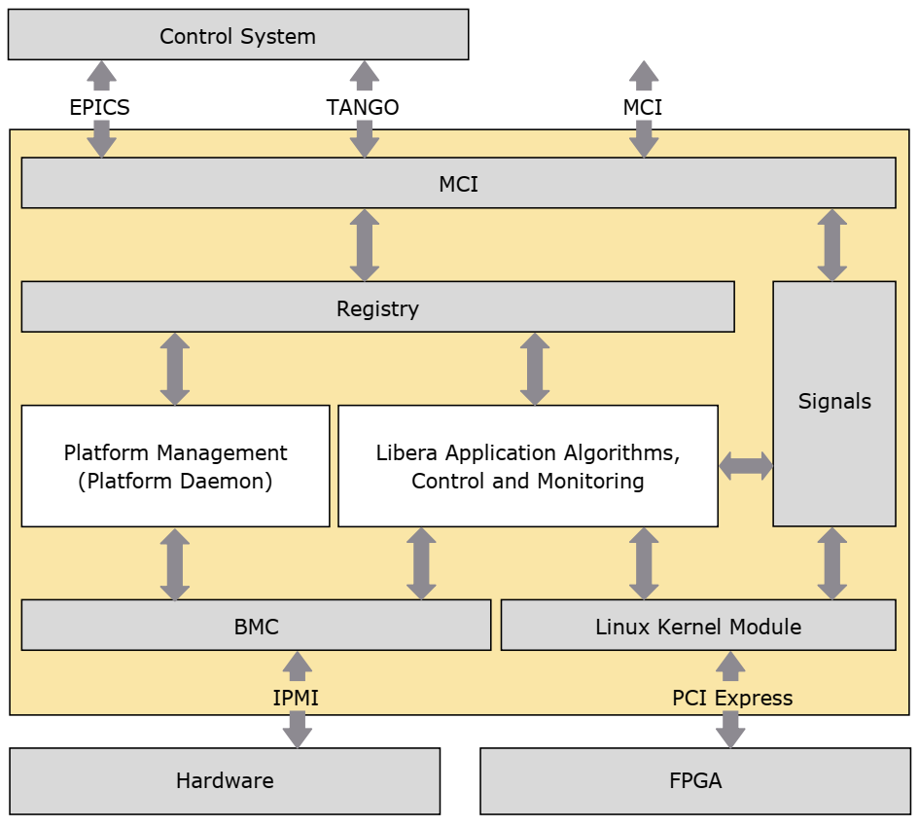
Software
Linux running on Inter connection board.
BMC – baseboard management controller
IPMI – Intelligent Platform Management Interface
MCI – Measurement and control interface

Slide 29
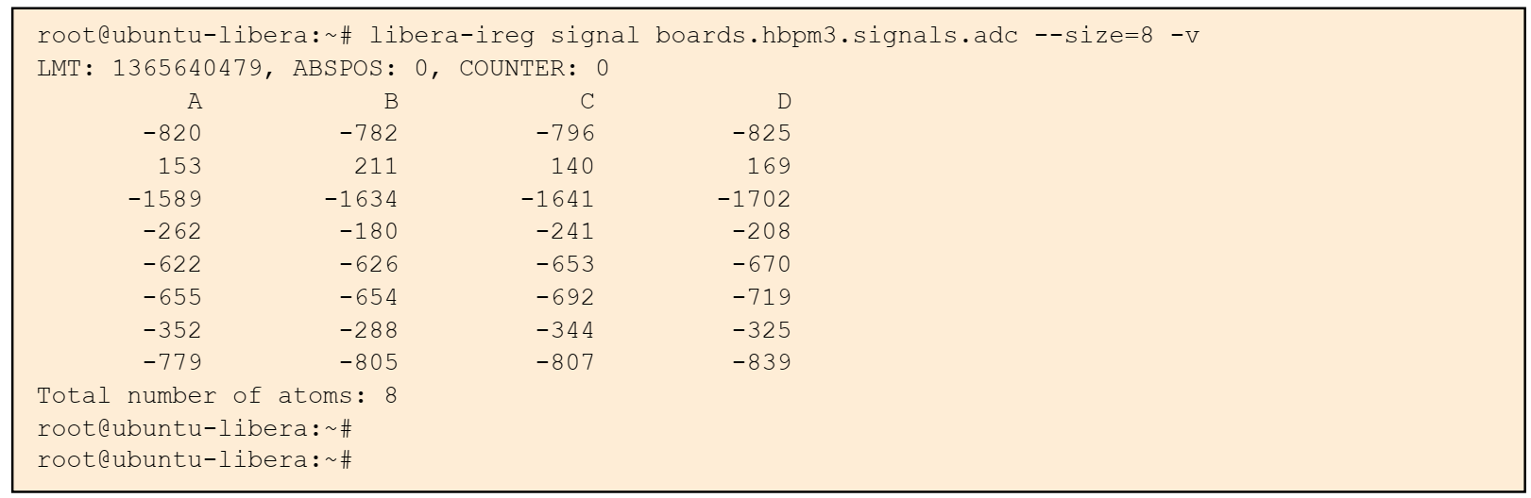
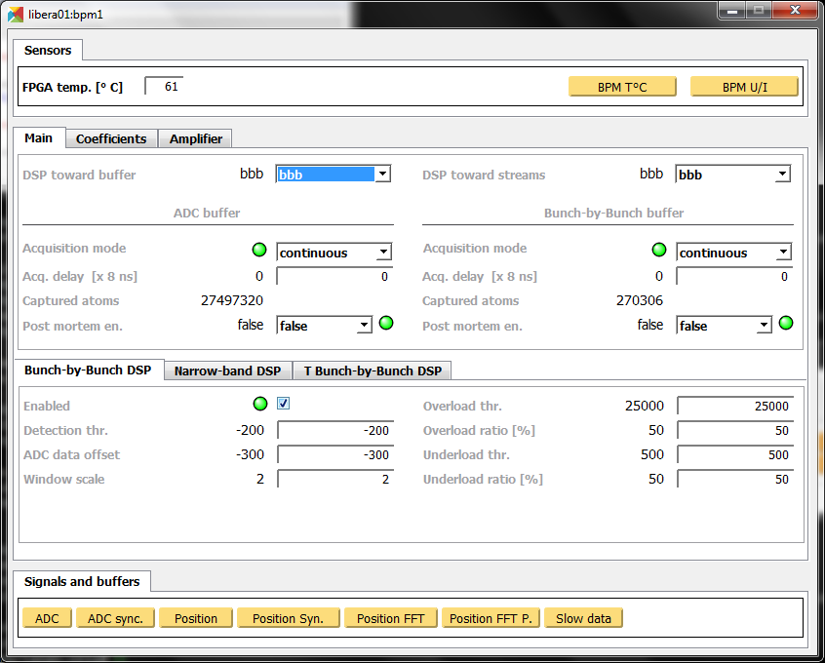
Software
1. Access to all registers and measurements via remote or local linux console.
2. EPICS server and client
3. TANGO device server mapping available registers, sensors and measurements to TANGO attributes. Configurable via xml file.

Slide 30
Ongoing tasks
Further measurement tests.
RF frequency distribution: repeater and cables to all Libera devices
Trigger and postmortem signals generation and distribution: cables to all Libera devices
Impedance matching circuits for all pickups
Calibration of 32 measurement devices (4 channels each): impedance matching circuit + Amplifer110 + Libera hbpm
Expected completion date - spring 2019.

Slide 31
Thank you for your attention!

