Slide 1
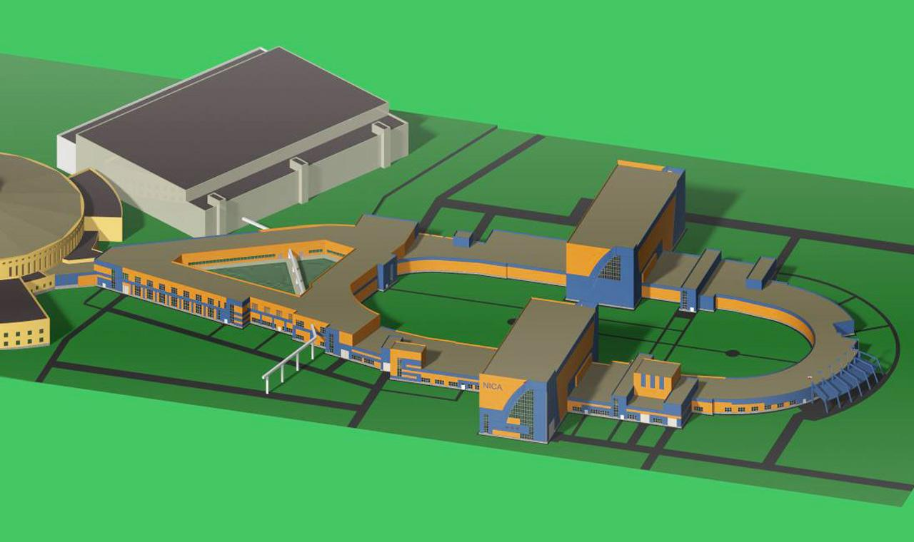
Beam collimation in NICA collider
O.Kozlov
LHEP, JINR, Dubna
International Workshop
“NICA accelerating complex: problems and solutions”
Sozopol, September 8-15, 2018

Slide 2
Contents
Introduction to Collimators and Absorbers
Roles of Collimation
Collimators designs
Collimation multistage scheme
NICA Collider parameters
Collimation scheme for Collider
Conclusions

Slide 3
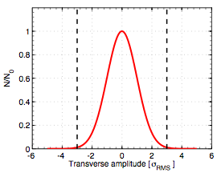
Collimator
Collimator is any device limiting beam distribution on amplitudes or angles
Collimator is placed at the definite distance from the beam to intercept particles
Collimator main use is controlled escape of the particle from the beam halo
Goals of Collimation system is depent on the machine
Beam core
Beam tails
“Collimator”

Slide 4
Roles of Collimation
Halo cleaning to protect accelerator components
Superconducting and permanent magnets, superconducting RF cavities .
Passive machine protection as beam absorbers or interceptors First line of defense in case of accidental failures.
Concentration of losses/activation in well defined areas Ease maintenance by avoiding many distributed high-radiation areas.
Reduction the radiation doses to accelerator components Provide local protection to equipment exposed to high doses.
Cleaning of physics products (in colliders) Protect superconducting elements close to high-luminosity experiments.
Background optimization for experiments Minimize the impact of halo losses on the quality of experimental data.
Beam tail/halo scraping and diagnostics Control and probe the transverse or longitudinal shape of the beam.

Slide 5
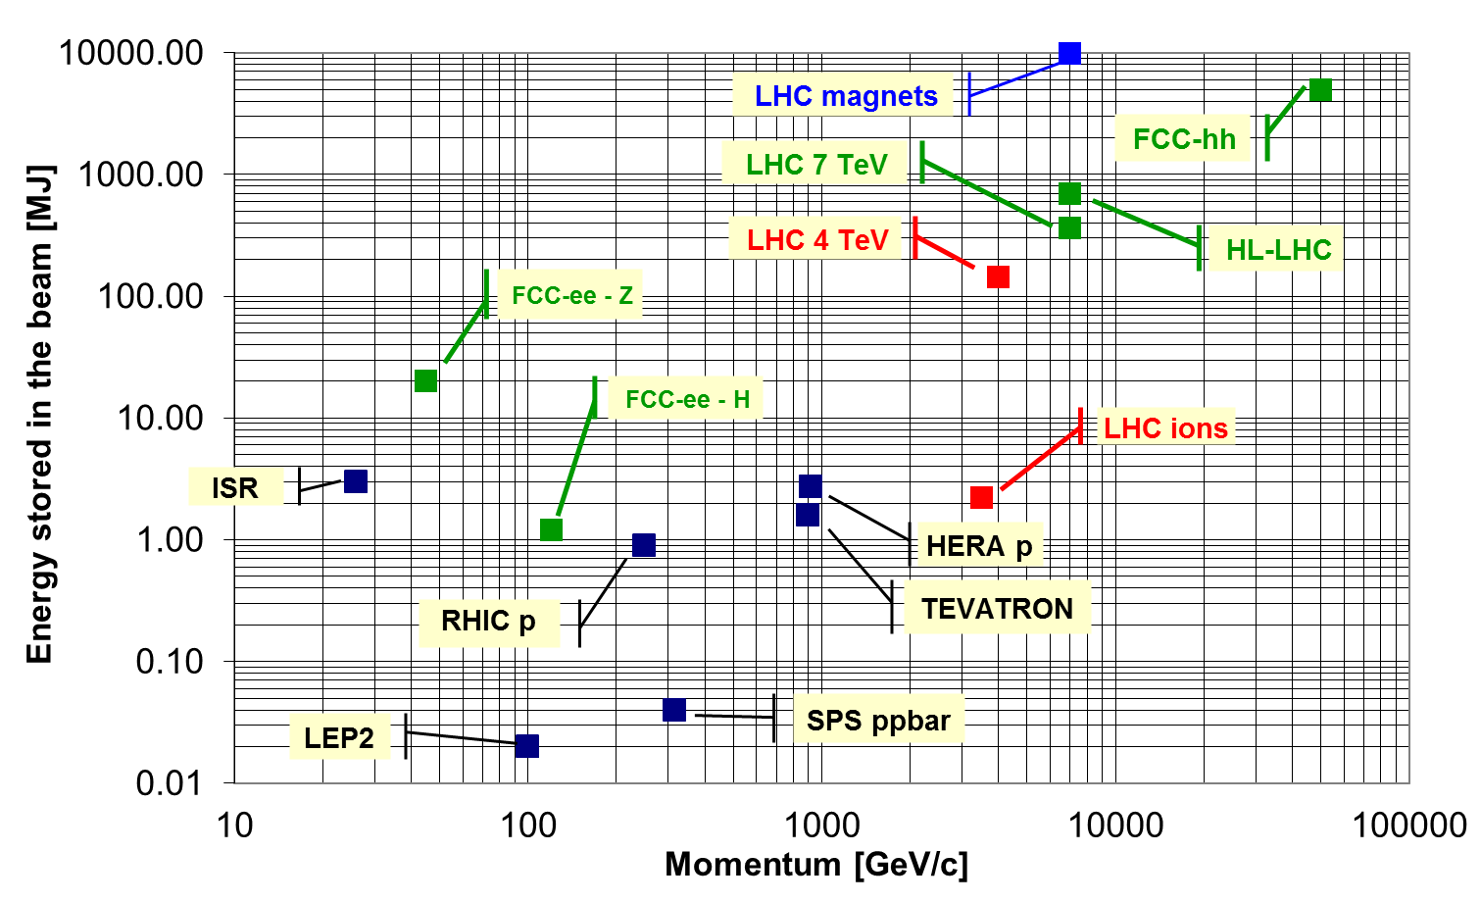
Colliders beam storage energy
NICA @4.5GeV/u, full int. Ebeam=7kJ

Slide 6
Beam losses in accelerators
In real machines several effects cause beam losses:
Collisions at the interaction points,
Interaction with residual gas and intra-beam scattering,
Beam instabilities (single-bunch, collective, beam-beam),
Dynamics changes during machine cycle (orbit and optics changes, energy ramps): operational losses,
Transverse resonances,
RF noise, RF capture and out-of-bucket losses,
Injection and dump losses,
Synchrotron radiation,
Equipment failures.

Slide 7
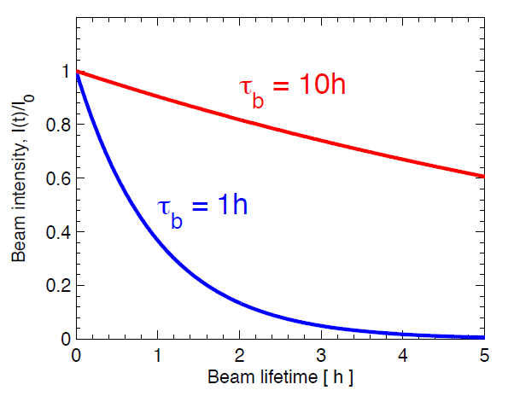
Beam life-time, power loss
Beam intensity t_{b} - beam life time
Particle loss rate
NICA Collider: beam life time t_{b}=~1h at full Intensity of N=5*10¹⁰ ions corresponds to loss rate ~1.5*10⁷ ions/sec, 2J/sec=2W

Slide 8
Collimators design
Fixed position collimators (absorbers):
Movable collimators:
Dual plane (x+y) in one device ,
Beam not confined,
Alignment more delicate (plane coupling).
Single plane (x) only,
Beam not confined.
Single plane (x) only,
Beam confined by double jaw

Slide 9
Requirements to Collimators
To absorb power from the beam (secondary collimator). Material for hadron machines – Cu, W, C, Be.
Surviving a beam impact (failure).
Close to be beam to limit the extend of the beam halo.
To minimize impact of collimator to beam stability (Impedance): excellent conductor, smooth transition to the vacuum chamber.

Slide 10
Collimation principals
Particle interaction with collimators
The aim of the Primary collimator is to scatter the particle and increase the particle angle and impact parameter. Usually a multiturn process.
The primary should be thin as the particle impact parameters can be very small (~mm).
Secondary collimators can be added to intercept the secondary halo and the showers that leak out of the primary collimator.
Some particles escape from the collimator with a reduced “rigidity” after loosing energy through inelastic interactions.
The interaction with collimator materials is itself a source of secondary halo.
Collimator
Showers + secondary halo
Beam
Multiple Column Scattering : transverse RMS kick.

Slide 11
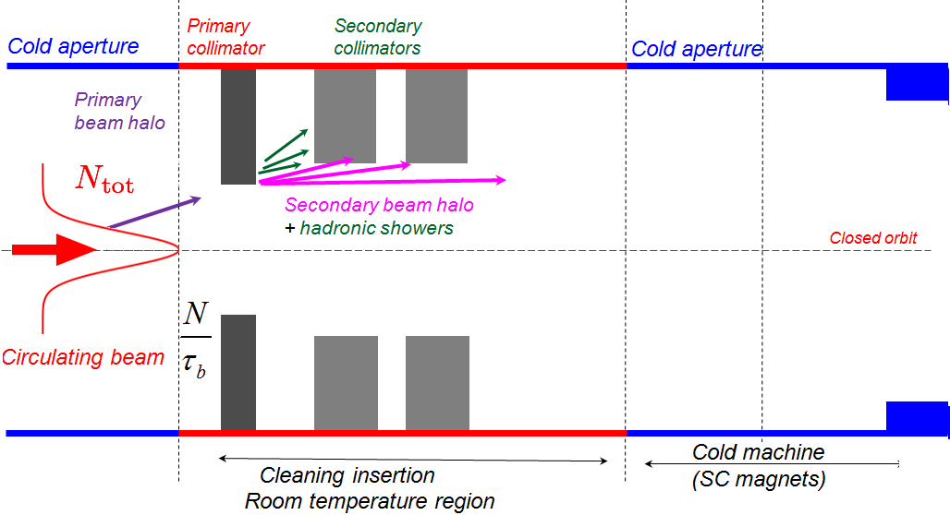
Collimation principals
2-Stage Collimation

Slide 12
Scraper –Collimators layout
Transversal phase space (Z,Z’)
(horiz. or vert., normalized coor.)

Slide 13
Collimator beam-based alignment
Alignment center of collimator jaws – beam/orbit position
Movable collimator gap – beam size
Alignment technique:
A reference halo is generated with a primary collimators.
The halo is touched with the other collimators (both sides) → local beam position.
Re-iterate at reference collimator to determine the relative aperture → local beam size.
Move the collimator to the correct settings.
Orbit / trajectory

Slide 14
NICA Collider goals
construction at JINR of a new accelerator facility that provides
1a) Heavy ion colliding beams 197Au79+ x 197Au79+ at
√s_{NN} = 4 ÷ 11 GeV (1 ÷ 4.5 GeV/u ion kinetic energy )
at L_{average}= 1E27 cm-2⋅s-1 (at √s_{NN} = 9 GeV)
1b) Light-Heavy ion colliding beams of the same energy range and luminosity
2) Polarized beams of protons and deuterons in Collider mode:
p↑p↑ √s_{pp} = 12 ÷ 27 GeV (5 ÷ 12.6 GeV kinetic energy )
d↑d↑ √s_{NN} = 4 ÷ 13.8 GeV (2 ÷ 5.9 GeV/u ion kinetic energy )
L_{average} ≥ 1E30 cm-2⋅s-1 (at √s_{pp} = 27 GeV)
3) The beams of light ions and polarized protons and deuterons for fixed target experiments:
Li ÷ Au = 1 ÷ 4.5 GeV /u ion kinetic energy
p, p↑ = 5 ÷ 12.6 GeV kinetic energy
d, d↑ = 2 ÷ 5.9 GeV/u ion kinetic energy
4) Applied research on ion beams at kinetic energy from 0.5 GeV/u up to 12.6 GeV (p) and 4.5 GeV /u (Au)

Slide 15
NICA collider: general parameters
Circumference, m | 503.04
Number of bunches | 22
rms bunch length, m | 0.6
β-function in IP, m | 0.35
Betatron tunes, Q_{x}/Q_{y} | 9.44 / 9.44
Chromaticities, Q’_{x}/Q’_{y} | -33 / -28
Ring Acceptance, π mm·mrad | 40
Momentum acceptance, Δp/p | ±0.010
γ_{tr} | 7.088
Kinetic energy of Au⁷⁹⁺, GeV/u | 1.0 | 3.0 | 4.5
Number of ions per bunch | 2.0·10⁸ | 2.4·10⁹ | 2.3·10⁹
Δp/p_{rms}, 10⁻³ | 0.55 | 1.15 | 1.5
ε_{rms}, (h/v) π mm·mrad | 1.1/0.95 | 1.1/0.85 | 1.1/0.75
Luminosity, cm⁻² s⁻¹ | 0.6·10²⁵ | 1·10²⁷ | 1·10²⁷
IBS growth time, s | 160 | 460 | 1800
Tune shift, ΔQ_{total} =ΔQ_{SC} +2ξ | -0.050 | -0.037 | -0.011

Slide 16
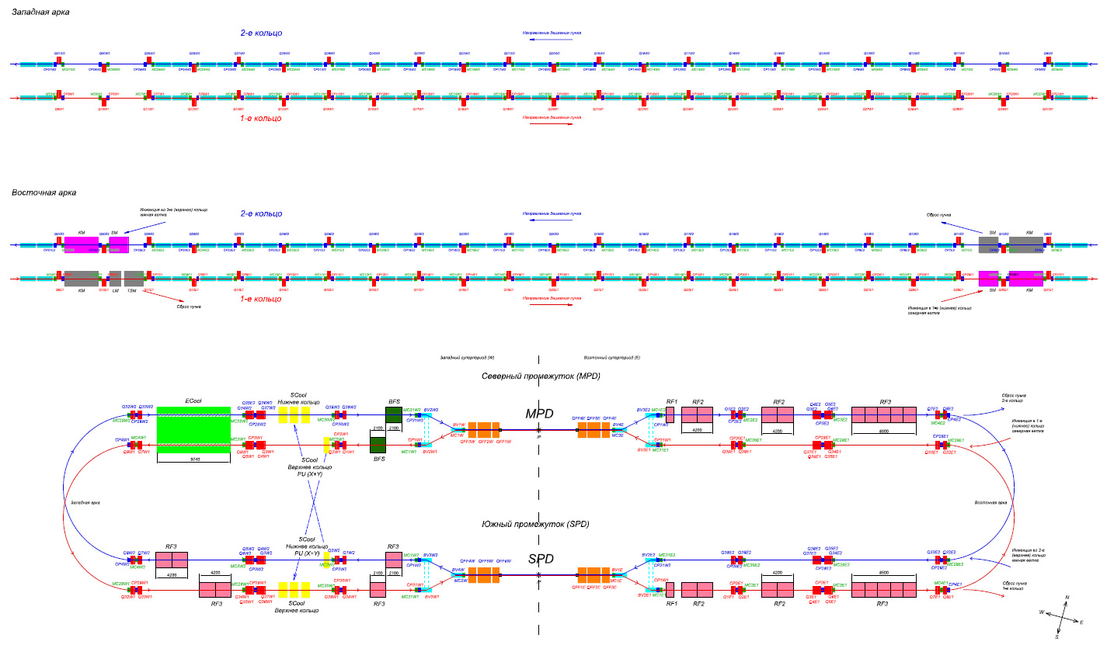
NICA Collider: Rings composition

Slide 17
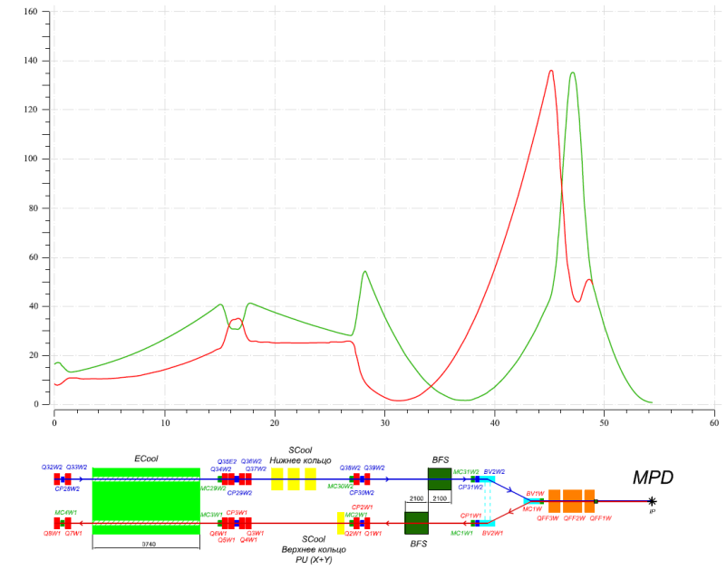
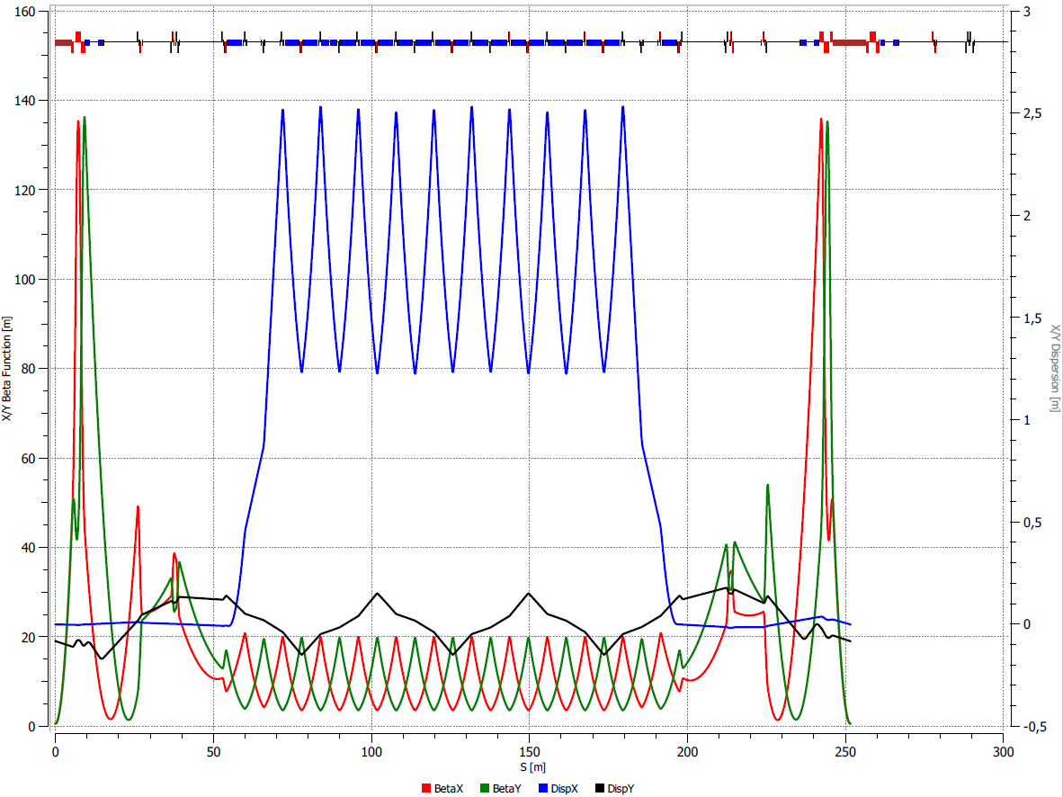
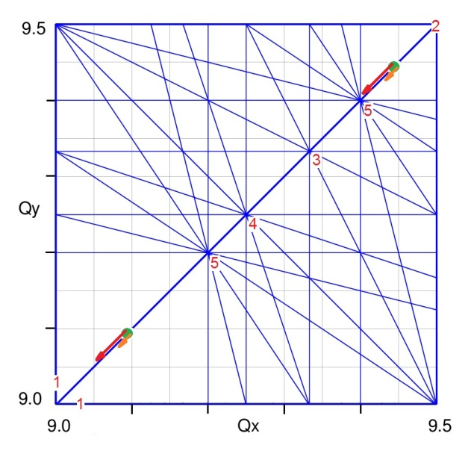
NICA Collider: optics
Beta-functions in Straight section.
β* @ IP = 0.6m
Twiss-functions in 1/2 Ring.
Q_{x,y} =9.44/9.44, β*=0.6m.
Bs_MPD=0.6T, Bs_Ecool=0.2T
Resonance diagram up to 5th order.
Collider Working points.
Space Charge Tune Shifts at 1 and 4.5 GeV/u

Slide 18
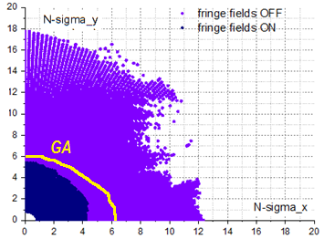
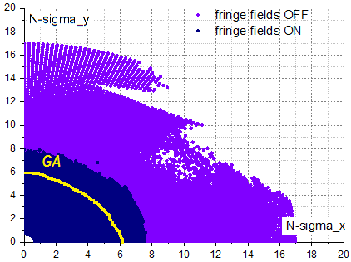
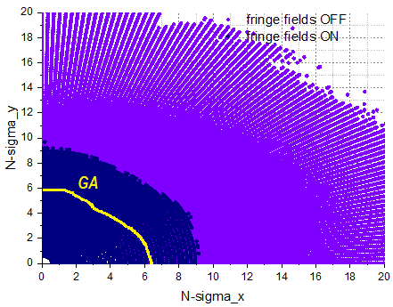
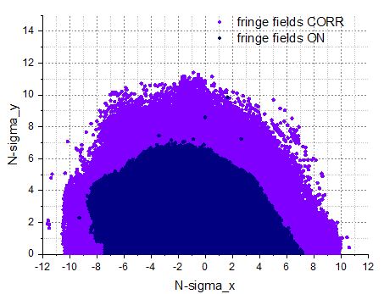
NICA Collider: Dynamic Aperture
β*=0.35m
β*=0.5m
β*=0.6m
25% Luminosity reduction
Use octupoles to compensate
“Fringe field effect”

Slide 19
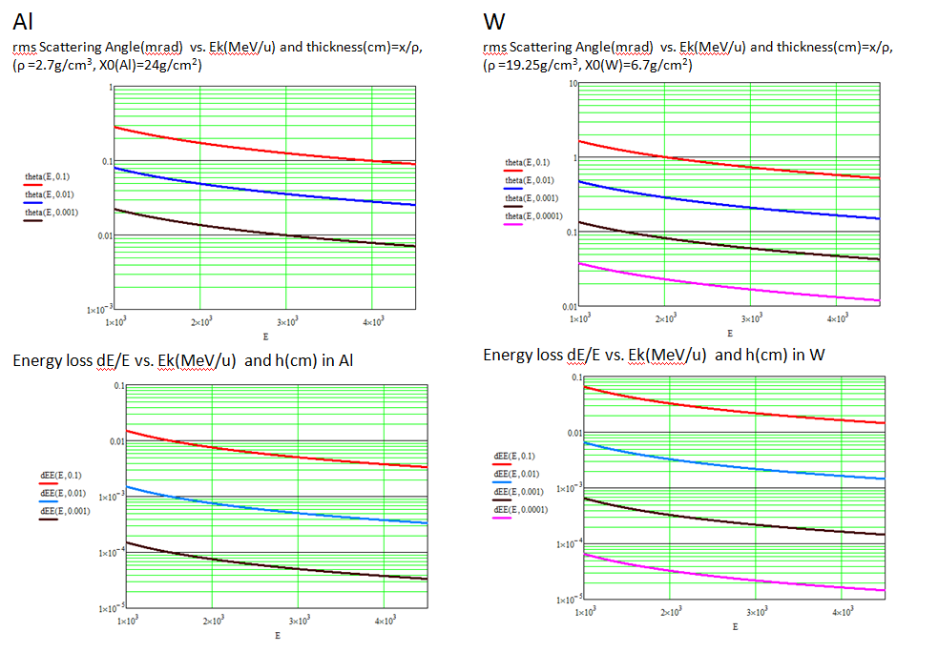
Scraper – Primary Collimator

Slide 20
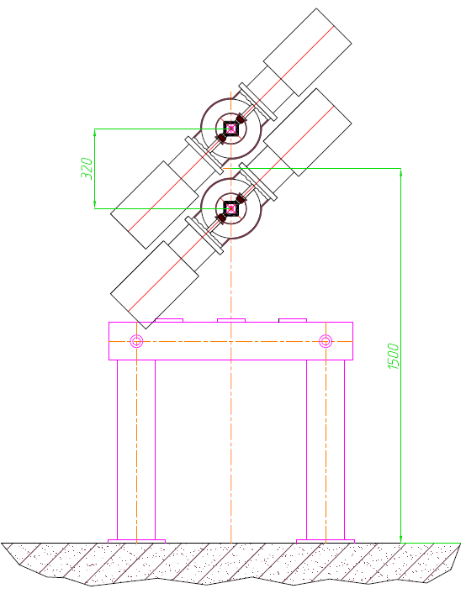
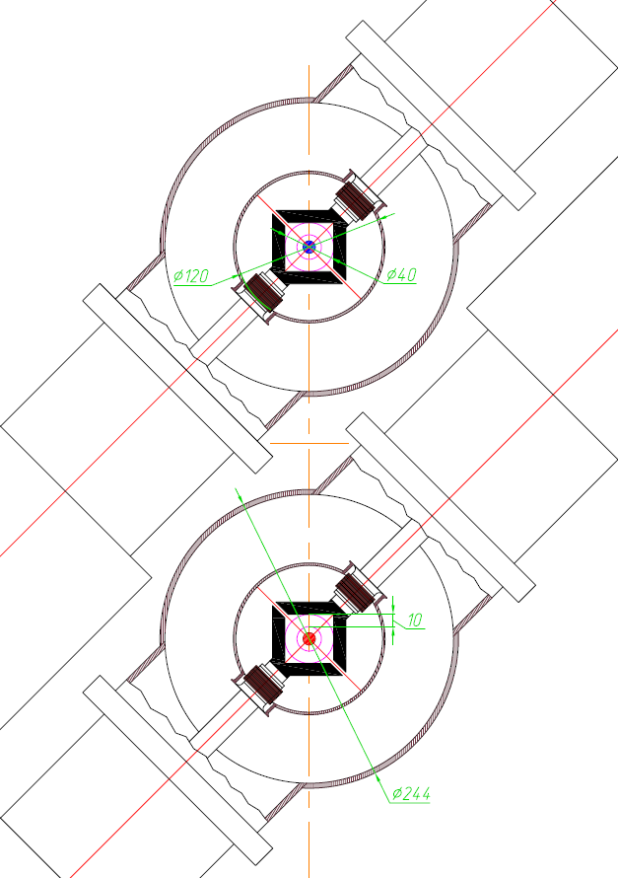
Scraper – Primary Collimator
Movable, L-shape, W

Slide 21
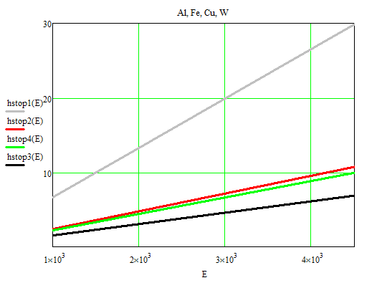
Secondary Collimator (catcher)
Stopping Energy range, H(cm), Ek(MeV/u)
Al
Movable collimators:
Longitudinal length 7cm W
Fe
Cu
W

Slide 22
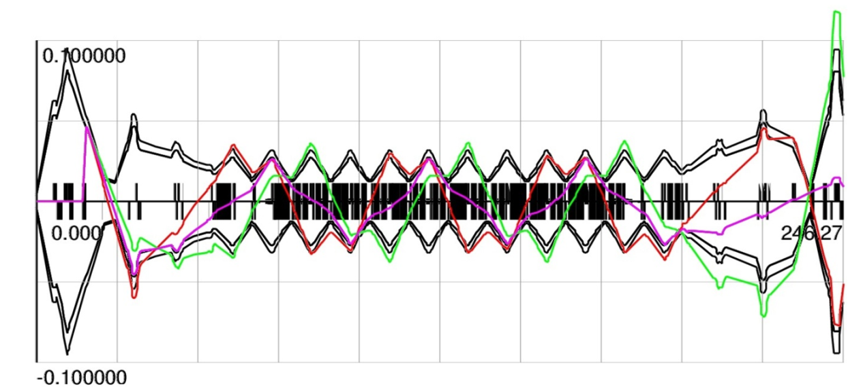
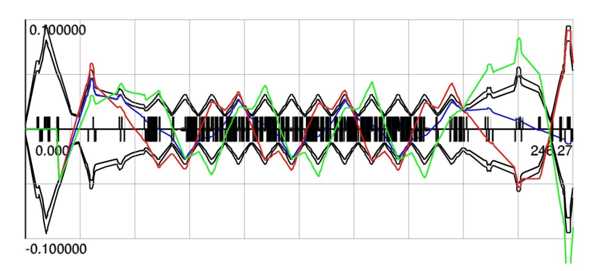
Betatron Collimation X/Y
ScrX1 ColX11 ColX12
⇓ ⇓ ⇓
X-plane
A _{X,Col}=7σ_{X}
A _{X,Scr}=5.5σ_{X}
A _{X,Acc}=6σ_{X}
Xscr1(+)
2x2 Secondary
X-collimators
ScrX2 ColX21 ColX22
⇓ ⇓ ⇓
Xscr2(-)
Δμ_{X,1}(Scrap-CollimX1)=2.88, Δμ_{X,2}(Scrap-CollimX2)=3.40

Slide 23
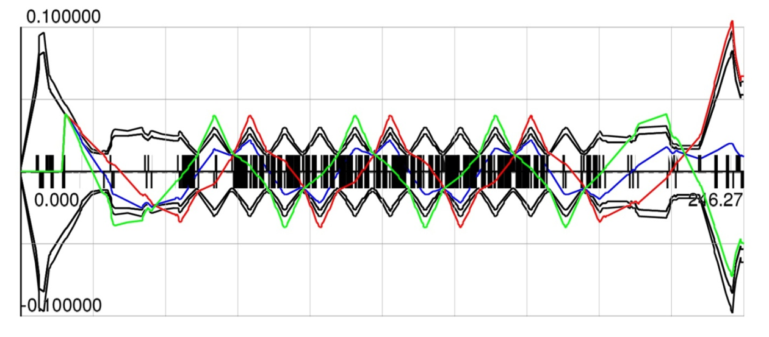
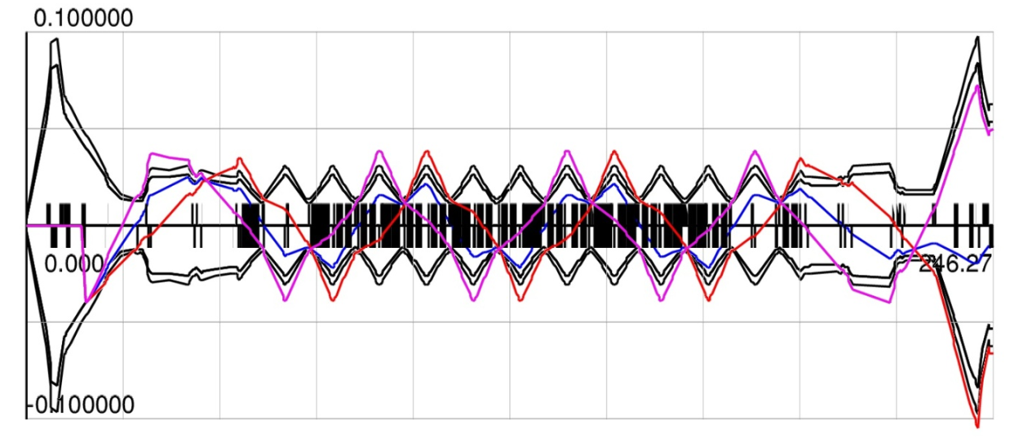
Betatron Collimation X/Y
ScrY1 ColY11 ColY12
⇓ ⇓ ⇓
Y-plane
A _{Y,Col}=7σ_{X}
A _{Y,Scr}=5.5σ_{X}
A _{Y,Acc}=6σ_{X}
Yscr1(+)
ScrY2 ColY21 ColY22
⇓ ⇓ ⇓
2x2 Secondary
Y-collimators
Yscr2(-)
Δμ_{Y,1}(Scrap-CollimY1)=2.30, Δμ_{Y,2}(Scrap-CollimY2)=3.73

Slide 24
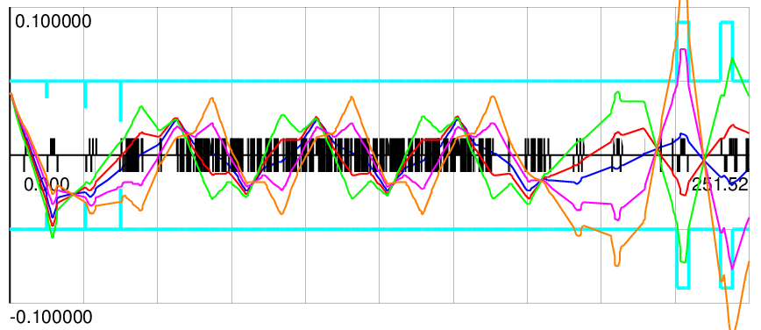
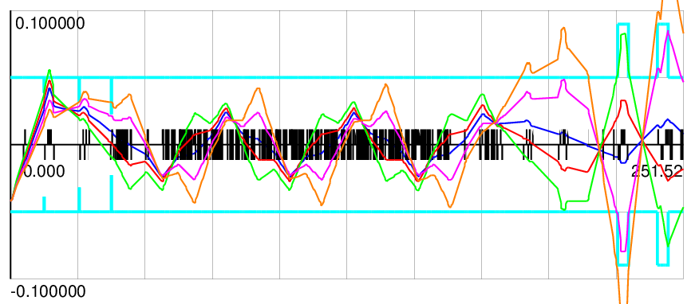
Betatron Collimation X/Y
X-plane
Xscraper1=5.5 σ_{X}
<θ>_{CS} =1mrad
X_{Col1} = +/-0.036
X_{Col2} = +/-0.031
Xscraper2=-5.5 σ_{X}

Slide 25
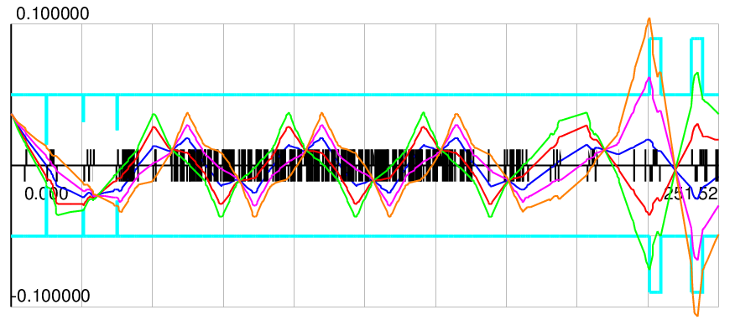
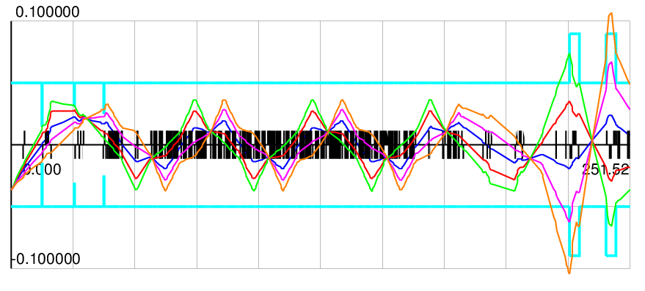
Betatron Collimation X/Y
Y-plane
Yscraper1=5.5 σ_{Y}
<θ>_{CS} =1mrad
Y_{Col1} = +/-0.0145
Y_{Col2} = +/-0.025
Yscraper2=-5.5 σ_{Y}

Slide 26
Conclusions
The scheme of beam halo collimation in NICA collider is considered. The collimation purposes are optimization of background for MPD experiment, first line of machine protection in case of technical fault.
Movable collimators give the possibilities to study beam size, beam orbit and alignment of collimation elements.
The design of scheme is started from the movable Scraper – the Primary collimator.
The Secondary collimators are placed outside the acceptance to provide the energy absorbtion of the scattered ions.
The preliminary calculation of the collimation process is carry out to estimate the possible location of the collimators.
Full-scale simulation of betatron and momentum collimation depending on the ring optics (tunes) will continue.

Slide 27
Thank you for your attention

