Slide 1
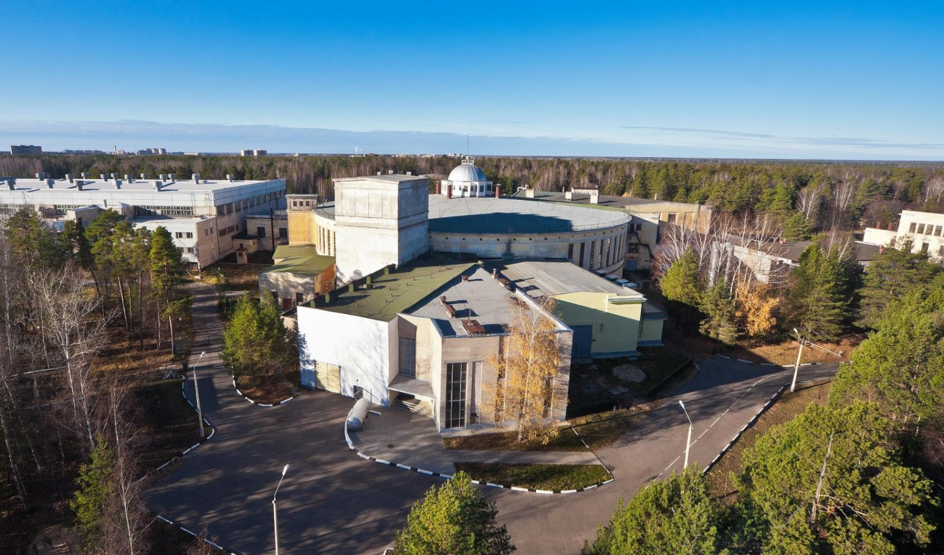
Injection facility of NICA
Levterov K. on behalf of Acceleration division

Slide 2
HILAC & LU-20 – two injectors for NICA
Into collider
Nuclotron
SPI
RFQ
LU-20
LIS
5 MeV/u
p↑, d↑, ions z/A>0.3
600 Me/u
HILАC
Booster
ESIS
RFQ
IH1
IH2
Au³¹⁺ 3.2 MeV/u
Beams of polarized protons and deutrons p↑ и d↑ and light ions will be accelerated by LU-20, then by Nuclotron
Heavy ions : HILAC + Booster + Nuclotron

Slide 3
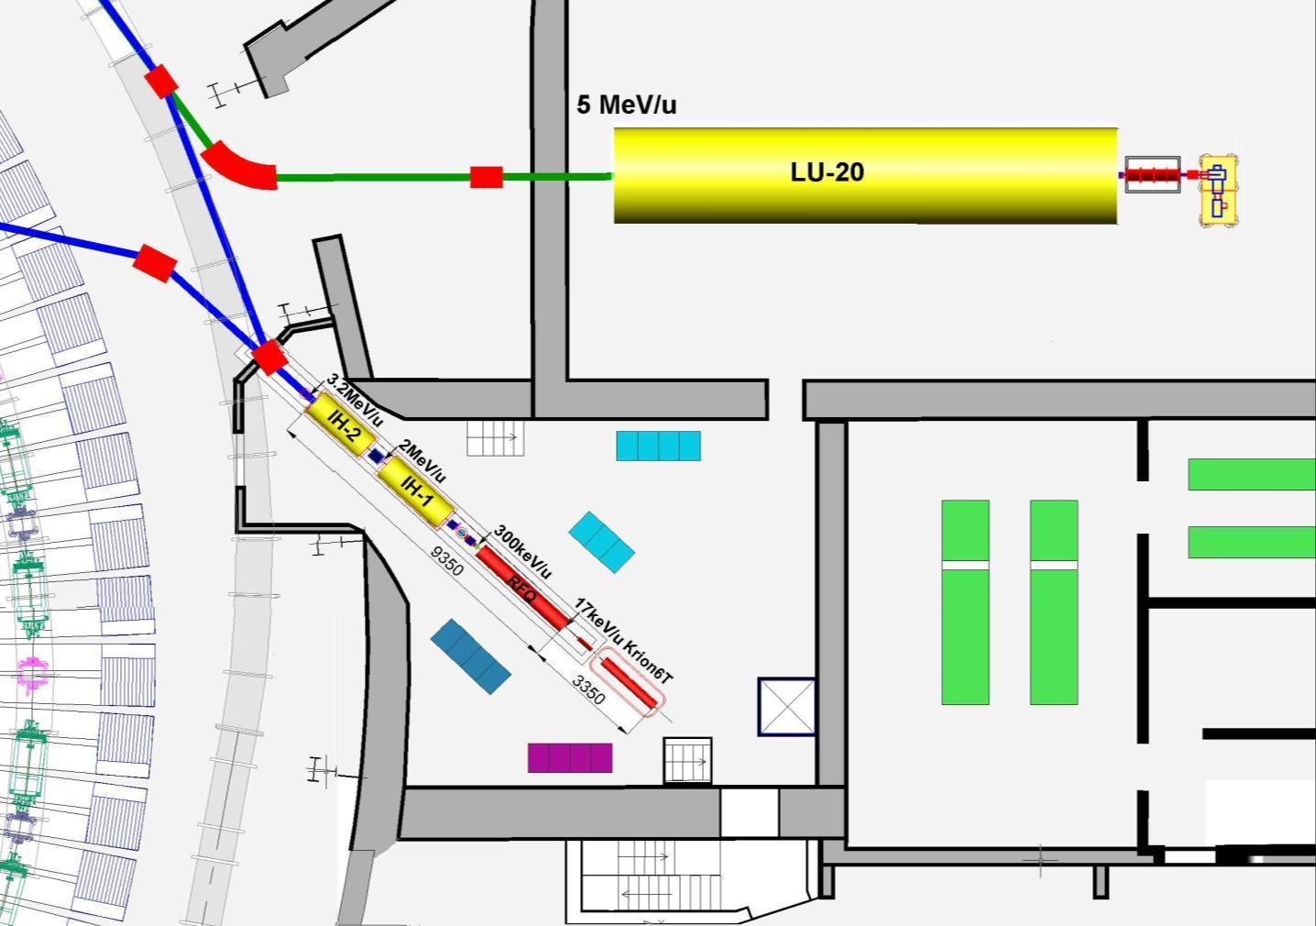
Injection Facility arrangement
p↑, d↑, ions Z/A>0,3
Ions Z/A>0,3
LIS
Transport channel
to Nuclotron
RFQ
Transport channel to booster
SPI
p↑,d↑
10mA
LU-20 Building
HILАC
ESIS
“KRION”
^{Booster}
^{Nuclotron}
RF amplifier for LU-20

Slide 4
TOPICS
RFQ commissioning in 2016
RFQ+IH1+IH2 first launch 2016
RFQ+IH1+IH2 comissioning 2017
RFQ+IH1+IH2 recomissioning 2018

Slide 5
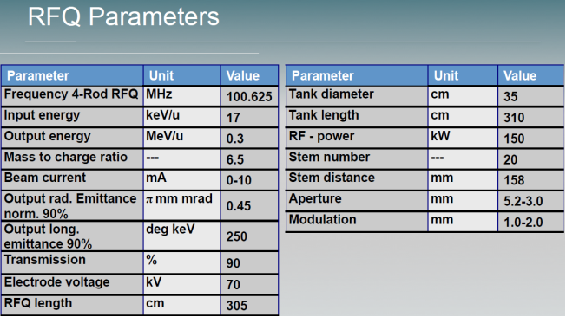
Estimation of output energy and transmission is Goal of RFQ commissioning
4-rod RFQ
Au31+, Ein=17 keV/u Eout=300 keV/u

Slide 6
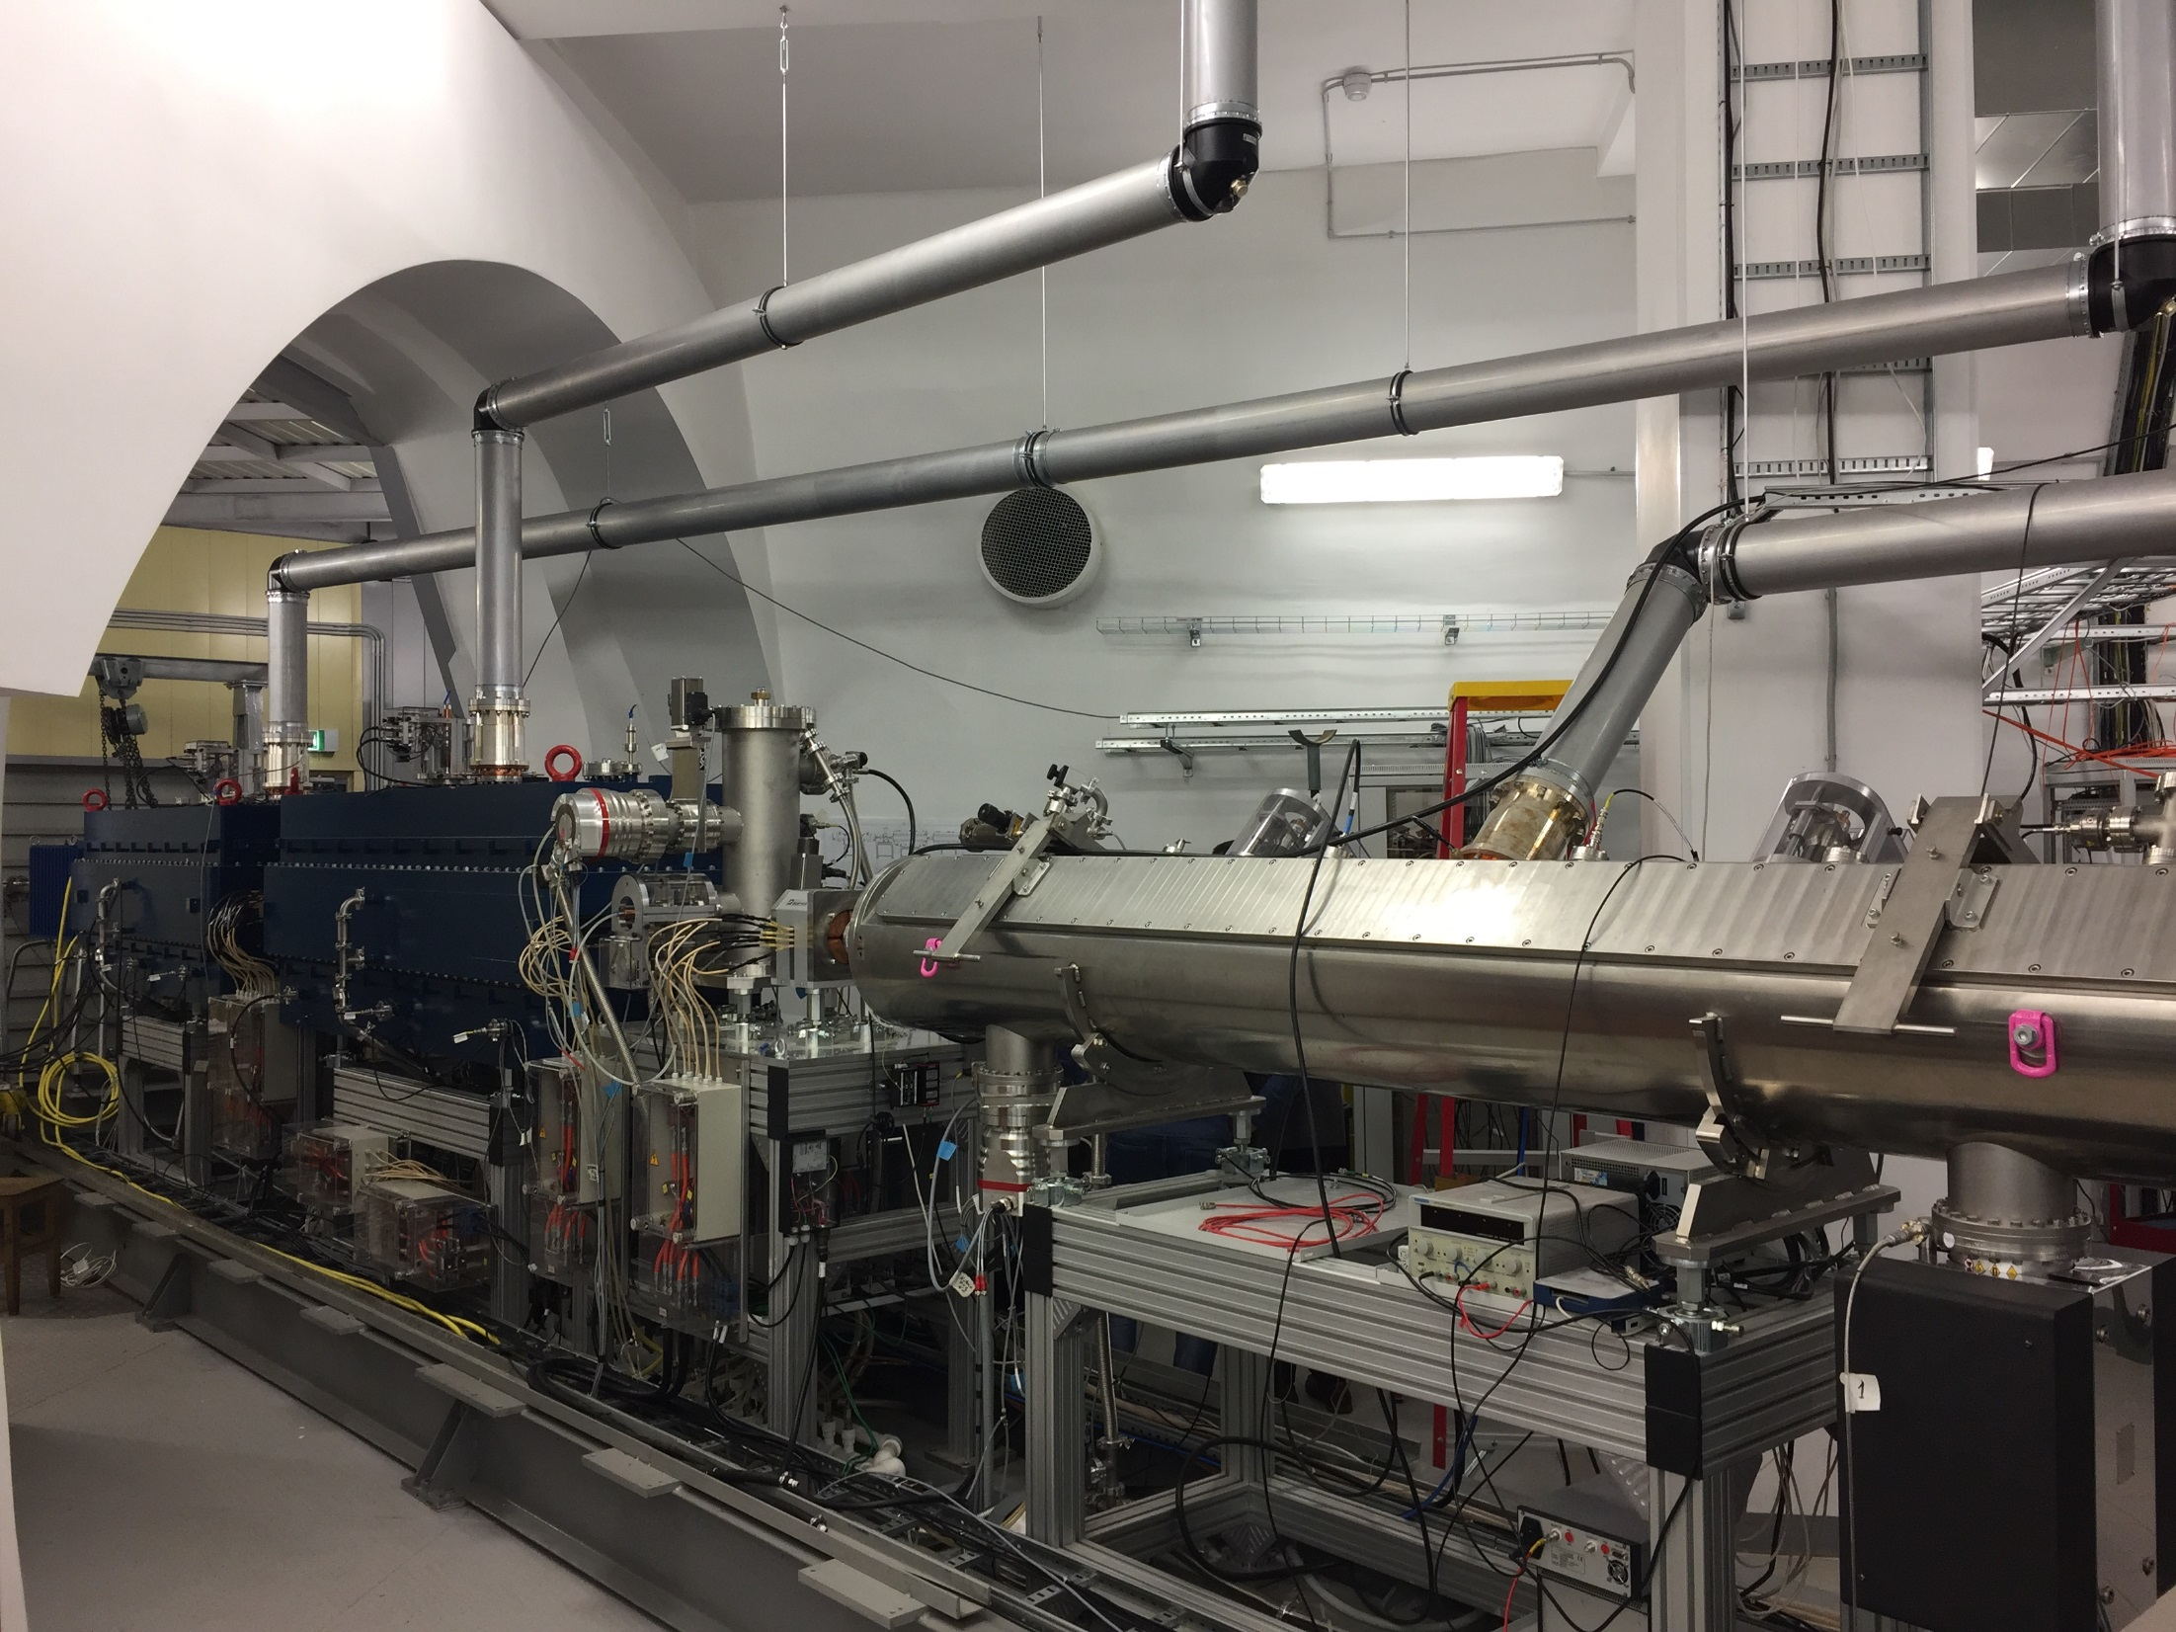

Slide 7
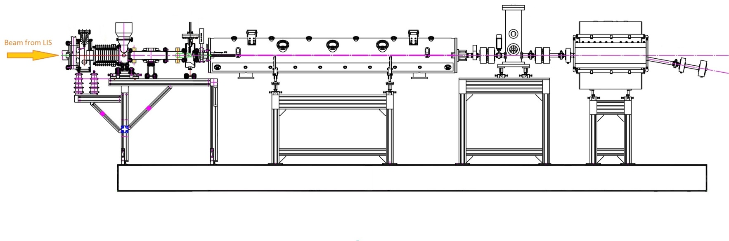
EXPERIMENTAL SETUP
LEBT
RFQ
MEBT
ANALISING MAGNET
Electrodes
Accelerating tube
Focusing
lenses
D1
Buncher
D2
Osciloscope

Slide 8
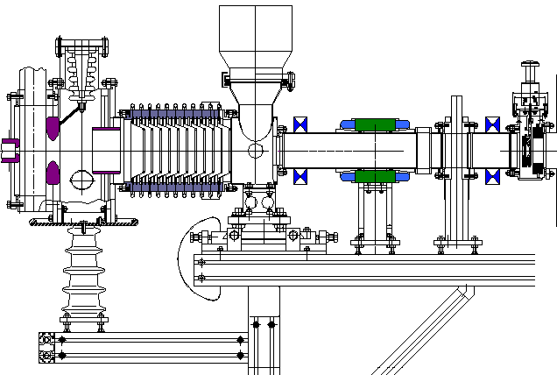
LEBT
Low Energy Beam Transport
Ein=3 keV/u Eout=17 keV/u
Electrodes
Accelerating
tube
RFQ input
Focusing magnet lenses
Steer

Slide 9
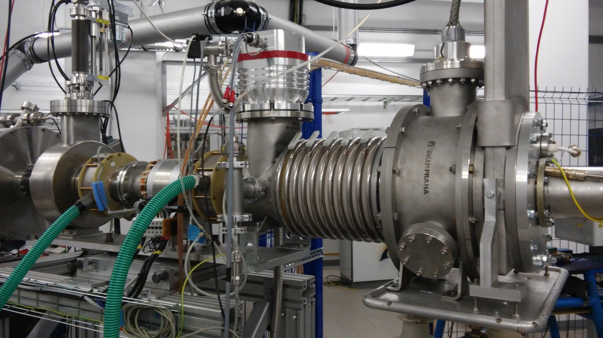
LEBT
Low Energy Beam Transport
Ein=3 keV/u Eout=17 keV/u

Slide 10
OUTPUT ENERGY
E=300 keV/u => β = 0.0253
STEPS :
Experimental searching for R at the given energy
Calculating βacc at the found R
β = [2(e/ mp с²) (Z/A) U]^{1/2}
β = 4.8 10⁻⁵ [(Z/A) U]^{1/2}
R= (mpс/e) β (A/Z) 1/B
R= 3,13 β A/Z 1/B

Slide 11
OUTPUT ENERGY searching for R
β = [2(e/ mpс2) (Z/A) U]^{1/2}
R= (mpс/e) β (A/Z) 1/B
R= 3,13 β A/Z 1/B
U=51 kV | Z/A | β | B, G | R, m
C2+ | 1/6 | 0,00430 | 484 | 1,665
C3+ | 1/4 | 0,00520 | 394 | 1,652
C4+ | 1/3 | 0,00603 | 340 | 1,669
<R>=1.662 m (+/-0.5%)

Slide 12
OUTPUT ENERGY
βуск = (e/mpC) (Z/A) BR
βуск = 0,319 Z/A BR
β = 0.0253, E=300 keV/n
 | I magnet, A | B, kG | Urf p-p, mV | Uinj, kV | β +/_0.5%
C2+ | 88,60 | 2,88 | 823 | 102 | 0,0254
C3+ | 59,50 | 1,95 | 565 | 65 | 0,0258
C4+ | 44,00 | 1,45 | 442 | 49 | 0,0255
C5+ | 35,70 | 1,18 | 340 | 41 | 0,0261
C6+ | 29,70 | 0,97 | 283 | 34 | 0,0257
D+ | 29,70 | 0,97 | 283 | 34 | 0,0257
H+ | 14,50 | 0,48 | 144 | 17 | 0,0256

Slide 13
DTL structure IH1 + IH2
Ein=300 keV/u Eout=3.2 MeV/u
«KONUS» (KOmbinierte NUll grad Struktur–нем.) – combined structure with zero synchronus phase.
IH, βλ/2 , TEM110.
- asynchronous beam injection with a surplus energy into structure with ‘fictional’ 0° synchronous particle, which defines only the drift tube structure
- Each accelerating section is followed by a transversal
focusing element
- At the entrance of each 0° synchronous particle
section the bunch must be longitudinally focused -35º.

Slide 14
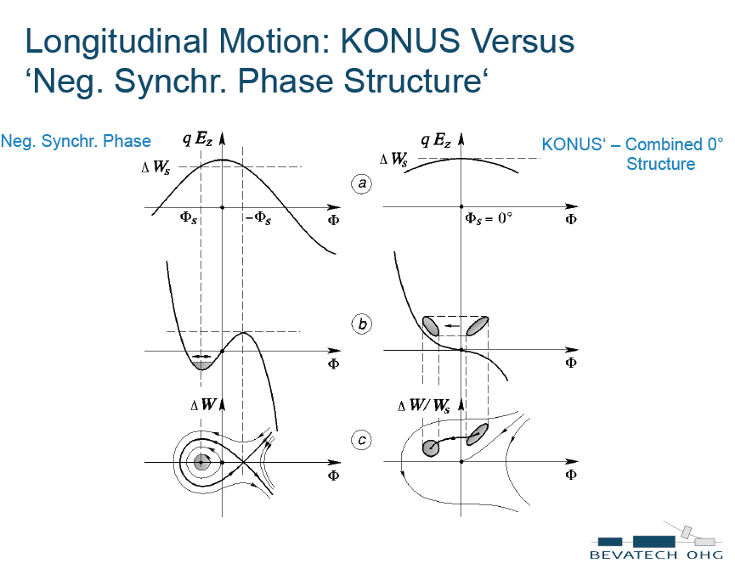
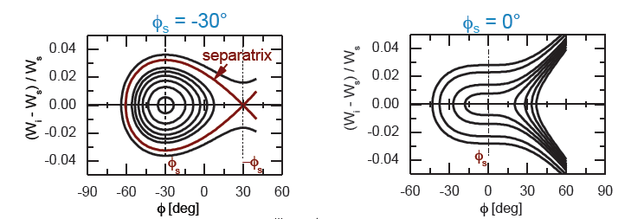

Slide 18
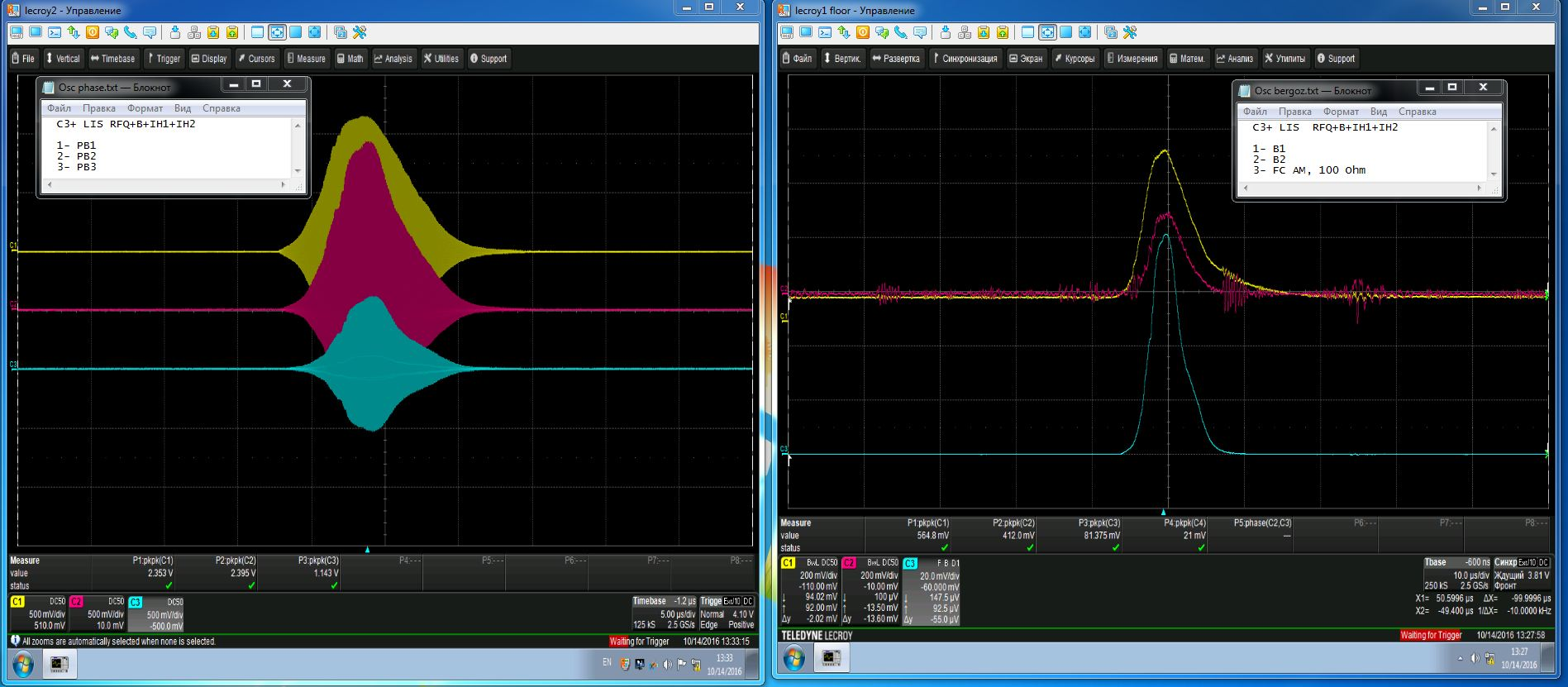
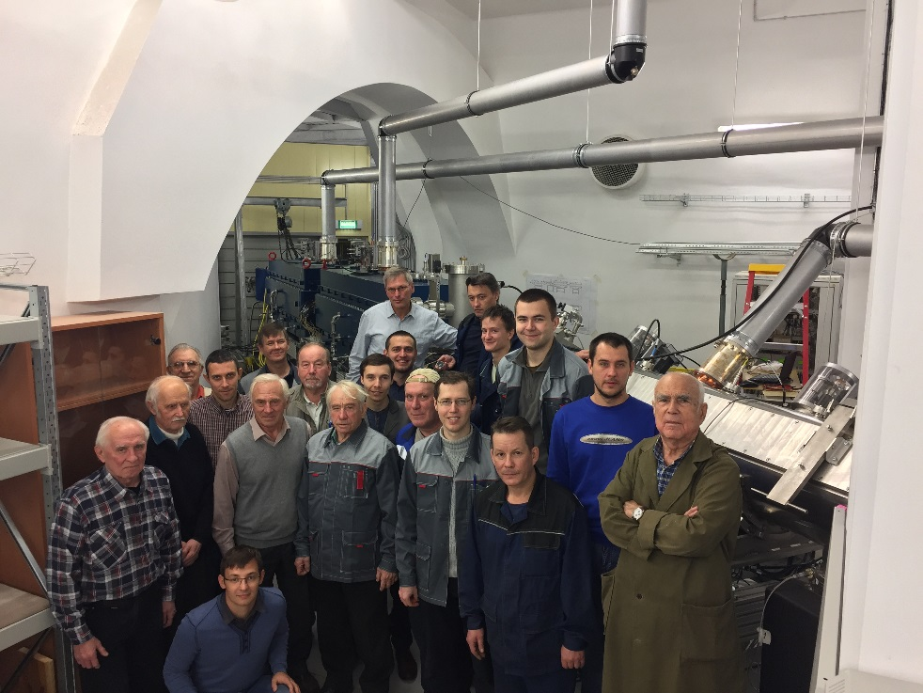
RFQ+IH1+IH2 first launch 2016

Slide 19

RFQ+IH1+IH2 comissioning 2017

Slide 20
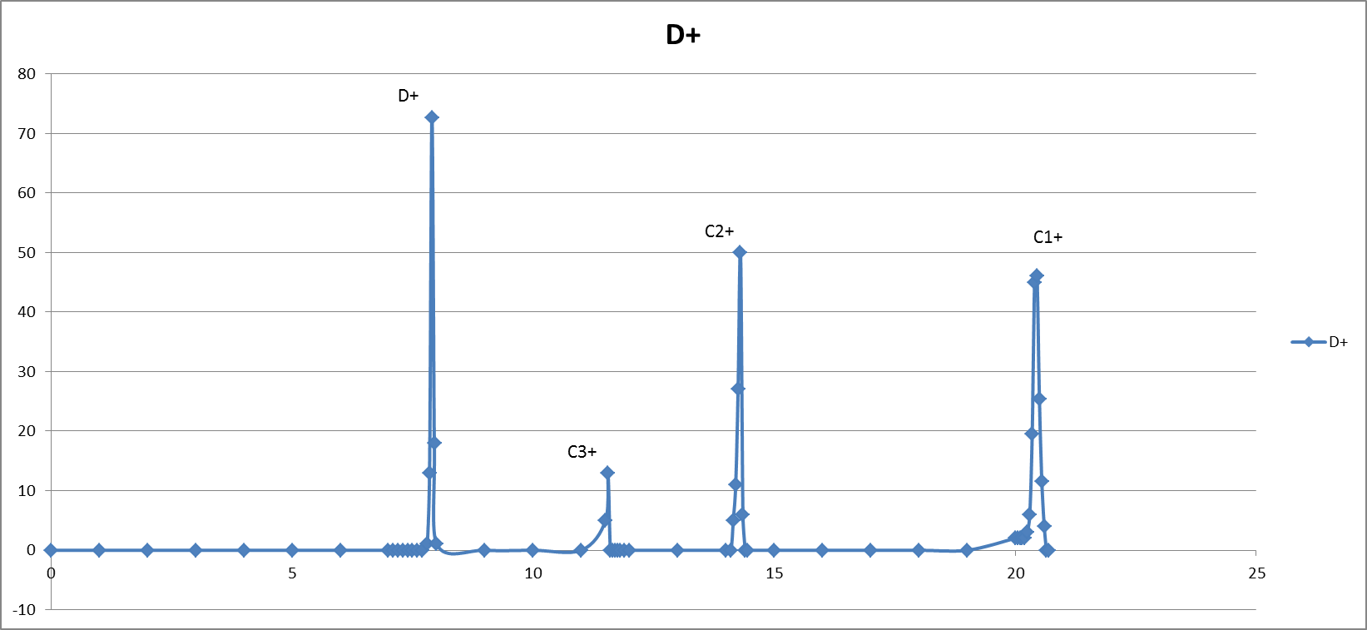
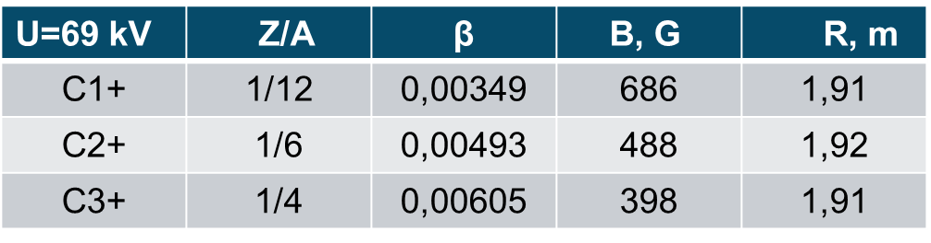
OUTPUT ENERGY searching for R
Uinj=69 kV
β = [2(e/ mpс2) (Z/A) U]^{1/2}
R= (mpс/e) β (A/Z) 1/B
R= 3,13 β A/Z 1/B
<R>=1.91 m (+/-1%)

Slide 21
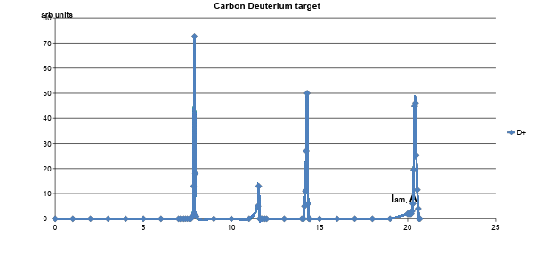
D+
C2+, 14.3
C1+, 20.4
C3+, 11.55

Slide 22
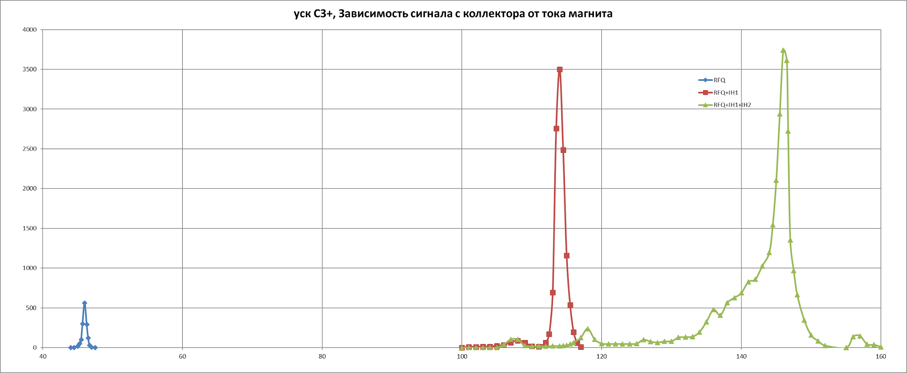
Three stages of C3+ beam acceleration in HILAC

Slide 23
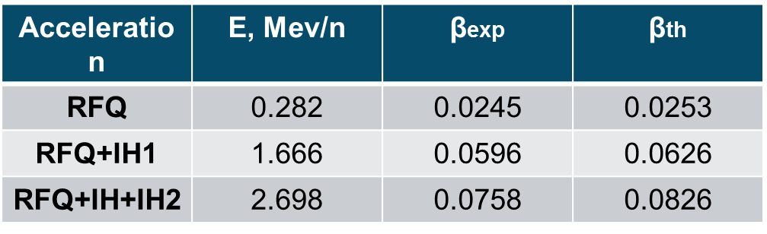
?OUTPUT ENERGY?
βуск = (e/mpC) (Z/A) BR
βуск = 0,319 Z/A BR

Slide 24
RFQ+IH1+IH2 recomissioning 2018

Slide 25
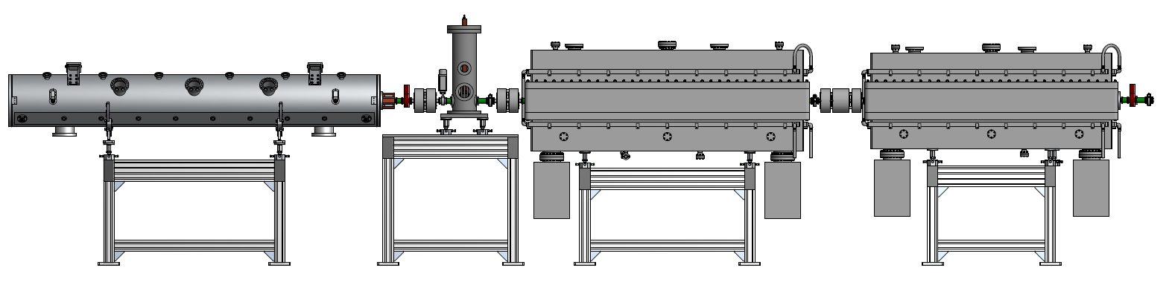
Experimental setup
S- steerer, CT-current transformer, PP-phase probe,
D- doublet, T- triplet, FC- Faraday cup
Experimental Eout= 3.2 MeV
CT1
PP1
PP2
CT2
PP3
FC
FC
Analizing
magnet
S2v, S2h
D1
D2
T1
T2

Slide 26
OUTPUT ENERGY
E=3.2 MeV/u => β = 0.0826
STEPS :
Experimental searching for R at the given energy
Calculating βacc at the found R
β = [2(e/ mp с²) (Z/A) U]^{1/2}
R= (mpс/e) β (A/Z) 1/B
R= 3,13 β A/Z 1/B

Slide 27
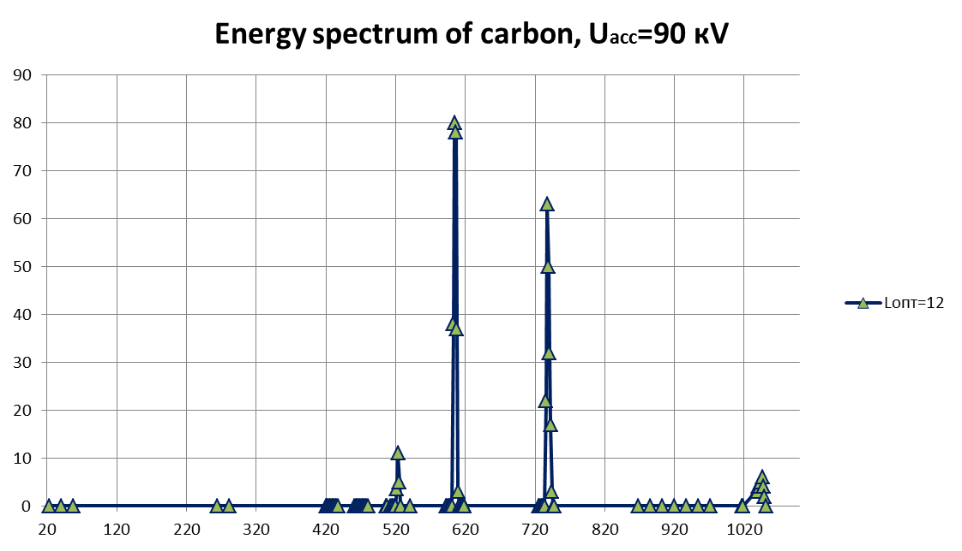
Searching for Reff of analising magnet
β = [2(e/ mpс2) (Z/A) U]^{1/2}
R= (mpс/e) β (A/Z) 1/B
R= 3,13 β A/Z 1/B
U=90 kV | Z/A | β | B, G | R, m
C1+ | 1/12 | 0,00563 | 1046 | 1,554
C2+ | 1/6 | 0,0069 | 737 | 1,574
C3+ | 1/4 | 0,0080 | 605 | 1,579
C4+ | 1/3 | 0,0089 | 524 | 1,589
<R>=1.587 m (+/-1%)

Slide 28
First stage of acceleration in HILAC, Eout=0,3 MeV
 | B, G | E, MeV | β +/_0.5%
C2+ | 3249 | 0,303 | 0,0255
C3+ | 2183 | 0,306 | 0,0256
C4+ | 1638 | 0,305 | 0,0256
C5+ | 1213 | 0,302 | 0,0255

Slide 29
Second stage of acceleration in HILAC, Eout=1,821 MeV
 | B, G | E, MeV | β +/_0.5%
C2+ | 7976 | 1,842 | 0,0629
C3+ | 5385 | 1,885 | 0,0636
C4+ | 3974 | 1,821 | 0,0625
C5+ | 3197 | 1,856 | 0,0631

Slide 30
Final stage of acceleration in HILAC, Eout=3,2 MeV, β=0.0829
 | B, G | E, MeV | β +/- 1 %
C2+ | 9617 | 3,26 | 0,0836
C3+ | 7075 | 3,26 | 0,0836
C4+ | 5354 | 3,31 | 0,0843
C5+ | 4267 | 3,28 | 0,0839
C6+ | 3335 | 3.26 | 0.0834

Slide 31
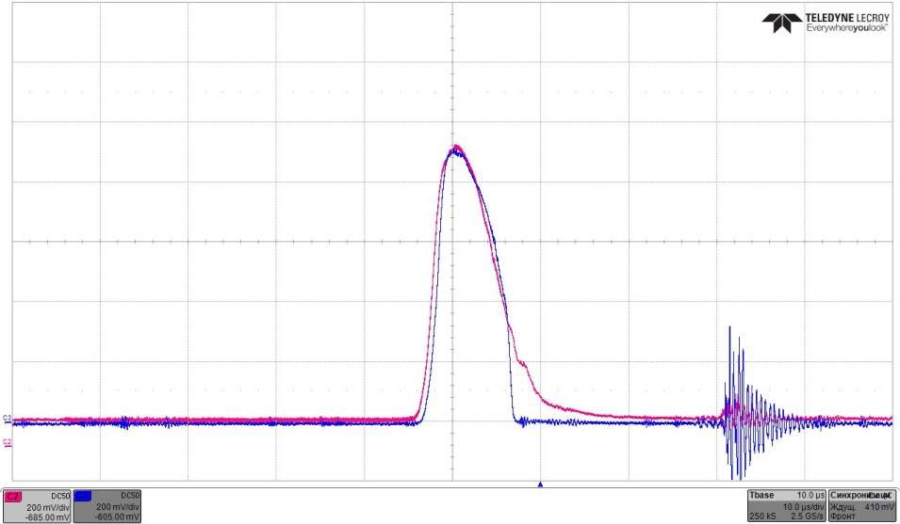
Bunching&Transmission
CT1
CT2
 | CT1, mA | CT2, mA Buncher on/Buncher off | K | Transmission
C2+ | 1.1 | 0.6/0.4 | 1,5 | 60%
C3+ | 2.2 | 1.0/0.44 | 2,3 | 50%
C4+ |  |  | ≥10 | 50%
C5+ |  |  | ≥10 | 50%

Slide 32
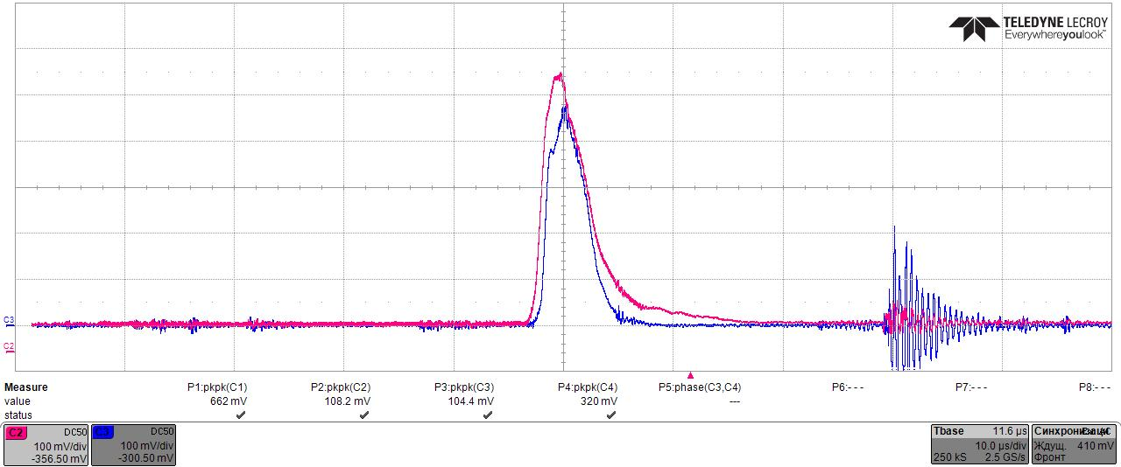
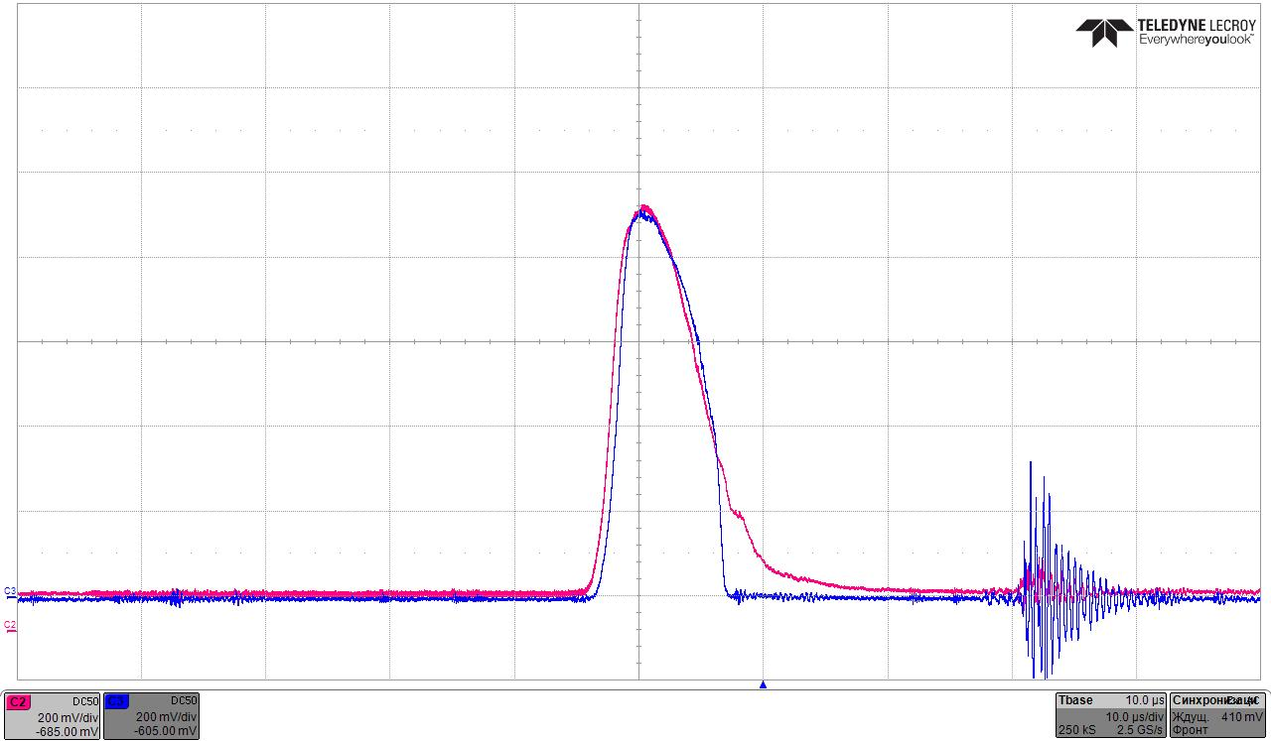
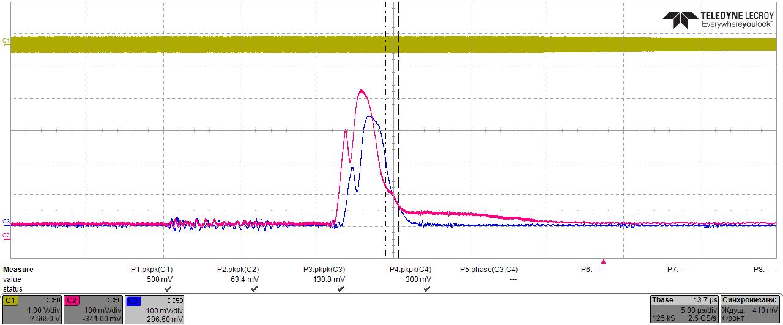
C2+
C3+
C4+
CT1, RFQ output
CT2, HILAC output

Slide 33
Acelerated beam or not?
Only phase probe PP1 and current transformer CT1 are behind the accelerator

Slide 34
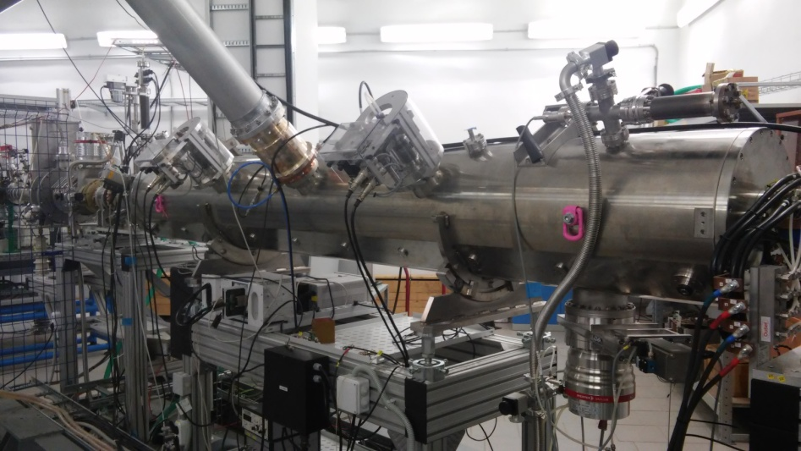
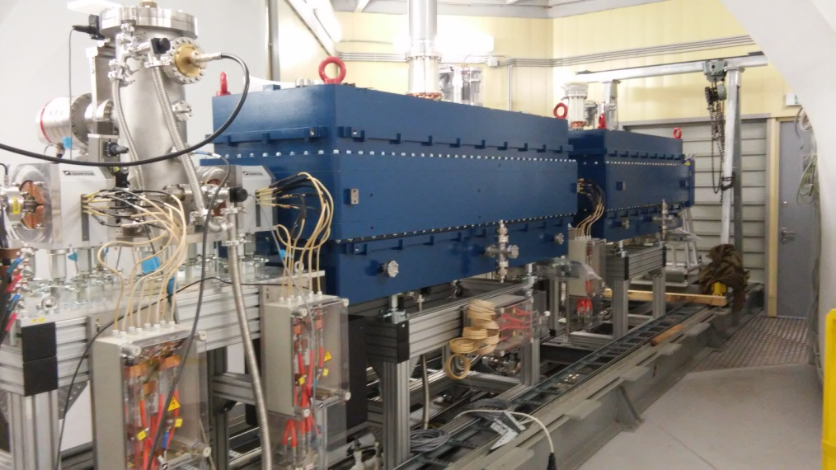
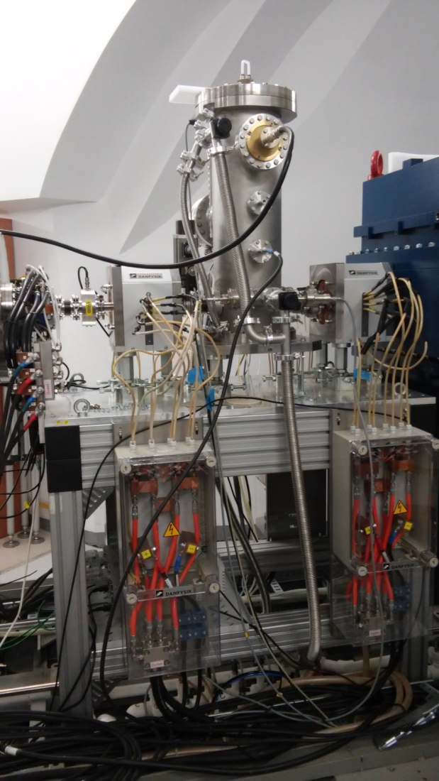
NEXT STEPS
LLRF upgrade.
Searchng for the modes.
Measurement of transmission.
Measurement of emittance at the output of HILAC.
Beam test with ESIS.

Slide 35

THANKS

