Slide 1
Testing of sc-magnets for NICA and FAIR

Slide 2
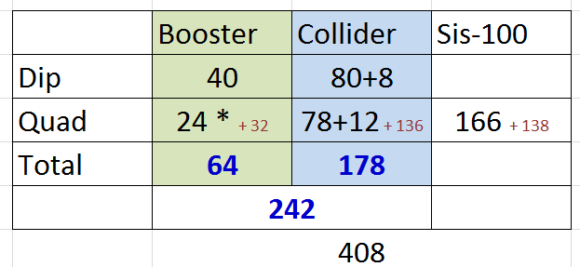
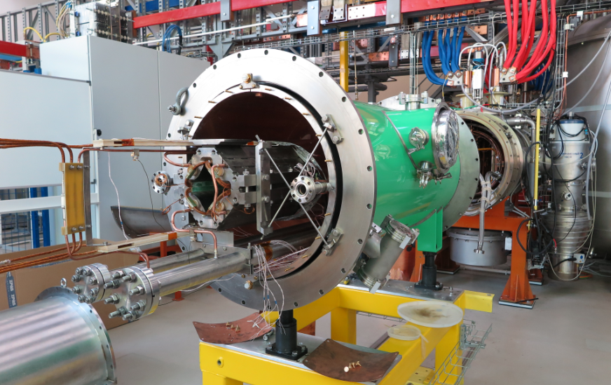
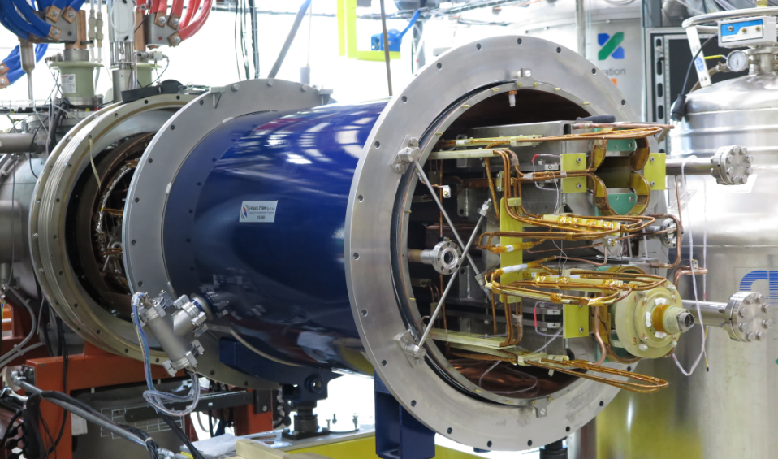
Testing of SC-magnet’s for NICA and FAIR

Slide 3
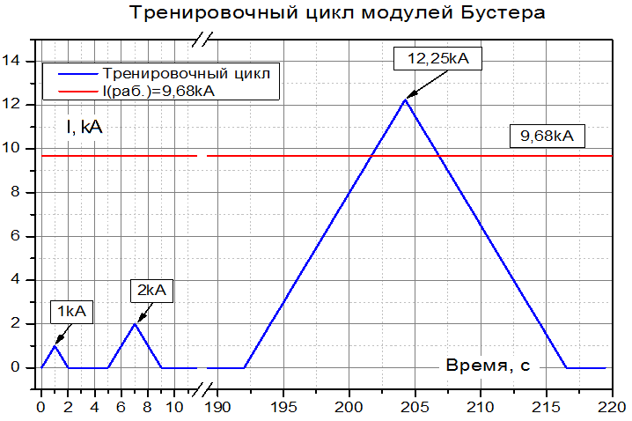
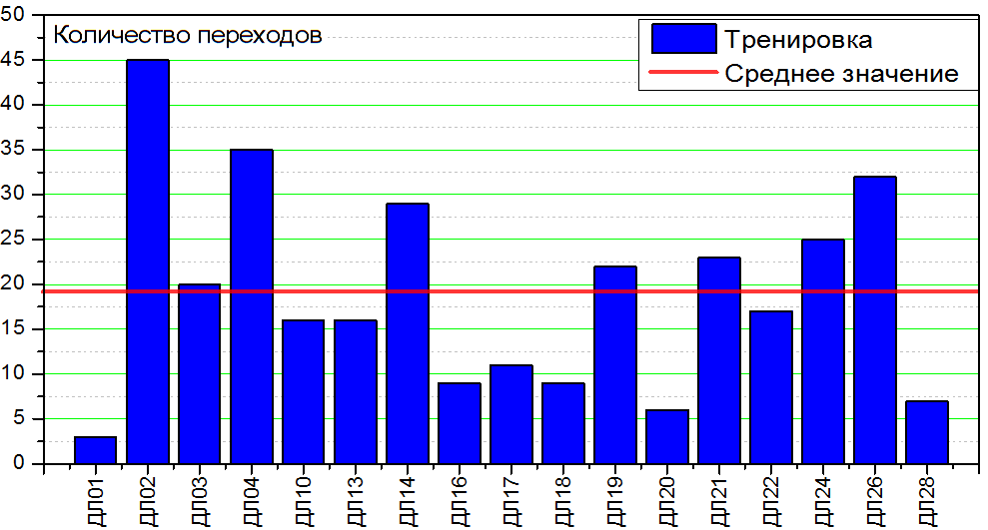
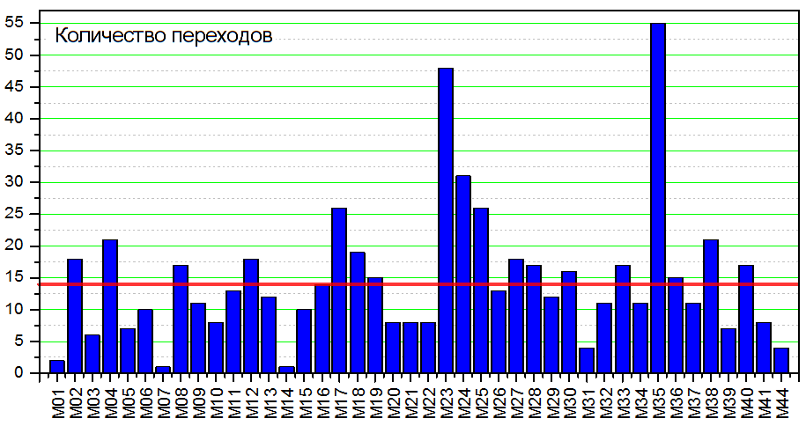
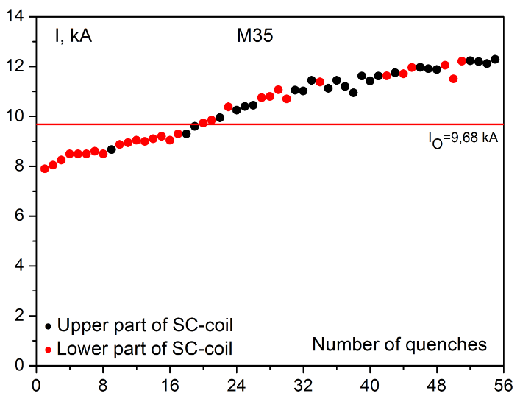
SC-magnet training
Quads
Dipoles

Slide 4
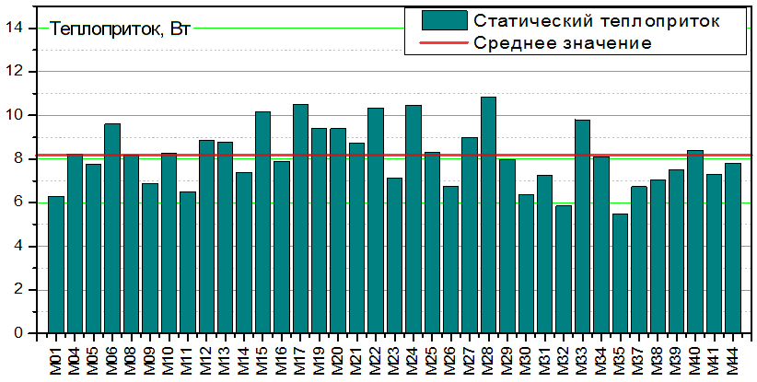
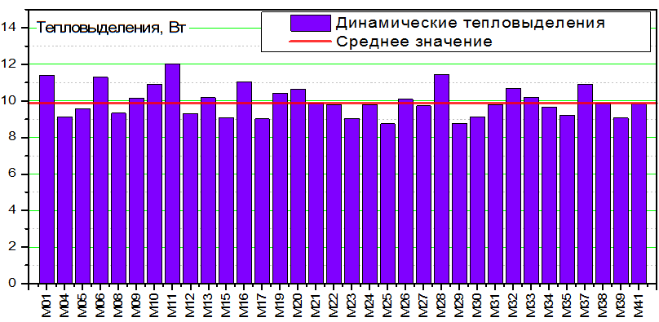
Static heat leak to dipoles
Calc. ~4.4 W
3 dipoles statistics without magnetic measurement system inside. ~4.8 W
Dynamic heat releases in dipoles
Calc. ~8.4 W

Slide 5
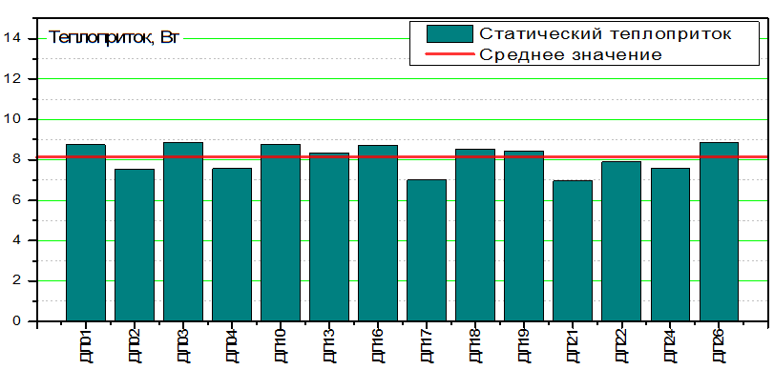
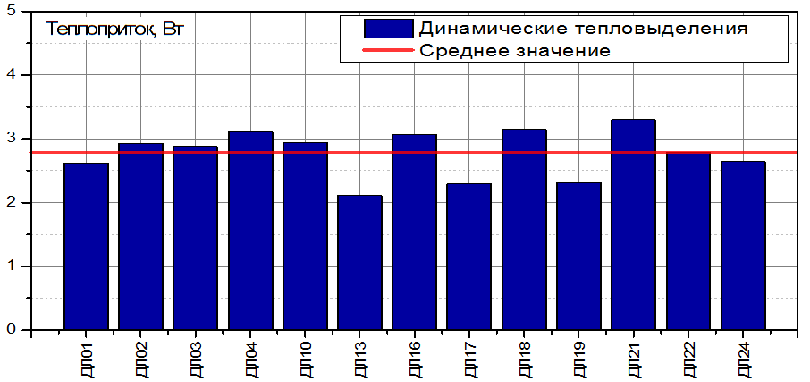
Static heat leak to quads’ doublets
Calc. ~3.0 W
1 doublet datawithout magnetic measurement system inside. ~4.2 W
Dynamic heat releases in quads’ doublets
Calc. ~1.6 W

Slide 6
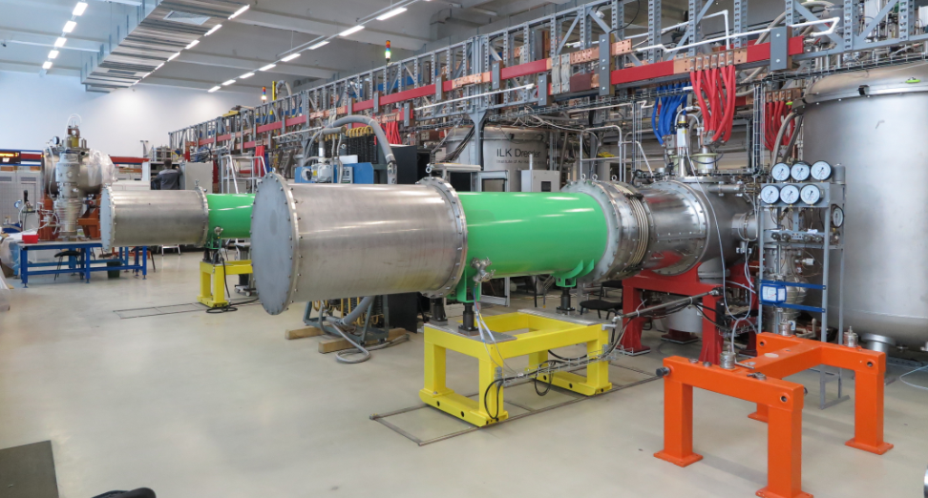
Cryogenic tests
05.09.2018
79%
80%

Slide 7
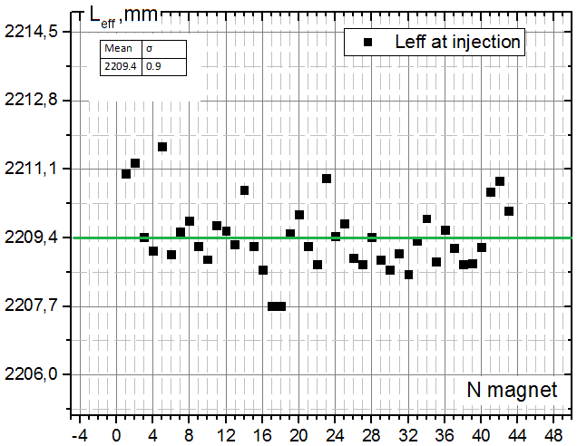
Magnetic field measurements
Booster dipoles
Leff. @ 625 A
σrms = 4*10^(-4)

Slide 8
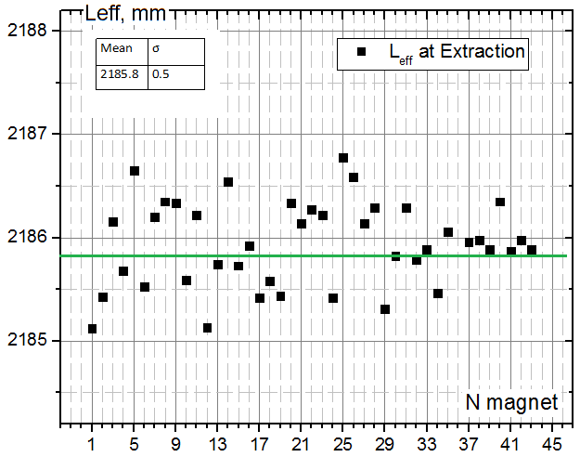
Magnetic field measurements
Booster dipoles
Leff. @ 9745 A
σrms = 2.3*10^(-4)

Slide 9
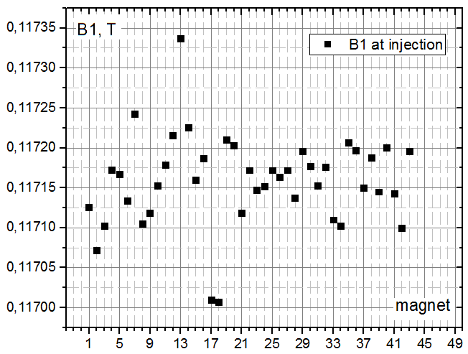
Magnetic field measurements
Booster dipoles
B1. @ 625 A

Slide 10
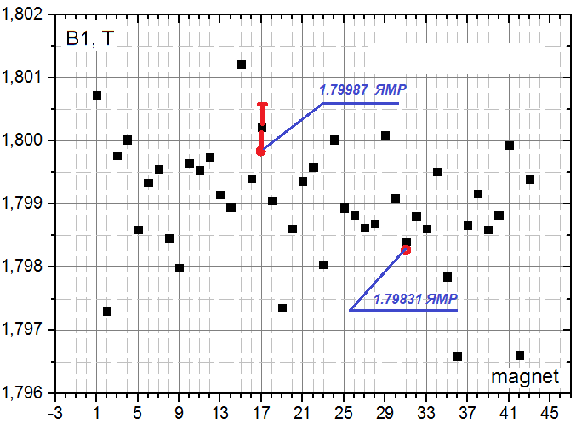
Magnetic field measurements
Booster dipoles
B1. @ 9745 A

Slide 11
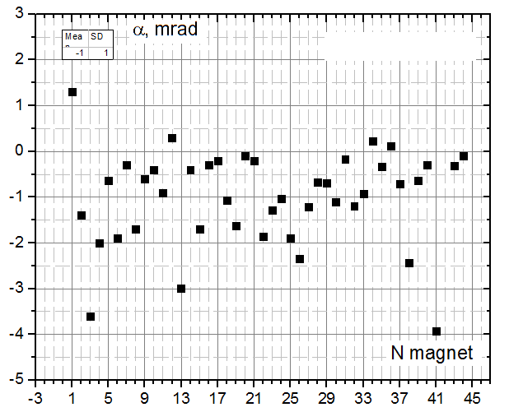
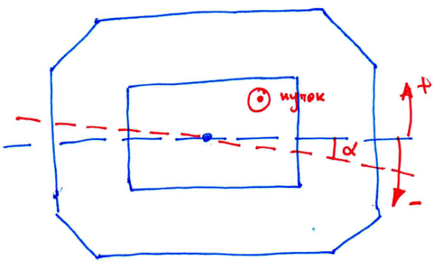
Magnetic field measurements
Booster dipoles
Угол между медианной и средней плоскостью

Slide 12
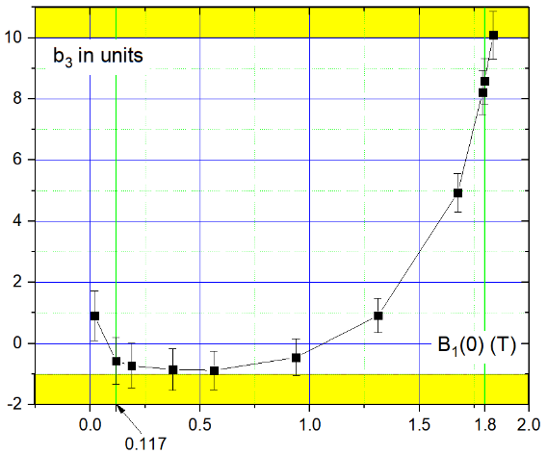
Magnetic field measurements
Booster dipoles
<b3>

Slide 13
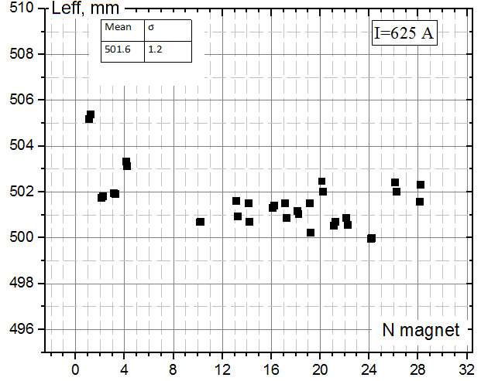
Magnetic field measurements
Booster quadrupoles
Leff. @ 625 A
σrms = 24*10^(-4)

Slide 14
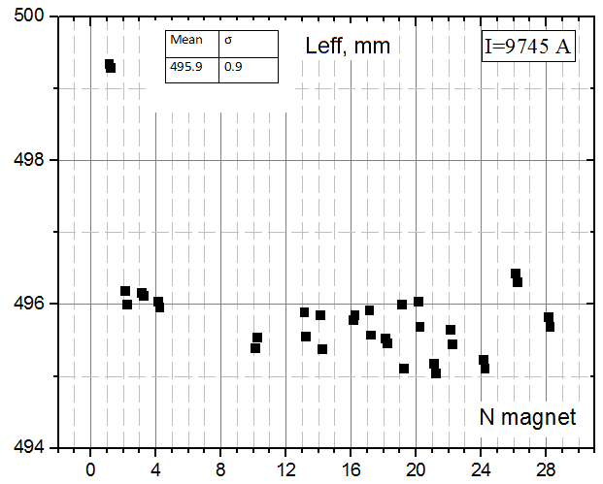
Magnetic field measurements
Booster quadrupoles
Leff. @ 9745 A
σrms = 18*10^(-4)

Slide 15
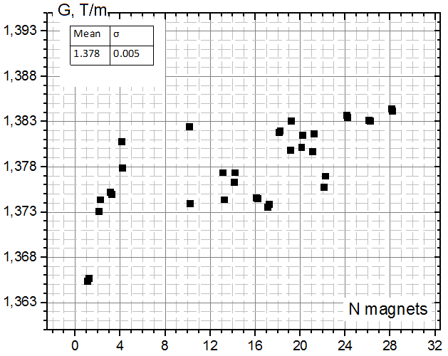
Magnetic field measurements
Booster quadrupoles
G @ 625 A
σrms = 36*10^(-4)

Slide 16
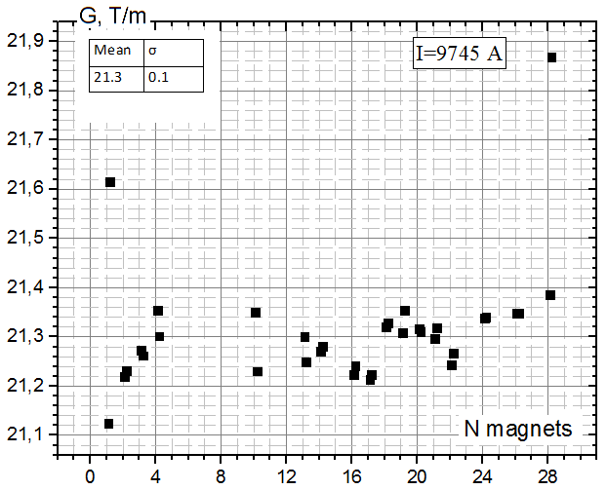
Magnetic field measurements
Booster quadrupoles
G @ 9745 A
σrms = 45*10^(-4)

Slide 17
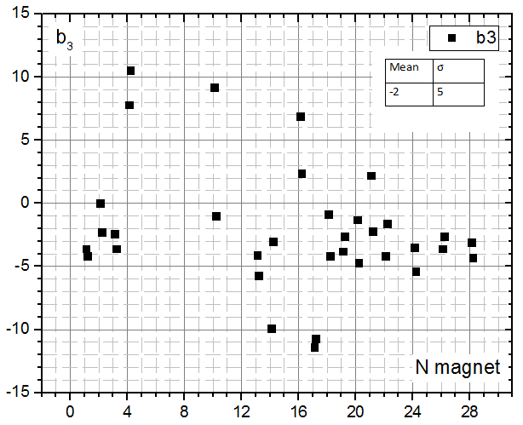
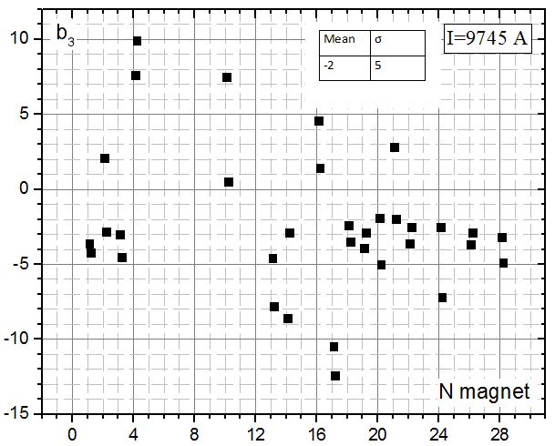
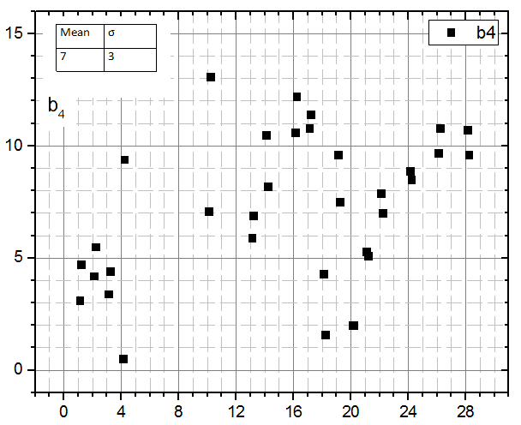
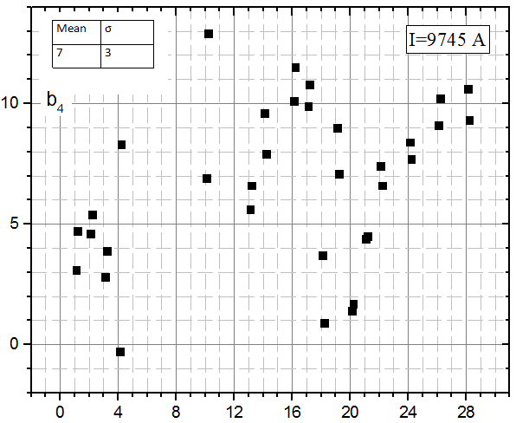
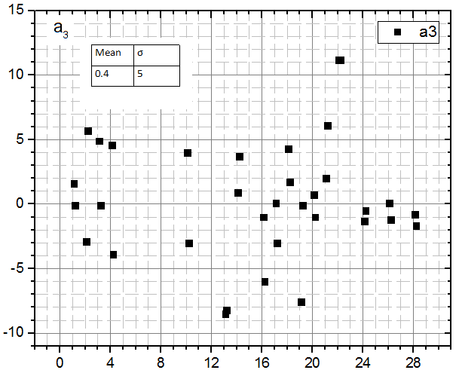
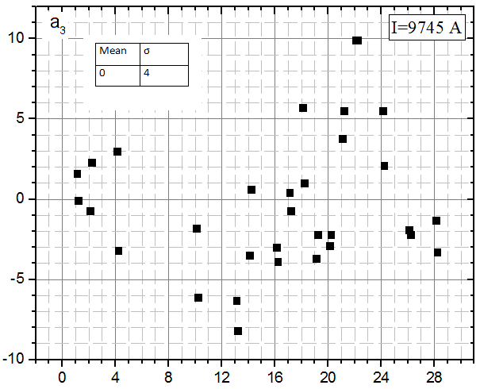
Magnetic field measurements
Booster quadrupoles
@ 625 A
@ 9745 A
<b3>=-2
<b3>=-2
σrms = 5
σrms = 5
<b4>=7
<b4>=7
σrms = 3
σrms = 3
<a3>=0.4
<a3>=0
σrms = 5
σrms = 5

Slide 18
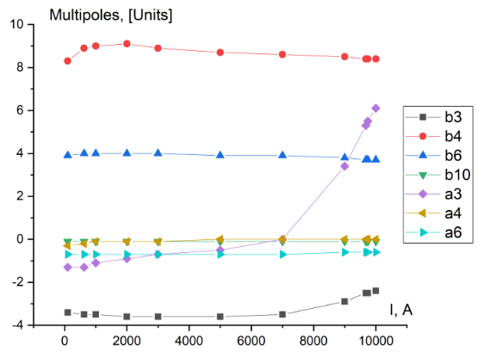
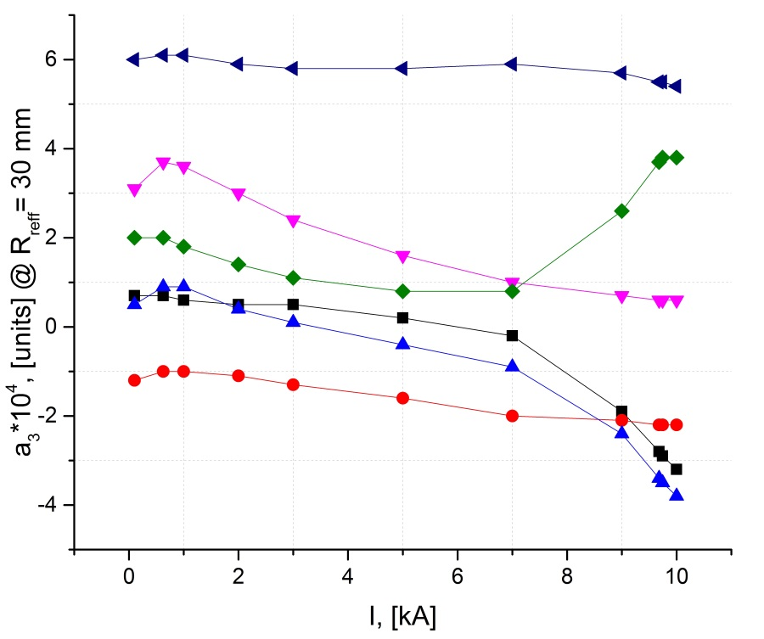
Magnetic field measurements
Booster quadrupoles
One quad
Several quads

Slide 19
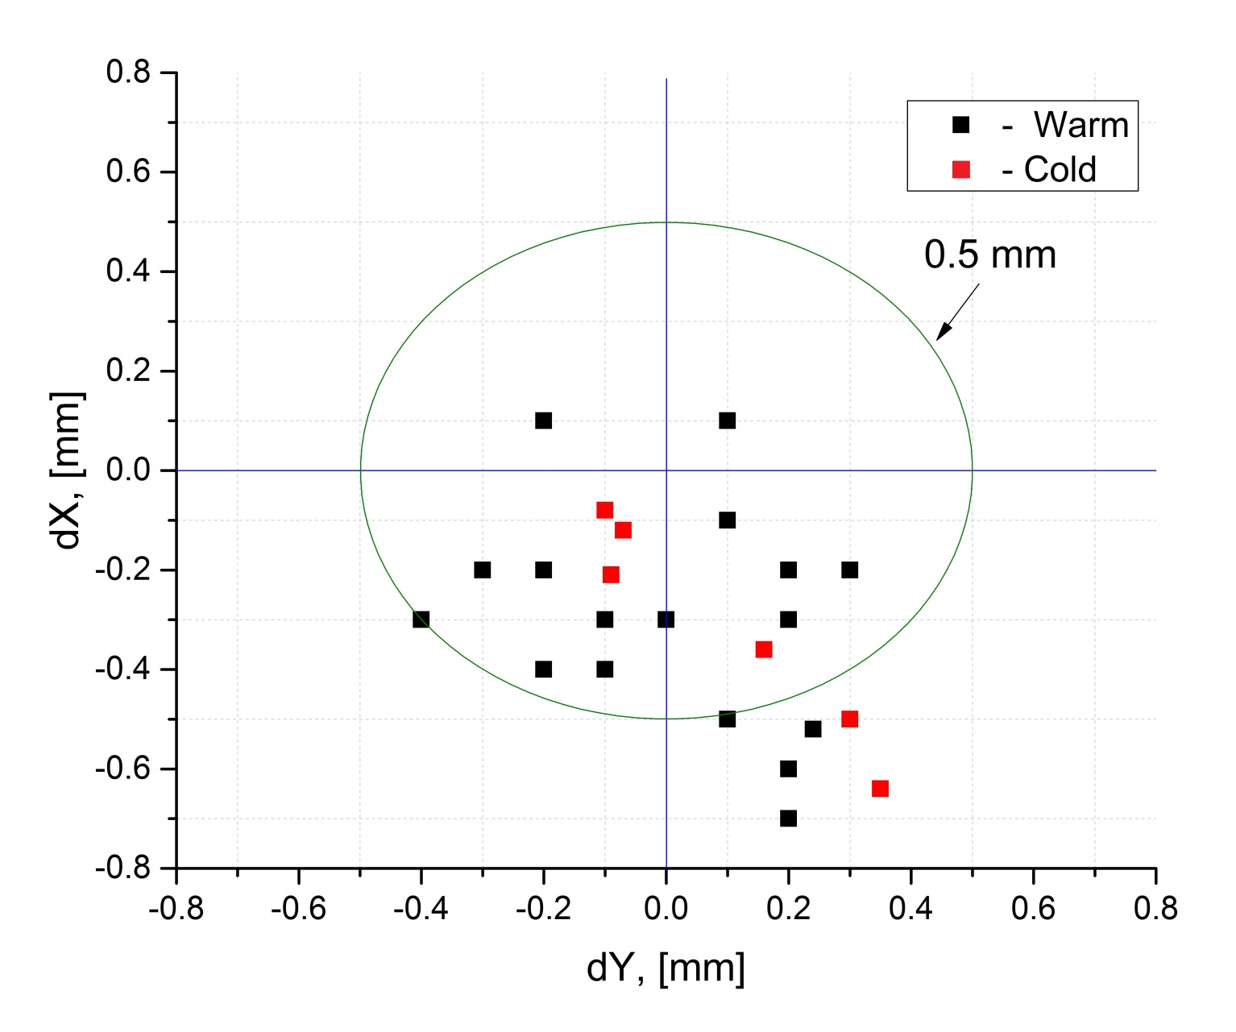
Magnetic field measurements
Booster quadrupoles
Position of magnetic axis

Slide 20
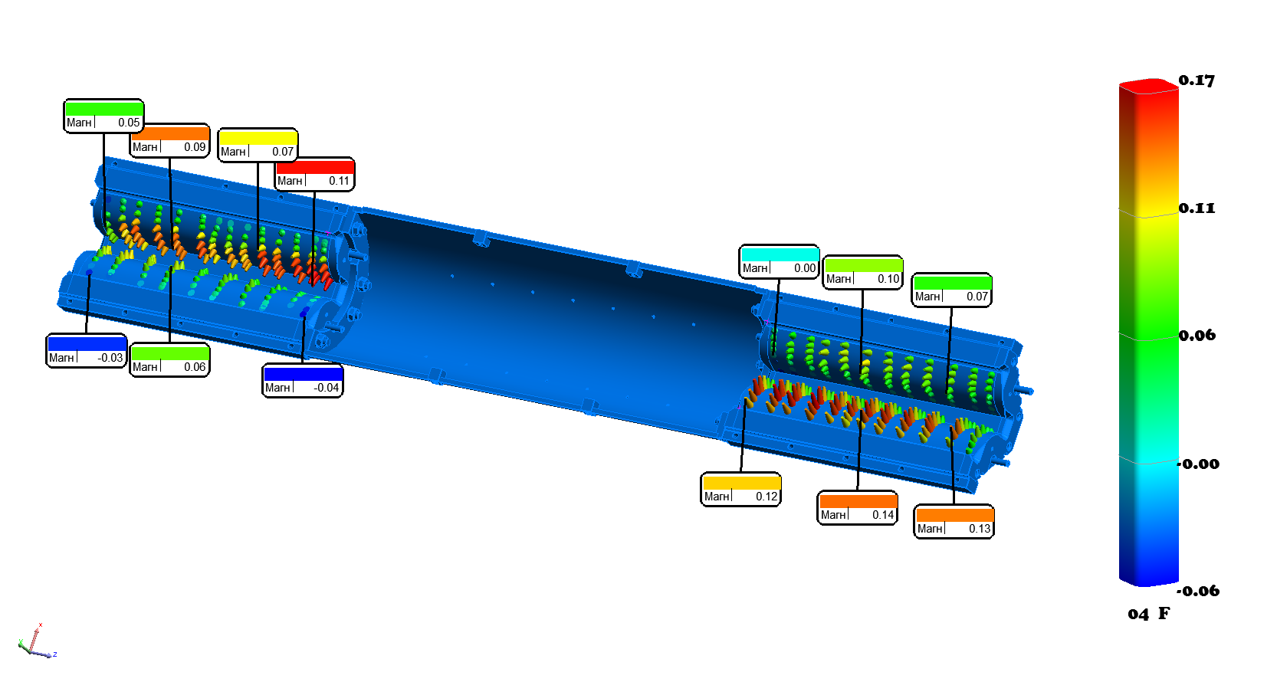
Ярмо дублета квадрупольных линз Бустера Отклонения гиперболических поверхностей от 3D-модели

Slide 21
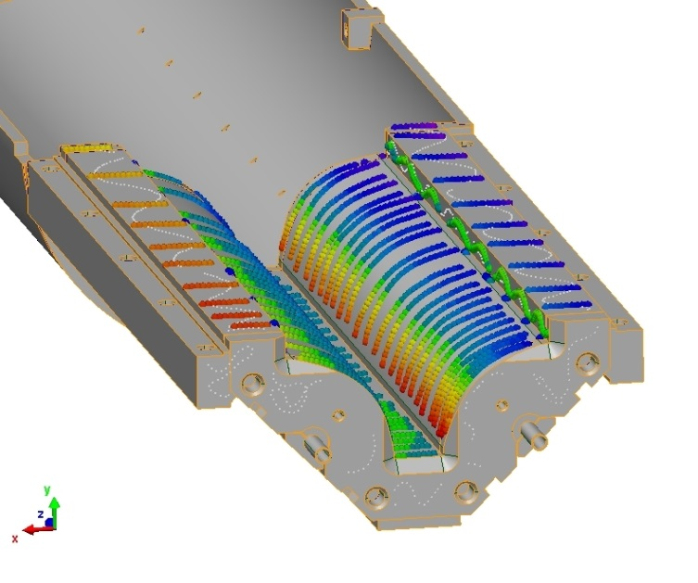
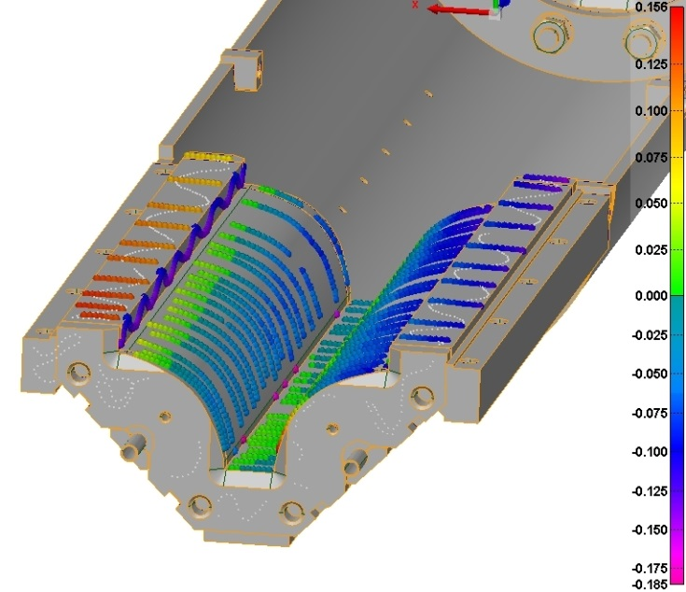
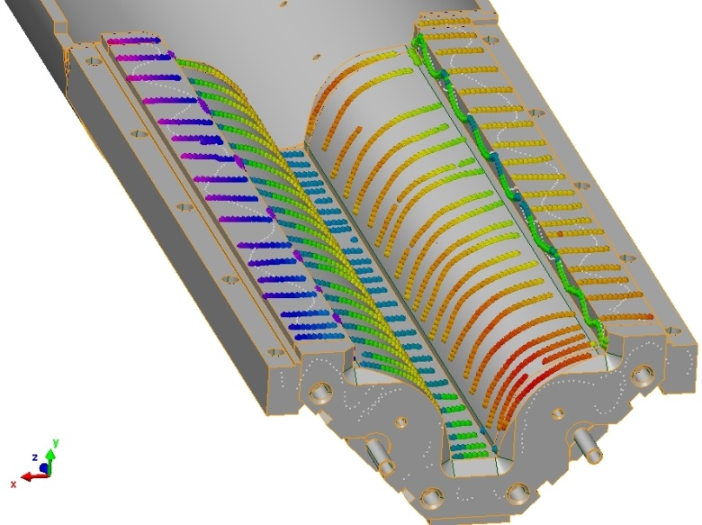
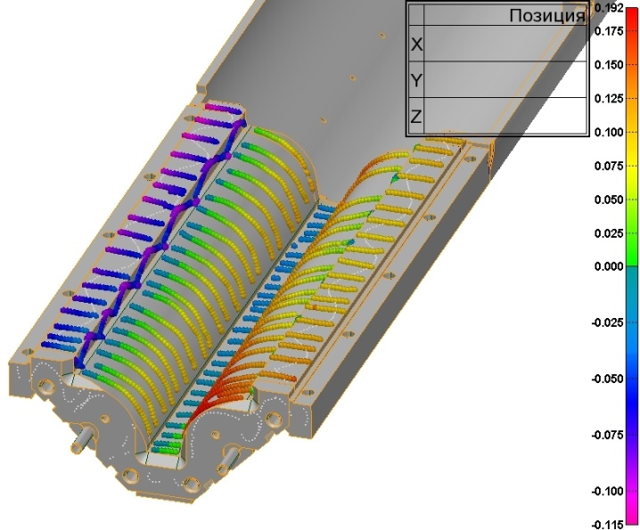
Yokes geometry
Booster quadrupoles
0,156
-0,185
Рис. 14 – Точки сравнения полу-ярма №22-1 с CAD – моделью.
0,192
-0,115
Рис. 15 – Точки сравнения полу-ярма №22-13с CAD – моделью.

Slide 22
Спасибо!

