Slide 1
Control system of the Booster injection power supply
A.A.Fateev, V.V.Tarasov, E.V.Gorbachev, H.P.Nazlev

Slide 2
Contents
Booster injection
Technical requirements for the power supply system of plates for the starting minimum
Requirements for the management and monitoring of units
Starting minimum
Full control system on compactRIO

Slide 3
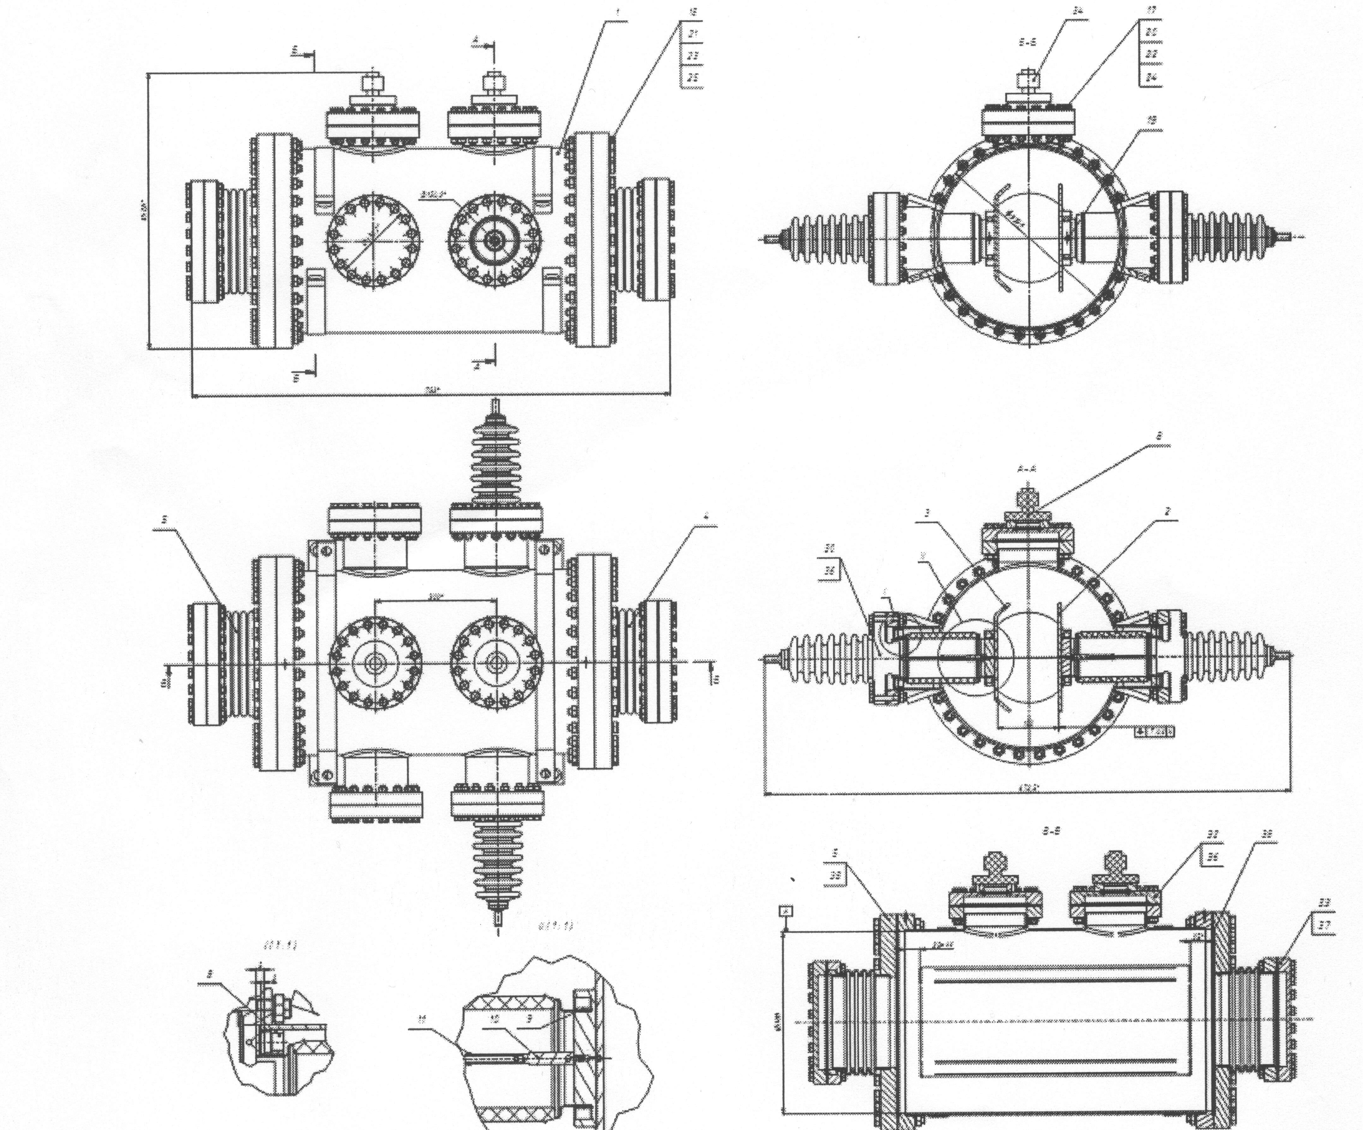
Booster injection
The NICA booster injection system will consist of three pairs of electrostatic deflecting plates (inflector plates) to provide the injection of the ion bunches into the Booster in single-turn, multi-turn and multiple injection modes.
The starting minimum will include only one pair of inflector plates. One of them is grounded.

Slide 4
Power scheme

Slide 5
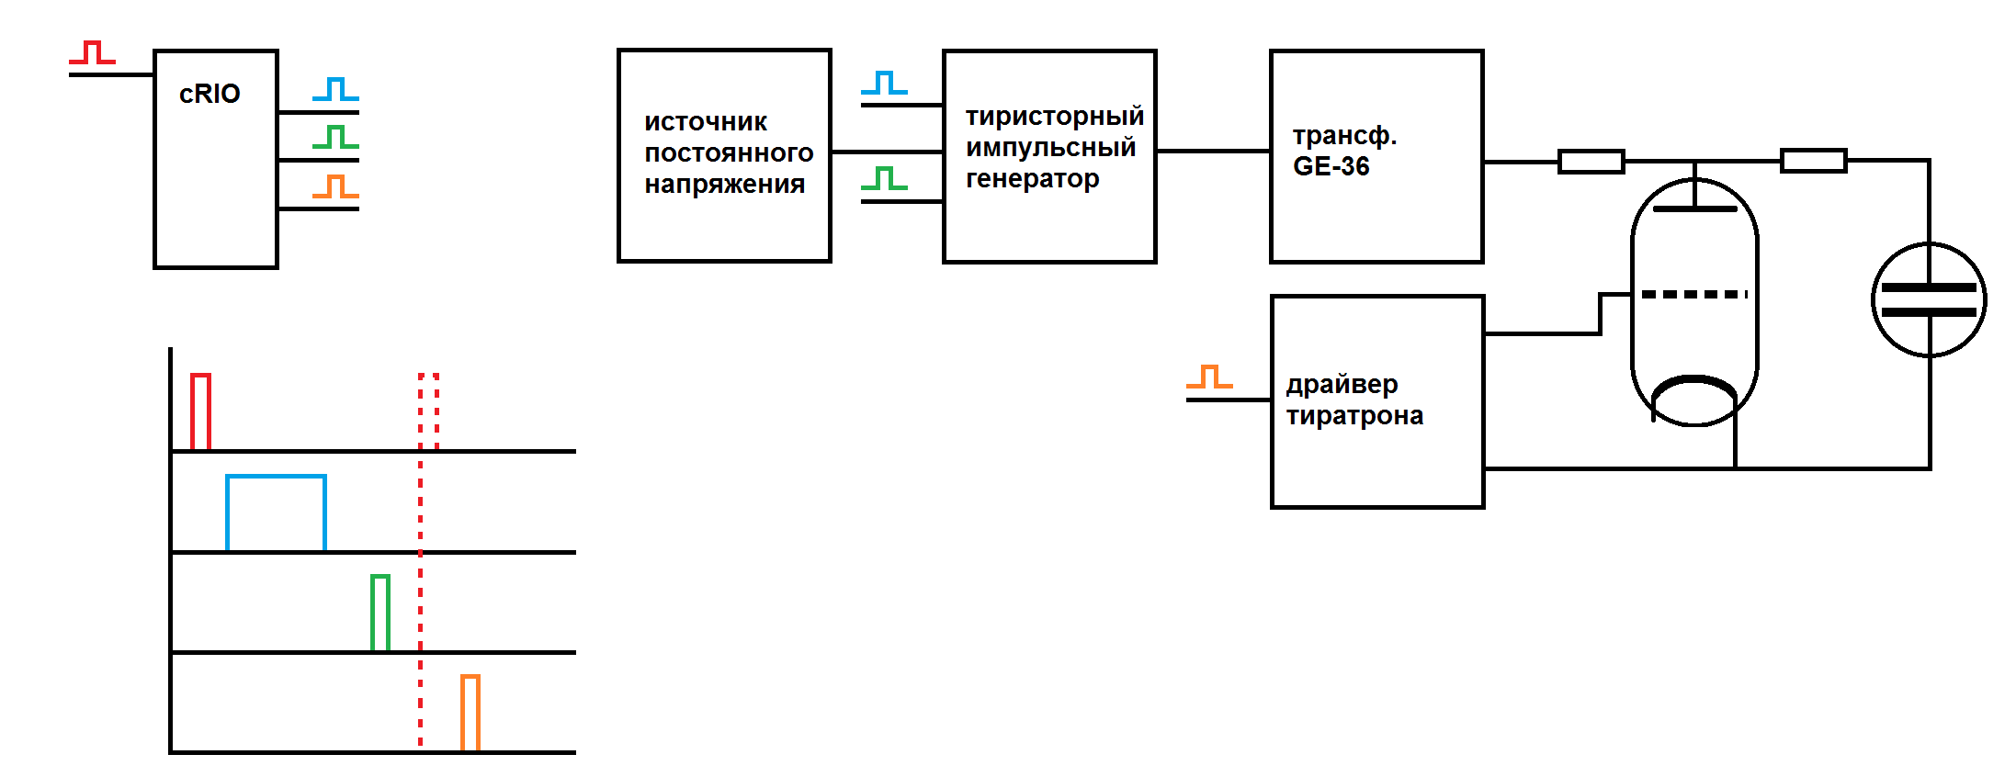
Power scheme

Slide 6
Technical requirements for the power supply system of plates for the starting minimum
Maximum electrical potential on the plate…………………. 60kV
Charging time of the plate…………………………………… <50µS
Duration of the plateau of the pulse, not less than……….. 30µS
Heterogeneity of voltage on the plateau…………………… ≤1%
The discharge time of the plate……………………………... ≤0.1µS
Residual voltage after discharge of plates…………………. ≤0.5kV
Number of pulses in a row…………………………………... 1 – 3
Pulse iteration rate…………………………………………… 10 Hz

Slide 7
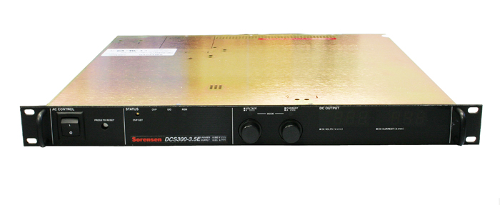
Requirements for the management and control of nodes
Power Supply DCS 300-3.5
- Remote start
- Output level control 0 - 300 V, accuracy 0.1%
- Control output output of the source (for ~ 10 ms before switching thyratron), accuracy 0.1%
- Switching on the output impulse (~ 100 ms before injection), accuracy 1 ms
- Switching off the output impulse (~ 10 ms before injection), accuracy 1 μs

Slide 8
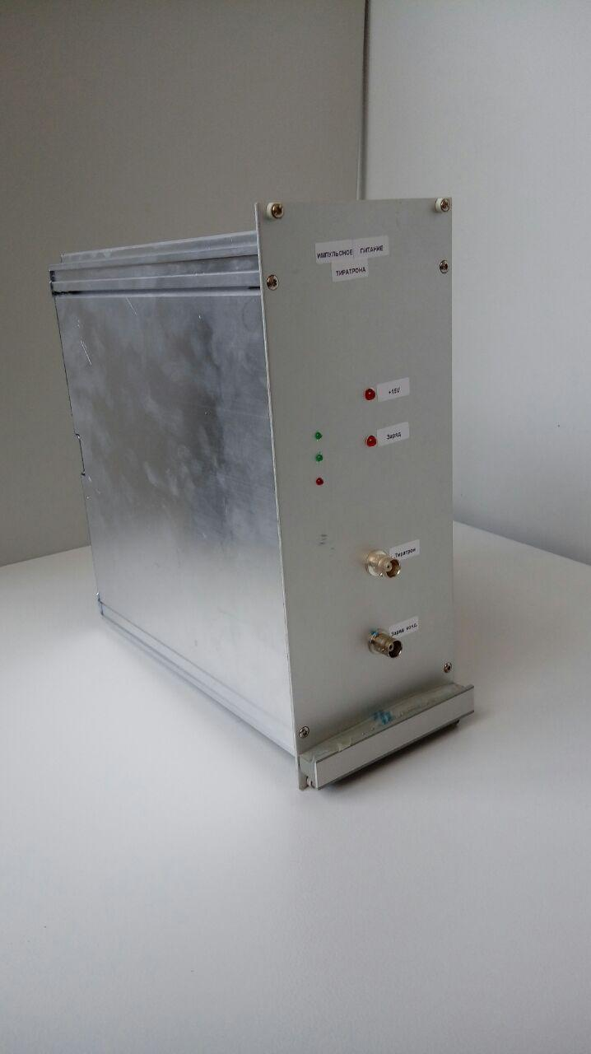
Requirements for the management and control of nodes
Thyristor pulse generator, trigger pulse
- Duration not less than 2 μs
- Time 0.5 - 2 ms before injection, step no more than 1 μs, jitter not more than 100 ns

Slide 9
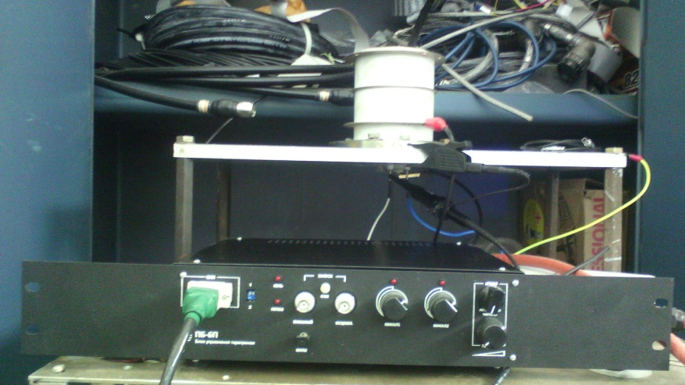
Requirements for the management and control of nodes
Thyratron TPI2-10k / 50-75 and block PB-6P
- Input trigger signal amplitude 10 - 15 V, load 50 Ω
- Adjustable start time and jitter ≤ 10 ns
- Control unit for thyratron PB-6P

Slide 10
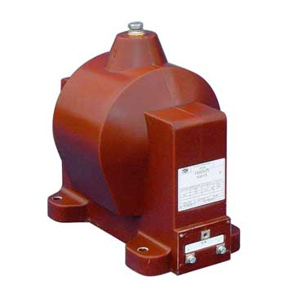
Requirements for the management and control of nodes
GE-36 Charging Transformer
- Measurement of amplitude and shape of the output impulse with the help of ADC (digital oscilloscope) with a range of 0 - 5 V (0.1%)

Slide 11
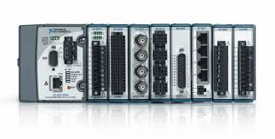
The main structural unit
compactRIO
667 MHz dual-core ARM Cortex-A9 CPU, 1 GB flash, 512 MB DDR3 RAM
8 slot chassis
Artix - 7
NI Linux Real-Time OS
Work with LabVIEW Real-Time or C / C ++ on Ethernet(2 gigabit) or RS-232
Modules, who we use:
NI 9239 – analog input module, for voltage measurement
NI 9269 – analog output module, for voltage control
NI 9401 – slow digital I/O module, for safety and lock signals
NI 9402 – fast digital I/O module, for activation of individual blocks
NI 9862 – CAN interface module, for thyratron drivers control

Slide 12
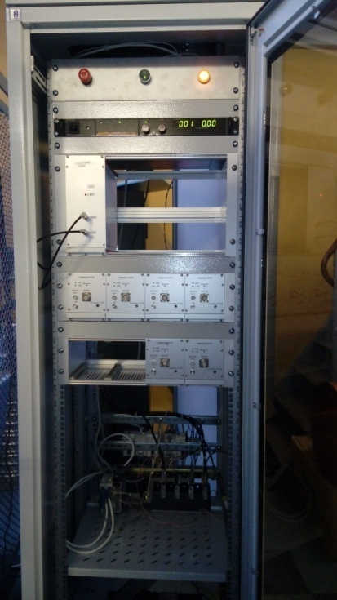
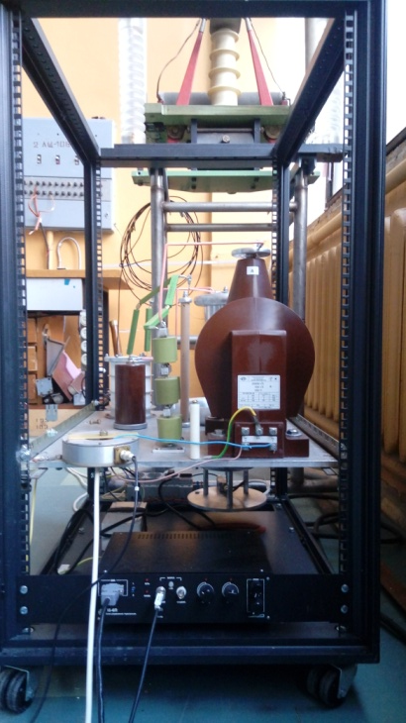
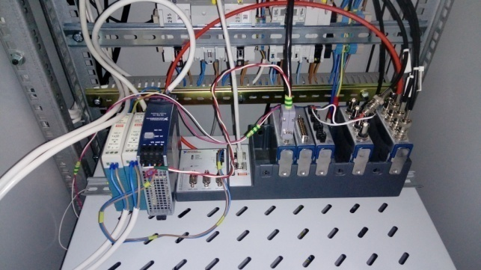
Assembling the control block for the starting minimum
cRIO-9068
Power section with thyratron
driver PB-6P
The control section

Slide 13
Results from tests in a starting minimum
The main result of the tests was the obtaining of the specified parameters of a high-voltage output pulse at an equivalent load of 450 pF.
The voltage on the equivalent load exceeds 60 kV. The amplitude of the post-pulses does not exceed 300V. The discharge time does not exceed 100 nsec.
A successfully completed test program allows us to conclude that the main parameters of the power supply system of the Booster inflector plates comply with the technical specification.
The system is ready to connect to the real load on the Booster installation.

Slide 14
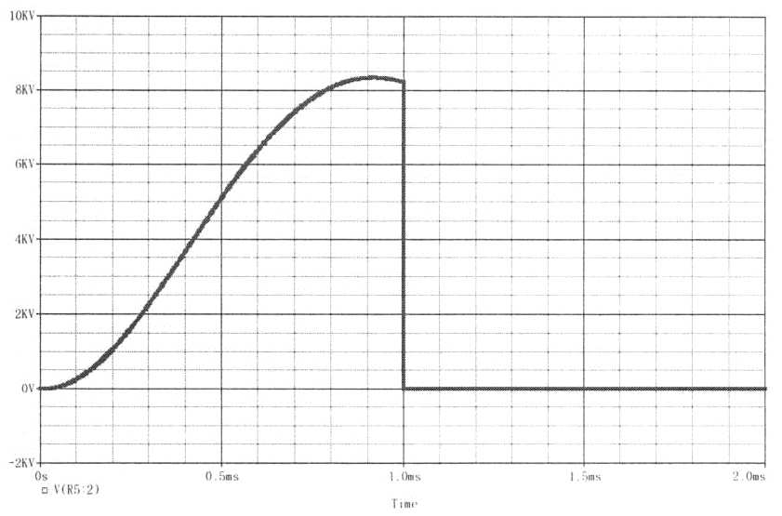
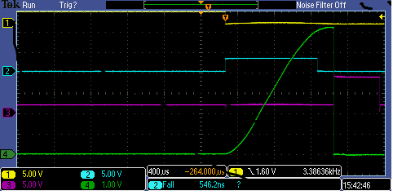
Results from tests in a starting minimum
yellow - disconnection of the controlled charging key;
cyan - starting the thyristor key;
purple - launch of thyratron;
green - voltage at equivalent load, 10kV / div.

Slide 15
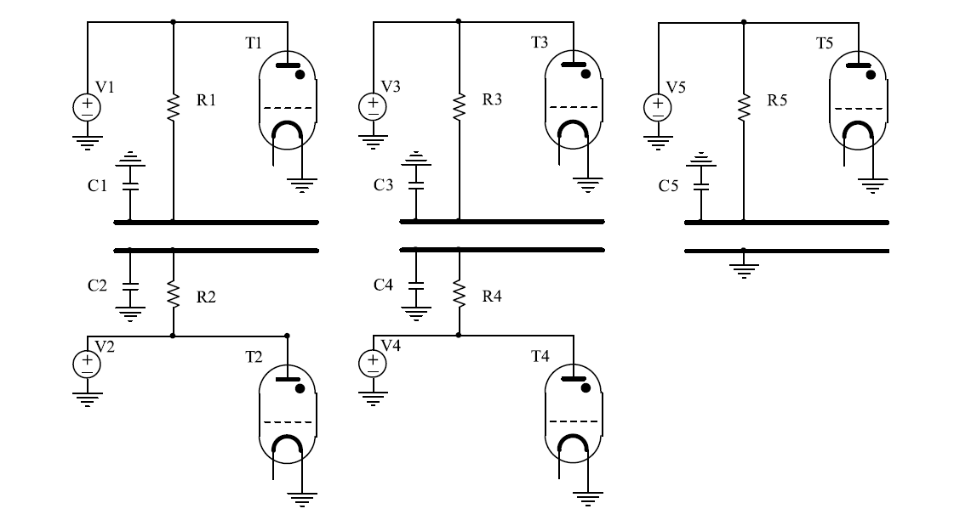
The full system scheme of power control

Slide 16
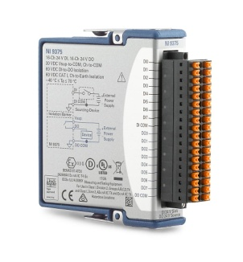
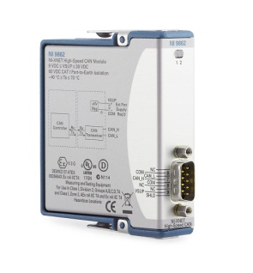
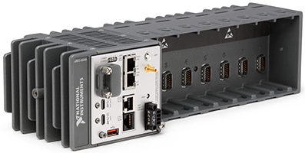
Control structural units
Chassis cRIO-9048
1.30 GHz Dual-Core CPU, 2 GB DRAM, 8 GB Storage, Kintex-7 160T FPGA, Extended Temperature, 8-Slot CompactRIO Controller
NI 9201 – analog input module, for voltage measurement
NI 9264 – analog output module, for voltage control
NI 9375 – slow digital I/O module, for safety and lock signals, and for capacitor pulse
NI 9402 – fast digital I/O module, for activation of individual blocks
NI 9862 – CAN interface module, for thyratron drivers control

Slide 17
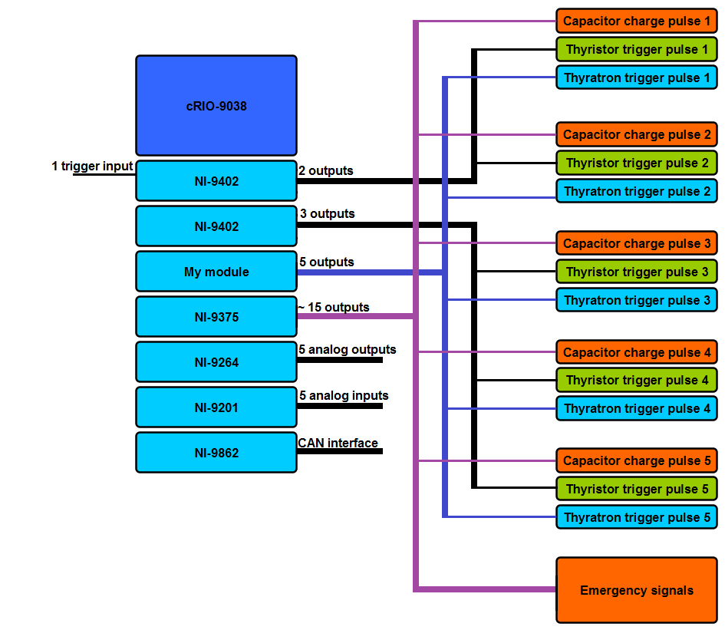
Structural scheme

Slide 18
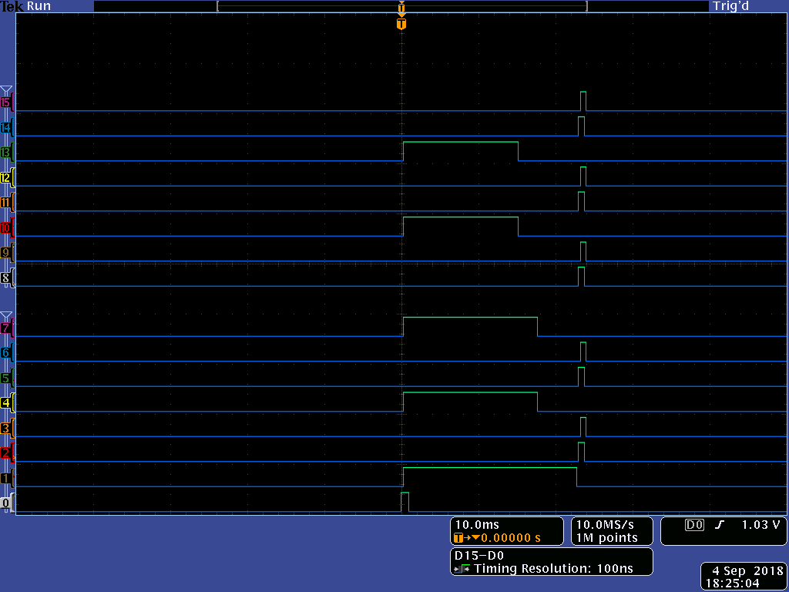
Oscillogram with trigger signals from cRIO modules
0 – injection trigger signal
1, 2, 3 – first plate
4, 5, 6 – second plate
7, 8, 9 – third plate
10, 11, 12 – fourth plate
13, 14, 15 – fifth plate

Slide 19
System advantages
The timing step is 5 ns
We can define the pulse packet and the time between them
We can turn on and off certain plates
The particle beam blocking was improved (safety signals)
Improved trigger signal management
One chassis serves to manage the entire system
7. An amplifier is developed that amplifies the signal from the divider to the digitizer.

Slide 20
The future plans
Purchase of the equipment
Making a comfortable GUI client.
Developing a module.

Slide 21

Thank you for attention!

