Slide 1





Manufacture, pre-assembly and testing of MPD magnet yoke on VHM
Vitkovice, Czech Republic
2016 - 2018
N.Topilin, E.Belyaeva, E.Gerasimov
Международное совещание
«Ускорительный комплекс NICA: проблемы и решения — 2018»,
08 - 15 сентября 2018 г., г. Созополь, Болгария

Slide 2
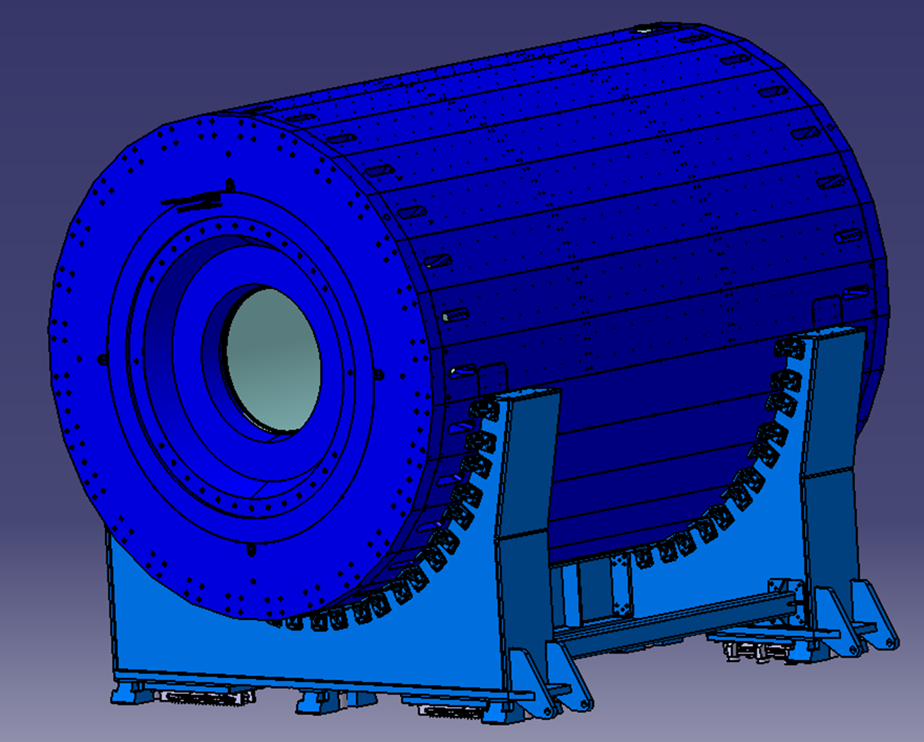
MPD Yoke (L=8970 mm, Ø6625 mm)
28 plates
16 t each
2 support rings
42.5 t each
2 poles
44 t each
Total: 621 t
Material:
Steel 10 (AISI 1010)
forging
Lodgement (Yoke support) – 70 tons, ordinary steel St.3 (Fe 360)

Slide 3
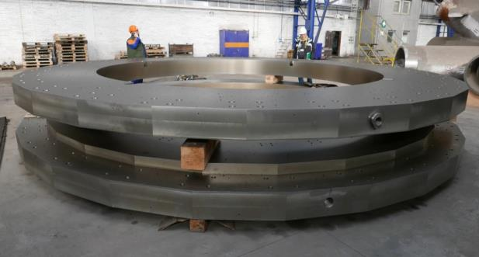
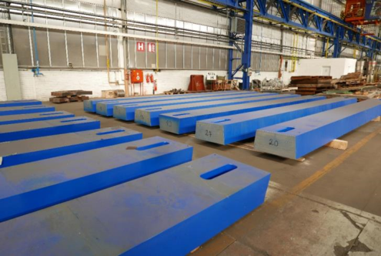
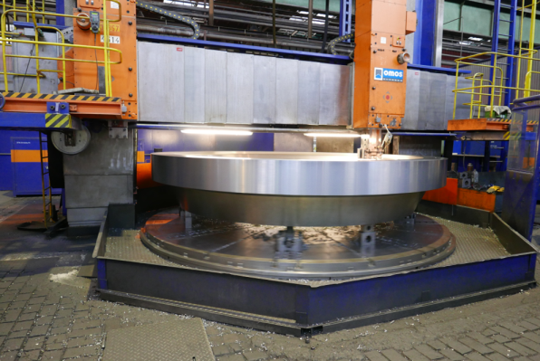
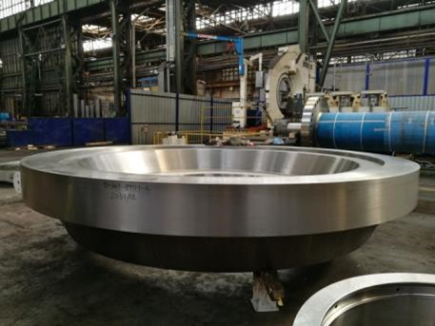
Support rings: need to have holes machining, sandblasting, painting
Yoke production status, March - 2018
Yoke plates: 25 from 28 are ready
Pole machining

Slide 4
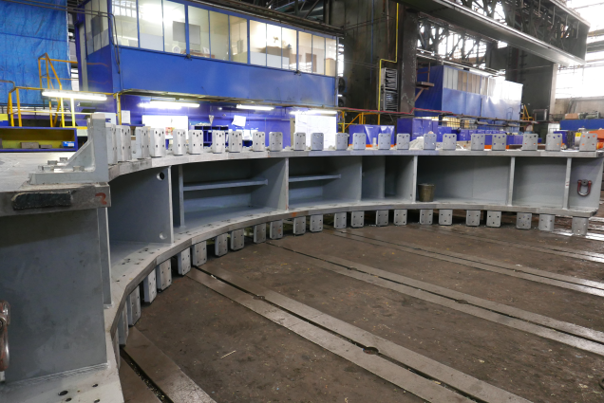
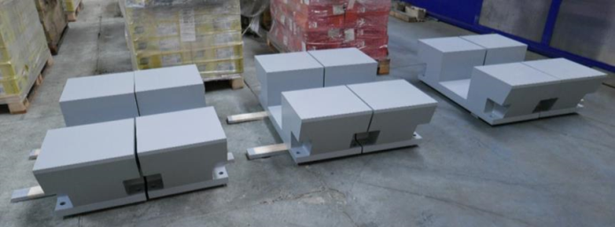
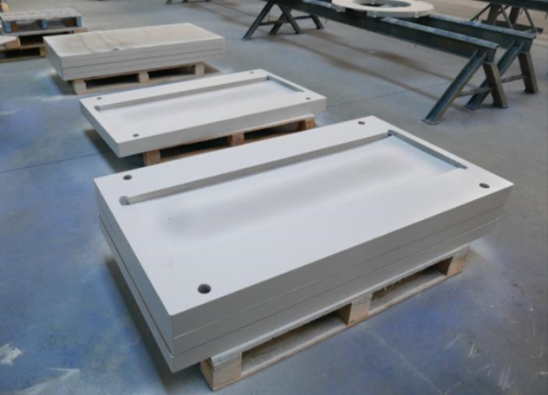
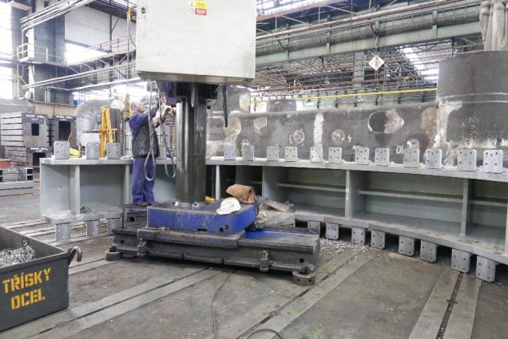
Cradles parts are in progress:
6 cradle support
Spacer plates between bottom surface
of cradle and Roller Skates

Slide 5
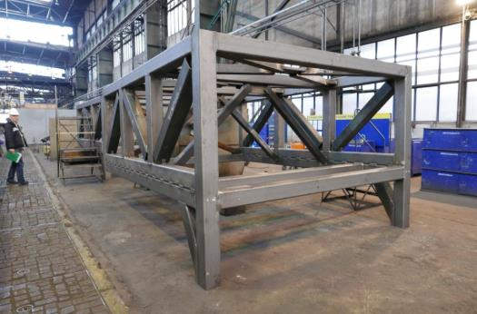
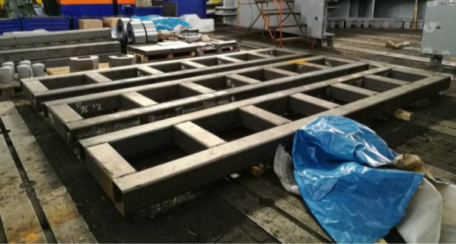
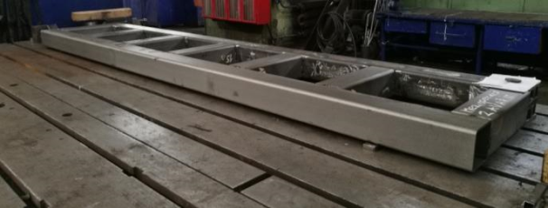
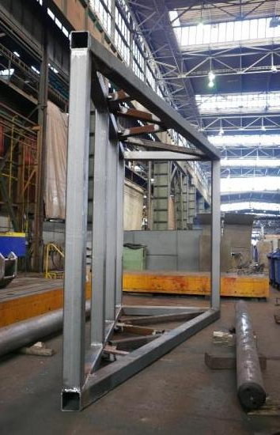
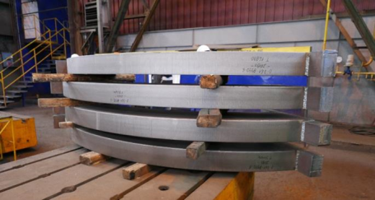
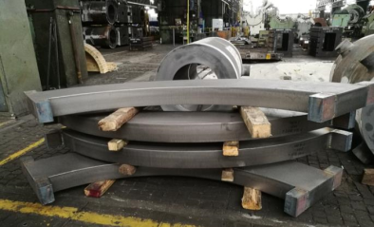
Poles transport supports (2 ps)
Front stand
Bottom base parts
Back stand
Bottom base parts
Rings billets

Slide 6
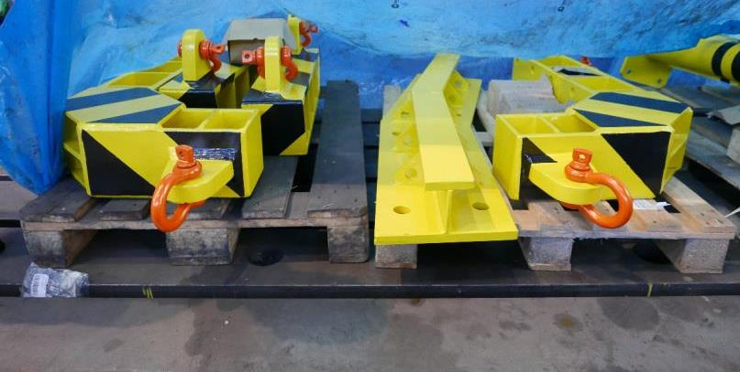
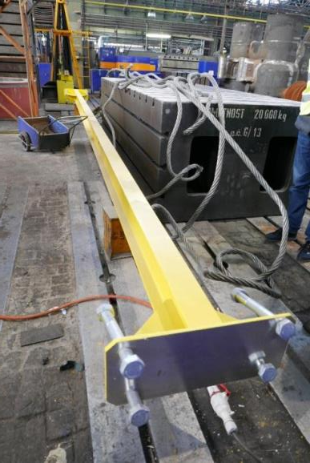
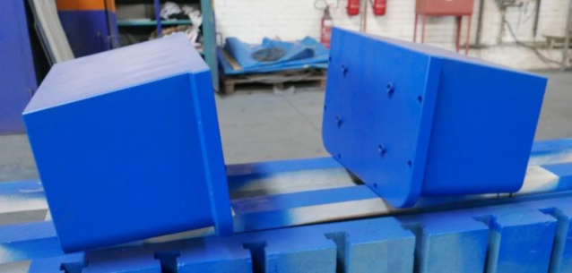
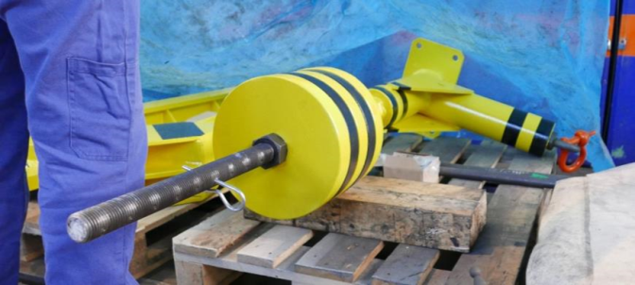

Technological tool
Top beam
Lifting beams and Base plate for face surface
Lifting beam for plugs inserting-removing in vertical plates

Slide 7
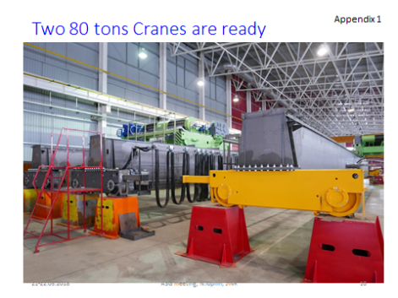
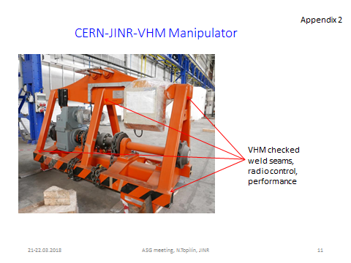
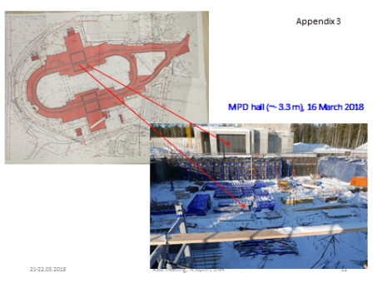
Plan of work at VHM (Feb_2018):
Machining
Control assembly
Yoke rigid test
Restart to work – 20 March
Floor measurement – 21 May
Cradle installation – 23 May
Cradle measurement – 24 May
13 plates installation – 05-09 June
13 plates measurement – 11 June
Support rings installation – 12-13 June
14-28 plates installation – 14-21 June
1-27 plates measurement – 21 June
700 Pins installation – 6 June - 23 July
Yoke test – 24 July
Disassembly, manufacture, packing – 1-Aug-30 Sept.
Transport to JINR – 1 October – 30 November

Slide 8
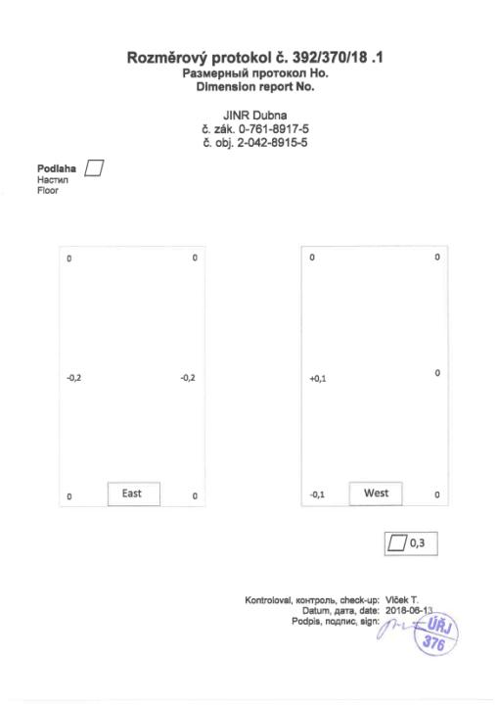
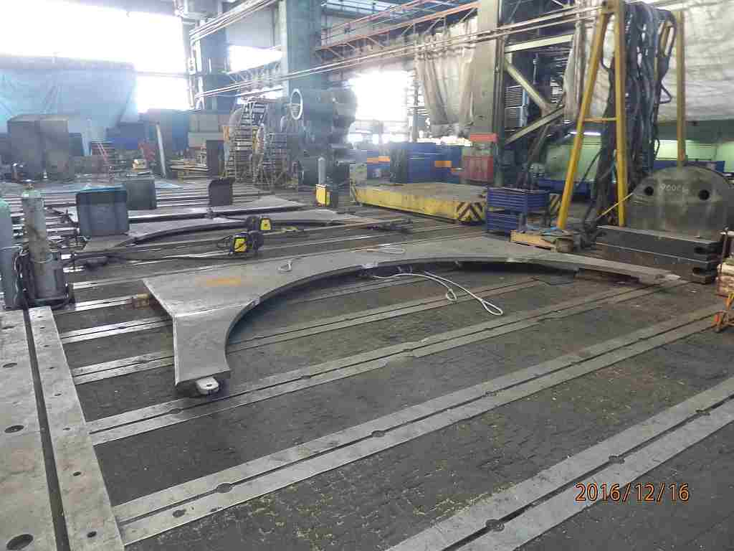
Floor flatness on area 7x7 m²
0
+0.2
+0.1
-0.1
Common non-flatness is 0.3 mm

Slide 9
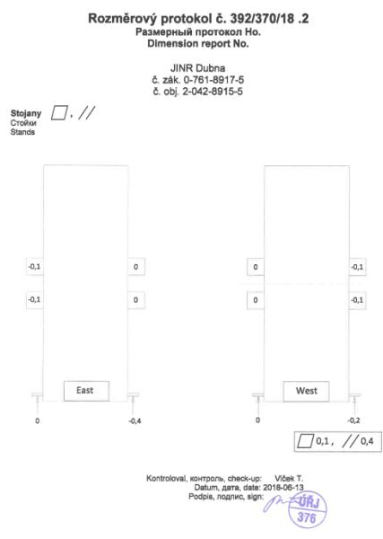
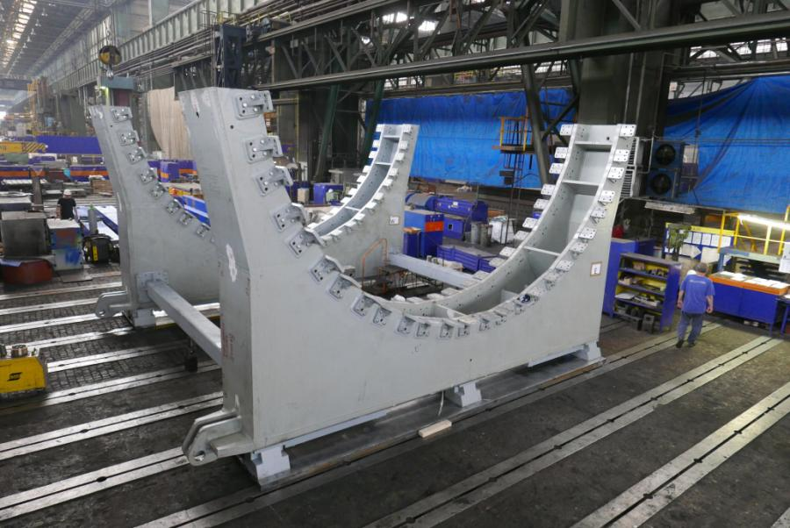
Stands shape

Slide 10
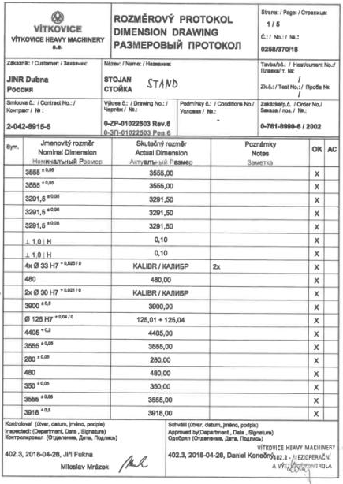
Measurement Protocol
(page 1/5) of
Stand #1
Drawing tolerances are +/- 0.05 mm
on the R=3655 mm and others
Main deviations are
“zero” !

Slide 11
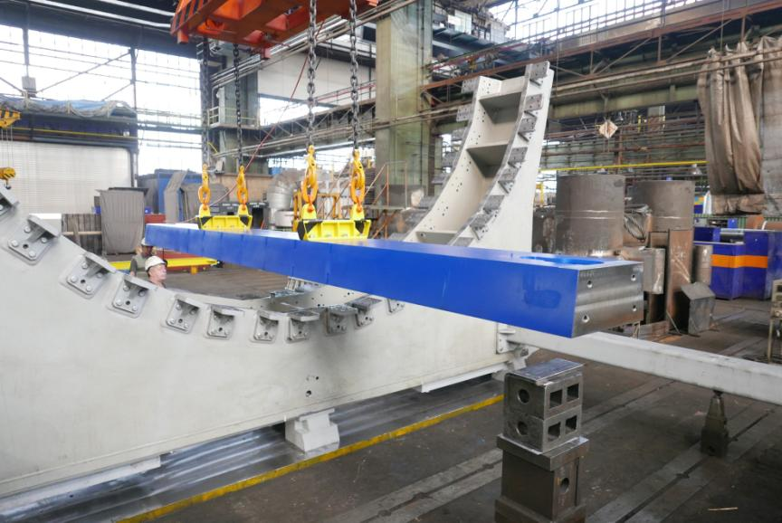
Plate #1 installation (5 June 2018)

Slide 12
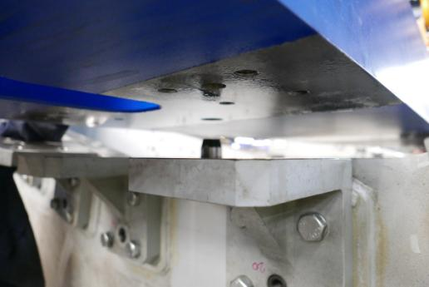
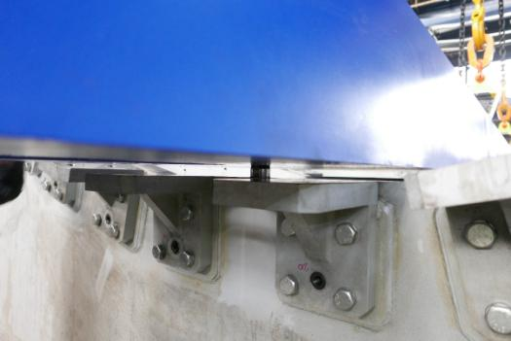
Plate #1 installation (5 June 2018)
Position pins Ø 50 mm

Slide 13
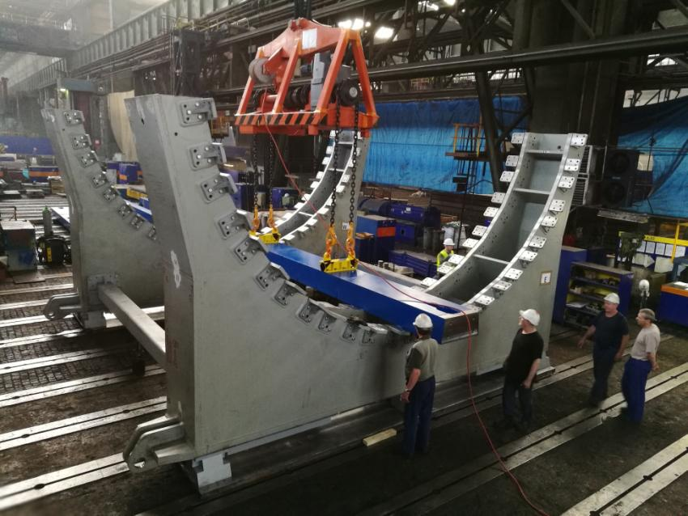
Plate #1 installation (5 June 2018)

Slide 14
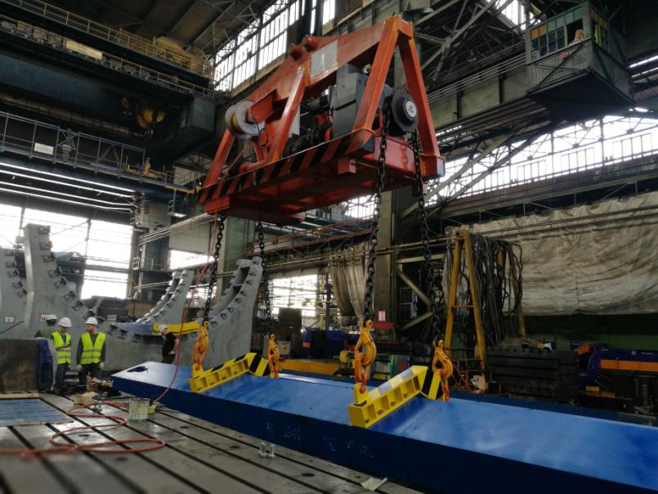
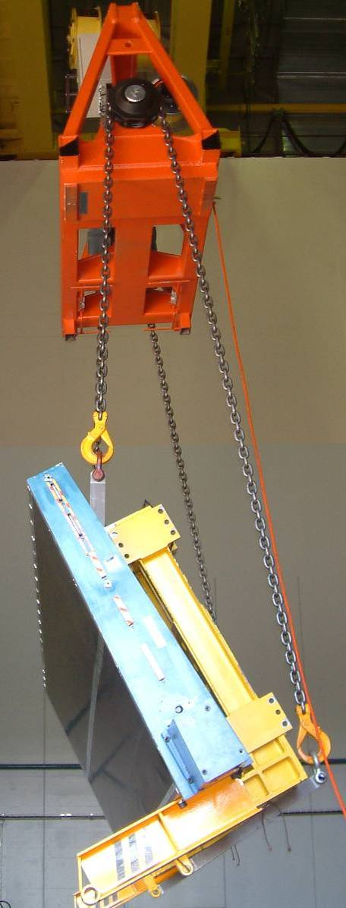
Plate #2 installation (5 June 2018)
Manipulator from
Tile Calorimeter
(ATLAS, CERN)
It was used in 2002-2006
Second life in 2018-2019
(NICA-MPD, VHM-JINR)

Slide 15
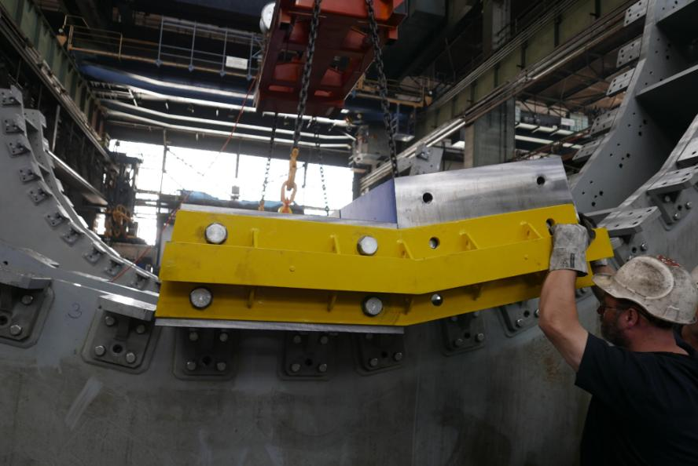
Plate #2 installation
Surface control tool

Slide 16
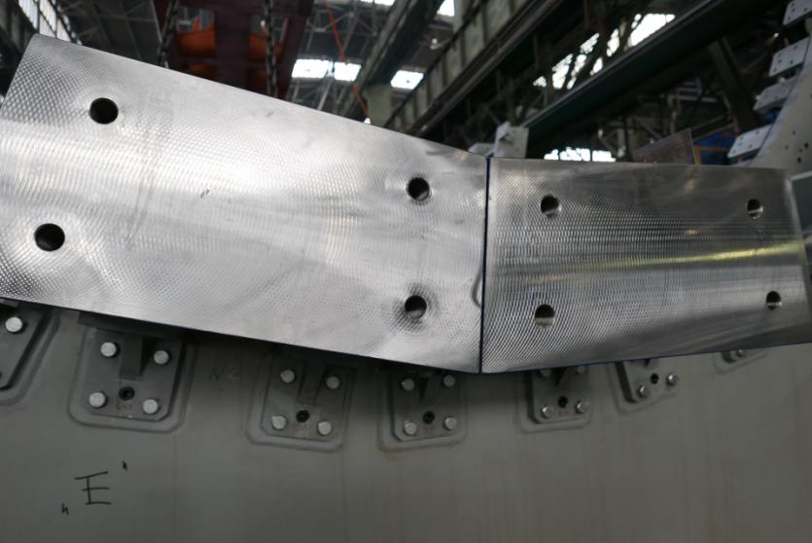
2 plates in place

Slide 17
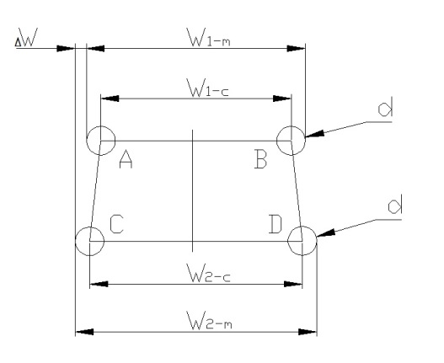
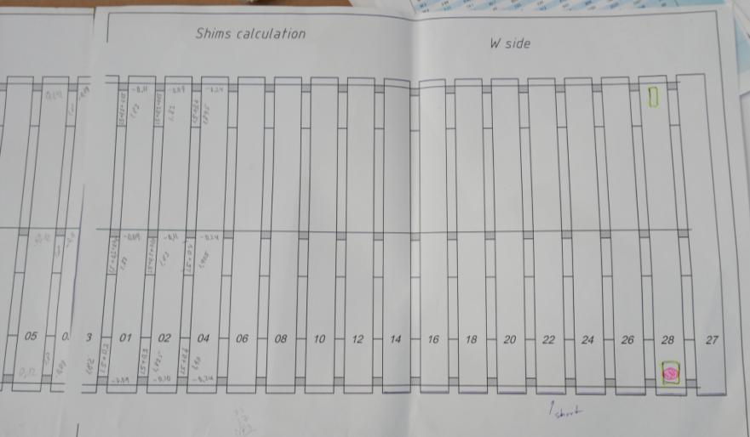
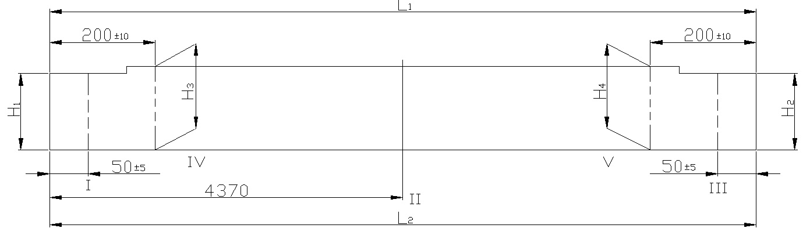
Shims calculation
S=1.73 + (Δ1+Δ2)/2
Δ1, Δ2 – plate passport data
S=1.8 mm as usual

Slide 18
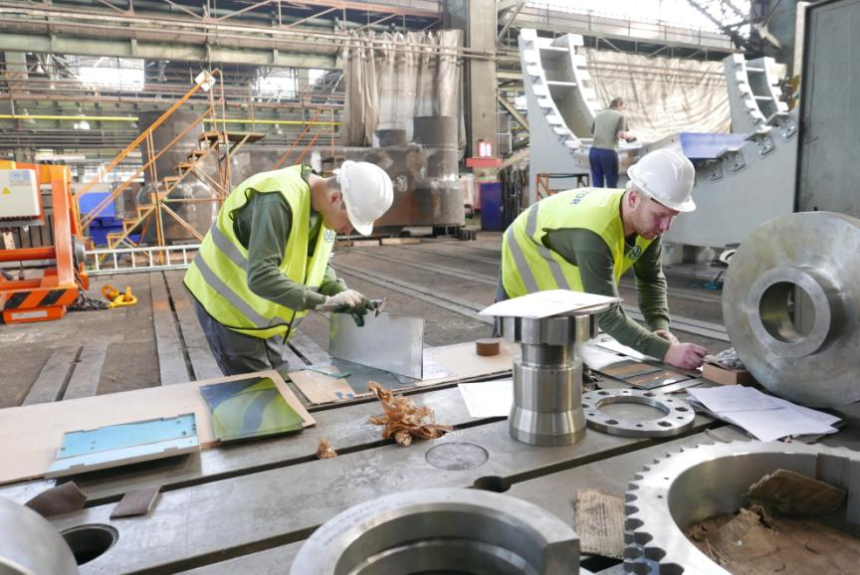
Shims preparing

Slide 19
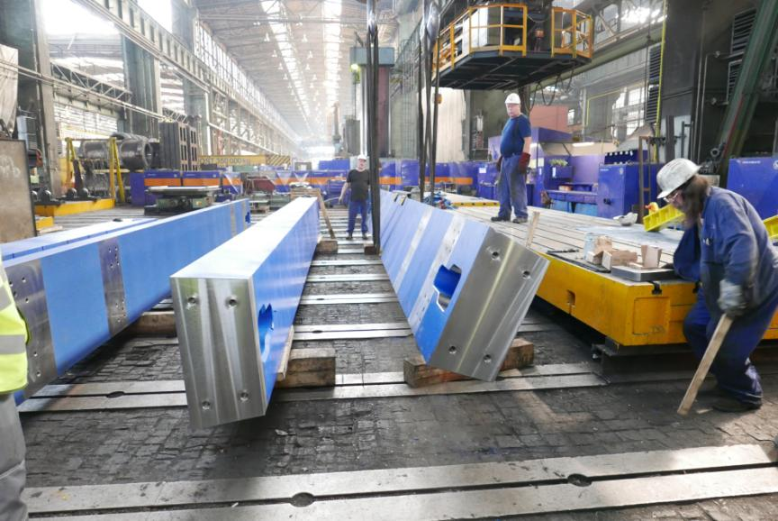
Plates preparing for assembly

Slide 20
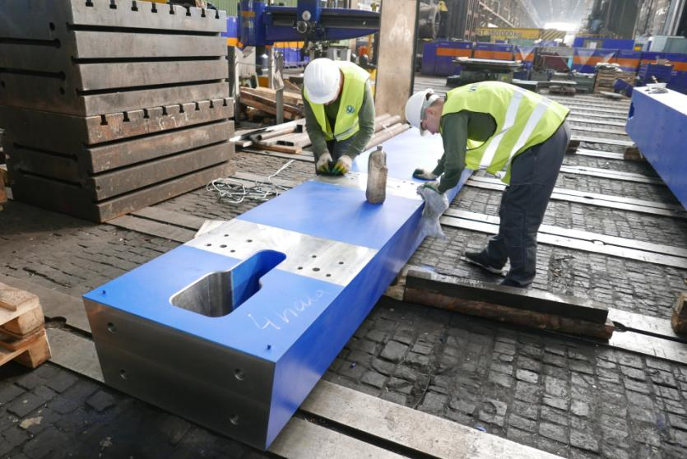
Plates preparing for assembly

Slide 21
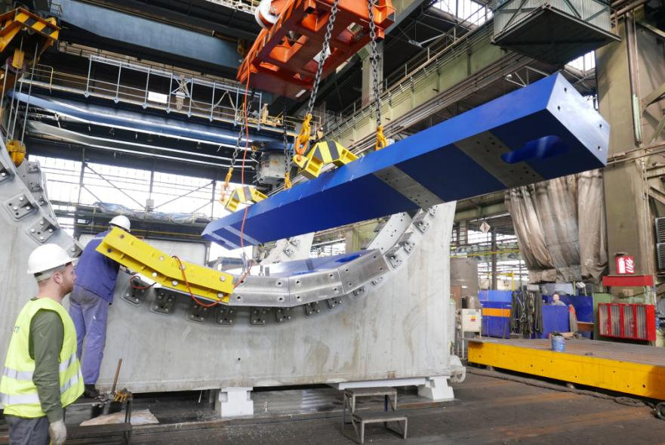
Plate #5 installation (7 June 2018)

Slide 22
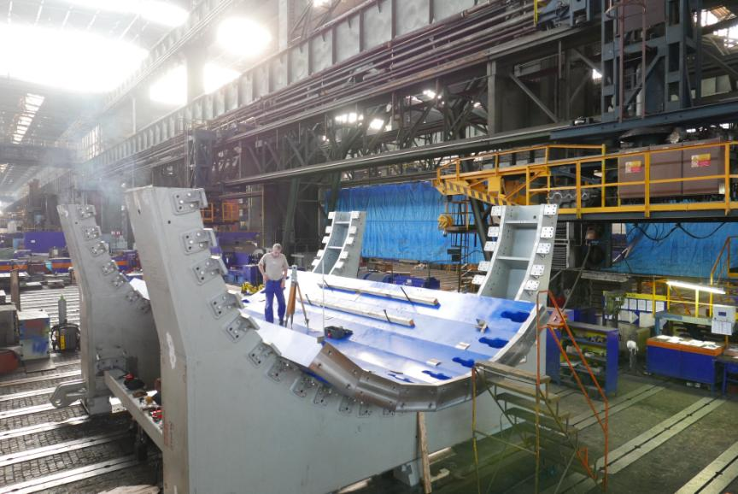
Top points flatness measurement of 7 plates

Slide 23
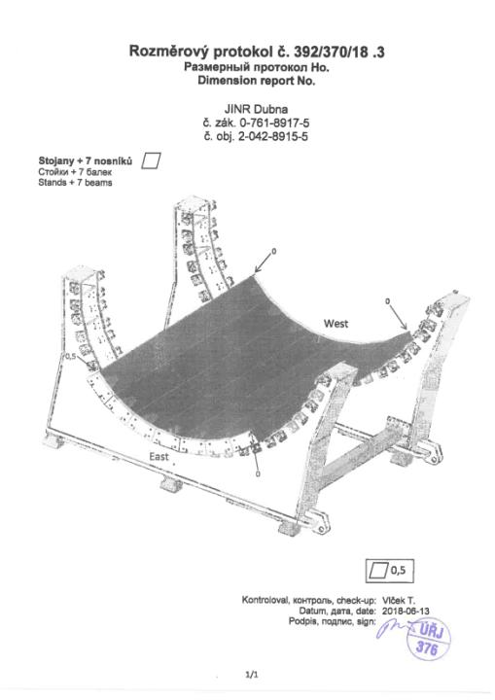
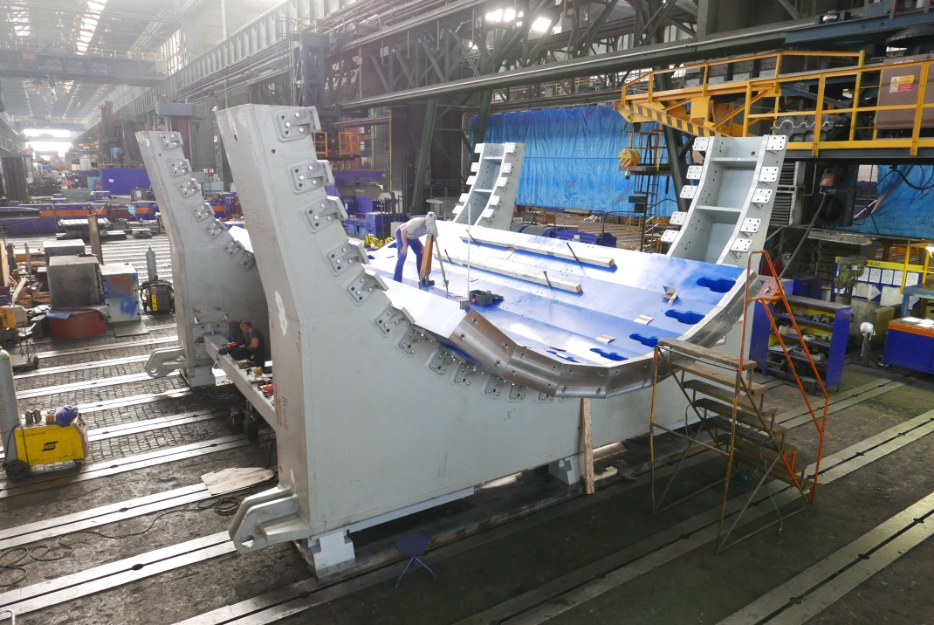
7 plates in assembly
0
0.5

Slide 24
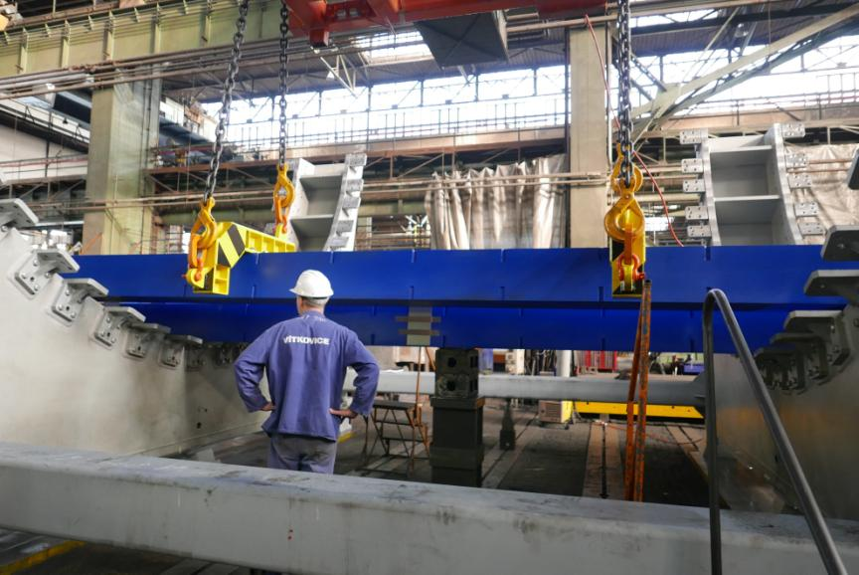
Assembly step

Slide 25
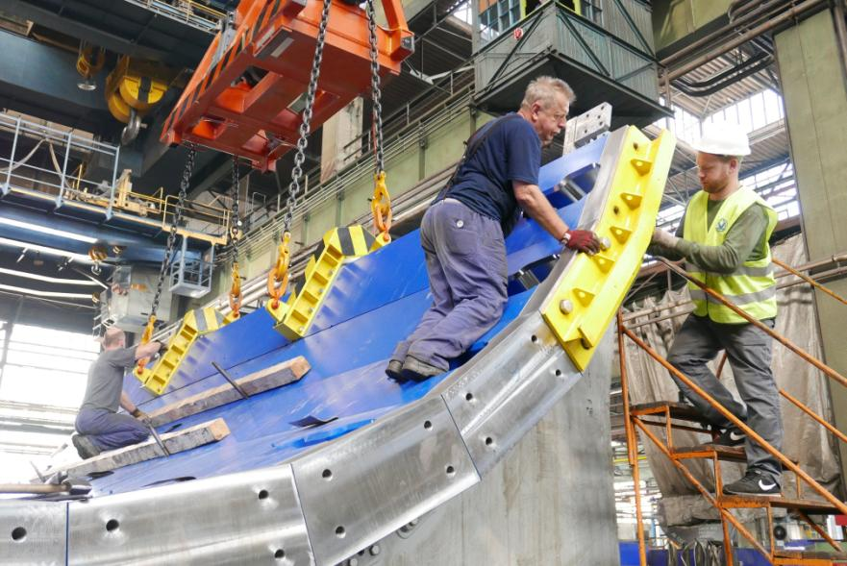
Plate #13 installation (9 June 2018)

Slide 26
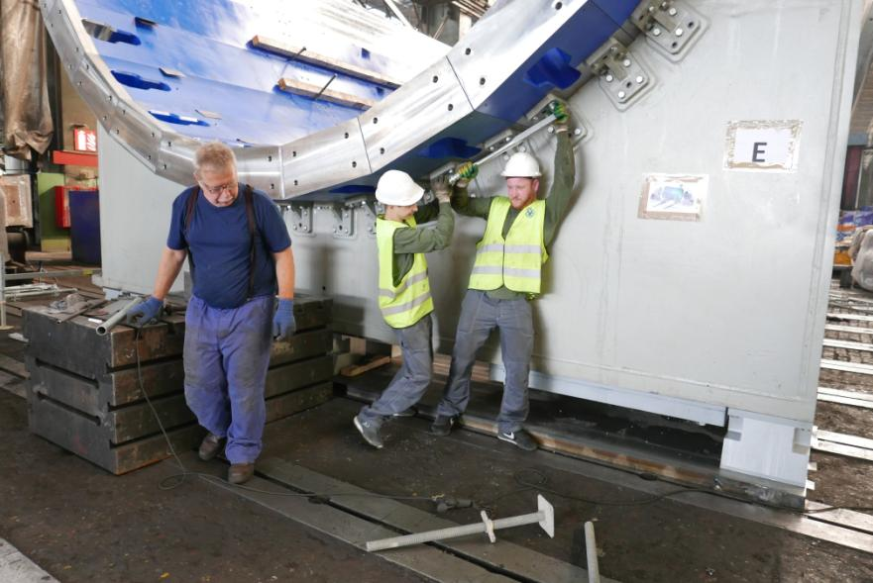
13 plates in place

Slide 27
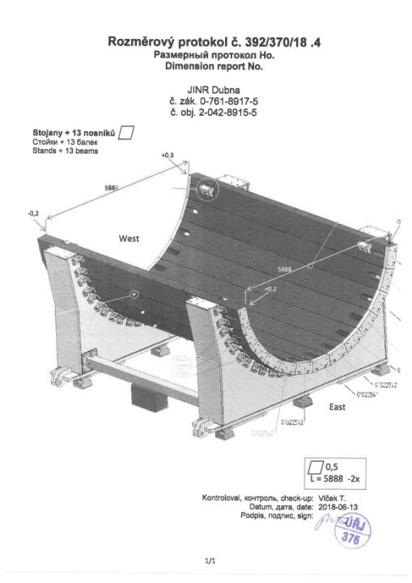
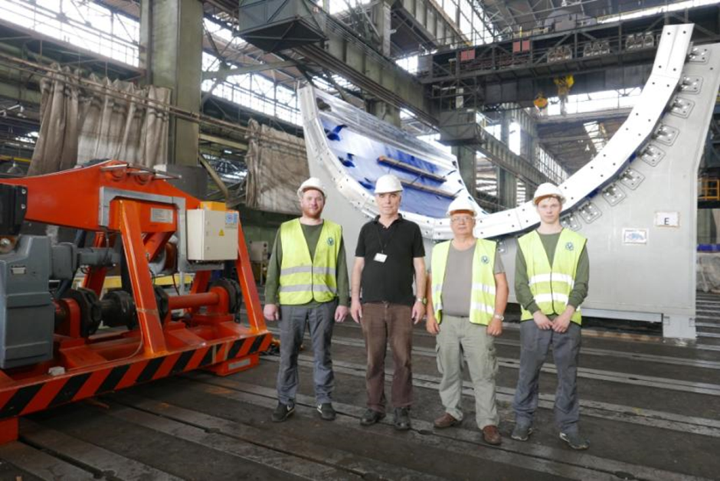
13 plates in assembly
+0.3
00
-0.2
L=5888 (+1 mm)
0
+0.2

Slide 28


Scaffolding erection
Complementary supports
from both sides

Slide 29




Support ring manipulation

Slide 30

Support ring #1 installation (12 June 2018)

Slide 31

Support ring #1 on side W
Gap 0.4 mm
Gap 0.6 mm
Non-symmetry 0.1 mm
#12
#13
Gap 0 mm
#6
#4
#3
#2
#1

Slide 32

Support ring #2 installation (13 June 2018)
Gap for plate #13 – 0.1 mm
Gap for plate #12 – 0.1 mm
Non symmetry 0 mm
Full contact on all bottom 11 plates

Slide 33


Measurement Protocol (page 1/5)
of Support ring
5887 -0.1 , really it is < 0.05 mm

Slide 34

Support rings on both sides

Slide 35

Technology beam (8470 mm) installation

Slide 36

Plate installation

Slide 37

2 support ring in assembly
0.66 mm out
0.53 mm out
Limit 0.5 mm

Slide 38





Plates position on support rings (the similar situation for all bottom ones)
W side (base)
E side
9 mm gaps for 8.5 mm shims
W side (base)

Slide 39




Plates position on support rings (the similar situation for all bottom ones)
W side (base)
W side (base)
E side

Slide 40



Plate #26 installation

Slide 41

27 plates in place (20 June 2018)

Slide 42



“Final” measurements report
(27 plates in assembly)
Side W – 0.55 mm out
Side E – 0.66 mm out

Slide 43



Plate #28

Slide 44




Top plates positions
Gap is zero
Gap is 0.2 mm
Gap between #27 and @28
Is 0.5 mm (fixed by steel shims)
Diameters have nominal dimensions
6583 mm in vertical and horizontal directions
on both sides

Slide 45

JINR technicians
Ivan
Sergei

Slide 46





It is half way of preassembly.
Next step is drilling of 544 holes
33H7 for pins 33p6.

Slide 47



712 Holes drilling (in 5 steps):
1 – drill 28 mm
2 – mill 30 mm, h = 90 mm
3 – mill 32 mm, h = 90 mm
4 – mill 32.6 mm, h = 90 mm
5 – rimmer 33H7 (0+0.025), h = 80-85 mm
279 from 712 are ready (on 23 June)

Slide 48


Unforeseen problem:
VHM promised steps
Useless parts

Slide 49





Predicted very useful tool !

Slide 50


TEST on 24 July 2018 at VHM
5. Выдвинуть шток домкрата А так, чтобы можно было убрать
одну дополнительную опору 1 из под стойки ложемента.
Убрать одну дополнительную опору 1 из под стойки ложемента
магнитопровода MPD.
Для удобства все дополнительные опоры можно сделать
составными из двух одинаковых пластин разной толщины.
В ходе испытаний убирать только тонкую пластину, как самую
легкую.
6. Плавно опустить шток домкрата А до образования зазора
1-2 мм между стойкой ложемента и верхней плоскостью
поршня домкрата, либо до падения давления в домкрате до нуля.
В результате этих действий магнитопровод MPD
будет опираться на 3 дополнительные опоры 2,3,4.
Измерить величину получившегося зазора В
между крайней точкой стойки ложемента и опорной
поверхностью цеха.
Вычислить величину отклонения крайней точки стойки
ложемента от своего первоначального положения.
Δ = Н доп.опоры – В, мм
Расчетная оценка величины Δ, мм |  |  | По результатам испытания
Нева-магнит | Прогресстех-Дубна | ЛФВЭ КО | VHM
5,6 | 4,5 | 0,1
?
Опорная поверхность цеха
В

Slide 51




TEST on 24 July 2018 at VHM
Расчетная оценка величины Δ, мм |  |  | По результатам испытания
Нева-магнит | Прогресстех-Дубна | ЛФВЭ КО | VHM
5,6 | 4,5 | 0,1
?
https://www.google.ru/search?q=magnet+vitkovice&newwindow=1&source=lnms&sa=X&ved=0ahUKEwjXq86_09jcAhUpP5oKHQysCIwQ_AUICSgA&biw=1920&bih=974&dpr=1

Slide 52
TEST on 24 July 2018 at VHM
Расчетная оценка величины Δ, мм |  |  | По результатам испытания
Нева-магнит | Прогресстех-Дубна | ЛФВЭ КО | VHM
5,6 | 4,5 | 0,1
?

Slide 53
TEST on 24 July 2018 at VHM
Расчетная оценка величины Δ, мм |  |  | По результатам испытания
Нева-магнит | Прогресстех-Дубна | ЛФВЭ КО | VHM
5,6 | 4,5 | 0,1
10.4

Slide 54
Conclusions
We are on the right way:
1 - there is no mechanical hysteresis
2 - All 4 support trolleys accept half of the standard load
3 - Local load on the concrete is 50% of the design: increases the
durability of the foundation and reduces the chance of
subsidence of rail tracks in the process of exploitation
(локальные нагрузки на бетон составляют 50% от расчетных:
повышается долговечность фундамента и уменьшается шанс
просадки рельсовых путей в процессе эксплуатации)

Slide 55
Next steps:
VHM:
- Manufacture finishing
- Checking
- Packing
- Transportation
- Customs procedure
JINR:
- Local store preparations
- Cranes installation and work permit receiving
- Foundation plates, underrails plates, rails installation
- Pre-assemble of magnet at JINR (Spring 2019)

Slide 56




MPD Hall today

Slide 57

Thank you for your attention

Slide 58

7 plates in place, top edges horizontality checking

Slide 59

Relative height of top edges of plates #6 and #7
Point 6W + 0.0
Point 7W + 0.0
Point 7E + 0.0
Point 6E + 0.5
W side is base
Non-flatness of
Faces of 7 plates =
= 0.1 mm
E side

