Slide 1
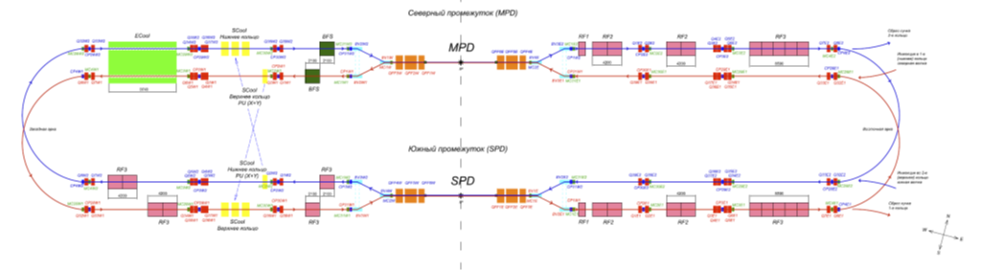
Ion Beam storage and bunchinhg in NICA collider
E. Syresin
on behalf of JINR and BINP teams
Scheme of collider NICA
Three RF systems of NICA collider
RF1 system is applied for formation of RF buckets at beam storage and ion acceleration.
RF2 system is used for beam bunching on 22 harmonic and beam acceleration/deceleration
RF3 system is used for beam bunching on 66 harmonic and beam acceleration/deceleration
BINP construction of RF1, RF2 and RF3 systems
Equipment | Schedule of BINP contract | Installation in NICA | NICA Configuration
2 RF1 stations | 2016-2018 | 2020 | base
RF2 Prototype | 2017-2019
4 RF2 stations | 2018-2020 | 2020 | base
4 RF2 stations | 2017-2021 | 2021 | extended
RF3 Prototype | 2017-2019
16 RF3 stations | 2017-2021 | 2021 | extended

Slide 2
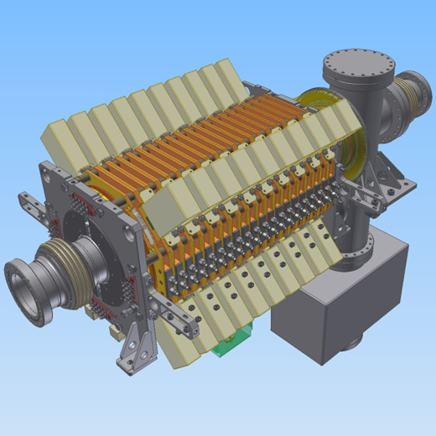
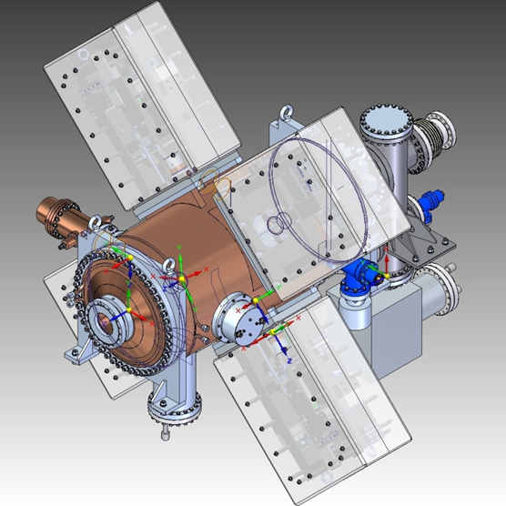
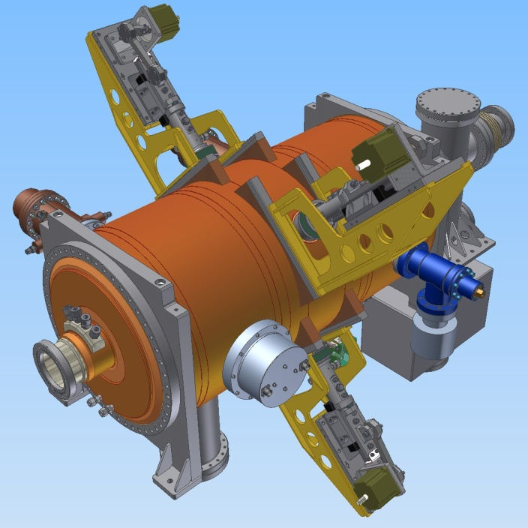
Construction of RF stations
3 D model of RF1 station
3D model of RF2 station
Parameters of RF2 and RF3 cavities
 | RF2 | RF3
harmonic | 22 | 66
Frequency, MHz | 11.484÷12.914 | 34.452÷38.742
Rsh,Ohms | 3.12ּ 10⁵ | 2.68 ּ10ּ⁶
Q | 3900 | 6700
Rate of cavity frequency variation, kHz/s | 14.7 | 25.7
RF voltage, kV | 25 | 125
Number of cavities per ring | 4 | 8
3D model of RF3 station

Slide 3
Construction of 16 RF 3 stations
Length of resonator was reduced from 1200 mm to 1000 mm
to increase space for diagnostic and other equipment in rings
Power was increased from325 kW to 402 kW
Solid state amplifiers developed by BINP and Triada (Novosibirsk) will be used instead lamp amplifiers
RF2 and RF3 will be used for bunching and acceleration (new function)

Slide 4

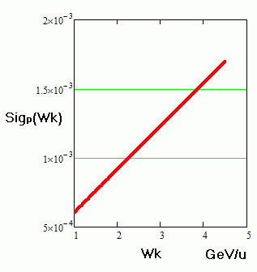


NICA collider parameters
Ring circumference, m | 503,04
Number of bunches | 22
Rms bunch length, m | 0.6
Beta-function in the IP, m | 0.35
Betatron tunes, Qx/Qy | 9.44/9.44
Ring acceptance | 40 π⋅mm⋅mrad
Long. acceptance, Δp/p | ±0.010
Gamma-transition, γ_{tr} | 7.088
Ion energy, GeV/u | 1.0 | 3.0 | 4.5
Ion number per bunch | 2∙10⁸ | 2.4∙10⁹ | 2.3∙10⁹
Rms dp/p, 10⁻³ | 0.55 | 1.15 | 1.5
Rms beam emittance, h/v, (unnormalized), π⋅mm⋅mrad | 1.1/ 0.95 | 1.1/ 0.85 | 1.1/ 0.75
Luminosity, cm⁻²s⁻¹ | 0.66e25 | 1e27 | 1e27
IBS growthe time, sec | 160 | 460 | 2000
R.m.s momentum spread
at equilibrium between IBS and
electron or stochastic cooling

Slide 5
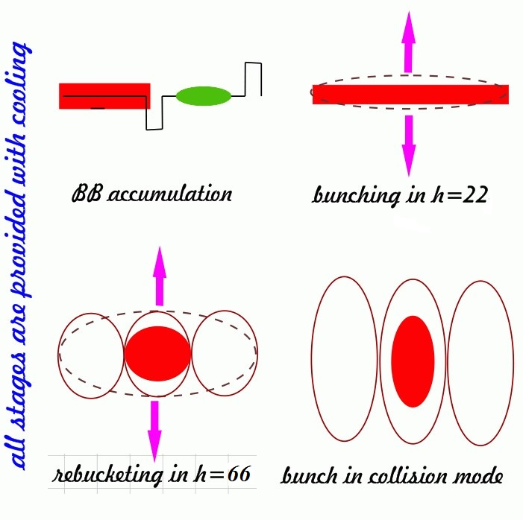
Beam preparation scheme
Beam storage at the experiment energy
RF barrier bucket system (RF1)
Allowing storage of the required beam intensity at half ring circumference Cring/2, about 50 injection pulses to each ring every 8 sec. Total accumulation time ≤ 10 min.
RF1 can be used for acceleration ions if injection energy is less then energy of experiment RF1 generates accelerating voltage up to 300 V.
1st narrow-band RF system (RF2)
Operating at 22 harmonics of revolution frequency; it provides the beam bunching.
RF2 can be used for acceleration or deceleration of ions
2nd narrow-band RF system (RF3)
Operating at harmonics number 66, that provides the bunch length necessary for collision experiments.
RF3 can be used for acceleration or deceleration of ions

Slide 6
Parameters of BB RF1 station
Maximal voltage – 5 kV
Two rectangular barriers with phase length- π/6
Stack phase zone– π (Nuclotron perimeter 251.5 м).
Kicker fronts – 2 x 100 ns = 0.27π
Kicker plato -200 ns=0.27 π
Injection zone = kicker frons + kicker plato=0.54 π=135.8 m
-π/2
0
π/2
π+Δ
Rf1₂
kick
Nuclotron
ϕ
ВМ
kik
Rf1₁
Synchronization of stack formation in two
Collider rings to avoid parasitic collisions
Barrier operation during one injection cycle

Slide 7
RF barrier buckets, scheme operation
RF1 generates four pulses of RF voltage during one revolution period. Pulses 1 and 4 are used for stored ions, pulses 2 and 3 -for injected particles.
Particle distribution and
BB positions at ion storage
Ion injection
Injection zone=0.54π (135.8m)
Stack zone=π (251.5 m)
b)BB position at bunches merging
Barriers 2 and 3 moved adiabatically in counter directions
to provide equal momentum spread in injection and stack zones Barriers 3and 4 than switch off and injection portion merging with stack.
c)BB start to prepare space
for new injection
d)BB are displaced to initial
injection position, BB 2-3 should be appeared at injection
16

Slide 8
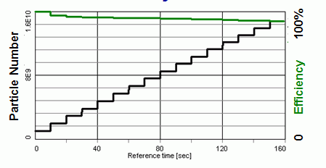
Accumulated particle number on time
BETACOOL simulation (e – cooling). E=1.5 GeV/u. Smirnov A. simulation of stochastic cooling. E= 3.5 GeV/u. T. Katayama
3.5 Gev/u
1.5 Gev/u
Accumulation process and its efficiency
Presently by A.Smirnov an N.Mityanina new version of Betacool code was developed with space charge effects at storage in RF bucket (RUPAC 18)

Slide 9
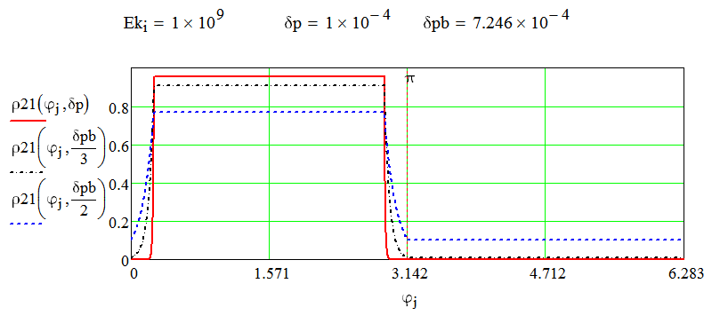
Storage of ion beam
Influence of ion beam space charge on self-consistent distribution of ion beam and its storage.
- Stationary longitudinal ion distribution at presence of RF bucket and space charge effects
- Influence of ion space charge on depth of potential well
Rms momentum spread in presence of space charge effects.
Motion equation in presence of space charge effects and RF bucket (N. Mitjanina, BINP)
- potential
- space charge and RF1 voltages
-Hamiltonian
distribution of ion density
Ion distribution at
normalization on beam current
for

Slide 10
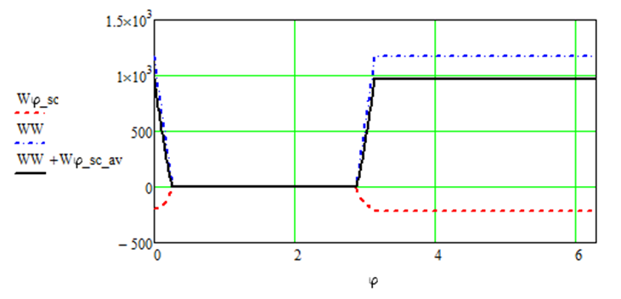
Longitudinal ion beam space charge effects averaged across ion beam
Density distribution of hollow tube beam with radius
in vacuum
chamber with radius
Longitudinal electrical field
longitudinal electrical for ion beam
with transverse distribution
Longitudinal voltage averaged at transverse ion distribution
-Gaussian distribution
=>
Potential defined by ion beam space charge effects
Potential defined by space charge effects, RF bucket and sum of space charge and RF bucket.

Slide 11
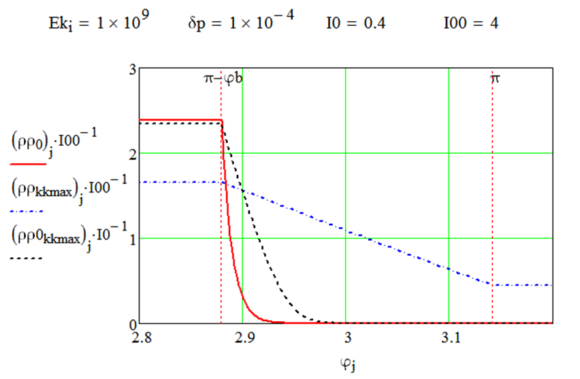
The momentum spread at stacking of new injected bunch captured in RF bucket should be equal to stack momentum spread.
The back and forward fronts of stack longitudinal profile and new injected profile are measured by fast current transformer.
It gives information about stack momentum spread and momentum spread of new injected beam, captured in RF bucket.
However the front of stack longitudinal profile strongly depends on stored stack current. The stack momentum spread can be extracted only from simulations.
Ion density distribution with space charge effects.

Slide 12
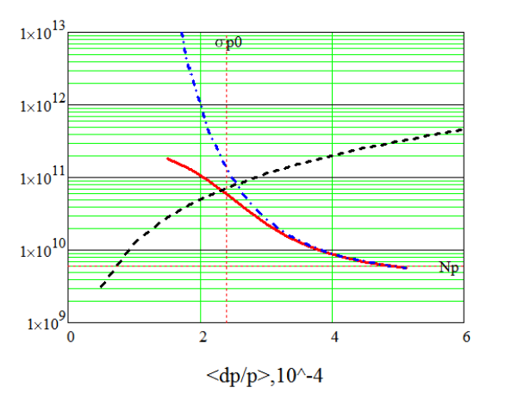
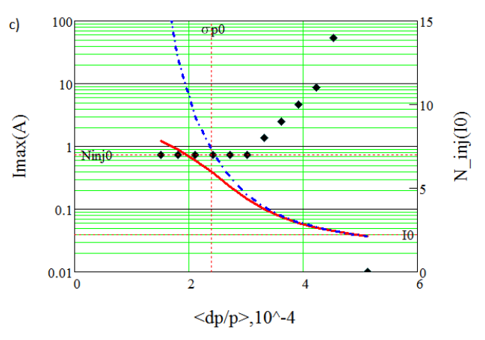
Maximal storage stack current
Maximal stack beam defined by equilibrium between new injection and ion losses from stack tails produced by kicker at injection (N. Mitjanina, BINP)
1 GeV/n, N=610⁹, σ_{p0}=2.410⁻⁴, N₀=10⁹
Dependence of maximal ion storage current on ion momentum spread with space charge effect ( red solid line) and without space charge effect (dashed blue line), dashed black line - threshold beam current at development instability.
Dependence of maximal storage ion current on momentum spread ( read solid line). Dependence of number injections on momentum spread at beam current I=0,04A (N=610⁹) (black points).

Slide 13
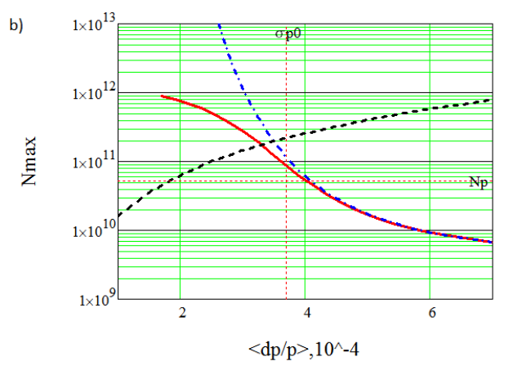
3 GeV/n, N=5.210¹⁰, σ_{p0}=3.710⁻⁴
Dependence of maximal ion storage current on ion momentum spread with space charge effect (solid line) and with out space charge effect (dashed line), dashed black line - threshold beam current at development instability.
Dependence of maximal storage ion current on momentum spread ( read solid line)
Dependence of number injections on momentum spread at beam current I=0,386A (N=5.210¹⁰) (black points).
Space charge effects leads to reduction
=3.7×10⁻⁴
to
(20% reduction of capacity of RF bucket)

Slide 14
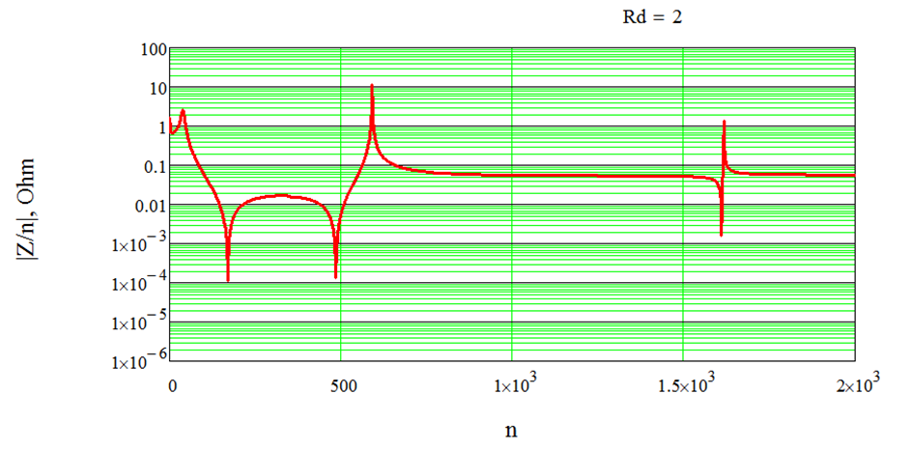
Beam instability
Impedance of RF1 cavity
Space charge impedance of vacuum chamber
Z₀ = 377 Оhm,
, a =5 cm– radius of vacuum chamber,
r=0,5 cm is beam radius
Z_{L}=68 Ohm at energy 3 GeV/n.

Slide 15
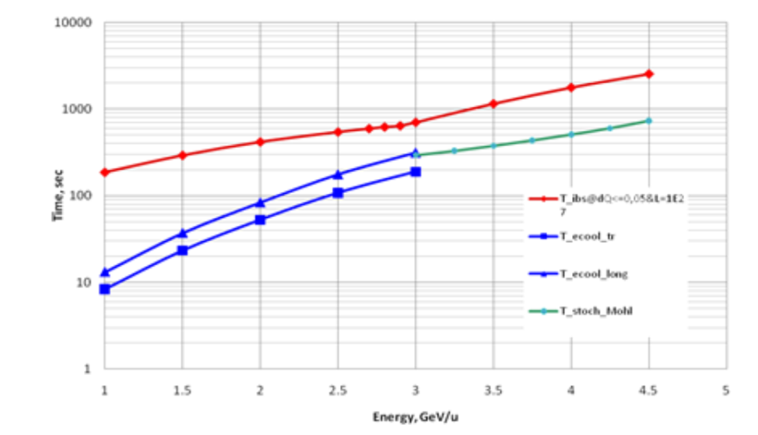
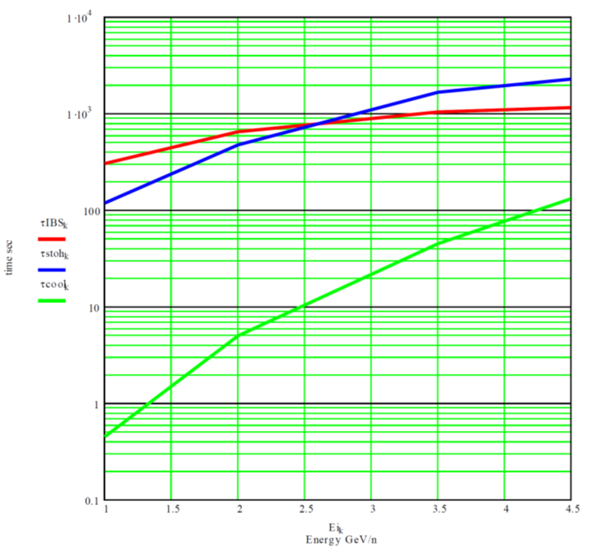
Cooling time
Dependence of cooling and IBS time on ion energy in JINR simulations
Dependence of cooling and IBS time on ion energy in BINP simulations

Slide 16
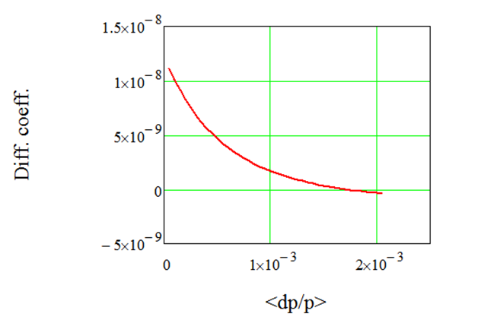
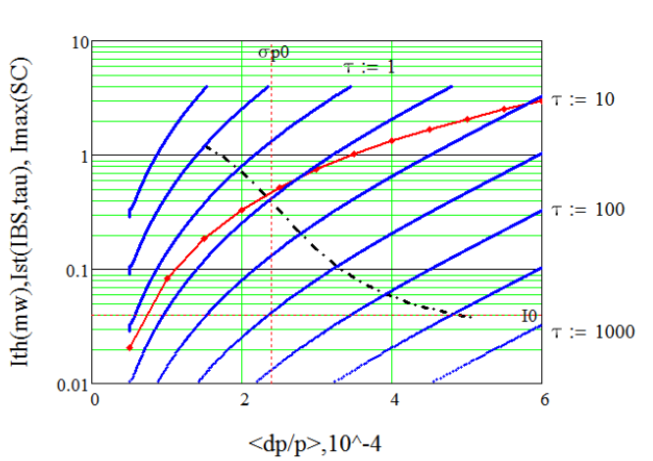
Equilibrium between IBS and cooling
IBS diffusion coefficient (S.Nagaitsev model)
Diffusion coefficient as function of momentum spread and bunch length:
Equilibrium momentum spread
at cooling and IBS:
RUPAC 18
A.Smirnov at al
Betacool simulation
of IBS and cooling at bunching
Dependence of IBS diffusion coefficient on momentum spread at
Dependence of beam current on momentum spread at equilibrium between IBS and cooling at energy E=1 GeV/n.

Slide 17
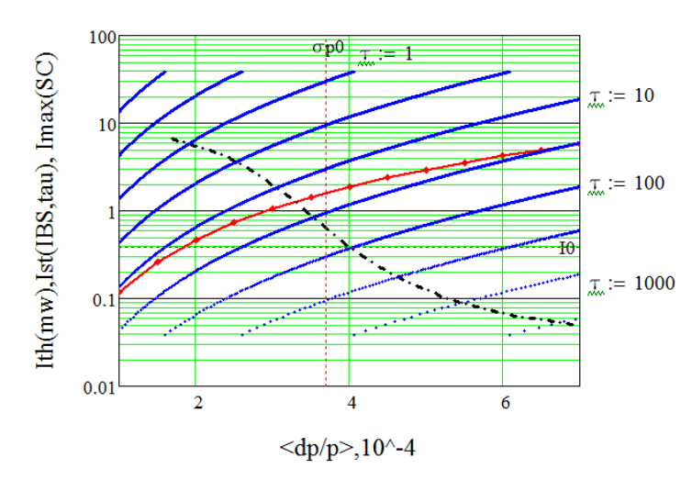
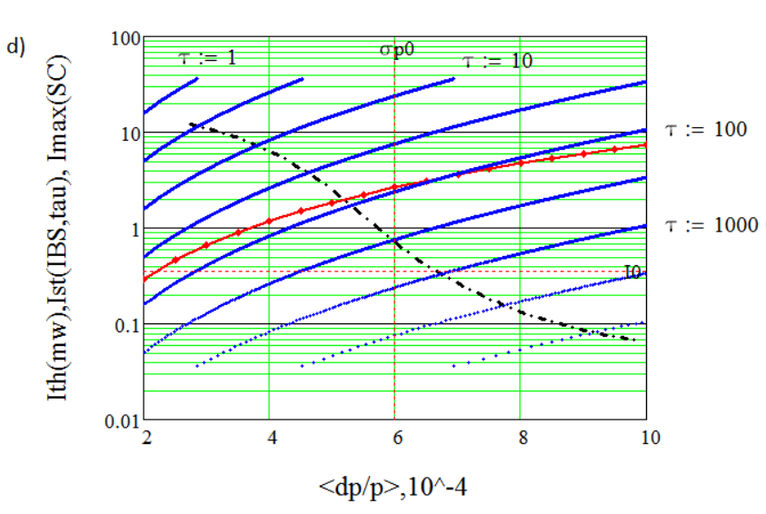
Dependence of beam current on momentum spread at equilibrium between IBS and cooling at energy E=3 GeV/n.
Dependence of beam current on momentum spread at equilibrium between IBS and cooling at energy E=4.5 GeV/n.

Slide 18
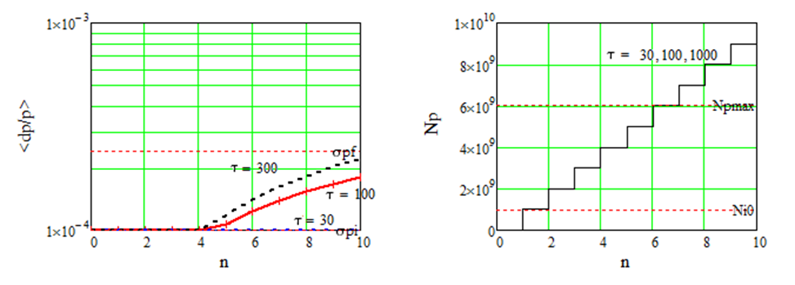
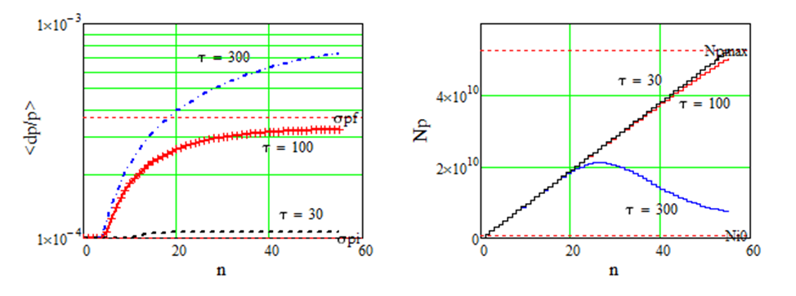
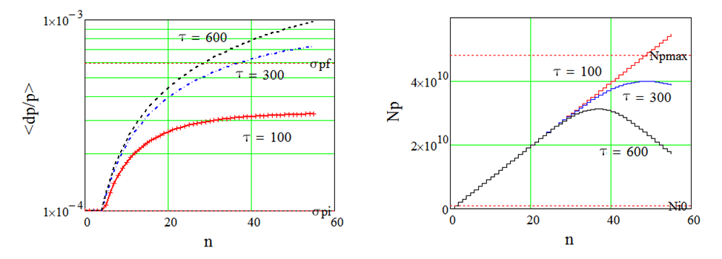
Storage of ion beams in RF bucket
E=1 GeV/n,
, σ_{l}=16 m
E=3 GeV/n,
, σ_{l}=10 m
E=4.5 GeV/n,
, σ_{l}=6 m
Dependence of momentum spread and ion intensity on number of injection cycles.

Slide 19
Parameters of ion beams at storage and bunching
Energy GeV/n) | 1 | 3 | 4.5
Number of ions per ring | 4.4∙10⁹ | 5.3∙10¹⁰ | 5.1∙10¹⁰
Rms (dp/p)_{σ} at ion collisions | 6⋅10⁻⁴ | 1.15⋅10⁻³ | 1.6⋅10⁻³
Threshold rms dp/p_{σ-th} for bunch at ion collisions | 2,1⋅10⁻⁴ | 5,7⋅10⁻⁴ | 6,5⋅10⁻⁴
Threshold rms dp/p_{σ-th} for stored coasting beam | 5.6∙10⁻⁵ | 1.5∙10⁻⁴ | 1.7∙10⁻⁴
Momentum spread for separatrix of RF1 barrier (dp/p)_{h} | 7.3∙10⁻⁴ | 1.1∙10⁻³ | 1.82∙10⁻³
Emittance at ion collisions, eV∙s | 28 | 120 | 235
Threshold emittance of stored ion beam, eV∙s | 31 | 173 | 300
Emittance of stored ion beam, eV∙s | 59 | 202 | 470
Cooling should provide reduction of emittance at bunching from initial level at storage to value required for collision regime with bunch length 60 cm.
RF2 and RF3 voltage should provide momentum spread at bunching larger threshold value related to beam instability.

Slide 20
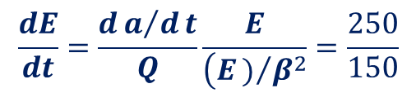
Ion acceleration in RF1, RF2 and RF3
1. Ion acceleration with RF1 at U_{ac}=300 V:
dE/dt=f₀(E)ZeU_{ac}=60 MeV/u/sec
2. Acceleration in RF2 and RF3
2.1 Ion acceleration defined by magnetic field rate:
2.2 Ion acceleration defined by frequency variations of RF 2,3 cavities:
$$\frac{dE}{dt}=\frac{da/dt}{Q}\frac{E}{\left(E)/{β^{2}}\right.}=\frac{250}{150}$$
MeV/u sec for RF2/RF3

Slide 21
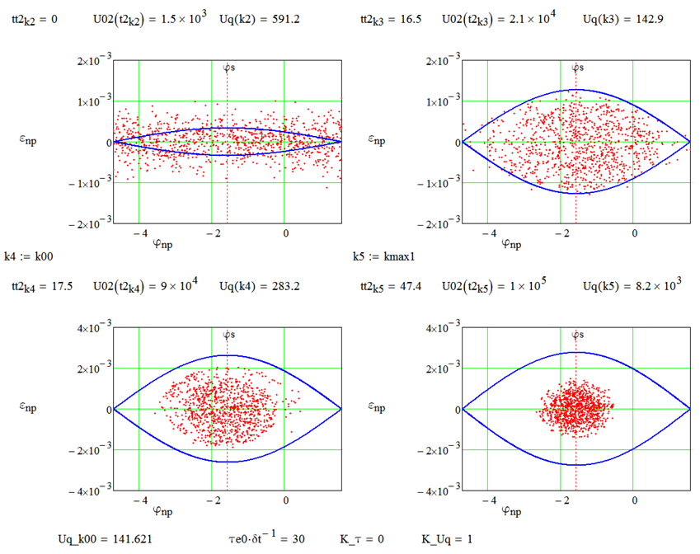
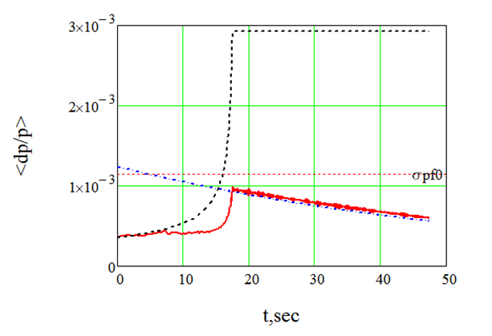
Bunching beam by RF2 (N. Mitjanina, BINP)
RF2 bunching at 3 GeV/n
U0_{Rf2}=1.5 kV, U_{Rf2}=100 kV at RF2 frequency variation 10 half bends/s, cooling time 30 s, for initial
maximal
at t=17,5 s and additional cooling to
during 40s
Dependence of momentum spread at adiabatic Rf2 bunching and cooling after 17,5 s (without IBS) .

Slide 22
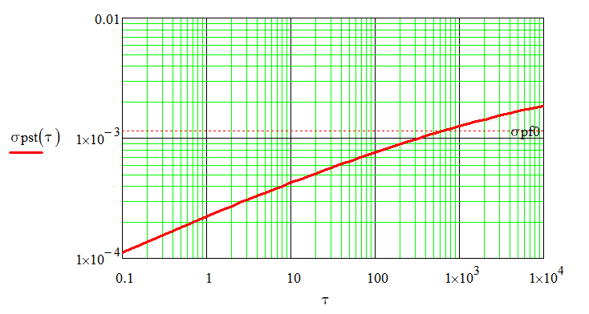
Сooling and IBS at RF2 beam bunching
Dependence of equilibrium momentum spread at cooling
after RF2 bunching at ion energy 3GeV/n.
Dependence of bunch length and momentum spread on time during RF2 bunching and cooling (τ=100 s)

Slide 23
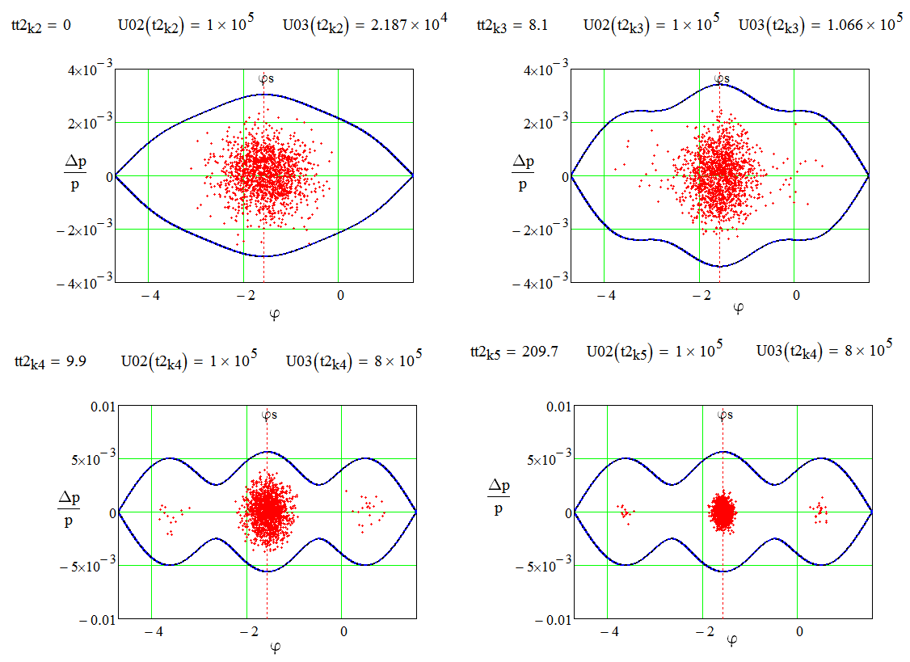
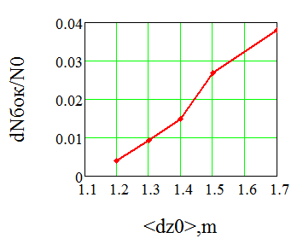
RF3 Bunching
E= 3GeV/n, U_{Rf2}=100 kV, URf30=21.8 kV, URf3=800 kV at RF3 frequency variation 10 half bends/s, cooling time 100 s, for initial
rms bunch length σ=1.7 m after R2 bunching
Dependence of bunch length and momentum spread on time at cooling time of 100 s.
Dependence of ratio of number of ions captured in side parasitic separatrix to number of ions captured in central separatrix on rms bunch length at adiabatic increase of RF3 voltage.

Slide 24
RF3 Bunching
E= 3GeV/n, U_{Rf2}=100 kV, URf30=21.8 kV, URf3=800 kV at RF3 frequency variation 10 half bends/s, cooling time 100 s, for initial
rms bunch length σ=1.2 m after R2 bunching
Project bunch parameters at energy 3GeV for collision regime
dp/p=1.15ּ×10⁻³ , σ=0.6 m.
Dependence of bunch length and momentum spread on time at cooling time of 100 s
for initial rms bunch length σ=1.2 m.

Slide 25
THANKS FOR YOU ATTENTION

