Slide 1



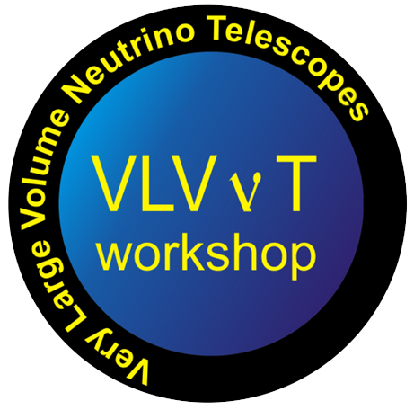



ASTERICS & KM3NeT
VLVnT – 2018 2 - 4 October 2018 Dubna Russia
Report on the Asterics projects
CORELib and ROAst
H2020-Astronomy ESFRI and Research Infrastructure Cluster (Grant Agreement number: 653477).

Slide 2
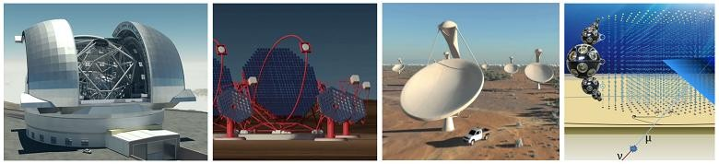
ASTERICS & KM3NeT
ASTERICS: Astronomy ESFRI and Research Infrastructure Cluster
In Horizon2020 programme
Brings together SKA, CTA, ELT, KM3NeT
Web site: http://www.asterics2020.eu
Core work package: WP 3 OBELICS (OBservatory E-environments LInked by common ChallengeS)
Data sharing and interoperability work package: WP 4 DADI (Data Access, Discovery and Interoperability )
Timing work package: WP 5 CLEOPATRA (Connecting Locations of ESFRI Observatories and Partners in Astronomy for Timing and Real-time Alerts)
Share, develop and co-develop common technologies that may turn useful both to existing ESFRI’s and to their upgrades (or future ones) to correlate and leverage shared knowledge
Make software and data usable also outside of the original environment in which they were generated/conceived

Slide 3
ASTERICS & KM3NeT
INFN and KM3NeT in ASTERICS (OBELICS)
CORELib: COsmic Ray Event Library – work within the KM3NeT CORSIKA WG (P. Mijakowski)
Based on CORSIKA, but output must be CORSIKA-independent
Main contributions:
  High statistics common production common set of parameters
  A common framework and tool to produce manage large productions
  Contributors:
  Simona Maria Stellacci
  Bernardino Spisso
  Carmelo Pellegrino
ROASt: ROot extension for Astronomy – mostly with KM3NeT Computing WG (K. Graf)
ROOT is the “de facto” standard for high-energy physics but it lacks packages and
tools for astrophysical research
Main contributions:
  Add astronomical catalogs
  Add astrophysical tools
  Contributor:
  Bernardino Spisso

Slide 4
ASTERICS & KM3NeT
CORELib
CORELib: COsmic Ray Event Library
  Background to many experiments
  Also a tuning benchmark
  Potentially useful to other communities
  Currently using CORSIKA as generator
Status of production
  Proton-induced showers (1° delivery production):
    HE models: QGSJET01 with CHARM, QGSJET01 with TAULEP, QGSJET-II with TAULEP, EPOSLHC with TAULEP
    LE model: GHEISHA
    about 21M Evts per HE model
    7 energy bins (2×10²GeV-10³GeV+equally logarithmically spaced from 1TeV to 10⁹GeV)
    power-law spectrum with -2 spectral index
    zenith angle from 0 to 89 degrees
  Nuclei (Fe He CNO ) induced showers:
    HE models: QGSJET01 with CHARM, QGSJET01 with TAULEP, QGSJET-II with TAULEP, EPOS-LHC with TAULEP
    LE model: GHEISHA
    about 21M Evts per HE model
    7 energy bins (A×2×10²GeV-A×10³GeV+equally logarithmically spaced from A×1TeV to A×10⁹GeV)
    power-law spectrum with -2 spectral index
    zenith angle from 0 to 89 degrees
CORELib can be downloaded via SFTP at corelib@193.205.188.227
pwd = Asterics2020

Slide 5
ASTERICS & KM3NeT
CORELib
CORELib: COsmic Ray Event Library
Status of production
Energy range (GeV) | Number of events
200-1000 | 10⁷
10³-10⁴ | 10⁷
10⁴-10⁵ | 10⁶
10⁵-10⁶ | 10⁵
10⁶-10⁷ | 10⁴
10⁷-10⁸ | 10³
10⁸-10⁹ | 10²
Production done with and without Cherenkov radiation
High energy model | Low energy model | Option
 |  | TAULEP | CHARM
QGSJET01 | GHEISHA |  | X
QGSJET01 | GHEISHA | X
QGSJETII-04 | GHEISHA | X
EPOS LHC | GHEISHA | X
About 21M events per HE model

Slide 6
ASTERICS & KM3NeT
Ongoing production
Proton-induced showers:
New production is on going using flat spectrum.
Sea level as observation level and the standard European atmosphere.
HEMODELS: QGSJET01 with CHARM, QGSJET01 with TAULEP, QGSJET-II with TAULEP, EPOSLHC with TAULEP
LEMODEL: GHEISHA.
about 15M Evts per HE model.
7 energy bins (2×10²GeV-10³GeV+equally logarithmically spaced from 1TeV to 10⁹GeV).
Flat power-law spectrum with 0 spectral index.
zenith angle from 0 to 89 degrees .
3.000.000 hi-energy events ( 10⁷-10⁹ GeV) Vs. 1.100 of the previous productions.
90 % Complete: only EPOS 10⁷-10⁹ GeV energy range left and on going.

Slide 7
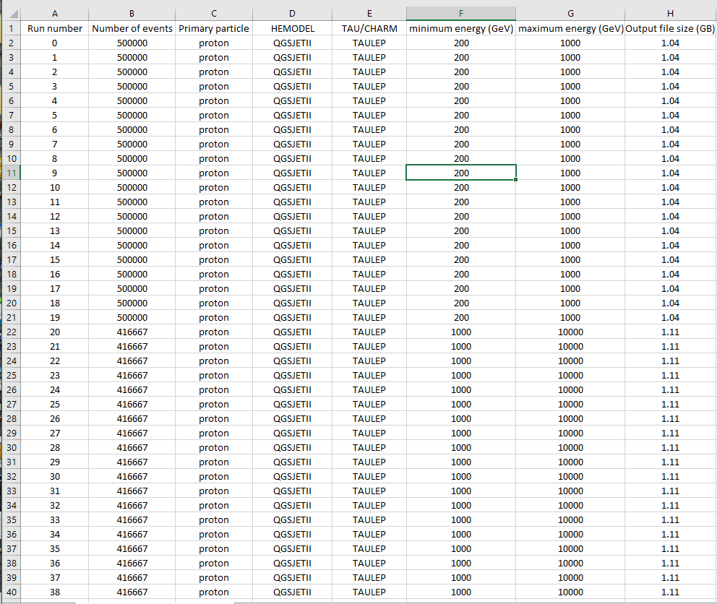
ASTERICS & KM3NeT
The details for each run for the first two productions are collected in SQLite data base which can be exported in an Excel compatible spreadsheet.

Slide 8
ASTERICS & KM3NeT
Ongoing support production
From binary CORSIKA output files, containing the cosmic ray induced showers, is on going a conversion in to the ASCII evt format.
Distinct files for Hadrons, E.M., Muons and Neutrinos.
The evt files are generated using CORANT ( conversion tool developed by T.Chiarusi, L.A. Fusco, C. Pellegrino and modified ad hoc by B. Spisso and S.M. Stellacci) -> Many thanks to Carmelo for the help.

Slide 9
ASTERICS & KM3NeT
ROAst
ROAst: ROot extension for Astronomy
  ROOT is the “de facto” standard for high-energy physics but it lacks packages and
  tools for astrophysical research. Indeed, the main aim of ROAst is to add native classes to access astronomical catalogues and general astrophysical tools in order to “bridge” the two worlds.
ROAst sky-map is available on GitLab!
Two local test catalogues are used: the UCAC4 (U.S. Observatory CCD Astrograph Catalog 4) and the URAT1; high accuracy positional catalogues integrating some extra information as proper motions and double star flag.
Supports the on-line Virtual Observatory (VO) catalogues and VizieR catalogue repository.
It features Graphic support library which rely on the ROOT graphic tools, all the ROOT graphical options are integrated.
It features Moon and Sun position.
- It uses an intermediate abstraction layer in order to speed-up the next catalogues implementations.
Supports equatorial, galactic, ecliptic, horizontal astronomical coordinates (using Lat-Long and UTM as geographical coordinates) and allows coordinate transformations.
Current improved version thanks to Aart Heijboer's suggestions.

Slide 10
ASTERICS & KM3NeT
The VizieR Catalogue Service
VizieR features 17621 catalogues available from CDS of which 16999 are available on-line, some examples are: Fermi/LAT Planck Catalog ROSAT etc…
The Virtual Observatory
The Virtual Observatory is an international astronomical community-based initiative. It aims to allow global electronic access to the available astronomical data archives of space and ground-based observatories and other sky survey databases.
Some examples of VO institutions are:
Euro-VO: the European VO (a partnership of VOs including AstroGrid, ESO, ESA...).
The Mikulski Archive for Space Telescopes (MAST): a NASA funded project.
The German Astrophysical Virtual Observatory (GAVO).
VAO: the US Virtual Astronomical Observatory.
IVOA: the International Virtual Observatory Alliance.

Slide 11
ASTERICS & KM3NeT
TROAstCatalogue class
The astronomical objects can be extracted projecting the catalogue to three different geometrical regions and using different coordinate system:
ExtractObjectsRectangle
Equatorial/Galactic coordinates
Horizontal coordinates
ExtractObjects
ExtractObjectsCircle
Equatorial/Galactic coordinates
Horizontal coordinates
ExtractObjectsEllipse
Equatorial/Galactic coordinates
Horizontal coordinates
The extracted astronomical objects are stored in the public vector ObjectsColletion and can be displayed using the Print method.

Slide 12
ASTERICS & KM3NeT
TROAstConversions class
This class contains all the coordinate and time conversion methods which are catalogue independent. The main methods are:
LL2UTM //Converts Lat-Long geographical coordinates to UTM coordinates.
UTM2LL //Converts UTM geographical coordinates to Lat-Long coordinates.
UTC2UnixTime //Converts UTC to Unix time.
UnixTime2UTC //Converts Unix time to UTC.
Equatorial2Horizontal //Converts equatorial coordinates to horizontal ones.
Horizontal2Equatorial //Converts horizontal coordinates to equatorial ones.
Equatorial2Galactic //Converts equatorial coordinates to galactic ones.
Galactic2Equatorial //Converts galactic coordinates to equatorial ones.
Equatorial2Ecliptic //Converts equatorial coordinates to ecliptic ones.
Ecliptic2Equatorial //Converts ecliptic coordinates to equatorial ones.

Slide 13
ASTERICS & KM3NeT
Passed
Coordinate conversions tested using existing ANTARES benchmarks

Slide 14
ASTERICS & KM3NeT
TROAstGraphics class
The aim is to supply a basic set of graphical tools fully coherent with the ROOT environment.
The customization of the plot is left to the user. The main methods are:
Draw //Draws the astronomical objects positions.
DrawFeature //Draws the selected feature of the astronomical objects.
DrawAitoff //Draws the astronomical objects using equatorial Aitoff projection.
DrawSkyMap //Draws the whole sky-map using equatorial Aitoff projection.
Draw and DrawFeature methods support equatorial/galactic/horizontal astronomical coordinate system.
A way to use decreasing RA axis in the graphs is implemented setting true a global variable.
(Thanks to Dorothea Samtleben)

Slide 15
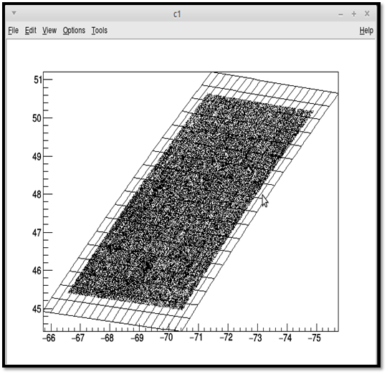
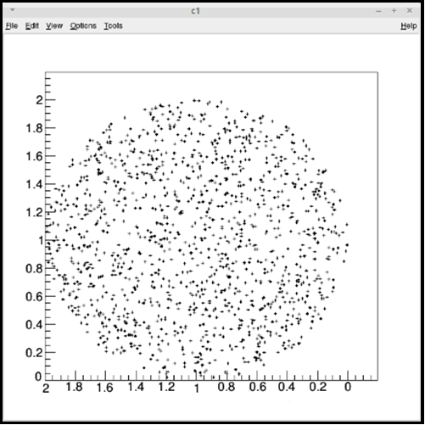
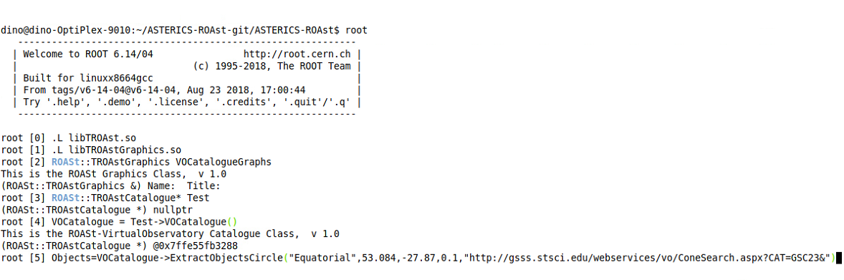
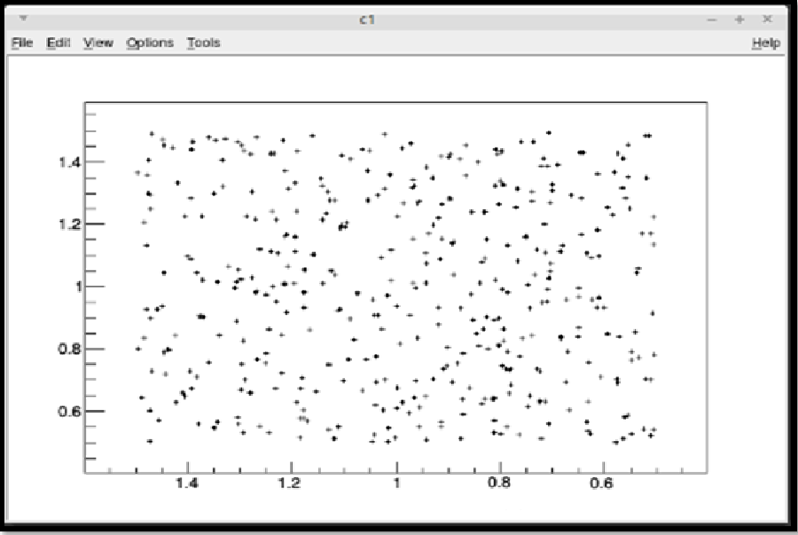
ASTERICS & KM3NeT
A graphical example

Slide 16
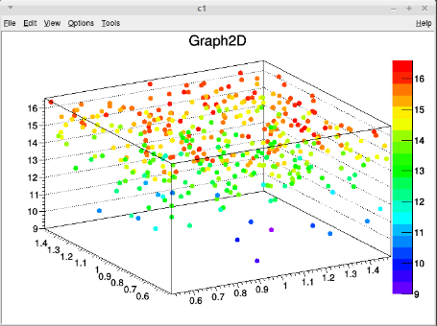
ASTERICS & KM3NeT
A graphical example
The DrawFeature method can be used to plot a feature. For example, the magnitude can be drawn at fixed wavelength or some special flags.

Slide 17
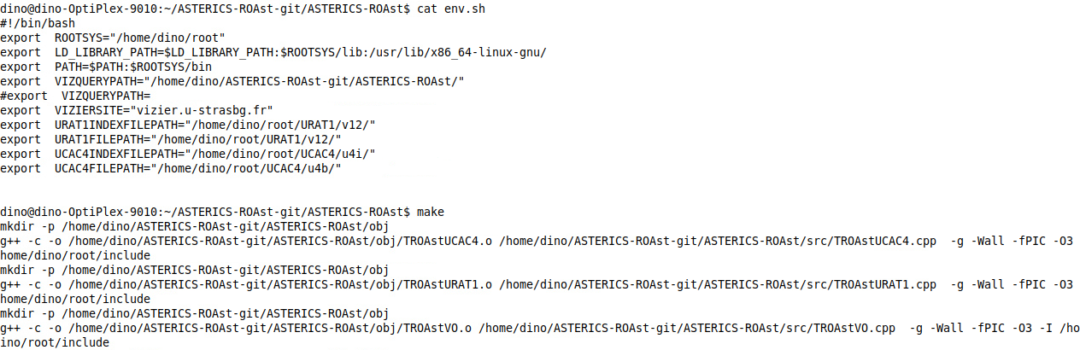

ASTERICS & KM3NeT
Compilation and support
What you need:
the optional local catalogues (UCAC4 and URAT1),
gcc/g++ version 4.8 (c++11 support) with libcurl library,
ROOT 6 (ROAst on ROOT 5 works but without dictionary since rootcint 5 does not support c++11),
to set the environment variables for the compilation (root location, local catalogue locations, remote catalogue end-point, …),
to run make and/or make TROAstGraphics.so (tested on CentOS 6 and 7).

Slide 18
ASTERICS & KM3NeT
Conclusions and perspectives
CORELib
Several models used to provide simulations.
Common data format using evt files for an immediate usage.
Open-access: SFTP with common user/pwd.
CORELib provides the full set of parameters, so if other Collaborations or institutions want to add datasets, they can do with/without overlap.
A new productions at different observation levels ( 2200 m , 4000 m and more) jointly with other Collaborations (within cooperation agreements to be defined ).
CORELib is in the spirit of ASTERICS: a tool needed by KM3NeT, whose features have been extended to prove useful to many people in the community.
ROAst
An updated and bug fixed version with an improved set of graphical tools is ready and can be found at https://baltig.infn.it/spisso/ROAst and https://gitlab.com/Spisso/ASTERICS-ROAst
A full test of supported coordinate transformations was performed.
Next: add other support methods for the coordinate manipulations.
Next: add methods which returns the positions of the major planets.
Next on catalogues: add the supports for the image catalogues.
Next on catalogues: add the support for asynchronous on-line query (TAP call).

Slide 19
ASTERICS & KM3NeT
Thank you for the attention.

