Slide 1
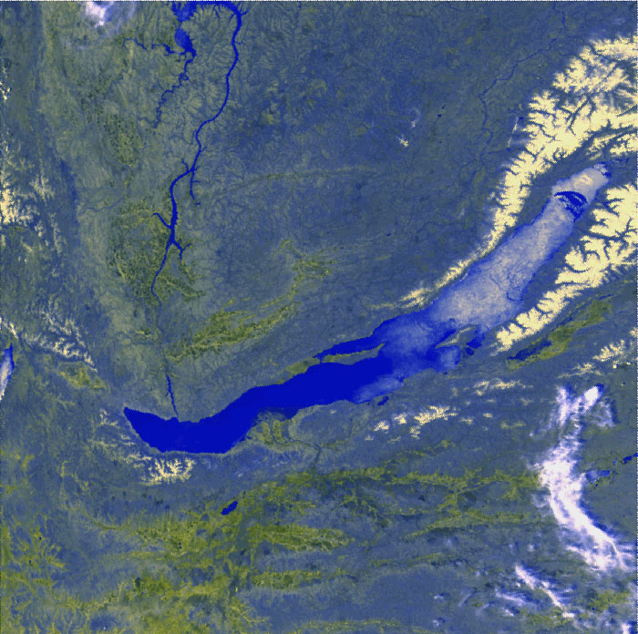
Baikal-GVD
results and plans MM
Zh.-A. Dzhilkibaev, INR (Moscow),
for the Baikal Collaboration
VLVnT-2018, October 04, 2018

Slide 2
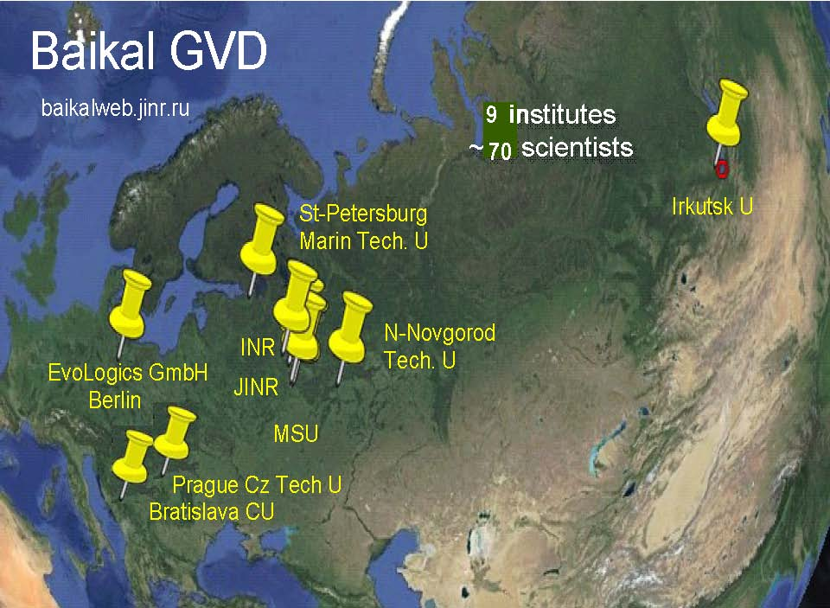

Slide 3
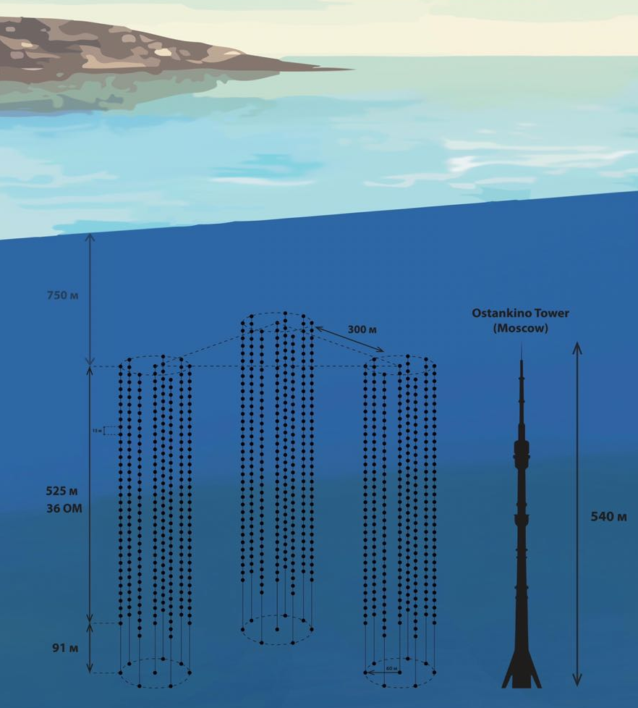
Status-2018 of the Baikal-GVD project
Cluster 1 since 2016
Cluster 2 since 2017
Cluster 3 since 2018
Powerful isotropic laser source
Data transmition
40 Gb per cluster per day to shore
5 Мb/s 40 km radio channel to Baikalsk
Raw data transferred to storage Dubna facility through Internet

Slide 4
Stages of deployment of the GVD-1
Configuration | 2015 | 2016 | 2017 | 2018
The number of OMs | 192 | 288 | 576 | 864
Geometric sizes, m | ∅80×345 | ∅120×525 | 2×∅120×525 | 3×∅120×525
Eff. Vol | 0.03 km³ | 0.05 km³ | 0.1 km³ | 0.15 km³
GVD-2017
Uui
Cluster 3
GVD-2018
Shore cable
Shore cable
Laser
NT200
Cluster 1
Cluster 2
(image: echo location from boat, bathymetry)
Notes:
Early Construction Phase of Baikal-GVD project is concluded in 2015 with deployment of the first GVD Cluster “DUBNA”. This cluster comprised 8 string with 24 optical modules. The first cluster was upgraded to baseline in 2016 (36 OM per string).
The second full-scale cluster was deployed in 2017. The view of two clusters and the topography of the lake bottom presented in this figure.
The third cluster was installed in this year.
The present configuration of detectors presented in this figure.
Three clusters located near to old detector NT200.
Each cluster connected to the shore with hybrid optical – electrical cable.
Laser calibration source located approximately in the center of this configuration.
4

Slide 5
Search for high-energy neutrinos associated
with the GW170817 in GVD-2017
GW170817 from binary neutron star merger
GW: 17.08.2017, 12:41:04 UTC = 1502973664 sec UNIX
(Advanced LIGO & Advanced VIRGO)
GRB170817A - (1.7 s delay – Fermi-GBM and INTEGRAL)
Location – galaxy NGS4993 at ~ 40 Mpc,
at equatorial coordinates
α(J2000.0) = 13^{h} 09^{m} 48^{s}.085,
δ(J2000.0) = -23°22′53′′.343

Slide 6
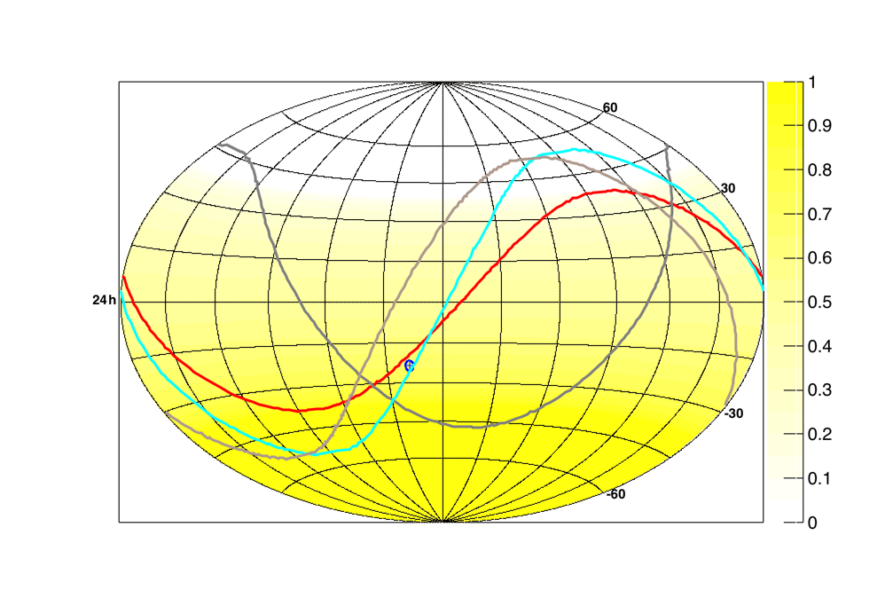
Search for neutrinos in coincidence with GW170817
Search for neutrinos by muon and cascade detection
in two time-windows: GW ± 500 sec (prompt emission)
GW +14 days (delayed emission)
Zenith angle of the
source at detection
time:
IceCube: 66.6°
ANTARES: 73.8°
Auger: 91.9°
SK: 108°
GVD: 93.3°
Horizons of arrays at equatorial coordinates
GVD SK Auger ANTARES IceCube

Slide 7
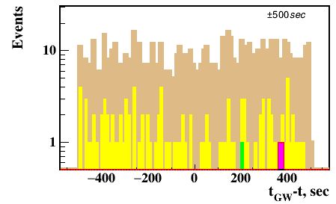
Search for neutrinos within GW ± 500 s time-window
Cl.#1, run g0269; duration 39347 sec; 2463792 ev.
Cut | Events in ± 500 sec window
N_{hit} > 5 OM/3 Str. | 731
χ²_{t} < 10 | 108
η > 0 | 3
L _{a} < 30 | 2
ψ < 20° | 0 (0.05 events is expected)

Slide 8
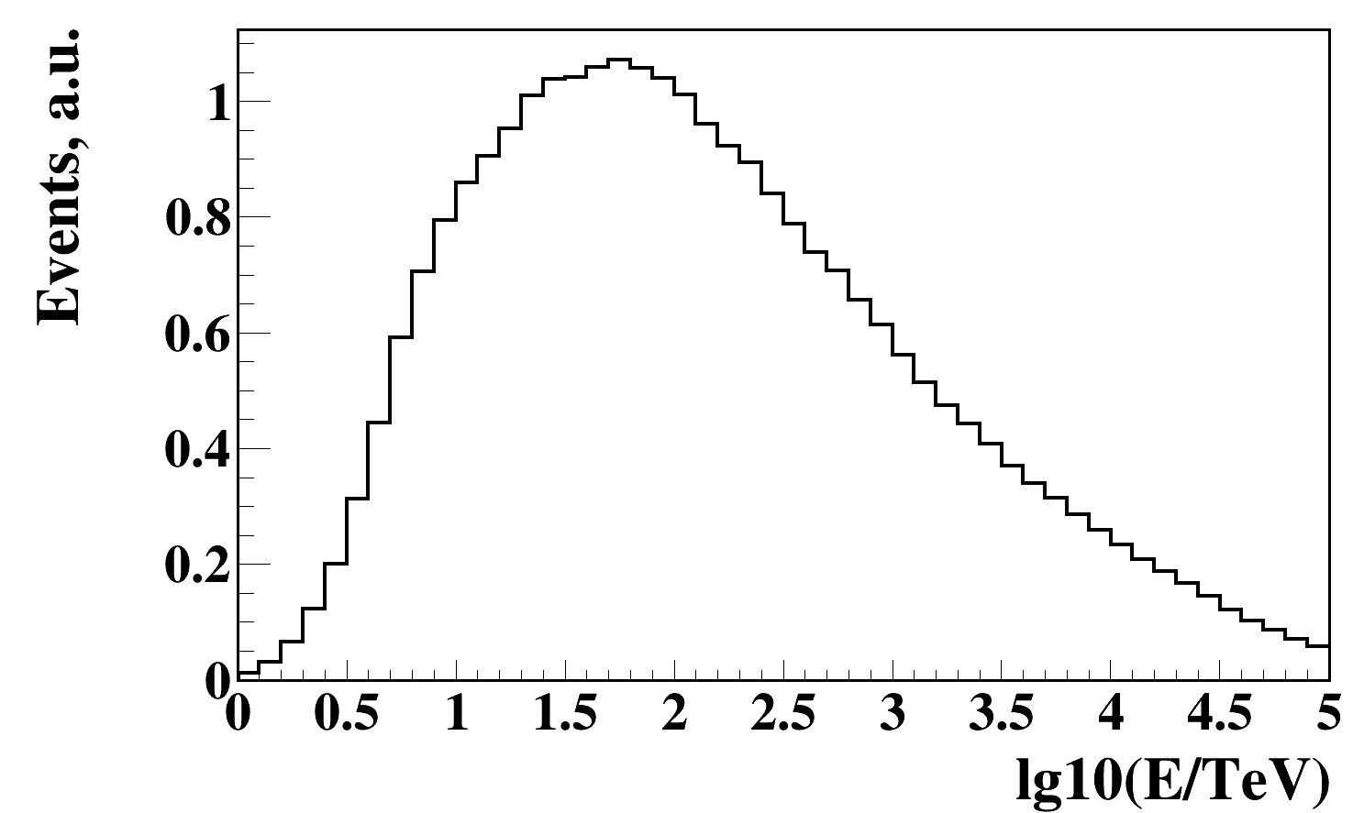
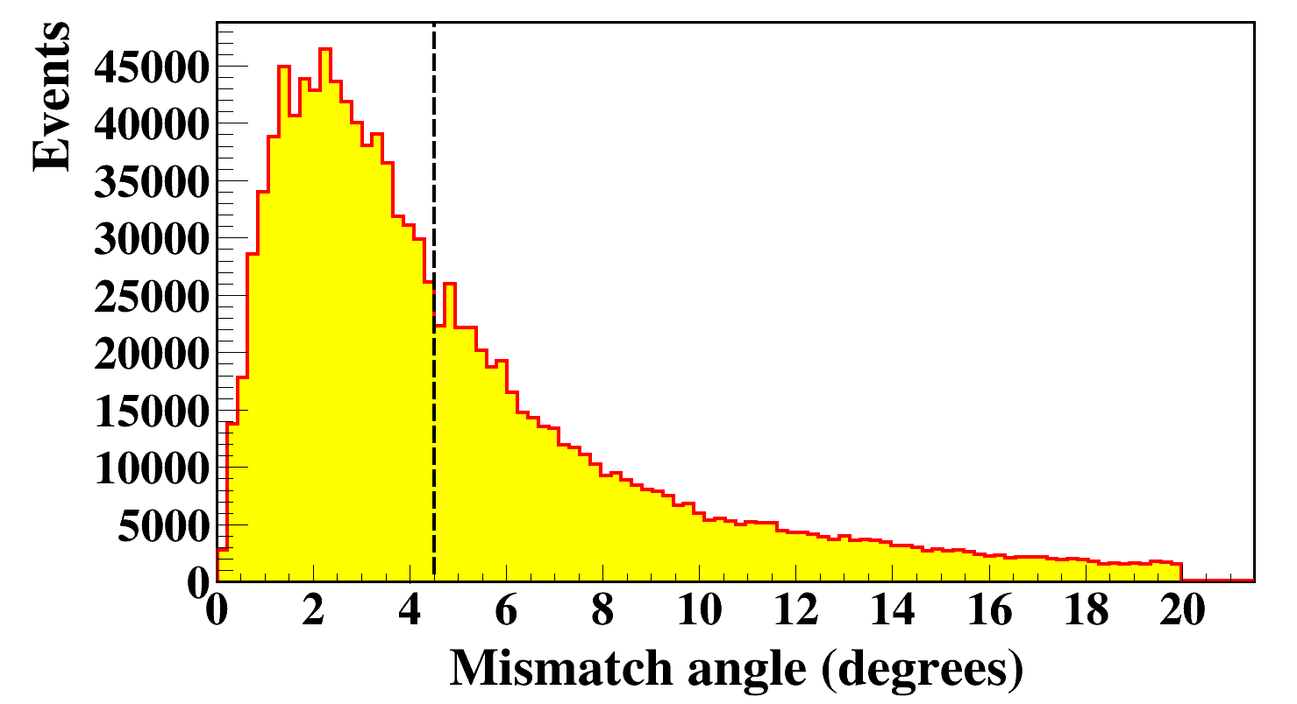
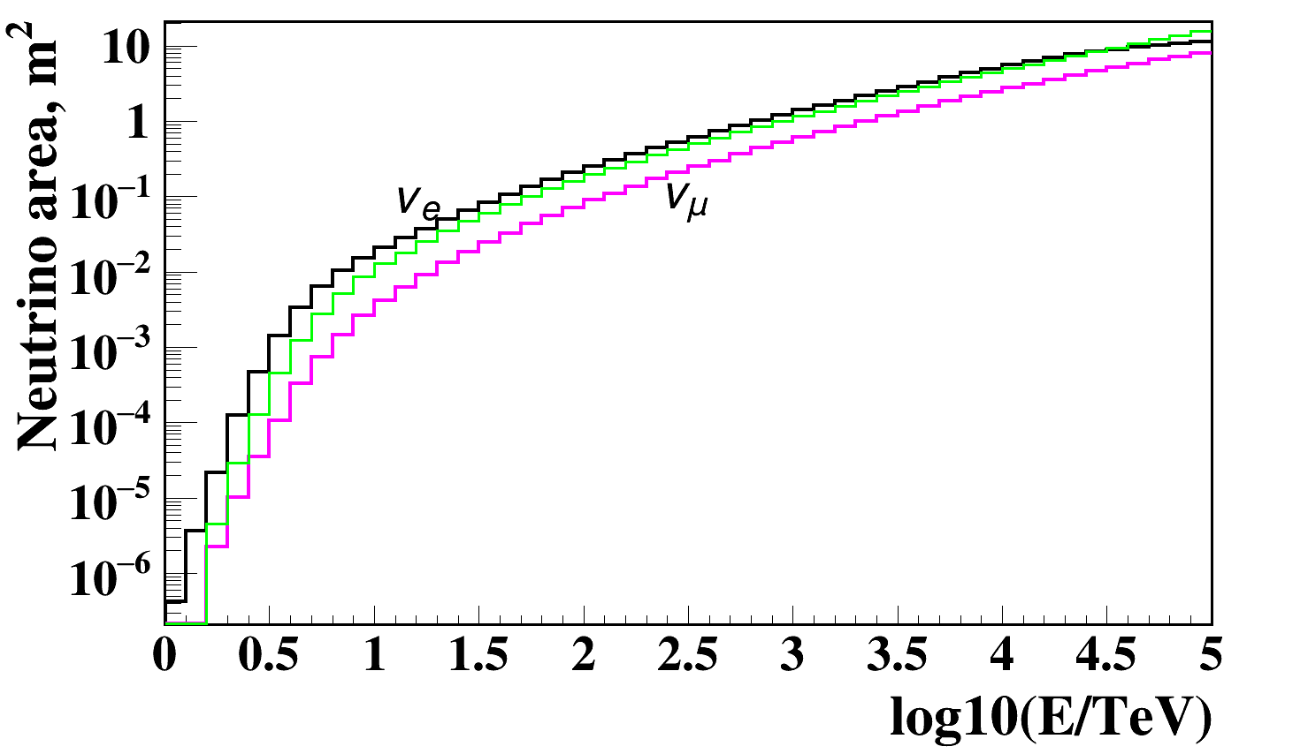
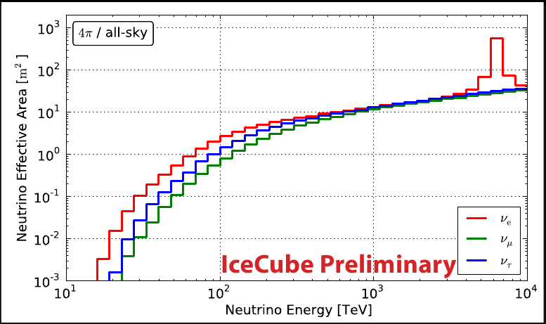
Search for neutrinos within GW ± 500 s time-window
Expected energy distribution of events.
90 % of events within 5 TeV < E < 10 PeV
Shower direction reconstruction error
E ⁻² spectrum
Neutrino effective area after all cuts

Slide 9
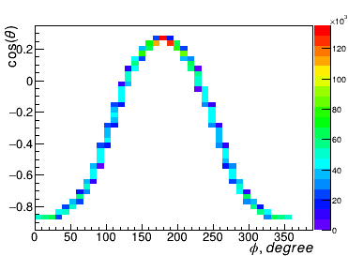
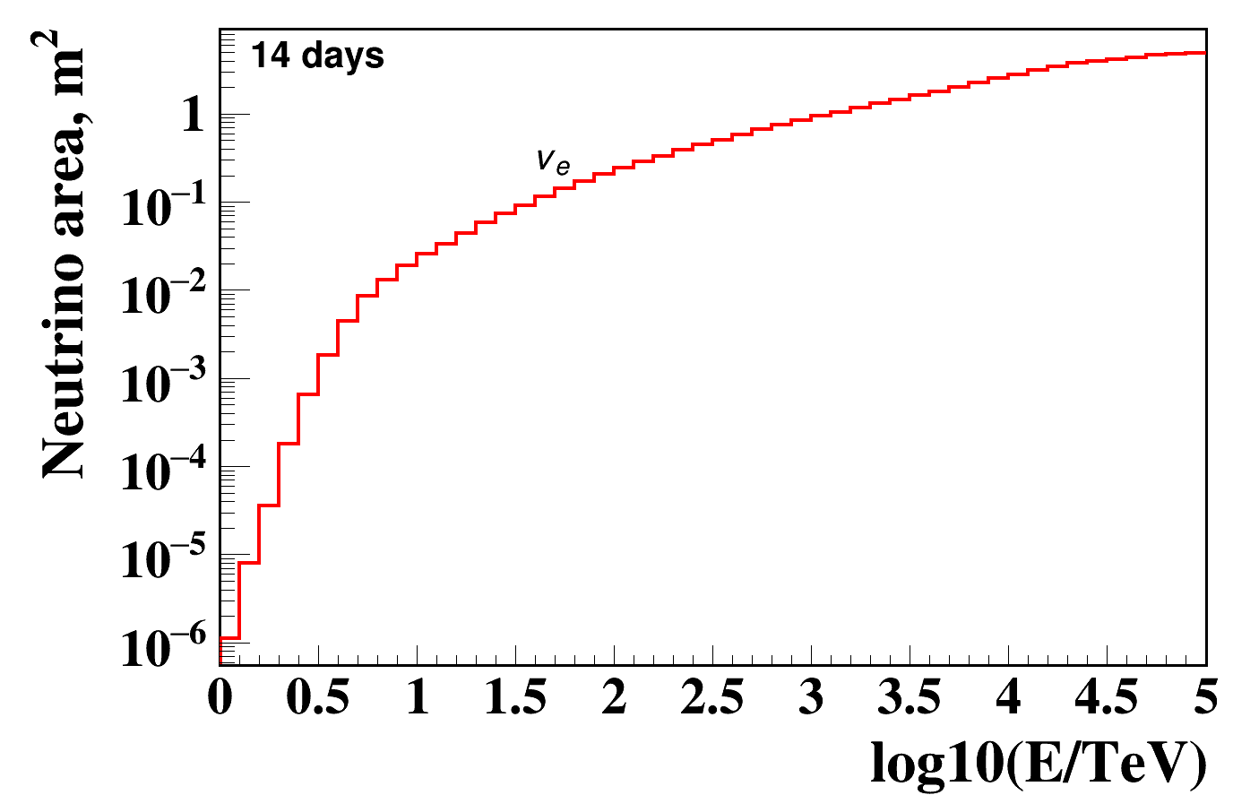
Search for neutrinos in GW170817 following 14 days time-window
Selection cuts
Coordinates of NGC4993
zenith angle range 74° < θ <150°
Cut | Events in 14 day window
N_{hit} > 7 OM/3 Str. | 384116
χ²_{t} < 6 | 12186
η > 0 | 445
L _{a} < 30 | 372
ψ < 20° | 0
Neutrino detection area

Slide 10
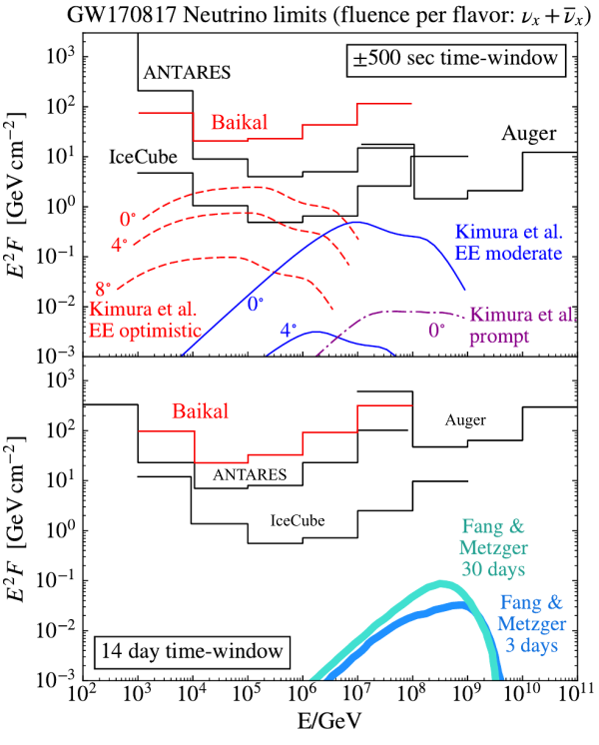
Upper limits on fluence of neutrinos associated with GW170817
No neutrino events associated
with GW170817 have been observed
Using cascade mode within ± 500 sec
window and 14 days after the neutron
star merger.
Assuming E⁻² spectral behavior and
equal fluence in all flavors
upper limits at 90% c.l. have been
derived on the neutrino fluence from
GW170817 for each energy decade.

Slide 11
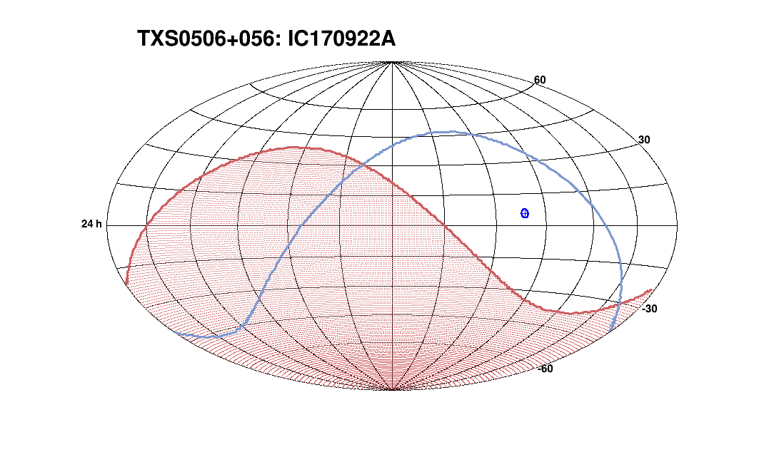
PRELIMINARY!!!
Search for neutrinos in coincidence
with IC170922A in Baikal-GVD
IceCube on 22 September 2017:
HE neutrino from the direction of
BL Lac TXS 0506+056 -
the first evidence for the existence of an astrophysical source of high-energy neutrinos
Baikal-GVD ANTARES
ANTARES - 104.2°
Baikal-GVD - 63° - search by cascade detection mode

Slide 12
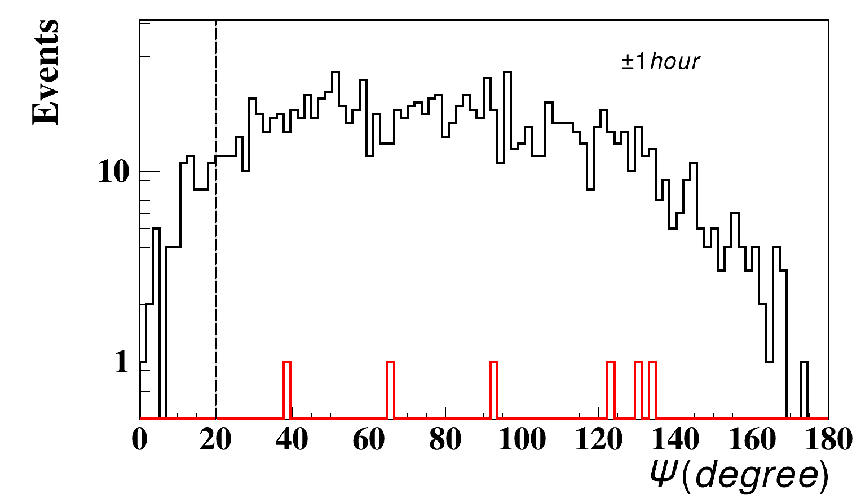
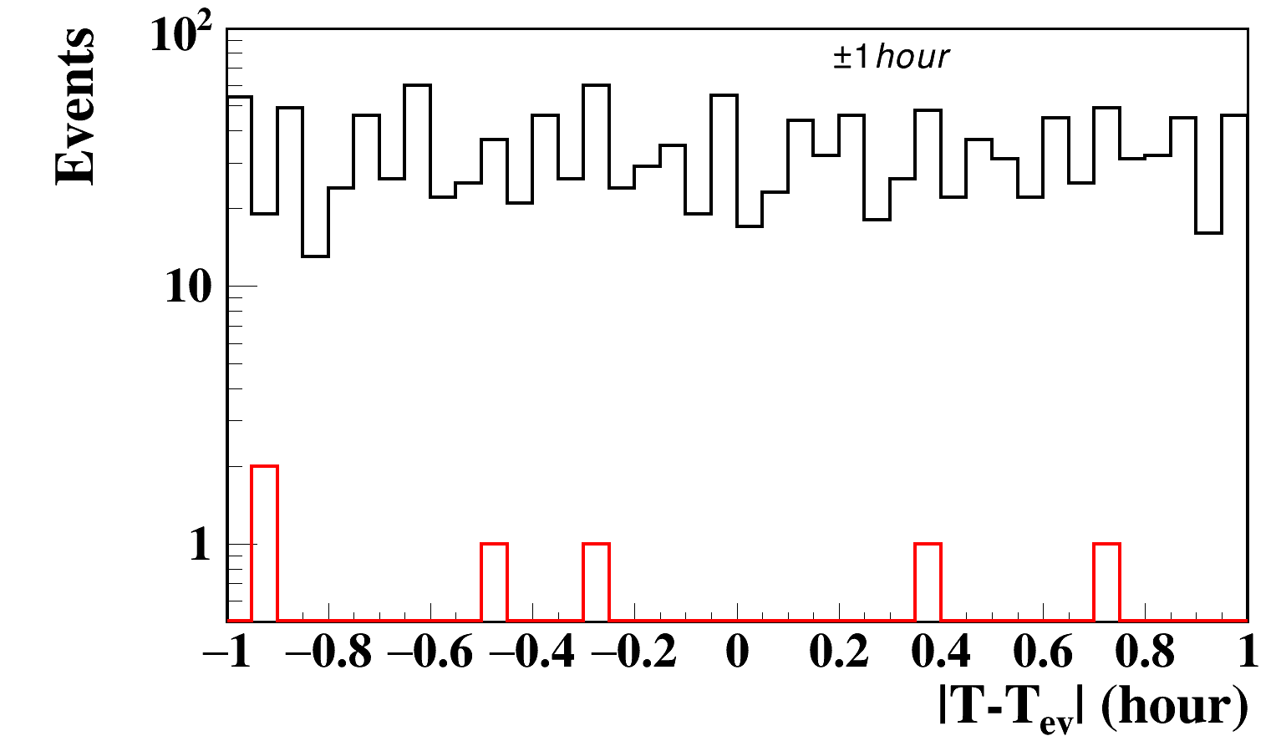
Search for neutrinos within ± 1 hour time-window around IC170922A
Events selection cuts
Cut | Events in ± 1 hour window
N_{hit} > 5 OM/3 Str. | 1345
χ²_{t} < 10 | 221
η > 0 | 11
L _{a} < 30 | 9
ψ < 20° | 0
Angular distance around the direction of the source
N_{hit} > 5
N_{hit} > 5
Before the cut ψ<20°
No neutrino candidate event was recorded within
± 1 hour time window around the IC170922A

Slide 13
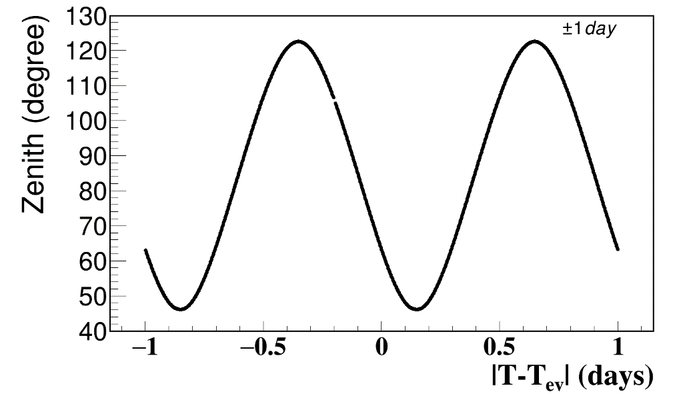
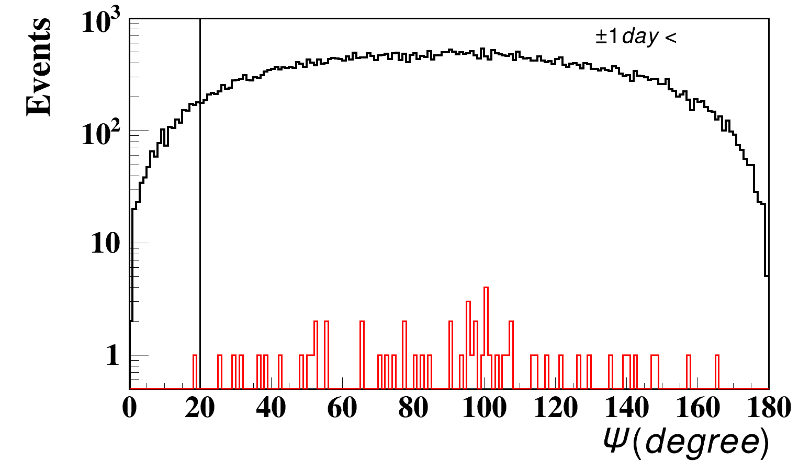
Search for neutrinos within ± 1 day time-window around IC170922A
Source direction at GVD site
zenith angle range 45° < θ <126°
Angular distance around the direction of the source
Events selection cuts
Cut | Events in ±1 day window
N_{hit} > 7 OM/3 Str. | 56822
χ²_{t} < 6 | 1717
η > 0 | 68
L _{a} < 30 | 58
ψ < 20° | 1 (ψ = 18°)
No neutrino events associated with IC170922A have
been recorded

Slide 14
Conclusion
Currently, neutrino telescope Baikal-GVD is under construction in Lake Baikal
Modular structure of GVD design allows a search for HE neutrinos at the
early phases of array construction
Data recorded by GVD in 2017 were used for search for neutrino events
associated with gravitational wave GW170817 and IC170922A event
Development of Baikal-GVD alert system for Multi Messenger studies
is in progress

