Slide 1


The Beam from Protvino
НАЦИОНАЛЬНЫЙ ИССЛЕДОВАТЕЛЬСКИЙ ЦЕНТР «КУРЧАТОВСКИЙ ИНСТИТУТ»
INSTITUTE FOR HIGH ENRGY PHYSICS, PROTVINO

Slide 2
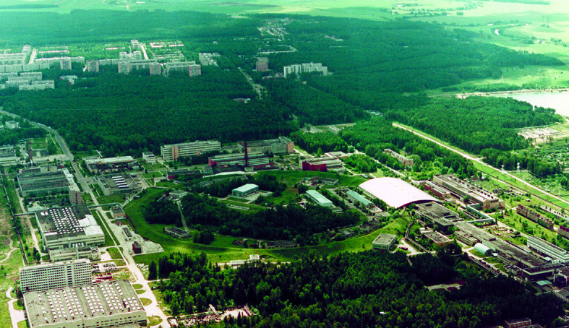
INSTITUTE for HIGH ENERGY PHYSICS
In 2017, Juergen Brunner drew our attention to the fact that the U-70 accelerator has the optimal energy and is located at the optimal distance from the ORCA facility to provide neutrino beam for experiments on mass hierarchy and CP-violation.
Here is a report on the preliminary results of the analysis of the feasibility of creating a neutrino beam for such an experiment.
V.Garkusha, S.Ivanov, R.Sinyukov, A.Sokolov, A.Zaitsev

Slide 3
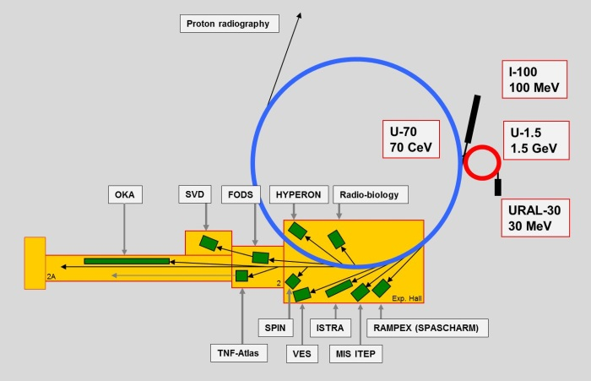
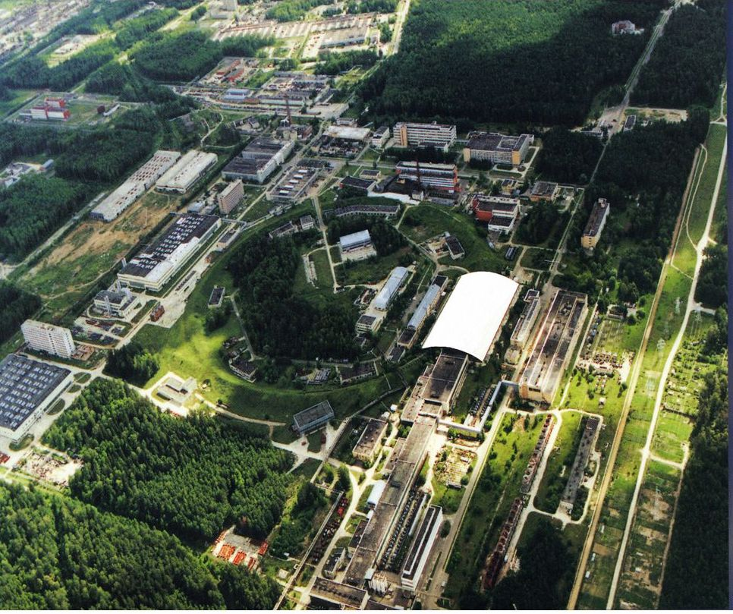
Accelerator complex U70
Eperimental Hall : 156 х 96 m²
Accelerator | Length, m | Energy
Linear accelerator Ural-30 | 25.3 | 30 MeV
Linear accelerator I-100 | 79.4 | 100 MeV
Synchrotron U-1.5 | 99.16 | 1.32 MeV
Synchrotron U-70 | 1483.7 | 50-70 GeV

Slide 4
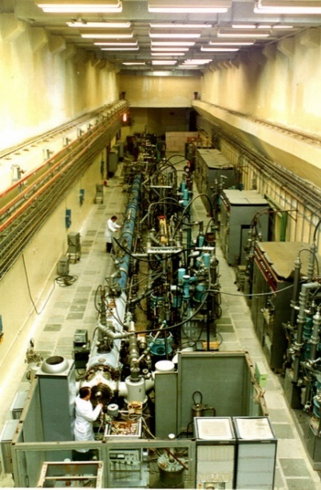
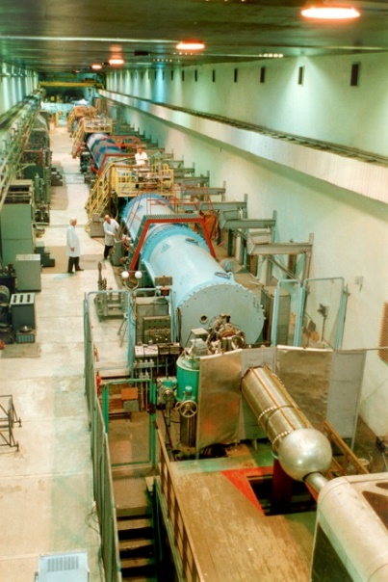
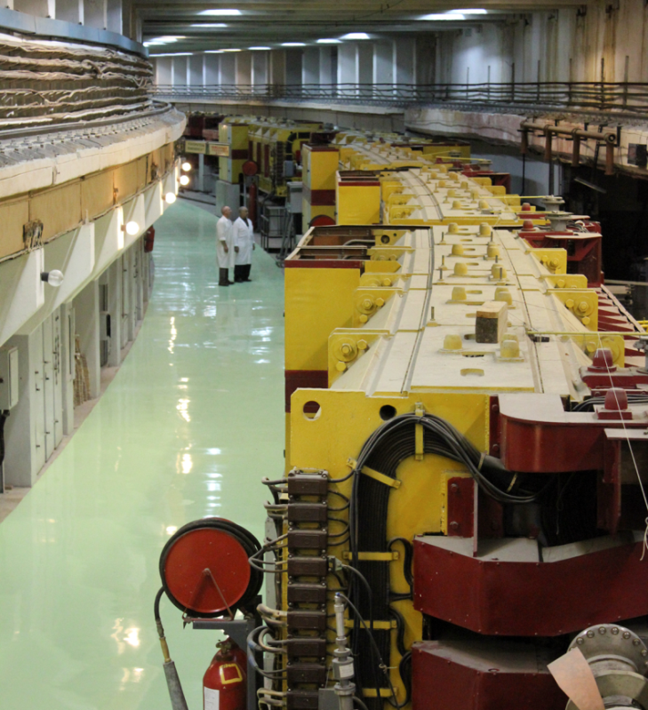
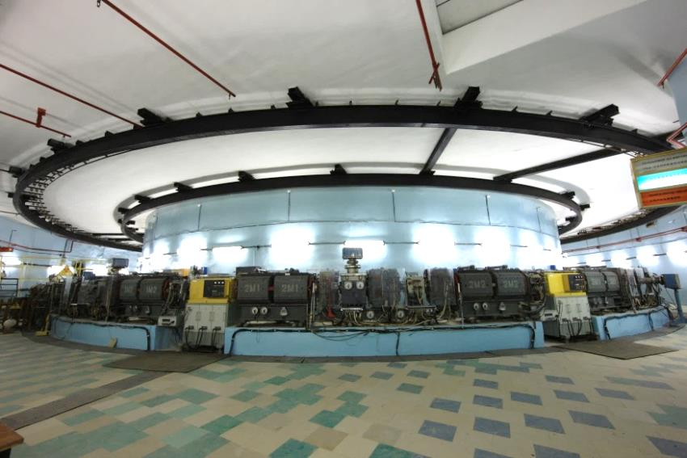
Accelerators
(RFQ)
Ural-30
(Alvarez)
I-100
Main synchrotron U-70
RC synchrotron (buster) U-1.5

Slide 5
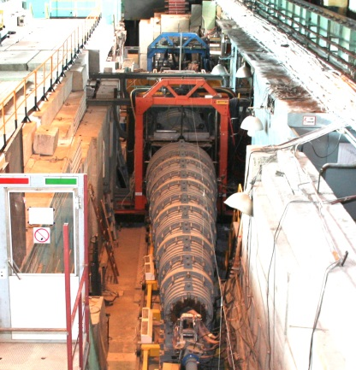
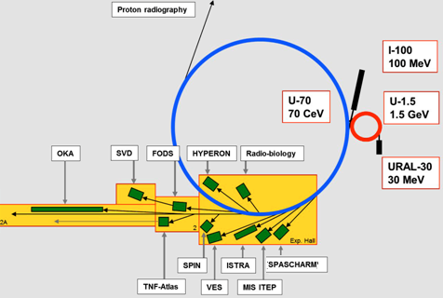
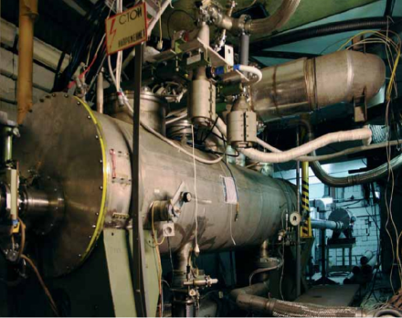
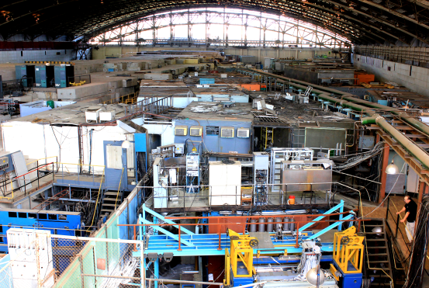
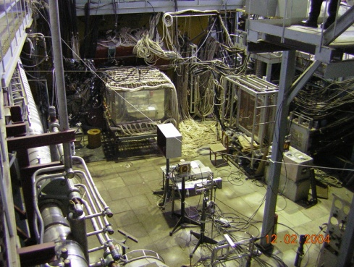
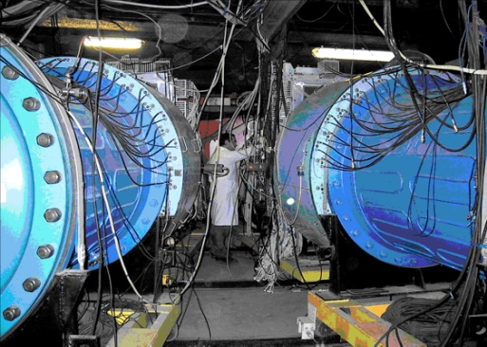
Layout of accelerators and research facilities
E=70 GeV, (50 GeV)
I=1.7·10¹³ppp(1.0·10¹³ppp)
Beams : π+-, K+-,p,p̄, e+-,¹²C
• Fast extraction
• Slow extraction
• Extraction by crystals
• Internal targets
Research directions:
hadron spectroscopy
rare kaon decays
spin asymmetries
baryon matter
nuclear physics
………
proton radiography
radiobiology
radiation hardness
beam optics with crystals
R&D on detectors
……….

Slide 6
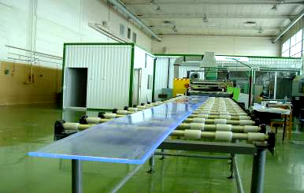
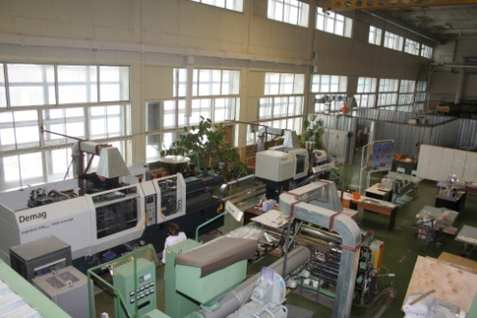
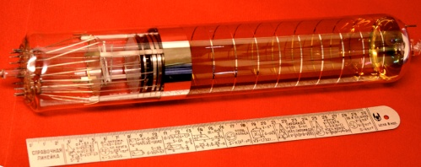
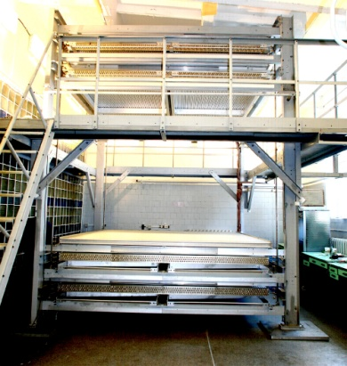
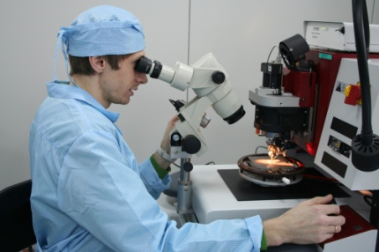
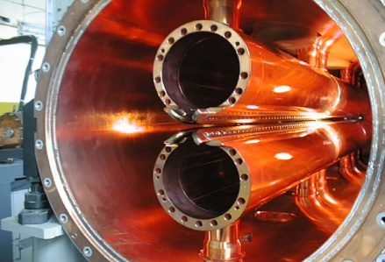
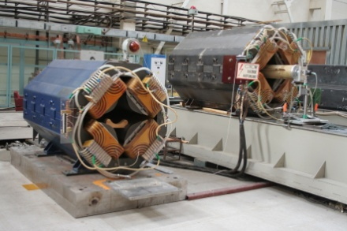
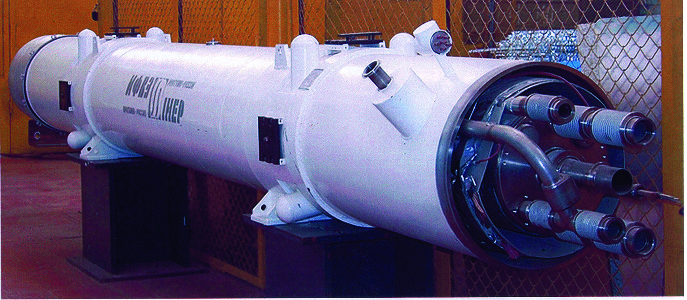
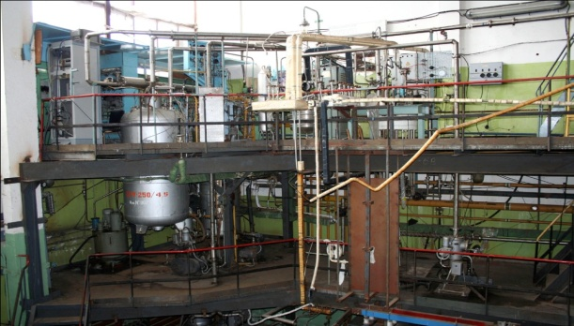
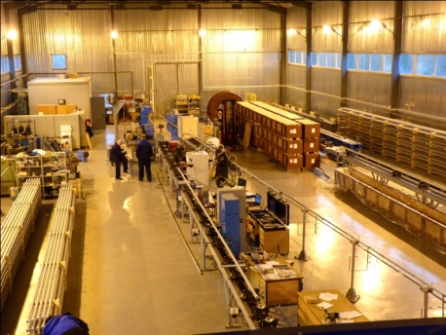
R@D
Scintillators
Photomultipliers
Muon tomography
GaAs detectors
RFQ development
Beam optics
Superconducting systems
…….

Slide 7
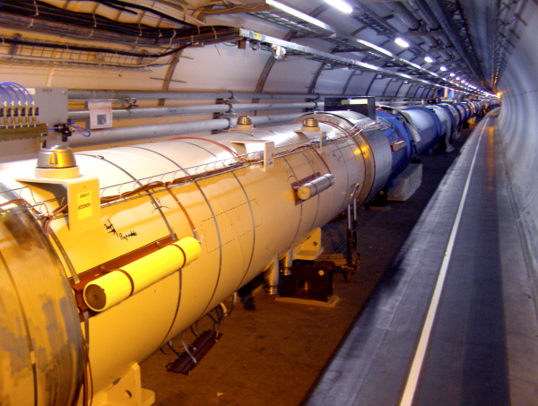
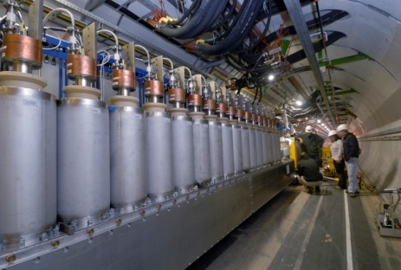
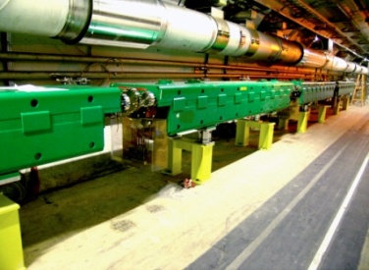
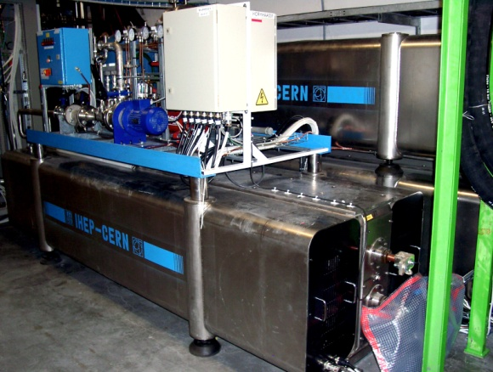
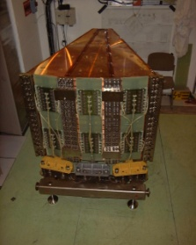
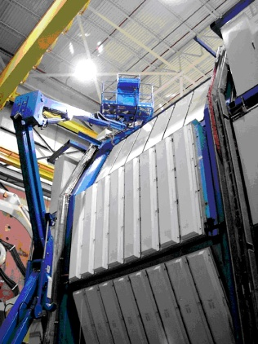
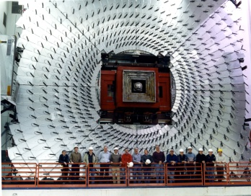
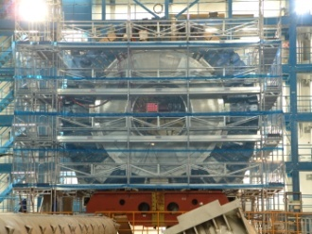
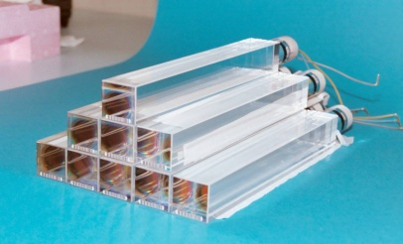
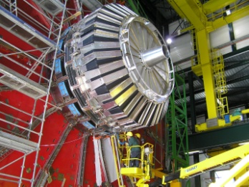
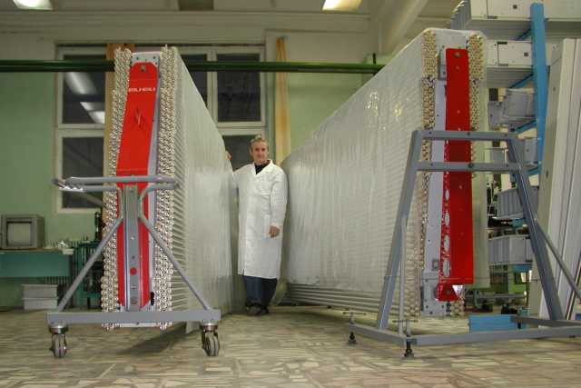
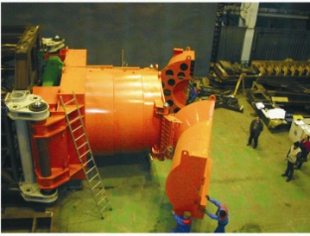
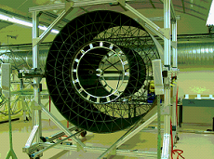
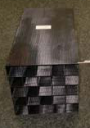
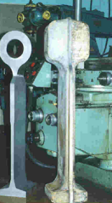
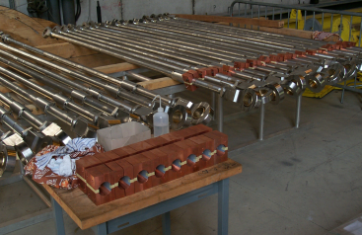
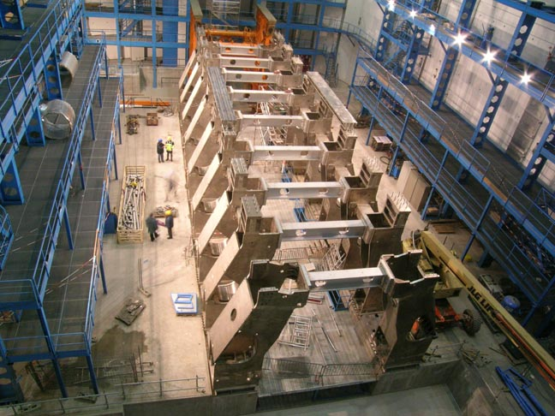
International collaborations
USA
  FNAL D0, MU2e
  BNL PHENIX, STAR
EUROPE
  DESI XFEL , HERMES
  FAIR PANDA
CERN
  LHC machine
  ATLAS
  CMS
  LHCb
  ALICE
  COMPASS
  DIRAC
  NA 62
  NA 64
JAPAN
  BELLE, BELLE II

Slide 8
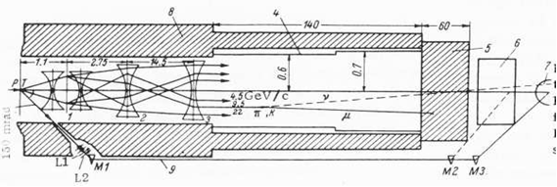
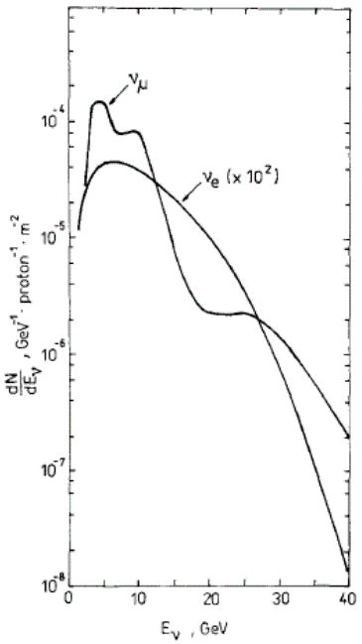
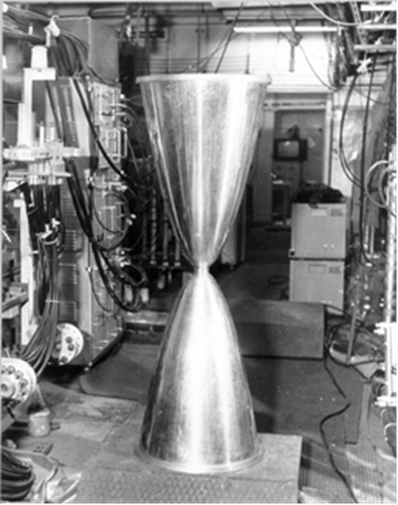
“Old” neutrino experiments
IHEP neutrino channel
p
Parameters of neutrino channel:
T - Target: Al, L=600 mm, Ø=10 mm,
1,2 - Focusing system: two Al X-lenses (Ø1= 16 cm, Ø2=50 cm),
4 - Decay channel: L=137 m, vacuum tube Ø=120 cm to Ø=140 cm,
5 - Forward shielding: iron, L=70 m,
Side shielding: from 1,0 to 1,5 m of iron and up to 1 m of concrete.
6 - Near detector can be located at the distance from the target L=220 m.
ν_{µ} , ν_{e} spectra
X-lens
L=143 cm, Ø=50 cm
< I_{p} > ~ (2-3) ⋅10¹² ppp
Ncc ν_{e} / Ncc ν_{μ} ~ 0.55 %

Slide 9
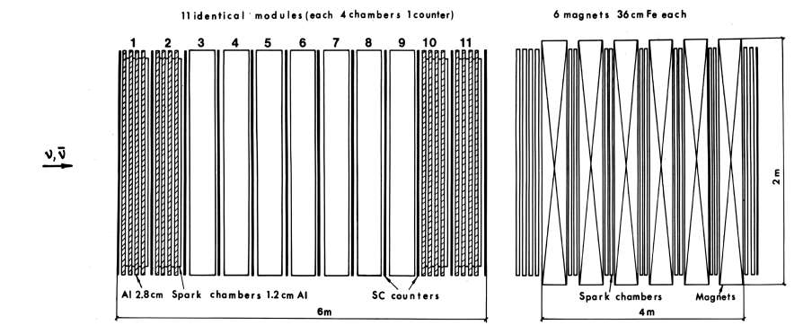

“Old” neutrino experiments
Spark chamber spectrometer ITEP
(1974 - 1989)
  ND outline
$$ν_{μ}\left({\overline{ν}}_{μ}\right)N$$
Main results - quasielastic and total cross sections measurement

Slide 10
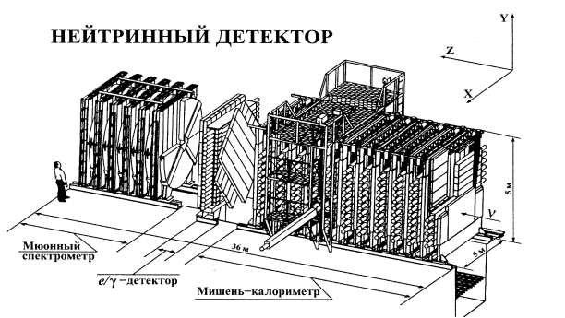
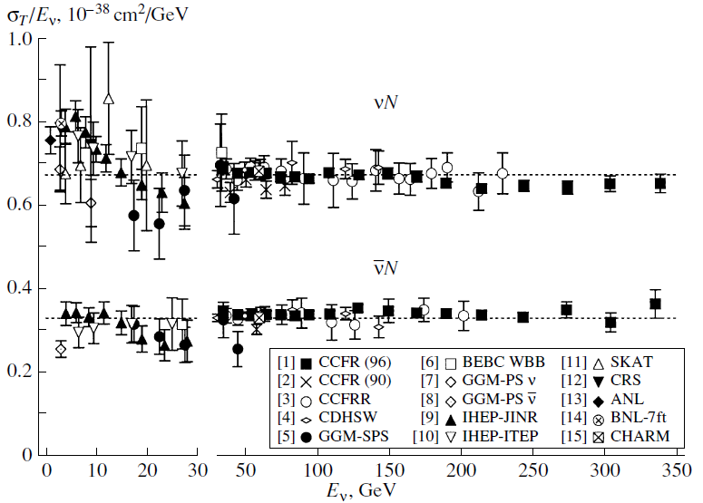
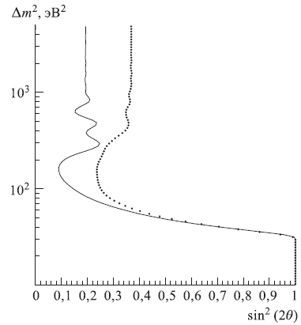
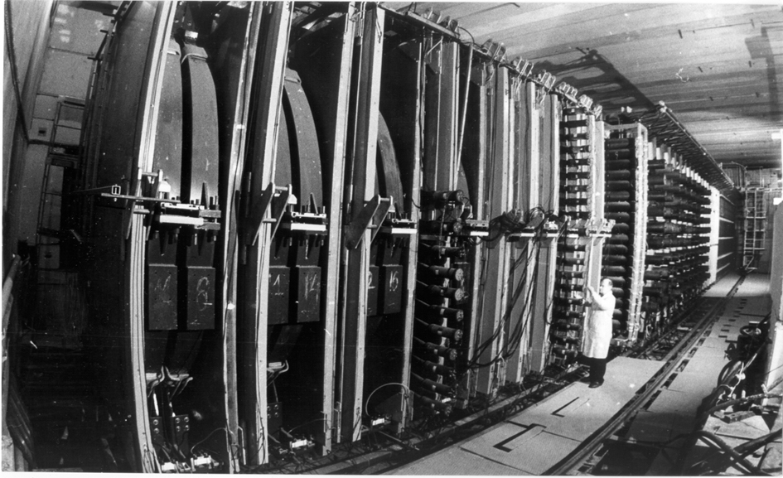

“Old” neutrino experiments
IHEP-JINR Neutrino Detector (1989 - 1995)
Anikeev V.B. et al., Z. Phys, C70, 39, 1996
$$ν_{μ}\left({\overline{ν}}_{μ}\right)N$$
total cross sections measurement
Батусов Ю.А. и др., Письма в ЭЧАЯ, т. 1, №4, 38, 2004
  ND outline
Барабаш Л.С. И др., ПТЭ, №3, 20, 2003
oscillation parameters limit

Slide 11
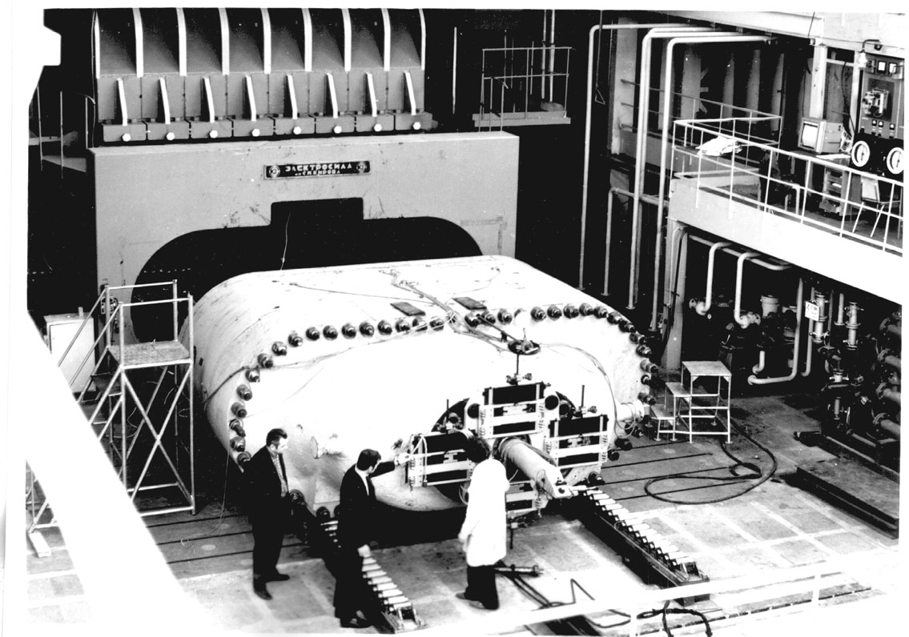
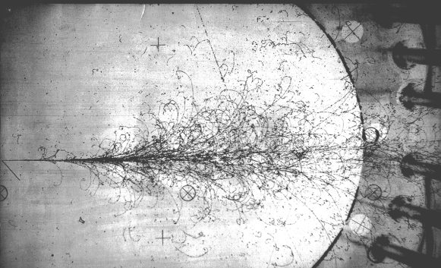



“Old” neutrino experiments
Bubble chamber SKAT (1975 - 1989)
CF₃Br (C₃H₈) V ~ 7 m³
Fid. V ~ 1.7 – 2.0 m³
< I_{p} > ~ (2-3) ⋅10¹² ppp
N_{ev} ~ 25 000
∫ I_{p} dt ≈ 1.0 ⋅10¹⁸ p
N_{ev} ~ 5 000
∫ I_{p} dt ≈ 0.9 ⋅10¹⁸ p
beam-dump
∫ I_{p} dt ≈ 1.0 ⋅10¹⁸ p
Main results:
• quasielastic and total cross sections measurement;
• measurement;
• ν_{μ} → ν_{e} oscillation study;
• observation of the baryon production in neutrino interactions.
$$ν_{μ}\left({\overline{ν}}_{μ}\right)N$$
$$R={σ_{NC}}/{σ_{CC}}$$
$$\left.Σ_{c}^{∗++}(2455\right)$$

Slide 12




LoI OMEGA
W (3.5 GeV)=1.1 MWt
W (69 GeV )= 0.45 MWt

Slide 13

OMEGA goals
Low energy
neutron spallation source
muon science;
isotope production;
studies with ultracold neutrons;
proton and neutron radiography;
studies of neutron-nuclei reactions byTOF;
Doppler spectroscopy of dynamic processes;
radiation material science;
studies of subcritical ADS.
High energy
Neutrino physics
Muon physics
Physics of charged and neutral kaons
Hyperon physics
New light objects
…..
Since the project OMEGA has not yet been approved, we are working to increase the beam intensity using the existing injection complex:
- injection H-
- shortening cycle

Slide 14



Magnet cycle
γ-transition
fast (1-turn) extraction,
flattop = 0 ca

Slide 15






From 1.3 to 69 GeV with U1.5
R = 1.2 Ohm L = 7 Henry
Trapezium
High voltage sustainability of coil insulation
Perturbation power supply mains

Slide 16





From 3.5 to 69 GeV with U3.5
Saw-tooth
Trapezium, s | 2.22 | 2.75 | 2.0 | 2.8 | 9.77
Saw-tooth, s | 0.2 | 2.4 | 0.2 | 2.4 | 5.2
Saw-tooth 1.3-69 GeV with U1.5 min cycle 7.3-7.4 s

Slide 17
List of tasks
Source of H-minus ions and charge-exchange-injection to U1.5
Longitudinal beam feedback, 3 MHz bandwidth (two transverse ones are upgraded)
Enhancing B-field correction, esp. the orbit one
Better handling of gamma-transition crossing
Smoothing of the vacuum chamber
Re-alignment of lattice, 120 of 200 t CF magnets, sub-mm accuracy
Deficit of free space along orbit -> freeing space in the straight sections
“Routine” tasks arising from the increase in beam intensity and run duration:
collimators (beam loss localization)
system redundancy
cooling
vacuum?
shielding?
Analysis of ways to further increase the intensity of the beam

Slide 18

Neutrino Beam Layout
U-70
Experimental
hall 1BV
Target hall
30m deep
Absorber hall
63 m deep
Near detector hall
90 m deep
Proton beam bend:
in horizontal plane – appr. 22⁰
in vertical plane – 11.8⁰

Slide 19

Elevation View of Neutrino Beam
Inclination angle – 11.8⁰ (206 mrad)
Target hall – 9×12×24 m (W×H×L)
Absorber hall – 6×12×12 m (W×H×L)
Near Detector hall – 9×12×36 m (W×H×L)

Slide 20


Two-Horn Focusing System
Primary proton beam energy: 70 GeV
Horn currents: 220 kA
Target: 1 m long, 5 mm diameter graphite rod
Decay pipe: 180 m long, 2 m diameter

Slide 21


Neutrino Flux at the Far Detector Location
for 4×10²⁰ Protons on Target

Slide 22
1MT Far Detector CC Event Rates
for 4×10²⁰ Protons on Target
 | Positive polarity beam |  | Negative polarity beam
 | E < 10 GeV | E < 20 GeV | E < 10 GeV | E < 20 GeV
ν_{μ} | 1.99×10⁴ | 2.11×10⁴ | 5.04×10² | 7.47×10²
anti-ν_{μ} | 1.16×10² | 1.53×10² | 4.88×10³ | 5.06×10³
ν_{e} | 8.67×10¹ | 1.44×10² | 9.53×10⁰ | 1.98×10¹
anti-ν_{e} | 3.01×10⁰ | 5.74×10⁰ | 2.03×10¹ | 2.89×10¹
(ν_{e}+anti-ν_{e}) / (ν_{μ}+anti-ν_{μ}), % | 0.45 | 0.70 | 0.55 | 0.84

Slide 23
Conclusion
The neutrino beam from the U-70 accelerator (with increased intensity) towards ORCA has a good potential for study neutrino oscillations at a new level
At this stage of the analysis, no stopping factors of a technical nature were identified to increase the power of the U-70 beam to 75 kW
The construction of a new injection complex (OMEGA) will create unique opportunities for neutrino experiments
A long base neutrino experiments at hand
“a high-intensity beam of sufficiently high energy to
a very large volume deep-water detector”
deserves further detailed study

