Slide 1
EMSO
European Multidiciplinary Seafloor and water column Observatories
Dominique Lefevre
VLNT 20148
October 2018 – Dubna-Russia

Slide 2
European Multidisciplinary Seafloor
and Water Column Observatory
European Research Infrastructure Consortium
EMSO ERIC is an intergovernmental organisation,
with autonomous legal status, the participation of European countries and is headquartered in Rome (Italy).
EMSO ERIC aims to promote excellent science through the coordination of a distributed infrastructure of deep sea observatories serving marine science researchers, marine technology engineers, policy makers, industry and the public.
EMSO ERIC was constitued on September 29, 2016
(EU Official Journal L268/59 October 1st,2016)
VLNT Oct 2018- Dubna -DL

Slide 3
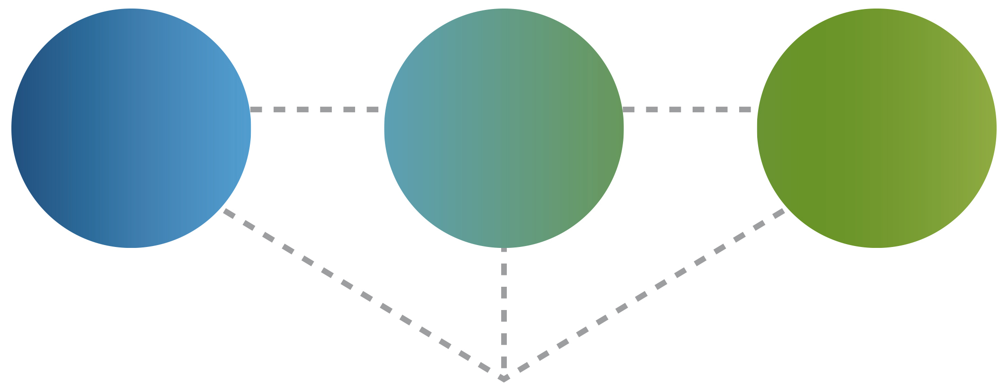
WHY
OBSERVE
THE DEEP
SEA?
Oceans play a crucial role in human wellbeing
- Degradation and loss of biodiversity impacts marine resource exploitation
- Ocean circulation affects climate change
- Natural hazards such as tsunamis from earthquakes and volcanic eruptions impacts human life
EMSO ERIC MISSION
Support investigations in:
Marine Ecosystems
Climate Change
Geo-hazard
TO ACHIEVE
sustainable management and protection of marine resources
TO UNDERSTAND
the complex interactions among the geosphere, biosphere and hydrosphere
VLNT Oct 2018- Dubna -DL
Notes:
Oceans impact crucially the human wellness in numerous way: from the role in modulating the climate to how it provides a variety of socio-economical, cultural and environmental benefits.
The mission of the EMSO ERIC Research Infrastructure is to progress in understanding the processes ongoing in the ocean and affecting globally the life and socio-economic fabric.
EMSO ERIC supports the investigations in the following themes:
Marine Ecosystems (i.e., ocean acidification, biodiversity and habitat, and water quality)
Climate Change (i.e., sea level, temperature)
Geo-hazard (i.e., generation process of earthquakes, tsunamis, landslides).
EMSO ERIC stimulates and supports the development of advances technologies for the in-situ ocean monitoring, pursuing the need to achieve sustainable management and protection of marine resources/environment.

Slide 4
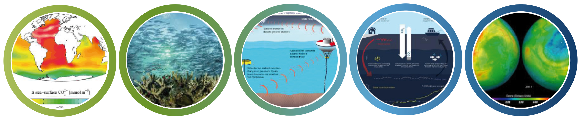
RESEARCH
INFRASTRUCTURE
CHALLENGES
To fulfil European societal scientific demands targeted
in the EU’s H2020 Blue Growth Strategy
Global ocean warming and acidification
Impact and sustainability
of Marine Resources exploitation
Real-time observations and early warning systems for earthquakes & tsunamis
Marine
Ecosystems
and Climate Change mitigation
Earth interactions hydrosphere, biosphere, lithosphere, atmosphere
ACCESS HIGH QUALITY MARINE ENVIRONMENTAL DATA
VLNT Oct 2018- Dubna -DL
Notes:
Sistemare testo freccia vedere maiuscolo/minuscolo

Slide 5
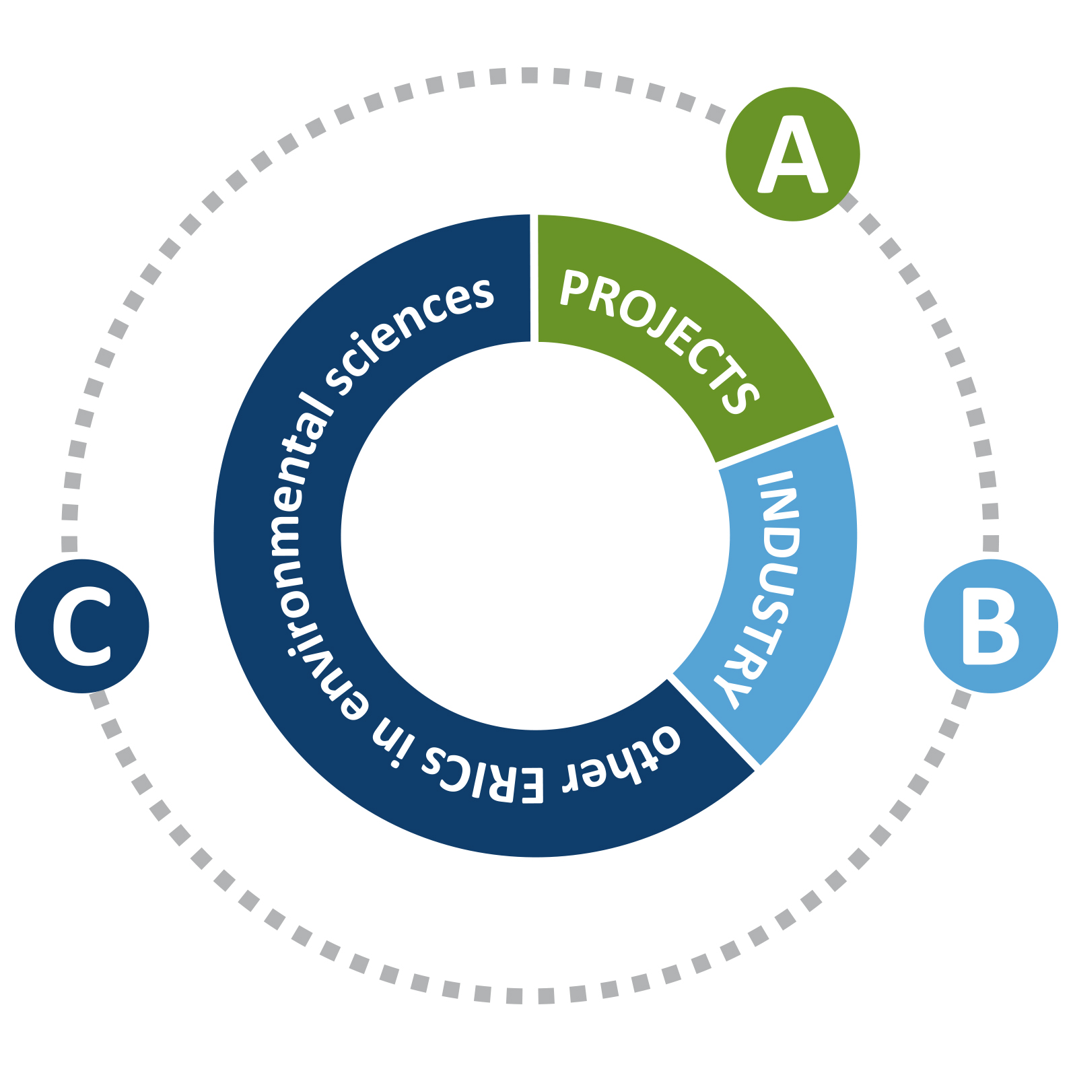
LINKS
WITH
PROJECTS such as EMSODEV, COOP+,AtralntOS, NeXOS and JERICONEXT to exchange information
and develop synergies on common issues (common forum for marine technology; metrology for marine sensors;
carbon flux and climate change).
INDUSTRY to improve/develop the technology behind EMSO ERIC and
to proffer the possibilities offered
by the network. (use of EMSO ERIC nodes as test beds for industrial equipment, methods or services)
INFRASTRUCTURES such as ERICs in environmental sciences (e.g., ICOS,
EURO-ARGO, EPOS) and other international infrastructures (e.g., OOI, ONC, IMOS) to reach a global monitoring
for marine environment.
and Km3NeT
VLNT Oct 2018- Dubna -DL
Notes:
EMSO ERIC is already joining efforts with counterpart research infrastructures around the world through the establishment of collaborations and formal links in order to face the global environmental challenges, such as the Ocean Observatories Initiative - OOI (USA), the Ocean Networks Canada - ONC (CANADA), the Integrated Marine Observing System - IMOS(Australia). Moreover the complementarities between EMSO ERIC and other environmental research infrastructures (e.g., EuroArgo, ICOS, EPOS) can extend the coverage and increase the density of the observation sites as well as the elaboration of innovative data products.
These international framework will leverage the added value generated by the collaboration by favouring the exchange of knowledge and best practices, the alignment of the strategy of the different countries and the development and promotion of the science global dimension.
EMSO’s ambition is to be part of the upcoming European Ocean Observing Systems (EOOS). This is a coordinated framework designed to align and integrate Europe’s ocean observing capacity; promote a systematic and collaborative approach to collecting information on the state and variability of our seas; and underpin sustainable management of the marine environment and its resources.

Slide 6

SHARING
EMSO
ACHIEVEMENTS
WITH
To make world-class science with multi-inter-disciplinary approaches supported by the infrastructure. To offer HQ data products and opportunities for collaboration.
scientific
community
Policy
makers
SOCIETY
Wider
public
To make aware on the need of increasing
the synoptic/aggregated information on marine health and for an efficient exploitation of sea resources through long-term observations.
To make aware also of the importance of the international cooperation in this domain
guaranteeing a support to make decisions
for a sustainable Blue Growth.
To increase the awareness of the marine domain on Earth good health and global processes (such as Climate Change).
To attract the youngest generation to a scientific
carrier for their future. To highlight the importance of European Union funds to finance the marine research in order to help a sustainable future.
VLNT Oct 2018- Dubna -DL

Slide 7
EMSO ERIC
OFFERS
Long-term time-series of multidisciplinary, synchronized,
high resolution, near-real-time marine data
Power, communications, sensors and shallow water facilities
for testing new devices through interactive ocean observations
Access to observatory-nodes for developing new experiments
VLNT Oct 2018- Dubna -DL

Slide 8
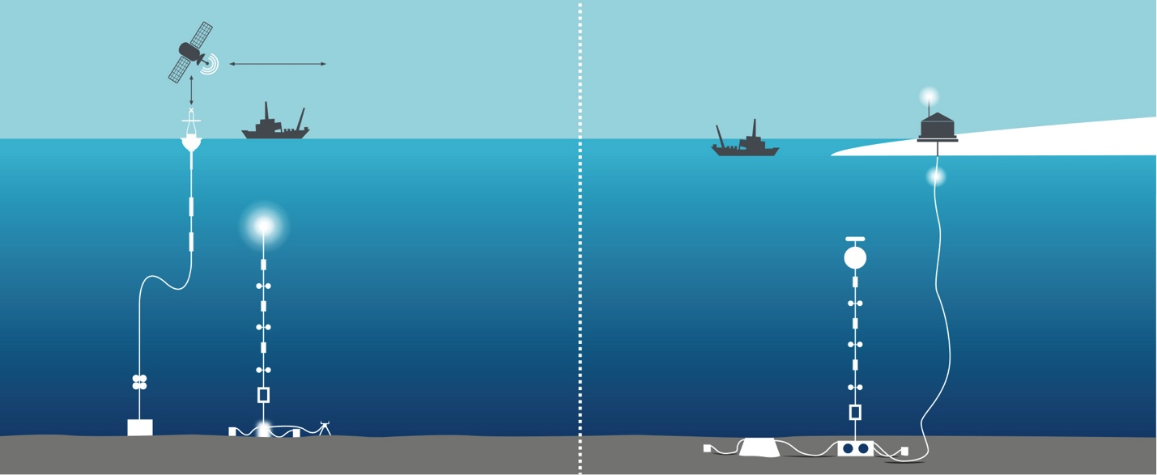
EMSO ERIC
INFRASTRUCTURES
STAND ALONE
CABLED
CABLED FACILITIES
STAND ALONE FACILITIES
To reach a standard configuration: each observatory shall be equipped with the EMSO Generic Instrument Module (EGIM) incorporating a suite of sensors to measure seven Essential Ocean Variables
VLNT Oct 2018- Dubna -DL
Notes:
EMSO ERIC integrates the existing fixed-point open ocean observatories whitin key sites around Europe, called EMSO regional nodes. These facilities provide long-term, high-resolution, near-real-time deep ocean time-series to sustain the observation of environmental processes at the Benthic Boundary Layer and along the water column including their mutual interactions.
EMSO regional nodes are high technology automated fixed platforms, powered by submarine cables or by onboard power-supply devices. They are equipped with a standardised suite of sensors assembled into an EMSO Generic Instrument Module (EGIM), and with additional ‘site-specific’ sensors.
EMSO Generic Instrument Module (EGIM) incorporates a suite of sensors to measure seven Ocean Essential Variables such as Temperature, Conductivity, Pressure, Dissolved Oxygen, Turbidity, Ocean currents and Passive acoustics with a unique time reference. This will allow the easy comparison across the nodes and will boost a multidisciplinary approach in understanding possible reciprocal relationships among processes.

Slide 9
RESEARCH
CONSORTIUM
COUNTRY | REPRESENTING ENTITY
FRANCE | Ifremer L’Institut Français de Recherche pour l’Exploitation de la Mer CNRS Centre National de la Recherche Scientifique
GREECE | HCMR Hellenic Centre for Marine Research
IRELAND | MI Marine Institute
ITALY Host Country | INGV Istituto Nazionale di Geofisica e Vulcanologia
PORTUGAL | FCT Fundação para a Ciência e a Tecnologia
ROMANIA | GeoEcoMar National Research and Development Institute for Marine Geology and Geoecology
SPAIN | PLOCAN Plataforma Oceánica de Canarias
UK | NOC National Oceanography Centre
VLNT Oct 2018- Dubna -DL

Slide 10
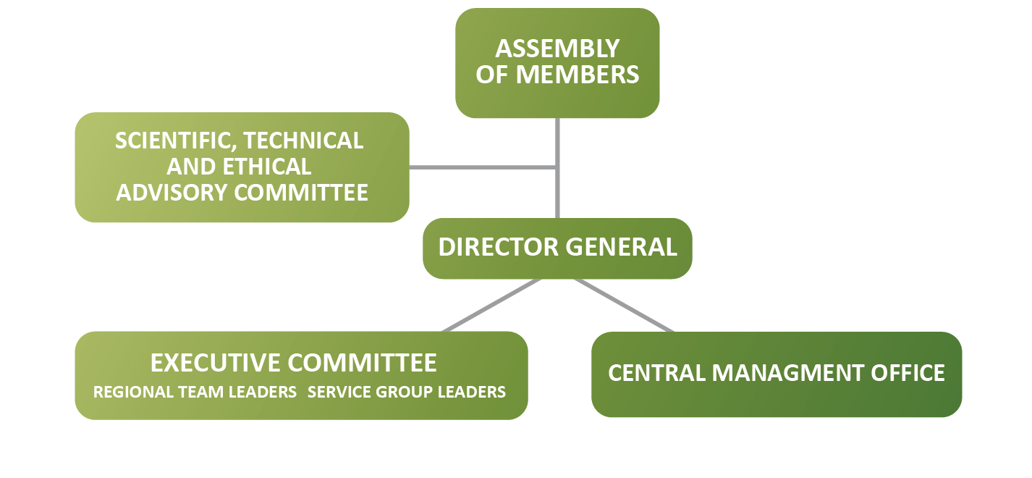
EMSO ERIC
GOVERNANCE
STRUCTURE
VLNT Oct 2018- Dubna -DL

Slide 11

Deep Sea EMSO cabled Sites
Western Ionian Sea
&
Western Ligurian Sea
The EMSO-Link project has received funding from the European Union’s Horizon 2020 research and innovation programme under grant agreements N° 731036.

Slide 12
Western Ionian Sea
Regional team
  Regional Team Leader’s name: Davide Embriaco
  Service Group members:
  Science SG: Nadia Lo Bue
  Eng & Log SG: Giuditta Marinaro
  Comm SG: Alessandra Giuntini
  Data SG: tbd
  Other responsible persons in regional team:
  People from the Italian Joint Research Unit
  agreement with CNR and INFN for managing operational activities on the node

Slide 13
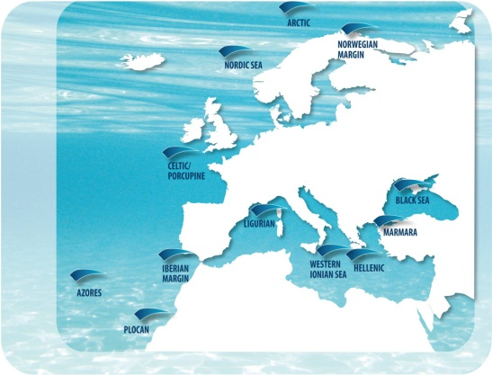
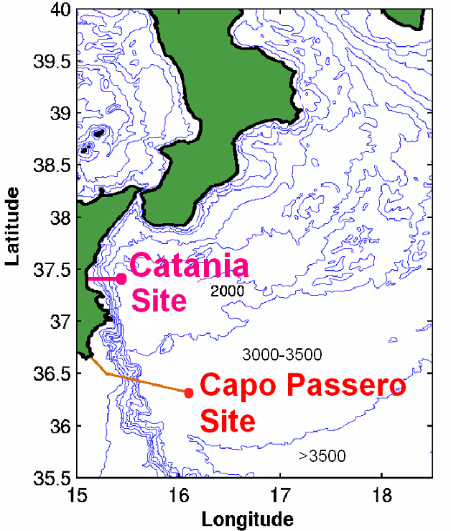
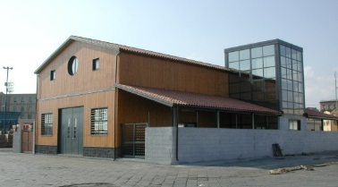
Outline - Description of the infrastructure
The Western Ionian node
primarly consists in two sites
North-eastern
Sicily (2100m bsl)
South-eastern
Sicily (3500m bsl)
LNS Test Site Lab
at Catania harbour
MOORING
JB
EGIM
5 km
NEMO-SN1
20 km
5 km
CREEP
OνDE2
UNDER CONSTRUCTION

Slide 14
Outline - Description of the infrastructure
CATANIA site
MEASURED PARAMETERS:
Physical oceanography (T, S, P, Turbidity, currents, dissolved oxygen, fluorescence, pCO₂)
Geohazard and Geophysics (Seismometer, Magnetometer, Pressure, Hydrophone, Gravimeter)
Bioacustic (Hydrophones array)
DATA TRASMISSION: real-time through electro-optical cable since 2005
AVAILABILITY OF ADDITIONAL SENSORS: one Junction Box with three plugs free for additional multiparmeter platforms
MAINTENANCE FREQUENCY: refurbishment of the NEMO-SN1 observatory has been performed on 2004 and between 2008-2012 supported with national and EU funds

Slide 15
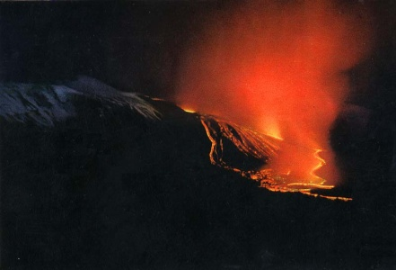
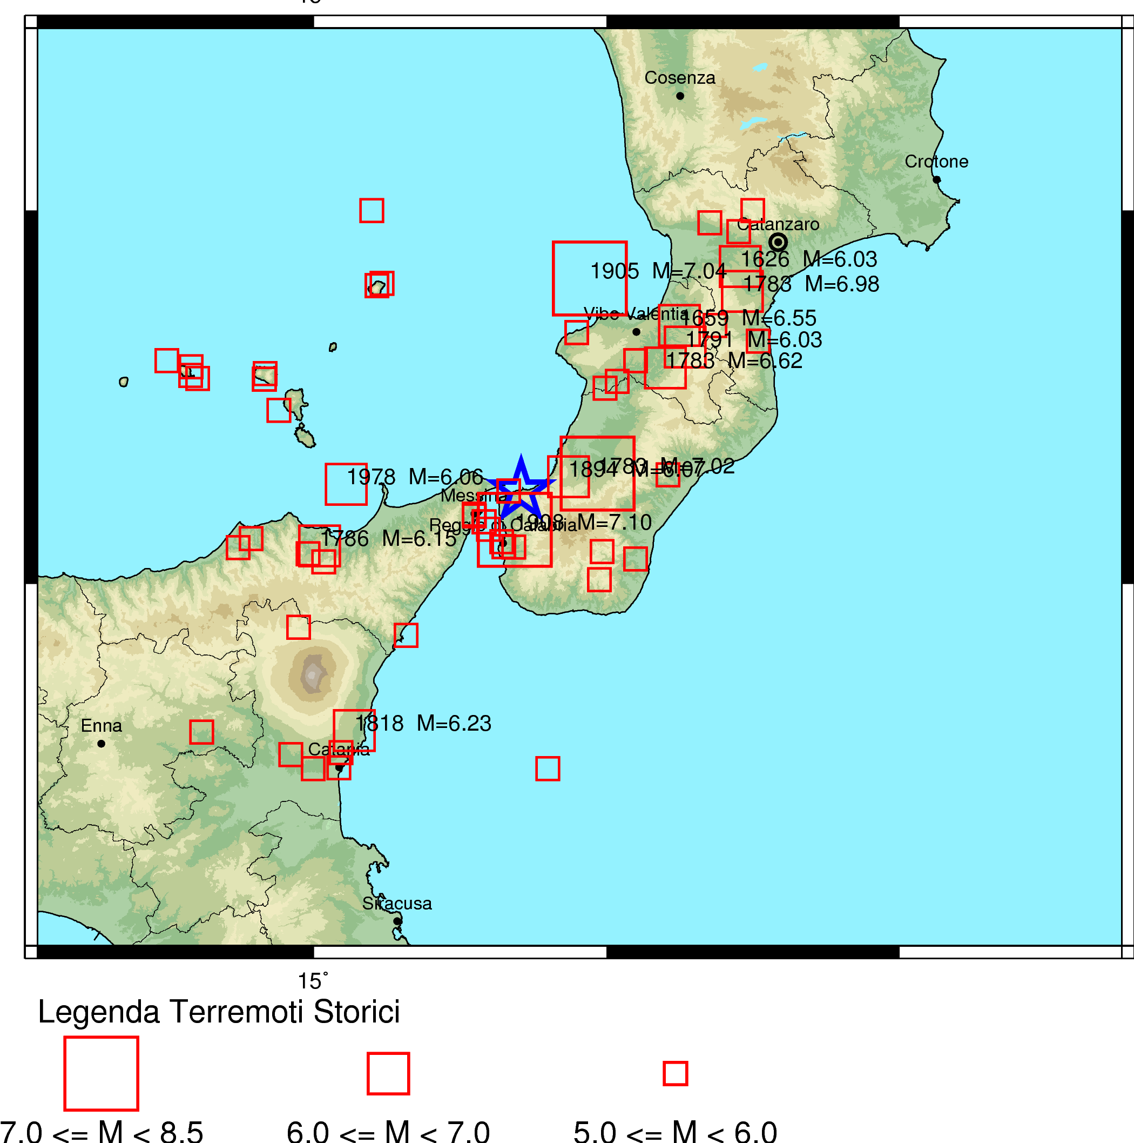
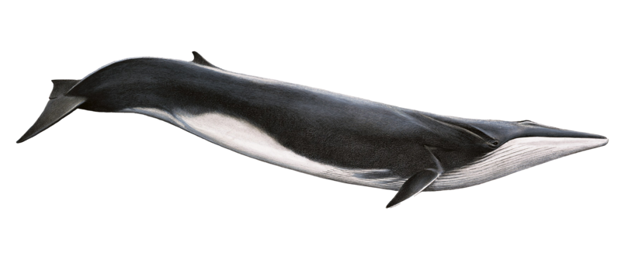
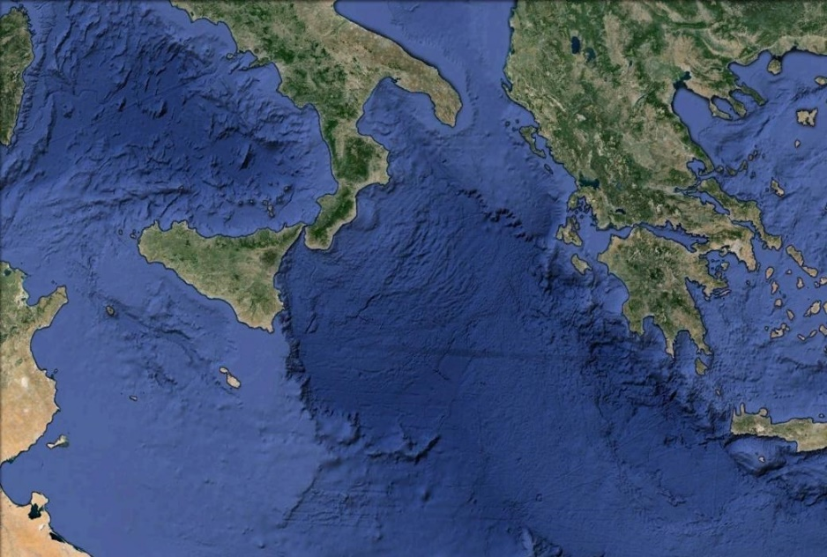
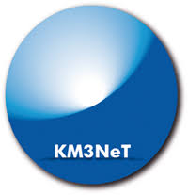

EMSO ERIC node - Western Ionian
Science objectives
Geo-hazard (Tsunami,
Seismic and Volcanic monitoring)
Oceanographic monitoring ( seafloor and water column)
Environmental monitoring (acoustic noise)
Bioacoustics marine mammals tracking
ETNA Volcano
Seismicity
Fundamental physics (solar neutrinos detection)
link with KM3Net consortium
Water circulation

Slide 16
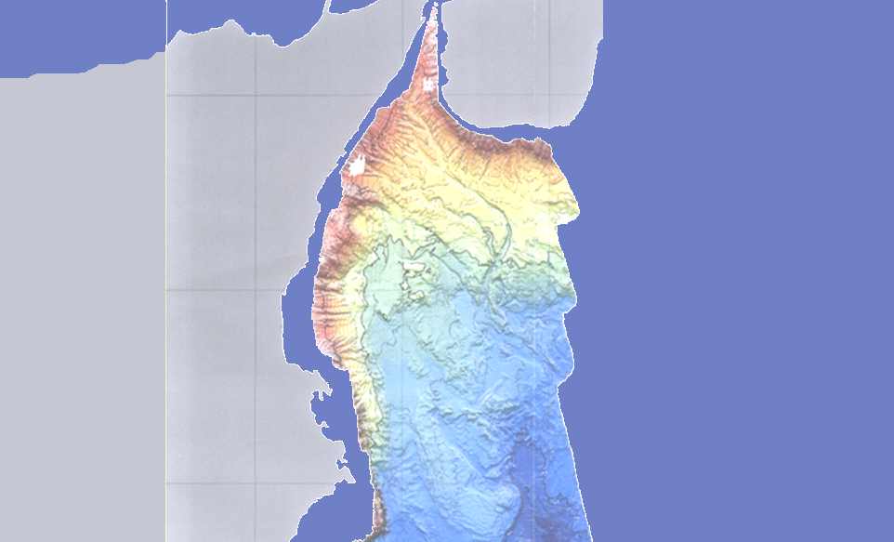
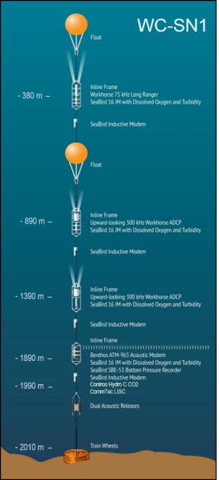
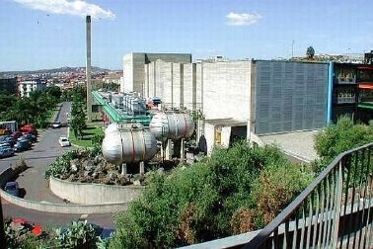
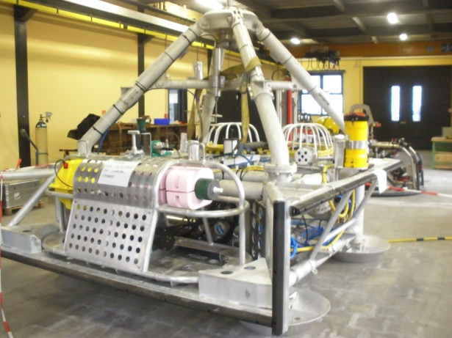

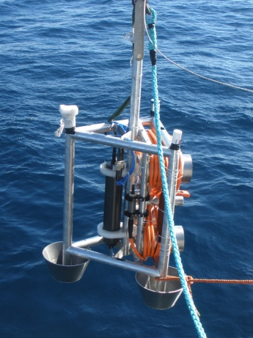
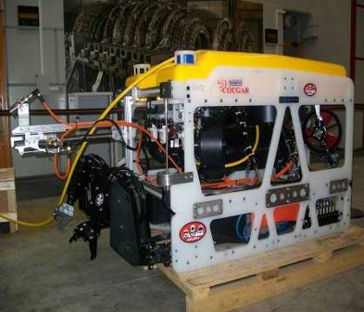
EMSO ERIC node – Western Ionian
Catania:
Shore lab
connected to internet
Submarine electro-optical cable with JBs
SN1
Onde2
Water column
INFN LNS Catania
1 Gbps fibre link
5 km
NEMO-SN1
2100 m bsl
Geo-hazards
(earthquakes, tsunamis, volcanic activity)
Bio-acoustics
(mammal tracking)
Oceanography
(e.g., deep & column water circulation, current intensity and direction, temperature, salinity)
20 km
5 km
LNS Test Site Lab
at Catania harbour
Stand-alone 2002-2003
Cabled (real-time data): 2005-2008 & 2012-2013
2018 (re-deployment during EMSODev project)
OνDE2
4000-m ROV

Slide 17
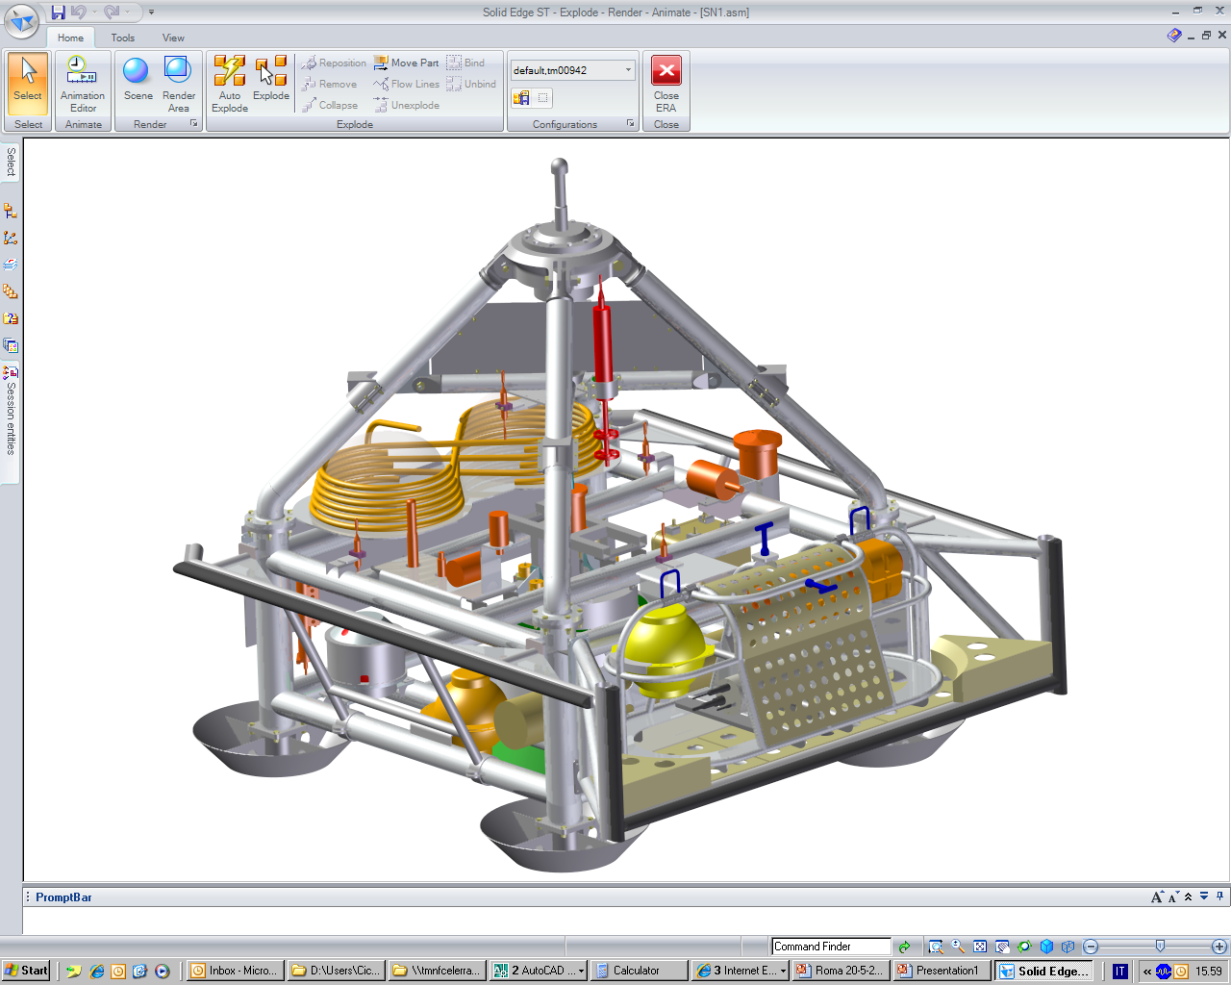
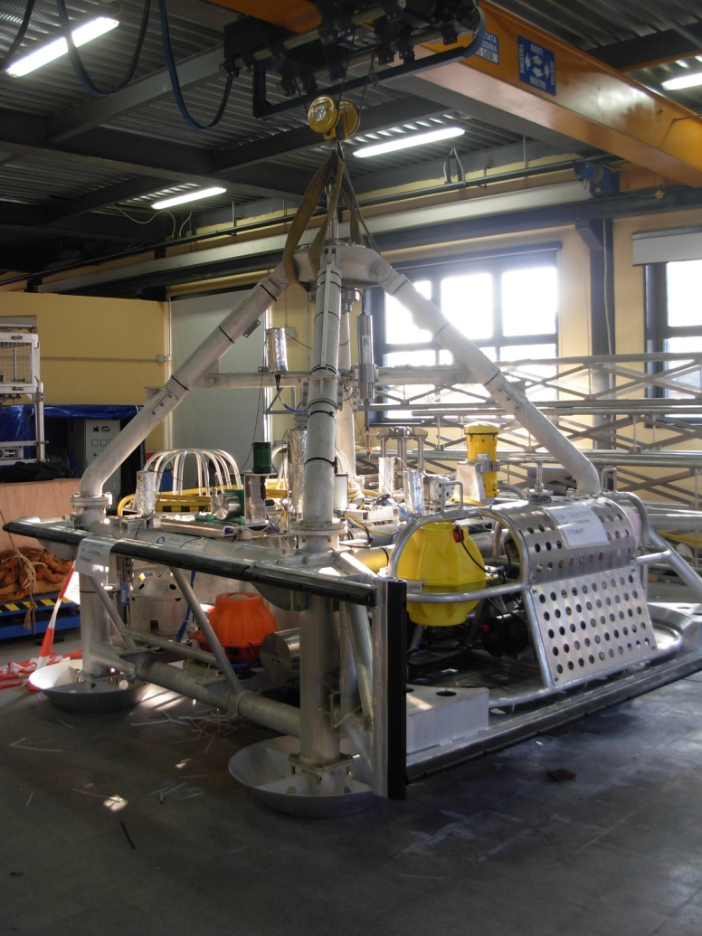


EMSO ERIC node – Western Ionian
NEMO-SN1
Bioacoustic hydrophone (1/4)
3-C current meter
ADCP
OAS hydrophone
Broad-band seismometer
APG
CTD
Gravity meter
Bioacoustic bentosphere
S &V magnetometers module
SMID hydrophone

Slide 18
EMSO ERIC node – Western Ionian
NEMO SN1 - Sensors
Sensor | Rate | Model
3-C broad-band seismometer * | 100 Hz | Guralp CMG-1T (0.0027-50 Hz)
Differential Pressure Gauge (DPG) | 100 Hz | Prototype Univ. California-St. Diego
Hydrophone (Geophysics) | 2000 Hz | SMID (0.05-1000 Hz)
4+4 Hydrophones (Bio-acoustics) | 96/192 KHz ** | SMID (100-70000 Hz)
Absolute Pressure Gauge (APG) * | 15 s | Paroscientific 8CB4000-I
3-C Accelerometer + 3-C Gyro (IMU) * | 100 Hz | Gladiator Technologies Landmark 10
Gravity meter | 1 Hz | Prototype IFSI-INAF
Scalar magnetometer | 1s/min | Marine Magnetics Sentinel (3000 m)
Vectorial magnetometer | 1 Hz | Prototype INGV
ADCP | 1 profile/h | RDI Workhorse Monitor (600 kHz)
CTD | 1 s/h | SeaBird SBE-37SM-24835
3-C single point current meter | 2 Hz | Nobska MAVS-3
GPS off shore
GPS off shore
GPS off shore
GPS off shore
* tsunami early warning system - Geo-Hazard
Chierici et al. (2012) ISOPE
Favali, et al. (2013), J. Oceanic Eng. http://dx.doi.org/10.1109/JOE.2012.2224536
Giovanetti, et al. (2016) Remote Sens. 2016, 8(4), 298; doi:10.3390/rs8040298
** 96 kHz at 4 NEMO-SN1 hydrophones,
192 kHz at 4 OνDE2 hydrophones
(both in tetrahedral shape) - Marine Environment

Slide 19
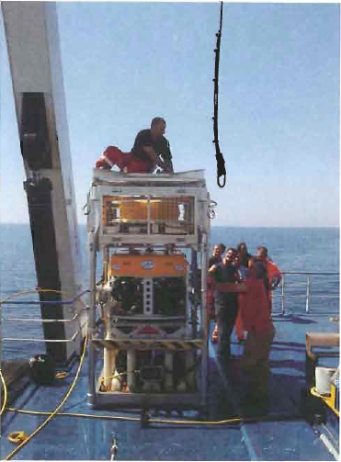
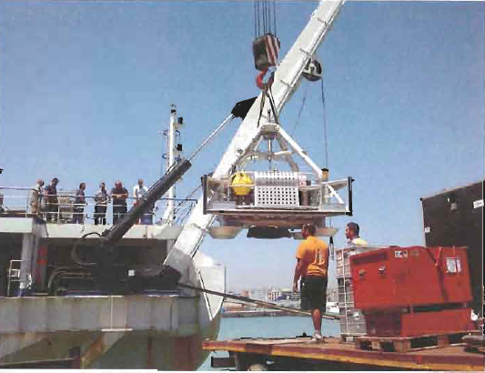
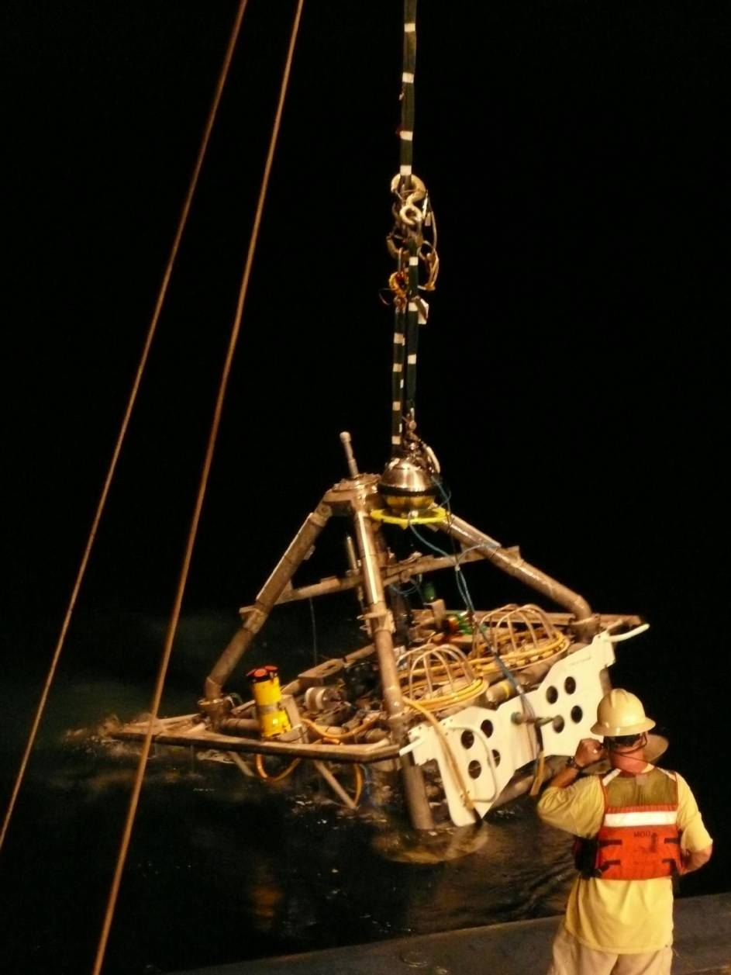
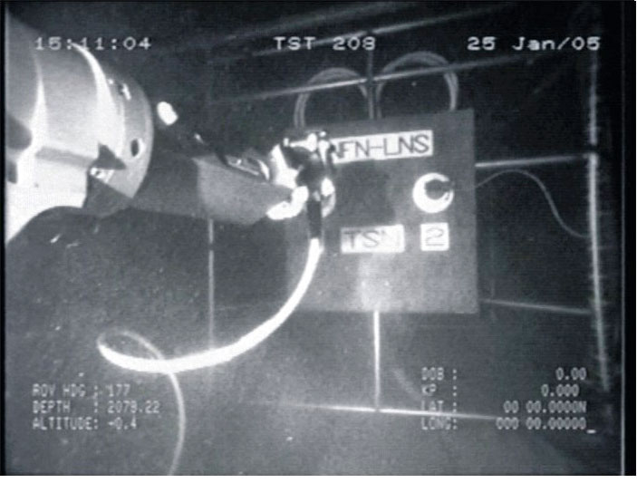
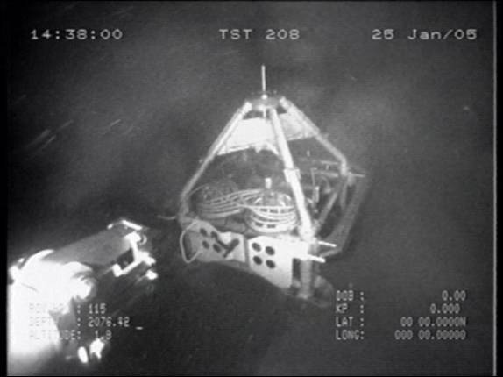
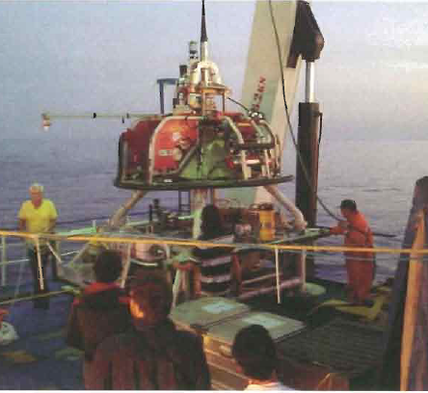
SN1 on Cable layer vessel Certamen (2012)
NEMO-SN1 operations
  2002 Stand alone observatory
  2005 Real-time data transmission
  2008 Recovery for refurbishment
  2012 Cabled and real time data
  2013 Recovery
  2018 Scheduled new deployment
ROV
ROV
NEMO-SN1 recovery July 2013
(2012)
NEMO-SN1
Underwater operations (2005)
@ 2100 m bsl

Slide 20
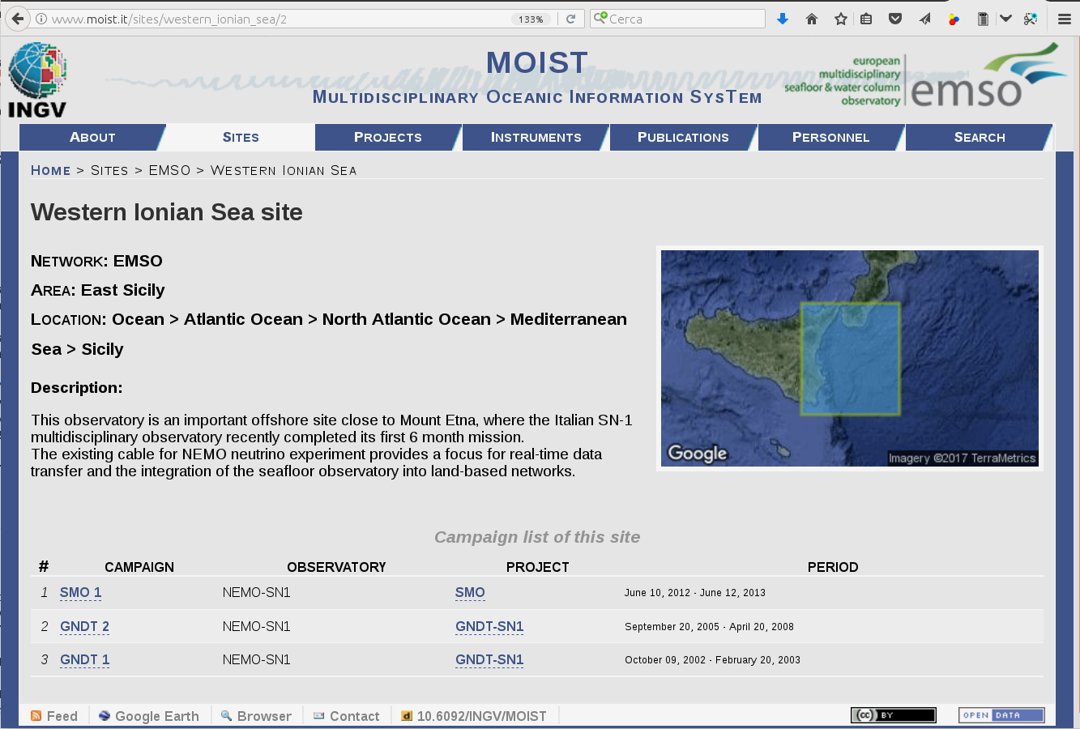
EMSO ERIC node – Western Ionian
Data managment
http://www.moist.it:
Data storage
Data web dissemination

Slide 21
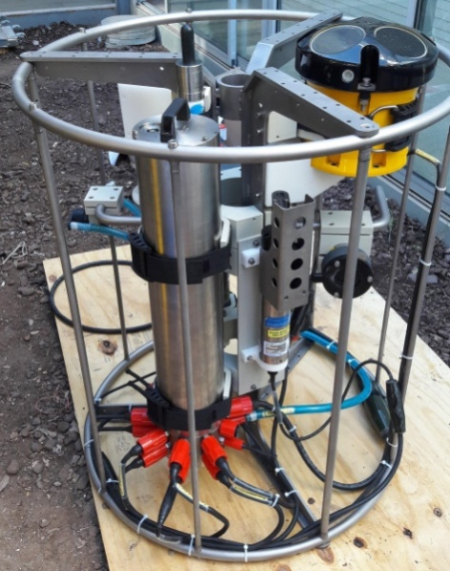
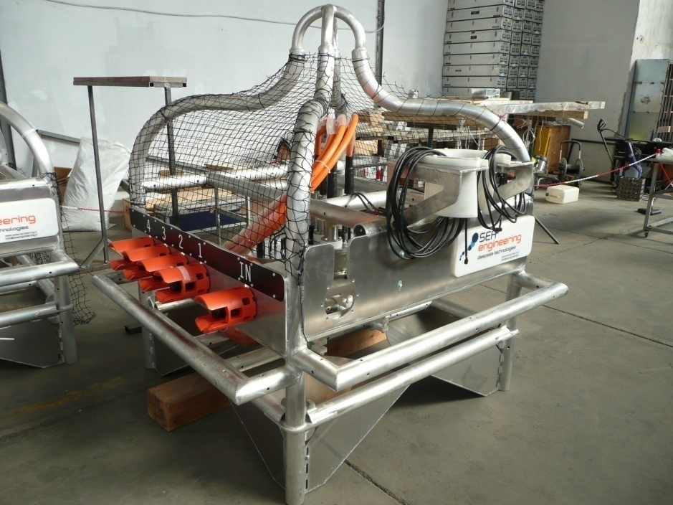
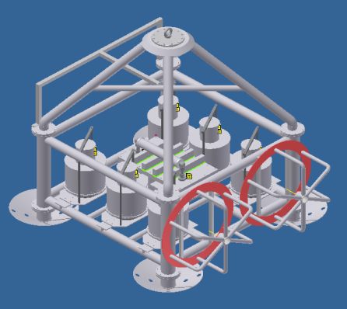
EMSO ERIC node – Western Ionian
On going scheduled operations 2018
Deployment of NEMO SN1,
Deployment of New Junction Box (JB) for TSN
Deployment of EGIM module & connection to JB
Deployment of CREEP2 experiment
EGIM
New INGV JB at Catania shore Lab
CREEP2
NEMO-SN1 reconfigured at Catania shore lab

Slide 22

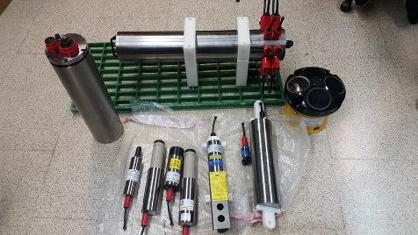
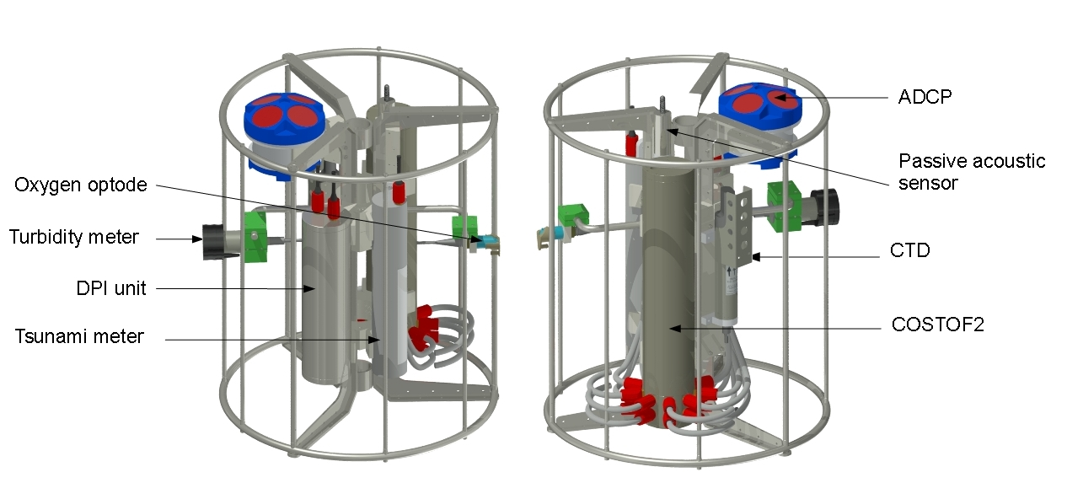
EMSO ERIC node – Western Ionian
EGIM - EMSO Generic Instrument Module
Parametres | Sensors
Temperature, Conductivity, Pressure | SEABIRD SBE37-SIP
Pressure | SEABIRD SBE 54 Tsunami
Dissolved O₂, temperature | AADI-3005214831 DW4831
Turbidity | Wetlabs NTUrdt
Ocean currents, Compass and tilt meter | Teledyne Workhorse monitor ADCP 300 KHz
Passive acoustics, Compass and tilt meter | OceanSonics icListen SB60L-ETH
EGIM installation at Western Ionian (Catania)
Dedicated electronic/vessel to interface COSTOF2 (ETH+serial)/ LAN on opctical cable
Dedicated frame to host EGIM and to allow deployment & recovery operation @ 2100 m

Slide 23
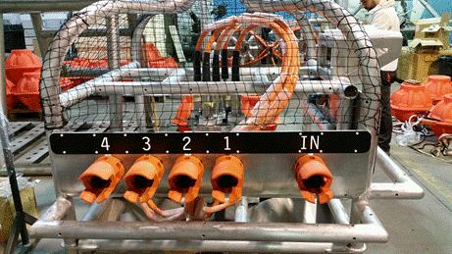
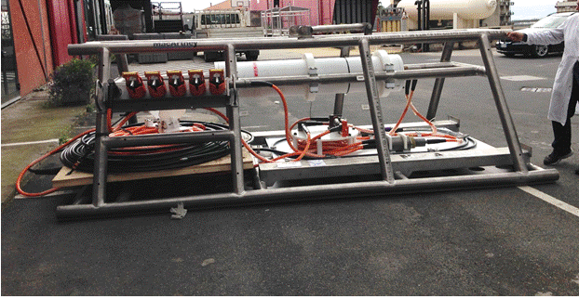

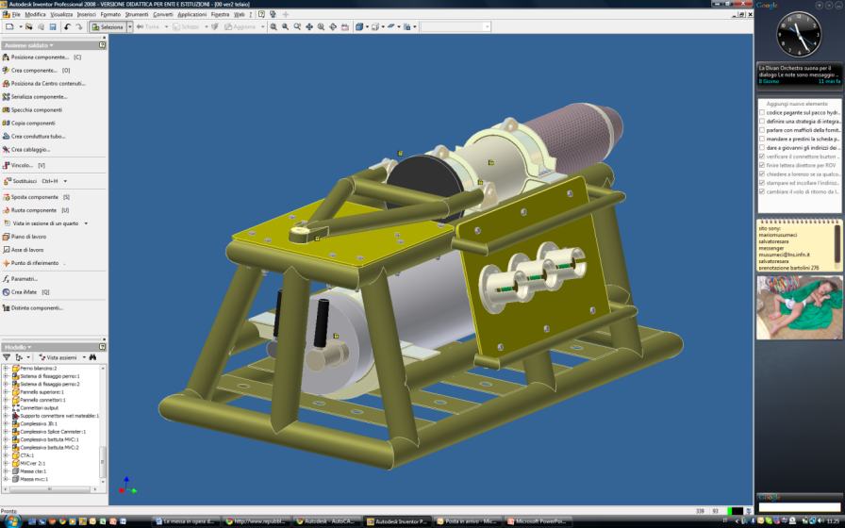
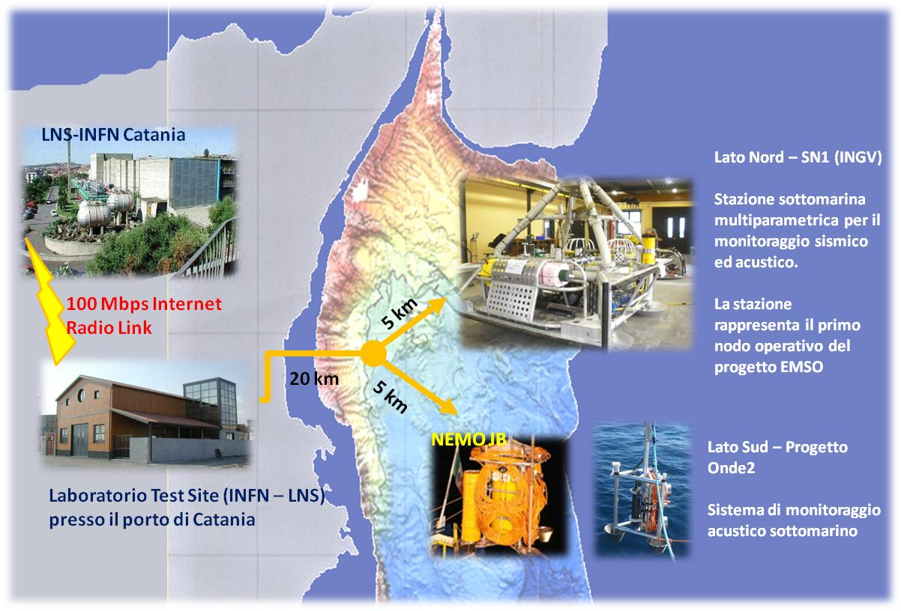



EMSO ERIC node – Western Ionian
Upgrade scheduled/on-going at Capo Passero
Junction box
(with multiprobe connections)
Seafloor multidisciplinary observatory
Cable termination
South-eastern Sicily (3500m bsl, 80km from coast) (Capo Passero site)

Slide 24
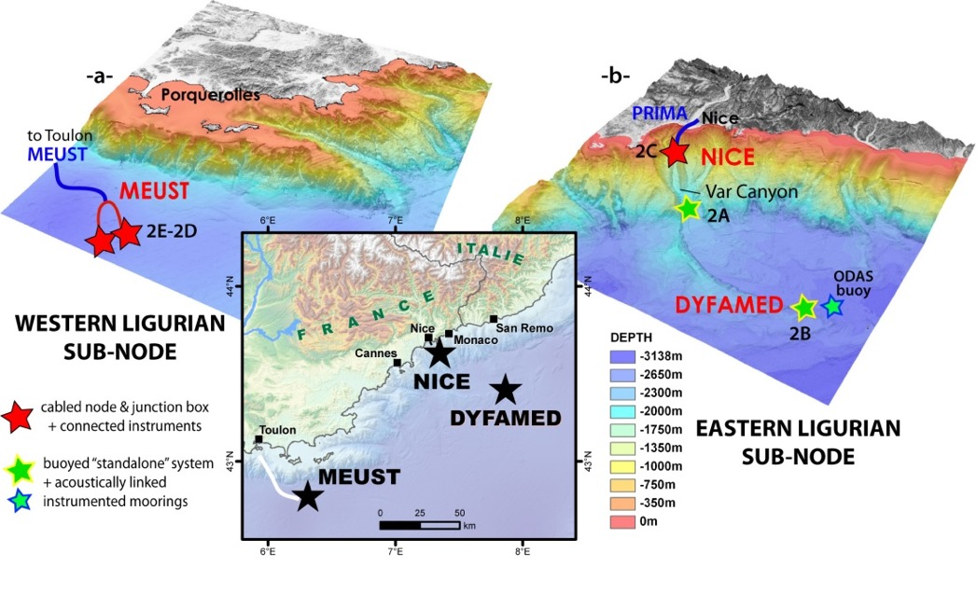
Ligurian Nodes
NICE Site : Cabled site on the slope (airport) + Var canyon
DYFAMED Site : Long term mooring + ODAS Buoy (SNO MOOSE)
ANTARES (Western Ligure) Site : Cabled site + ALBATROSS (Long term mooring)

Slide 25
Ligurian Regional team
  Regional Team Leader’s name:
    Laurent Coppola
  Service Group members:
    Dominique Lefevre (Science SG)
    Thierry Carval (Data SG)
    Carl Gojak (Eng & Log SG)
    Déborah Chavrit (Com SG)
  - Other responsible persons in regional team
    D. Rivet (CNRS-Geoazur), Y. Aoustin (Ifremer), P. Charvis (CNRS-Geoazur), X.Bompais (IFREMER), Y.Hello (IRD-Geoazur), C.Gojak (DT-INSU), Sebastien Garziglia (Ifremer)

Slide 26
Nodes presentation
LIGURE : ANTARES (ligure Ouest)
  - Responsible persons in regional team
    Dominique Lefevre
    Carl Gojak
    Christian Tamburini
    Bruno Zakardjian
    Laure Chirurgien
    Marc Garel
    Nagib Bhairy
    Maurice Libes

Slide 27



InfrastRucture
Including whole description of infrastructure, what part of the ocean is measured (seafloor, water column, surface waters), measured parameters, is data transmitted?, are there free slots to plug additional sensors? How is the node maintained (yearly? Is maintenance funding secured?)
ANTARES Site
Western Ligurian Sea
A multidisciplinary a deep water column observatory
Infrastructure KM3Net :
Cabled – Deep water Nodes, Neutrino telescope
Infrastructure EMSO-INSU:
Instrumented node, mooring line
Monthly cruise : SNO MOOSE (TETHYS II)
Annual refit of mooring line ALBATROSS, IR EMSO
Collaboration: CPPM, M.I.O., IFREMER, DT-INSU

Slide 28
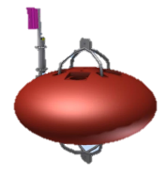
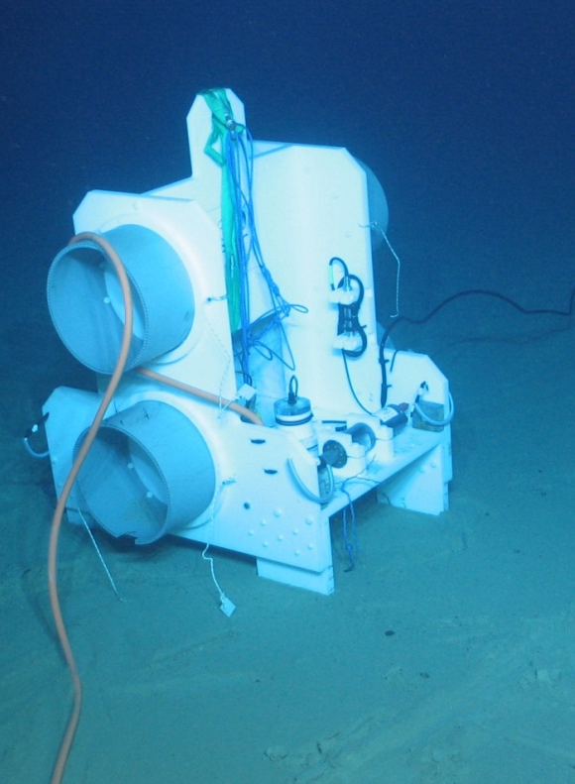
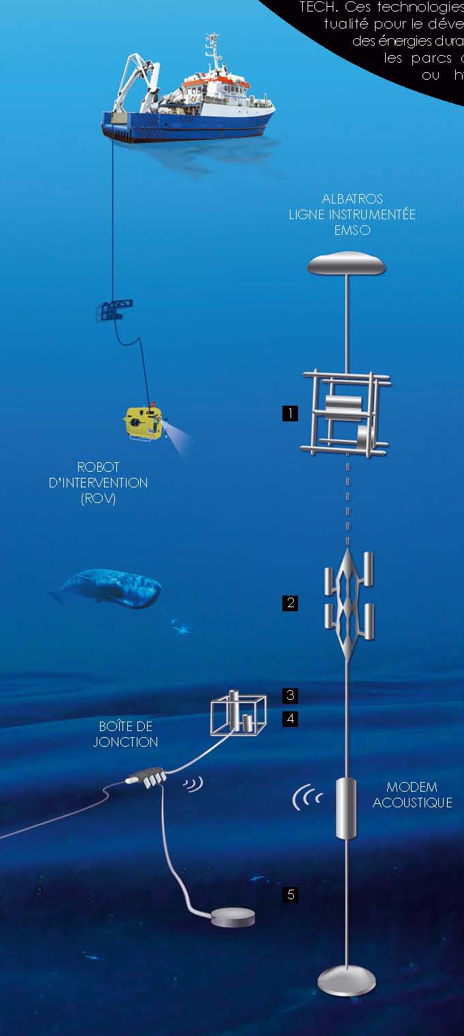
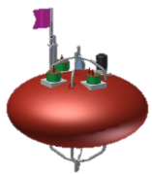
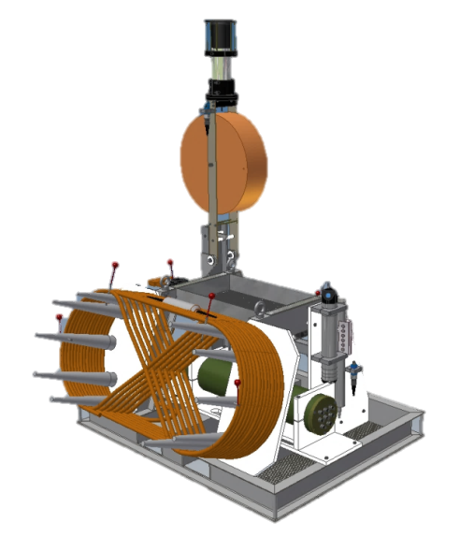
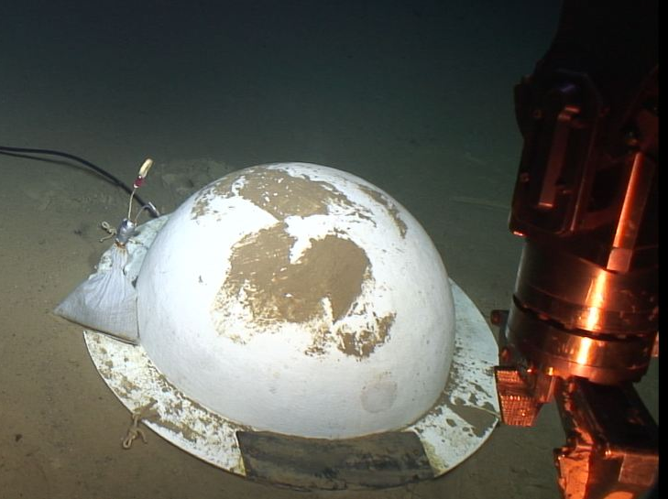

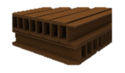
InfrastRucture
Deep Sea observatory for ESS Description
Mooring line communication through inductive communication
Communication between Line and MII via an acoustic link
Seismometer MODULE
Cabled Instrumented Interface Module (MII)
Autonomous Mooring Line ALBATROSS

Slide 29
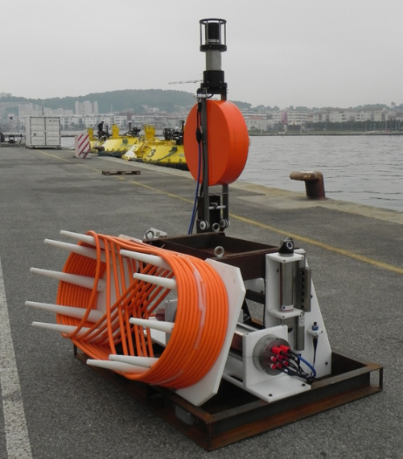
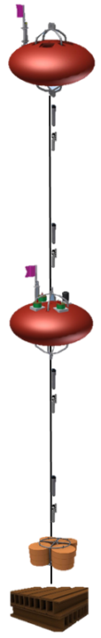
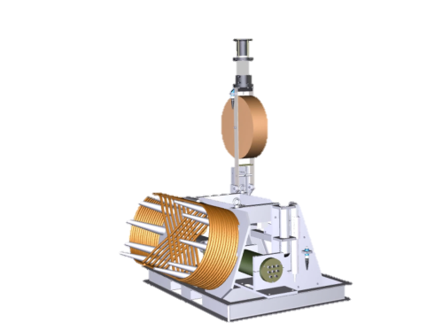


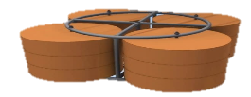

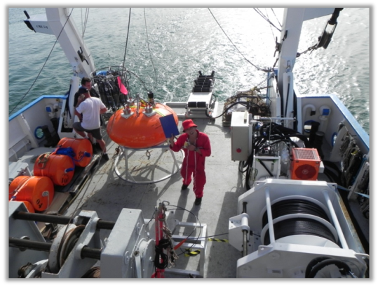








Sea Sciences
Instrumented sea sciences module Autonomous instrumentation line with inductive and acoustic communication
) ) ) ) ) ) ) ) )
To node
Sea sciences module MII to be connected on the node
Instrumented module
Instrumented line
Current meter
Buoy
Inductifve modem
Buoy
Acoustic releases
Inductive coupler
CTD
Inductive cable
ALBATROSS line deployed in May 2018
Dead weight
200 m
500 m
900 m
1000 m
1500 m
1950 m

Slide 30
Scientific services rendered by the existing infrastructure ?
Please indicate the general goals (scientific or other) of the deployed instruments.
Hydrological and Biogeochemical properties of water masses (heat content O2 and pH trends)
Fluxes of organic matter throughout the water column, Carbon budget.
Marine Biodiversity and Deep marine ecosystem

Slide 31









Northern Western méditerranean Sea
Western ligurtian Sea
Northern current & convection sites
MEDOC/Ligure
Courtoisie I. Taupier-Lepage
Niewiadomska et al., 2008. Limnol. Oceanogr.

Slide 32

Present-day science services - details
Please indicate to what specific question (scientific or other) is dedicated each of the measured parameters, what parameter(s) are presently missing to fully achieve the objective, and whether there are plans for improvements of the infrastructure.

Slide 33






Instrumentation & other means...
ALBATROSS mooring :
5 currentmeter doppler
10 CTD microcat
+ ADCP NORTEK
Oct. 2016 – May. 2017
0-500m ...
Surface Current
HF Radar
X

Slide 34

Instrumentation & other means...
ALBATROSS Mooring:
5 currentmeter doppler
10 CTD microcat
+ ADCP NORTEK
Oct. 2016 – May. 2017
0-500m ...
High resolution modelling
X

Slide 35


NORTEK & Aquadop ALBATROSS mooring
E-W speed N-S Speed
All NORTEK bins
1st bin NORTEK ~ 402 dBar
ID0101~ 480 m
ID0601~ 1386 m
ID0901 ~ 1735 m
ID1201 ~ 2141 m
ID1401 ~ 2346 m

Slide 36


Déconvolution des composantes barotrope et barocline ...
Exemple du 29 novembre 2016
→ la composante barotrope ~ 15 cm/s WSW
→ composante barocline WSW ~ 50 cm/s

Slide 37

ALBATROSS 2016-2017
Oxygen trend (8 levels) Uncorrected data
»Deep » water formation @ 500 m ?
2370 m
2160 m
1960 m
1500 m
1400 m
1100 m
1000 m
484 m

Slide 38
1500 m
1750 m
Current meter doppler (ADCP)
Speed and current direction
Echo intensity is a proxy of particles
Particles dynamics may supply over 50% of the observed O2 consumption.
Current velocity (m s-1)
Suspended matter (mg L-1)
2000 m
2200 m
2400 m
Yearly rate : 1.8 µmol O₂ dm⁻³ a⁻¹
Notes:
INSERIRE IL MOTTO

Slide 39



Particles sources
Vertical migration
Surface export

Slide 40
Advection is another unquantify source
Deep Sea
Carbon/Oxygen budget
And subsequent paper
Pending

Slide 41



MEUST/NUMerEnv : Deep Sea Observatory
Neutrinos Physics
Oceanography
  Physics chemistry
Marine Biology
Bioacoustics
Bioluminescence
Biocamera
Radioactivity (K)
Microbial Ecology
Biogeochemistry
Seismology
Environnemental Sciences
R&D underwater technologies
…
Project NUMerEnv 2016-2020
(MEUST phase II)

Slide 42




MEUST phase II/NUMerEnv
Crawler : Biodiversity – Colonisation – Benthic-pelagic
camera
A Joystick!!!
Crawler instrumentation:
Temperature, salinity, pH, O₂, CO₂, CH₄
Benthic Chamber

Slide 43









MEUST phase II/NUMerEnv
WALLY (Pelagos – Benthos coupling)
Bioluminescence
BioCam
Whales decaying on the sea floor
Biology of Deep Sea organism
Environnementale
Sciences
Ifremer®
Detritus
Crawler
Hydrocarbure Degradation

Slide 44
EMSO Western Ligurian site : Data worklow
Notes:
INSERIRE IL MOTTO

Slide 45


Slide 46





“That’s one small step for Oceanography, one giant leap for Environmental Science”

Slide 47

Notes:
INSERIRE IL MOTTO

