Slide 1
Time Calibration in Baikal-GVD
Shelepov Mark for Baikal collaboration
VLVνT 2018, Dubna, 03 September

Slide 2
Methods of time calibration
The differences in time shifts of individual OMs are caused by:
PMT delays - Intra-section Calibration
Channel Cable delays (OM - CM) - Intra-section Calibration
Section Cable delays (CM - CC) - Inter-section Calibration
Measurements:
PMT delays are measured with calibration runs with test pulses
Channel Cable delays are measured in the laboratory (transition time of pulse)
In addition, combination of PMT delays and Channel Cable delays can be studied with internal LEDs. It provides cross check
Section Cable delays can be measured with LED matrix runs

Slide 3
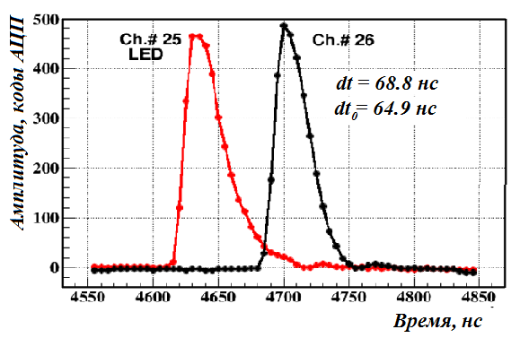
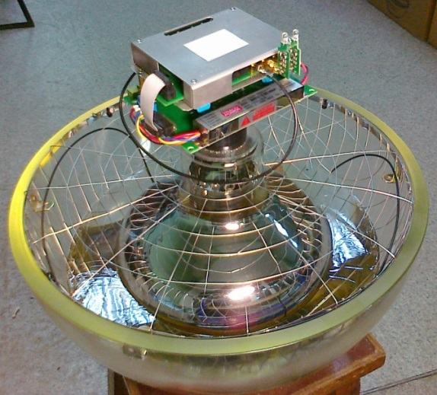
Intra-section calibration
T2
1) The first method: LED calibration
Relative time shifts are measured. Time shifts of channels in one section
are calculated relative 6 (middle) channel in this section
Amplitude of signals is small (Q<50 p.e.).Measured OMs is located upper
OM with switch on LED.
Time shifts are calculated by equation: dT₂ = T₂ – T₁ – dT₁ - T_{th} ,
T_{th} = 68 нс – time of light propagation between OMs
Q ≈ 5
OM 4
T1
Q ≈ 30
OM 3
15 м
OM 2
Q ≈ 700
LED
OM 1
Amplitude, ADC channels
dT
Method 1
internal LEDS
Time, 5ns

Slide 4
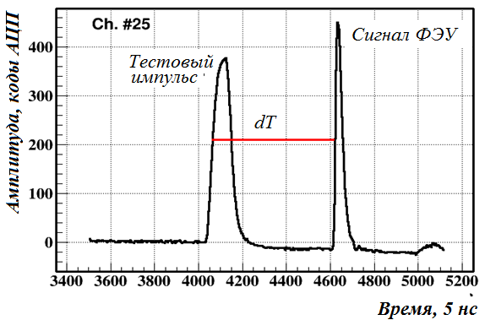
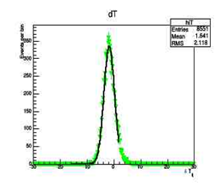
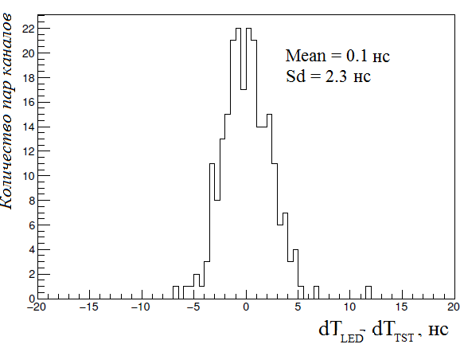
2)The second method: Calibration with test pulses
Time between test pulse and LED pulse is measured:
dT_{TST} = T_{TSTi} − T_{TSTi−1} of two neighboring OMs,
where T_{TST} = PMT time delay +cable time delay
dT distribution is fitted and final time shift is measured in maximum of distribution.
Amplitude, ADC channels
Method 2
Then we compare results of two methods
Time, 5ns
dT_{LED} - dT_{TST}
Number of channels
Number of events
dT
dT distribution
Compare of two methods gives σ ≈ 2ns

Slide 5
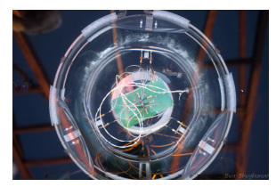
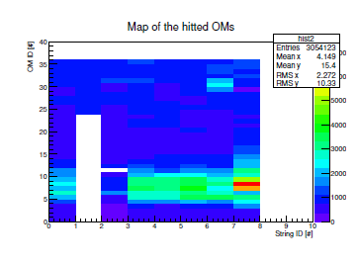
Inter-Section calibration: LED Matrix
LED matrix:
12 LEDs oriented in different directions ,
- FWHM ~6 ns, λ = 470nm
- LED intensities regulation: 1…~10⁸ photons
- Light propagation distance for maximum LED intensity ~100 m in Baikal water.
OM ID
String ID
OMs illuminated by LED matrix
located at eight string (string ID = 7)
between 7th and 8th OMs
Time difference between different pairs of channels of two strings: expected and measured values.

Slide 6
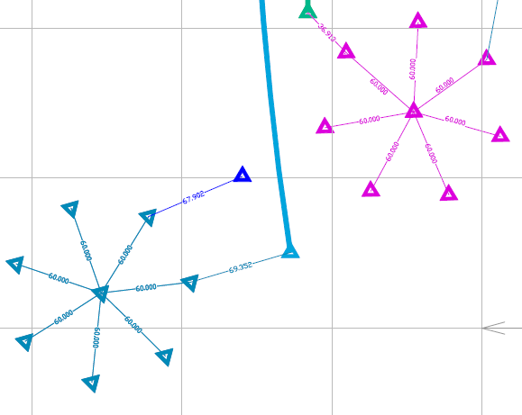
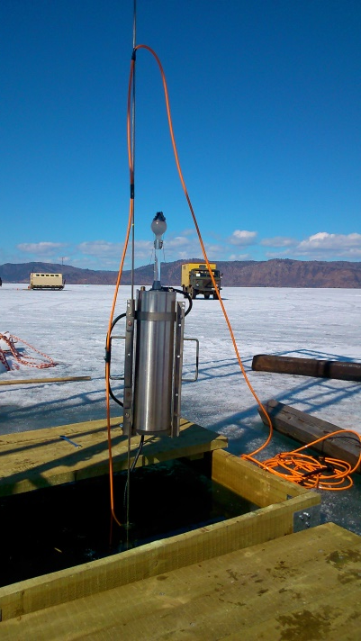
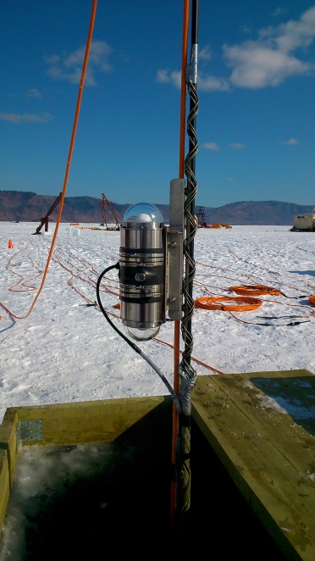
2017 new calibration units
1
7
2
POCAM
6
3
7
1
Laser
5
4
6
POCAM
2
Cluster_1
5
4
3
Cluster_2
Laser
Cluster_1
Cluster_2
Precision Optical Calibration Module (POCAM)
Underwater Laser :
Wavelength: 532 nm
Pulse energy: 0.37 mJ (~10¹⁵ photons)
Flash duration ~1 ns
Laser
POCAM

Slide 7
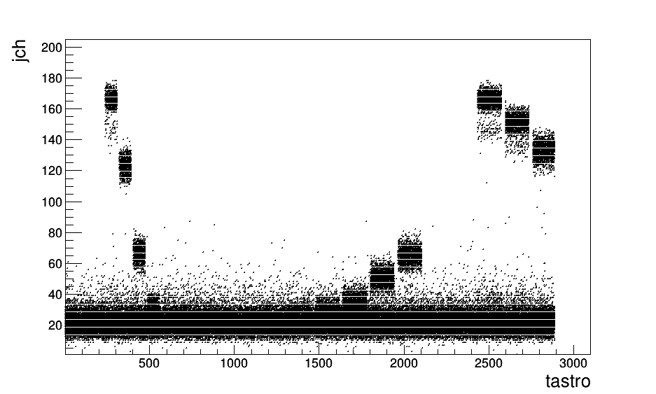
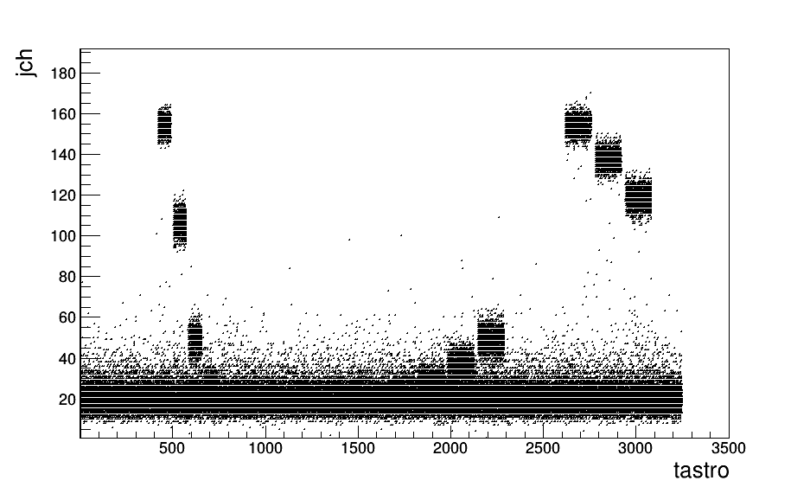
Laser data
Cluster_1
Cluster_2
Multiplicity of hitting channels
Multiplicity of hitting channels
Time relative to the first event, sec
Time relative to the first event, sec
Areas in red circle were chosen for further analysis,
where laser worked with highest pulse and long duration

Slide 8
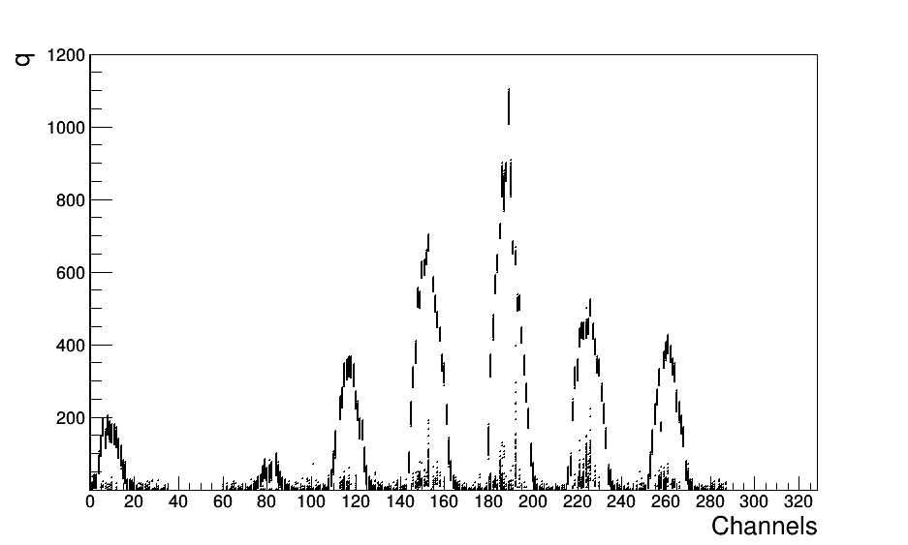
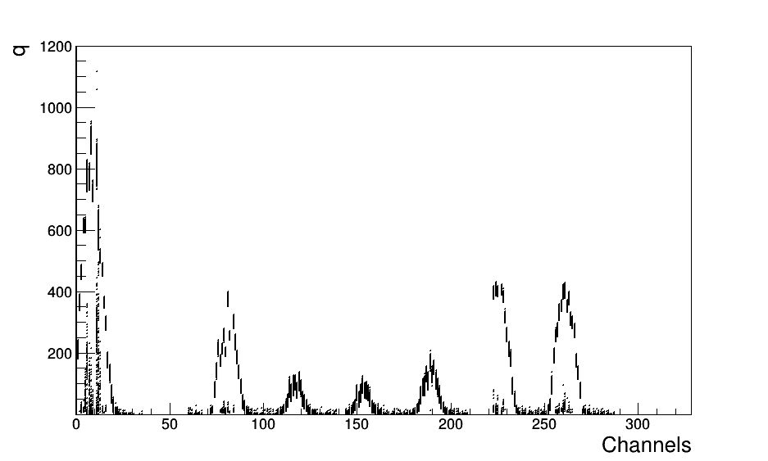
Laser data: response of Clusters (charge)
Cluster_1
Cluster_2
Number of ph. e
Number of ph. e
Note: Some channels were excluded from configuration 2017

Slide 9
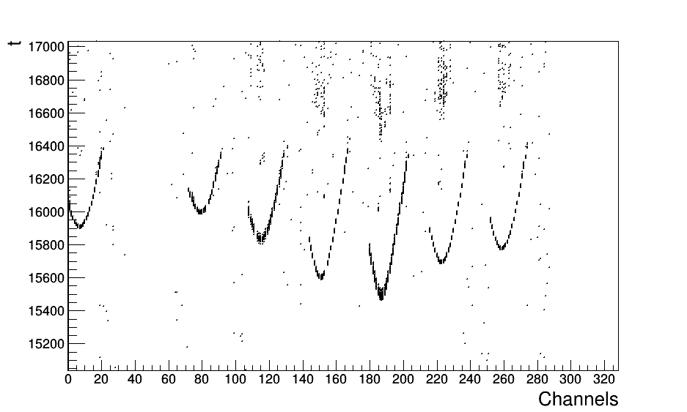
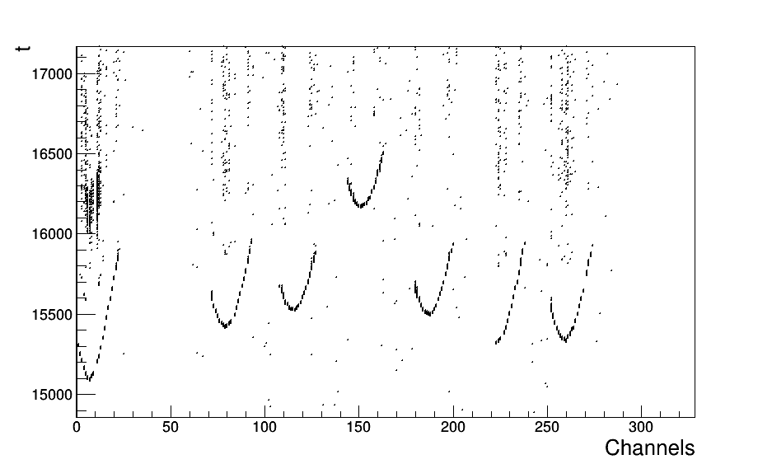
Laser data: response of Clusters (time)
Cluster_1
Cluster_2
T, nsec
T, nsec
Summary: Laser hit almost whole detector
and so far we can do calibration between sections and strings of both clusters

Slide 10
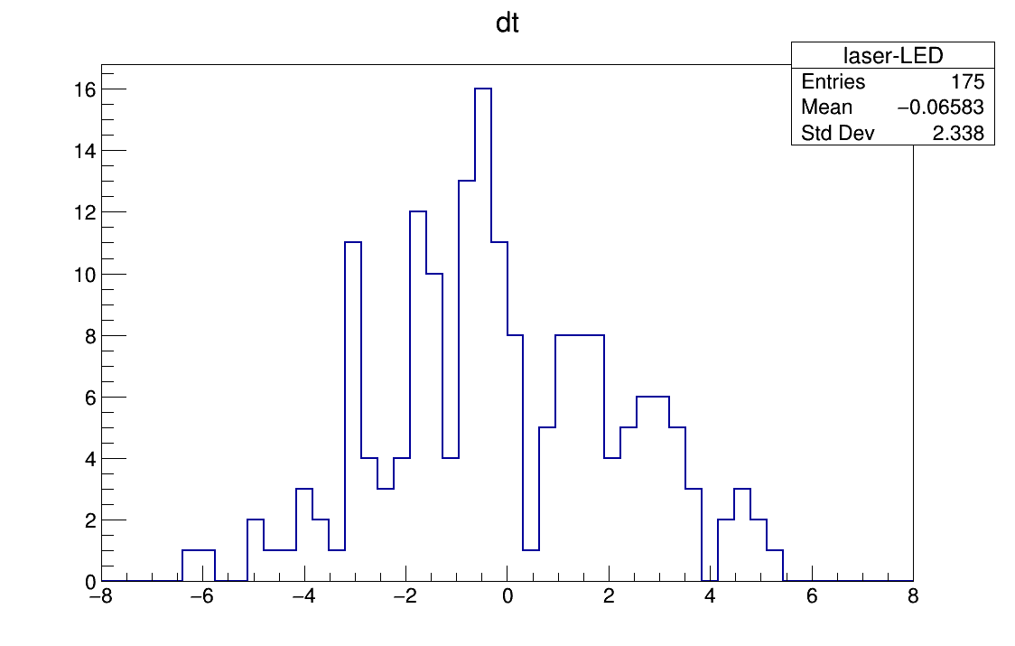
Compare Laser and LED calibration
Number of channels
dT_{laser}-dT_{LED}, ns
σ = 2.3 ns

Slide 11
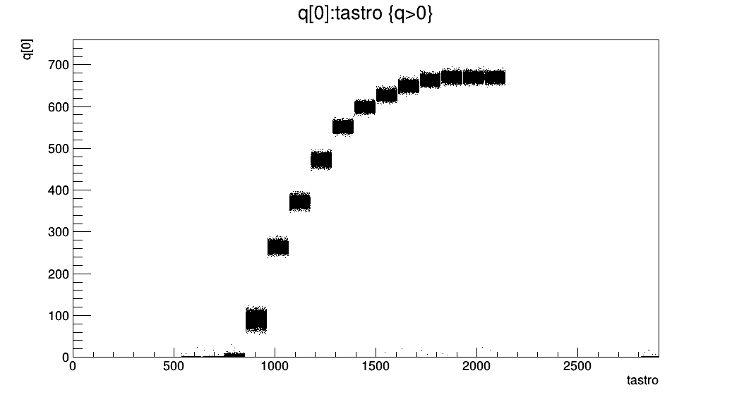
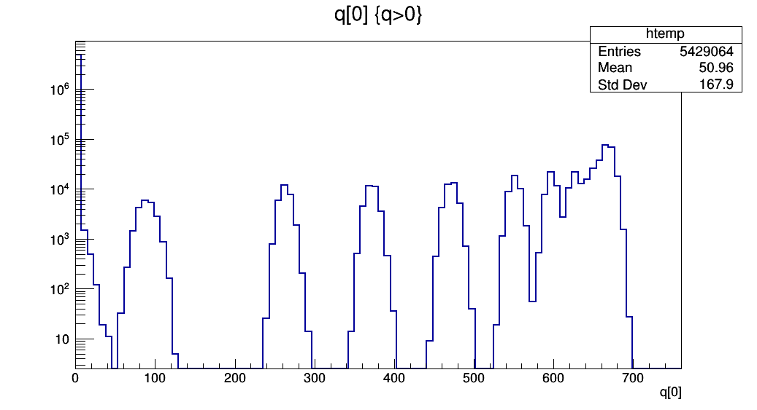
Calibration runs with different intensities
charge, ADC channels/100
Time relative to the first event, sec
Number of events
charge, ADC channels/100

Slide 12
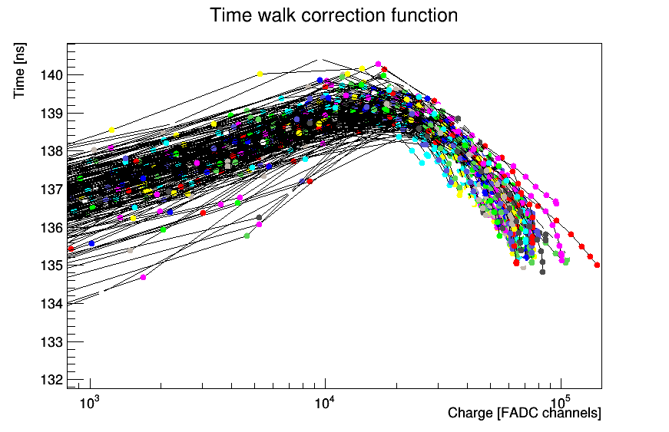
Time walk effect
Dependence of channel time shifts on charge for all OM of cluster3

Slide 13
Summary
The methods and systems used to perform the time calibration for the Baikal-GVD neutrino detector have been reviewed.
The accuracy of the obtained calibration parameters was checked by compare results of independent time calibration methods. It gives an agreement of ~2 ns.
Dependence of channels time shifts on charge were measured for all OM

Slide 14
Thank you for your attention

Slide 15
Backup slides

Slide 16
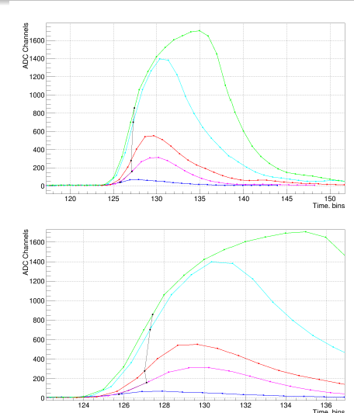
Time walk effect
The signal time is calculated at the half-height of the pulse and depends on its shape.
The shape of the pulse depends on the amplitude of the signal.

