Slide 1
The new CLBv4 for the KM3NeT neutrino telescope
David Calvo, Diego Real
VLVNT 2018, Dubna
1

Slide 2
KM3NeT
Neutrino telescope in Mediterranean sea
12800 Digital Optical Modules (DOM) in the deep sea
Complex optical network to connect the DOMs with the shore station
2
VLVNT-18 10-2018

Slide 3
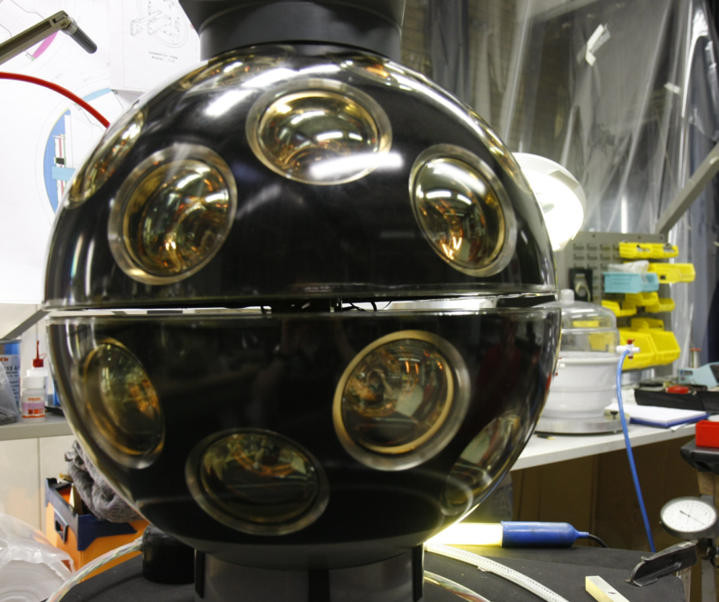
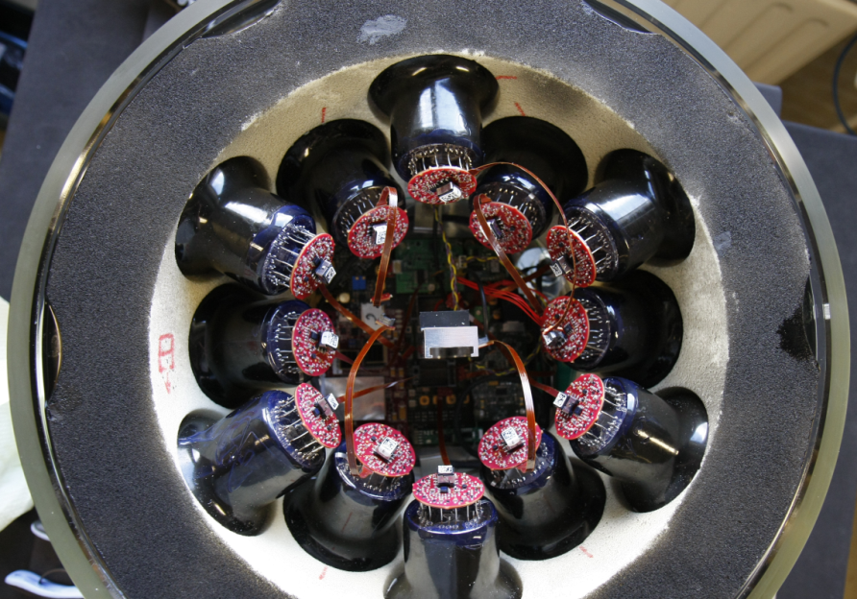
Digital Optical Module (DOM)
31 PMTs.
1 Central Logic Board (CLB)
1 Power Board
2 Octopus
Lower Hemisphere
19 PMTs
Upper Hemisphere
12 PMTs
Central Logic Board
(CLB)
PMT Base:
High Voltage Supply
Analog Front-End
3
VLVNT-18 10-2018

Slide 4
First version of CLB (CLBv2)
SFP Transceiver
White Rabbit:
Tunable oscillators
References, DACs
Octopus:
PMT signals
Kintex 7
FPGA
Configuration:
SPI Flash
FMC HPC
Instrumentation
Nanobeacon LED
Test and Debug
4
VLVNT-18 10-2018

Slide 5
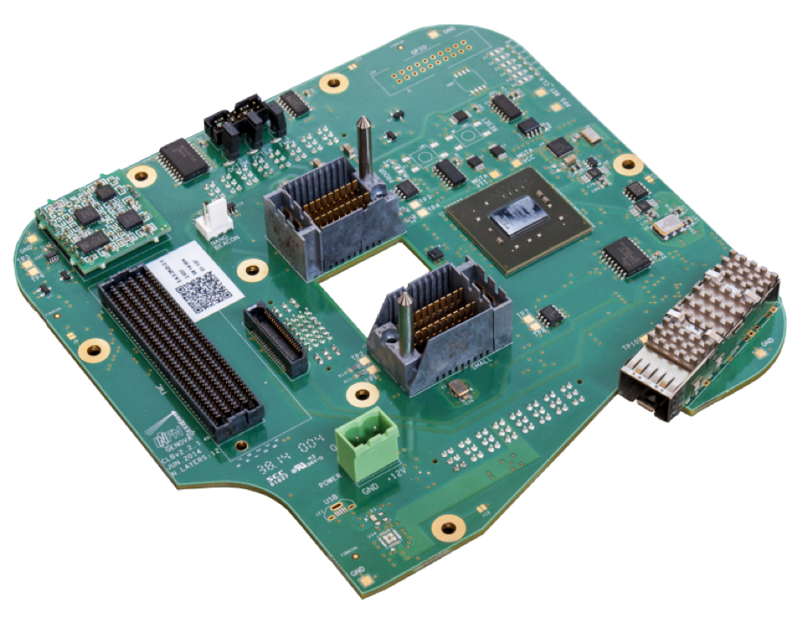
First version of CLB (CLBv2)
Successfully tested:
JTAG and FLASH programming
Nanobeacon and instrumentation
Optical and acoustic readout
Currently installed in the lines.
Next implementation:
Maintain performance
Reduce cost
Reduce power consumption
5
KM3NeT Electronic meeting 02-03-2018

Slide 6
Second version of CLB (CLBv3)
SFP Transceiver
White Rabbit:
Tunable oscilators
References, DACs
Octopus:
PMT signals
Artix
FPGA
Configuration:
SPI Flash
FMC LPC
Instrumentation
Nanobeacon LED & acoustic
Test and Debug
6
VLVNT-18 10-2018

Slide 7
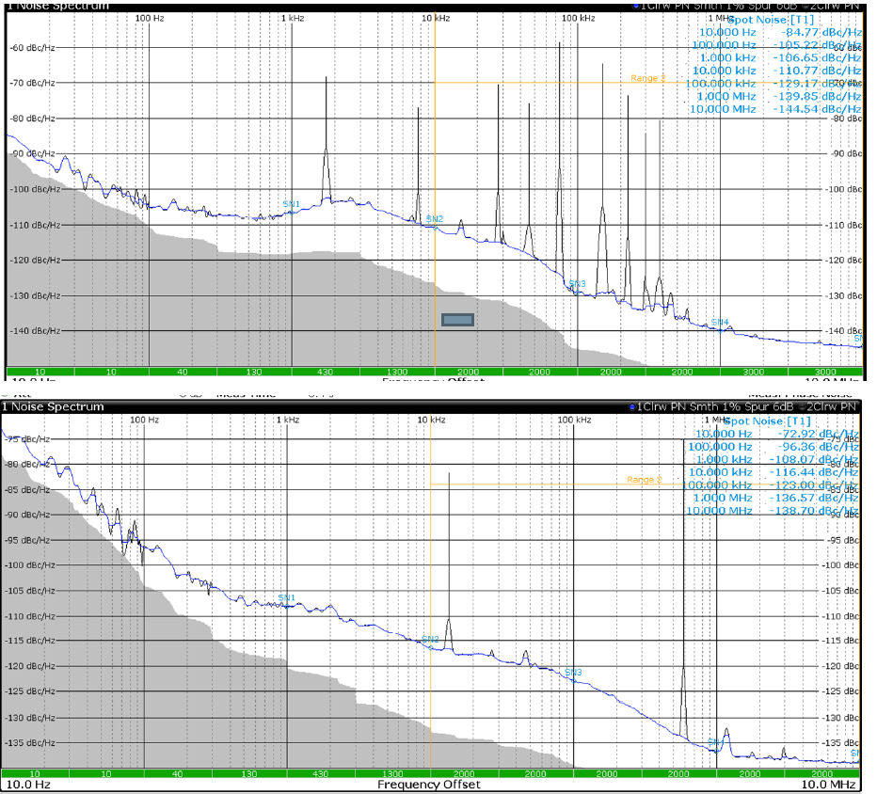
Spectrum analysis of CLBv3 and CLBv2
CLBv3
CLBv2
7
VLVNT-18 10-2018

Slide 8
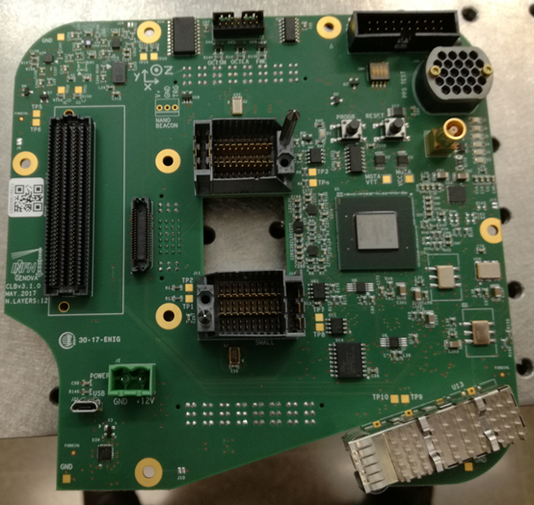
CLB upgrade: CLBv4
After CLBv3 tests:
Power consumption: no big difference
Lower performance.
Lower switching frequency
Difficult to implement optical
front-end (250 MHz)
Noisy clocks
More or less the same price.
Conclusion:
Redesign the CLBv3.
Move back to Kintex7-160T -2
Improve the clocks layout
8
KM3NeT Electronic meeting 02-03-2018

Slide 9
Third version of CLB (CLBv4)
Glenair Transceiver
White Rabbit:
Tunable oscilators
References, DACs
Octopus:
PMT signals
Kintex
FPGA
Configuration:
SPI Flash
FMC HPC
Instrumentation
Nanobeacon LED & acoustic
Test and Debug
9
VLVNT-18 10-2018

Slide 10
CLBV4 clock scheme
REFERENCE CLOCK
25 MHz
CDCM
125 MHz
125 MHZ
125 MHz
FPGA
DMTD CLOCK
25 MHz
CDCM
124.99 MHz
124.99 MHZ
10
VLVNT-18 10-2018

Slide 11
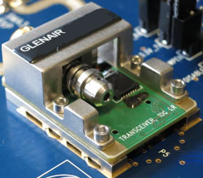
CLBV4 Glenair transceiver
The design of the optical network will change in KM3NeT Phase 2:
Improving the reliability is mandatory
New Glenair BiDi model with better reliability.
11
VLVNT-18 10-2018

Slide 12
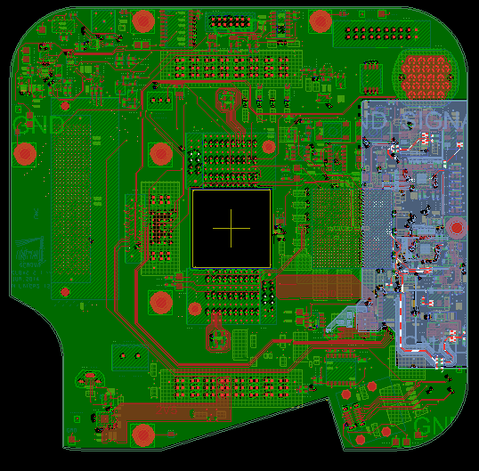
CLBV4 Layout
More than 200
new components
w.r.t. to CLBv3
Improved the placement of
the synchronization stuff
Improved teh routing and grounds to avoid noise
The new design has been sent to the company to produce the first prototypes
12
VLVNT-18 10-2018

Slide 13
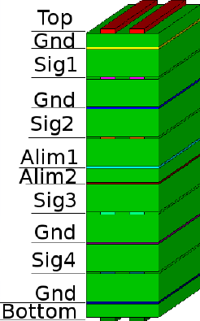
CLB layout
12 Layers:
2 Power planes
4 Ground planes
4 Signal layers
Differential pairs delay:
less than 100 ps between PMT signals
Less than 20 ps between clock signals
13
VLVNT-18 10-2018

Slide 14
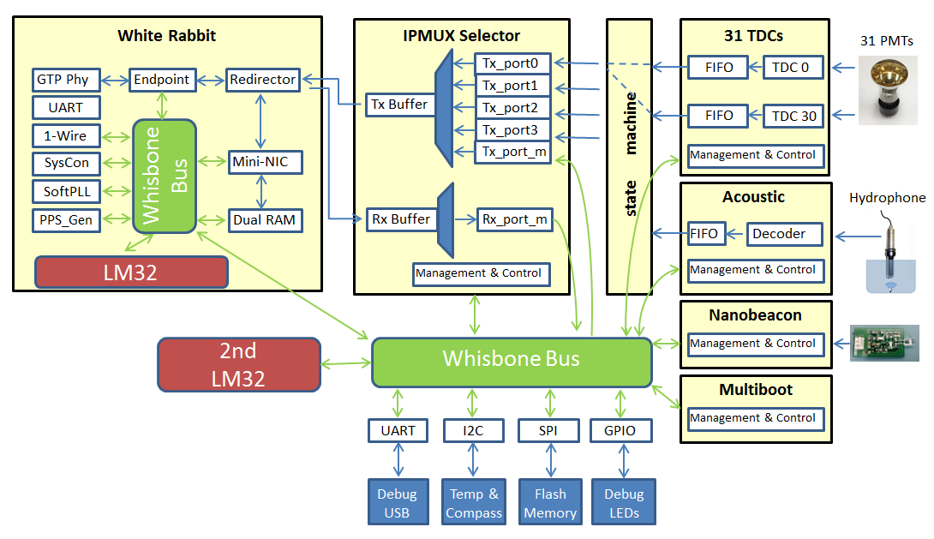
CLB Firmware
14
VLVNT-18 10-2018

Slide 15
Summary
The CLB manages the full DOM functionalities
The design has been improved over time
Hardware, firmware and software
Last protoype ready for production:
Routing improvement
New clock scheme
New transceiver
15
VLVNT-18 10-2018

Slide 16
The new CLBv4 for the KM3NeT neutrino telescope
David Calvo, Diego Real
VLVNT 2018, Dubna
16

