Slide 1
The GNN Dissertation Prize
(GNN = Global Neutrino Network)
Uli Katz
VLVnT 2018 - Dubna
2 October 2018

Slide 2
Since 2015:
GNN Dissertation Prize
Call
For students who successfully completed an outstanding thesis in the broader area of neutrino astronomy. Also for technical work or method development.
2015: Tri Astraatmadja, Jakob van Santen, Juan Pablo Yáñez
2016: Lars Mohrmann, Agustín Sánchez Losa, Chris Weaver
2017: Stefan Coenders, Janik Hofestädt, Ryan Maunu

Slide 3
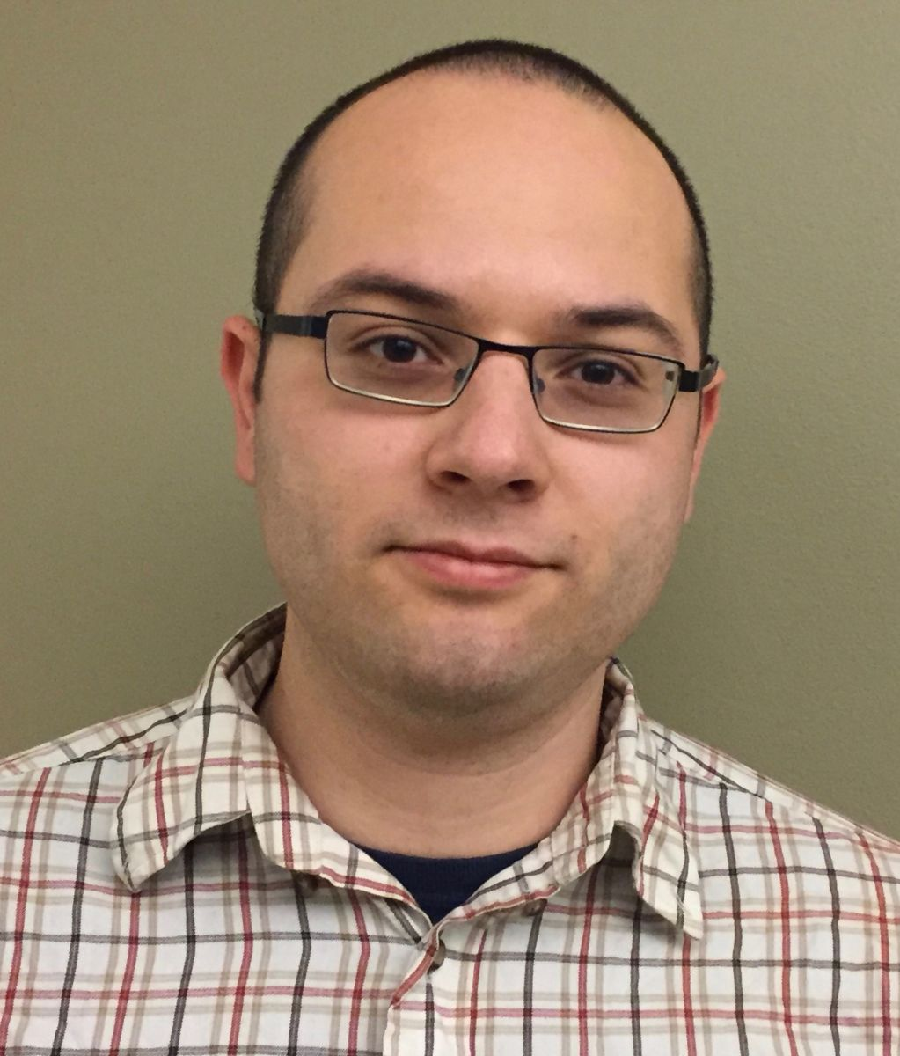
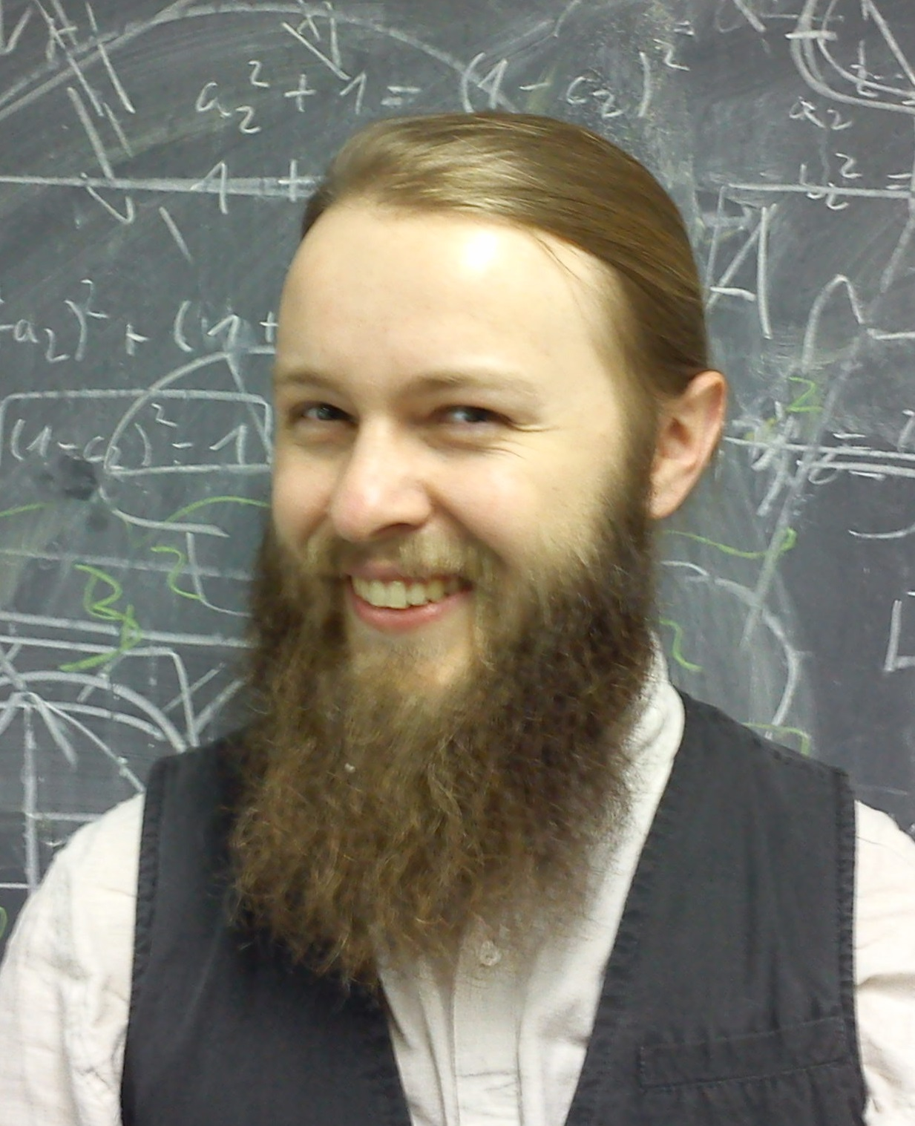
And the winners 2018 are …
Gary Binder (UC Berkeley): Measurements of the flavour composition and inelasticity distribution of high-energy neutrino interactions in IceCube
Lew Classen (U Münster): The mDOM – a multi-PMT digital optical module for the IceCube-Gen2 neutrino telescope

