Slide 1
Energy Production and Transmutation of Nuclear Waste by Accelerator Driven Systems (ADS)
P. Zhivkov
Institute of Nuclear Research and Nuclear Energy, BAS, Bulgaria

Slide 2
Motivation
1. Energy production. Neutron induced fission of ²³⁸U and ²³²Th.
♦ production of ²³⁹Pu by radiation capture:
♦ production of ²³³U by radiation capture:
2. Transmutation of nuclear waste and possibility to use the waste as fuel for ADS.

Slide 3
Long-lived nucleus product of NPP
⁷⁹Se | ⁹⁹Tc | ¹⁰⁷Pd | ¹²⁶Sn | ¹²⁹I | ¹³⁵Cs | ²⁴⁷Cm | ²⁴⁰Pu
1.E+6 | 2.E+5 | 7.E+6 | 1.E+5 | 2.E+7 | 2.E+6 | 2.E+7 | 7.E+7

Slide 4
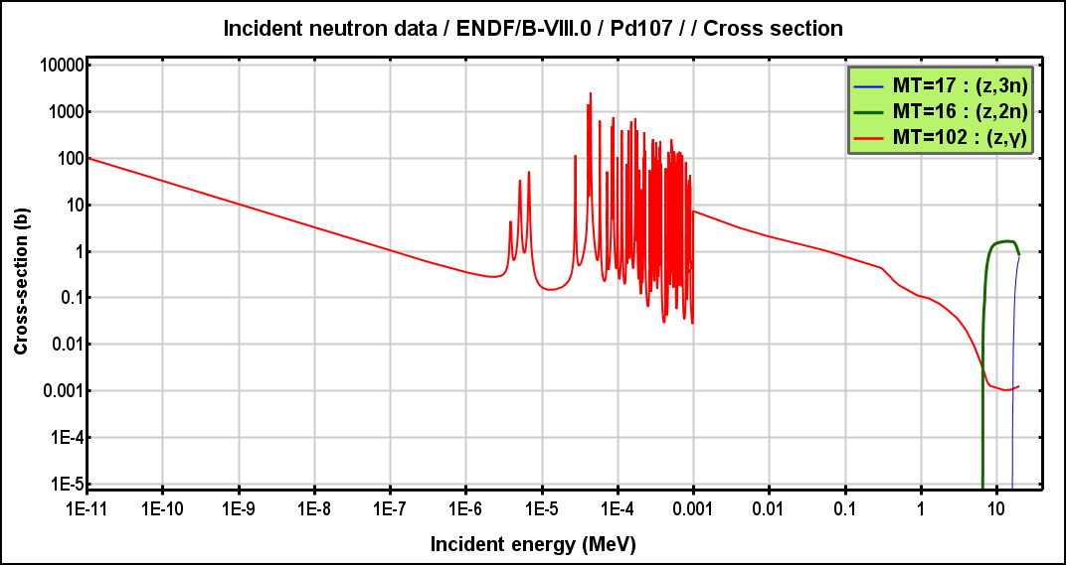
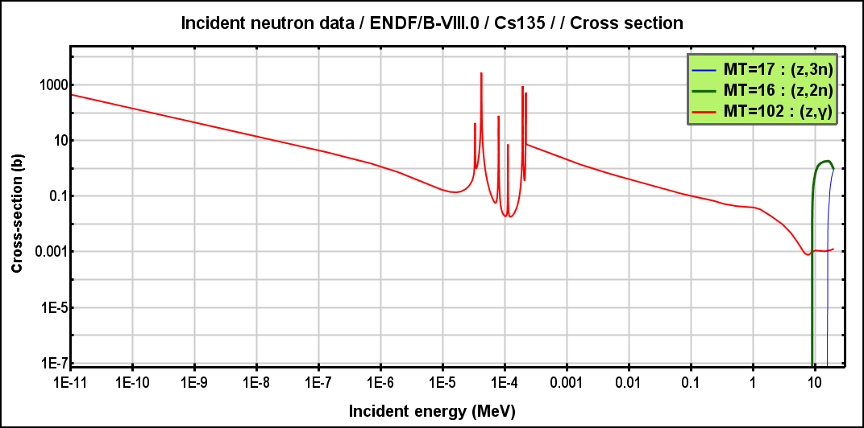
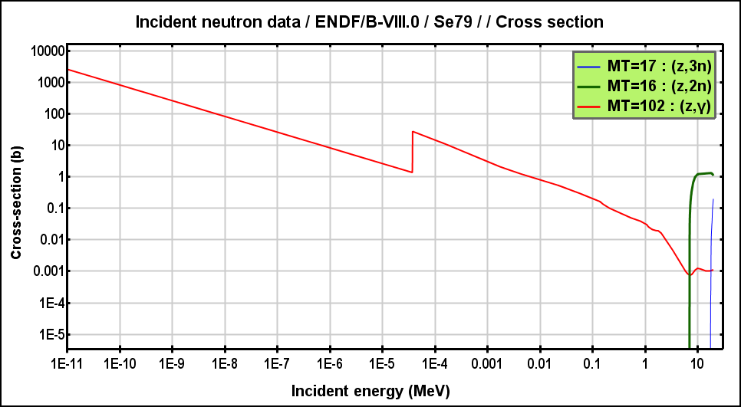
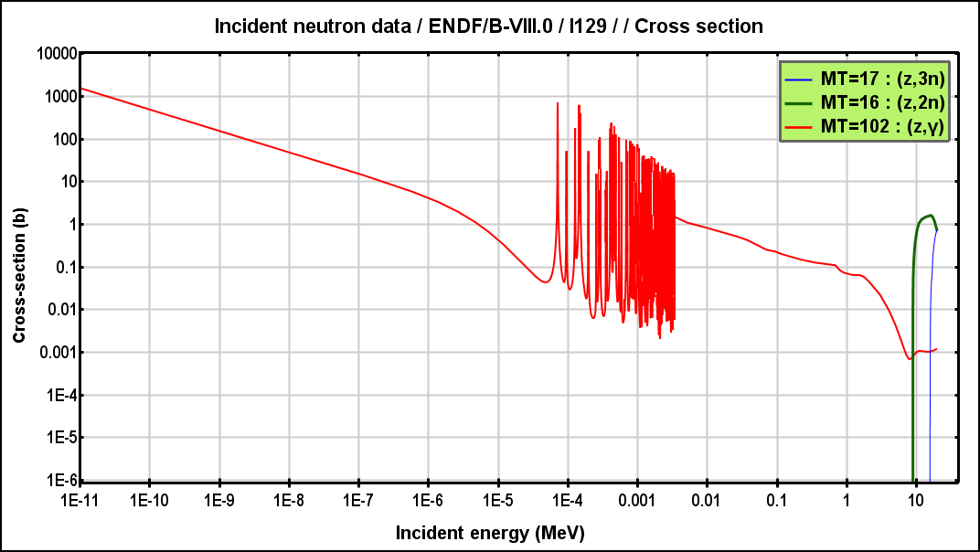
Neutron induced (n,2n), (n,3n) and (n,γ) reactions for ¹⁰⁷Pd, ⁷⁹Se, ¹³⁵Cs and ¹²⁹I

Slide 5
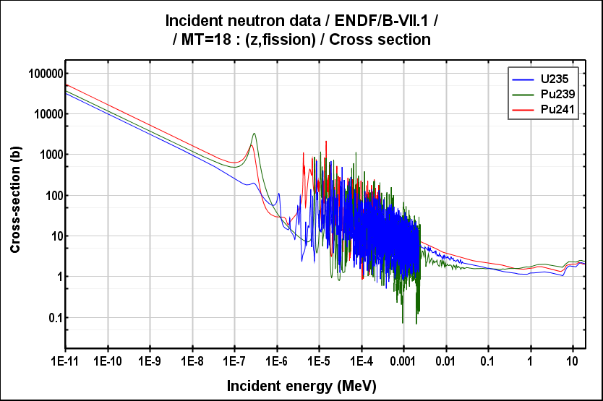
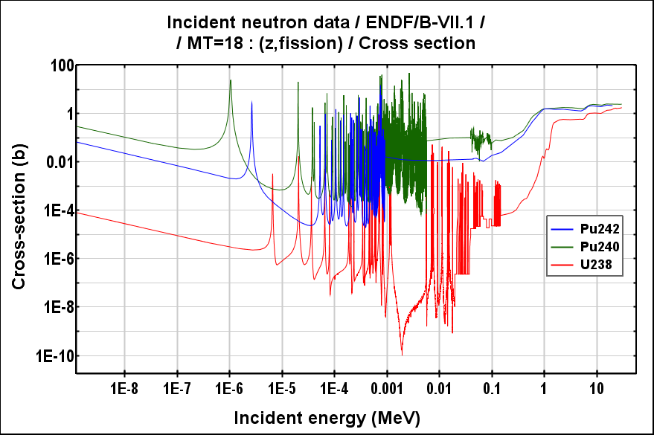
Cross sections of neutron induced fission of U and Pu isotopes

Slide 6
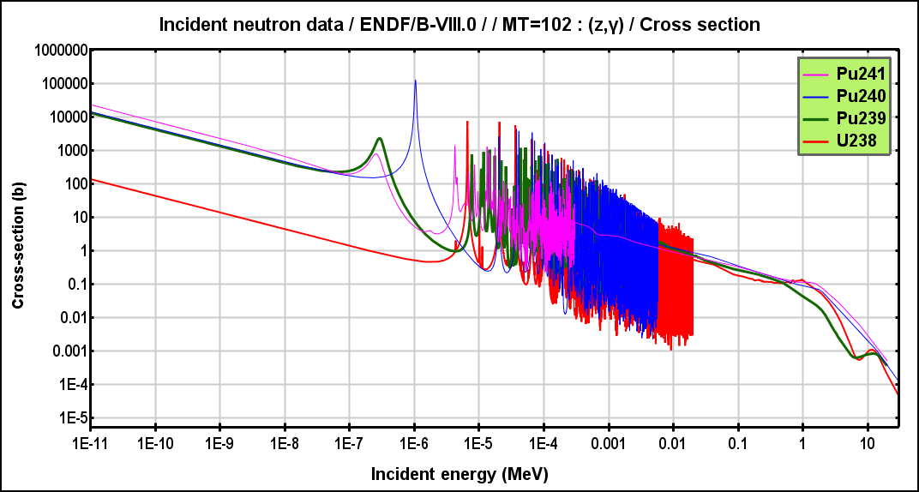
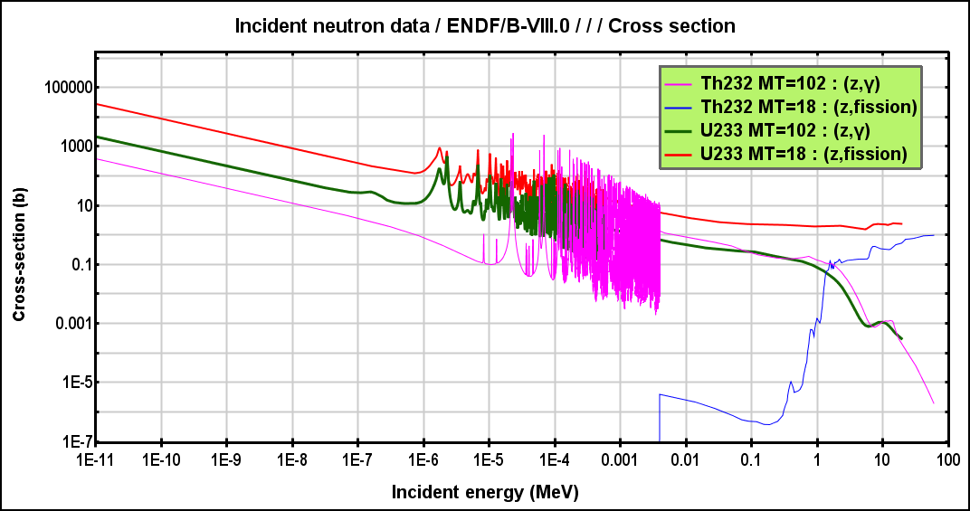
Cross sections of neutron induced radiative capture
for isotopes of U, Pu, and Th isotopes

Slide 7
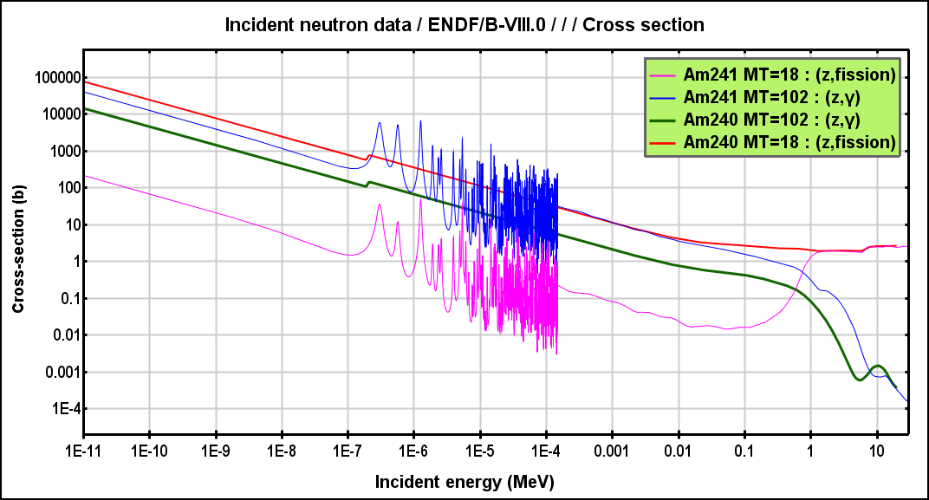
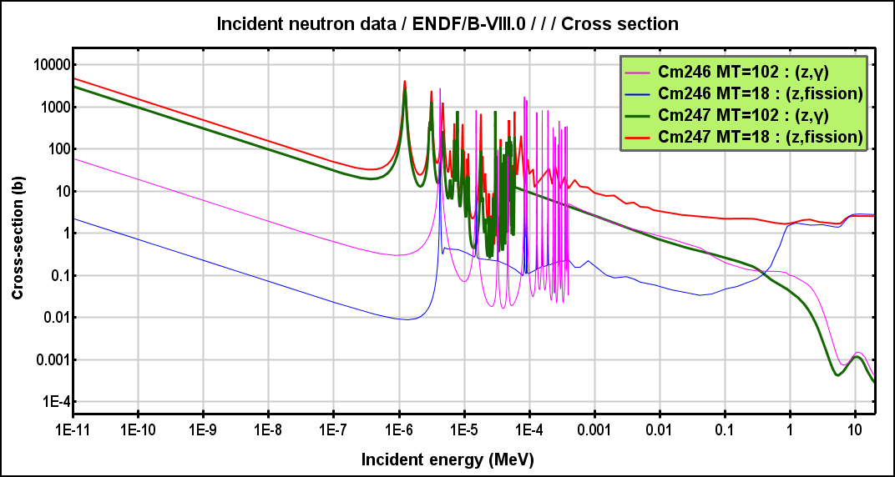
Cross sections of neutron induced fission and radiative capture for isotopes of Am and Cm

Slide 8
Balance of the neutron induced fission and radiative captive
reactions in massive targets
Reactions Rate Ratio (RRR) for fission nuclides: RRR = N(n,γ)/N(n,f)
I) U/Pb set up (Vassilcov-Goldanski) 1) ^{nat}U RRR=2,5
2) ^{depl.}U RRR= 3
II) For Quinta set up: 1) Pb shield: RRR = 1,2 – 1,4
2) w/o Pb shield: RRR = 0.8
III) For Buran set up RRR = 4.3-4.4

Slide 9
ADS - requirements
0.98 < K_{eff} < 1 during working. The fuel production rate in the reactor part
and the target have to be less than fission rate.
2. Energy production
3. Transmutation of nuclear waste

Slide 10
Results 1. Calculations of total (n,f) reactions in ADS. 2. Calculation of total (n,γ)²³⁸U, (n,γ)²³²Th, (n,γ)²³⁹Pu reactions 3. Calculation of ionization energy deposition in ADS. 4. Calculation of BPG (Beam Power Gain). BPG=(E_{fiss}+ E_{ion}+ E_{capture})/E_{beam}

Slide 11
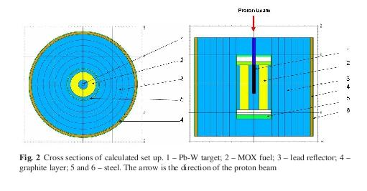
Parameters investigation of sub-critical ADS
with 0.95< K_{eff}<1
ADS without ^{depl}U/ ²³²Th protection shield, only biological
MOX (Mix Oxide Fuel concentration of 20-30 % ²³⁹Pu+²³⁵U

Slide 12
Reaction balance in ADS
Uranium target, cylinder d=5 cm и l=50 cm
E_{p} GeV | N_{total} | N_{escape} | (n,f)²³⁵U | (n,f)/(n, γ)²³⁸U | (n,f)/(n,γ)²³⁹Pu | (n, γ)²⁴⁰Pu | (n, γ)^{nat}Pb
0,66 | 1350 | 363 | 6 | 37/106 | 330/62 | 6 | 61
1 | 2630 | 706 | 12 | 70/190 | 636/134 | 12 | 120
2 | 5540 | 1490 | 24 | 140/407 | 1364/255 | 23 | 247
E_{p}=2 GeV
N_{escape} = 1500 – total number of escaped neutrons (30% from total production)
(n,γ)²³⁸U + (n,γ)²⁴⁰Pu = 430 – total fuel production in ADS
(n,f)^{235,238}U +(n,f)²³⁹Pu = 1530 – total fission reaction

Slide 13
Energy deposition E_{fiss} и E_{ion} [х10 GeV] in ADS for different targets and energy of the proton beam. The Beam Power Gain (BPG), E_{tot}/E_{p}, E_{tot}=E_{fiss}+E_{ion} shows the coefficient of the energy multiplier.
 | E_{p}=0.66GeV |  |  | E_{p}=1GeV |  |  | E_{p}=2GeV
Target | E_{fiss} | E_{ion} | E_{tot}/E_{p} | E_{fiss} | E_{ion} | E_{tot}/E_{p} | E_{fiss} | E_{ion} | E_{tot}/E_{p}
^{nat}U | 9.0 | 0.6 | 147 | 15.5 | 1.1 | 166 | 35.5 | 2.5 | 190
^{nat}Pb | 9.0 | 0.66 | 145 | 16 | 1.1 | 170 | 36.2 | 2.5 | 194
^{nat}P+W | 6.8 | 0.5 | 110 | 12,8 | 0.92 | 127 | 29.2 | 2.5 | 158
The fissions produced by neutrons with energy En>20 MeV, gammas and charged particles
is estimated to be 20% from fission induced by neutrons with energy En<20 MeV
For targets ^{nat}U, Pb and Еp=2 GeV the Beam Power Gain (BPG), E_{tot}/E_{p} is 180-200

Slide 14
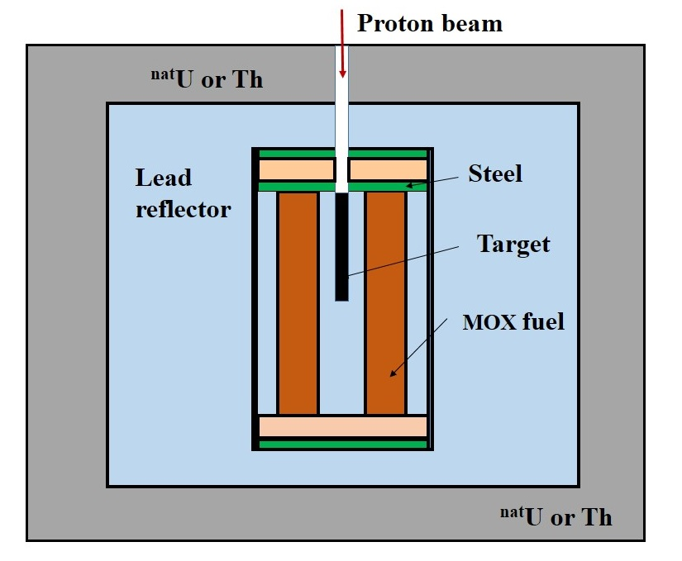
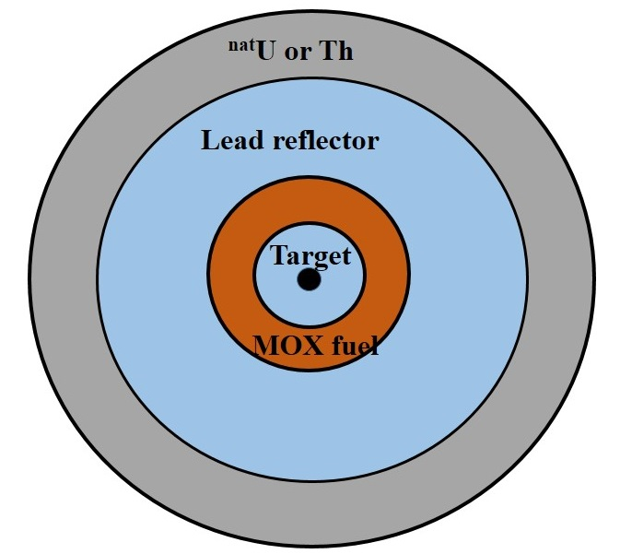
Parameter investigation of sub-critical ADS
with 0.95< K_{eff}<1
ADS with ^{depl}U/ ²³²Th protection shield,
i.e. production of nuclear fuel ²³⁹Pu and ²³³U

Slide 15
Simulations
Targets: Pb or ²³⁸U (95-98 %) and ²³⁹Pu (5-2 %)
Reflector: Pb, or Pb+H₂O and air
Shielding: protection from neutrons and nuclear fuel production area
K_{eff.} = 0.98 – 0.997
Different cross sections for lead reflector and fission nuclides
Leakage of neutrons: 2% from generated neutrons
N_{(n,f)} = 0.6 N_{(n,γ)}
1). 120 < BRG < 1400, BPG=E_{fiss.}/E_{p}
2). 200 < BPG < 4000, BPG=(E_{fiss.}+E_{(n,γ)})/E_{p}

Slide 16
Equilibrium of fission reaction rate and fuel
production rate in the targets
The (n,f) reaction in the reactor part depends on neutron flux induced in the target.
The targets are made of U, Pb, Pu, Bi, Th, W and alloys.
In the targets fuel production rate (n,γ) – reaction must be less than total fission rate.

Slide 17
C O N C L U T I O N
Calculation of ADS system is not easy task.
A) Cross sections for high energy neutron induced fissions, multiplicity and
spectrum of the fissions are not well known.
B) Cross sections files for incident neutrons with energy up to 150 – 200 MeV were done
with unacceptable approximation.
C) Cross sections for thermal neutrons with ^{206,207,208}Pb are very important
because of to high amount of MOX – fuel.
D) Cross sections for reactions (n,f)^{nat}Pb, (n,f)²⁰⁹Bi do not exist in cross section file.
2. The design of the reactor part (dimension, beam power, quantity of fission nucleus,
type of the accelerator and cooling system) is not clear yet.

Slide 18
Спасибо за внимание

