Slide 1

Information about an intent to open new themes: "Development of the critical design report for a new Dubna Neutron Source (DNS-IV)" and "Construction of the Laboratory for Structural Research of Macromolecules and New Materials at the SOLARIS National Synchrotron Radiation Centre of the Jagiellonian University (Kraków, Poland)"
V. Shvetsov
49th meeting of the PAC for Condensed Matter Physics

Slide 2
"Construction of the Laboratory for Structural Research of Macromolecules and New Materials at the SOLARIS National Synchrotron Radiation Centre of the Jagiellonian University (Kraków, Poland)"

Slide 3




Slide 5
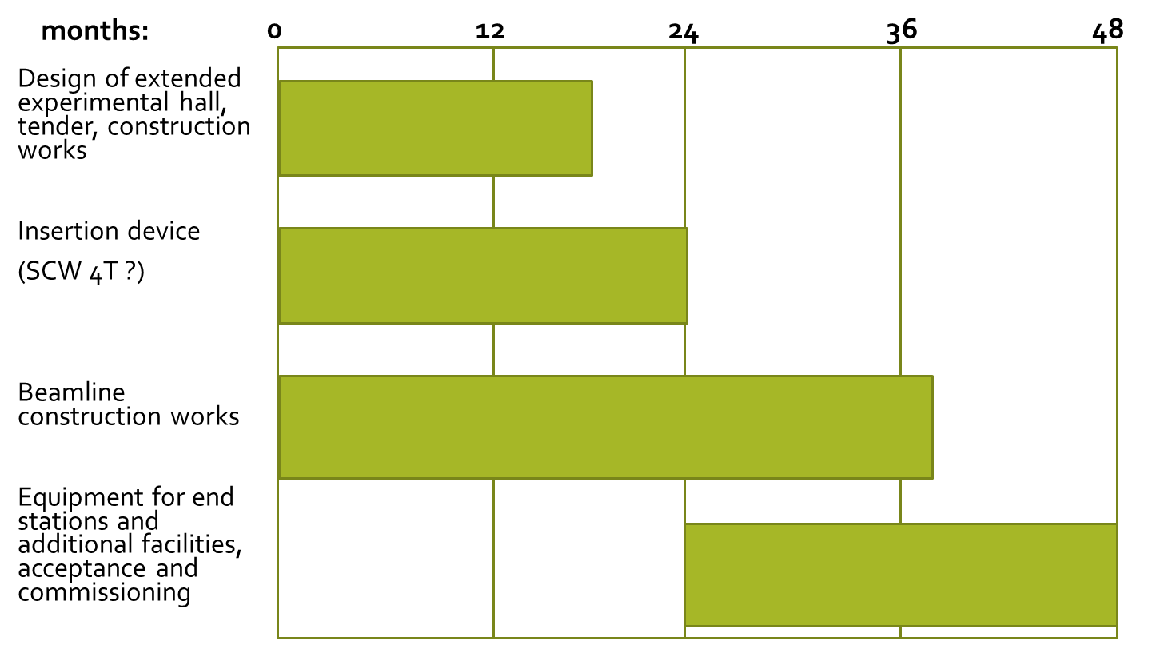

Slide 7
FLNP directorate appeals to the PAC on Condensed Matter Physics looking for support in our decision to open the new theme in JINR topical plan "Construction of the Laboratory for Structural Research of Macromolecules and New Materials at the SOLARIS National Synchrotron Radiation Centre of the Jagiellonian University (Kraków, Poland)“ for the period of 3 years.
In case of your support and successive approval from the JINR Scientific Council, all necessary materials will be submitted at the 50-th meeting of PAC.

Slide 8
"Development of the critical design report for a new Dubna Neutron Source (DNS-IV)"

Slide 9
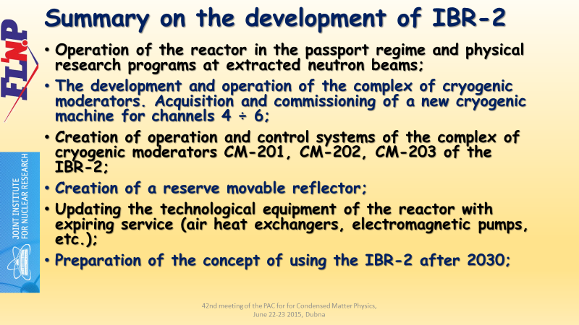
June 2015
2016 preparation of the 7-years plan

Slide 10

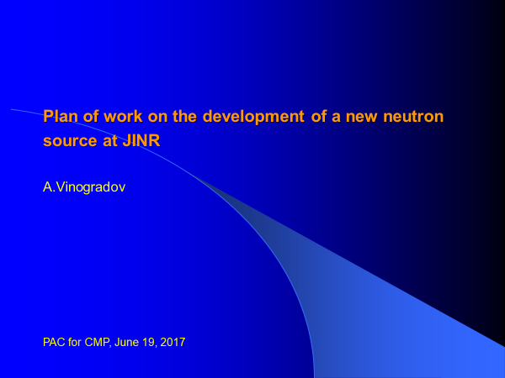

Year 2017

Slide 11
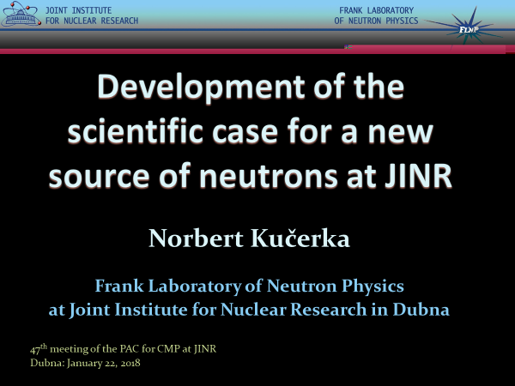

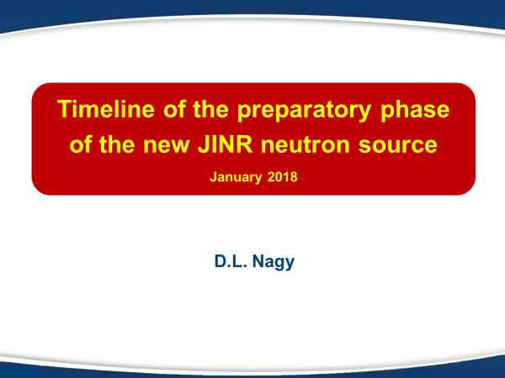


Slide 12
Other activity
Two meetings of the international working subgroup on JINR Strategic Planning (June 2018 and January 2019);
Workshop "Advanced ideas and experiments for the new Dubna Neutron Source (DNS-IV). Related moderators and infrastructure.“ December 2018;
Contract to NIKIET for the preliminary design of the two options of the DNS-IV;

Slide 13
FLNP directorate appeals to the PAC on Condensed Matter Physics looking for support in our decision to open the new theme in JINR topical plan "Development of the critical design report for a new Dubna Neutron Source (DNS-IV)" for the period of 3 years.
In case of your support and successive approval from the JINR Scientific Council, all necessary materials will be submitted at the 50-th meeting of PAC.

Slide 14
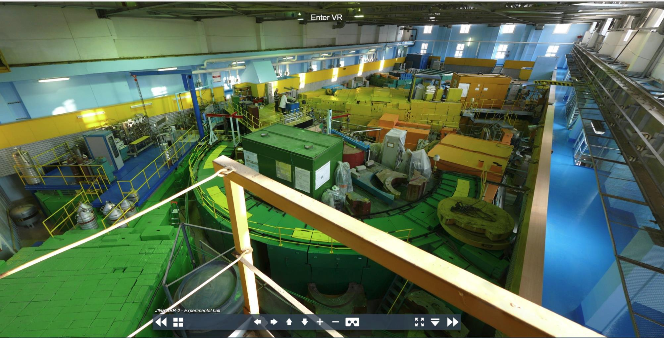
Thank you for your attention!

