Slide 1
Programme Advisory Committee
for Condensed Matter Physics
follow up after
48th meeting (14 – 15 June 2018)
Dénes Lajos Nagy
49th session of the PAC for Condensed Matter Physics, Dubna, 24–25 January 2019

Slide 2
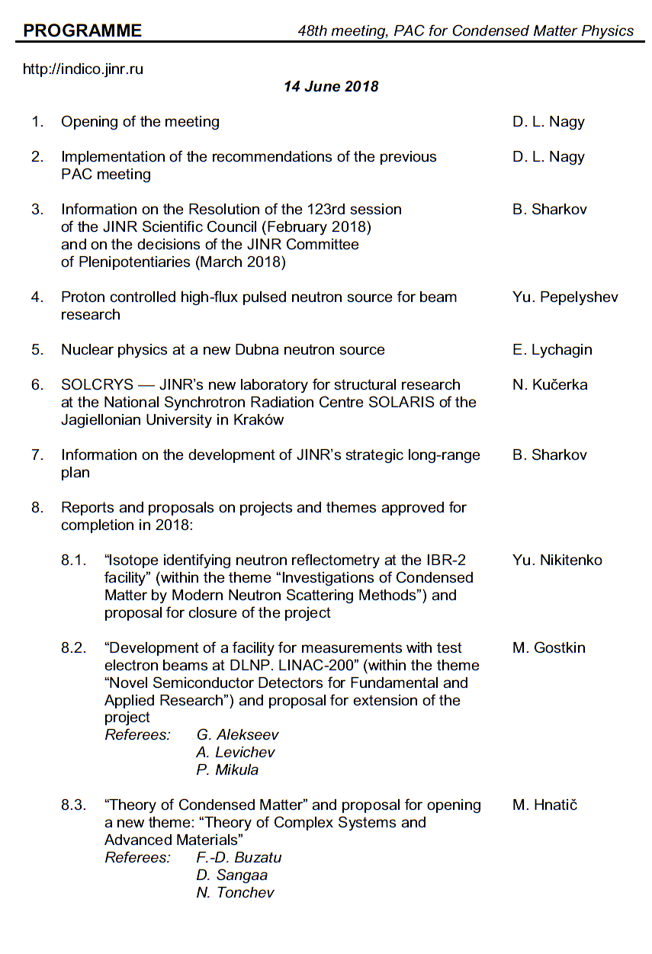
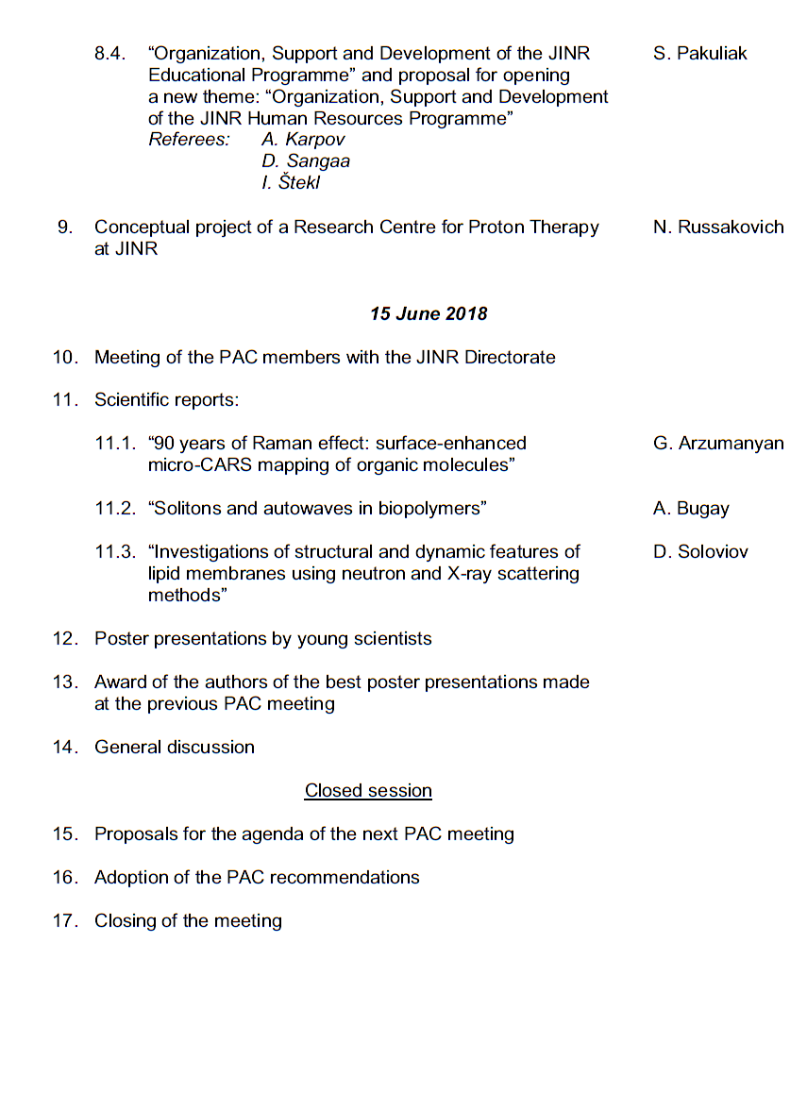
Agenda of the 48th PAC meeting
Highlights of the PAC-CMP meeting:
Alternative option of a new source of neutron at JINR
The scientific case for JINR’s new neutron source
Cooperation between JINR and the National Synchrotron Radiation Centre SOLARIS
Reports and proposals on themes and projects

Slide 3
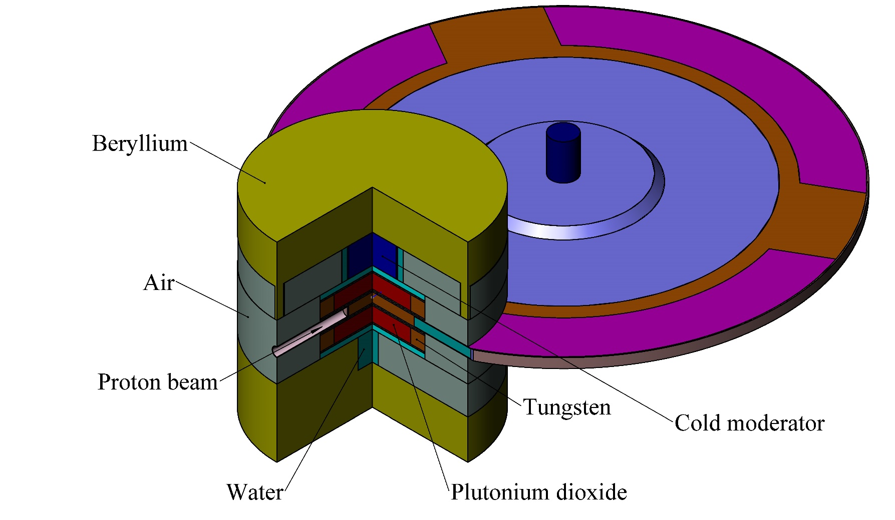
Alternative option of a new source of neutron at JINR
The PAC heard with interest the report on an alternative option for the development of a new source of neutrons at JINR, presented by Yu. Pepelyshev. The physical scheme of the source is based on a subcritical booster with a plutonium dioxide core giving a criticality level of no more than 0.98 and a non-multiplying tungsten target.
Optimal variant of the source
Recommendation. The PAC recommends that the work on the development of the general concept of a new neutron source on the basis of the presented physical models be continued.
Evaluation model of a booster with a rotating tungsten target and plutonium dioxide core.

Slide 4
Development of the scientific case for JINR’s new neutron source
The PAC took note of the report on a scientific programme in nuclear physics being proposed for a new JINR’s neutron source as presented by E. Lychagin.
The PAC notes that very cold and ultracold neutrons are of great interest for fundamental physics research. At the same time, the scientific case for use of these neutrons for condensed matter studies should be elaborated. In this regard, the PAC considers it necessary to continue discussions about ultracold and very cold moderators for a new neutron facility.
Reasons to discuss NUCLEAR PHYSICS PROGRAM at the PAC for CONDENSED MATTER PHYSICS:
The new source has been discussed here several times.
To show that the nuclear researchers will need several neutron beams at a new source.
We hope that we are all interested in a very cold neutron source and we have to unite our efforts.
Recommendation. The PAC recommends starting the development of a scientific case for the moderators of ultracold and very cold neutrons at a new JINR neutron source.

Slide 5
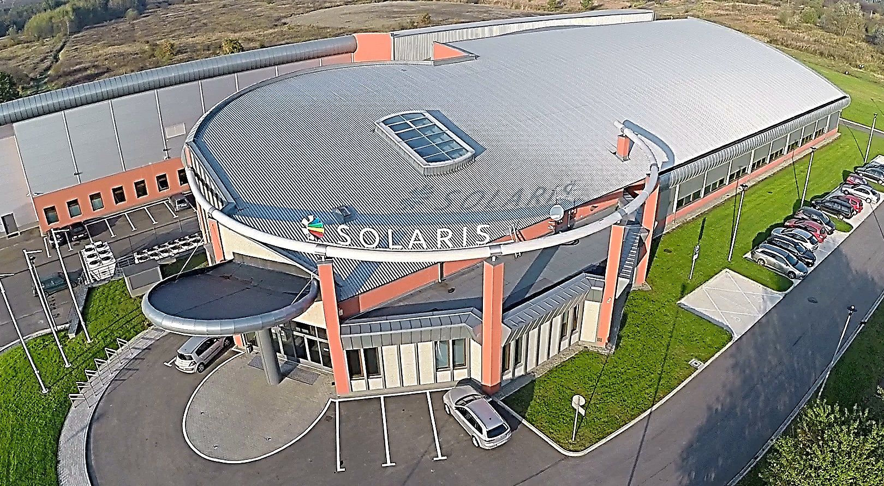
SOLCRYS — JINR's new laboratory for structural research at the National Synchrotron Radiation Centre SOLARIS of the Jagiellonian University in Kraków
Materials science
- structure of crystalline materials
- semiconductors and new electronic materials
- alloys and nanocomposites
- polymers and fibers
Chemistry
- catalysis
- porous materials
Pharmacy
- drug polymorphism
- drug carriers
- gels, lotions, creams
Structural biology
- proteins and nucleic acids
- biomacromolecular solutions
The PAC took note of the activities of the team coordinated by the FLNP Directorate concerning the development of the concept for a new laboratory for structural research of macromolecules and new materials at the National Synchrotron Radiation Centre SOLARIS, presented by N. Kučerka. The PAC acknowledges that the new capability to be provided by the new laboratory will become a part of the JINR research tools, especially in terms of complementarity between existing neutron-based techniques and future X-ray methods. At the same time the PAC recommends continuing the analysis of the feasibility of the technical design and parameters required by future experiments.

Slide 6
Information on the development of JINR’s strategic long-range plan
The PAC was informed by Vice-Director B. Sharkov about the progress of the development of JINR’s strategic long-range plan up to 2030 and beyond. The PAC endorses the steps towards formation of the memberships of the subgroups for condensed matter physics and neutron physics, as well as for radiobiology and astrobiology and the work plans for 2018–2019.
Recommendation. The PAC recommends that the subgroups provide regular information on their work at its future meetings.

Slide 7
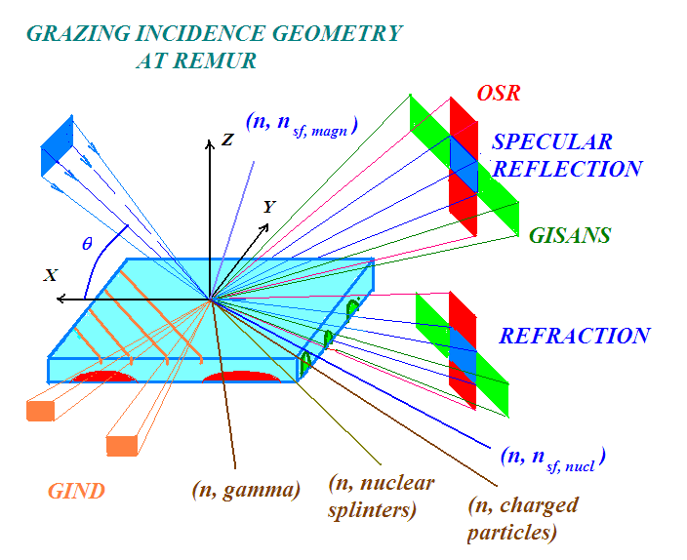
Reports and proposals on themes and projects
The PAC took note of the report presented by Yu. Nikitenko on the concluding project “Isotope identifying reflectometry at IBR-2 reactor” within the theme “Investigations of Condensed Matter by Modern Neutron Scattering Methods”. The PAC is pleased to note that Isotope Identifying Reflectometry (IIR), a principally new method designed to study diffuse processes in layered nanostructures, has been successfully implemented at the IBR-2 reactor. The performance of the reflectometer which realizes this method corresponds to the one planned before. IIR is an important step in the modernization of the IBR-2 instruments.
Recommendation. Given the successful completion of the project “Isotope identifying reflectometry at the IBR-2 reactor”, the PAC recommends its closure.

Slide 8
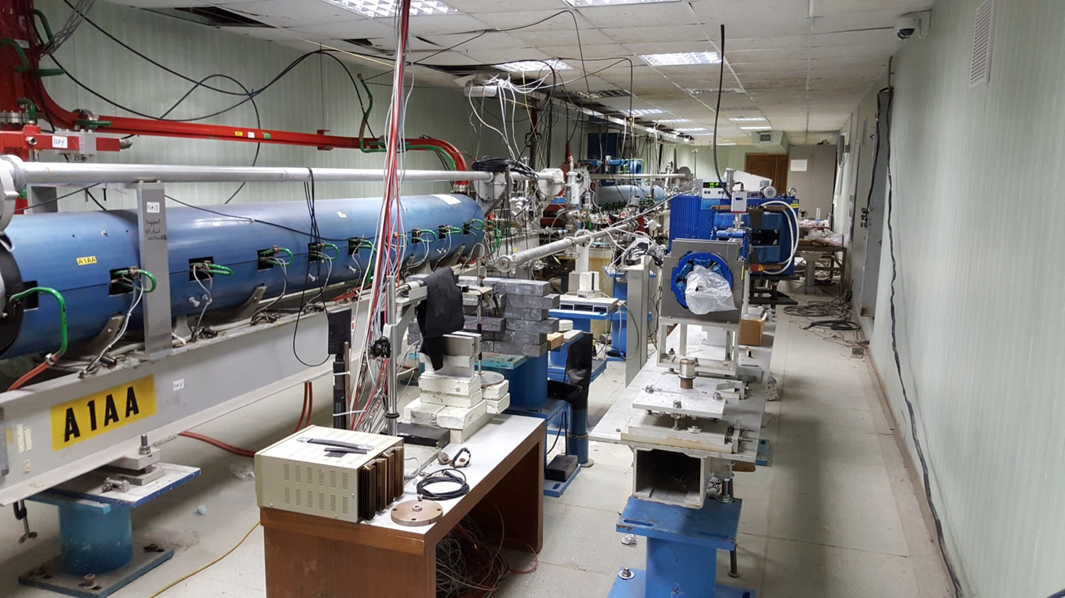
Reports and proposals on themes and projects
The PAC considered a proposal for opening a new project “Development of a facility for measurements with test electron beams at DLNP. LINAC-200”, presented by M. Gostkin. The PAC appreciates DLNP's efforts in developing new types of elementary particle detectors capable of operating under conditions of high rates and at the same time providing the performance, precision, and reliability of registration required for experiments at future accelerators. Nevertheless, it misses a scientific case of the project within the competency of this PAC and feels that, on the basis of the presented information, no support to the initiative can be granted at this stage.
LINAC-200
Recommendation. The PAC encourages the authors of the proposal “Development of a facility for measurements with test electron beams at DLNP. LINAC-200” to elaborate a detailed scientific case within the scope of the PAC for Condensed Matter Physics or, alternatively, to consider submitting their proposal to another PAC.

Slide 9
Reports and proposals on themes and projects
The PAC took note of the report on the concluding theme “Theory of Condensed Matter” and considered a proposal for the opening of a new theme “Theory of Complex Systems and Advanced Materials” presented by M. Hnatič.
The PAC highly appreciates the results obtained in the main research directions: complex materials and nanostructures, contemporary problems of statistical physics. It also appreciates the interrelation between the ongoing theoretical studies and the JINR experimental programmes.
The PAC supports continuation of this research under a new theme that should incorporate the development of new theoretical methods and approaches for describing and predicting the properties of new materials and identification of universal laws of behaviour of equilibrium and non-equilibrium statistical systems which are of current interest in modern condensed matter physics. The PAC welcomes the deepening, within a new theme, of cooperation with the experimental groups of JINR and its Member States in order to raise it to a higher level. The PAC considers the requested funding reasonable.
Recommendation. The PAC recommends closure of the theme “Theory of Condensed Matter” and opening a new theme “Theory of Complex Systems and Advanced Materials” for the period 2019–2023.

Slide 10
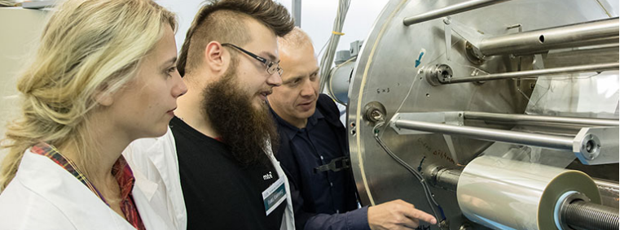
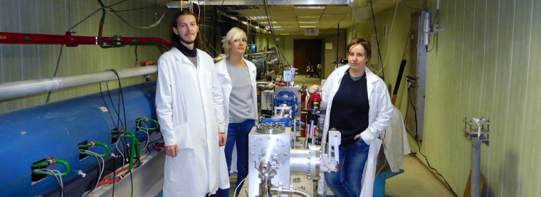
Reports and proposals on themes and projects
The PAC took note of the report on the concluding theme “Organization, Support, and Development of JINR Educational Programmes” and considered a proposal for opening a new theme “Organization, Support and Development of the JINR Human Resources Programme”, presented by S. Pakuliak.
The PAC notes that the University Centre (UC) has been performing the overall coordination and support of the educational and human resource development programmes at JINR within the current theme. As part of the theme, one of the main issues and functions of JINR is being implemented –– attracting talented young people and partner scientific research organizations of the Member States to the Institute. In order to accomplish this, certain conditions are being created at JINR to assign Bachelor, Master, and PhD students from Member-State universities to work on their theses. Together with JINR Laboratories, the UC organizes and runs student programmes of various levels, which allow attracting talented young people and ensuring the continuity of JINR’s scientific schools. It is of utmost importance to continue the current activities within the framework of the proposed new theme, enhancing the cooperation with the leading universities of the Member States to attract young people to work on the JINR flagship projects.
Recommendation. The PAC recommends closure of the theme “Organization, Support, and Development of JINR Educational Programmes” and opening a new theme “Organization, Support and Development of the JINR Human Resources Programme” for the period 2019–2023.

Slide 11
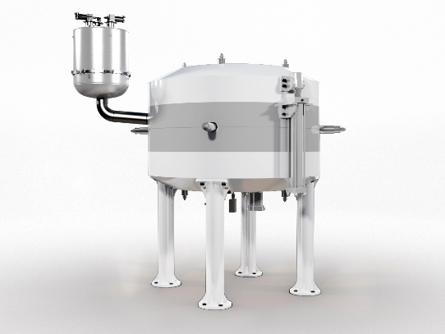
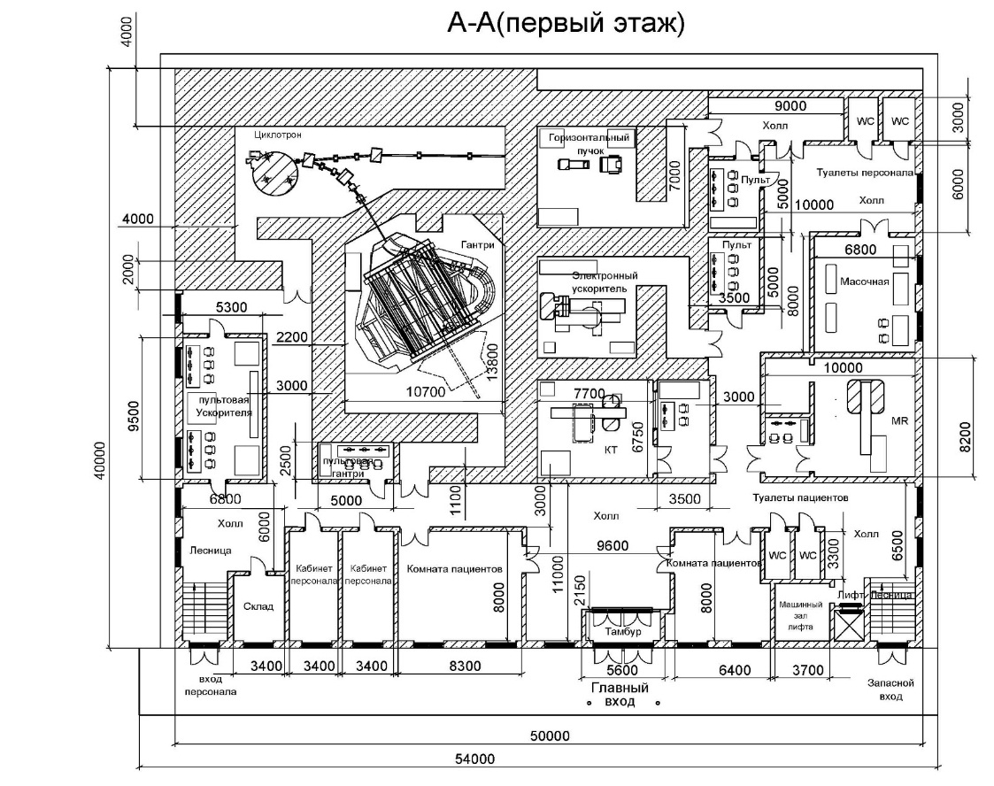
Reports and proposals on themes and projects
The PAC took note of the conceptual project of a Research Centre for Proton Therapy at JINR presented by N. Russakovich. The PAC recognizes the importance of further development of instruments and methods for proton therapy at JINR and fully supports the idea of playing a leading role in disseminating the culture of proton therapy in JINR Member States.
Recommendation. Taking into account the real state of the Phasotron and the ongoing work on the construction, together with Chinese colleagues, of the SC202 therapeutic cyclotron, the PAC invites the JINR Directorate to elaborate the project of a new, compact research infrastructure for therapy with proton beams which could serve also as a pilot facility for future use in JINR Member States as well as an educational tool for training specialists in proton therapy.
Superconducting cyclotron SC202

Slide 12
General remarks by the JINR Scientific Council (124th session)
On the priority goals of JINR’s scientific programme
The Scientific Council emphasizes the importance of consolidating the scope of in-house experiments and of experiments within the framework of international partnership programmes with essential contribution being made by the JINR staff.
On implementation of the Seven-year plan for the development of JINR for 2017–2023
On the whole, the Scientific Council highly appreciates the on-going efforts to implement the Seven-year plan. However, considering the increasing number of new scientific themes and projects reported, the Scientific Council stresses that JINR needs to consolidate its research programme within the major objectives of the Seven-year development plan.

Slide 13
CMP-issues noted by the JINR Scientific Council (124th session)
The Scientific Council took note with interest of an alternative option for the development of a new source of neutrons at JINR, submitted to the PAC for Condensed Matter Physics. The Scientific Council recommended that the suggested physical scheme based on a subcritical booster with a plutonium dioxide core and a non-multiplying tungsten target be thoroughly considered while elaborating the general concept of a new neutron source.
The Scientific Council welcomed the initiation of a discussion concerning the relevant scientific programme for a new source and, in particular, the development of a scientific rationale for the use of the moderators of ultracold and very cold neutrons at this facility.
The Scientific Council expressed its intention to continue, together with this PAC, to follow up on the development of the general concept of a new neutron source and its scientific programme.

Slide 14
CMP-issues noted by the JINR Scientific Council (124th session)
The Scientific Council took note of the activities of the team coordinated by the FLNP Directorate concerning the development of the concept of a new laboratory for structural research of macromolecules and new materials at the National Synchrotron Radiation Centre SOLARIS of the Jagiellonian University in Kraków (Poland).
The Scientific Council agreed that such a laboratory would contribute to extending the JINR research tools, which is of considerable importance in terms of complementarity between existing neutron-based techniques and future X-ray methods.
At the same time the Scientific Council concurs with the PAC’s recommendation to continue the analysis of the feasibility of the technical design and parameters required by future experiments in such a laboratory.

Slide 15
CMP-issues noted by the JINR Scientific Council (124th session)
The Scientific Council supports the PAC’s recommendations on the reviewed themes and projects. In particular, the Scientific Council welcomes the successful completion of the project “Isotope identifying reflectometry at the IBR-2 reactor”, which resulted in implementing a principally new method to study diffuse processes in layered nanostructures at the IBR-2 facility, and concurs with the closure of this completed project.
The Scientific Council expects that the revised proposal of the project “Development of a facility for measurements with test electron beams at DLNP. LINAC-200” be reconsidered, assuming that the authors of the project will elaborate a detailed scientific proposal within the scope of the PAC for Condensed Matter Physics or, alternatively, will submit this proposal to another PAC.
Appreciating the recent achievements within the concluding theme “Theory of Condensed Matter”, the Scientific Council agrees that a new theme “Theory of Complex Systems and Advanced Materials” be opened for the period 2019–2023. The Scientific Council especially appreciates the opportunity to achieve closer correlation between the on-going theoretical studies and experimental programmes at the JINR.

Slide 16
Other issues noted by the JINR Scientific Council (124th session)
Issues, related to the PAC for Condensed Matter Physics
With regard to the considered conceptual project of a research centre for proton therapy at JINR, the Scientific Council recognizes the importance of further development of instruments and methods for proton therapy at JINR and supports the idea of assuming a leading role in disseminating the culture of proton therapy in JINR Member States.
Considering the discussed on-going work on the construction, together with the Chinese colleagues, of the SC202 therapeutic cyclotron, and the current state of the Phasotron, the Scientific Council recommends that the JINR Directorate develop the possibility of implementing a project of a compact research infrastructure for proton therapy at JINR.

Slide 17
Other issues noted by the JINR Scientific Council (124th session)
Common issues
The Scientific Council notes the efforts by the University Centre (UC) in coordination and support of the educational and human resource development programmes at JINR within the concluding theme “Organization, Support, and Development of JINR Educational Programmes”.
As part of this theme, one of the main issues and functions of JINR is being implemented –– that of attracting talented young people and partner scientific research organizations of the Member States to JINR. In order to accomplish this, conditions are being created at JINR to assign Bachelor, Master, and PhD students from Member-State universities to work on their theses. Together with JINR Laboratories, the UC organizes and runs student programmes of various levels, which may attract talented young people and ensure the continuity of JINR’s scientific schools.
The Scientific Council considers it important to continue these activities within the framework of the new theme “Organization, Support and Development of the JINR Human Resources Programme” proposed for 2019–2023, enhancing the cooperation with leading universities of the Member States to attract young people to work on JINR’s flagship projects.

Slide 18
Thank you for your attention

