Slide 1

IBR-2 STATUS REPORT
V. Shvetsov
49th meeting of the PAC for Condensed Matter Physics

Slide 2
IBR-2 RIGHT NOW

Slide 3
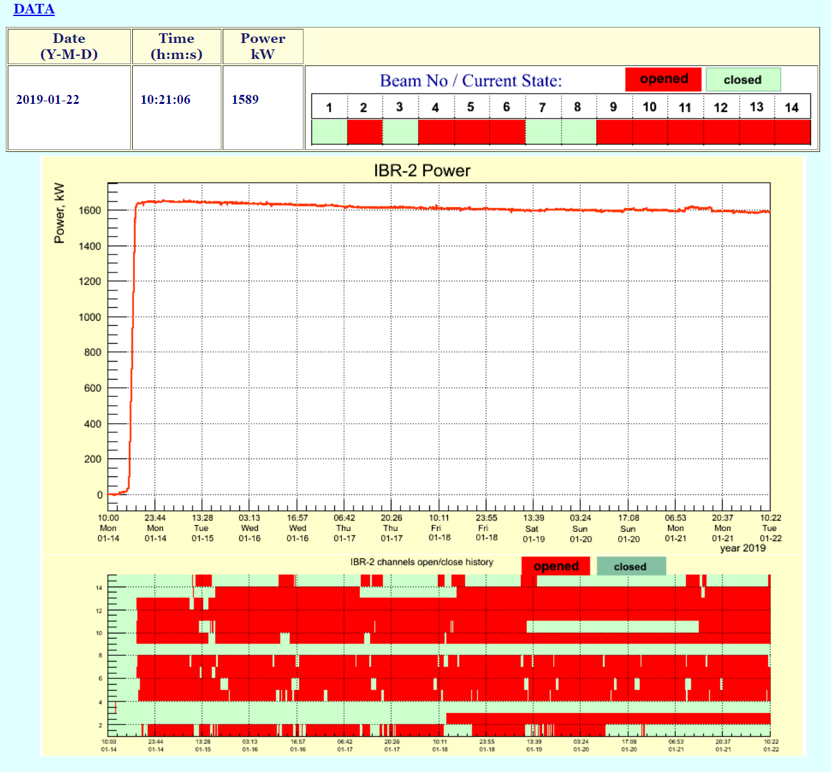
CURRENT STATE OF THE IBR-2

Slide 4
CONTENT
IBR-2 OPERATION IN 2018;
LABORATORY PLANS ON UPGRADE OF THE MAJOR TECHNOLOGICAL COMPONENTS;
INVESTIGATION OF THE DYNAMICS OF THE POWER FEEDBACK EFFECTS AT THE IBR-2;
CONCLUSION;

Slide 5
IBR-2 OPERATION IN 2018

Slide 6
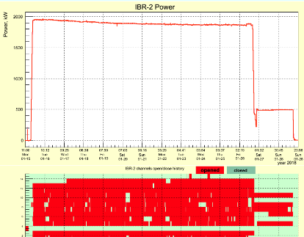
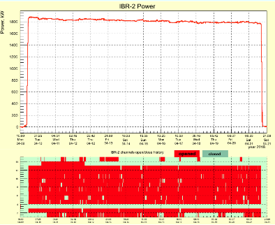
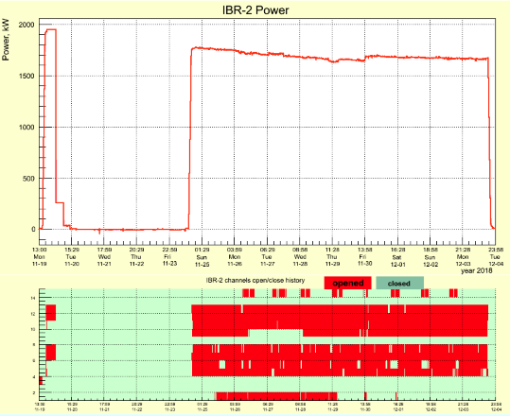
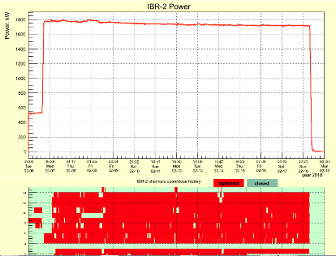
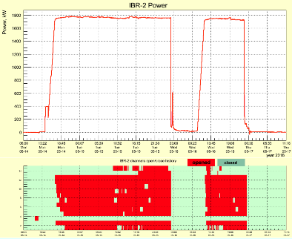
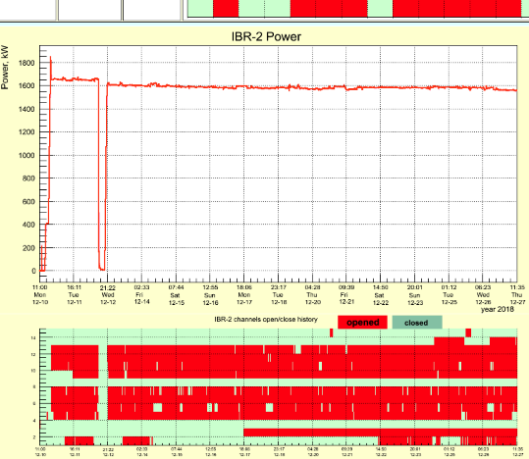
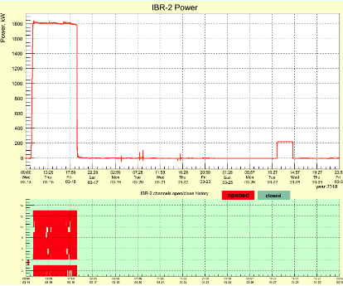
I
IV
VIII
V
II
IX
III
IBR-2 CYCLES IN 2018
2+ CYCLES LOST
≈ 1500 HOURS OP.TIME

Slide 7
IBR-2 2018 OPERATION STATISTICS
Cycle # | Time period | Power level, MW | Time of operation, hours | Power generation, MW⋅hour | The number of emergency shut-downs
1 | 15.01.2018 г. ÷ 28.01.2018 г. | 2,0 | 262 | 551 | -
2 | 06.02.2018 г. ÷ 18.02.2018 г. | 1,8 | 272 | 503 | -
3 | 14.03.2018 г. ÷ 17.03.2018 г. | 1,8 | 56 | 103 | 1
4 | 09.04.2018 г. ÷ 21.04.2018 г. | 1,8 | 283 | 513 | -
5 | 16.05.2018 г. | 1,7 | 45 | 80 | 2
6 | 24.09.2018 г. ÷ 05.10.2018 г. | cancelled
7 | 16.10.2018 г. ÷ 02.11.2018 г. | cancelled
8 | 19.11.2018 г.÷ 04.12.2018 г. | 1,8 | 247 | 454 | -
9 | 10.12.2018 г.÷ 25.12.2018 г. | 1,7 | 332 | 564 | 1
Σ |  |  | 1497 | 2768 | 4

Slide 8
Shut-downs analysis
Emergency shutdown 17.03.2018 at 02:32: malfunction of the control circuit of the electromagnetic sodium pump;
Emergency shutdown 16.05.2018 г. at 02:17: short term power failure outside of JINR;
16.05.2018 at 23:19 reactor stopped by personnel due to the leak of sodium in the second loop;
Emergency shutdown 12.12.2018 г. at 14:00: short term power failure outside of JINR;

Slide 9
IBR-2 RESULTS OF 2018
IBR-2 operational time was about 1500 hours instead of 2500 consequences for the users program will be reported by Dorota Chudoba;
2-nd and 4-th cycles were cryogenics ones;
In December 2018 the spare movable reflector manufacturing was finished and now it’s transportation to JINR is under preparation. The total weight of the equipment is 69 tons. Until the end of 2019 it’ll be ready for installation at IBR-2 in case of necessity;
Sections I and II of the SB-117 0.4 kV switchboard of the external power supply system were replaced;
The water recycling cooling system is under complex upgrade;
Fresh fuel assembly was added to the IBR-2 core in order to compensate fuel burnup in the period 2011-2018;

Slide 10
CRYOGENIC MODERATORS DEVELOPMENT

Slide 11
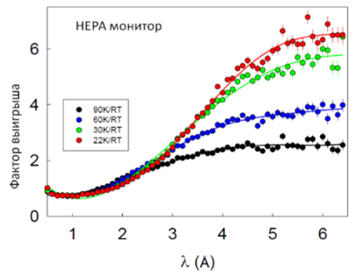
Cryogenic moderators in 2018
22% gain
relative to 30 K
CM-202 operation in 2 cycles with new Linde cryocooler
Date | Power generation, MW*h | Temperature in the moderator chamber, K
06-16.02 | 490 | 22
09-20.04 | 513 | 22

Slide 12
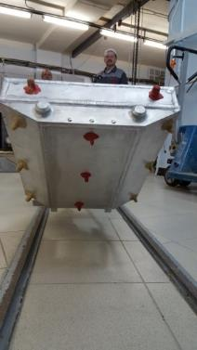
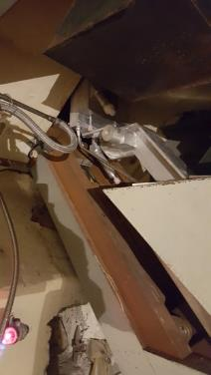
CM-201 for beams #1,9 and 4-6: plans for 2019
CM-201 is manufactured and in2018 fitted on site. The results of the fitting with our remarks are transferred to manufacturer in order to correct the moderator design.
CM-201 acceptance after corrections is scheduled for May 2019;
CM-201 fitting – June-July 2019;
CM-201 commissioning :
  without cryogenics – September – November 2019;
  with cryogenics – September – November 2019 (opt.);
  2020 (real.)

Slide 13
MAJOR EQUIPMENT UPGRADE AND REPLACEMENT

Slide 14
Major equipment replacement plans for 2019
Replacement of the sections III and IV of the SB-117 0.4 kV switchboard of the external power supply system;
Technical specifications preparations and design works on replacement of the different switchboards and ventilation controls at the IBR-2 building;
Replacement of the filters in the special ventilation system (scheduled until 2022);
Realization of the backup power supply system project;
Finances: 1.2 M$

Slide 15
Major equipment replacement plans 2020 - 2026
Detailed annual plans for equipment replacement exists. It includes the electromagnetic sodium pumps (by 2024) and air heat exchangers of the secondary cooling loop (by 2023 loop A and by 2024 loop B);
Finances for years 2020-2026: 6.14 M$

Slide 16
INVESTIGATIONS OF THE DYNAMICS OF THE POWER FEEDBACK EFFECTS AT THE IBR-2
COURTESY OF THE FLNP NUCLEAR SAFETY GROUP HEADED BY Y.N.PEPELYSHEV

Slide 17
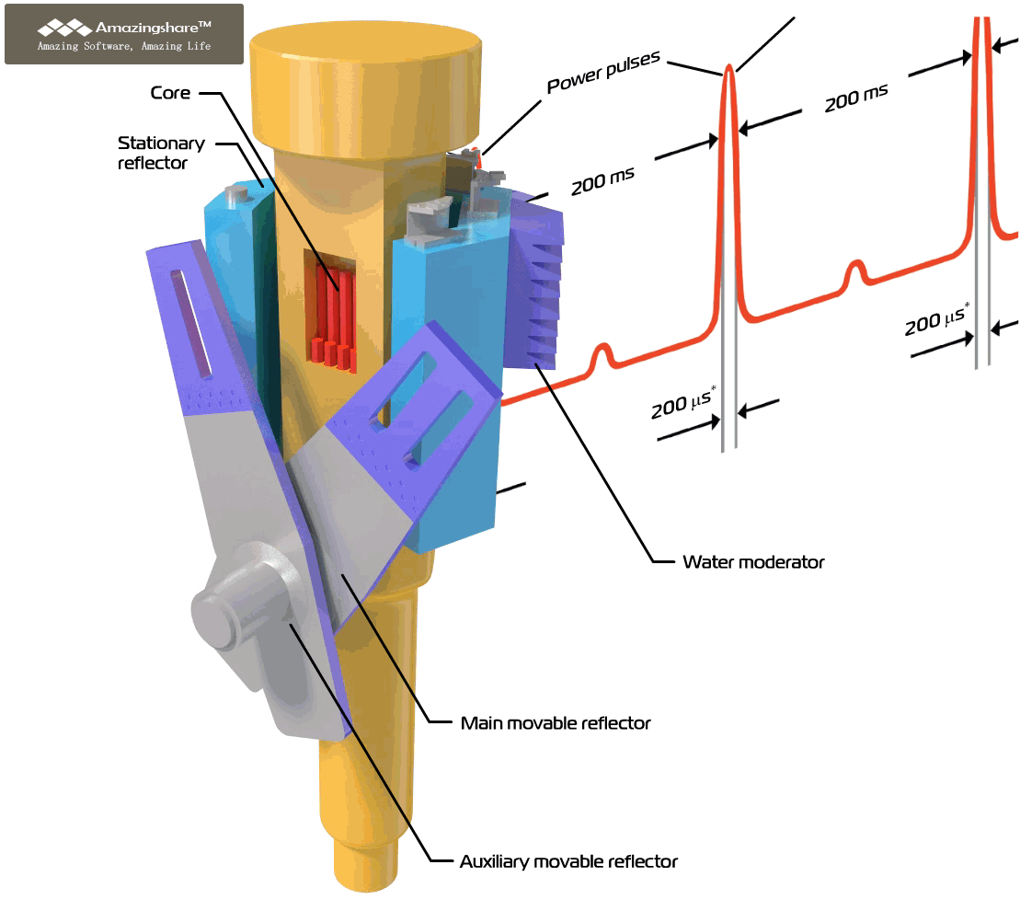
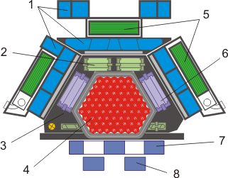
IBR-2 Power Noise Sources
1 – water moderators; 2 – stationary reflector; 3 – blocks of the RPS; 4 – fuel assemblies; 5- cold moderators; 6 – control rods; 7 – main movable reflector; 8 – auxiliary movable reflector; sodium coolant flow in the core;

Slide 18
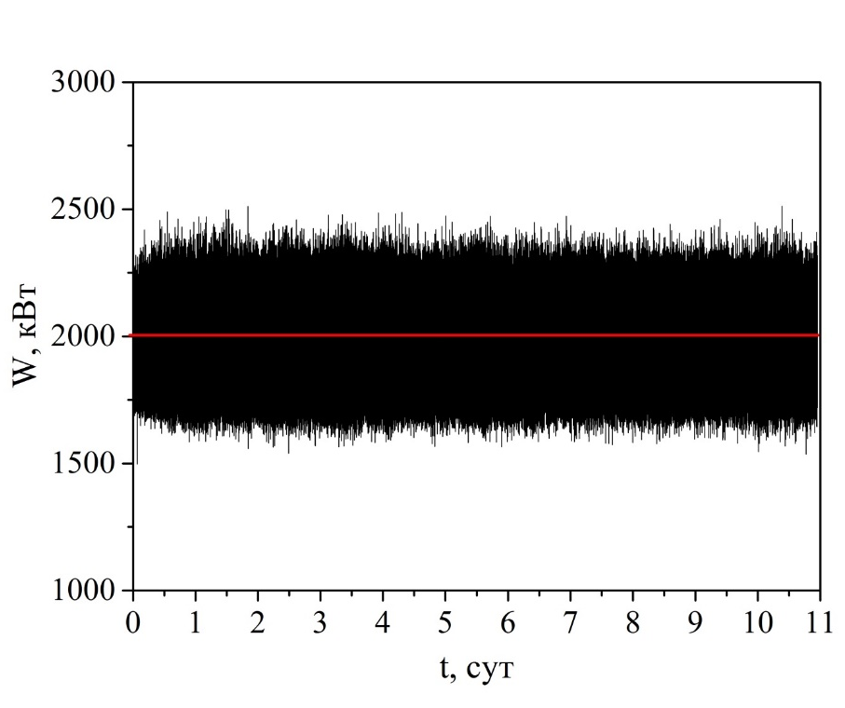
IBR-2 power noise at 2 MW

Slide 19
IBR-2 noise spectral composition
Spectral density of the pulse energy fluctuations at 2 MW average power. Shaded region – vibrations of the movable reflectors. Grey colored region from 0 to 0.26 Hz – result of the operation of automatic power controller.

Slide 20
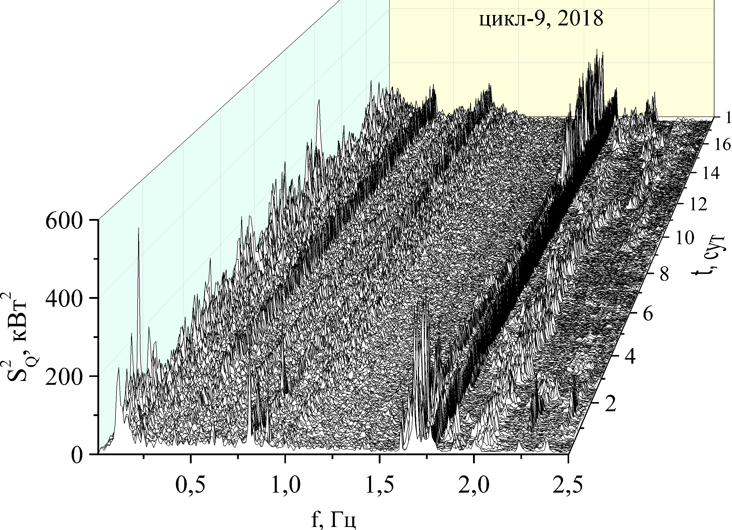
IBR-2 noise spectral density evolution (short-term)
Evolution of the spectral density of the pulse energy during cycle #9 in December 2018. Average power 1.7 MW, cycle duration 17.6 days, 927 spectra accumulated.

Slide 21
IBR-2 noise spectral density evolution
(long-term)
Evolution of the spectral density of the pulse energy in the full frequency region (left) and in the low frequency region (right) during 2011-2018

Slide 22
Dispersion of the maximal amplitude of the low frequency pulse power oscillations. Red and blue points corresponds to the different cycles.

Slide 23
CONCLUSION

Slide 24
Since 2017 at the modernized IBR-2, as well as at the first version IBR-2, there is a noticeable increase in fluctuations of the pulse power. This effect starts at approximately 600 MW⋅days power generation and saturates at the level about 1300 MW⋅days;
These fluctuations are totally within the limits, established for safe operation;
Nevertheless, in order to ensure the long-term operation of the reactor the following safety measures are currently taken:
  An average power of the reactor during experimental cycles will be reduced to 1.7 MW;
  The flow rate of sodium coolant in the first loop is set to at least 100 m³/hour;
  pulse power fluctuations and core dynamics will be monitored in every cycle in order to unhide the root causes of this phenomenon;
  FLNP will involve the IBR-2 chief designer NIKIET into these activity;
Depending on the progress in the abovementioned investigations we’ll increase the duration of reactor cycles in order to fulfil the demands from the user community;

Slide 25
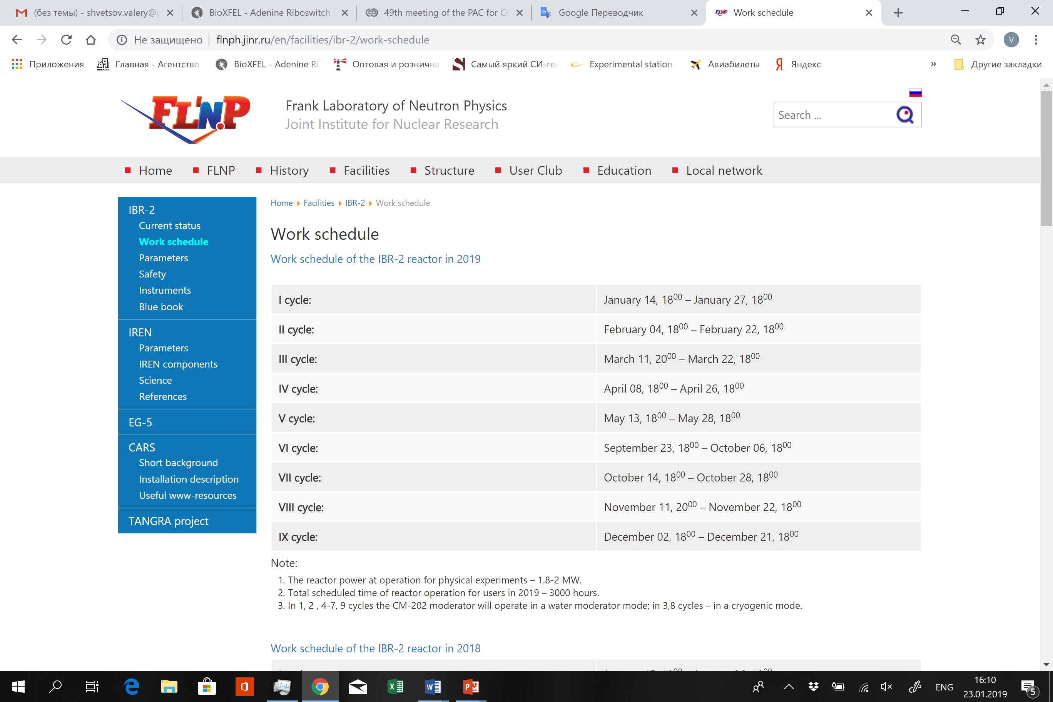
MORE THAN 3000 HOURS

Slide 26
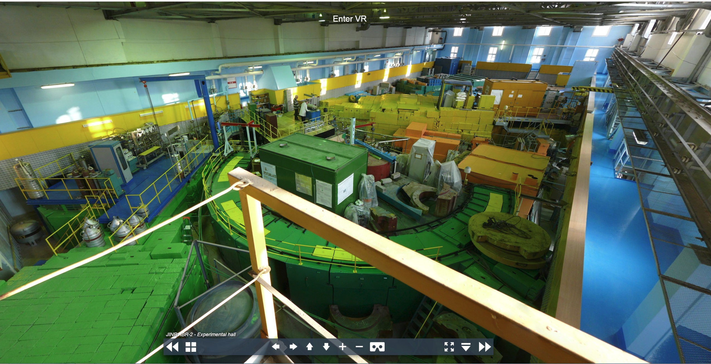
Thank you for your attention!

