Slide 1
Condensed matter research at the IBR-2: overview of main scientific results and instrumentation developments in 2018
D.P. Kozlenko
Frank Laboratory of Neutron Physics, Joint Institute for Nuclear Research, 141980 Dubna, Russia

Slide 2
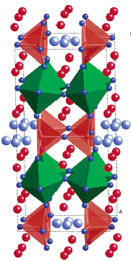
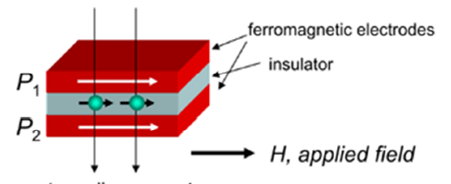
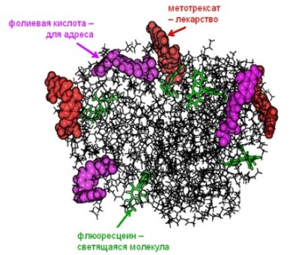
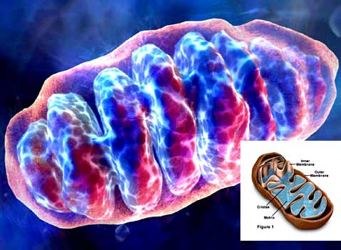
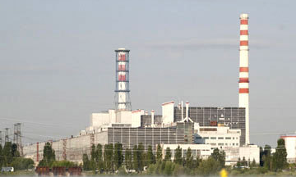
The priority directions of scientific research :
Physics and chemistry of novel functional materials;
Physics of nanosystems and nanoscale phenomena;
Physics and Chemistry of Complex Liquids and Polymers;
Molecular Biology and Pharmacology;
Materials and Engineering Sciences.

Slide 3
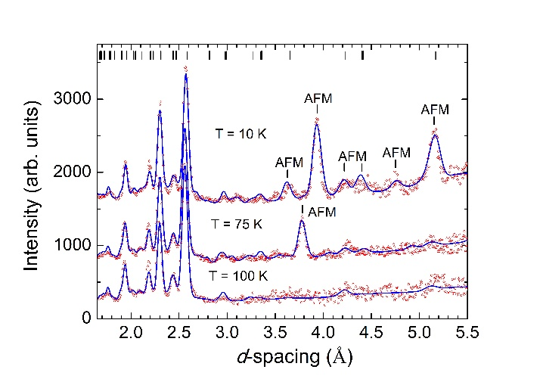
Spin-induced multiferroicity in novel phase of binary oxide Mn₂O₃
0
Ferroelectric polarization as function of temperature and magnetic field
Perovskite-like crystal structure of Mn₂O₃
Modulated magnetic structures formed in Mn₂O₃ below T_{N1} = 100 K and T_{N2} = 50 K.
Neutron diffraction patterns of Mn₂O₃, measured at the DN-12 diffractometer
J.Cong, … D.P.Kozlenko, S.E.Kichanov et al., Nature Communications (2018)

Slide 4
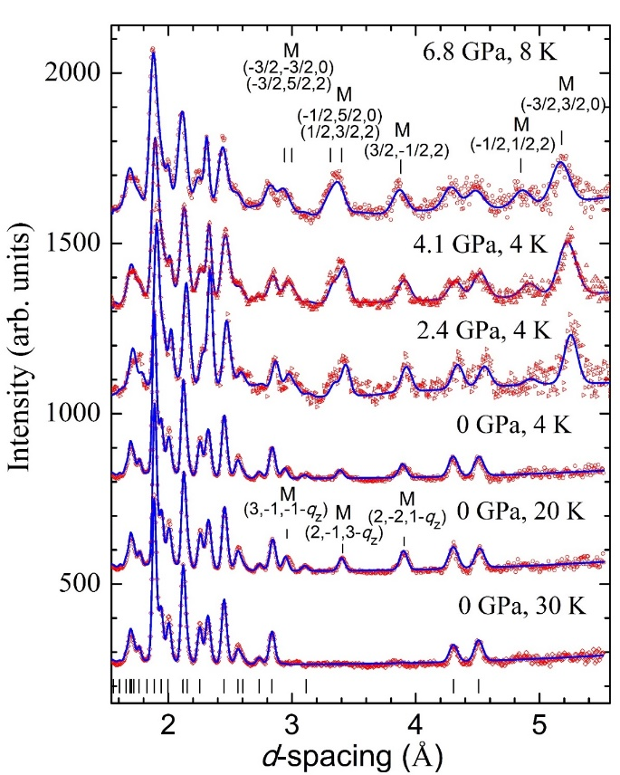
Novel pressure-induced phase in the spin-chain compound Ca₃Co₂O₆
Commensurate AFM phase, T_{N} = 26 K at 2 GPa
P
Incommensurate spin density wave (SDW) phase, T_{N} = 25 K
Crystal structure, in-chain (J₁) and inter-chain (J₂, J₃) magnetic interactions of Ca₃Co₂O₆
Neutron diffraction patterns of Ca₃Co₂O₆, measured at DN-6 diffractometer at different pressures and temperatures
D.P.Kozlenko et al., Phys. Rev. B (2018)

Slide 5
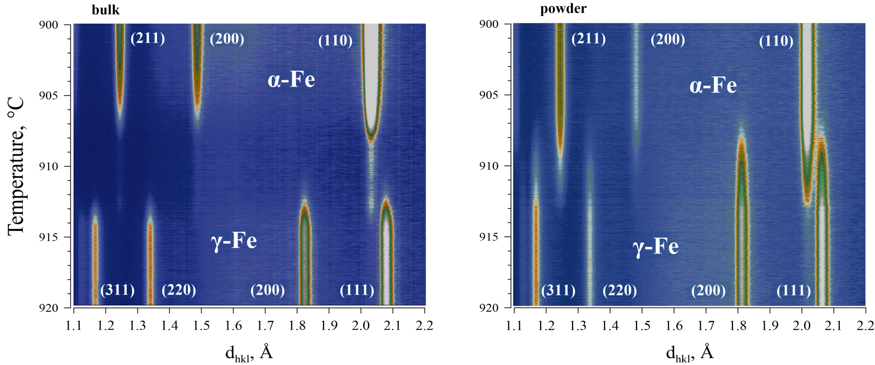
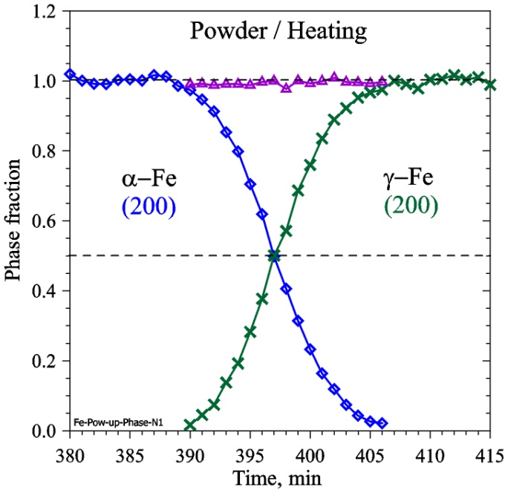
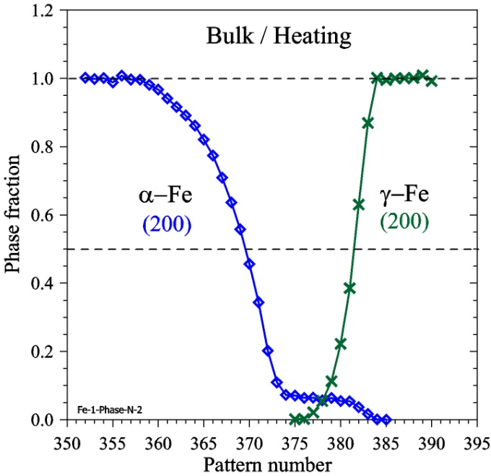
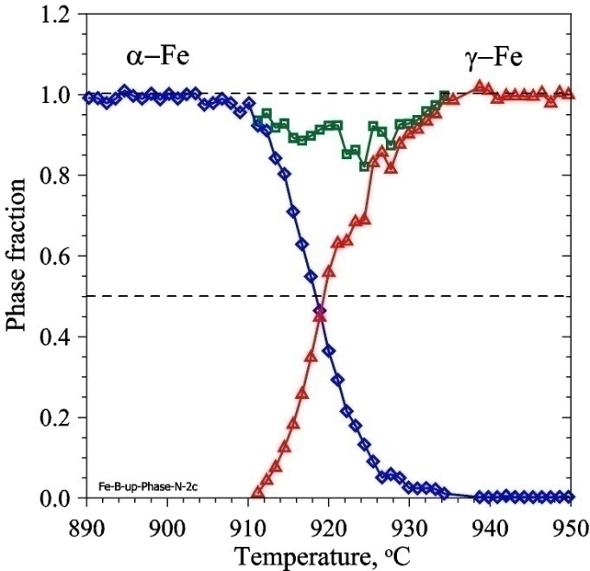
In situ real-time study of α- γ structural phase transition in bulk and powdered iron
Bulk
Powder
Powder
α + γ ≈ 1
Bulk
Bulk, 2nd heating
Δd = (1.1 – 2.2) Å ΔT = (905 – 925)°C ΔT/Δt = 0.5°C/min
Δt = 40 min t_{s} = 1 sec ΔN ≈ 2400 patterns
α + γ << 1
α + γ < 1
A.M.Balagurov et al., JETP Letters (2018)

Slide 6
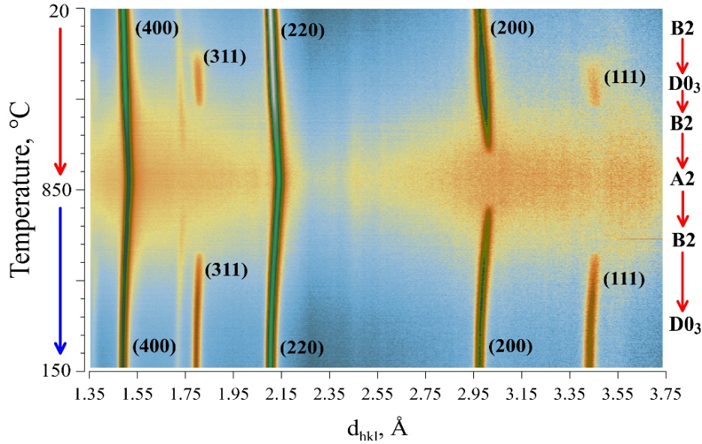
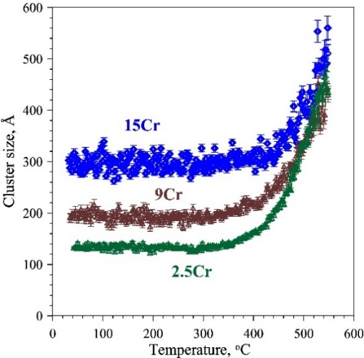
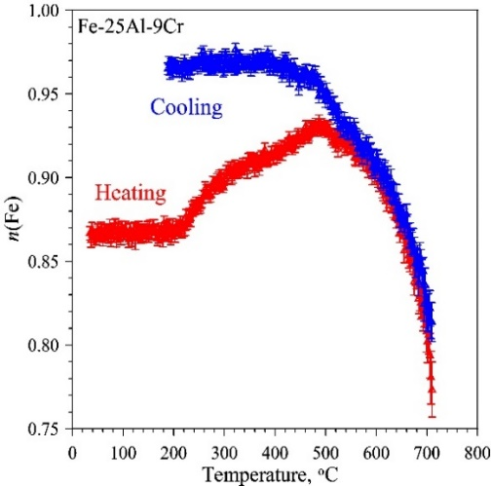
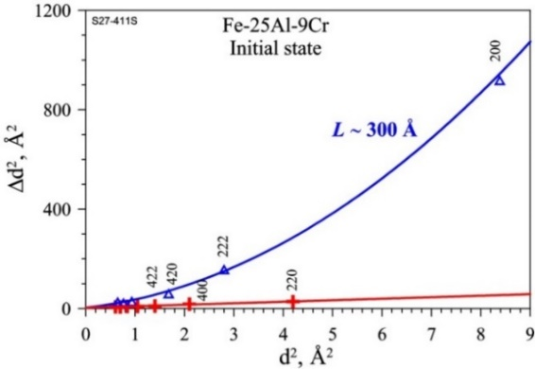
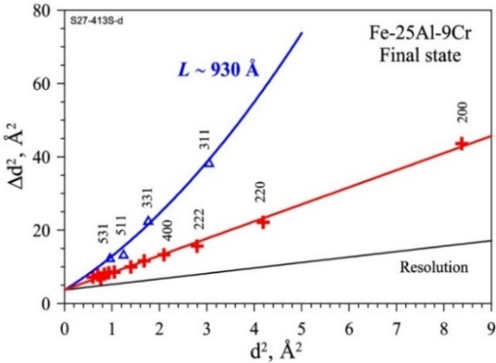
Structural study of Fe-Al-Cr intermetallics
Temperature dependence of the average cluster size with ordered structure in compounds with 2.5, 9 and 15 at. % Cr
Temperature dependence of the occupation factor of one of the iron positions in Fe-25Al-9Cr
2D presentation of neutron diffraction patterns of Fe-25Al-15Cr and squared peak width dependence on squared peak position of Fe-25Al-9Cr
A.M.Balagurov et al, Phys. Rev. Materials, accepted (2018)

Slide 7
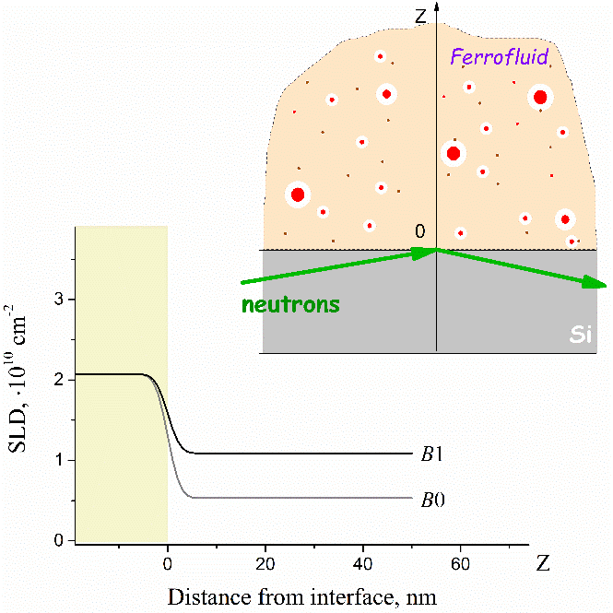
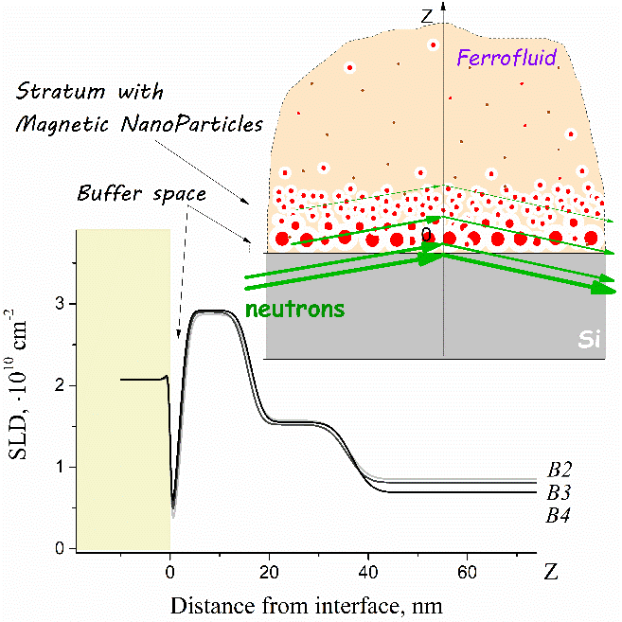
Magnetic nanoparticle assembling induced by non-homogeneous magnetic field at interface by neutron reflectometry
(FLNP JINR – KNU – IEP SAS)
Reflectivity curves
no visible structural ordering of MNPs at near-interface region at low magnetic field
Principal scheme of a sample cell for NR experiments on the ferrofluid/silicon interface under an external magnetic field
zero and weak magnetic fields
high magnetic flux density (35-75 mT)
Reflectivity curves
A.V.Nagornyi et al. Appl. Surf. Sci. (2018) in press

Slide 8
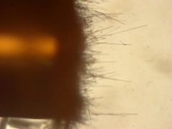
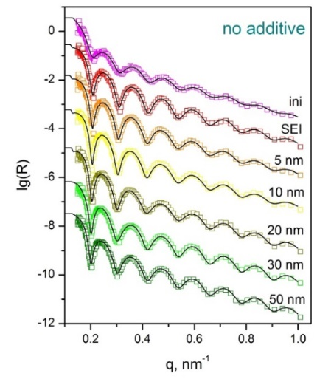
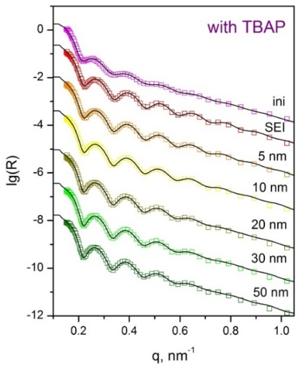
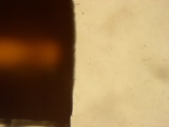
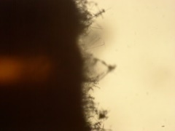
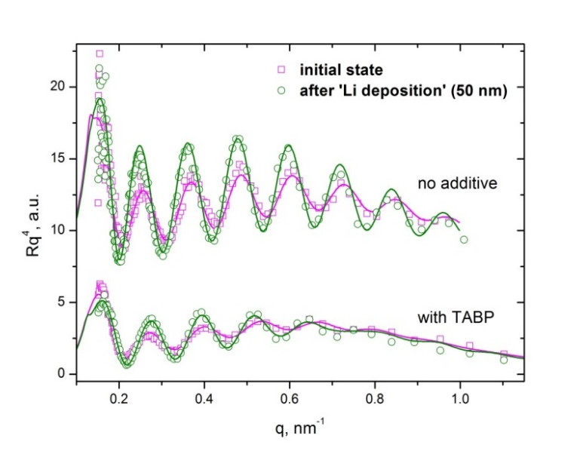
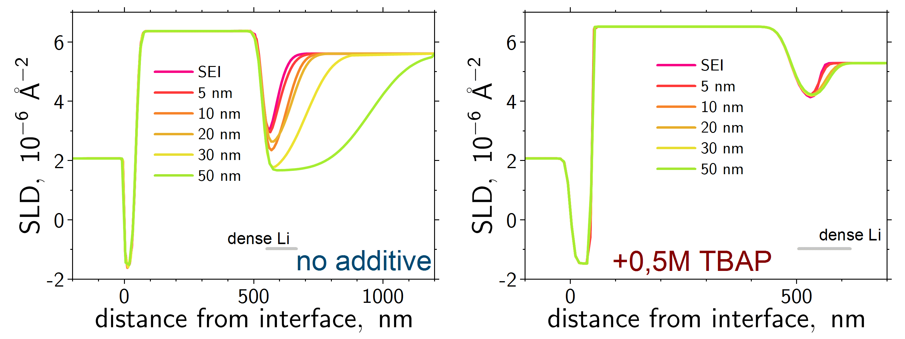
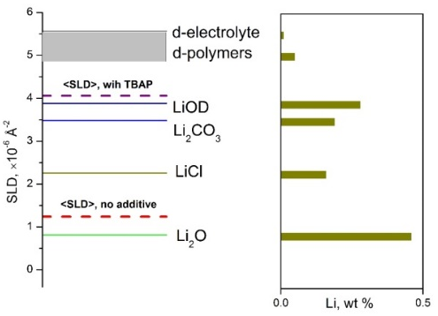
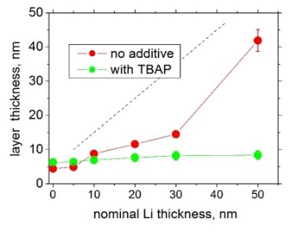
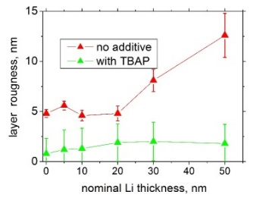
Effect of non-electroactive additives on electrochemical interfaces by neutron reflectometry
(FLNP JINR – Chem. Dep. MSU – Dubna University - Engineering Incubator Ltd.)
Effect of Non-Electroactive Additive: Optical Microscopy
NR Study of TBAP Effect on Li Plating
without additives
τ ~ 1 h
TBAP addition
TBAP changes ‘dendrite’ morphology
Reflectivity curves
SLD profiles
Structure of Li-deposition Layer by NR
thickness
roughness
M.V.Avdeev, et al. Coll. Surf. A (2018) submitted

Slide 9
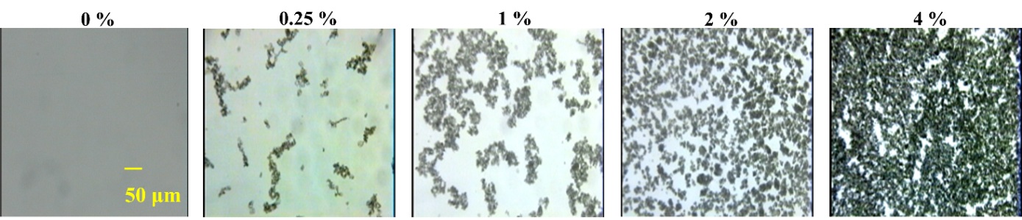
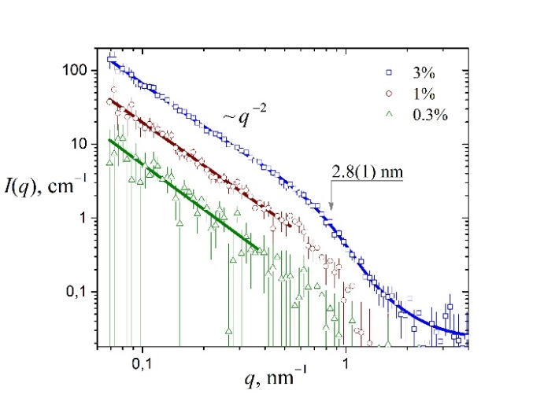
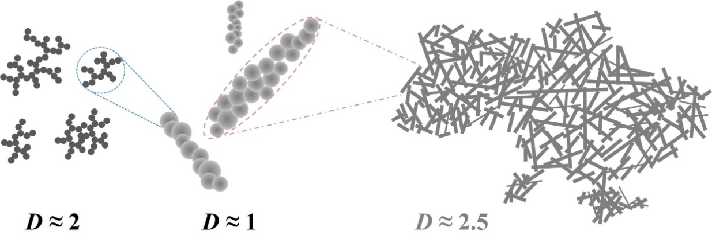
Aggregation of diamond nanoparticles in nematic liquid crystal-based composites
SANS curves and structural organization of liquid crystal suspension with nanodiamonds
S.V. Tomylko et al., Materials Today: Proceedings (2018) submitted

Slide 10
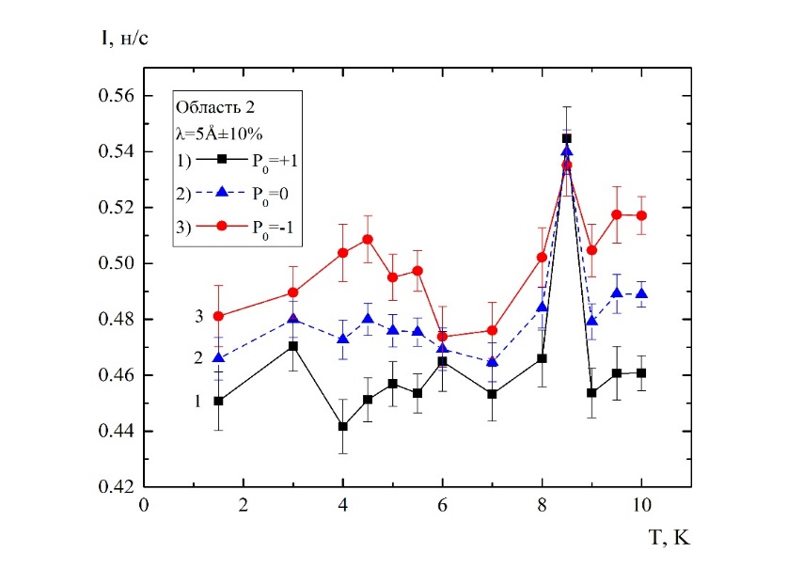
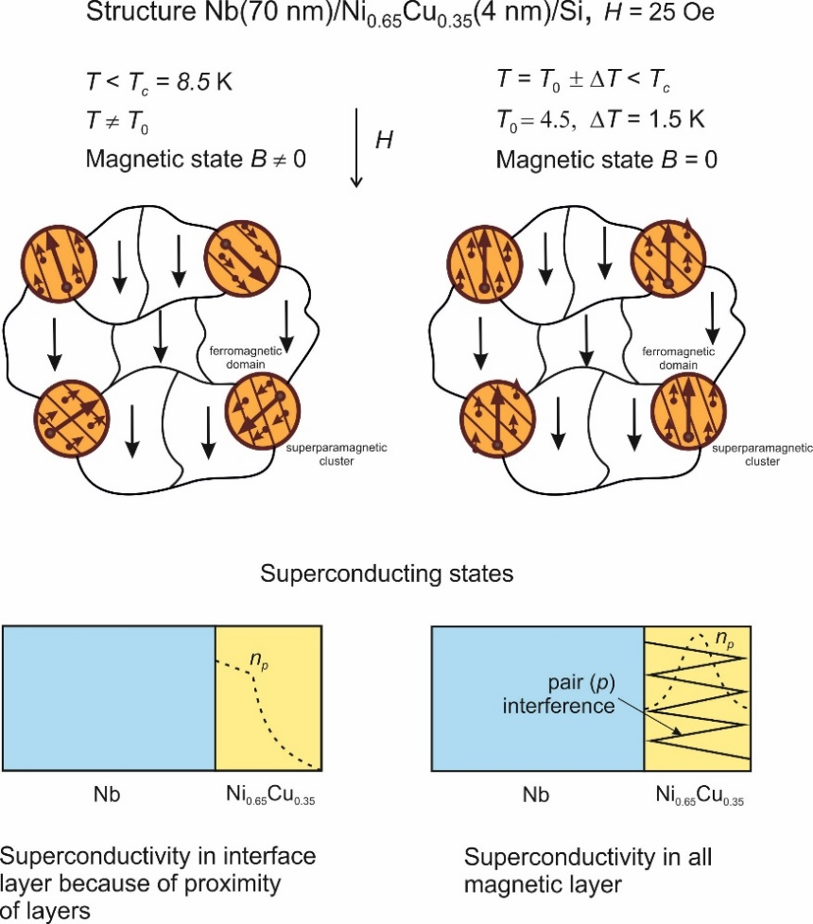
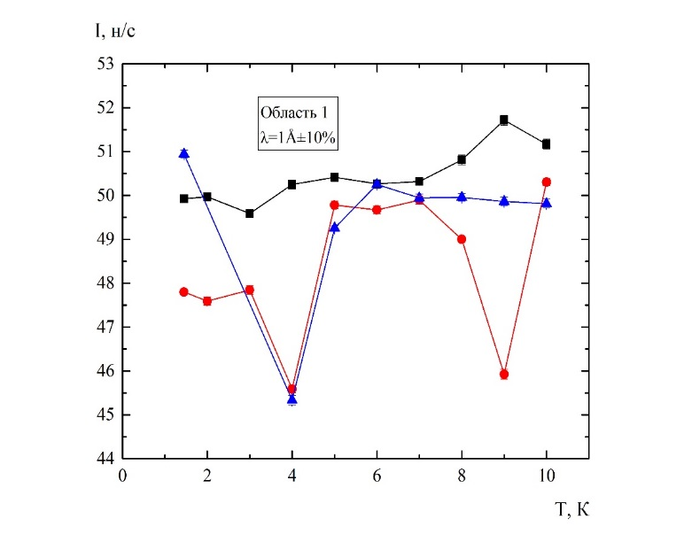
Magnetic and superconducting states in layered nanostructure Nb(70nm)/Ni_{0.65}Cu_{0.35}(6.5nm)
Scattering intensity of neutrons with wavelengths λ = 5 and 1 Å

Slide 11
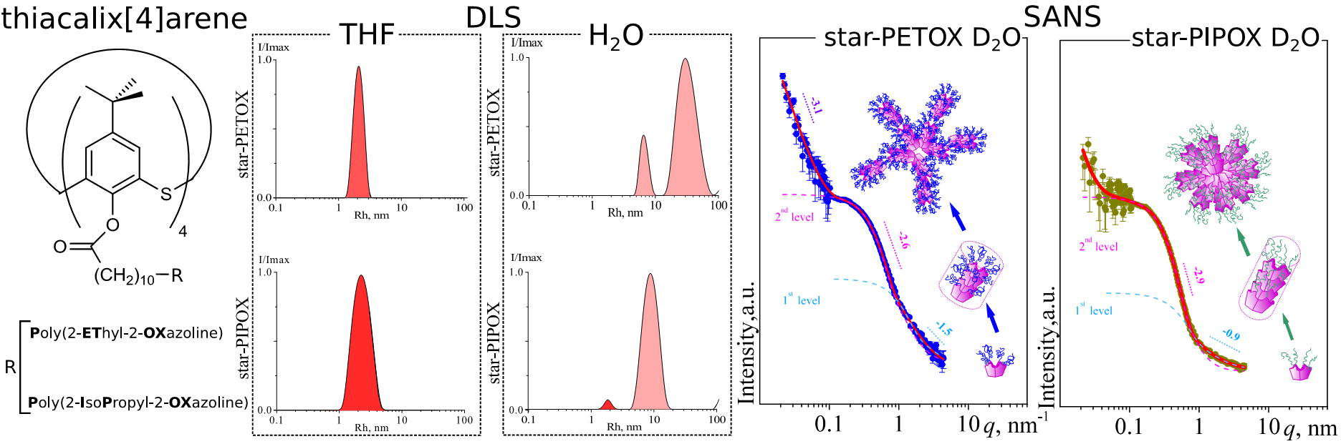
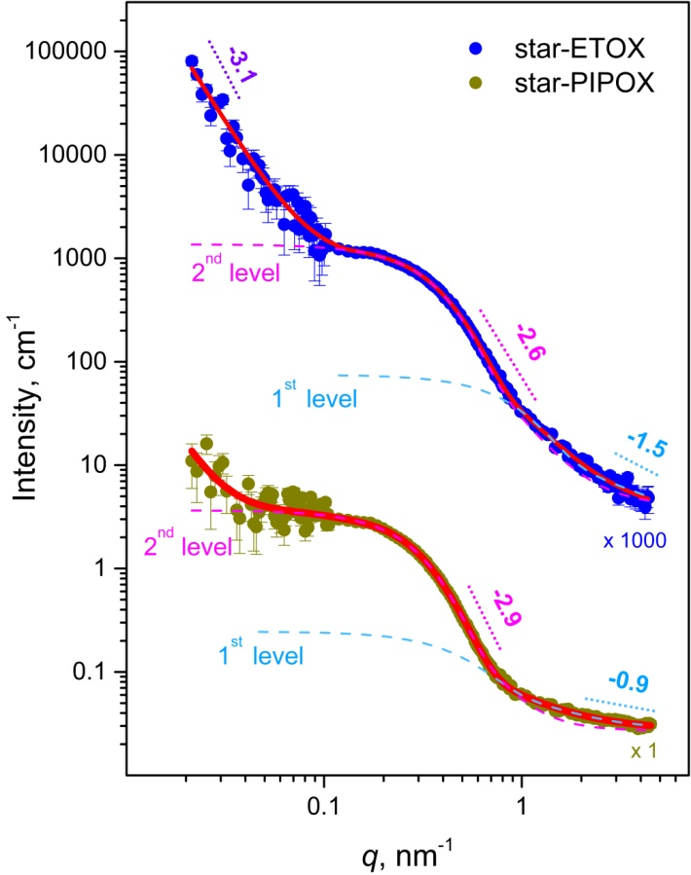
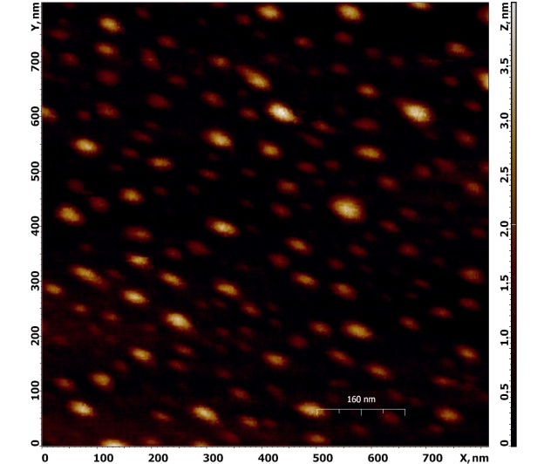
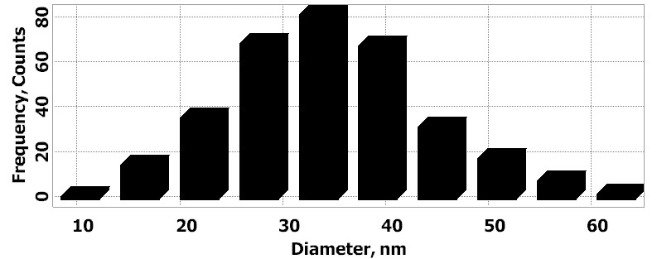
Structural organization of star-shaped poly(2-ethyl-2-oxazoline) and poly(2-isopropyl-2-oxazoline) with central thiacalix[4]arene fragments
SPBU–JINR,RU
SANS &DLS: ϱ = R_{g}/R_{H} = 1.4—1.8
USANS
FRM-II
SANS
IBR-2
MOLECULAR-DISPERSITY STARS
AFM image: star-ETOX
12
19
A.A. Lezov, A.S. Gubarev, …, Yu.E. Gorshkova,
Colloid and Polymer Science, 2019.
Notes:
Introduction
Poly(2-oxazoline)s are a versatile tool for designing polymer objects with complex architecture and adjustable physico-chemical properties. Due to their biocompatibility, the obtained structures can be used in medicine and pharmaceutics [1, 2]. Great interest in oxazoline studies is related to the fact that these polymers can partially replace poly(ethylene glycol) (PEG) in medical applications. Besides, as compared with PEG, poly(2-oxazoline)s possess additional useful physico-chemical properties, such as low viscosity and high stability. Furthermore, synthesis of poly(oxazolines) is easier than PEG preparation [3]. Recently [4] it has been demonstrated that immune system may produce anti-PEG antibodies, which results in accelerated blood clearance of PEG-containing medicinal preparations. This fact causes additional interest in the studies of poly(2-oxazoline)s as PEG substitutes.
Poly(2-oxazoline)s have already found applications in the synthesis of hydrogels [5], in development of biomedical devices [6–8].

Slide 12
Crystal field effects in Ho¹¹B₁₂
Ho¹¹B₁₂ scattering law (grey circles) measured at DIN 2PI and NERA spectrometers at 3.5K. The initial energy at DIN 2PI spectrometer was 5meV and final energy at NERA 4.85meV. Solid red line is the S(ω) calculated with the crystal field model including mean field and blue dashed line is expected spectrum without magnetic order i.e. crystal field only.

Slide 13
Mechanical properties and microstructure of 3D sample from austenitic steel 304 obtained by selective laser melting (SLM)
The 3D sample manufactured by SLM method
The texture effects at different sample sides in neutron diffraction patterns compared to powdered material
The obtained residual strains and stresses in the studied 3D sample

Slide 14


Crystallographic Preferred Orientations (CPO) in eclogites
Metamorphic rocks: ultrahigh pressure metamorphism of mafic rocks:
at p > 1.2 GPa (45 km depth), T = 600-650°C
R. Keppler, J.Struct. Geol. (2018)

Slide 15
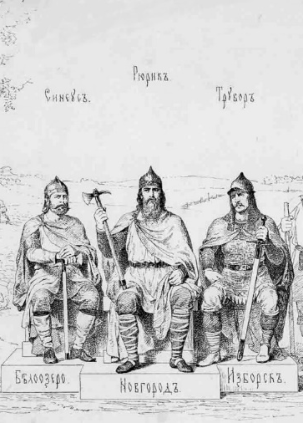
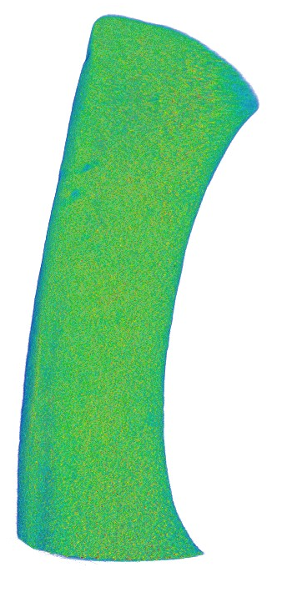
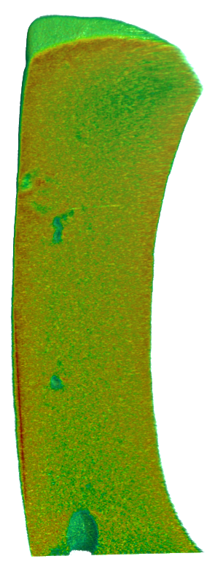
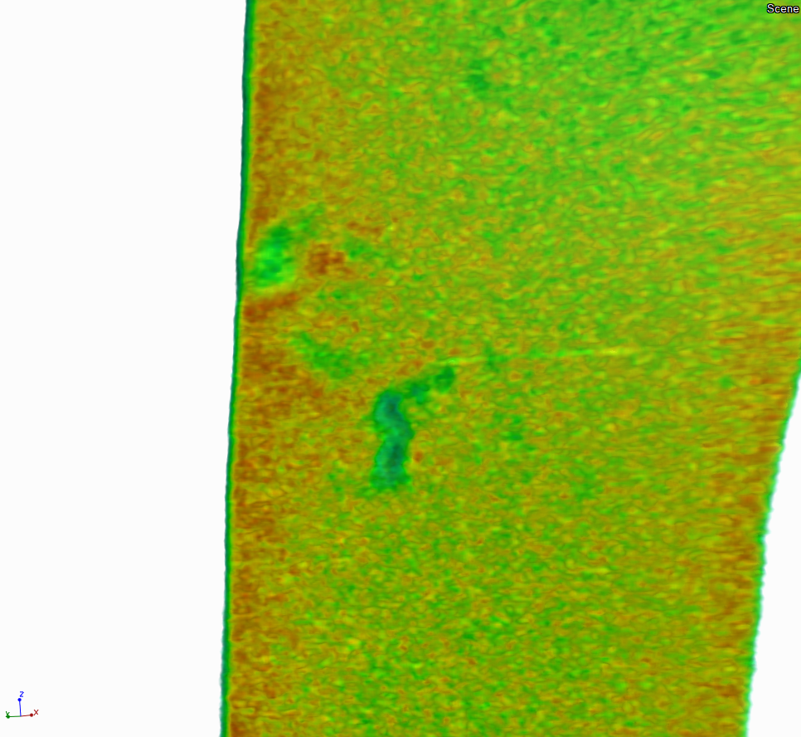
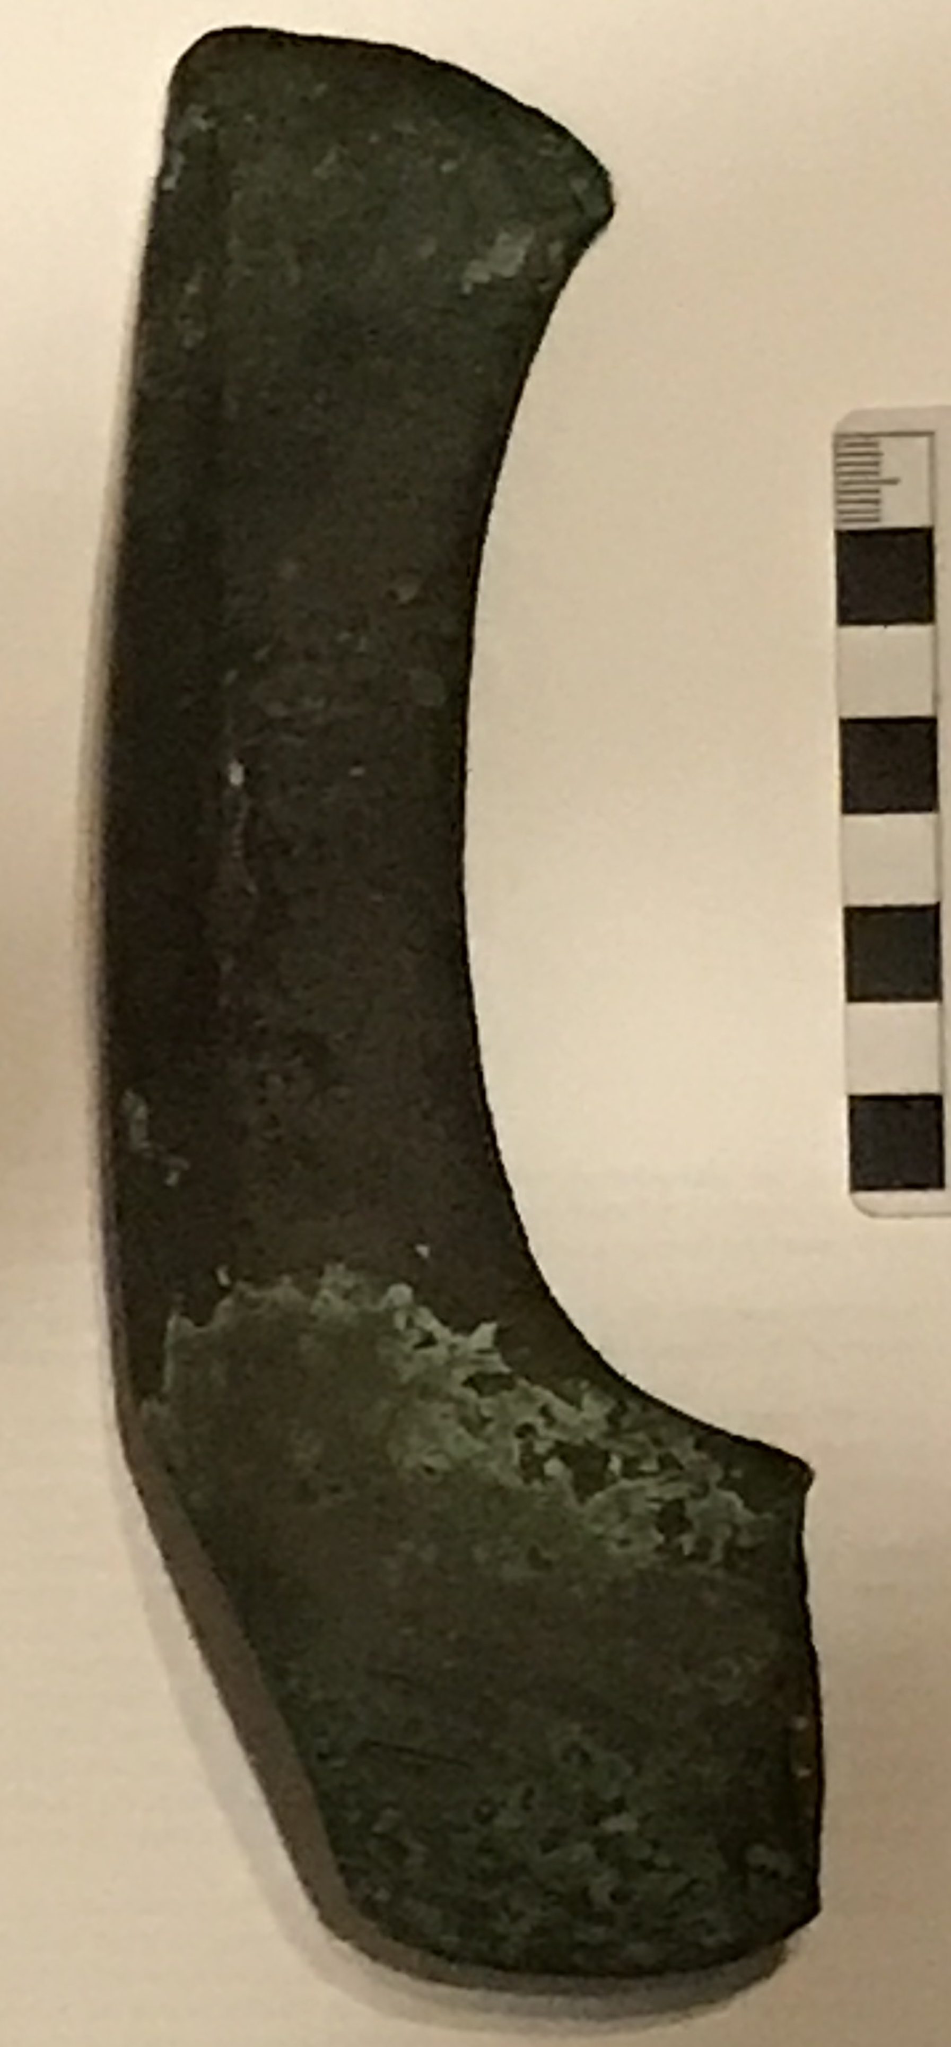
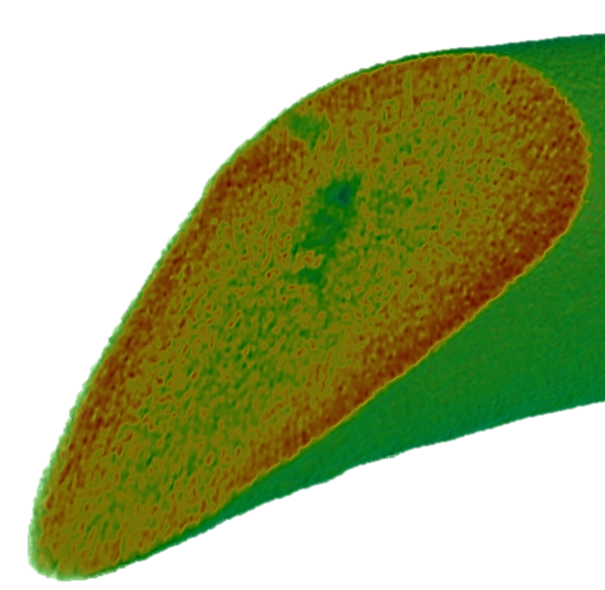
The X-century ancient Slavic axe : the neutron tomography studies
Notes:
Методом нейтронной томографии исследован древнеславянский топор, датируемый X веком нашей эры. В данный момент сотрудники Института Археологии РАН ведут работы по исследованию технологии изготовления этого топора и определяют степень сохранности этого объекта. Это связано с выяснением культурологического происхождения топора: норманская группа (викинги) или локальное, древнерусское происхождение. Нейтронная томография указывает на процессы распространения дефектов в толще топора, что может указывать как на сохранность объекта, так и на механические повреждения.

Slide 16
Development of the new Fourier-chopper for the FSD diffractometer
The model design of the Fourier chopper: general view (left) and internal construction (right)

Slide 17
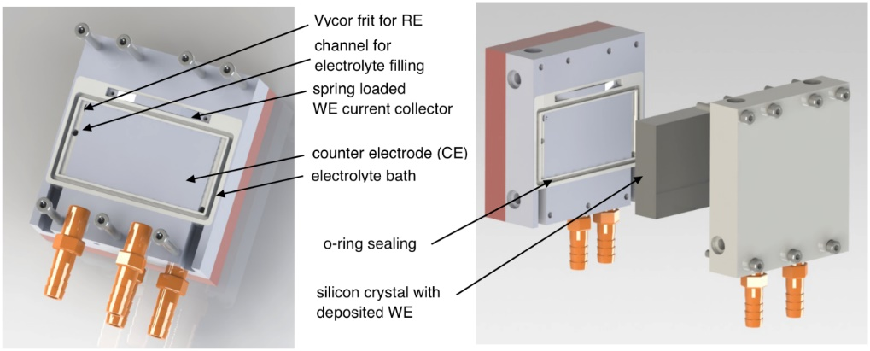
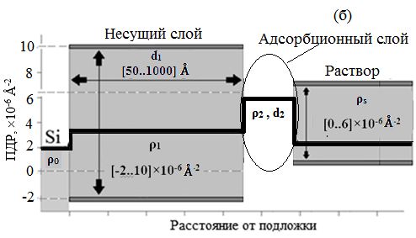
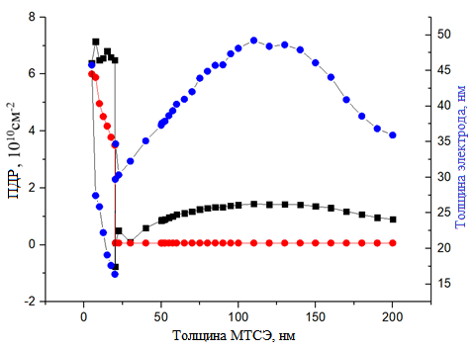
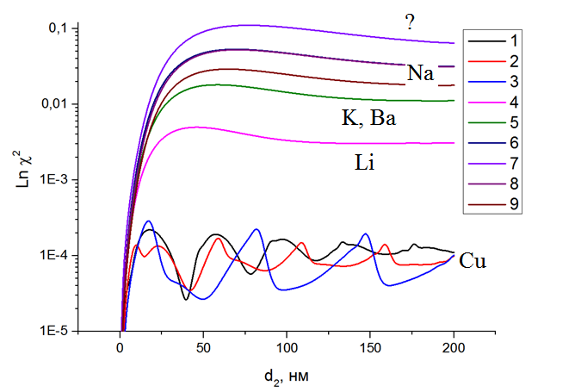
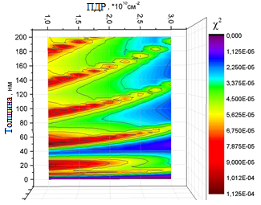
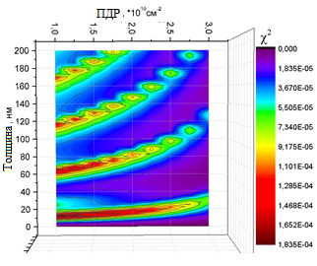
Electrochemical cell for neutron reflectometry and optimization procedure
Electrochemical cell for neutron reflectometry
(FLNP JINR – KNU – Chem. Dep. MSU)
Support layer
(electrode)
Adsorption layer
Liquid electrolyte
SLD, x10⁻⁶ A⁻²
Distance from substrate
Kataev E.Yu., Gapon I.V., Itkis D.M., Belova A.I., Avdeev M.V., RF Patent 2654317 (2018)
Optimal values of cell parameters for various regimes
Sensitivity of NR curves for various cell parameter sets
SLD, x10¹⁰ cm⁻²
Lnχ²
SLD, x10⁻⁶ A⁻²
Thickness of the electrode, nm
Thickness, nm
Thickness of the adsorption layer, nm
d, nm
Petrenko V.I., Kosiachkin Ye.N., Bulavin L.A., Avdeev M.V., J. Surf. Invest. (2018)
Petrenko V.I., Kosiachkin Ye.N., Bulavin L.A., Avdeev M.V., J. Surf. Invest. (2018) in press.

Slide 18





Development of Isotope-identifying neutron reflectometry at IBR-2 reactor
Creation of three registration channels of secondary radiation: spin-flipped neutrons,
charge particles and gamma-quants
The equipment of the spin-flipped neutrons (left),
charge particles (middle) and gamma-quants (right) registration channels
Intensity dependencies for nanostructure
Cu(10 nm)/V(55 nm)/CoFe(5nm)/ ⁶LiF(5 nm)/V(L nm)/glass, L = 5 (1), 15 (2)
of reflected neutrons (red) and charge particles (black) from neutron wavelength at glancing angle 3 mrad
Notes:
At the FLNP JINR, the project “Isotope-identifying neutron reflectometry (IINR) at IBR-2M reactor” was realized during last years. In the framework of the project, three complementary channels for registration of the spin-flipped neutrons, charge particles and gamma-quants have been created at the REMUR reflectometer. They allow obtaining detailed information about magnetic properties and isotope spatial distribution of the complex layered nanostructures, leading to better understanding of the physical properties of such systems. The necessary equipment has been developed and created and first test experiments were performed.

Slide 19


New neutron guide (m=2) at FSS diffractometer (beamline 13)
FSS: comparison of spectral distributions measured with old and new neutron guides.
FSS: spectra measured with old and new neutron guides
FSS spectrum fitted by Rietveld method
FSS: new neutron guide
Comparison of FSD and FSS

Slide 20
Development of the water-cooled spin rotator coils for the SESANS instrument
The spin rotator coil design (a), the calculated temperature distribution (b), water cooling radiators of spin rotators (c) and air-water cooling for electronics supply (d).

Slide 21
Development of the neutron guide system of the NERA spectrometer
Elements of the supermirror neutron guide with vertical focusing (m = 5)
Spectral distribution of the incident neutron beam at the sample position measured with the vanadium sample
The end part sections of the mirror neutron guide (m = 1) at the NERA spectrometer of 25 m length have been replaced by the supermirror sections ( m = 5) with vertical focusing, fabricated by SwissNeutronics. The average gain factor of 1.5 times has been achieved.

Slide 22





Development of the neutron radiography and tomography spectrometer at the stationary reactor WWR-K (INP, Kazakhstan)
Neutron flux at the sample position
~4.5×10⁸ н/см²/с
Design of the basic configuration of the instrument at the channel No. 1
Two mirror CCD camera-based detector system
First experimental results: neutron images of the alarm clock, padlock and rotor of small engine

Slide 23
Thank You for Your Attention!

