Slide 1
STRUCTURAL AND FUNCTIONAL PROPERTIES OF MUTANT NMDA SYNAPTIC RECEPTORS
DUSHANOV E., BUGAY A., BATOVA A.
Laboratory of Radiation Biology

Slide 2
INTRODUCTION
In the development of various kinds of neurodegenerative diseases, as well as after exposure to ionizing radiation, a number of disorders are associated with changes in the synaptic transmission. It is suggested that these effects are of a genetic nature and are associated with the occurrence of mutations in genes encoding key proteins.
The aim of this work was to develop a computational approach capable to establish a link between mutations in a genetic structures and high-level observable properties of neural tissue.
In the course of the work, molecular-dynamic modeling of NMDA receptor ion channel gating was carried out. The receptor was constructed from mutant forms of proteins. The analysis of the resulting configurations made it possible to determine the change in the conductivity of the ion channels, and the obtained data were implemented in the structure of model neural network of hippocampus.
As a result, it was possible to identify the effect of single and double point mutations in the genes encoding protein subunits of NMDA receptors on the generation of theta- and gamma- rhythms by the neural network. Obtained results can be applied for the analysis and evaluation of possible cognitive impairments arising from the action of radiation and other negative factors

Slide 3
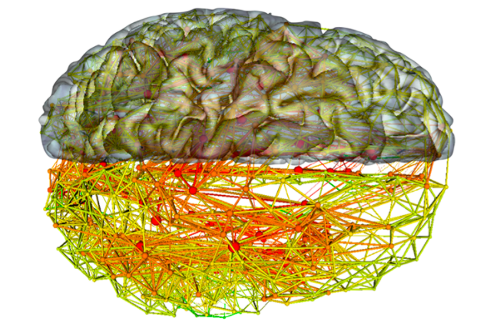
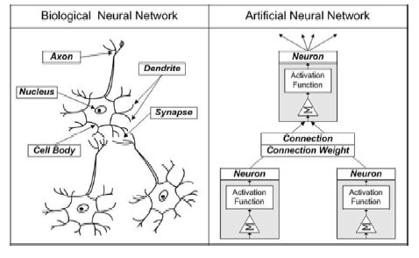
NEURAL NETWORKS
In neuroscience, a biological neural network is a series of interconnected neurons whose activation defines a recognizable linear pathway.
The interface through which neurons interact with their neighbors usually consists of several axon terminals connected via synapses to dendrites on other neurons. If the sum of the input signals into one neuron surpasses a certain threshold, the neuron sends an action potential at the axon hillock and transmits this electrical signal along the axon.
Biological neural networks have inspired the design of artificial neural networks.
Images credit: Quanta Magazine and Wikipedia

Slide 4
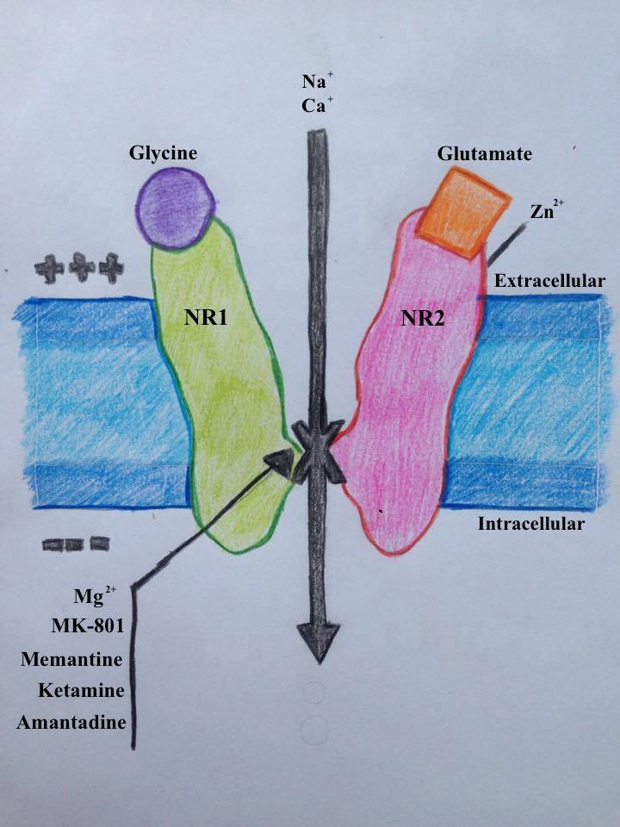
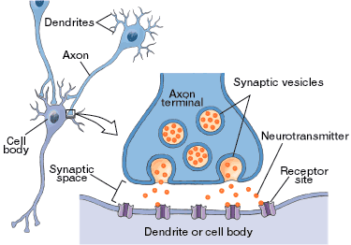
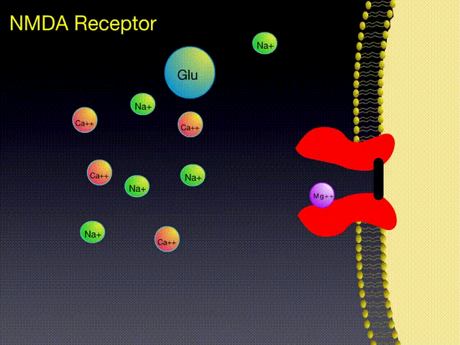
NMDA SYNAPTIC RECEPTOR
Axons terminals connected via synapses to dendrites
Neurotransmitters in the synaptic space
Activation of NMDA receptor (ion channel)
Gating mechanism of ion channel

Slide 5
GRIN2B MUTATIONS
Mutation | Phenotype | Consequences
p.Cys461Phe p.Arg540His p.Asn615Leu p.Val618Gly p.Phe671_Gln672del | Autistic features ID, focal epilepsy West syndrome West syndrome Mild ID, autism | ND Decreased magnesium block Decreased magnesium block Decreased magnesium block ND
Lemke, JR et al. GRIN2B Mutations in West Syndrome and Intellectual Disability with Focal Epilepsy // Ann Neurol., (2013) 75:147-154.
Burnashev N and Szepetowski P. NMDA receptor subunit mutations in neurodevelopmental disorders // Current Opinion in Pharmacology (2015) 20:73-82.

Slide 6
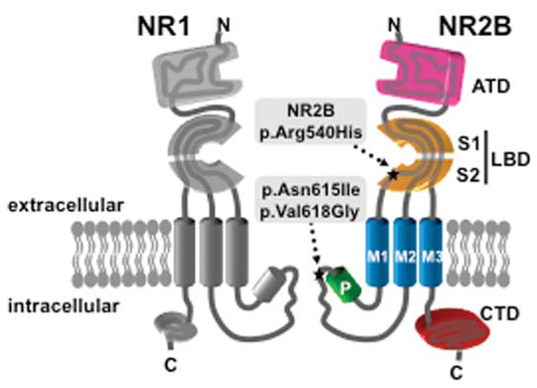
GRIN2B MUTATIONS
Preparing structures to simulation:
The first structure was chosen to be native; other ones carried one of three known missense mutations in NR2b subunit and the last one corresponded to deletion. First one (p.Arg540His) is located in the extracellular glutamate-binding domain, whereas other two belong to the NR2B ion channel-forming reentrant loop (p.Asn615Ile and p.Val618Gly). Additionally we
have analyzed the deletion in the gene GRIN2B c.2011-5 2011-4delTC, which is predicted to result in an inframe deletion of amino acids Phe671 and Gln672
(p.Phe671_Gln672del). These mutations were reported in various neurological deceases, including West syndrome and focal epilepsy.
Lemke, JR et al. GRIN2B Mutations in West Syndrome and Intellectual Disability with Focal Epilepsy // Ann Neurol., (2013) 75:147-154.
Burnashev N and Szepetowski P. NMDA receptor subunit mutations in neurodevelopmental disorders // Current Opinion in Pharmacology (2015) 20:73-82.

Slide 7
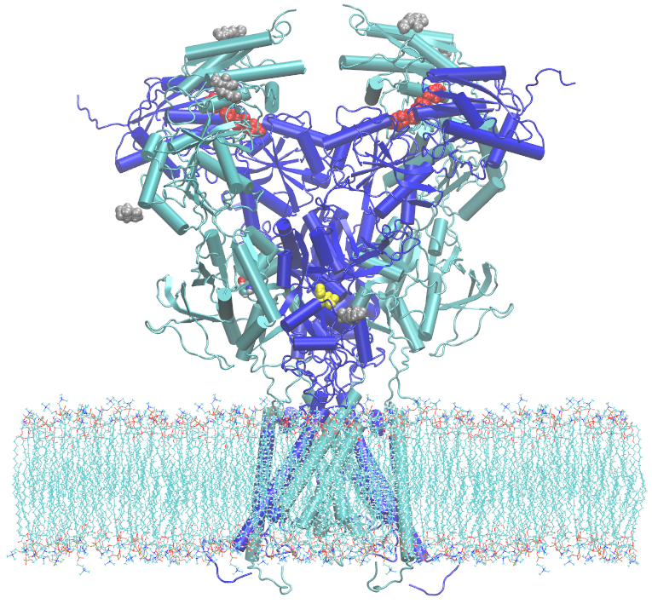
MOLECULAR DYNAMICS
The molecular structure of the tetramer, which is formed by subunit pairs NR1/NR2b, has been constructed based on the 5FXJ crystal structure from the Protein Data Bank (PDB) archive, added by reconstructing the missing amino acid residues by the MODELLER software.
Rapid activation was accomplished by the use of TclForces utility of NAMDpackage.
Linear acceleration was given on the Cα atoms of NR1 residues T396 to K543 (but excluding the modelled scratch T442-H449) and R663 to C798 and NR2B residues D404 to R540 and E658 to H802. The force constant to produce acceleration was 10 kcal mol⁻¹Å. The activation process depended on the vector $\vec{r_{i}}$between each two carbon atoms, one from the closed-state and other from the agonist-bound conformation, respectively. It was finished until $\vec{r_{i}}$decreased linearly towards to zero.

Slide 8
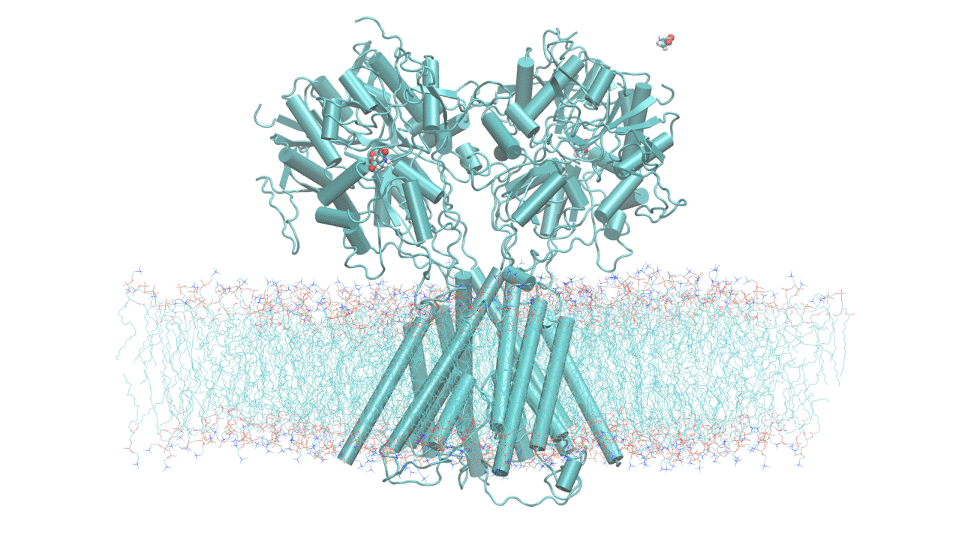
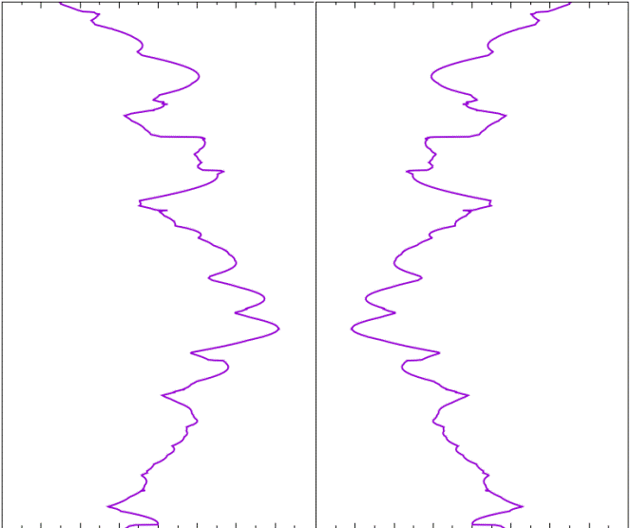
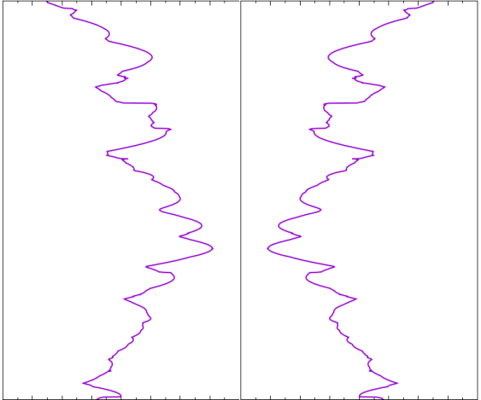
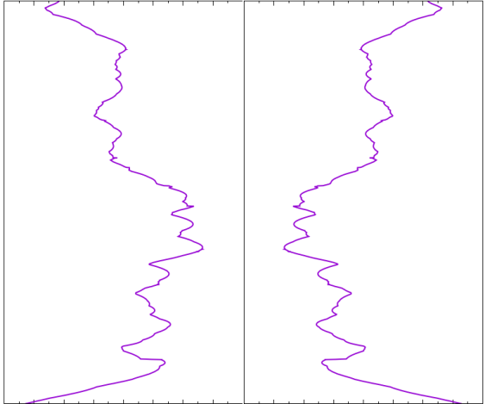
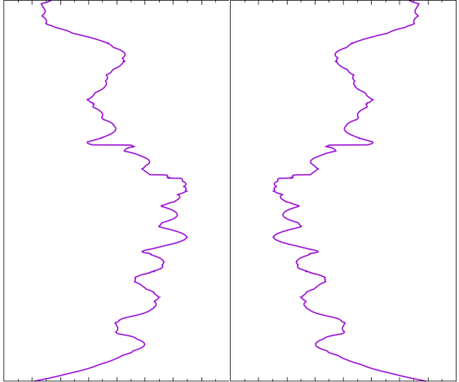
TARGETTED ACTIVATION DYNAMICS
+
+
+
+
~1 Å
~1.2 Å
~2 Å

Slide 9
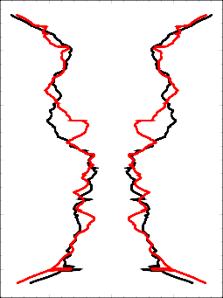
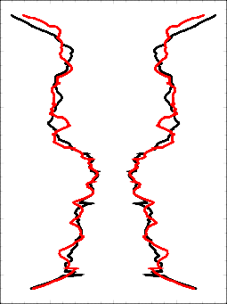
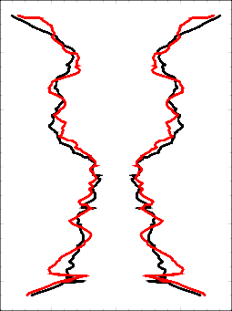
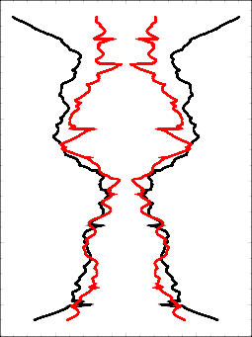
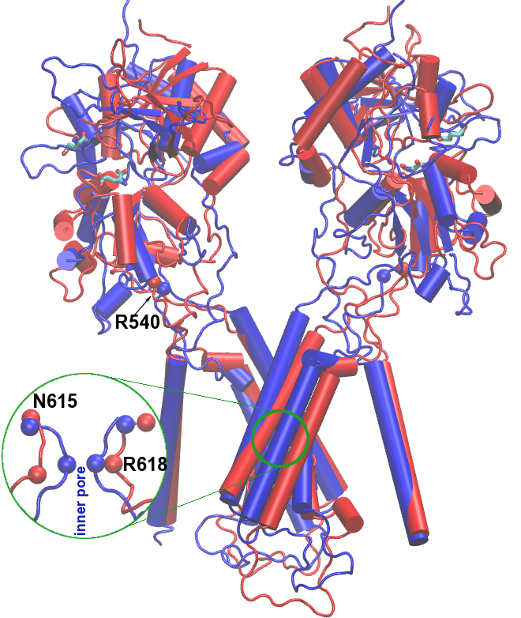
PARAMETERS CALCULATIONS
p.R540H
p.N615L
p.N618G
p.F671_Q672del
Mutation | G_{mut}/G_{wild}
None p.Arg540His p.Asn615Leu p.Asn618Gly p.Phe671_Gln672del | 1.00 0.93 1.03 1.06 0.37
-5 0 5
The p.Arg540His mutation of any NR2 subunit can lead to the formation of a hydrogen bond with the Gln622 residues of its pair NR2 subunit, which would slow down the activation process.
The p.Asn615Leu mutation in a NR2 subunit leads to the formation of strong hydrogen bonds with the Ala640 and Met641 residues of the nearest NR1 subunit. As a result, insignificant opening of the ion channel is observed in the region of the filters (residues 616-620).
The deletion p.Phe671 Gln672del resulted in the poorest opening of the channel among the rest studied mutations.

Slide 10
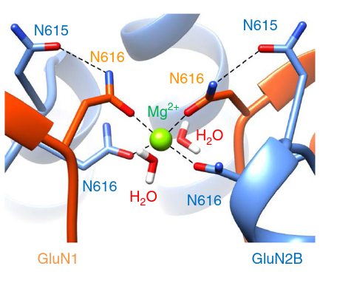
PARAMETERS CALCULATIONS
$$\frac{1}{c}=K_{d}=C_{R}\left(\frac{N_{m}B_{m}}{N_{b}B_{b}}−1\right)$$
K_{d} is dissociation constant
N_{m} is the number of Mg²⁺ ions that reach binding site in the TMD
N_{b} is the number of bound Mg²⁺ ions
B_{b} is the actual number of bonds with one of four N616 residues.
In the case of native conformation Mg²⁺ coordination site positions in transmembrane domain, where Mg²⁺ ion form bonds with four Asn616 residues from NR1 and NR2 subunits. During the modelling the loss of these bonds was observed for all considered mutants. The mutations p.Arg540His and p.Phe671_Gln672del resulted in relatively low block loss, while p.Val618Gly and p.Asn615Leu resulted in almost complete loss of Mg²⁺ binding. Thus, our simulation results fall into agreement with previous studies, which demonstrated mild loss of Mg²⁺ block in the case of p.Arg540His, but much stronger for p.Val618Gly, and, especially, for p.Asn615Leu.
Mutation | N_{m}/N_{b} | B_{b} | u, Å | G_{mut}/G_{nat} | c, mM⁻¹ | q, mV⁻¹
None | 1 | 2 | 1.87 | 1.00 | 0.280 | 0.062
p.Arg540His | 2 | 2 | 1.99 | 0.93 | 0.093 | 0.058
p.Asn615Leu | 4 | 1 | 4.60 | 1.03 | 0.018 | 0.025
p.Val618Gly | 3 | 1 | 1.95 | 1.06 | 0.025 | 0.059
p.Phe671_Gln672del | 1 | 2 | 4.15 | 0.37 | 0.28 | 0.028

Slide 11
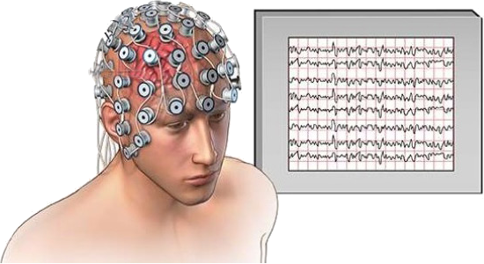
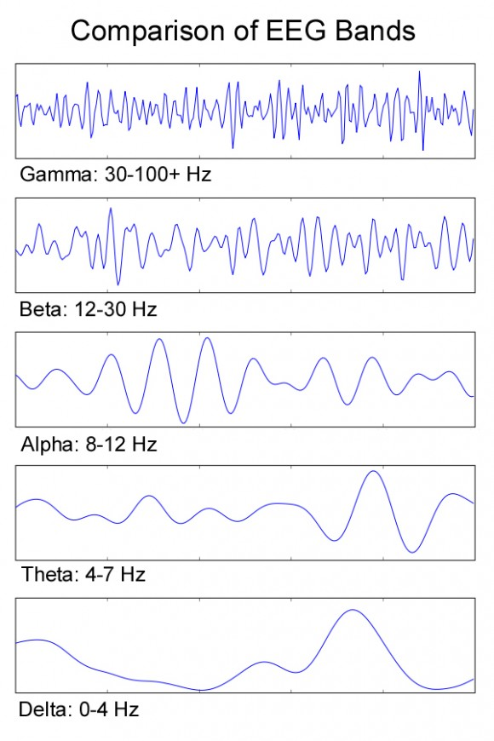
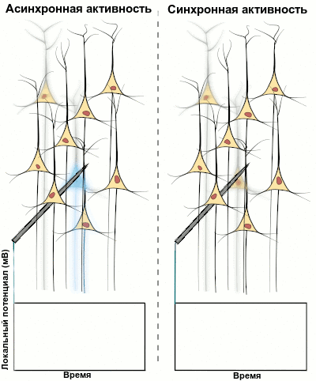
SYNCHRONIZATION OF NEURON OSCILLATIONS
Asynchrony Synchrony
Local potential (mB)
Time Time
Local field potential (EEG)
Electroencephalography (EEG) signal bands

Slide 12
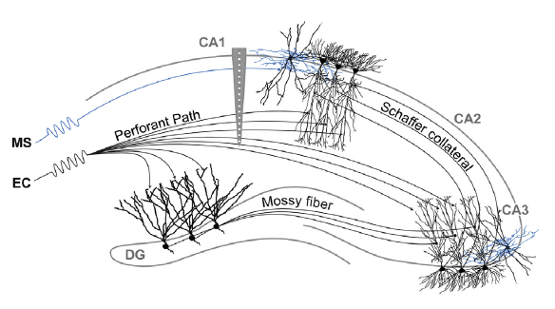
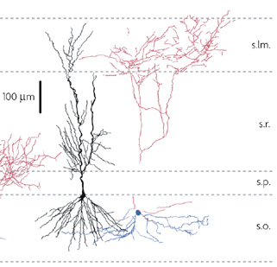
OSCILLATIONS IN HIPPOCAMPUS
interneuron
pyramidal neuron
θ-wave
γ-wave
G. Buzsaki. «Rhythms of the Brain».//Oxford University Press, 2016.

Slide 13
HIPPOCAMPUS NEURAL NETWORK ELEMENT
Neymotin S.A. et al. The Journal of Neuroscience, 2011, V. 31(32), P.11733
Synapses:
$I_{ext}$=50 pA
$I_{ext}$= -25 pA
B
P
OLM
~7 Гц
P – pyramidal cell (800)
B – basket cell (200)
OLM – OLM-cell (200)
MS – medial septum
MS

Slide 14
HIPPOCAMPUS NEURAL NETWORK MODEL
Action potential equations
Pyramidal cell
$$C\frac{dV_{p}}{dt}=−g_{Na}{m_{p}}_{}^{3}h_{p}\left({V_{p}−E}_{Na}\right)−g_{K}{n_{p}}_{}^{4}\left({V_{p}−E}_{K}\right)−g_{K\left(A\right)}a_{p}b_{p}\left(V_{p}−E_{K}\right)−$$
$${−g}_{h}r_{p}\left(V_{p}−E_{h}\right)−g_{L}\left(V_{p}−E_{L}\right)+I_{ext}−I_{syn}−I_{syn(noise)}$$
Basket interneuron
$$C\frac{dV_{b}}{dt}={−g}_{Na}{m_{\left(∞\right)b}}_{}^{3}h_{b}\left({V_{b}−E}_{Na}\right)−g_{K}{n_{b}}_{}^{4}\left({V_{b}−E}_{K}\right)−g_{L}\left(V_{p}−E_{L}\right)−I_{syn}−I_{syn(noise)}$$
Oriens-lacunosum moleculare (OLM) interneuron
$$C\frac{dV_{O}}{dt}={−g}_{Na}{m_{\left(∞\right)O}}_{}^{3}h_{O}\left({V_{O}−E}_{Na}\right)−g_{K}{n_{O}}_{}^{4}\left({V_{O}−E}_{K}\right)−g_{K\left(AHP\right)}{q_{O}}^{2}\left({V_{O}−E}_{K}\right)−$$
$${−g_{Ca}{s_{\left(∞\right)O}}_{}^{2}\left(V_{O}−E_{Ca}\right)−g}_{h}r_{O}\left(V_{O}−E_{h}\right)−g_{L}\left(V_{O}−E_{L}\right)+I_{ext}−I_{syn}−I_{syn(noise)}$$
Synaptic currents
$$I_{syn}=I_{NMDA}+I_{AMPA}+I_{{GABA}_{(A)}}=\sum{g_{ij}s_{i}\left(t\right)}\left(V_{j}−V_{syn}\right),$$
$$\frac{ds_{i}}{dt}=ρ\left(V_{i}\right)\frac{1−s_{i}}{τ_{R}}−\frac{s_{i}}{τ_{D}}$$

Slide 15
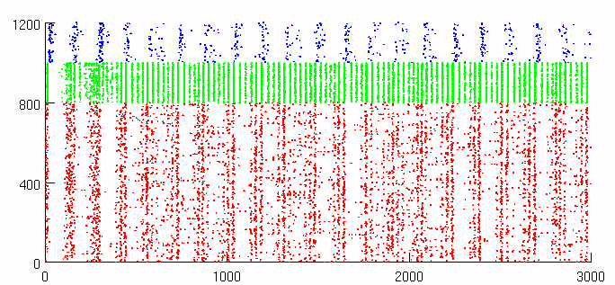
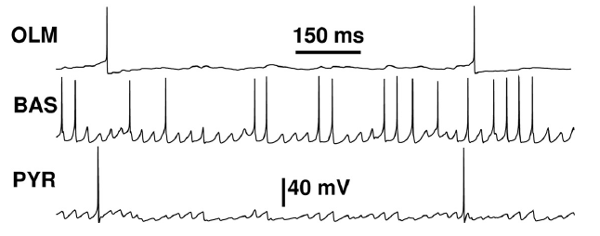
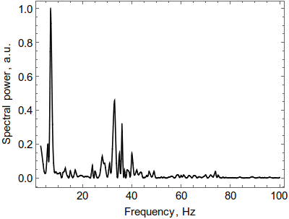
RECORDING FROM HIPPOCAMPUS NEURAL NETWORK UNDER STIMULATION
Spike coordinates
Action potentials
Number of neuron
θ
γ
Time, ms
Local field potential
Power spectrum

Slide 16
LOCAL FIELD POTENTIALS
10.0
5.00
0.00
-5.00
Native
10.0
5.00
0.00
-5.00
p.ARG540HIS
p.ASN615LEU
6.00
0.00
-6.00
LFP, mV
p.VAL618GLY
4.00
0.00
-4.00
10.0
5.00
0.00
-5.00
p.PHE671_GLN672del
0 500 1000 1500 2000 2500 3000
Time, ms

Slide 17
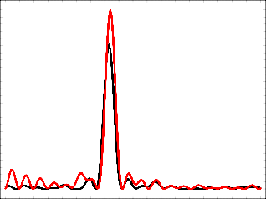
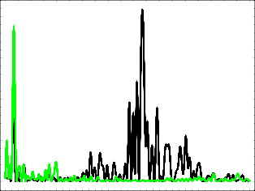
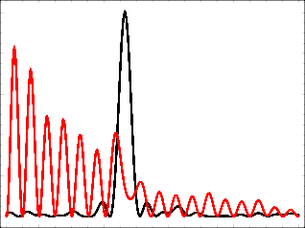
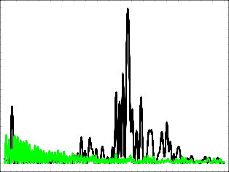
LFP SPECTRAL POWER (THETA & ALPHA)
p.ARG540HIS
1.20
1.00
0.80
0.60
0.40
0.20
0.00
0.20
0.15
0.10
0.05
0.00
Specrtral power, a.u.
p.ASN615LEU
1.00
0.80
0.60
0.40
0.20
0.00
0.20
0.15
0.10
0.05
0.00
Specrtral power, a.u.
2 4 6 8 10 12
0 15 20 25 30 35 40 45 50
Frequency, Hz
Frequency, Hz

Slide 18
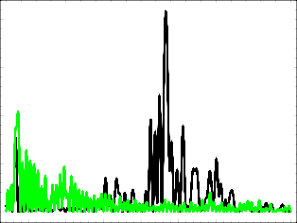
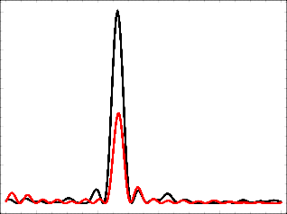
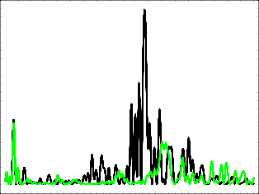
LFP SPECTRAL POWER (BETA & GAMMA)
p.VAL618GLY
1.00
0.80
0.60
0.40
0.20
0.00
0.20
0.15
0.10
0.05
0.00
Specrtral power, a.u.
p.PHE671_GLAN672del
1.00
0.80
0.60
0.40
0.20
0.00
0.20
0.15
0.10
0.05
0.00
Specrtral power, a.u.
2 4 6 8 10 12
0 15 20 25 30 35 40 45 50
Frequency, Hz
Frequency, Hz

Slide 19
CONCLUSION
In the course of the work, molecular-dynamic modelling of NMDA receptor ion channel gating was carried out. The receptor was constructed from several mutant forms of proteins. The analysis of the resulting configurations made it possible to determine the change in the conductivity of the ion channels, and the obtained data were implemented in the structure of model neural network of hippocampus. Based on this model, the calculation of the onset of synchronous neuronal oscillations contributing to theta- and gamma rhythms was carried out.
The dominant effect of missense mutations p.Arg540His, p.Asn615Leu and p.V618G in GRIN2b gene product was found in reducing Mg²⁺ binding to ion channel pore and removing conductivity block. In agreement to previous studies block removal was observed to be maximal in p.Asn615Leu and minimal in p.R540H. Analysis of their open channel geometries showed insignificant differences from normal conductivity. In contrast, the deletion p.F671_Q672del resulted in insignificant Mg block removal, but produced strong decrease of channel conductivity instead.

Slide 20
CONCLUSION
The change of ion channel properties resulted in abnormal oscillation patterns in a model of hippocampal neural network with mutant receptors. Network activity demonstrated overexcitation over normal state. LFP signal of network with mutant receptors p.N615L showed loss of normal frequency peaks producing a series of frequency combs instead. Other mutations resulted in slight perturbation of normal oscillation patterns followed by decrease of gamma and low amplification of theta in the case of p.R540H and strong reduction of theta in the case of p.F671_Q672del.
Proposed approach can be further extended for analysis of other synaptic receptor mutations and evaluation of possible cognitive impairments following hereditary deceases or consequences of radiation and other negative factors.
The work was conducted under financial support of Russian Foundation for Basic Research (grant No.17-29-01007). A.N. Bugay acknowledges the financial support from the Russian Science Foundation (grant No. 17-11-01157).
Published works on this topic:
Boreyko A et al., Clustered DNA double-strand breaks and neurobiological effects of accelerated charged particles, PEPAN Letters, 15(5):551-561.
Batova A et al., Effect of mutant NMDA receptors on oscillations in a model of hippocampus. Journal of Bioinformatics and Computational Biology (in press).

