Slide 1

Information on the moss survey in 2015: some preliminary results
Intergovernmental International Organization
Joint Institute for Nuclear Research
Dubna, Moscow Region, Russian Federation
Marina Frontasyeva
Sector of Neutron Activation Analysis and Applied Research, Frank Laboratory of Neutron Physics,
E-mail: marina@nf.jinr.ru
Notes:
Thank you, Dr. Harmens, for introducing me to the audience.

Slide 2
Coauthors:
Harry Harmens
ICP Vegetation Programme Coordination Centre,
Centre for Ecology and Hydrology, Bangor,
United Kingdom, E-mail: hh@ceh.ac.uk
Eiliv Steinnes
Norwegian University of Science and Technology, Trondheim, Norway, E-mail: eiliv.steinnes@ntnu.no

Slide 3
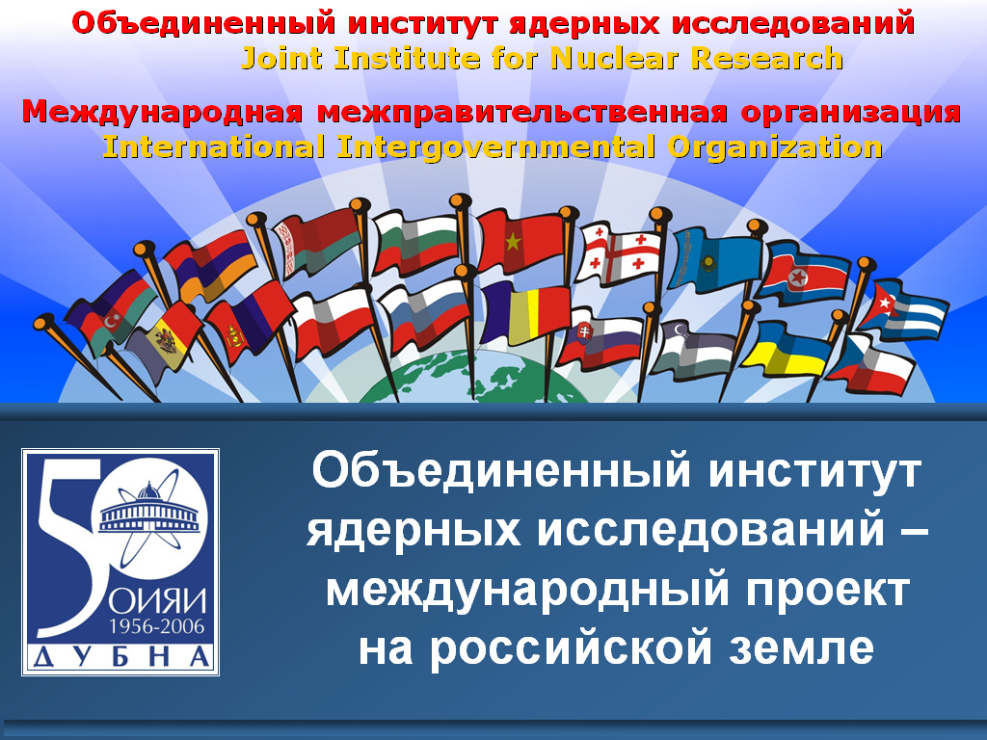
18 member states and 7 associated states:
Germany, Italy, Hungary, Japan, South Africa, Serbia, Egypt
The 20th Task Force Meeting of UNECE ICP
Vegetation was held in Dubna in 2007
Notes:
The moss surveys, and the moss survey in 2015/2016, will be coordinated from the Joint Institute for Nuclear Research which is an international intergovernmental organization, registered by the United Nations Secretariat in 1957. Direct access to 25 countries, besides, my 20 years experience in moss biomonitoring, probably, explained the choice of my candidature as a coordinator of moss survey in Europe and Asia.
Harry, such a preamble is quite appropriate, as I show the relevance of JINR to the UN, and this is a”bridge” to the next slide on the priorities of LRTAP
Convention.
Can we have this slide as a map with 18 member states and 7 associated states (member states different colour from 7 associated states)?

Slide 4
International Program for the monitoring and evaluation of effects of air pollutants on vegetation (ICP Vegetation), established under the Convention on Long Range Transboundary Air Pollution by Economic Commission for Europe (UNECE)
Notes:
in 1987, the international cooperative programme on effects of air pollution on crops (icp crops) was established as a subsidiary body of the Working Group on effects of the
Unece convention on long-range transboundary air pollution (ltrap), established in 1979.

Slide 5
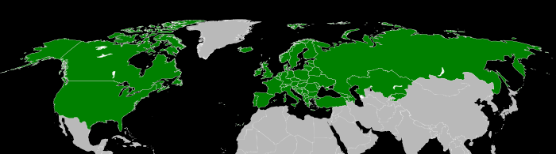
Map showing Convention on Long-Range Transboundary Air Pollution signatories as of July 2007
http://en.wikipedia.org/wiki/Convention_on_Long-Range_Transboundary_Air_Pollution

Slide 6
Air pollution
Acid rain
Air quality index (AQI)
Atmospheric dispersion modeling
Chlorofluorocarbon
Indoor air quality
Global dimming (clouds, etc)
Global distillation (grasshopper effect)
Global warming
Ozone depletion
Atmospheric particulate matter
Smog

Slide 7
Radioactive contamination
Actinides in the environment
Environmental radioactivity
Fission product
Nuclear fallout
Plutonium in the environment
Radiation poisoning
Radium in the environment
Uranium in the environment

Slide 8
  History of moss biomonitoring surveys in Europe

Slide 9

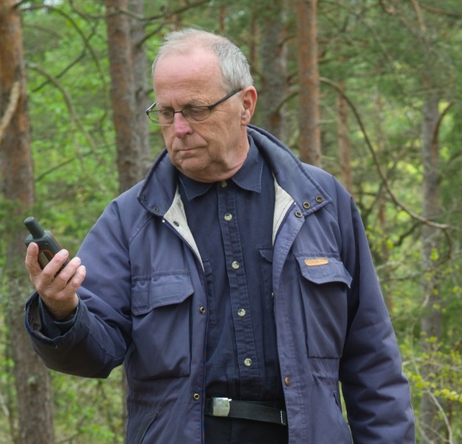
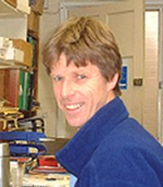
Åke RÜHLING Eiliv STEINNES Harry HARMENS
Sweden Norway United Kingdom
Notes:
The survey on heavy metal concentrations in mosses was originally established in 1980 as a Swedish initiative under the leadership of Åke rühling, Sweden. The idea of using
mosses to measure atmospheric heavy metal deposition was developed in the late 1960s by rühling and tyler (Rühling and Tyler, 1968). It is based on the fact that mosses,
especially the carpet-forming species, obtain most of their nutrients directly from precipitation and dry deposition; there is little uptake of metals from the substrate as these mosses
do not have a well-developed root system.

Slide 10
History of moss biomonitoring surveys in Europe
1968: Moss technique was first proposed (Å. Rühling and G. Tyler, Sweden)
1975: First nationwide survey in Sweden (Åke Rühling, coordinator)
1977: First nationwide survey in Norway (Eiliv Steinnes, coordinator)
1985: First joint Nordic Survey (Denmark, Finland, Norway, Sweden)
(Åke Rühling, coordinator, supported by Nordic Council of Ministers)
1990: First European survey (Joint Nordic/Baltic survey) (Åke Rühling, coordinator)
1995: Second European survey, 28 countries (Åke Rühling and Eiliv Steinnes, coordinators)
2000: Third European survey, 28 countries (UNECE ICP Vegetation)
2005: Fourth European survey, 28 countries (UNECE ICP Vegetation)
2010: Fifth European survey, 27 countries (UNECE ICP Vegetation)
2015: Sixth European survey, 36 countries (UNECE ICP Vegetation)
(Marina Frontasyeva, JINR, coordinator)

Slide 11
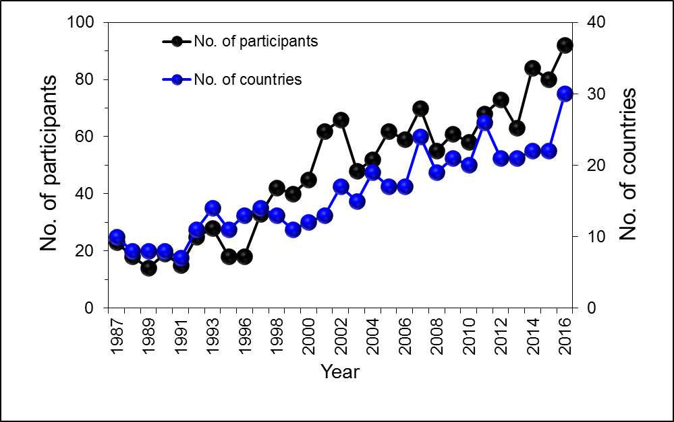
Number of experts and countries participatin in ICP Vegetation Task Force Meetings between 1987 and 2016

Slide 12
Priority LRTAP Convention
(see Decision 2010/18 and 2011/14)
Improve ratification and compliance of Protocols by countries in Eastern Europe, the Caucasus and Central Asia and South-Eastern Europe to improve air quality
Increase participation and activities of all Convention Bodies (including ICP Vegetation) in those countries
Hence, decision to transfer coordination European moss survey to the Russian Federation to enhance network activities as supported by JINR
Results will be reported to ICP Vegetation Task Force
Notes:
As follows from the Long Range Transboundary Air Pollution Convention, priority areas of interest for the UN are Eastern Europe, the Caucasus, Central Asia and South-Eastern Europe. Moreover, JINR provides financial support of air pollution studies in the JINR member states through the system of grants.

Slide 13

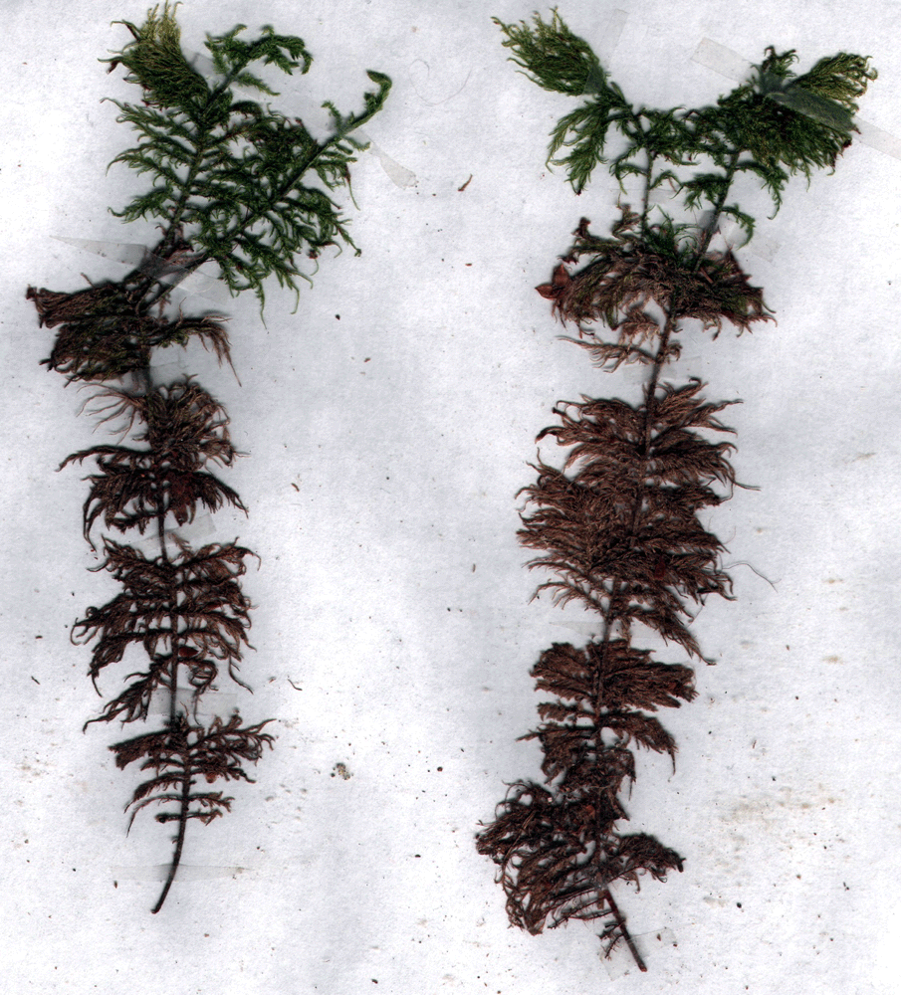
1993: Biomonitoring…
M.V. Frontasyeva, V.M. Nazarov and E. Steinnes. Mosses as monitors of heavy metal deposition: Comparison of different multi-element analytical techniques. In R.J. Allan and J.O. Nriagu, eds., Heavy Metals in the Environment, Vol.2, pp. 17-20. CEP Consultants, Edinburgh 1993.
Hylocomium splendens
1
2
3
4
5

Slide 14
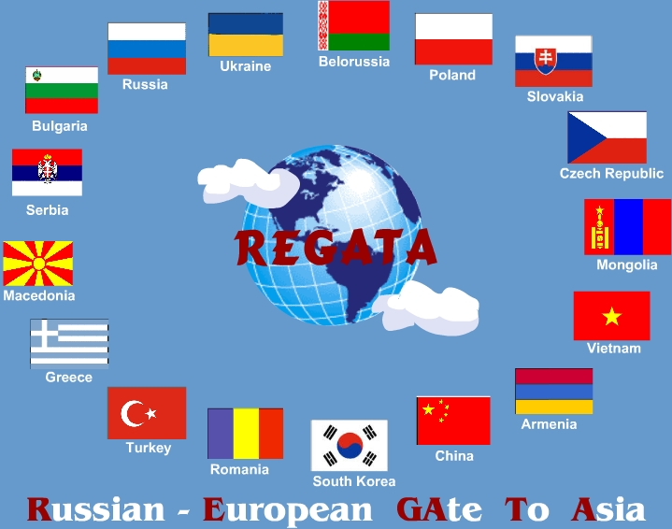
Project REGATA
(1995-2000-2005-2010-2015/2016)
Title
Heavy metal atmospheric deposition study in selected European and Asian countries using nuclear and related analytical techniques
Participating countries:
Russia, Azerbaijan, Belarus, Bulgaria, Croatia, Georgia, Poland, Romania, Slovakia, Greece, Kazakhstan, Macedonia, Moldova, Serbia, Croatia, Albania, Turkey, Mongolia, Vietnam, South Korea, Thailand

Slide 15
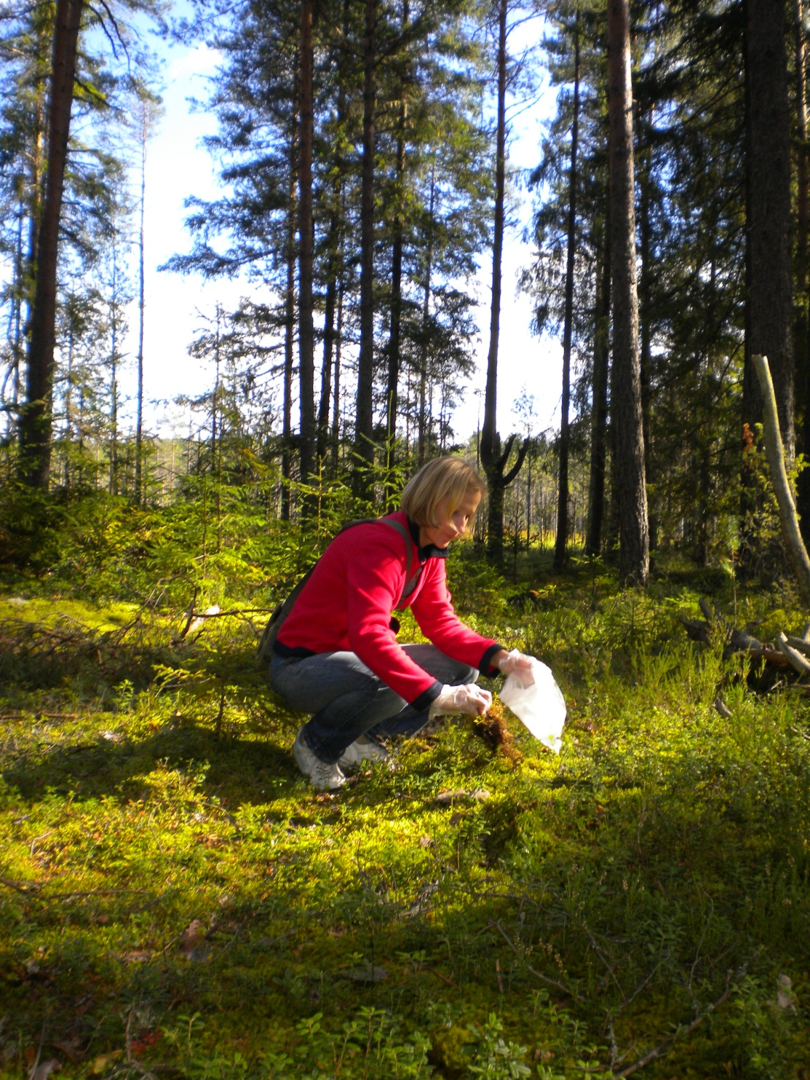

Slide 16

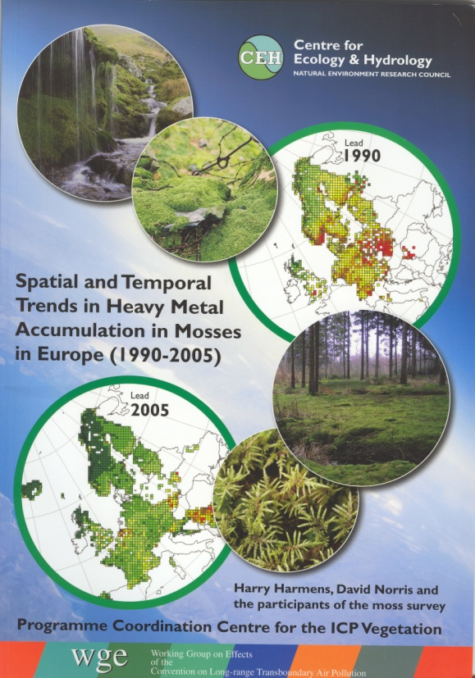
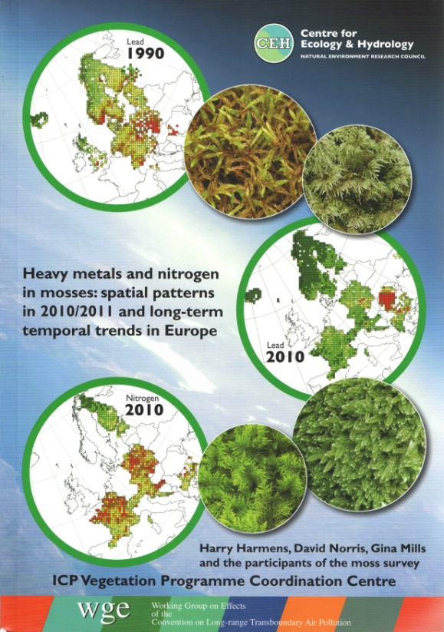
UNECE
CONVENTION ON
LONG-RANGE TRANSBOUNDARY
AIR POLLUTION
adopted in 1979
entered into force 1983
United Nations Economic Commission for Europe
International Cooperative Programme on Effects of Air Pollution on Natural Vegetation and Crops
Working Group on Effects - 1981

Slide 17
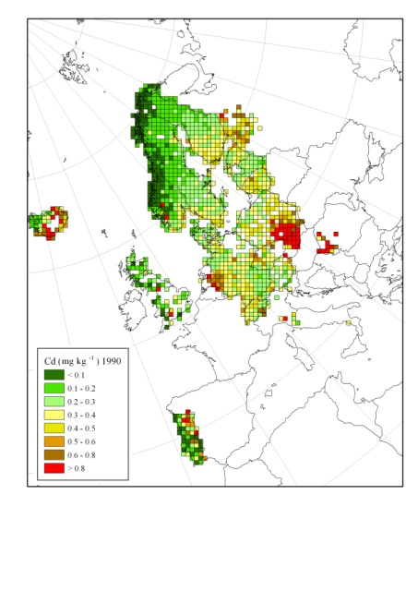
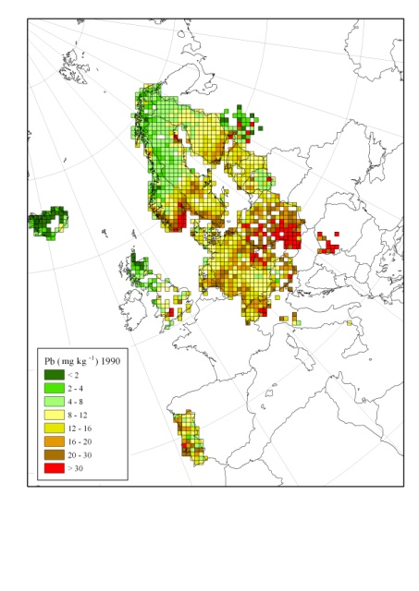
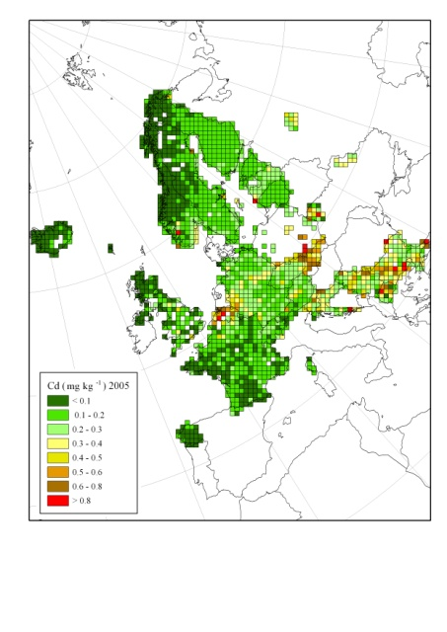
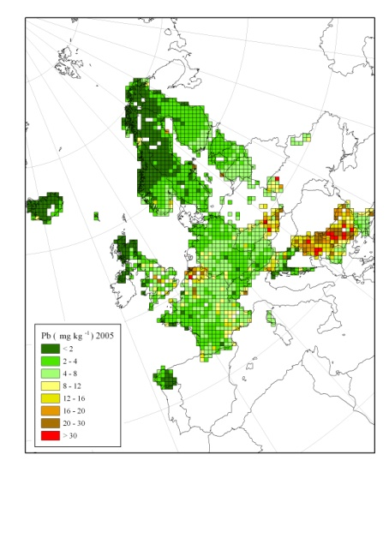

Cadmium
Lead
Mosses provide a complementary method to assess spatial patterns and temporal trends of atmospheric heavy metal deposition:
Carpet forming mosses receive
trace elements and nutrients mainly
from the atmosphere.
In recent years, the lowest
concentrations of heavy metals in
mosses were found generally in
northern Europe and the highest
concentrations in Belgium and
eastern Europe .
Europe-wide the concentration in
mosses of arsenic, cadmium,
lead and vanadium has declined
the most between 1990 and 2010,
with hardly any reduction being
observed for chromium and
mercury.
Temporal trends were country-
specific.
Spatial patterns and temporal trends
for cadmium and lead agree quite
well with those modelled by the
European Monitoring and
Evaluation Programme (EMEP).
-72%
-12%
-2%
1990
1990
-20%
Cadmium
Lead
-20%
-62%
2005
2005
-45%
-29%
-52%
-72%
ICP Vegetation Programme Coordination Centre
Notes:
17

Slide 18
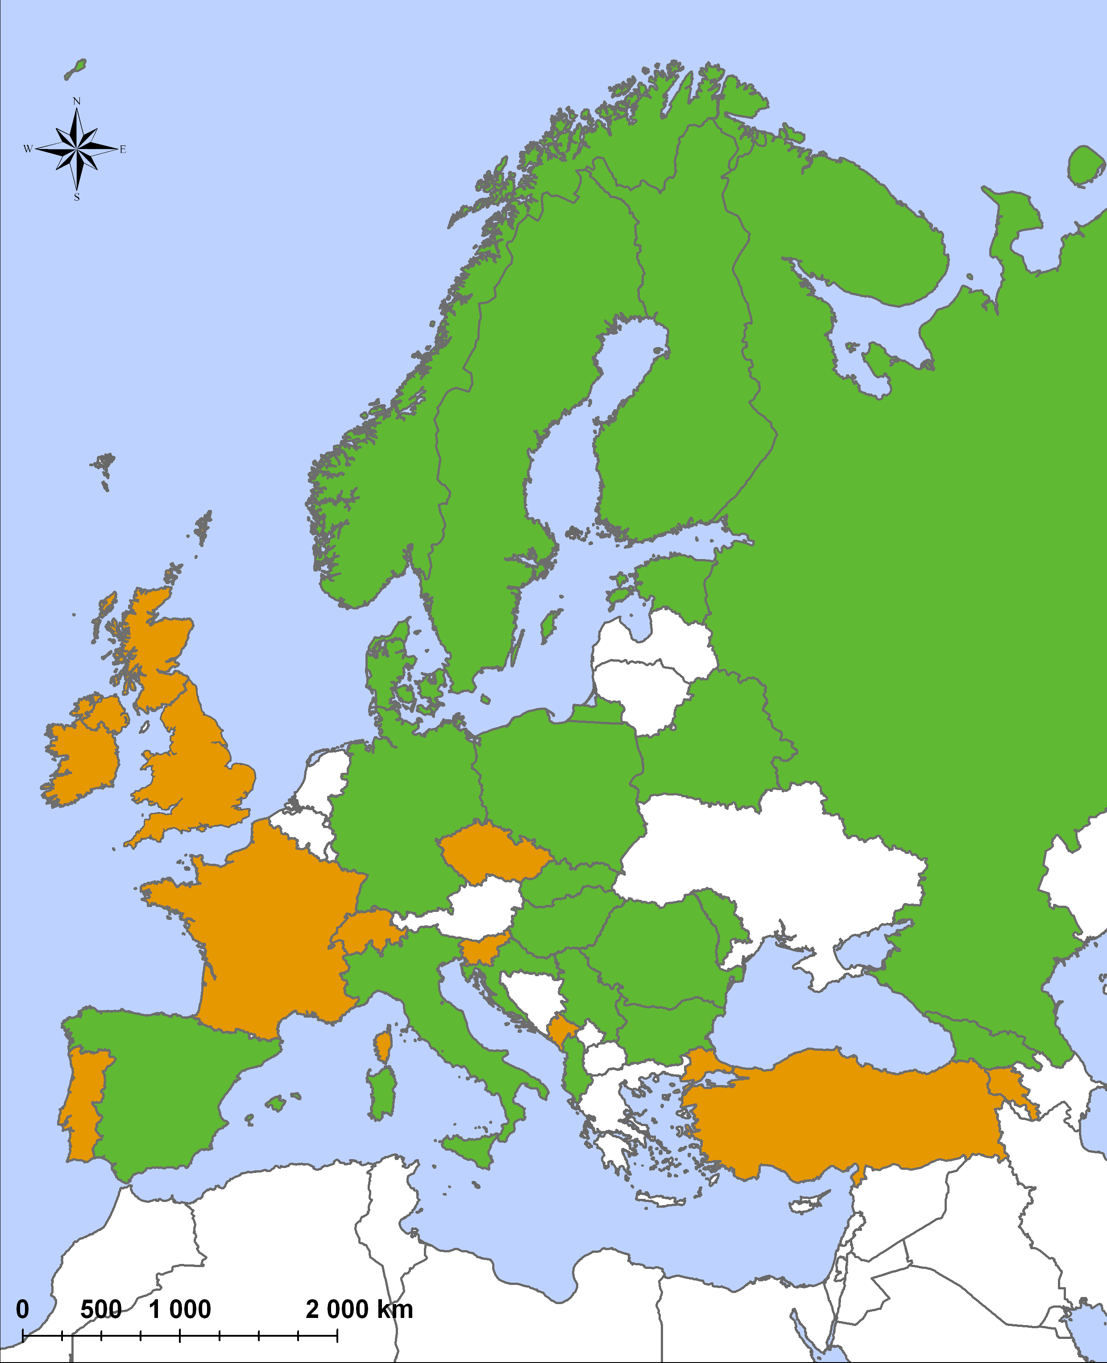
INTEREST IN MOSS SURVEY 2015
Heavy Metals
Analytics connected with JINR
Armenia* - (under negotiations)
Azerbaijan
Belarus (Minsk and Gomel Regions)
Bulgaria
Georgia
Hungary (territory adjacent to Croatia)
Kazakhstan (Alma-Ata, Astana, Ust’-Kamenogorsk)
Moldova
Montenego* - (under negotiations)
Northern Serbia
Poland
Romania
Russia (extension to the East and South)
Slovakia
UK (South)
Geen – intend to participate
Yellow – most likely
Notes:
This map shows the countries who revealed interest in Moss survey 2015/2016. Certainly, the moss sampling will not cover the whole territories as marked in the map. But still the expected outcome seems to be remarkable. In the right side of the slide the countries are enlisted for which JINR will provided analyses of Heavy Metals using nuclear and related analytical techniques.
Harry, I mean NAA and AAS. I don’t think that it is necessary to focus on methodology. Enough the general statement: “nuclear and related analytical techniques”.
If questions arise, I shall answer.
We need to make clear that this is of moss participants who showed an interest, but it will depend on funding who will participate in the end. Can you make a map with countries showing ‘yes’ and ‘most ‘likely’ (as done for POPs)? Maybe use a different colour than yellow for ‘most likely’ as yellow is a colour that does not show up well in projections in the UNECE building (maybe use blue or pink). Funding might not be always from the national government, for example for UK it will be initiative of individuals, also for Germany (will Schroeder take part?). What about Switzerland: I think Lotti will take part, Switzerland is included in the N and POPs map? Have you heard anything from France? You have included France in the N and POPs map.

Slide 19
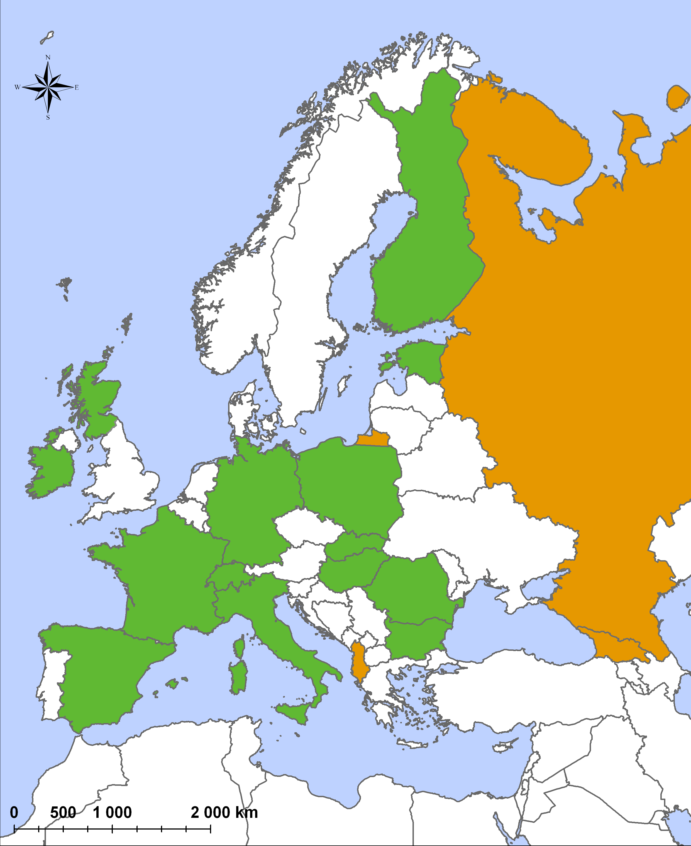
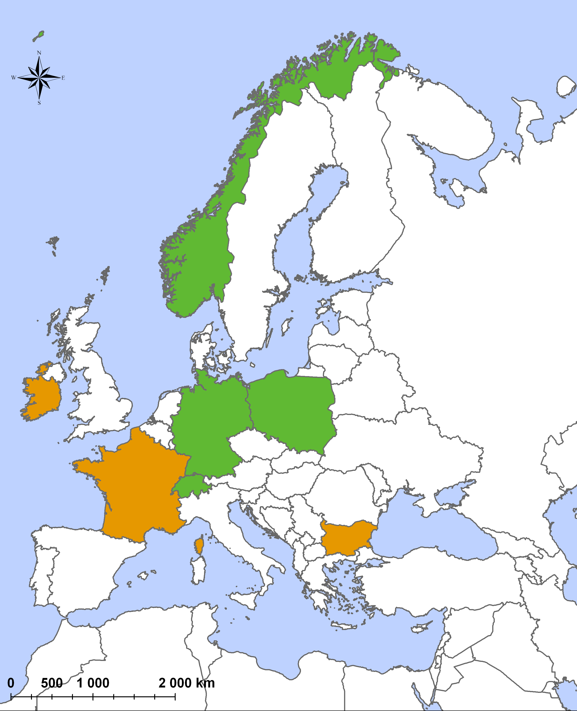
POPs
Nitrogen
(PAHs, PCBs, PBDEs, dioxins, PFOS, etc)
Geen – intend to participate; Yellow – most likely
Notes:
These are the countries which intend to determine nitrogen in the 2015/2016 moss survey.
In spite of great interest in pollution with persistent organic pollutants, very few countries responded positively. Most probably, because of high price of analysis. Nevertheless, Germany suggested to focus on PAHs, PCBs, polybromodiphenylethers (PBDEs), dioxins, and perfluorooctane sulfonic acid and its salts (PFOS), and other POPs could also be included if there is a national interest.
Again, also show countries ‘most likely’ (in a different colour from ‘yes’). Also, I am sure Finland will do N if they participate as they have done since 1980. Croatia and Macedonia also did N in previous years, so will they do it again in 2015? France and Switzerland are not included in the HM map. Put the N and POPs maps on one slide, with ‘yes’ and ‘likely’ indicated on the same maps.

Slide 20
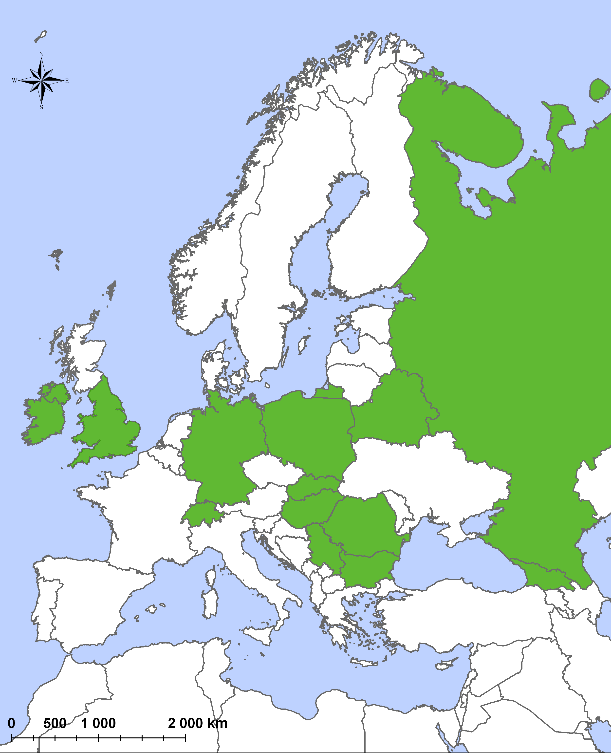
Radionuclides
Intend and most likely
Low-level background laboratories
Russia (JINR)
Kazakhstan (Alma-Ata)
Serbia (Novi Sad)
Slovakia (Bratislava)
Notes:
This was my initiative to suggest the radionuclide determination (Pb-210 and Cs-137), first of all, to trace the global mixing of man-made radionuclides from Fukushima, and to assess the present-day situation in the European counties previously affected by the Chernobyl accident. One just need to collect more moss material (up to 10-12 g of dry weight). There are four laboratories:
Russia (JINR), Kazakhstan (National Centre for Nuclear Physics), Serbia (University of Novi Sad) and Slovakia (low-level background laboratory in the Comenius University in Bratislava).
Can you also include countries that said ‘most likely’?

Slide 21
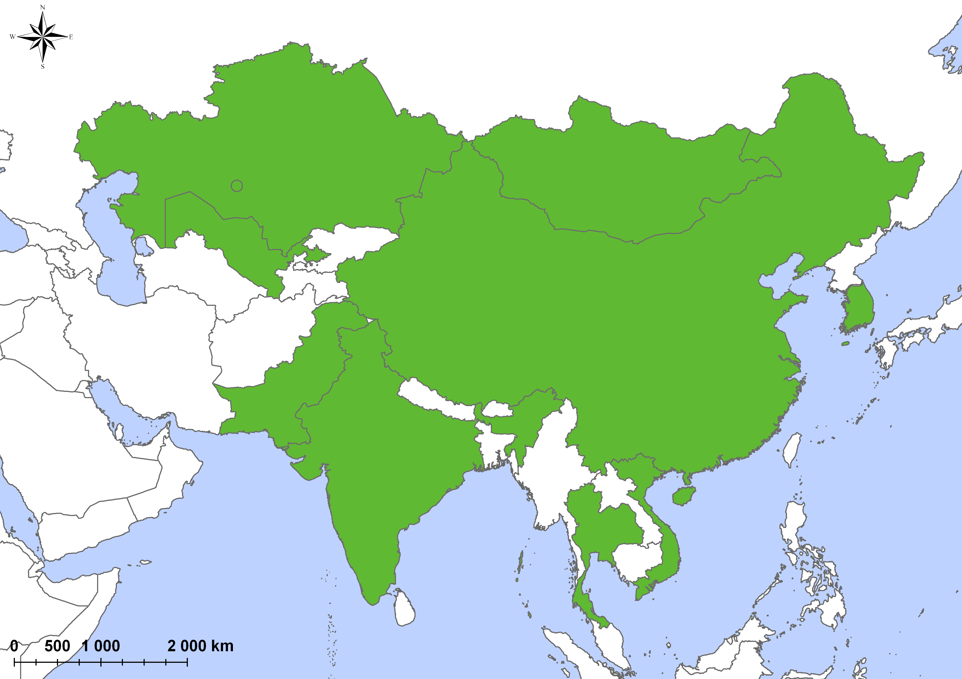
Asia (Heavy metals)
China (Beijing province)
India
Kazakhstan
Mongolia
Vietnam (Central)
South Korea
Thailand
Uzbekistan
Notes:
Eight Asian countries revealed interest in participation the moss surveys in their countries. Besides China, India, and Uzbekistan, the other countries (see slide) are connected with JINR through long-term cooperation in moss-biomonitoring studies.
Is this for HMs only? If so, maybe add this to the title of the slide.

Slide 22
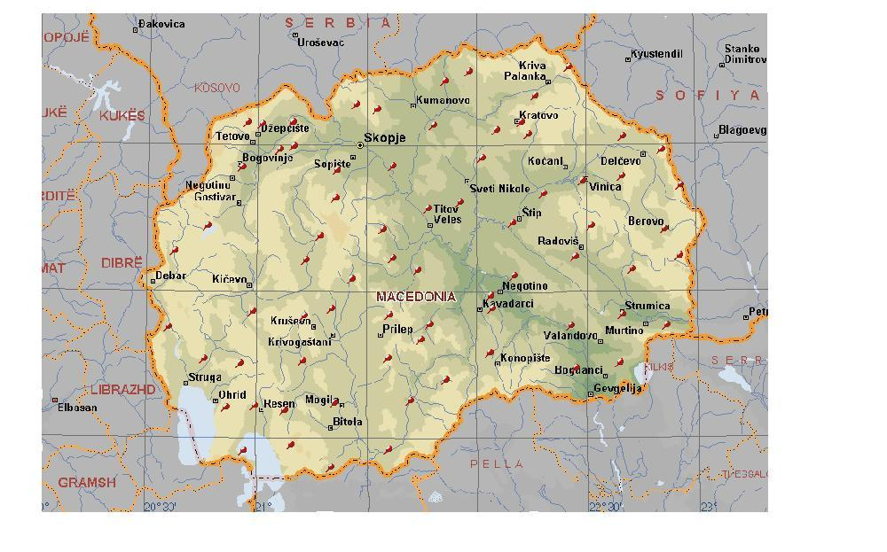
Macedonia 2015

Slide 23
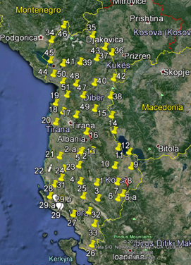
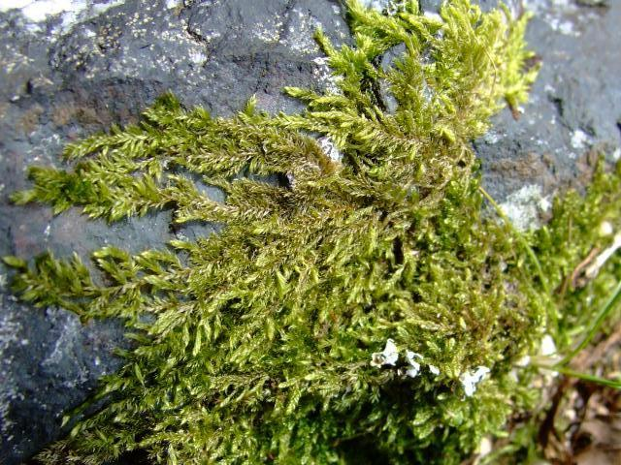
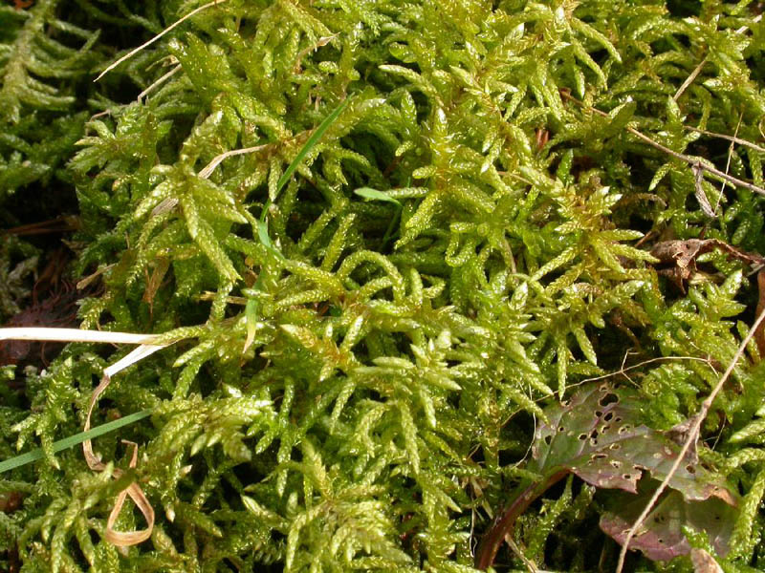
Albania 2015
Total: 57 sampling sites
Hypnum cupressiforme
Scleropodium Purum
At 15 sampling sites both species were sampled

Slide 24
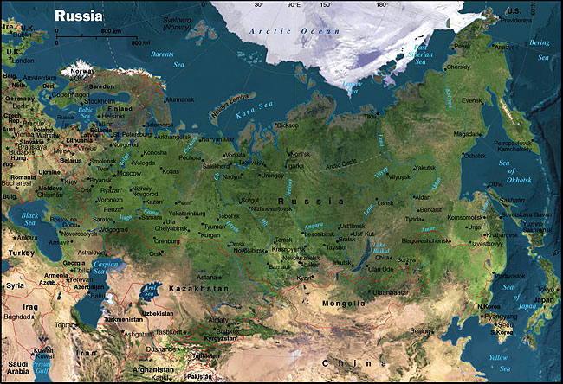
Russian Federation
Notes:
The huge territory of RF is planned to be covered in the following areas: (shown in yellow circles)
Three latter areas [I show circles in the Far East) are connected with our project on assessment of radionuclide deposition in the Far East of RF and South Korea using mosses.

Slide 25
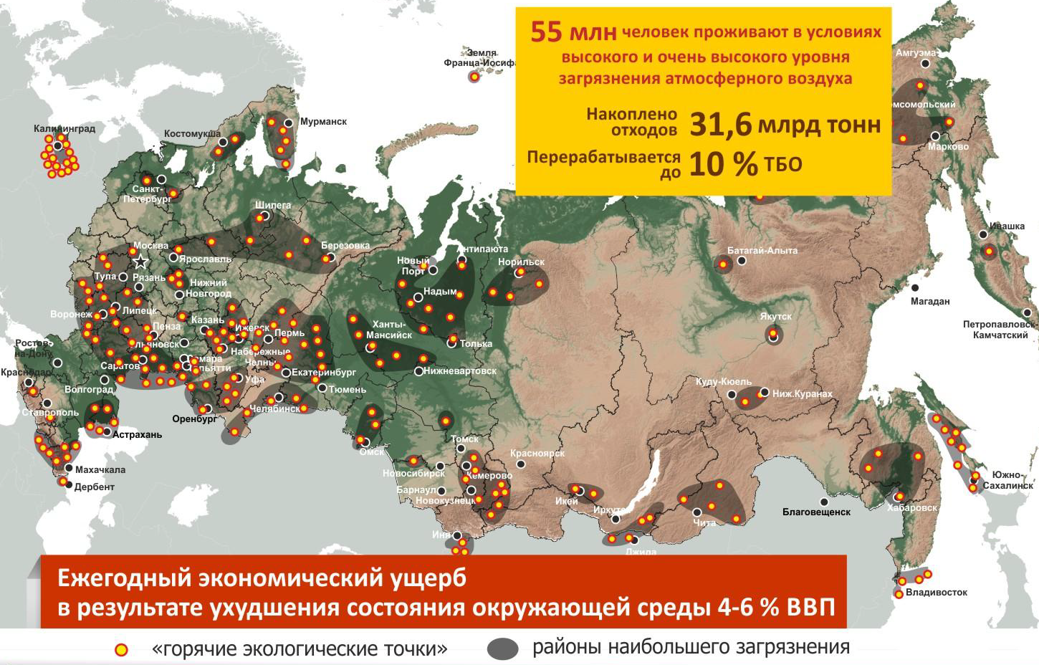
From the State Program of the Russian Federation “Protection of the Environment” for 2012-2020
Annual economic damage as a result of environmental degradation is 4-6 % of Gross Budget of RF
environmental “hot sports”
most contaminated areas
Notes:
In addition to the countries of the Western Europe which intentions to participate in the Moss Survey 2015 we shall know by the end of The 27th Task Force Meeting, the following countries will contribute to the Moss Survey 2015. Three countries where we initiated moss sampling in the previous moss surveys, - Albania, Croatia, Macedonia – reported their results based on ICP-MS. They are welcome to our collaboration, too.

Slide 26
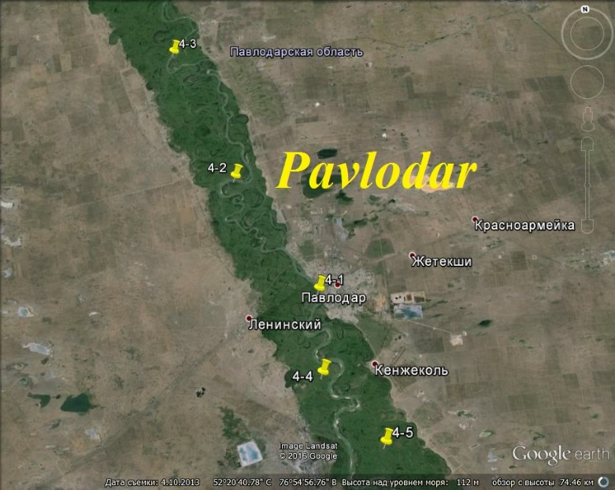
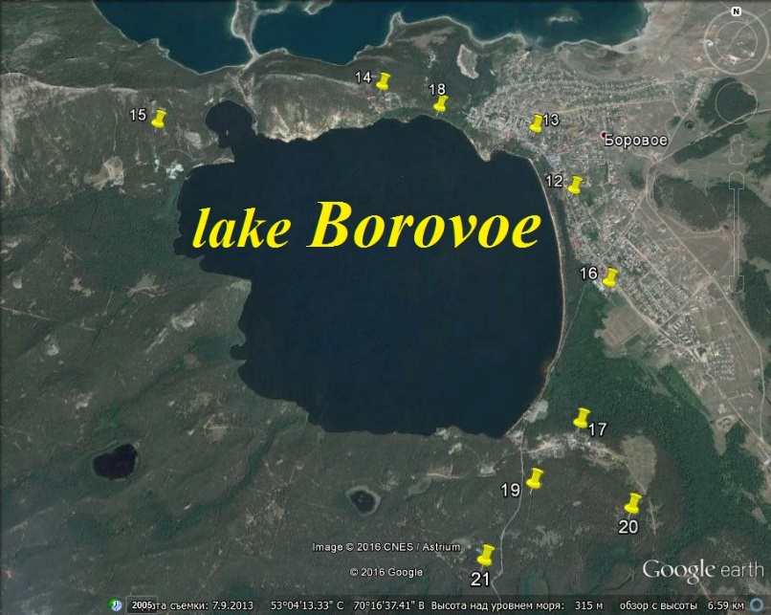
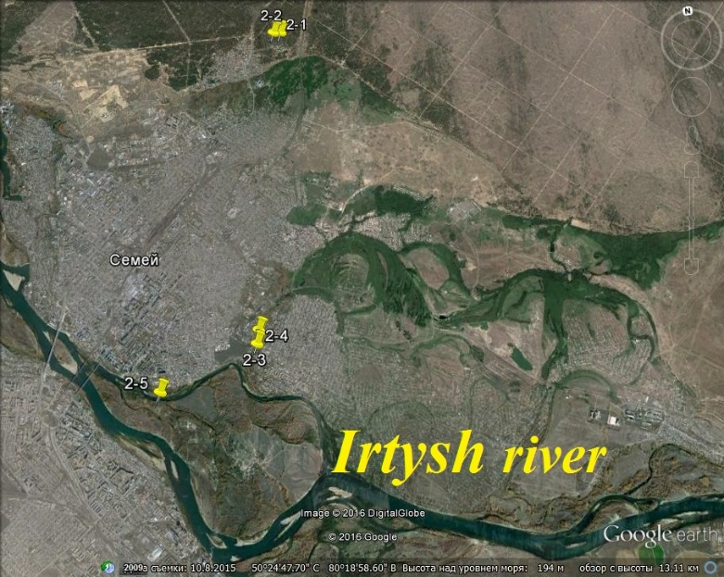
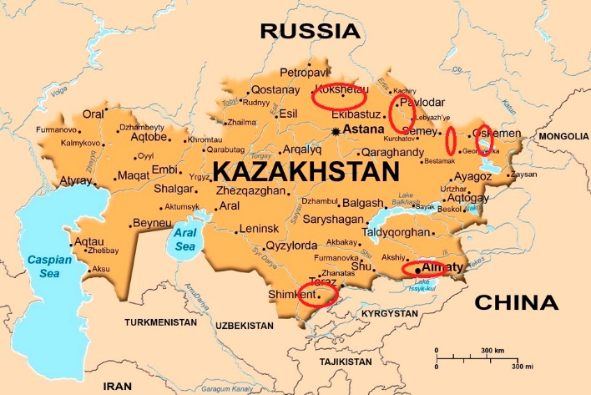
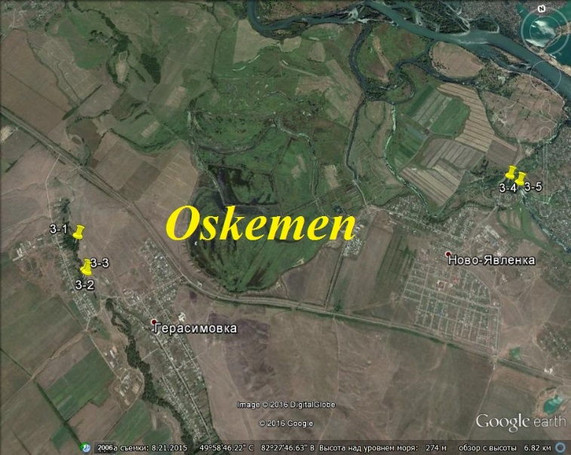
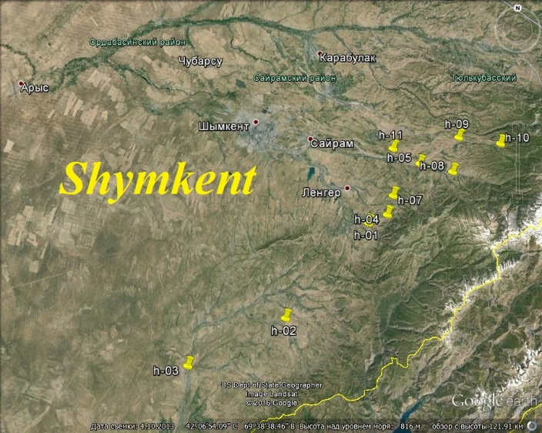
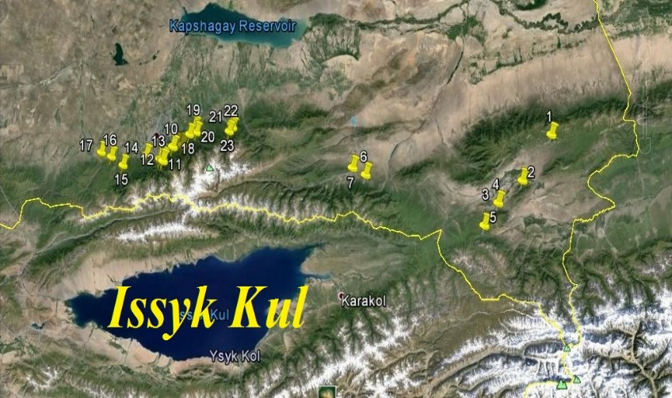
Grant of Plenipotentiary of Kazakhstan in 2014 and 2015

Slide 27
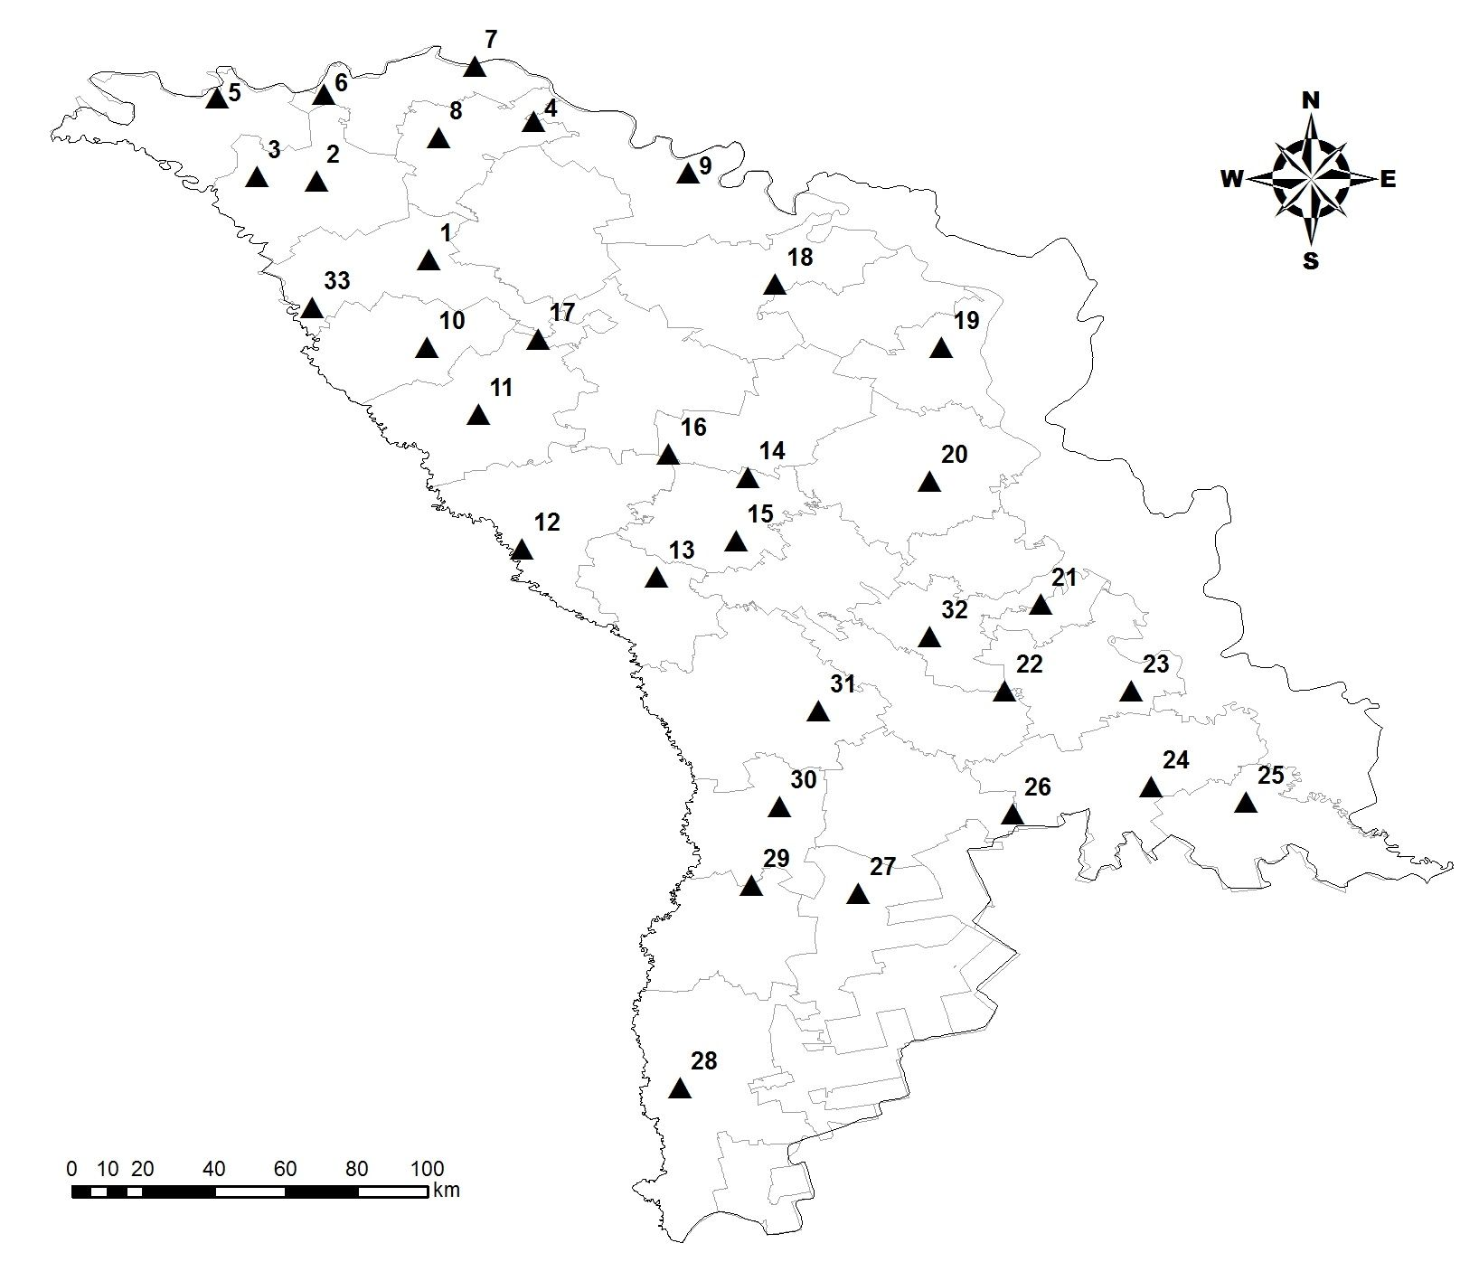
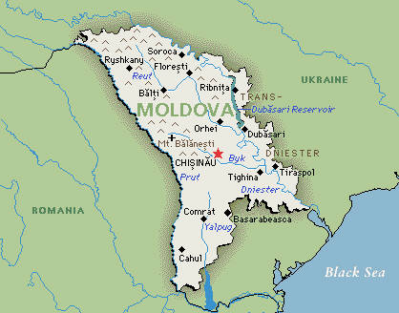
Moldova 2015
35 sampling sites collected and analyzed (NAA+AAS)

Slide 28
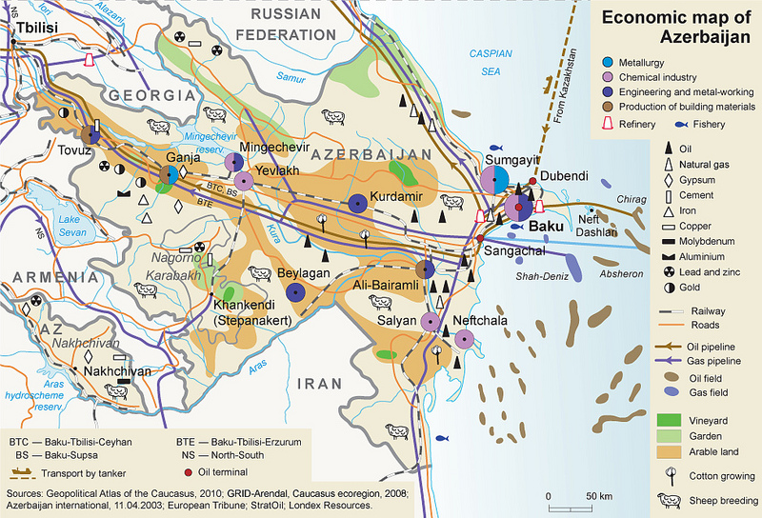
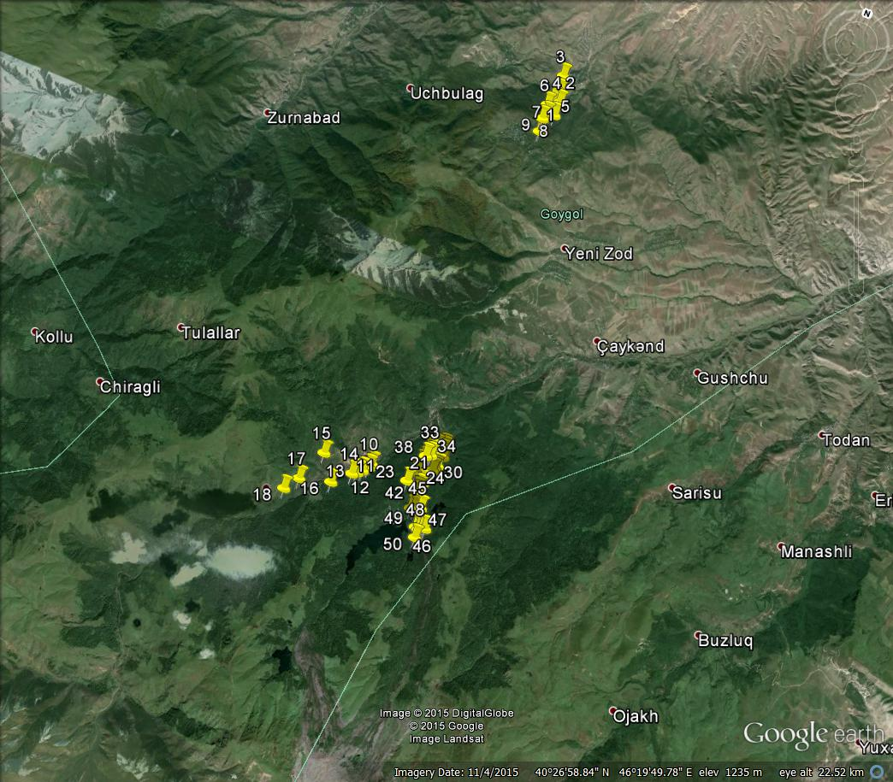
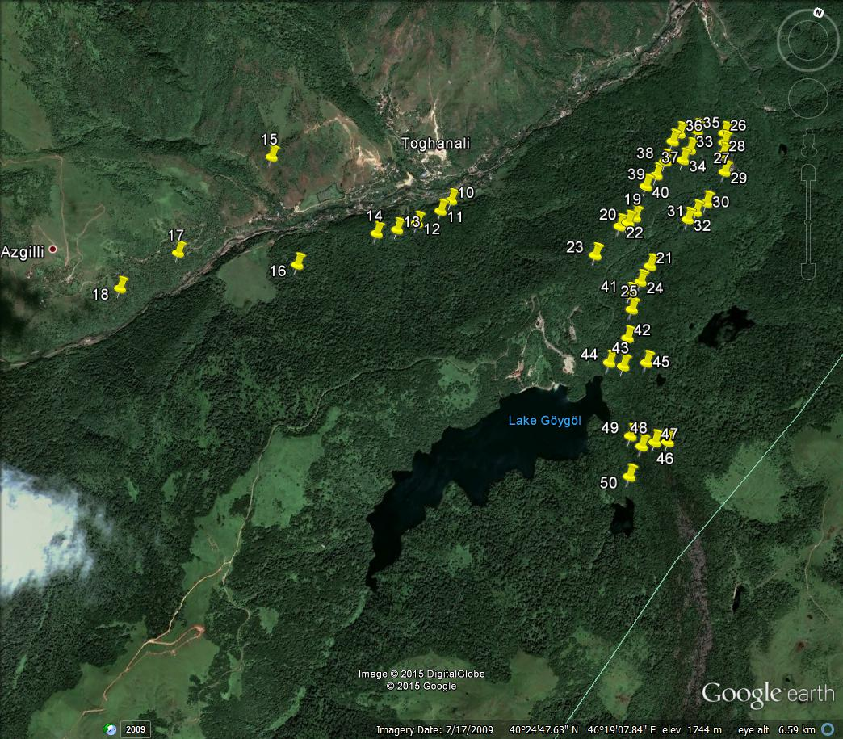
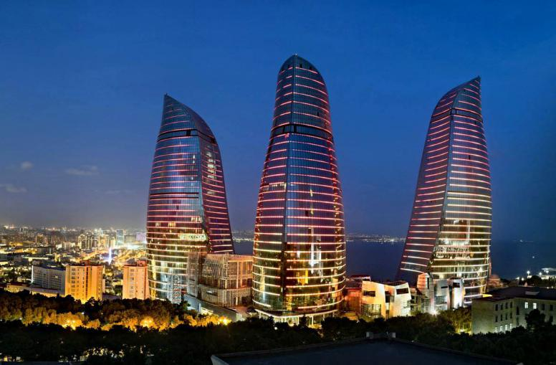
Azerbaijan

Slide 29
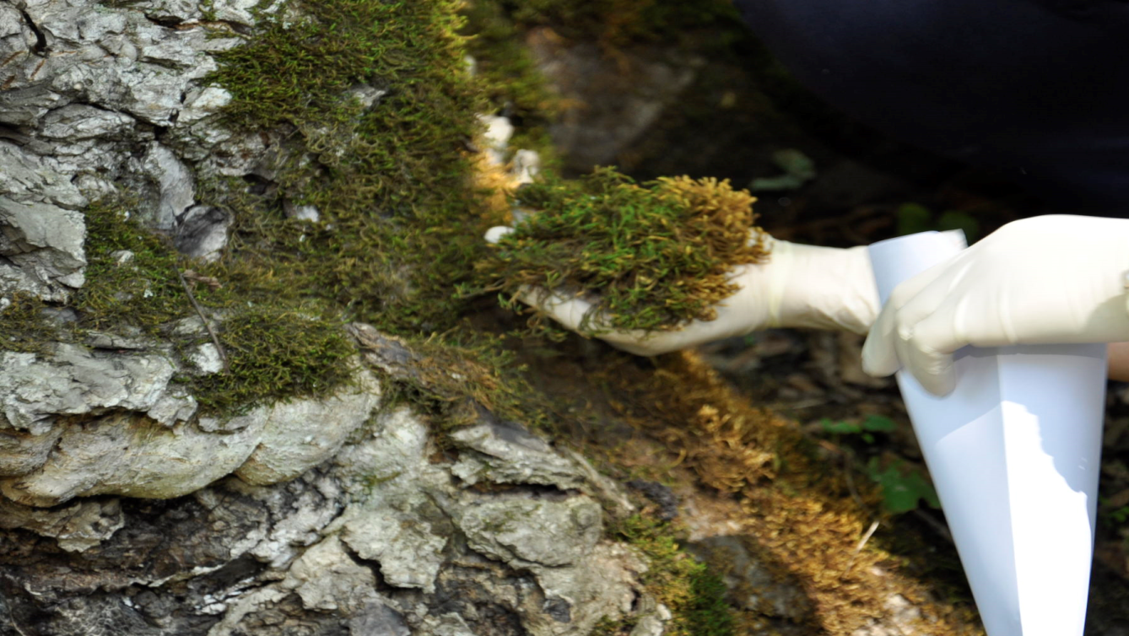
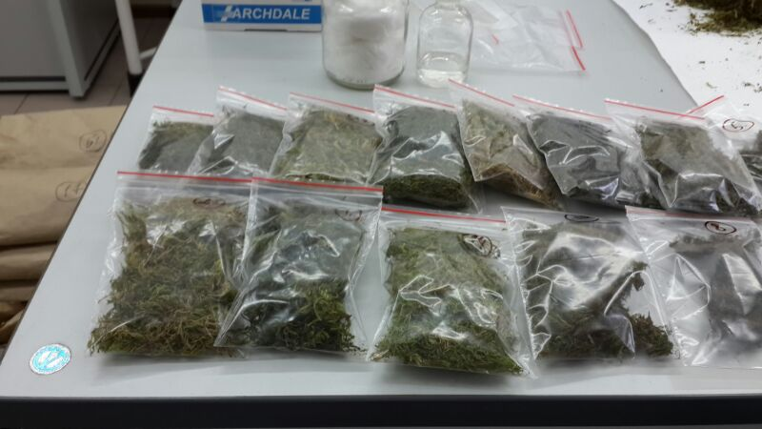
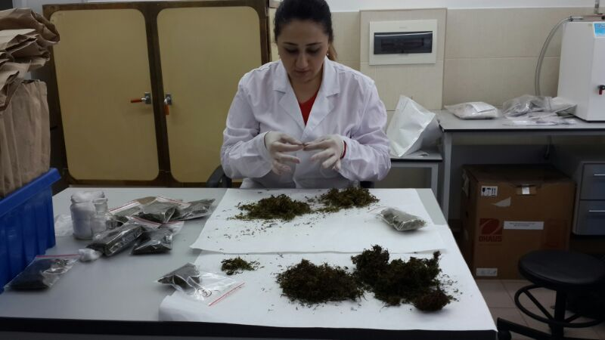
Azerbaijan
Project to National Foundation of Azerbaijan (2016-2017)
Monitoring atmospheric deposition of heavy metals
and radionuclides of technogenic and natural origin
for the environmental safety of Azerbaijan (AZ, RF, Norway)
Grant of Plenipotentiary of Azerbaijan in JINR, 2017

Slide 30
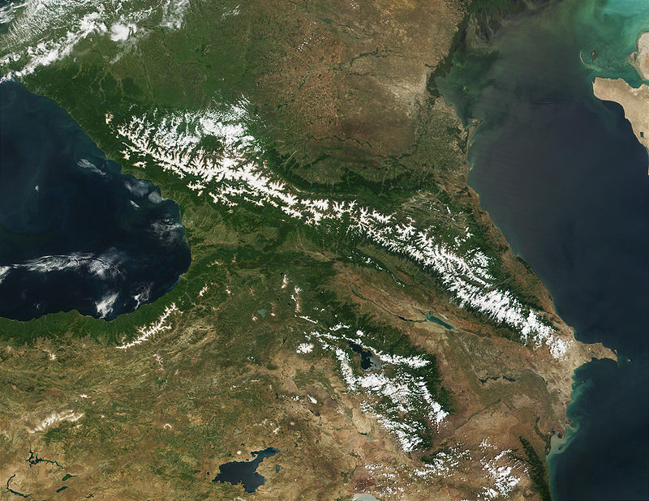
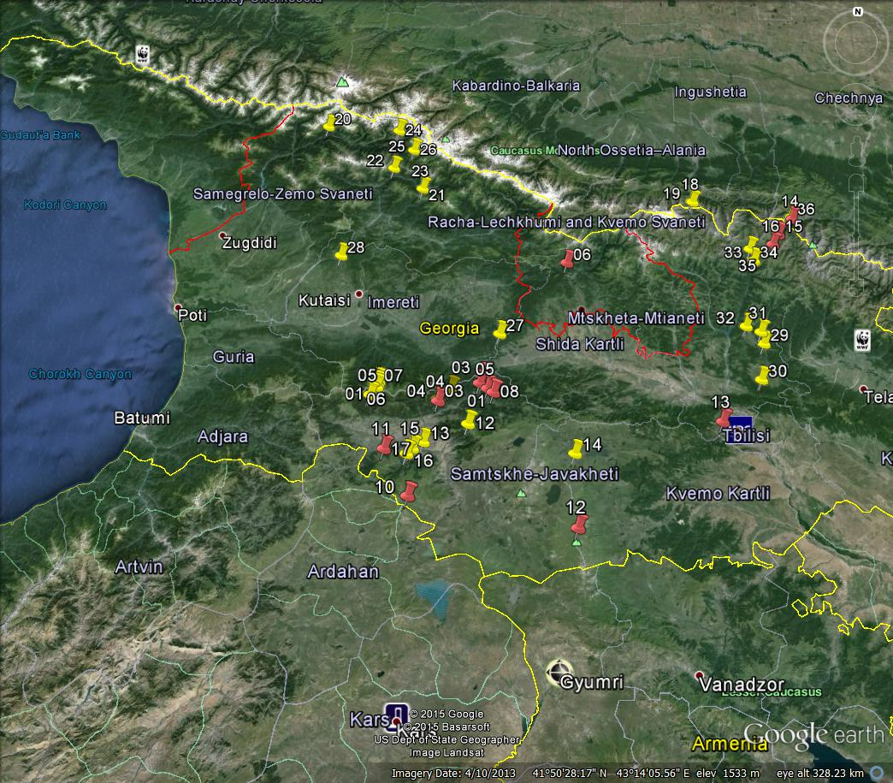
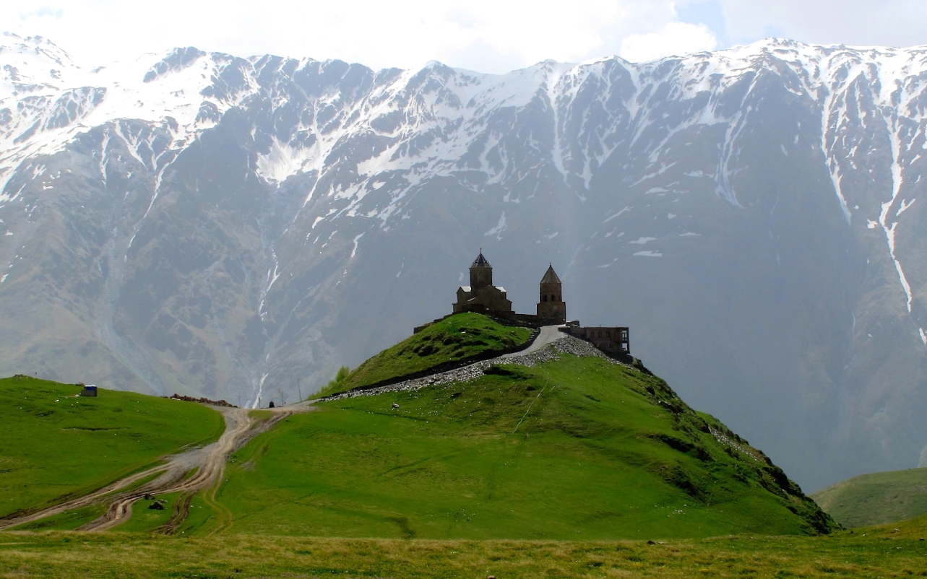
Georgia 2014 + 2015
Black Sea
Georgia Shota Rusta-veli National Science Foundation grant (2015-2017)
Grant of Plenipoten-tiary of Georgia in JINR, 2016
Tbilisi

Slide 31
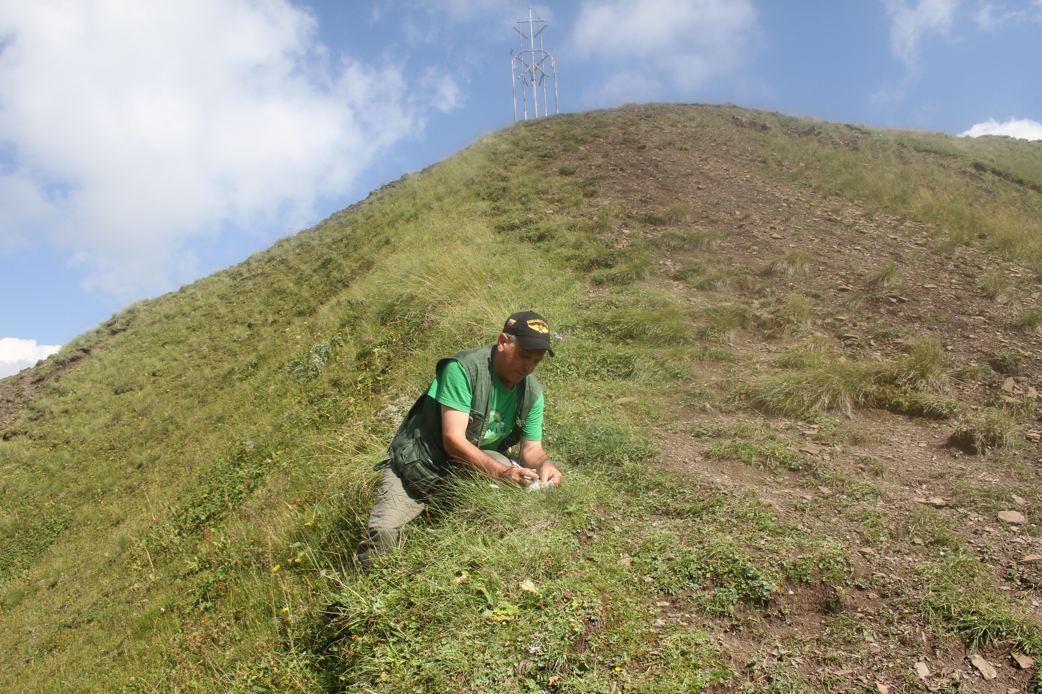
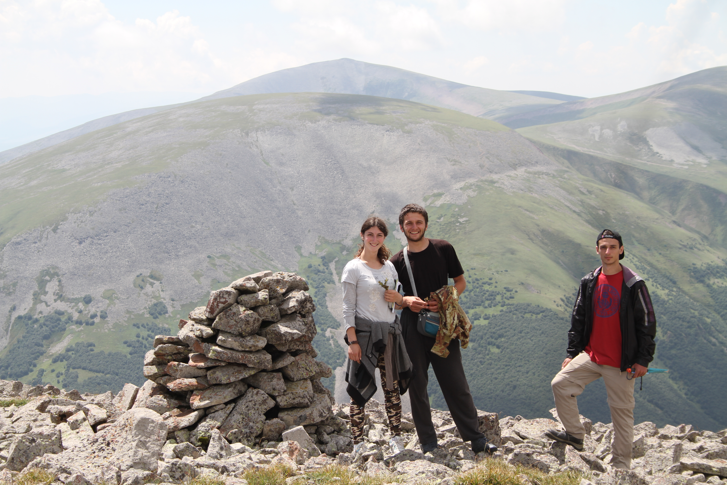
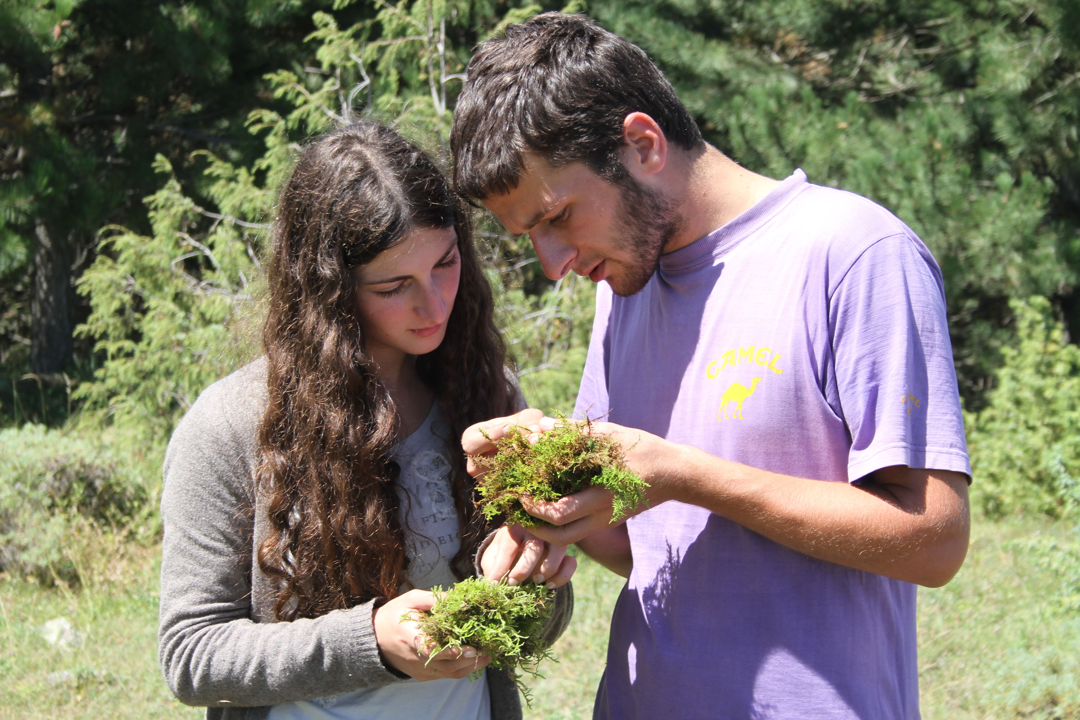
Georgia 2015

Slide 32
HM – N – POPs – RN – CD
Heavy Metals (~1970)
Nitrogen (1980-…)
Persistent Organic Pollutants (2010)
Radionuclides (1980 - 2015)
Cosmic Dust (?)

Slide 33
The most important emission sectors include:
Metals industry (Al, As, Cr, Cu, Fe, Zn)
Other manufacturing industries and construction (As, Cd, Cr, Hg, Ni, Pb)
Electricity and heat production (Cd, Hg, Ni)
Road transportation (Cu and Sb from brake wear, V, Zn, W from studded tires and Pb if leaded gasoline is used)
Petroleum refining (Ni, V)
Phosphate fertilizers in agricultural areas (Cd)

Slide 34
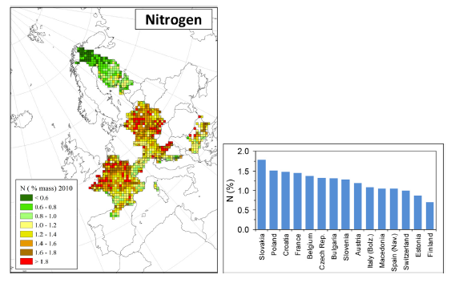
Mean nitrogen (N) concentration in mosses per EMEM grid square (5-km x 50 km) in Europe in 2010 (left) and medium value per country (right)
Italy: Bolzano region,
Spain: Navarra region
Notes:
here are many groups within Europe studying the atmospheric nitrogen fluxes and its impact on vegetation (e.g. NinE, NitroEurope, COST 729). Within the ICP Vegetation, we synthesise the main results on impacts of nitrogen on vegetation for the benefit of the LRTAP Convention.
Examples of nitrogen effects on vegetation include (see annual report 2008/9):
(1) Lichens and mosses contain species that are among the most sensitive to elevated atmospheric nitrogen deposition. Therefore, critical levels of ammonia have recently been set at a lower concentration (1 μg m-3) for lichens and mosses (and ecosystems where lichens and mosses are a key part of ecosystem integrity) than for higher plants (3 μg m-3).
In a separate study, the ICP Vegetation Programme Centre investigated long-term temporal trends (ca. 1860-2000) in the nitrogen concentration in mosses by analysing herbarium material collected from selected European countries. In general, the total nitrogen concentration in mosses did not change before 1960, but increased after 1960, most likely due to the increased deposition of oxidised nitrogen

Slide 35
Radionuclides
Sumerling T. J. The use of mosses as indicators of airborne radionuclides near a major nuclear installation. The Science of the Total Environment, 1984, No. 35, p. 251-265
Steinnes E. and Njastad O. Use of mosses and lichens for regional mapping of 137Cs fallout from the Chernobyl Accident.
J. Environmental Radioactivity, 1993, No. 21, p. 65-76
Nifontova M.G. Mushrooms, lichens and mosses as biological indicators of radioactive environmental contamination. Radioecology and the restoration of radioactive-contaminated sites, 1996, p. 155-162
Nifontova M.G. Content of long-lived artificial radionuclides in moss-lichens cover of terrestrial ecosystems of the Ural-Siberian Region. Ecology, 1998, No. 3, p. 196-200 (in Russian)
Delfanti R., Papucci C., Benco C. Mosses as indicators of radioactivity deposition around a coal-fired power station. The Science of the Total Environment, 1999, No. 227, p. 49-56

Slide 36
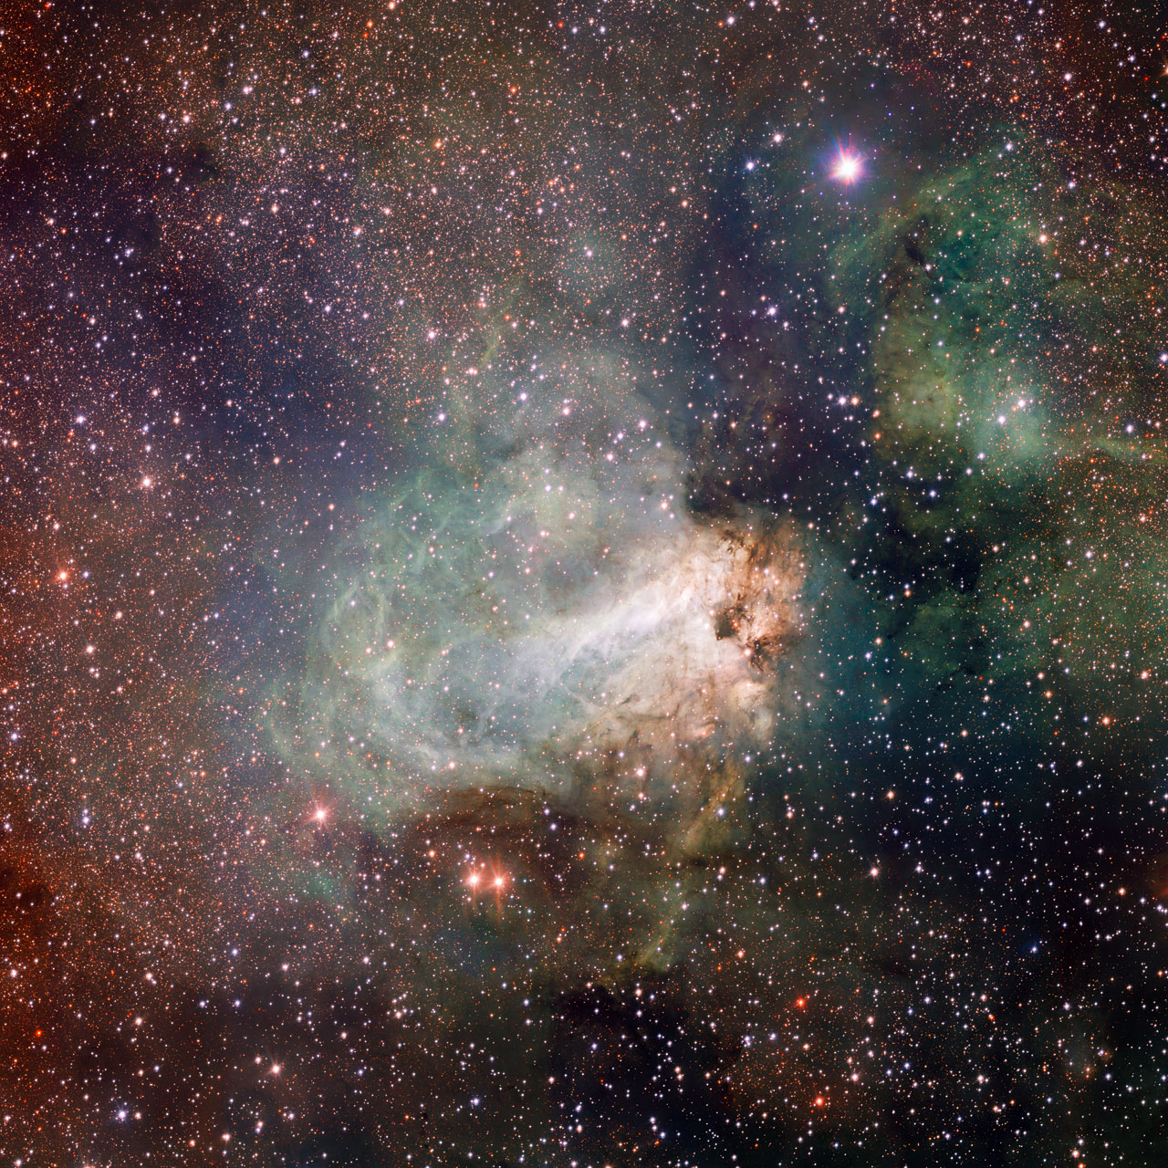
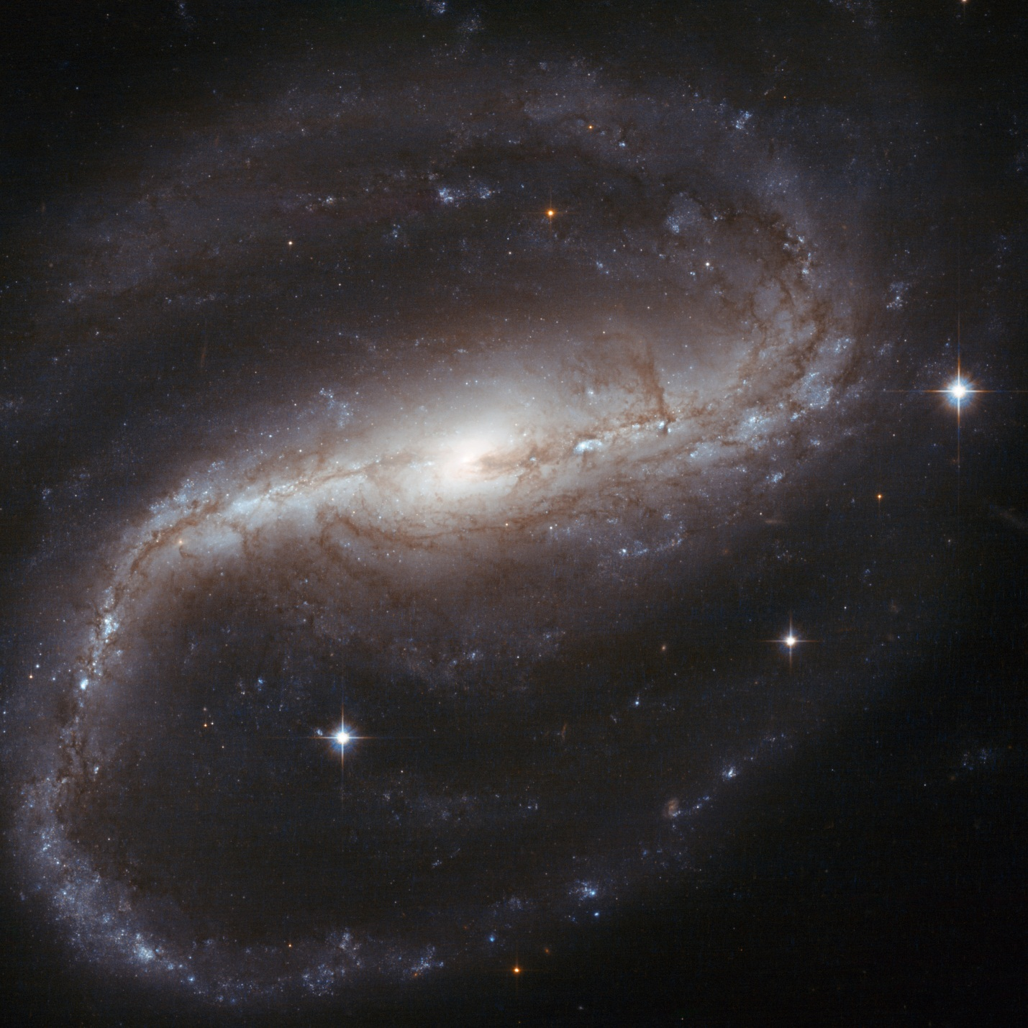


COSMIC DUST

Slide 37




Slide 39



Caucasus, Georgia
Sample No. 8
Elements | Weight, % | Atom %
O K | 57.12 | 70.83
Mg K | 1.46 | 1.19
Al K | 14.00 | 10.29
Si K | 21.63 | 15.28
K K | 2.30 | 1.17
Fe K | 3.49 | 1.24
In total | 100.00

Slide 40

446
Arctic, Northern Norway
427
428
418
411

Slide 41


No. 428
Element | Weight % | Аtomic %
O K | 43.33 | 71.62
Al K | 0.93 | 0.91
Si K | 0.99 | 0.93
K K | 1.00 | 0.67
Mn K | 53.76 | 25.88
Итоги | 100.00

Slide 42





No. 411
Element | Weight % | Atomic %
O K | 38.15 | 69.36
Ni K | 61.85 | 30.64
In total | 100.00

Slide 43


No. 418

Slide 44


No. 428

Slide 45



No. 411
No. 411

Slide 46

No. 411
Testate amoebae (TA), Centropyxis aerophila and Phryganella acropodial
Spectrum | O | Al | Si | K | Fe | In total
1 | 15.7 | 0.00 | 0.00 | 0.0 | 84.3 | 100.0
2 | 56.2 | 0.00 | 43.72 | 0.0 | 0.0 | 100.0
3 | 54.8 | 10.01 | 24.32 | 10.9 | 0.0 | 100.0
4 | 53.9 | 0.00 | 46.12 | 0.0 | 0.0 | 100.0
5 | 79.3 | 0.00 | 20.71 | 0.0 | 0.0 | 100.0
6 | 65.9 | 10.96 | 23.11 | 0.0 | 0.0 | 100.0
7 | 55.5 | 9.80 | 26.95 | 7.7 | 0.0 | 100.0
Mean | 54.5 | 4.40 | 26.42 | 2.66 | 12.0 | 100.0
STD | 19.4 | 5.49 | 15.46 | 4.63 | 31.8
Max | 79.3 | 10.96 | 46.12 | 10.9 | 84.2
Min | 15.7 | 0.00 | 0.00 | 0.00 | 0.00

Slide 47


Slide 48

THANK YOU FOR ATTENTION!

