Slide 1
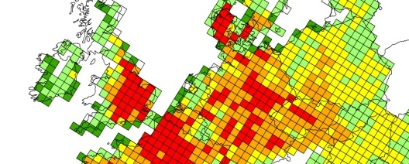
Preparations for the Ozone Critical Levels Workshop (November, 2016)
Report from the Ozone Epidemiology Worksop (November, 2015)
Gina Mills*, Sabine Braun, Per Erik Karlsson, Håkan Pleijel, Patrick Büker and Ignacio Gonzalez-Fernandez
* Head of the Programme Coordination Centre, ICP Vegetation

Slide 2
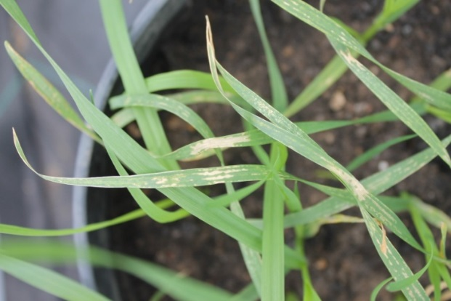
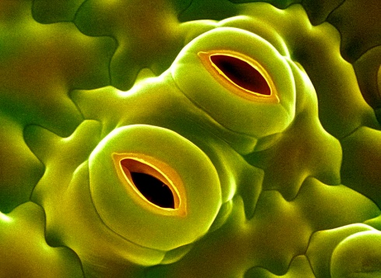
Critical levels for ozone: background
Ozone
Cell membrane damage
Altered partitioning
Reactive Oxygen Species
Photosynthesis inhibited
What are the thresholds/critical levels above which detrimental effects occur?
Which effects are most important for policy?
How do these critical levels differ for different species?
Reduced growth and seed production

Slide 3
Ozone risk assessment methodology
Ozone concentration
(AOT40)
Ozone flux/stomatal uptake is growth stage dependent and calculated from hourly mean:
Ozone conc.
Light
Temperature Humidity (VPD)
Soil moisture

Slide 4
Critical levels for ozone, an evolving process
Year | Workshop | Progress
1988, 1989 | Bad Harzburg, Germany | Annual mean
1992 | Egham, UK | AOT40 introduced
1993 | Bern Switzerland | AOT40 established
1996 | Kuopio, Finland | AOT40 extended
1999 | Gerzensee, Switzerland | First flux-based critical levels considered
2002 | Gothenburg, Sweden | First flux-based critical levels accepted
2005 | Obergurgl, Austria | CLs updated based on new knowledge
2009 | Ispra, Italy | CLs updated based on new knowledge
2016 | Madrid, Spain | CLs and methodology to be updated, including climate change impacts

Slide 5
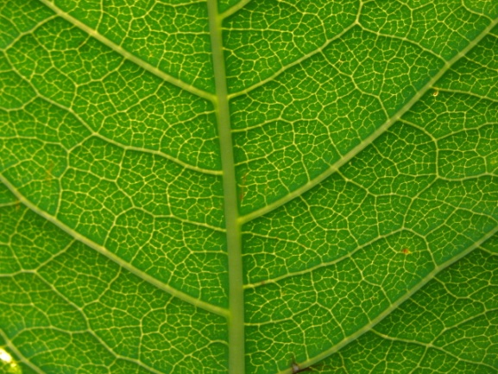
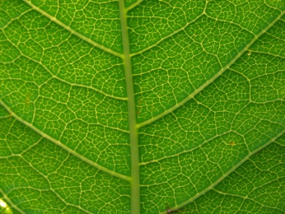
Ozone flux and flux-effect models in LRTAP Manual
POD_{Y}-based functions and critical levels
Ozone
flux
Crops | Trees | Grasslands
Wheat * | Birch * | Clover spp*
Potato * | Beech * | Viola spp
Tomato * | Norway spruce * | Buttercup spp
Grapevine | Scots pine | Cocksfoot
Maize | Temperate oak
Soybean | Poplar
Sunflower | Aleppo pine
 | Holm Oak
Influenced by:
O3
Temperature
VPD, PAR
SMD,
Phenology
* Flux-effect relationships available
POD_{Y}: Phytotoxic Ozone Dose
(absorbed by plant)
Available at: http://icpvegetation.ceh.ac.uk/manuals/

Slide 6
Preparations for next Critical Levels Workshop
Hindås Methodology Workshop
Sweden, 24 – 25 November, 2015
27 representatives from ICP Vegetation, ICP Forests, WGE and EMEP from Finland, Germany, Italy, Spain, Sweden, Switzerland and the UK.
Deganwy Response Functions Workshop
7- 9 June, 2016, UK
Ca 30 participants to review progress towards the main meeting in November

Slide 7

Revision process
O₃
Calculating relative biomass
Time interval for accumulation of PODy
Defining Y
Ozone
gradients
Defining Minimum conductance
Relative biomass
PODy
Regional parameterisations
More species
Deriving critical levels
e.g. long living vegetation

Slide 8
Working Groups
Forests, chaired by Patrick Büker, UK
Crops, chaired by Håkan Pleijel, Sweden
(Semi-)natural vegetation, chaired by Ignacio Gonzalez-Fernandez, Spain
Supported by:
Unified methodology (Sabine Braun, Switzerland)
Field evidence (Felicity Hayes, UK)

Slide 9
Second Expert Workshop Epidemiological Analysis of Air Pollution Effects on Vegetation
Hindås, Sweden, 23 – 24 November, 2015
A follow-up from the first Expert Workshop on Epidemiological Analysis of Air Pollution Effects on Vegetation in Basel, 16-17 September 2014
Attended by 24 scientists from Finland, Italy, Sweden, Spain, Switzerland, and United Kingdom
12 presentations
Recommendations for the application of epidemiological methods were revised and will be submitted to a peer reviewed journal, Braun et al. (in preparation)

Slide 10
2nd Epidemiology Workshop, continued
Epidemiological analysis cannot prove causality but can provide strong indications for causality
The combination of monitoring, well-designed experimental studies, gradient studies (epidemiological analysis) and modelling can taken together provide credible, quantitative estimates of ozone impacts on European forests
Air Pollution
Climate Change
Monitoring, Damage and Recovery Assessment
Lab Experiments
Field Experiments
Epidemiology studies
Ecosystem Modelling: steady-state, dynamic

Slide 11
Preparations for next Critical Levels Workshop
Hindås Methodology Workshop
Sweden, 24 – 25 November, 2015
Deganwy Response Functions Workshop
7- 9 June, 2016, UK
Ozone Critical Levels Workshop
w/s 7 November, 2016, Spain

Slide 12
SPARES

Slide 13
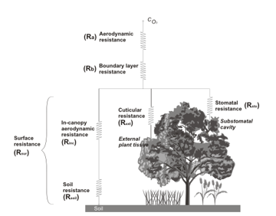

DO3SE
Deposition of Ozone for Stomatal Exchange
http://www.sei-international.org/do3se

