Slide 1
Spatial interpolation of N concentration and δ¹⁵N values in the moss collected within or outside the area of canopy drip line
Skudnik M.^{1*}, Jeran Z.², Batič F.³ & Kastelec D.³
¹ Slovenian Forestry Institute, Ljubljana, Slovenia
² Jožef Stefan Institute, Ljubljana, Slovenia
³ Biotechnical faculty, University of Ljubljana, Ljubljana, Slovenia
Dubna, 1st March, 2016

Slide 2
INTRODUCTION METHODS RESULTS CONCLUSIONS
Maps of pollution are often used to develop emission control policies.
The techniques share a common aim, which is to predict the concentration of the pollutant in a nonsampled area based on the concentrations measured in the sampled areas.
The error associated with the predicted concentrations depends on:
the spatial and temporal density of the sampling,
the characteristics of the sample area,
the characteristics of the monitored pollutant and
selection of the spatial interpolation technique.

Slide 3
INTRODUCTION METHODS RESULTS CONCLUSIONS
The general suitability of mosses for identifying areas at risk for high atmospheric deposition of N has been demonstrated by numerous studies.
However, some studies have reported only a weak dependence of N in moss tissue on the N in deposition – possible explanation:
role of N in moss metabolism.
different species have different abilities to bind atmospheric N.
other environmental variables also influence the N concentrations in the mosses.
the N concentrations can be affected by the selection of the sampling locations, particularly in the zone of canopy drip.
ICP-Vegetation guidelines – mosses should be (if possible) collected in open field.
From a forest ecology perspective, one seeks to obtain estimates of the atmospheric N deposited on the forest overstory or in clearings. Mosses collected under the canopy should reflect the N deposited on the forest floor, beneath the tree canopies.

Slide 4
INTRODUCTION METHODS RESULTS CONCLUSIONS
The aims of this presentation:
To present two different techniques for the spatial interpolation of N concentrations and δ¹⁵N values in the mosses that were collected within or outside the area of the canopy drip line.
To determine, with Slovenia as a case study, which aspects of the information based on the spatial interpolation methods was essential for discussion and inclusion in the published maps.

Slide 5
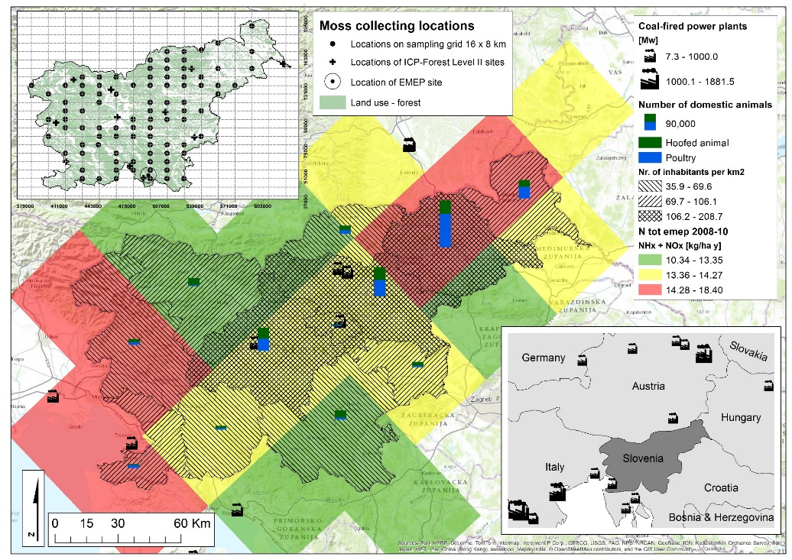
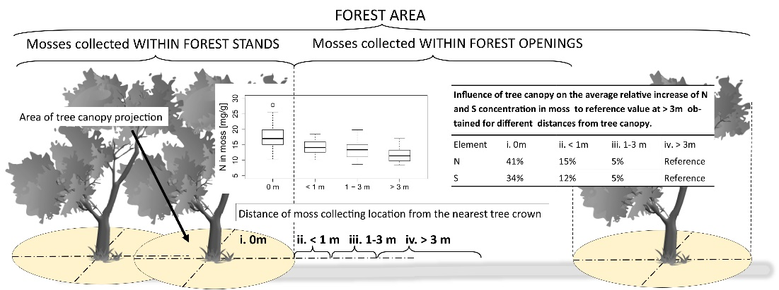
INTRODUCTION METHODS RESULTS CONCLUSIONS
MOSS SAMPLING
The samples of cypress-leaved plait moss (Hypnum cupressiforme Hedw.) were collected in the summer of 2010 at 103 locations.
At each location, the moss samples were collected from two types of site:
under the tree canopies (N_{canopy}),
in adjacent forest openings/clearings (N_{open}).
Chemical analysis: LECO CNS-2000, isotope ratio mass spectrometer (IRMS)

Slide 6
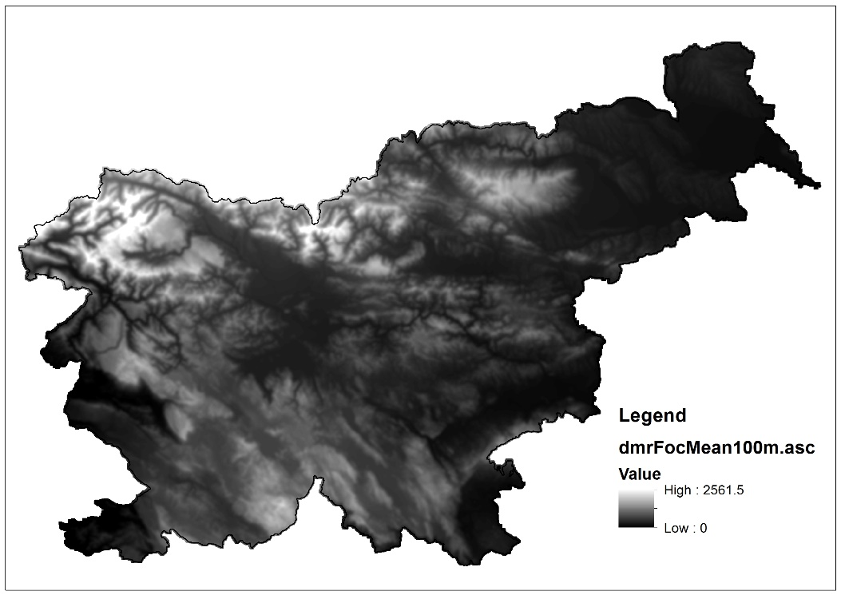
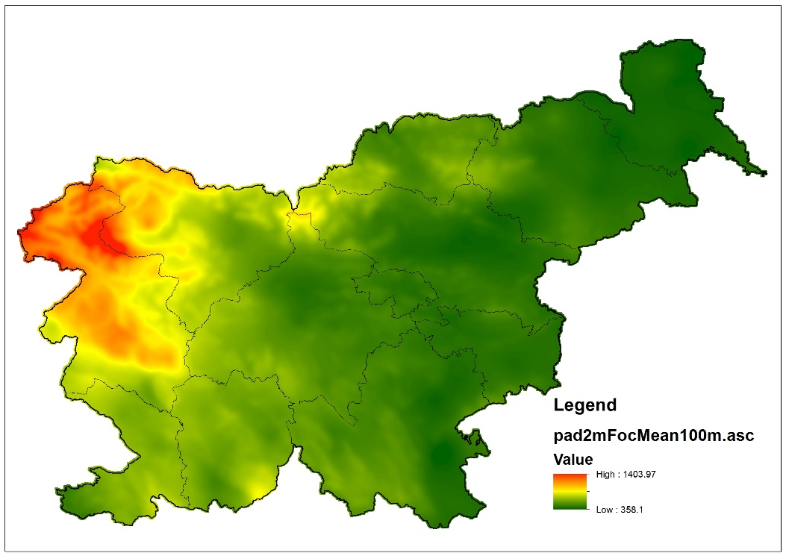
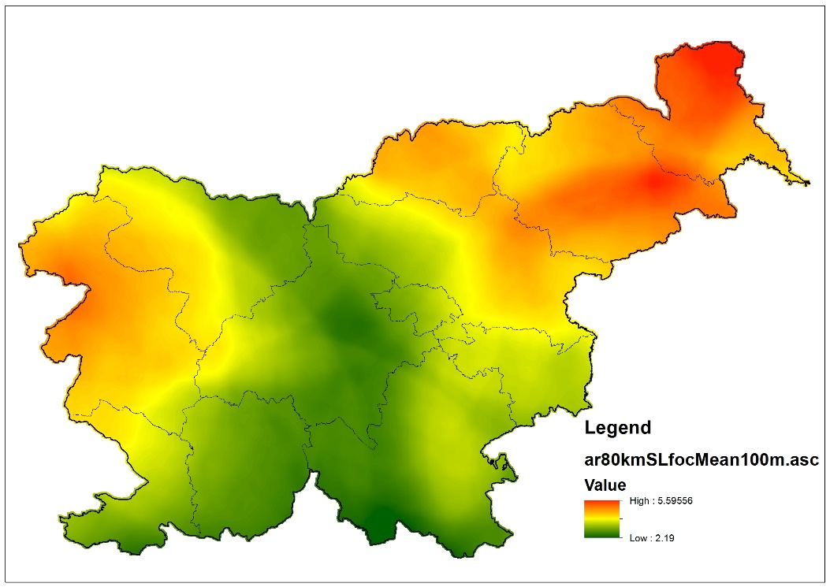
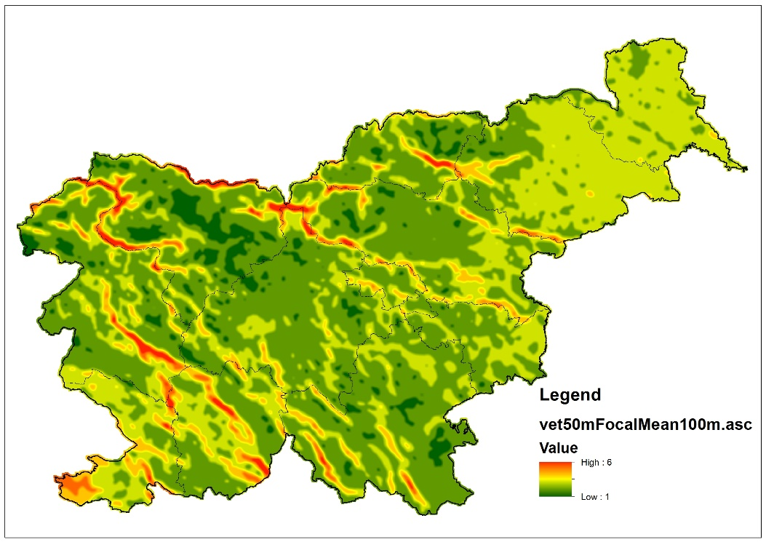
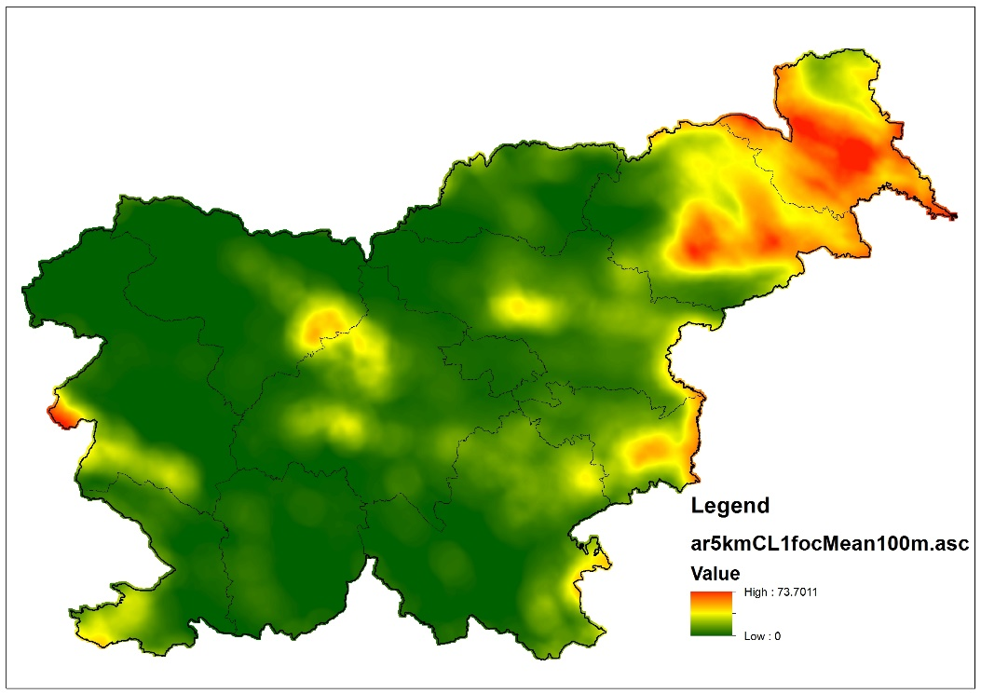
INTRODUCTION METHODS RESULTS CONCLUSIONS
SPATIAL EXPLANATORY VARIABLES
GIS data
Maps used within regression models | Data type used | Data source
Distance to nearest tree | Calculated | Field assessment – SFI
Tree mixture* | Original | Corine Land Cover (EEA, 2006)
Altitude | Original | Digital Elevation Model 100 (GURS, 2000)
Sum of 120 days of precipitation | Recalculated | Daily precipitation maps (ARSO, 2010)
Average wind speed 50 m above ground | Original | Map of wind speed (ARSO, 2011)
% of urban land within 80 km radius | Recalculated | Corine Land Cover (EEA, 2006)
% of cropland within 5 km radius | Recalculated | National Land Use Map (MKGP, 2010)
% of cropland within 0.5 km radius | Recalculated | National Land Use Map (MKGP, 2010)
% of forested land within 0.5 km radius | Recalculated | National Land Use Map (MKGP, 2010)
Modeled deposition (total reduced N + total oxidized N) (08-10 average) | Recalculated | EMEP MSC – W deposition model (EMEP, 2004)
Modeled deposition (total reduced N) (08-10 average) | Recalculated | EMEP MSC – W deposition model (EMEP, 2004)
Modeled deposition (total oxidized N) (08-10 average) | Recalculated | EMEP MSC – W deposition model (EMEP, 2004)

Slide 7
INTRODUCTION METHODS RESULTS CONCLUSIONS
SPATIAL INTERPOLATION
Monte Carlo simulation of sample variograms was used to examine spatial correlation.
The analyses of the spatial correlation were conducted:
First, without consideration of their dependence on the environmental variables;
Second, on the residuals from the multiple regression models.
SPATIAL EXPLANATORY VARIABLES
Multiple regression models -> which environmental characteristics are important in explaining of the variation of N concentrations and δ¹⁵N values in the mosses.
EVALUATION OF RESULTS
Cross-validation -> leave-one-out

Slide 8
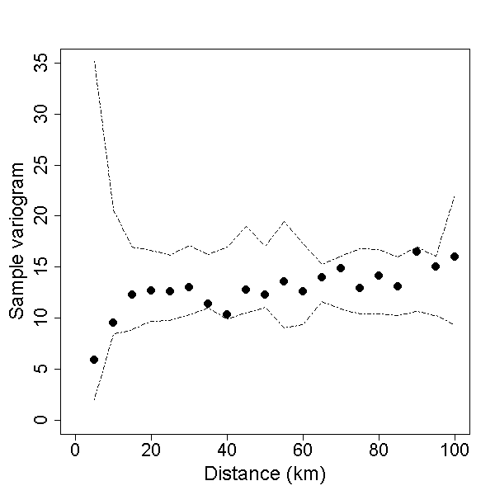
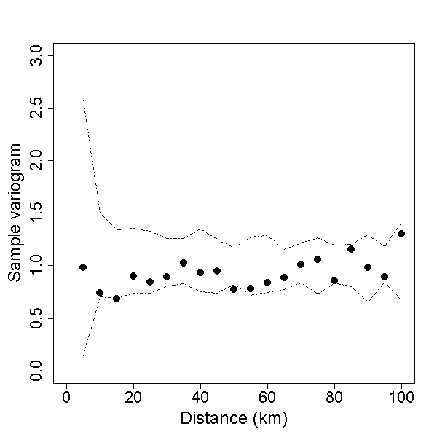
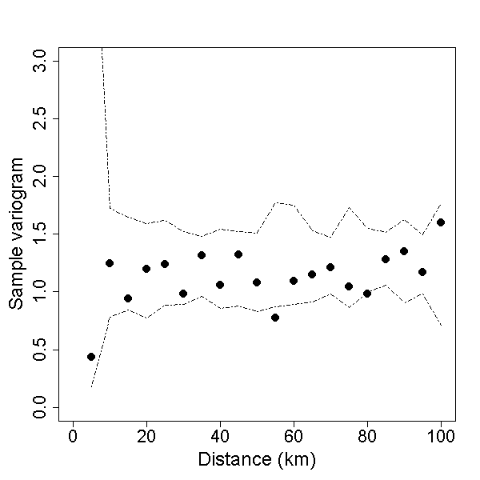
INTRODUCTION METHODS RESULTS CONCLUSIONS
Sample variogram (points) and envelope of Monte Carlo variogram simulations
-> If the original sample variogram values fall outside the envelope, then the spatial correlation is statistically significant.
N_{open}
N_{canopy}
δ¹⁵N_{open}
δ¹⁵N_{canopy}

Slide 9
INTRODUCTION METHODS RESULTS CONCLUSIONS
Results of regression models
Measurement in moss | N_{open} | N_{canopy} | δ¹⁵N_{open} | δ¹⁵N_{canopy}
Regression function for regression predictions and inverse distance weighted interpolation of residuals | N_{open} = % of UL within 80 km radius (15%) + modeled N_{tot} deposition (13%) + precipitation (9%) + distance to nearest tree (7%) + altitude (6%) + % of CL within 5 km radius (3%) R²: 0.53 (p < 0.001) | N_{canopy} = tree mixture* (7%) + average wind speed 50 m above ground (6%) + % of FL within 0.5 km radius (6%) + modeled N_{tot} deposition (6%) R²: 0.25 (p < 0.001) | δ¹⁵N_{open} = altitude (11%) + tree mixture* (8%) + % of CL within 0.5 km radius (6%) + modeled NH_{y} deposition (5%) + modeled NO_{x} deposition (2%) R²: 0.32 (p < 0.001) | δ¹⁵N_{canopy} = altitude (12%) + tree mixture* (5%) + % of CL within 5 km radius (3%) R²: 0.20 (p < 0.001)
increase of the element concentration in moss -> italics
decrease of the element concentration in moss -> underlined
categorical variables -> bold letters

Slide 10
INTRODUCTION METHODS RESULTS CONCLUSIONS
Results of regression models
Measurement in moss | N_{open} | N_{canopy} | δ¹⁵N_{open} | δ¹⁵N_{canopy}
Regression function for regression predictions and inverse distance weighted interpolation of residuals | N_{open} = % of UL within 80 km radius (15%) + modeled N_{tot} deposition (13%) + precipitation (9%) + distance to nearest tree (7%) + altitude (6%) + % of CL within 5 km radius (3%) R²: 0.53 (p < 0.001) | N_{canopy} = tree mixture* (7%) + average wind speed 50 m above ground (6%) + % of FL within 0.5 km radius (6%) + modeled N_{tot} deposition (6%) R²: 0.25 (p < 0.001) | δ¹⁵N_{open} = altitude (11%) + tree mixture* (8%) + % of CL within 0.5 km radius (6%) + modeled NH_{y} deposition (5%) + modeled NO_{x} deposition (2%) R²: 0.32 (p < 0.001) | δ¹⁵N_{canopy} = altitude (12%) + tree mixture* (5%) + % of CL within 5 km radius (3%) R²: 0.20 (p < 0.001)
increase of the element concentration in moss -> italics
decrease of the element concentration in moss -> underlined
categorical variables -> bold letters

Slide 11
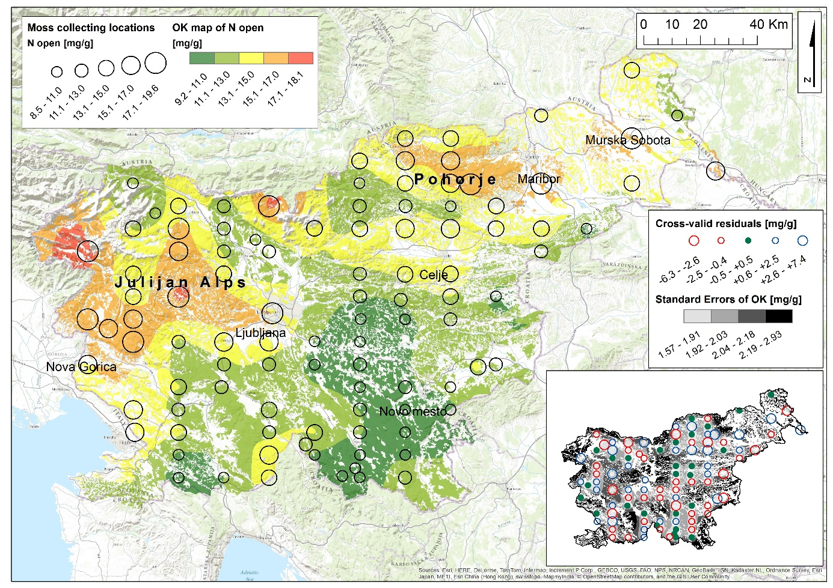
INTRODUCTION METHODS RESULTS CONCLUSIONS
Map of locations of measured N_{open} in mosses and spatial interpolation of N_{open} using ordinary kriging.

Slide 12
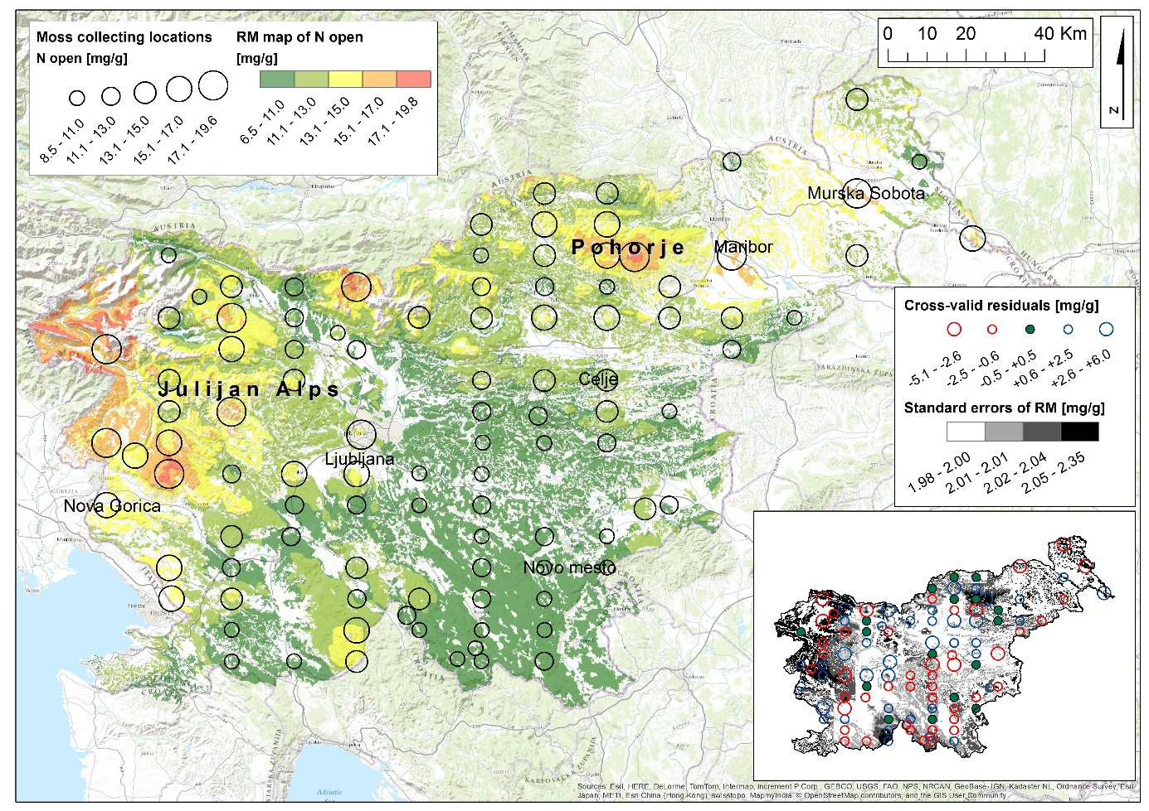
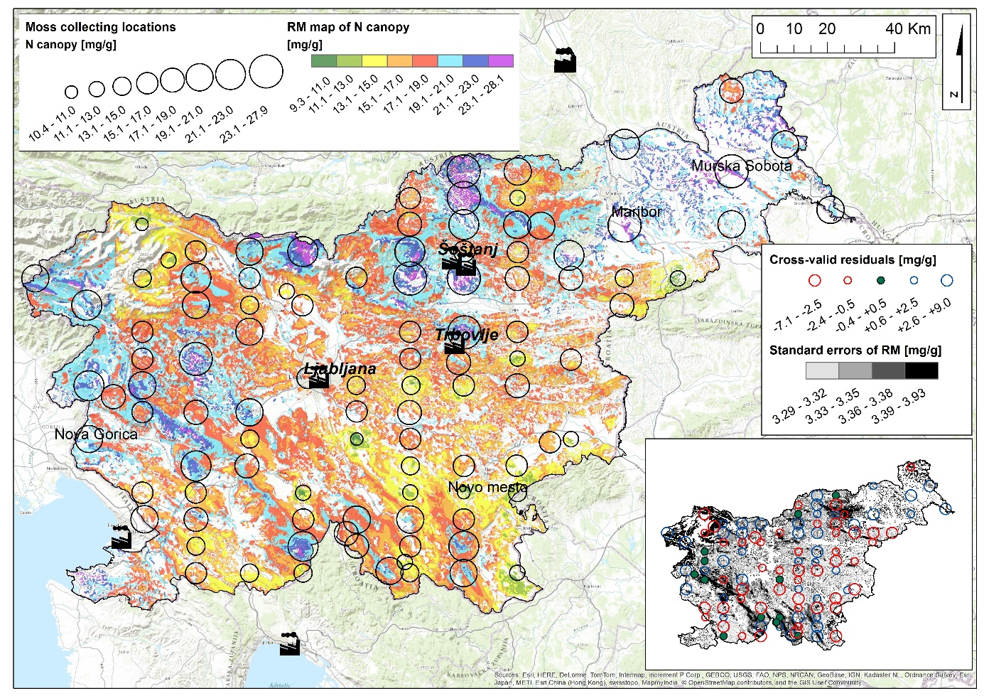
INTRODUCTION METHODS RESULTS CONCLUSIONS
Map of locations of measured N_{open} and N_{canopy} in mosses and spatial interpolation of N using regression model.

Slide 13
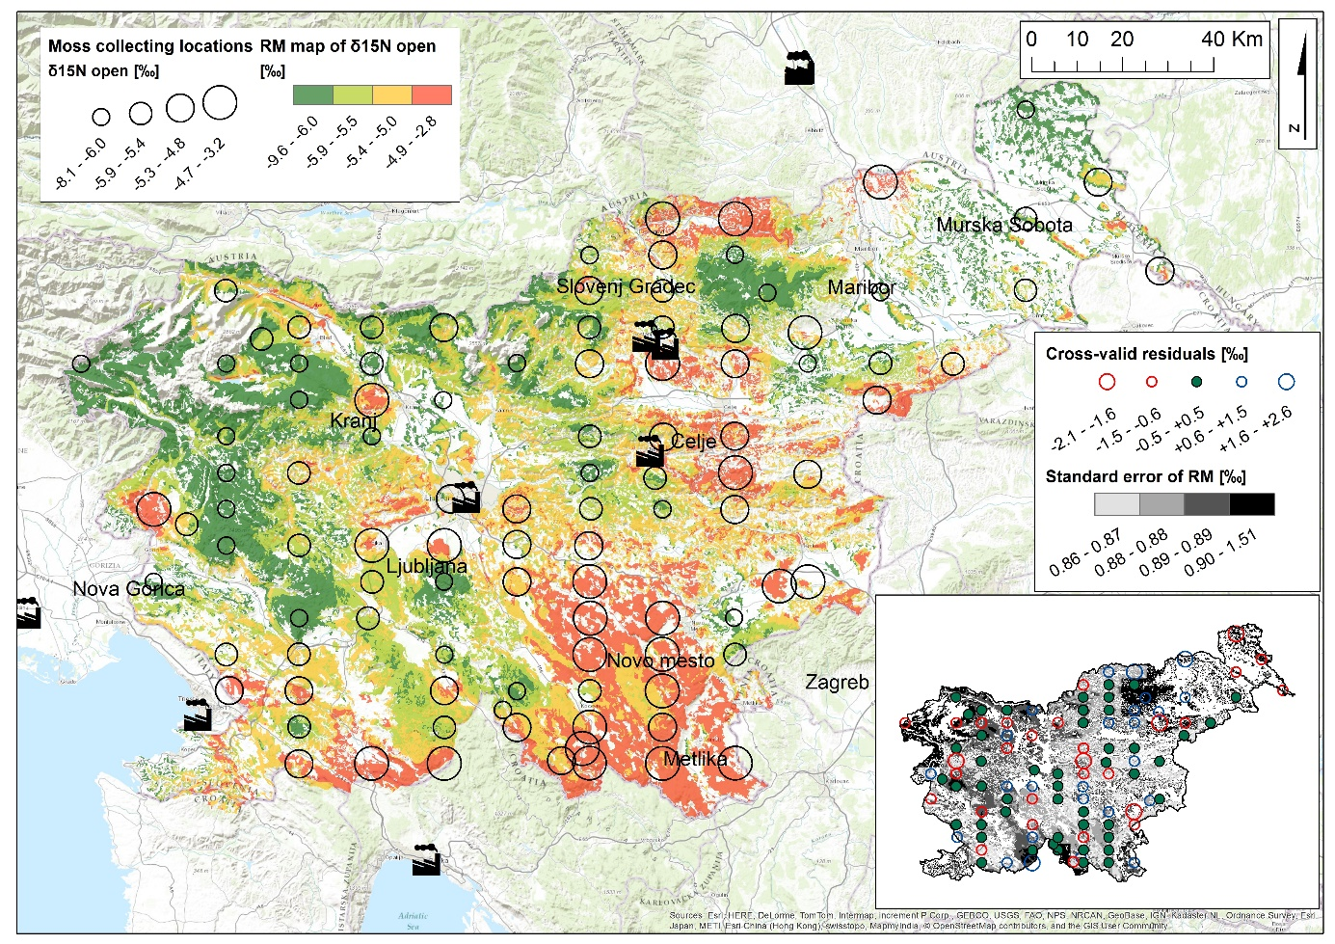
INTRODUCTION METHODS RESULTS CONCLUSIONS
Map of locations of measured δ¹⁵N_{open} in mosses and spatial interpolation of δ¹⁵N_{open} using regression model.

Slide 14
INTRODUCTION METHODS RESULTS CONCLUSIONS
Range of measured values for N_{open}, N_{canopy}, δ¹⁵N_{open} and δ¹⁵N_{canopy} in mosses and the ranges of resulting interpolated values with cross-validation results.
Used spatial interpolation technique | Measurement | Range of measured values | Range of interpolated values | Range of interpolated standard error [mg/g] | Cross-validation results
Ordinary kriging | N_{open} | 8.5 - 19.6 mg/g | 9.2 - 18.1 mg/g | 1.57 - 2.93 mg/g | 25%
Regression predictions with inverse distance weighted interpolations of regression residuals | N_{open} | 8.5 - 19.6 mg/g | 6.5 - 19.8 mg/g | 1.98 - 2.53 mg/g | 44%
 | N_{canopy} | 10.4 - 27.9 mg/g | 9.3 - 28.1 mg/g | 3.29 - 3.93 mg/g | 15%
 | δ¹⁵N_{open} | -8.1 - -3.2‰ | -9.6 - -2.8‰ | 0.86 - 1.51‰ | 22%
 | δ¹⁵N_{canopy} | -8.8 - -2.7‰ | -8.8 - -2.6‰ | 1.02 - 1.16‰ | 11%

Slide 15
INTRODUCTION METHODS RESULTS CONCLUSIONS
Numerous parameters influence the resulting interpolation maps -> the potential users should be informed about the procedure used to create a map, the level of accuracy and the limitations of the map.
In general, all three maps showed similar N patterns. However, some differences also occurred among the maps -> influence of environmental variables and some local emitters of NO_{x} were apparent on N_{canopy}, while not on the N_{open} map.
To enhance the quality of the spatial interpolation for the N_{canopy} and for the δ¹⁵N_{open} in Slovenia we suggest that the moss-sampling grid should be denser and maybe stratified for the different forest types. Denser sampling grid would increase also the quality of N_{open} map.

Slide 16
INTRODUCTION METHODS RESULTS CONCLUSIONS
References:
Skudnik, M., Jeran, Z., Batič, F., Kastelec, D., 2016. Spatial interpolation of N concentrations and δ15N values in the moss Hypnum cupressiforme collected in the forests of Slovenia. Ecological Indicators 61, 366-377.
Skudnik, M., Jeran, Z., Batič, F., Simončič, P., Kastelec, D., 2015. Potential environmental factors that influence the nitrogen concentration and δ15N values in the moss Hypnum cupressiforme collected inside and outside canopy drip lines. Environmental Pollution 198, 78-85.
Skudnik, M., Jeran, Z., Batič, F., Simončič, P., Lojen, S., Kastelec, D., 2014. Influence of canopy drip on the indicative N, S and δ15N content in moss Hypnum cupressiforme. Environmental Pollution 190, 27-35.
Thank you for your attention!

