Slide 1

Swift heavy ions in radiation material science
V.A. Skuratov
Flerov Laboratory of Nuclear Reactions, Joint Institute for Nuclear Research, Dubna, Russia

Slide 2
Swift heavy ions – ions with energies near and above 1 MeV/nucleon
E ≥ 1 МeV/nucleon
M ≥ 6 (Li)
Main sources of high energy ions:
Accelerators
Galactic cosmic rays
Fission fragments

Slide 3
High energy heavy ion accelerator facilities:
GANIL (Caen, France) 1-100 MeV/amu
GSI (Darmstadt, Germany) 10-1000 MeV/amu
NSC (New Delhi, India) 15 MeV×Z
JINR (Dubna, Russia) 1.2-10 MeV/amu
CRC (Louvain-la-Neuve, Belgium) 0.6-27.5 MeV/amu
ANU (Canberra, Austarlia) 15.5 MeV×Z
RIKEN (Tokai, Japan) 7-135 MeV/amu
JAERI (Takasaki, Japan) 2.5-90 MeV/amu
ISRC (Astana, Kazakhstan) 0.42-1.67 MeV/amu
BNL (Berkeley, USA) 4.5-55 MeV/amu

Slide 4
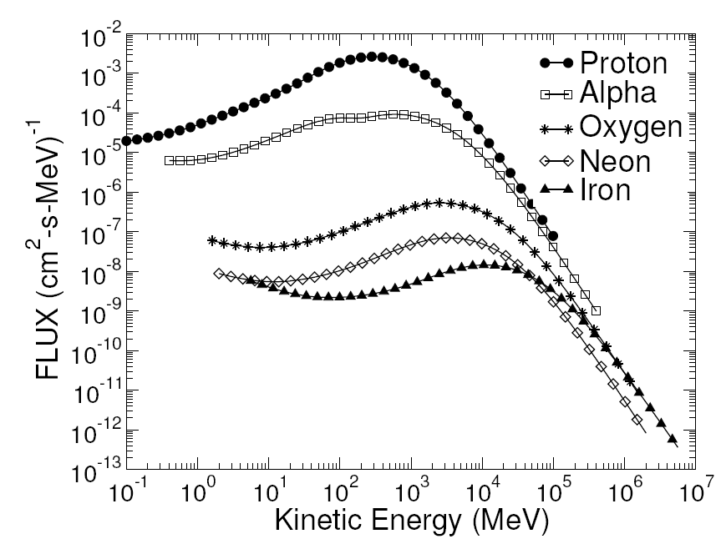
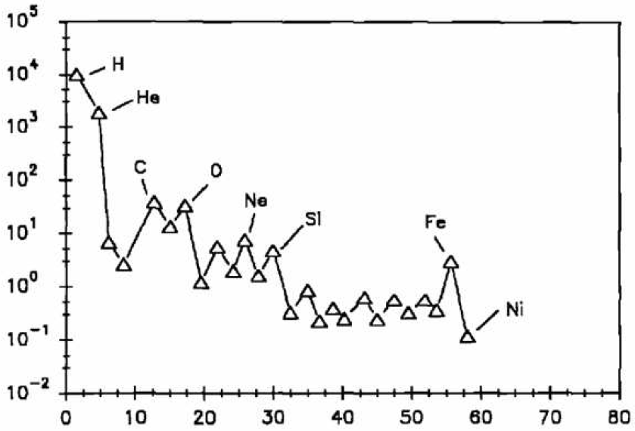
II. Galactic cosmic rays
The composition of galactic cosmic rays includes:
83% protons
13% alpha particles
3% electrons
1% heavy ions (Z>4)
Nuclear charge (Z)

Slide 5

SEE – Single Event Effects
e⁻
h⁺
Electric field
SEE cross-section σ = $\frac{numbers of events}{fluence ×\cos{θ}}$
LET - Linear Energy Transfer [MeV×cm²/mg]
LET range: threshold LET_{tr} ÷ ≈ 100 MeV×cm²/mg

Slide 6
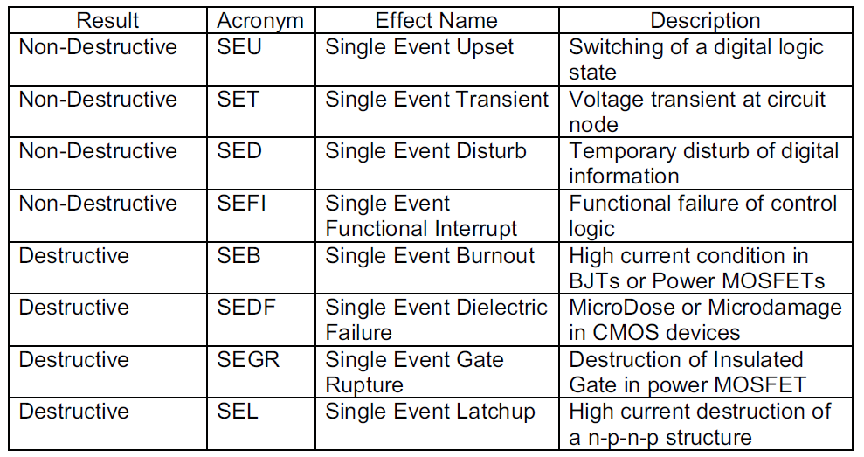
SEE – Single Event Effects
Todd Weatherford. FROM CARRIERS TO CONTACTS, A REVIEW OF SEE CHARGE COLLECTION PROCESSES IN DEVICES, 2002 IEEE NSREC Short Course

Slide 7
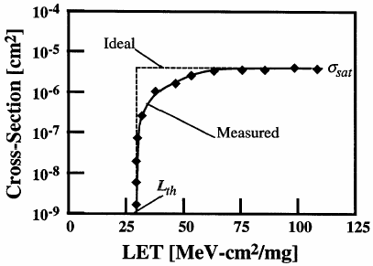
WEIBULL FIT of threshold curve
s= σ_{sat} {1-exp[-(L-L_{th})/W]S}
σ_{sat} : saturation value
L_{th}: threshold LET value
W and S are fitting parameters
Alessandro Paccagnella. Single Event Effects: Introduction
Scuola Nazionale di Legnaro. 29/3/2007

Slide 8
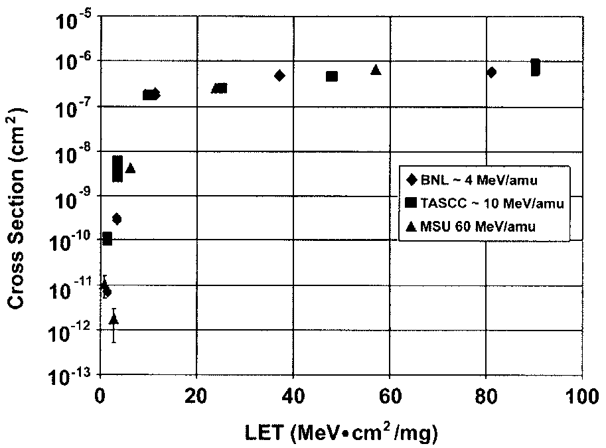
Example cross-section curves for a Matra 32 K 8 SRAM
IEEE TRANSACTIONS ON NUCLEAR SCIENCE, VOL. 50, NO. 3, 2003

Slide 9


FLNR accelerator complex.
Some crucial points for the SEE testing
Ion energy 3 - 50 MeV / nucleon
Beam intensity: 10¹ ÷ 10⁵ сm⁻²s⁻¹
Beam uniformity: ≤ 30 %
Energy accuracy: 10 %
Ion range in Si: ≥ 30 mkm (ion energy > 3 MeV/nucleon)
Dedicated beam operation time for testing: 2000 hours per year

Slide 10
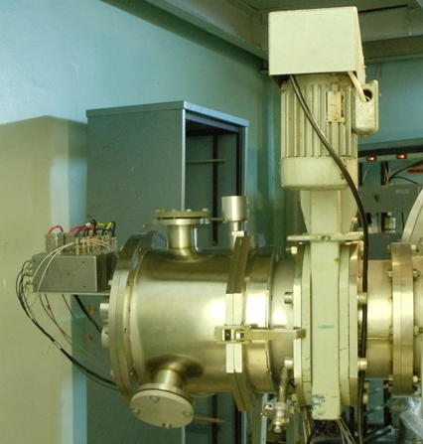

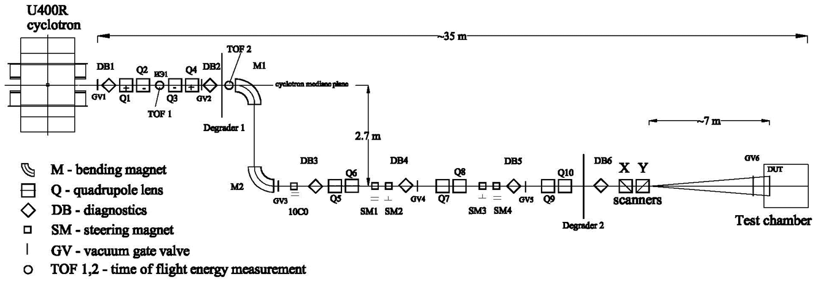
Low energy beam line on the base of U400
…first step in 2007
The first dedicated beam line for low energy (3-6 MeV/nucleon)
Irradiation area: 80*160 mm.
Beam uniformity better than 30%
Beam intensity 10 ÷ 10⁵ cм⁻²s⁻¹ .
41st meeting of the PAC for Condensed Matter Physics
Dubna, 23/01/2015

Slide 11
U400M experimental hall.
High energy (14-40 AMeV) ion beam-line
Low energy (3-6AMeV) ion beam-line
41st meeting of the PAC for Condensed Matter Physics
Dubna, 23/01/2015

Slide 12
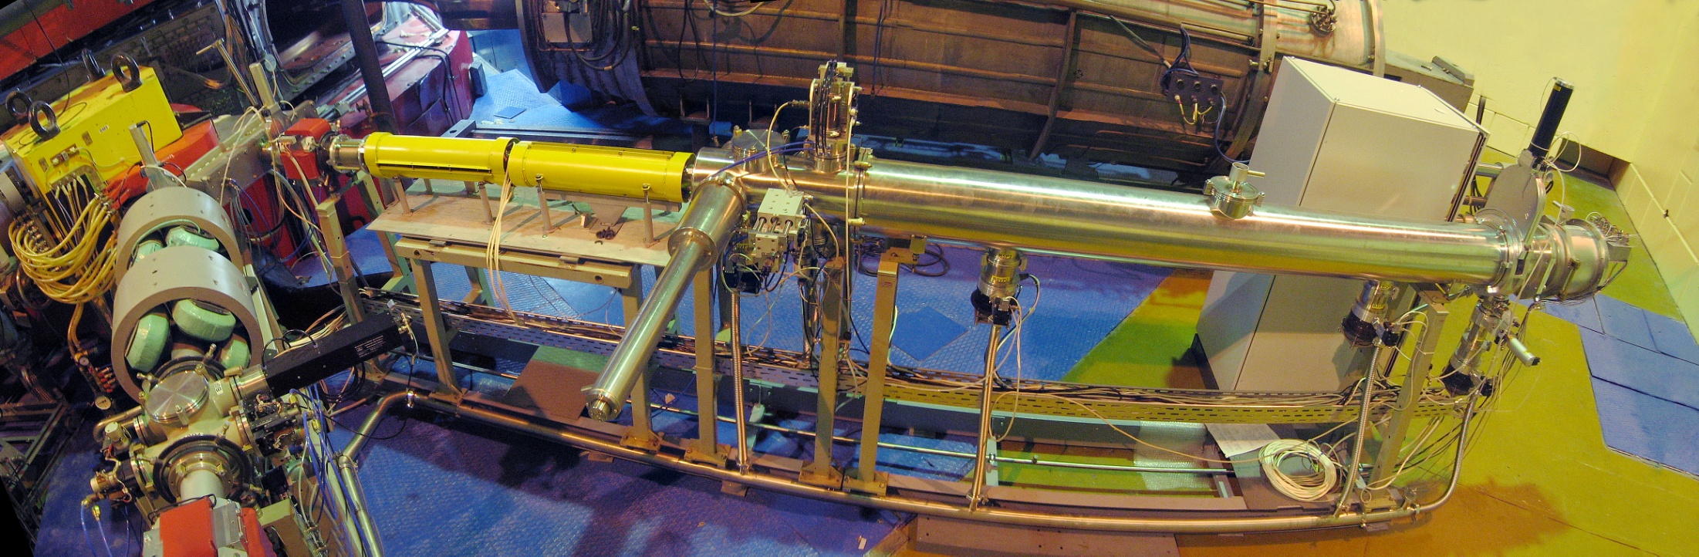
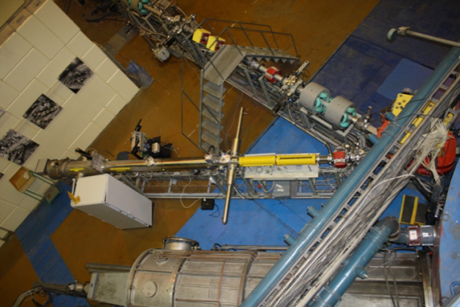
Low energy ion beam line.
Bending magnet
TOF measurement
X-Y correction magnets
Faraday cup
Vacuum gate valve
Luminophore drive
Test chamber
X-Y scanning system (50 Hz)
Turbo molecular pumps
Ta foils (5-27 μm) drive
41st meeting of the PAC for Condensed Matter Physics
Dubna, 23/01/2015

Slide 13
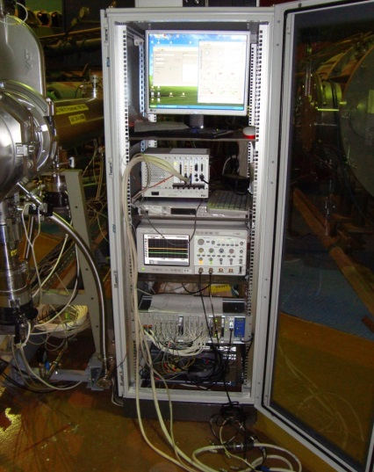
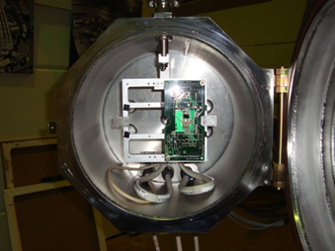
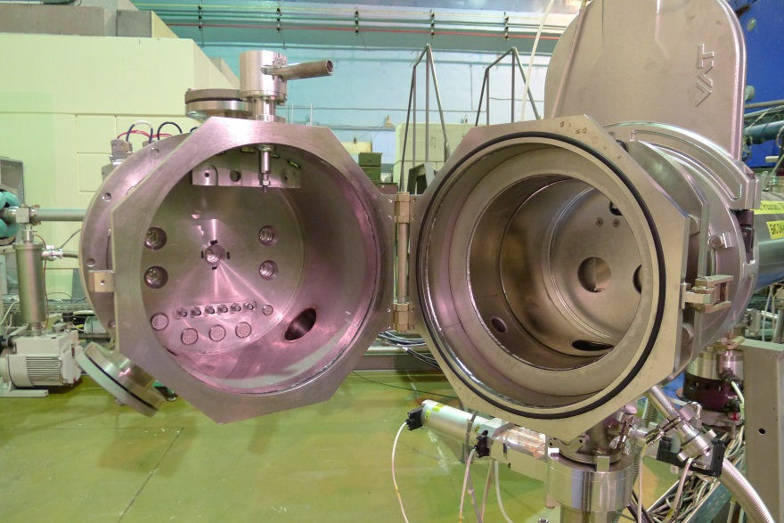
Irradiation chamber for LE
Dedicated beam-line for high energy (3 ÷ 6 MeV/nucleon)
ions (usially Ne, Ar, Kr, Xe, Fe or Bi)
Irradiation area – 200x200 mm².
Beam uniformity better then 30%
Beam flux 1 ÷ 10⁵ cm⁻²s⁻¹
41st meeting of the PAC for Condensed Matter Physics
Dubna, 23/01/2015

Slide 14
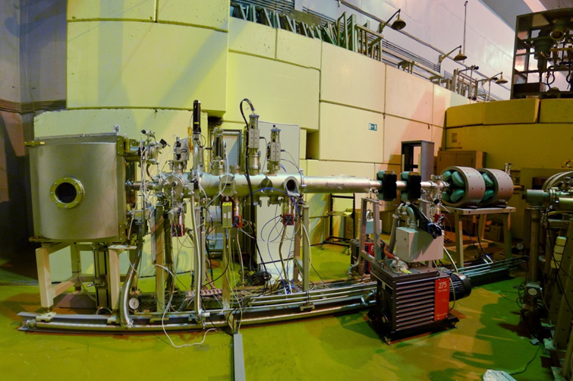
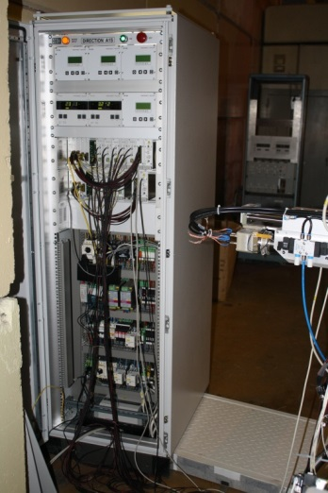
Main components of the high energy beam-line.
vacuum gate valve (1 and 9)
quadrupole lenses
steering magnets
turbo molecular pumps
beam monitoring system (5, 6, 8, 10, and 11)
energy measurement system
the user target chamber
remote movement
41st meeting of the PAC for Condensed Matter Physics
Dubna, 23/01/2015

Slide 15
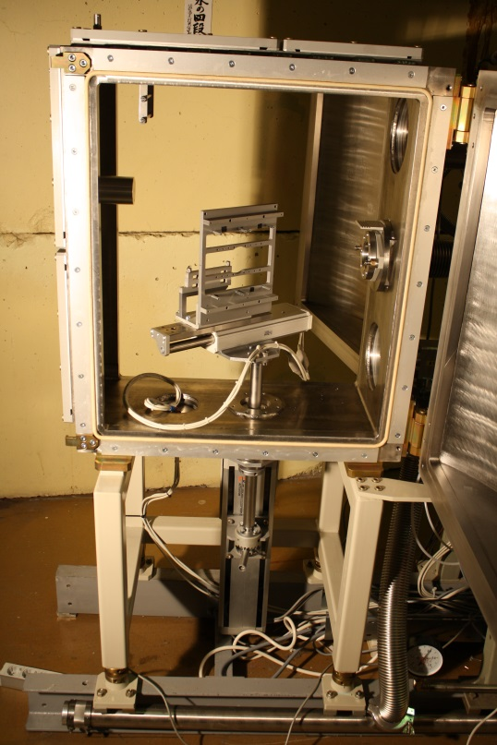
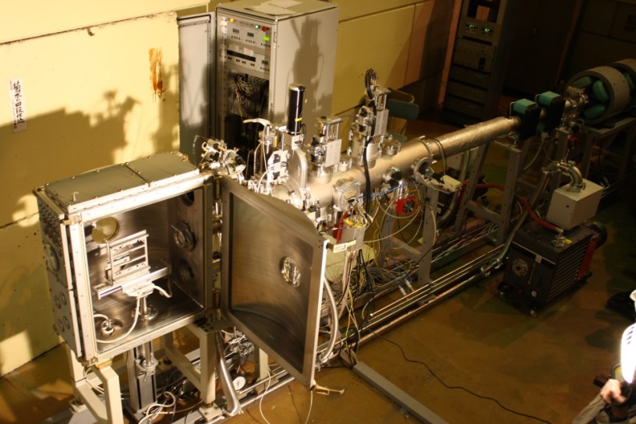
Irradiation chamber for HE
Design of the experimental chamber allows:
the SEE testing in vacuum (10⁻² torr) and air ambient
irradiation area of 60 mm in diameter.
automatic movement of the DUT in two orthogonal axes
(X and Y) in respecting of the beam direction (Z)
to change beam incident angle in the range of 0-90 degrees.
installation of degraders set.
41st meeting of the PAC for Condensed Matter Physics
Dubna, 23/01/2015

Slide 16
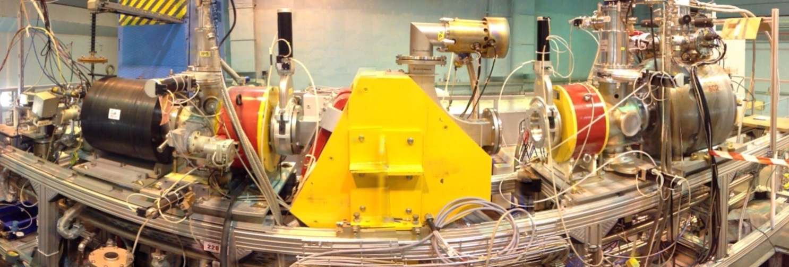
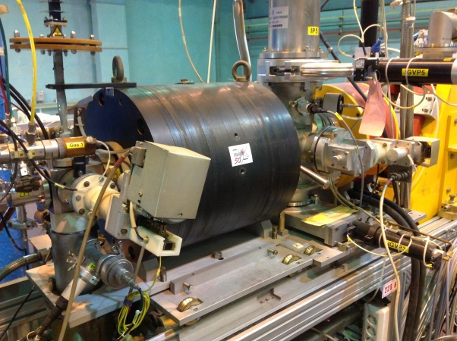
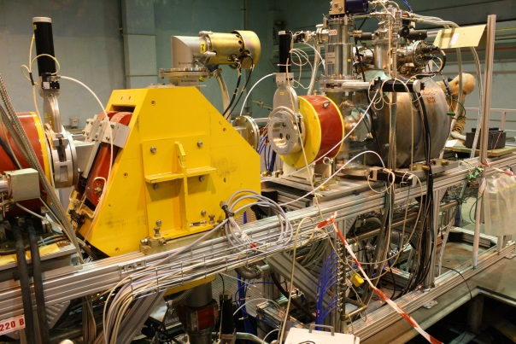
ECR source modernization up to the DECRIS-SC2 level
The main motivation of this update is the production of high charge state heavy ions which could boost the available beam energy and beam currents out of the U-400M cyclotron. On the other hand, another goal of the DECRIS-SC2 is to develop a compact superconducting ECR ion source with a high performance at 14 GHz which allows replace easily old room temperature ion sources from both cyclotrons keeping many existing subsystems.
the new ECR ion source is designed for high LET and high penetration of the DUT
DECRIS-2 “warm”
DECRIS-SC2 superconducting
From Li to Xe
From Kr to Bi
41st meeting of the PAC for Condensed Matter Physics
Dubna, 23/01/2015

Slide 17
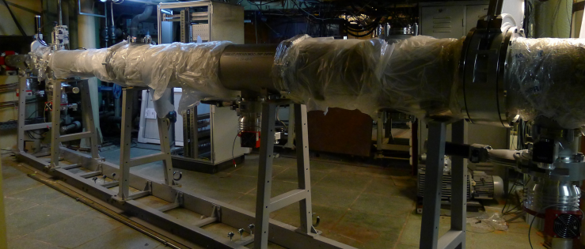
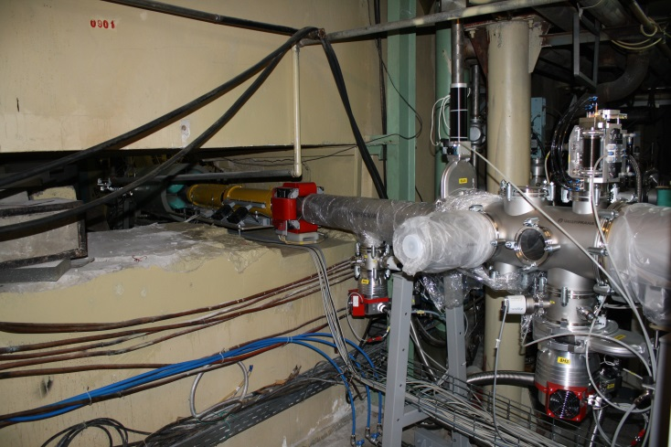
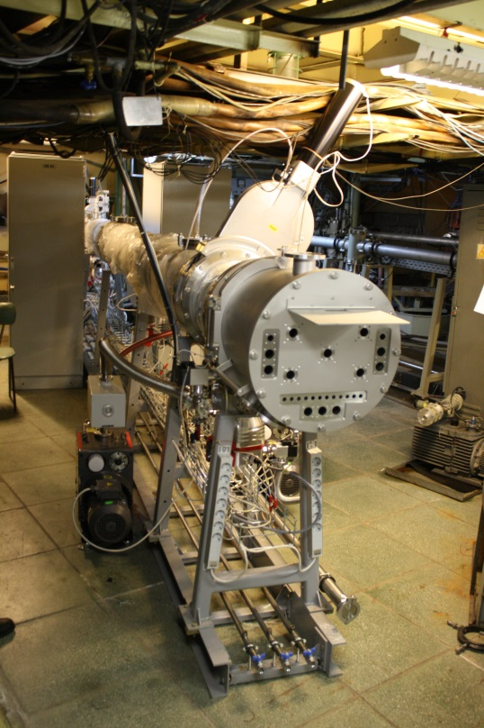
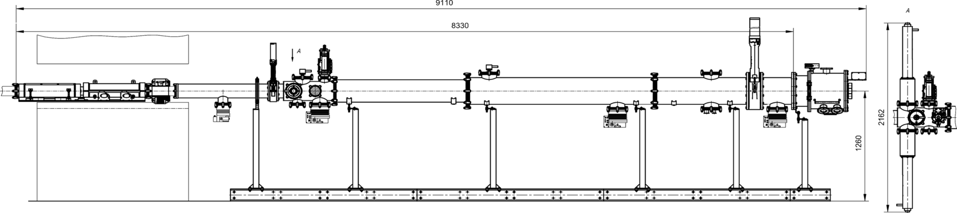
The NEW low energy ion bean line on U400
Main features of the new facility are:
200 mm x 155 mm irradiation area
beam uniformity over irradiation area better then 10%
Ne, Ar, Fe, Kr, Xe, Bi ions with 3-6 MeV/nucleon
LET range of 4.5-100 MeV/(mg/cm2).
Fluent energy variation in the U400R will allows changing the ion energy without degraders.
41st meeting of the PAC for Condensed Matter Physics
Dubna, 23/01/2015

Slide 18
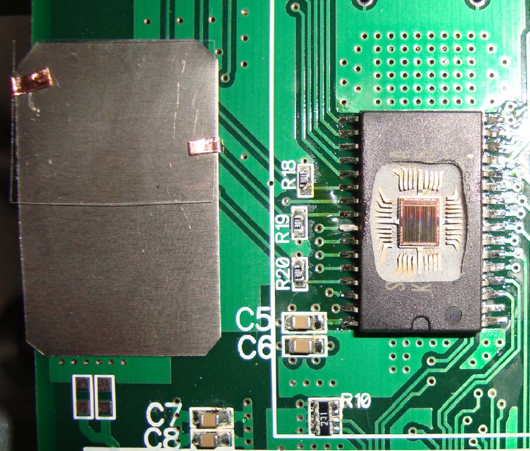
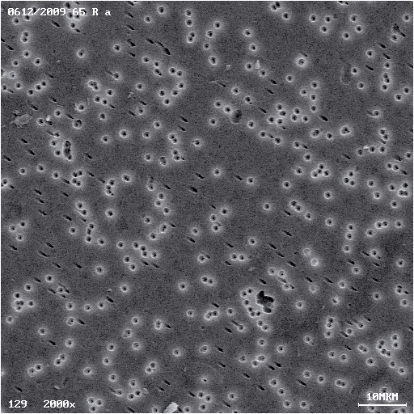
Ion beam diagnostic
Polymer track detector and the DUT
SEM micrograph of polymer track detector
Etching threshold for ion tracks in
polycarbonate – 2.5 MeV/(mg/cm²) (O, Ne)
polyethylene terephthalate – 8 MeV/(mg/cm²) (Ar÷Bi)

Slide 19
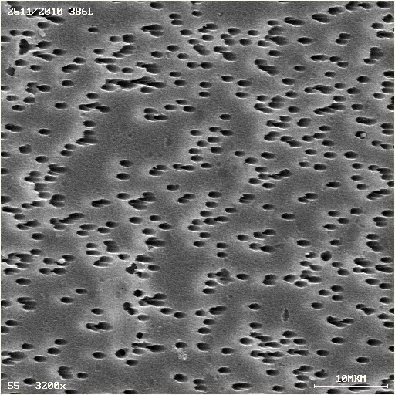
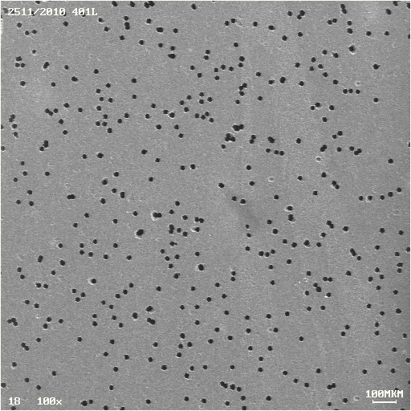
Ion beam diagnostic
9.55×10⁶ cm⁻²
1.48×10⁶ cm⁻²
SEM micrographs pictures of the track detectors surfaces irradiated under 30º tilted and normal 56 MeV oxygen ion beam incidence

Slide 20
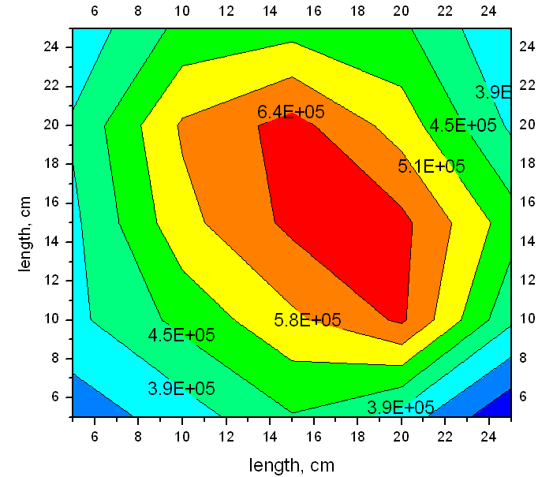
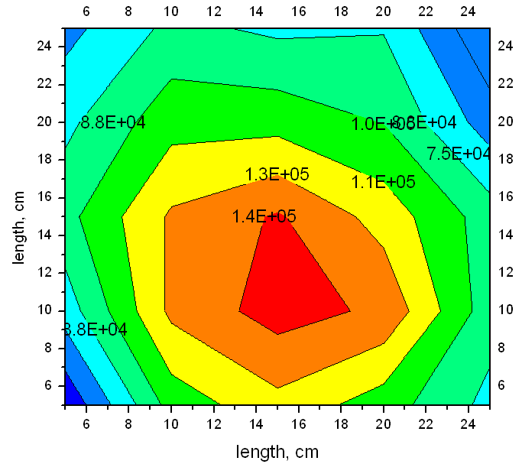
Ion beam distribution over the irradiating area
Ar, 120 MeV
Bi, 490 MeV

Slide 21
ION BEAM PARAMETERS USED FOR SEE TESTING AT U-400M FLNR JINR CYCLOTRON
Ion type | Energy, MeV | LET, MeV/(mg/cm²) | Ion flux, cm⁻²s⁻¹
¹⁶O | 56±3 | 4.5 | 1 ÷ 10⁵
²²Ne | 65±3 | 7
⁴⁰Ar | 122±7 | 16
⁵⁶Fe | 213±3 | 28
⁸⁴Kr | 240±10 | 41
¹³⁶Xe | 305±12 | 67
²⁰⁹Bi | 490±10 (820±20) | 95 (100)

Slide 22
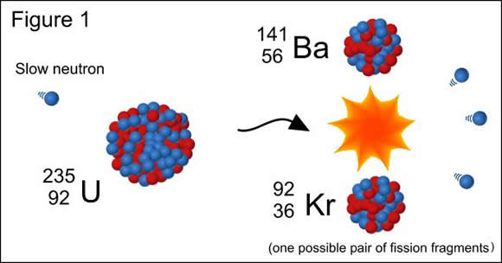
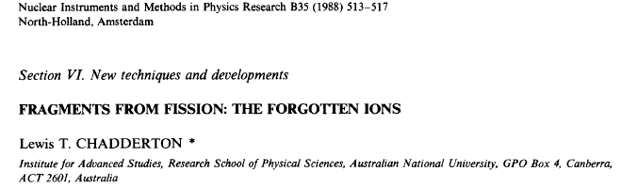
III. Fission fragments

Slide 23
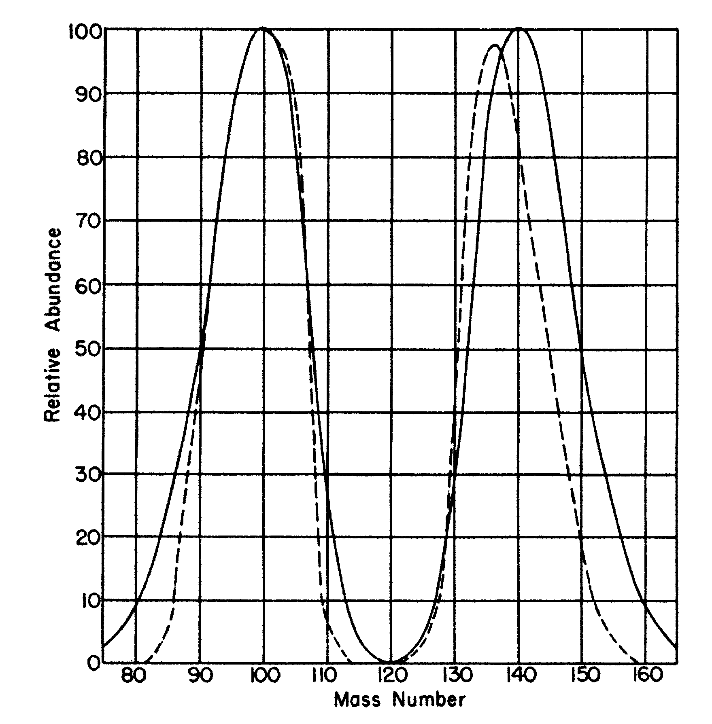
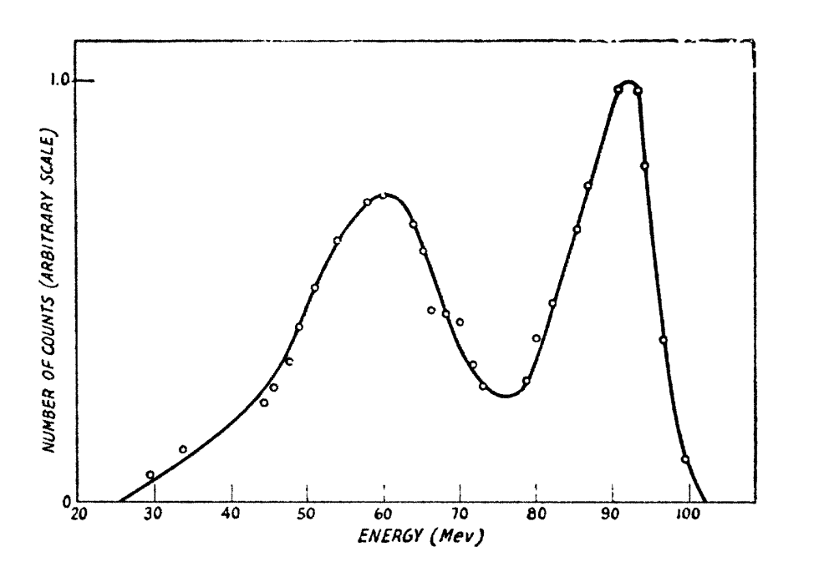
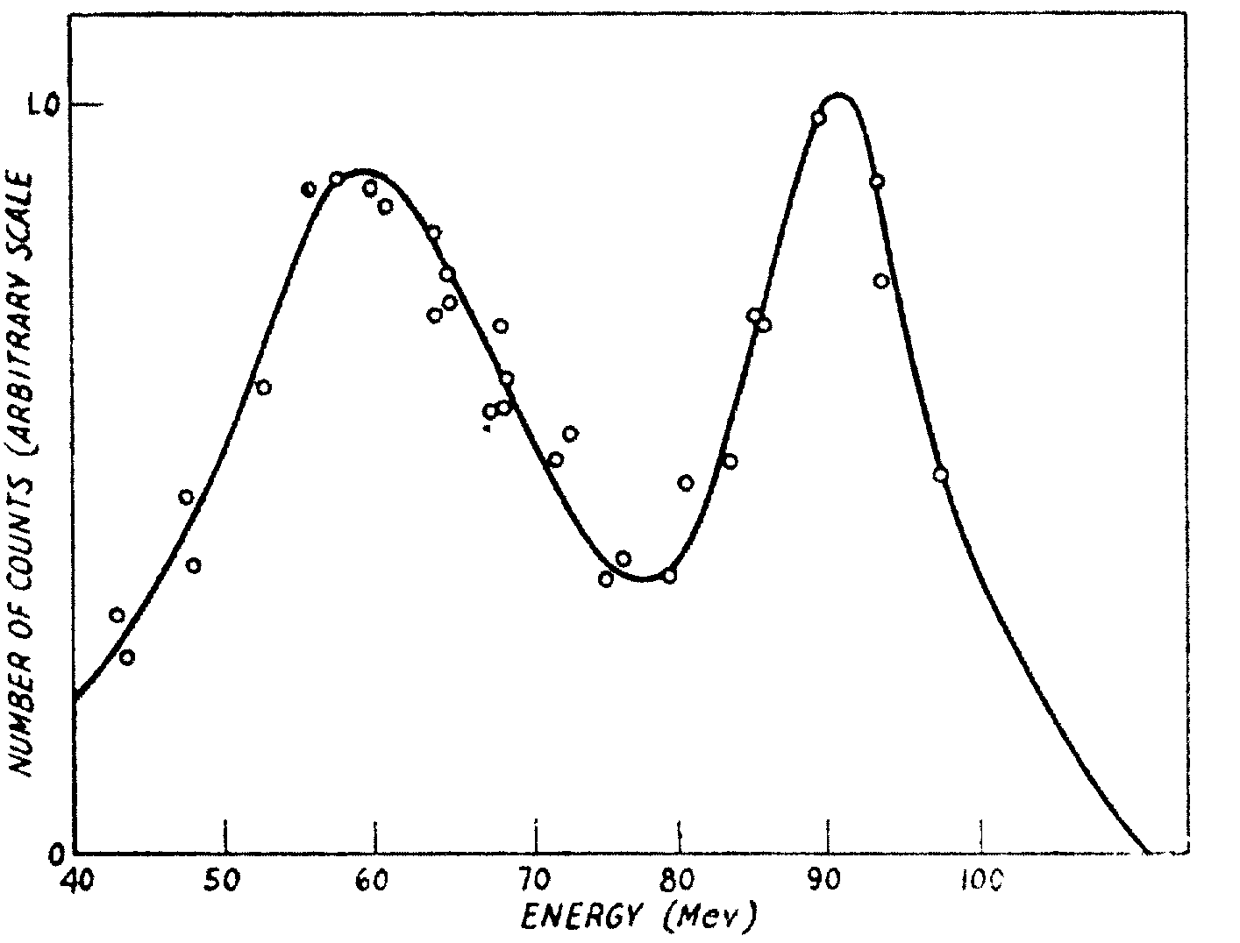
a
b
Mass distribution of fission fragments from Pu²³⁹.
Solid line is coincident fragment experiment; dashed line is chemical analysis.
D.C.Brunton and W.B.Thomson. Phys. Rev. 76(1949), 848
Energy spectrum of U²³⁵ fission fragments
induced by thermal (a) and 2.5 MeV (b) neutrons.
Stephen S. Friedland. Phys. Rev. 84(1951), 75

Slide 24
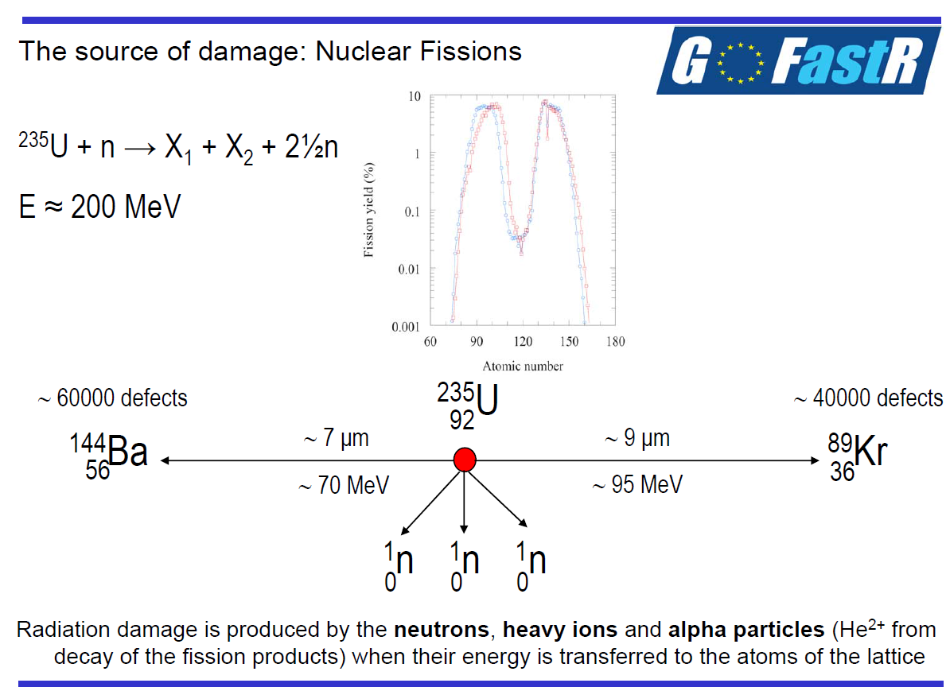
D. Staicu. Radiation damage modeling
in oxide, nitride and carbide fuels

Slide 25
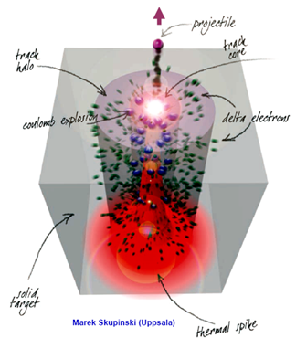
(-dE/dx)_{t} = (-dE/dx)_{n} + (-dE/dx)_{ion}
∼ 1% ∼ 99%
Main peculiarity of swift heavy ion interaction with solids is a high level of ionizing energy losses which may result in formation of specific radiation damage – latent tracks
Scheme of ion track formation process
Nanostructuring may enhance localization of energy deposition in the ion trajectory region and affect the latent track formation processes

Slide 26
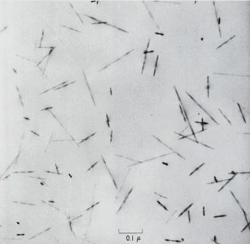
TEM image of tracks from ²³⁵U fission fragments in a synthetic fluor-phlogopite mica.
R.L., P.B. Price, R.M. Walker: "Nuclear Tracks in Solids: Principles and Applications." University of California, Berkeley, 1-605, (1975)

Slide 27
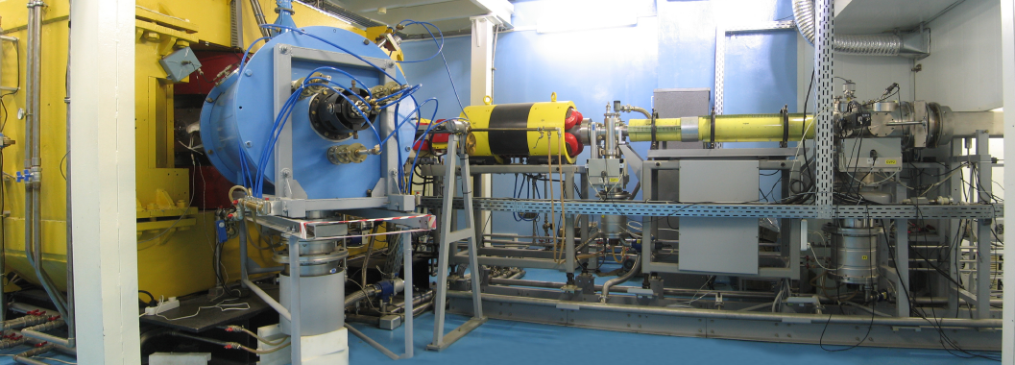
Accelerator for applied research – IC100
B⁺², Ne⁺⁴, Ar⁺⁷, Kr⁺¹⁷, Xe⁺²⁶ ions with energy ≈ 1.2 MeV/amu
Ion fluence range – up to 10¹⁵cm⁻²

Slide 28
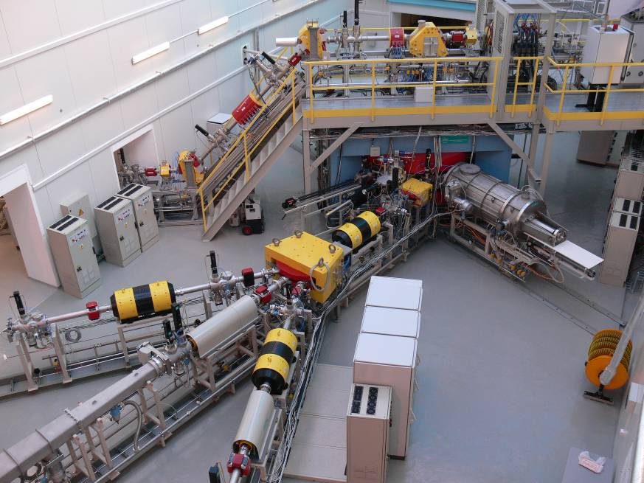
DC-60 CYCLOTRON (Astana)
E= 0.42-1.75 MeV/amu

Slide 29
Examination of the dense ionization effect in ceramics and oxides with heavy ions of fission fragments energy
Inert matrices - ceramics with a high melting point and with low neutron absorption cross sections to be used as hosts for transmutation of actinides via nuclear reactions
Examples of fuel compositions for LWR:
(Pu)O₂ - MgO-ZrO₂
(Pu,Np,Am)O₂, MgO-ZrO₂
(Am,Np,Pu,Zr)N
High energy heavy ion irradiation testing of materials that show promise for nuclear applications:
inert matrix fuel hosts: oxides (Al₂O₃, MgO), spinels, carbide and nitride based ceramics (ZrN, Si₃N₄, AlN)
ZrN, TiNZrN coating layers on Zircaloy alloys
Oxide dispersion strengthened (ODS) steels
Our central objectives are:
to study the structural changes and mechanical stresses induced by swift heavy ions as function of ion fluence and ionizing energy loss
to elucidate the dense ionization effect on pre-existing defect structures in irradiated materials
to compare the radiation stability of nanocrystalline and bulk ceramics.

Slide 30
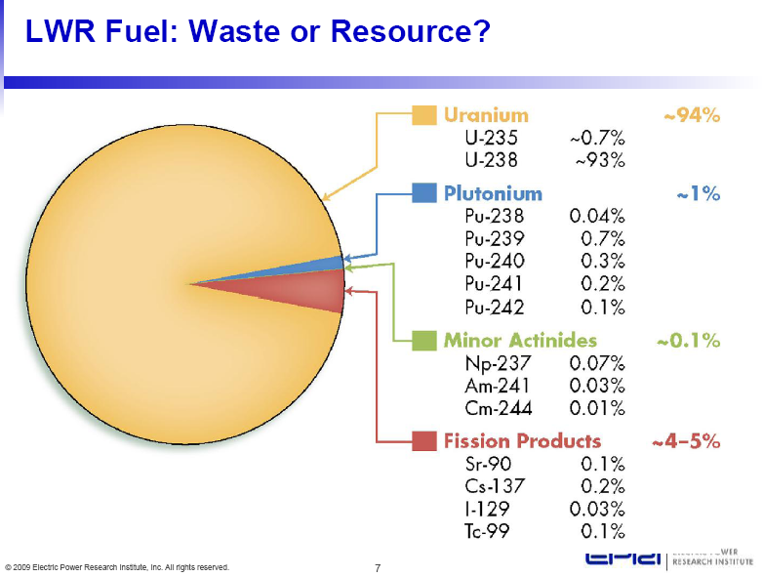

Slide 31
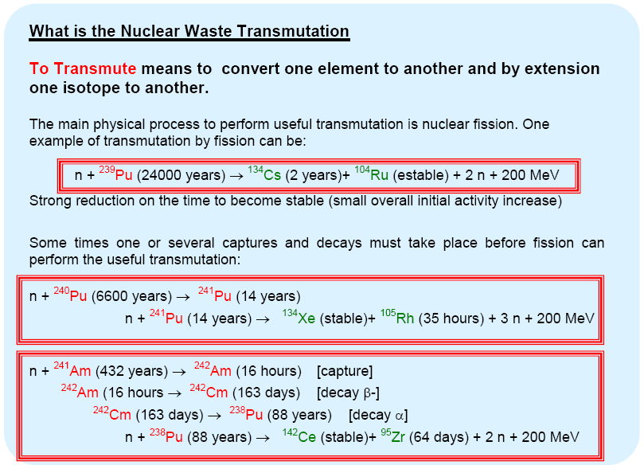

Slide 32
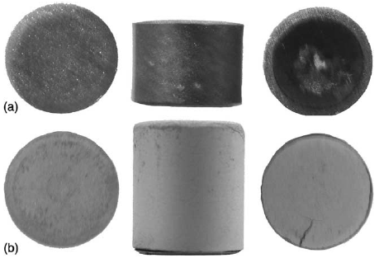
8,2 мм
M. Streit et al. Journal of Nuclear Materials 319 (2003), pp. 51–58

Slide 33
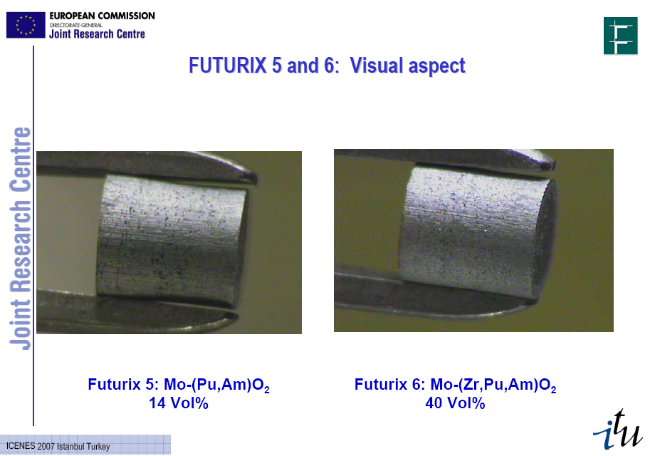

Slide 34
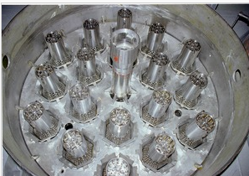

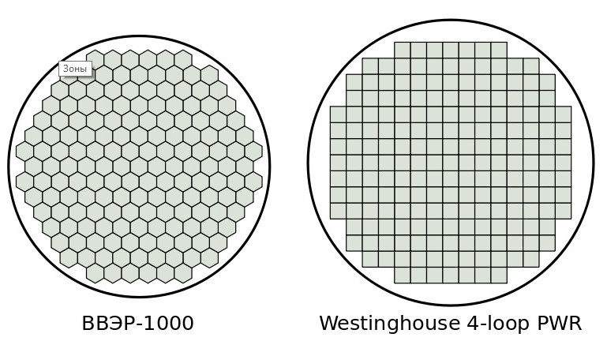
VVER-1200 fuel assembly

Slide 35
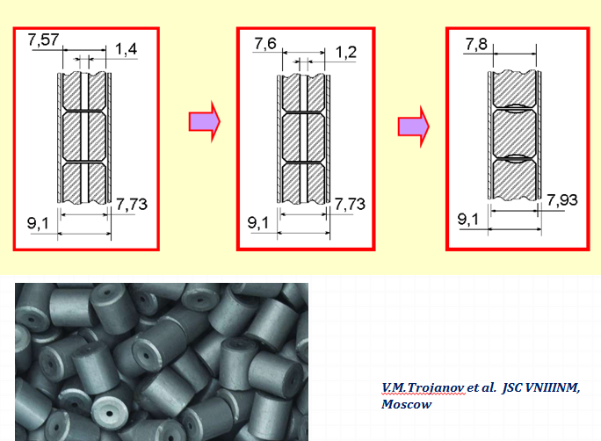
VVER-1000 fuel pin design

Slide 36
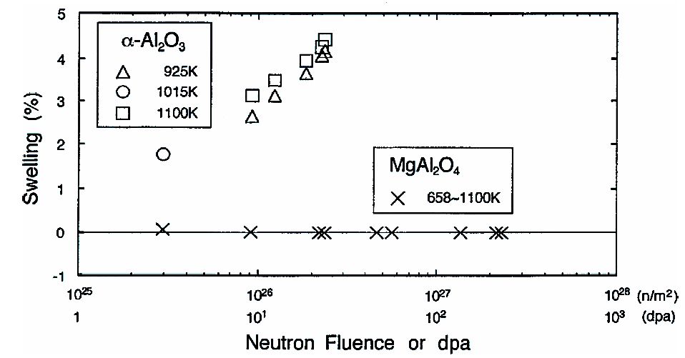
Examination of the dense ionization effect in ceramics and oxides with heavy ions of fission fragments energy
C. Kinoshita. Microstructural evolution of irradiated ceramics. In: Radiation effects in solids. Eds. K.Sickafus, E.Kotomin and B.Uberaga. Nato Science series. V.232, p.193
spinel is not amorphized by electron, neutron and low-energy ion irradiation at T > 300 K

Slide 37
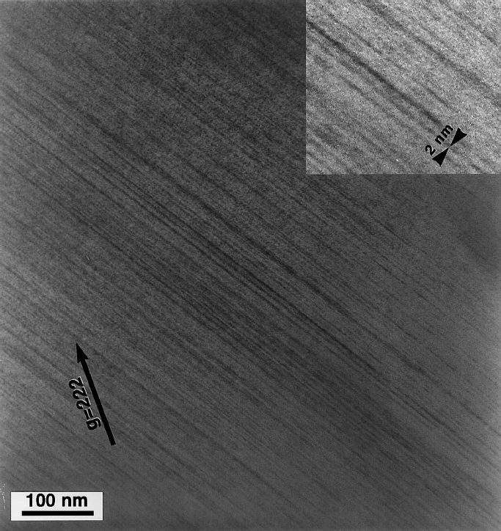
Examination of the dense ionization effect in ceramics and oxides with heavy ions of fission fragments energy
MgAl₂O₄
Ion tracks in spinel irradiated with 430 MeV Kr ions to a fluence of 1.1×10¹² cm⁻² at room temperature.
The average TEM track diameter is ~2 nm.
S.J. Zinkle, V.A. Skuratov . NIMB. B 141 (1998) 737

Slide 38
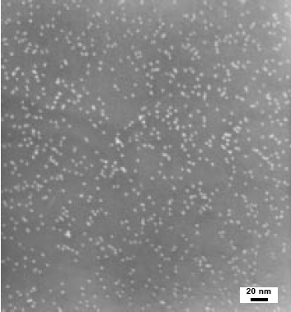
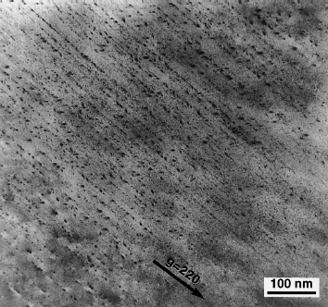
Examination of the dense ionization effect in ceramics and oxides with heavy ions of fission fragments energy
Ion tracks in spinel irradiated with 430 MeV Kr ions
Swift heavy ions induce discontinuous nonamorphous tracks in spinel
S.J. Zinkle, V.A. Skuratov . NIMB. B 141 (1998) 737

Slide 39


Examination of the dense ionization effect in ceramics and oxides with heavy ions of fission fragments energy
Cross-section microstructure of MgAl₂O₄ irradiated to a fluence of 1x10¹⁶ 72 MeV Iodine ions/cm²
volumetric swelling is ≈35% for the crystalline to amorphous phase transformation
Calculated damage energy and electronic stopping power for 72 MeV I ions in MgAl₂O₄
S.J. Zinkle, Hj. Matzke, V.A. Skuratov, Mat. Res. Soc. Symp. Proc. 540 (1999) 299.

Slide 40

Examination of the dense ionization effect in ceramics and oxides with heavy ions of fission fragments energy
Step heights formed on the surfaces of MgAl₂O₄ and Al₂O₃ along a border of masked and 85 MeV I⁺⁷ ion irradiated area. Ion fluence 1.2× 10¹⁵ cm-²
The swelling due to amorphization is estimated to be around 15–20%
T. Aruga et al. / NIM B 197 (2002) 94–100

Slide 41


Examination of the dense ionization effect in ceramics and oxides with heavy ions of fission fragments energy
XTEM image of polycrystalline MgO sample irradiated with 85 MeV I⁺⁷ ions to 0.28× 10¹⁵ cm-² (a) and 1.2× 10¹⁵ cm-² (b)
No amorphization occurs for MgO samples at the fluence of 1.2× 10¹⁵ cm-²
T. Aruga et al. / NIM B 197 (2002) 94–100

Slide 42

3D AFM image of of MgAl₂O₄ surface irradiated with 710 MeV Bi ions.
Ion fluence 5x10¹⁰ cm⁻².

Slide 43




3D AFM images of α-A₂O₃ surface irradiated with 5x10¹⁰ cm⁻² Bi ions of different energies
710 MeV
41 keV/nm
495 MeV
39 keV/nm
E= 0 MeV
128 MeV
25.4 keV/nm

Slide 44
Examination of the dense ionization effect in ceramics and oxides with heavy ions of fission fragments energy
Ionizing energy loss threshold values for latent track formation in nitrides and carbides
Material | S_{et}, keV/nm | Ref.
AlN | > 34 | S.J.Zinkle, V.A.Skuratov and D.T.Hoelzer. NIMB 191(2002) 758
 | > 21.6 | S. Mansouri et al. // NIMB 266(2008) 2814
BN | > 17.6 | S. Mansouri et al. // NIMB 266(2008) 2814
SiC | >34 | S.J. Zinkle, J.W. Jones, V.A. Skuratov. MRS Symposium Proceedings, Vol. 650, MR, Warrendale, PA, 2001, p. R3.19.1.
SiC Nano-SiC | > 22 > 17 | A. Audren et al. // NIMB 267(2009) 976, NIMB 266 (2008) 2806
Nano-ZrN | > 49 | A. Janse van Vuuren, V. A. Skuratov, V.V. Uglov J. Nucl. Mater. 442 (2013) 507.
Si₃N₄ | 15 | S.J.Zinkle, V.A.Skuratov and D.T.Hoelzer. NIMB 191(2002) 758

Slide 45




Formation of nitride coatings
    ZrN coatings were formed by Cathodic Arc Vapor Deposition (CAVD) technique.
    Pretreatment: p = 10^{–3} Pa, U_{bias}= -1 kV, I_{Zr}= 100 A.
    Deposition parameters: p_{N}= 10^{–1} Pa, U_{bias}= – 120 V, I_{Zr}= 100 A.
    deposition time 15-18 s, 10-11 min, 40 min.
    Objects: CAVD coatings ZrN // Si
Equipment for deposition
(VU-2MBS)
ZrN coating
100 nm
3 μm
10 μm
1 μm
5 μm
5 μm
V.V. Uglov et. al. // Surf.Coat.Technol., 204( 2010), 2095

Slide 46


Radiation stability of nanocrystalline ZrN against swift heavy ion irradiation
TEM image of as-grown 80 nm ZrN layer
Bright field TEM micrograph of virgin ZrN sample

Slide 47


TEM (100 nm / 167 MeV Xe)
3x10¹²
5x10¹²
1x10¹³
2.5x10¹³
1x10¹⁴
5x10¹⁴
FFTs of the ZrN after irradiation with Xe ions to fluences from 3x10¹² to 5x10¹⁴ ions/cm²

Slide 48










TEM (10 μm / 695 MeV Bi, 250 MeV Kr)
As Deposited
1x10¹³ Kr
3x10¹³ Kr
7.06x10¹³ Kr
Ring Pattern Simulation for ZrN
1x10¹² Bi
3x10¹² Bi
7x10¹² Bi
1x10¹³ Bi
Selected Area Diffraction of the 10μm ZrN layers before irradiation and after irradiation with Kr ions (top row) and Bi ions (bottom row) at doses ranging from 1x10¹² to 7.06x10¹³ ions/cm²
Centre for High Resolution Transmission Electron Microscopy

Slide 49
Results (XRD)
Xe, 167 MeV
Bi, 695 MeV
X-ray diffraction patterns recorded on virgin and swift heavy ion irradiated nanocrystalline ZrN samples
The phase composition of nanocrystalline ZrN is not changed after heavy ion irradiation at electronic stopping power up to 49 keV/nm
TEM examination does not reveal latent tracks formation in ZrN irradiated with heavy ions of fission fragments energy

Slide 50

Radiation stability of ODS alloys against fission fragment impact
ODS = Oxide dispersion strengthened alloys:
Thermally stable oxide nanoparticles dispersed in ferritic matrix
Strengthening principle in ODS alloys:
NPs are obstacles to dislocation glide
Production:
mechanical alloying of metal-oxide powders / sealing / extrusion or hot pressing
High performance at elevated temperatures:
High creep strength
High radiation resistance
Low swelling under neutron irradiation
Y₄Al₂O₉ nanoparticles in KP4 ODS steel

Slide 51
Motivation
Radiation stability of oxide nanoparticles in ODS alloys against swift heavy ion irradiation simulating fission fragments impact
Scanty information about dielectric nanoparticles in metal matrices irradiated in electron stopping regime

Slide 52



Cr16 ODS alloy (Y₂Ti₂O₇, Y₂TiO₅, Cr₂₃C₆)
Cr₂₃C₆ grain
Y-Ti-O
Ferritic grain with large Y-Ti oxide particles (A), dislocations and Cr₂₃C₆ grain (B)
SAD patterns: orthorhombic (o) and fcc (с) Y-Ti oxides

Slide 53


Cr16 ODS alloy
(Cr,W)₂₃C₆
BF image and SAD pattern of α-Fe matrix with Me₂₃C₆ particle

Slide 54



EP450 ODS alloy
Coherent Y₂Ti₂O₇ (cubic) oxides in α-Fe matrix
Oxide size distribution →
d = 5 - 200 nm; ‹d› = 10 nm; concentration ~ 10¹⁵ cm⁻³

Slide 55



Cr16/ Bi 700 MeV/ 1.5×10¹²cm⁻²
S_{e} = 53 keV/nm
Amorphous tracks in Cr₂₃C₆ carbide grain
(cross-sectional BF, SAD)

Slide 56


EP450/ Xe 167 MeV/ 1×10¹²cm⁻²
S_{e} = 35 keV/nm

Slide 57


EP450/ Xe 167 MeV/ 1×10¹²cm⁻²
S_{e} = 35 keV/nm
The upper limit of S_{e} threshold value in Me₂₃C₆ carbides is estimated to be around 35 keV/nm
No latent tracks of high energy heavy ions are registered in carbides

Slide 58


Cr16/ Bi 700 MeV/ 1.5×10¹³cm⁻²
Amorphization of Y-Ti oxides induced by irradiation in the ion track overlapping regime (plane view DF, SAD)

Slide 59
Cr16/ Bi 700 MeV/ 1.5×10¹³cm⁻²

Slide 60

EP450/ Xe 167 MeV/ 1×10¹²cm⁻²

Slide 61

EP450/ Xe 167 MeV/ 1×10¹²cm⁻²
S_{e} = 23 keV/nm
HRTEM and DF TEM micrographs of latent tracks in Y₂Ti₂O₇

Slide 62



EP450/ 26 MeV Xe/10¹² cm⁻²
S_{e} =9.5 keV/nm
Amorphous tracks in Y₂Ti₂O₇ particle (plane view DF, HR, SAD)

Slide 63

15CRA-3/ Xe 167 MeV/ 1×10¹²cm⁻²
S_{e} = 23 keV/nm
Mean track diameter is 7.5 nm

Slide 64

Latent track diameter as a function of stopping power for various ions in Y₂Ti₂O₇

Slide 65
Accumulation of mechanical stresses under swift heavy ion irradiation
The knowledge about of high energy heavy ion-induced stress is of considerable practical value in view of simulation of fission product impact in radiation resistant oxides and ceramics, considered as candidate materials for nuclear waste management (inert matrix fuel host)
Main questions addressed to real-time measurements:
Radiation damage and stress accumulation processes before and
after ion track region overlapping
Variation in the stress state under ion irradiation characterized
by specific ionizing energy losses higher and lower than the threshold
of radiation damage formation via electronic excitations.

Slide 66

STRESS IN Al₂O₃:Cr UNDER SWIFT HEAVY ION IRRADIATION
Basis of the piezospectroscopic effect – the applied stress strains the lattice and alters the energy of transitions between electronic states
Δν = Π_{ij}×σ_{ij}
Π_{ij} – piezospectroscopic coefficients
R1-line
R2-line
Typical piezospectroscopic probes: Cr³⁺ in Al₂O₃
Eu³⁺, Nd³⁺ in silica glasses
Sm³⁺ in borosilicate glasses
D. Clarke et. al.

Slide 67
Al₂O₃ MgO
Dose dependence of ionoluminescence spectra in Al₂O₃ and MgO measured during
167 MeV Xe ion irradiation at 80 K.

Slide 68




ii, iii
each Cr³⁺ ion acts as an independent strain sensor
The splitting of the R-lines directly indicates on the presence of differently stressed regions in the irradiating ruby specimen
Kr
Xe
Bi
Ion fluence, cm⁻²
S_{e}=25 keV/nm
S_{e}=16 keV/nm
S_{e}=41 keV/nm
wavenumber, cm⁻¹
The stresses are compressive in basal plane of the sample and tensile in perpendicular direction

Slide 69

Xe
S_{e}=25 keV/nm
Ion fluence, cm⁻²
wavenumber, cm⁻¹

Slide 70



167 MeV xenon ion induced tracks in Al₂O₃.
Ion fluence is 2×10¹³ cm⁻².

Slide 71

STRESS IN Al₂O₃:Cr UNDER SWIFT HEAVY ION IRRADIATION
Kr,107 MeV
Xe,167 MeV
Bi,700 MeV
Δν₁=3.26(σ₁₁+σ₂₂)+1.53σ₃₃
Δν₂=2.73(σ₁₁+σ₂₂)+2.16σ₃₃
σ_{ii} (i = 1, 2, 3) – stress tensor components, oriented along a, m and с axes

Slide 72
STRESS IN Al₂O₃:Cr UNDER SWIFT HEAVY ION IRRADIATION

Slide 73


167 MeV Xe in Al₂O₃

Slide 74

Normalized density variation as a function of radial distance from the track center (MD simulation)
Two experimental plots of 1 mean basal plane lattice dilation as a function of radial distance from the track center (TEM images processing)
J.H. O’Connell et al., NIM B (2015), http://dx.doi.org/10.1016/j.nimb.2015.09.067

Slide 75
Thank you for your attention!

