Slide 1
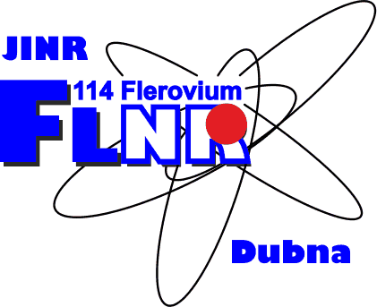
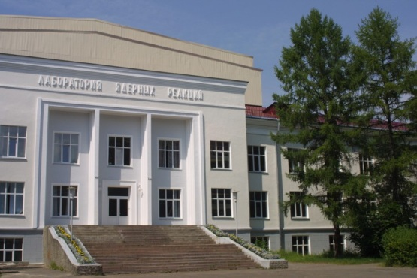
Light exotic nuclei: beyond the nuclear stability
Leonid Grigorenko
Flerov Laboratory of Nuclear
Reactions, JINR, Dubna, Russia
AYSS 2016, Dubna, March 14-18, 2016

Slide 2
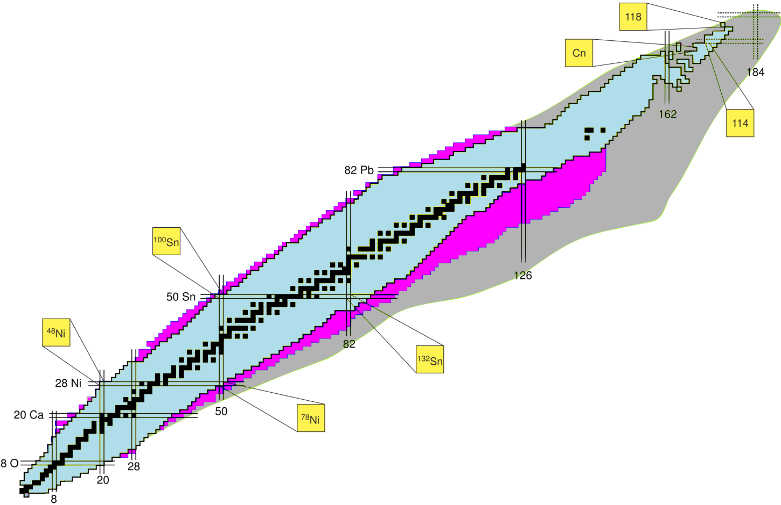
Nuclear chart
Total 256 stable isotopes
Total 339 “natural”
About 3100 nuclear stable isotopes
500 -800 isotopes to be found soon
2000 -3000 more isotopes can exist
Stable vs. nuclear stable
G.N. Flerov, A.S. Ilyinov (1982)

Slide 3

Flerov Lab: Superheavies
Detailed studies of stability island is now due
Elements 113 - 118 discovered at Flerov lab.
Elements 116 Livermorium and 114 Flerovium recently officially recognized
Chemical periodic table is now about to be completed
island of Superheavy Elements
114
peak of U
strait of
instability
82
peak of Pb
Number of protons
strait of
radioactivity
sea of instability
50
peak of Sn
20
sea of instability
peak of Ca
20
82
126
184
G.N. Flerov, A.S. Ilyinov (1982)
Number of neutrons

Slide 4
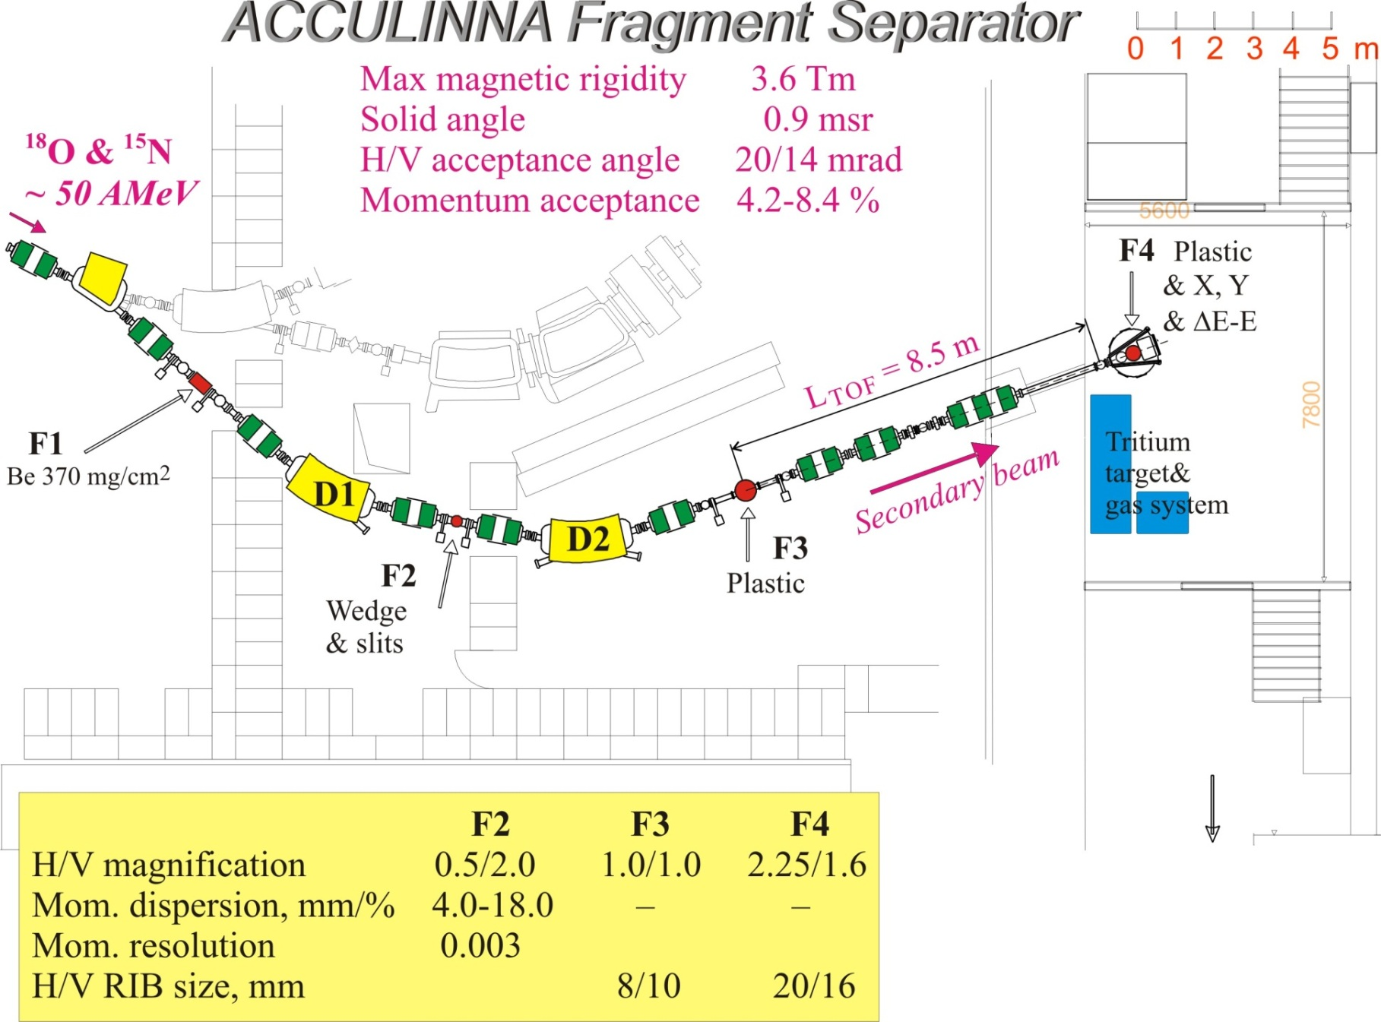
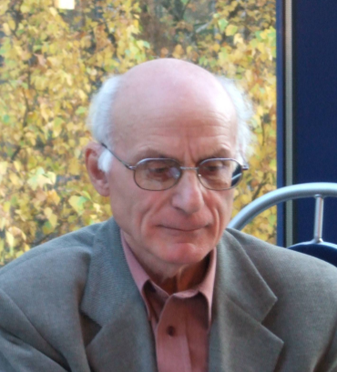
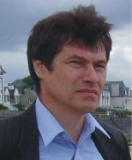
Flerov Lab: Superlights – fragment separator ACCULINNA
U-400M :
⁶Li @ 47 AMeV
I ~ 3×10⁷ 1/s
BS ~ 5 mm
C degrader
¹H(⁶Li,⁶Be)n
E(⁶Li)=33 A MeV
I ~ 2×10⁴ 1/s
BS ~ 15 mm
P ~ 90 %
¹¹B @
34 AMeV
no wedge
Δp/p=0.4%
Be 1.8 mm
Historically: injection line for K4-K10 facility
Be 1.0 mm
Δp/p=3.6%
³H(⁸He,p)¹⁰He
E(⁸He)=22 A MeV

Slide 5
Flerov Lab: Superlights – fragment separator ACCULINNA
- Very intense primary beams
- Tritium cryogenic target
- Theoretical school + “technologies”
to work with correlation data
U-400M :
⁶Li @ 47 AMeV
I ~ 3×10⁷ 1/s
BS ~ 5 mm
A.A.Korsheninnikov, PRL 82 (1999) 3581.
A.A.Korsheninnikov, PRL 87 (2001) 092501.
S.V. Stepantsov et al., PLB 542 (2002) 35.
M.S. Golovkov et al., PLB 566 (2003) 70.
G.V. Rogachev et al. PRC 67 (2003) 041603(R).
M.S. Golovkov et al., PRL 93 (2004) 262501.
M.S. Golovkov et al., PLB 588 (2004) 163.
M.S. Golovkov et al., PRC 76 (2007) 021605(R).
M.S. Golovkov et al., PLB 672 (2009) 22.
L.V. Grigorenko et. al., PLB 677 (2009) 30.
S.I. Sidorchuk et al., PRL 108 (2012) 202502.
A.S. Fomichev et al., PLB 708 (2012) 6.
I.A. Egorova et al., PRL 109 (2012) 202502.
C degrader
¹H(⁶Li,⁶Be)n
E(⁶Li)=33 A MeV
I ~ 2×10⁴ 1/s
BS ~ 15 mm
P ~ 90 %
¹¹B @
34 AMeV
no wedge
Δp/p=0.4%
Be 1.8 mm
Historically: injection line for K4-K10 facility
Be 1.0 mm
Δp/p=3.6%
³H(⁸He,p)¹⁰He
E(⁸He)=22 A MeV

Slide 6
Nuclear chart
G.N. Flerov, A.S. Ilyinov (1982)

Slide 7
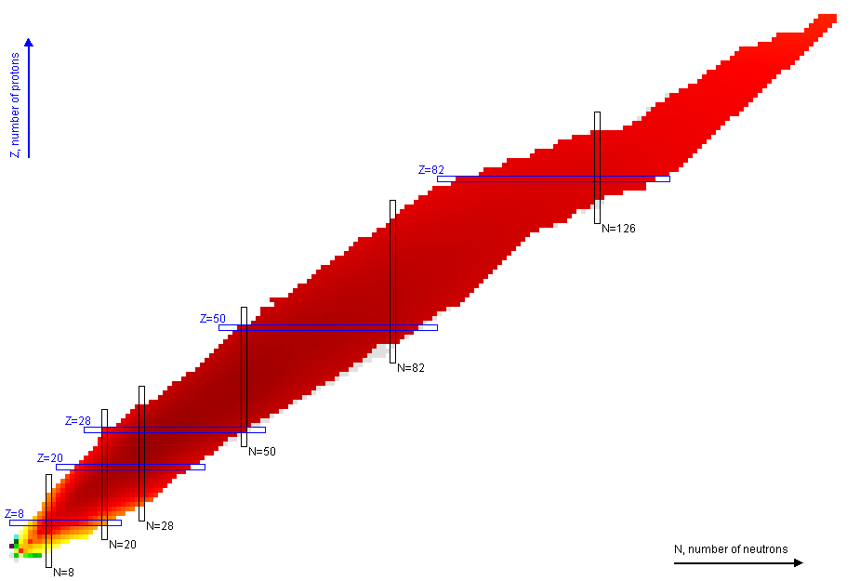
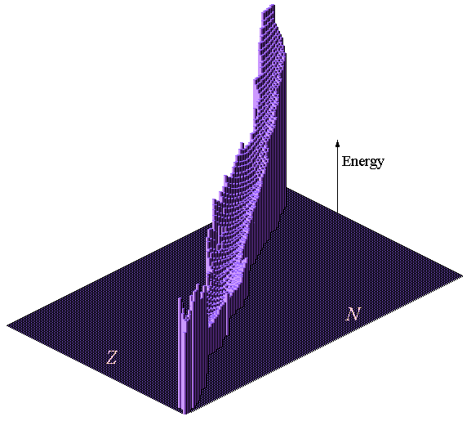
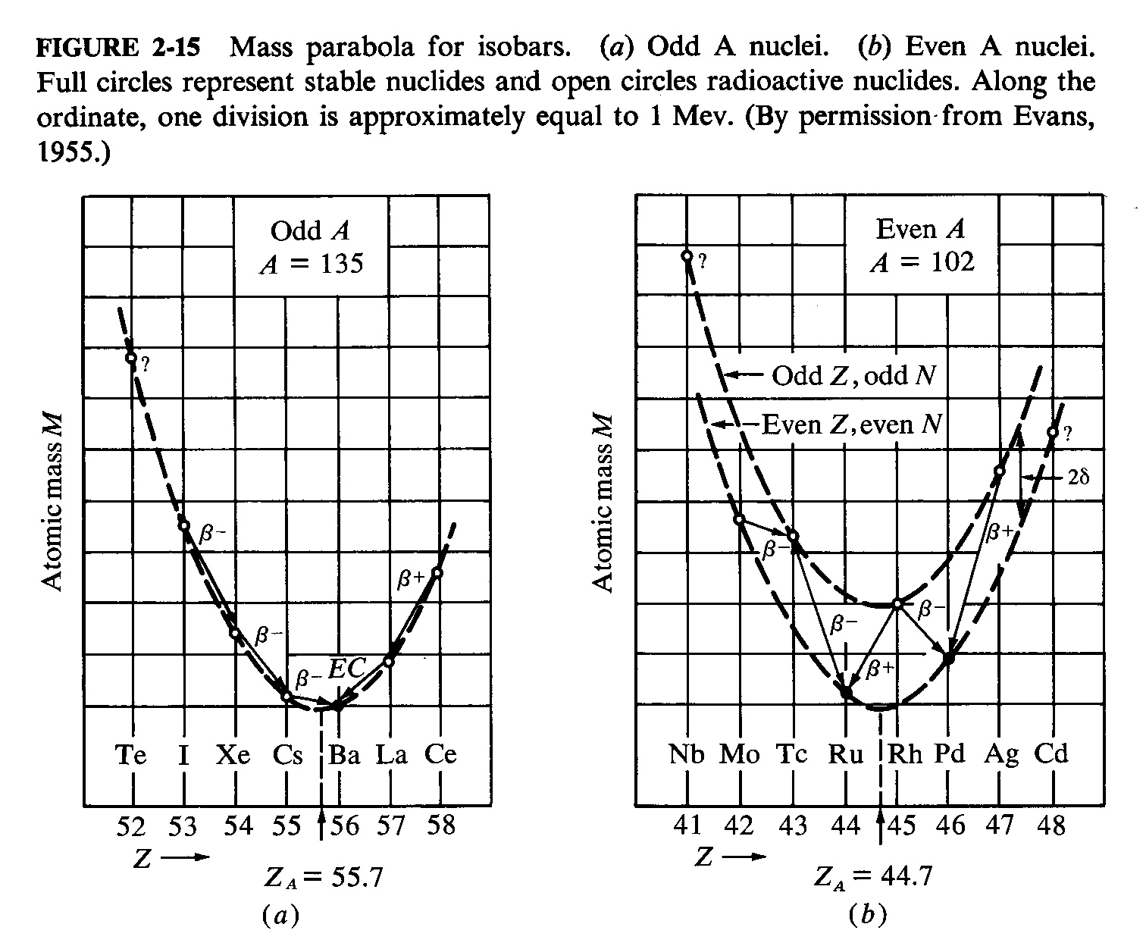
Stability valley

Slide 8
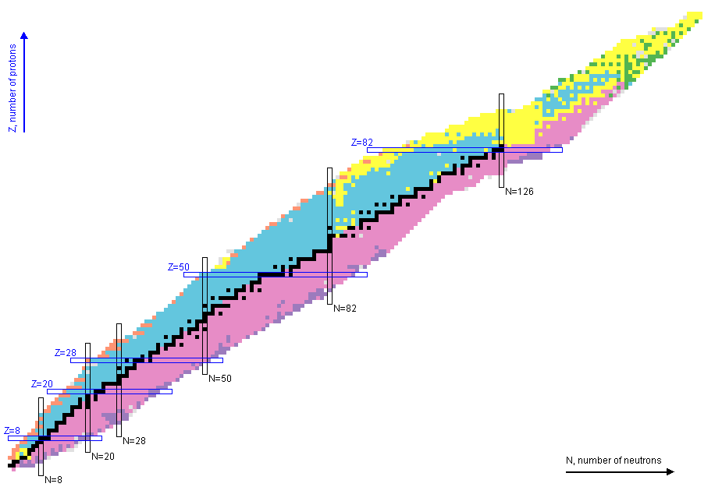

Decay modes in nucleus

Slide 9

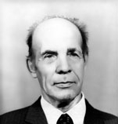
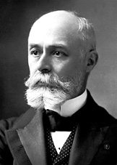
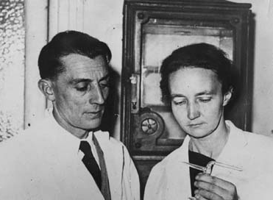



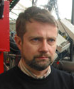
Radioactivity “hall of fame”
G.N. Flerov and K.A. Petrzhak
spontaneous fission
F. Jouliot and I. Curie:
β⁺
Henri Becquerel: three classes of radioactivity - negative, positive, and electrically neutral
?
?
V.A. Karnaukhov and G.M. Ter-Akopian
β-delayed p
S. Hofmann:
p
M. Pfutzner:
2p
???
2n radioactivity
???
4n radioactivity

Slide 10
Nuclei near stability valley

Slide 11

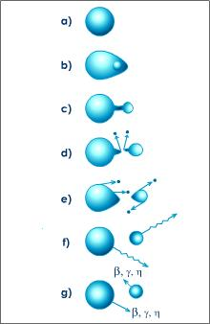
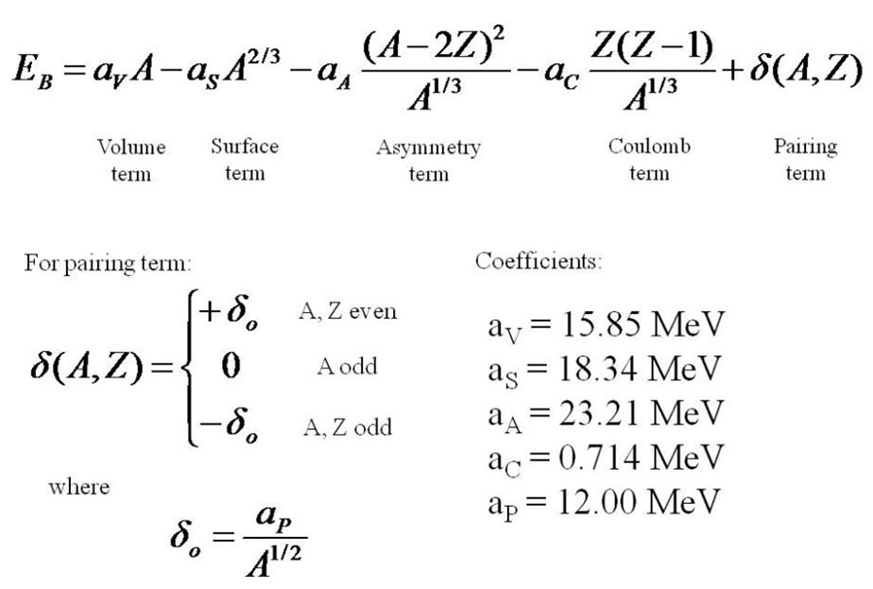
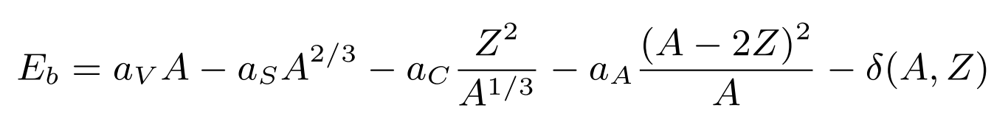
Nucleus is droplet
Substance with saturated density - liquid
Liquid droplet model of nucleus
Fission physics: analogy with charged droplet instability
Simple mass relations: Bethe-Weizaecker formula

Slide 12
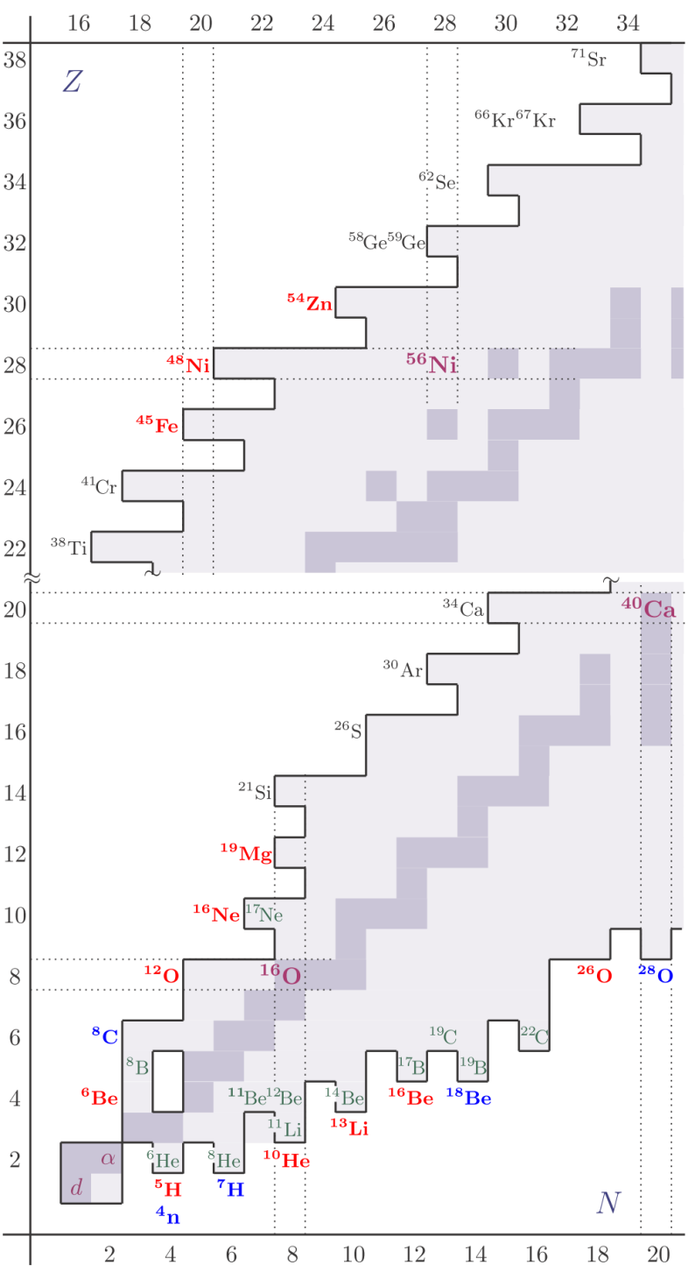
Nucleus is defined by shells
Qualitative difference: energy levels in Coulomb field vs. energy levels in oscillator potential
Nuclear shells: 2, 8, 20, 28, 50, 82, 126
Atomic potential is connected with interaction with “singular” strength center
In contrast nuclear potential has s mean field origin: there is nothing special sitting in the “center”
Origins of the nuclear shells

Slide 13
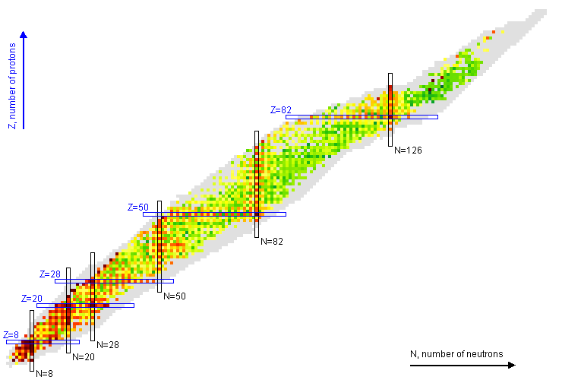

Nucleus is defined NN interaction. Paring in nuclei
Effect of paring and nuclear structure on the energy of the first excited state
Effect of paring: odd/even staggering and “ridges” near the dripline

Slide 14
Nuclei far from stability valley: exotic phenomena

Slide 15
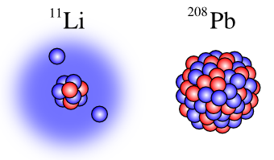
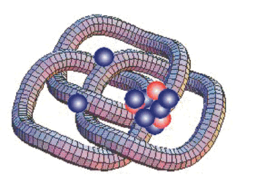

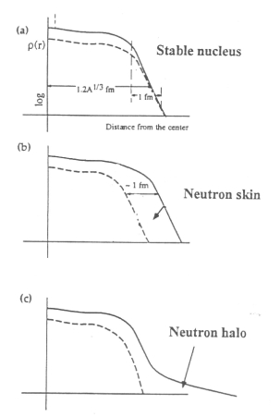
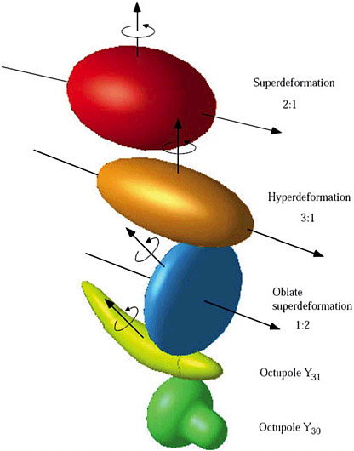
Nuclear exotics
Nucleon haloes
Two-nucleon haloes, Borromean systems
Four-nucleon haloes
Neutron skins
Superdeformation

Slide 16
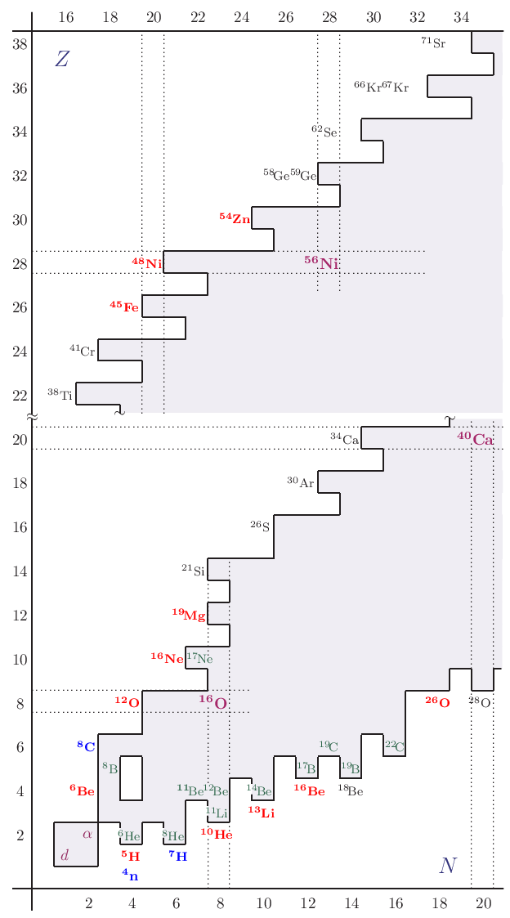
Nuclear exotics “in continuum”
Proton radioactivity
Two-proton radioactivity
Predicted by Goldansky in 1960 -> 42 years -> discovered at GSI 2002
Two-neutron/four-neutron radioactivity
Excitation modes
Nucleon haloes ->
Soft dipole mode
Neutron skin ->
Pigmy resonances
Locations of exotics near the driplines

Slide 17
Nuclei far from stability valley: importance for astrophysics

Slide 18
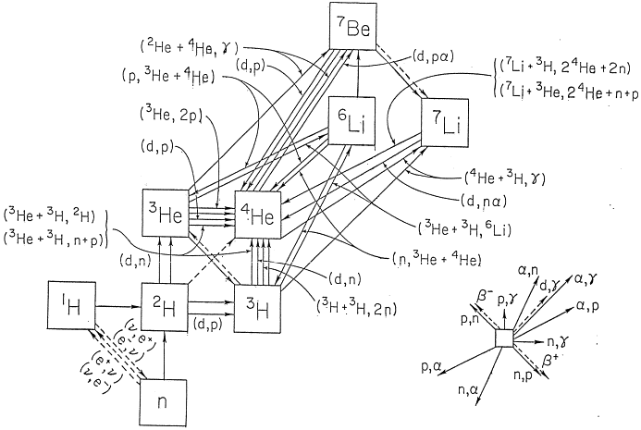
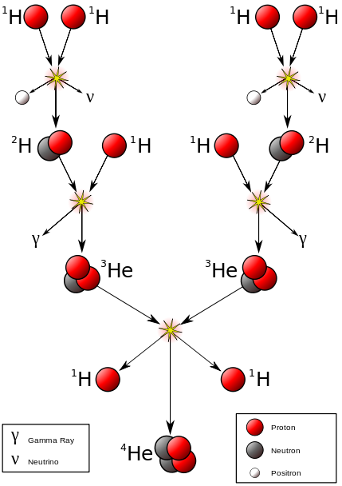
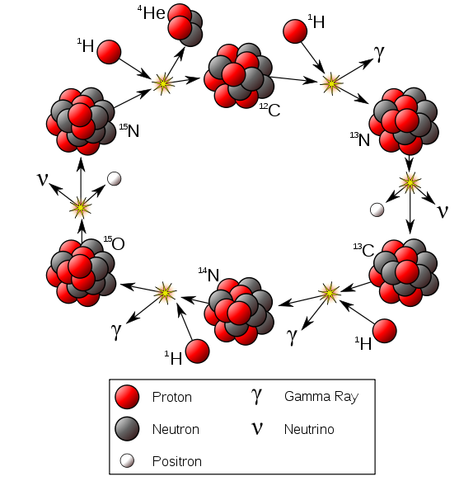
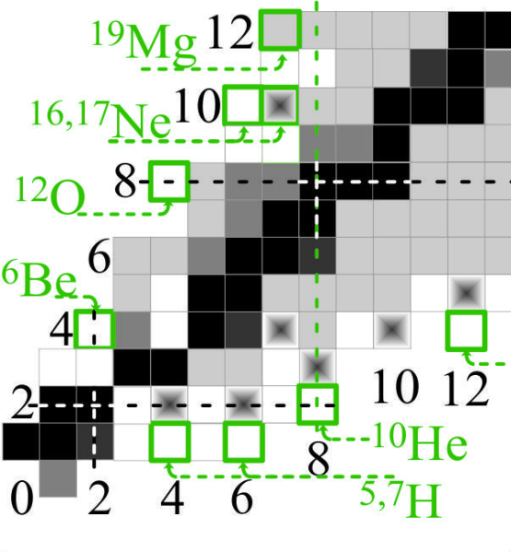
Nucleosynthesys basics
Premodual nucleosynthesys
p-p chain
CNO cycle
Sequence of weak (leptons emitted) and radiative (gammas emitted) capture reactions
Chemical equilibrium equations
Need to know: (p,γ), (α,γ), (p,p’), (α,p), (n,γ), (α,n), β⁻, β⁺……
Catalytic cycles (pp vs. CNO)
Mass gaps at A=5, A=8
“Waiting points”
A=5 A=8

Slide 19
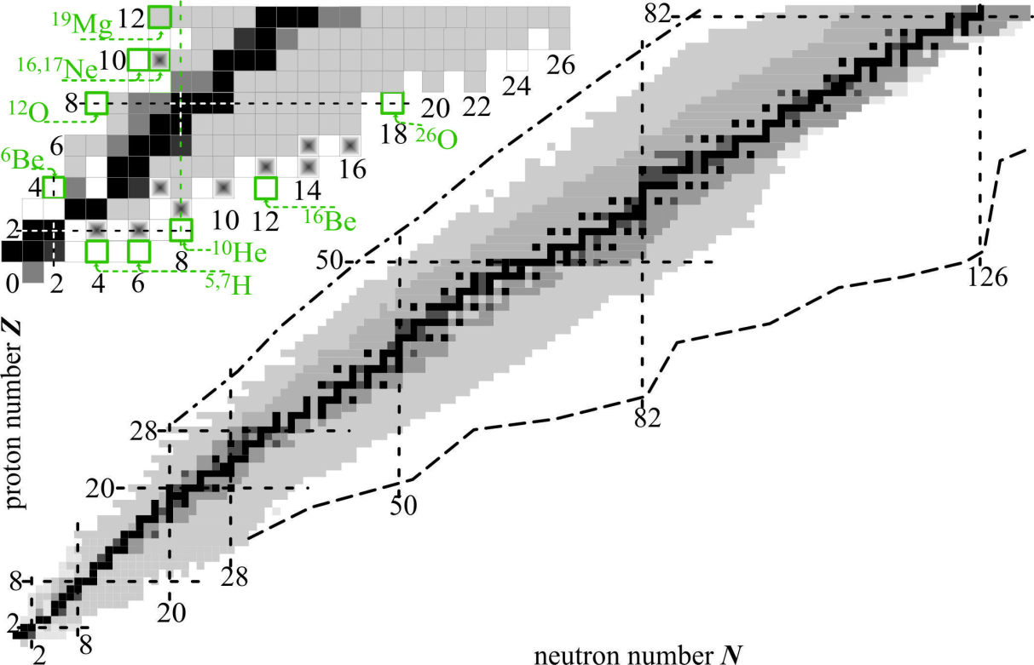
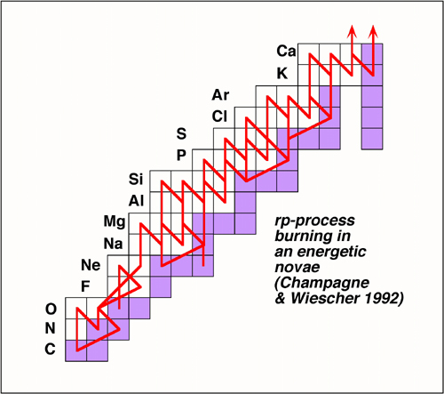
Nucleosynthesys basics
s-process
rp-process fragment
rp-process
r-process
Hydrostatic burning – slow process
Explosive burning – rapid processes
Where does it take place?
Every day observed violent events in space are produced by rp-processes
Element abundance in space is connected with r-processes
No quantitative understanding until the driplines are studied in details

Slide 20
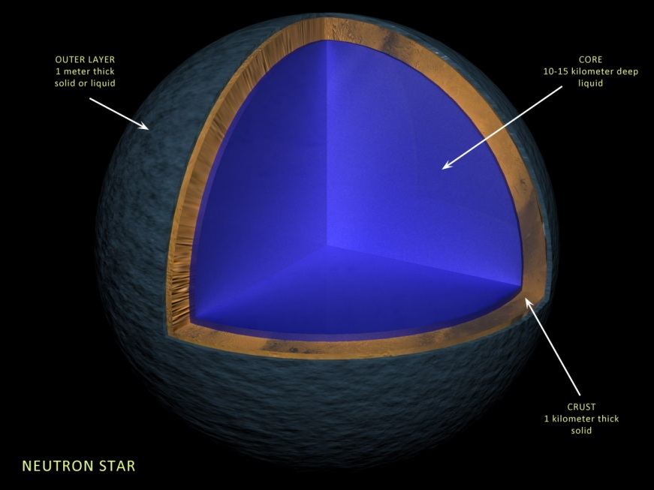
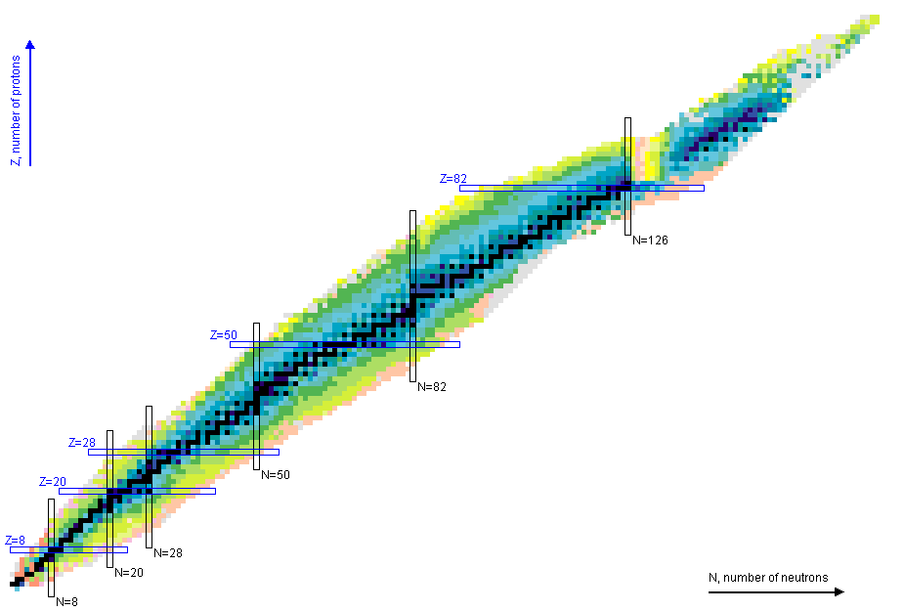
Neutron stars
All the heavy elements in the Universe are produced in explosive nucleosynthesys
PV = (m/μ) RT
Equation of state for ideal gas. What about nuclear matter?
Supernovae explosions. How we get from neutron star to Supernova?
Known nuclei: practically symmetric
nuclear matter
Neutron star: very large nucleus with
absolutely asymmetric nuclear matter
Moving towards the driplines we get experimental knowledge about more and more asymmetric nuclear matter

Slide 21
Nuclei far from
stability valley
How to populate
How to study
How to interpret
G.N. Flerov, A.S. Ilyinov (1982)

Slide 22
Why to increase energy
How to make something exotic? Take something heavy (e.g. uranium), accelerate, crash it on the target nucleus, select exotic fragments
10¹⁰ layers
~ 1m
Complicated to utilize much of the primary beam for nuclear reactions
r ~ 3 fm
10⁵ fm
Beam energy loss by ionazation
10⁵ fm
Trend to energy increase at modern RIB facilities
G.N. Flerov, A.S. Ilyinov (1982)

Slide 23
RIB production: ISOL (Isotope Separation On-Line)
Possible ISOL layout (SPIRAL2)
Neutron converter
Noble gas
flow
Uranium
foils
Deuteron beam
neutron beam
Selective laser ionization
RIB extraction
Problems:
Extraction selectivity
Extraction time (> 10 ms)

Slide 24
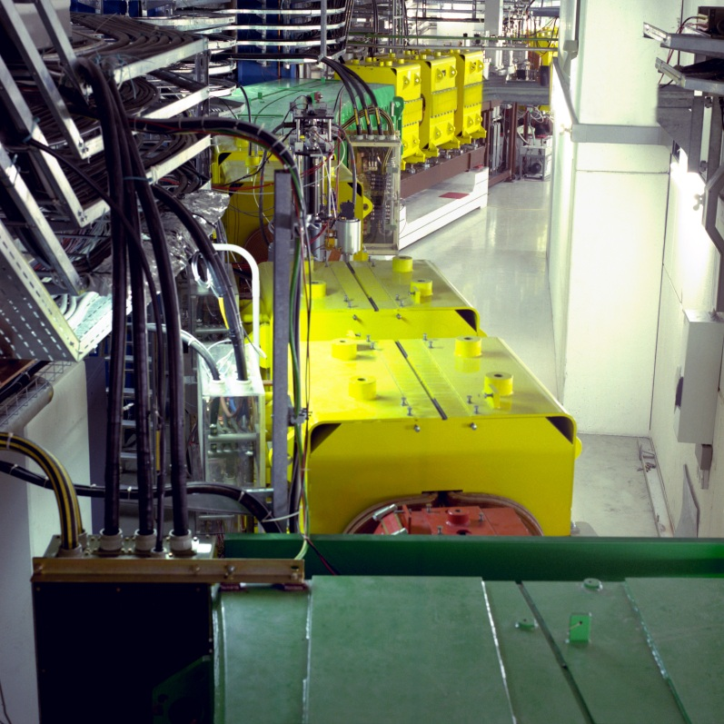
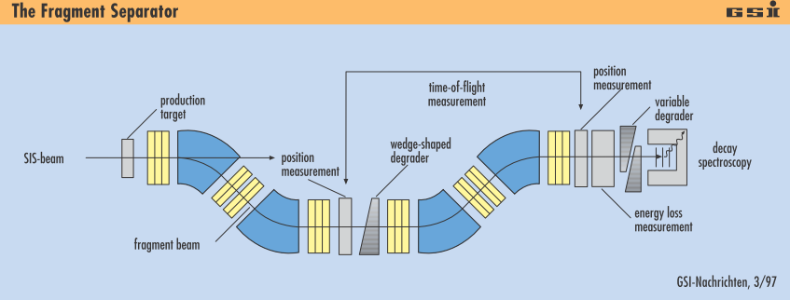
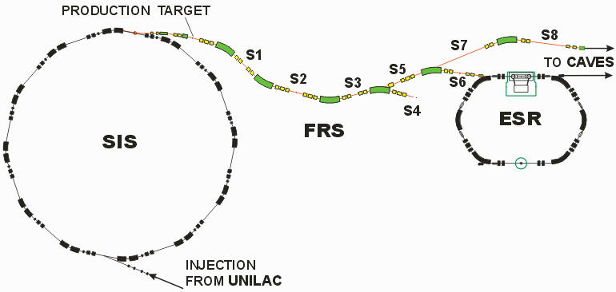
In-flight method: FRS – The Fragment Separator
FRS is an absolutely classic (translation – “giving example”) facility.
FRS defined the landscape of radioactive ion beam research of the last 25 years
Commissioned: end 80-th
Two achromatic stages
Three focal points
150-1000 MeV/Amu operation energies
Relativistic beams – low chromatic aberrations – easy to operate
Muenzenberg: “At this time there was no confidence that it will work in a reasonable way”

Slide 25
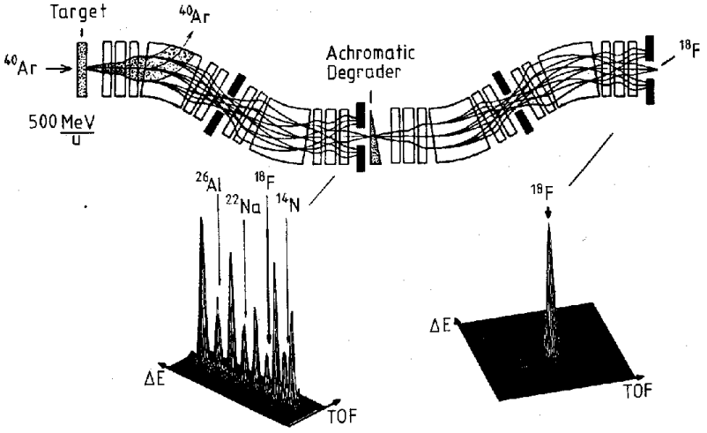
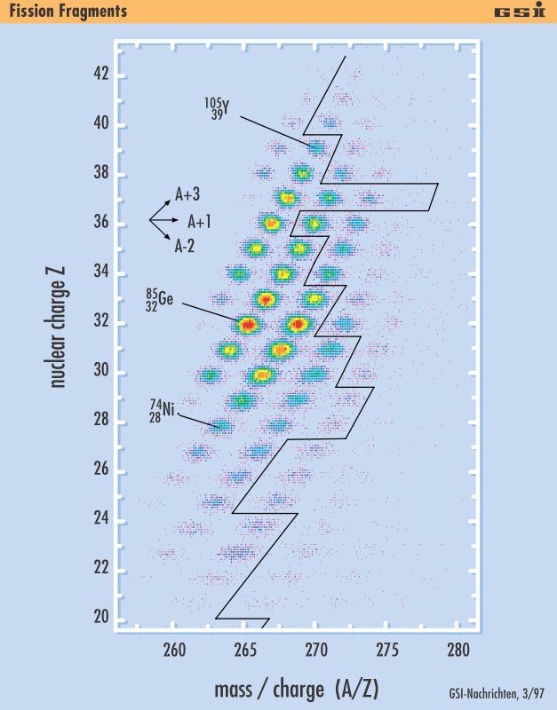
Ion-optical idea of fragment separation
Typical FS design: 1-3 achromatic stages
Perfectly focused primary beam
Secondary:
  Many products
  Large longitudinal and transversal dispersion
Wedge:
  Reduce longitudinal dispersion
  Clean beam – without it second stage is transport line or spectrometer
Final focus:
  Clean beam with minimal longitudinal dispersion
  Further transport is possible
TOF – Δ E particle identification
Many new isotopes can be identified in one such experiment

Slide 26
Modern RIB facilities: the course to upgrade

Slide 27
Flerov Lab: Superlights – fragment separator ACCULINNA
U-400M :
⁶Li @ 47 AMeV
I ~ 3×10⁷ 1/s
BS ~ 5 mm
C degrader
¹H(⁶Li,⁶Be)n
E(⁶Li)=33 A MeV
I ~ 2×10⁴ 1/s
BS ~ 15 mm
P ~ 90 %
¹¹B @
34 AMeV
no wedge
Δp/p=0.4%
Be 1.8 mm
Historically: injection line for K4-K10 facility
Be 1.0 mm
Δp/p=3.6%
³H(⁸He,p)¹⁰He
E(⁸He)=22 A MeV

Slide 28
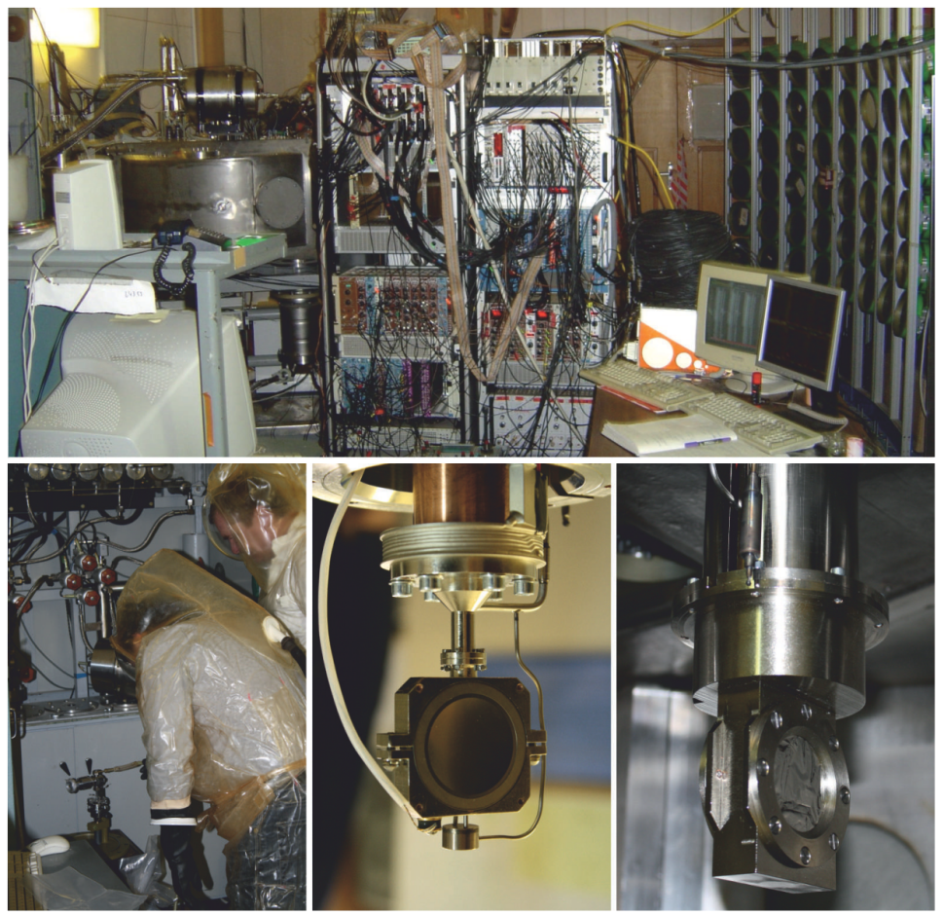
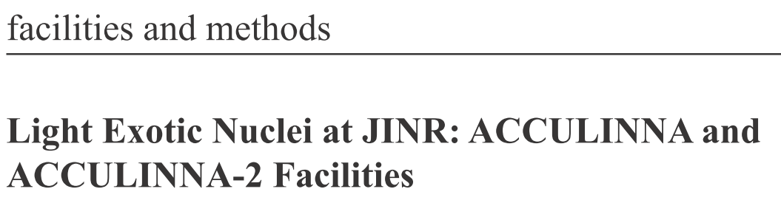
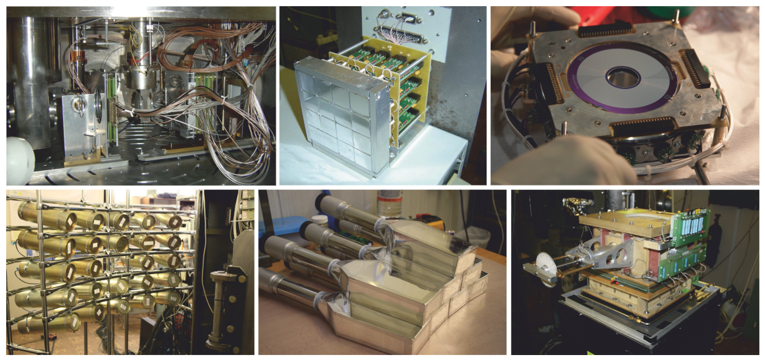
NuPECC NPN paper
Инструментарий

Slide 29
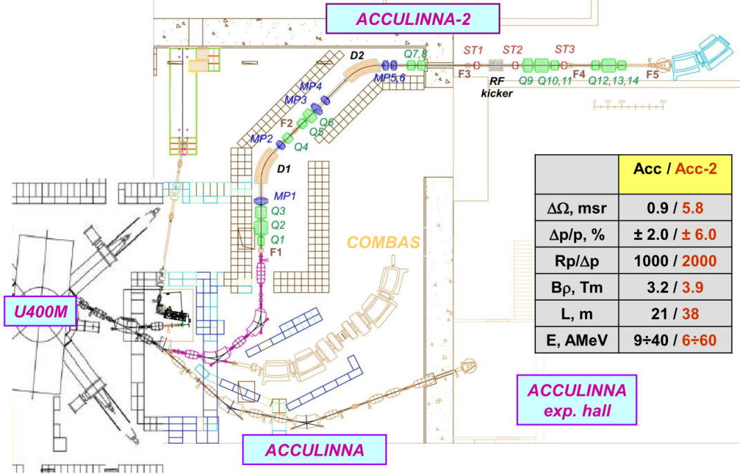
ACCULINNA-2 at Flerov laboratory, JINR
Location: Dubna, Russia
Production: beams up to Kr
Source: cyclotron
Intensity: 10¹³ pps
Separation: In-flight ACCULINNA-2
In operation: 2016

Slide 30
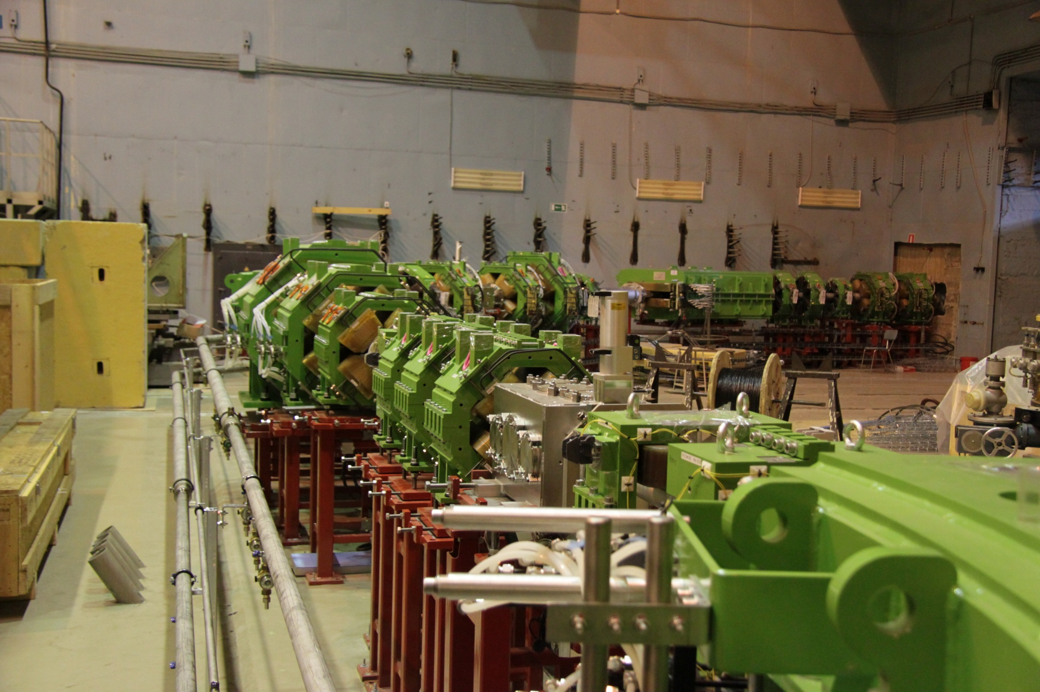

Slide 31
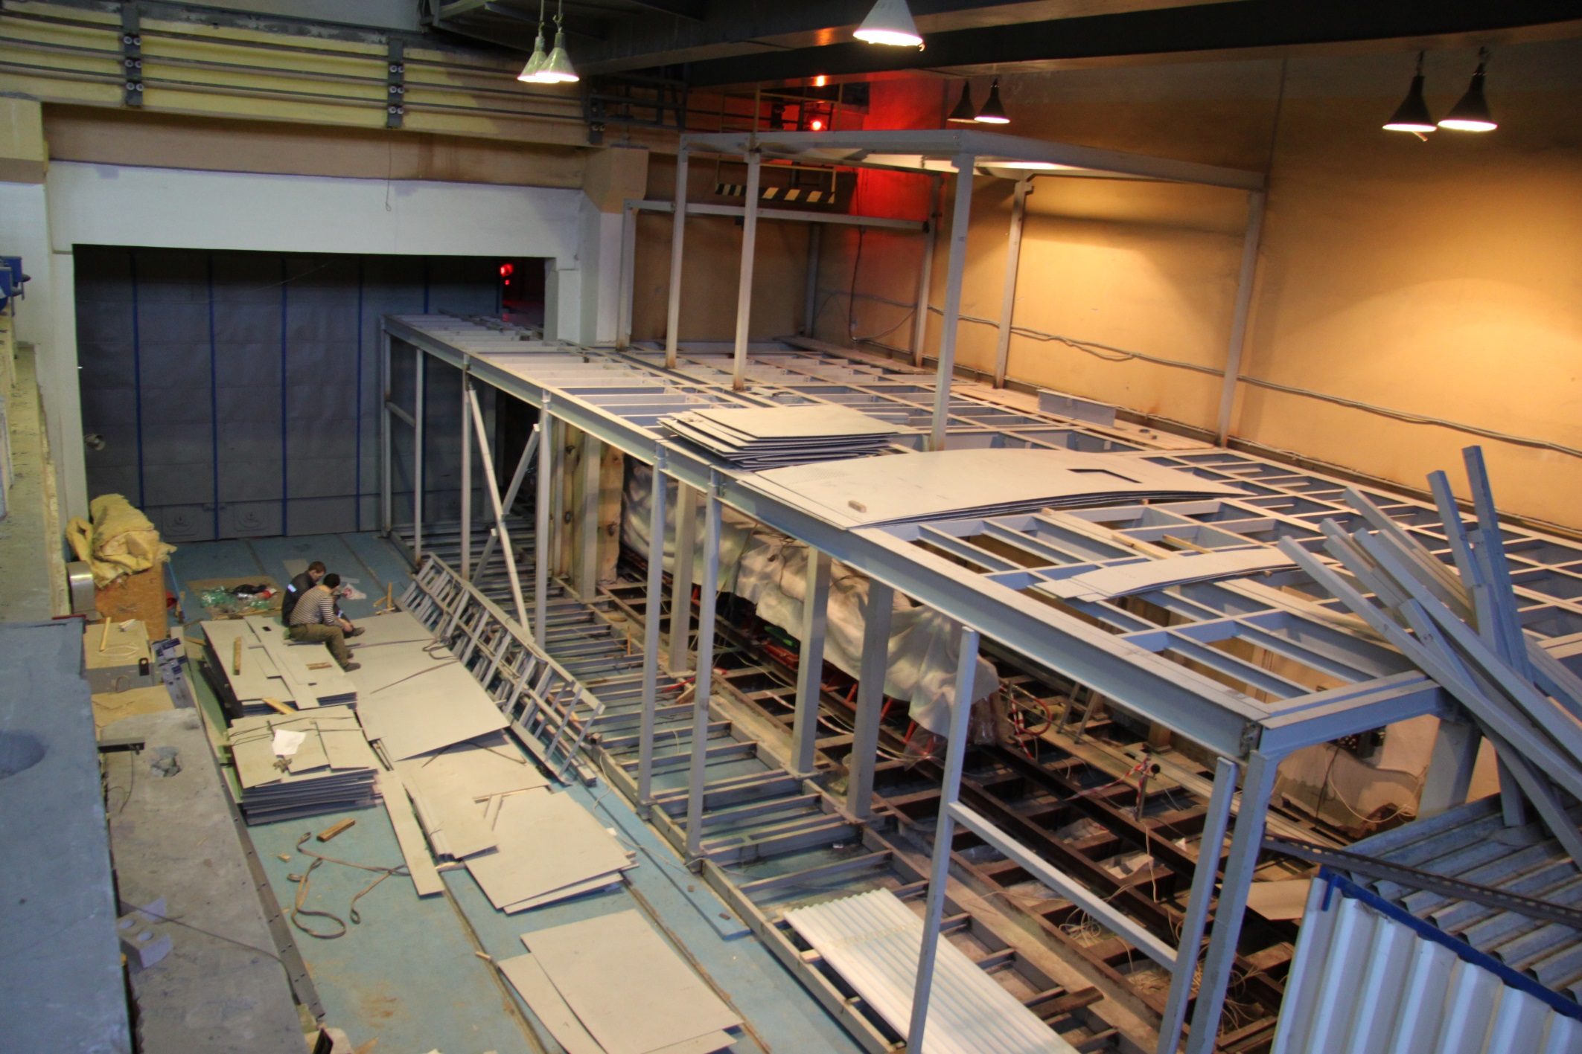

Slide 32
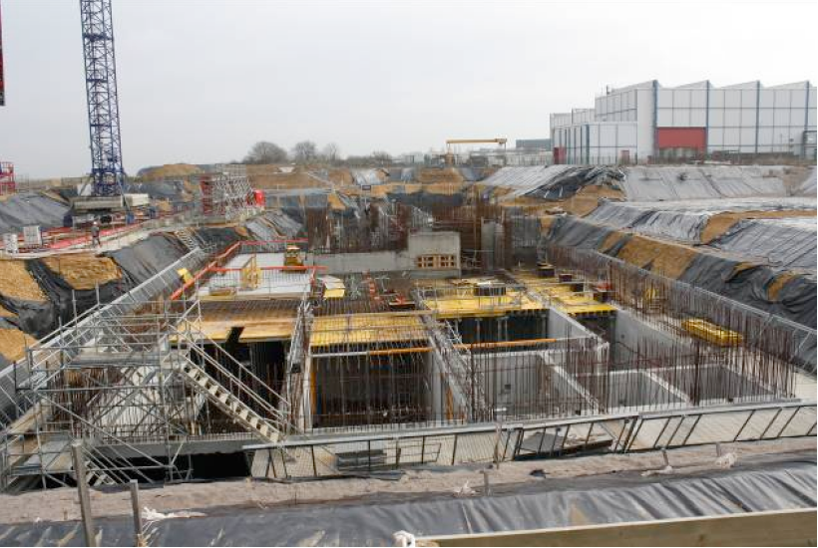
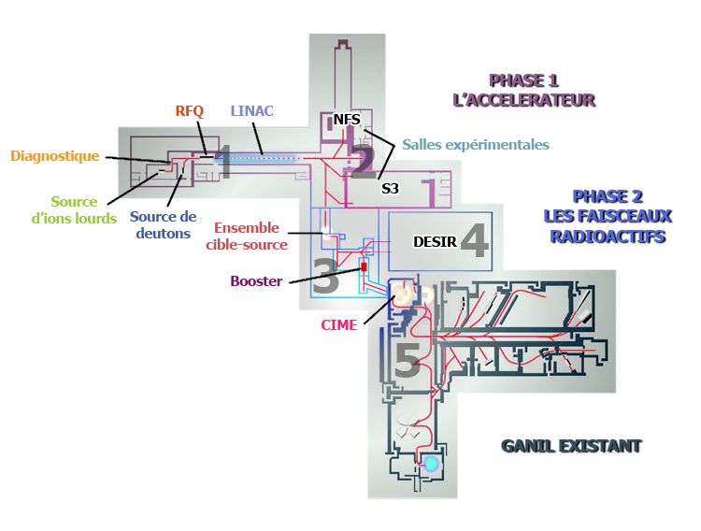
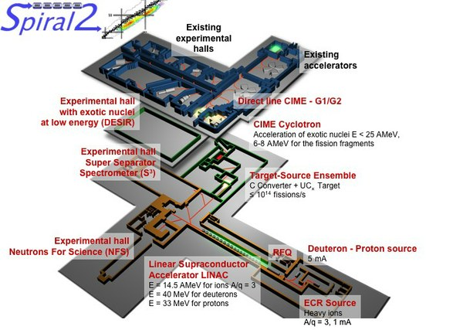
GANIL -> SPIRAL-2
⁶Be
Factory
Location: Caen, France
Production: U target, n beam
Source: linac, deuteron beam
Intensity: 10¹²-10¹³ fissions/s
Separation: ISOL
In operation: 2018
Yellow text
Thick text

Slide 33
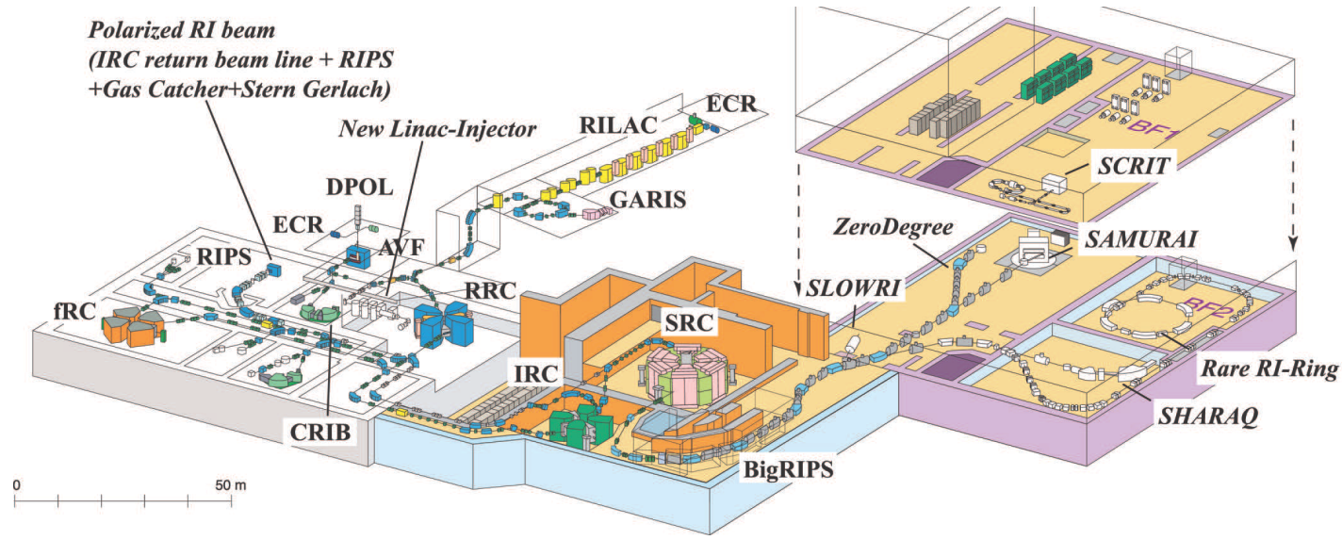
RIKEN -> RIBF (Radioactive Isotope Beam Factory)
⁶Be
¹¹Be
Location: Tokio, Japan
Production: 350-440 MeV/Amu primary beams
Source: cascade of SC cyclotrons
Intensity: 10¹²-10¹³ fissions/s
Separation: BigRIPS fragment separatorS
In operation: since 2010

Slide 34
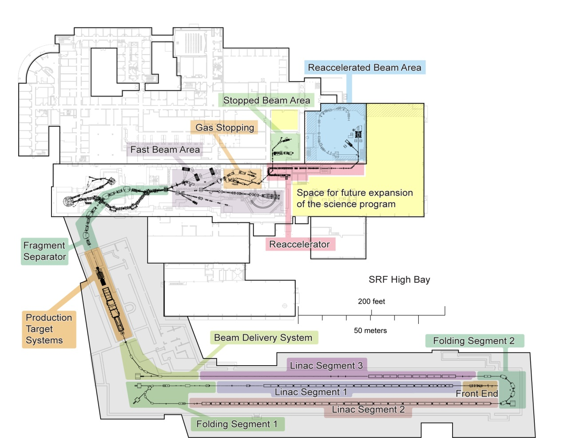
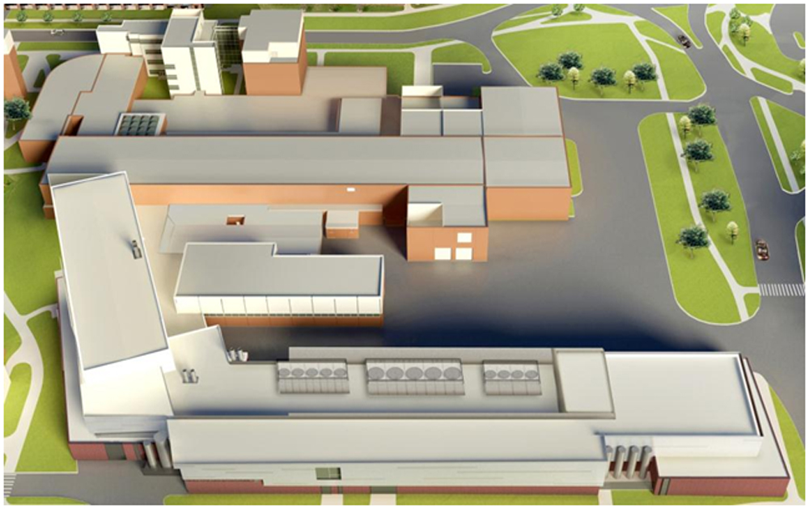
NSCL -> FRIB (Factory Radioactive Isotope Beam)
Location: East Lancing, Michigan, USA
Production: 300 MeV/Amu primary beams
Source: SC linac
Intensity: 10¹²-10¹³ pps
Separation: fragment separator & ISOL
In operation: 2019

Slide 35
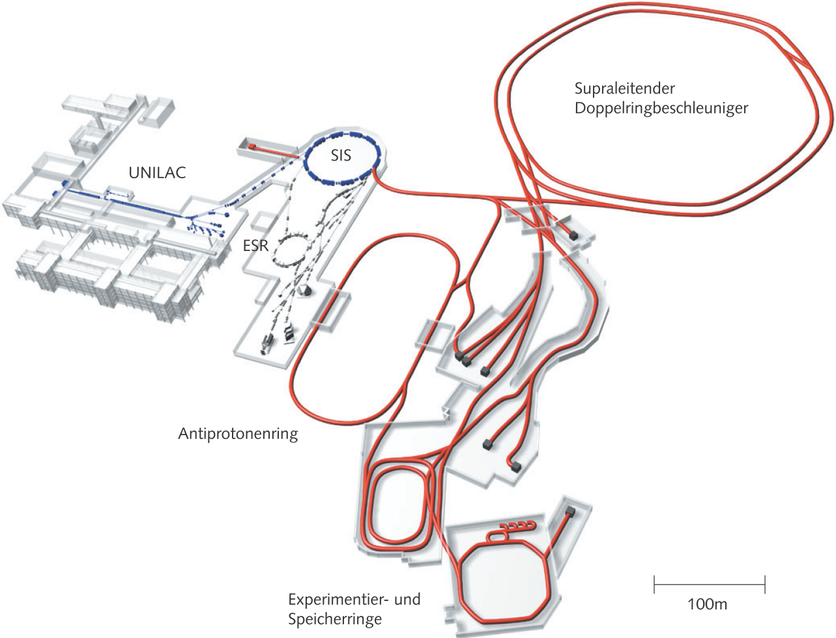
GSI -> FAIR
4 major subprojects:
RIB, relativistic heavy ion, antiproton, applied research
Most complicated and expensive
~1.5 GEuro,
International consortium
Location: Darmstadt, Germany
Production: 2000 MeV/Amu primary beams
Source: cascade of syncrotorons
Intensity: 10¹¹-10¹² pps
Separation: fragment separator SuperFRS
In operation: 2018

Slide 36




Big, bigger, the biggest
SPIRAL 2
FAIR
FRIB
ACCULINNA
RIBF

Slide 37

Competitive scientific program at JINR
Intermediate energy reactions (20-70 MeV/nucleon)
High energy reactions
(>70-100 MeV/nucleon)
Transfer reactions
Knockout reactions
Importance of complementary reaction studies

Slide 38
Nuclei far from stability valley: exotic phenomena

Slide 39



Few-body dynamics
More than 2
First of all three-body
Less than 6-7

Slide 40

Few-body dynamics at the driplines
Modern RIB research: move towards and beyond the driplines
Few-body dynamics at the driplines as consequence of (i) clusterization and (ii) paring
Exotic phenomena in vicinity of driplines:
Haloes (green)
True 2p/2n decays (red)
4p/4n emitters (blue)
NOT INVESTIGATED (gray)
NOT SO EXOTIC: More or less every second isotope in vicinity of the driplines has features connected to few-body dynamics

Slide 41



Irreducible few-body dynamics
Many nuclear models are based on utilization of the single-particle basis
For certain situations (certain observables) single-particle basis is far from being adequate
Basis states based on collective coordinates. E.g. in hyperspherical harmonics method:
Borromean halo nuclei: none of the subsystems are bound.
Borromean rings logo: integrity and loyalty

Slide 42
Quantum mechanics and boundary conditions
Two-body
Three-body
~ A₃ e^{− κρ} /ρ ^{5/2} + Σ_{i>j} A_{ij} e^{− kijrij} /r_{ij} e^{− kkrk} /r_{k}
Discrete
~ A e^{− kr} /r
Continuum
~ A₃ e ^{iκρ} /ρ ^{5/2} + Σ_{i>j} A_{ij} e ^{i kijrij} /r_{ij} e ^{ikkrk} /r_{k}
~ A(θ ) e ^{ikr} /r
ANC and scattering amplitudes
A₃ - is always not zero
Asymptotic component depending on collective variable - hyperradius
A_{ij} - some are typically equal to zero
True three-body system - if all A_{ij} are equal to zero
1
r₁₂
r₃₁
r₂₃
2
3
Dynamics of the processes can not be reduced to the two-body dynamics
and studies should be done using methods of the few-body theory

Slide 43


Nucleon halo
G.N. Flerov, A.S. Ilyinov (1982)

Slide 44




Nucleon halo. Borromean nuclei
G.N. Flerov, A.S. Ilyinov (1982)

Slide 45



Soft dipole mode
Existance of soft dipole mode strongly influence the nonresonant radiative capture rate in astrophysics
G.N. Flerov, A.S. Ilyinov (1982)

Slide 46


Two-proton radioactivity: a qualitative view
Goldansky and
Zeldovich, 1960
Pfutzner et al and
Giovinazzo et al, 2002
Classical case:
one particle emission is always possible
Quantum mechanical case:
it could be that both particles should
be emitted simultaneously
Exclusive Quantum-Mechanical phenomenon
No deeper bound orbitals.
The common orbital for two protons exists only when both are “inside”.
When one of them goes out, their common orbital do not exist any more and the second HAS to go out instantaneously

Slide 47
Analogy with Borromean property of halo nuclei
True two-proton radioactivity is a "substitute" for Borromean
halo nuclei when we move from neutron to proton dripline.
⁶He ⇔ ⁶Be ⁹Be ⇔ ⁹B ¹²Be ⇔ ¹²O

Slide 48

True 2p decay lifetime systematics
20 orders of the magnitude variation of the lifetime
Different experimental techniques are required: implantation, decay in flight, missing mass
In broad lifetime ranges the true 2p lifetime measurements are not accessible
Nice agreement overall. Problem with ¹²O and ¹⁶Ne lifetimes is recently resolved

Slide 49
True 2p decay lifetime systematics
Recent findings
20 orders of the magnitude variation of the lifetime
TAMU
MSU
GSI
Different experimental techniques are required: implantation, decay in flight, missing mass
Dubna
In broad lifetime ranges the true 2p lifetime measurements are not accessible
Nice agreement overall. Problem with ¹²O and ¹⁶Ne lifetimes is recently resolved

Slide 50


⁴⁵Fe: the first found and the best studied
diproton Brown, 1991
Pfützner et al., EPJA 14 (2002) 279
Giovinazzo et al., 89 (2002) 102501
Dossat et al., PRC 72 (2005) 054315
Q_{2p} = 1.154 MeV
Miernik et al., PRL 99 (2007) 192501
Special design Optical TPC → nuclear physics “life video”
Improved lifetime:
Complete momentum correlations provided
L.Grigorenko et al., PLB 677 (2009) 30
L.Grigorenko et al., PRC 82 (2010) 014615

Slide 51


Three-body correlations.
3-body decays: 2-dimensional “internal” 3-body correlations
2-body decay: state is defined by 2 parameters - energy and width
2-dimensional “internal three-body correlations” or “energy-angular correlations”
ε = E_{x} / E_{T} cos(θ _{k}) = (k_{x},k_{y})/k_{x}k_{y}
“T” and “Y” Jacobi systems reveal different dynamical aspects
Three-body variables in coordinate and in momentum space.

Slide 52
Common properties of correlations
How can we use the correlation information?
Energy correlation in the core-p channel well corresponds to original prediction of Goldansky: energies of the emitted protons tend to be equal.
Energy correlation in the p-p channel in the s-d shell nuclei quantitatively depend on the structure
Energy correlation in the p-p channel in the p-f shell nuclei qualitatively depend on the structure

Slide 53

⁴⁵Fe: internal correlations
⁴⁵Fe
Miernik et al., PRL 99 (2007) 192501
Complete kinematics reconstructed
Both lifetime and correlations provide W(p²) ~ 30%

Slide 54
Growing sophistication of the theoretical methods

Slide 55

⁶Be at MSU: correlations on resonance
Experiment:
R. Charity and coworkers, MSU ⁷Be(⁹Be,X)⁶Be
I. Egorova et al., PRL 109 (2012) 202502.
High statistics (~10⁶ events/state)
High resolution
Nice agreement with the previous (Texas A&M,
Dubna) experimental data

Slide 56


⁶Be at MSU: energy evolution of correlations
Note: the higher decay energy – the more developed is low-energy p-p correlation (“diproton”)
Note: when two-body states enters the decay window the intensity at expected peak position is suppressed
Note: above 2⁺ the ε distribution is practically insensitive to decay energy
Note: sequential decay patterns appears only for E_{T} > 2E_{r}+ Γ

Slide 57
Long-range character of three-body Coulomb by example of ⁴⁵Fe
⁴⁵Fe, E_{T} = 1.154 MeV
Start point for extrapolation: typical range of 1000 fm in ρ value
End point for extrapolation: typical range of 100000 fm in ρ value
Complicated treatment of experimental effects

Slide 58



Long-range character of three-body Coulomb by example of ¹⁶Ne
¹⁶Ne g.s., E_{T} = 1.466 MeV
New level of experimental precision. MSU 2013: ¹⁶Ne populated in n knockout from ¹⁷Ne
The energy distribution in “Y” Jacobi system only reproduced for extreme range of calculation
K. Brown et al., PRL 113 (2014) 232501

Slide 59
Few-body dynamics studied at FLNR

Slide 60




IsoVector Soft Dipole Mode in ⁶Be
A.S.Fomichev et al., PLB 708 (2012) 6.
Large cross section above 2⁺ and no resonance
ΔL = 1 identification – some kind of dipole response
No particle stable g.s. – can not be built on spatially extended g.s. WF
Built on the spatially extended ⁶Li g.s.
Experimentally observed and theoretically discussed: IVSDM as a specific form of SDM

Slide 61



¹⁰He studied in the ⁸He(t,p)¹⁰He reaction
M.S. Golovkov et al., PLB 672 (2009) 22
S.I. Sidorchuk et al., PRL 108 (2012) 202502
Ground state position for ¹⁰He
Angular distributions of ⁸He in ¹⁰He frame – one of “external” three-body correlations
Unusual level ordering in ¹⁰He: 1⁻ is the first excited state.
2⁺ and 1⁻ systematics of N=8 isotone
Evidence for shell structure breakdown in ¹⁰He

Slide 62
Theoretical dreams: two-neutron and four-neutron radioactivities

Slide 63


What about neutron radioactivity?
L.V. Grigorenko, I.G. Mukha, C. Scheidenberger, and M.V. Zhukov, PRC 84 (2011) 021303(R)
Since we realized that three-body “virtual state” is likely to form narrow peak…
Two-proton radioactivity is the long awaited and the most recently found
mode of the radioactive decay. Can neutron radioactivity exist?
Estimates: one-neutron radioactivity is highly unlikely.
There are additional effective few-body “centrifugal”
barriers making few-body emission relatively slower.
Long-living Two-neutron decay states are reasonably
probable.
²⁶O:
Lunderberg et al., PRL 108, 142503 (2012)
C. Caesar et al., PRC 88, 034313 (2013)
Z. Kohley et al., PRL 110, 152501 (2013)

Slide 64





2n radioactivity in ²⁶O ?
L.V. Grigorenko, I.G. Mukha, M.V. Zhukov,
PRL 111 (2013) 042501
2p radioactivity:
Core recoil – negligible
Paring - factor 200-500
Importance of fine three-body effects
2n radioactivity:
Core recoil – factor 5-10
Paring - factor 2000-10000
T_{1/2} = 4.5 ps:
2n radioactivity discovered?
Extreme low-energy decay of ²⁶O should be inferred

Slide 65


Two- (and more)-neutron radioactivity search prospects
L.V. Grigorenko, I.G. Mukha, C. Scheidenberger, and M.V. Zhukov, PRC 84 (2011) 021303(R)
Energy conditions for true 4n decay
Long-living true four-neutron decay states are most probable.
Nearest candidates for 4n radioactive decay: ⁷H, ¹⁸Be, ²⁸O

Slide 66
Prospects at Flerov lab
Commissioning of ACCULINNA-2 in 2016
Location: Dubna, Russia
Production: beams up to Kr
Source: cyclotron
Intensity: 10¹³ pps
Separation: In-flight ACCULINNA-2
In operation: 2014

Slide 67
Prospects at FAIR
EXPERT:
EXotic Particle Emission and Radioactivity by Tracking
Joint GSI / ACCLINNA@FLNR@Dubna / Warsaw /
/ St. Pitersburg proposal
for SuperFRS@FAIR collaboration

Slide 68

Physical layout
S388 GSI, 2012
EXPERT:
2-3 “stations”
μSi tracker GADAST
OTPC
OTPC
RH DSSD
μSi tracker GADAST
NeuRAD

Slide 69
Basic idea
Prof. I. Mukha: opportunity to investigate particle radioactivity in fs-ns lifetime range
Radioactivity studies
HOWEVER. Found to be well suited for spectroscopy
Not an invariant mass measurement: only transverse momentum distributions
Two-body decay
Better than invariant mass method! IF you understand what is happening

Slide 70
EXPERT:
EXotic Particle Emission and Radioactivity by Tracking
VERY THICK secondary
target for one- or two-nucleon knockout
Identification of heavy fragment excitations by target area γ array GADAST
Last achromatic stage of fragment separator is Hi-res spectrometer for heavy decay fragment
Degrade the heavy fragment energy
^{A-1}(Z-2)
4
5
^{A-2}(Z-1)
Beam
Warsaw OTPC
Radioactive particle emission for stopped reaction and decay products
p
^{A}Z
^{A-1}Z
n
^{A}(Z-1)
1
Radiation-
-hard SSDs
for beam diagnostics
2
3
μSi tracking
detector system
for light charged
particles
NeuRad
High-angular resolution neutron detector
6
MC simulation
framework
to interpret the
correlation data with
incomplete kinematics
FRS, SuperFRS
one of the middle focal planes
Particle unstable systems beyond proton or neutron driplines
Hi-res angular measurements both for proton and neutron dripline nuclei populated on secondary target

Slide 71

Prospects in Russia
FAIR-Russia Research Centre
http://frrc.itep.ru/
Joint "Rosatom" and Helmholtz Association venture

Slide 72
Conclusions
There exists broad field of research in the nuclear systems far from stability.
This field would not be “exhausted” in the observable future.
Exotic novel phenomena discovered in the last two decades. Prospects of new discoveries.
There is active research program in this field at FLNR – DRIBS-3 (ACCULINNA-2 and prospective continuations).
Russia is the largest foreign contributor to FAIR project. FRRC - Prospects for young researchers.
EXPERT program for SuperFRS@FAIR with large contribution from FLNR

