Slide 1

Accelerator complex of FLNR
B.N.Gikal
FLNR, JINR, Dubna, Russia

Slide 2
FLEROV LABORATORY of NUCLEAR REACTIONS founded in 1957

Slide 3
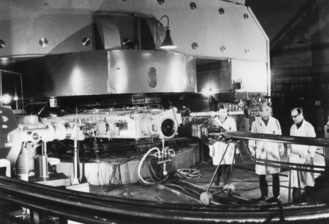
FLNR History
1957 | FOUNDATION of the LABORATORY
1960 | CLASSICAL CYCLOTRON U300 START-UP
1963 | DISCOVERY of 102 ELEMENT
1964 | DISCOVERY of 104 ELEMENT
1965 | DISCOVERY of 103 ELEMENT
1968 | ISOCHRONOUS CYCLOTRON U200 START-UP
1970 | DISCOVERY of 105 ELEMENT - DUBNIUM
1971 | CYCLOTRON U300 + U200 TANDEM START-UP
FIRST ACCELERATOR
U-300 - classical cyclotron
of heavy ions (1960- 1989)
R=3m
Ions: Li – Xe
E=3-13 MeV/n
Synthesis of new elements
Notes:
Many interesting experiments have been made on this machine, including the program on the synthesis of new elements

Slide 4
FLNR’s BASIC DIRECTIONS of RESEARCH
1. Heavy and superheavy nuclei:
synthesis and study of properties of superheavy elements;
chemistry of new elements;
fusion-fission and multi-nucleon transfer reactions;
nuclear- , mass-, & laser-spectrometry of SH nuclei.
2. Light exotic nuclei:
properties and structure of light exotic nuclei;
reactions with exotic nuclei.
3. Radiation effects and physical groundwork of nanotechnology.
Notes:
4
each accelerator is specialized for certain tasks

Slide 5

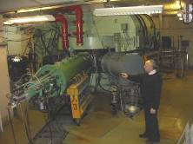

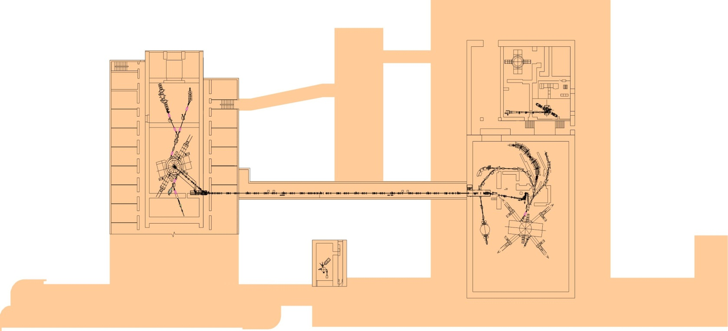
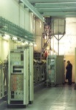
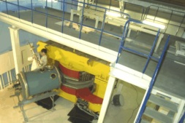
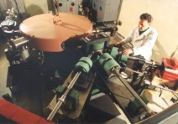
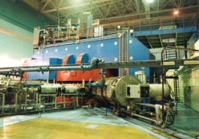
FLNR accelerator complex in 2014.
4 heavy ion cyclotrons and MT-25 microtron – electron accelerator
U200
IC100
DRIBs
U400M
U400
MT25
U-400M - E= 6÷50 MeV/nucleon
U-400 - E=3.5÷20 MeV/nucleon
U-200 - E=3÷15 MeV/nucleon
IC-100 - E≈1.2;0.5 MeV/nucleon
МТ-25 - electron accelerator E = 25 MeV
DRIBs (U400М+U400) ⁶He,⁸He E = 6 ÷ 13 MeV/nucleon
Notes:
Each accelerator has been created and tailored for certain a physical task

Slide 6
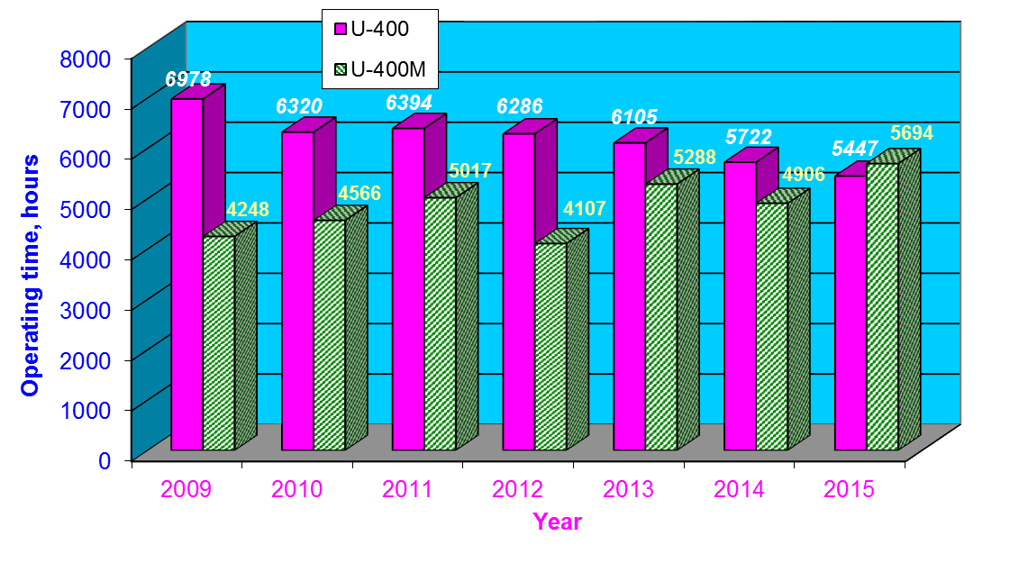
TOTAL OPERATION TIME OF U-400 AND U-400M ACCELERATORS
Notes:
Cyclotrons in operation all year, except summer vacation for staff, which is 1 month and the Christmas holidays

Slide 7
FLNR cyclotrons
for Physics Research

Slide 8
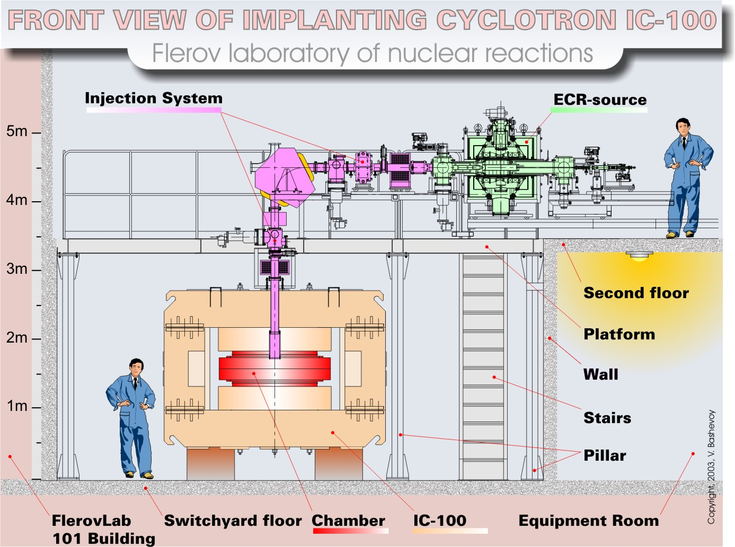
Conceptual design of FLNR cyclotrons
ECR ion source

Slide 9

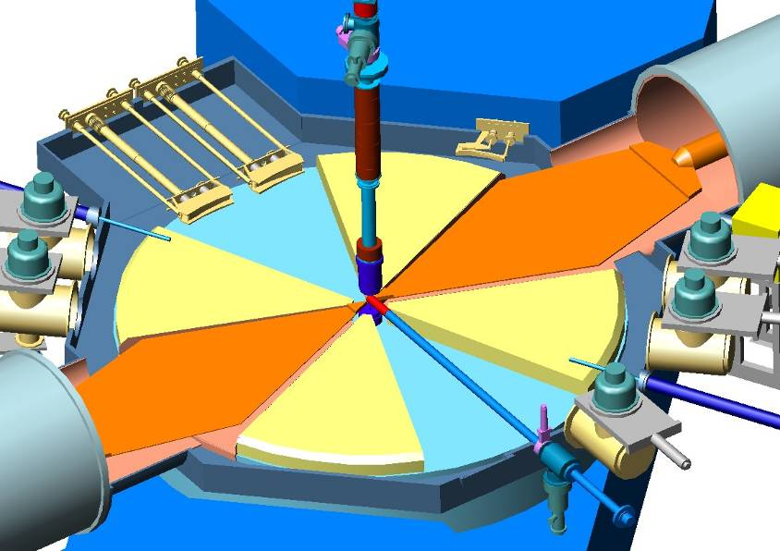
deflector
axial injection
system
inflector

Slide 10
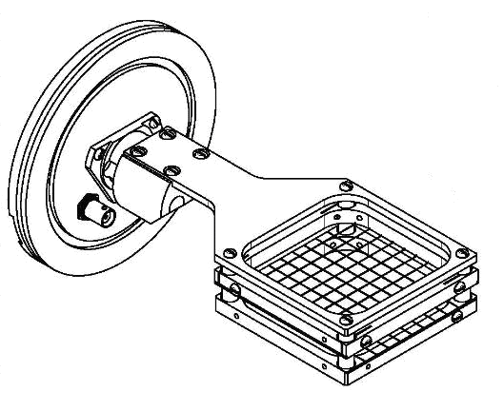
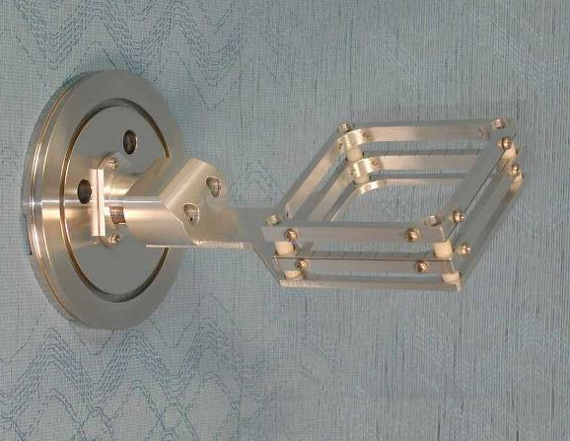
Buncher system
Phase length of ion bunch, which is captured in the acceleration – 20-40° from 360 °.
Buncher system increases the coefficient of capture of the injected beam into the acceleration due to the compression of ions in the capture area
V_{ion}
ΔV
U _{банч}
I
ΔV
ϕ
0°
180°
360°
L - drift section
I
Конструкция банчера
30°
0°
180°
360°
First accelerating gap
(Phase capture to acceleration – 20°-40°)
Notes:
Buncher system allows to increase the coefficient of capture of the injected beam to the acceleration due to the compression of ions in the capture area.
Ions, which come first, are decelerated by the electric field of buncher, ions, that arrive late, are obtained extra speed

Slide 11

U400 Cyclotron (1978)

Slide 12
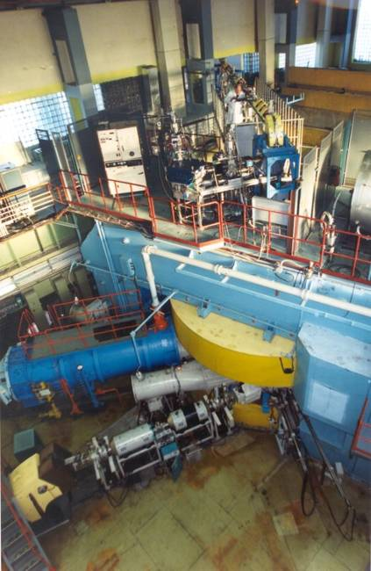
U400 CYCLOTRON
stand-alone & post-accelerator
Ion | Ion energy [MeV/A] | Output intensity
⁴ He ¹⁺ | - | -
⁶ He ¹⁺ | 11 | 3⋅10⁷ pps
⁸ He ¹⁺ | 7.9 | -
¹⁶ O ²⁺ | 5.7; 7.9 | 5 pμA
¹⁸O³⁺ | 7.8; 10.5; 15.8 | 4.4 pμA
⁴⁰ Ar ⁴⁺ | 3.8; 5.1 * | 1.7 pμA
⁴⁸ Ca ⁵⁺ | 3.7; 5.3 * | 1.2 pμA
⁴⁸Ca⁹⁺ | 8.9; 11; 17.7 * | 1 pμA
⁵⁰ Ti ⁵⁺ | 3.6; 5.1 * | 0.4 pμA
⁵⁸ Fe ⁶⁺ | 3.8; 5.4 * | 0.7 pμA
⁸⁴Kr⁸⁺ | 3.1; 4.4 * | 0.3 pμA
¹³⁶Xe¹⁴⁺ | 3.3; 4.6; 6.9 * | 0.08 pμA
¹⁶⁰Gd¹⁹⁺ | 5.5 | 0.01 pμA
²⁰⁹Bi¹⁹⁺ | 3.4 | 0.01 pμA
New heavy isotopes
Fusion-fission
Nuclear spectroscopy
SHE chemistry
Multi nucleon transfer reactions;
Reactions with exotic nuclei
Structure of light exotic nuclei;
Notes:
12

Slide 13
Axial injection system of U-400 Cyclotron
ECR4M
Inflector
Notes:
Bending or analyzing magnet is used for selection of particles and bending the beam from horizontal part of axial injection system into vertical channel.

Slide 14
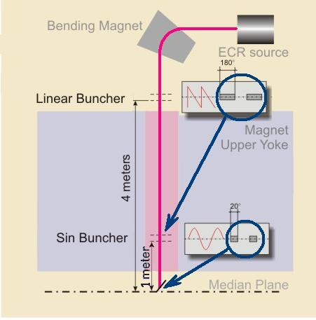
Axial injection system of U-400 Cyclotron
Phase bunch length, which is captured in the acceleration – 20-40 degrees.
Buncher system of U-400
Phase length of bunch, which is captured in the acceleration – 20-40° from 360°.
Influence of space charge
Accelerated beam ⁴⁸Ca⁵⁺ U inj =14,7 kV; I inj = 52 μА | Sin – off Lin – off | Sin – on Lin – off | Sin – off Lin – on | Sin – on Lin – on
The beam intensity on the target | 2,3 μА | 11 μА | 4,9 μА | 20 μА
The magnification ratio of the intensity |  | К = 4,8 | К = 2,1 | К = 8,7
Notes:
It means that only a tenth part of the injected beam comes in the acceleration process. Bunching system increases the density of the beam in the capture area. The space charge effect in the beam decreases the bunching coefficient with increasing beam intensity.
The shape of an electrical signal is a sawtooth

Slide 15
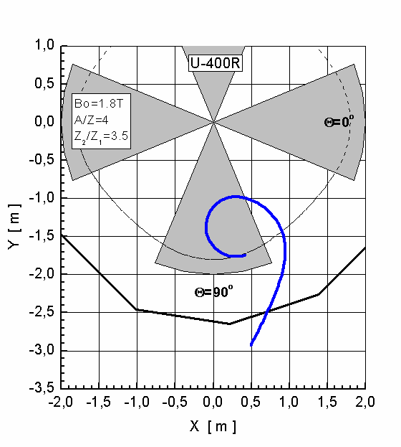
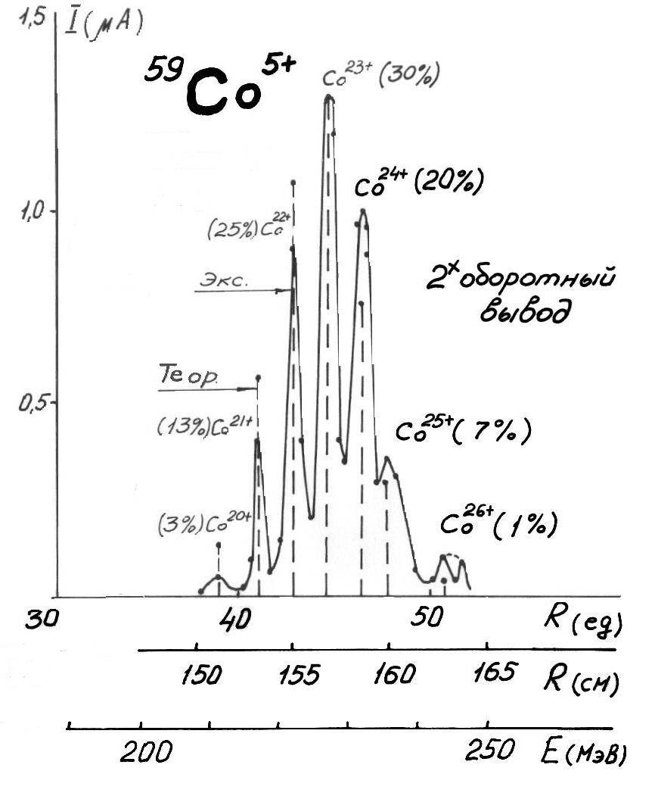
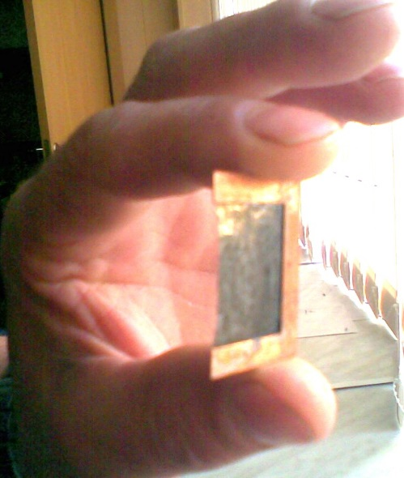
Heavy Ion Beam Extraction by Stripping Foil
The method of heavy ion beam extraction from AVF (azimuthally-varying-field) cyclotrons suggested by G.N. Vialov, G.N. Flerov and Yu. Oganesyan in 1964
¹⁴N⁺² → ¹⁴N⁺⁷
Thickness of stripping foil – 20 -200 μg/cm²
Thickness of stripping foil – 20 -200 μg/cm²
Notes:
The beam passes the stripping foil, the ions change their charge, for example, from nitrogen two plus into nitrogen seven plus , beam loses orbital stability and leaves the acceleration zone.
But after the stripping foil for heavy ions there is a spectrum of ion charges, which completely determines efficiency of extraction.

Slide 16
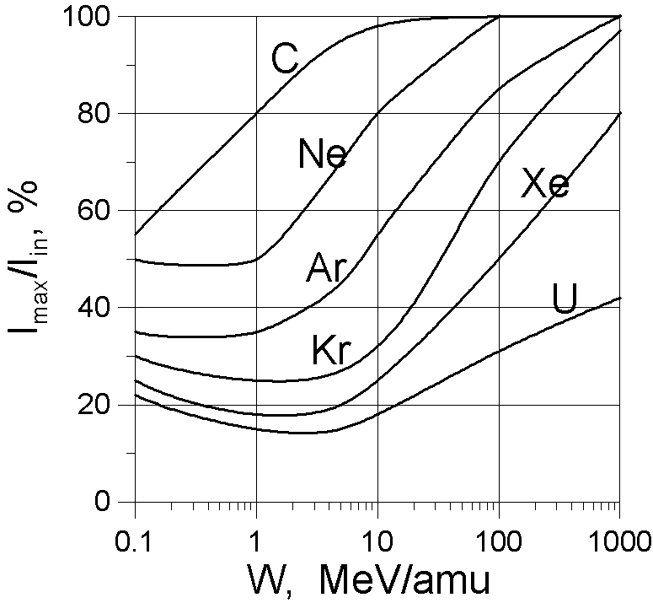
Heavy Ion Beam Extraction by Stripping Foil
1. Charge spread
2. Life time of stripping foil
1 day
Dependence of the maximum efficiency of a single charge extraction by stripping versus the ion energy
Dependence of life time of carbon stripping foil versus beam current density

Slide 17
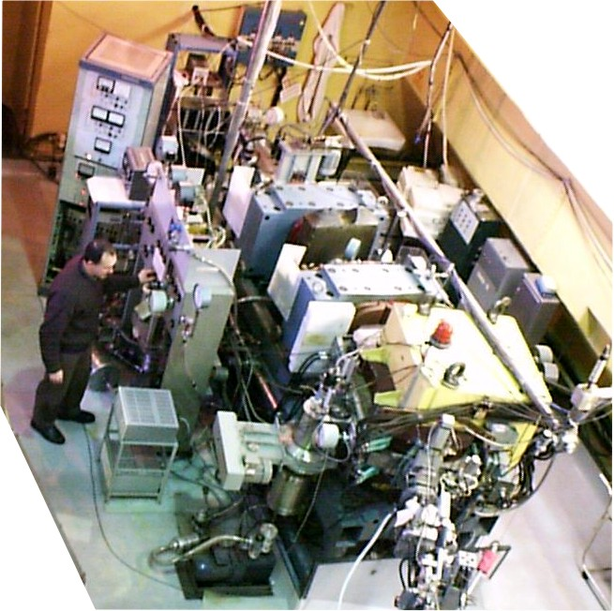
DUBNA Gas Filled Recoil Separator
Target Beam Isotopes
²³⁸U, ^{242,244}Pu, ²⁴³Am, ^{246,248}Cm, ²⁴⁹Cf + ⁴⁸Ca → 112 – 118
Ion beam energy: 5.00 – 5.75 MeV/A
Beam intensity: 6 - 8⋅10¹² pps
Consumption of ⁴⁸ Ca < 0.5 mg/h
Beam time: 2000 – 4000 hours per year

Slide 18
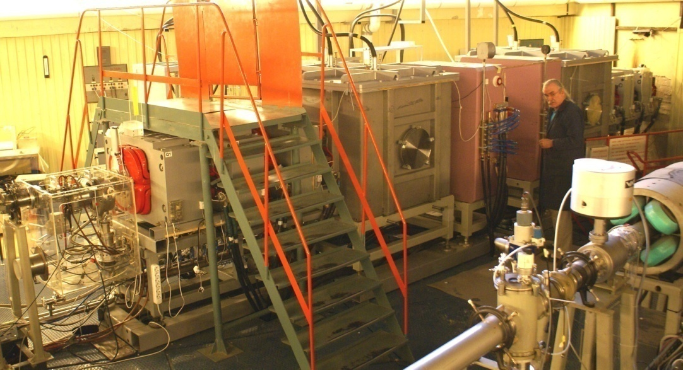
New experimental set up - SHELS velocity filter
(Separator for Heavy ELement Spectroscopy)

Slide 19
Efficiency of transporting a ⁴⁸Ca⁵⁺ beam
from the ECR source to a physical target
Measuring point | Beam intensity |  | Ion | Transmission factor
ECR source, after separation | 1⋅10¹⁴ pps | 84 μAe | ⁴⁸Ca⁵⁺ | 32% |  |  |  | 8.5%
Cyclotron centre | 3.5⋅10¹³ pps | 27 μAe | ⁴⁸Ca⁵⁺ |  | 81%
Extraction radius | 2.8⋅10¹³ pps | 22 μAe | ⁴⁸Ca⁵⁺ |  |  | 40%
Extracted beam (by charge exchange) | 9.7⋅10¹² pps | 28 μAe | ⁴⁸Ca¹⁸⁺ |  |  |  | 82%
Target | 8⋅10¹² pps | 23 μAe | ⁴⁸Ca¹⁸⁺
Ionization efficiency of ⁴⁸Ca (neutral) to ⁴⁸Ca⁵⁺ - about 10%
Transformation of ⁴⁸Ca as working substance into the
⁴⁸Ca beam on target is about 1% in routine operation.
Notes:
transmission factor.
Less than 20% of beam is lost in the process of acceleration
The overall efficiency is slightly less than 10 percent

Slide 20
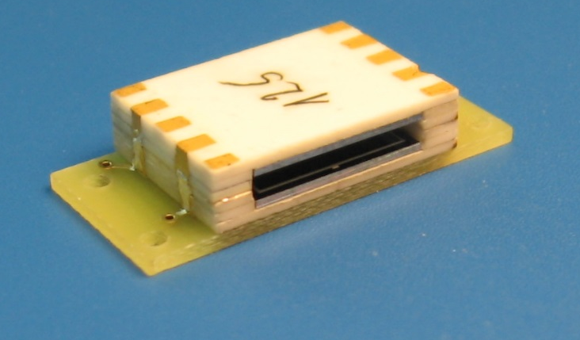
The element 112 experiment
Beam (⁴⁸Ca; 233-239 MeV)
Teflon capillary
Window/
Target (²⁴²Pu ²⁴⁴Pu; ≅1 mg/cm²)
SiO₂-Filter
Ta metal
850°C
Cryo On-line Detector (4π COLD)
(32 pairs PIN diodes, one side gold covered)
Hg
112
Rn
Loop
Quartz inlay
Recoil chamber
Quartz column
Temperature gradient: 35°C to – 184 °C
Beam stop
T
Carrier gas He/Ar (70/30)
l

Slide 21
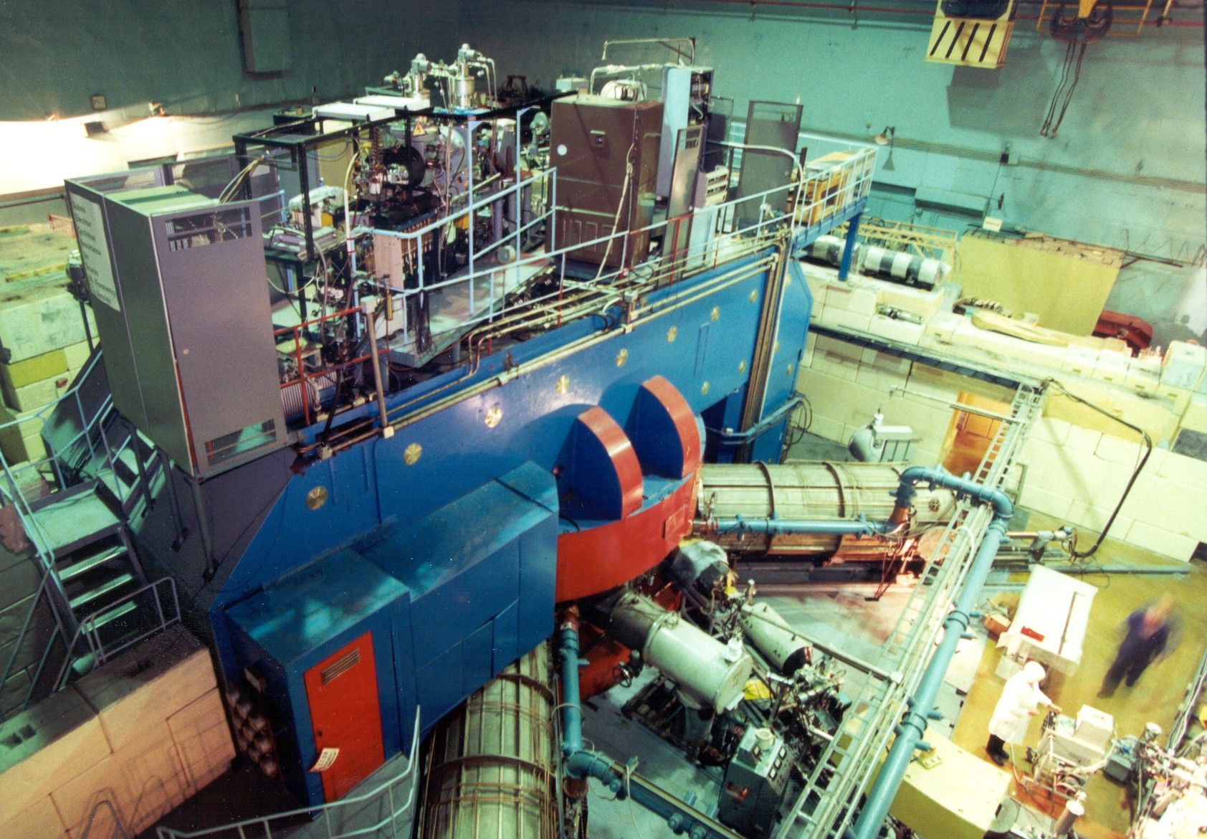
U-400M Cyclotron (1991)

Slide 22
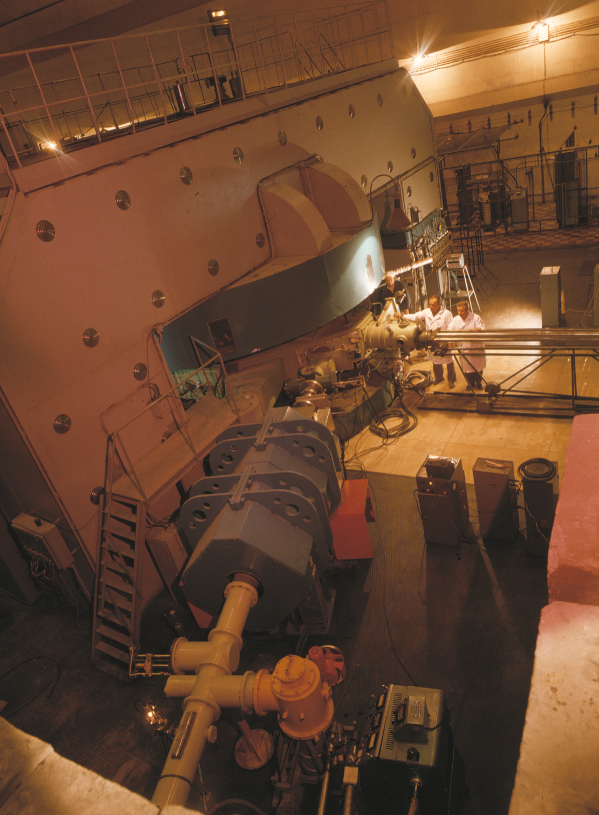
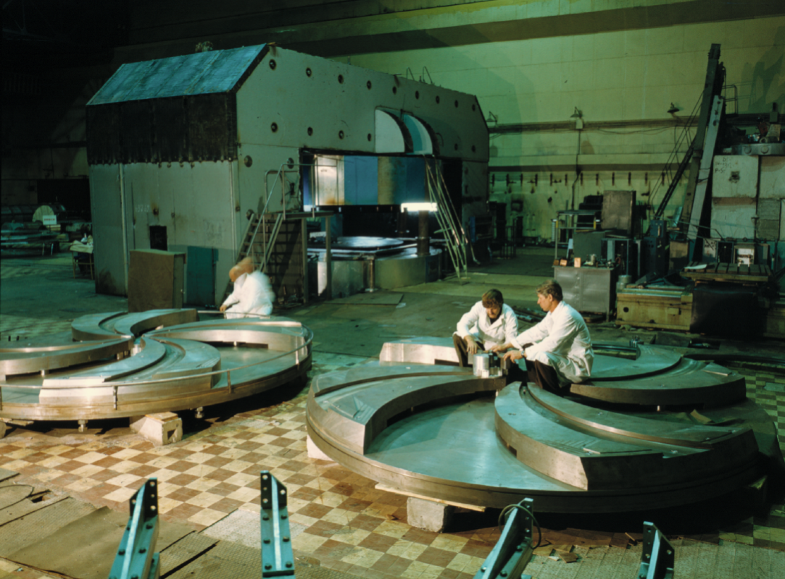
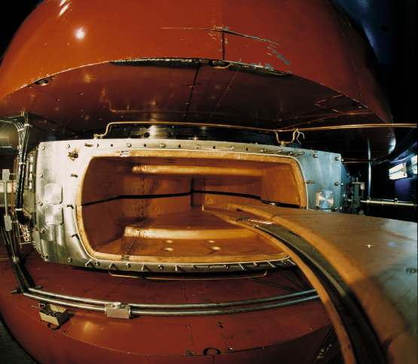
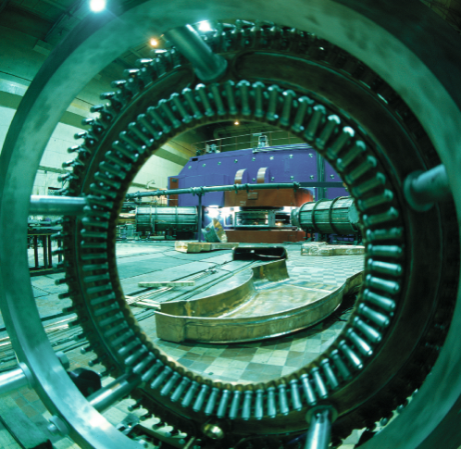
FLEROVLAB
1989- 1991: Reconstruction
U-300→U-400M
U-300 Cyclotron
1960-1989

Slide 23

U400M CYCLOTRON
stand-alone & driving accelerator
U400M E=30 ÷ 50 MeV/A E=4.5 ÷ 9 MeV/A
Ion | Ion energy [MeV/A] | Output intensity
⁷Li | 35 | 6×10¹³
¹⁸O | 33 | 1×10¹³
⁴⁰Ar | 40 | 1×10¹²
⁴⁸Ca | 5 | 6×10¹²
⁵⁴Cr | 5 | 3×10¹²
⁵⁸Fe | 5 | 3×10¹²
¹²⁴Sn | 5 | 2×10¹¹
¹³⁶Xe | 5 | 4×10¹¹
²³⁸U | 7 | 2×10¹⁰
Properties and structure of light exotic nuclei;
Astrophysics;
Reactions with exotic nuclei;
Light neutron-rich nuclei;
Deep inelastic scattering;
Production of RIBs.
Notes:
23

Slide 24
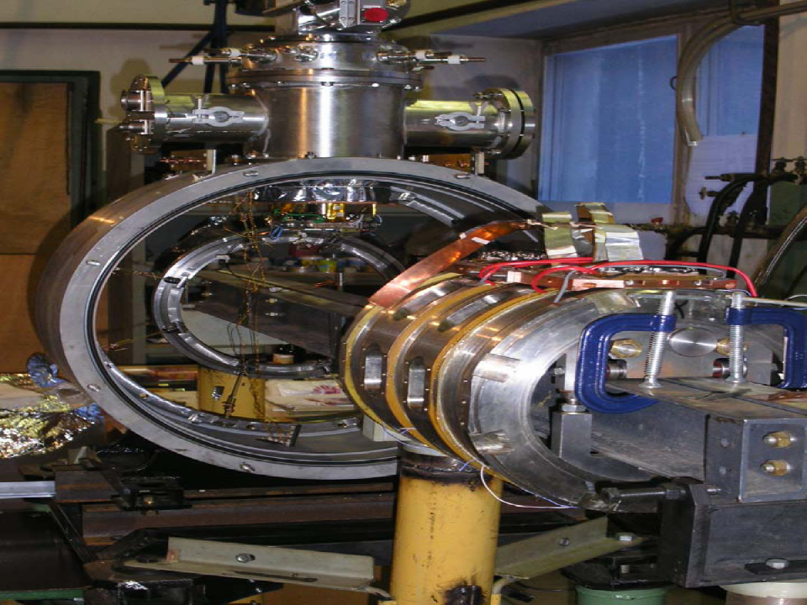
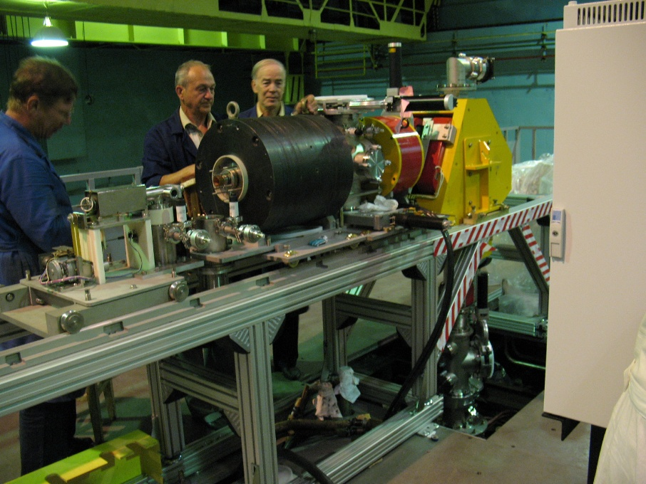
U400M. New ion sources and axial injection system
DECRIS-SC2 18 GHz
Beam ntensity:
Kr¹⁵⁺ ~ 100 eμA,
Kr²⁰⁺ ~ 10 eμA,
Xe ³⁰⁺ ~ 5 eμA
DECRIS-2 14 GHz
Median plane
Notes:
Система аксиальной инжекции позволяет установить два ионный источника. Модернизированный ЭЦР с медными обмотками установлен на циклотроне. ЭЦР со сверхпроводящими катушками находится на стенде.

Slide 25
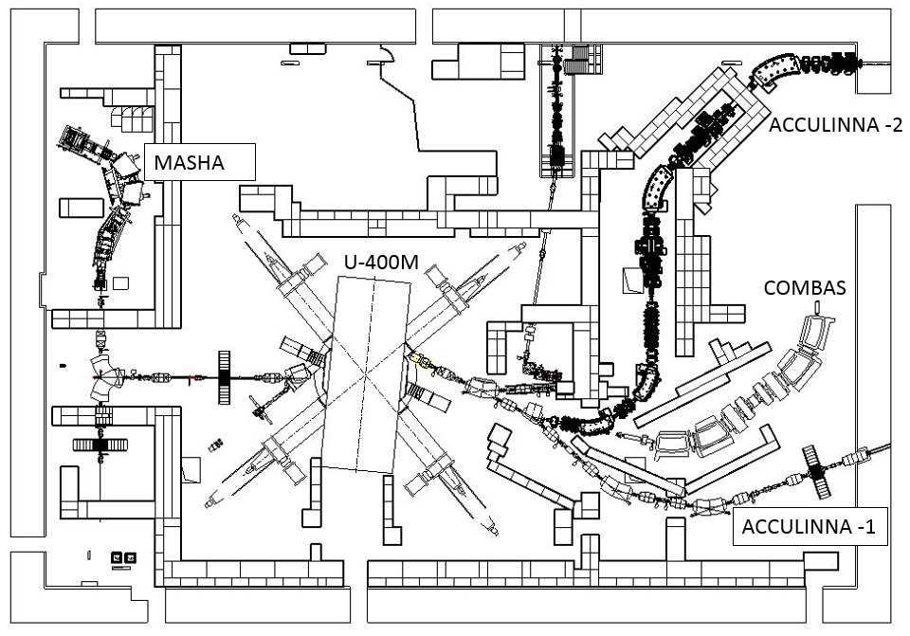
New experimental set-ups at U400M
Low energy ion beams
High energy ion beams

Slide 26
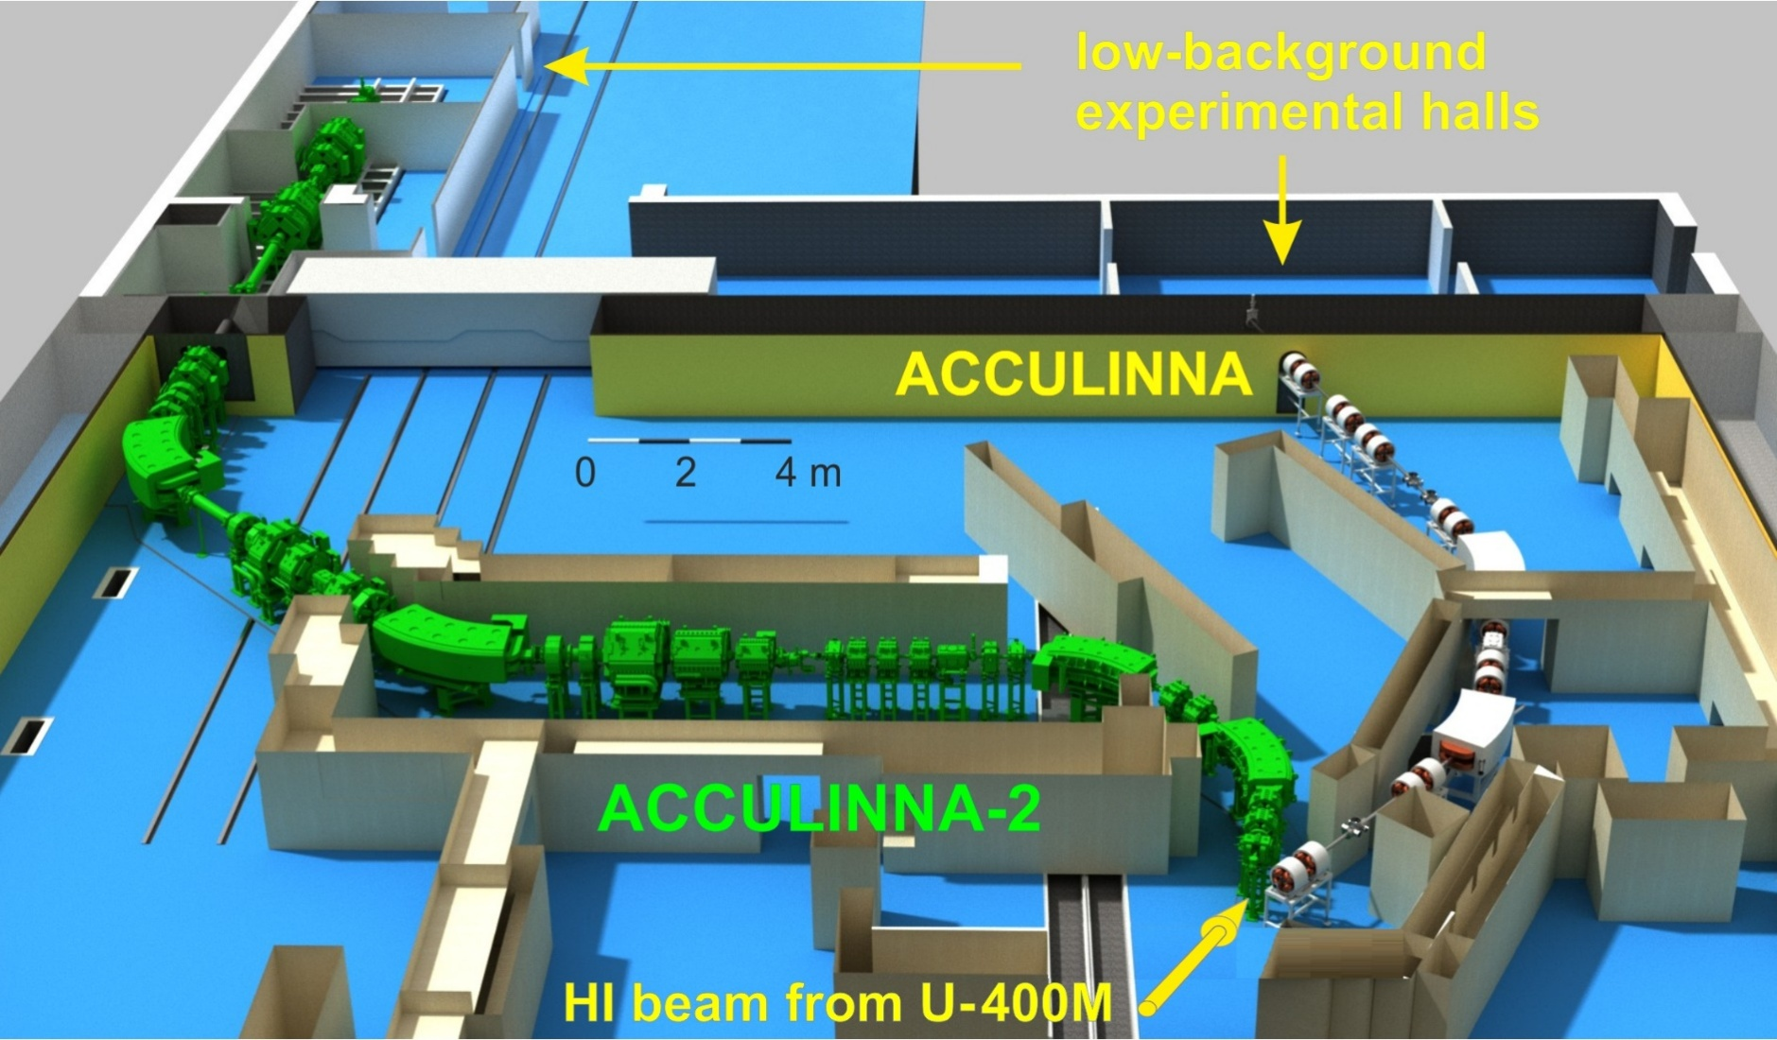
Fragment-separator ACCULINNA-II lay-out

Slide 27
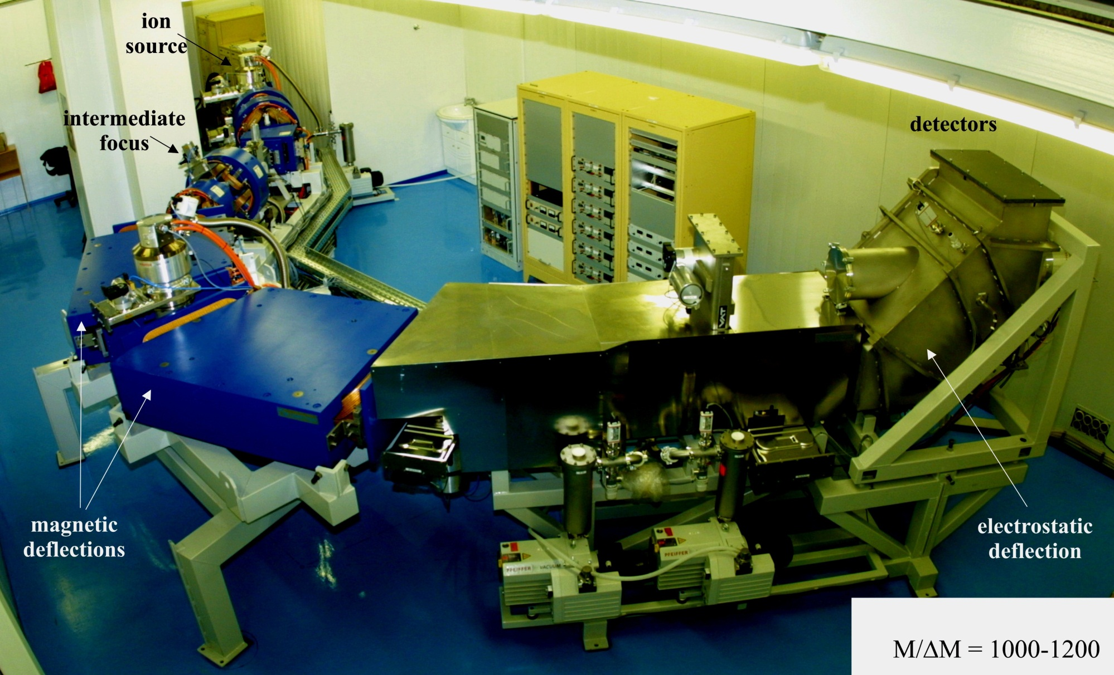
Mass-spectrometer MASHA

Slide 28
DRIBs-I & II have been formulated at the end of XX-th century
DRIBs-II
Production of fission fragments
U400M - driver
DRIBs-I
U400 – post accelerator
Notes:
The project DRISS-II was not implemented because of problems with a high level of radioactivity in the target area.

Slide 29
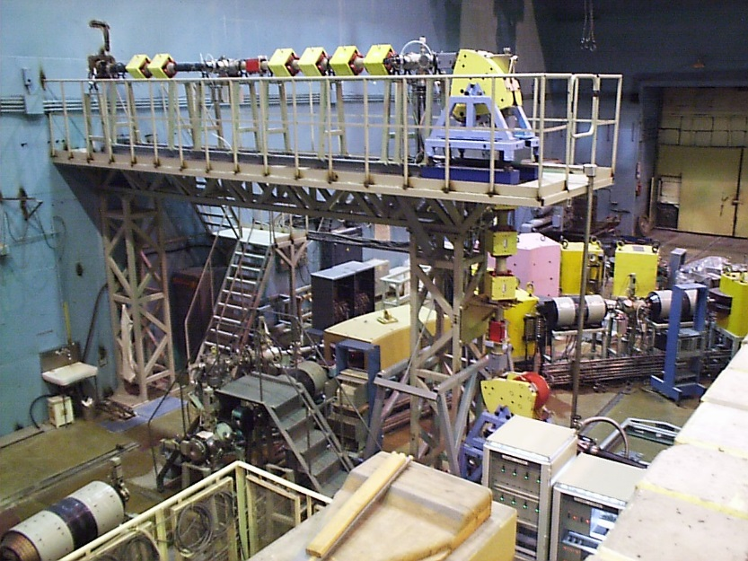
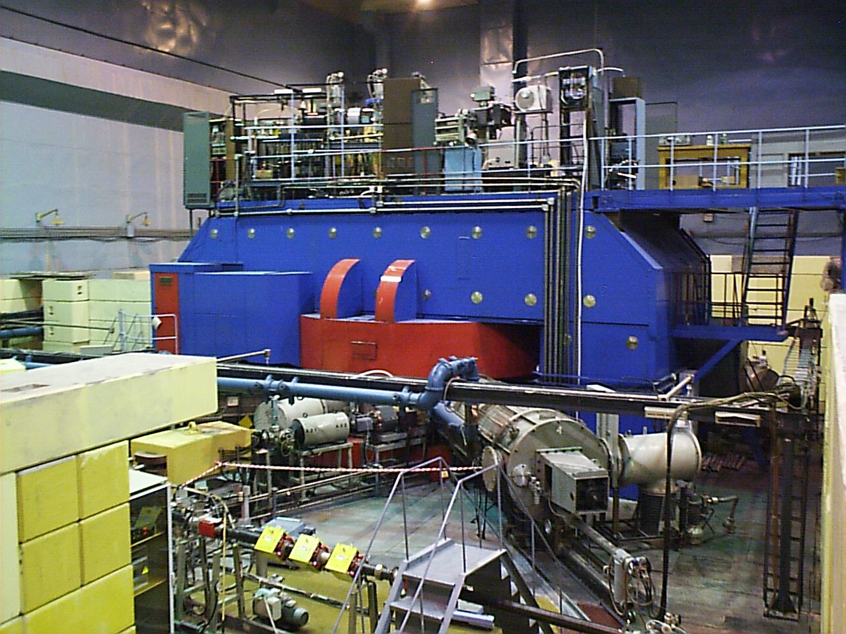
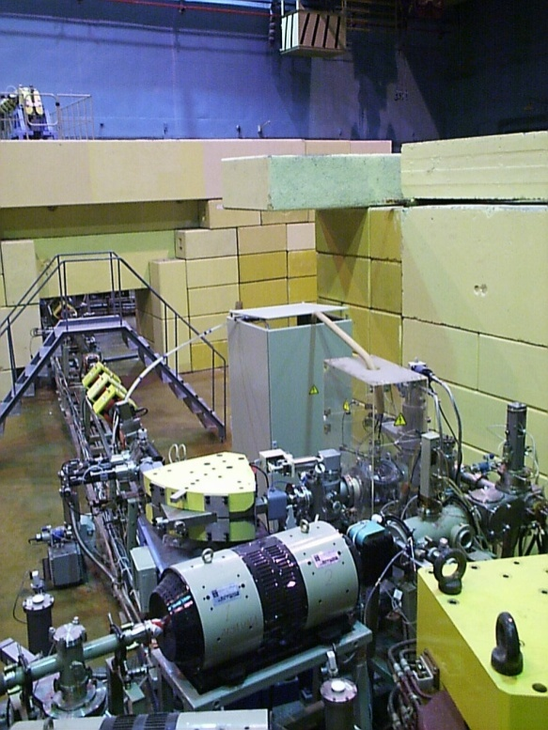
DRIBs – I
U400M – driver-accelerator
Production target
Beam transport line
Notes:
The radioactive gas flows through the tube into the ion source where it is ionized

Slide 30
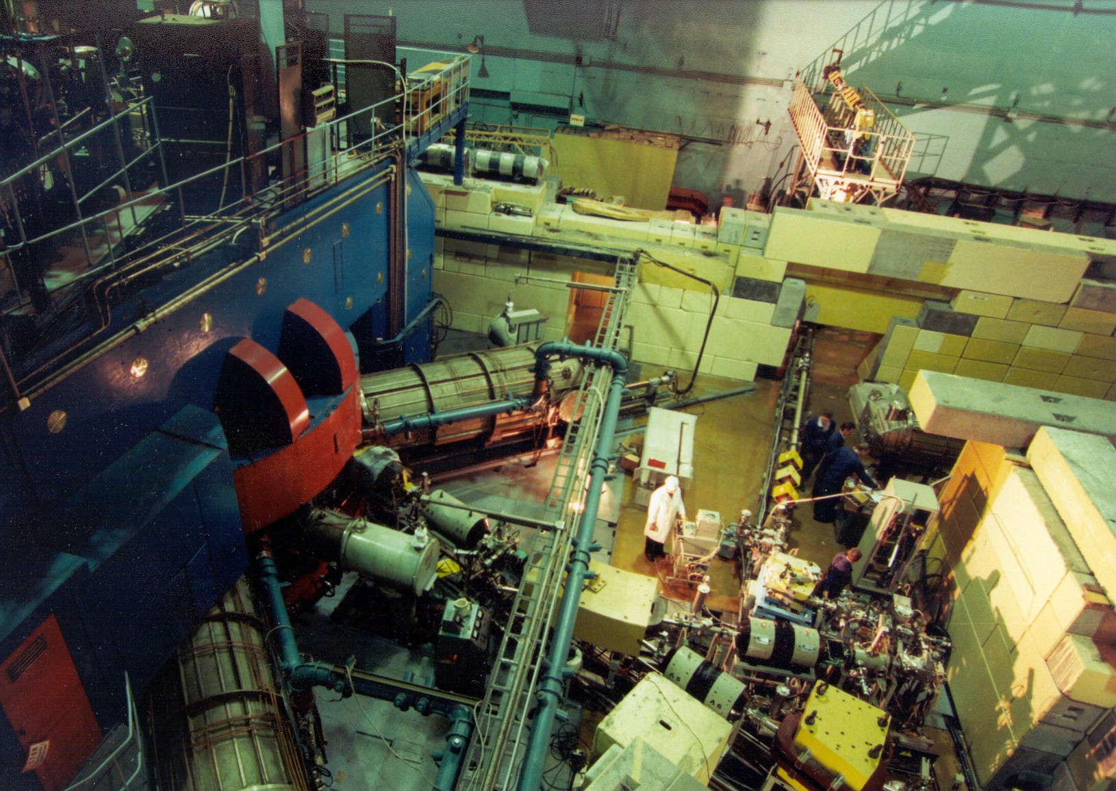
U400M Cyclotron with DRIBs Complex
Next slide

Slide 31
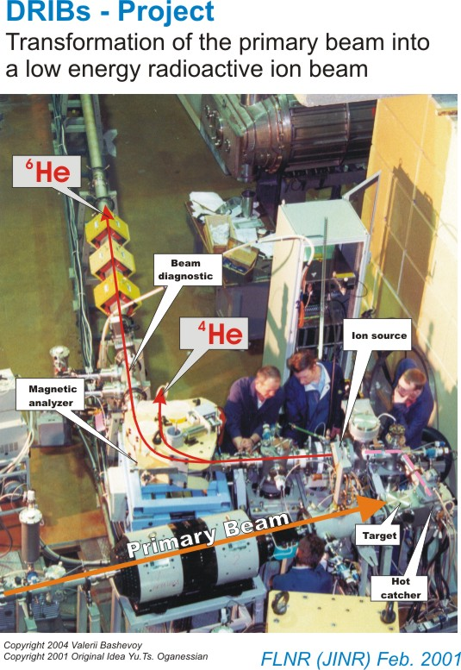
Notes:
The radioactive gas flows through the tube into the ion source where it is ionized

Slide 32
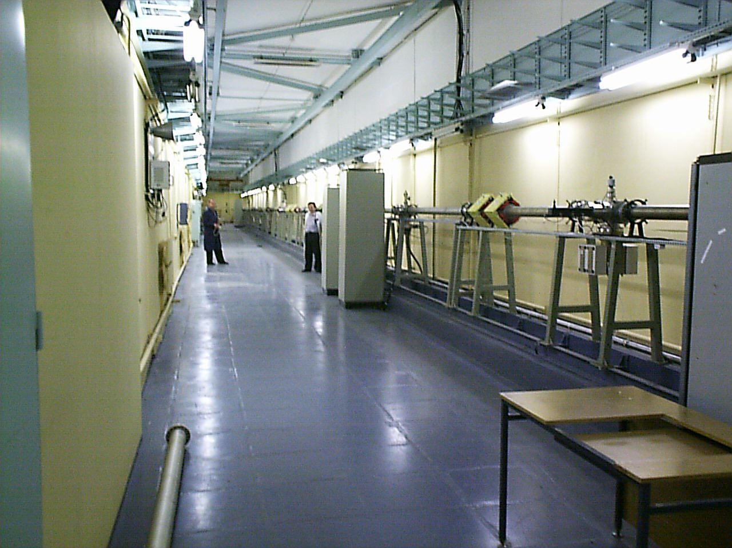
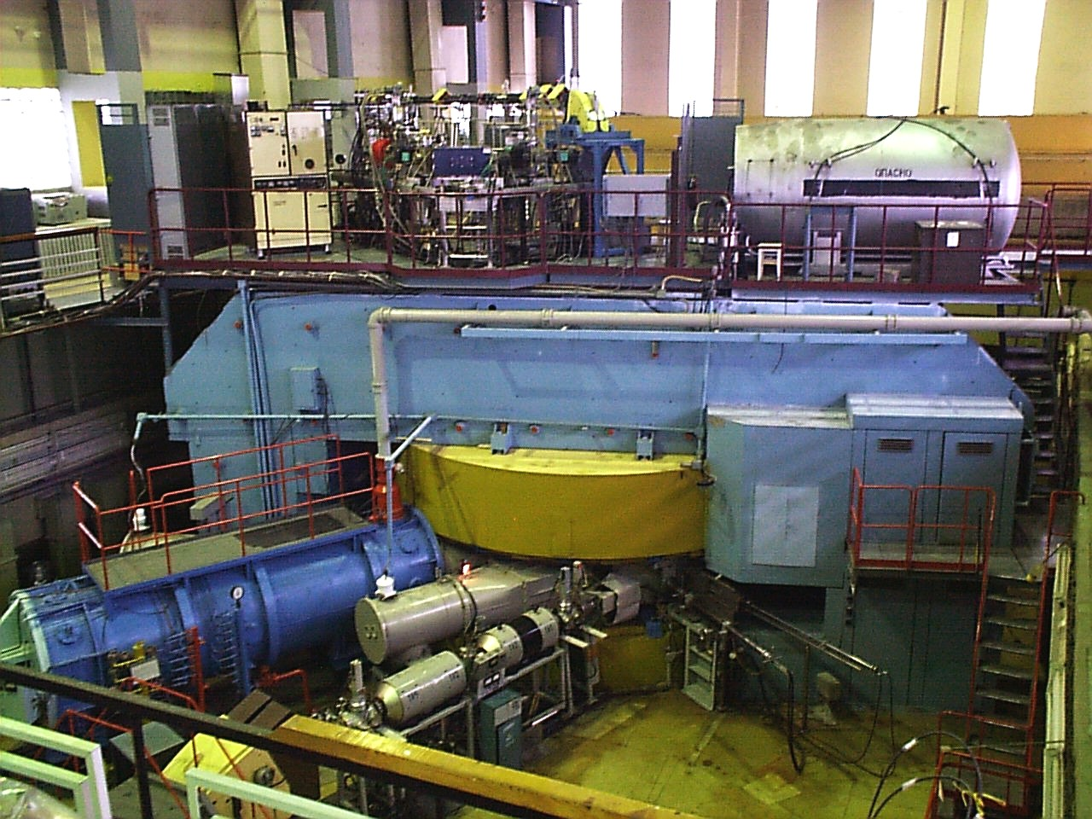
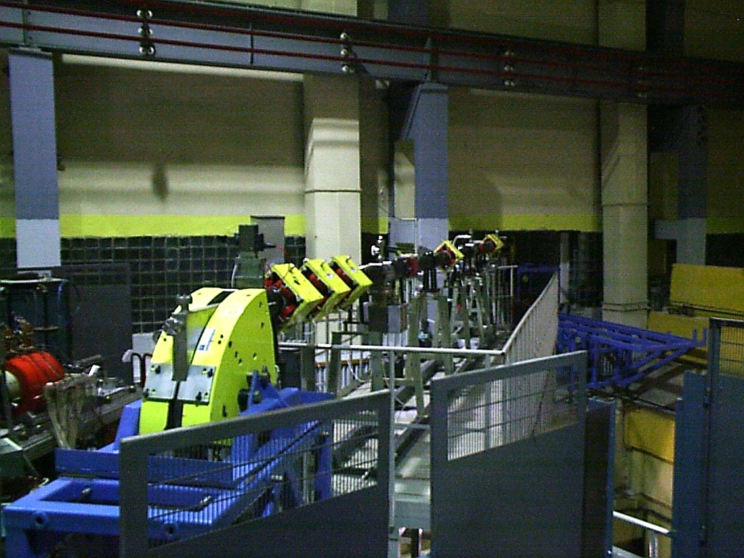
DRIBs – I
Transportation gallery
Beam injection
U400 – post accelerator

Slide 33
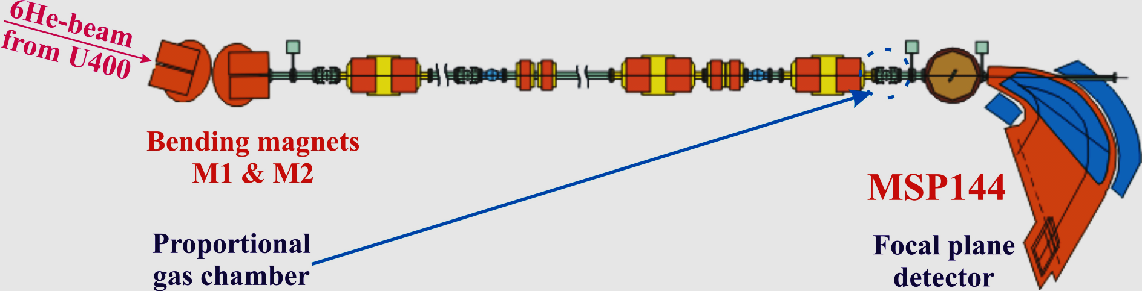
DRIBs-I: experiments with ⁶He beam

Slide 34
The main task of the FLNR Seven-Year Plan for 2017–2023 is the full implementation of the DRIBs-III Project, namely:
Commissioning and development of "SHE Factory" based on the DC-280 cyclotron (design parameters of beams with smoothly variable energy; attaining maximum beam intensity (up to 10 pµA) for nuclei with А≤100; development of infrastructure for accommodation and use of experimental set-ups of other research centers);
Reconstruction of the U-400 cyclotron and building of a new experimental hall (extension of the range of accelerated ions from helium to uranium with energies smoothly varying within a wide range 0.8–25 MeV·А);
Reconstruction of the U-400M cyclotron (production of intensive beams of radioactive ions, advancing toward the boundaries of proton and neutron stability of nuclei; conduct of research of nuclear interactions with maximum proton and neutron excess, employing the new powerful ACCULINNA-II separator);
Development of long-running experimental set-ups.

Slide 35
DC-280
Why new cyclotron ?
Notes:
Let's look at trends in accelerator development

Slide 36
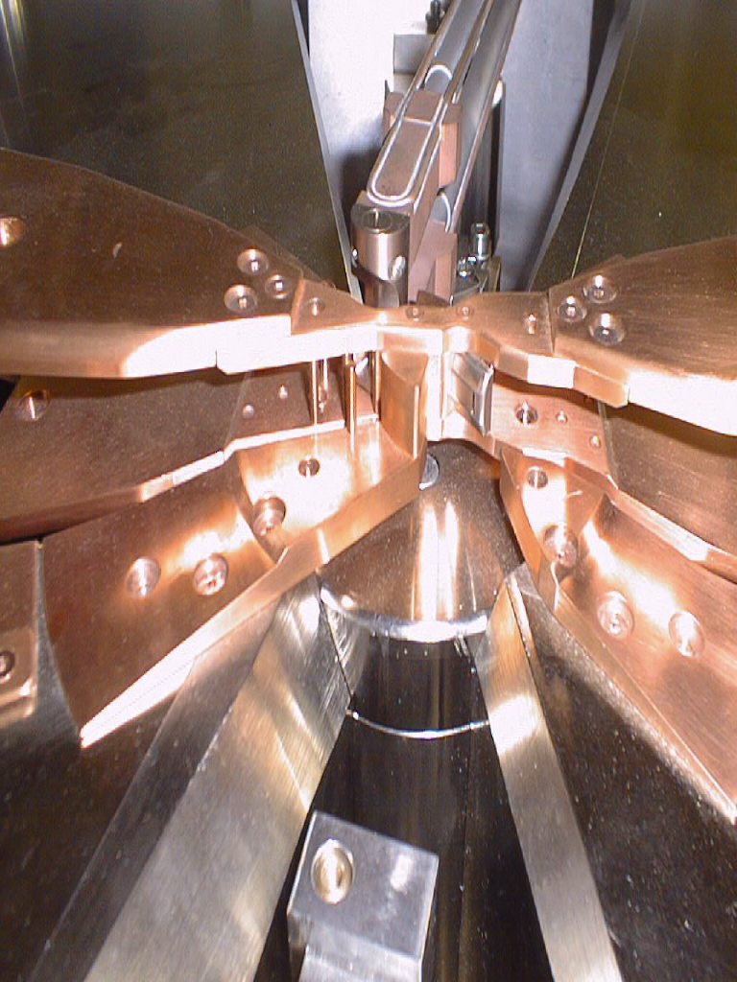
Trends in the development of heavy ion cyclotrons for the last 20-30 years
The replace the internal PIG ion source to external source of ECR type
External source of ECR type
- high intensity of multicharged ions,
- high efficiency of beam capture into acceleration up to 70% due to the use of the bunching system in the injection channel,
- it is necessary to create a axial injection system of beam.
Internal ion source of PIG type
- Simple construction, ease of use
- low intensity of multicharged ions
- beam capture in cyclotron is approximately
30° from 360°.
It means that only 8 % of the beam
is captured in the acceleration process.
Notes:
Let's look at the trend of development of the cyclotrons for the last 20-30 years. In the case of internal source, the extracting slit of the dee is located opposite the ion source. The beam comes from the plasma directly into the first accelerating gap.

Slide 37
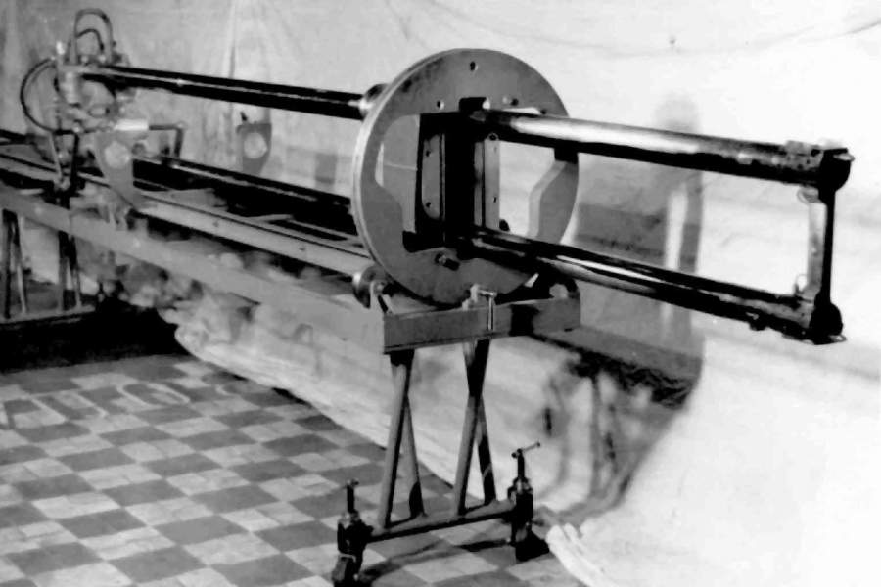
General view of the PIG ion source for the U-300 cyclotron
FLNR Ion Sources Group

Slide 38
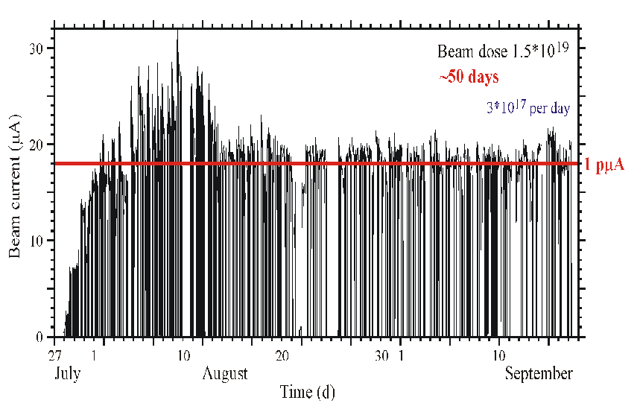
Cyclotron U-400. ⁴⁸Ca⁵⁺
1996
PIG: I ~ 0.4 μA,
48Ca consumption: 4 ÷ 15 mg/h
ECR: I ~ 8 μA,
48Ca consumption 0.4 ÷ 0.5 mg/h
2010
I ~ 18 μA (1pμA)
Transformation of 48Ca working substance into the 48Ca beam on the target is about 1% in the routine operation.
2016
DC-280
Intensity 48Ca 1 pμA → 10 pμA

Slide 39
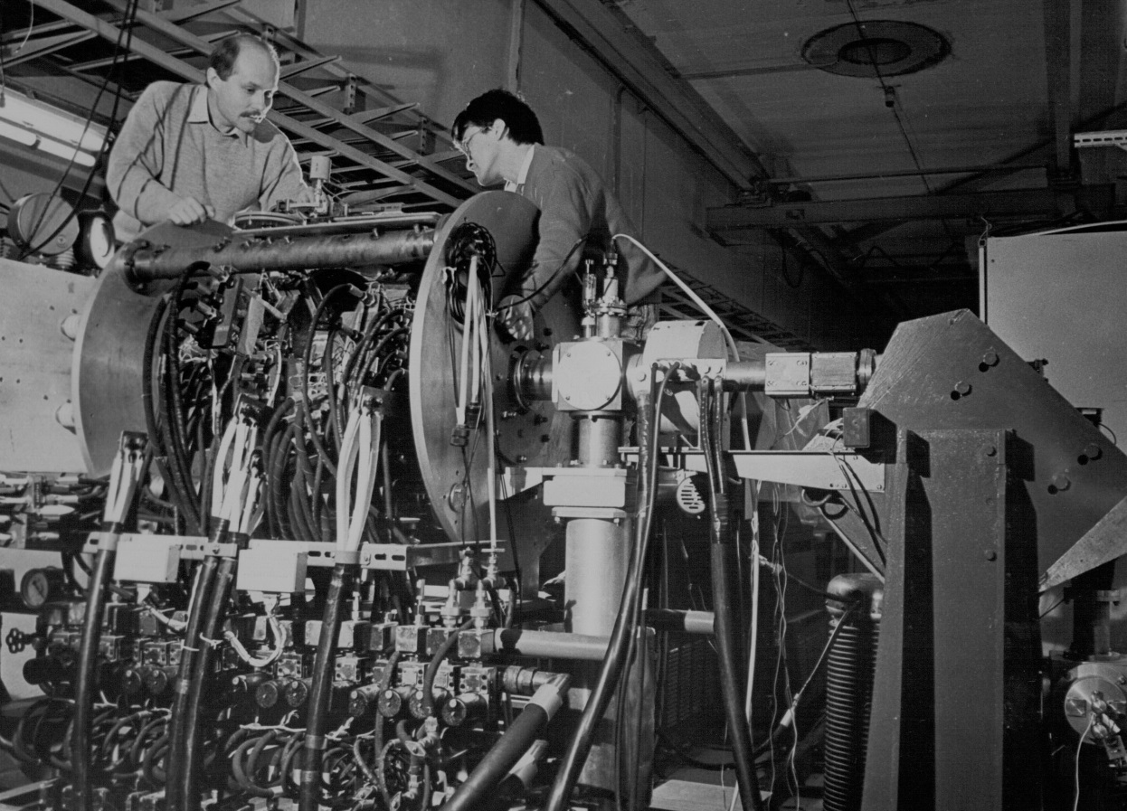
First ECR ion source at FLNR
DECRIS-1

Slide 40
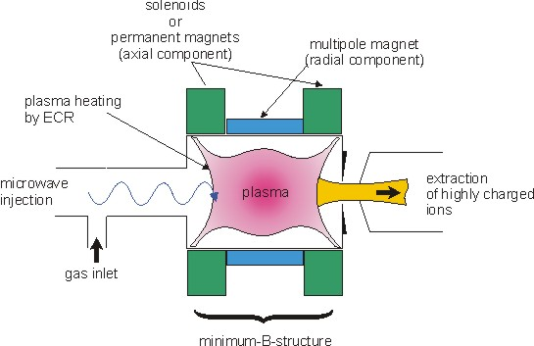
The ECR ion source
ω_{ECR} ~ B×e /m_{e}
FLNR Ion Sources Group
Notes:
The solenoids generate an axial component of magnetic field, The multipole magnet generates an radial component of magnetic field.
The combination of these two fields creates a magnetic trap for plasma,
The plasma is heated by microwave power.
Calcium enters the discharge in the form of steam

Slide 41
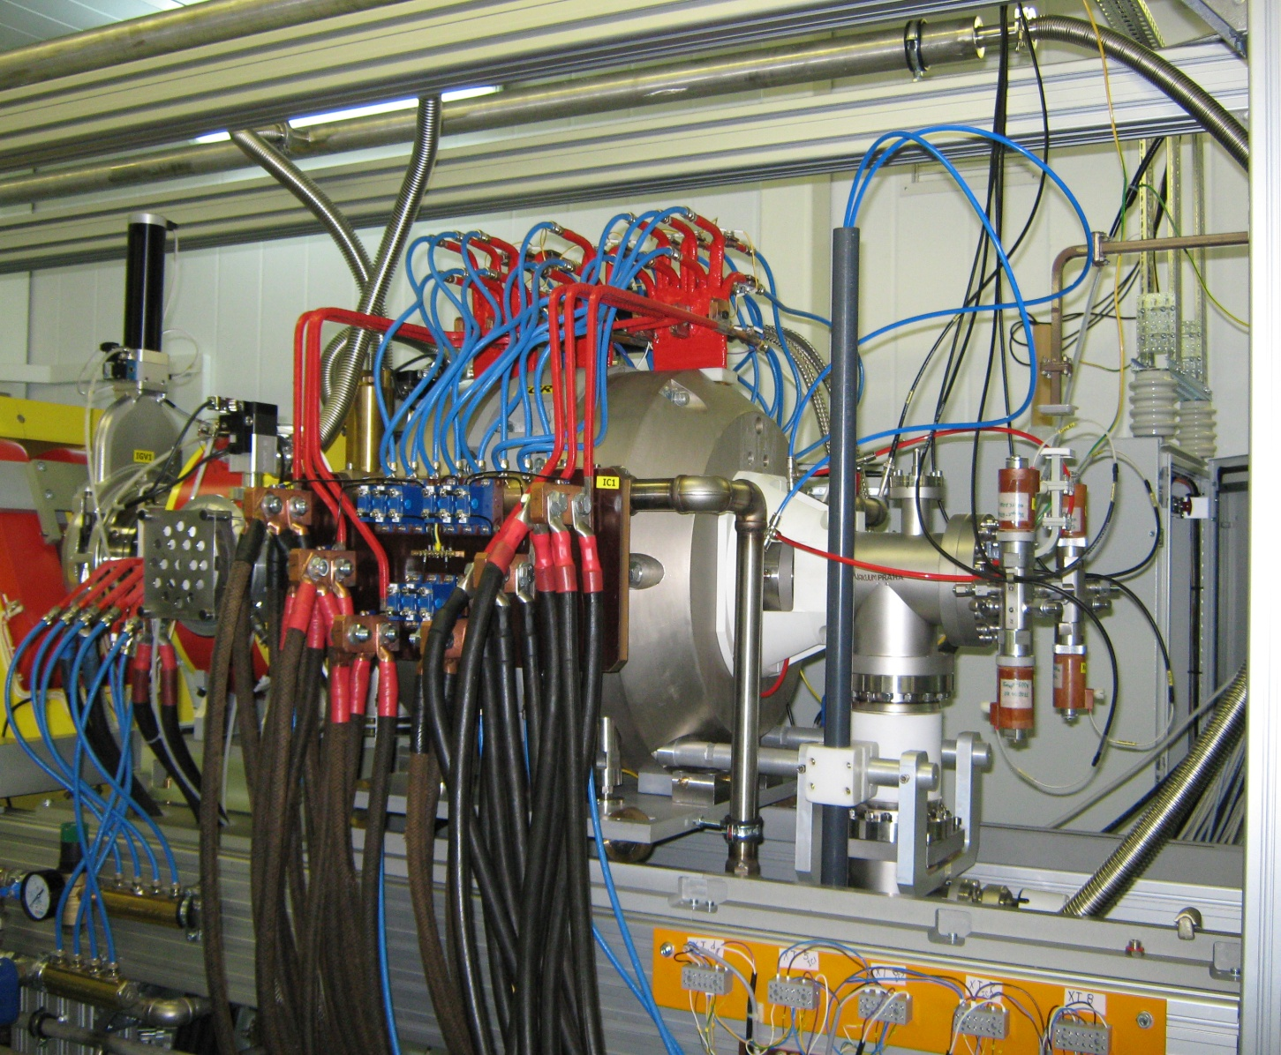
DECRIS-5 ion source (18 GHz)
with copper coils
41
Notes:
41

Slide 42
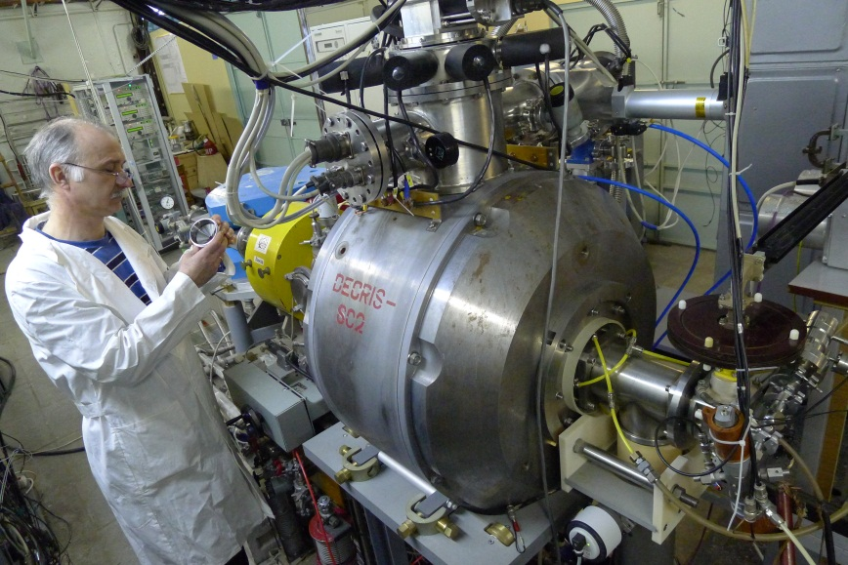
Superconducting DECRIS-SC2 (18 GHz)
42
Notes:
42

Slide 43
The beam parameters of the source DECRIS made in FLNR
Ion source | Frequency | Power consumption | Beam intensity
DECRIS-3 | 14 GHz | 60 kW | О⁵⁺ - 660 μA Ar⁸⁺ - 600 μA | Kr⁹⁺ - 100 μA Xe¹⁸⁺ - 45 μA
DECRIS-4 | 14 GHz | 60 kW | О⁵⁺ - 400 μA Ar⁸⁺ - 400 μA | Kr¹¹⁺ - 110 μA Xe²⁰⁺ - 25 μA
DECRIS-SC (superconducting) | 18 GHz | 20 kW | Ar⁸⁺ - 400 μA | Kr¹⁵⁺ - 110 μA Xe²³⁺ - 30 μA
DECRIS-5 | 18 GHz | 150 kW | Ar⁸⁺ - 1200 μA | Kr¹⁵⁺ - 325 μA Xe²⁰⁺ - 220 μA

Slide 44
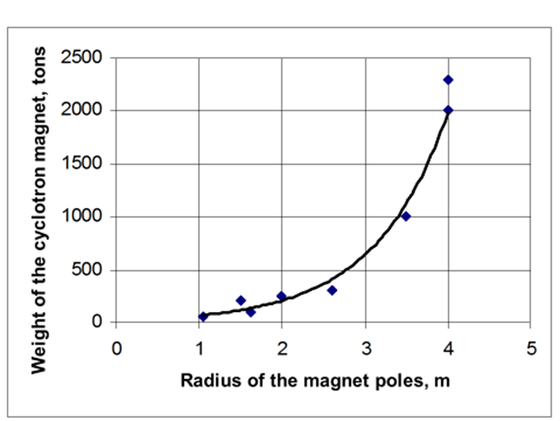
Trends in the development of heavy ion cyclotrons for the last 20-30 years
Magnetic system
2,0 Т
Iм=2000А
1,6 Т
Iм=700А
The energy of accelerated ions:
E=0.48⋅B²⋅R²⋅(Z/A)² (MeV/A)
Z – ion charge,
В – magnetic field,
R – radius of the magnet poles,
Weight of the magnet ~ R³
For Kr (5 MeV/A)
Kr⁹⁺
Weight of the cyclotron magnet – 2000 tons
Kr¹⁵⁺
Weight of the cyclotron magnet – 430 tons
The dependence of the magnetic field in the cyclotron from a winding current of the magnet U-400
Notes:
Direct growth of magnetic field has a limitation because of the effect of the saturation effect of iron yoke of the magnet.
The increase in the current of the magnet winding does not lead to a proportional increase of the magnetic field.
The weight of the magnet increases in proportion to the radius cubed.

Slide 45
Ion source
Возможности ЭЦР источников, работающих на частотах 6, 14, 28 и 56 ГГц по получению пучков ионов аргона [D.Leiter,S.Caspi, P.Ferraci,C,V.LYneis, S.Prestemon, G.L/Sabbi, D.S.Nodd, Trillaud. HIAT 2009, Venice, Italy].
Operating frequency ECR ion source | Power of microwave generator | Maximum magnetic field on the axis of the source | Type of magnetic structure | Consumed electric power
6-10 kW | менее 1 kW | < 1 Т | Copper coils Hexapole – permanent magnets | 30 kW
14 kW | ~ 1 kW | ~ 1,25 Т | Copper windings. Hexapole – permanent magnets | ~ 60 kW
14 kW | ~ 1 kW | ~ 1,25 Т | Superconducting coils, Hexapole – permanent magnets | ~ 20 kW
18 kW | ~ 2 kW | ~ 1,9 Т | Copper coils Hexapole – permanent magnets | ~ 150 kW
18 kW | ~ 2 kW | ~ 1,9 Т | Superconducting winding, Hexapole – permanent magnets | ~ 20 kW
28 kW | ~ 4-7 kW | ≥ 3 Т | Superconducting winding, Hexapole – superconducting winding | ~ 20 kW
Notes:
bare Argon nucleus

Slide 46
DC-280
Overall (ion source target) beam current transfer efficiency

Slide 47
Heavy Ion Beam Extraction by Stripping Foil
1. Charge spread
2. Life time of stripping foil
1 day
Dependence of the maximum efficiency of a single charge extraction by stripping versus the ion energy
Dependence of life time of carbon stripping foil versus beam current density

Slide 48
Beam Extraction System
ELECTROSTATIC DEFLECTOR
Deflector
Magnetic
Channel
Beam Output
Port
Magnet
Valley
Beam
Efficiency of extraction ~ 50% or better
(deflector – к = 0.7; magnetic channel - к = 0.7)

Slide 49
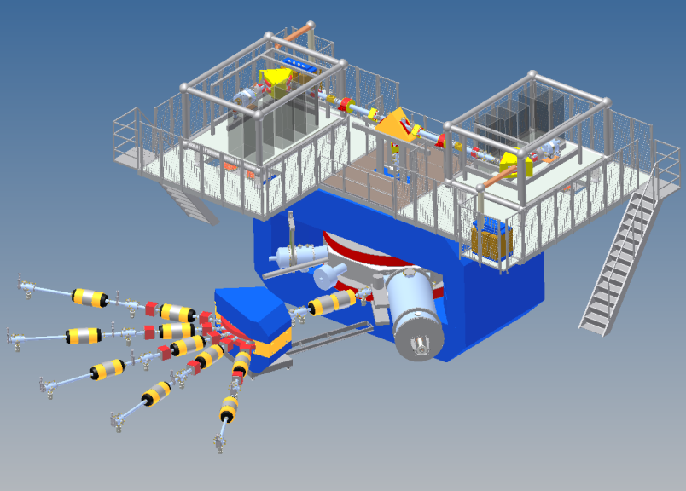
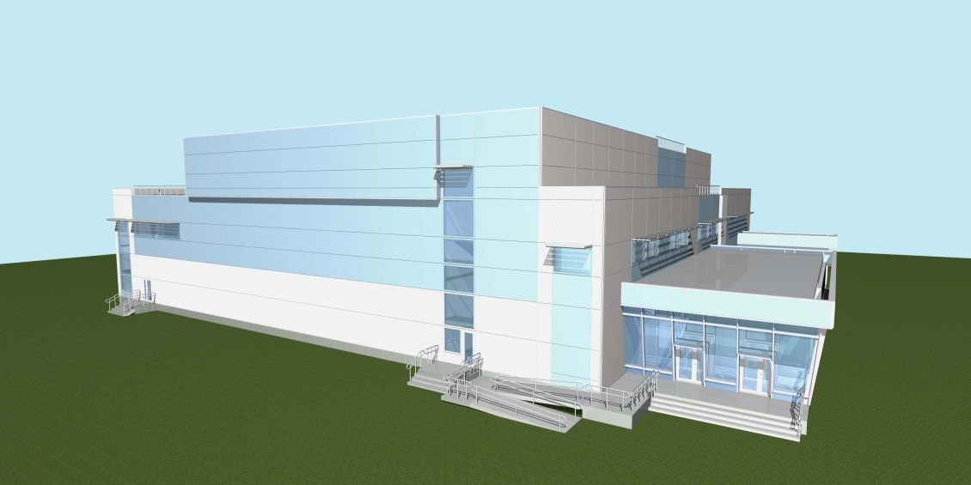
SHE factory:
High-current cyclotron
DC-280
New facilities
New experimental hall
Notes:
The project of the SHE factory includes three principal components: i) high current accelerator, ii) new experimental hall and iii) a number of the next generation facilities.

Slide 50

DC-280 cyclotron – stand-alone SHE-factory
DC-280 (expected) E=4÷8 MeV/A
Ion | Ion energy [MeV/A] | Output intensity
⁷Li | 4 | 1×10¹⁴
¹⁸O | 8 | 1×10¹⁴
⁴⁰Ar | 5 | 6×10¹³
⁴⁸Ca | 5 | 0.6-1.2×10¹⁴
⁵⁴Cr | 5 | 2×10¹³
⁵⁸Fe | 5 | 1×10¹³
¹²⁴Sn | 5 | 2×10¹²
¹³⁶Xe | 5 | 1×10¹⁴
²³⁸U | 7 | 5×10¹⁰
Synthesis and study of properties of superheavy elements.
Search for new reactions for SHE-synthesis.
Chemistry of new elements.

Slide 51
DC-280. Parameters and Goals
 | DC-280 Parameter | Goals
1. | High injecting beam energy (up to 100 kV) | Shift of space charge limits by a factor of 30
2. | Large gap in the center | Space for long spiral inflector
3. | Low magnetic field | Large starting radius. Good separation of orbits. Low deflector voltage
4. | High acceleration rate | Good separation of orbits.
5. | Flat-top system | High capture efficiency. Single orbit extraction. High beam quality.

Slide 52

DC-280 Cyclotron
30 kV
Ion Beam Separation
100 kV
Ion Beam Bending
100 kV
Platform
30 kV
ECR Source
DC280
Cyclotron

Slide 53

3D calculation of DC-280 cyclotron magnetic field
Calculated average magnetic fields
Model of DC-280 cyclotron magnet system
Magnetic field of the radial coils

Slide 54

Flat-Top system
Net effect A₁Sin(ω_{rf} t) + A₂Sin(3ω_{rf} t)
A₂ ≈ 0.1⋅A₁
3F_{rf}
F_{rf}

Slide 55
DC280
Main Parameters
Ion source | DECRIS-4 - 14 GHz DECRIS-SC3 - 18 GHz
Injecting beam potential | Up to 100 kV
A/Z range | 4÷7
Energy | 4÷8 MeV/n
Magnetic field level | 0.6÷1.35 T
K factor | 280
Gap between plugs | 400 mm
Valley/hill gap | 500/208 mm/mm
Magnet weight | 1000 t
Magnet power | 300 kW
Dee voltage | 2x130 kV
RF power consumption | 2x30 kW
Flat-top dee voltage | 2x14 kV

Slide 56

The main magnet of DC-280

Slide 57

DC-280. Vacuum chamber

Slide 58

DC-280. Bending magnet
Notes:
58

Slide 59

DC-280. Water cooling system
Notes:
59

Slide 60

DC-280. Equipment of water cooling system
Notes:
60

Slide 61

Experimental Hall of the SHE-Factory 12.08.2015

Slide 62

Ground floor
Level 0.000 и -0.500
Notes:
62

Slide 63

New FLNR gas-filled separators
“physical”
“chemical”
Reaction | Transmission factor
²⁴⁴Pu(⁴⁸Ca,3n)²⁸⁹114 | 60 %
²⁴⁴Pu(⁵⁸Fe,4n)²⁹⁸120 | 75 %

Slide 64
New experimental set-up - SHELS velocity filter
(Separator for Heavy ELement Spectroscopy)

Slide 65
Modernization of the U400 cyclotron
(Project U-400R)
The U-400 cyclotron has been operating since 1978.
The project of the U-400 cyclotron modernization is developed.
The upgrade will be performed after the completion of the DC-280 cyclotron construction
MAIN PURPOSE
Improvement of the quality and intensity of stable and radioactive beams (⁴⁸Ca – 2.5÷3 pμA ),
Providing a smooth variation of ion energy in the range of 0.8 – 27 MeV/A,
Decrease the consumption of rare isotopes,
Decrease the power consumption from 1 to 0.25 MW.
Cyclotron U400
has been operating since 1979

Slide 66
U400 → U400R
U400R Average Magnetic Field
Radius, m
Radial Distribution of Average Magnetic Field without Trim Coil’s Shimming

Slide 67
Typical ion beam parameters of U400 and U400R
U400
Ion | Ion energy [MeV/u] | Output intensity
⁴ He ¹⁺ | - | -
⁶ He ¹⁺ | 11 | 3⋅10⁷ pps
⁸ He ¹⁺ | 7.9 | -
¹⁶ O ²⁺ | 5.7; 7.9 | 5 pμA
¹⁸O³⁺ | 7.8; 10.5; 15.8 | 4.4 pμA
⁴⁰ Ar ⁴⁺ | 3.8; 5.1 * | 1.7 pμA
⁴⁸ Ca ⁵⁺ | 3.7; 5.3 * | 1.2 pμA
⁴⁸Ca⁹⁺ | 8.9; 11; 17.7 * | 1 pμA
⁵⁰ Ti ⁵⁺ | 3.6; 5.1 * | 0.4 pμA
⁵⁸ Fe ⁶⁺ | 3.8; 5.4 * | 0.7 pμA
⁸⁴Kr⁸⁺ | 3.1; 4.4 * | 0.3 pμA
¹³⁶Xe¹⁴⁺ | 3.3; 4.6; 6.9 * | 0.08 pμA
U400R (expected)
Ion | Ion energy [MeV/u] | Output intensity
⁴ He ¹⁺ | 6.4 ÷ 27 | 23 pμA **
⁶ He ¹⁺ | 2.8 ÷ 14.4 | 10⁸ pps
⁸ He ¹⁺ | 1.6 ÷ 8 | 10⁵ pps
¹⁶ O ²⁺ | 1.6 ÷ 8 | 19.5 pμA **
¹⁶ O ⁴⁺ | 6.4 ÷ 27 | 5.8 pμA **
⁴⁰ Ar ⁴⁺ | 1 ÷ 5.1 | 10 pμA
⁴⁸ Ca ⁶⁺ | 1.6 ÷ 8 | 2.5 pμA
⁴⁸ Ca ⁷⁺ | 2.1 ÷ 11 | 2.1 pμA
⁵⁰ Ti ¹⁰⁺ | 4.1 ÷ 21 | 1 pμA
⁵⁸ Fe ⁷⁺ | 1.2 ÷ 7.5 | 1 pμA
⁸⁴ Kr ⁷⁺ | 0.8 ÷ 3.5 | 1.4 pμA
¹³² Xe ¹¹⁺ | 0.8 ÷ 3.5 | 0.9 pμA
²³⁸ U ²⁷⁺ | 1.5 ÷ 8 | 0.1 pμA

Slide 68

U-400R. Median plane level. Second floor.

Slide 69


Slide 70

U400 U400R Time-schedule
U400 beam switched-on
Hall design
Building
U400 U400R
upgrade
U400R beam switched-on

Slide 71







FLNR (JINR)
Nuclear physics with stable & RI-beams
SHE Factory
U200
Applied
research
IC100
1000m²
1500m²
DRIBs
Nano/Lab
1500m²
DC-280
MT25
Production &
studies of the
exotic nuclei
U400R
upgraded
U400M
&SC ECR
U400R - U400M
Accelerator Complex

Slide 72
THE JINR FLNR HEAVY ION CYCLOTRON
FOR APPLIED RESEARCH AND INDUSTRIAL APPLICATION

Slide 73

Track membrane production technology
Notes:
technology of production of track membranes has been and remains the most popular in industrial use

Slide 74
HEAVY ION ACCELERATORS FOR TRACK MEMBRANE PRODUCTION AND POLYMER MODIFICATION
U-300 Cyclotron
- U-300 was created in D.V. Efremov Institute
- U-300 was in operation at FLNR JINR from 1961 to 1989.
A specialized accelerator channel for polymer film irradiation has been created in the middle of 70ies.
Хе ion beams of 1MeV/nucleon energy were used for manufacture of track membranes and for research tasks.
U-300 Cyclotron (1961-1989)
The track membrane technology has been developed on the basis of heavy particles registration by plastic detectors.
.

Slide 75

HEAVY ION ACCELERATORS FOR TRACK MEMBRANE PRODUCTION AND POLYMER MODIFICATION
FLNR JINR
Cyclotron U-400 (1978)
Beams of Kr, Xe, Bi ions with an energy of 2.5-5 MeV/n are used for track membrane production.
The irradiation chamber provides an opportunity of processing polymer films with a width of up to 60 cm
power consumption - 1500 kW

Slide 76

IMPLANTING CYCLOTRON IC-100
History pages 1985
The first dedicated cyclotron for production of track membranes (nuclear filters)
Energy of ions: ~ 1.2 MeV/nucleon.
Internal source of ions – PIG-type
Accelerated ions:
C - Ar (A/Z = 5.7-6)
Beam intensity of Ar - 1 μA

Slide 77
Reconstruction of IC-100 cyclotron (2001-2002)

Slide 78

Reconstruction of IC-100 cyclotron (2001-2002)

Slide 79
Parameters of the IC-100 cyclotron
 | Parameters | Project | Operation
1 | Accelerated ions | Ar, Kr, Xe | ²²Ne⁺⁴ ⁴⁰Ar⁺⁷ ⁵⁶Fe⁺¹⁰ ⁸⁶Kr⁺¹⁵ ¹²⁷I⁺²² ¹³²Xe⁺²³ ¹³²Xe⁺²⁴ ¹⁸²W⁺³² ¹⁸⁴W⁺³¹ ¹⁸⁴W⁺³²
2 | Mass-to-charge ratio of accelerated ions | A/Z = 5.3 – 6.0 | A/Z = 5.5 – 5.95
3 | Ion energy | 1-1,25 MeV/A | 0,9-1,2 MeV/A
4 | Diameter of the magnet pole | 1 m | 1 m
5 | Average magnetic field | 1.88 – 2.01 T | 1.78 -1.93 T
6 | Frequency of the RF system | 20.4 - 20.9 MHz | 19.8 - 20.6 MHz
7 | Injection energy | 12.5 kV | 14-15 kV
8 | Vacuum in injection channel | 5·10⁻⁷ Torr | 1.5·10⁻⁷ Торр
9 | Working vacuum in cyclotron | 5·10⁻⁷ Torr | 5·10⁻⁸ Torr
10 | Voltage on the dees | 50 kV | 45-55 kV
11 | Intensity of the accelerated and extracted beam of ⁸⁶Kr¹⁵⁺ | ∼10¹² pps (2.5 μA) | 1.4·10¹² pps (3/5 μA)
12 | Intensity of the accelerated and extracted beam of ¹³²Xe²³⁺ | ∼ 2.6·10¹¹ pps (1 μA) | ∼ 10¹² pps (3.7 μA)

Slide 80
Intensity of the accelerated and extracted ion beams
(IC-100 cyclotron, February 2007).
Ion energy: 0.9 -1.2 MeV/nucleon
Element | Ion | A/Z | F_{HF} MHz | Target beam current in the experiments | Maximum beam current
Neon | ²²Ne⁺⁴ | 5.5 | 20.160 | 0.7 μА
Argon | ⁴⁰Ar⁺⁷ | 5.714 | 20.200 | 2.5 μА
Iron | ⁵⁶Fe⁺¹⁰ | 5.6 | 20.240 | 0.5 μА
Krypton | ⁸⁶Kr⁺¹⁵ | 5.733 | 20.200 | 3.5 μА | 3.5 μА
Iodine | ¹²⁷I⁺²² | 5.773 | 20.200 | 0.25 μА
Xenon | ¹³²Xe⁺²³ | 5.739 | 20.180 | 3.7 μА | 3.7 μА
Xenon | ¹³²Xe⁺²⁴ | 5.5 | 20.180 | 0.6 μА
Tungsten | ¹⁸²W⁺³² | 5.6875 | 20.142 | 0.015 μА | 0.015 μА
Tungsten | ¹⁸⁴W⁺³¹ | 5.9355 | 20.142 | 0.035 μА | 0.035 μА
Tungsten | ¹⁸⁴W⁺³² | 5.75 | 20.142 | 0.017 μА | 0.017 μА

Slide 81


Reconstruction of IC-100 cyclotron (2001-2002)

Slide 82

MAIN PURPOSE :
- Education of students.
- Surface modification of standard materials, creation of new materials with required properties.
- Production of track membranes with special properties.
- Creation of micro- and nanostructures.
DC-60 CYCLOTRON
DC-60 is developed and created at FLNR JINR for Research Center of L.N.Gumilev Euroasia State University in Astana, Kazakhstan
Start of the DC-60 project – 2004
Commissioning of the cyclotron - 2006

Slide 83

DC-60 CYCLOTRON: GENERAL VIEW
DC-60 Cyclotron
ECR source
Low Energy Channel
DC-60 Cyclotron
DC-60 Cyclotron
Target Chamber
Analytical Chamber
Film Irradiation Channel
New cyclotron design is based on experience of already developed and operating cyclotrons: U-400, U-400M, CI-100 and DC-72

Slide 84

DC-60 CYCLOTRON

Slide 85


ECR ION SOURCE
DC-60 CYCLOTRON
F | 14 GHz | 18 GHz
W_{total} | 68 kW | 120 kW
B_{inj} | 1.23 T | 1.45 T
B_{min} | 0.46 T | 0.58 T
B_{extr} | 1.04 T | 1.25 T
L_{mirror} | 20 cm | 20 cm
Source length | 40 cm | 40 cm
Source diameter | 44 cm | 44 cm
Plasma chamber diameter | 6.4 cm | 6.4 cm

Slide 86
MAIN PARAMETERS
DC-60 CYCLOTRON
Ion beam injector | ECR ion source (14 GHz) + axial injection system
Magnet pole diameter | 1.62 m
Cyclotron magnetic field Power consumption | 1.45 Т - main mode 1.25 -1.65 Т - magnetic field variation 12 - 45 kW
Correction coils: - radial coils - azimuth coils Total power of correction coils | 5 couples 2 couples ~ 1 kW
RF system: - frequency - harmonic number - dee voltage - RF power | 11.00 - 17.5 MHz 4 and 6 50 kV One amplifier of 20 kW (two coaxial resonators connected in the cyclotron centre)
Pressure in cyclotron vacuum chamber | (1-2)·10 ⁻⁷ Torr

Slide 87
PARAMETERS OF ACCELERATED ION BEAMS
DC-60 CYCLOTRON
Ions | Li - Xe
Mass to charge ratio A/Z | 6 - 12
Energy of accelerated ions | 0.35 - 1.77 MeV/nucleon
Energy spread | 2 %
Discrete change of ion energy | Due to A/Z ratio
Smooth energy variation with respect to nominal energy | -25 % / +25% Due to magnetic field variation
LOW ENERGY ION BEAM PARAMETERS (from ECR)
Ions | He - Xe
Mass to charge ratio (A/Z) | 2 - 20
Ion energy from ECR source | 10 - 20 keV/charge
Energy spread | 0.1 %
Discrete ion energy change | Due to change of A/Z
Smooth ion energy variation | Due to extracted potential variation in ECR source

Slide 88


Track membranes produced at DC-60
December 2006
- Irradiation with ⁸⁴Kr ion beam
- Energy of ions 1.0 MeV/nucleon.
- Full current of the beam – 0.1 μA
- Speed of film transport - 5 cm/sec
- The size of the beam on the target:
Vertical 100 mm
Horizontal 30 mm
- Beam scanning frequency- 100 Hz
PARAMETERS OF A TRACK MEMBRANE
- Film thickness 12 microns
- Pore diameter 0.38 - 0.4 microns
- Pore density 2⋅10⁸ pores/cm²
- Non-uniformity of pore density
across the width and length of the film ±5 %
- Pore axis angle to surface normal 0±15º

Slide 89


All the design parameters of the DC-60 have been achieved. In 2014 the DC-60 accelerator was in operation for experiments for 4,000 hours.
2016 is the 10th year of the DC-60 operation
In December 2015 - planned reconstruction:
- replacement of vacuum equipment
- replacement of the klystrons microwave generator of the ion source with a generator equipped with a traveling-wave tube TWT ~ 1 kW.
- upgrade of the control system.

Slide 90
DC-110 Heavy Ion Cyclotron
for track membrane production
for “BETA” research and industrial complex in Dubna (Russia)
The aim of the project:
Industrial production of track membranes based on polymer films with a thickness of 30 μm.
Requirements to the accelerator:
- accelerated ions: Ar ,Kr ,Xe
- ion energy : 2.5 MeV/nucleon (fixed),
- intensity: ~ 1 pμA ( 6⋅ 10¹² pps)
The equipment must be simple and reliable.
Operating time in the mode of film irradiation - 7000 hours/year
Project start: August 2009.
Commissioning: 2012.

Slide 91
Main parameters of DC-110 cyclotron.
ACCELERATED IONS | ⁸⁶ Kr ¹³⁺ | ¹³² Xe ²⁰⁺ | ⁴⁰ Аr ⁶⁺
Mass to charge ratio of ions A/Z | 6.615 | 6.60 | 6.667
Ion energy | 2.5 | 2.5 | 2.5
Beam intensity, pps | 6⋅10¹² | 3⋅10¹² | 6⋅10¹² (*)
MAGNETIC SYSTEM
Pole diameter, m | 2
Average magnetic field B_{о}, [T] | 1.670 | 1.666 | 1.6830
Increasing average magnetic field at final radius ΔB,[Gs] | 45 | 45 | 45
RF SYSTEM
Ion revolution frequency, F_{ion}, [MHz] | 3.877 | 3.877 | 3.877
Acceleration harmonic number | 2 | 2 | 2
Frequency of RF system, F_{RF} , [MHz] | 7.754 | 7.754 | 7.754
ION SOURCE | ECR, 18 GHz
EXTRACTION SYSTEM | Electrostatic deflector

Slide 92

DECRIS-5 - ECR ion source of the DC-110 cyclotron
(18 GHz, copper coils)
The maximum intensity of ion beams
Charge | 8+ | 9+ | 11+ | 15+ | 18+ | 19+ | 20+
Ar | 1200 | 750 | 300
Kr |  |  |  | 325 | 182 | 120 | 70
Xe |  |  |  |  |  |  | 220

Slide 93
Ion beam parameters of the DC-110 cyclotron
Optimal frequency values of the RF system and the magnetic field during
acceleration of ⁴⁰Ar⁶⁺, ⁸⁶Kr¹³⁺ and ¹³²Xe²⁰⁺ ions.
Ion | Mass to charge ratio (A/Z) | Cyclotron magnetic field, T | Acceleration harmonic | RF generator frequency, MHz | Frequency difference, ΔF,
⁴⁰Аr ⁶⁺ | 6.6667 | 1.6612 | 2 | 7.653 | 23 kHz
⁸⁶Kr¹³⁺ | 6.6154 | 1.6612 | 2 | 7.712 | -18 kHz
¹³²Хе²⁰⁺ | 6.6000 | 1.6612 | 2 | 7.730 | 0 kHz
Experimental beam parameters of the DC-110 cyclotron obtained after completion of start-up works
Ion | Beam intensity from ECR source, μA | Accelerated and extracted beam intensity, μA |  | Ion energy, MeV/nucleon
 |  | design | obtained result
⁴⁰Аr ⁶⁺ | 94 | 6 | 13 | 2.5
⁸⁶Kr¹³⁺ | 150 | 13 | 14.5 | 2.5
¹³²Хе²⁰⁺ | 190 | 10 | 10.9 | 2.5

Slide 94





DC-110 dedicated heavy ion cyclotron developed and created at the Flerov Laboratory of Nuclear Reactions of the Joint Institute for Nuclear Research for the BETA research and industrial complex in Dubna (Russia)
December 29, 2012
first samples of track membranes were received
Photo of membrane on the electron microscope. Pore density - 1.32 ⋅10⁸ pores/cm2.
Magnification of 30,000 times
Spot of ¹³²Xe²⁰⁺ beam on luminophor
Facility for polymer film irradiation

Slide 95

Testing of electronic devices at FLNR cyclotron beams
The Russian Space Agency (Roscosmos) carries out investigations of single-event effects (SEE) in electronic devices using ion beams of U-400 and U400M.
U400 cyclotron delivers beams of ions with atomic masses of 4÷209 at energies of 3÷20 MeV/nucleon.
U400M cyclotron was intended for acceleration of ion beams in two modes:
- high energy ion acceleration mode - 19–53 MeV/nucleon (mass to charge ratio of accelerated ions A/Z = 2.8 – 5),
- low energy ion acceleration mode - 5–10 MeV/nucleon (mass to charge ratio of accelerated ions A/Z = 7– 10).
Now, ions of O, Ne, Ar, Fe, Kr, Xe, Bi with an energy of 3÷6 MeV/nucleon
and ions from C up to Xe with energies from 25 to 53 MeV/nucleon
are available for experiments of testing the electronic devices at 4 beam channels of U-400 and U-400M.
U-400M U-400

Slide 96

Ion Beam Line for SEE Testing
Bending magnet
TOF energy measurement sensors, L=1.602 m. Accuracy ≈ 1%
X-Y correction magnets
Faraday cup
Vacuum gate valve
Luminophore drive
X-Y scanning system (50 Hz)
Test chamber
Turbo molecular pumps
Ta foils (5-27 μm ) drive)

Slide 97


Test chamber and user diagnostic equipment

Slide 98
Flerov Laboratory of Nuclear Reactions
NEW
cyclotrons
for applied research

Slide 99

New building of the nanotechnology Center
This year the construction of a new nanotechnology center in the Laboratory of nuclear reactions was completed

Slide 100

The equipment in the new building of the nanotechnology Center

Slide 101


The equipment of the nanotechnology Center
Scanning electron Microscope (resolution 1.3 nm)
Scanning electron Microscope (resolution 6 nm)

Slide 102
New nanotechnology center requires
a new specialized accelerator

Slide 103
The U-200 Cyclotron
In 1968 the U-200 was put into operation in the FLNR. In 2013 it was decommissioned, because of being outdated physically and technologically.
Parameters of U-200:
Diameter of the magnet pole – 2 m
Internal ion source of PIG type
Accelerated ions – He – Ar
The ion energy 3 -18 MeV/nucleon
The project of modernized U-200M cyclotron
The programme of applied research that is performed at the FLNR cyclotron IC-100, U-400, U-400M takes approximately 6000 hours of accelerator operation.
Main tasks for U-200M:
- research in the field of solid state physics,
- production of track membranes,
- testing of electronic components,
- the production of radioactive isotopes with He beam.
Technical characteristics of U-200M: - range of ions from helium to uranium,
- external beam injection from ECR ion source,
- mass-to-charge ratio of the accelerated ions: 4 - 8
- ion energy : 1.5 to 6.5 MeV/nucleon.
Physical installations:
- installation for scientific and applied research,
- facility for irradiation of polymer films,
- installation for testing of electronic components,
- installation for the production of radioisotopes.

Slide 104


The U-200M Cyclotron
Ion beam injector | ECR (18 GHz) ion source + axial injection system
Pole diameter of magnet | 2 m
Cyclotron magnetic field | 1.65 Т
RF system: frequency harmonic number dee voltage | 12.7 ÷ 6.3 MHz 2 and 4 50 kV
Pressure in cyclotron vacuum chamber | 1÷2·10 ⁻⁷ Torr

Slide 105
Reconstruction of the U-200 cyclotron into U-200M
Accelerated ion beam parameters
Beam parameters of U-200
Internal ion source of PIG type
Ion | E/A, MeV/n | Intensity of the accelerated beam, μA
³Не¹⁺ | 16 | 5*
(DН)¹⁺ | 16 | 1*
⁴Не¹⁺ | 9 | 330*
(DD)¹⁺ | 9 | 10*
¹²C²⁺,¹²C³⁺, ¹²C²⁺ | 4-16 | 10-30
¹⁴N²⁺,¹⁴N³⁺, ¹⁴N⁴⁺,¹⁴N⁵⁺ | 3-18 | 6-30
¹⁶O³⁺,¹⁶O⁴⁺, ¹⁶O⁵⁺ | 5-14 | 6-13
²⁰Ne⁴⁺,²⁰Ne⁵⁺ | 5-9 | 0,5-6
⁴⁰Ar⁷⁺,⁴⁰Ar⁸⁺ | 4,5-5,8 | 0,07
* - limit due to biological shielding
Beam parameters of U-200M cyclotron
External superconducting ECR ion source (18 GHz)
Ion | A/Z | E/A, MeV/n | E, MeV | Intensity from ECR source , μA | Intensity of the accelerated beam, μA
⁴Не¹⁺ | 4 | 6,4 | 25,6 | >1000 | 50
¹²C²⁺ | 6 | 2,8 | 33,6 | >200 | 20
¹⁴N²⁺ | 7 | 2,1 | 29,1 | >500 | 30
¹⁶O²⁺ | 8 | 1,6 | 25,6 | >500 | 30
Ne, Ar, Kr
¹³²Xe¹⁵⁺ | 5,28 | 3,6 | 482 | 200 | 15
¹³²Xe¹⁷⁺ | 7,76 | 1,7 | 223 | 200 | 15
¹³²Xe²⁰⁺ | 6,6 | 2,3 | 308 | 150 | 15
²⁰⁹Bi²⁶⁺ | 8,04 | 1,6 | 329 | 20 | 2
²⁰⁹Bi³⁰⁺ | 6,97 | 2,1 | 438 | 15 | 1,5
²³⁸U³⁰⁺ | 7,93 | 1.6 | 380 | 10 | 1
²³⁸U³²⁺ | 7,44 | 1.8 | 428 | 5 | 0,5

Slide 106

Equipment-set of the U-200M
Equipment from U-200 cyclotron:
The yoke of the magnet
Vacuum chamber (?)
Infrastructure (premises, biological shielding, ....)
Equipment from IC-100 cyclotron:
Superconducting ECR ion source and an axial injection system.
RF generators.
Power system and control system.
Water cooling system.
Vacuum system.
Channel for irradiation of polymer films.
New equipment:
RF resonators and dees.
Magnetic structure (poles, sectors, correcting coils)
electrostatic beam extraction system.
Beam channel and installation for applied research.
Beam channel of low energy ions from ECR ion source.
Beam channel and installation for testing of electronic components
Layout of
the U-200M cyclotron
U-200М
IC-100

Slide 107
FLNR, JINR
Nuclear physics with stable & RI-beams
SHE Factory
U200
U-200M
Applied
research
IC100
1000m²
1500m²
DRIBs
Nano/Lab
1500m²
DC-280 new
MT25
Production &
studies of the
exotic nuclei
U400R
upgraded
U400M
&SC ECR
U400R - U400M
Accelerator Complex

Slide 108

THANK YOU
FOR YOUR
ATTENTION !
Flerov Laboratory of Nuclear Reactions, JINR

Slide 109
Efficiency of transporting a ⁴⁸Ca⁵⁺ beam from the ECR source to a physical target
Measuring point | Beam intensity |  | Ion | Transmission factor
ECR source, after separation | 1⋅10¹⁴ pps | 84 μAe | ⁴⁸Ca⁵⁺ | 32% |  |  |  | 8.5%
Cyclotron centre | 3.5⋅10¹³ pps | 27 μAe | ⁴⁸Ca⁵⁺ |  | 81%
Extraction radius | 2.8⋅10¹³ pps | 22 μAe | ⁴⁸Ca⁵⁺ |  |  | 40%
Extracted beam (by charge exchange) | 9.7⋅10¹² pps | 28 μAe | ⁴⁸Ca¹⁸⁺ |  |  |  | 82%
Target | 8⋅10¹² pps | 23 μAe | ⁴⁸Ca¹⁸⁺
Ionization efficiency of ⁴⁸Ca (neutral) to ⁴⁸Ca⁵⁺ - about 10%
Transformation of ⁴⁸Ca as working substance into the ⁴⁸Ca beam on target is about 1% in routine operation.

Slide 110
Сравнение интенсивности ускоренного пучка ионов ⁴⁸Са⁵⁺ на циклотроне У-400 с внутренним источником ионов типа PIG и внешним ECR источником
Циклотрон У-400 ЛЯР ОИЯИ, 1996 г.
⁴⁸Ca⁵⁺
PIG: I ~ 0.1 pμA, расход 4 ÷ 15 мг/час
ECR: I ~ 1 pμA, расход 0.4 ÷ 0.5 мг/час

Slide 111

Heavy Ion Beam Extraction by Stripping Foil
The method of heavy ion beam extraction from AVF cyclotrons suggested by G.N. Vialov, G.N. Flerov and Yu. Oganesyan in 1964
¹⁴N⁺² → ¹⁴N⁺⁷
Thickness of stripping foil – 20 -200 μg/cm²

Slide 112


The method of heavy ion beam extraction from AVF cyclotrons by charge exchange on thin foils was suggested by G.N. Vialov, G.N. Flerov and Yu.Ts. Oganessian in 1964 [1]
Academician of the RAS G.N. Flerov
Academician of the RAS Yu.Ts. Oganessian
[1] G.N. Vialov, G.N. Flerov, Y.Ts. Oganessian.. JINR Preprint №1884, Dubna, 1964
Notes:
azimuthally-varying-field (AVF) cyclotrons.

Slide 113
Heavy Ion Beam Extraction by Stripping Foil
Charge spread
Ion beam extraction by stripping foil at U-400 cyclotron.

Slide 114
Heavy Ion Beam Extraction by Stripping Foil
The method of heavy ion beam extraction from AVF cyclotrons suggested by G.N. Vialov, G.N. Flerov and Yu. Oganesyan in 1964
¹⁴N⁺² → ¹⁴N⁺⁷
Thickness of stripping foil – 20 -200 μg/cm²
Notes:
The beam passes the stripping foil, the ions change their charge, for example, from nitrogen two plus into nitrogen seven plus , beam loses orbital stability and leaves the acceleration zone.
But after the Stripping foil, spectrum of ion charges is formed, which completely determines efficiency of extraction.

