Slide 1




EUROPEAN UNION
GOVERNMENT OF ROMANI
Structural Instruments
2007-2013
Sectoral Operational Programme
„Increase of Economic Competitiveness”
“Investments for Your Future”
Extreme Light Infrastructure – Nuclear Physics (ELI-NP)
Project co-financed by the European Regional Development Fund
ELI-NP Project : Nuclear Physics with Lasers
Florin Negoita for ELI-NP team

Slide 2

Extreme Light Infrastructure
2006 – ELI on ESFRI Roadmap
ELI-PP 2007-2010 (FP7)
  ELI-Beamlines (Czech Republic)
  ELI-Attoseconds (Hungary)
  ELI-Nuclear Physics (Romania)
  EU Competitiveness Council December 2009
  Total investment: ~ 1 Billion Euro
  (mainly European Structural Funds)
ELI-DC (Delivery Consortium):
Czech Republic, Hungary, Romania,
Italy, Germany, UK

Slide 3

ELI – Nuclear Physics
two 10 PW lasers,
output energy higher than 250 J, ~25 fs,
intensity higher than 10²³W/cm²
the most brilliant γ beam, <19.5 MeV, BW:~10⁻³
produced by Compton scattering on a 720 MeV
electron beam (LINAC)

Slide 4
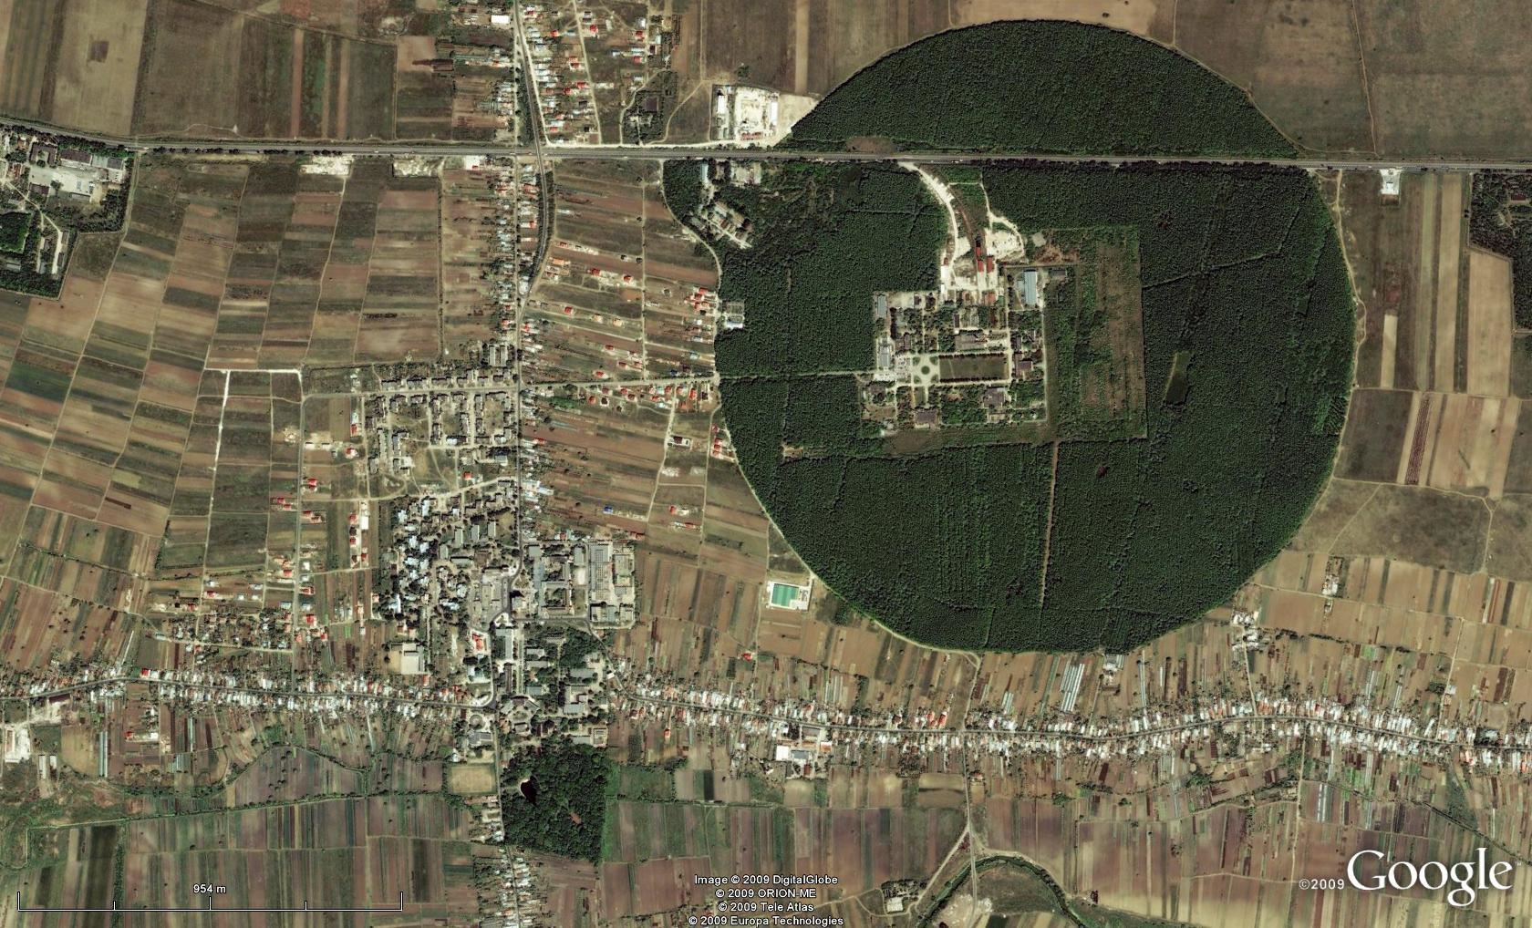
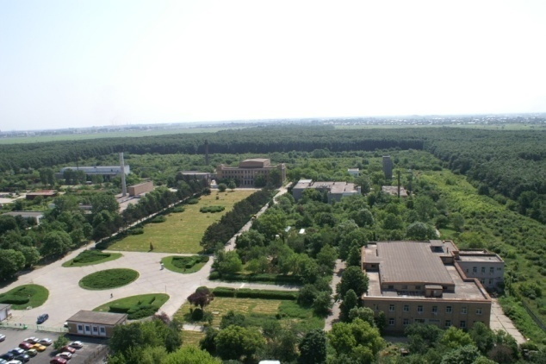
Bucharest-Magurele
National Physics Institutes
IFIN-HH
Tandem accelerators Cyclotrons
γ – Irradiator
Advanced Detectors
Biophysics
Environmental Physics
Radioisotopes
BUCHAREST
ring rail/road
ELI-NP
Lasers
Plasma
Optoelectronics
Material Physics
Theoretical Physics
Particle Physics
Information Technologies
ELI-NP

Slide 5
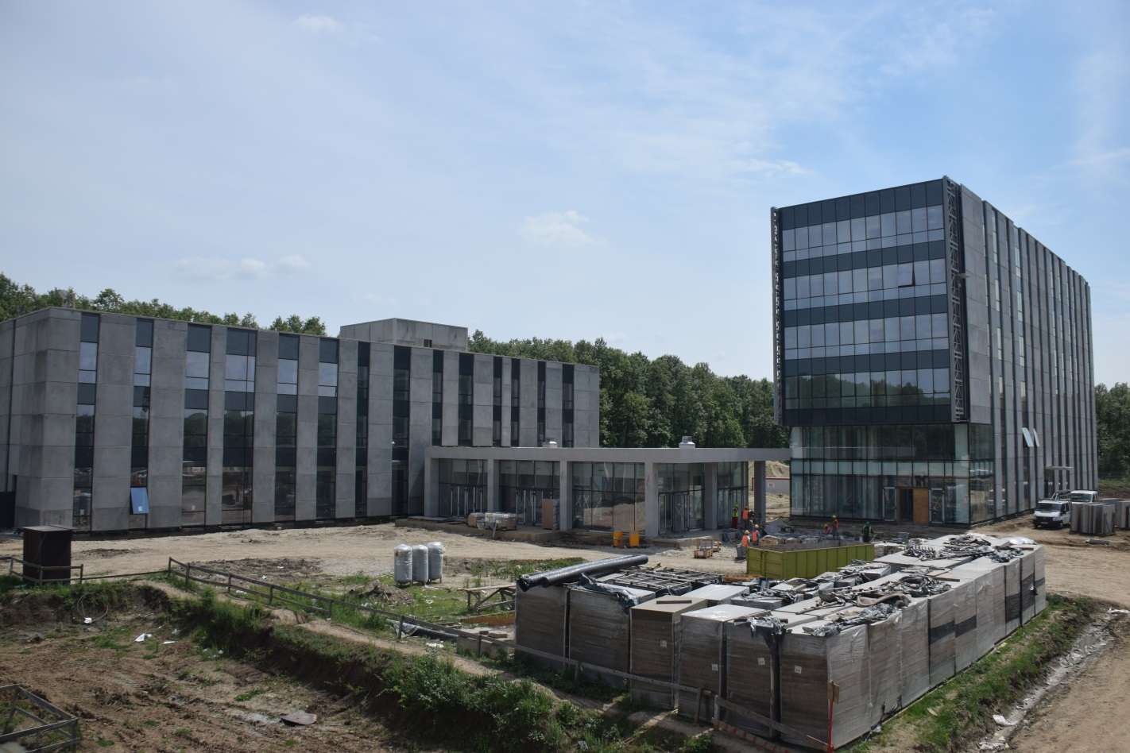
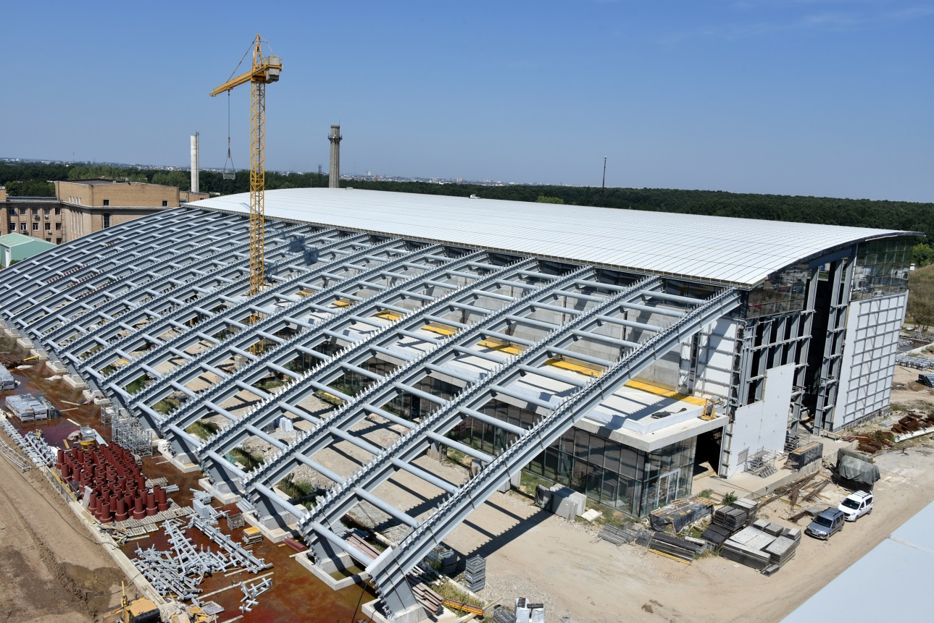
EL-NP Buildings, 33000 m² total
Experimental area,
Office building,
Guest house,
Canteen
Building to be ready
in June 2016

Slide 6

Timelines and Human Resources
2015: Design Reports for experiments
End 2015: Construction of buildings completion
2016-2018: Lasers and Gamma Beam System instalation
2019: Start operation
See http://www.eli-np.ro/jobs
for open positions
Technical Staff (18)
Eng. Staff (18)
PhD students (50)
Jr. researchers (107)
Senior researchers (20)
Head of Res. Activities (5)
2013 2014 2015 2016 2017 2018 2019

Slide 7
Content
1. Introduction (done)
2. ➢ ELI-NP Gamma Beam System
➢ Nuclear Physics with Gamma beam (and applications)
3. ➢ ELI-NP High Power Laser System
➢ Particle (Electron and Ion) acceleration with lasers
➢ Nuclear Physics with Lasers (and applications)
➢ High Fields Physics and QED

Slide 8
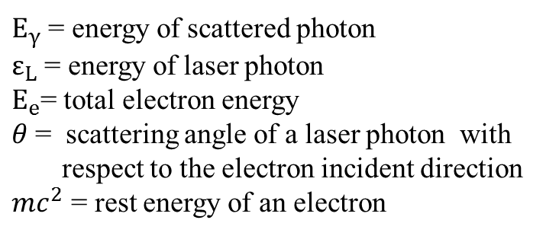
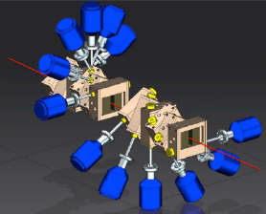
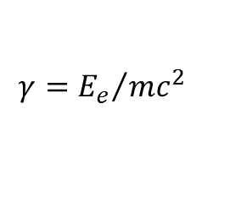

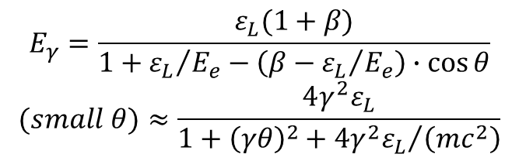
Laser Compton Scattering (LCS) gamma source
The γ ray beams are produced by the inverse Compton scattering of laser photons from relativistic electrons.
$$E_{γ}=\frac{ε_{L}(1+β)}{1+{ε_{L}}/{E_{e}}−\left(β−{ε_{L}}/{E_{e}}\right)∙\cos{θ}}$$
$$(small θ)≈\frac{4γ^{2}ε_{L}}{1+{\left(γθ\right)}^{2}+{4γ^{2}ε_{L}}/{\left(mc^{2}\right)}}$$
$$E_{γ}\sim 4γ^{2}ε_{L}$$
$$γ={E_{e}}/{mc^{2}}$$
Collimator to
select only
highest energies

Slide 9
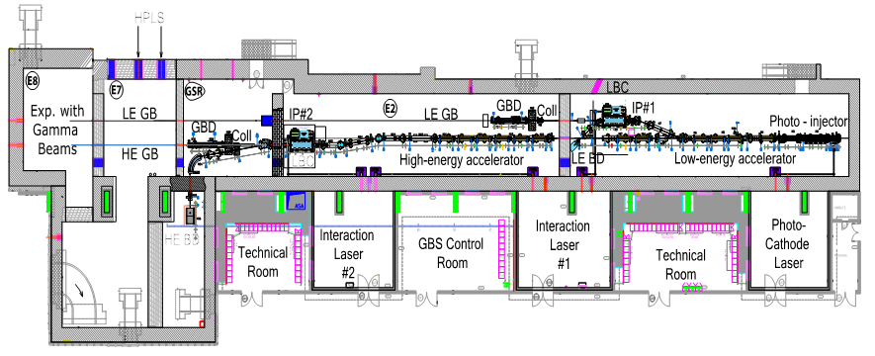
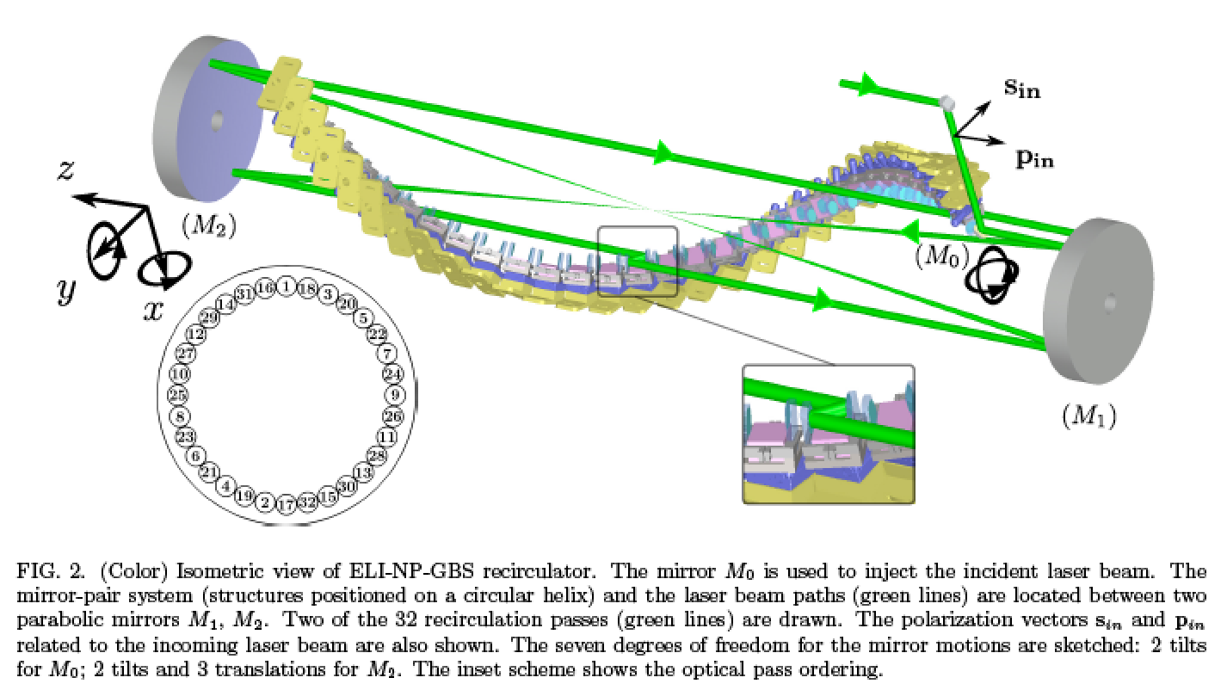
ELI–NP Gamma Beam System
E_{e} max. 720 MeV
E_{γ} max. 19.5 MeV
E_{e} max. 300 MeV
E_{γ} max. 3.5 MeV
Interaction lasers : 2 J / 1 ps @ 100 Hz
Spot size corresponds to max. energy
Laser Recirculator (Mirror system) with 32 passes

Slide 10
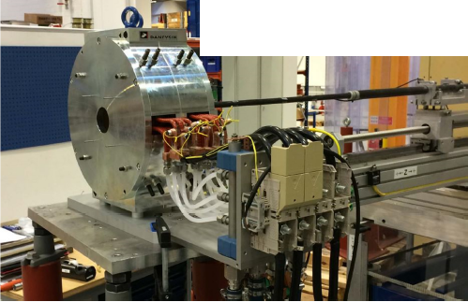
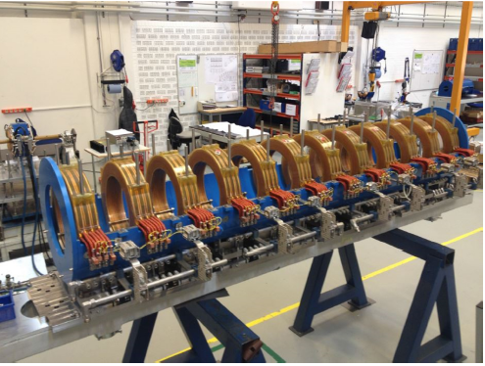
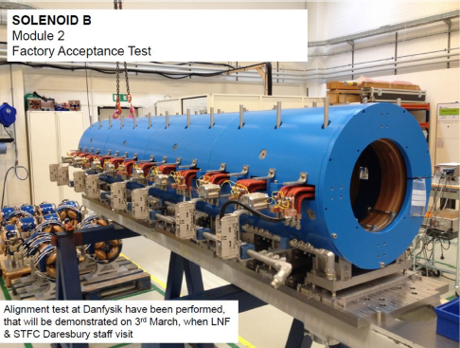
ELI–NP Gamma Beam System

Slide 11
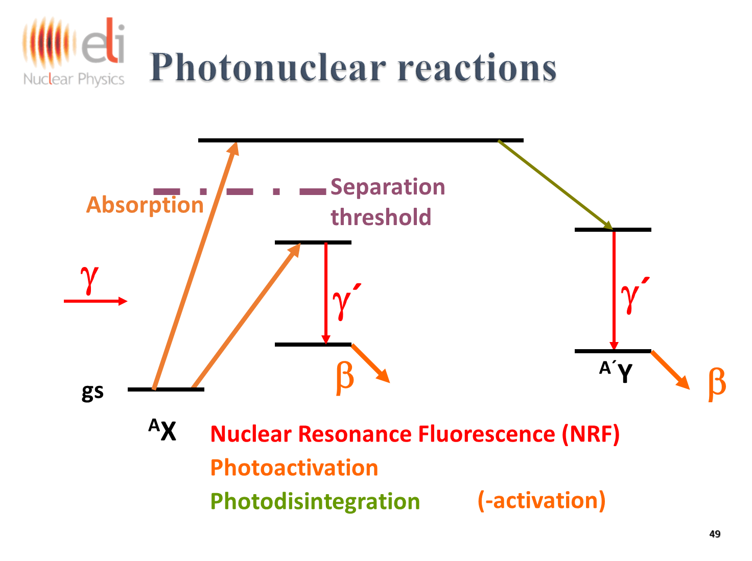
Photonuclear reaction with gamma beam
ELIADE array: 8 segmented HPGe Clover detectors @ 90° and 135° with anti-Compton shields + 4 LaBr3 detectors @ 90°

Slide 12
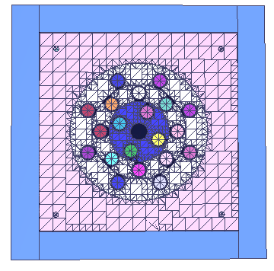
Gamma Above Neutron Threshold
Photonuclear reactions play a fundamental role in nucleosynthesis and accurate cross sections for (γ,n) reactions are needed.
Understanding PDR and GDR
through measurement of the
absolute values of B(E1)
and B(M1) for E* ≥ EB
and of the absolute values
of the neutron and γ branching
ratio

Slide 13
Photonuclear reaction
with charge particle emission

Slide 14
High energy resolution
studies of photo-fission
An array of 12 modules of
Thick Gas Electron Multipliers
(ThGEM)
Ionization chambers with strip silicon detectors

Slide 15
IGISOL facility at ELI-NP
Beam purification
in magnetic separators needed

Slide 16
Gamma Beam Application:
Isotope Identification through NRF
Scattering method
Transmision method

Slide 17
Gamma Beam Application:
Production of Radioisotopes
Photonuclear reactions with γ beams allow to produce certain radioisotopes,
47Sc, 44Ti, 67Cu/(64Cu), 103Pd, 117mSn, 169Er, 195mPt , 225Ac, 99Mo (99mTc), 111In
with higher specific activity and/or more economically than with classical methods.
New path for production of 99Mo/99mTc form 100Mo (~7% abundance):
99mTc is the most used
isotope (in SPECT)
accounting for ~80%
of all nuclear medicine
diagnostic procedures

Slide 18
Gamma Beam Application: Positron Source

Slide 19
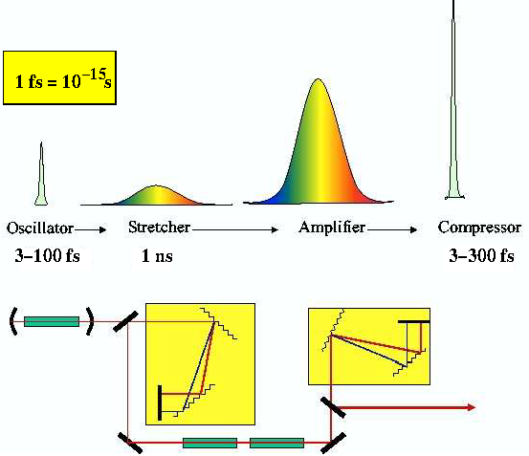
Amplification of Ultra-Short Laser Pulses
Chirped Puls Amplification (CPA):
- very short laser pulse → large bandwidth (30 fs: ca. 30 nm)
- direct amplification: would lead to destruction of amplifier medium
→ peak pulse intensity needs to be reduced
- pulse is stretched in time
by dispersive delays (gratings)
amplification
compression by reversed delay
amplifier medium
input
energy
output
energy
Stored energy
G. Mourou, D. Strickland
Optics Comm. 56, (1985) 219

Slide 20
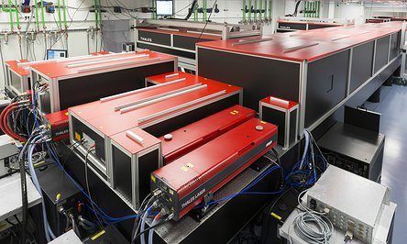
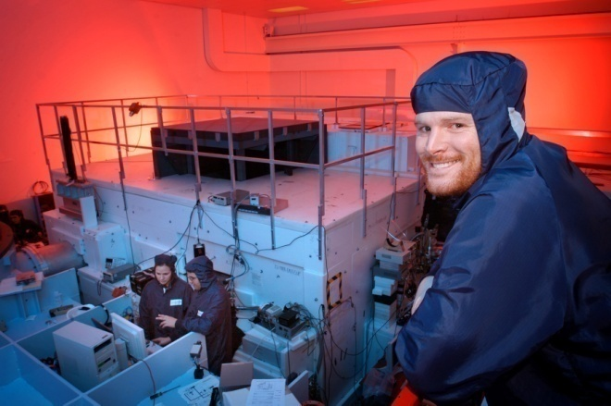
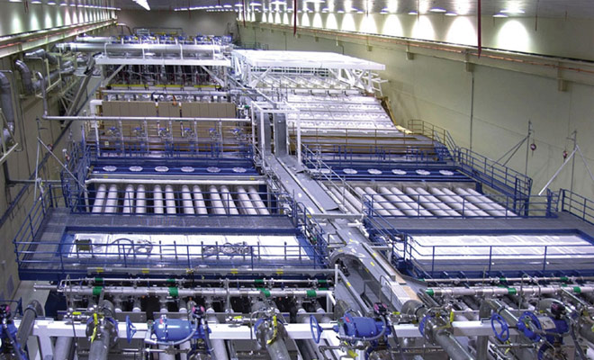
PW Lasers
( only ~W in average)
decrease the pulse duration or increase the pulse energy:
fs - Ti:Sapphire systems
→ CETAL (Magurele):
- 5-30J, 5-30fs ⇒ 1 PW
- high rep-rate: ~ 1 Hz
- compact
- low energy content
other: Dresden, JAERI,
KAERI, Hercules, Paris,
….
sub-ps Nd:glass systems
Vulcan (RAL/UK):
- 500J, 500fs ⇒ 1 PW
- med. rep-rate:
~ 1 shot per hour
- large
- medium energy content
other: PHELIX (GSI), Trident (Los Alamos),
Texas-PW (Austin) …
ns - Nd:glass systems
→ NIF (LLNL/US):
- 4MJ, 4ns ⇒ 1 PW
- low rep-rate:
<3 shots per day
- very large
- high energy content
- other:
LMJ (Bordeaux),
Omega (Rochester),…

Slide 21
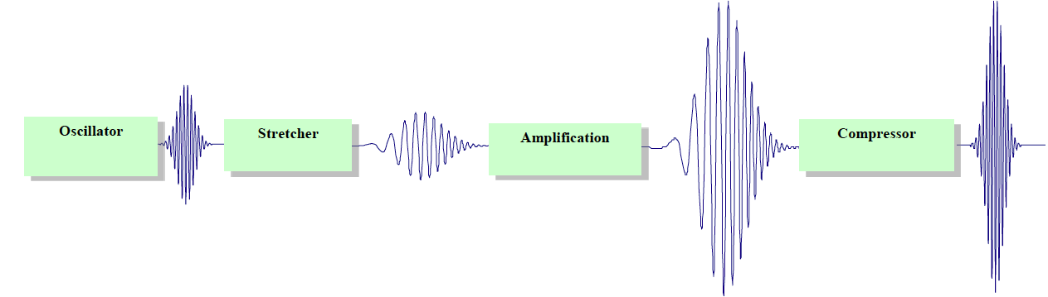
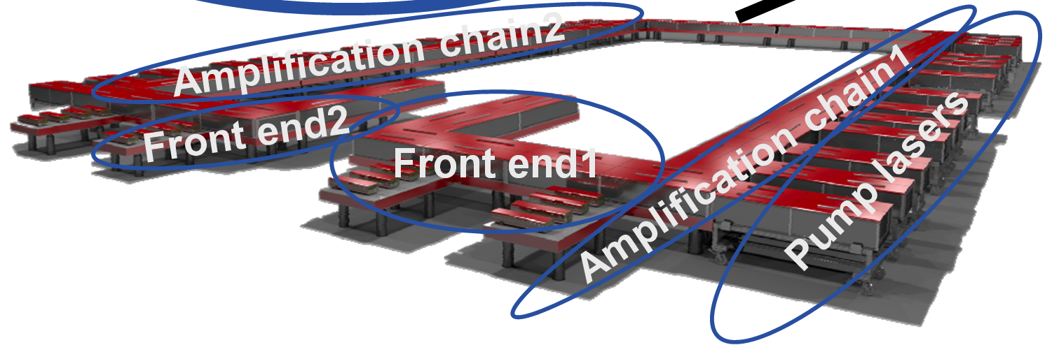
ELI–NP High Power Laser System
2 x 0.1 PW 10Hz
2 x 1 PW 1 Hz
2 x 10 PW 0.1 Hz
THALES – France
THALES - Romania
2013-2018
Based on the principle of OPCPA
to compressors

Slide 22
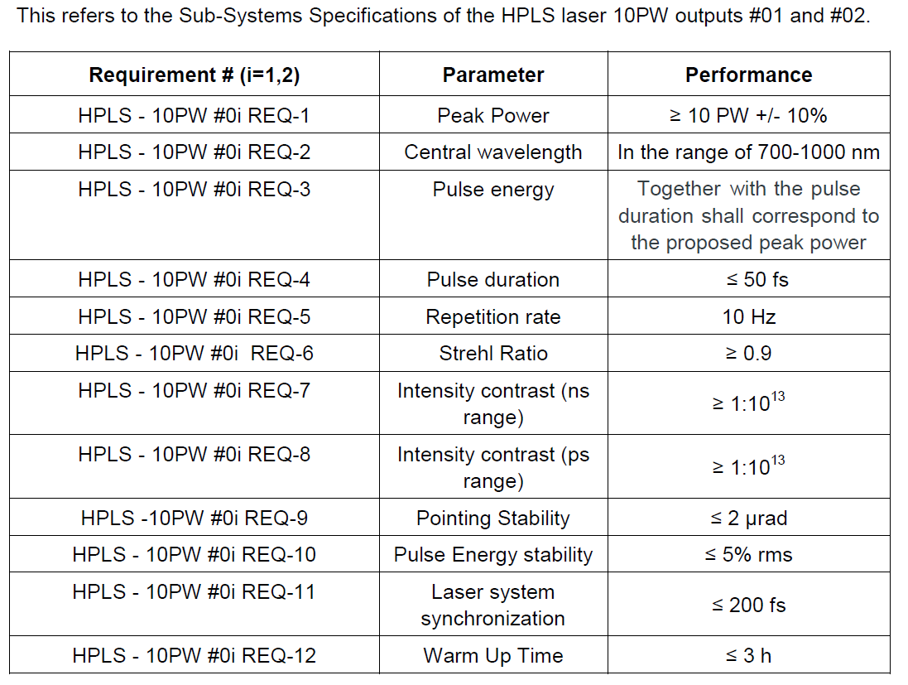
HPLS Specs
~ 250 J
~ 25 fs

Slide 23
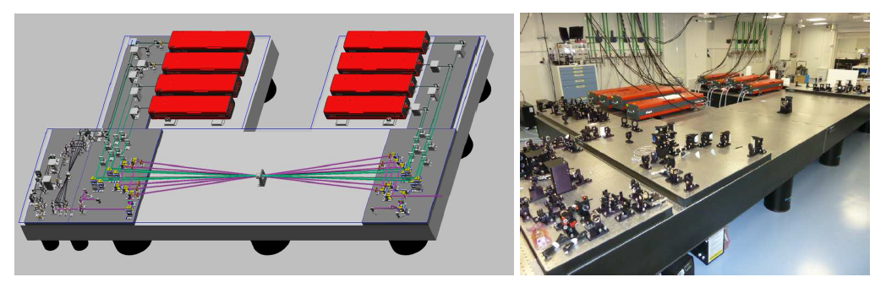
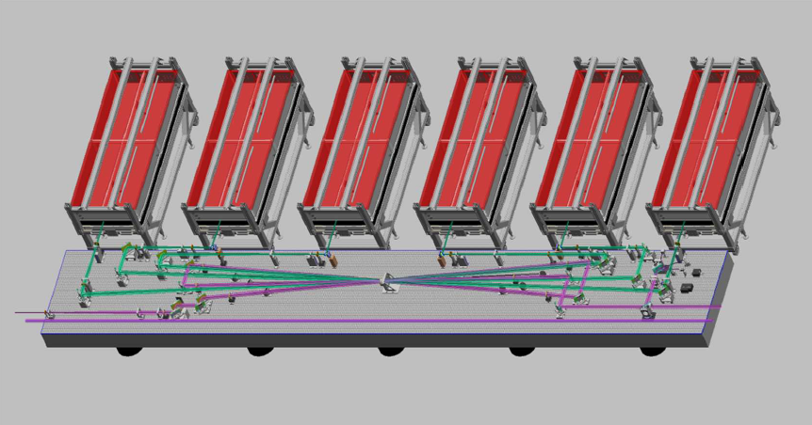
HPLS
100 TW Amp.
8 SAGA HP Pump
Lasers
(16 SAGA total)
1 PW Amp.
6 GAIA HP Pump
Lasers
(12 GAIA total)

Slide 24
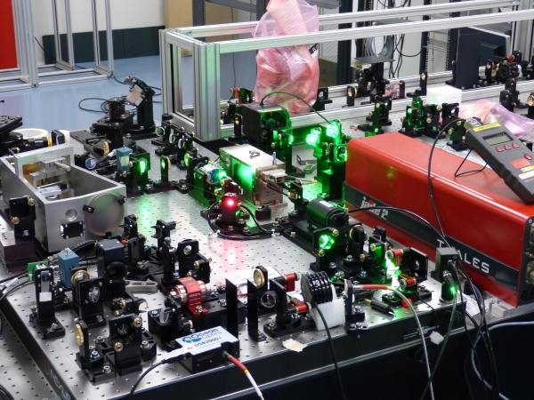
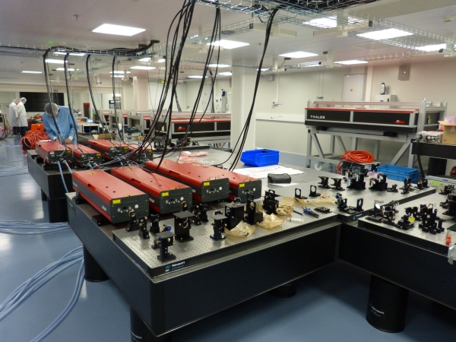
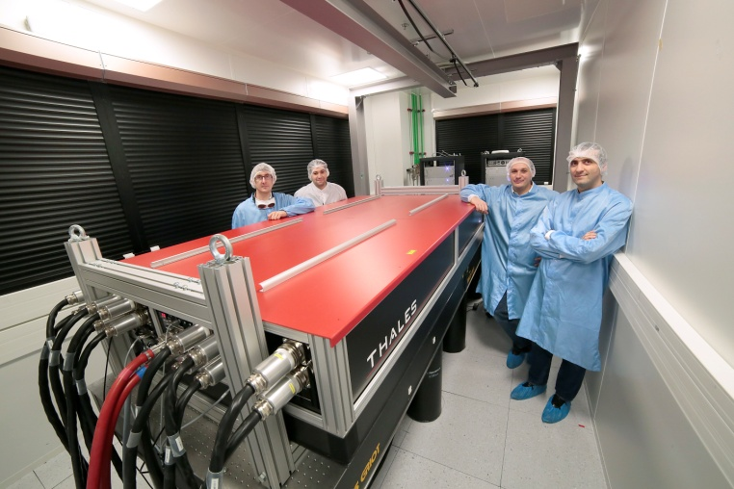
High Power Laser System

Slide 25
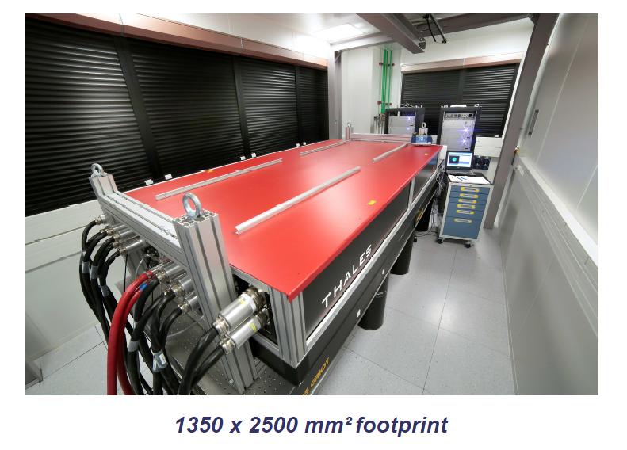
HPLS – Atlas 100 Pump Laser
AMP 3 – 10PW:
- 8 ATLAS 100 Pump Lasers (16 ATLAS total/32 PS)

Slide 26
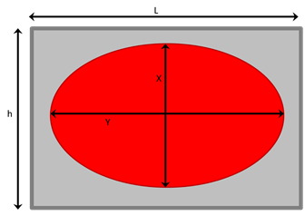
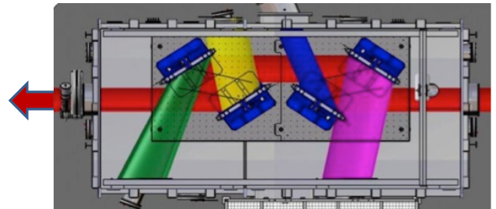
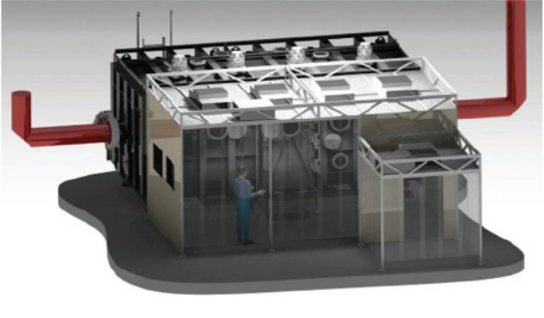
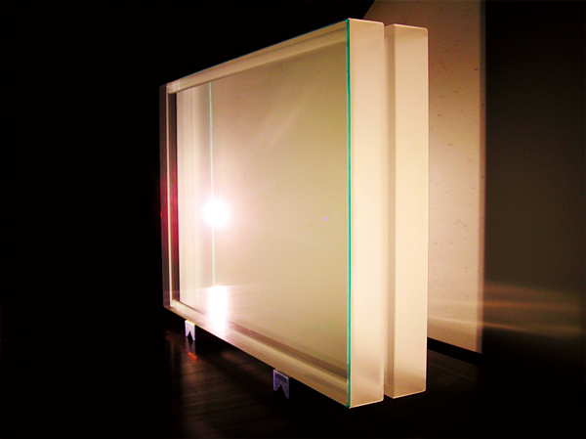
10 PW Compressor chamber and Transport Mirrors
L
H
Flat mirrors 650mm x 880mm
Weight: about 300 kg
Cost: about 200.000Eur.
with motors: 400.000Eur

Slide 27
High power laser pulses:
definitions and orders of magnitude
1- Time scales
Laser wave period for 1 eV (λ∼1µm) photons: T = 4.10⁻¹⁵ s = 4 fs
Pulse duration (for ELI-NP) ΔT = 25 fs ( about 6 periods)
Bohr orbital electron period τ= 4 10 ^{–17} Z⁻² s (Al: 0.02 fs; Ca:0.01fs)
2 - Electric field scales
Intra-nuclear electric field: F_{n} = 10¹⁹ V/cm
Binding electric field in hydrogenoid atom F_{e} = (Z³ /n²) 2.7 10⁹ V/cm
₁₃Al F_{e} ~ 6 10¹² V/cm ₂₀Ca F_{e} ~ 2 10¹³ V/cm
Laser wave electric field as a function of the intensity: F_{l} = 13.7 I ^{0.5}
I (W/cm²) 10¹⁴ 10²⁰ 10²² 10²⁴ 10²⁶
F₁(V/cm) 10⁸ 10¹¹ 10¹² 10¹³ 10¹⁴
10 PW/1 µm²
normalized laser amplitude
a₀= eA / m_{e}c²

Slide 28
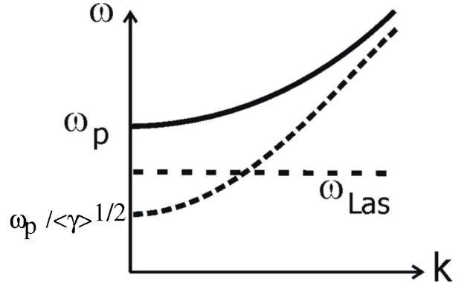
Relativistic Laser-Plasma Interaction
focussed laser intensities > 10¹⁹ W/cm² :
- target material ionizes, turns into plasma
- laser accelerates target electrons
induced transparency:
laser light propagates in plasma:
- dispersion relation
- plasma frequency
n_{e}: electron density
dense plasma (ω < ω_{p}) : light cannot propagate, is reflected from the surface
- relativistic intensities: <γ> can be large
→ plasma becomes transparent
Notes:
- Electrons can reach relativistic regime: I> 10^18 W/cm2
Relativistic mass increases by factor gamma
Plasma frequency reduced in relativistic regime by sqrt(gamma)
→ dense plasma: opaque for laser, cannot propagate, reflected : when omega_las < omega_p
→ after reduction: omega_laser > omega_p’ → relativistic transparency
if the e-m-oscillations are faster than the plasma oscillations (omega_p!) can react to their presence, the plasma charges cannot rearrange fast enough to shield the plasma volume from the outer field → field can penetrate
If the e-m-oscillations are slower than the rearrangement time of the plasma charges, the wave is shielded from the inside. Energy conservation demands that the wave must be reflected.
reverse argumentation: for a given omega , the wave can only propagate inside a
plasma with a density smaller than n_crit:
n_e < (omega^2 epsilon_0 m_e)/e^2 =: n_crit
n_crit is called critical density (at a given frequency)
n_e < n_crit is called ”underdense“ : wave can only propagate in underdense plasma with undercritical electron density
n_e > n_crit is called ”overdense“

Slide 29
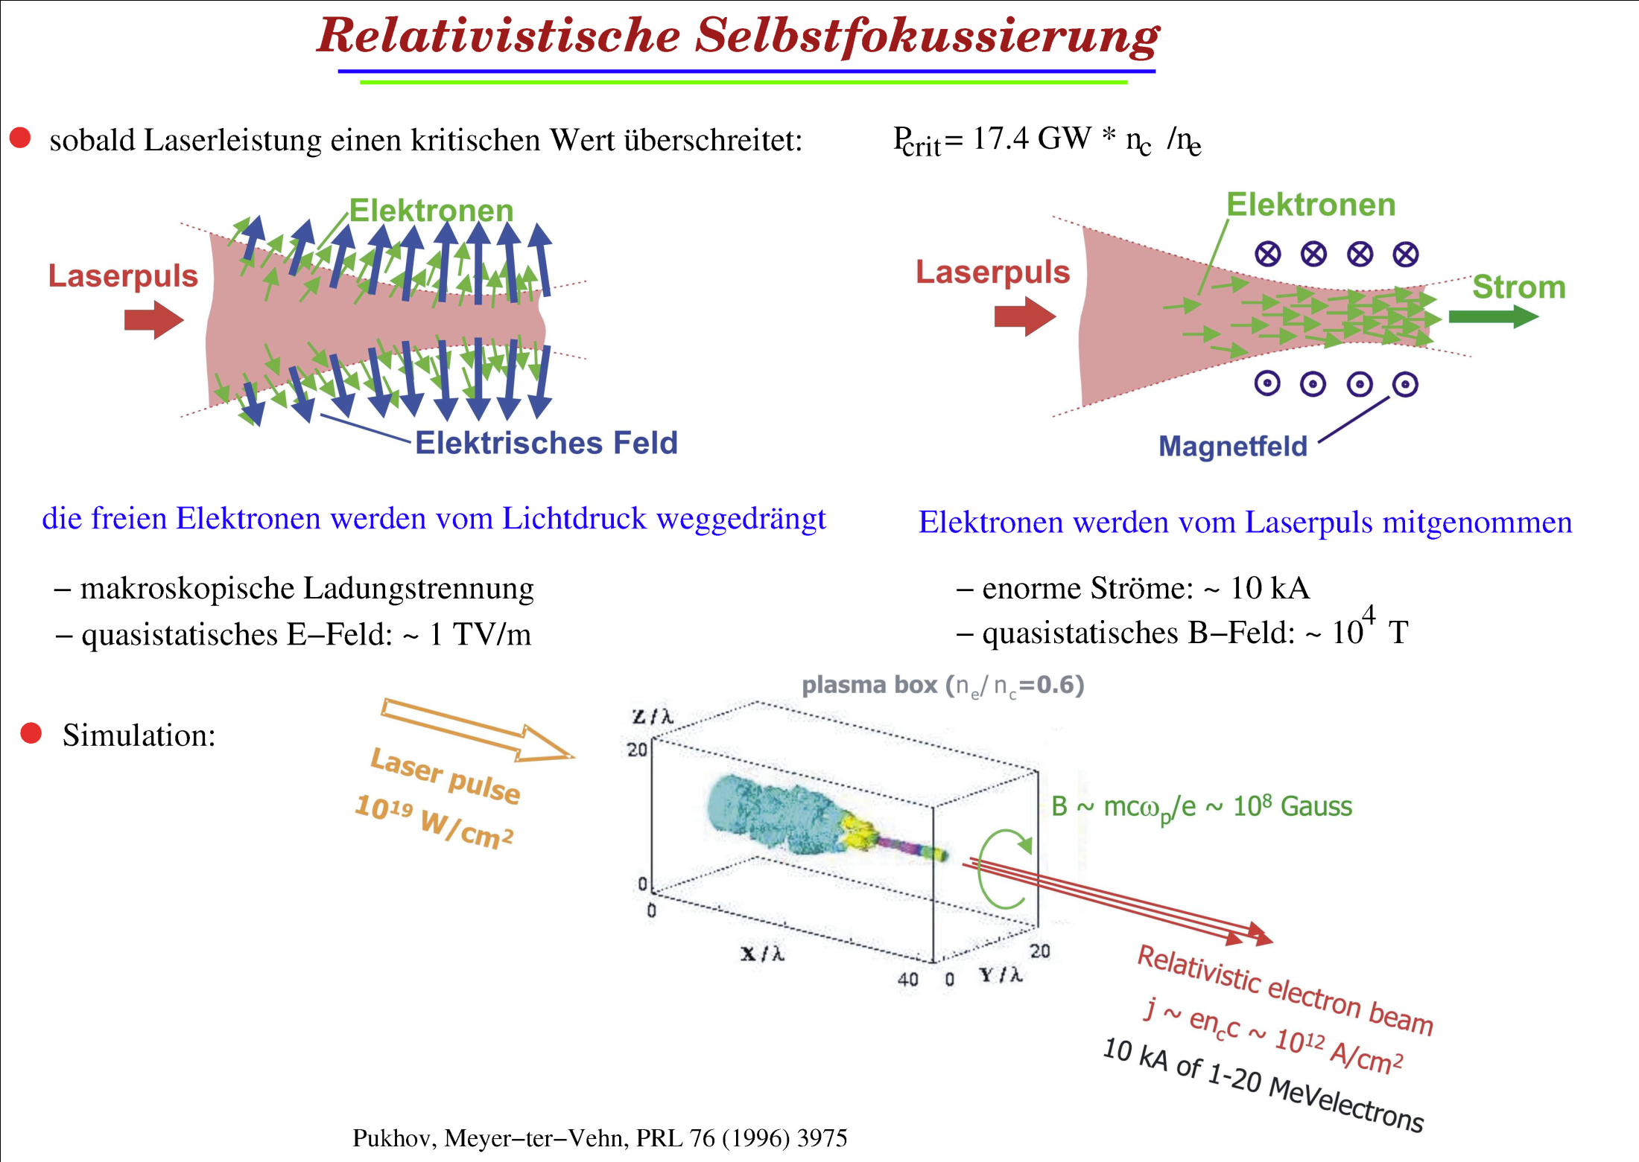

Relativistic Self-Focusing
electrons
electrons
laser pulse
laser pulse
current
electric field
magnetic field
free electrons: pushed aside by light pressure
- macroscopic charge separation
- quasi-static E-field: ~ TV/m
electrons are dragged by laser pulse:
- enormous currents: ~ kA
- quasi-static B-field: ~ 10⁴ T
9
Notes:
Ponderomotive force: a ponderomotive force is a nonlinear force that a charged particle experiences in an inhomogeneous oscillating
electromagnetic field.
charged particle in an inhomogeneous oscillating field not only oscillates at the frequency of ω but also drifts towards the weak-field area.

Slide 30
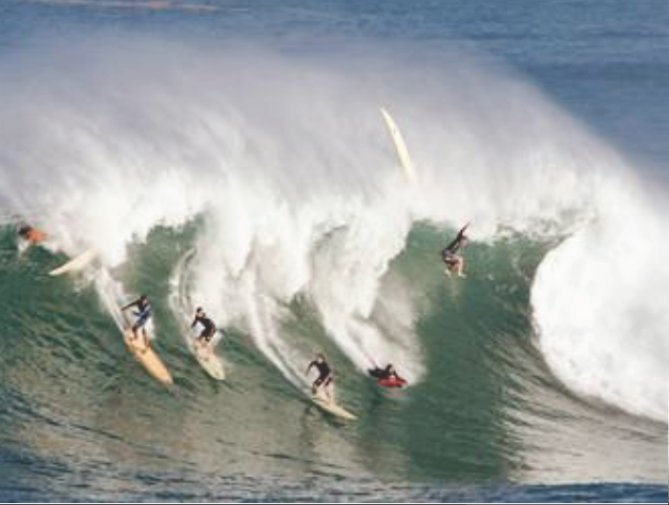
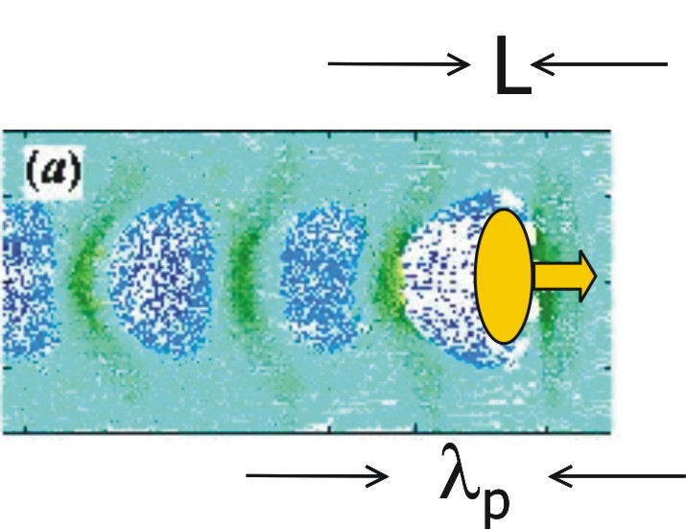
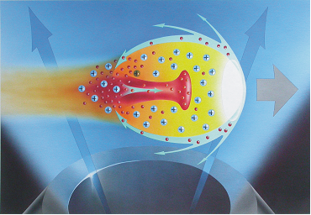
Electron Laser-’Bubble-Acceleration’
electron injector:
wave breaking already after first plasma period
creation of a soliton-like wakefield ‘bubble’
(depleted from electrons)
electrons continuously trapped into bubble
→ acceleration
laser
best for short laser pulses (<30 fs):
→ pulse length < λ_{p}
plasma wavelength
laser pulse
A. Pukhov, J. Meyer-ter-Vehn, Appl. Phys. B74 (2002) 355

Slide 31
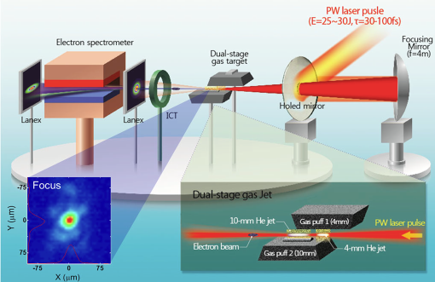
Laser-Accelerated Electron Beams
Dual-stage laser wakefield acceleration:
electron injection – acceleration at Gwangyu
(Korea)
Laser: 1PW, 30 J, 30 fs → 3.10¹⁹ W/cm²
25 mm focal diameter: in center gap (2 mm) between gas jets => 3 GeV electrons
H.T. Kim et al., PRL 111,165002 (2013)
0.3 m, 1.33 T
acceleration
injection
New record at BELLA (Berkeley, SUA): 4.2 GeV in 9 cm capillary
Phys. Rev. Lett. 113, 245002 – (December 2014)
Notes:
2 helium gas jets, injector,accelerator, low density: larger bubble , easier injection
ICT: integrating current transformer → measures the charge of the electron bunch
Lanex: rare-earth screens (gadolinium mainly) for x-ray absorption
Question: what about (fraction of) transmitted unfocused beam through the mirror hole ?? (diagnostics ??)
Why not off-axis parabola ??

Slide 32
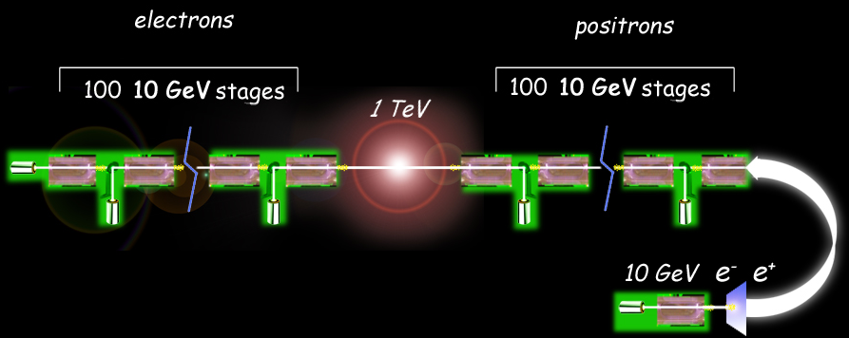
Perspective: ‘Staging’ -
Cascaded Electron Acceleration
‘staging’:
- adapt the concept of cascaded acceleration cavities
- requires: controlled, periodic, rapid plasma formation via discharge
laser-pulse injection into each stage
refocusing of electron beams is inevitable to efficiently suppress beam-quality
degeneration due to betatron-phase decoherence
vision of a (cascaded) laser-driven electron-positron collider:
W. Leemans et al., Physics Today (March 2009): BELLA project (Berkeley)
17
Notes:
Final goal: laser acceleration for high-energy particle acceleration
Compare to present ‘vision’ at CERN: Future Circular Collider (100 TeV, 80-100 km ring tunnel)

Slide 33
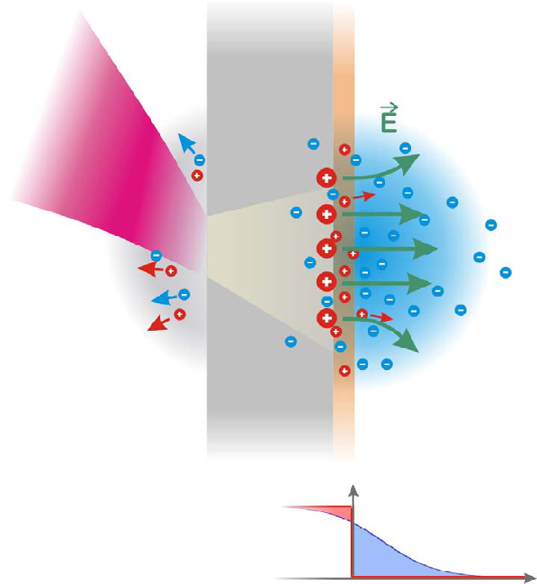
Laser-Ion Acceleration
‘Traditional’ mechanism: Target Normal Sheath Acceleration (TNSA)
electron acceleration
hot (MeV) electrons penetrate the
(μm) foil
- quasi-static field forms normal to
target surface
- source size > laser spot
foil
MeV/u protons
and ions
Laser
I > 10¹⁹ W/cm²
use thick (metallic) foil targets (~μm)
proton source: CH contamination on foil
surfaces (typically ~50Å)
ion source: foil bulk material/
proton removal by heating.
hot electron propagation
MeV energy, μC charge
N_{e, hot}
space charge field:
E ~ T_{hot}/λ_{Debye} ~ MeV/μm = 10¹² V/m
conversion efficiency:
(from laser to ions)
first publications: E.L. Clark et al., PRL 84 (2000) 670
R. Snavely et al., PRL 85 (2000) 2945
Notes:
Now turn to ion acceleration
Carbo-hydrates on surfaces→ inevitable proton acceleration, unless heating is performed to clean surface

Slide 34
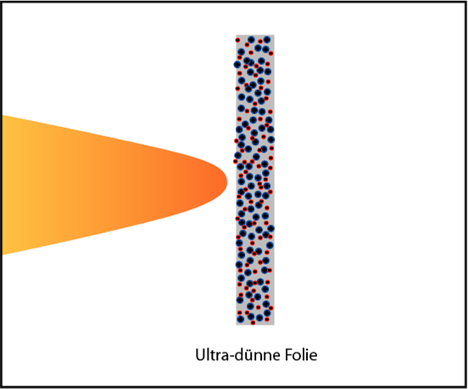
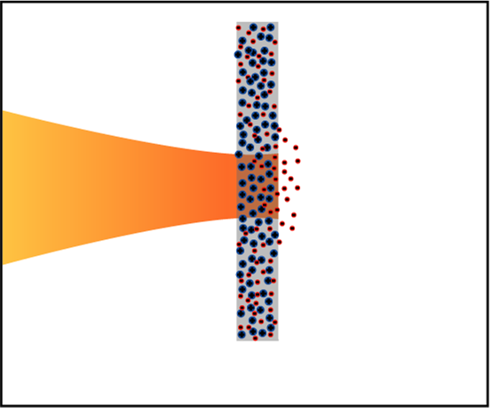
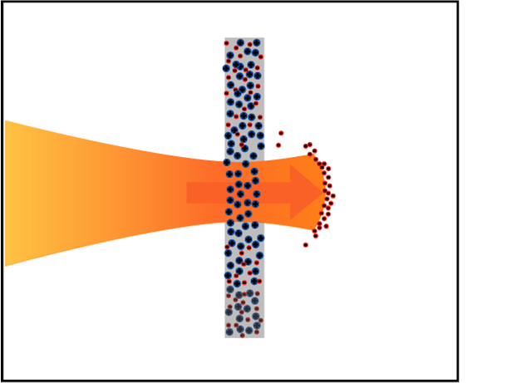
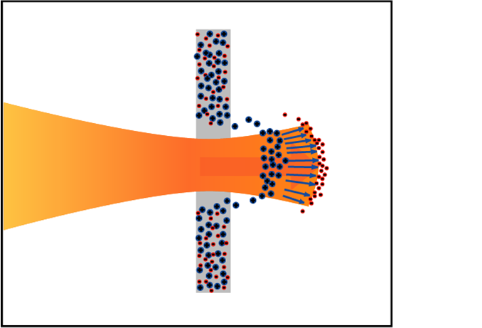
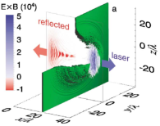
Hole-Boring vs. Light Sail Regime
light sail regime:
- the target is sufficiently thin for the laser pulse to punch through the
target and accelerate a slab of plasma as a single object
ultra thin foil (d~5-10 nm)
circularly polarized laser pulse: focused on an ultra-thin foil
→ fully ionizing the foil.
electrons leave the foil
Light sail
electrons pull ions
hole boring regime:
laser pulse interacts with semi-infinite target
(overdense plasma: opaque)
→driving material ahead of it as a piston
no interaction with the target rear surface

Slide 35
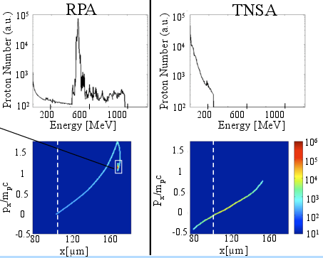
Comparison: TNSA vs RPA @ 10²¹ W/cm²
almost all protons in small
phase-space volume
note: beam is
quasi-neutral
- RPA dominates for realistic intensities using circular polarization
- excellent longitudinal emittance possible: ΔEΔt~ 10 MeV * 5 fs ~ 5.10⁻⁸ eV s
- extremely short pulse duration: foil thickness/c ~ 100 attoseconds
Notes:
10^21 W/cm2: regime of present PW laser systems: RPA favorable
Circular polarization important
Extremely short pulse: < 1 fs

Slide 36
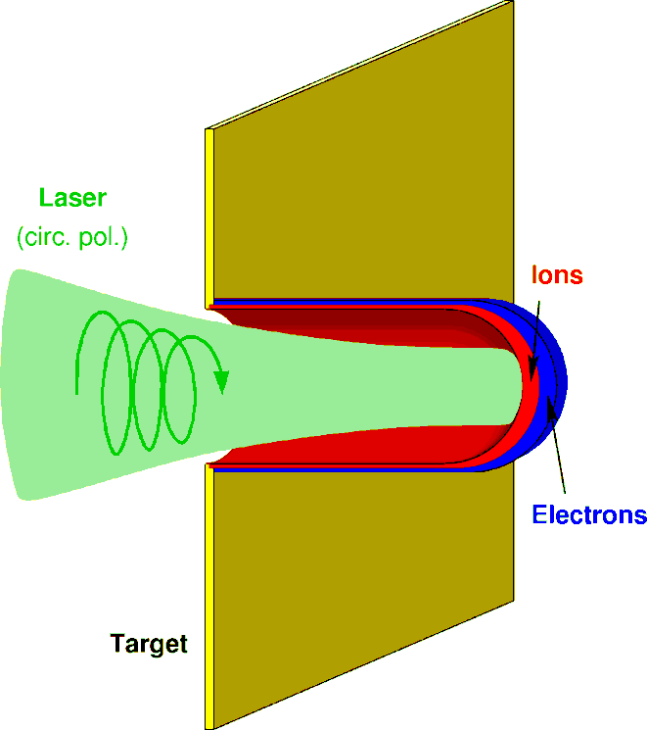
Summary: Laser Acceleration
- high-power (100 TW – 10 PW ), short-pulse (few fs) lasers
- focused intensity on target: 10²⁰ – 10²⁴ W/cm²
Electron acceleration (gas jet)
Ion acceleration (thin foil)
LWFA
(laser wake-field acceleration)
TNSA & RPA
(radiation-pressure acceleration)
accelerated
electrons
laser
pulse
field ~ TV/m
E_{e} ≤ GeV
E_{ion} ≤ 150 MeV/u
charge ~ 10’s of pC
ΔE/E ~ 1-2% (e⁻)
~ 10-20% (ion)
ε~10⁻⁵ mm mrad
wakefield
“bubble”
E. Esarey et al., Rev. Mod. Phys. 81 (2009) 1229
Main application: X-ray source, XFEL
for material and life sciences
A. Henig et al., PRL 103 (2009) 245003.
Main application: hadrontherapy
Main focus at ELI-Beamlines (Czech Republic)

Slide 37
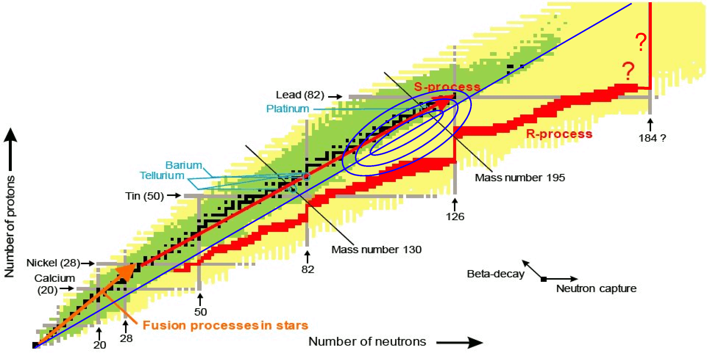
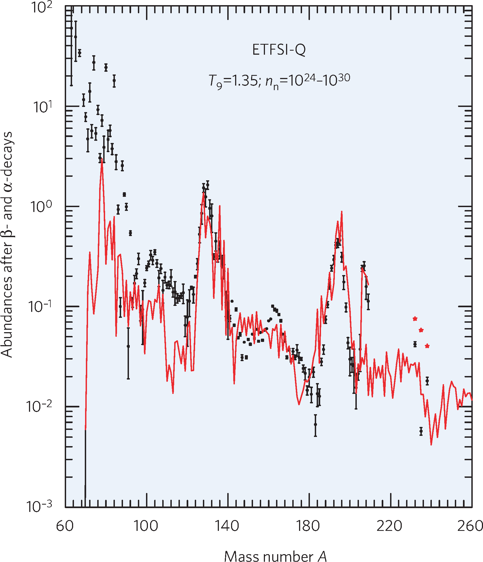
Astrophysical r process:
waiting point N=126
r process:
- path for heavy nuclei far in ‚terra incognita‘
- astrophysical site(s) still unknown:
Au, Pt, Ir,Os
- waiting point N=126: bottleneck for nucleosynthesis
of actinides
- last region of r process ‘close’ to stability

Slide 38
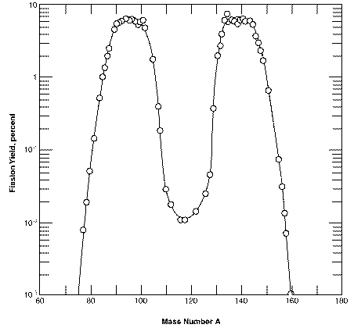
Fission – Fusion Mechanism
Mass distribution
in Th fission
F_{L}
F_{H}
²³²Th:
<A_{L>} ~ 91,
ΔA_{L} ~ 14 amu (FWHM)
ΔAL ~ 22 amu (10%)
<Z_{L}> ~ 37.5 (Rb,Sr)

Slide 39

In-flight Separator for ELI-NP
concept proposed by H. Geissel (GSI/U Giessen)
for separation of nuclei of interest from all other
accelerated particles and reaction products
Measuring basic properties of N~126 nuclei: masses
lifetimes
decay modes
28

Slide 40



Nuclear Reactions in Plasma
Study of screening factor in nuclear reactions
of astrophysical interest
Proposal of S. Tudisco et al. – INFN-LNS (Italy)
σ (E) = 1/E exp(-2πη) S(E)
Extrapolation toward low energy
is complicated by screening
Salpeter formula:

Slide 41




Study of screening factor – The method and cases
Peta-Watts
6×10²⁰ W/cm²
10¹⁸ Atoms/cm³
D.C. Carrol et al., New J. of Phys. 12 (2010) 045020
The method requires
measuring high energy
neutrons.

Slide 42
Nuclear (de-)excitations in plasma
Proposal of F.Hannachi et al. (CENBG)
NEET observed in cold targets.
Never observed
in plasma.
NEEC was never observed
Significant changes in lifetimes are predicted in plasma conditions:

Slide 43
Nuclear excitations in plasma: ^{84m}Rb case
Calculation of nuclear excitation rates by NEET and NEEC:
need of a description of the atomic states in plasmas
  ISOMEX based on a Relativistic Average Atom Model under Local Thermodynamic Equilibrium (LTE) hypothesis: all the ions in plasmas are described by one average ion
  New model developed at CENBG
Atom
Plasma
Nucleus
Very difficult !
Gosselin et al., Private Communication
Experiment proposed:
one 10 PW beam used to produce
isomeric state in a solid target
one uncompressed beam focussed to
10¹⁵ W/cm² used to produce plasma
measure delayed gamma from isomer
de-excitation

Slide 44

Nuclear excitation in plasma: ²⁶Al case
Proposal of K. Spohr et al.(SUPA)
The 1809 keV gamma emission associated with the decay of ²⁶Al ( T_{1/2}=7.2×10⁵ y) ground state was first observed gamma ray proving on-going nucleosynthesis.
Still highly relevant observable in astrophysics.
Lifetime changes in high temperature plasma predicted up to a factor of 10⁹ by A.Coc, M.G.Porquet F. Nowacki [PRC61(199)015801]

Slide 45


Neutron production
Trident facility (Los Alamos)
M. Roth et al.
PRL 110, 044802 (2013)
More than 10¹⁰ n/pulse
Expected at ELI-NP

Slide 46


Neutron Production in Photonuclear Reactions
Proposal of I. Pomerantz,
Univ. Tel-Aviv
more than 10⁹ n/pulse
with 50 ps pulse duration
expected at ELI-NP

Slide 47



Laser TDR1: High B-Fields
Nature Scientific Report 3 (2013)1170
All above phenomena are
proposed to be studied
and also large magnetic splitting of nuclear level.

Slide 48

Neutron production:
moun catalysed fusion (μCF)
Principle of μCF:
μ⁻ replaces bound electrons efficiently
in D and T atoms
Due to their larger mass (same as the mass of a
proton), it dramatically reduced the size of the
potential barrier, enabling the atomic nuclei to
come closer => enhanced fusion
Reaction chain stopped by μ⁻ decay (σ_{μ−}=2.2 μs)
and by μ⁻ sticking on He nuclei
Well studied process:
F.C. Frank, Nature 160(1947)525
L.W. Alvarez et al. Phys. Rev. 105(1957) 1127,
D. Balin et al., Phys. Part. Nucl. 42, 185 (2011).
Bungau, Adriana, and Robert Cywinski. "Impact of the Energy of the Proton Driver on Muon Production." IPAC 10 (2010): 259.
Current moun facilities around the world: ISIS (UK),
TRIUMF(Canada), PSI(Switzerland), J-PARC (Japan), JINR(Russia)
Nano-second duration moun source can be produced at
ELI-NP with ~400 MeV protons
  Other applications:
  - muon-spin relaxation to
  study hyperfine fields)

Slide 49
Neutron Generation:
Hot plasma confinement
Proposal of
S. Moustaizis et al.,
(Univ. Crete)
Compact Magnetic Photo-Fusion (CMPF) device in open magnetic topology for high neutron flux production and study burning process in different types of fusion fuels (D-D, D-T and p-¹¹B). Enhanced neutron production is based on trapping of high density
(10¹⁸cm^{–3} – 10¹⁹cm^{–3}) and high temperature (tens of keV) magnetized plasmas
(about 120 T) for duration of order of microsecond.

Slide 50
High-density high-temperature plasma confinement
with laser driven B-field ( kTesla – nanosecond duration)
Nature Scientific Report 3 (2013)1170
Application to:
Nuclear (de-)excitation in plasma
Nuclear reaction in plasma
Neutron generation
¹¹B-p fusion and alpha generation
Astrophysics, etc.
Proposal of
J. J. Santos et al. (CELIA)

Slide 51



Laser Configurations for Nuclear Physics Experiments
Focal length for all parabolas: 1500 mm
Requirements:
  - all configuration in the same interaction chamber
  - direction of acceleration keep the same for all configurations
  - uncompressed pulses for “red” beam

Slide 52

Interaction Chamber
Shape: Rectangular
Material: aluminium
Volume: 3×4x2 (=24) m³
Vacuum:
10⁻⁶ mbar (empty chamber)
Pump-down to
5x10⁻⁶ mbar: 45 min.
Multiple flanges and ports
Isolation of optical table
Removable roof and
side flanges
Access on top for target exchange system
Internal crane for heavy equipment (mirrors) manipulation
Door for access inside through a cleanroom attached to the chamber
(not shown)

Slide 53



Target Systems
and Target Exchange systems
Needs for targets:
On-site fabrication and qualification
Target automatic movement
and alignments
Tape (continuous) target
In-situ proton/carbon cleaning
Gas targets also foreseen
Second target (gas or fixed foil)
possible
Activated (used) targets handling
Needs Target Exchange System:
Changing target AND diagnostics
Simple: only 3 translations
Remote controlled
(not fully automatized)
Mounted on top to keep
horizontal plane for diagnostics
(no enough space below chamber)

Slide 54
Active and passive diagnostics
A full range of active and passive detector employed by high-power laser experiments at other facilities and adapted to ELI-NP:
    proton or ion spectrometers
      - passive: Thomson parabola + IPs, RCF stacks
    - active: Thomson parabola + scintillator
    (or MCP+screen) + CCD
    gamma detectors:
    - prompt spectrum
    - short lived states with in-situ LaBr3 scintillators
    - off-line (activation) detectors
    neutron detectors: scintillators, bubble detectors
    plasma diagnostics and electromagnetic fields (Optical, THz, XUV) including fast probe beams
Several detectors specific to ELI-NP
    Decay station with Ge detectors
    Recoil separator
    Stopping gas cell and RFQ and MR-TOF or Penning traps

Slide 55






In-situ gamma spectroscopy and on-line digital processing
proton
LULI experiment
⁹⁰Zr(p,n)⁹⁰Nb
Zr foil
laser
LaBr₃
detector
Oscilloscope
(Traces @ 250 MS/s)
Fast Amplifiers
TNT 14 bits; 100 MS/s
with PSA optimized for Ge detectors
5

Slide 56


Fast Transport System to the Decay Station for high resolution gamma spectroscopy
Carbon clusters aerosol
(Mainz reactor)
Ph. Dessagne et al.,
DESIR @ SPIRAL2 TDR
M. Eibach et al., NIM A 613 (2010) 226
Filter to catch aerosols
+ Ge detectors
Other aerosol possible: NaI (600 °C) or PbCl₂ (430 °C)
 | Fast Tape Station Transport System | Gas-jet Transport System
Pro’s | Constant (measurable) transport efficiency No servicing required over large operating time Well defined transport time | Suitable for both linear and non-linear long transport paths (a)
Limitations | Tested speeds of up to 5 m/s (pre-acceleration could improve transport times) | Variable transport efficiency 45-65% over several running hours Wide distribution of the transport time typically in the range of 0.4-1 s for a 7 m path
Con’s | Mechanically challenging for transport over large distances and/or non-linear paths | Need for regular maintenance each 1-2 UT’s Changer the filter ?
Mixed solution: aerosol + tape system at ELI-NP (S.-W. Xu et al., PRC 71 (2005) 054318)

Slide 57





Production of short duration
mono-energetic neutron pulses
Experiment at Titan/LLNL (USA)
32 channel switch
capacitor digitizer
Spokesperson: J. Fuchs (LULI) et al.
Plastic scintillator (4x4x12 cm³)
couplet to PMT
2 mm
2 mm
Cylinder
Distance
Pinhole-end of Cyl.
Main Pulse
1 mm
+ 11 neutron-tof
detectors
3 mm
Pinhole
Al support
Target:
PET/Al 23 μm
Catcher:
LiF
Split pulse
=10% of Main
(~50 ps delay)
Longer focal length for more energetic protons
Detailed study of the method in:
T. Toncian at al., AIP Advances 1, 022142 (2011)

Slide 58





Fast neutron detection with plastic scintillator
Background (no LiF)
with
selection
30 cm Pb
Signal (mV)
without
selection
On-going Geant4 simulation to extract neutron spectrum from the measured waveform
High granularity detector system proposed at ELI-NP:
small volume and ~ 1000 segments => Single neutron event in detector per shot
Try SiPM (silicon photomultipliers) instead of dynode PMT
  PA shielding against EMP
  test gating (polarization needed is ~ tens V)
compact
high photo-detection efficiency
high gain
single photon sensibility
excellent timing performance
low operative voltage
insensitivity to large electric
and magnetic fields
SiPM

Slide 59
X-ray Backlighter for High Density Plasma Characterisation
Proposal of D. Stutman et al.
Two target density profiles assumed in the simulation, and calculated X-ray intensity profiles.
Using betatron emission occuring
during LWFA electron acceleration
in gas as probe beam for high
density plasma.
Zoom around
target position

Slide 60
Beam-dump
7.9 μSv/h @ 1 cm
5.6 μSv/h @ 1 m
Top
View
North
Corridor
Side
View
67 μSv/h @ 1 cm
44 μSv/h @ 1 m
Roof
Total mass of beam-dump: 525 tons
Additional shielding under evaluations:
- to reduce prompt doses on corridor
- to access the target if activation too high

Slide 61



Strong Field - QED with two 10PW Beams
ELI-NP with two 10PW synchronized laser beams will met the requirements to radiation reaction and pair creation due to electrons in intense EM fields:
First beam for electron acceleration to high Lorentz factor (10’s GeV)
Second laser intensity of 5x10²² Wcm⁻² from 10PW focused to 5mm spot.
Laser
field
Radiation
Electron trajectory
Two main types of experiments are proposed in E6 interaction area:
(a) Interaction of multi-GeV electron beam (Wakefield) with 10PW laser. Electrons accelerated from Gas targets.
(b) 10PW laser pulse interactions with dense plasma from Solid target. Reaction rates are high due to high electron density.

Slide 62




First investigations of the
QED-plasma regime physics
For the first time: Measure the three signatures of the onset of radiation damping due to the synchrotron radiation:
The scaling of multi-MeV Gamma emission with laser intensity 10²¹ to 10²³ Wcm⁻².
(2) The angular profile of energetic photon emission
(3) Charged particle spectra: Radiation reaction results in significant reduction in the high energy part of the fast electron spectrum.
F#20
(10 m)
Simulation results of angular distribution of Gamma photons produced by (a) skin depth emission in a solid targets, and (b) the RESE mechanism in which electrons propagate backwards into the incoming laser light. [CS Brady, 2014]
  Detectors proposed for angular emission of energetic photonics.
(a)
(b)

Slide 63


Combined laser - gamma experiments
1. Electron induced nuclear processes
investigated with gamma beams
2. Electron – Laser beam interaction
3. Gamma assisted electron-positron pair
production in vacuum;
4. QED birefringence studies
5. Dark field search (Four-wave
mixing in the vacuum)
700 MeV e-
~100 MeV γ
e-
γ
e+
D. Habs et al.

Slide 64

Laser-TDR4: Applications in Material Sciences
Effects of direct short-pulse laser irradiation:
SEM W probe SEM C probe SEM Be probe
• testing new materials for fusion and fission energy application
• testing of new materials for accelerator components
• testing materials for space science (electronics components,
hypervelocity impacts)
• surface and volume modification; micro- and nano-technology)
• biological science research (effects on bio-molecules, cells of short
duration gamma/electron/particle pulses)
• testing radiation hardness and developments of detectors
• irradiated optical components testing

Slide 65
Laser-TDR4: Applications in Life Sciences
Combined irradiation with electrons, gammas, protons, heavy ions, neutrons produced
by 2 x 1 PW @ 1 Hz

Slide 66


ELI-NP Team, March 5, 2013
Thank you!

