Slide 1
Схема коллайдера NICA
JINR-BINP Meeting, 24-25 Dec, 2018, JINR, Dubna

Slide 2
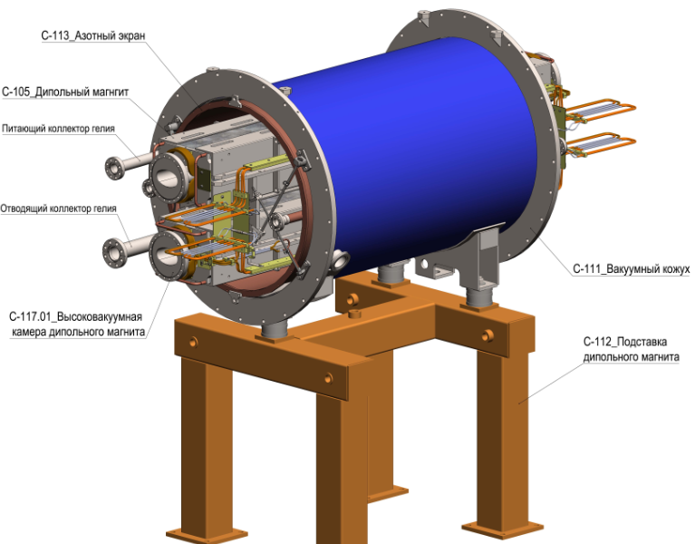
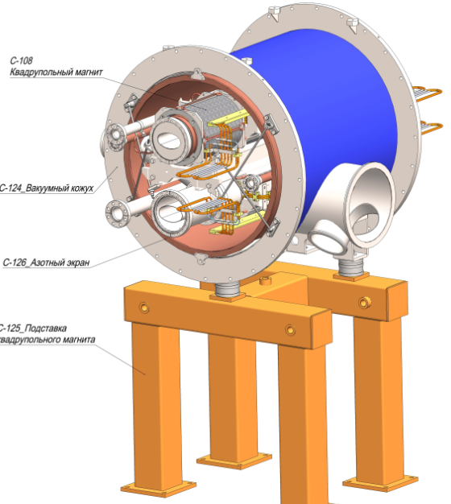
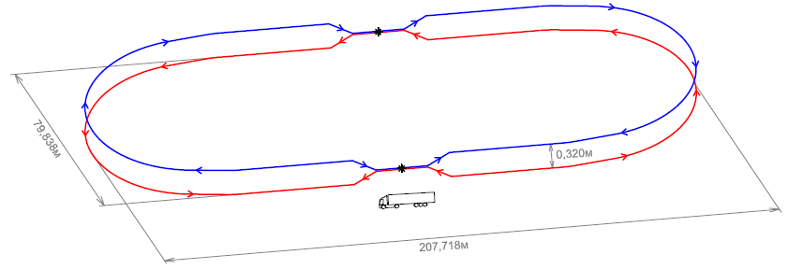
“Nuclotron” - technology

Slide 3
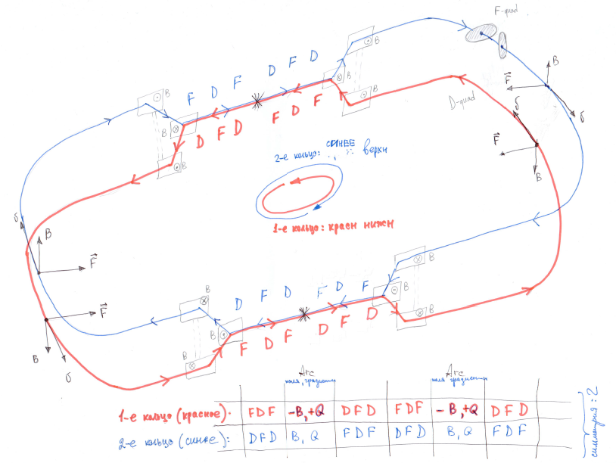
Ring + vertical beam separation
Rings structure
Ring symmetry =2
Two Beams ⬄ symmetric optics

Slide 4
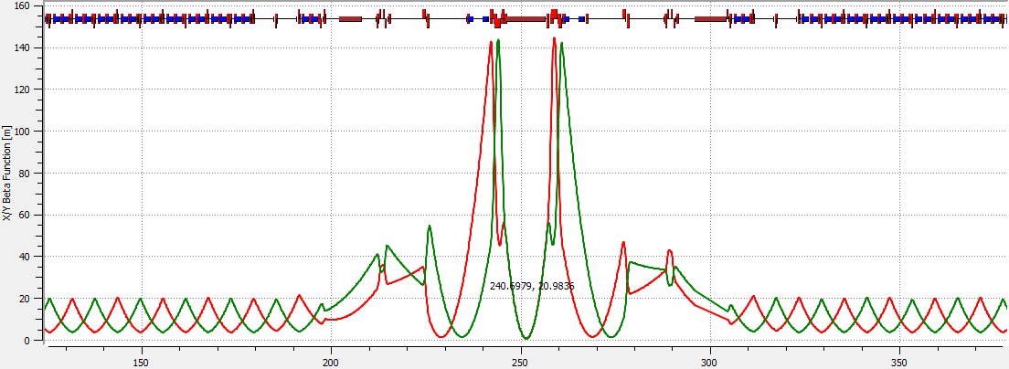
Lattice
Two Beams ⬄ symmetric optics
Ring + vertical beam separation

Slide 5
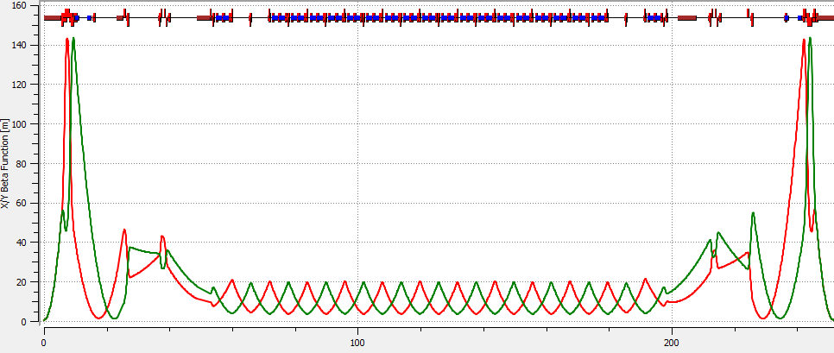
Ring + vertical beam separation
Lattice
Ring symmetry =2
Beta-IP = 0.6m
Beta-max=145m
Two Beams ⬄ symmetric optics

Slide 6
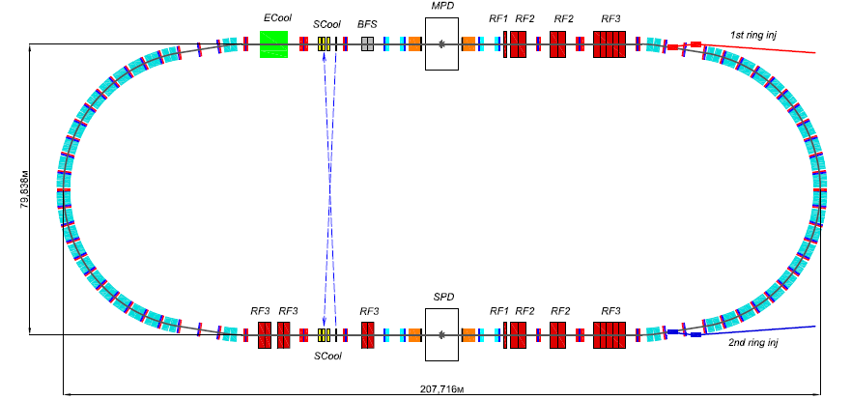
Collider scheme plan view

Slide 7
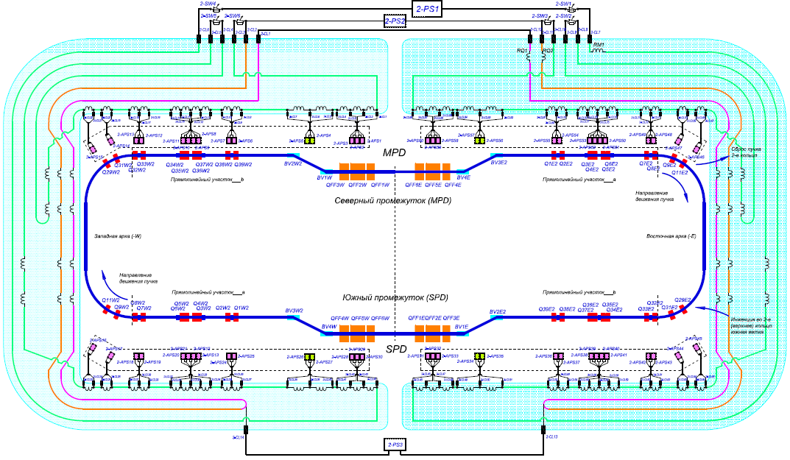
Collider electrical power supply scheme
for 1 ring (2nd-blue-upper)
Main power supplies
Add power supplies
Индекс | Max Ток, А
2-PS-1 | 10500
2-PS-2 | 1000
2-PS-3 | 600
Индекс | Max Ток, А
2-APS-1… 2-APS-60 | 300

Slide 8
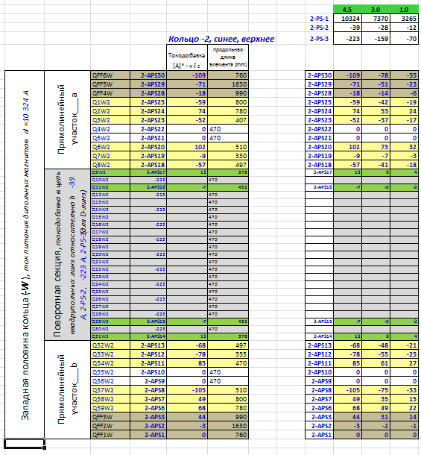
Feed currents
for half ring (2nd-blue-upper)

Slide 9
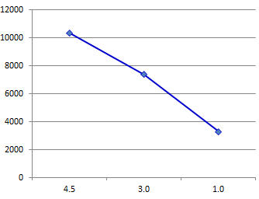
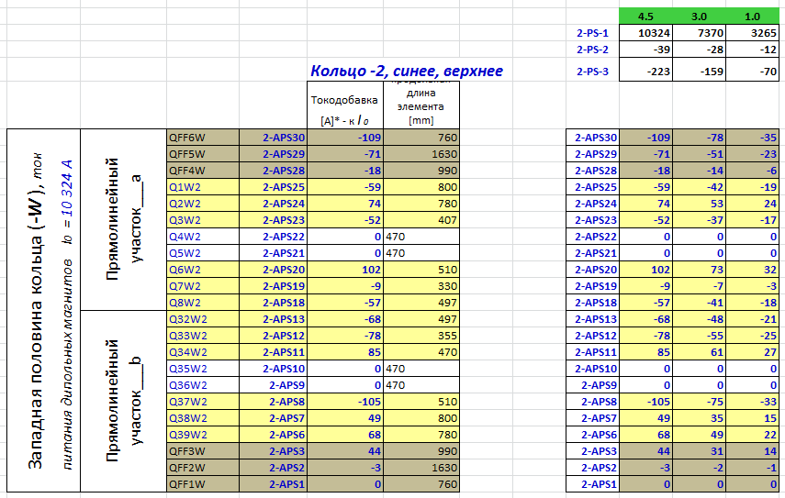
Feed currents
2-PS-1
Additional power supplies (APS)
for 1 ring (2nd-blue-upper)
Currents values scaling with beam energy

Slide 10
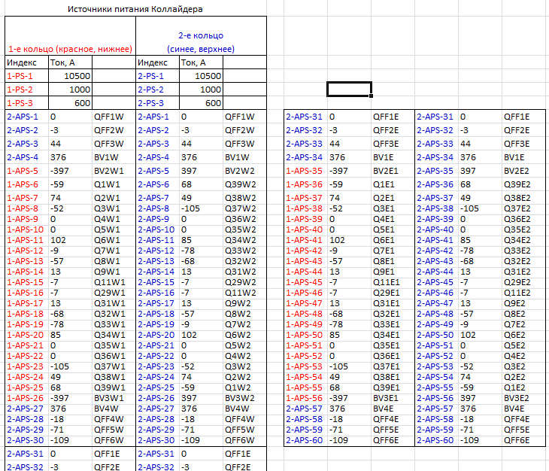
Feed currents

Slide 11
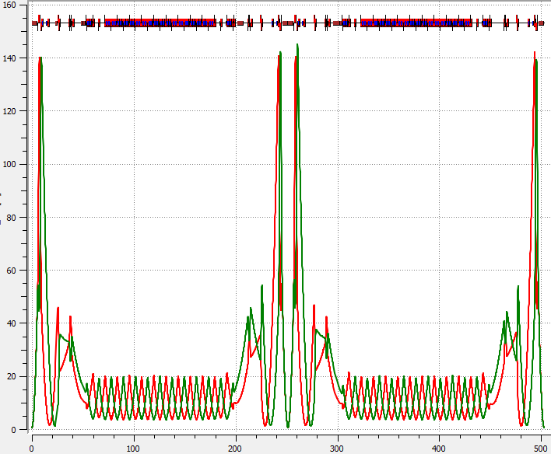
Ring-10 –
quads lengths adjusted to power all magnets in series
Beta-functions
Linear optics
Beam Vertical separation magnets
MPD+ECool solenoids
RF-system
Corrector magnets:
Closed Orbit
Chromaticity
X-Y-coupling
Edge fields
Qx,y = 9.44
β* = 0.6m

Slide 12
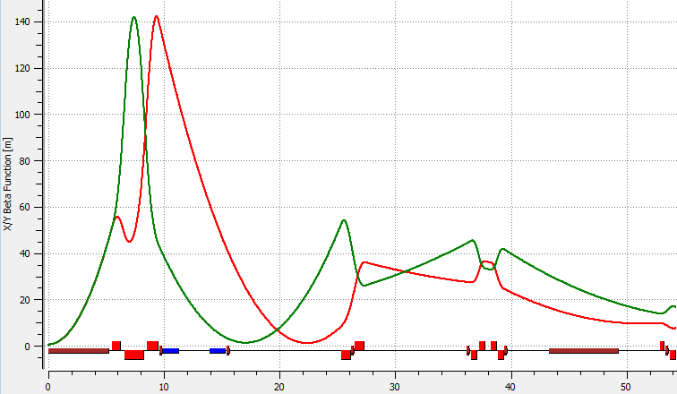
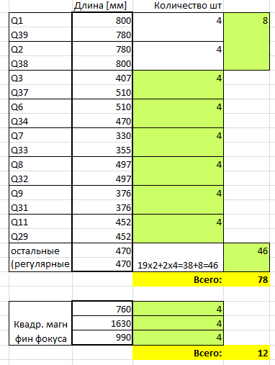
Collider quads spec.

Slide 13
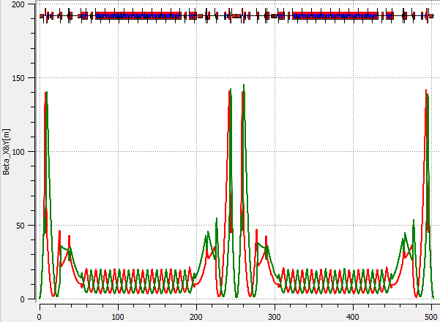
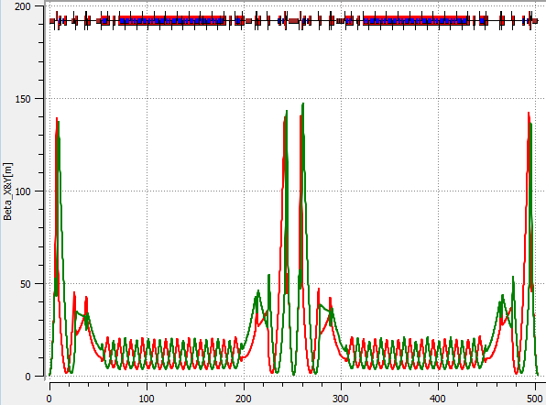
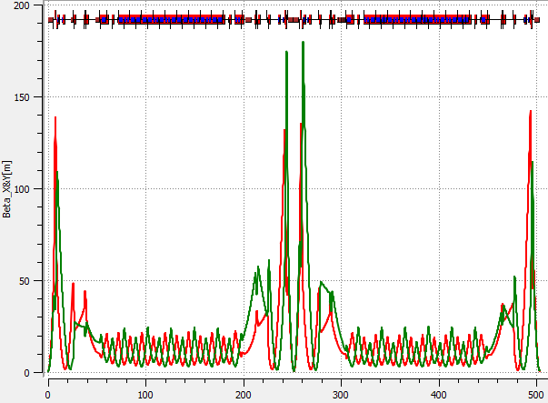
4.5 GeV\n
Beta-functions
3.0 GeV\n
1.0 GeV\n

Slide 14
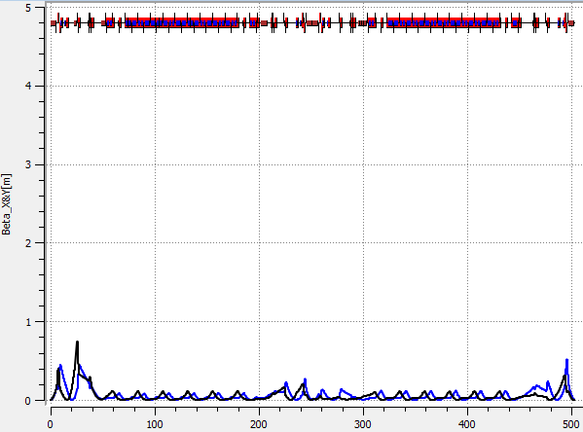
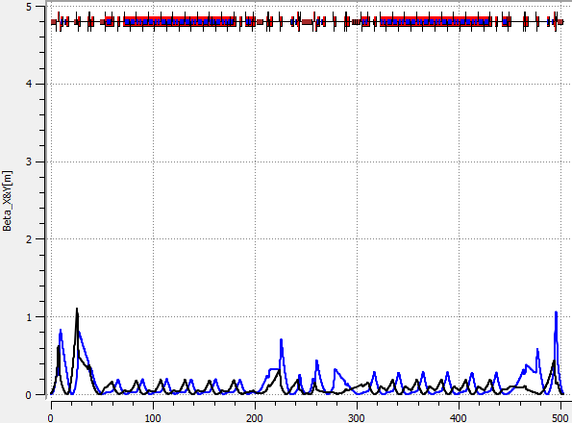
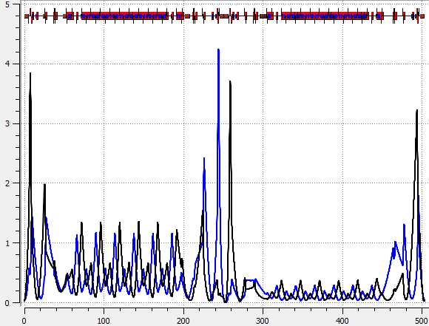
4.5 GeV\n
Beta-functions
3.0 GeV\n
1.0 GeV\n

Slide 15
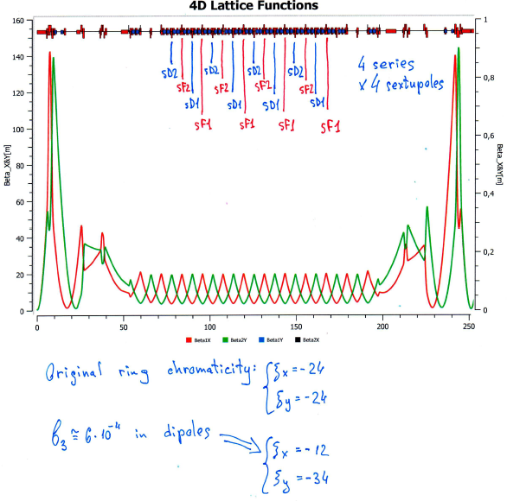
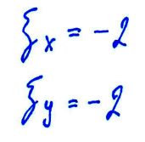
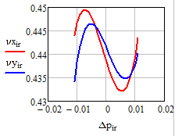
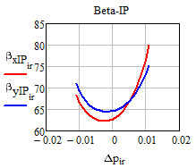
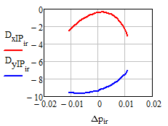
Chromaticity correction
sF1=43 T/m^2
sD1=173 T/m^2
sF2=43 T/m^2
sD2=173 T/m^2

Slide 16
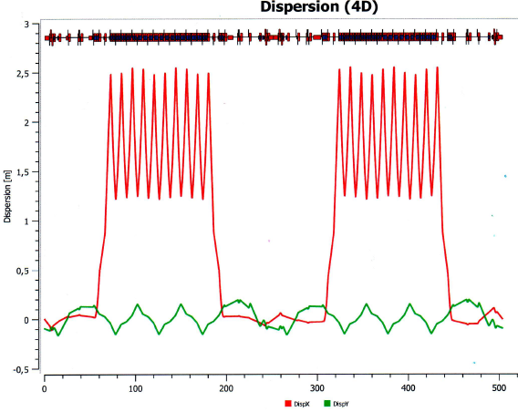
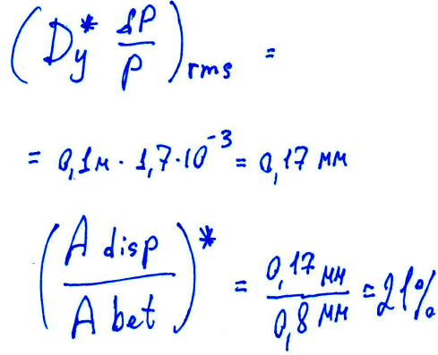
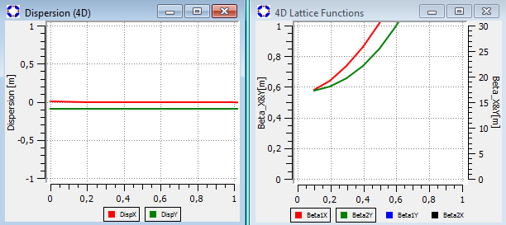
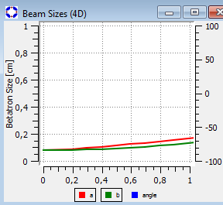
Dy –correction
- skipped

Slide 17
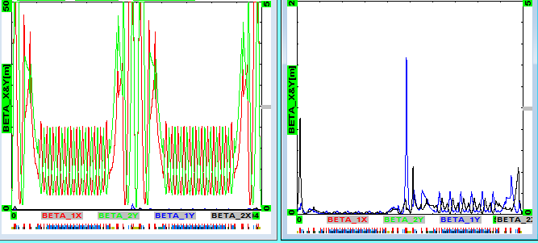
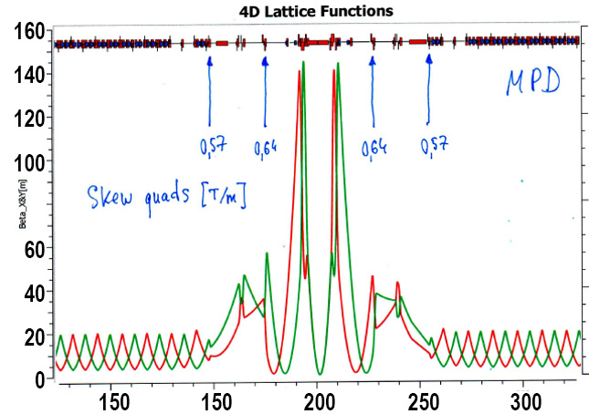
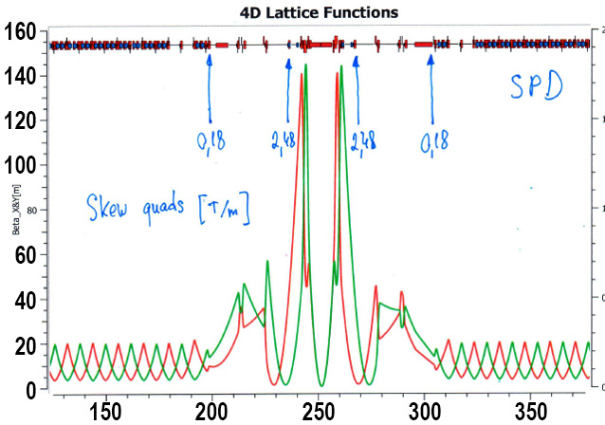
X-Y Coupling suppression
4 skew quads /
half ring [T/m]:
-2.48
0.18
0.57
0.64

Slide 18
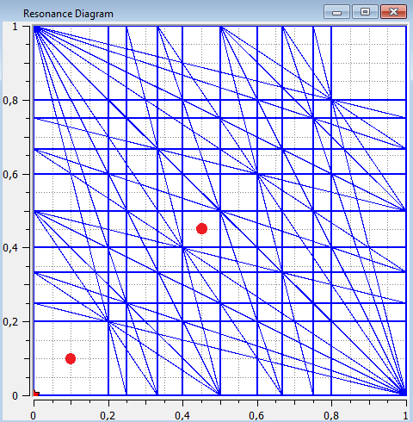
Ring tune
9.10 9.44
3 % of focusing strength

Slide 19
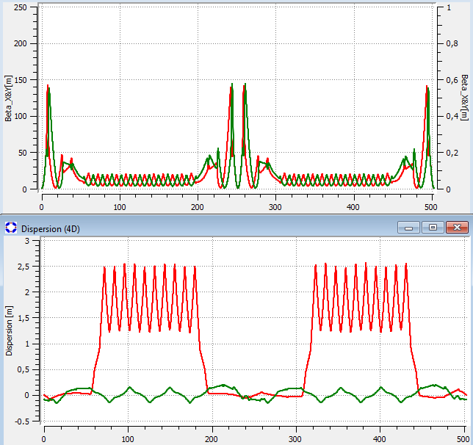
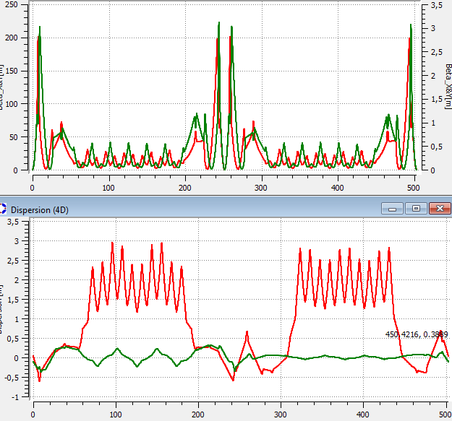
9.44 9.10
Ring tune
-300 А – to all quads (except FF) +0 А to D-quads in arcs

Slide 20
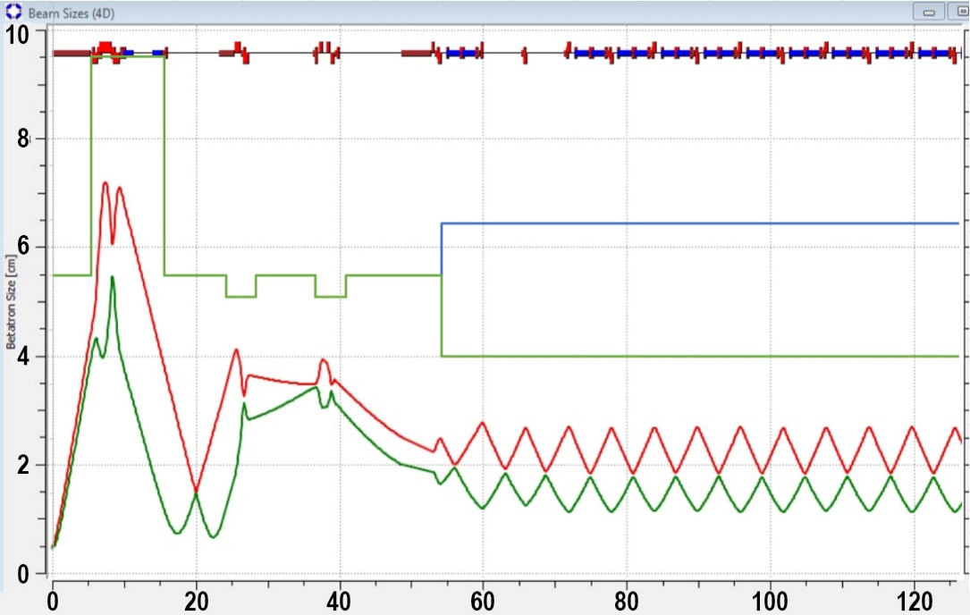
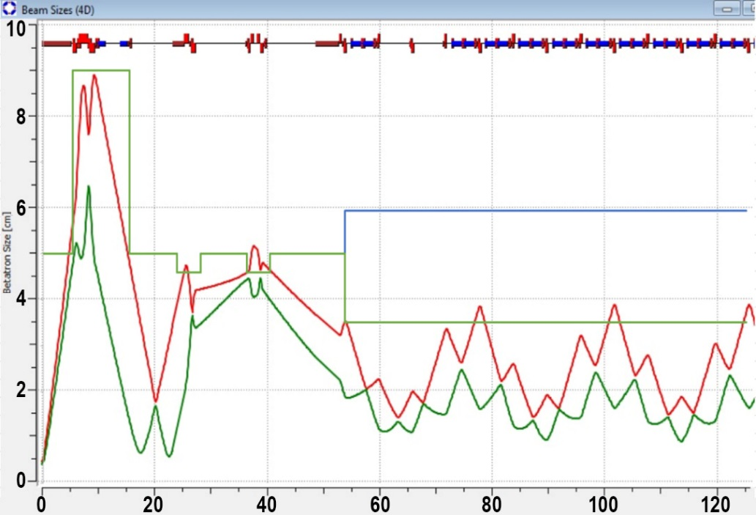
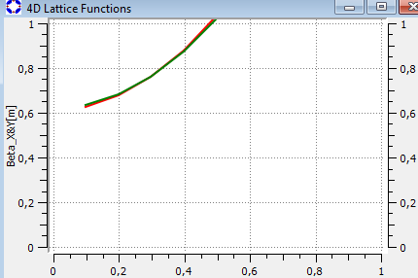
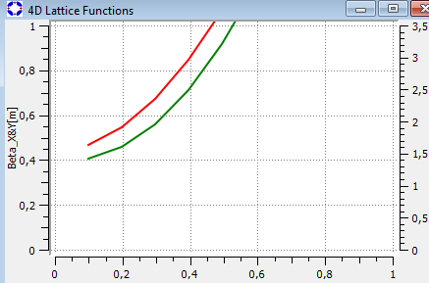
9.44 9.10
Ring tune
Beam size
Beam size at IP

Slide 21
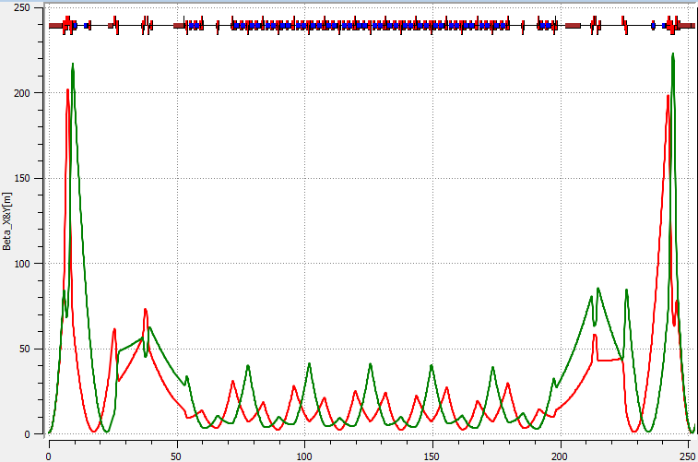
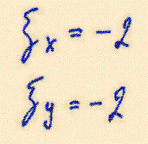
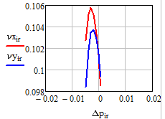
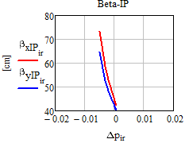
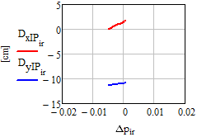
9.10
Chromaticity correction
preliminary
sF1=48 T/m^2
sD1=185 T/m^2
sF2=48 T/m^2
sD2=185 T/m^2

Slide 22
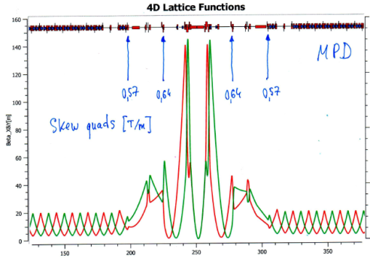
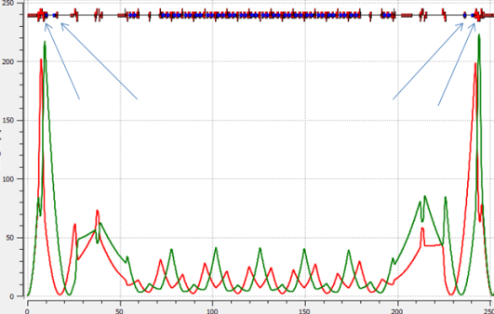
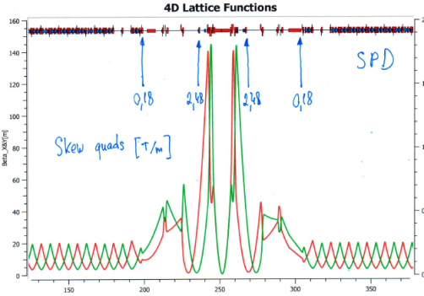
Correction magnets setup
Chromaticity correction
X-Y coupling correction
Fringe fields correction
sF1=43 T/m^2
sD1=173 T/m^2
sF2=43 T/m^2
sD2=173 T/m^2
oF1=150 T/m^3
oF2=60 T/m^2
oF1=150 T/m^3
oF2=60 T/m^2
[T/m]: -2.48
0.18
0.57
0.64
9.44
9.44
sF1=48 T/m^2
sD1=185 T/m^2
sF2=48 T/m^2
sD2=185 T/m^2
[T/m]: -2.51
0.26
0.59
0.61
oF1=150 T/m^3
oF2=60 T/m^2
oF1=150 T/m^3
oF2=60 T/m^2
Orbit correction
9.10
9.10
+
Bx=0.15 T
By=0.15 T

Slide 23
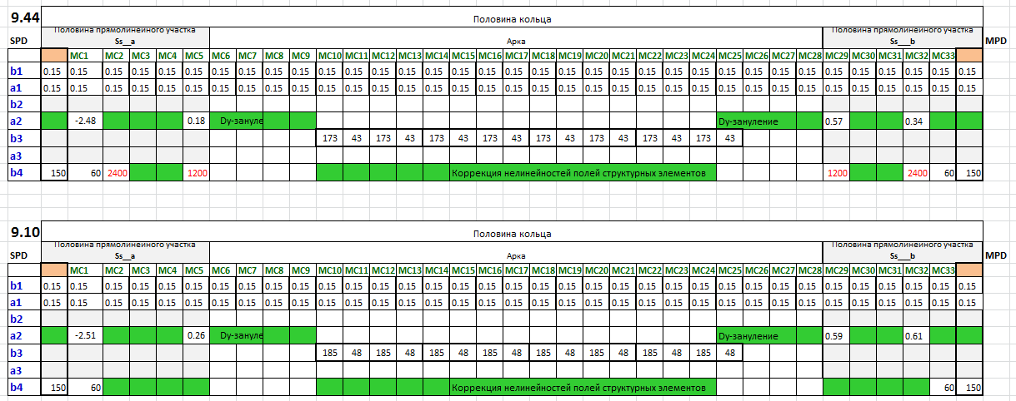
Correction magnets setup

Slide 24
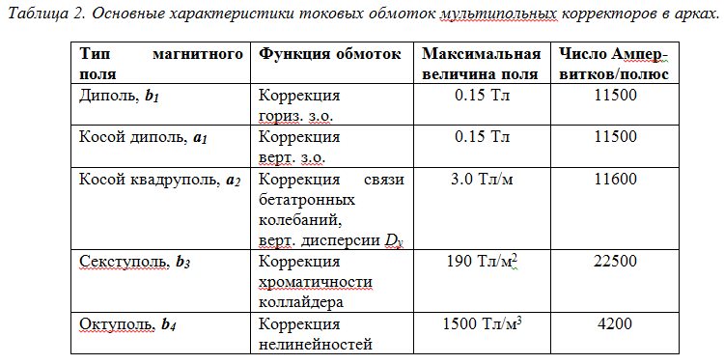
Correction magnets setup
MC in Arcs
MC in Straight sections

Slide 25
Спасибо !

Slide 27
9.10 9.44
Ring tune

Slide 28
NICA collider magnets design
Lattice

Slide 29
Ring + vertical beam separation
Lattice
Ring symmetry =2
Beta-IP = 0.6m
Beta-max=145m
Two Beams ⬄ symmetric optics

