Slide 1
PROGRAM MANAGER FOR DC-280 CYCLOTRON CONTROL SYSTEM
V. Aleinikov, S. Pashchenko, K. Sychev,
V. Zabanova, FLNR JINR, Dubna, Russia

Slide 2
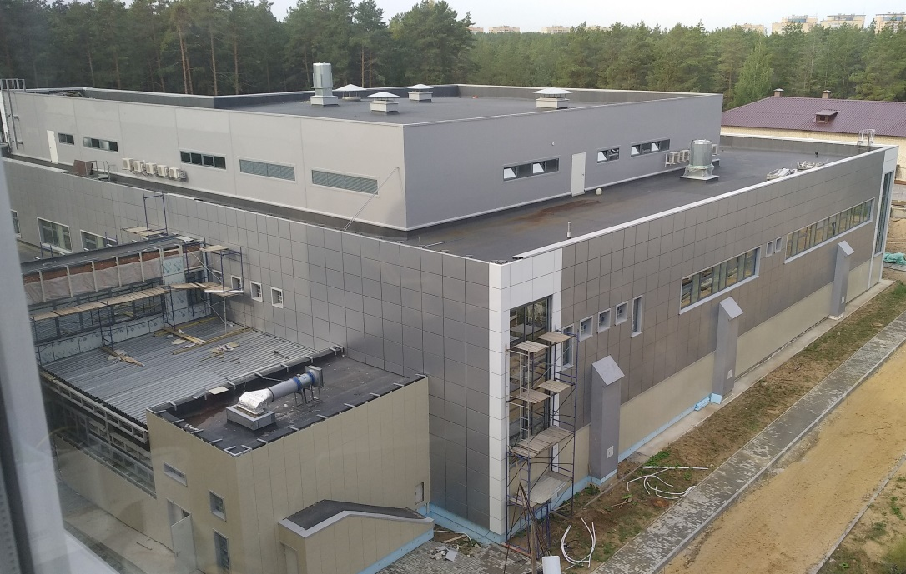
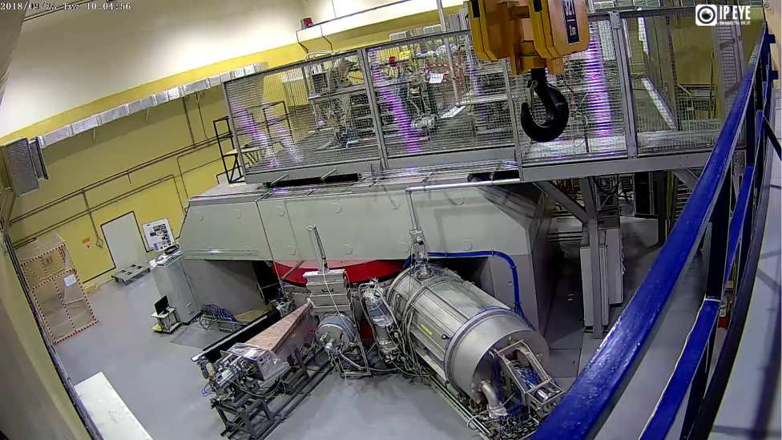
DC-280
DC-280 cyclotron is basic facility of Superheavy Elements (SHE) factory at the FLNR JINR.
The main tasks
the synthesis of new elements (Z≥119)
detailed study of the nuclear-physical and chemical properties of the previously discovered 112-118 ones.

Slide 3
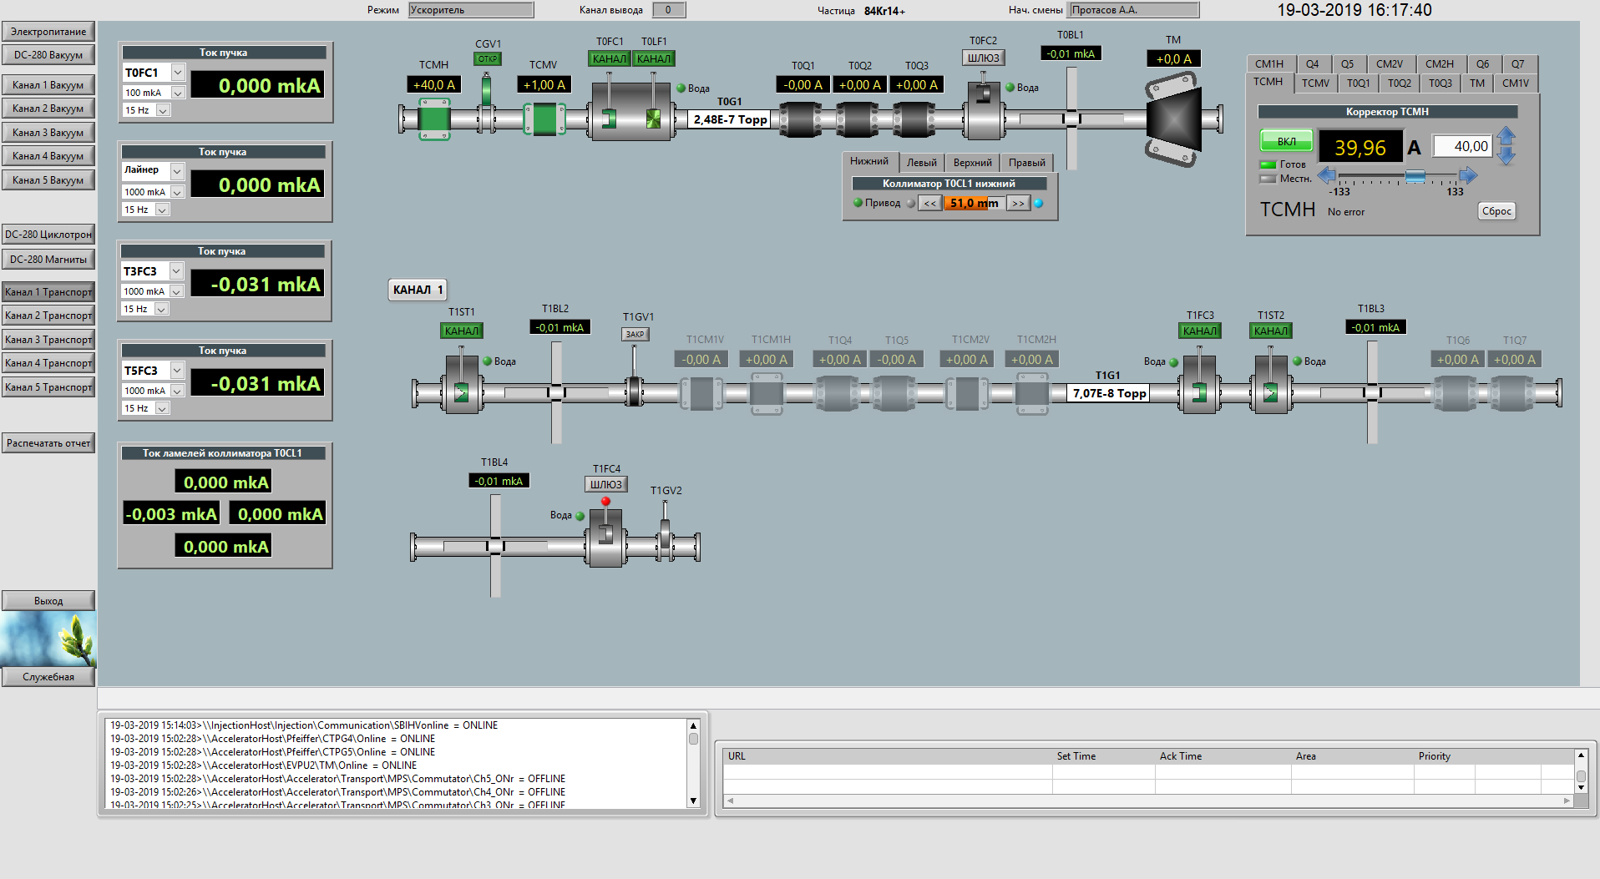
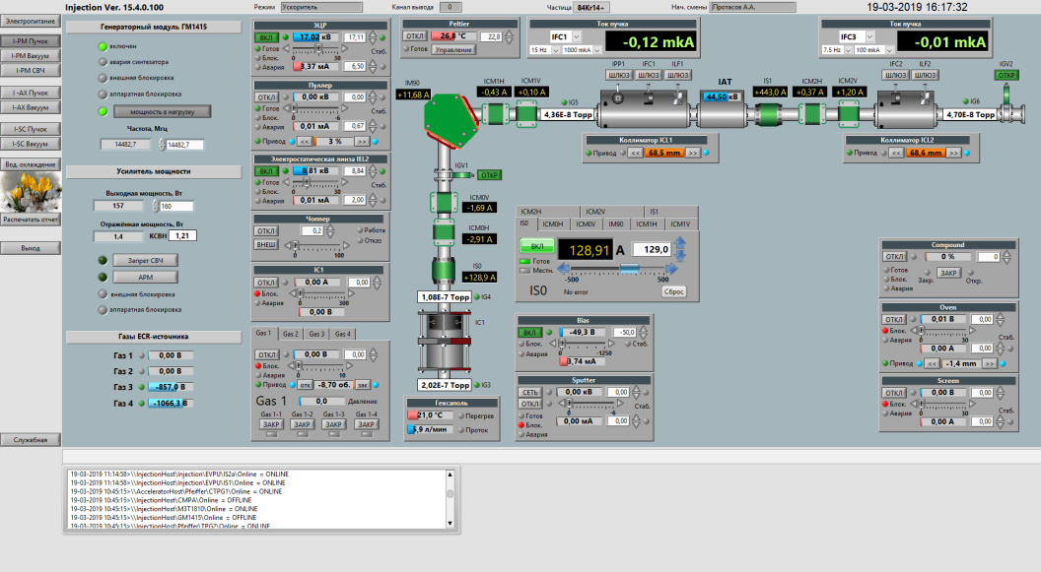
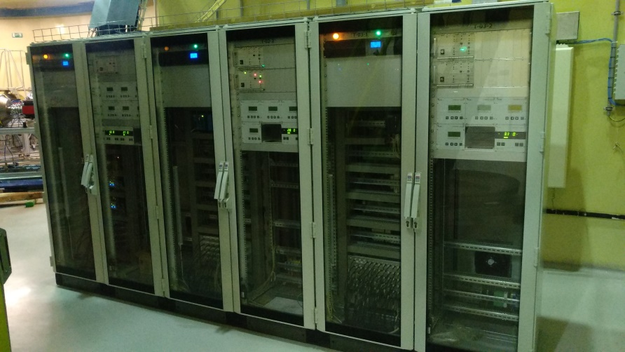
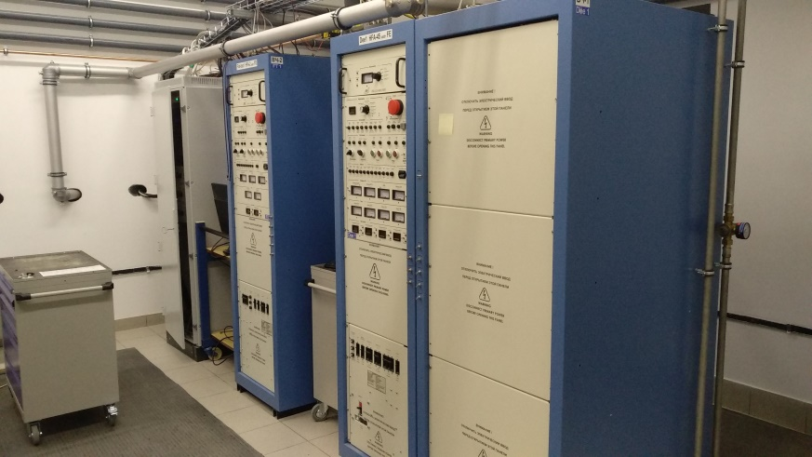
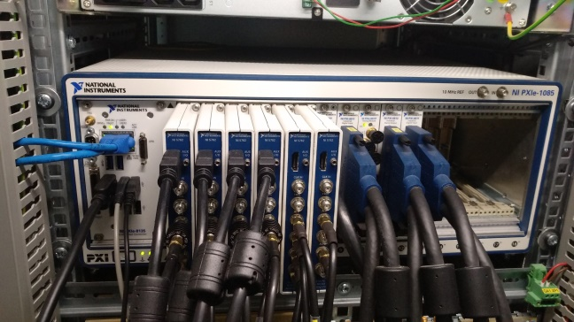
Control system
NI LabVIEW platform and
Datalogging and Supervisory Control (DSC) module.
Software programs :
device drivers
alarms monitor
beam diagnostics
user interfacing
Total amount of the process variables is about 9000.

Slide 4
Goals
Auto run group of software modules at startup
Module individual control (run, stop, restart)
New version update from a centralized repository
Supervising of every module

Slide 5
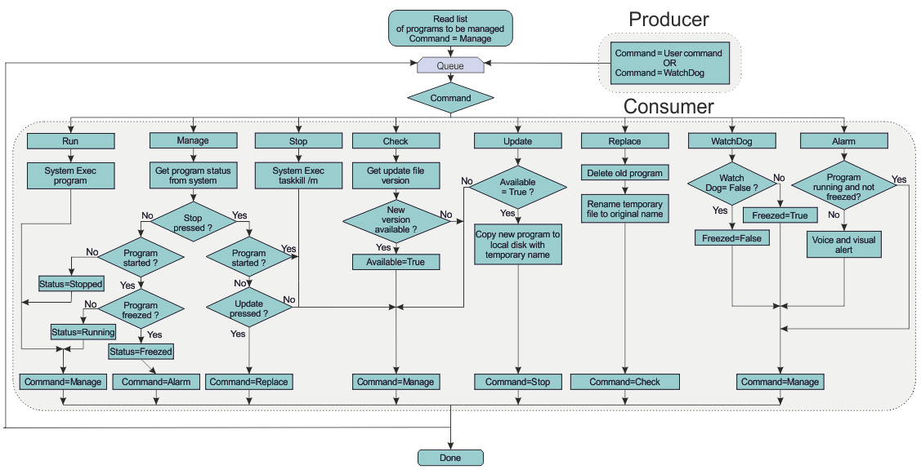
Algorithm
A version of the Producer/Consumer design was used, where the user interface (producer) produces messages and the tasks (consumers) consume them.

Slide 6
User Interface
In the Program Manager each project module is presented as an object with a set of parameters: name, path to the executable file, startup checkbox, control buttons and operation status indicator, version information.

Slide 7
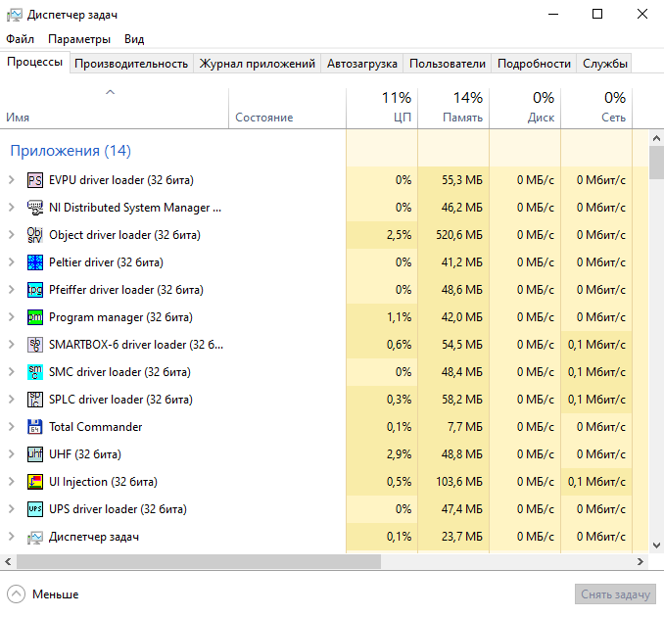
Execution monitoring
To ensure the reliability of the system it is very important to know that all the modules are running and not hanging. We use two technics for it:
Check if module name presents in the list of Windows Task Manager
Use WatchDog logic

Slide 8
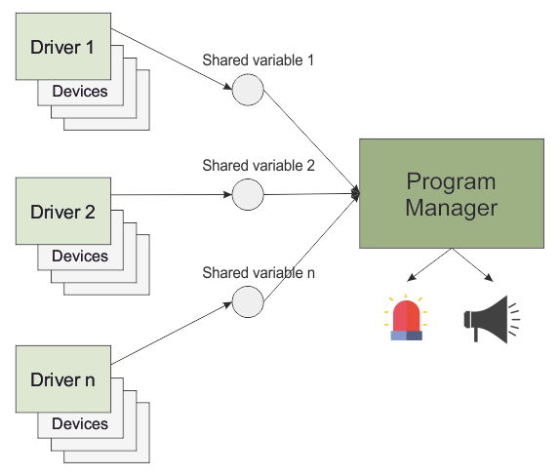
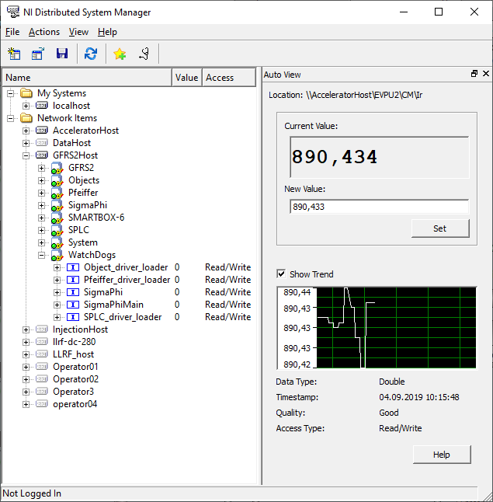
WatchDog
Every driver executes at least one process that interacts with the dedicated device. Every process has its own time counter that is supervised by the driver. If any of these processes stop, driver will increment the value of the “watchdog variable”. Program Manager reads this variable and if it is greater than zero, an alarm occurs. When an alarm occurs, the status indicator on the front panel will turn red and a voice alert will pronounce alarm message, for instance, «Module SMARTBOX-6 malfunction».

Slide 9
Conclusion
The Program Manager was used on all project computers for a year.
Voice notification allows the operator to respond quickly and call service personnel to resolve the problem. It increases the reliability of the project.
Auto run of modules allows to simplify the startup of the software.
The available update service significantly saves system maintenance time.
The Program Manager is an standalone application and can be used on other systems as well.

