Slide 1
Project of a Fast Interaction Trigger for MPD experiment .
V. Yu. Rogov, S. V. Sergeev, V. I. Yurevich

Slide 2
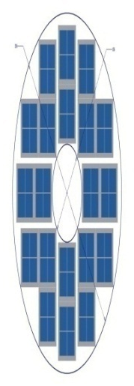
FFD geometry
FFD
2.7< |η| < 4.1
FFD
E
W
L
R
γ
p
π
Au
θ
Au
p
p
π
γ
L = 140 cm
FFD should provide ZERO-level trigger generation based on
Z-axis interaction coordinate
Hit multiplicity

Slide 3
FFD location

Slide 4
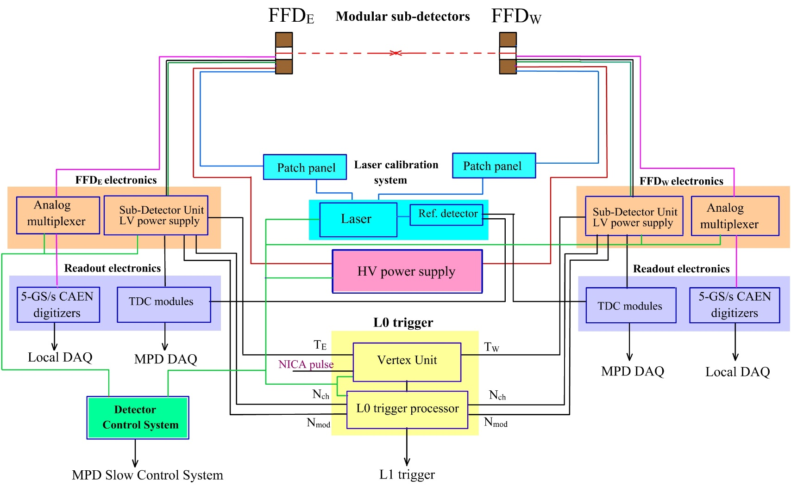
FFD equipment

Slide 5
Arm processor (SDU)
Ethernet
Serial line server
LVM
SPM
LVM
SPM
APM
SPM
LVM
SPM
LVM
IM
To TDCs
RS485
Optical link to DAQ
5 FE boards
5 FE boards
To vertex processor
5 FE boards
5 FE boards

Slide 6
SPM+ LVM
LVM
Back-Plane
Positive regulated power supply +4V-8V, 150 mA
I,V,En
RS485
MCU
Positive regulated power supply +4V-8V, 150 mA
I,V,En
Negative power supply
-7,3V, 100 mA
I,En
HDMI for one FEE module (4 LVDS channels)
SPM
RS485
4 * LVDS fan-out 1:2
individual
Signal processing
To Arm module
Signals to DAQ

Slide 7
Signal processor module
MCU
RS485
Station address 5 bits
Programmable delay
FPGA
RS485
Individual signals
JTAG
CLM
Programmable delay
RS422
Programmable delay
From/to other electronic
Programmable delay
20 delay lines per SPM

Slide 8
Individual channel diagram
TDC (width)
Histogram
To TDC
N_{ch} N_{mod}
Σ
Latch
Fan-out
Counter
Counter
Adjustable delay
8
Pulse width discriminator
Shaper
20 channels
20 channels
OR
Shaper
Fan-out
Counter
Counter
Adjustable delay
Counter
Pulse width discriminator
Shaper
FPGA

Slide 9
Vertex processor
MCU
RS485
Precise Programmable delay #1
Preprocessing block
FPGA
RS485
processing block
Precise Programmable delay #2
RS
JTAG
CLM
RS422
AND
Precise Programmable delay #3

Slide 10
Development Constrains
Since the system is quite complicated we use KISS approach (Keep It Stupidly Simple)
Complicated modules should be split to a set of simple ones
The content of FPGA (firmware) for each trigger operation mode should be as simple as possible
Different operation modes of firmware are realized as a set of independent FPGA configurations instead of a complicated one having many branches
This brings a need to reload FPGA RAM “in the flight”

Slide 11
FPGA configuration loading module (CLM)
CLM is a daughter board with dimensions 50*60 mm^2
CLMs could be connected to a branch a daisy chain
The CLM unit contains a library of configurations recorded to a micro-SD card with FAT32 file system
The configurations could be loaded via JTAG to all FPGAs in parallel by one command from the central DCS. Loading time is about 3 sec.
FPGA configurations could be loaded to CLMs via serial link. Loading time is about 2 min. Loading could be done in parallel to many CLM branches

Slide 12
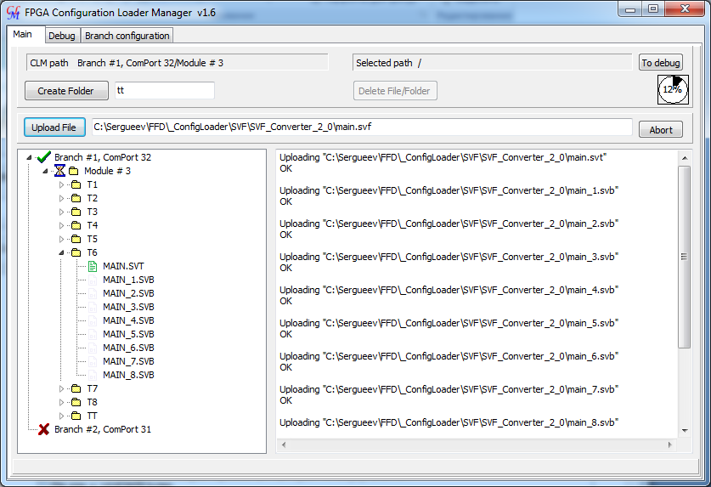
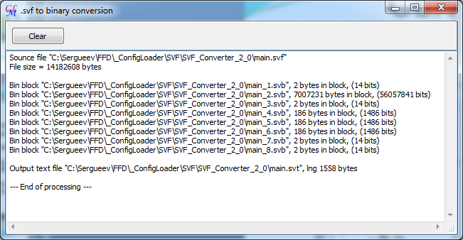
CLM manager prototype

Slide 13
Actual status
The architecture of the FFD system is fixed
The prototypes of SPM, LVM, APM, VPM main units are tested using FPGA Cyclone IV test board. Some adjustment will be needed to migrate to Cyclone X GX
SMP, LVM and a backplane are in production
Arm Processor Module and a Vertex Processor Module are under development
CLM prototype has been successively tested.

Slide 14
Thank you for the attention

