Slide 1
SmartLINAC
Anomaly detection and breakdown prediction in RF power source output: a review of approaches
* Smart Anomaly Detection and Maintenance Planning Platform for Linear Accelerators
Notes:
Two parts, first introduction to the project, then of our research

Slide 2
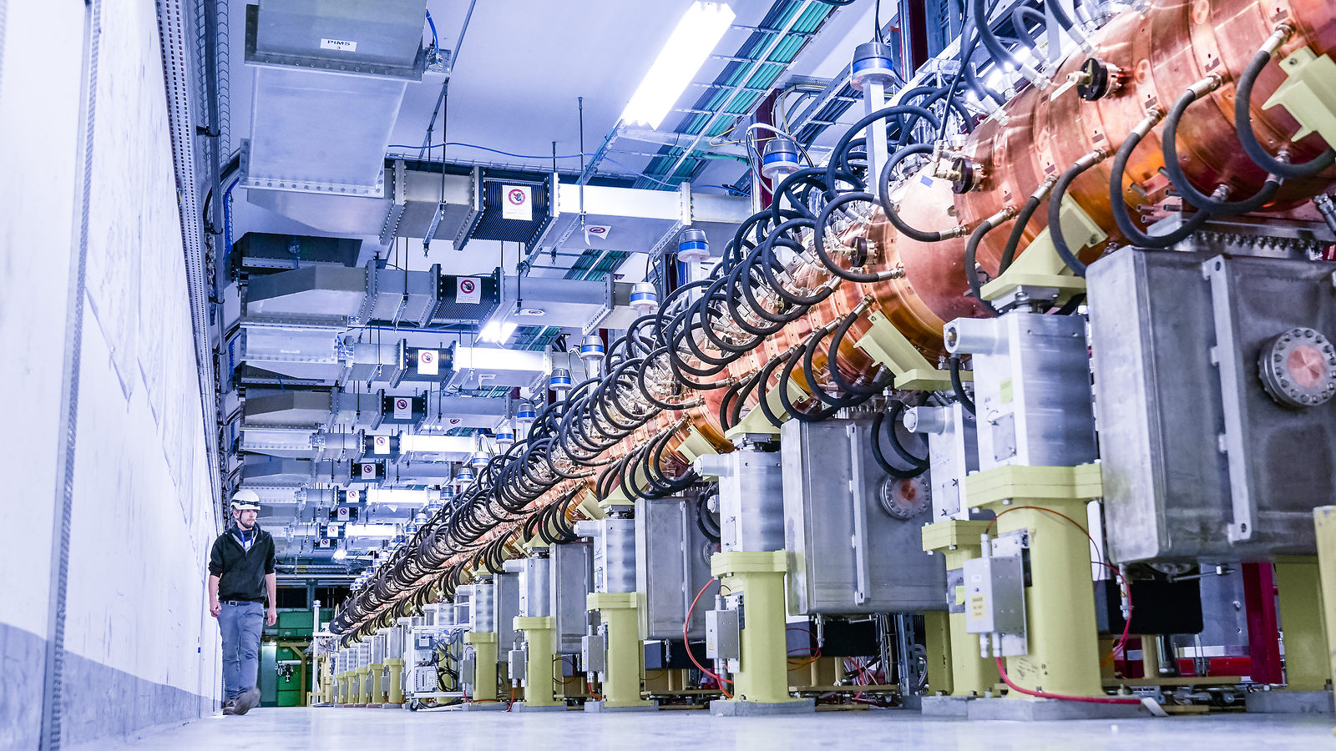
Introduction
Linear Accelerators (LINACs) are a type of particle accelerators able to accelerate charged particles to high speeds
Used in research, industrial and medical applications, from particle physics research, to cancer treatments or non-destructive material testing
Electron linear accelerators are today the core of modern radiation therapy facilities
The international cancer corp emphasis the vital importance of reducing maintenance cost, the main barrier to the spreading of the technology
SmartLINAC

Slide 3
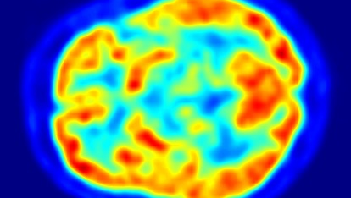
SmartLINAC project objectives
Increase availability, reduce operational costs:
Lower the technical skills maintenance requirements by:
Fault diagnosis allowing local resources to make guided interventions
Planned maintenance by:
Personalized fault prediction (machine learning)
I will now present you our advances towards an on fit preventive maintenance system
It is a collaborative project between Samara University, CERN and medical industry
SmartLINAC

Slide 4
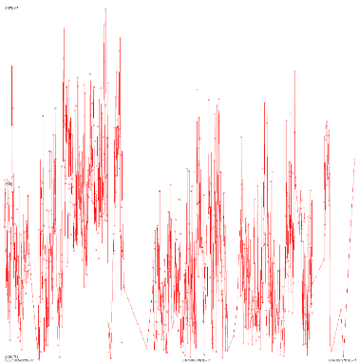
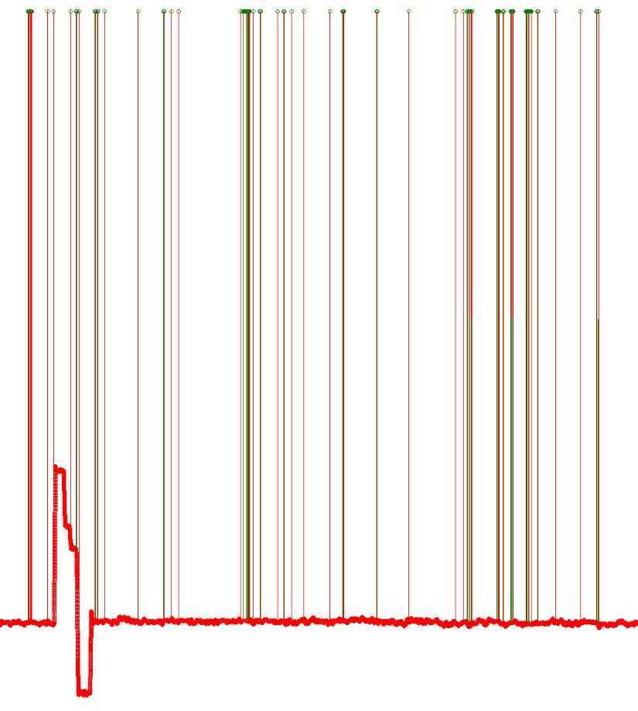
Noise:
Anomaly:
SmartLINAC
Notes:
THE DATASET
we investigate jitters on LINAC4’s 2MHz RF plasma generators’ forward power’s history, which plasma form’s the LHC’s proton beam
5 million entries, unlabeled, 3 periods of anomaly
An anomaly is a sequence where the source start jittering more violently
First challenge was to label data and second to understand them
Taken by window, the anomaly periods can’t be distinguished from normal usage and noise

Slide 5
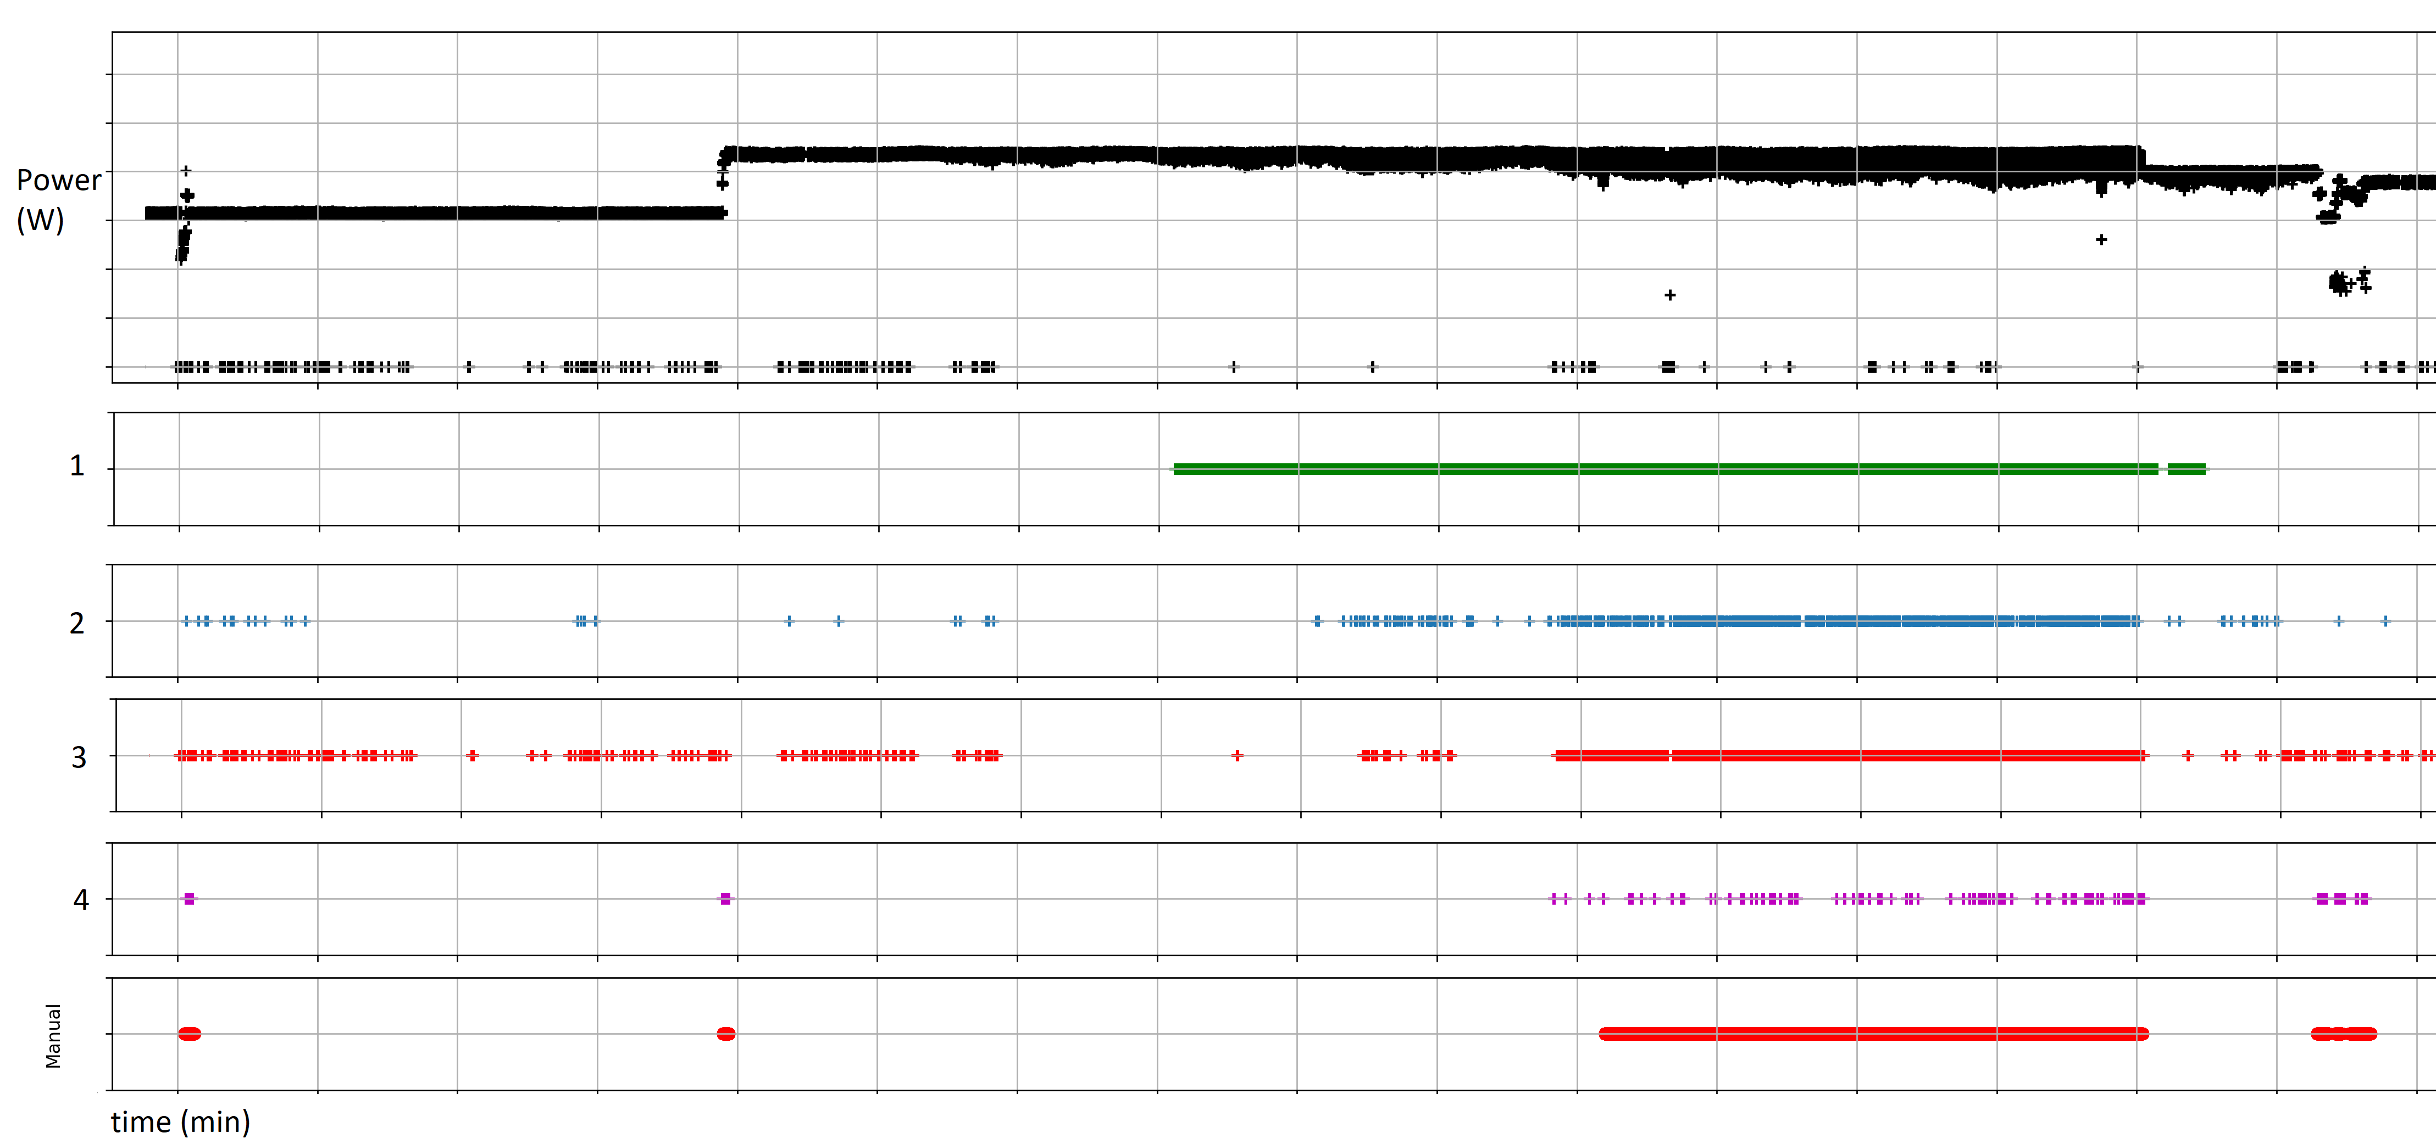
SmartLINAC
Notes:
First challenge was to label data and second to understand them
We took a somewhat unusual approach; we took four big data specialists and asked the m to solve the problem their way
3.1 Filtering, smoothing and distance from average highlighted the first signals of an anomaly and showed its growths structure
Distance from average and Markov kernel
3.2 Label-related clustering, showed the possibility to solve the problem using machine learning approach, with an excellent scalability, which is essential for the adaptability of the solution to our project.
The method is based on the search for features that distinguish the marked problem intervals of jitter from the rest of the data
3.3 Sequence analysis using statistical features highlighted the possible clustering in the data, giving us an opportunity to differentiate in depth states and stages of anomalies.
This method consists in processing the sequence by sliding window and calculating the statistical features for the fragments of the sequence located in this window [9].
The idea behind the approach is based on the assumption that there are some statistical characteristics allowing predicting the appearance of abnormal periods in time series (anomalies).
3.4 clarified for us the nature of the noise present in the data and allowed to differentiate jittering by their origins.
In this approach, statistical calculations are based on time series’ statistical metrics.
As a result we can now label the data, understand them, we can spot early symptoms (predict) anomalies
We have the material to train a neural network able to find the right characteristics in order to adapt to any output of the RF’s source output

Slide 6
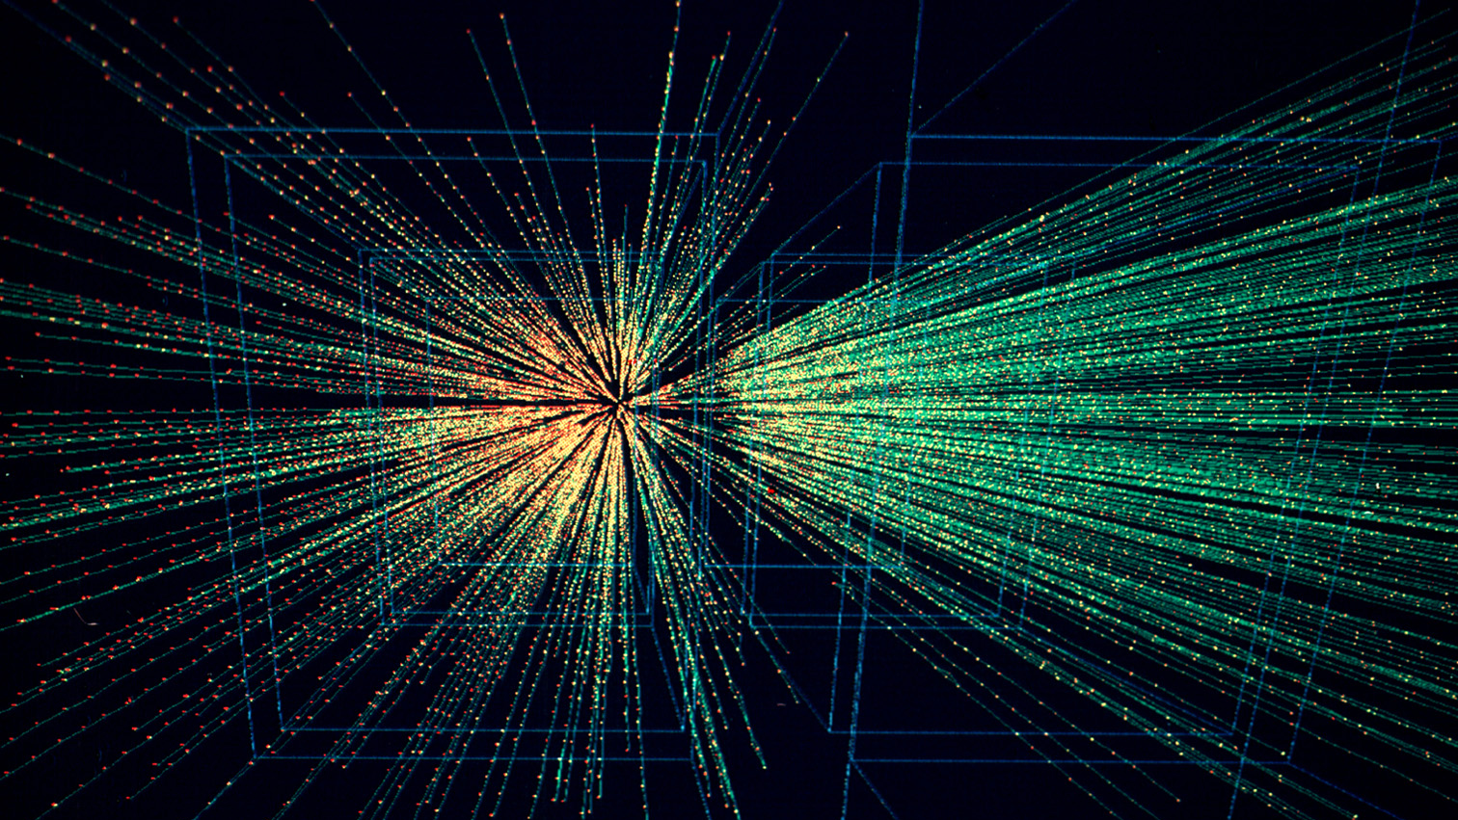
Next steps
Implementing existing solution
Combination of methods overviewed
Getting more environmental data
Getting more data from other sources
Test
Repeat!
Adaptable software solution
SmartLINAC

Slide 7
SmartLINAC
Contact:
Yann Donon
Ul. Lesnaya 4, Samara, Russia
Tel. RU: +7 999 969 54 24
Tel. CH: +41 79 870 62 89
yann@donon.ch
Yann Donon^{a,b,c,d} , Alexander Kupriyanov^{a,b,d}, Dmitriy Kirsch ^{c}, Alberto Di Meglio^{b,c}, Rustam Paringer^{a,b,d}, Pavel Serafimovichª, Sergey Syomic^{a,d}
ª Samara National Research University, Moskovskoye shosse 34, Samara 443086, Russia
^{b} CERN openlab, Information Technology Department, CERN, CH-1211 Genève 23, Switzerland
^{c} CERN, Espl. des Particules 1, 1211 Meyrin, Genève, Switzerland
^{d} Image Processing Systems Institute оf RAS, – Branch of the FSRC “Crystallography and Photonics” RAS, Molodogvardeyskaya 151, Samara 443001, Russia

