Slide 1
Cloud integration within DIRAC Interware
Nikita Balashov, JINR
Ruslan Kuchumov, SPBU
Nikolai Kutovskiy, JINR
Igor Pelevanyuk, JINR
NEC2019

Slide 4
Base of the slide taken from Dr. Tadeusz KURTYKA talk during NEC2019
Already Use DIRAC

Slide 5
DIRAC@JINR resources
CREAM-CE
Clouds
SE
Over GridFTP
Over xRootD

Slide 6
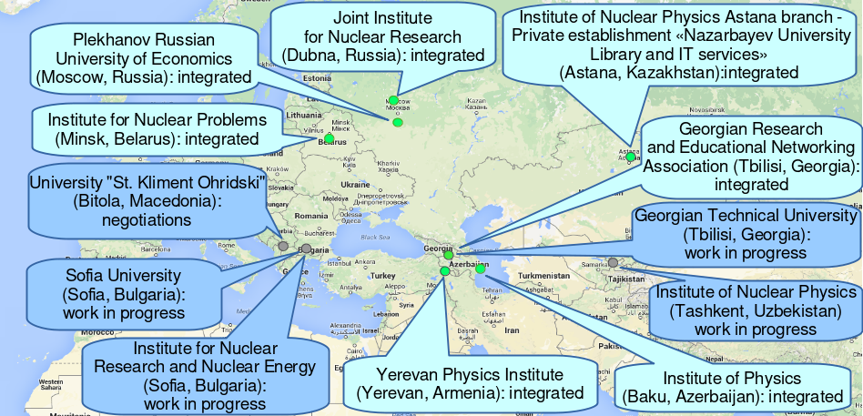
“Cloud bursting”
To join resources for solving common tasks as well as to distribute a peak load across resources of partner organizations to speed up receiving of scientific results.
Most of clouds are based on OpenNebula platform.

Slide 7
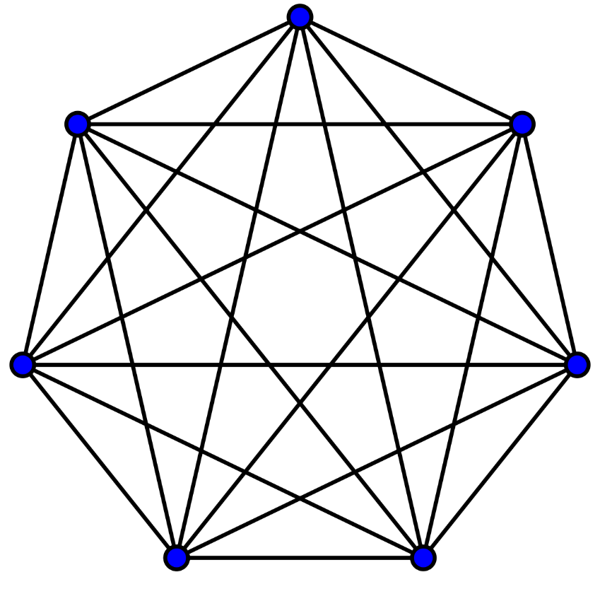
“Cloud bursting”
Cloud bursting is a model in which the local resources of a Private Cloud are combined with resources from remote Cloud providers.
All the clouds should be aware about each other.
Complexity of the system grows significantly with increasing number of participants.
Schema of 7 clouds interconnected

Slide 8
Integration via DIRAC

Slide 9
DIRAC pilots(simplified)
DIRAC Pilot
DIRAC Cloud Pilot
Install DIRAC basic
Bootstrap a VM
Perform tests
Start VirtualMachineMonitor
Initiate JobAgent
Start DIRAC Pilot
Request job
Complete job
Upload result
If no workload, request VM delete
Get new job or exit

Slide 10
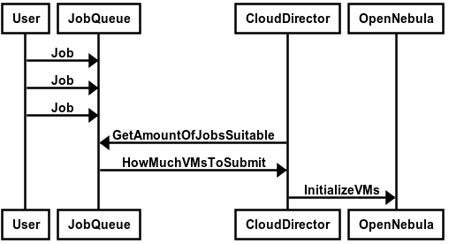
Creation of VM workflow

Slide 11
Clouds integration
In order to make it real we had to choose the technology for talking with the clouds.
rOCCI interface – already existed.
OCCI – had been developed and tested, but it still requires OCCI service running on all clouds.
DIRAC Cloud Endpoint
rOCCI
OCCI specs
OpenNebula

Slide 12
Cloud Endpoint
Create VM
Stop VM
Get all VM IDs on endpoint(optional)
Assign Floating IP(optional)
DIRAC Cloud Endpoint
rOCCI
OCCI specs
OpenNebula

Slide 13
OpenNebula Endpoint

Slide 14
OpenNebula Endpoint
OpenNebula XML-RPC endpoint created and tested
All basic functionality are there. It was successfully used to integrate clouds. Present status and main directions of the JINR cloud development: https://indico.jinr.ru/event/738/session/6/contribution/118
Some not-mandatory methods still have to be implemented.
Performance of cloud resources is mostly limited by the properties of particular cloud resources. Especially by network connectivity.

Slide 15
OpenNebula Endpoint
OpenNebula XML-RPC endpoint created and tested
All basic functionality are there. It was successfully used to integrate clouds. Present status and main directions of the JINR cloud development: https://indico.jinr.ru/event/738/session/6/contribution/118
Some not-mandatory methods still have to be implemented.
Performance of cloud resources is mostly limited by the properties of particular cloud resources. Especially by network connectivity.

Slide 16
Results
OpenNebula endpoint was developed for DIRAC.
It was used to integrate JINR Member state clouds into JINR DIRAC infrastructure.
It was added as a standard resource endpoint to DIRAC repository.
Right now apart from JINR it is already used by BES/JUNO/CEPC DIRAC installation

Slide 17
Cloud integration within DIRAC Interware
Nikita Balashov, JINR
Ruslan Kuchumov, SPBU
Nikolai Kutovskiy, JINR
Igor Pelevanyuk, JINR
Thank you for attention!
NEC2019

