Slide 1
Distributed control and monitoring tools at LU-20 and HILAC complexes.
Elkin Vladimir
Joint Institute for Nuclear Research
VBLHEP

Slide 2
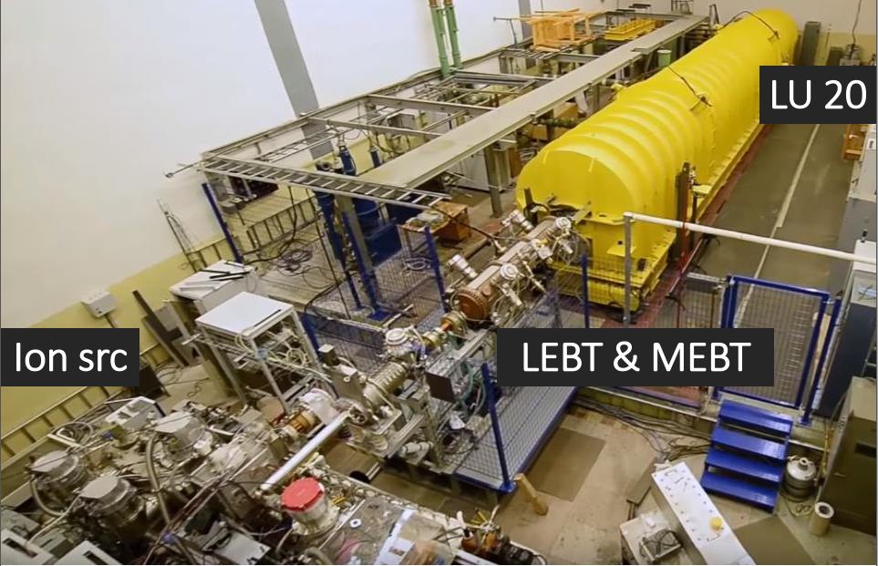
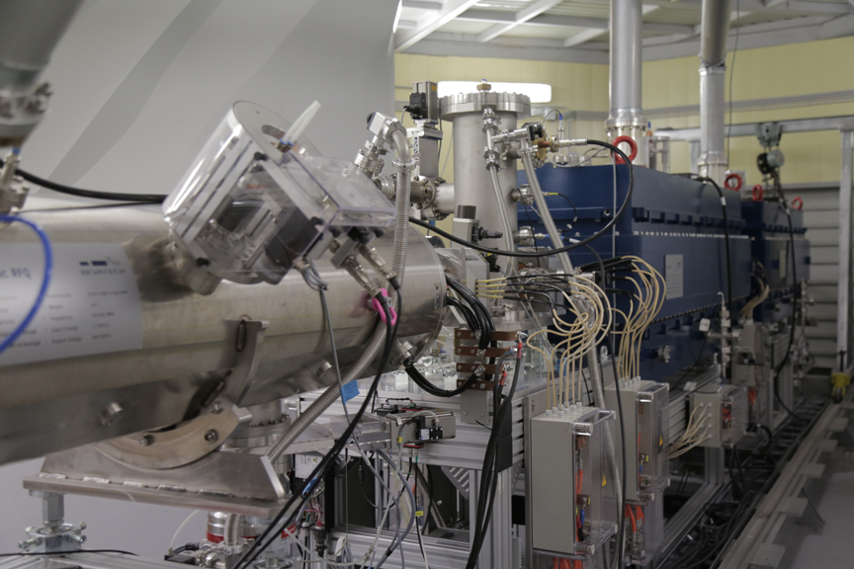
Injection complex
HILAC
LU 20

Slide 3
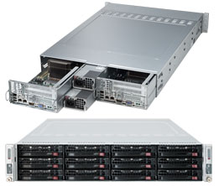
Server equipment
SuperServer 6028TR-D72R
Two hot-pluggable systems (nodes) in a 2U form factor.
Includes:
CPU Intel® Xeon E5-2640v4 2.40GHz,25M,8.00GT/s 10-Cores
Memory modules DDR4-2400MHz 8GB (8pcs)
HDD SAS 3,5" Seagate Enterprise 600GB (8pcs)
2-port controller Ethernet 1GbE
2-port controller Ethernet 10GbE

Slide 4
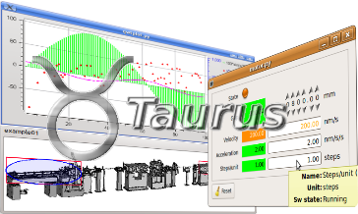
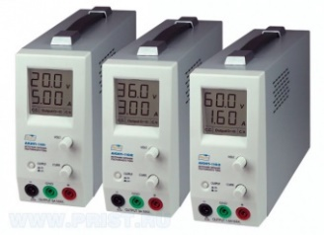
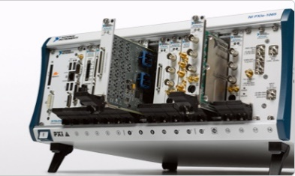
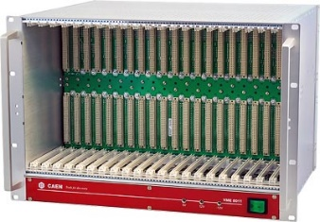
Control System layout
Web Application
Desktop Application
Client
layer
WebSocket
TANGO
protocol
REST (HTTP)
Service
layer
CS services
Tango DB
Archiving
Storage
MODBUS, TCP/IP SOCKET … etc
Equipment
PXI, VME
PS …

Slide 5
The TANGO Device Server
A Tango device server is the process where the Tango class(es) are running.
A Tango device server
Tango device class A
Tango device class B
Device
sr/v-ip/1
Device
sr/v-ip/2
Device
id4/mot/1
Device
id4/mot/1
Device
id4/mot/3

Slide 6
TANGO devices
Client
Client
TANGO Software Bus
Macro device: e.g. Accelerator
sub devices: e.g. powersupplies
sub devices: e.g. ADC, modbus…

Slide 7
TANGO devices
Each Tango device is a CORBA object
Each Tango device supports the same network interface
What do we have in this interface ?

Slide 8
Commands & Attributes
On the network a Tango device mainly has
Command(s): Used to implement “action” on a device (switching ON a power supply)
Attribute(s): Used for physical values (a motor position, a temperature, a spectrum, an matrix)
Clients ask Tango devices to execute a command or read/write one of its attributes
A Tango device also has a state and a status which are available using command(s) or as attribute(s)

Slide 9
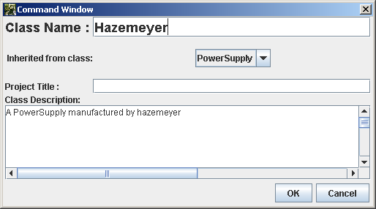
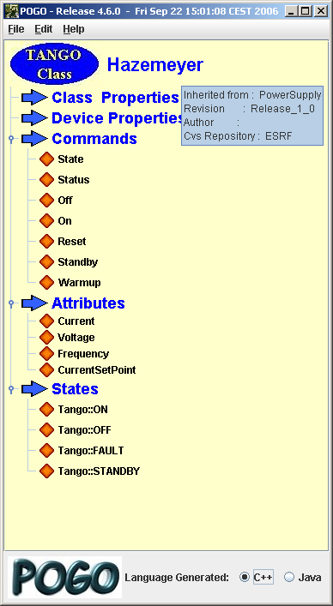
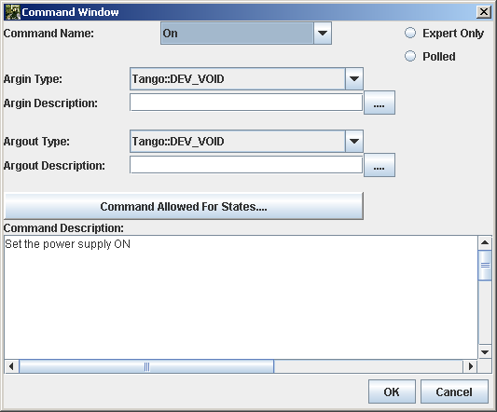
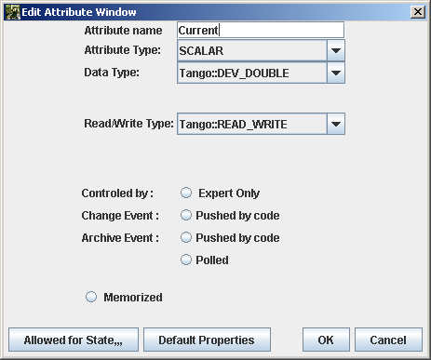
POGO. Device Server Code Generator

Slide 10
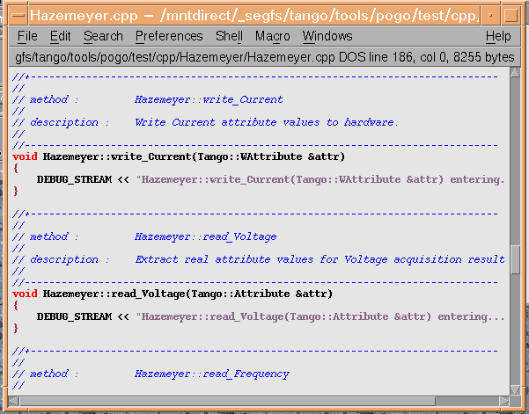
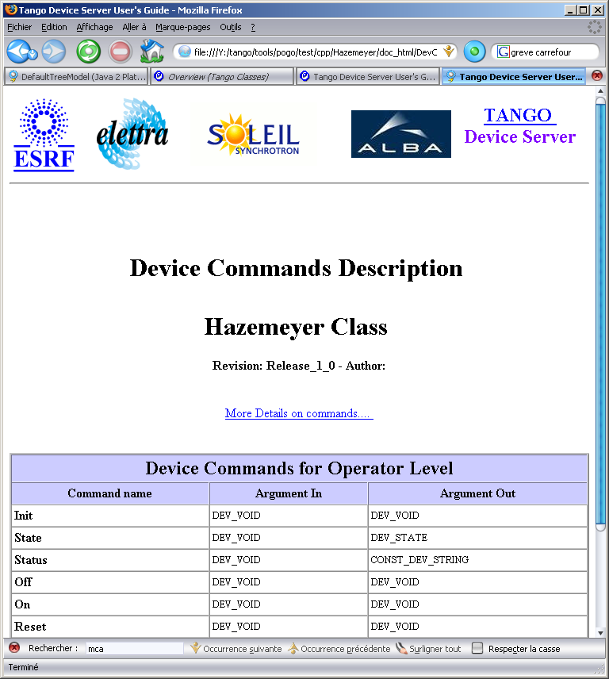
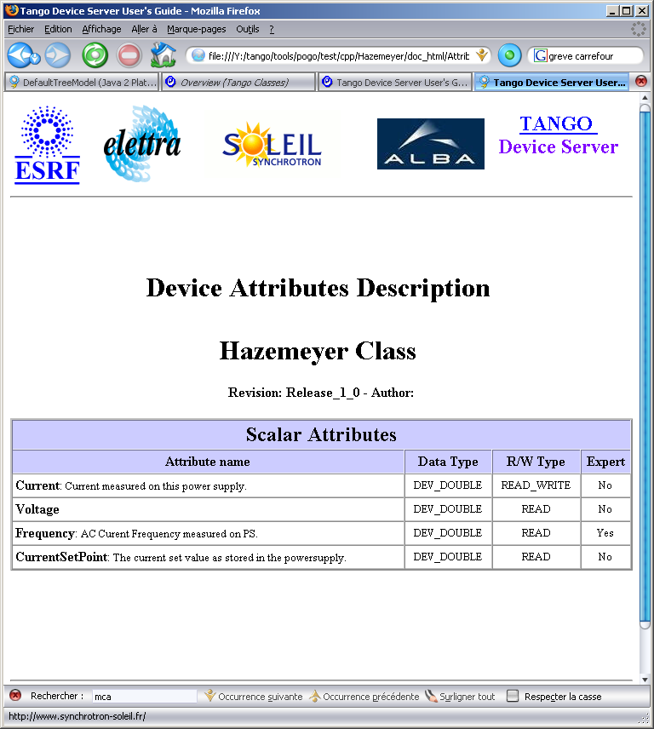
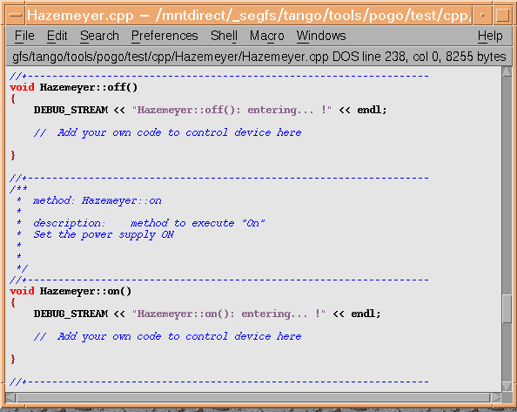
POGO. Device Server Code Generator

Slide 11
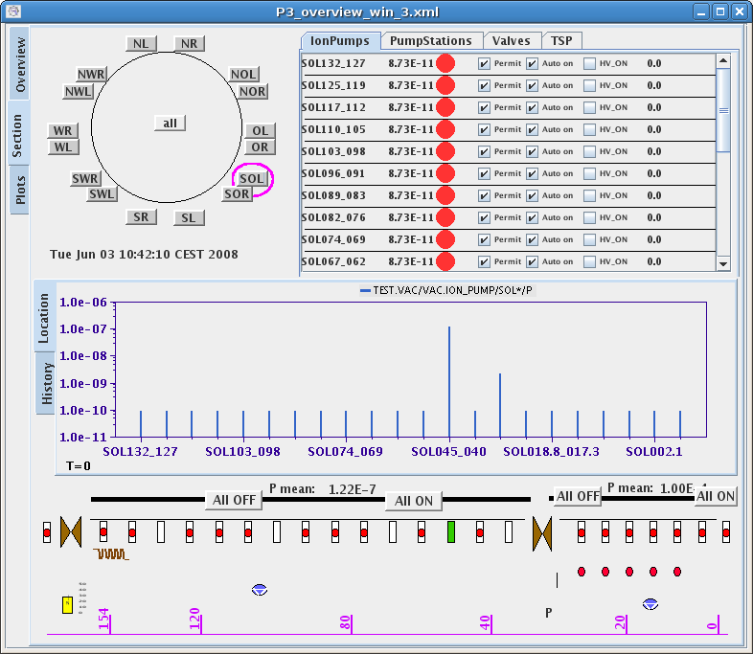
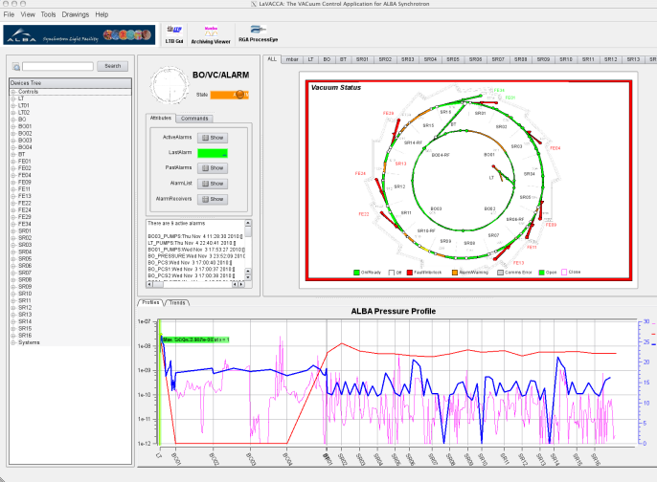
Control System. Client layer. TANGO apps.
TANGO control system has several software suites for client-level.
Sardana (open source SCADA using python)
Jddd (Java editor for control system panels)
QTango (c++ and python)
Taurus (python)
Labview (client API)

Slide 12
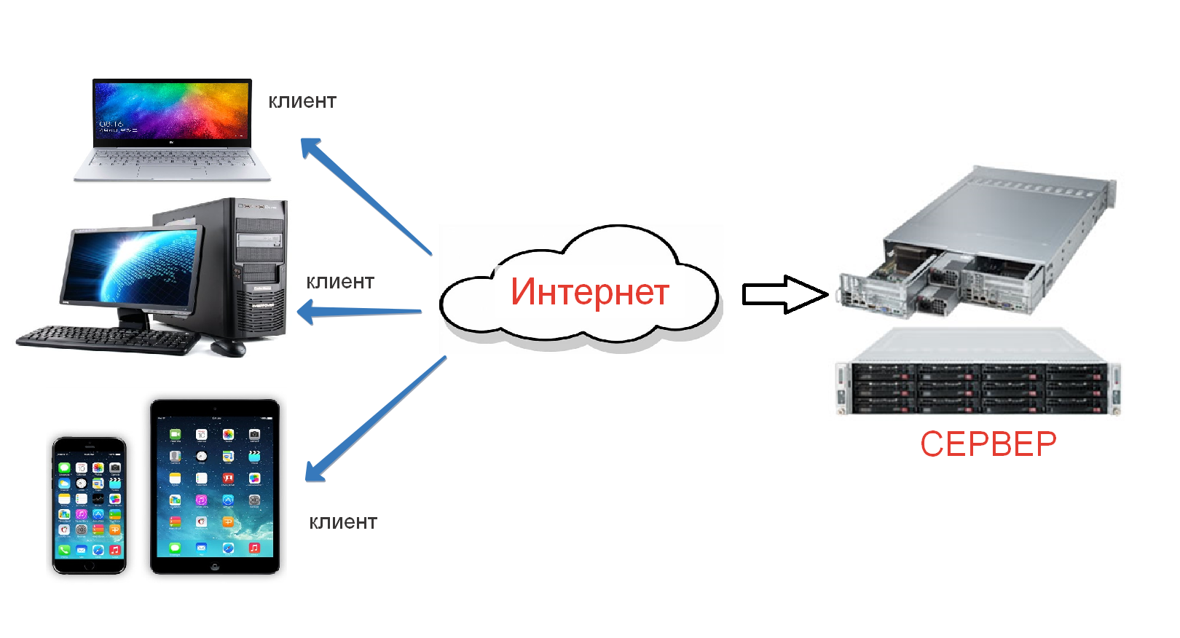
Control System. Client Layer. Web applications

Slide 13
Client-Server communication
This TANGO modules are used for communications between TANGO devices and Web applications
RestDS - to provide access to TANGO control system units through http(s) requests (Ajax) (The developer - Sedykh G.)
WebSocketDS - to provide access to TANGO control system units through WebSocket. Its main advantage is the use of full duplex communication. (The developer - Elkin V.)
These modules are cross-platform generic Tango device-servers, developed in C++ with Boost library. It includes built-in web servers. No additional software is needed. The client web pages could be developed in html with any JavaScript framework

Slide 14
RestDS
HTTP providing half-duplex communication
One connection - One request – One response
http://host:port/tango/rest/rc4/devices/thermo/shoulder/1/attributes/T56/value
Web-Client
JSON response if successful
RestDS
{
“name”: “T56”,
“quality”: “VALID”,
“timestamp”: 1473348563,
“value”: 273.12,
}
Host:port
Threads number
Authentication
Security (SSL)
Or error code in case of failure
400 – Bad Request 403 – Forbidden
401 – Unauthorized 404 – Not Found

Slide 15
WebSocketDS
WS providing full-duplex communication
One connection - Unlimited requests – Data from server without requests
ws://host:porte
Web-Client
JSON data from events
JSON data from events
WebSocketDS
Command or other request
Host:port
Authentication
Security (SSL)
Command response
ETC…
Or error code in case of failure
400 – Bad Request 403 – Forbidden
401 – Unauthorized 404 – Not Found

Slide 16
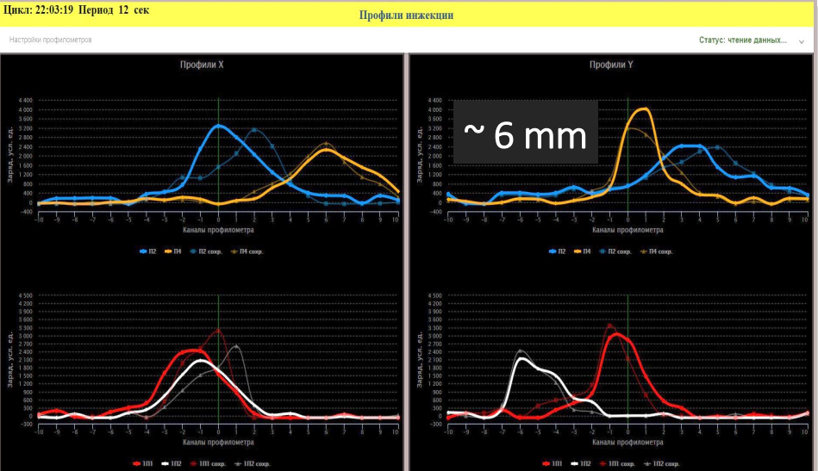
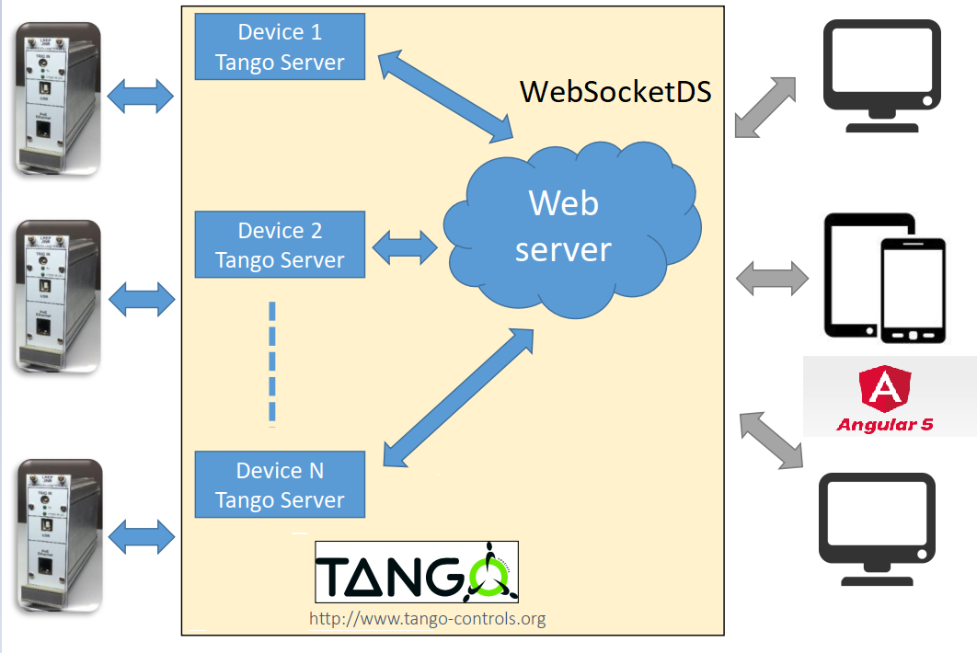
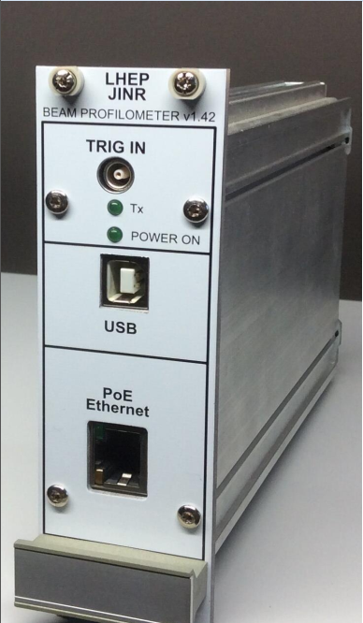
Beam profile measurement module
A client for managing and monitoring injection profiles is a great example of the effectiveness of using WebSocketDS.
(Профилометр автор Д. Понкин)

Slide 17
Beam profile measurement module HTTP or WebSocket?
HTTP (RESTDS)
WEBSOCKET (WEBSOCKETDS)
Do you have
new data?
CLIENT
SERVER
CLIENT
SERVER
No,
Sorry
ETC…
ETC…
1 request every
100 ms
5 - 10 seconds or more
ETC…
ETC…
Do you have
new data?
Hey!
New data for you
Yes. Get it

Slide 18
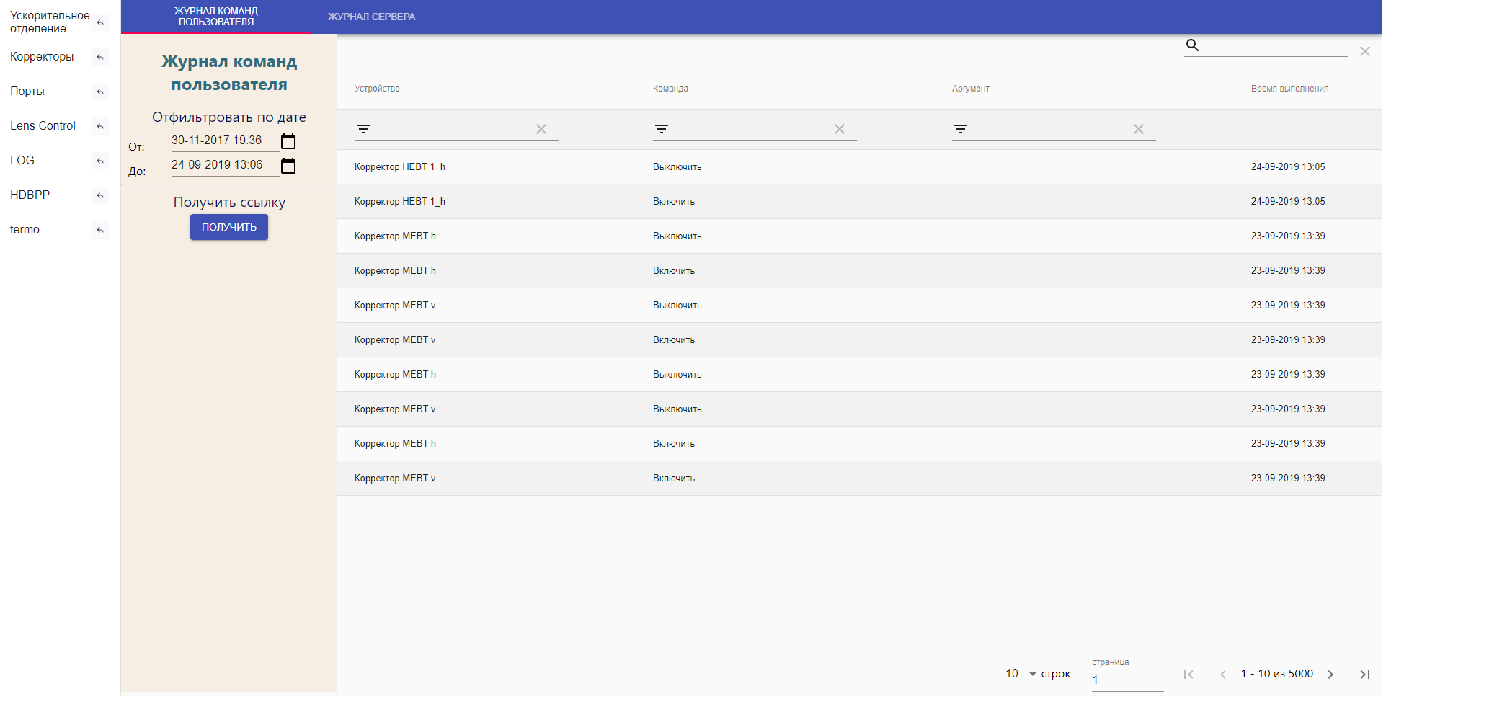
Web application for combining pages
<iframe> An inline frame places another HTML document in a frame.
list of links to other pages
selected page in tag
<iframe>

Slide 19
Desktop Emulation
Widgets can be moved within the page. Position is saved in local storage. Widgets are set to the last position on the next loading page.

Slide 20
Desktop Emulation

Slide 21
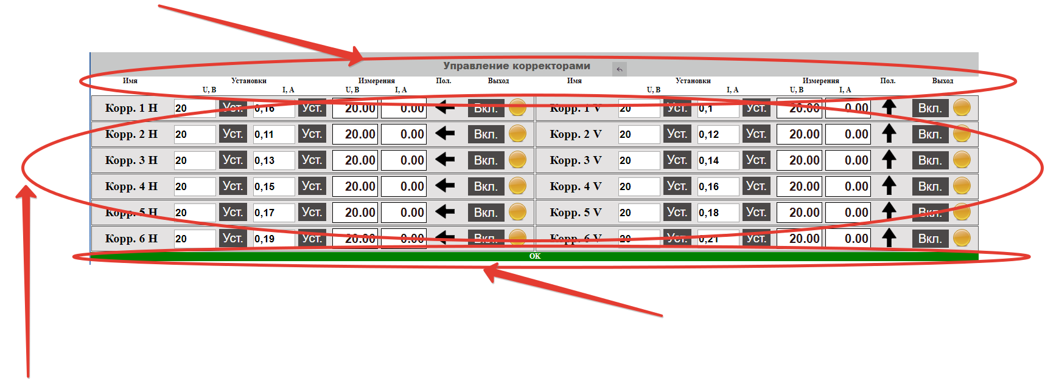
Clients for PS Control
This parameters are set In JSON file:
table headers. Names and widths
connection status
List of power supplies with used components (Inputs, outputs, buttons)

Slide 22
Clients for PS Control
Output data of chosen attributes
Buttons with commands
Alias of device
Input with max min and step set
Polarity
List of power supplies with used components (Inputs, outputs, buttons) is written in JSON file. Each components has JSON object with parameters.

Slide 23
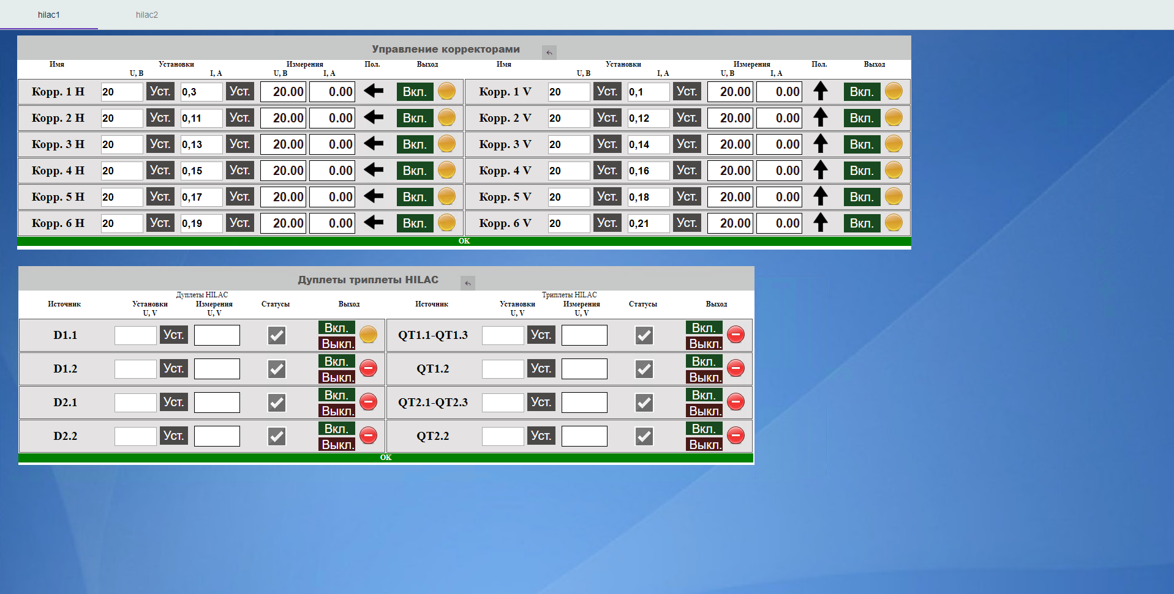
Clients for PS Control
tabs
<div> with <iframe>

Slide 24
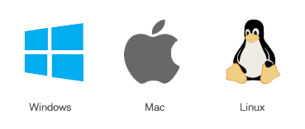
Web + Desktop applications
Desktop APP
Web Application
Another method is to write a universal application that works as a standard desktop application, and through a browser (web application).

Slide 25
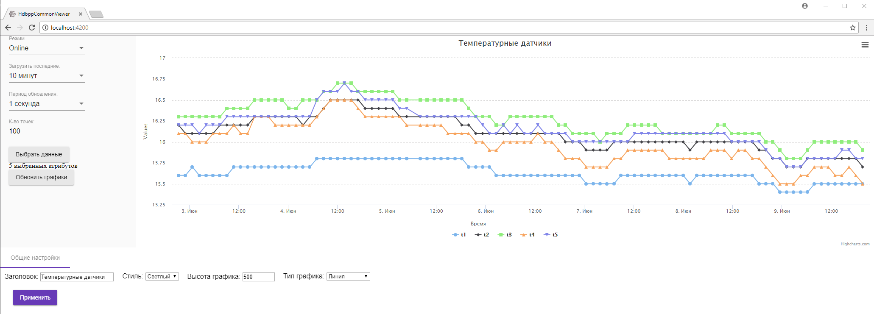
Web application for visualizing archived and online data
This Web application can work in different modes.
Mode with settings panel. The user sets the type of graph, and also sets the data source and data types (online or archived data) as well as common chart settings

Slide 26
Web application for visualizing archived and online data
The mode of the saved charts.
All settings for the type of charts and data source are contained in the URL (GET parameters) or are stored in the database
Title
Aliases

Slide 27
Web application for visualizing archived and online data. URL mode
List of displayed attributes
svconf=BASE64(JSON)
JSON configuration contains
Displayed attribute names
The minimum settings of the general form
In this mode, all settings are contained in the URL. This, for example, eliminates the need to write individual clients for different data sources. Charts can be inserted into any webpages using the <iframe> tag

Slide 28
Thanks for attention

Slide 29
Protection. 2-step authentication
One of the security methods used is 2-step authentication.
A managed application is running on this server
This server has several IP:
External (eg 159.93.0.0/16)
Internal (eg 172.16.0.0/12)
8
response
5
6
4
checking
confirmation
MD5(“nonce” + “password”)
Getting «salt» (nonce)
2
This server has only an internal local IP. (eg 172.16.0.0/12) The application (AuthDS) is located on this server.
1
“nonce” request with login
7
Removal of "salt"
3
Temporary storage

