Slide 1
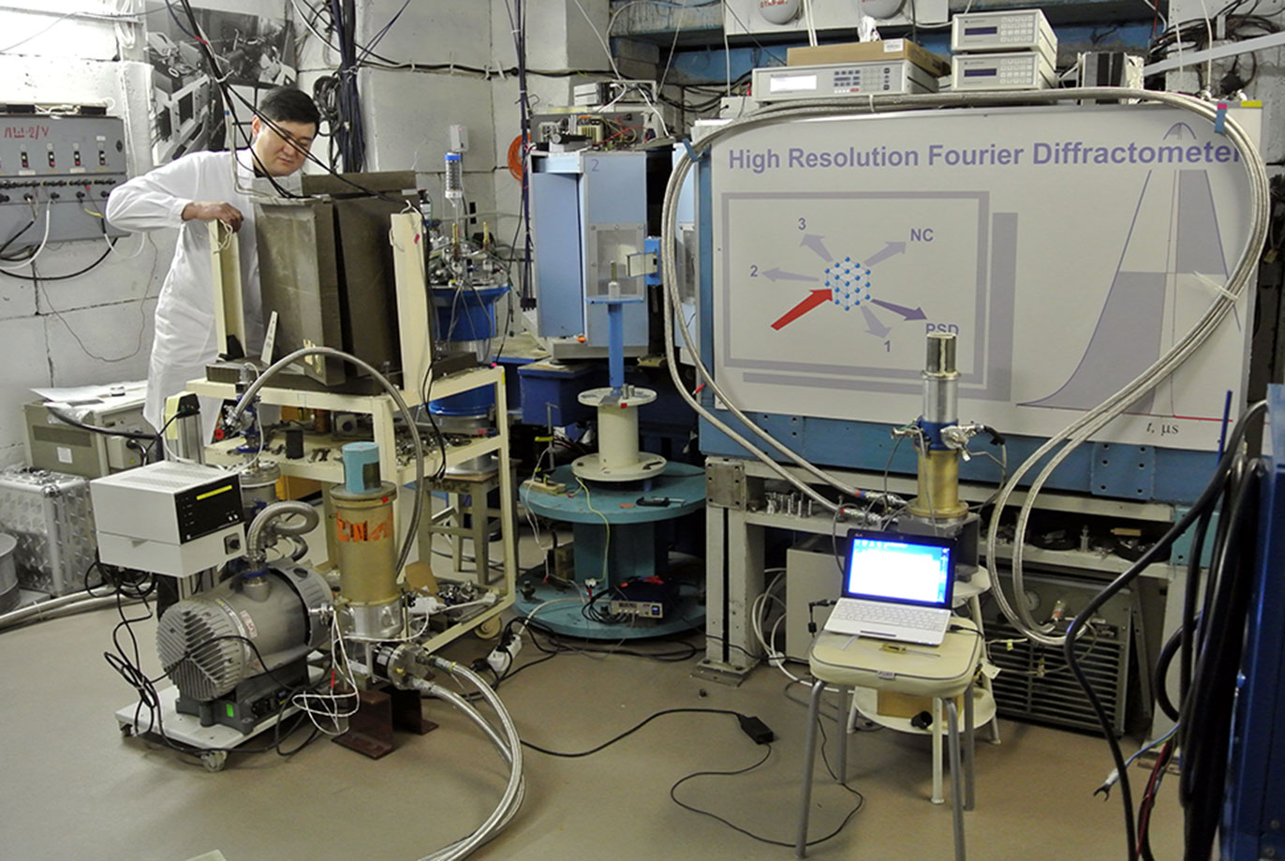
Modernization of neutron Fourier chopper for High-resolution Fourier diffractometer (HRFD) at the IBR-2 (research pulsed reactor), JINR (Dubna)
Dmitry Balagurov, Anatoly Balagurov, Ivan Bobrikov, Svetlana Murashkevich, Alexander Sirotin, Tatiana Petuhova, Nikolay Zernin, Valery Zhuravlev (JINR, Dubna)
Vasvari Gyula, Szasz Gabor (Mirrotron Ltd, Budapest)

Slide 2
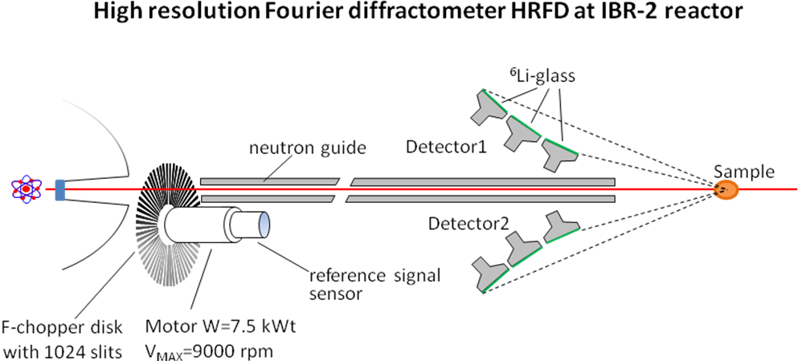
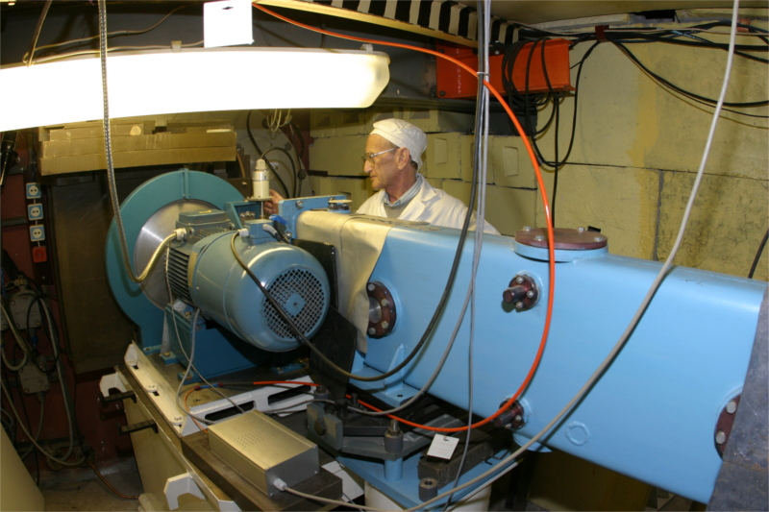
Introduction
The high resolution diffractometers are one of the indispensable types of spectrometers in every advanced neutron research center. At pulsed neutron sources with short pulses (Δt ≤ 30 μs) based on proton accelerators with a heavy metal target, a high resolution (Δd/d ≤ 0.003) of the time-of-flight (TOF) diffractometer is reached if the flight path, is 50 m or longer.

Slide 3
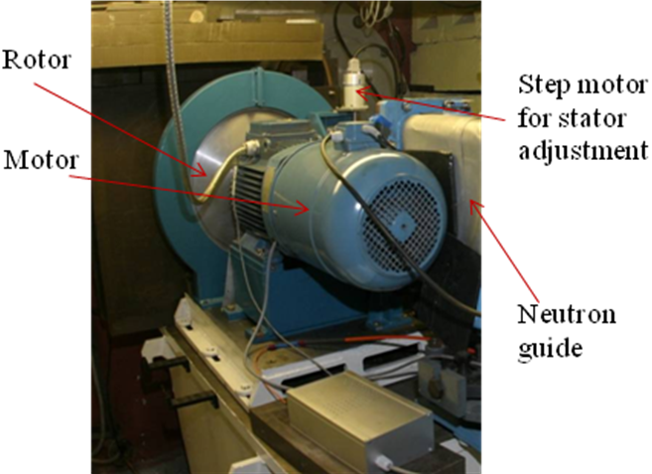
HRFD before upgrade
Rotor diameter | 540 mm
Max rotation speed | 6000 rpm
Number of tapered slits | 1024
Slit length | 60 mm
Slit width in the middle of the length | 0.703 mm
Slit filling material | Gd₂O₃
Gd₂O₃ layer thickness | 0.8 mm
Beam: Neutron guide aperture | 30x200 mm
The distance between Fourier-chopper disk and control drive | 20 m
The distance between control drive and DAQ | 35 m
Fourier chopper of the HRFD. Disk of the Fourier chopper, M2AA motor, and beginning of the neutron guide are seen.
The stator is placed on the opposite side of the motor before the neutron guide.

Slide 4
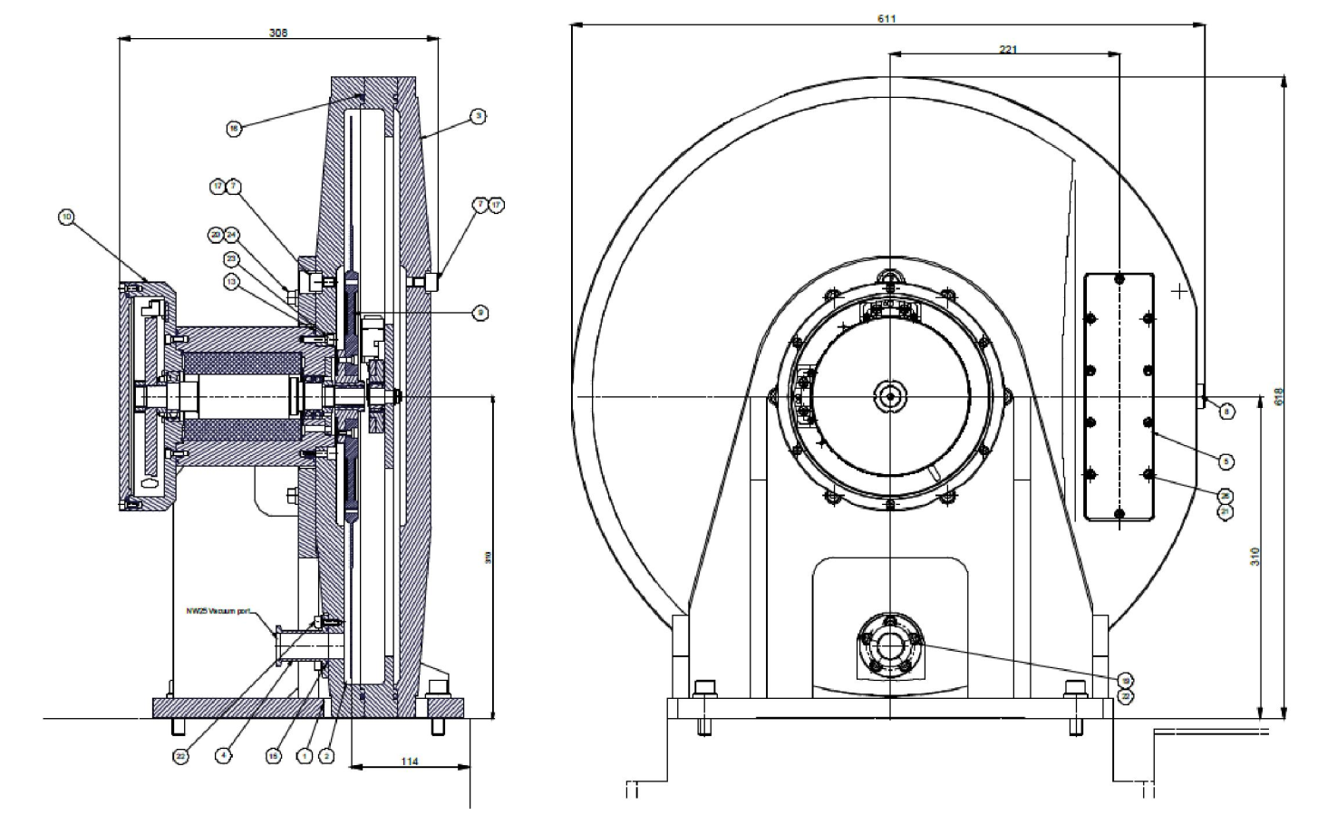
The new HRFD Chopper concept
About the chopper - Vibration sensors: PCB 4-20mA loop powered. Acceleration and speed. - Temperature sensor: TC comp. PT100/3w. - Synchronous servo motor: Kollmorgen/Danaher bearing-less: KBM-17H03-D. 320 VDC bus voltage. - LTN resolver: RE-10 - Vacuum gauge: Thyracont pirani with 4-20mA output. - Encoder for servo and for the DAQ: L&B 512 theet wheel and 2 pcs. Of readhead with interpolation 2.
- Actuator integrated stepper motor for the movement of the stator: Haydon Kerk 21H4AA-2.5

Slide 5
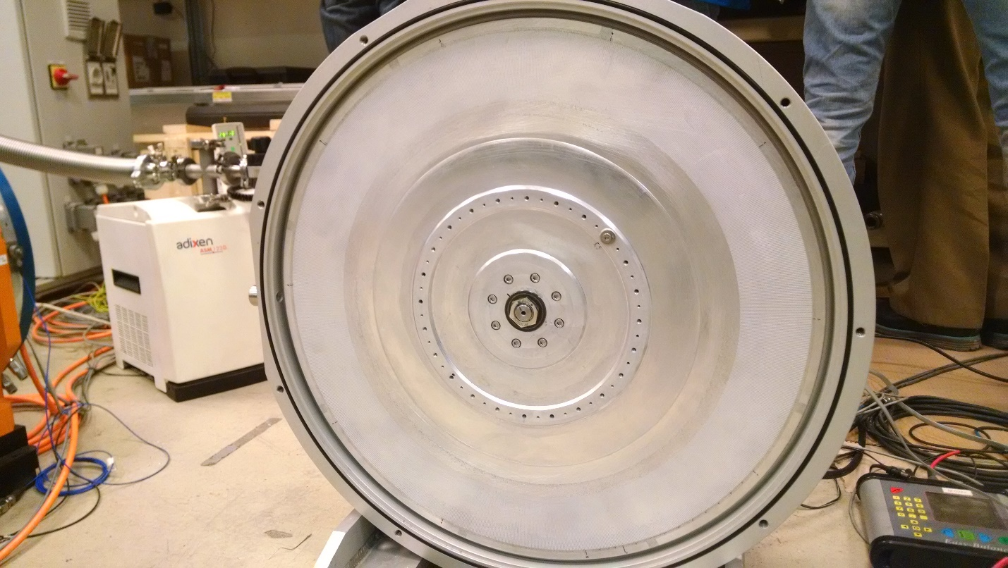
Disk grooves
Disk properties
Chopper disk material | Al 7075 T6
Axis to beam center : | 229 mm
Outer diameter: | 540 mm
Coating inner edge radius : | 199 mm
Coating outer edge radius: | 259 mm
Gd2O3 coating height: | 60 mm
Gd2O3 coating thickness: | 0.8 mm
Gd2O3 coating width: | 0.61-0.79 mm
Al disc total thickness: | 1.6 mm
Al thickness under Gd2O3 coating : | 0.8 mm
Al bridge thickness at middle height: | 0.703 mm
Gd2O3 content in coating: | 0,58 g/cm3

Slide 6
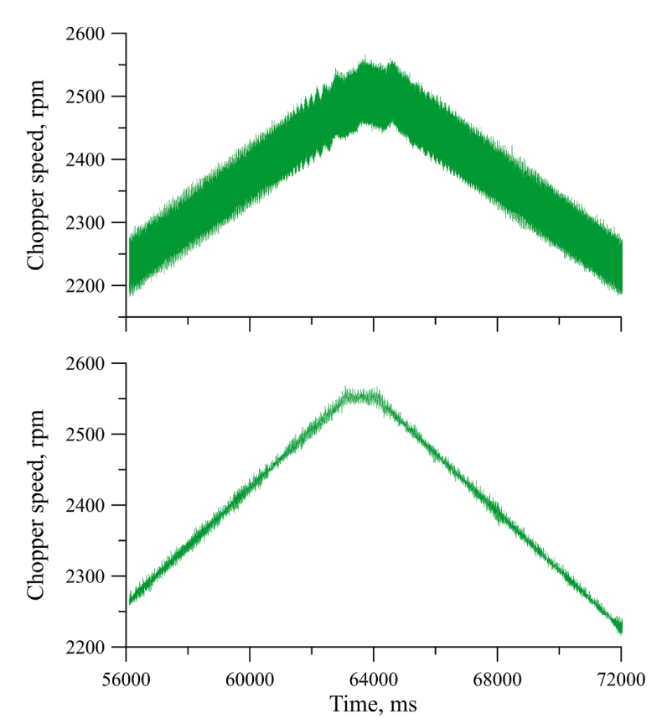
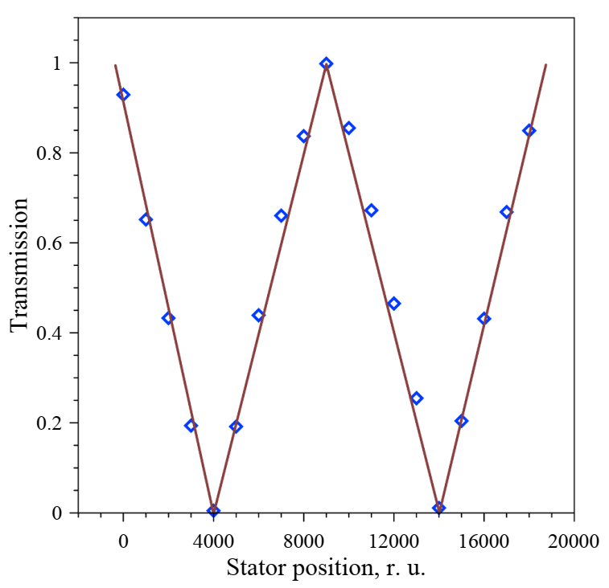
The new Chopper performance
The fluctuations of the chopper speed signal (converted into chopper speed) during frequency scanning in the vicinity of 2500 rpm for the old (upper) and new (lower) control systems.
Transmission of the chopper for the stator step-by-step movement. The solid line is provided as a guide for the viewer.

Slide 7
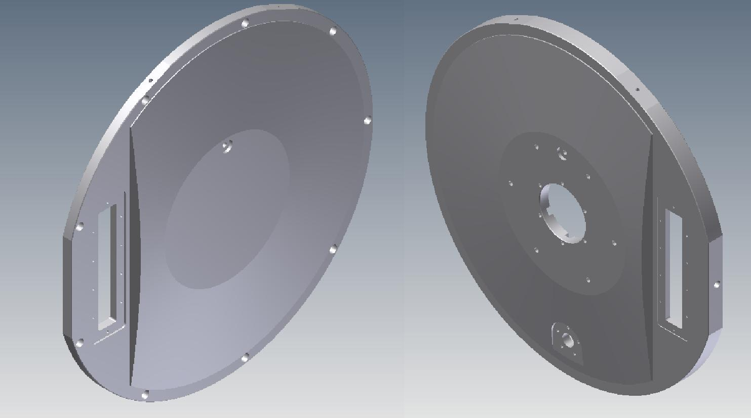
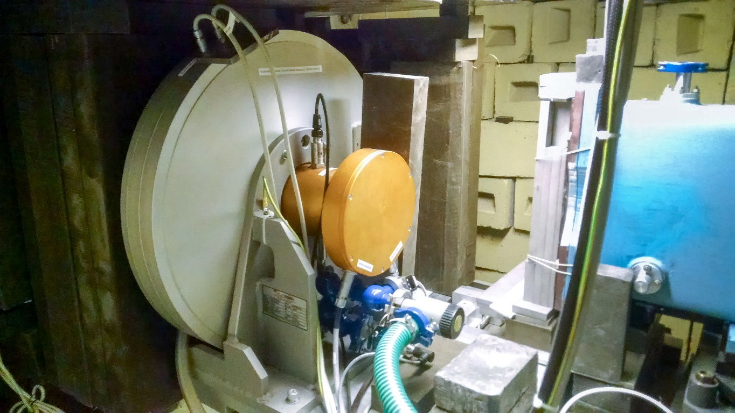
The rotor casing
The two housing shells and the support is made of aluminum alloy (AlMgSi1). Total width between the two windows’ external faces is 92 mm. The housing is compact;
All electrical, pressure and interlock connections are attached to the system on the spindle side. Connections and the shells are sealed with elastomeric vacuum seals.
The vacuum level of 5 ∙ 10^-2 mm. Hg. Pillar.
The Fourier Chopper upstream and downstream shells
The Fourier Chopper at the HRFD spectrometer

Slide 8
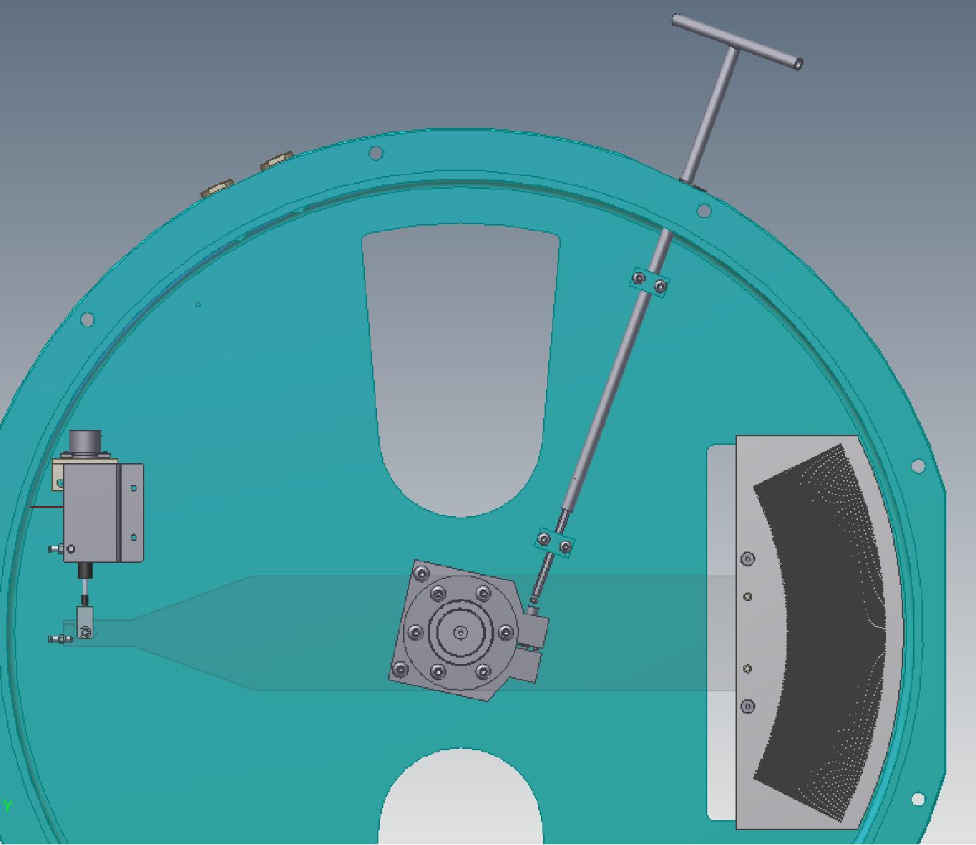
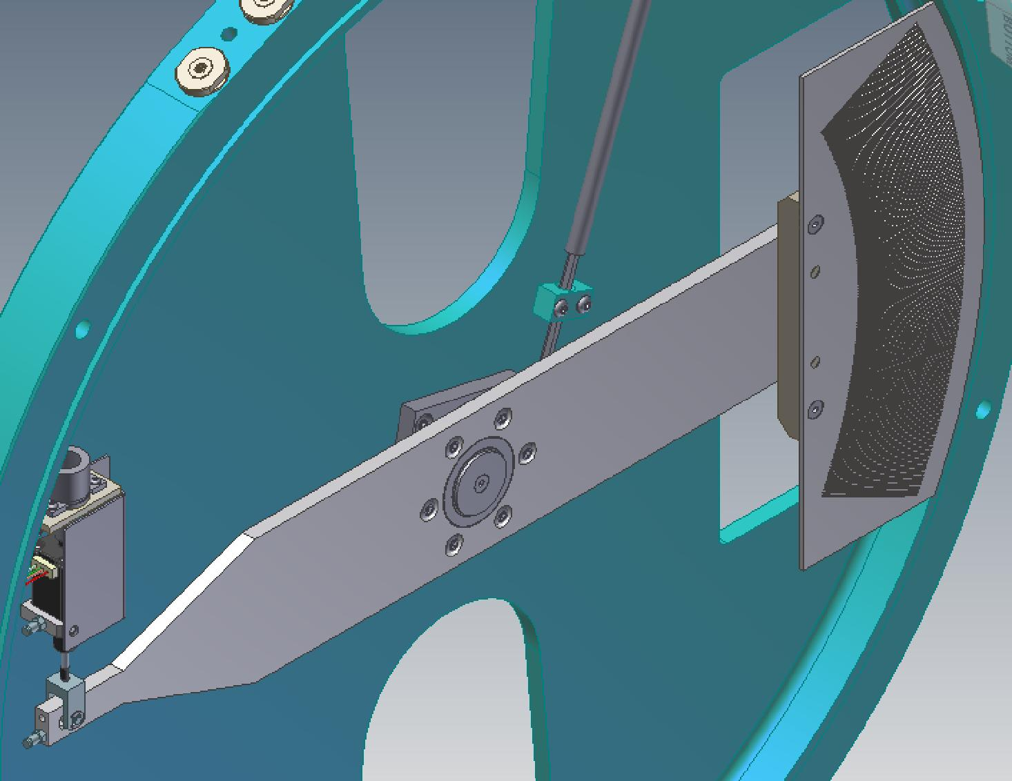
The new stator position control system
The mechanical design of the stator allows precise adjustment and fixation of the phase of pick-up signals.

Slide 9
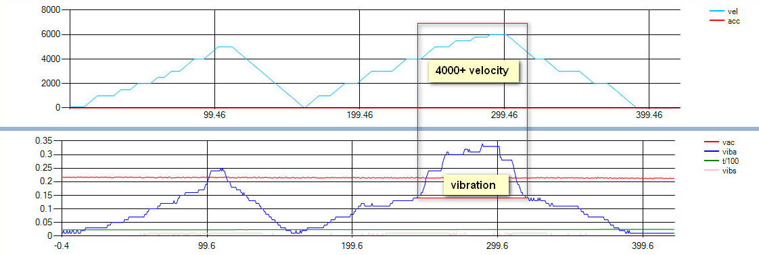
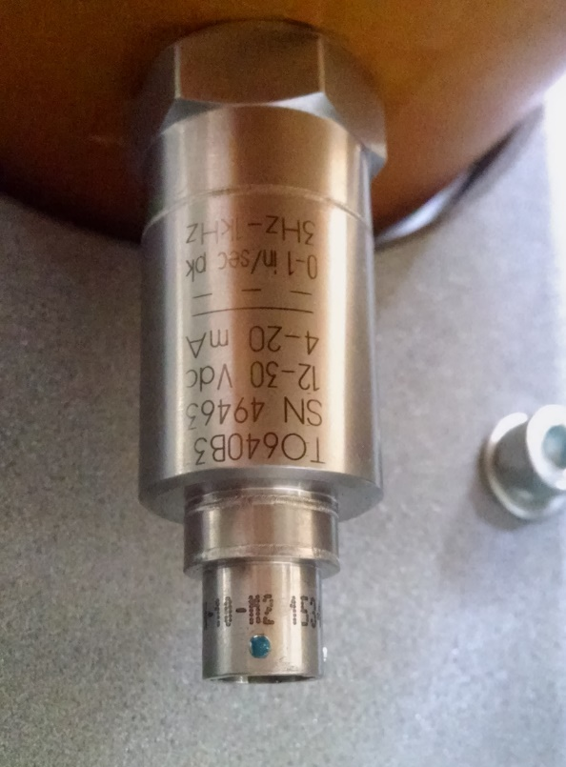
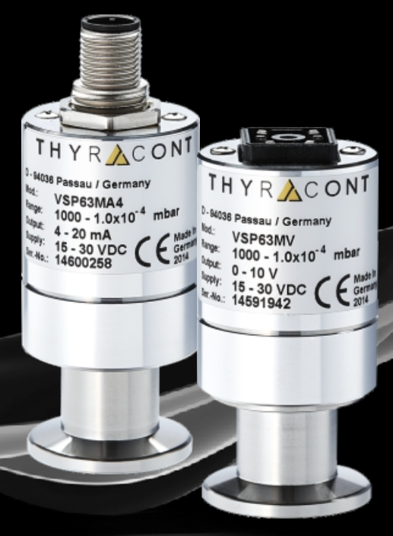
Monitoring sensors
The sensors for monitoring the vacuum ( Thyracont pirani with 4-20mA output )
vibration ( PCB piezotronics MODEL: TO640B30) of the rotor are installed on the Fourier chopper disc.
PERFORMANCE vibr sensor
Measurement Range (Vibration) | 0.0 to 12.7 mm/s pk
Measurement Range (Temperature) | -40 to 125 °C
Output | 4-20 mA
Frequency Range (±10 %) | 3 Hz to 1 kHz
Broadband Resolution | 0.13 mm/s pk
Non-Linearity | 1 %
Excitation Voltage | 12 to 30 VDC
Load Resistance | 50 (Vs-12) Ohm
Measuring Principle | Heat conduction (pat. Impulse Pirani)
Measurement Range | 1000 - 1e-4 mbar (750 - 1e-4 Torr)
Accuracy | 20 - 0,002 mbar: 2% from reading
Voltage Supply | 15 - 30 VDC

Slide 10
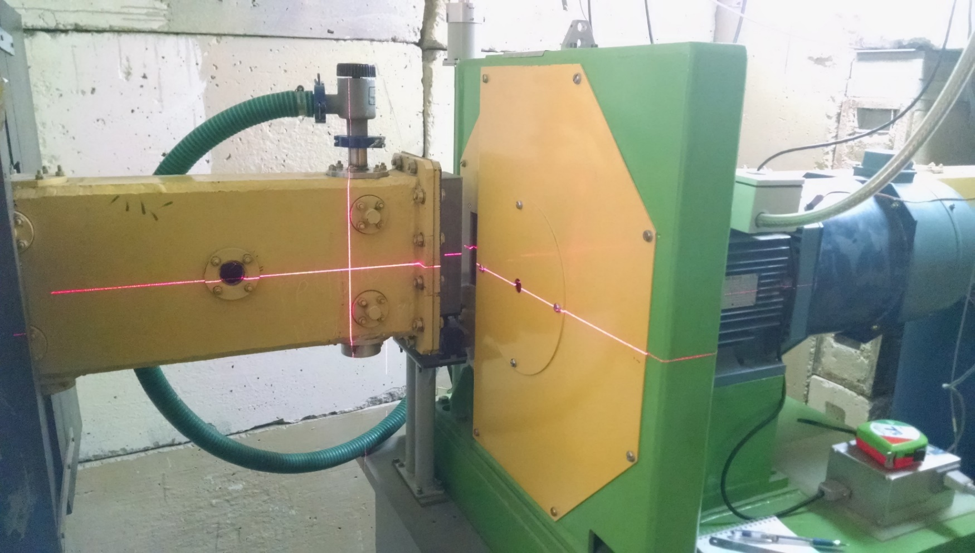
Operation of the Fourier chopper on the FSD spectrometer (Fourier stress diffractometer)
Fourier chopper disc | Aluminium alloy
external diameter, mm | 540
gap width, mm | 0.7
number of slots | 1024
maximum rotation speed, rpm | 6000 rpm
maximum beam modulation frequency, kHz | 100 kHz

Slide 11
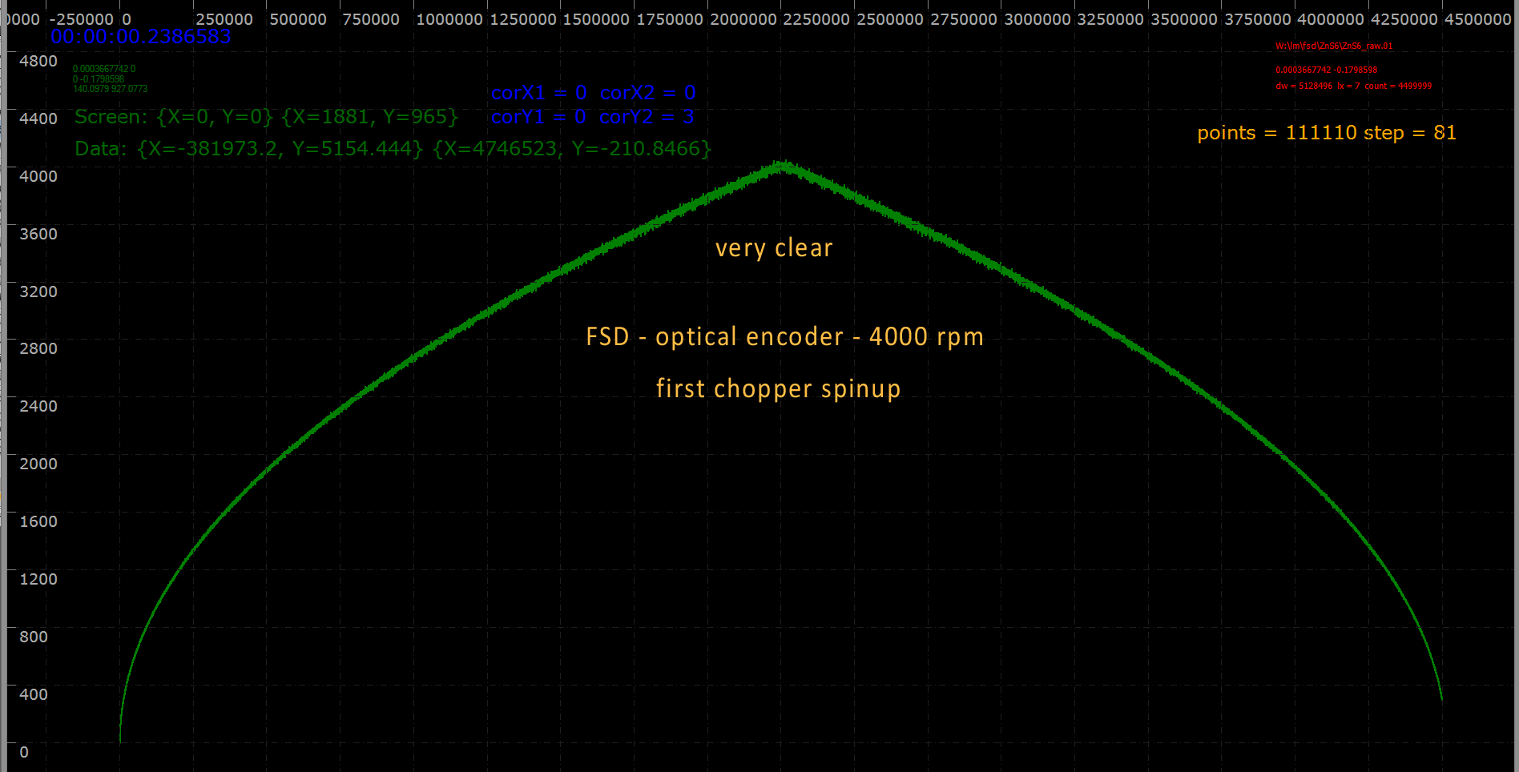
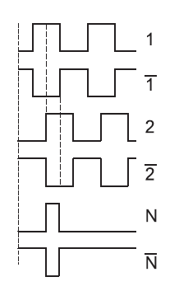
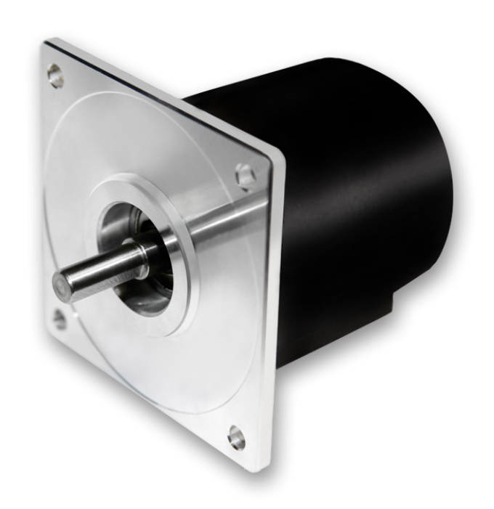
Incremental optical sensor FSD spectrometer. Interpolation =1
- Tekel TK2 561-F-1024 optical incremental sensor.
- The output signals are two square-wave signals offset by 90° for the detection of direction (tracks 1 and 2) and their inverse signals.

Slide 12
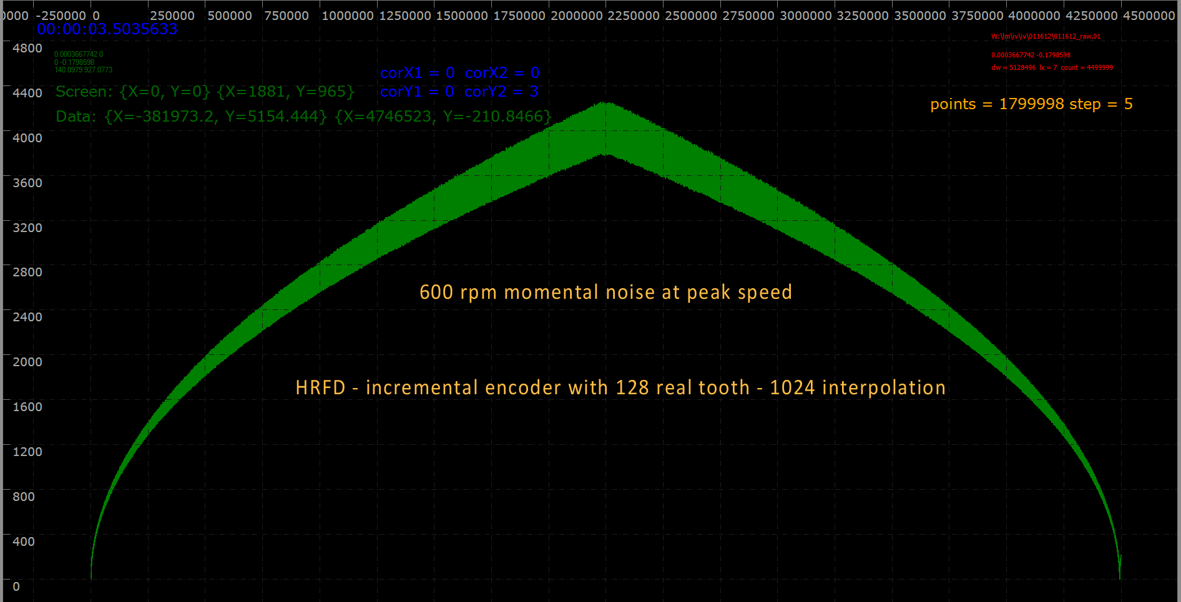
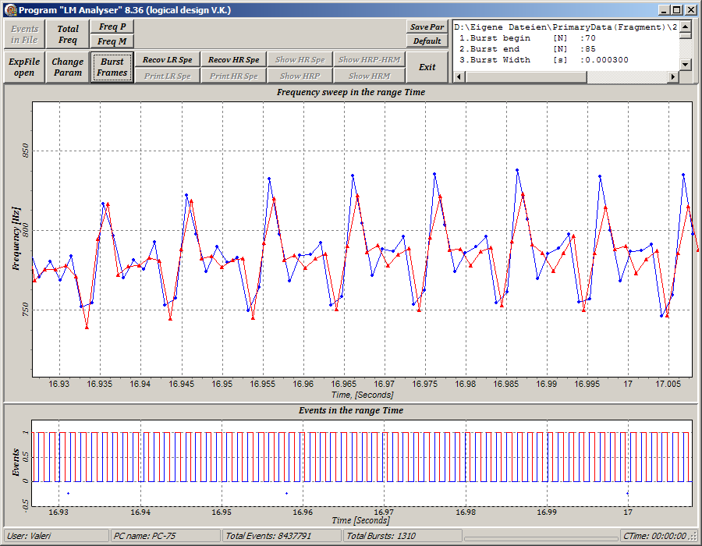
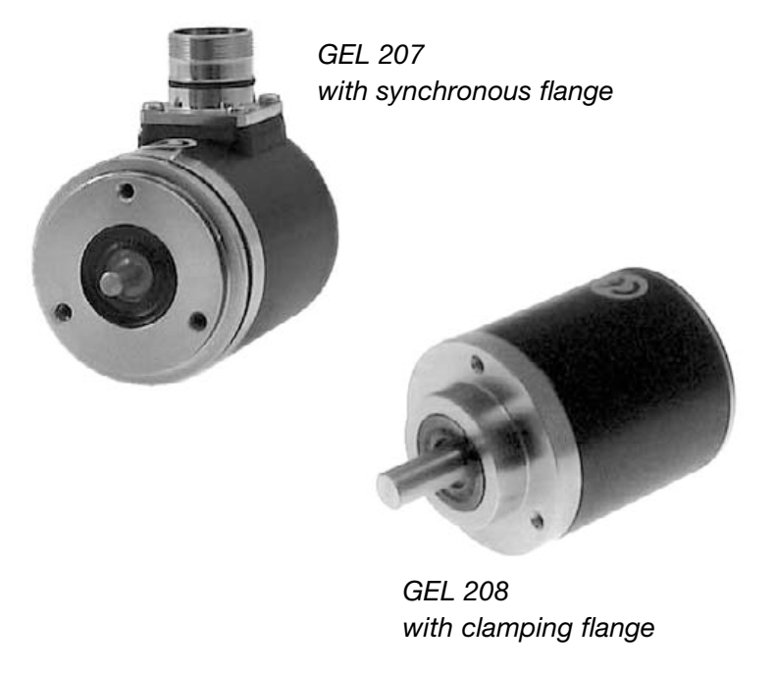
Interpolation 128 real tooth - 1024
This is how the HRFD magnetic sensor works.
Frequency graph strongly increased in time at Δt = 0.07 sec. This is how the FSD magnetic sensor works.
The magnetic sensors used on the FSD and HRFD have 128 physical poles (teeth). A further 3 bits (up to 1024) are interpolated electronically inside the magnetic sensor.
Sensor GEL 208-TN01024-H031

Slide 13
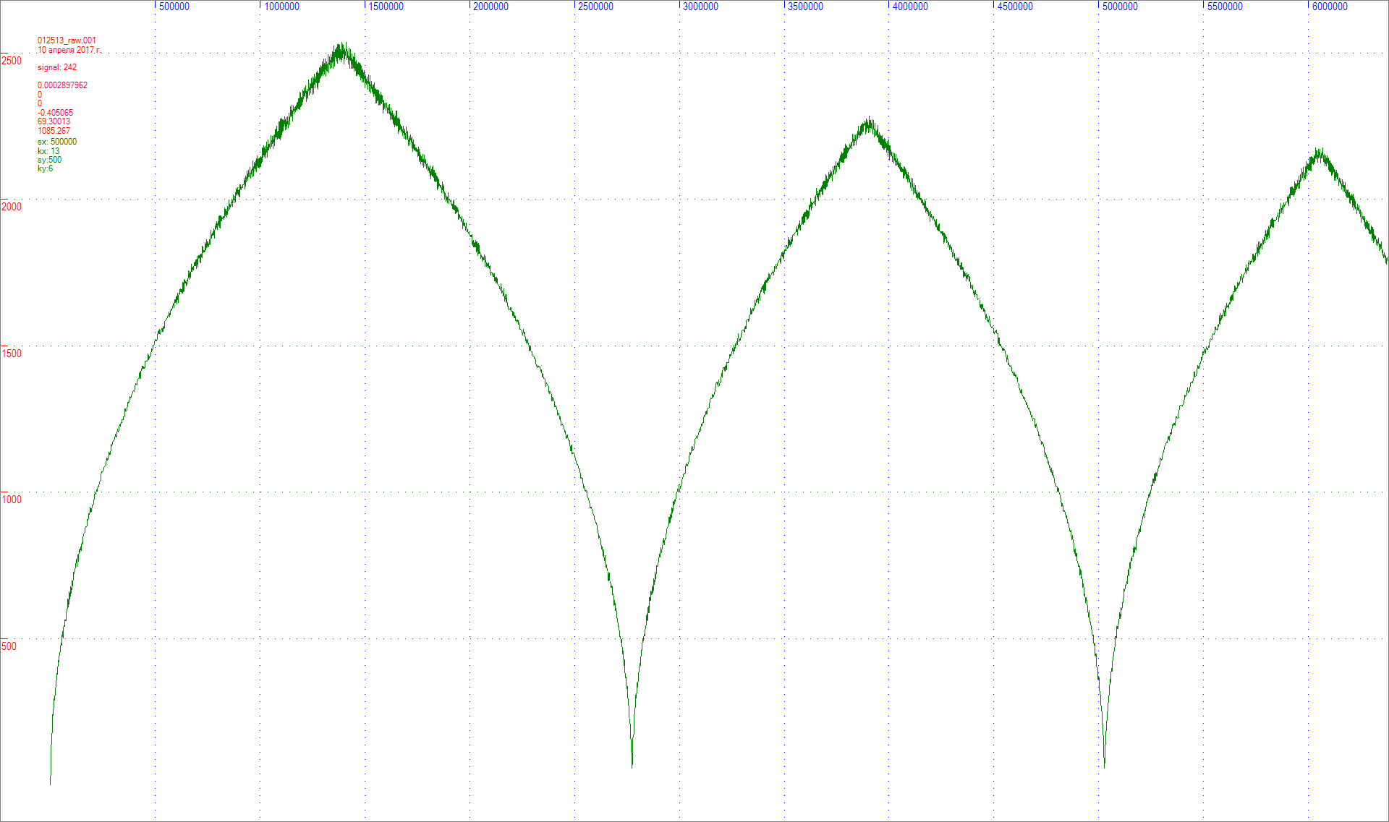
Lenord and Bauer MiniCoder GEL 2444T-Z2G3K-030E
In the figure below you can see the speed graph taken from the GEL 2444 magnetic sensor as a result of radiation degradation.

Slide 14
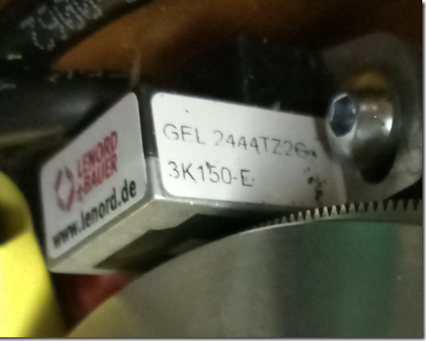
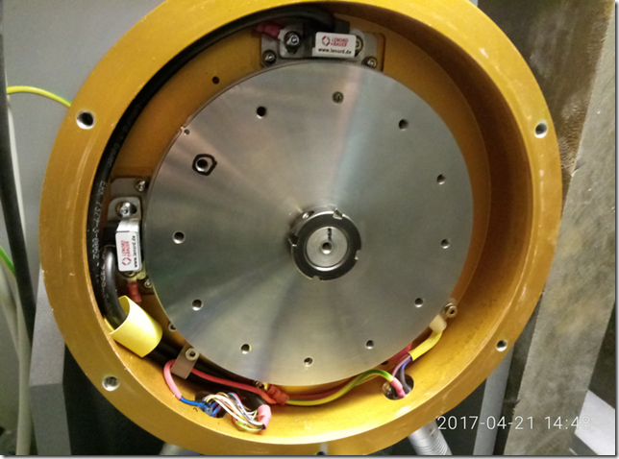
The Lenord and Bauer MiniCoder GEL 2444T and the Lenord and Bauer ZAZ 0512 with 512 teeth
The new Fourier chopper uses a rigid connection of the encoder — the gear wheel and motor shaft, in contrast to the previous system, where the encoder and motor shaft were connected by a flexible coupling.

Slide 15
Evaluation of the temporal characteristics of the encoder clutch of the Fourier transform diffractometers FSD and HRVD
Coupling Type | Kinematic transmission error(±”) | Torsional stiffness(Nm/rad) | Allowable moment(Nm) | Permissible speed
SAGA GP10 | 35 | 250 | 0,3 | 10000
K17-3, GmgH | 10 | 300 | 0,2 | 16000
K17-04 GmbH | 10 | 200 | 0,1 | 16000
An optical encoder TK2-561-F-1024 with an accuracy of 3“ at a speed of 6000 rpm was used on the FSD spectrometer
Coupling ± 10” or 77 n/sec at 6000 rpm
DAQ Pick-up Binding Accuracy ± 8 n/sec
$$6000 rpm=100\frac{rp}{sec}→1 revolution in \frac{1}{100}sec$$
Then we calculate the error TK2-561-F-1024 :
$3^{"}={\left(3^{"}∗\frac{1}{360∗3600}\right)}^{°}∗{10}^{−2}sec=\frac{3}{3.6∗3.6}∗{10}^{−7}=23∗{10}^{−9}=23 n/s$ec
Coupling ± 10"or 77 n/sec
(The chopper disk itself, as well as the electronics, also give its error in accuracy)
The accuracy of the magnetic sensor, for comparison:
GEL 208-TN01024-H031 Sensor
Incremental deviation 0.02 ° = 72"
Stability 0.009° = 32.4"
Error limit 0.14° = 504"
Sensor type | Moment (Nm) | Start moment (Nm)
Tekel sensor | 0,03 | 0,025
Gel sensor | 0,03 | 0,05

Slide 16
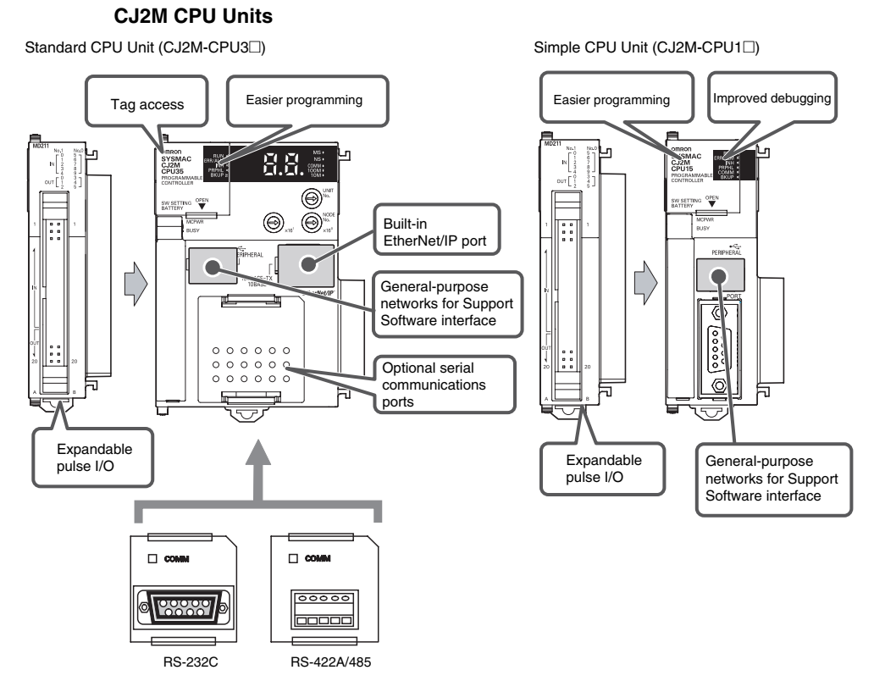
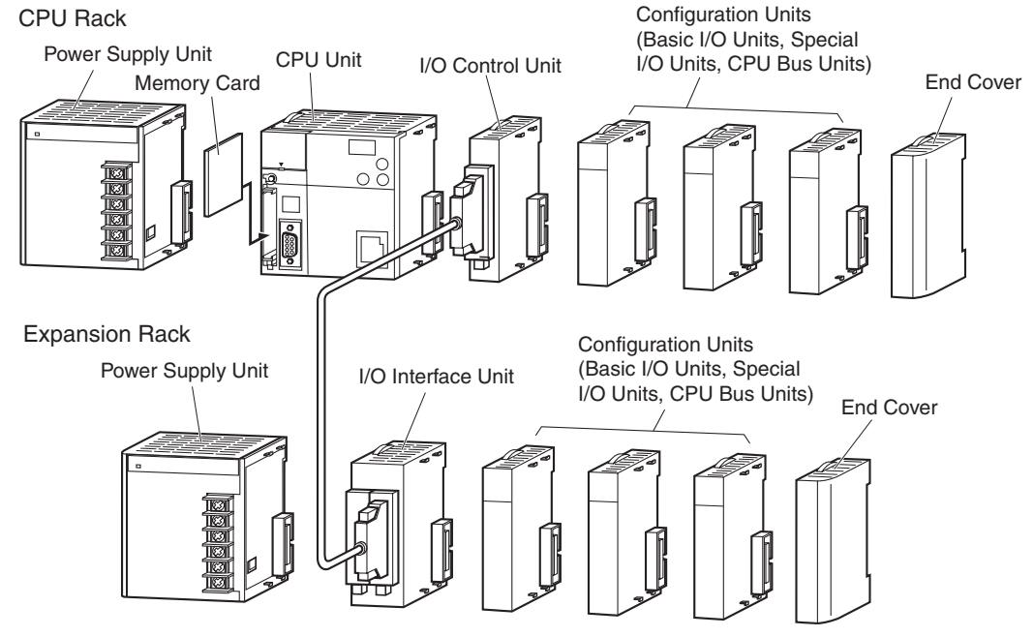
PLC Omron CJ2M-CPU31
CJ-series Expansion Rack can be connected to the CPU Rack or another CJ-series Expansion Rack. An Expansion Rack can consist of an I/O Interface Unit, a Power Supply Unit, Basic I/O Units, Special I/O Units, CPU Bus Units, and an End Cover.

Slide 17
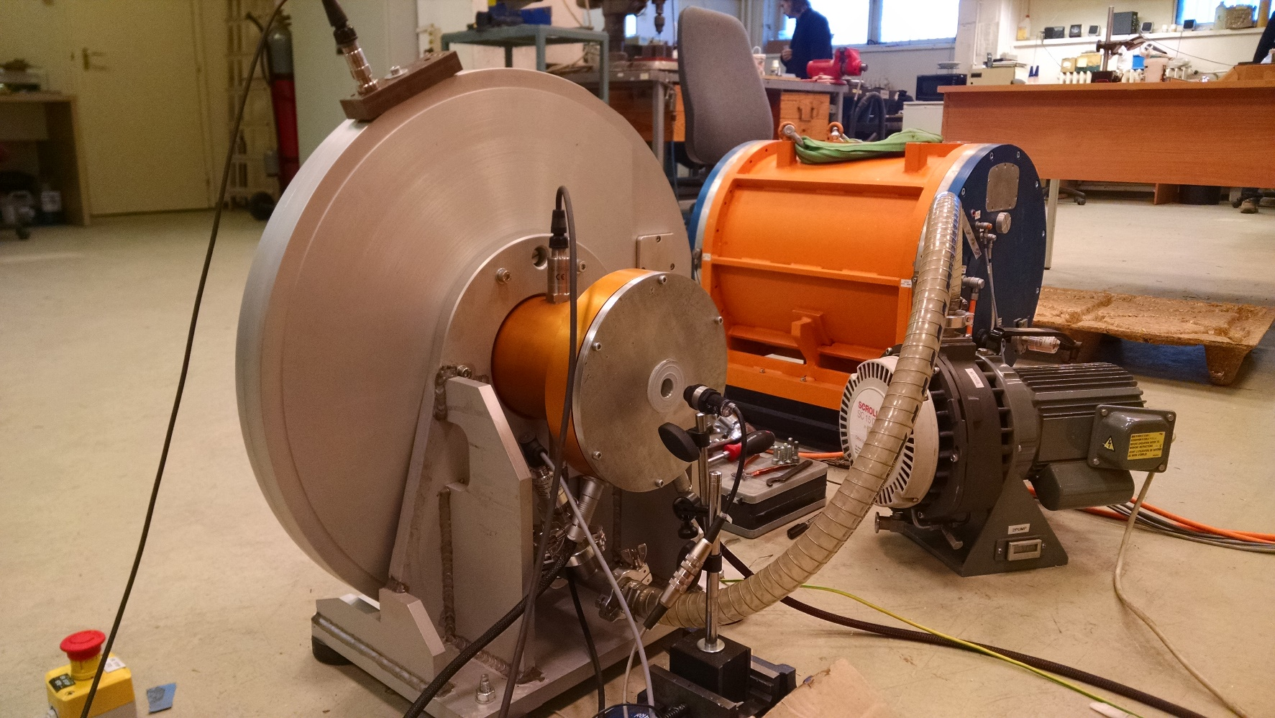
THANKS FOR YOUR ATTENTION

