Slide 1




Development and Integration of the Electronic Logbook for the BM@N experiment at NICA
K. Gertsenberger, A. Moshkin, A. Chebotov
Veksler and Baldin Laboratory of High Energy Physics, JINR
on behalf of the BM@N collaboration
4 October 2019

Slide 2
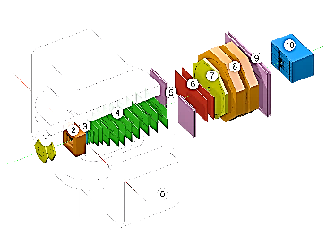



Nuclotron-based Ion Collider fAcility
Nuclotron-based Ion Collider fAcility
Beams: from $p, d^{↑}$to${Au}^{79+}$
Fixed target experiment: BM@N (2018)
2 interaction points: MPD (2022) & SPD
Official site: nica.jinr.ru
Luminosity: ${10}^{27}$(${Au}^{79+}$), ${10}^{32}$ ($p$) $cm^{−2}s^{−1}$
Collision energy: $\sqrt{S_{NN_{AU}}}$ = 4 – 11 Gev $E_{lab}$ = 1 – 6 AGev

Slide 3
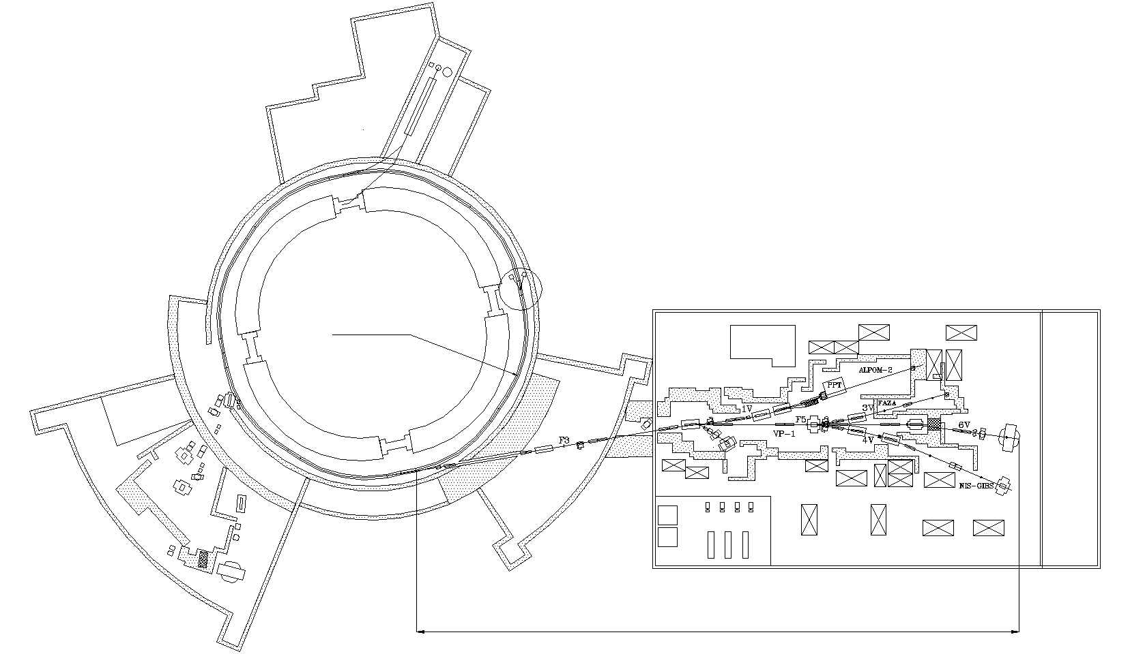
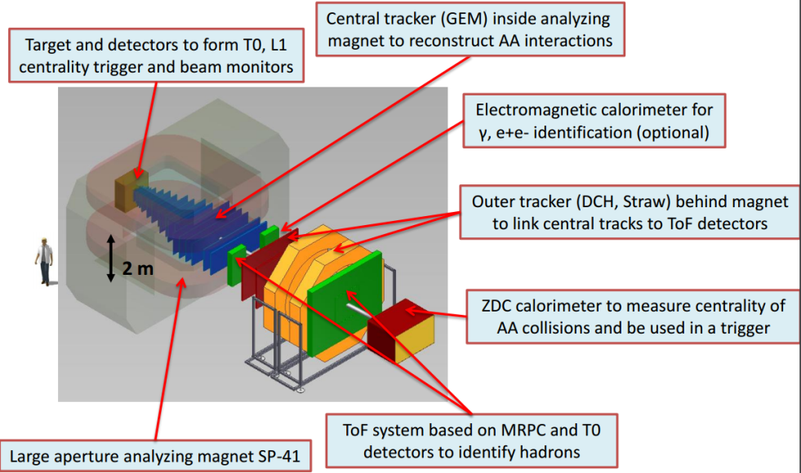
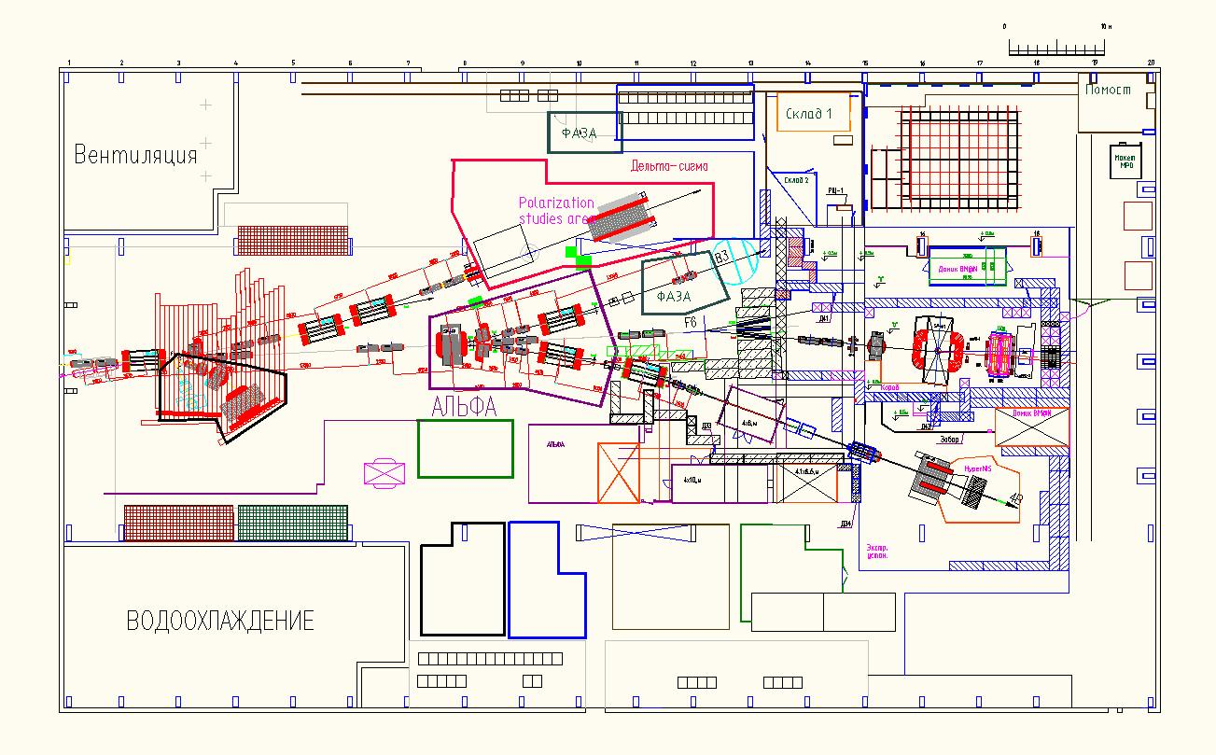
Baryonic Matter @ Nuclotron
BM@N physics program:
strange / multi-strange hyperon and hypernuclei production at the threshold
in-medium modifications of strange & vector mesons in dense nuclear matter
hadron femtoscopy
short range correlations
event-by event fluctuations
electromagnetic probes, states decaying into γ, e (with ECAL)
Nuclotron
~160 m

Slide 4
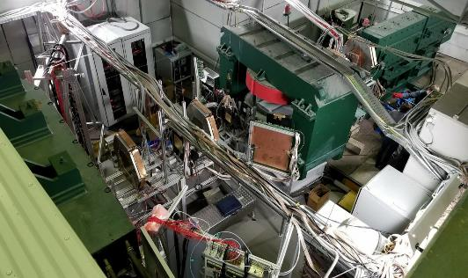
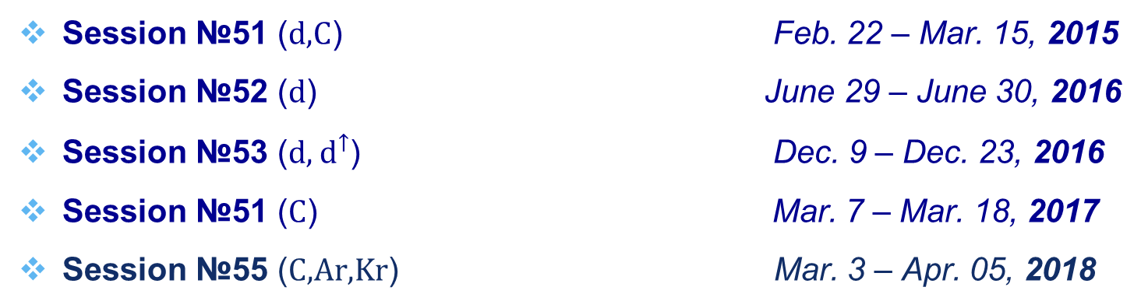
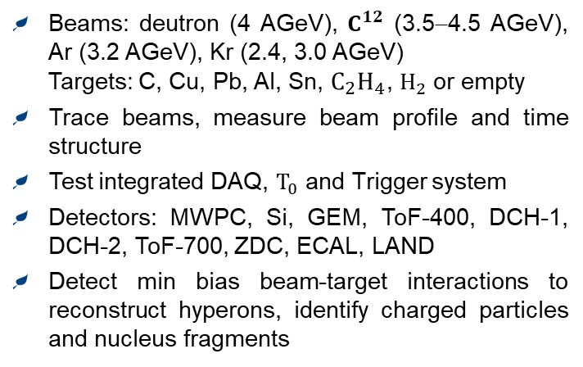
BM@N in Nuclotron Sessions (2015 – 2018)
Session №51 (d,C) Feb. 22 – Mar. 15, 2015
Session №52 (d) June 29 – June 30, 2016
Session №53 (d, $d^{↑}$) Dec. 9 – Dec. 23, 2016
Session №51 (C) Mar. 7 – Mar. 18, 2017
Session №55 (C,Ar,Kr) Mar. 3 – Apr. 05, 2018
Technical
interaction rate: 5 KHz
Technical + Physics
interaction rate: 10 KHz
Beams: deutron (4 AGeV), $C^{12}$ (3.5−4.5 AGeV), Ar (3.2 AGeV), Kr (2.4, 3.0 AGeV)
Targets: C, Cu, Pb, Al, Sn, $C_{2}H_{4}$, $H_{2}$ or empty
Trace beams, measure beam profile and time structure
Test integrated DAQ, $T_{0}$ and Trigger system
Detectors: MWPC, Si, GEM, ToF-400, DCH-1, DCH-2, ToF-700, ZDC, ECAL, LAND
Detect min bias beam-target interactions to reconstruct hyperons, identify charged particles and nucleus fragments

Slide 5
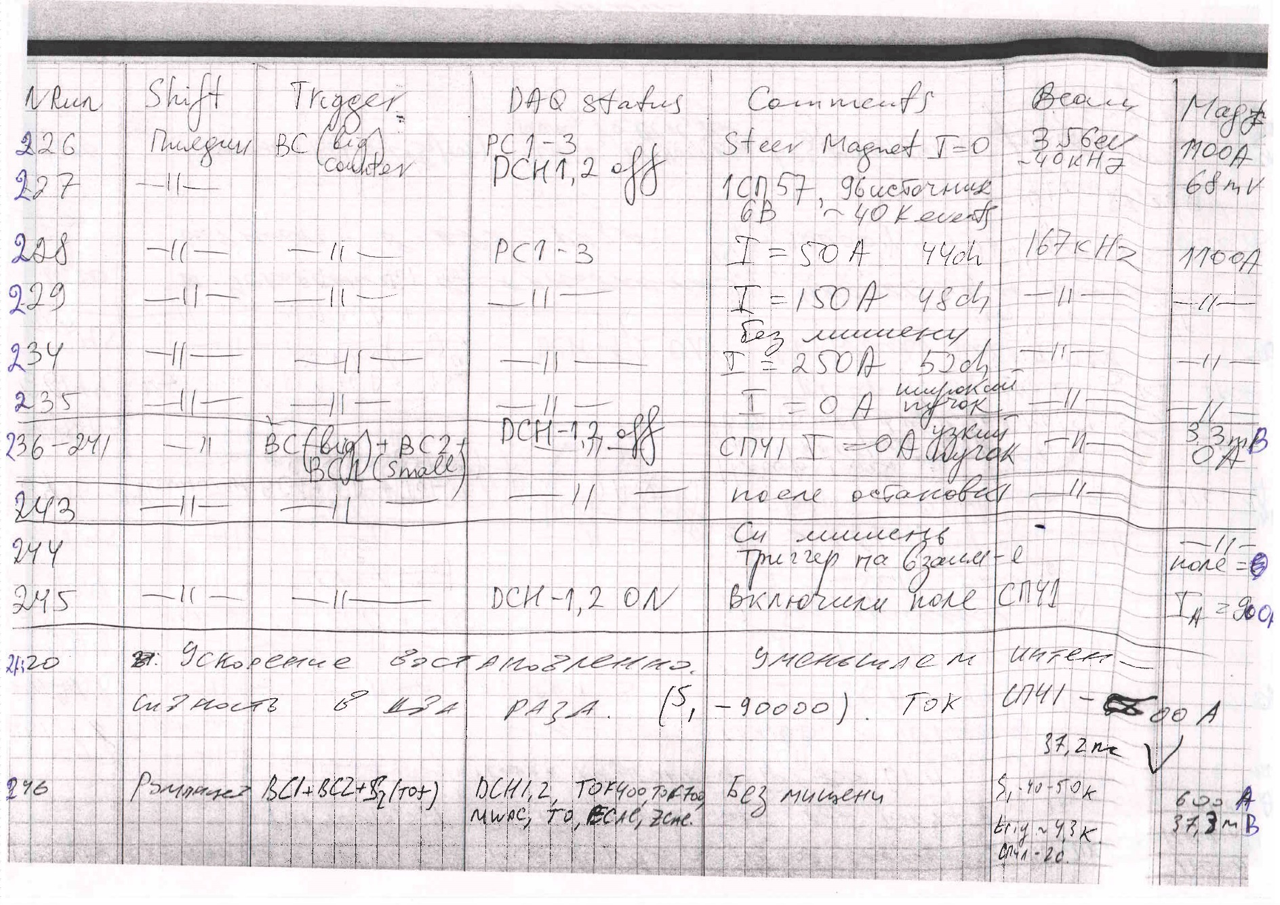
Paper version of the logbook

Slide 6
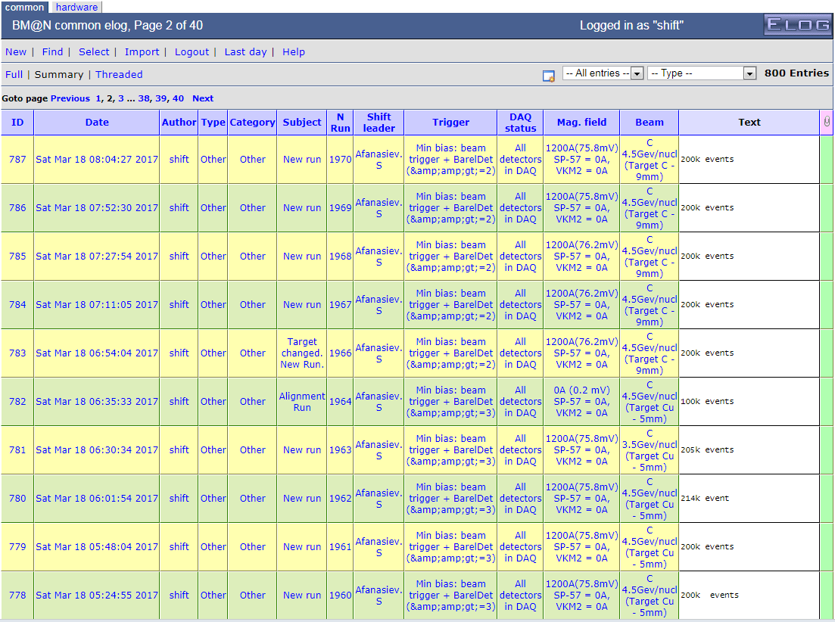
1st version of the electronic logbook: Web-table
Ivan Slepov @ LHEP/JINR

Slide 7

1st BM@N Web-table Logbook
Shortcomings of the Web-table Logbook
with a file storing approach
Some data were duplicated at different columns
Web-logbook contained some information which was never used
There was no interface to get data for external information systems
It was comparable with artificial intelligence to automatically parse the text file of the Web-table Logbook with columns of arbitrary format in order to transfer required data to other systems
a database and stricter rules had been necessary instead of the text file storing

Slide 8
Electronic Logbook
e-Log platform is a collaborative tool which provides shift crews with an interface to store and share information with offline users on various events or problems occurred in the experiment during its operation.
The e-Log system uses a developed Logbook Database based on PostgreSQL which ensures correct multi-user access, data consistency, integrity and automatic backup of the stored data.
A part of e-Log data is automatically transferred to the Unified Database of the experiment to use in offline analysis.
Developed interfaces provide a unified access to required logbook data for various online and offline systems, and convenient viewing, transparent managing and searching for required information by users.

Slide 9

Electronic Logbook data
record number
record type
record time
current shift leader
period number
run number
DAQ status
trigger type
magnetic field
beam particle
beam energy
target
target width
record comment
record information during experiment runs on current events, states of various systems, operation conditions of detectors and many others which are further used in the processing and physics analysis of the particle collision events

Slide 10
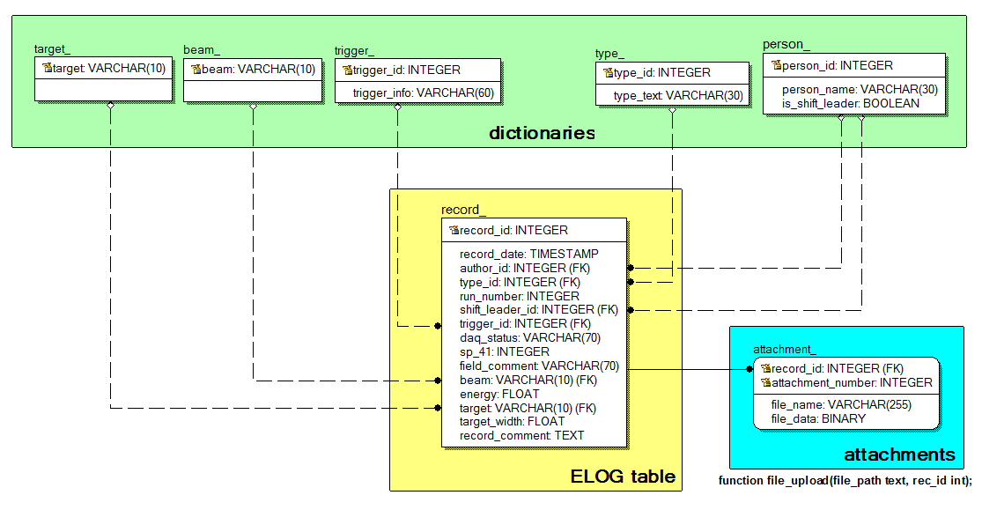

e-Log Database scheme

Slide 11
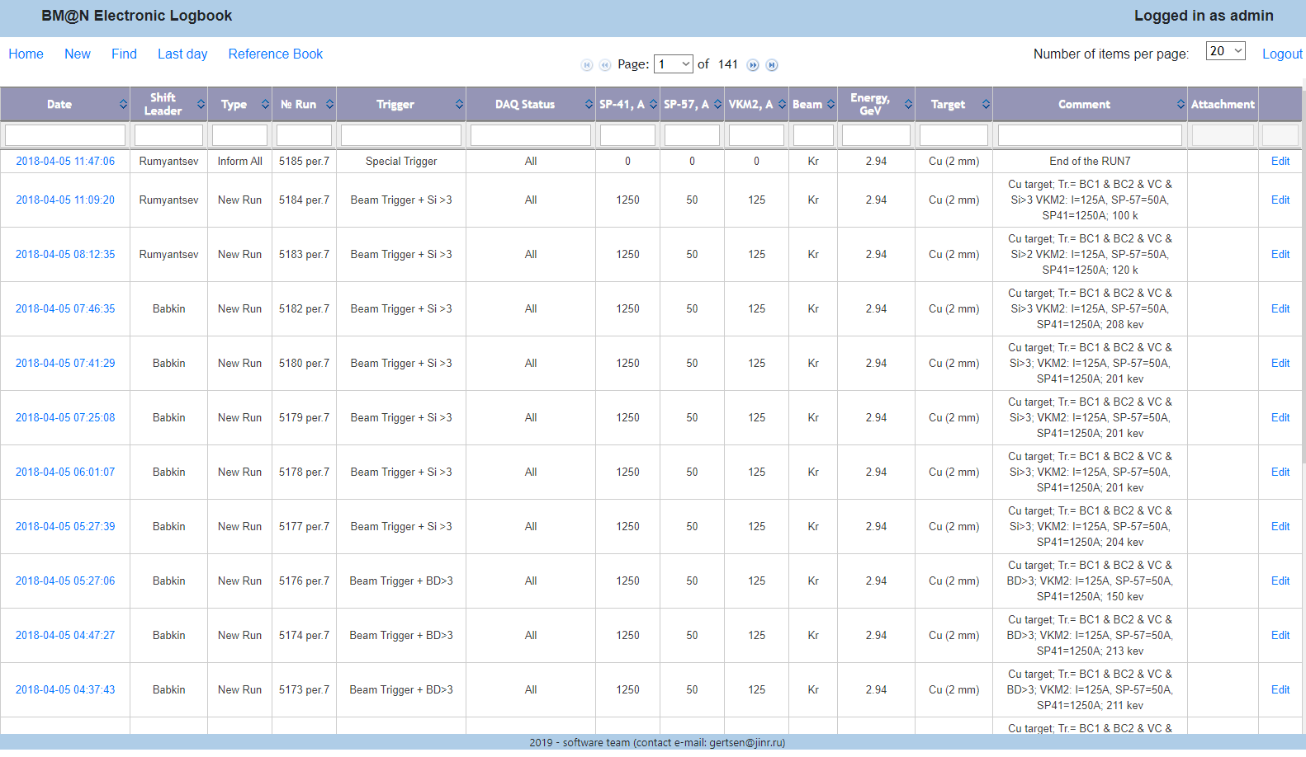
Web-interface of the Electronic Logbook
BM@N Runs 1 - 7
# records ~ 3 000
It contains records of different types for all BM@N conducted Runs
Easy search by all parameters

Slide 12
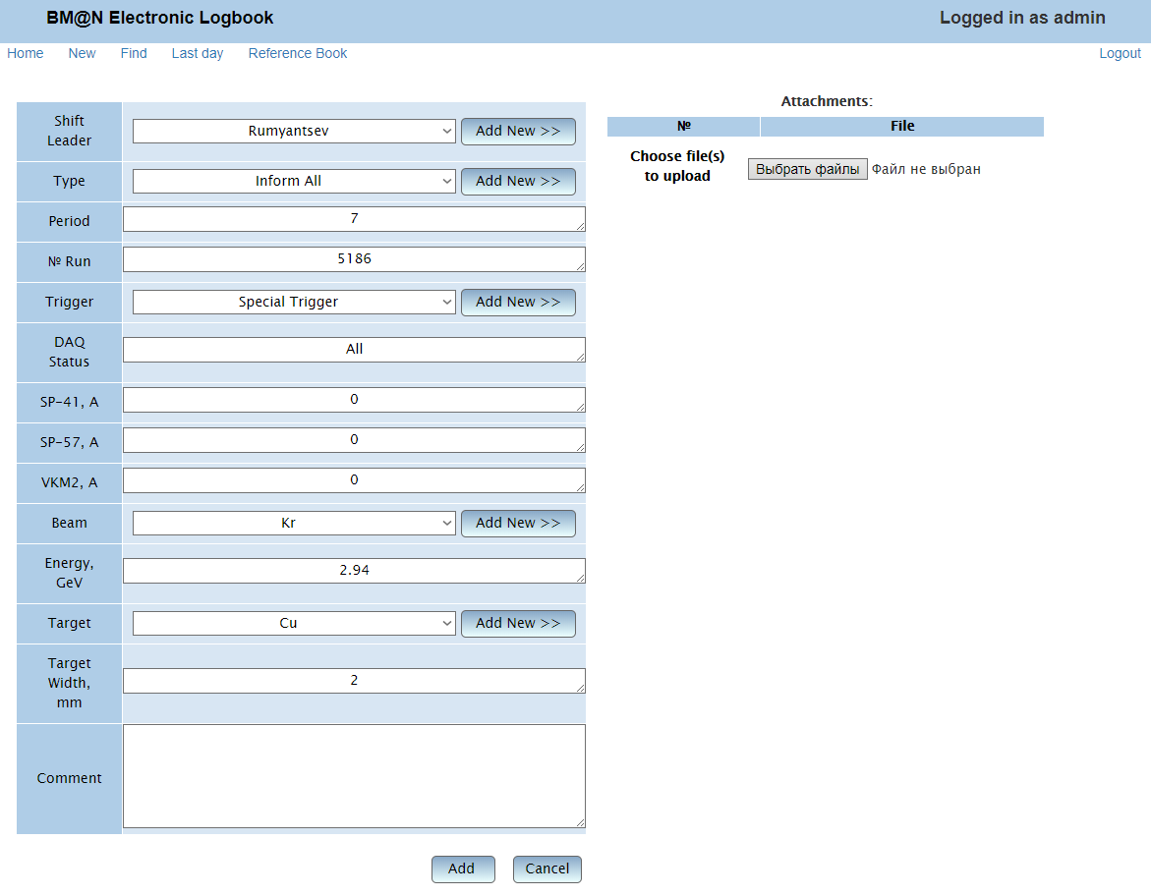
Web-interface: modification by BM@N shift crew
Features:
Authentication: database roles (administrator, shift operator, user)
File Attachments (text description, photo, e.g. detector mapping)
Multi-Column Sorting
LastDay View…

Slide 13
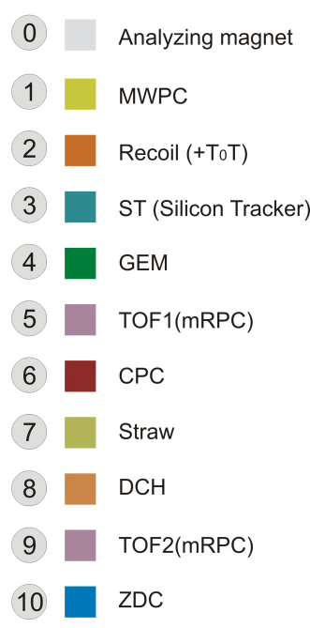
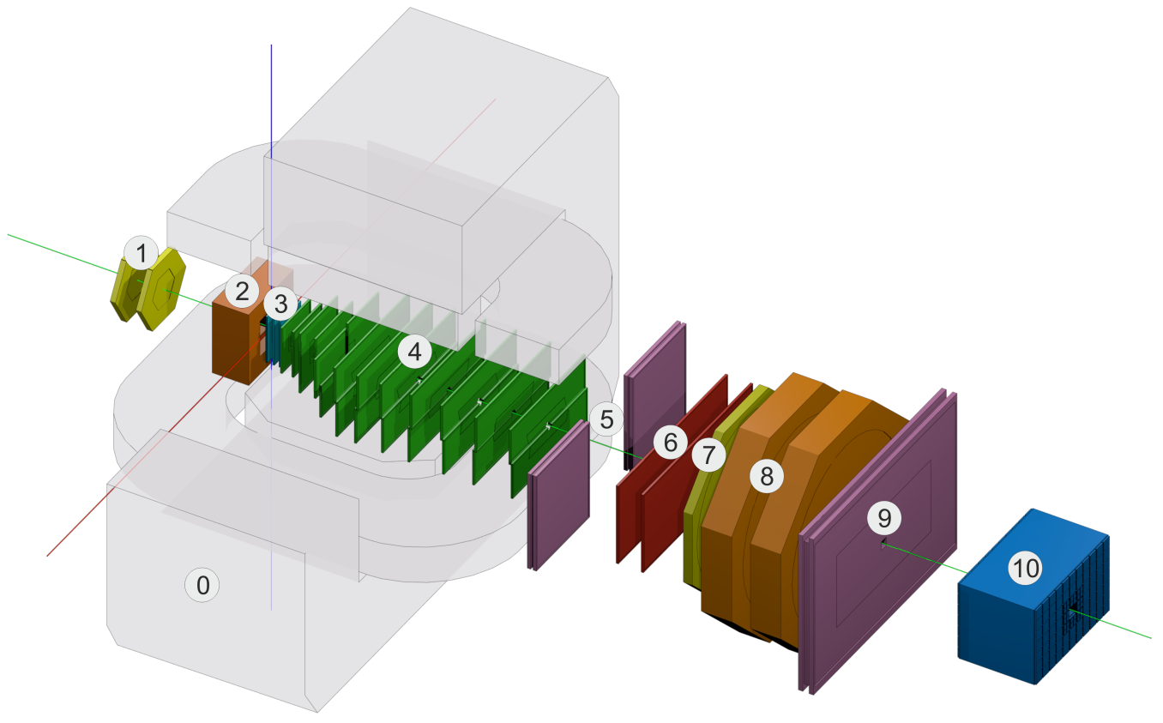
BmnRoot Framework
The software BmnRoot is developed for event simulation, reconstruction of experimental or simulated data and following physics analysis of collisions of elementary particles and ions with a fixed target at the BM@N facility.
C++ classes, Linux OS support,
based on ROOT and FairRoot
The BmnRoot software is available in GitLab@JINR: https://git.jinr.ru/nica/bmnroot

Slide 14
C++ database interface
Class wrappers for database tables with many specific functions allow to access and manage the data without SQL statements in experiment software
ElogDbRecord – records written by a shift crew during the experiment runs which describe operating modes of various systems and detectors and different types of events
ElogDbType – record types: ‘Shift started’, ‘Problem report’, ‘Configuration’, ‘New Run’, etc.
ElogDbPerson – a list of the experiment staff
ElogDbTrigger – dictionary of all possible trigger types
ElogDbBeam – dictionary of all possible beam particles
ElogDbTarget – dictionary of all possible targets
ElogDbAttachment – files attached to a record for detailed description of an event
UniDbConnection – serves to open and close connections to the e-Log database
UniDbSearchCondition – forms criteria for selection of e-Log records
The main functions of the e-Log interface:
for data objects (static): Create, Delete, Get, Search, PrintAll.
for attributes (non-static): Getters and Setters functions, Print.

Slide 15


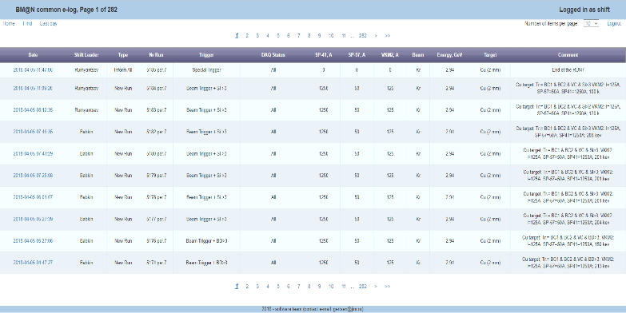
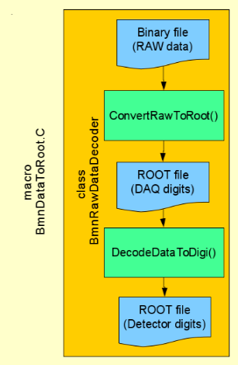
e-Log: Communication Scheme
shift operators
Online
Online Histogramming
…
Raw Data Converter
BM@N Offline Database
Event Analysis in BmnRoot
…
users
C++ Interface
Web-interface
Offline
C++ Interface

Slide 16
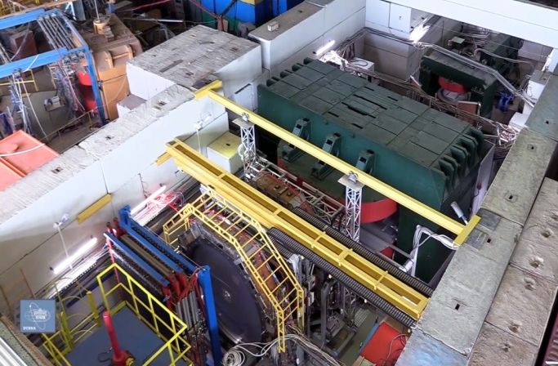
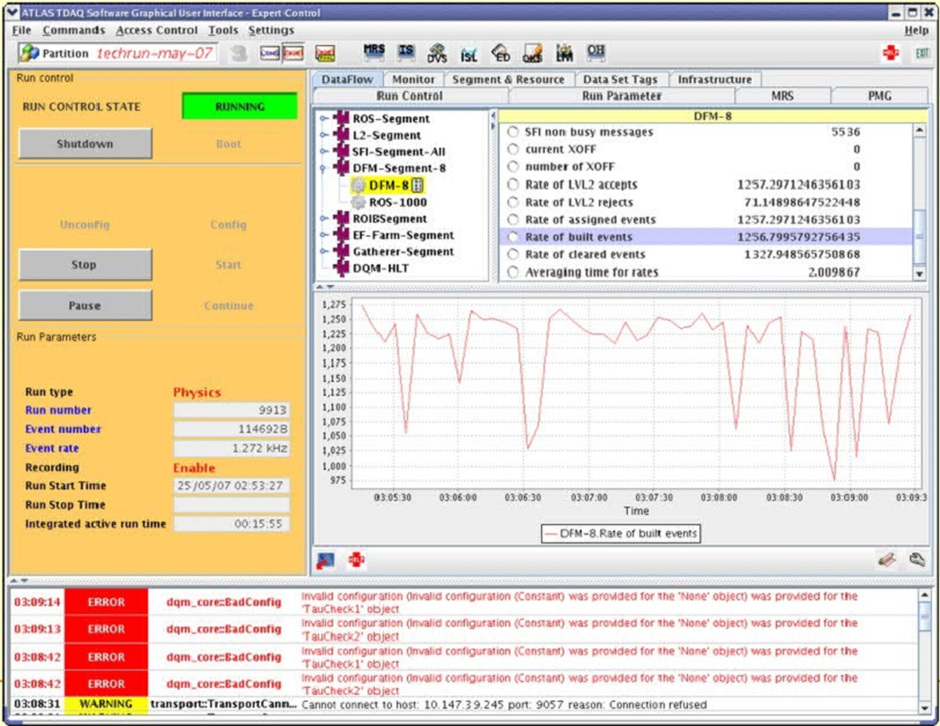

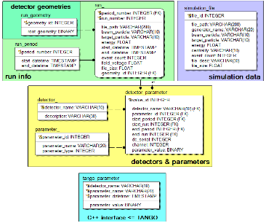
e-Log integration into Online Architecture
Raw
Event
Builder
Run Control System has not been implemented yet
DAQ
system
Online Histogramming
period, run
start & end time, event count, file path, file size
new run
BM@N
Database
central data storage for offline data analysis
unified access and data management for all collaboration members
correct multi-user data processing
new run
period, run
beam, energy, target,
magnetic field

Slide 17
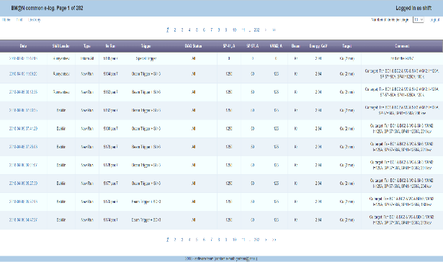
e-Log: Notification Service
under testing now
shift
group 1
e-mail notifications
record type 1
shift
group 2
record type 2
record type 3
shift
group 3
record type 3
different types of events:
“shift started”
“problem report”
“configuration”
“inform all”
…
shift
group 4

Slide 18




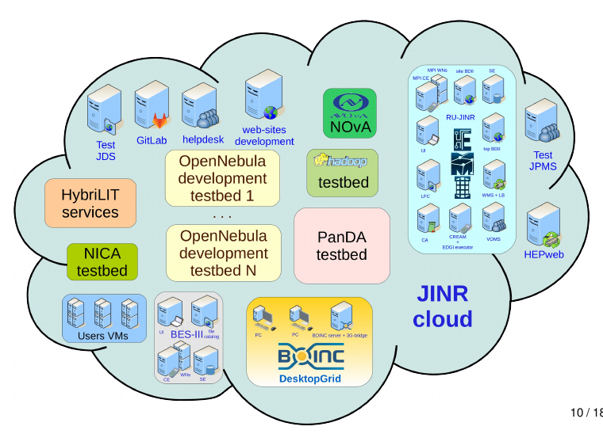
e-Log: Authentication Service
shift operators
admins
users
JINR Authentication
database roles
e-Log FreeIPA Authentication and Auto Recovery Services are under development

Slide 19

Information Systems for online & offline processing
BmnRoot
Run Control System
Online Histogramming
Event Display: offline/online…
Logbook IS
Configuration IS
Event Indexing IS
BM@N Software Ecosystem
Geometry IS
Condition IS
RFBR Grant 2019 – 2021: Development of Information Systems for Online and Offline Data Processing for the Experimental Setups of the NICA Complex

Slide 20
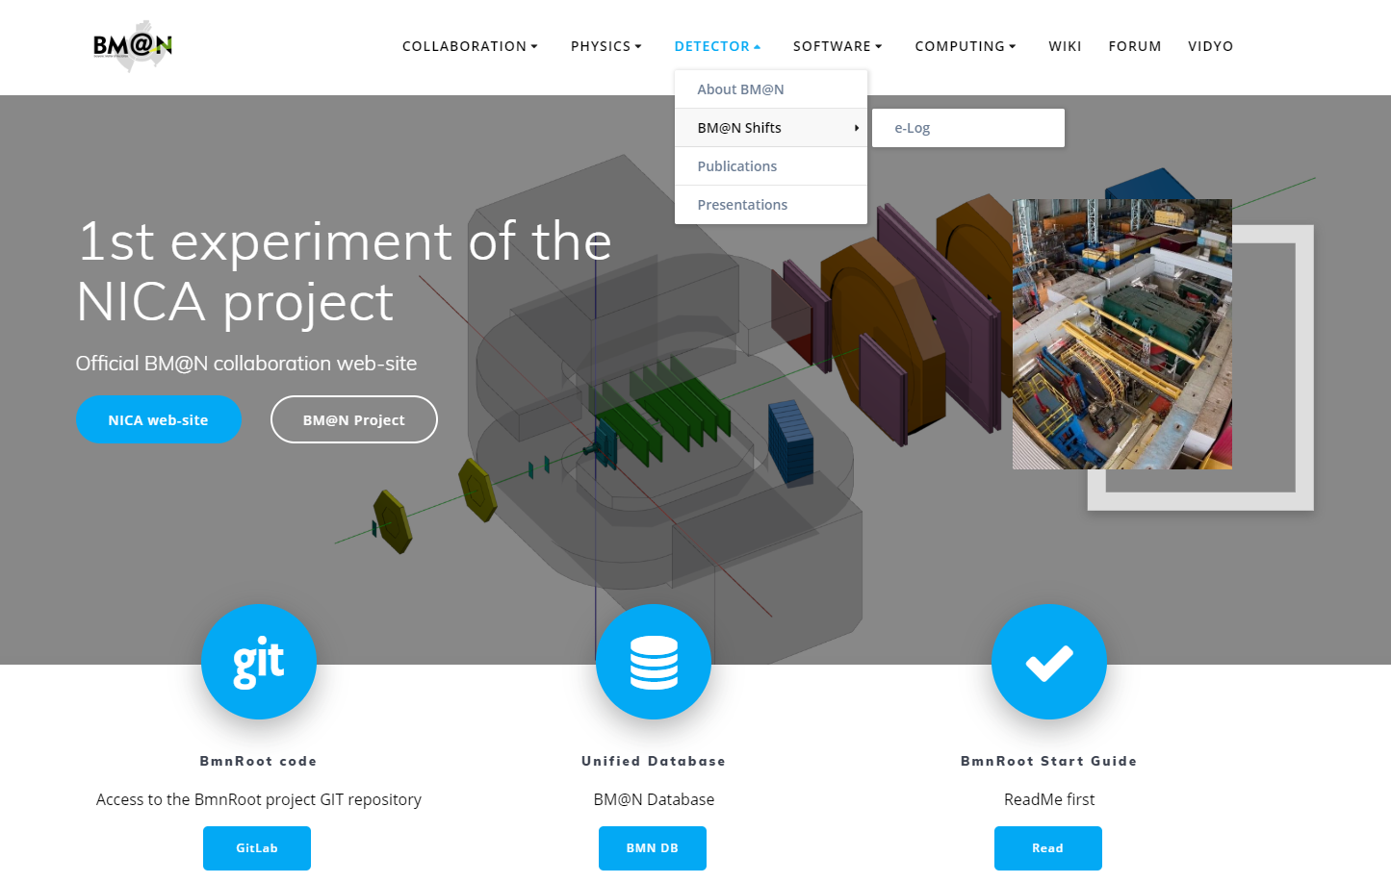
e-Log on the BM@N Web site

Slide 21
Summary
e-Log platform is a collaborative tool which provides an interface for shift crews to store and share information with offline users on various events or problems occurring in the experiment during its operation.
The e-Log system uses the developed Logbook Database based on PostgreSQL which ensures data consistency, integrity and automatic backup of the stored data.
Manual insertion of BM@N run information has been replaced by the automatic procedure. A part of e-Log data is automatically transferred to the Unified (Condition) Database of the experiment to use in offline analysis.
Developed interfaces provides an unified access to required logbook data for various online and offline systems, and convenient viewing, transparent managing and searching for users.
RFBR support with the NICA three-year grant (№18-02-40125) enables to develop and improve the Information Systems for online and offline data processing including the online Electronic Logbook system.

Slide 22



NEC’2019: XXVII International Symposium
on Nuclear Electronics & Computing
Thank you for your attention!
More information: bmn.jinr.ru
email: gertsen@jinr.ru

Slide 23
Backup slides

Slide 24
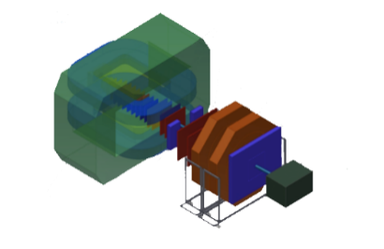
BM@N Data Processing Pipeline
FLP
First Level
Processor
Data Check Flow Control Formatting
EvB
Event
Builder
Buffering
Sorting
Distribution
Rootifier
ROOT Format
Mapping
Alignment
REC
Event
Reconstruction
PA
Physics
Analysis
HLT
High Level
L3 Trigger
RQ
Raw Data
Quality
Check
BmnRoot @ distributed clusters
TDS
Transient Data Storage
PDS
Permanent Data Storage
DRE
LDC
FT REC
Fast Event
Reconstruction
HIST
Online
Histograms
EvM
Event
Monitor
Databases
￼
DAQ
On-line
Processing
Off-line
Processing
matched from “Data Acquisition System TDR”, DAQ Collaboration

