Slide 1

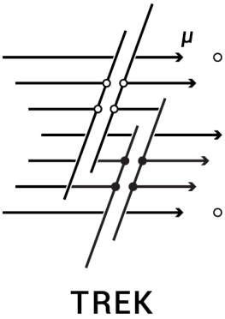
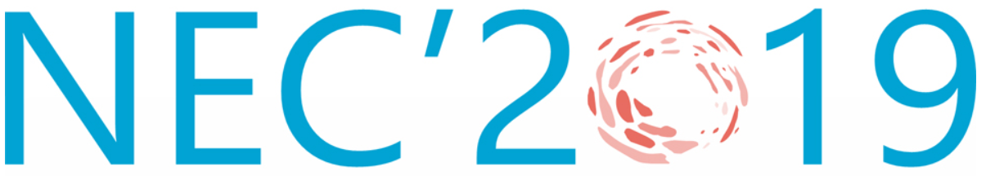
A new machine learning approach for identification of afterpulses in drift chamber data
Vorobyev V.S., Nikolaenko R.V., Petrukhin A.A., Zadeba E.A.
XXVII International Symposium on Nuclear Electronics and Computing
Montenegro, Budva, Becici, 30 September – 4 October 2019
Notes:
1

Slide 2
Detector TREK
264 drift chambers
Chamber’s area is 2 m²
TREK’s area is about 250 m²

Slide 3
Drift chamber
Coordinate resolution~ 1 mm
Angle resolution ~ 1.7°
Medium mixture: 94% Ar + 6% CO₂
Drift time < 6 μs
Drift velocity– 0.04 mm/ns

Slide 4
Reconstruction methods
The histogram method was developed for a parallel track reconstruction. The corridor with certain region and variable angles are drawn from each points of the first channel to other channels. Then the tracks in the corridors are counted dependence on its angle. The true reconstruction has maximum number of tracks.

Slide 5
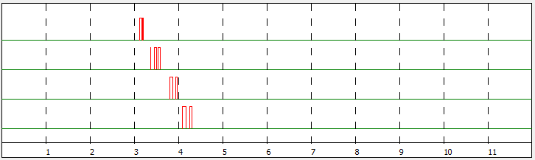
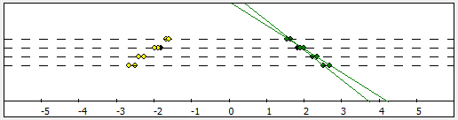
Afterpulses
There are afterpulses in experimental data – signals appearing after original signals often observed at shaper-amplifier output. The presence of afterpulses leads to fake reconstructions.

Slide 6
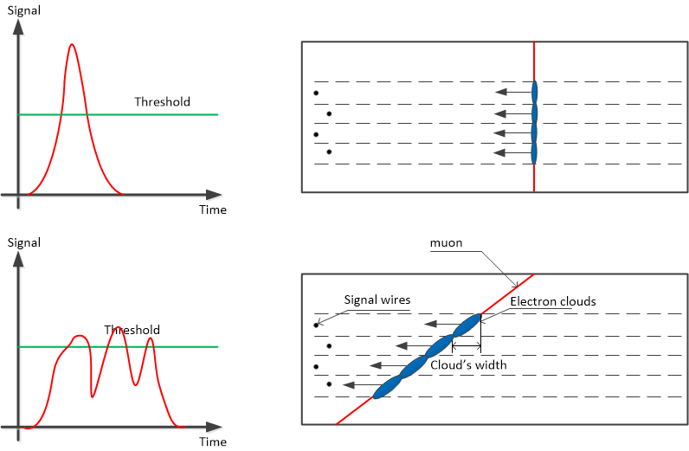
The cause of afterpulses presence
Vertical track
Inclined track

Slide 7
Excluding afterpulses by convolutional neural networks
Representation of waveforms
Data obtained from the drift chamber can be represented as a binary image. The value 0 of the matrix element corresponds to the absence of a signal, 1 - to the presence. Such a matrix has 4 rows corresponding to 4 signal channels.
Each column corresponds to 10 nanoseconds. The maximum drift time is 6 µs so we get 600 columns. Such a pixel image represens both the drift time of the signal and its duration.

Slide 8
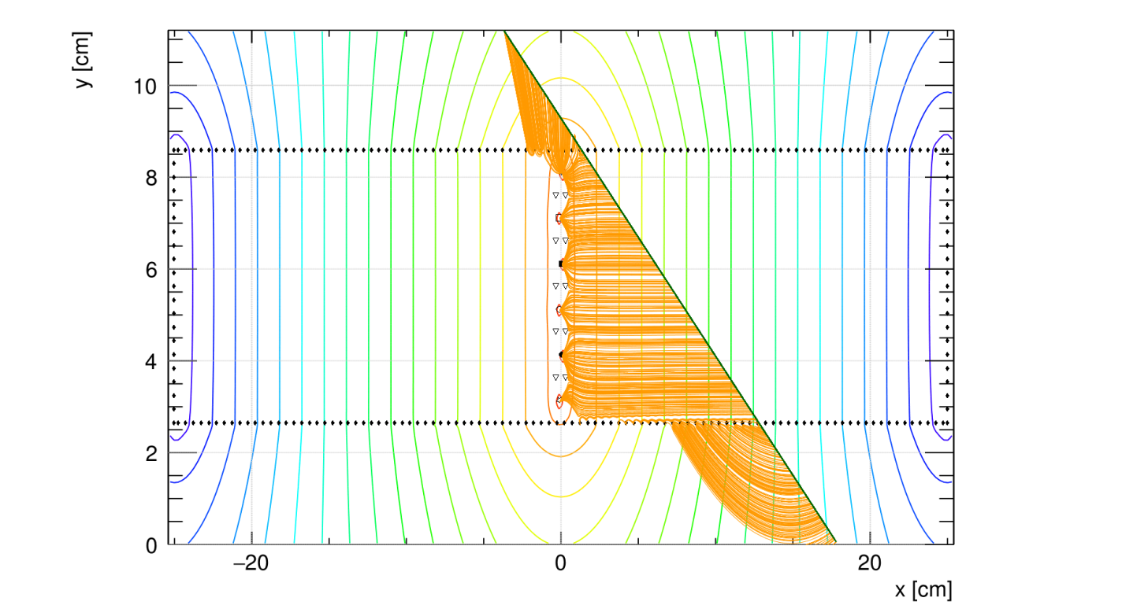
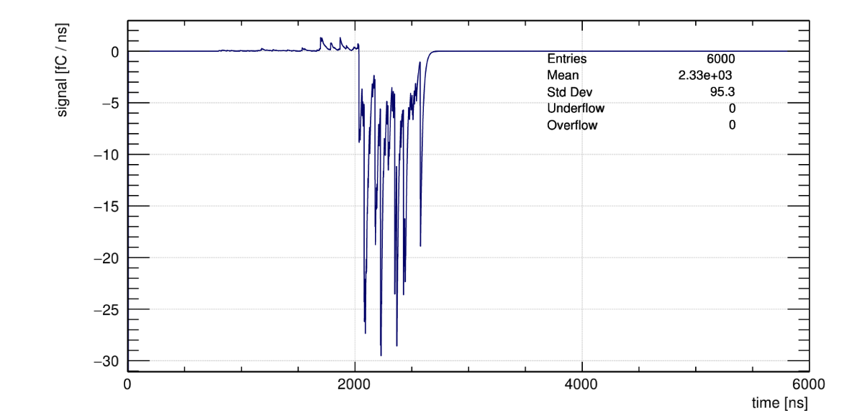
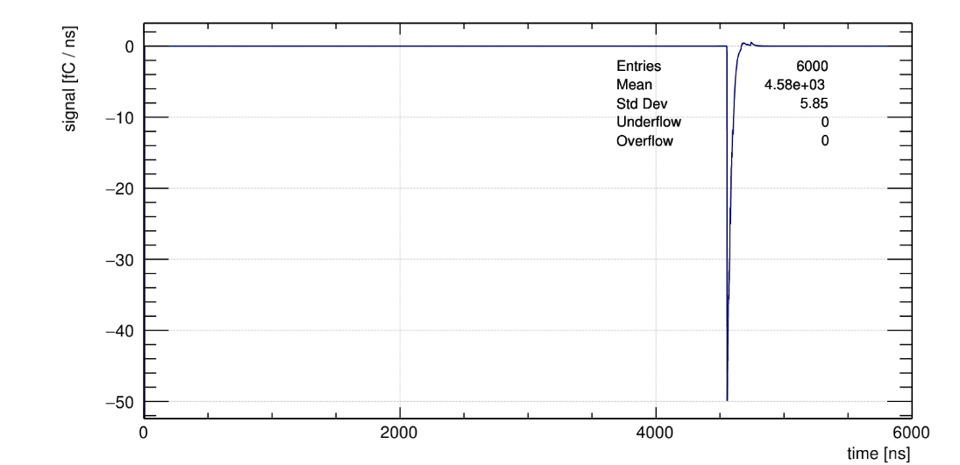
Garfield++ simulation
Garfield++ allows detailed simulation of the drift chamber operation (gas ionization, drift of electron clouds, output signals)
30000 events were simulated for the training data
20000 events were simulated for the test data
Response for an inclined track
Response for a vertical track

Slide 9
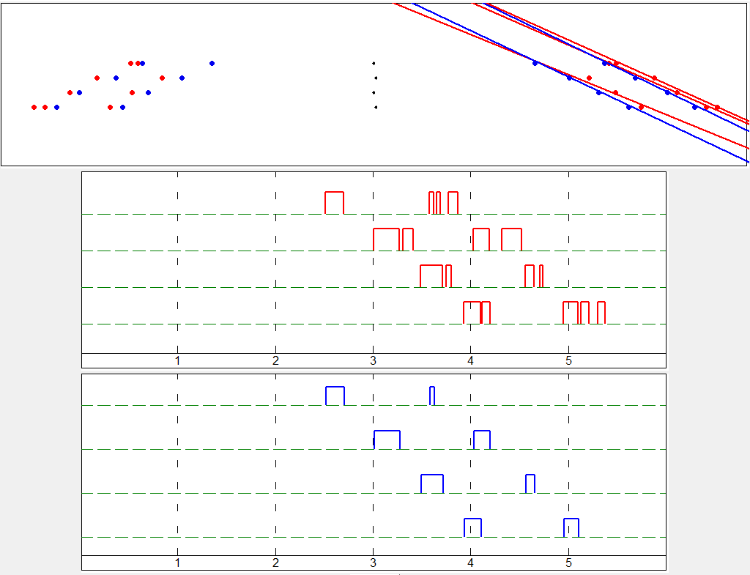
Example of the neural network operation

Slide 10
Comparison of networks performance
Network | Saved original signals (Training set) | Excluded afterpulses (Training set) | Saved original signals (Test set) | Excluded afterpulses (Test set)
Conv-Conv | 92.5% | 71.0% | 82.0% | 50.9%
Conv-Transpose | 99.1% | 93.4% | 94.2% | 84.5%

Slide 11
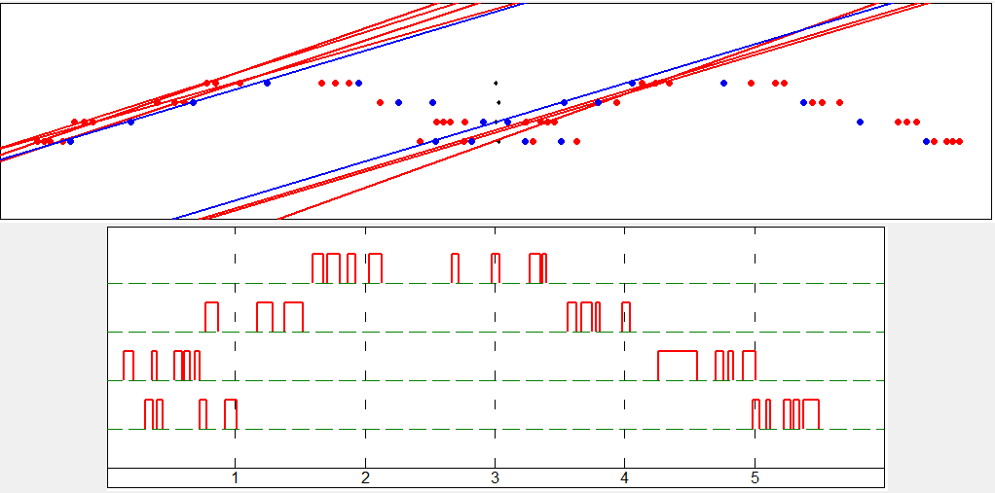
Comparison of reconstructions with and without network
 | Mean difference between number of reconstructed and simulated tracks | Standard deviation of the difference
Without network | 1.39 | 2.04
With network | -0.43 | 0.85

Slide 12
Conclusion
The new approach based on machine learning to exclude afterpulses from drift chamber data has been developed. For the test data it excludes more than 80% of all afterpulses and saves more than 90% of original signals.
The application of the approach reduces systematic uncertainty in multiplicity definition in more than 2 times.
The development of the new event reconstruction method based on machine learning is planned.

Slide 13
Thank you for attention!

