Slide 1
The new ATLAS Fast Calorimeter Simulation
Michele Faucci Giannelli
on behalf of the ATLAS collaboration
NEC, Budva, 30/9-4/10 2019

Slide 2
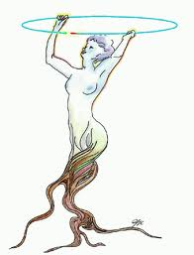
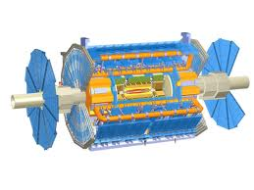
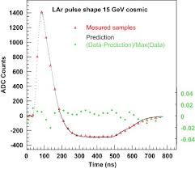
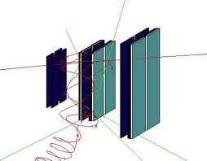
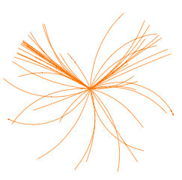
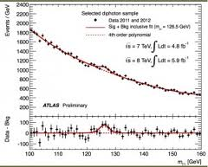
What is Simulation?
Simulation Group Responsibility
Event
Generation
Detector
Simulation
Digitization
Reconstruction
Rootification
EVGEN
HITS
DIGITS
ESD/AOD
TTree/THist
RDOs
Analysis
µ times

Slide 3
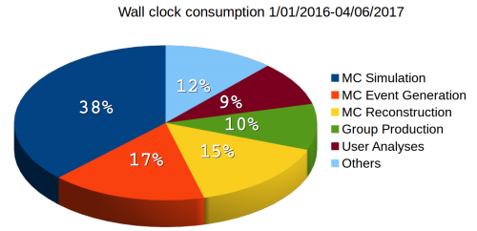
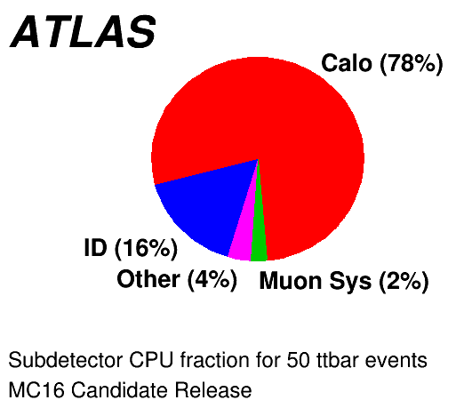
Status of simulation
Monte Carlo production takes almost 70% of the GRID CPU time used by ATLAS on the GRID: this is dominated by full simulation
Great success: so far ~30B events were generated with full simulation
The rapid increase in luminosity of LHC will not allow us to provide a similar ratio of MC using only Geant4 for the simulation step
For measurement in the Run 3 data-taking period we will need to rely on Fast Simulation
Specifically on Fast Calorimeter simulation

Slide 4
Fast Simulation overview
ATLAS has a FastSimulation developed in Run 1 called ATLFASTII (AFII)
FastCaloSim for calorimeters fast simulation, Geant4 for everything else
It was validated in September 2017 for Run 2
AFII has some limitations which we plan to overcome with a new generation of fast simulation tools
It is calibrated with different scale factors w.r.t. Geant4
Double work for all calibration teams
It cannot be used in some regimes, so more computing resources are need to have G4 samples
Boosted topologies
Forward region

Slide 5
New tools
Two efforts to improve fast simulation:
FastCaloSim v2
Most advanced tool, aimed at fixing know limitations
DNNCaloSim
Exploits latest ML generative tools, longer time scale
Further speed-up using FastChain
Possibility of further speed increase by adopting a fast simulation of other detectors
Fast digitisation and reconstruction
Combination of all fast simulation tools in a flexible and configurable way

Slide 6
Path toward the new FastCaloSim
Full Sim single particle production Particles: e⁻, γ, π
Event generated at calorimeter surface
Geant4 produce detailed hits
Digi & Reco run with special flags
Hit to cell matching
FastCaloSim parametrisation
Principal component analysis used for the Energy parametrisation
Shape parametrisation using 2D histograms
Further optimisation to optimise memory consumption
FastCaloSim V2
Standard event generation
Replace G4 with FCS
Standard digitisation & reconstruction
Validation
Comparison of low and high level variables

Slide 7
Special FullSim production
Production parameters of a η×Energy grid:
η range: -5 to 5, using bins of size 0.05
Energies: 11 points from 64 MeV to 4 TeV (logarithmic spacing)
Three particle types: π⁺, e⁺ and photon
Additional validation of K⁺ and p⁺

Slide 8
Principal Component Analysis
We decorrelate the energy deposits in each layer using Principal Component Analysis
The first component is used to divide the events in 5 groups of the same size

Slide 9
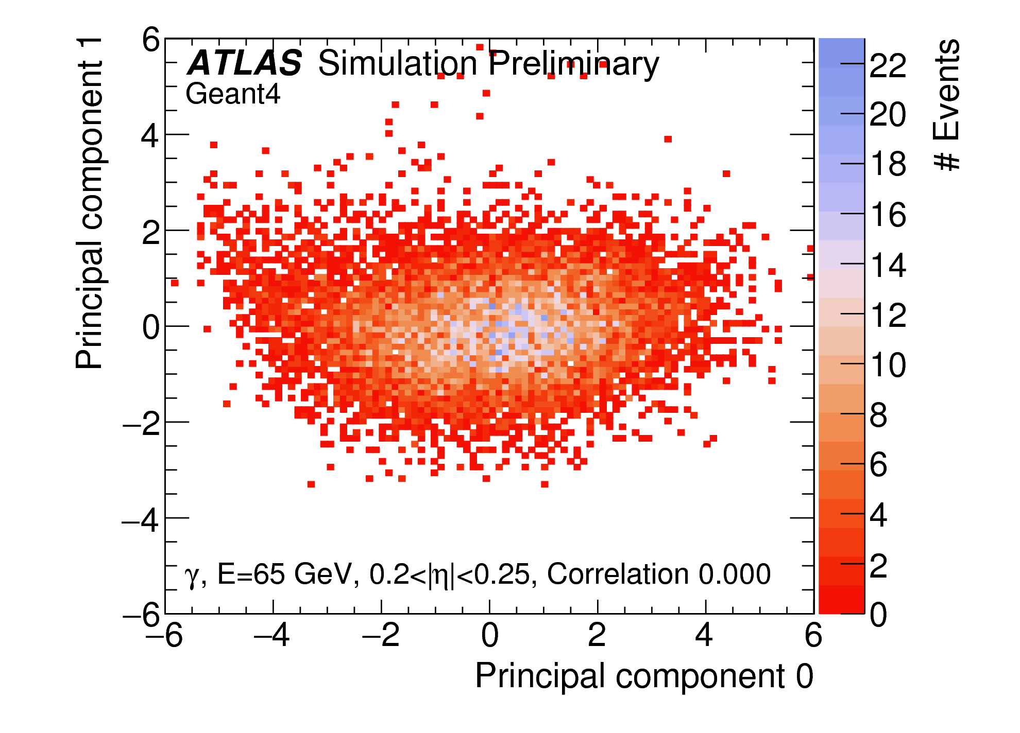
Effect of the PCA
PCA
From correlated layer to decorrelated information

Slide 10
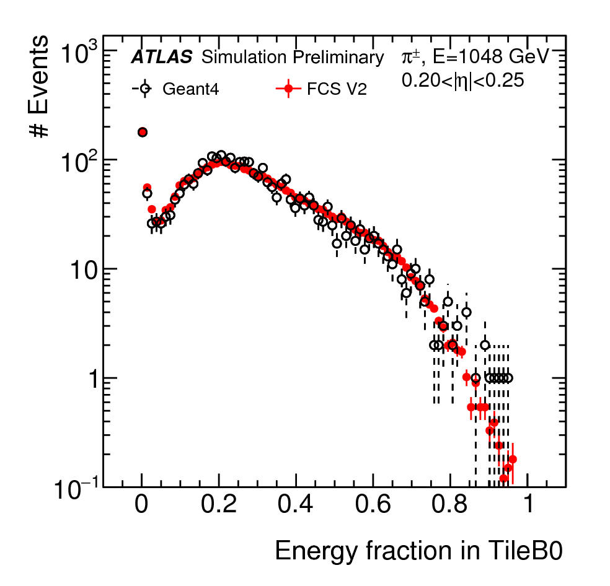
Longitudinal energy parametrisation
The energy parametrisation is validated using toys and compared to the G4 distribution
Examples from pions

Slide 11
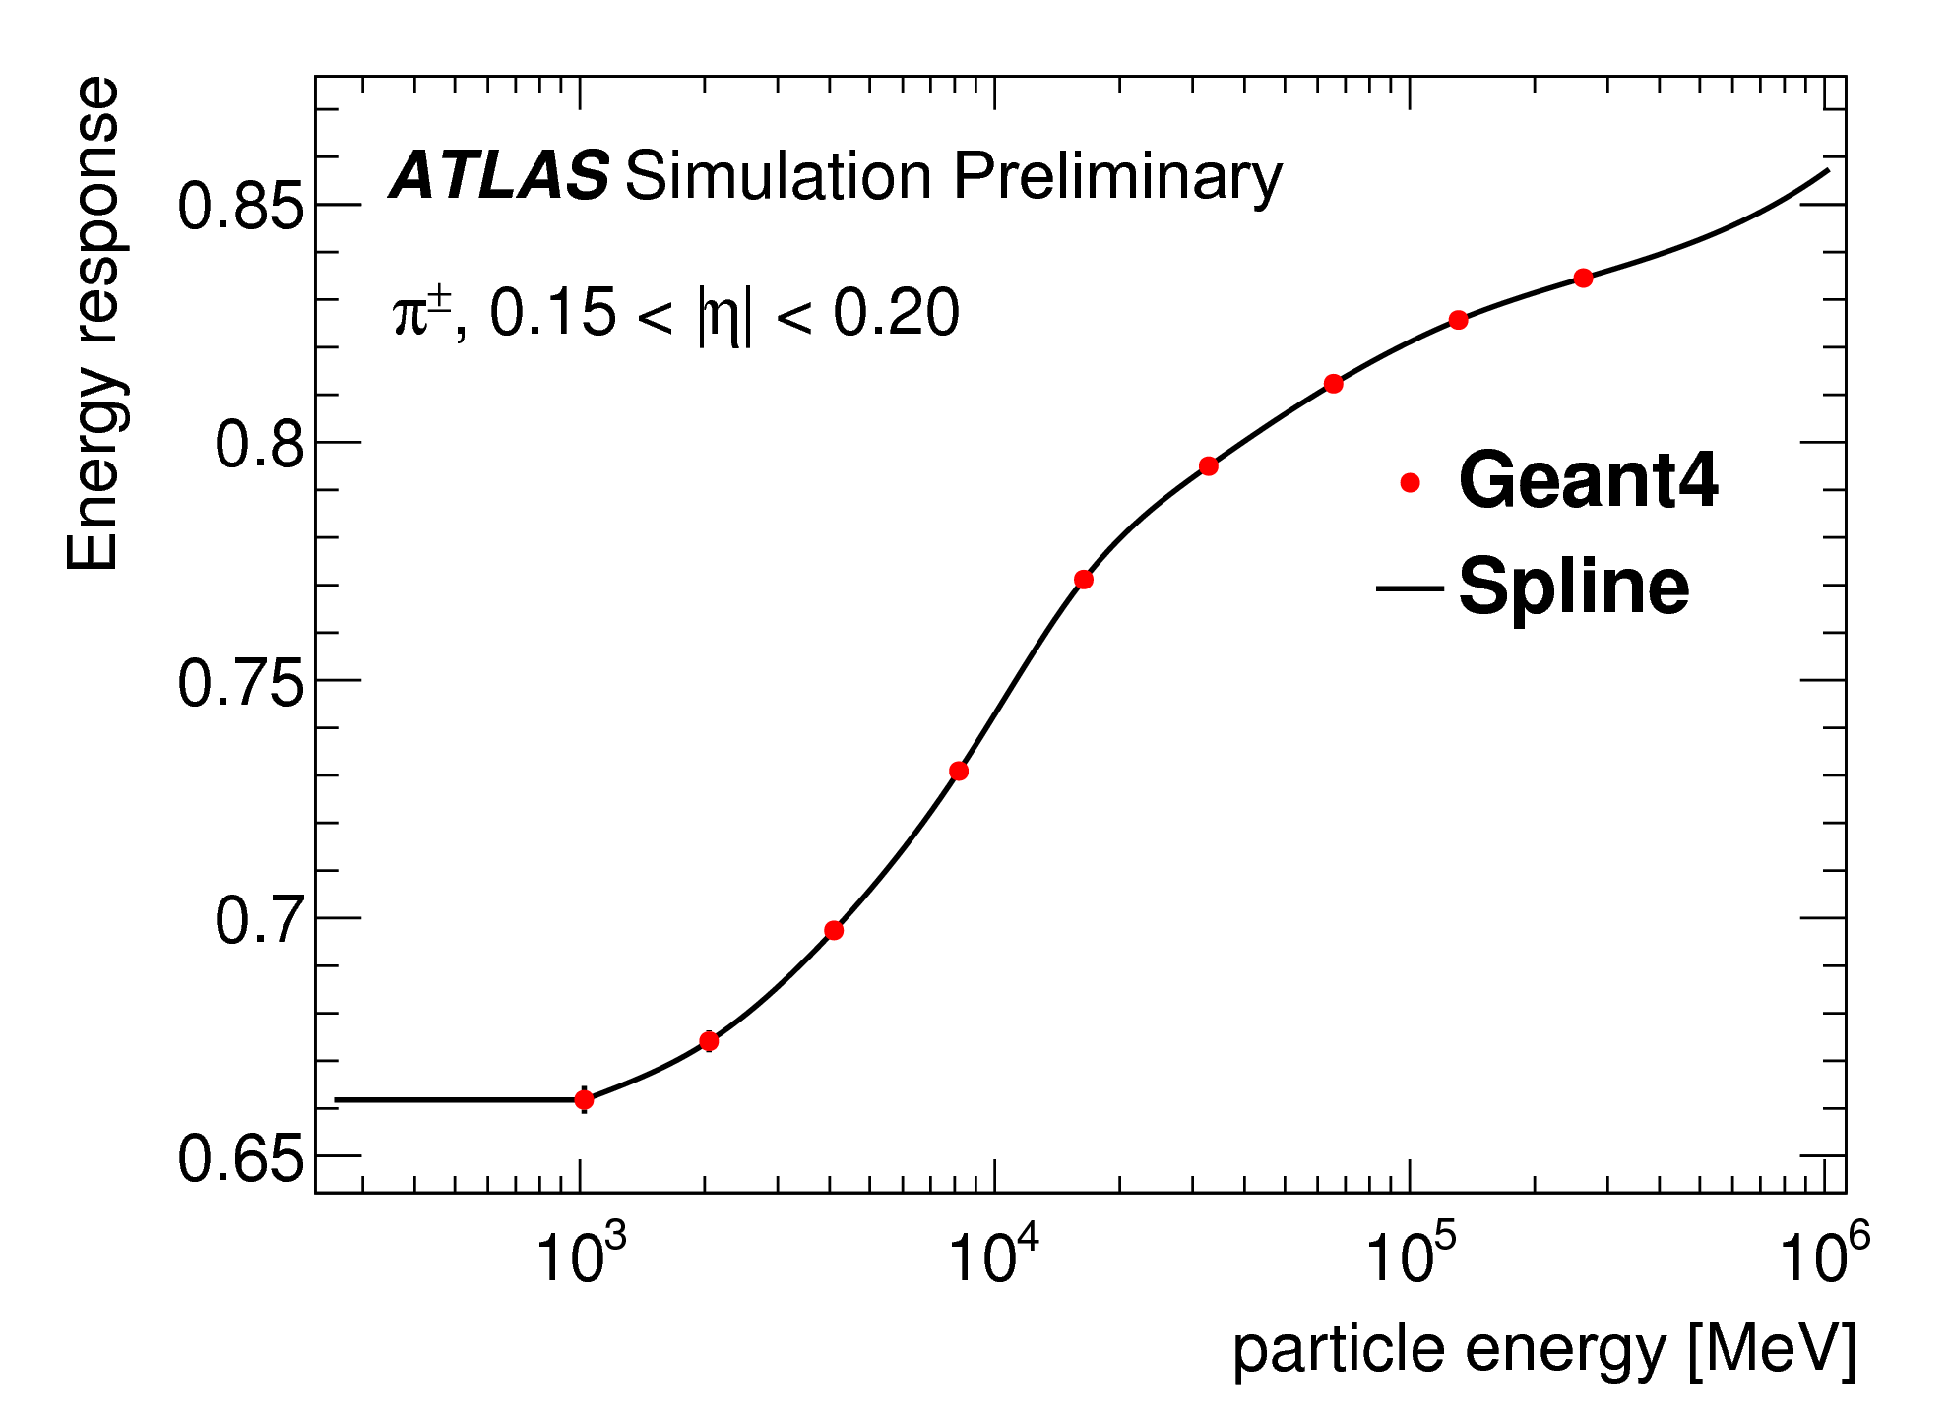
Shape parametrisation
The parametrisation of the lateral distribution of the shower is done using 2D distributions
The symmetry in φ is exploited to reduce the memory requirement
The energy is interpolated between the simulated energy points using a spline function

Slide 12
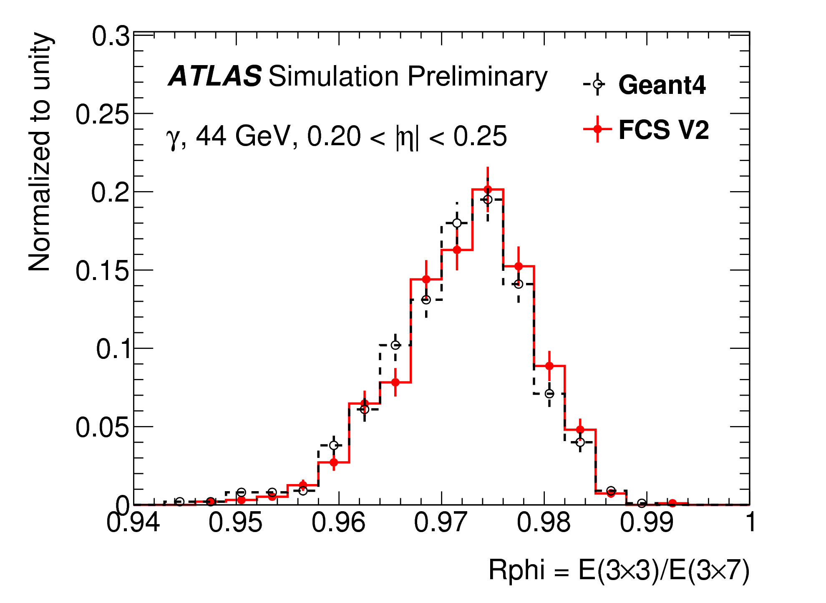
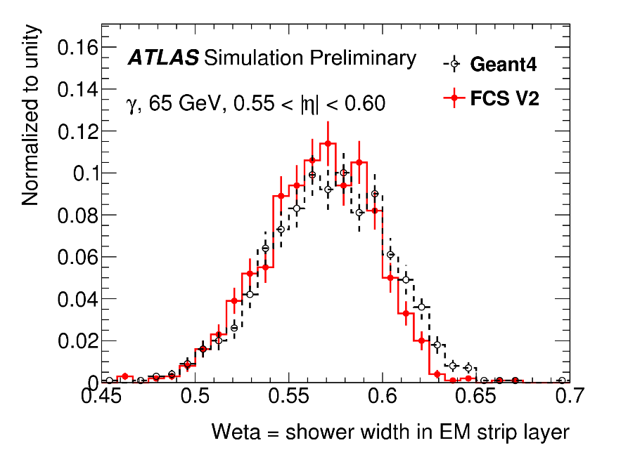
FastCaloSim performance on photons
The energy of the electromagnetic showers is well modelled in each layer energy
The shape of the tails in G4 is also well reproduced

Slide 13
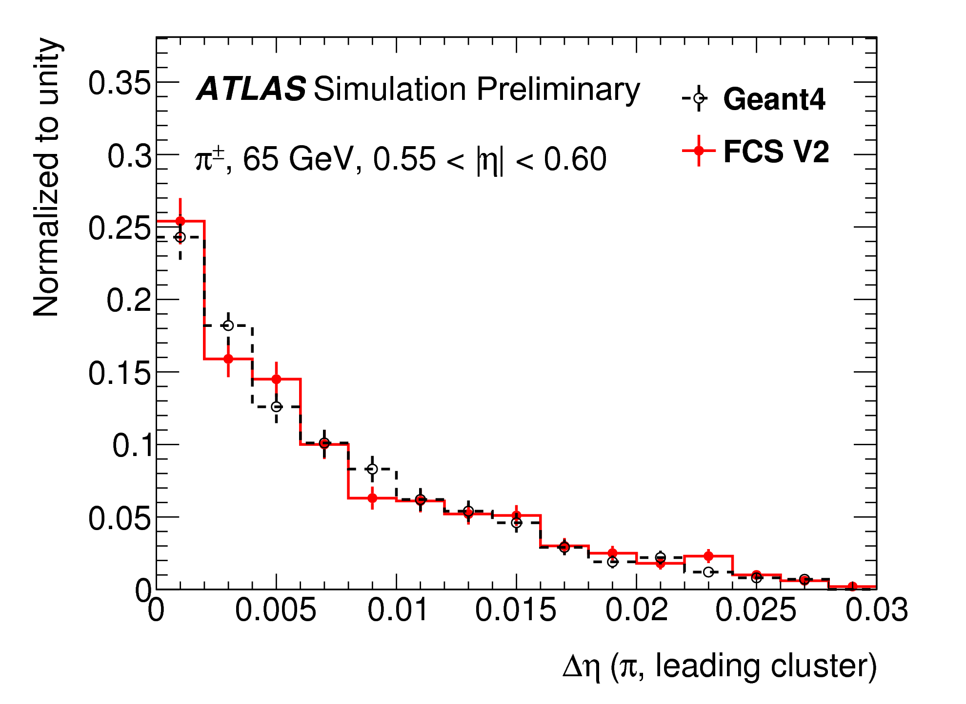
FastCaloSim performance on pions
The substructure of hadronic showers is well modelled
The shapes of the clusters are reasonably modelled

Slide 14
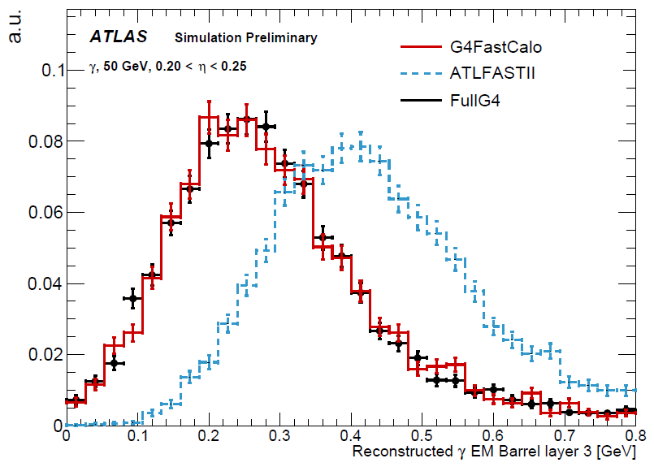
FastCaloSim comparison with AFII
Significant improvement on both EM and hadronic showers
Better modelling in the number of clusters → FCS can be used for boosted topologies
Better EM shower crucial for H→γγ

Slide 15
Speed performance

Slide 16
Recent updates
Better accuracy achieved since last year
Improvements throughout all the detector
In particular FCAL and EC modelling
Running physics validation to have the system in production in the near future
Stay tuned!

Slide 17
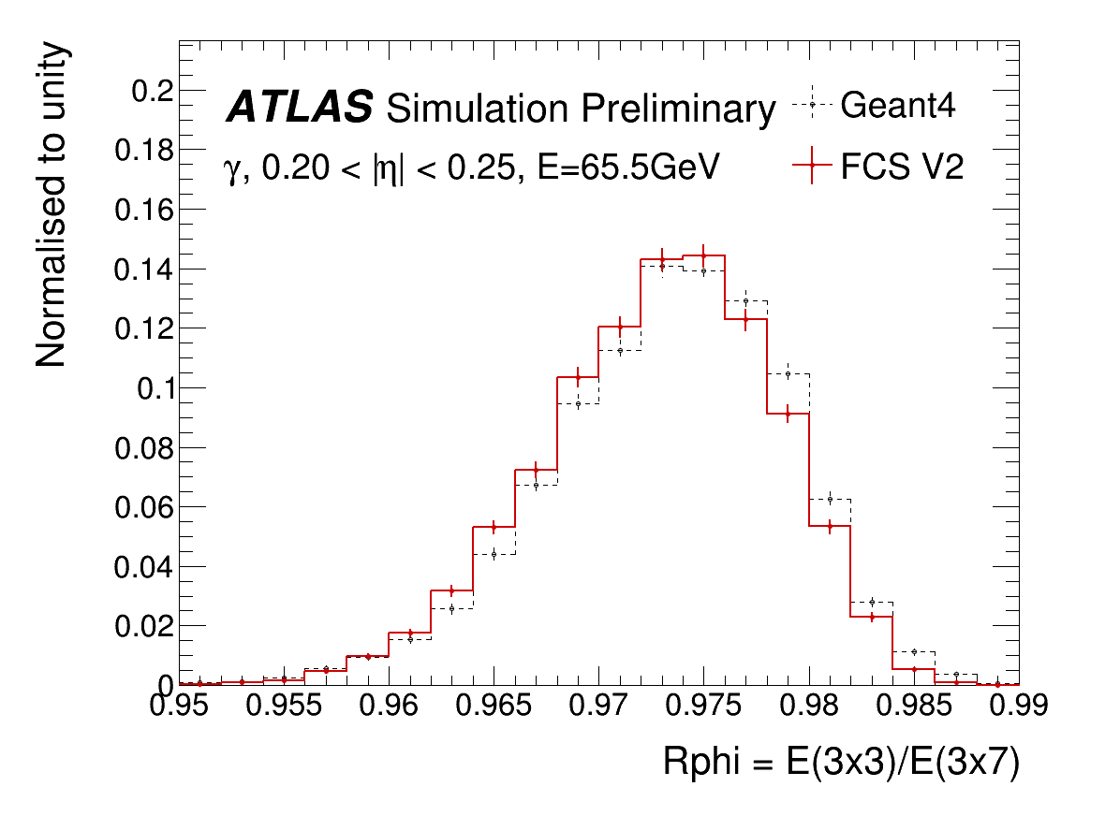
New results: photons
To be replaced with approved plot
Significant improvement, especially along eta

Slide 18
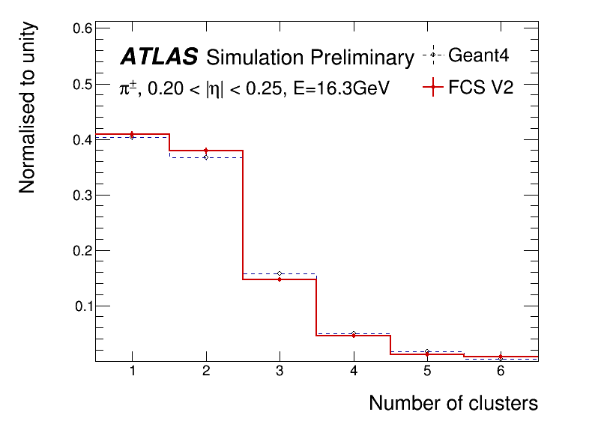
New results: pions
Agreement within statistical uncertainty up to six clusters

Slide 19
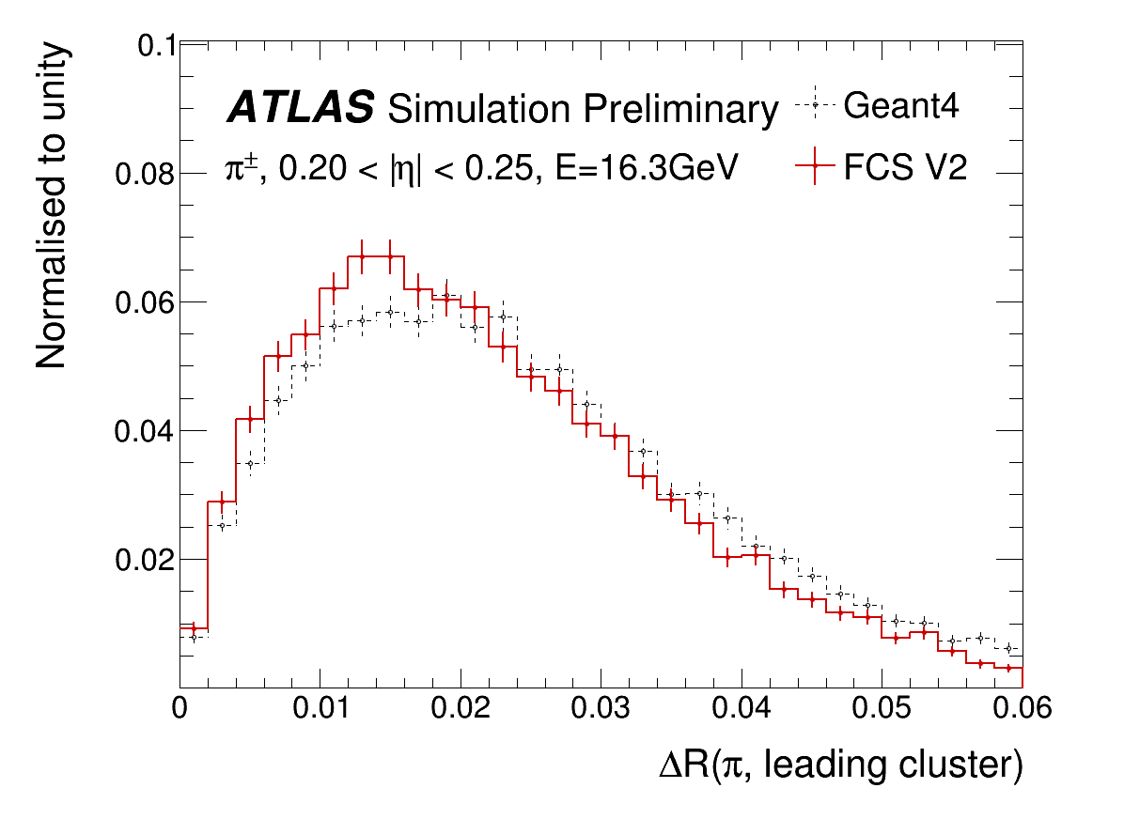
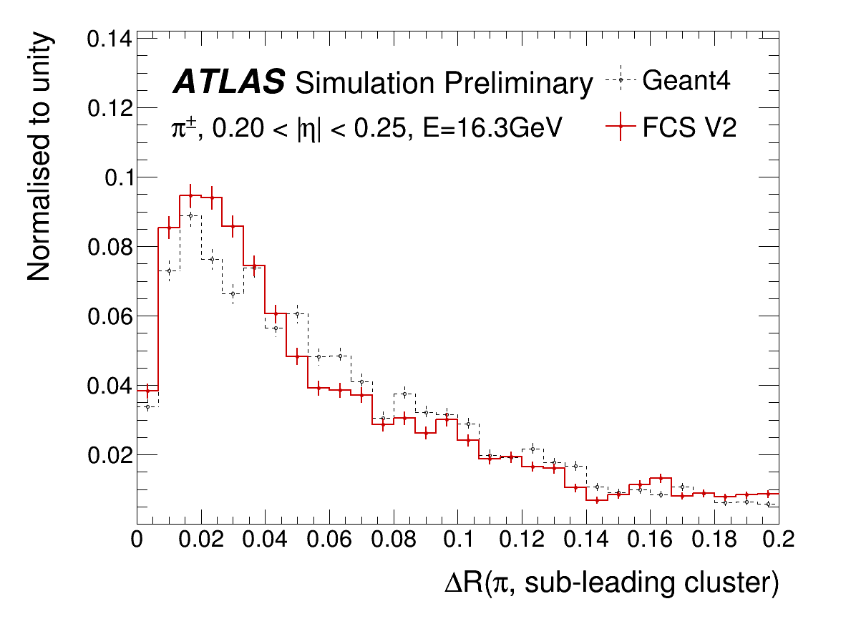
Leading and sub-leading clusters
Angular distance of clusters is crucial for boosted regime
Really good agreement between FCS and Geant 4

Slide 20
DNN for fast simulation
While the new FCS was in development, a new technology emerged in the ML community: generative models
First used to create realistic, but fake, faces
Is should be possible to apply these tools for generating the special type of images that are the shower produced in the calorimeters
In ATLAS we have 3 approaches under development, testing different approaches and tools
All information available here
The main advantage over FCS would be the possibility to learn (and reproduce) local correlations within and between layers

Slide 21
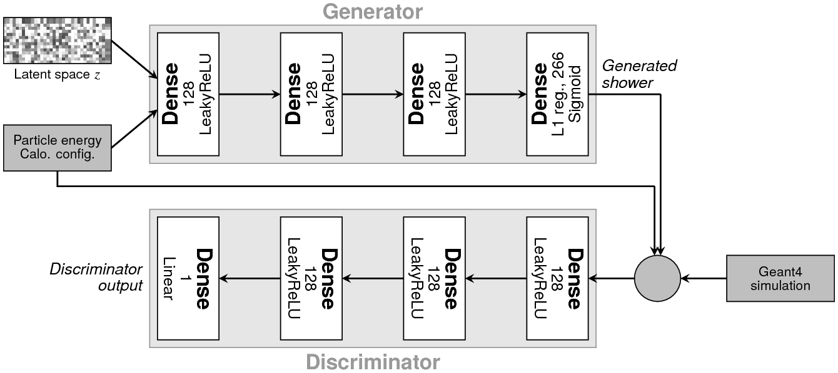
GAN
Combine two deep networks competing in generate images and trying to discriminate the generated image as fake.
By competing over many iterations, the Generator learns to produce realistic images based on the training Geant4 dataset.

Slide 22
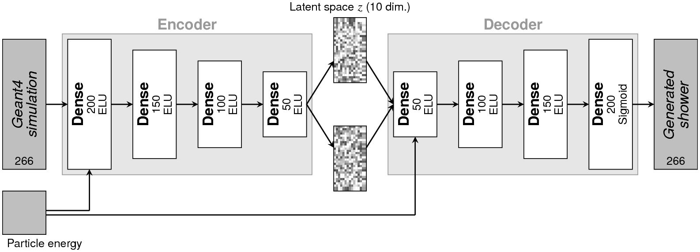
VAE
The encoder learns the main features from the training dataset and compress them into a low dimensionality latent space.
The decoder learns to reproduce the original distribution from the latent space and, once trained, can be used in isolation to produce the showers.

Slide 23
Voxelisation
Both approaches require the information to be discretised in voxel.
The two approaches presented use the ATLAS cell structure as the voxel and add the same information multiple times to consider all possible shifts induced by different impact point in a cell

Slide 24
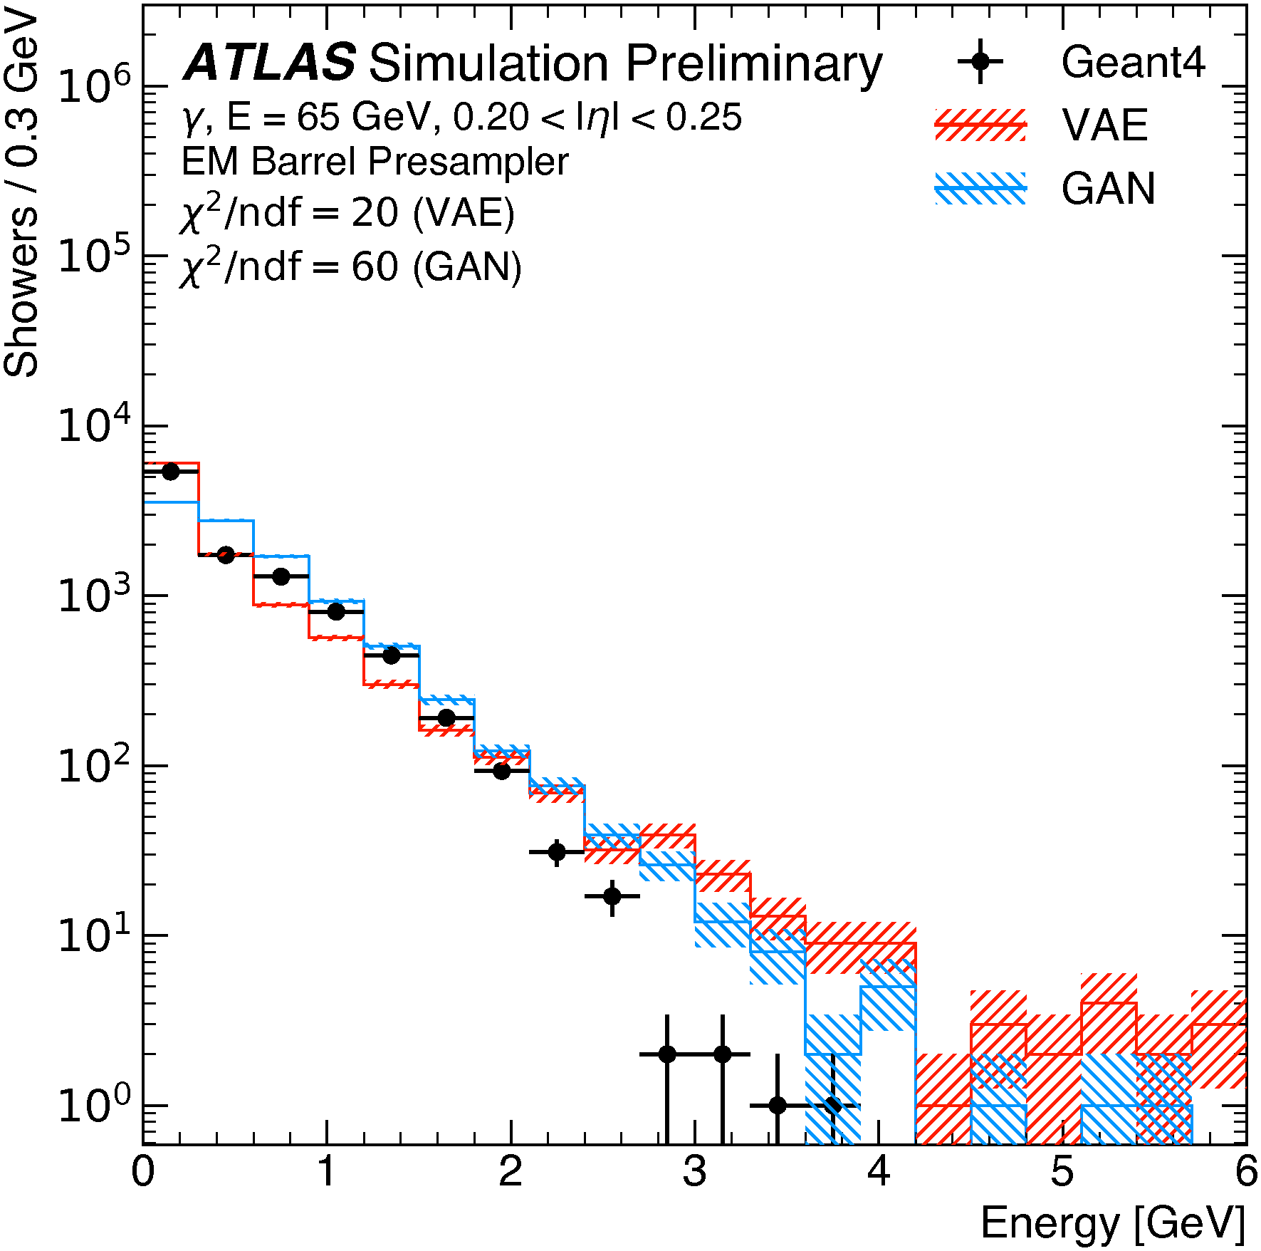
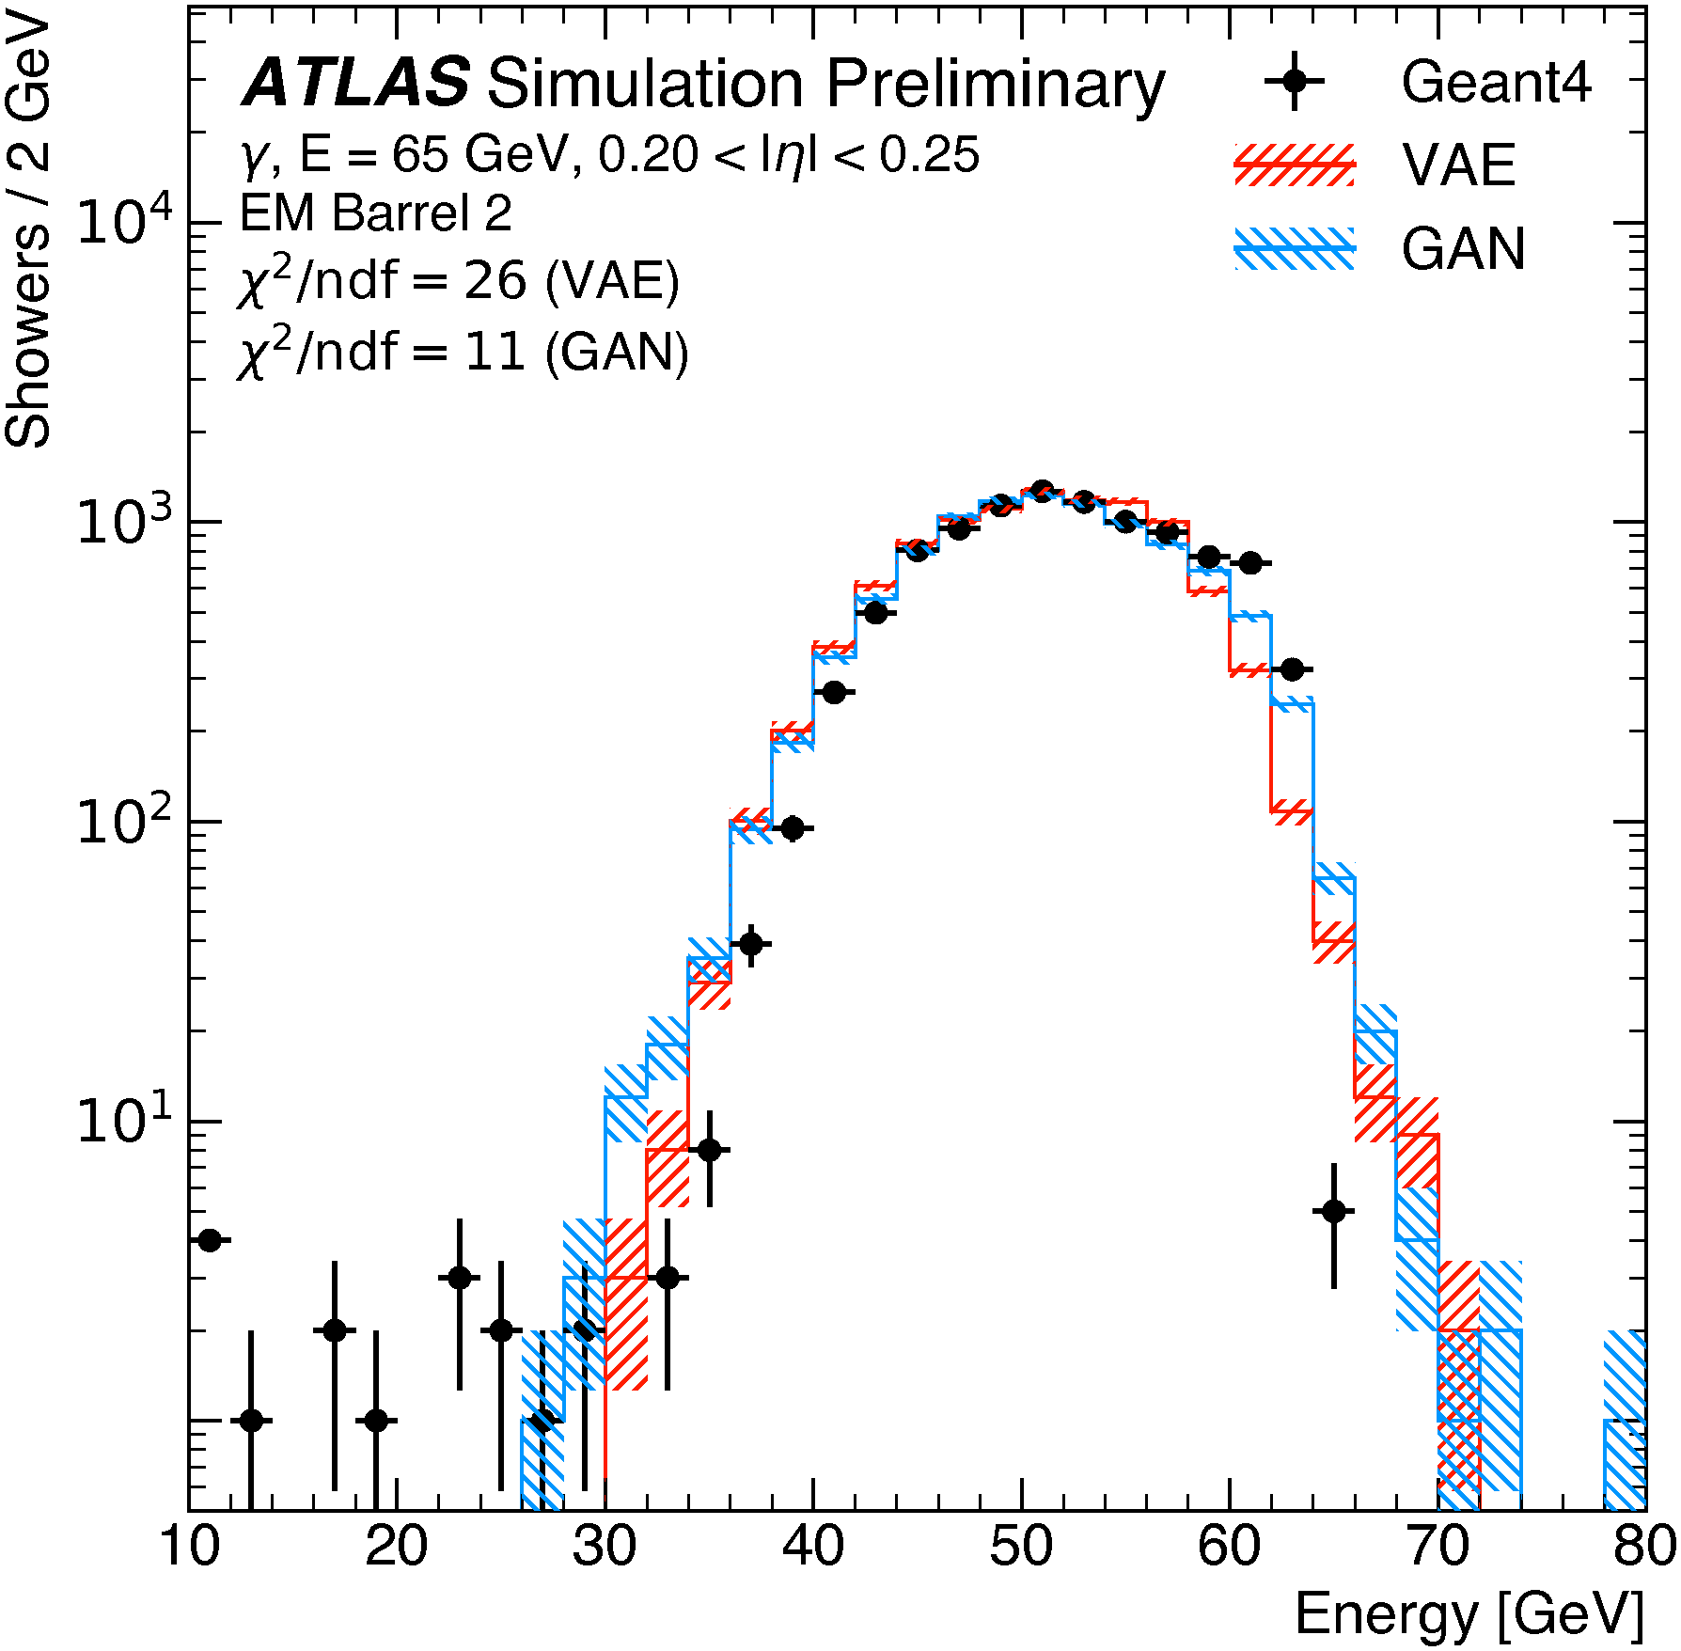
Performances: energy per layer
Both VAE and GAN can reproduce rather well the energy distribution in each layer with only minor problems in the tails

Slide 25
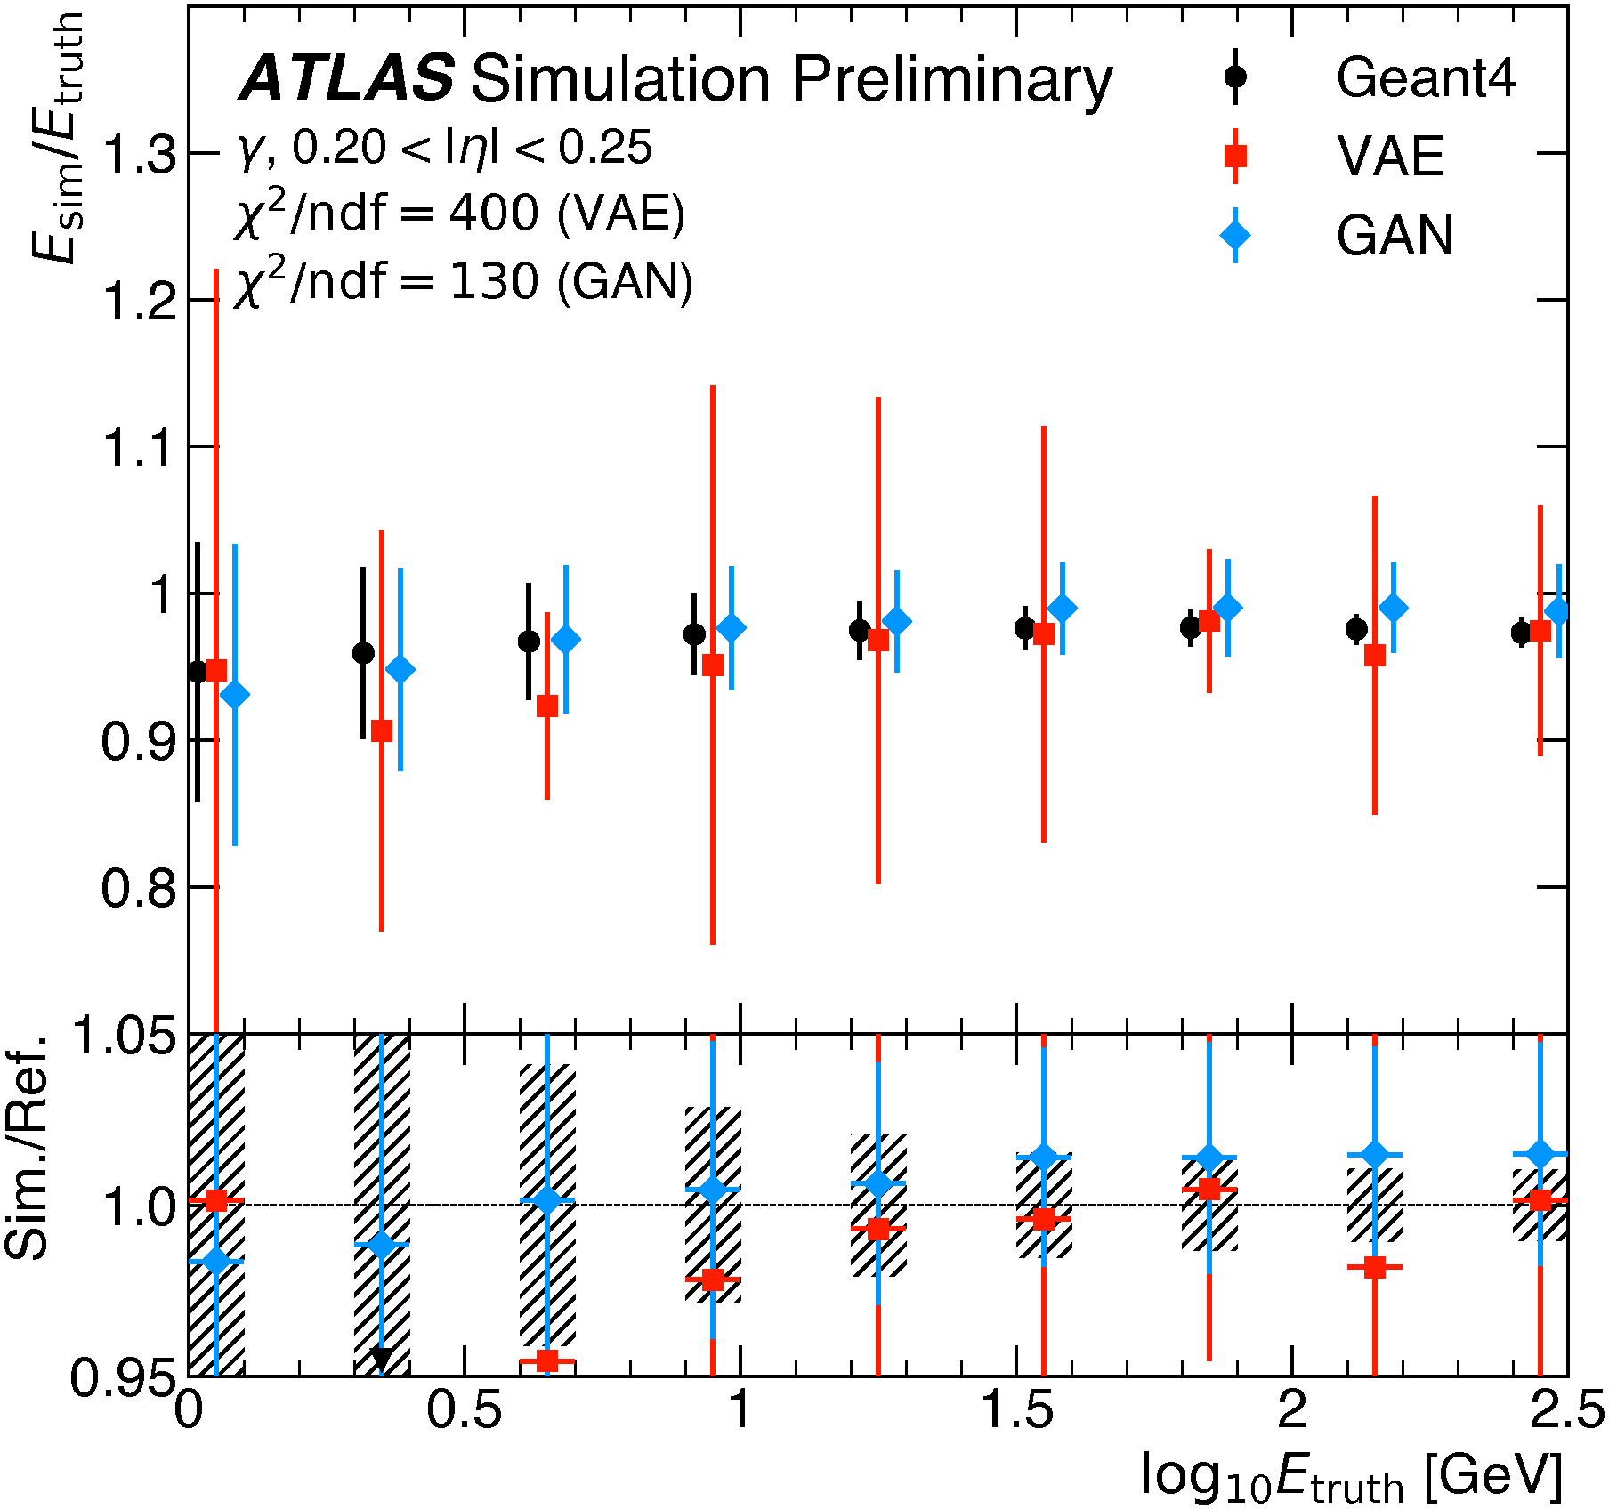
Performance: total energy
The correlation between layers is not well reproduced and the total energy distribution is wider than G4
This is true at all energies and is worse for the VAE

Slide 26
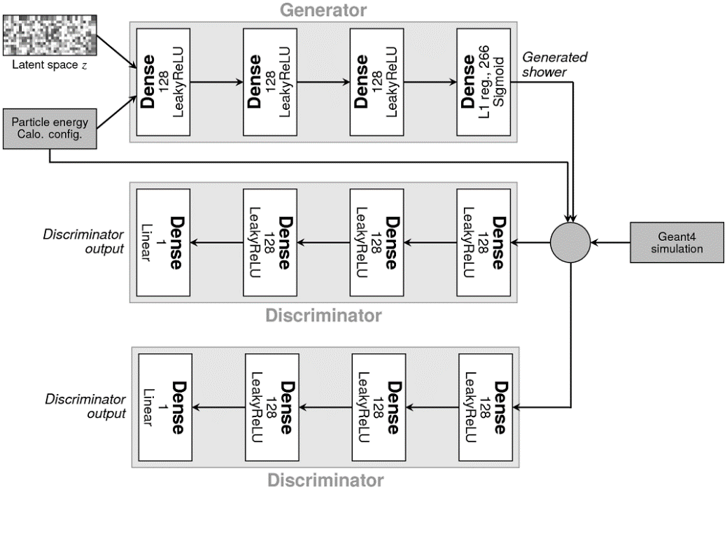
New results
The GAN is also conditioned on the impact point, which help reproduce the shower shape
Adding a second discriminator with a different learning rate allowed to get the correct width of the total energy

Slide 27
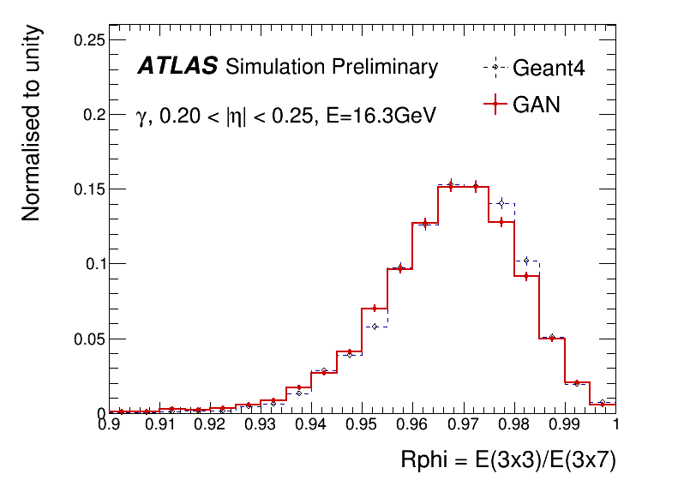
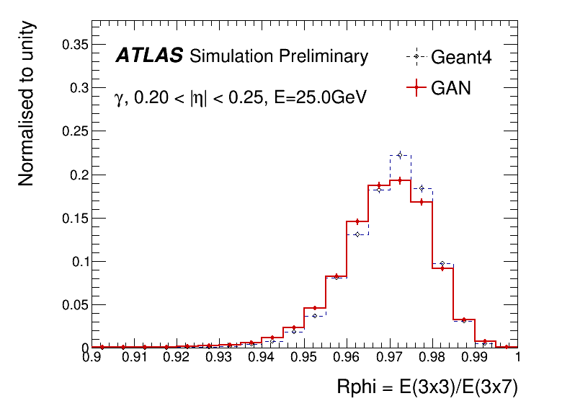
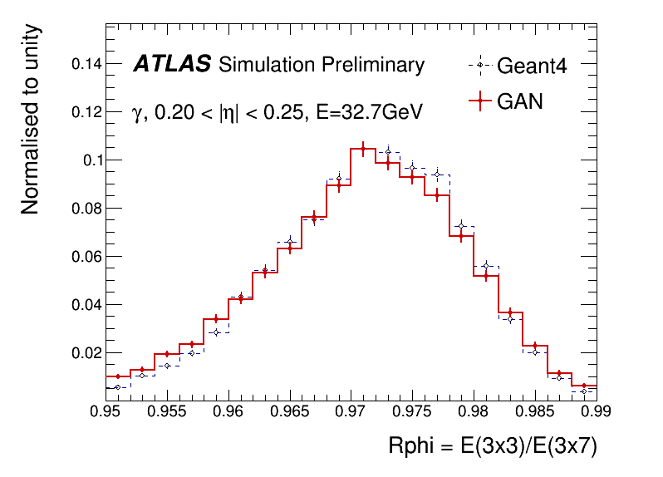
Optional: Comparison of reconstructed objects
GAN output read in ATLAS software framework
Objects reconstructed and compared to G4
Really good agreement in cluster shape
Even for the interpolated point at 25 GeV

Slide 28
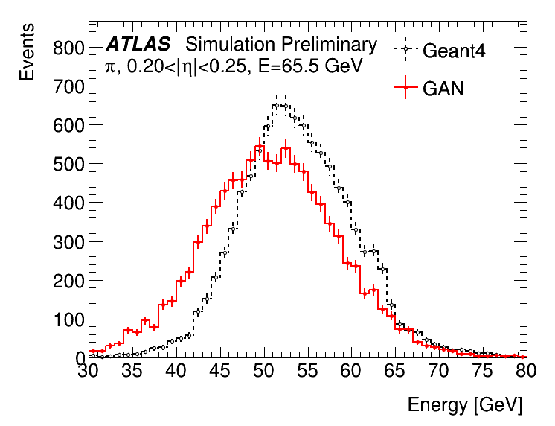
GAN simulating pions
A new GAN is being developed that, like FCS, uses hits instead of cells
The voxelisation is in this case is performed in the same reference frame used in FCS (r, α) and the binning is optimised to reproduce the shower lateral shape. This approach is more flexible and can be applied to both pions and photons and to the whole detector as it does not depend on the cells structure
Preliminary results on pions are encouraging, we can reproduce the total energy with the correct width as in the latest other approaches

Slide 29
FastChain
With FastCaloSim, CPU budget becomes dominated by the reconstruction
FastChain is a highly configurable environment:
Replace digi and/or reco
Treat the different sub-detectors in different ways
Reduces CPU consumption by an order of magnitude

Slide 30
Conclusion
The large amount of data collected by ATLAS will soon force the analysis teams to reduce the use of Full Simulation
A new Fast Calorimeter Simulation is being developed to provide an improved simulation in all regimes
Preliminary results are very encouraging
The path to production is well defined
The ATLAS Simulation team is also working on even faster simulation methods that will allow another significant speed-up and a more sophisticated simulation strategy

Slide 31
Backup

Slide 32
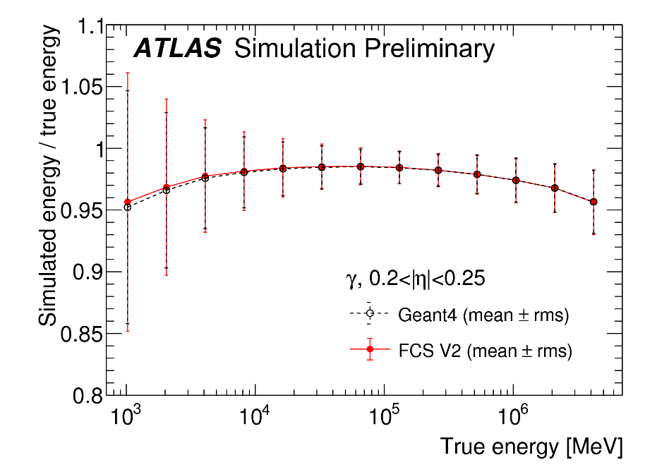
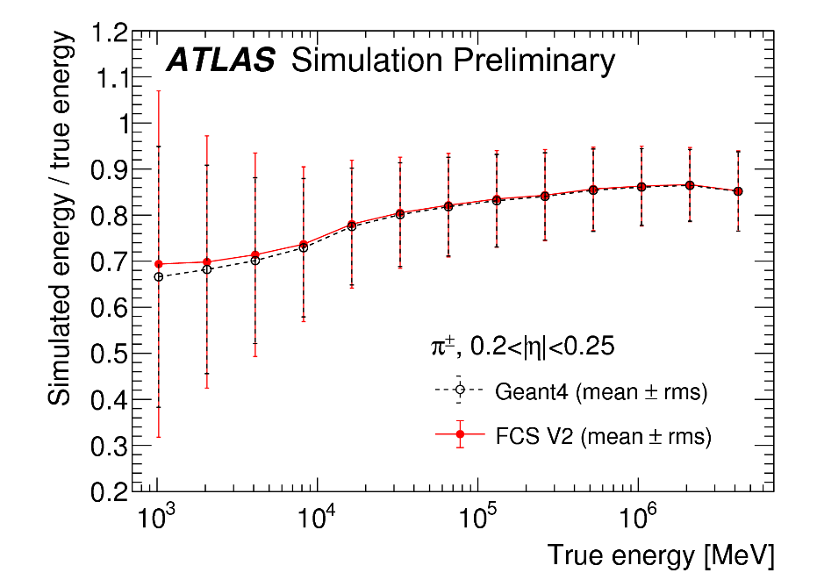
Energy response

Slide 33
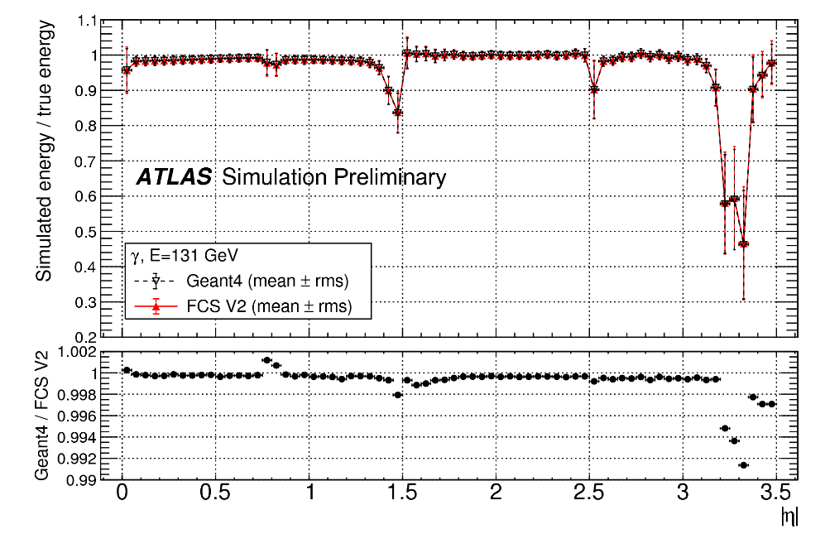
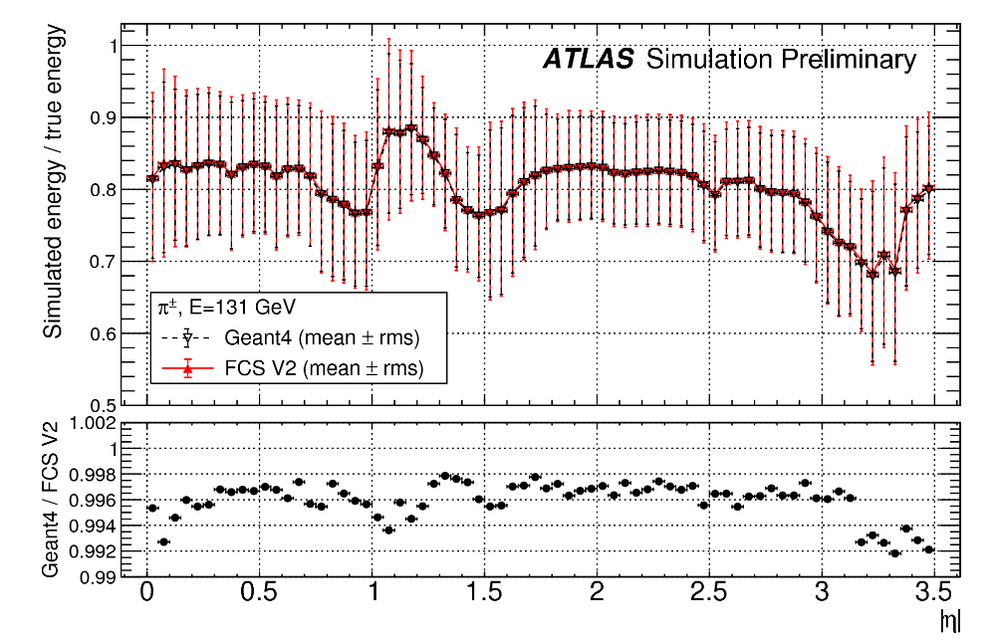
Response vs eta

Slide 34
Spline photons

Slide 35
Total production time for diboson events

