Slide 1

Modern Heavy Ion Accelerator Facilities in JINR and Worldwide
Boris Sharkov JINR, Dubna
Состояние дел в ведущих ускорительных центрах
Борис Шарков
Boris Sharkov JINR Dubna
1

Slide 2
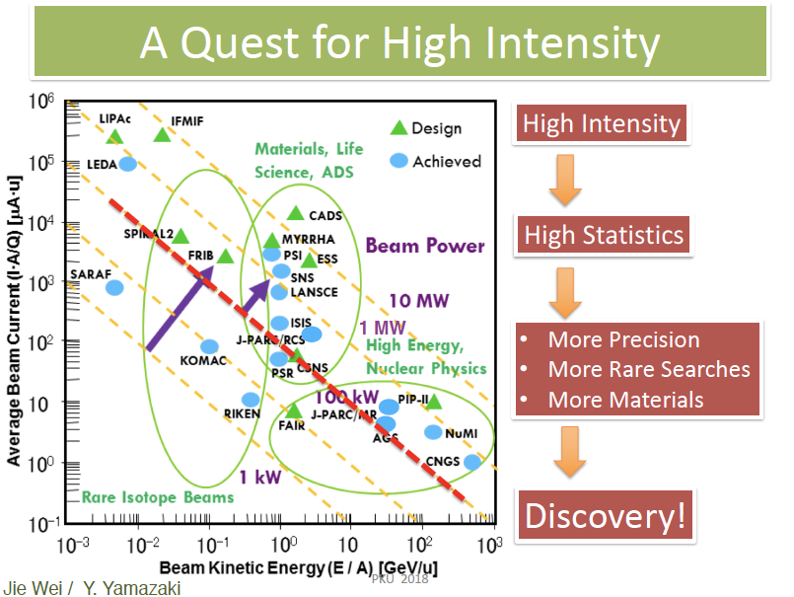

Slide 3
1. Low and medium enegy accelerators E < N GeV
Facilities goals : pushing the “intensity” and the “precision frontiers” to the extremes – not “energy frontier”!
Full range of ion beam species: p+ - 239U ;
Highest beam intensities & luminosities;
Generation of ‘Precision beams’: sophisticated beam manipulation methods-stochastic and electron cooling of ion beams, also applicable to the secondary radioactive and antiproton beams;
Rings as accelerator structures of choice: capability to store, cool, bunch, and stretch beams ;
Substantial increase in beam energy variation: by a factor of 20 in energy for beams as heavy as Uranium .
Boris Sharkov JINR Dubna
3

Slide 4
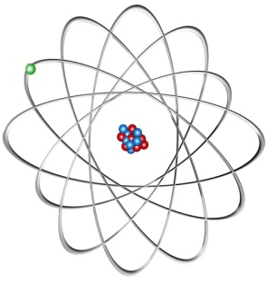
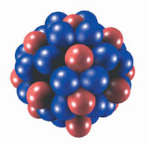

Key Questions in modern Nuclear Physics

Slide 5
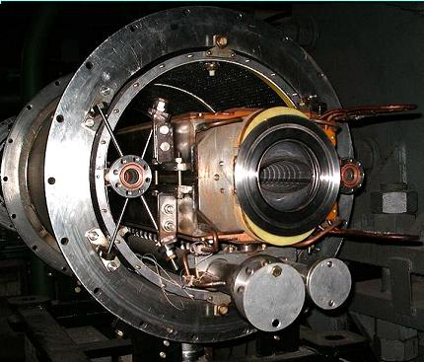
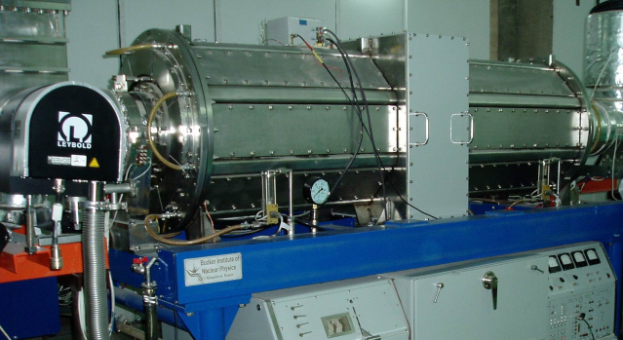
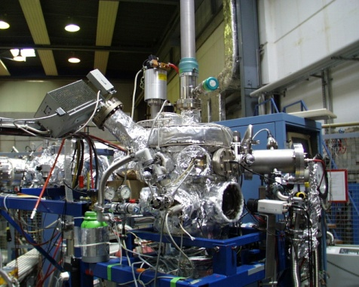
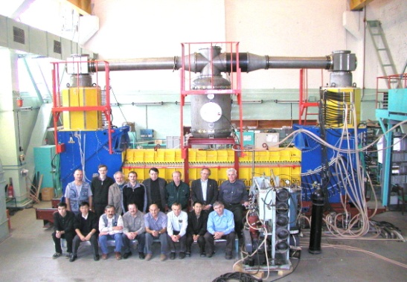
Accelerator Challenges
Compact & cost effective accelerators
Fast cycling superconducting magnets
dB/dt ~ 4T/s
Fast acceleration
High gradient, variable frequency
Ferrite & MA loaded cavities
XHV @ high beam intensities
Extremely high vacuum ~10⁻¹² mbar
Precision beams
Electron & stochastic cooling
Accelerator performance – is progressing well
Notes:
Accelerator components are being manufactured in high-tech industrial plants in partner countries. A big fraction of them are manufactured in Russia (JINR, Budker, Efremov etc….)

Slide 6
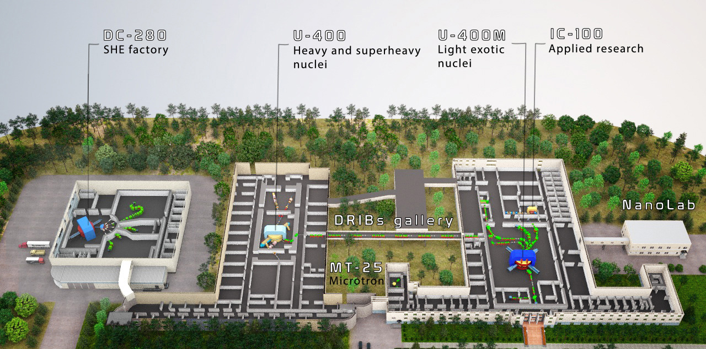

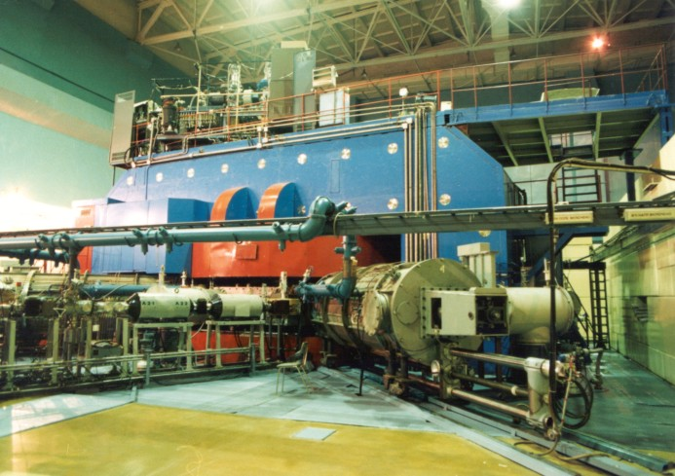
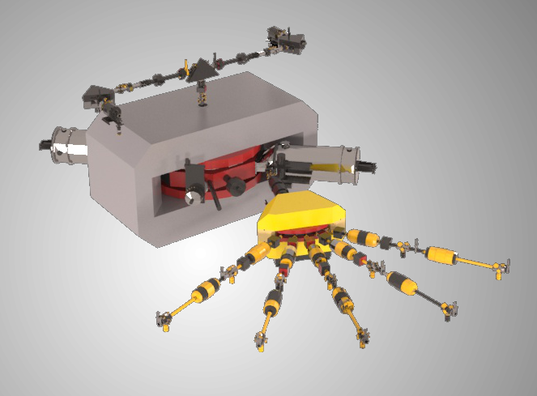
Flerov Laboratory of Nuclear Reactions

Slide 7
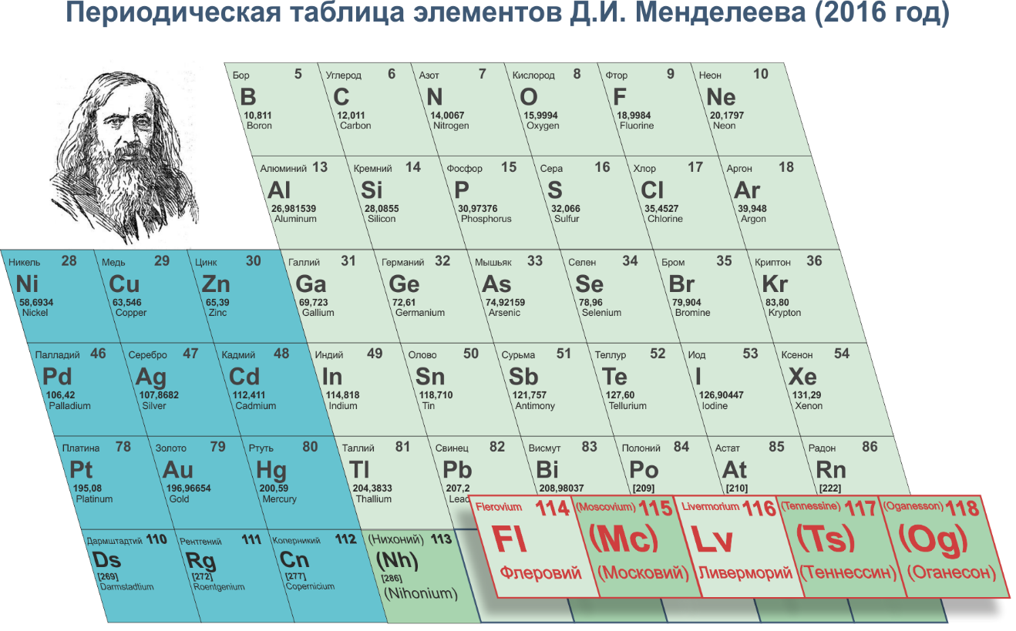

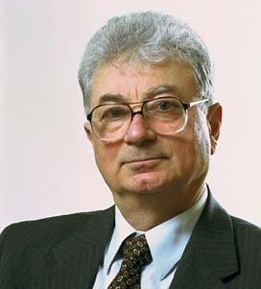
D.I. Mendeleev's Periodic Table
105
Db
]
Dubnium
Notes:
Thus, now the seventh period of D.I. Mendeleev’s Table is fully completed. A considerable (dozens of times) increase of the experimental efficiency is required in order to go ahead and start the pioneer experiments on the synthesis of the elements 119 and 120, the first elements of the 8th period, as well as in order to perform a detailed study of the chemical and physical properties of the known elements. To this end, the JINR implements an ambitious project to construct the world's first Factory of superheavy elements. This accelerator complex was included into the NuPECC Long-Range Plan.

Slide 8
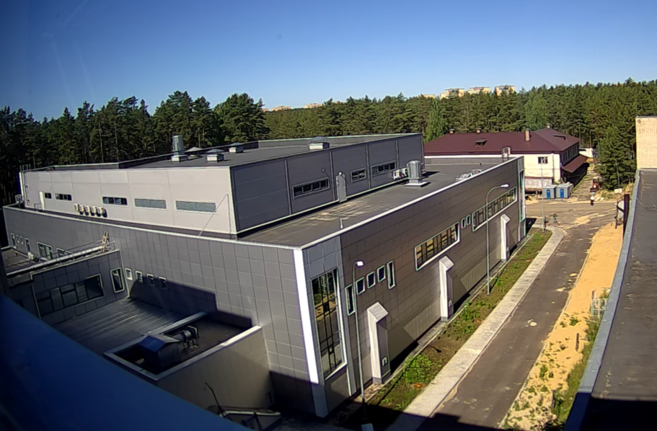
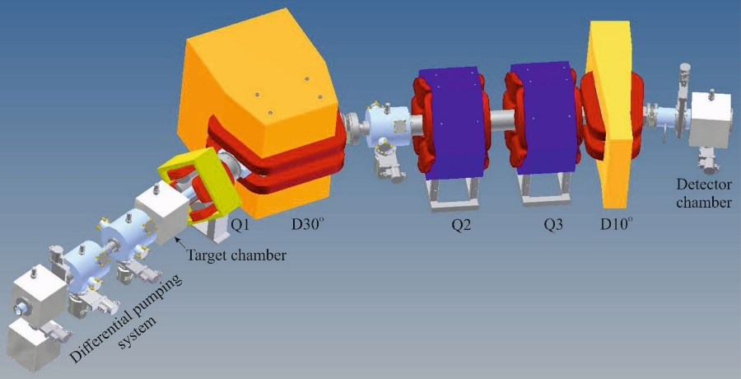
SHE Factory
Flerov Laboratory of Nuclear Reactions JINR
SHE Factory Building
High-current cyclotron DC-280
New facilities:
New gas-filled separator
Preseparator
SHELS
Notes:
The project of the SHE factory includes three principal components: i) high current accelerator, ii) new experimental hall and iii) a number of the next generation facilities.

Slide 9
DC-280 cyclotron – stand-alone SHE factory
DC280 (expected) E=4÷8 MeV/A
Ion | Ion energy [MeV/A] | Output intensity
⁷Li | 4 | 1×10¹⁴
¹⁸O | 8 | 1×10¹⁴
⁴⁰Ar | 5 | 6×10¹³
⁴⁸Ca | 5 | 0,6-1,2×10¹⁴
⁵⁴Cr | 5 | 2×10¹³
⁵⁸Fe | 5 | 1×10¹³
¹²⁴Sn | 5 | 2×10¹²
¹³⁶Xe | 5 | 1×10¹⁴
²³⁸U | 7 | 5×10¹⁰
Synthesis and study of properties of superheavy elements.
Search for new reactions for SHE-synthesis.
Chemistry of new elements.

Slide 10
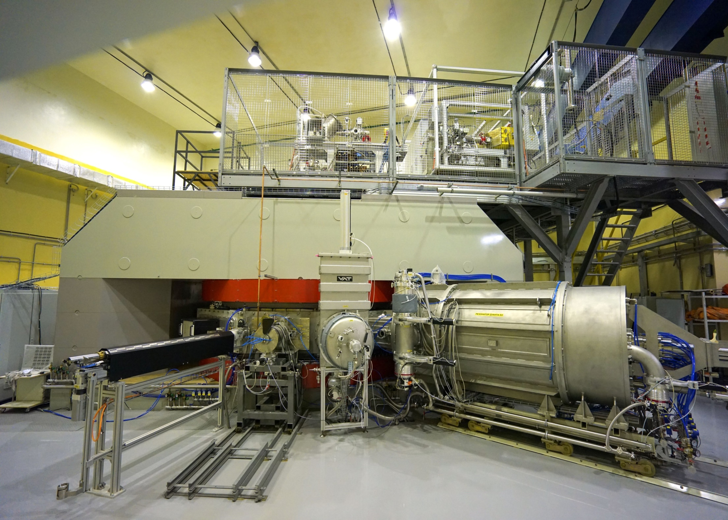
New cyclotron DC-280
First extracted beam – 17.01.2019

Slide 11
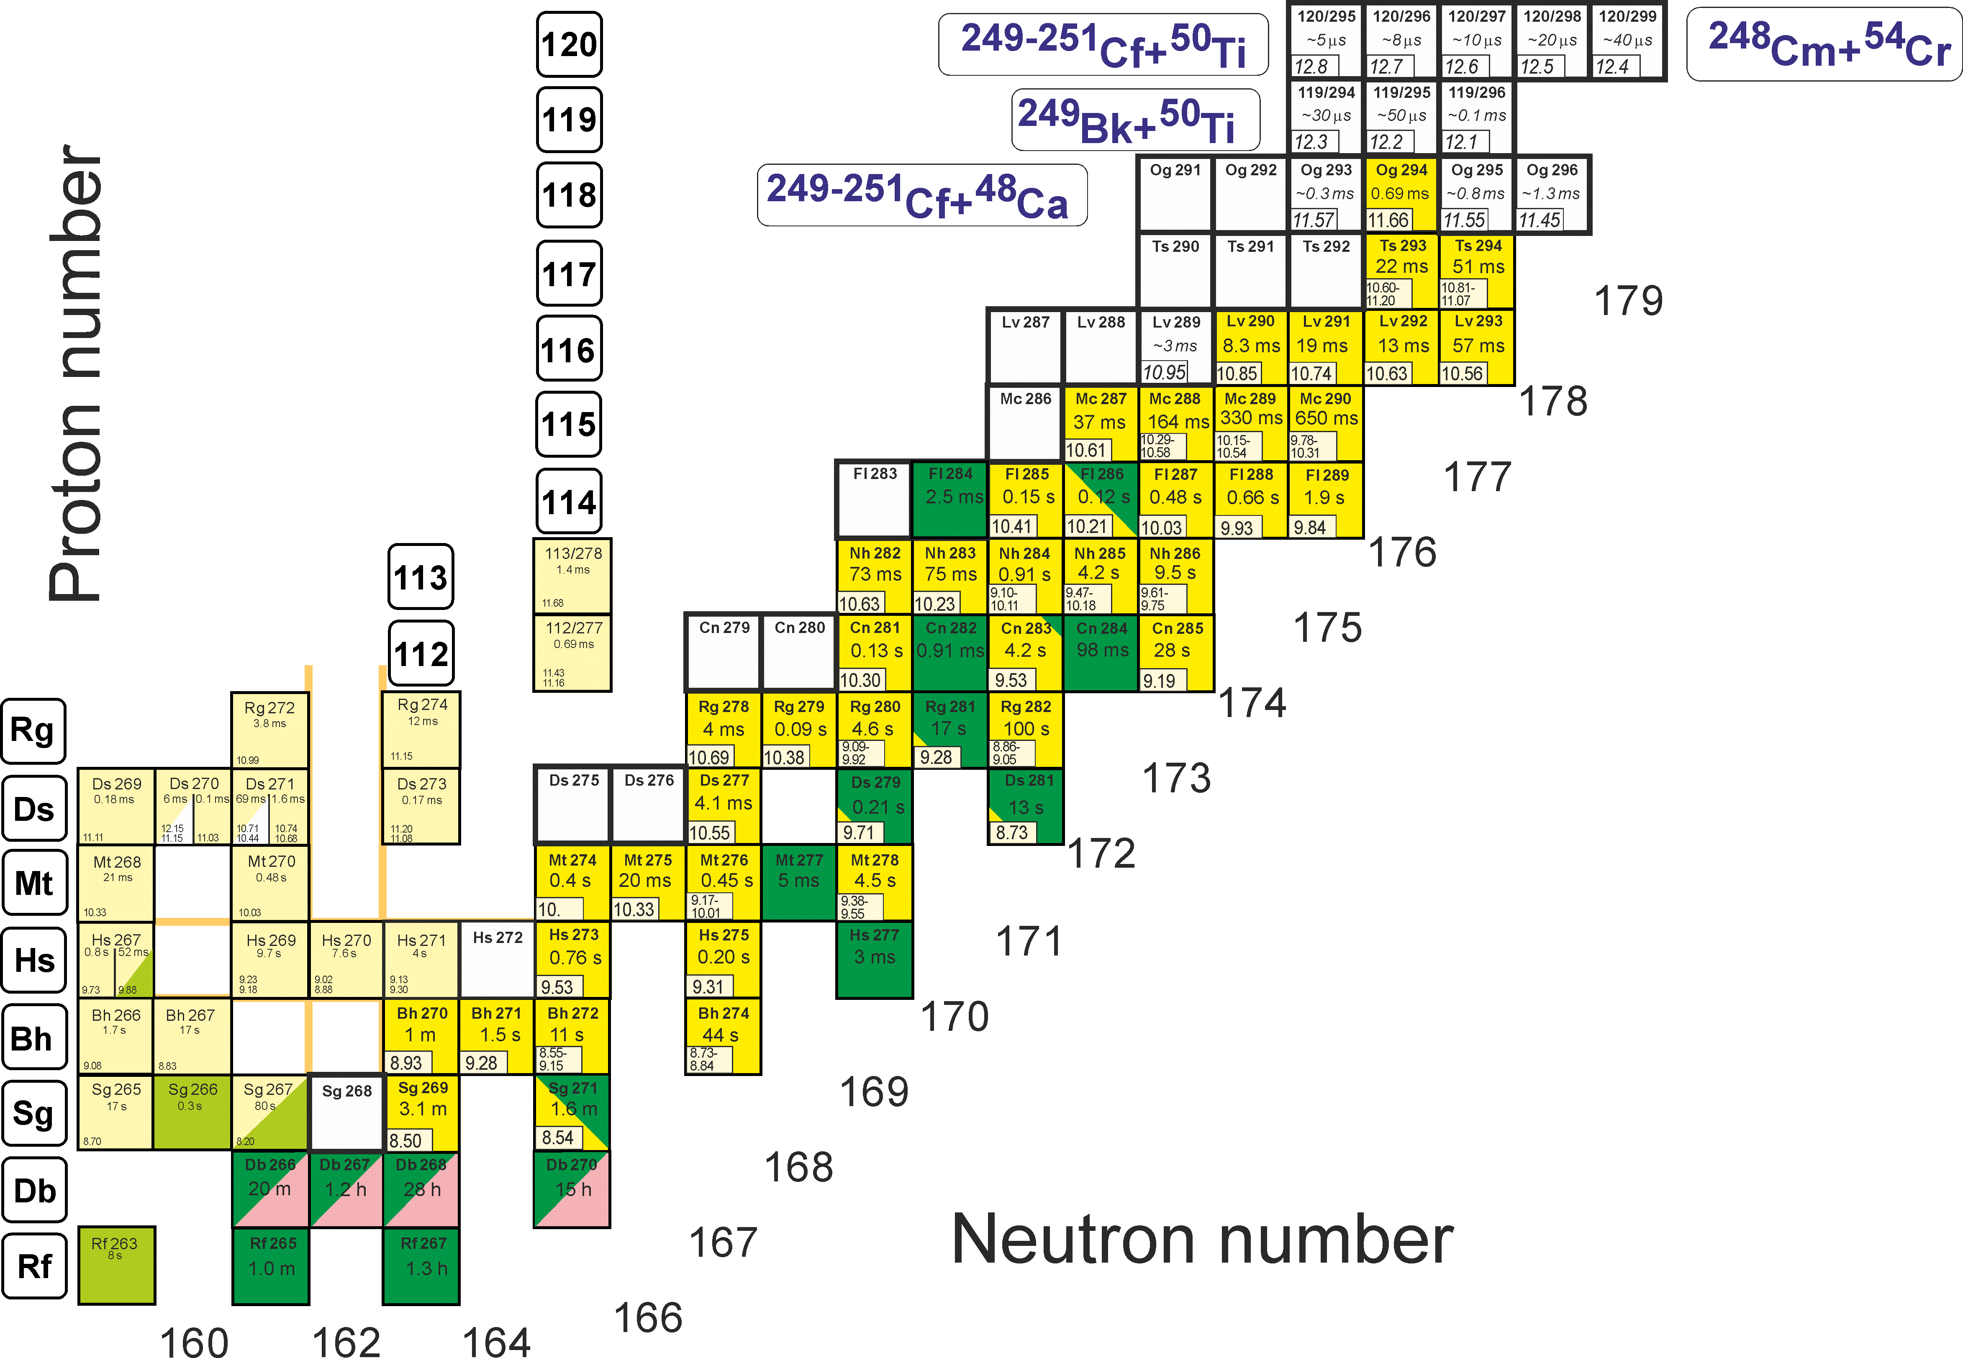
First experiments at SHE Factory
Synthesis of new elements 119 and 120
From ⁴⁸Ca to ⁵⁰Ti
Test reactions: ²⁴⁶Cm+⁴⁸Ca ²⁹⁴Lv* ²⁴⁴Pu+⁵⁰Ti ²⁹⁴Lv*

Slide 12
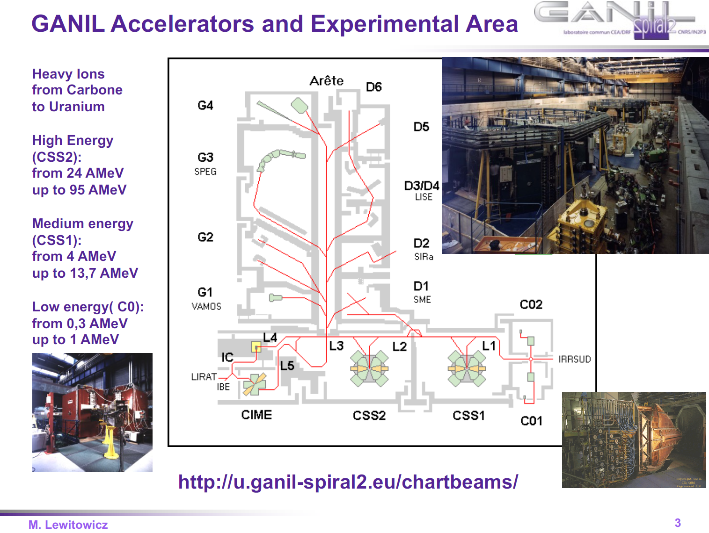

Slide 13
Классика : SHE-factory, GANIL, MSU, DERICA
Rel. HI : NICA, FAIR magnets
HEP & PP : LHC, HL-LHC, FCC , technologies

Slide 14
SPIRAL2 LINAC
33 MeV p,
40 MeV d (5mA)
14.5 A.MeV HI (1mA)

Slide 15
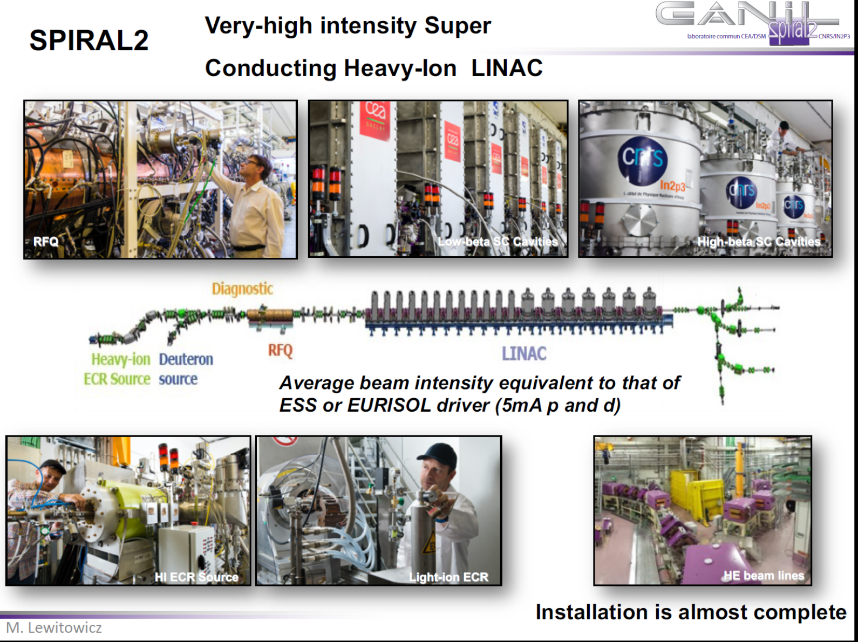

Slide 16
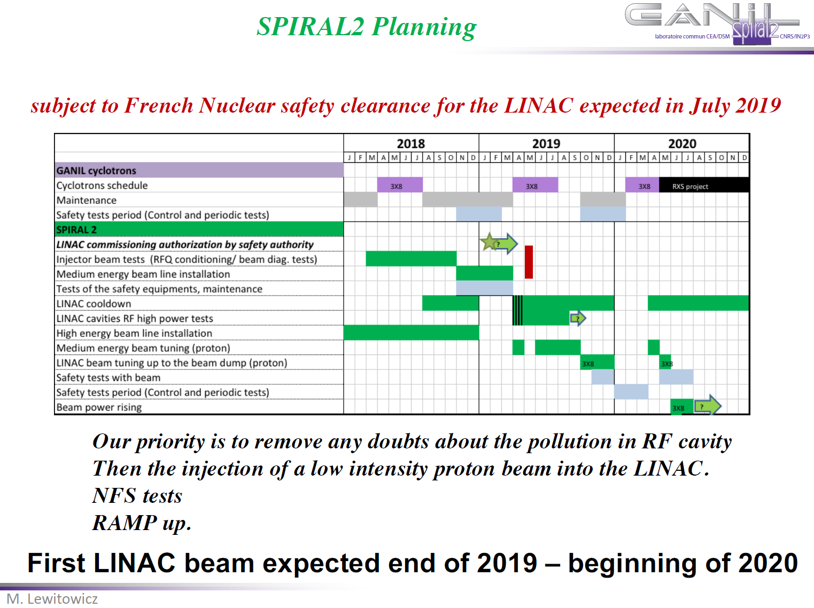

Slide 17
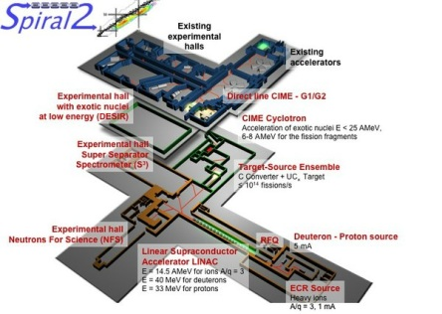
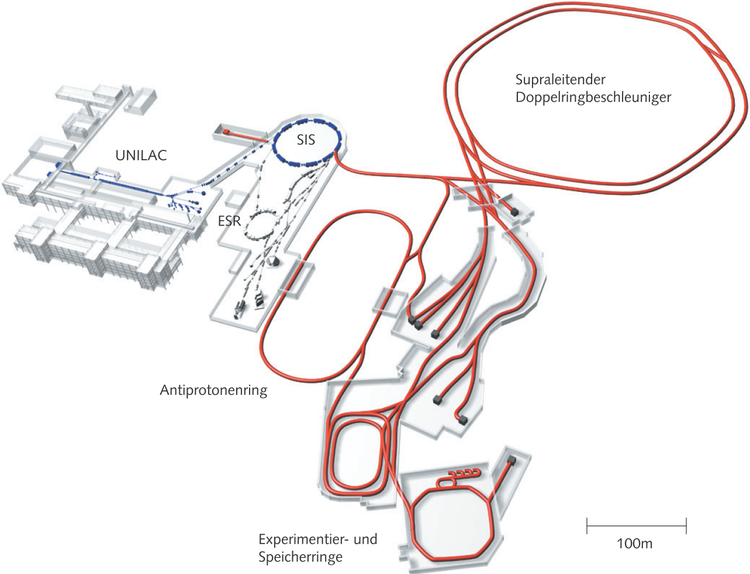
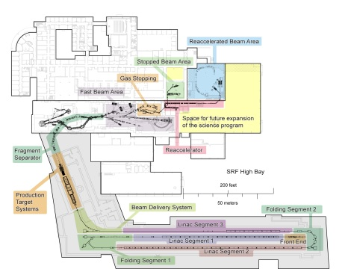
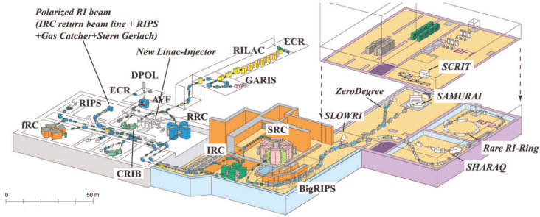
Фабрики радиоактивных изотопов: Все больше, и больше, и больше…и дороже !
SPIRAL2 France
FRIB USA
FAIR, Germany
RIBF Japan

Slide 18
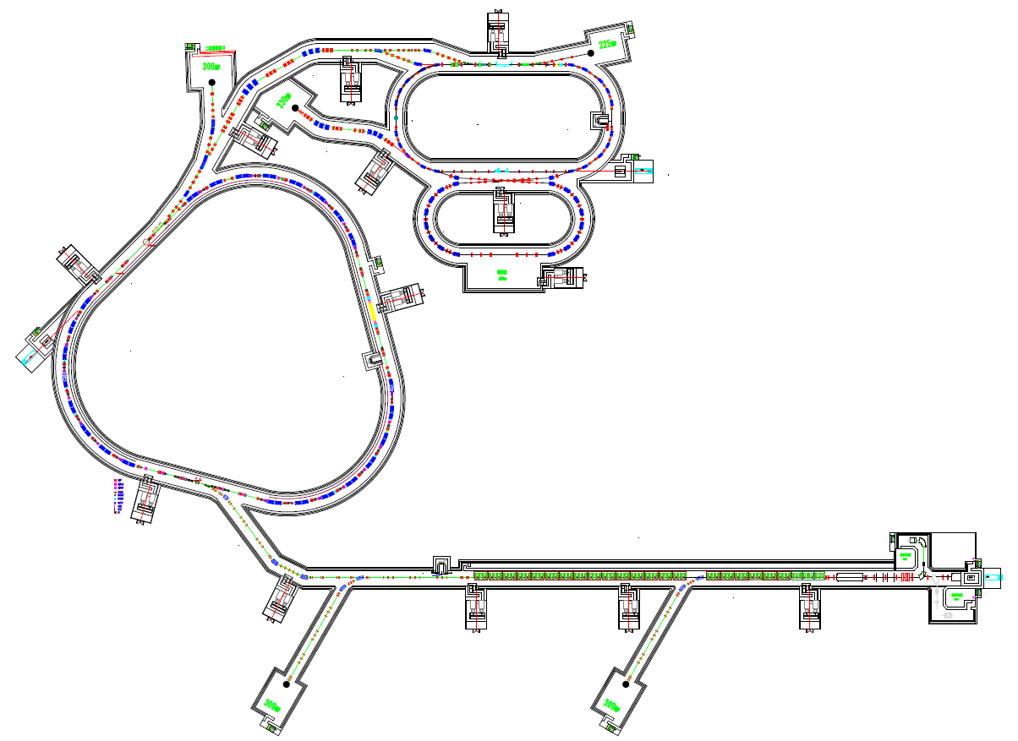
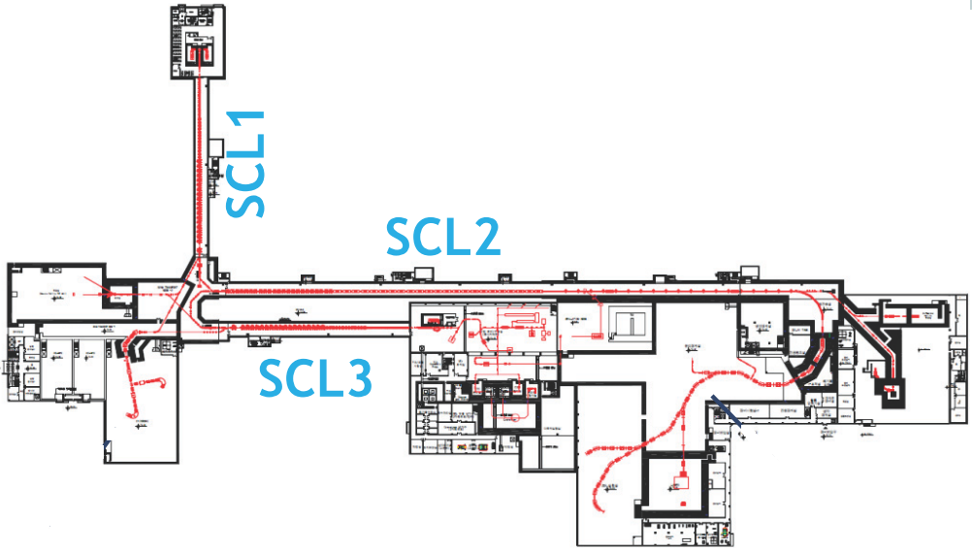
No. Even bigger…
HIAF China
Horizontal scale of the slide ~1 km
RAON Korea

Slide 19
Поиск тематической «экологической ниши»
«Дефицитная» область: физика экзотических ядер в накопительных кольцах
«Пустыня»: изучение экзотических ядер в электрон-РИ коллайдере
Etc….
Комплекс электрон-РИ коллайдера
Изохронная масс-спектрометрия
Спектрометр в точке
столкновения
Высокоточные реакции на внутренних газовых мишенях
Накопительное
кольцо для РИ
Электронное
накопительное кольцо
Электронный ускоритель
Атомная физика с ободранными ионами
Исследования радиоактивности с ободранными ионами

Slide 20
Empty “thematic niche”
Storage ring physics with RIBs
Non-explored field: studies of RIBs in electron-RIB collider
Studies of electromagnetic formfactors of exotic nuclei in e-RIB collider
Isochronous mass spectromentry
RIB storage ring
Precision reaction studies on internal gas jet target
electron storage ring
Atomic physics studies with striped ions
Etc….
Radioactivity studies with striped ions

Slide 21
Concept of DERICA (Dubna Electron – Radioactive Ion Collider fAcility) project
Experimental hall EH-1: Application science
50 m
LINAC–100 (E_{HI}: 100 AMeV)
Ion Sources
DERICA Fragment Separator DFS
Fast Ramping Ring Synchrotron FRR: E_{RIB} ≤ 300 AMeV
Gas jet target
p,d,^{3,4}He
Velocity filter
Electron cooler
e-RIB collider
- Gas cell - Ion trap
- Charge breeder
Collector Ring CR:
E_{RIB} ≤ 300 AMeV
Electron
Ring ER
Experimental hall EH-2: RIBs 15–70 AMeV
LINAC–30 (E_{RIB}: 30 AMeV)
Stage 0: LoI, CDR, R&D etc. 2018-2019
Stage 1: Buildings, LINAC–100, DFS, EH-1,2 2020-2024
Stage 2: Gas cell etc., LINAC–30, FRR, EH-3 2022-2027
Stage 3: CR, e-RIB collider, ring experiments 2025-2030
Neutron source
≥ 10⁸ n/cm²
e-LINAC (E_{e}: 500 MeV)
Long-term research program of RIB at JINR
Experimental hall EH-3: reaccelerated RIBs
5 – 300 AMeV

Slide 22
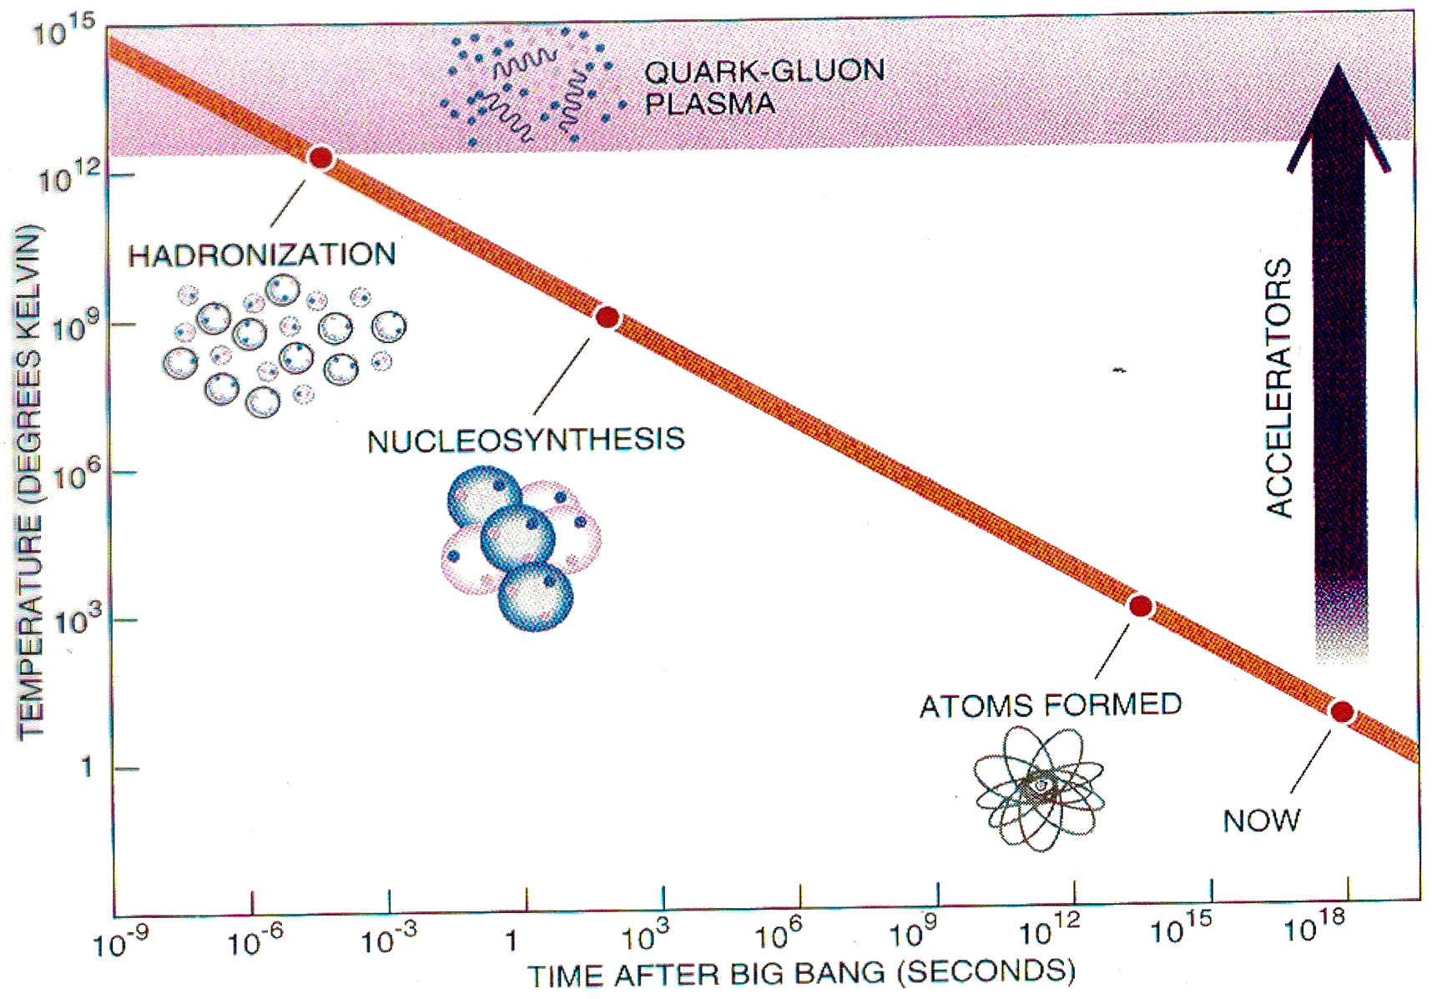
Strong Field QED & QCD @ FAIR & NICA
Stoecker & Gutbrod Scientific American 1992
Notes:
Utilizing the most powerful particle accelerators, physicist now conduct head- on- head collisions between heavy ions, such as gold or lead nuclei, to recreate the conditions that existed at the birth of Universe.
22

Slide 23

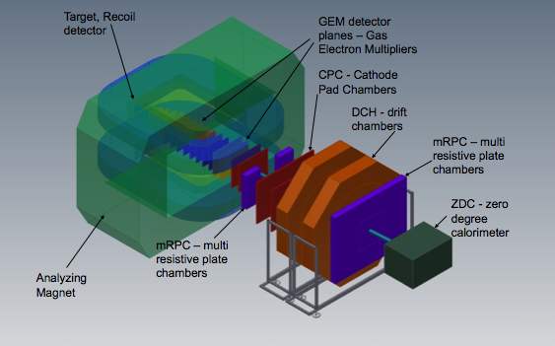
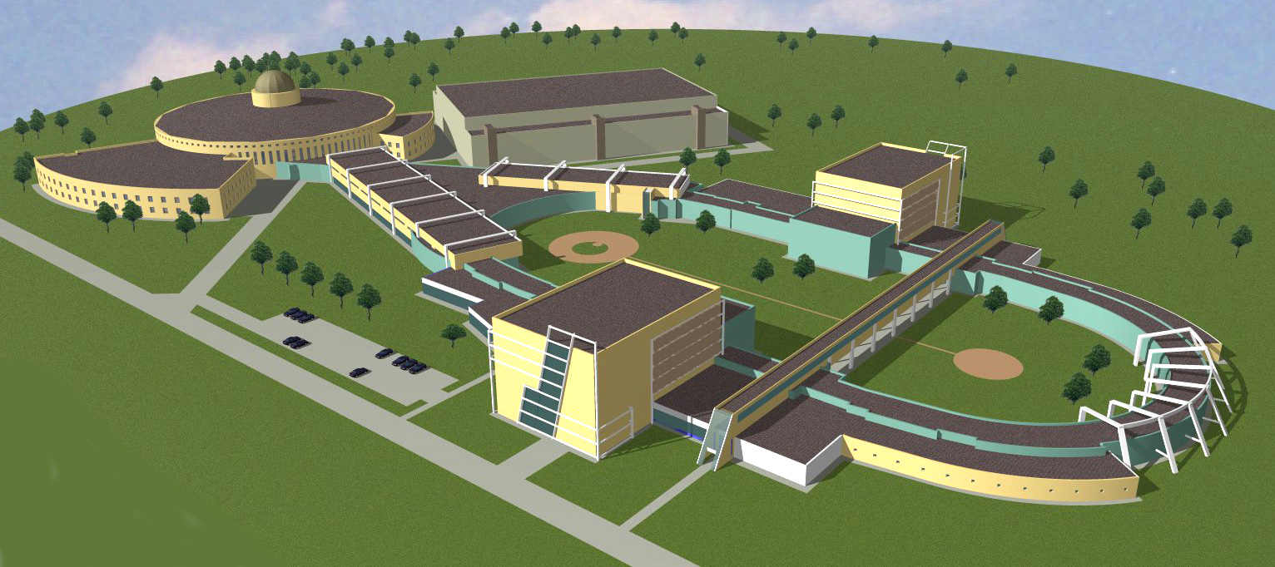
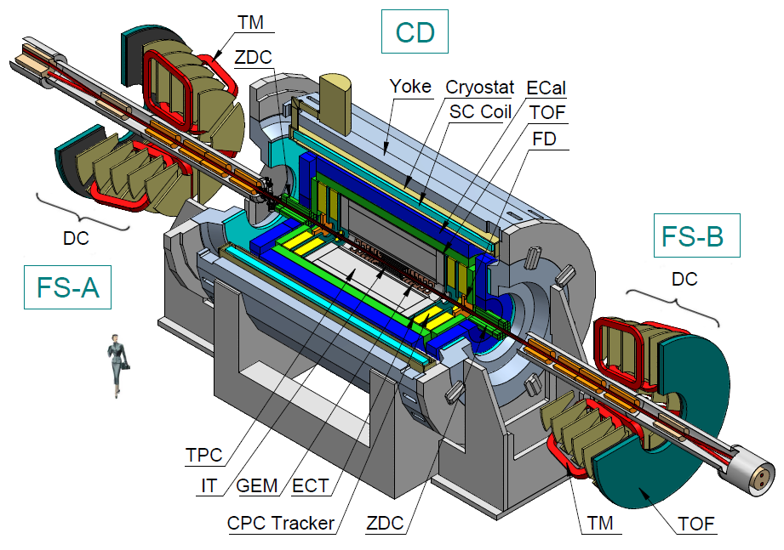
The NICA Complex - JINR
existing facility
under construction
KRION-6T+ HILac (3MeV/u)
BM@N
PS & LU-20 (5MeV/u)
hall for fixed target
experiments
SPD hall
Booster
(600 MeV/u)
MPD hall
NUCLOTRON 0.6-4.5 GeV/u
MPD
Collider
Boris Sharkov JINR Dubna
23
Notes:
23

Slide 24

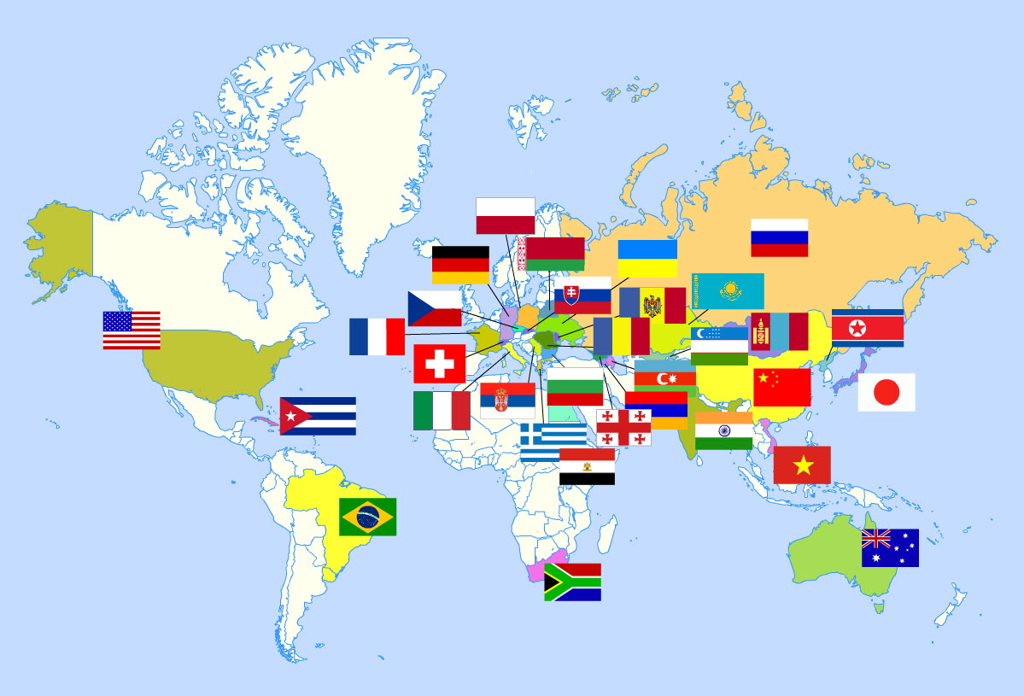
International cooperation NICA
Armenia
Australia
Azerbaijan
Belarus
Bulgaria
Brazil
CERN
China
Cuba
Czech Rep.
DPRK
France
Georgia
Germany
Greece
India
Italy
Japan
Kazakhstan
Moldova
Mongolia
Poland
Romania
RSA
Russia
Serbia
Slovakia
Ukraine
USA
Uzbekistan
Vietnam

Slide 25
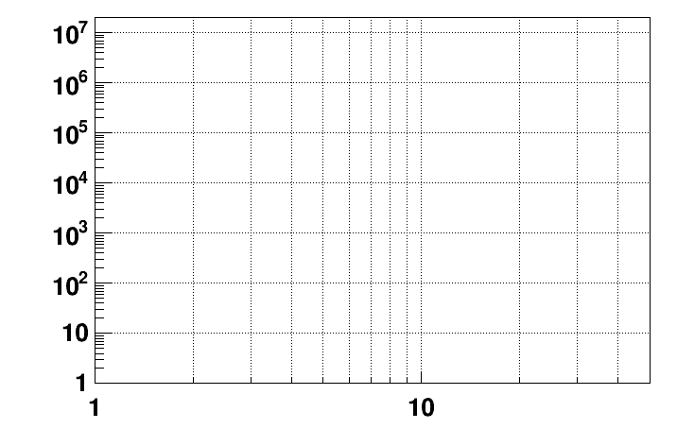
Present and future HI experiments/machines for super-dense
nuclear matter physics
CBM
energy region of max.
baryonic density
SIS-100 SIS-300
NICA/BM@N II
NICA/BM@N I
HADES
NICA/MPD
Interaction rate [Hz]
STAR F.T.
STAR BES II
NA-61/SHINE
Collision energy √S [GeV]
NN
25
Boris Sharkov JINR Dubna
Notes:
25

Slide 26
HPC technological challenges
Central Au+Au collision at 25 AGeV (UrQMD + GEANT4):
160 p 400 π⁻ 400 π⁺ 44 K⁺ 13 K⁻
➢ 10⁵ - 10⁷ Au+Au reactions/sec
➢ determination of (displaced) vertices (σ ≈ 50 μm)
➢ identification of leptons and hadrons
➢ fast and radiation hard detectors
➢ free-streaming readout electronics
high speed data acquisition and high performance
computer farm for online event selection
➢ 4-D event reconstruction

Slide 27

Сегодня и завтра в физике
«умеренно» высоких энергий
energy region of max.
baryonic density
CBM
> 2025: SIS-100 FAIR
NICA/BM@N II
HADES
NICA/MPD
«Скорость счёта» [Гц]
STAR F.T.
STAR BES II
NA-61/SHINE
Полная энергия NN соударений √s_{NN} , [GeV]

Slide 28
Existing and future HI accelerators
Fixed target:
L-limited by
detectors
Colliders:
scale of L,
in cm⁻²s⁻¹
20??
SIS-300 (FAIR)
10²⁷
10²⁵
10²³
>
2025
SIS-100 (FAIR)
2022
Expected region of phase transition at max baryonic density
NICA (JINR)
2018
BM&N (JINR)
Nuclotron-M (JINR)
RHIC (BNL)
in operation
SPS (NA-49/61, CERN)
AGS (BNL)
SIS-18 (GSI)
2
4
6
8
20
40
60
80
√S_{NN}, GeV
1
10
10²
for Au+Au
CBM – NICA co-operation agreement
28
Notes:
Compared to other heavy ion facilities CBM driving experimental requirements are in precision and extremely high reaction rates for the most interesting energy range of heavy ion collisions.

Slide 29


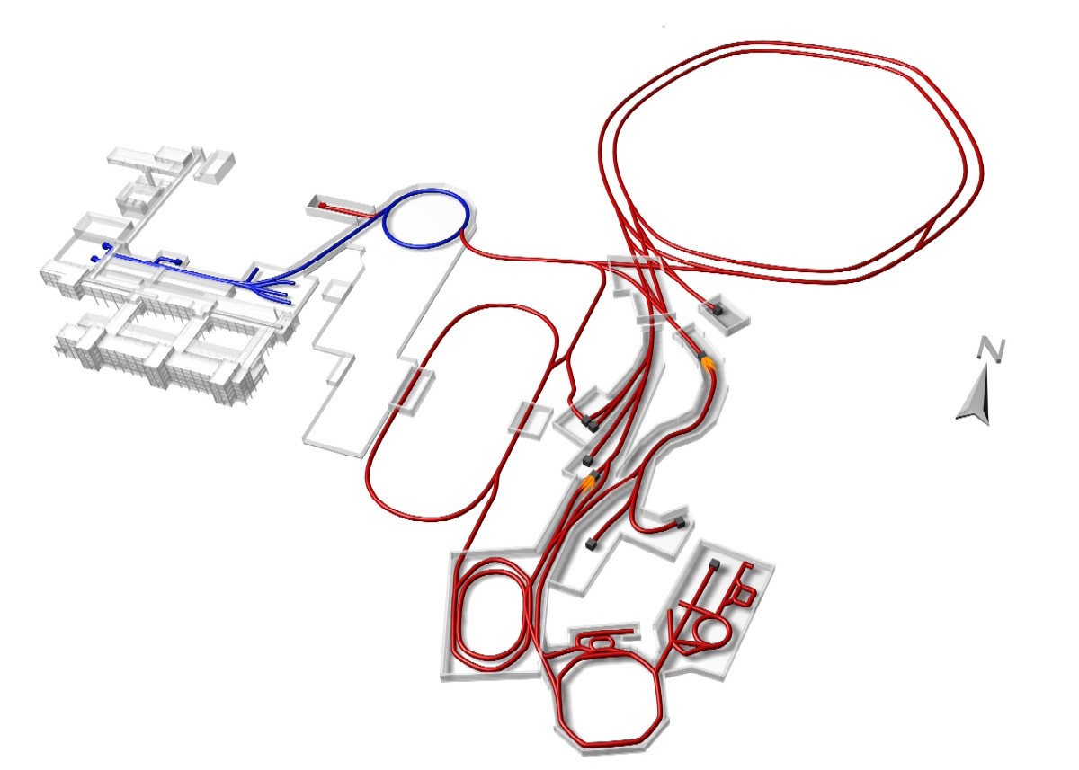
ФАИР (FAIR) – новый, крупнейший в мире, строящийся, международный исследовательский центр
в г. Дармштадт, Германия
Россия – стратегический партнер и
собственник установки
СП Синхротроны
SIS100 SIS300
p - Линак
Russia
300m
Rare Isotope
Production Target
Antiproton
Production Target
Антипротонное Накопительное кольцо
HESR
СП фрагмент-сепаратор
Super-FRS
Накопитель
CR
Рециркулятор RESR
Новое экспериментальное кольцо
NESR

Slide 30
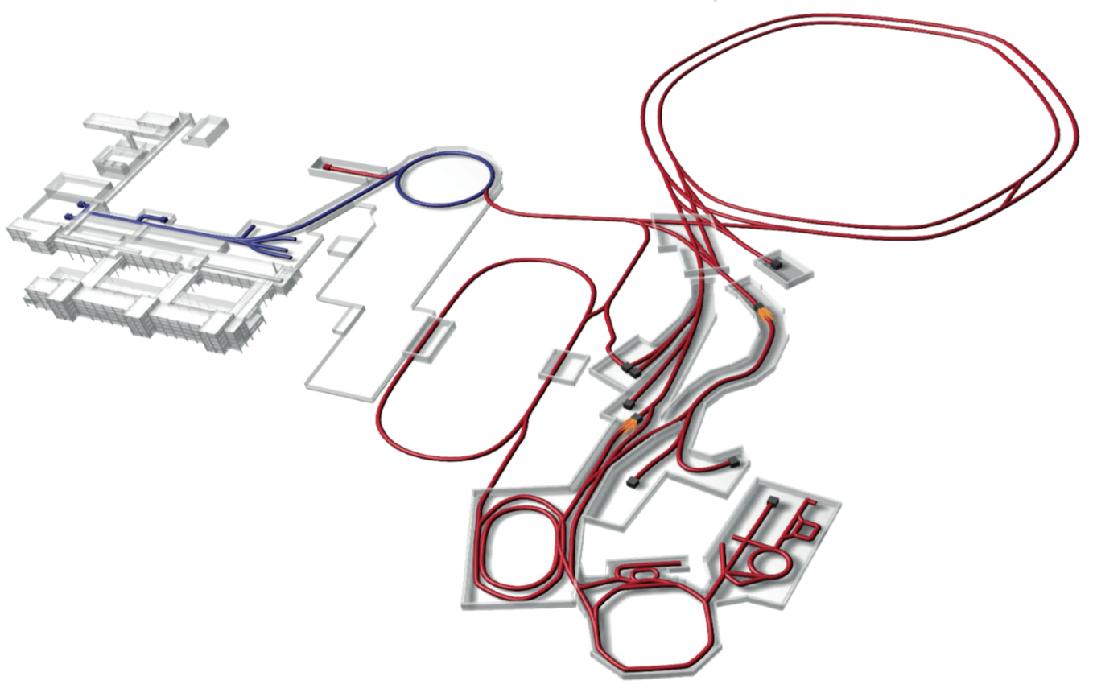


ФАИР (FAIR) – новый, крупнейший в мире, строящийся, международный исследовательский центр в г. Дармштадт, ФРГ
new international research laboratory to explore the nature of matter in the Universe
Primary Beams
10¹²/s; 1.5 GeV/u; ²³⁸U²⁸⁺
10¹⁰/s ²³⁸U⁷³⁺ up to 35 GeV/u
3x10¹³/s 30 GeV protons
p-Linac
SIS18
SIS100/300
UNILAC
Secondary Beams
range of radioactive beams up to
1.5 - 2 GeV/u; up to factor 10 000 higher in intensity than presently
antiprotons 3 - 30 GeV
HESR
Rare-Isotope
Production Target
Anti-Proton
Production Target
Storage and Cooler Rings
radioactive beams
10¹¹ antiprotons 1.5 - 15 GeV/c,
stored and cooled
CR &
RESR
Cryring
NESR
100 m
Technical Challenges
cooled beams, rapid cycling superconducting magnets
Notes:
FAIR accelerator will generate beams of heavy ions, protons and antiprotons of unprecedented intensity, brightness and luminousity.

Slide 31
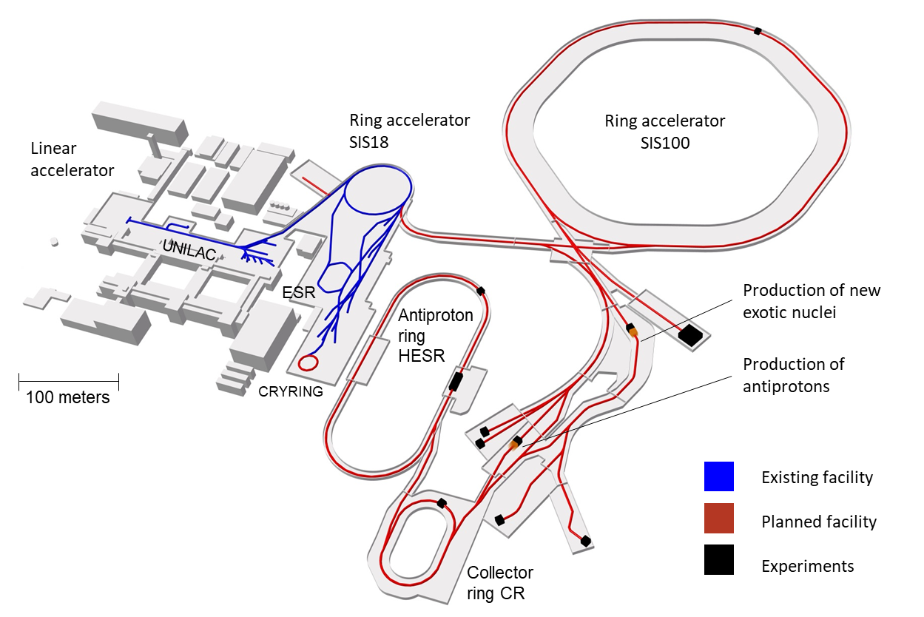
FAIR: Facility for Antiproton and Ion Research
– a World-Wide Unique Accelerator Facility
Intensity gain: x 100 – 1000
10 x energy (comp. to GSI)
Antimatter: antiproton beams
Precision: System of storage and cooler rings
Russia
ESFRI Landmark
Top priority for European
Nuclear Physics Community
Driver for Innovation in Science and Technology
Unique features:
Flexibility and parallel operation
Intense and high-energy heavy-ion beams
Storage rings and beam cooling: Beam quality
Major accelerator developments

Slide 32

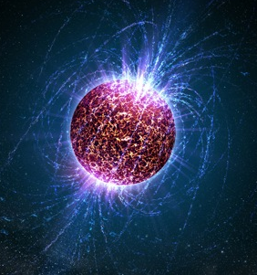
4 Research Pillars of FAIR
CBM
nuclear matter at high densities
APPA
ions in extreme electro-magnetic fields
PANDA
hadron physics with antiprotons
NUSTAR
neutron-rich nuclei

Slide 33










Международный проект FAIR
Германия
Россия
Финляндия
Франция
Индия
Польша
Румыния
Словения
Швеция
Великобритания (a)
FAIR – исследовательская
инфраструктура, нацеленная на
международное междисциплинарное
сотрудничество
~3 000 ученых из ~50 стан мира
FAIR – 500 ученых из 20 российских
Институтов участвовало в
разработке Н/Т Обоснования (BTR)
Россия – стратегический партнер и
собственник установки
FAIR Signatory Countries

Slide 34


Институты России в мега-проекте ФАИР
Структура заявки головных институтов России на участие в ФАИР
Институт | Стоимость в М€ (в ценах 2005)
 | эксперименты | ускорители | Сумма
ИЯФ СО РАН | 2,9 | 34,5 | 37,4
ИФВЭ | 17,34 |  | 17,34
ОИЯИ | 13,32 | 27,1 | 40,42
ИТЭФ | 5.8 | 0.27 | 6,07
НИИЭФА |  | 17,8 | 17,8
ПИЯФ | 9,29 |  | 9,29
ФТИ РАН |  | 0,83 | 0,83
ИПХФ РАН | 1,77 |  | 1,77
ИЯИ РАН | 0,78 |  | 0,78
НИЦ КИ | 0,48 |  | 0,48
МЭИ | 0,35 |  | 0,35
ФИ РАН | 0,35 |  | 0,35
ИТОГО | 52,38 | 80.5 | 132,88
75% вклада РФ должно возвратиться в виде контрактов в российские институты
34
Notes:
34
PANDA Collaboration Meeting
March 03, 2008
34

Slide 35
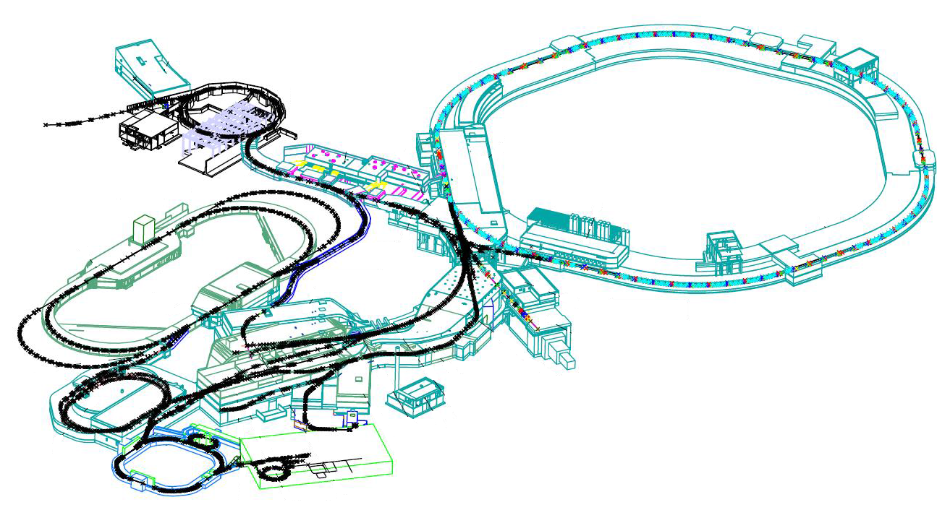
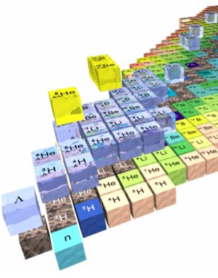
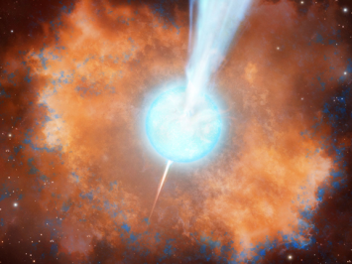
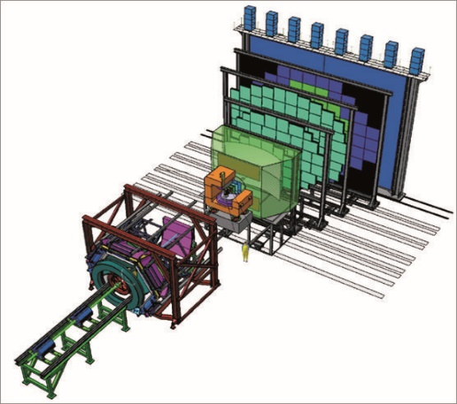
Heavy ion accelerator chain
SIS18
SIS 100
NuSTAR
Collector Ring
CBM
Super-FRS
Plasma Physics
cave
CBM
35

Slide 36
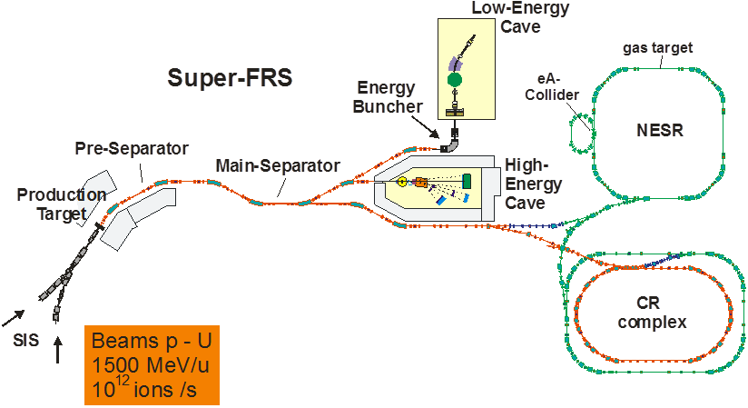
The NuSTAR experimental facilities at FAIR
Important beam parameters:
- all elements (H through U)
- intensity ~ 10¹² ions/sec.
- beam energies up to 1.5 GeV/u
- fast and slow (DC-type) extraction
Four experimental areas:
- superconducting fragment separator
- high-energy branch with reaction setup
- storage-ring complex (CR, RESR, NESR, eA)
- low-energy branch with energy focusing and re-acceleration

Slide 37
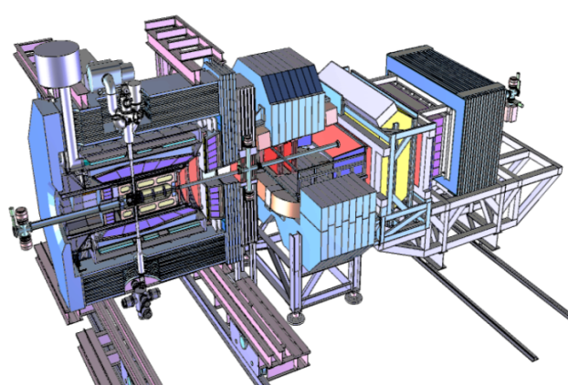
Anti proton accelerator chain
p-Linac
SIS18
SIS 100
PANDA
HESR
p-bar target
Collector Ring
37

Slide 38
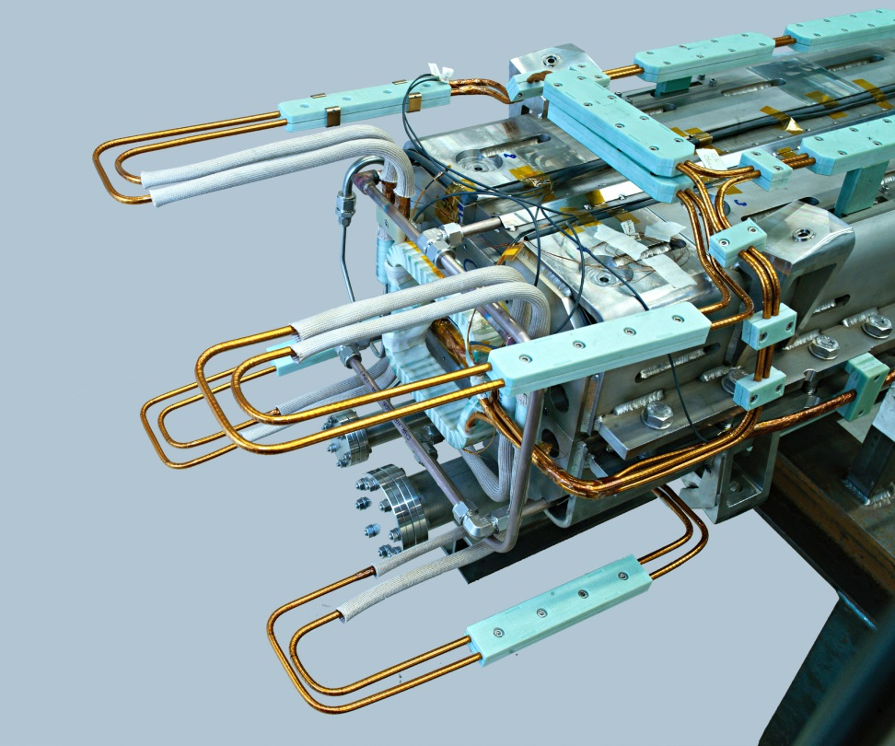
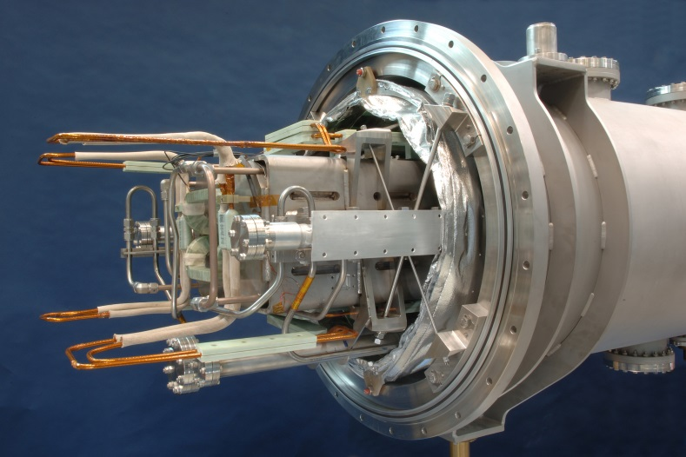
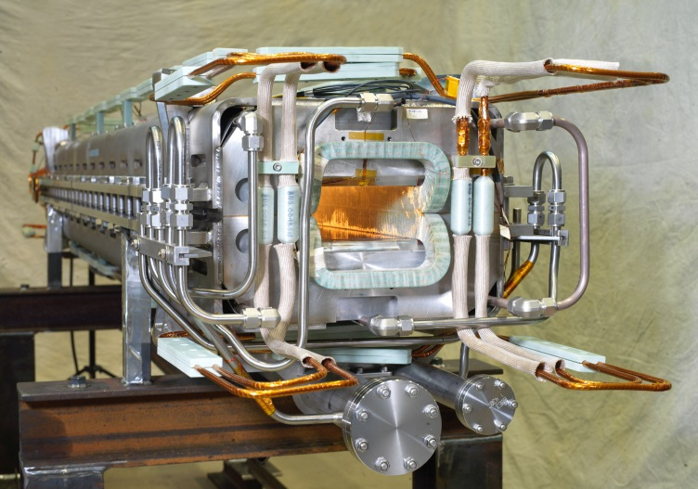
Full Length SIS100 Dipole
Manufactured by BNG (Würzburg)
Dipole and quadrupole under manufacturing at JINR and BNG

Slide 39
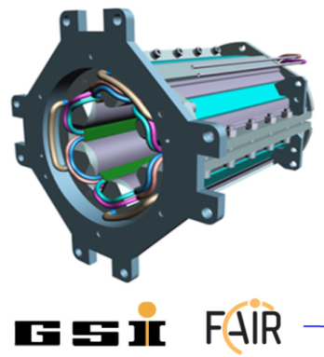
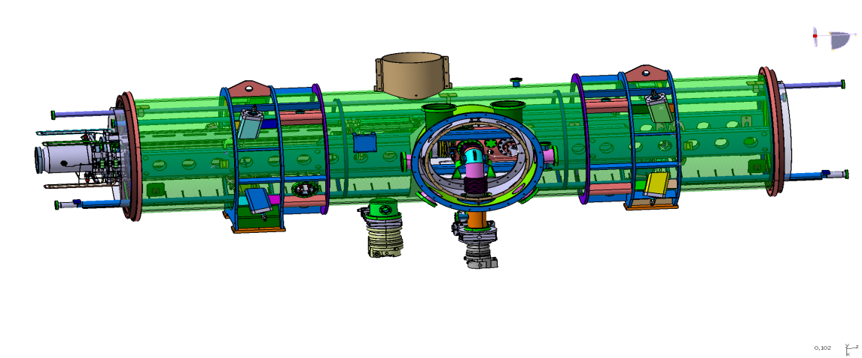
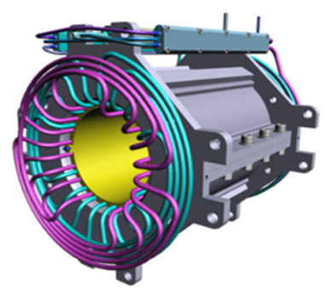
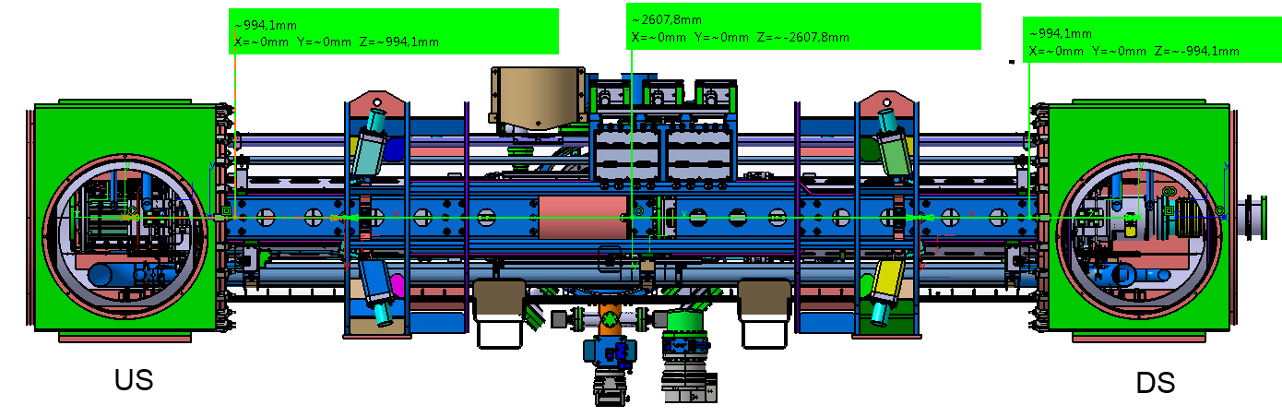
Cryomagnetic Quadrupole Modules for SIS100 (JINR)
Manufacturing design of first of series module, completed by GSI design department
Design service contract for overall cryomagnetic quadrupole module system signed and progressing
In-kind & R&D contract for production and testing of quadrupole units with JINR signed
Production of FoS unis until end of 2017 in JINR
Design of FoS modul and components by GSI Design Office
SIS100
Design of QM module including end boxes (link to local cryogenics)

Slide 40
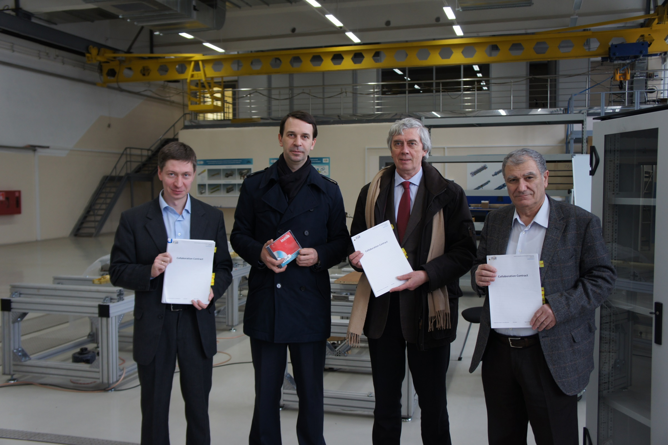
SIS100 Quad. Units Collaboration Contract with JINR
Dubna 20.02.2015

Slide 41
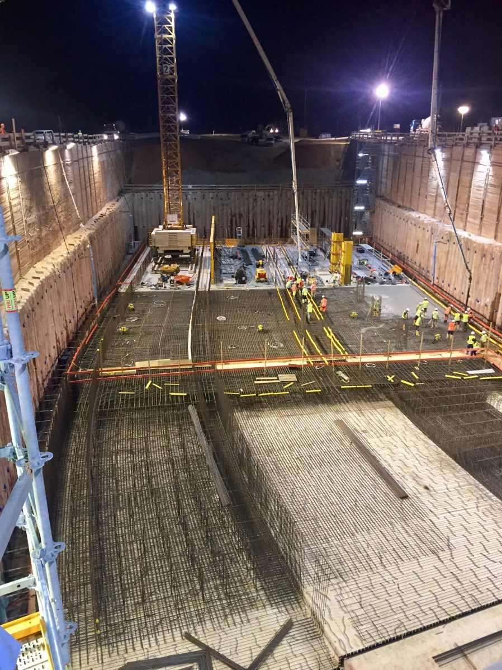




Status of FAIR: Civil Construction rapid progress since official start on 4th of July 2017
Civil Construction
Excavation SIS100 tunnel
Upgraded SIS18 completed ready for FAIR and FAIR phase 0
Excavation transfer building & CBM cave
Start of concrete shell works for SIS100

Slide 42
High-Intensity Heavy Ion Accelerator Facility General description – Main components
SRing: Spectrometer ring
Circumference:290m
Rigidity: 13Tm
Electron/Stochastic cooling
Two TOF detectors
Four operation modes
SRing
MRing: Figure “8” ring
Circumference: 268 m
Rigidity: 13 Tm
Ion-ion merging
MRing
BRing
iLinac: Superconducting linac
Length:100 m
Energy: 17MeV/u(U³⁴⁺)
SECR
iLinac
BRing: Booster ring
Circumference: 530 m
Rigidity: 34 Tm
Beam accumulation
Beam cooling
Beam acceleration

Slide 43
General description – Basic beam parameters
 | Ions | Energy | Intensity
SECR | ²³⁸U³⁴⁺ | 14 keV/u | 0.05 pmA
iLinac | ²³⁸U³⁴⁺ | 17 MeV/u | 0.028 pmA
BRing | ²³⁸U³⁴⁺ | 0.8 GeV/u | ~1.4×10¹¹ ppp
SRing | RIBs: neutron-rich, proton-rich | 0.84 GeV/u(A/q=3) | ~10⁹⁻¹⁰ ppp
 | Fully stripped heavy ions H-like, He-like heavy ions | 0.8 GeV/u(²³⁸U⁹²⁺) | ~10¹¹⁻¹² ppp
MRing | ²³⁸U⁹²⁺ | 0.8 GeV/u | ~1.0×10¹¹ ppp

Slide 44



General description – New campus
HIAF site
HIAF site
Artist impression HIAF campus

Slide 45
General description – Schedule
20~ | 09 | 10 | 11 | 12 | 13 | 14 | 15 | 16 | 17 | 18 | 19 | 20 | 21 | 22 | 23 | 24
Critical Points
Design
Construction and Installation
Commissioning
Budget periods
Plan
Approval
Commissioning
Start
construction
Operation
Key technologies R&D
Idea design
Conceptual design
Design report preparation,
submission,
approval
Detailed design &
prototype
Civil construction
Equipment construction, Fabrication
Installation
iLinac, BRing, CRing commissioning
Combined commissioning
Start of operation
BP1
BP2
BP3
BP4

Slide 46
Summary
A number of modern international research facilities are under construction;
Generation of intense “precision beams” : sophisticated beam manipulation methods-stochastic and electron cooling of ion beams, also applicable to the secondary radioactive and antiproton beams;
Rings as accelerator structures of choice: capability to store, cool, bunch, and stretch beams ;
Full range of ion beam species: p+ - 239U ;
Highest beam intensities & luminosities;
A number of large scale experiments are in advanced praparatory phase.
46
Boris Sharkov JINR Dubna

Slide 47

2.

Slide 48
Future Energy Frontier Colliders
All proposals are focused on :
  (High) Luminosity and Cost (Affordable)
  Usually :
  Scale of civil construction grows with Energy
  Cost of accelerator components grows with Energy
  Requirement site power grows with Energy
So, the total cost grows with ENERGY
  Thankfully, not linearly , more like cost ~ β E ^{κ} , κ≈ ½…2/3
    Take ILC as an example: 0.25 → 0.5 → 1 TeV 0.69 : 1 : 1.67
  Still, huge challenge for energies E some x10 of LHC
  Choice of technology ( β ) and prior investments are critical

Slide 49




Slide 50
Accelerator Technologies advanced in PP
Type | Acclerator | Op. Years | Beam Energy (TeV) | B [T] | E [MV/m] | Pioneering/Key Technology
CC hh | Tevatron | 1983-2011 | 2 x 0.5 | 4 T |  | Superconducting Magnet (SCM)
 | HERA | 1990 -2007 |  | 4.68 T |  | SCM, e-p Collider,
 | RHIC | 2000 ~ |  | 3.46 T |  | SCM
 | SPS LHC HL-LHC | 1981-1991 2008 ~ Under constr. | 2 x 0.42 2 x ( 6.5 >> 7) | (NC mag.) 7.8T -->8.4 11~12 |  | P-bar Stochastic cooling SCM (NbTi) at 1.8 K, SRF SCM (Nb₃Sn), SRF, e-cooling
CC ee | TRISTAN | 1986-1995 | 2 x 0.03 |  | 5 | SRF (Nb-bulk), SCM-IR-Quad (NbTi)
 | LEP | 1989-2000 | 2 x 0.55 |  | 5 | SRF (Nb-Coating) , SCM-IRQ
 | KEKB Super-KEKB | 1998~2010 2018 ~ | 0.002+0.008 0.004+0.007 |  | 5 5 | Luminosity, SRF Crabbing, SCM-IRQ Luminosity, Nano-beam, SCM-IRQ
LC ee | SLC/PEP-II | 1988/98~2009 | 2 x 0.5 |  |  | Normal conducting RF
 | (Eu-XFEL) | (2018 ~) | (0.0175) |  | (23.6) | SRF (Nb-bulk)

Slide 51



LHC performance at a glance
F. Bordry, CERN Director for A&T
7 TeV → 8.33 tesla, 86% of the max Ic
WG on quench performance.
E. Todesco, chair
Notes:
Trovare rampa cpllisioni 30 marzo 2010 2x3.5; in 2012 2x4 T ; in 2015 2x6.5 T

Slide 52



LHC Performance: Integrated Luminosity
F. Bordry, CERN Director for A&T
Cryo availbility: 97-99 % !
Goal of Run1+Run2 was 150 fb⁻¹!

Slide 53
Goal of HL-LHC
From EC-FP7 HiLumi LHC Design Study application of 2010
The main objective of HiLumi LHC Design Study is to determine a hardware configuration and a set of beam parameters that will allow the LHC to reach the following targets:
A peak luminosity of L_{peak} = 5×10³⁴ cm⁻²s⁻¹ with levelling, allowing:
An integrated luminosity of 250 fb⁻¹ per year, enabling the goal of L_{int} = 3000 fb⁻¹ twelve years after the upgrade.
This luminosity is more than ten times the luminosity reach of the first 10 years of the LHC lifetime.
Ultimate performance established 2015-2016: with same hardware
and same beam parameters: use of engineering margins:
L_{peak ult} ≅ 7.5 10³⁴ cm⁻²s⁻¹ and Ultimate Integrated L_{int ult} ∼ 4000 fb⁻¹
LHC should not be the limit, would Physics require more…
Experiment are designing for this goal. We need to be compatible with it!

Slide 54

Performance: Integrated Luminosity
7 TeV → 8.33 tesla, 86% of the max Ic
Half way

Slide 55
HL-LHC parameters
ОИЯИ - Экономичные 6 Тл магниты для реконструкции SPS

Slide 56


Pile up
400
events
5 events
Pushing at the maximum the parameters of HL-LHC we would start the fill at L = 15x10³⁴ with 400 events/crossing.
Notes:
Ask Rogelio how degrade sensitivity wit pile up and ple up density.

Slide 57





Technology landmarks

Slide 58

LBH_A (11T)
By-pass cryostat with collimator
LBH_B (11T)
Complete 11.2 T cryo-assembly replacing a 15 m long 8.3 LHC dipole
Operation 7 TeV
7 TeV
L. Bottura & A. Devred
HiLumi WP11- F. Savary et al.
Hybrid (long proto): Excellent!, But strong permanent degradation after thermal cycle. Absence of thermal gradient control in the procedure.
JINR – efficient 6T magnets for SPS upgrade
ОИЯИ - Экономичные 6 Тл магниты для реконструкции SPS

Slide 59

What will look like this new HE-LHC option?
A realistic LHC1.5 @ 21 TeV for 2040…
HTS
In LHC, 14 T dipoles give 23.5 TeV
But timeline is NOT the same
12 T Nb₃Sn dipoles HiLumi technology in LHC: 21 TeV c.o.m.
LHC1.5
Energy tripler 100km
7 T Nb-Ti dipole (low cost LHC, 4.2 K):
44 TeV c.o.m. (100 km)
2040

Slide 60


Circular pp Colliders
Input #133
Input #136
HE-LHC CDR (2018)
FCC-hh CDR (2018)
HE-LHC 27 TeV
FCC-hh 100 TeV
SppC 75 TeV
Key facts: HE-LHC / FCC-hh* / SppC*
Large tunnel – 27 / 100 / 100 km
SC magnets – 16 / 16 / 12 T
High Lumi / pileup O(10³⁵) / O(500)
Site power (MW) – 200 / 500? / ?
Cost (BCHF) – 7.2 / 17.1 / ?
* follow up after e+e- Higgs factories
Input #51

Slide 61


Slide 62


Slide 63

CEPC-SppC timeline
X. Lou

Slide 64


Circular hadron colliders: FCC-hh and SppC
circumference $\sim$100 km, two high-luminosity experiments up to 3 (1) x 10³⁵ cm⁻²s⁻¹, two additional experiments possibly combined with injection section, collimation insertions (betatron and momentum cleaning), extraction/dump insertion, RF insertion,
FCC-hh
SppC
values in brackets refer to CEPC
based on existing CERN injector chain,
Luminosity goal ~20 ab-1 per main IP within 25 years
new injector chain,
simultaneous operation with e+e- collider

Slide 65
Frontier Accelerators based on SC Technology
Courtesy, A. Ballarino
High-energy and High-Intensity frontier accelerators
are relying
on superconductivity
as core technology
Notes:
New slide from Davide.
Showing that conductor development is launched at international level, Russia, Japan, (Korea and Europe in preparation)
Underline importance of that development as main cost driver for the hadron collider machine.

Slide 66


high-field magnet R&D for FCC-hh
FCC baseline: 16 T magnets, Nb₃Sn, exploiting experience of LHC and HL-LHC
In parallel, HTS magnets (special magnets, hybrid configurations)
Worldwide wire R&D towards
J_{c} (16T, 4.2K) > 1500 A/mm²
Worldwide short model magnet R&D → various coil geometries
2018 – 2025
FCC goal
After ~2 years development, prototype Nb₃Sn wires from several R&D partners already achieve HL-LHC J_{c} performance
CEA, CIEMAT, INFN, PSI,
US-MDP (FNAL, LBNL), BINP
Notes:
New slide from Davide.
Showing that conductor development is launched at international level, Russia, Japan, (Korea and Europe in preparation)
Underline importance of that development as main cost driver for the hadron collider machine.

Slide 67
Personal View on Relative Timelines
Timeline | ~ 5 | ~ 10 | ~ 10 |  |  | ~ 15 |  | ~ 20 |  | ~ 25 | ~ 30 | ~ 35
Lepton Colliders
SRF-LC/CC | Proto/pre-series | Construction | Construction |  |  |  |  | Operation |  |  | Upgrade
NRF—LC | Proto/pre-series | Construction | Construction | Construction |  |  |  | Operation |  |  | Upgrade
Hadron Collier (CC)
8~(11)T NbTi /(Nb3Sn) | Proto/pre-series |  | Construction |  |  |  |  | Physics Experiment | Operation |  |  | Upgrade | Upgrade
12~14T Nb₃Sn | Short-model R&D |  |  |  | Proto/Pre-series |  |  |  | Construction | Construction to Physics Experiment | Operation
14~16T Nb₃Sn | Short-model R&D |  |  |  |  |  | Prototype/Pre-series |  |  |  | Construction | Construction
Note: LHC experience: NbTi (10 T) R&D started in 1980’s --> (8.3 T)
Production started in late 1990’s, in ~ 15 years

Slide 68


Slide 69





Challenges for hadron colliders
High stored energy in the beam ~8-9 GJ
  Beam handling and dumping
  Collimation cleaning system optimisation
High synchrotron radiation inside magnets several MW
  Beam screen design and cryogenic efficiency
FCC Secondary Collimator
max power density
115 Wcm⁻³
FCC dump pattern
Beam screen prototype
LHC pattern
R&D on new materials, kickers & generators, vacuum systems, cryogenic system, electron lenses, ….
Notes:
New slide from Davide.
Showing that conductor development is launched at international level, Russia, Japan, (Korea and Europe in preparation)
Underline importance of that development as main cost driver for the hadron collider machine.

Slide 70
Summary: Challenges - SRF and SC Magnet
Superconducting RF:
  Nb-bulk (for > 1 GHz)
    High-Q (> 3E10) and High-G (> 45 MV/m) , w/Low-T treatment w/ or w/o N-infusion.
    Large-Grain SRF cavity for cleaner condition with cost-reduction,
  Thin-Film (for wider applications)
    Thin-film on Nb to improve effective B_{sh}, resulting higher gradient, and further Potential
    New material such as NB₃Sn/MgB₂ to drastically improve performance.
Superconducting Magnet:
  Nb3Sn requires much longer steps to reach 16 T, for improvement of SC current density, mechanical property, field quality control, training quenches, magnet protection, and industrialization.
  “Nb3Sn + HTS-insert” be inevitably required, beyond 16 T, and cost effective HTS will be essentially required for practical accelerator applications.

Slide 71
Personal Prospect (2/2)
Nb₃Sn superconducting magnet technology for hadron colliders, still requires step-by-step development to reach 14, 15, and 16 T.
It would require the following time-line (in my personal view):
  Nb₃Sn, 12~14 T: 5~10 years for short-model R&D, and the following 5~10 years for prototype/pre-series with industry. It will result in 10 – 20 yrs for the construction to start,
  Nb₃Sn, 14~16 T: 10-15 years for short-model R&D, and the following 10 ~ 15 years for protype/pre-series with industry. It will result in 20 – 30 yrs for the construction to start, (consistently to the FCC-integral time line).
  NbTi , 8~9 T: proven by LHC and Nb₃Sn, 10 ~ 11 T being demonstrated. It may be feasible for the construction to begin in > ~ 5 years.
Continuing R&D effort for high-field magnet, present to future, should be critically important, to realize highest energy frontier hadron accelerators in future.

Slide 72
Comparisons
Project | Type | Energy [TeV] | Int. Lumi. [a⁻¹] | Oper. Time [y] | Power [MW] | Cost
ILC | ee | 0.25 | 2 | 11 | 129 (upgr. 150-200) | 4.8-5.3 GILCU + upgrade
 |  | 0.5 | 4 | 10 | 163 (204) | 7.8 GILCU
 |  | 1.0 |  |  | 300 | ?
CLIC | ee | 0.38 | 1 | 8 | 168 | 5.9 GCHF
 |  | 1.5 | 2.5 | 7 | (370) | +5.1 GCHF
 |  | 3 | 5 | 8 | (590) | +7.3 GCHF
CEPC | ee | 0.091+0.16 | 16+2.6 |  | 149 | 5 G$
 |  | 0.24 | 5.6 | 7 | 266
FCC-ee | ee | 0.091+0.16 | 150+10 | 4+1 | 259 | 10.5 GCHF
 |  | 0.24 | 5 | 3 | 282
 |  | 0.365 (+0.35) | 1.5 (+0.2) | 4 (+1) | 340 | +1.1 GCHF
LHeC | ep | 60 / 7000 | 1 | 12 | (+100) | 1.75 GCHF
FCC-hh | pp | 100 | 30 | 25 | 580 (550) | 17 GCHF (+7 GCHF)
HE-LHC | pp | 27 | 20 | 20 |  | 7.2 GCHF

Slide 73


Slide 74

Conclusion
Success of experiments is granted by two basic factors :

Slide 75
Back up slides

Slide 76

















New oppurtunities:
Physics at the Femtometer scale
Fission dynamics
Equation of state
ν−π pairing
2p radioactivity
Coupling to
continuum
Lattice Effective
Field Theory
Limits of existance
New magic numbers
Clusters
Shape
Coexistance
Exotic Shapes
Neutron halos
Search and understand regular and simple patterns that emerge in the structure of
complex nuclei
Key variables in the dynamics of colliding nuclei

Slide 77
Cyclotrons vs. LINACs – pro et contra
Cyclotron
LINAC
Factor 6
Basic
Injection <50% transmission
Accelerate 1 charge state
RFQ ~99% transmission
Accelerate 3 charge states
Compact
“No loss” operation
Flexible acceleration strategy
Plus
Easy to operate
Upgradable
Easy to repair
Could be hard to repair
Length
Minus
HI Injection/extraction problems
Cost per AMeV
Superconductivity for
U > 50 AMeV
Superconductivity for CW

Slide 78
Cyclotrons vs. LINACs – pro et contra
Cyclotron
LINAC
Factor 6
Basic
Injection <50% transmission
Accelerate 1 charge state
RFQ ~99% transmission
Accelerate 3 charge states
Compact
“No loss” operation
Flexible acceleration strategy
Plus
Easy to operate
Upgradable
Easy to repair
Could be hard to repair
Length
Minus
HI Injection/extraction problems
Cost per AMeV
Superconductivity for
U > 50 AMeV
Superconductivity for CW

Slide 79


Superconducting?
Superconducting magnets and RF structures are widely used in modern accelerators.
Superconducting CW machines like SNS in the USA or j-Parc in Japan reach high acceleration efficiency in their RF structures (>50% efficiency from wall plug to beam is possible in SC CW linacs including refirigerator.).
Pulsed superconducting RF delivers often no higher energy efficiency compared to NC due to the longer RF pulse required or high complexity and cost for low gain.
Losses, caused for example by ramped synchrotron magnets, must be cooled by liquid helium with a typical efficiency of 1 W cooling power for 250 W of refrigerator/ liquefier.

Slide 80




Superconducting technologies (Т=4.5 К, Т=77К)
R&D and construction of high-temperature superconducting current leads (HTSC @ 77К), conductors and elements. (20кА х 200 V = 4 МW).
Power saving factor of ~ 20-30
R&D, serial production of compact fast-cycling superconducting (5 Hz, 4-8 T/s) magnets (dipoles, quadrupoles, multipoles). Compactification with factor
of ~2-3 in geometrical sizes in comparison to “warm” magnets.

Slide 81


International Research - global dimension
FAIR and NICA are building
research infrastructures with a
specific focus on international
and interdisciplinary collaboration.
Research Projects – a platform
for coordination of international
efforts in order to define
research priorities and
maximise scientific impact.
FAIR Signatory Countries
B. Sharkov
81

Slide 82

HIAF General description – Basic beam parameters
Unprecedented beam Intensity( Comparison with HIRFL):
Primary beam intensity increases by x 1000 - x 10000
secondary beam intensity increases by up to x 10000
Wide beam Energy: heavy-ion energy : x 10 - x 15
Precisely-tailored beams
beam cooling (Electron, Stochastic, laser; high quality, very small spot )
Beam compression (Ultra-short bunch length: 50-100ns)
Super long period slow extraction
(Super long, high energy, quasi-continuous beam )
Versatile operation modes:
parallel operation, beam splitting
( increase of target time, high integrated luminosity)

Slide 83
Science motivations
Nuclear physics
Nuclear astrophysics
High energy and density physics
Atomic physics
Spontaneous electron–positron pair production
Notes:
First is science motivations, the proposed research fields of HIAF are ….

Slide 84
HIAF建设经费概算
General description – Budget
Items | 1st phase (MRMB)
iLinac | 360
BRing | 350
High energy electron cooling
Beam transfer line | 50
Experiment setups | 240
Cryogenics | 80
Civil engineering | 190
Tunnel construction | 160
Contingency cost | 100
Total of facility | 1530 (central government)
Land & infrastructure | 1000 (local government)
Total | 2530

Slide 85
Future – Path to Very High Energies:
Hadron /e+e-/ Muon Colliders

Slide 86


US electron-ion colliders
two collider rings (e-, A) at c.o.mass energies from 20 - 100 GeV, upgradable to 140 GeV; high luminosity $\sim$10 ³³⁻³⁴ cm ⁻² s ⁻¹, highly polarised electron and nucleon beams; possibility of 2 IPs, ion beams from deuteron to the heaviest nuclei (uranium or lead); pre-CDRs completed
BNL-eRHIC
JLAB-JLEIC
Some key ingredients: efficient SRF cavities; crab cavities; high-energy hadron beam cooling (IBS) for high luminosity, high field magnets for the interaction points, etc.
Electron ion colliders combine challenges of circular ee & hh colliders → strong opportunities for collaborations

Slide 87




FCC-eh & CEPC-SppC
Future hadron colliders will provide possibility for lepton-hadron collisions.
FCC-eh: ~60 GeV e⁻ from Energy Recovery Linac (PERLE test facility proposal Orsay)
SppC: e-beam from co-existing CEPC in same tunnel
ep Higgs factory based on
FCC-hh & ERL
luminosity e-p
~5 x10 ³³ cm ⁻² s ⁻¹
luminosity
~10 ³⁴ cm ⁻² s ⁻¹
PERLE TF
at Orsay
Y. Zhang

Slide 88


Long term development of SC is critical for HEP Hadron Collider: Open SC Lab Proposal
L. Bottura and F. Bordry
Phase I - Construction and commissioning (3 years)
• Equipment and labour: 10 MCHF
• Surface: 2000 m2
• Personnel: 10 FTEy (1 project engineer + 2 techn.)
Phase II - Facility ramp-up and initial operation (7 years, processed R&D material of the order of 25 kg/week, operation 40 weeks/year)
• Total cost: 20-30 MCHF

Slide 89
General Summary: Personal Prospect (1/2)
Accelerator Technologies are ready to go forward for lepton colliders (ILC, CLIC, FCC-ee, CEPC), focusing on the Higgs Factory construction to begin in > ~5 years.
SRF accelerating technology is well matured for the realization including cooperation with industry.
Continuing R&D effort for higher performance is very important for future project upgrades.
  Nb-bulk, 40 – 50 MV/m: ~ 5 years for single-cell R&D and the following 5 – 10 years for 9cell cavities statistics to be integrated. Ready for the upgrade, 10 ~ 15 years.

