Slide 1
NEC-2019
27th Symposium on Nuclear Electronics and Computing - NEC'2019,
Budva, Montenegro
30 September – 4 October, 2019
System of safe data transmission from
the SHE-factory DC-280
Joint Institute for Nuclear Research
Flerov Laboratory of Nuclear Reactions
Baginyan A.S., Pashenko S.V., Sorokoumov V.V.

Slide 2
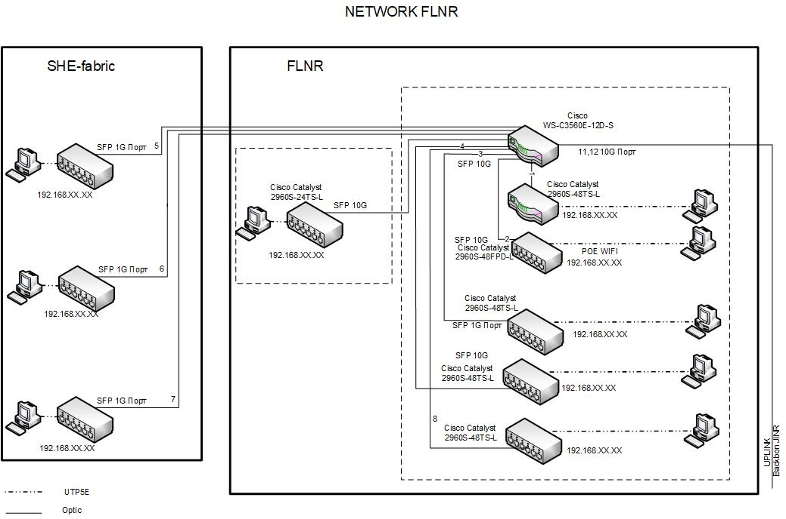

Slide 3
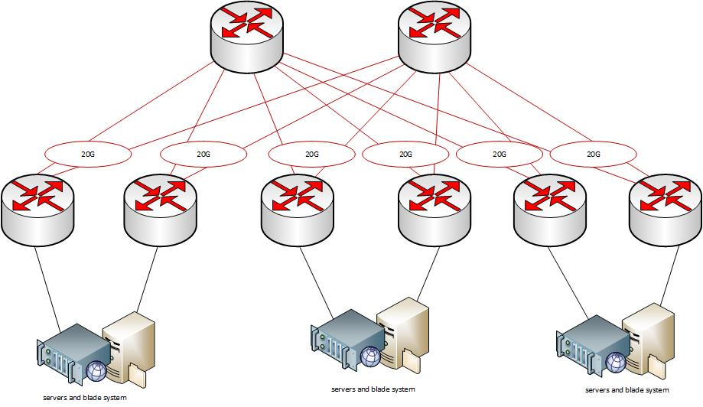
Non-blocking architecture
The network architecture of the SHE-fabric data center at JINR is designed with a dual route between the distributed level and the core level on the Cisco equipment. Each server will have access to the network segment with two equal-value connections of 10G with a total bandwidth of 20G. In addition to the tasks of virtualization in the Flerov Laboratory of Nuclear Reactions in the Joint Institute for Nuclear Research, the problem of simulating experimental events has a significant load on the network.
Tim Berners-Lee URL, HTTP, HTML
Radia Joy Perlman
1985 - Spanning tree
1992 - IS-IS
2010 - Transparent Interconnection
of Lots of Links

Slide 4
AAA system
(Authentication, Authorization, Accounting)
TACACS+ is a security application that provides centralized validation of users attempting to gain access to a device or network access server. TACACS+ services are maintained in a database on a TACACS+ daemon running, typically, on a UNIX workstation. TACACS+ provides for separate and modular authentication, authorization, and accounting facilities. TACACS+ allows for a single access control server to provide each service-authentication, authorization, and accounting-independently. Each service can be tied into its own database to take advantage of other services available on that server or on the network, depending on the capabilities of the daemon.
The goal of TACACS+ is to provide a methodology for managing multiple network access points from a single management service. The Cisco family of access servers and devices and the Cisco user interface can be network access servers.

Slide 5
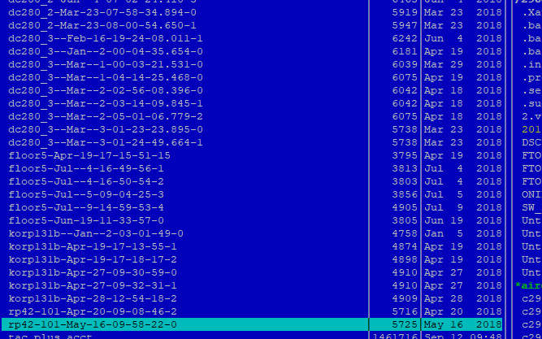
Archive

Slide 6
Logging

Slide 7
DHCP services
For network security, DHCP snooping functionality is implemented. DHCP snooping is a security feature that prevents unauthorized users from connecting to a third-party DHCP server network in order to intercept client DHCP requests.
The essence of DHCP snooping is to close the ability to handle DHCP requests on untrusted ports. The network administrator must manually configure trusted ports — the ports behind which this DHCP server is located.
The technology prevents the use of an unauthorized DHCP server on the network, which allows, for example, a man-in-the-middle attack. It also protects the network from DHCP depletion attacks (DHCP starvation / exhaustion), which is not particularly relevant.

Slide 8
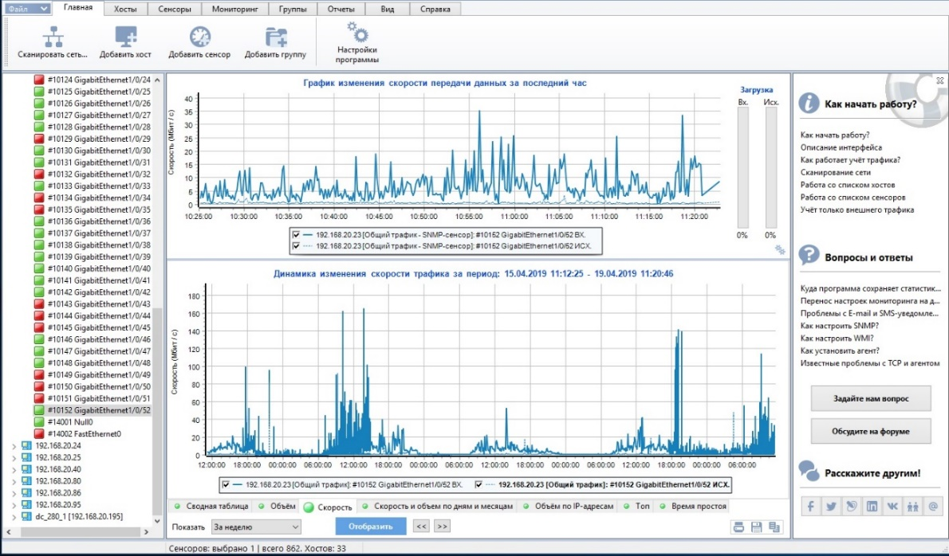
Monitoring system
To monitor the state of links is using the software package “10-Strike”. A software that allows you to build graphs using SNMP. 10-Strike collects statistical data for certain time intervals and allows you to display them in graphical form. Mostly, standard templates are used to display statistics on CPU usage, memory allocation, the number of running processes, the use of incoming / outgoing traffic. Figure presents data on loading I/O interfaces between links of the distribution level and the access level.

Slide 9
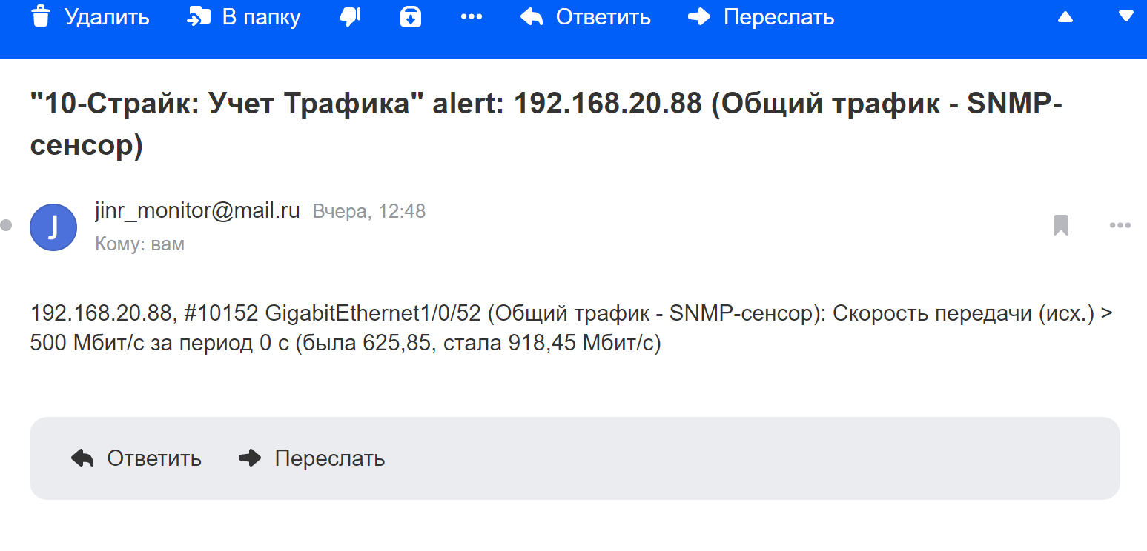

Slide 10
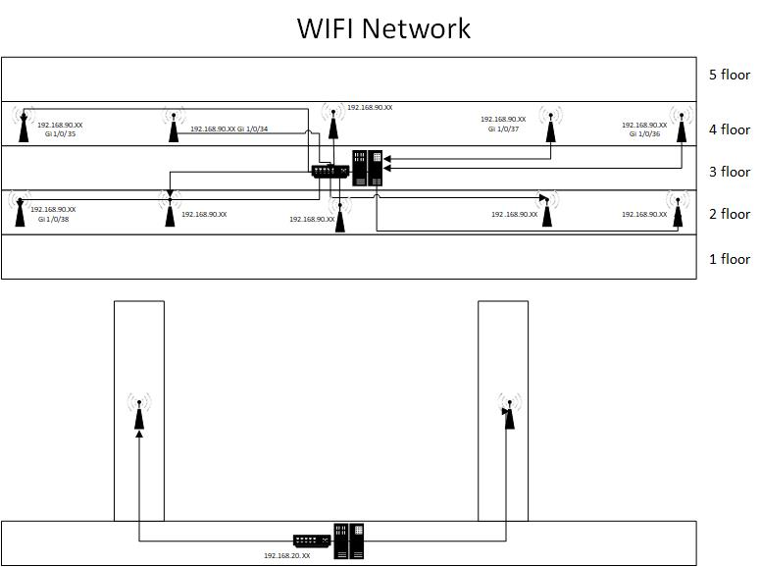

Slide 11
Conclusion
The following functionalities were developed and implemented in production:
Settings of network devices that provide secure access to network resources
Settings for transmission of unicast and multicast packets
An authorization scheme and storage system for the entire switch configuration sequence
The monitoring system of the network and the payload of links
Forecast for future utilization of communication unblocked channels
DHCP snooping functionality
A system of wireless access to a local computer network
Summary and a forecast on the future development of the LAN of the accelerator complex, as well as the backbone of the communication links

Slide 12
Thank you

