Slide 1
Application of modern commercial digitizers for new approaches to neutron's detection
Dmitrii Ponomarev
2019

Slide 2
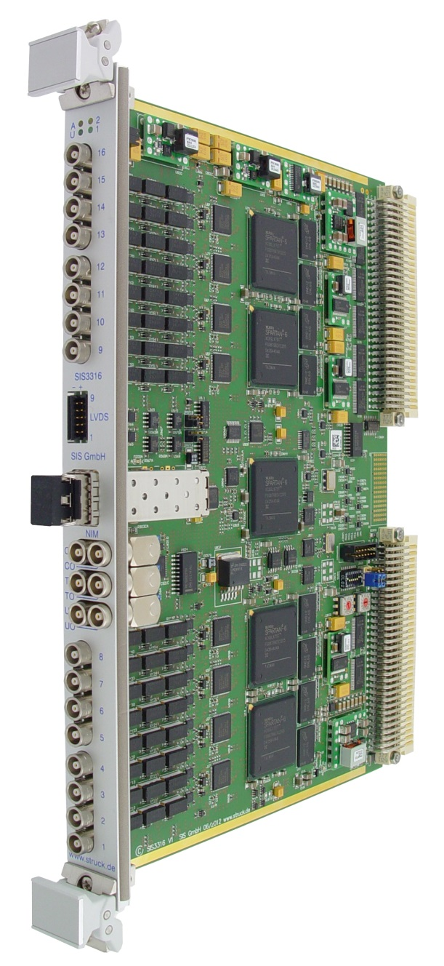
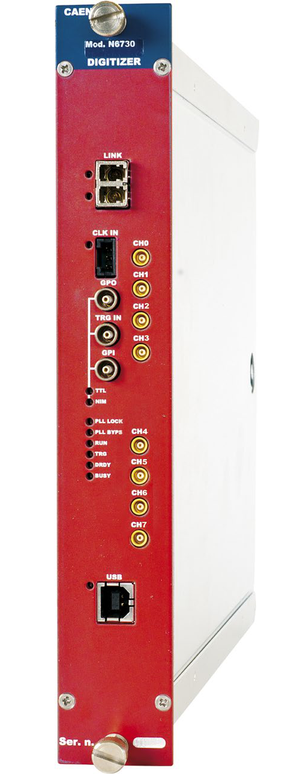
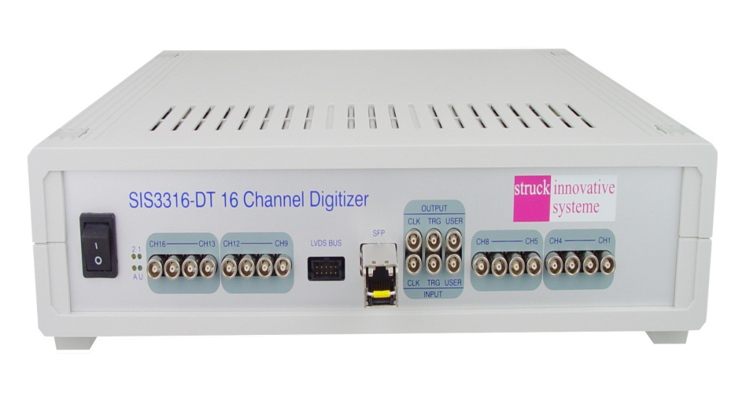
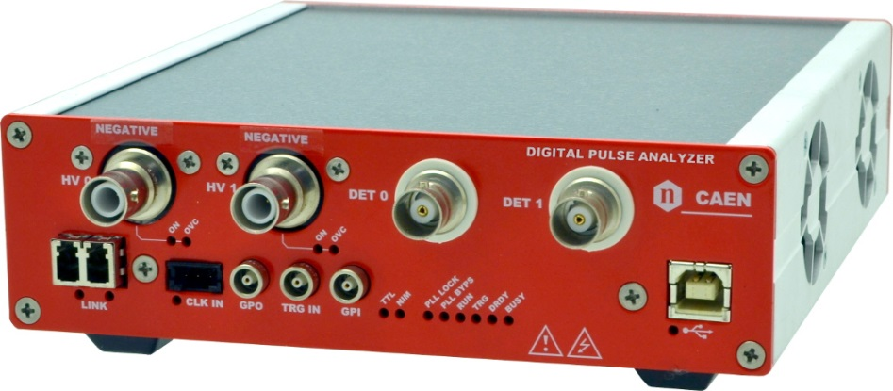
Modern digitizers

Slide 3
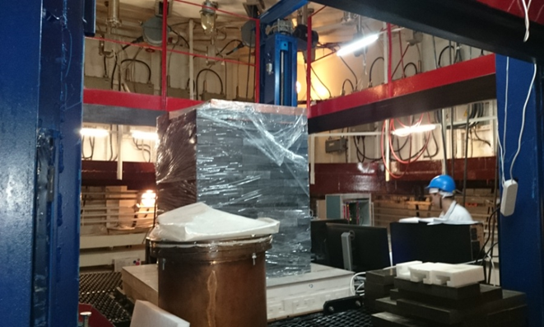
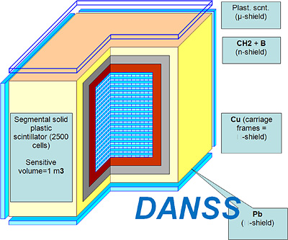
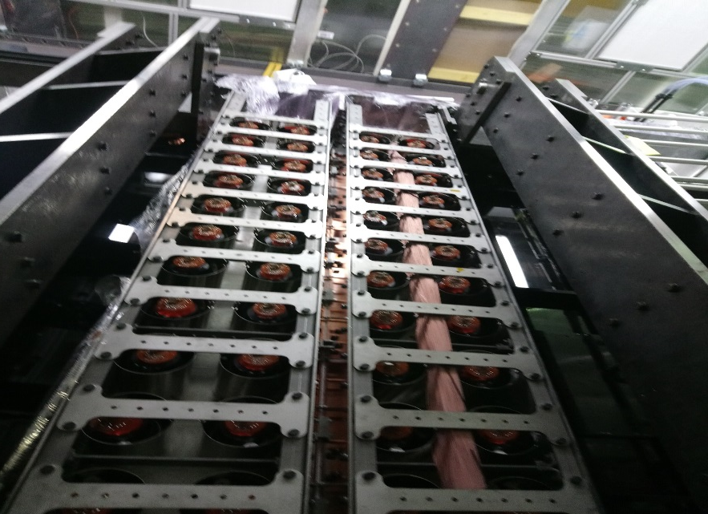
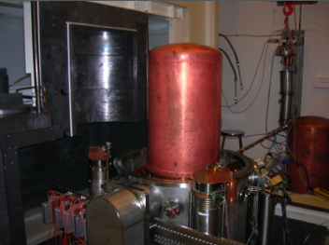
Low background experiments

Slide 4
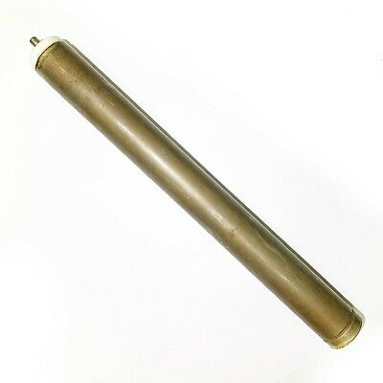
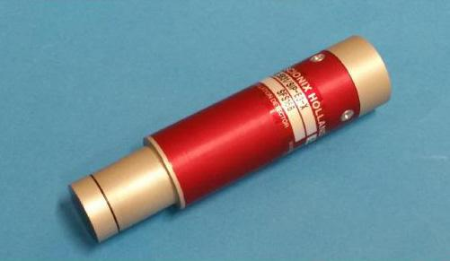
Neutron’s detectors
³He- neutron detectors
n+ ³He → ³H+ ¹H+764keV
Thermal neutron cross section
of ³He = 5333±7 barns
⁶Li- neutron detectors
⁶Li+n → t + α +4.79 MeV
Thermal neutron cross section
of ⁶Li = 940barns
Pulse shape discrimination neutron’s from gamma’s

Slide 5
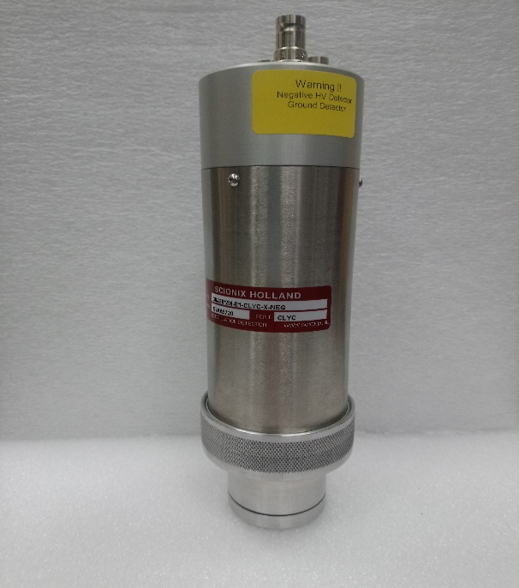
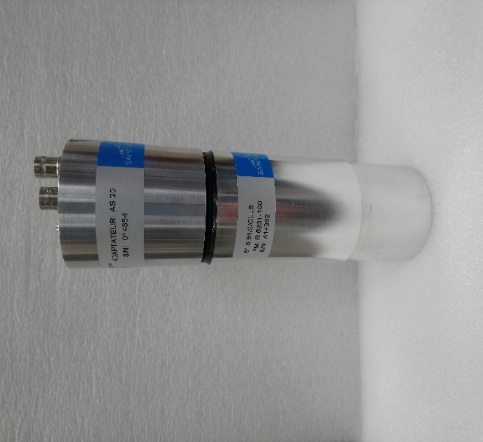
CLYC (Cs₂LiYCl₆: Ce) detector
Crystal dimensions: 51X51mm
Energy resolution 662keV: ≈ 4.3%
Natural lithium- ⁶Li ≈ 7,5%
CLLB (Cs₂LiLaBr₆: Ce) detector
Crystal dimensions: 38X38mm
Energy resolution 662keV: ≈ 5.8%
⁶Li enrichment: ≈ 96%

Slide 6
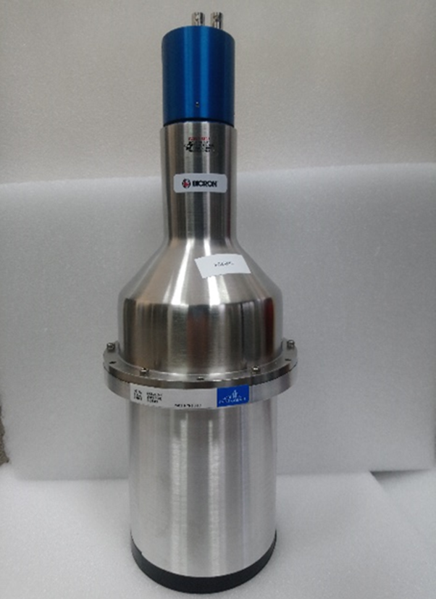
NaIL (NaI(Tl+Li)) detector
Crystal dimensions: 127X152mm
Energy resolution 662keV: ≈ 6.7%
⁶Li concentration: ≈ 1% of mass of the detector
CAEN DT5790
Sampling Rate: 250 MS/s simultaneously on each channel
Resolution: 12 bits

Slide 7
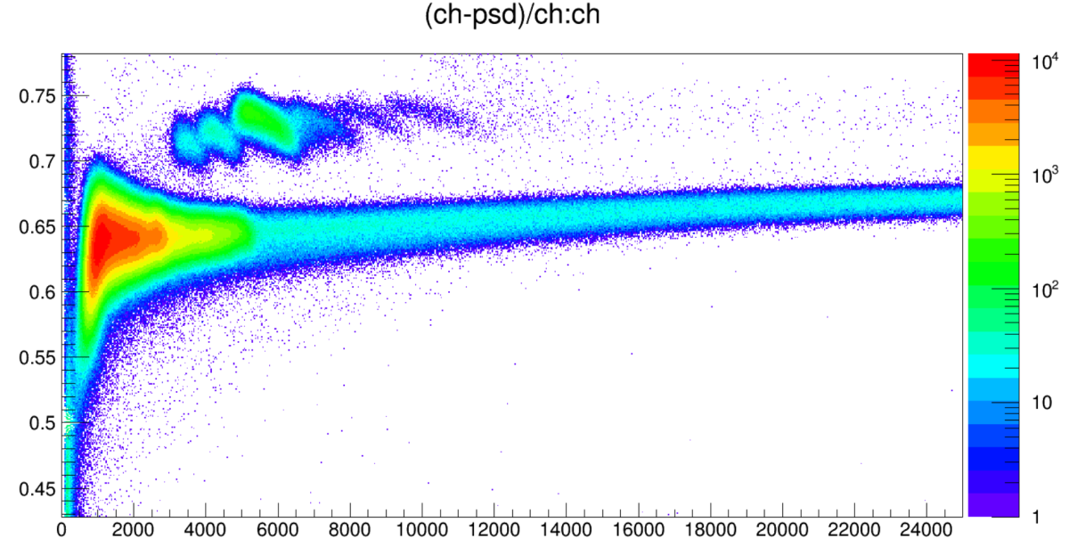
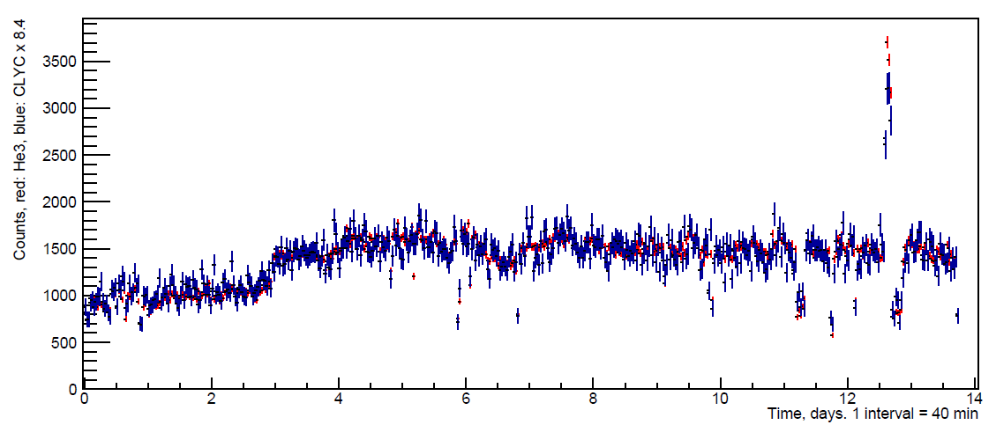
PSD diagram and neutron flux for CLYC detector
neutrons
α- particles
1x10⁻³ n cm⁻² sec⁻¹

Slide 8
Contaminations in the ⁶Li containing detectors
CLLB background spectra
CLYC and NAIL detectors:
Contamination by ²³⁸U chain
Daughter isotopes has alpha-activity in zone of interest
CLLB detector:
Contamination by ²²⁷Ac chain
Daughter isotopes has alpha-activity in zone of interest.
Significant ¹³⁸La contamination in gamma spectrum.

Slide 9
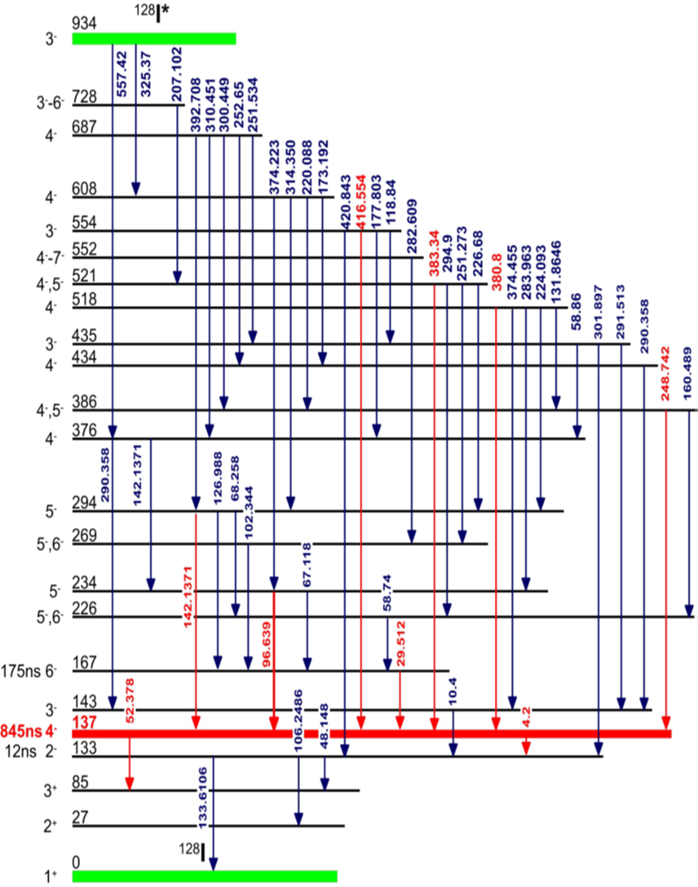
Neutron measurements with NaI
NaI (solid) has 545 times as many moles as an
equal volume of ³He (gas, normal pressure)
Iodine has only one stable isotope: ¹²⁷I
σ_{γ} = 6.2(2) barn (860 times lower than ³He)
Efficiency of thermal neutron capture in 1 kg NaI detector is ~50% (almost all captures will be on iodine because for ²³Na: σ_{γ} = 0.9(1) barn)
Result of neutron capture is ¹²⁸I in 6.8 MeV excited state
¹²⁸I decay to the ground state proceeds through a series of low-energy levels
¹²⁸I has 137.8 keV isomeric state T_{1/2} = 0.845(20) µsec
~40% de-excitations pass through the 137.8 keV level
Delayed coincidences to identify neutrons

Slide 10
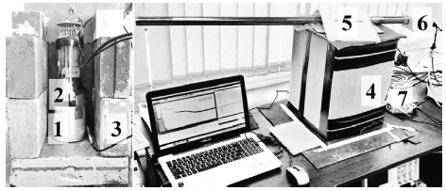
Test in with NaI Dubna
NaI(Tl) Ø63 mm x 63 mm
PMT Hamamatsu R6091
CAEN Multi channel analyzer DT5780
T_{prompt} – T _{delay} = 1.8-5 µsec
Simultaneous measurement with bare ³He detector

Slide 11
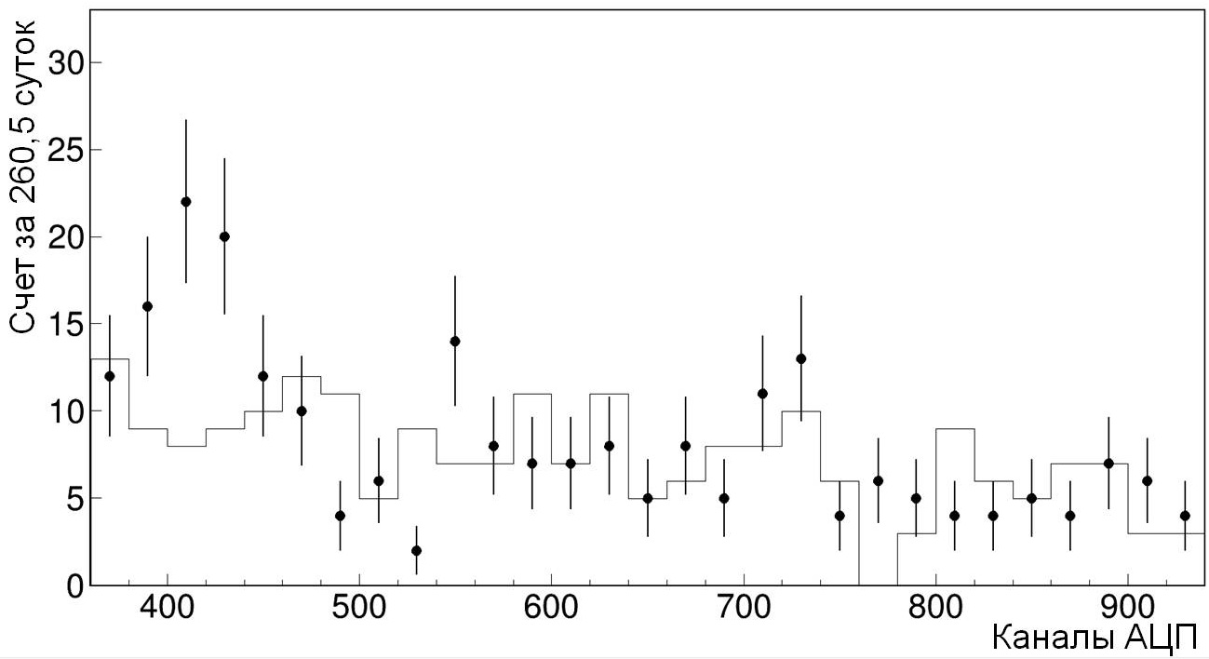
Result after 260.45 days
Cut:
T_{prompt} – T _{delay} = 1.8-5 µsec, Prompt: ADC channels >300
Results:
For ADC channel (delayed) 380-460, i.e. neutrons
1.8 - 5 µsec: 70 events
Expected background (calculation) 33,969 ± 0,003 events
Measured 11.8 -15 µsec: 37 events
Flux = 2.1 ± 0.5 × 10⁻⁶ cm⁻² sec⁻¹
same as ³He detector on the top (2.3 × 10⁻⁶ cm⁻² sec⁻¹),
about 30% less than ³He detector
located near the wall (3.1 × 10⁻⁶ cm⁻² sec⁻¹)
137.8 keV
Counts/260.45d
ADC channels

Slide 12
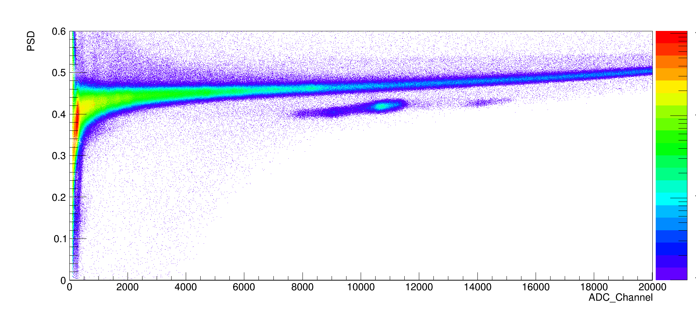
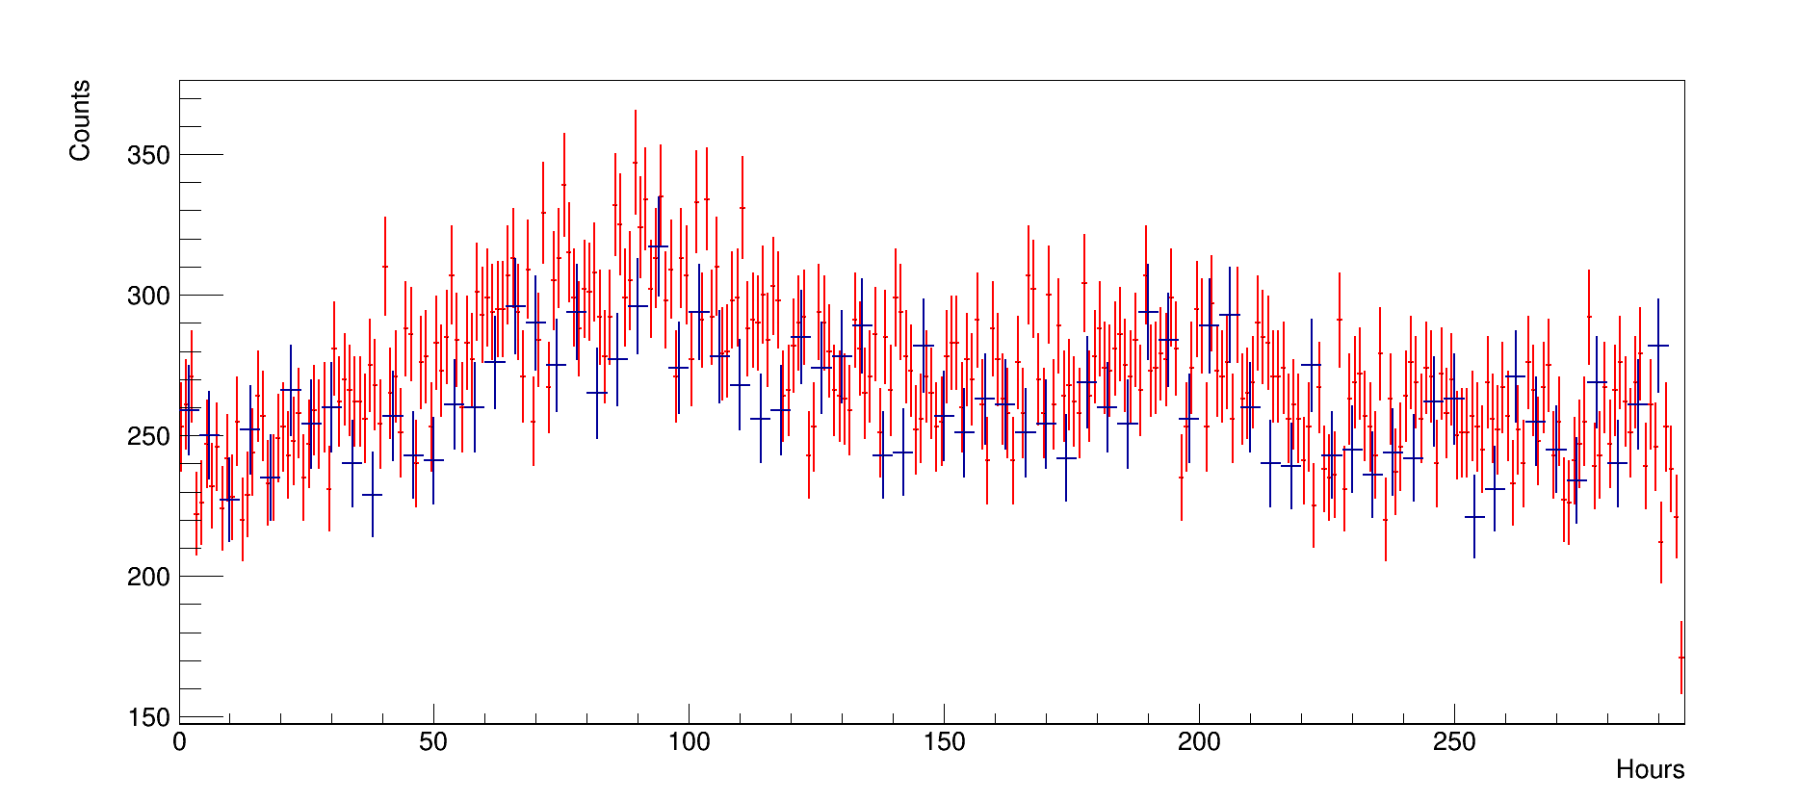
PSD diagram and neutron flux for NAIL detector
neutrons
α- particles
I-127
Li-6

Slide 13
Conclusion
Ambient neutron background with CLYC, CLLB and NAIL detectors were measured
Results of the measurement showed good sensitivity of mentioned detectors to small changes in neutron flux on the level 10⁻³ n cm⁻² s⁻¹
These detectors can be well used in strong or even on ground level neutron fields
Unfortunately, high intrinsic background make CLYC, CLLB and ,for now, NAIL detectors inapplicable for low background environments.
Modern commercial digitizers makes it possible to find new ways for neutron detection as with completely new detectors, as and with well known old ones.

