Slide 1
Meson-baryon scatterings in the Regge realm
Byung-Geel Yu
Korea Aerospace Univ. in collaboration with K.-J. Kong
APCTP-BLTP Joint workshop
Dubna, July 17, 2019

Slide 2
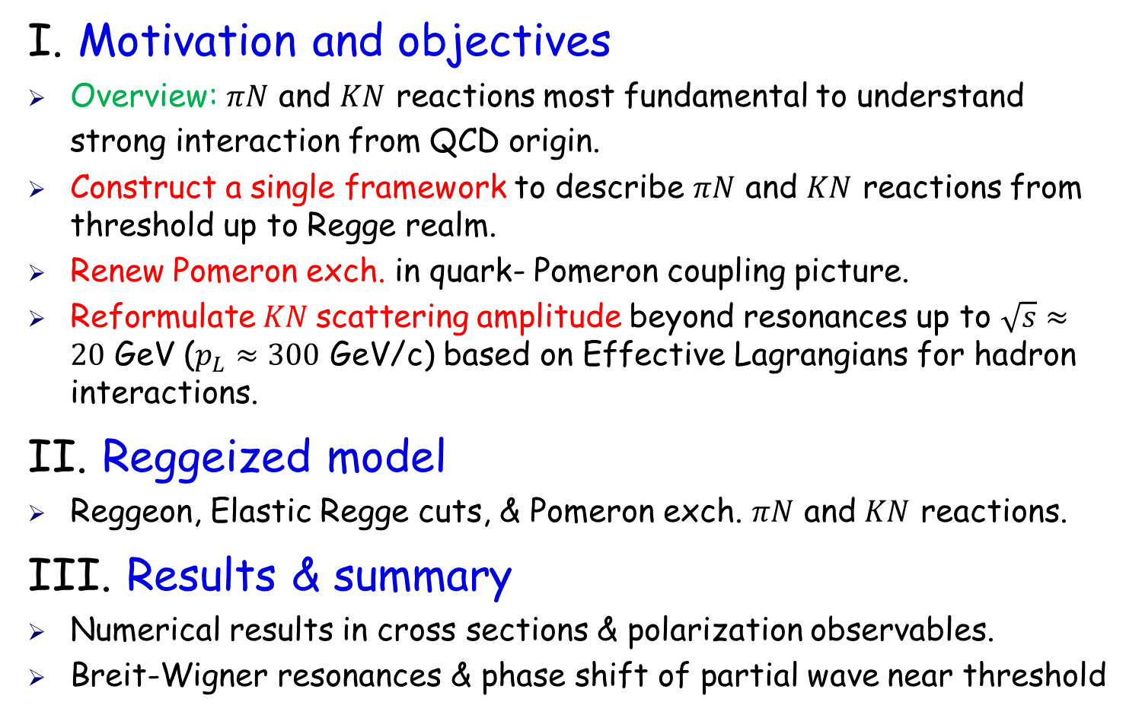
Outline
I. Motivation and objectives
Overview: $πN$ and $KN$ reactions most fundamental to understand strong interaction from QCD origin.
Construct a single framework to describe $πN$ and $KN$ reactions from threshold up to Regge realm.
Renew Pomeron exch. in quark- Pomeron coupling picture.
Reformulate$KN$scattering amplitude beyond resonances up to $\sqrt{s}≈20$ GeV ($p_{L}≈300$ GeV/c) based on Effective Lagrangians for hadron interactions.
II. Reggeized model
Reggeon, Elastic Regge cuts, & Pomeron exch. $πN$ and $KN$ reactions.
III. Results & summary
Numerical results in cross sections & polarization observables.
Breit-Wigner resonances & phase shift of partial wave near threshold

Slide 3
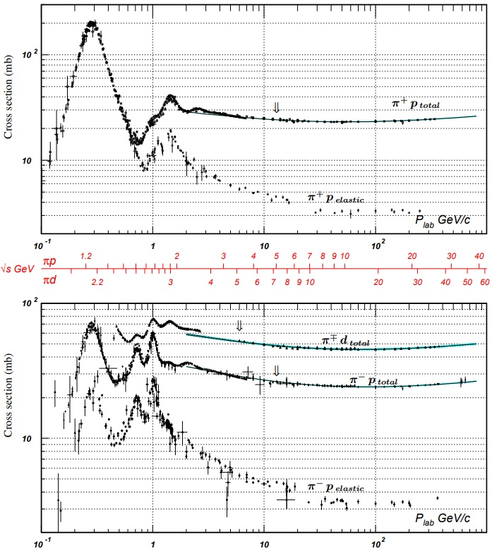



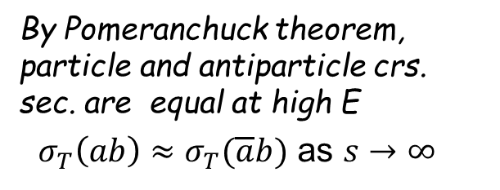



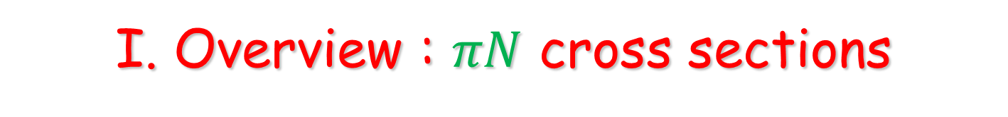




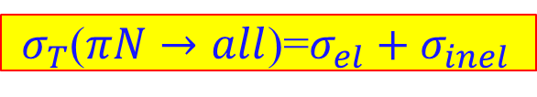
I. Overview : $πN$ cross sections
$σ_{T}$($πN→all$)=$σ_{el}+σ_{inel}$
$$Δ^{++}(1232)$$
$$σ_{el}=σ(πN→πN)$$
$$σ_{inel}=σ_{D}+σ_{DD}+…$$
Total cross sections vs. elastic cross sections
$$Δ^{++}(1905)$$
By Pomeranchuck theorem, particle and antiparticle crs. sec. are equal at high E
$σ_{T}\left(ab\right)≈σ_{T}(\overline{a}b)$ as $s→∞$
$$Δ^{0}(1232)$$
Baryon resonances in low $P_{L}$, nonresonant diffraction at high $P_{L}$
$$N(1675)$$

Slide 4
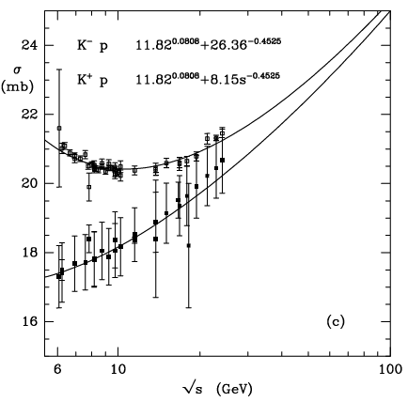
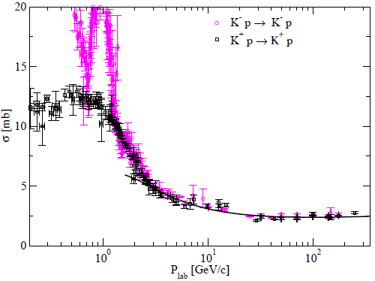


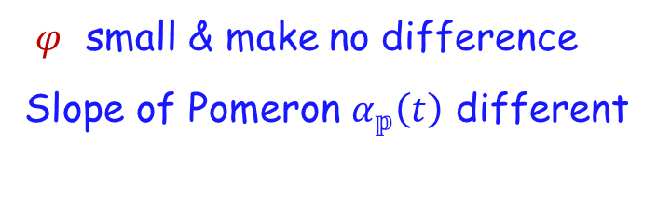
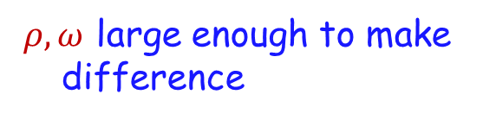
$Kp$Cross sections at high energies
Total crs. section
Elastic crs. section
$$M(K^{±}p)=∓ρ±ω+f_{2}+a_{2}+ℙ$$
$$M\left(K^{±}p\right)={f_{0}+a}_{0}∓φ+f_{2}+a_{2}+ℙ$$
$ρ, ω$ large enough to make difference
$φ$ small & make no difference
Slope of Pomeron $α_{𝕡}\left(t\right)$ different

Slide 5
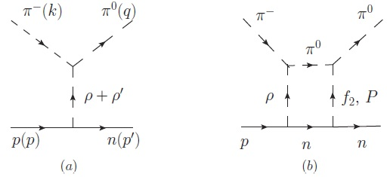
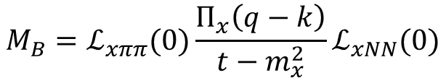


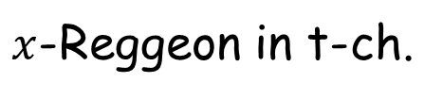

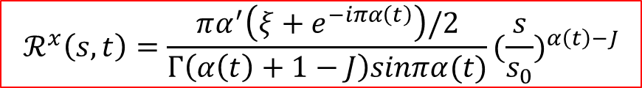

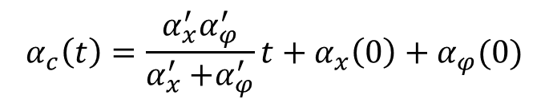



II. Reggeized Born term model
$x$-Reggeon in t-ch.
$$M_{B}=ℒ_{xππ}(0)\frac{Π_{x}\left(q−k\right)}{t−m_{x}^{2}}ℒ_{xNN}(0)$$
$$M_{R}=ℒ_{xππ}(0)Π_{x}(q−k) ℒ_{xNN}(0)ℛ^{x}(s,t)$$
$$⟶$$
reggeization
$$ℛ^{x}\left(s,t\right)=\frac{πα^{′}\left(ξ+e^{−iπα\left(t\right)}\right)/2}{Γ\left(α\left(t\right)+1−J\right)sinπα(t)}(\frac{s}{s_{0}})^{α\left(t\right)−J}$$
$$({t−m_{x}^{2})}^{−1}$$
$$⟶$$
trajectory
$$α\left(t\right)=α^{′}t+α(0)$$
phase
$[(−1)^{J}+e^{−iπα}]/2$ ; nEXD
$1, e^{−iπα} ;$ EXD $(ρ,a_{2})$, $(ω, f_{2})$
$x$-$φ$ elastic Regge-cut
Donnachie Kalashinikova, PRC93, 025203 (2016)
$$M_{R}^{c}=ℒ_{xππ}\left(0\right)Π_{x}\left(q−k\right)ℒ_{xNN}\left(0\right)\{ℛ^{x}\left(s,t\right)+\sum{C_{φ}e^{d_{φ}t}e^{−\frac{iπα_{c}}{2}}(\frac{s}{s_{0}})^{α_{c}−1}\}}$$
$$α_{c}\left(t\right)=\frac{α_{x}^{′}α_{φ}^{′}}{α_{x}^{′}{+α}_{φ}^{′}}t+α_{x}\left(0\right)+α_{φ}(0)$$

Slide 6
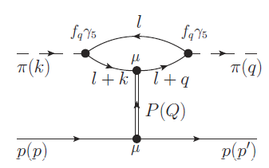
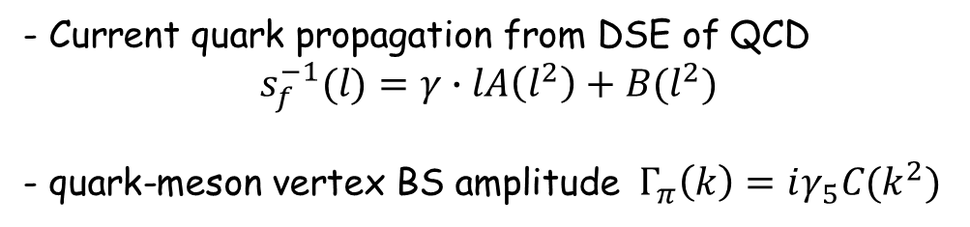

- Current quark propagation from DSE of QCD
$$s_{f}^{−1}(l)=γ∙lA\left(l^{2}\right)+B(l^{2})$$
- quark-meson vertex BS amplitude $Γ_{π}\left(k\right)=iγ_{5}C(k^{2})$
$$Γ_{π}\left(k\right)=iγ_{5}C(k^{2})$$
Quark-Pomeron coupling picture
Donnachie-Landshoff (DL) NPB244, 322 1984, Laget NPA581, 397 1995
- Pomeron couples to an individual quark in the hadron rather than the hadron as a whole.
- Cpling strength of Pomeron to a hadron is determined by the radius of hadron (FF)
Isoscalar photon of $C=+1 →ℙqq\sim F_{h}(t)β_{q}γ^{μ}$
$$\frac{dσ(πp)}{dt}=\frac{1}{4πs^{2}}|\left(2β_{q}F_{π}\right)(−iα^{′}s)^{α_{ℙ}\left(t\right)}(3β_{q^{′}}F_{1})|^{2}$$
Pichowsky PRD56, 1644 1997
- But, current quark propagation at high E $⇒$ free quark propagation, and on-shell approximation for quark loops with hadron form factors are a good approximation

Slide 7









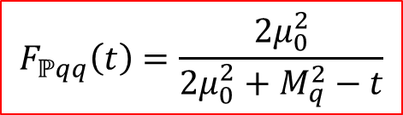
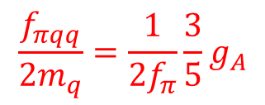



Pomeron amp.
Soft Pomeron Exch.
K.-J.Kong & B.-G. Yu, PRC98, 045207 (2018)
Pseudoscalar cpl. at $πqq$ vertex
Cpl.const. from G-T relation at quark level
$$Γ_{π}(k)=if_{πqq}γ_{5} ,$$
$$\frac{f_{πqq}}{2m_{q}}=\frac{1}{2f_{π}}\frac{3}{5}g_{A}$$
Off-shell quark loop ($l=−q/2$)
Vector meson photo.
$πN$ scatt.
$M_{ℙ}=i\left({2F}_{π}{\left(t\right)β}_{q}\right)\frac{f_{πqq}^{2} 2m_{π}^{2}}{{2m}_{q}^{2}−\frac{m_{π}^{2}}{2}−t}F_{ℙqq}\left(t\right)(3F_{1}\left(t\right)β_{q^{′}})\overline{u}(p′)γ∙\left(k+q\right)u\left(p\right)ℛ^{ℙ}(s,t)$
Form Factors
$$F_{π}\left(t\right)=({1−t/Λ^{2})}^{−1}$$
Pion F.F.
$$F_{ℙqq}\left(t\right)=\frac{{2μ}_{0}^{2}}{{2μ}_{0}^{2}+M_{q}^{2}−t}$$
$μ_{0}^{2}=1.1 {GeV}^{2}$ fixed
$$F_{1}\left(t\right)$$
Nucleon isoscalar F.F. fixed

Slide 8
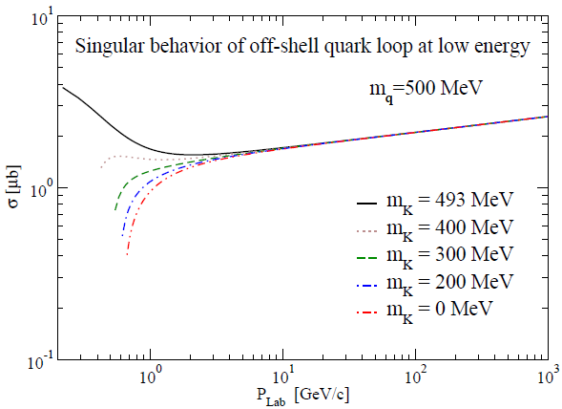

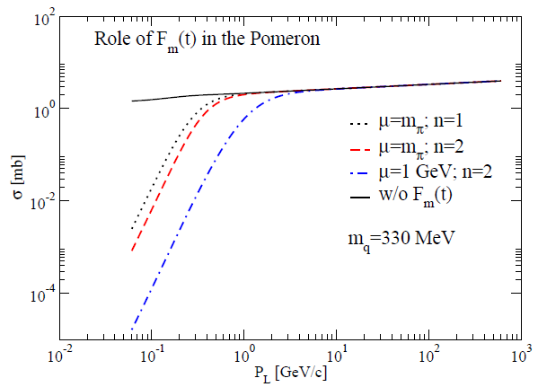

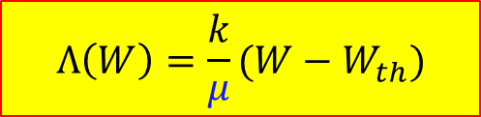

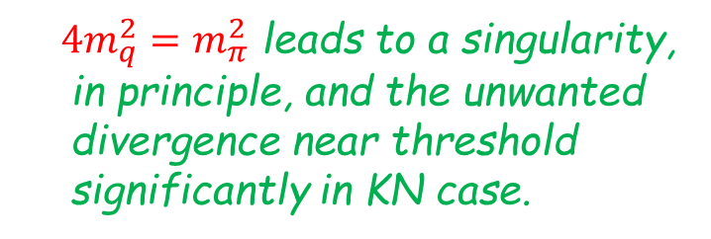
Singularity of Pomeron at low energy from quark loop
$4m_{q}^{2}=m_{π}^{2}$ leads to a singularity, in principle, and the unwanted divergence near threshold significantly in KN case.
Pion(kaon) form factor with cutoff $Λ$ having energy dependence to control the range of suppression.
$$F_{π}\left(t\right)=({1−t/Λ^{2})}^{−n}$$
$$Λ\left(W\right)=\frac{k}{μ}(W−W_{th})$$

Slide 9

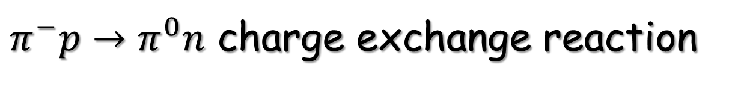
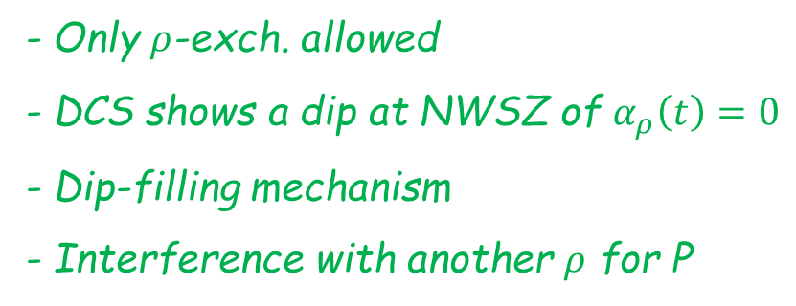




III. CEX & Elastic Cross sections
$π^{−}p→π^{0}n$ charge exchange reaction
- Only $ρ$-exch. allowed
- DCS shows a dip at NWSZ of $α_{ρ}\left(t\right)=0$
- Dip-filling mechanism
- Interference with another $ρ$ for P
$M=−\sqrt{2}[ρ\left(775\right)+ρ(1450)+ρ$-cuts$]$
$ρ$-Reggeon $I^{G}\left(J^{PC}\right)=1^{+}(1^{−−})$
$$M_{ρ}=g_{ρππ}(q+k)^{μ}(−g_{μν}+Q_{μ}Q_{ν}/m_{ρ}^{2})\{g_{ρNN}^{v}γ^{ν}+\frac{g_{ρNN}^{t}}{4M}\left[γ^{ν}, γ∙Q\right]\}ℛ^{ρ}(s,t)$$
Elastic Regge cuts $ρ$-$f_{2}$ & $ρ$-$𝕡$
$$M_{R}^{c}=ℒ_{xππ}\left(0\right)Π_{x}\left(Q\right)ℒ_{xNN}\left(0\right)\{ℛ^{x}\left(s,t\right)+\sum{C_{φ}e^{d_{φ}t}e^{−\frac{iπα_{c}}{2}}(\frac{s}{s_{0}})^{α_{c}−1}\}}$$
$α_{f}\left(t\right)=0.9t+0.53$,
$$α_{ρ}\left(t\right)=0.9t+0.46$$

Slide 10
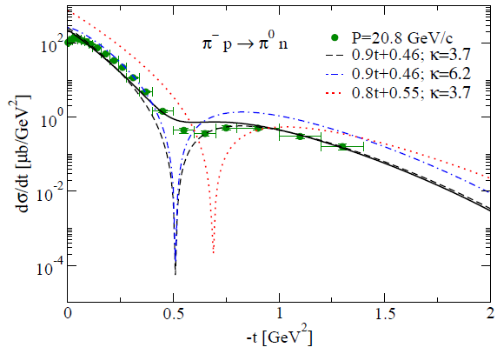
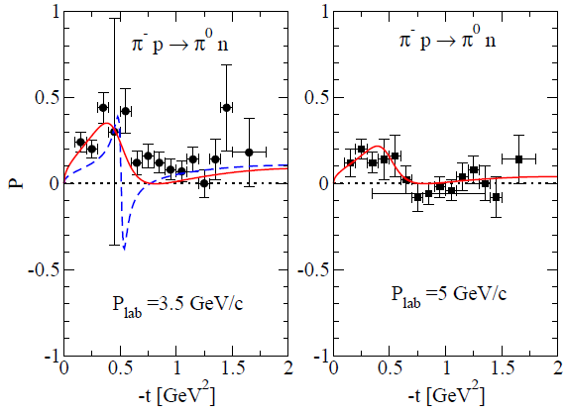












Good to test $ρ$-trajectory & cpl. const.
$ρ$-trajectory
$α_{ρ}\left(t\right)=0.9t+0.46$
$$α_{ρ}\left(t\right)=0.8t+0.55$$
$ρ$-cpl.const.
$g_{ρNN}^{v}=2.6$, $κ_{ρ}=3.7$ (VMD)
$g_{ρNN}^{v}=3$, $κ_{ρ}=6.2$ (NN)
$ρ$-$f_{2}$ & $ρ$-$𝕡$ cuts
Another $ρ$ for polarization
$$ρ\left(1450\right), 1^{+}{(1}^{−−})$$
Trajectory from Rel. quark model
D. Ebert, et al., PRD79, 114029 (2018)
$α_{ρ}\left(t\right)=t−1.23$
cpl.const. from the fit
$G_{ρ(1450)NN}^{v}=40$, $G_{ρ(1450)NN}^{t}=−75$

Slide 11
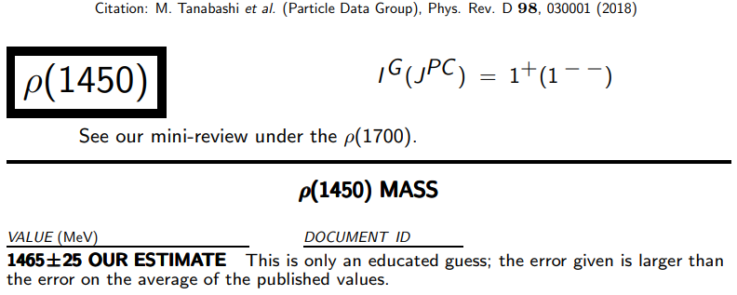

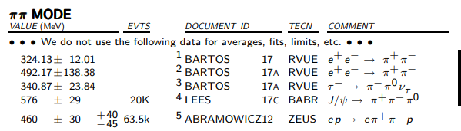

Slide 12
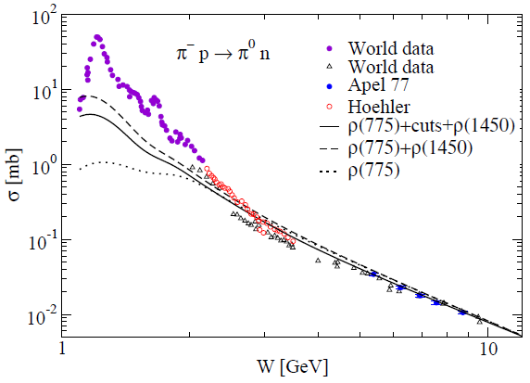
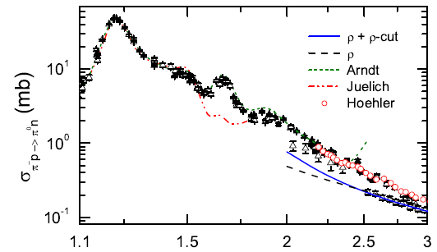


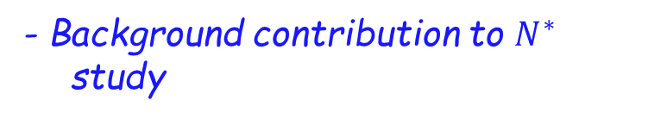
- Energy-dependence of crs. sec.
in good agreement with data
- Background contribution to $N^{∗}$ study
$$2$$
$$3$$
F. Huang, et al., EPJA40, 77 (2009)

Slide 13

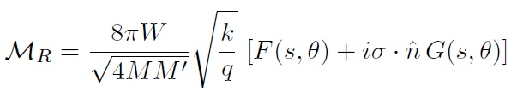
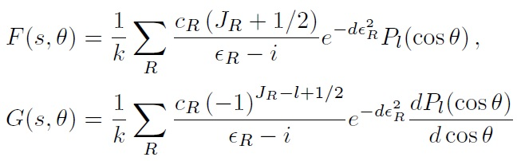
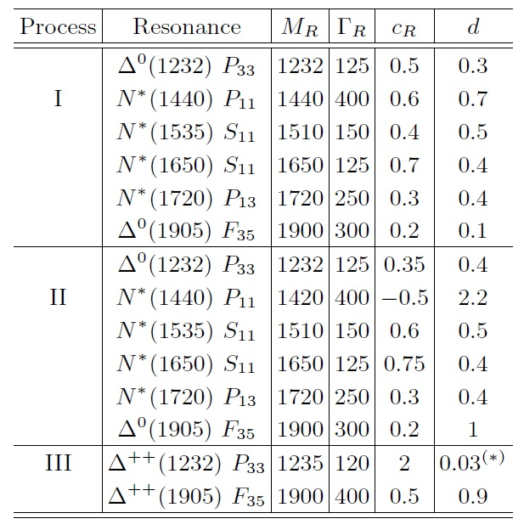
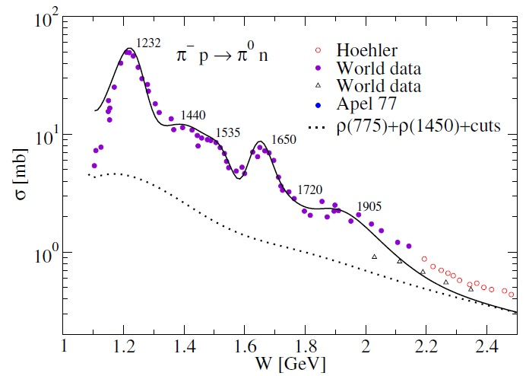
Nucleon resonances in the B.-W. type

Slide 14
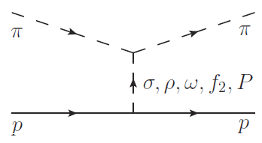


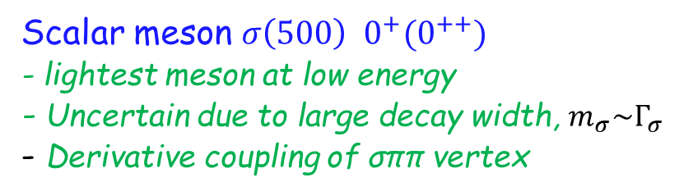

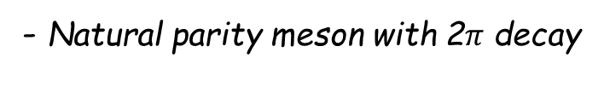

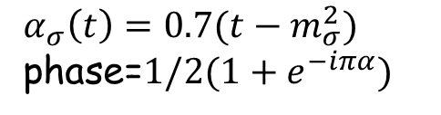

Scalar meson $σ\left(500\right) 0^{+}(0^{++})$
- lightest meson at low energy
- Uncertain due to large decay width, $m_{σ}\sim Γ_{σ}$
- Derivative coupling of σππ vertex
$π^{±}p→π^{±}p$ elastic Scattering
- Natural parity meson with 2$π$ decay
$$M\left(π^{±} p\right)=σ±ρ+\left(f_{2}∓ω\right)+ℙ$$
$σ$-Reggeon
chiral partner ${ g}_{σNN }≈g_{πNN}$
$α_{σ}\left(t\right)=0.7(t−m_{σ}^{2})$ phase=$1/2(1+e^{−iπα})$

Slide 15
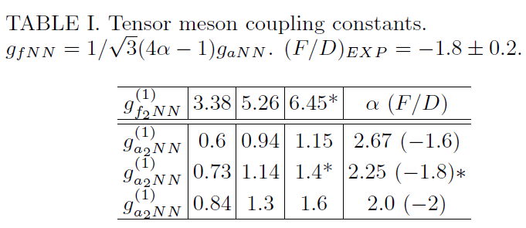




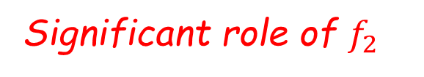




Vector meson $ω(782)$ $0^{−}(1^{−−})$
B.-G.Yu, et al., PLB701, 332 (2011)
$α_{ω}\left(t\right)=0.9t+0.44$
Tensor meson $f_{2}(1275$) $0^{+}(2^{++})$
$α_{f}\left(t\right)=0.9t+0.53$
Significant role of $f_{2}$
Determination of cpl. const. $g_{f_{2}NN}$ and phase.
($ω−f_{2}$) EXD pair $⇒$ constant phase “1” for both reactions.
$f_{2}$-Reggeon

Slide 16
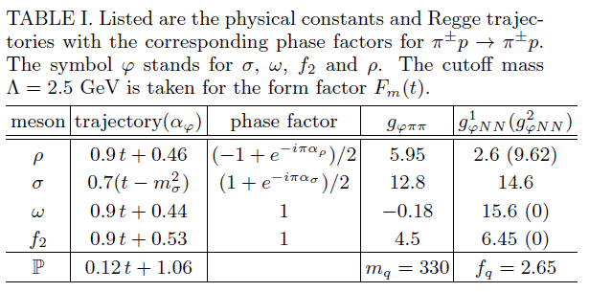
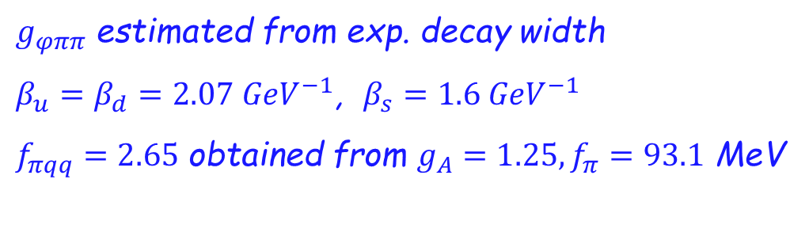

Coupling constants, etc …
$g_{φππ}$ estimated from exp. decay width
$β_{u}=β_{d}=2.07 {GeV}^{−1}$, $β_{s}=1.6 {GeV}^{−1}$
$f_{πqq}=2.65$ obtained from $g_{A}=1.25, f_{π}=93.1$ MeV
$f_{πqq}=2.514$ without form factor $F_{ℙqq}\left(t\right)$

Slide 17
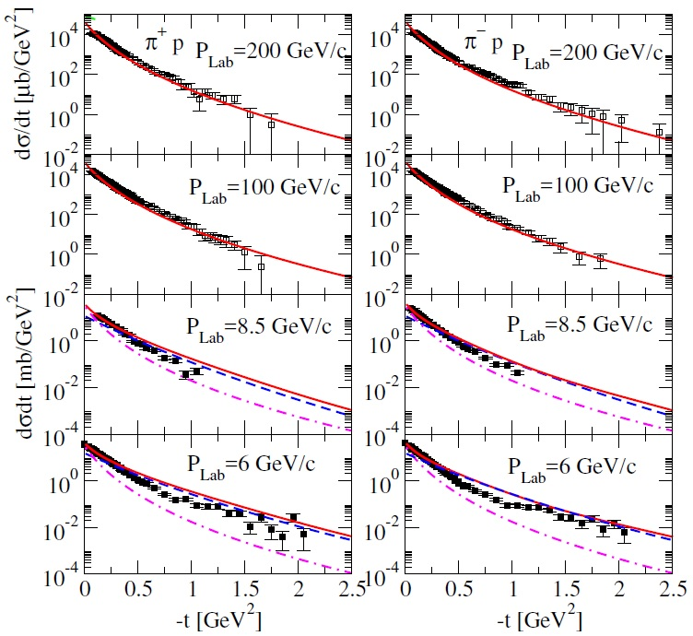
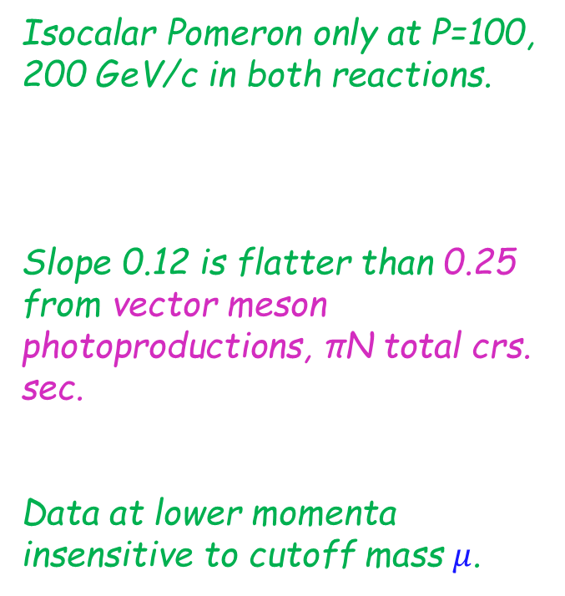
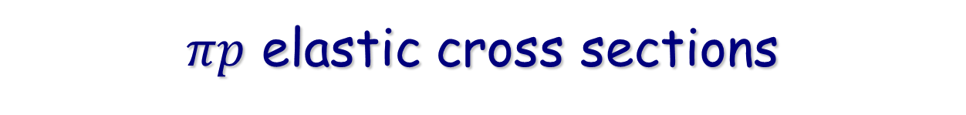


$πp$ elastic cross sections
Determine Pomeron trajectory from data at p=100, 200 GeV/c
Isocalar Pomeron only at P=100, 200 GeV/c in both reactions.
Slope 0.12 is flatter than 0.25 from vector meson photoproductions, πN total crs. sec.
Data at lower momenta insensitive to cutoff mass $μ$.
$α_{ℙ}\left(t\right)=0.12t+1.06$
$α_{ℙ}\left(t\right)=0.25t+1.08$

Slide 18
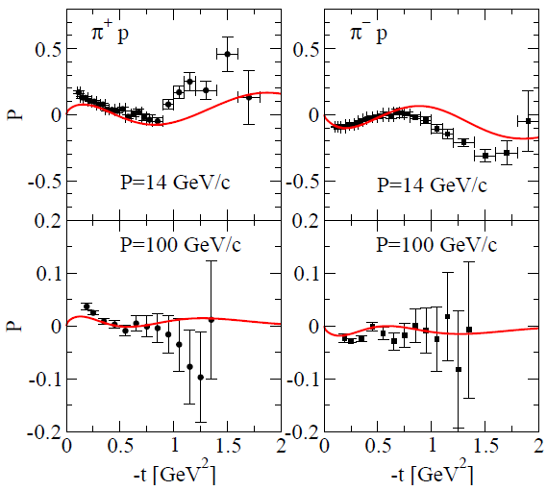
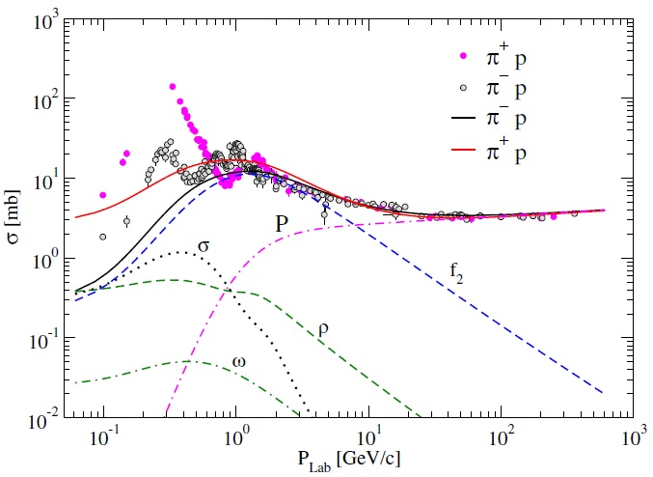
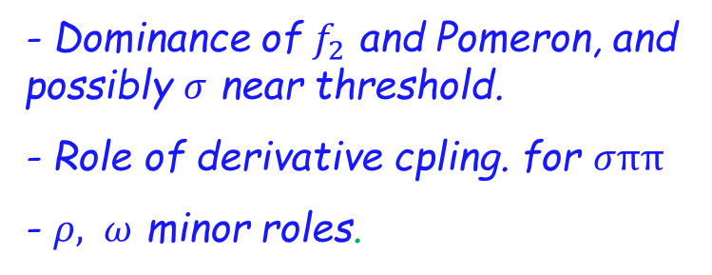
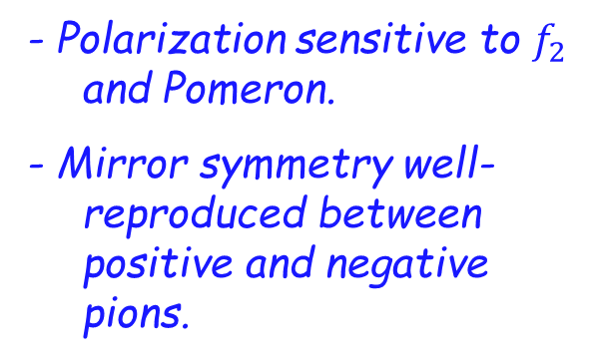
$πp$ elastic cross sections
- Polarization sensitive to $f_{2}$ and Pomeron.
- Mirror symmetry well-reproduced between positive and negative pions.
- Dominance of $f_{2}$ and Pomeron, and possibly $σ$ near threshold.
- Role of derivative cpling. for $σππ$
- $ρ, ω$ minor roles.

Slide 19



Resonances in $πp$elastic cross sections
Resonance peaks are included in s-ch. based on mesonic background contributions.
Resonance peaks are reproduced by the parameterization of B.-W. type.
Underestimate of t-ch. exch -> No double-counting.

Slide 20


KN CEX & Elastic reactions
Elastic amp.
B.-G. Yu & K.-J.Kong, arXiv:1905.07106
$$M\left(K^{±}p\right)=f_{0}+a_{0}∓φ+f_{2}+a_{2}+ℙ$$
$$M\left(K^{±}n\right)=f_{0}−a_{0}∓φ+f_{2}−a_{2}+ℙ$$
Isospin relations between amp.
$$M\left(K^{−}p→\overline{K^{0}}n\right)=M\left(K^{−}p→K^{−}p\right)−M(K^{−}n→K^{−}n)$$
$$M\left(K^{+}n→K^{0}p\right)=M\left(K^{+}p→K^{+}p\right)−M(K^{+}n→K^{+}n)$$
CEX amp.
$$M\left(K^{−}p→\overline{K^{0}}n\right)=M\left(K^{+}n→K^{0}p\right)=2(a_{0}+a_{2})$$
- Only isovector scalar meson $a_{0}\left(980\right)$ and tensor meson $a_{2}(1320)$ exch.
- Good for testing tensor meson $a_{2}(1320)$ at high energies.
- Polarization Data ; canon. phase and complex phase for scalar & tensor mesons.

Slide 21





$K^{−}p→\overline{K^{0}}n$, $K^{+}n→K^{0}p$ CEX
- Role of scalar meson $a_{0}(980)$ below $P_{L}≈3$ GeV/c.
- Dominance of tensor meson $a_{2}(1320)$ over $P_{L}≈3$ GeV/c.
- Consistency with polarization data.
- Data show equality of both processes: same amp. for both reactions.

Slide 22





$K^{±}p→K^{±}p$ Elastic reactions
- Pomeron exch. universial with $πN$ reaction.
- $f_{Kqq}=0.988$ fit to data
- Tips from ratio at $P_{L}=250$ GeV/c
$\frac{σ_{el}(K^{+}p) }{σ_{el}(π^{+}p)}=\frac{2.76}{3.3}≈\frac{|f_{Kqq}^{2}m_{K}^{2}β_{s}|^{2}}{|f_{πqq}^{2}m_{π}^{2}β_{d}|^{2}}$
$${→f}_{Kqq}\sim 0.91$$
$α_{ℙ}\left(t\right)=0.12t+1.06$

Slide 23



$Kp$ elastic total cross sections
- Dominance of $a_{0}\left(980\right)+f_{2}\left(1275\right)+$Pomeron overall range of $P_{L}$.
- $φ(1020)$ vector meson contribution negligible: Data show equality of both processes $K^{+}p$ and $K^{−}p$ except for low momentum region.

Slide 24








$Kp$ elastic total cross sections at low energy
- s-wave phase shift below 1 GeV/c in $K^{±}p$ elastic process.
- B.-W. resonances up to 2 GeV/c in $K^{−}p$ elastic process.

Slide 25

Summary
- Roles of meson exch. are investigated in πN and KN CEX and elastic reactions up to hundreds of GeV/c.
- Unique roles of vector meson $ρ$(775) in the $πN,$ and tensor meson $a_{2}(1320)$ in $KN$ CEX are studied.
- Soft Pomeron in the quark-Pomeron coupling picture is constructed for $πN$ and $KN$elastic scatterings and applied successfully only with one parameter $μ$.
- Dominance of isoscalar channel, $f_{2}(1275)$ and Pomeron over $P_{L}≈2$ GeV/c in $πN$ and $KN$elastic scatterings.
- K$N$reactions without ρ+ω are well adopted to describe exp. data.
- Present Model offers a useful tool to explore 12 GeV region, and provides mesonic background contributions good enough to analyze baryon resonances in the partial wave expansion.

Slide 26
Backup

Slide 27





Overview : KN cross sections
Energy-dep. from Regge Theory
Amp.
$$M\sim f\left(t\right)s^{α\left(t\right)}$$
DCS
$$\frac{dσ}{dt}\sim \frac{1}{s^{2}}{|M|}^{2}\sim s^{2α\left(t\right)−2}$$
TCS
$$σ\sim \frac{1}{s}Im{[M(t=0)]}^{2}\sim s^{α\left(0\right)−1}$$
$$α\left(0\right)−1<0 :Reggeon α(0)≈0.5$$
$$α\left(0\right)−1>0 :Pomeron α\left(0\right)≈1+ε$$
Exch. of trajectory $α\left(t\right)=α^{′}t+α(0)$
BDS
No resonances in $σ\left(K^{+}p\right)$ repulsive s-wave phase shift below $P_{L}\sim 1$ GeV/c.
$\overline{K}N$ B.S. in the $πΣ$ continuum from below $σ\left(K^{−}p\right)$ threshold.
cpled ch.

Slide 28



Previous works vs present model
Previous works : Total reactions in the t-ch. helicity Reggeons with coupling strength (residues) fit to exp. data
Mathieu (2015), Nys (2018) from JPAC
Huang (2008)
$$M_{Kp}\sim ω+ρ+f_{2}+a_{2}+ℙ$$
$$M_{x}\sim β_{13}(t)β_{24}(t)ℛ^{x}(s,t)$$
Present work : CEX and elastic reaction in the Reggeized Born terms with interaction Lagrangians and coupling constants common in other hadron reactions, e.g., photoproductions
$$M_{Kp}\sim f_{0}+a_{0}+φ+f_{2}+a_{2}+ℙ$$
$$M_{x}\sim ℒ_{xKK}(0)Π_{x}ℒ_{xNN}(0)ℛ^{x}(s,t)$$
$Γ\left(ω\right), Γ\left(ρ\right)⇏KK$
$f_{0}≈small$

Slide 29






$πp$Cross sections at high energies
Total crs. section
Elastic crs. section
$$M \left(π^{±}p\right)=ℙ+f_{2}∓ρ$$
$$M\left(π^{±}p\right)=σ+f_{2}+ℙ∓ω∓ρ$$
$ρ$ large enough to make difference
$ρ, ω$ small & make no difference,
Slope of Pomeron $α_{𝕡}\left(t\right)$ different
Pomeron for elastic crs.sec.
Pomeron for tot. crs. sec.

Slide 30







$K^{+}p$ elastic cross section at low energy
Repulsive s-wave phase shift
- Extrapolation of phase shift to higher momentum region.
matching point
Parameterize s-wave:
$p_{0}=1.5 GeV/c$
$$δ_{0}\left(p\right)=a_{2}p_{2}+a_{1}p+a_{0}$$
$$δ_{0}\left(p\right)=De^{−(p−1.5)/m_{0}}$$
-Continuity of two phases by b.c. at $p_{0}=1.5 GeV/c$.
- Coulomb repulsion is excluded for simplicity.

Slide 31


Differential cross sections

